Slide 1
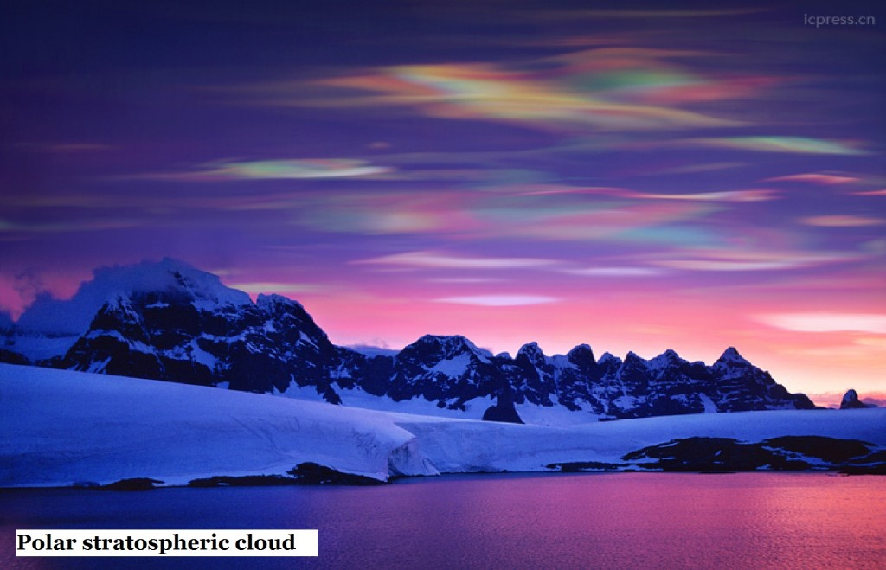
New insights into PSCs from the nearly 17-year CALIPSO data record
Michael Pitts¹ and Lamont Poole²
¹NASA Langley Research Center, Hampton, VA, USA; ²Science Systems & Applications, Inc., Hampton, VA, USA

Slide 2
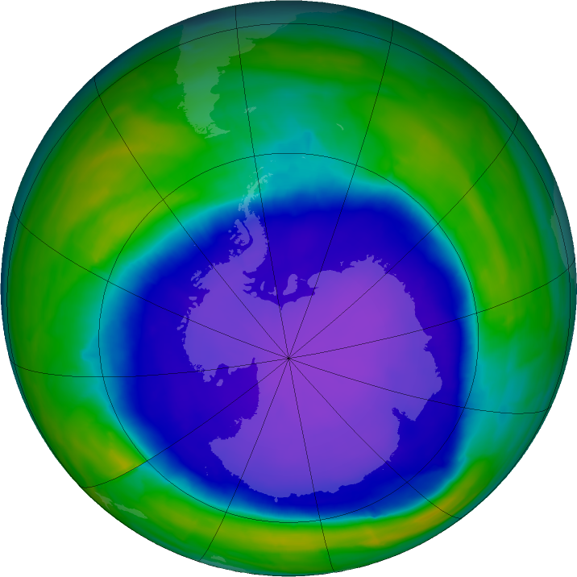

Polar Stratospheric Clouds (PSCs) and
Their Role in Polar Ozone Depletion
PSCs form in the Antarctic and Arctic stratosphere at T< ~195 K
Three known compositions: liquid super-cooled ternary solution (STS) H₂SO₄-HNO₃-H₂O droplets, nitric acid trihydrate (NAT) crystals, and H₂O ice
PSCs play key role in chemical depletion of ozone at high latitudes
  Heterogeneous reactions on PSC particle surfaces convert inactive chlorine reservoirs (HCl and ClONO₂) to active (ozone-depleting) chlorine radicals
  Sedimentation of large NAT particles irreversibly removes reactive nitrogen (denitrification), which delays chlorine deactivation and prolongs ozone depletion
2015 Antarctic Ozone Hole Area Approaches
Annual Maximum in October

Slide 3


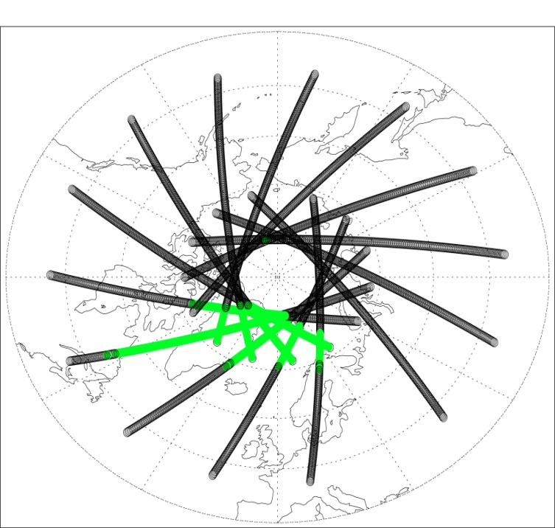
Contemporary satellite datasets providing unprecedented
information on PSC characteristics including:
            Spatial, temporal, and long-term variability of PSC occurrence
            Particle composition, growth kinetics, and nucleation processes
Cloud-Aerosol LIdar with Orthogonal Polarization (CALIOP) on CALIPSO
  17 years (2006 to present)
  Dual wavelength (532 and 1064 nm), polarization-sensitive lidar
  Provides high spatial resolution measurements of clouds and aerosols
Microwave Limb Sounder (MLS) on Aura
  19 years (2004 to present)
  Flies in formation with CALIPSO until 2018
  Measures primary PSC condensables: HNO₃ and H₂O
CALIOP PSC Composition
CALIOP PSC Locations 122410
MLS HNO₃ Mixing Ratio
MLS H₂O Mixing Ratio

Slide 4
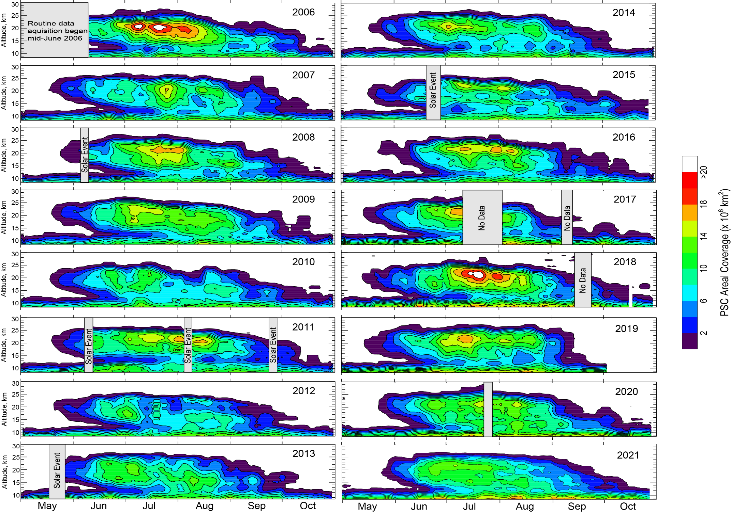
Antarctic PSC Spatial Coverage: 2006-2021

Slide 5

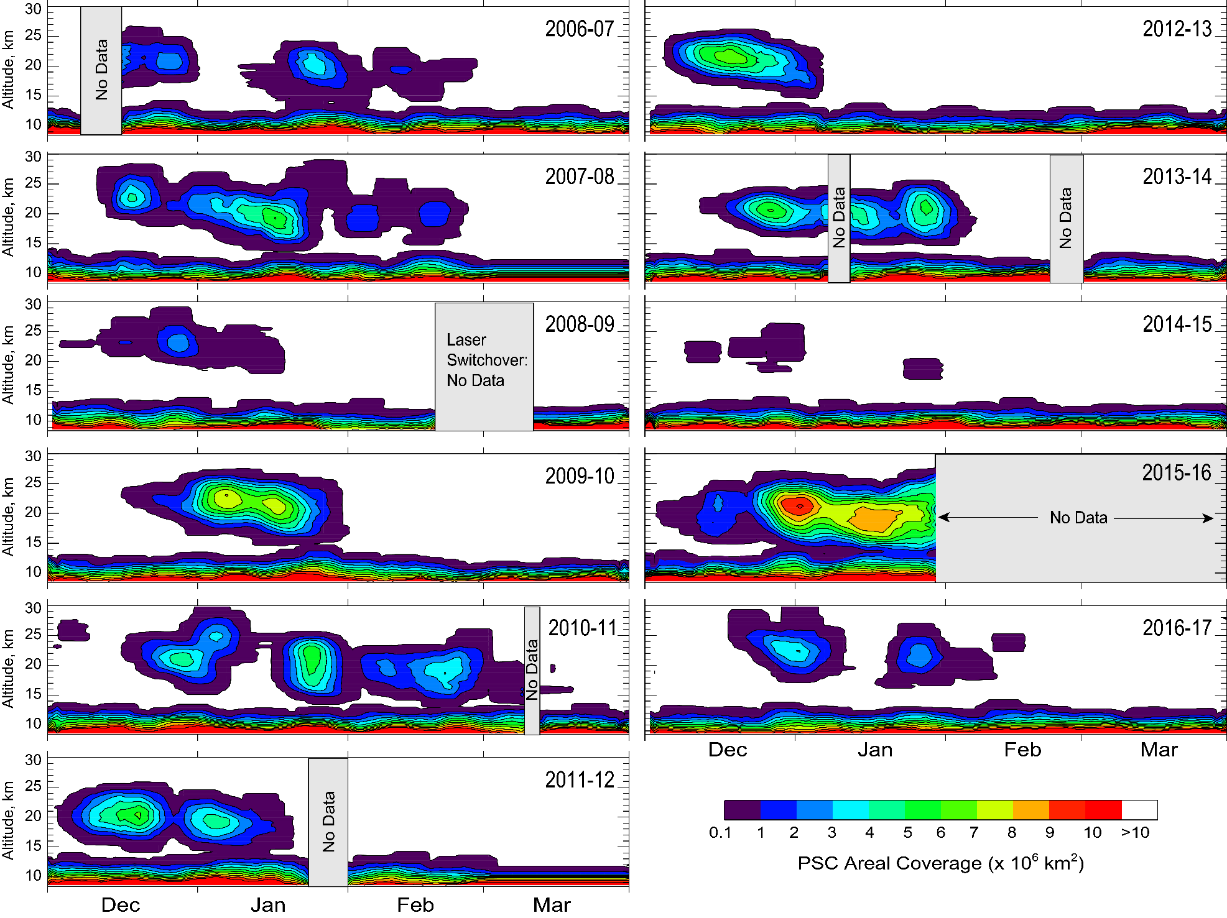
Arctic PSC Spatial Coverage: 2006-2017

Slide 6
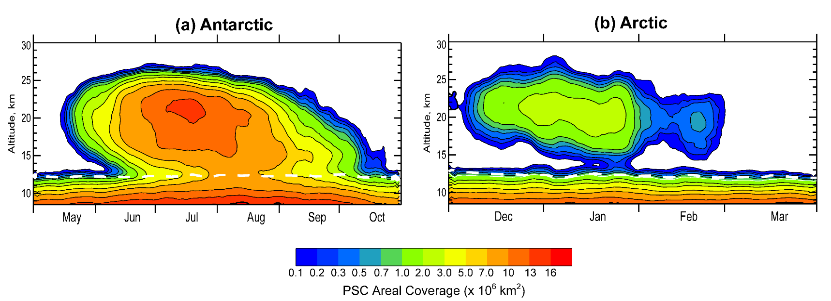
Mean PSC Coverage and Interannual Variability

Slide 7
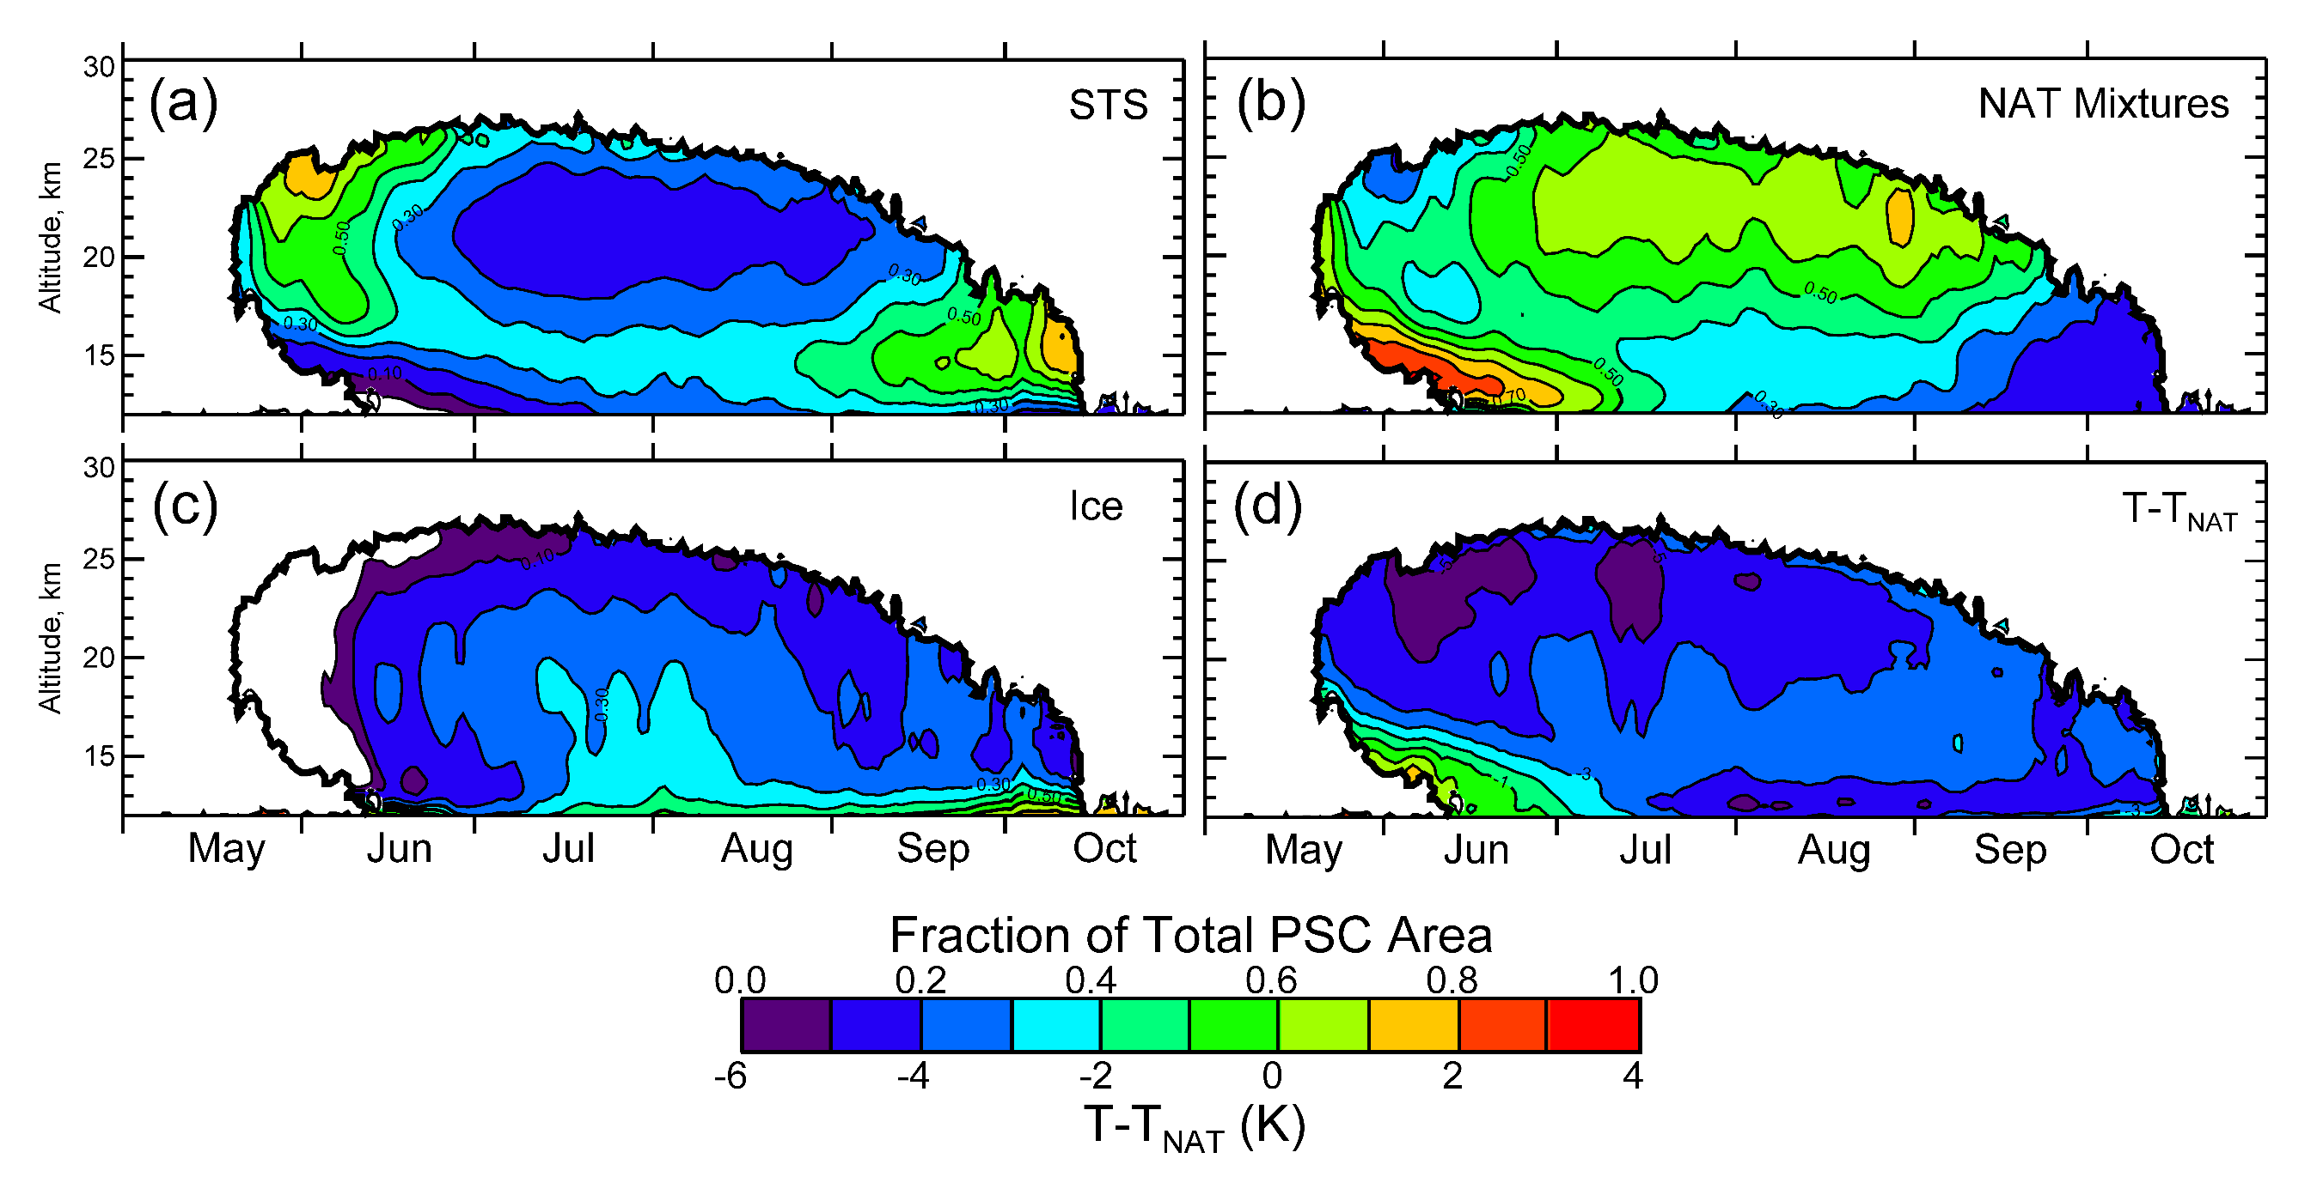
Seasonal Evolution by Composition
Unprecedented vortex-wide climatological views of PSC occurrence and composition reveal variation in composition with season, altitude, and spatial position; tying in with changes in HNO₃ and H₂O caused by denitrification and dehydration.

Slide 8
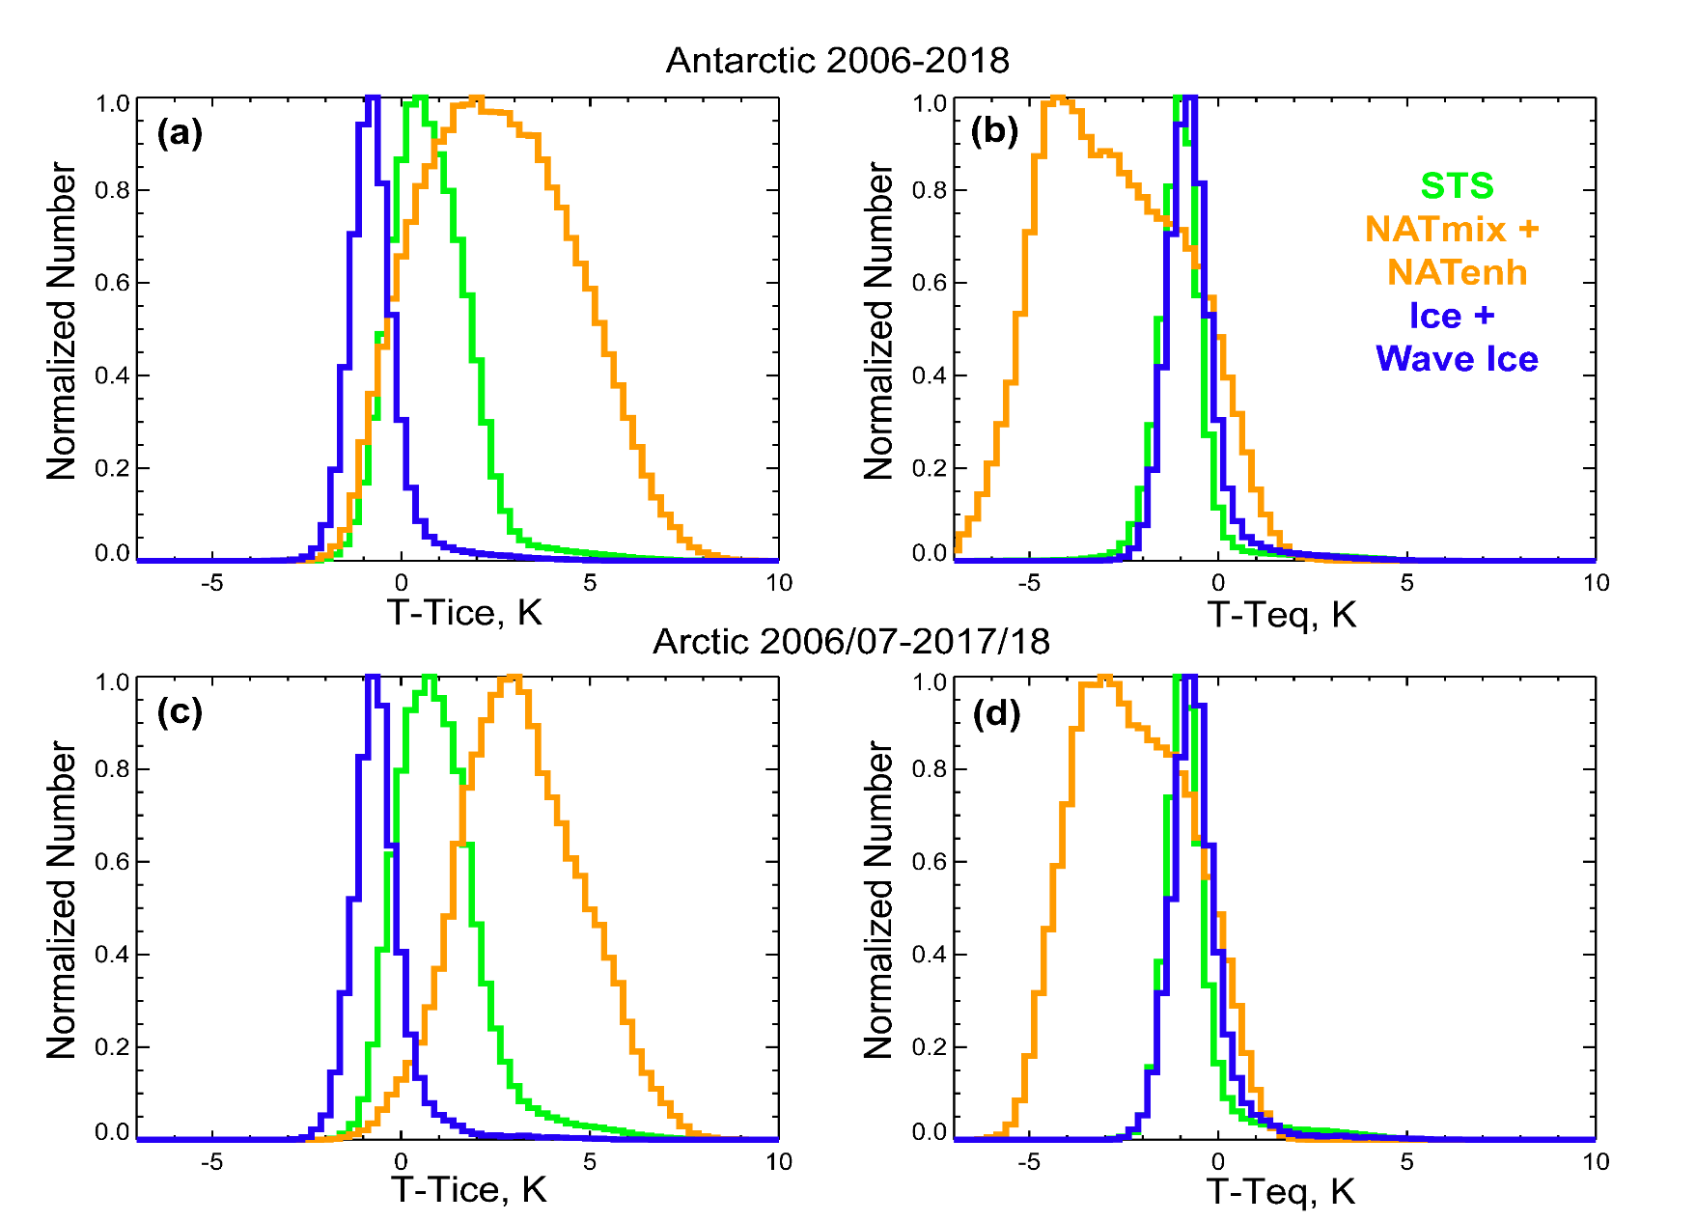
CALIOP PSC Occurrence by Composition
21 km
Composite
STS
Mix1+Mix2
Mix2-enhanced
Wave Ice
Combined analysis of CALIOP and MLS show that STS and ice PSCs occur near thermodynamic equilibrium; NAT mixture PSCs show bimodality, one mode near T_{NAT} for long exposure time to temperatures below T_{NAT}, one near T_{STS} for short exposure times and kinetically limited HNO₃ uptake on NAT.

Slide 9
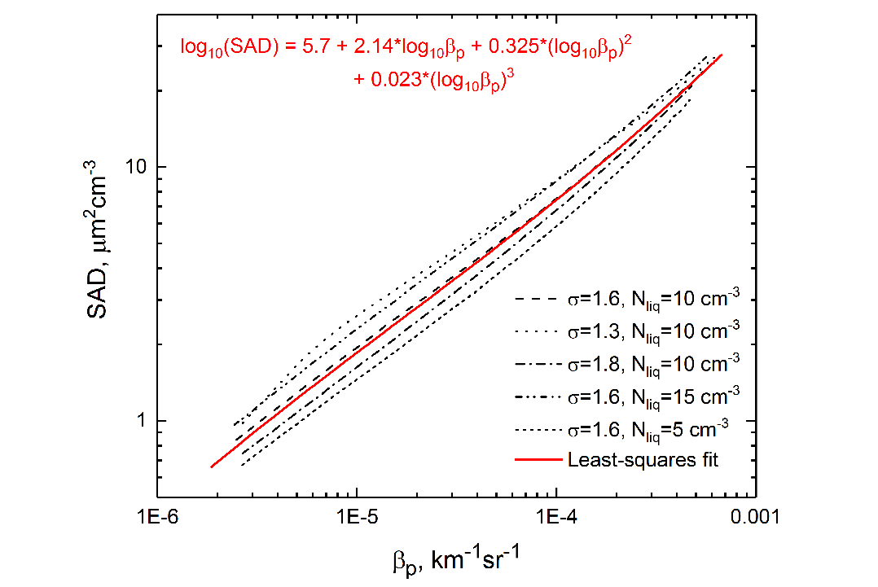
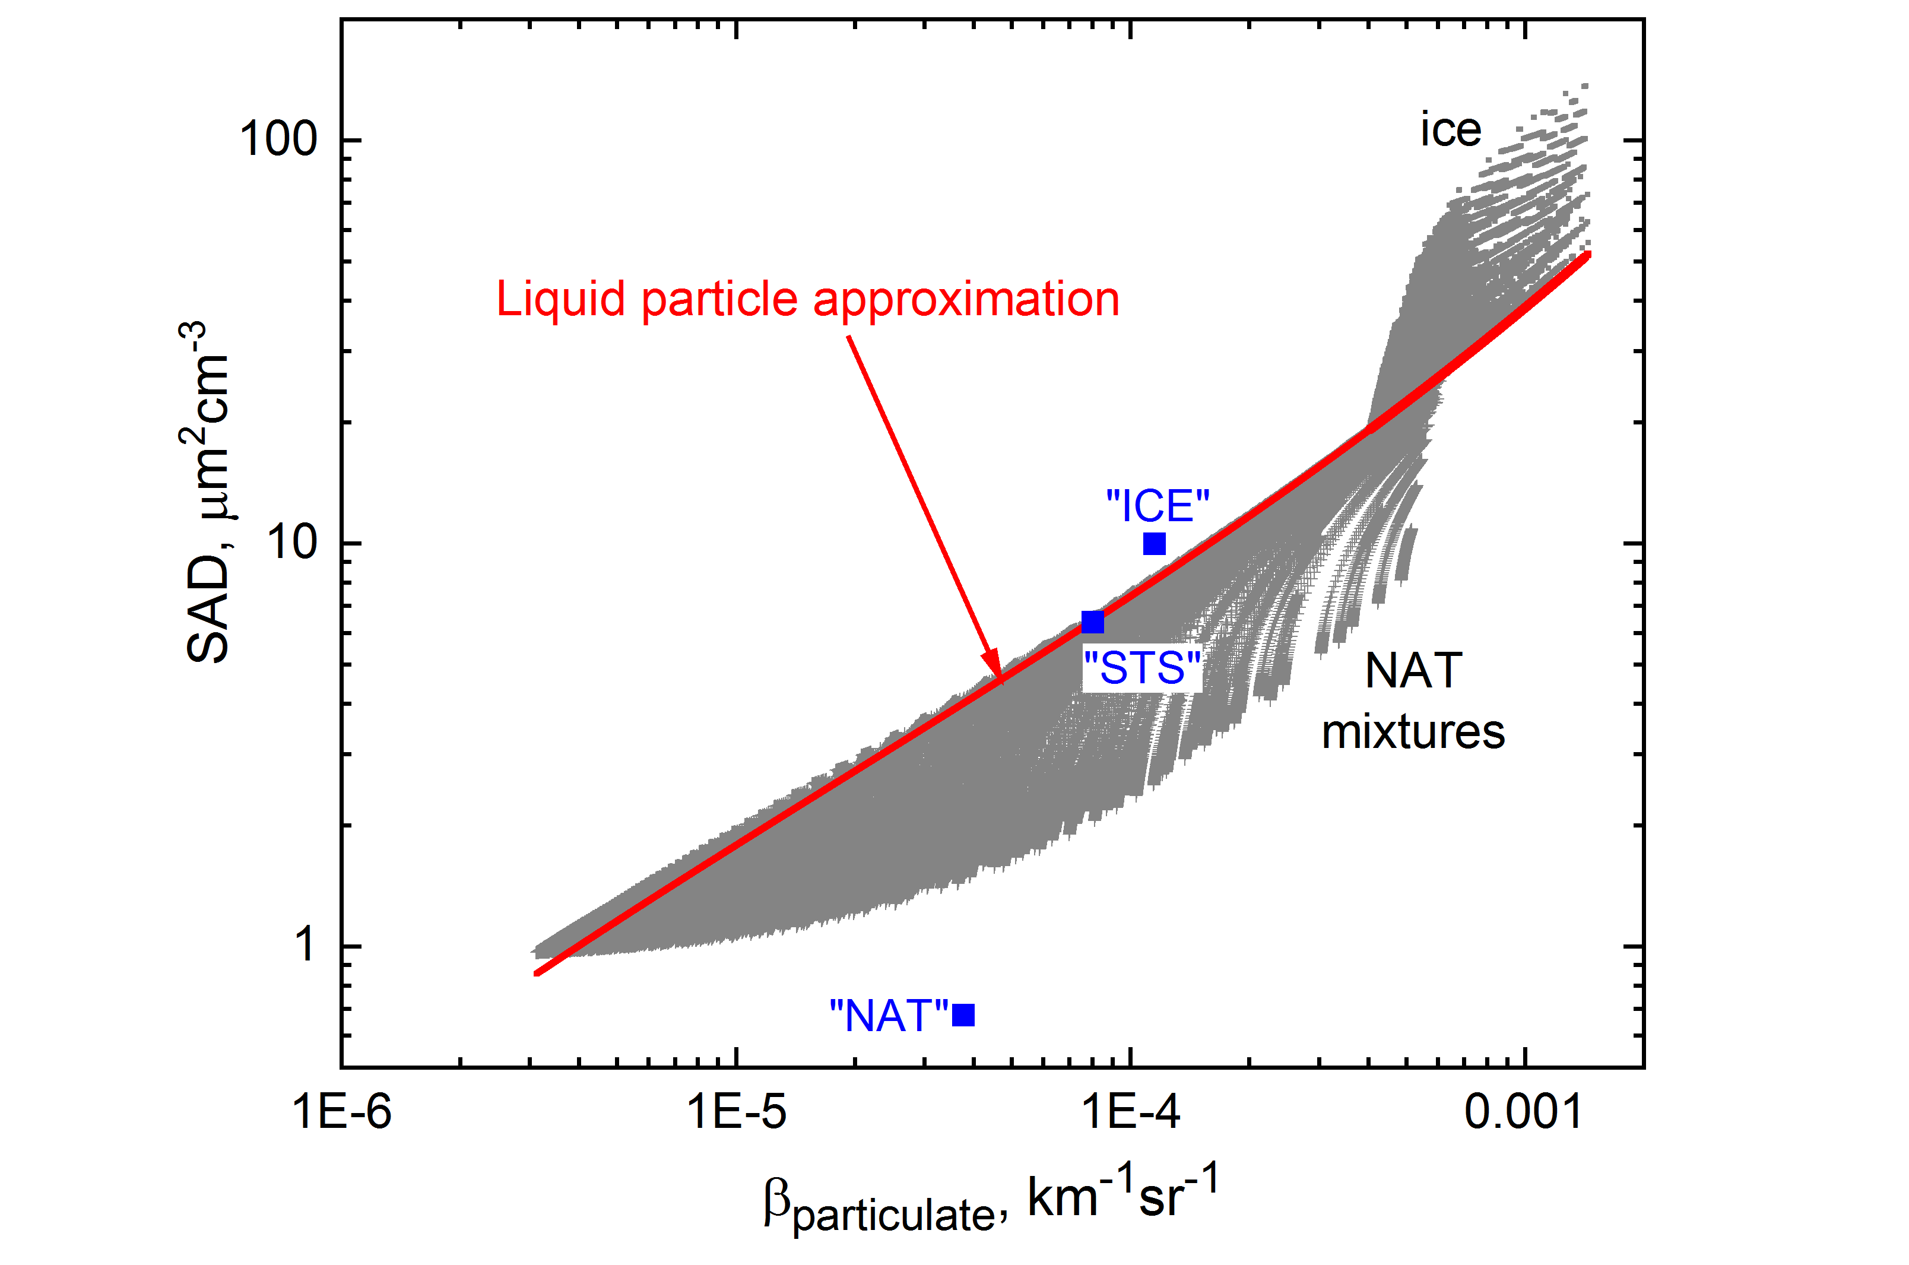
Particulate Surface Area Density (SAD)
Heterogeneous reaction rates ∝ SAD
Power law relationship between particle backscatter, β_{532,particulate}, and SAD
Retrieve “unattenuated” β_{532,particulate} from measured CALIOP attenuated backscatter using composition-dependent extinction-to-backscatter (lidar) ratio
SAD estimates based on liquid only surface area-backscatter relationship
  Lower limit for ice
  Upper limit for NAT mixtures
Composite
STS
Mix1+Mix2
Mix2-enhanced
Ice
Wave Ice

Slide 10
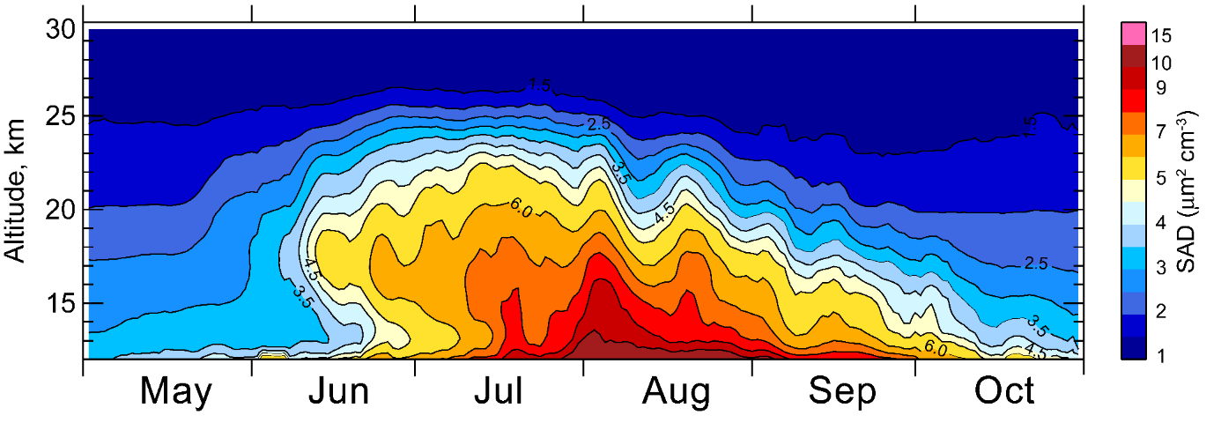
Particle Surface Area Density (SAD) and Volume Density (VD)
CALIOP Antarctic Vortex-averaged SAD (2006-2017)
CALIOP SAD and VD estimates based on assumption of liquid particles only
Retrieval of VD from MIPAS mid-infrared limb-radiances under the assumption of small particles (r < 1 µm)
CALIOP/MIPAS VD’s agree well with respect to magnitude and altitude distribution
2011-05-29
Example:
STS
MIPAS
NAT/mixed
CALIOP mean
Ice
CALIOP mean convolved with MIPAS averaging kernel

Slide 11

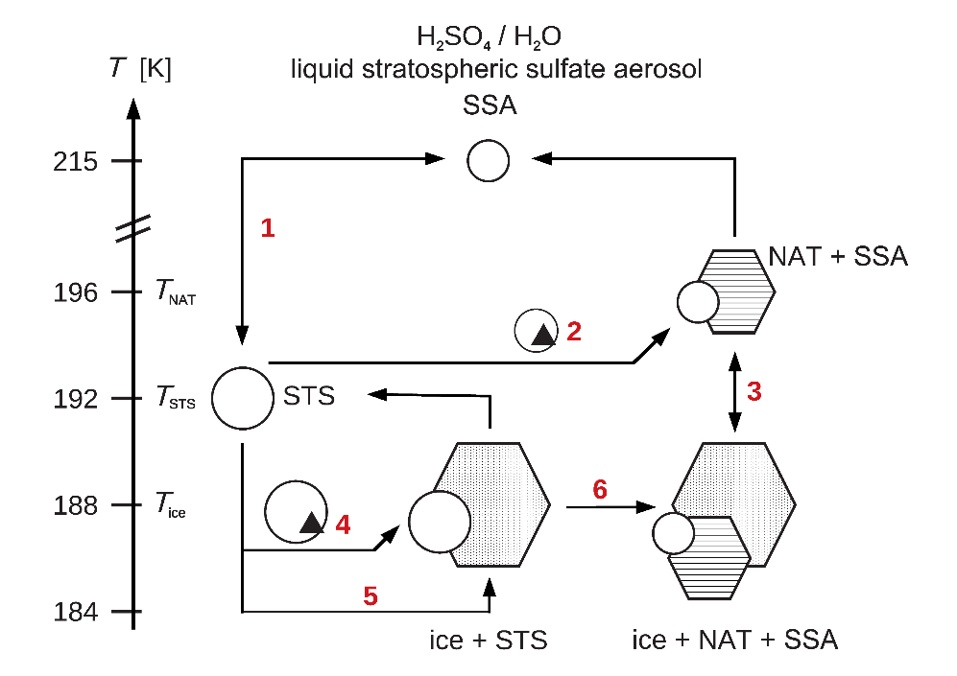
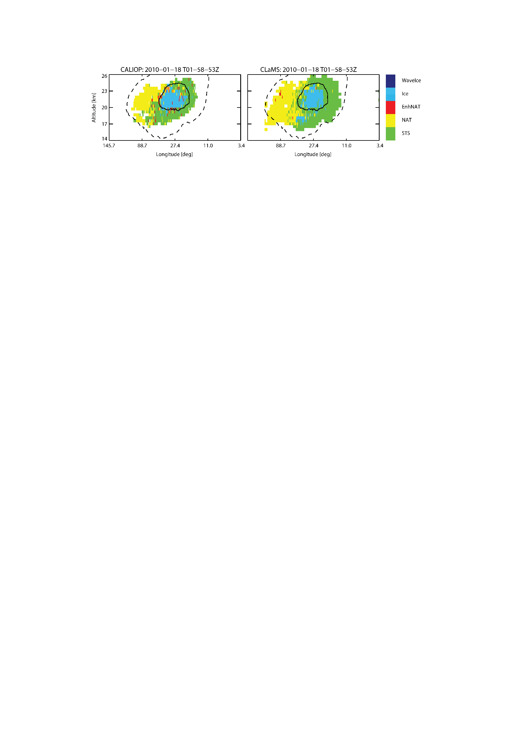
PSC Formation: New Heterogeneous Pathways
▲
Heterogeneous ice and NAT nucleation on foreign nuclei imbedded in liquid SBS
Evidence for the existence of foreign nuclei, possibly of meteoritic origin (e.g. Weigel et al., 2014)
Parameterization based on active site theory (Marcolli et al., 2007)
Parameterizations of heterogeneous NAT and ice nucleation are required in CLaMS to reproduce the PSC distributions observed by CALIOP.
PSC classification derived from CALIOP for a single satellite orbit between latitudes 60°N–82°N (left) and corresponding simulation by CLaMS (right). The solid and dashed lines in the panels enclose the regions with temperatures below T_{ice} and T_{NAT}, respectively.

Slide 12
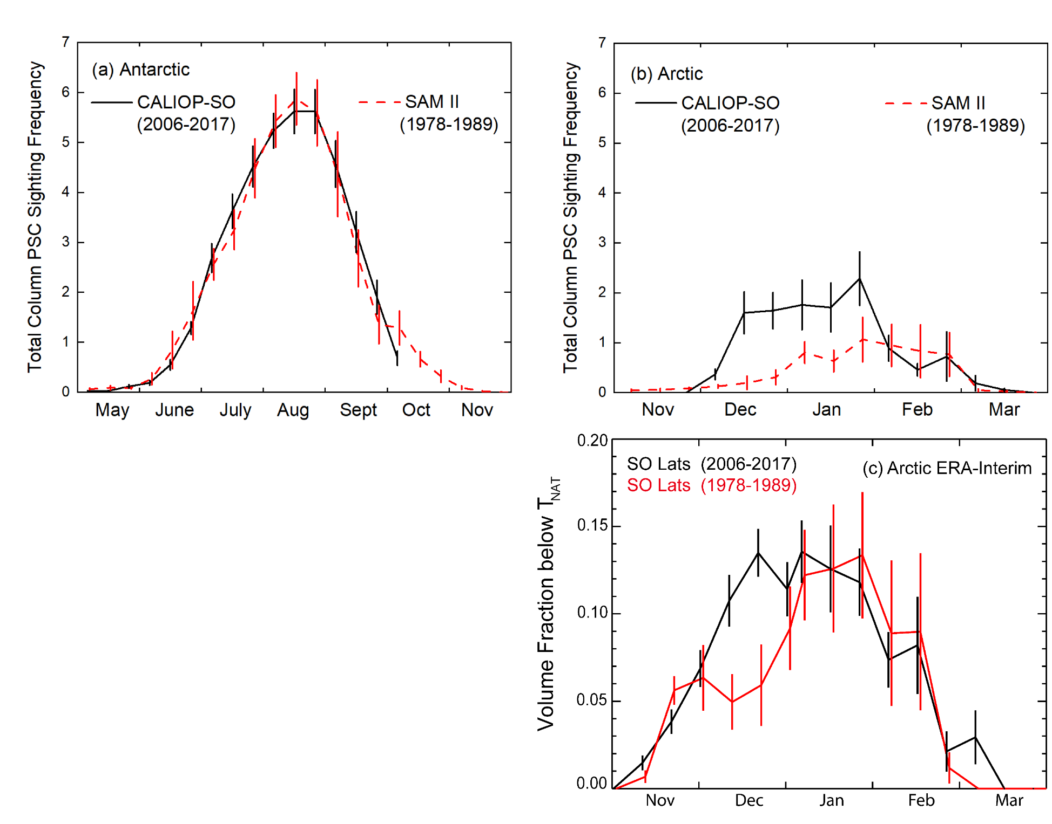
Search for long-term trends: CALIOP/SAM II Comparisons
Composite
STS
Mix1+Mix2
(a) Antarctic and (b) Arctic PSC column occurrence frequencies for CALIOP (2006–2017, black solid) and SAM II (1979–1989, red dashed), along with 1-σ uncertainties in the multi-year means. Panel (c) shows the volume fraction of temperatures below T_{NAT} based on ERA-Interim reanalysis data for the CALIOP (black solid) and SAM II (red dashed) time periods, again with 1-σ uncertainties in the means. (a) and (b) adapted from Pitts et al. (2018).
Mix2-enhanced
Wave Ice

Slide 13

Summary and Outlook
CALIOP 17-year data record is the first observation-based record of PSC occurrence, composition, and particle characteristics on polar vortex-wide spatial scales and decadal time scales
State-of-the-art climatology provides basis for testing and improving parameterizations of PSC processes in global chemistry/climate models, leading to improved simulations of ozone loss and predicted recovery times
CALIOP PSC climatology is the foundation for comprehensive paper reviewing recent progress in our understanding of PSCs
  Tritscher, I., et al., 2021: Polar stratospheric clouds: Satellite observations, processes, and role in ozone depletion. Reviews of Geophysics, 59, e2020RG000702, https://doi.org/10.1029/2020RG000702.
Remaining open science questions:
  NAT particle formation, shape, and size distributions
  Cloud formation and particle characteristics in polar UTLS
  Long-term trends as climate changes
  Importance of meteoritic dust in particle nucleation

