Slide 1
Advanced Air Mobility
High Density Vertiplex
Detect and Avoid (DAA)
April 7th, 2022
Lou Glaab
Marcus Johnson

Slide 2
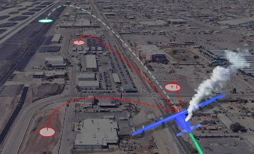
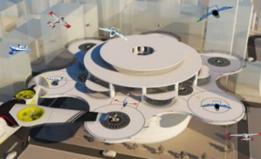
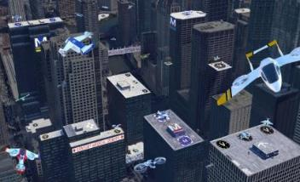
HDV Project Overview
HDV Spirals
Two primary thrusts in HDV
  Prototype and assess representative UAM Ecosystem
  Perform testing and Safety Risk Assessment (SRA) to expand operations and achieve operational credit for NASA techs
    Provides off-ramp to sUAS Part-135 operations
    Benefits for envisioned UAM vehicles
Prototype representative UAM Ecosystem including
  Vertiport automation systems (primary focus)
  On-board autonomous systems
  Airspace management systems
  Ground control/fleet management systems
Perform coordinated spiral development and test series
  Ingest NASA techs for specific spiral (AOA, SAO, VO)
  Apply sim-to-flight test techniques
  Perform comprehensive safety risk assessments
  To both support the UAM Ecosystem prototyping/assessment
  And to generate essential data and results to achieve meaningful operational credit
Advanced Onboard Automation
Scalable Autonomous Operations
Vertiplex Operations

Slide 3
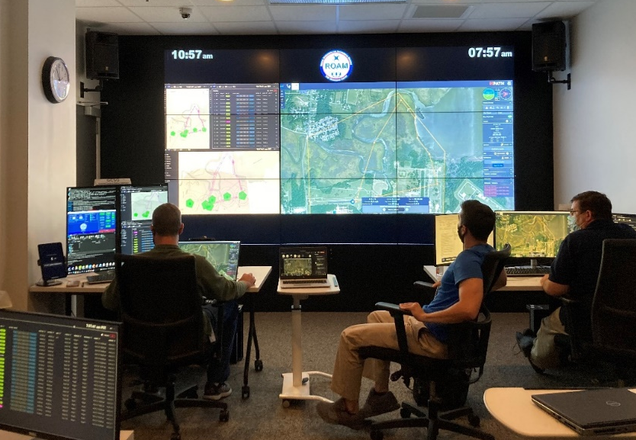
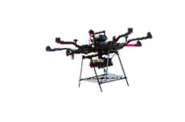
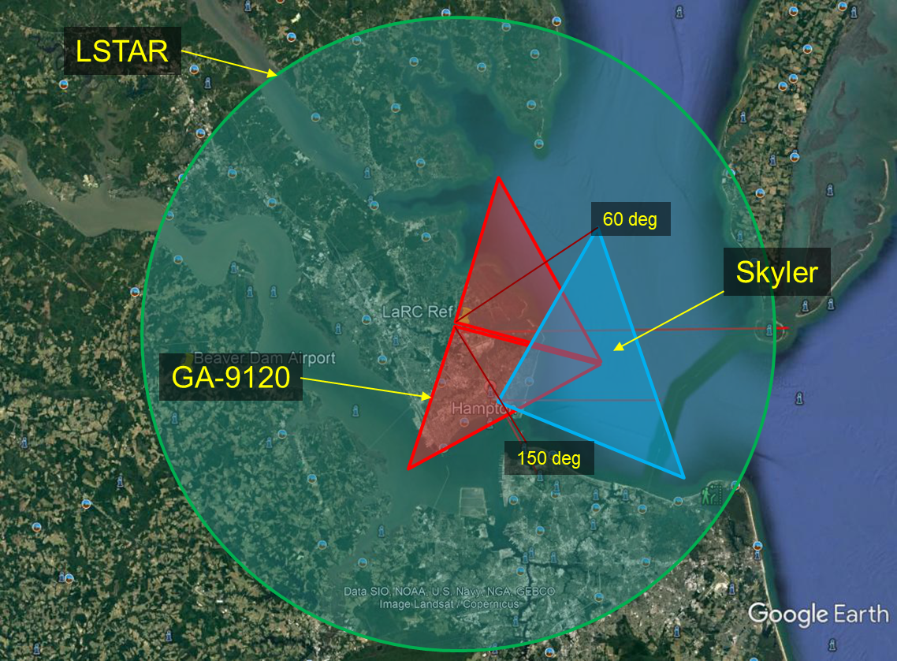
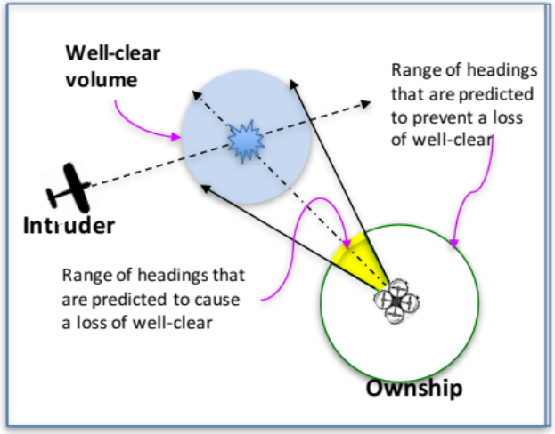
Hybrid Ground-Air Detect and Avoid OPSCON
GCSO primary for ensure well clear
  ICAROUS alerts used to trigger avoidance maneuver
ICAROUS primary for lost link RTLs
  Progressive expansion of RTL segments
  Extensive development, testing, documentation
  S2D used for autonomous remote landings
Initial BVLOS at CERTAIN range
  Short segments up to ~1 mile
Expansion to longer range flights
  To/from Ft Monroe
  ~6 miles
  Support maritime surveillance function for Hampton PD
  SAA with Longbow
ICAROUS
Flight Alarm in/out
ADS-B in
Well-clear Volume
ZTHR = 500’
ROAM UAS Ops Center (LaRC)
Primary control stations
Shared SA
Anra SS CTR data fusion (Radar/ADS-B/FLARM)
Radar
DTHR = 2000’
CERTAIN
LR Flights
Integrated composite radars surveillance
Decoder key: Remote Operations for Autonomous Missions (ROAM), Integrated Configurable Architecture for Reliable Operations of Unmanned Systems, Safe 2 Ditch: S2D

Slide 4

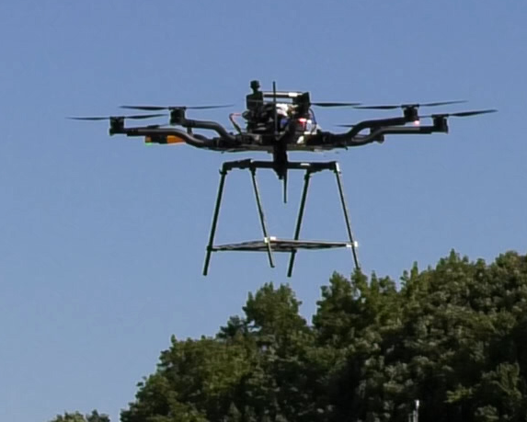
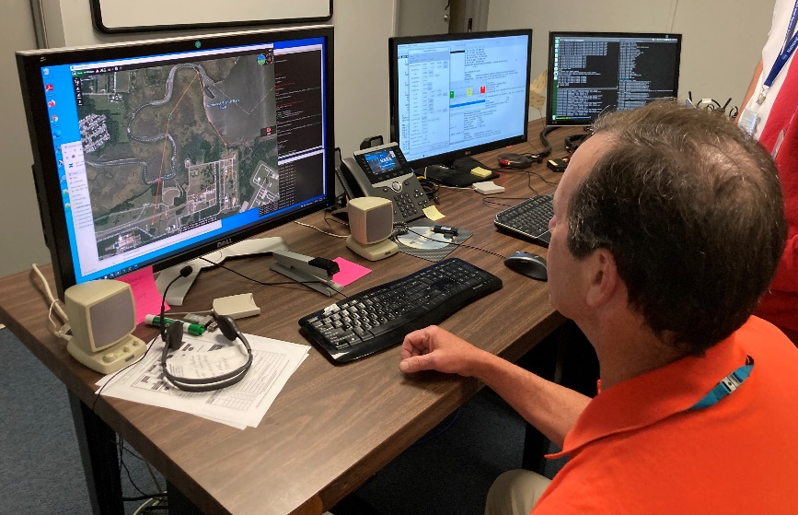
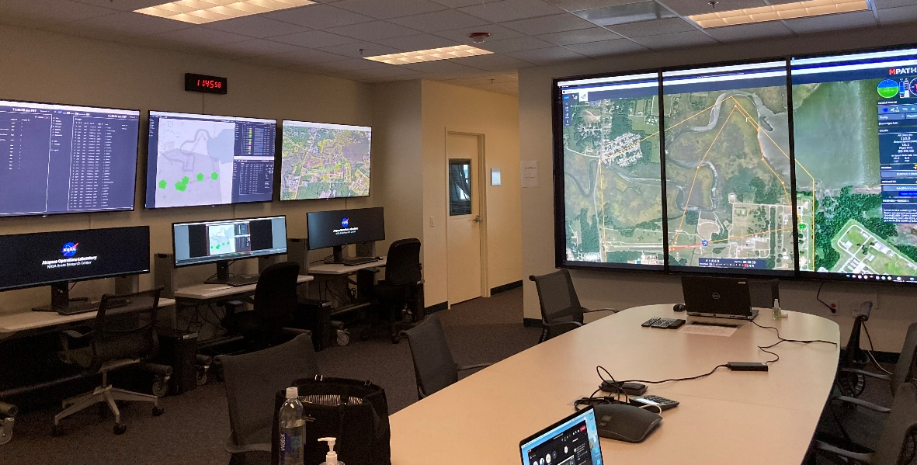
HDV Test Environment
ROAM UAS Ops Center (LaRC)
Primary control stations
Shared SA
Sim or Flight
sUAS UAM surrogates
Valid data across interfaces
SIVL (LaRC)
6 DOF sim
Autonomous systems
ARC AOL/AVAL
UAM Ecosystem Prototype

