Slide 1
Ceramic Metallic (Cermet) Nuclear Fuel Development in Space Nuclear Propulsion
Space Technology Mission Directorate
Space Nuclear Propulsion Project
Jhonathan Rosales, PhD. | April 21st 2022

Slide 2
Agenda
Background on Space Nuclear Propulsion
Cermet Fuel Concept
Nuclear Fuel Surrogate Work
Nuclear Fuel Article Fabrication
Nuclear Fuel Testing
Current Work
Case Study
Conclusions

Slide 3
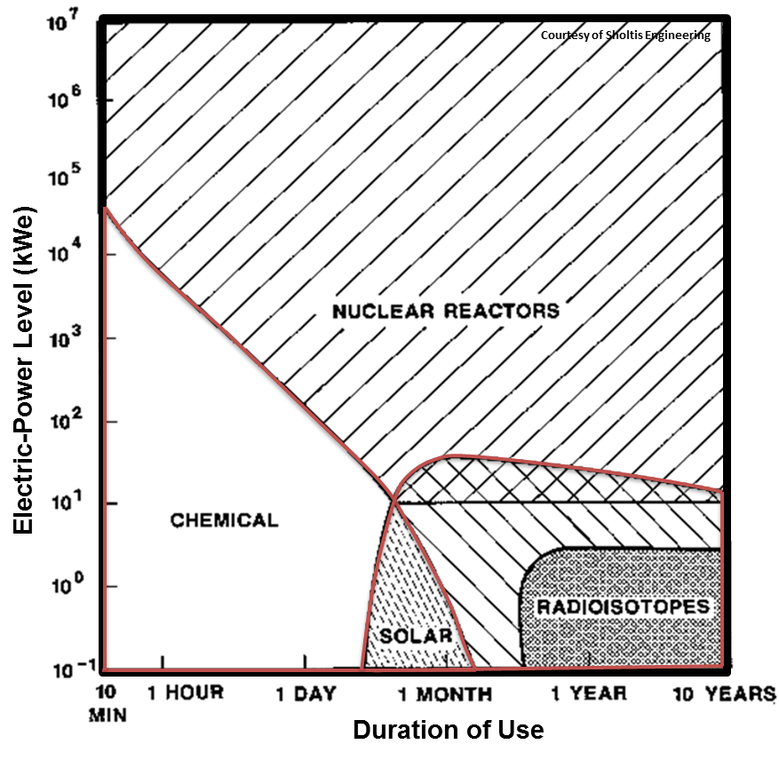
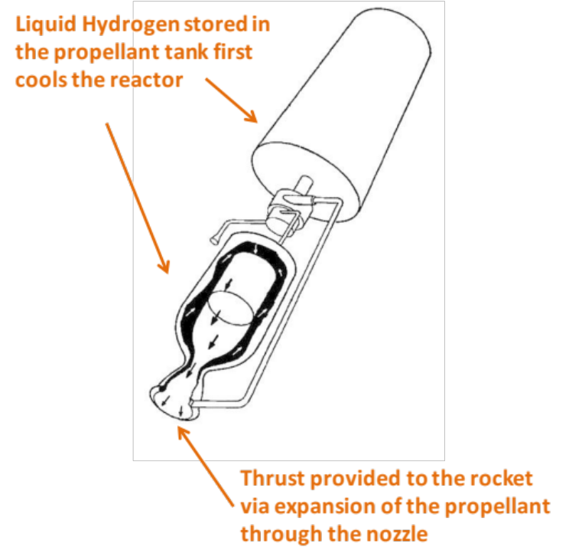
Background
Nuclear Thermal Engine
Development of nuclear technologies can allow a safer, more efficient, and effective space exploration [1].
Nuclear fuel housing
[1]
Notes:
In order to guarantee the efficiency of NTRs, our operating conditions are really constrained.
Diatomic Hydrogen is the lowest molecular mass propellant and is usually required for NTRs.
Here is a figure whats going on inside, first liquid hydrogen …
It’s flow rate will control the reactor and provide thrust through expansion of the propellant out the nozzle.

Slide 4

Background
[1]
Specific Impulse (I_{sp})
$$Isp=\frac{FT}{ṁ}$$
2x
Ratio of thrust (F_{t} ) and mass flow rate (ṁ) during ejection. Measures the overall performance of the rocket engine. Unit (s).
90 – 120 minute total operation time at maximum temperature
Notes:
NTP is an in-space propulsion technology capable of high specific impulse and thrust
A propulsion system with a higher specific impulse uses the mass of the propellant more efficiently
M:kg/s
F:N :kg*m/s2
Multiply by 9.8066 m/s^2 to acquire SI units (m/s)
Ammonia with LO2

Slide 5
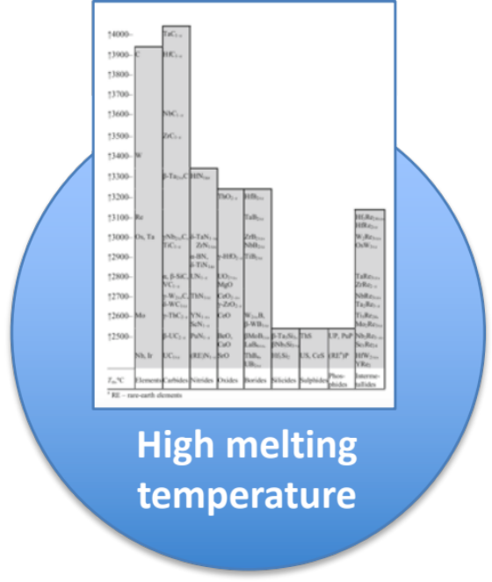
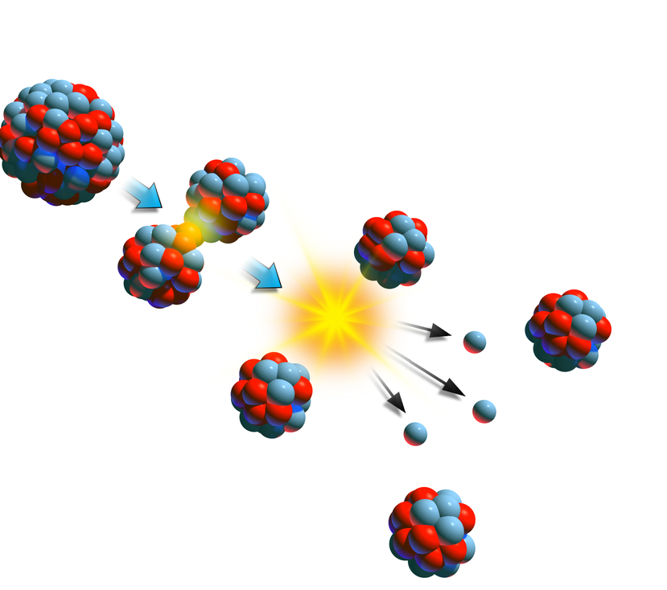
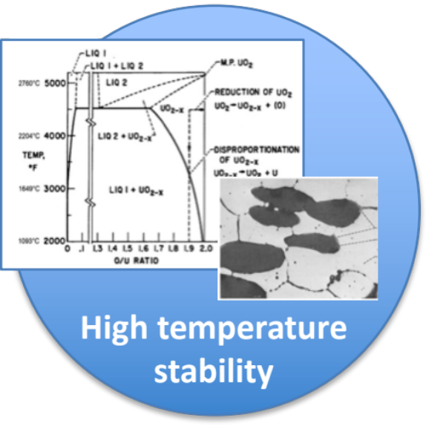
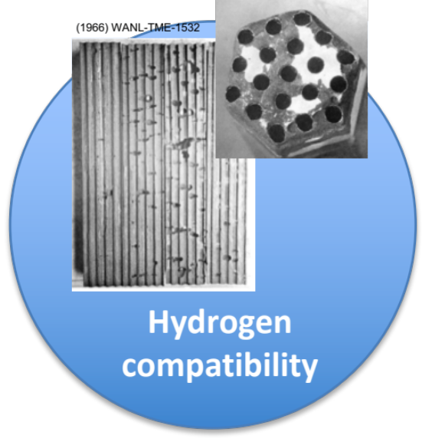
Limited material systems exist with the attributes desired for space nuclear propulsion applications
Background
Low neutron absorption

Slide 6
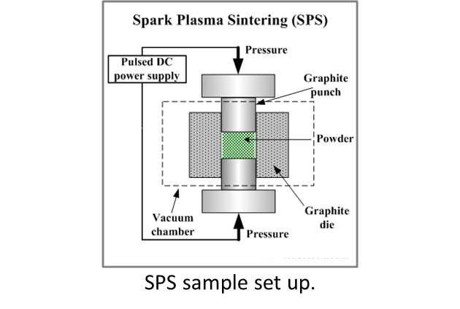
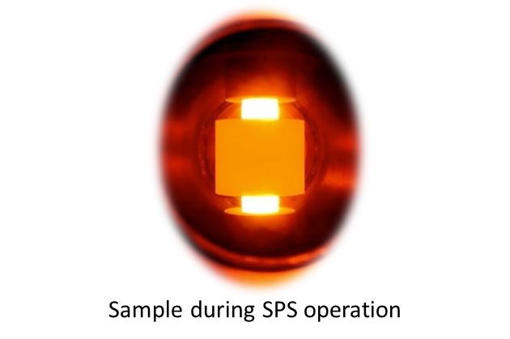
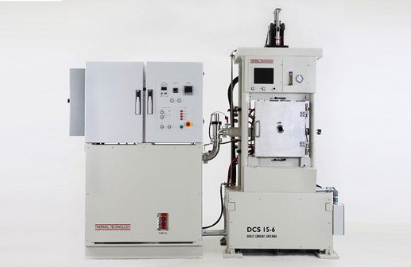
Cermet Fuel
A cermet is a composite material composed of ceramic (cer) and metal (met) materials
Designed to have the optimal properties of a ceramic
  High temperature resistance and hardness
And properties of a metal
  Ability to undergo plastic deformation
Cermet fuel is fabricated via spark plasma sintering (SPS) at MSFC
  Rapid Consolidation/Sintering
  Near Net-Shape Parts
  High Density Parts
  Minimal Grain Growth
SPS model DCS 15.

Slide 7
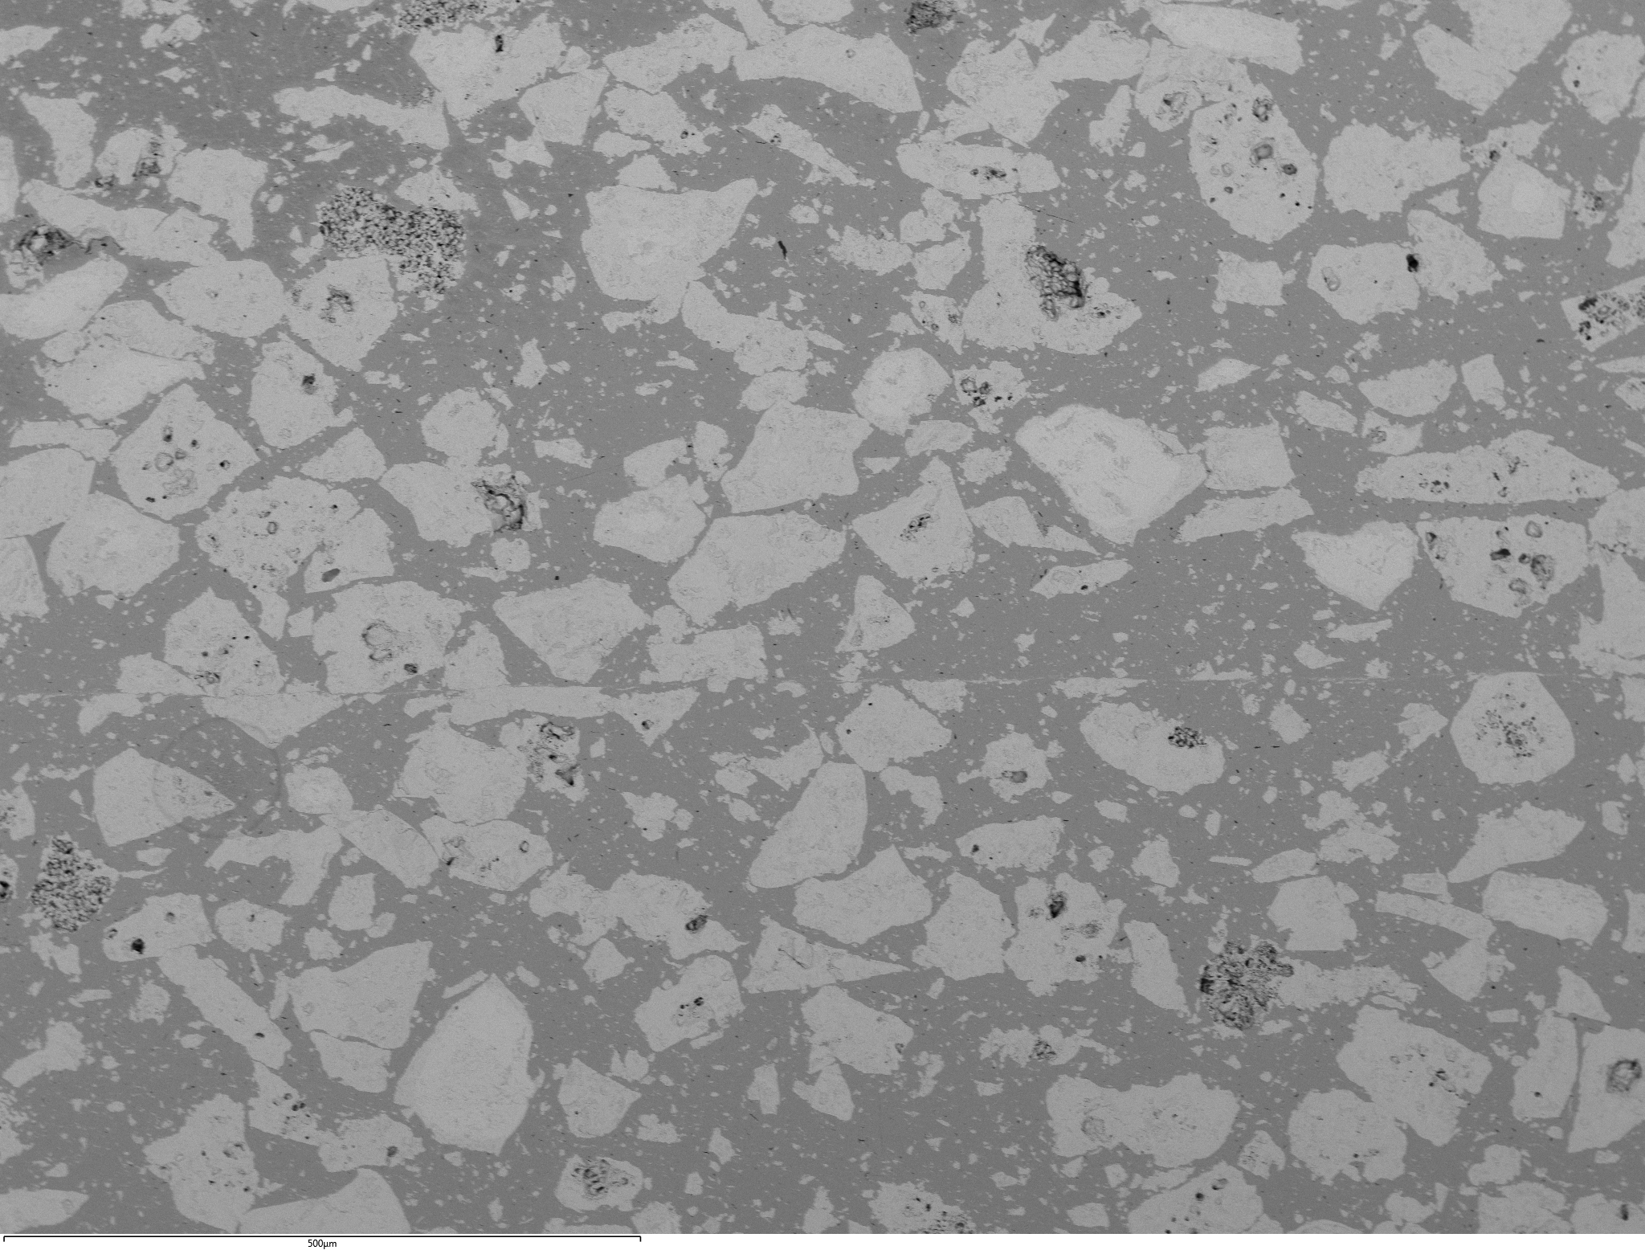
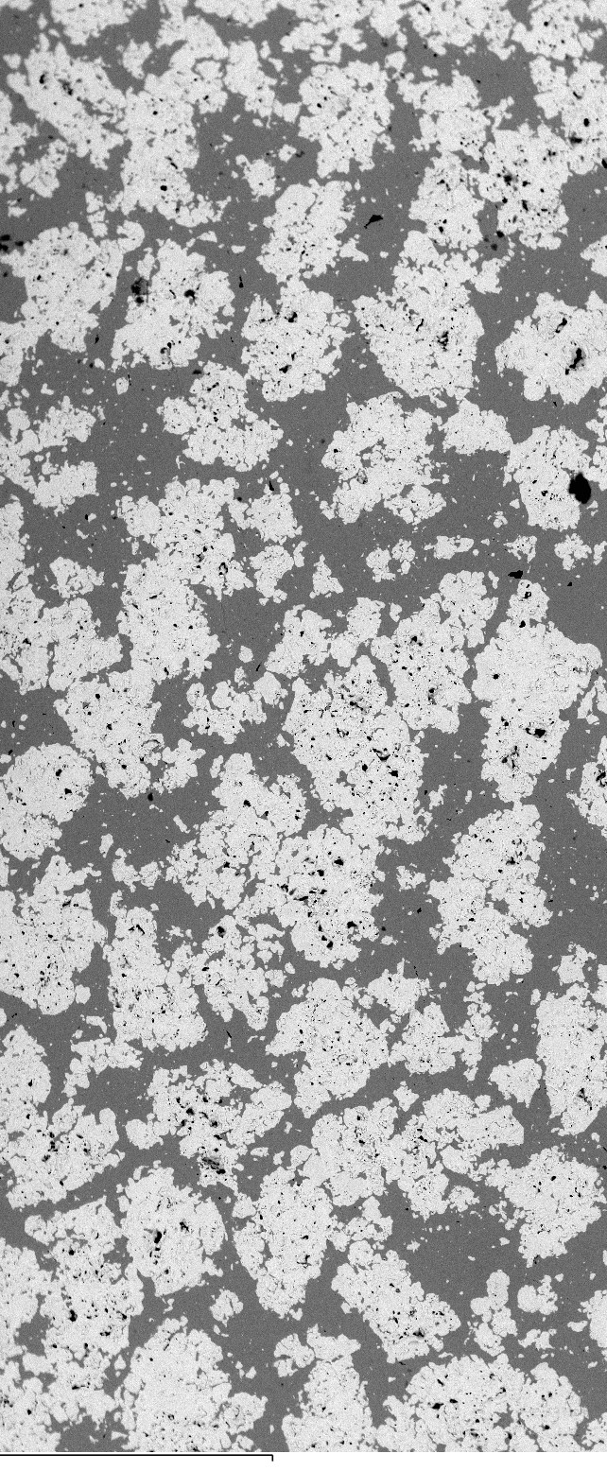
Nuclear Fuel Surrogate
  Research focuses on synthesis to understand chemical reactions and product formation prior to experiments with uranium
  Surrogate of choice is hafnium nitride (HfN)
    high melting temperature
    crystallographic structure same as (UN)
  Surrogate work allows to predict morphology and
  microstructural features prior to working with uranium
  Advantages include:
    Reduced cost
    Reduced safety guidelines and processes
    Faster turn around times
HfN
UN
Mo
Surrogate work is faster and safer
Compound | Melting Point (°C) | Density (g/cm³) | Crystal Structure | Thermal Conductivity (W/m*K)
HfN | 3,385 | 13.8 | Cubic | 11.71
UN | 2,850 | 14.3 | Cubic | 54.0
100 µm
Similar microstructure of UN and HfN on a molybdenum matrix.
Nuclear fuel and surrogate properties.

Slide 8
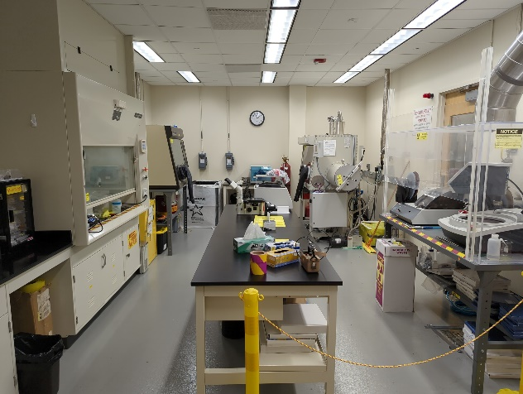

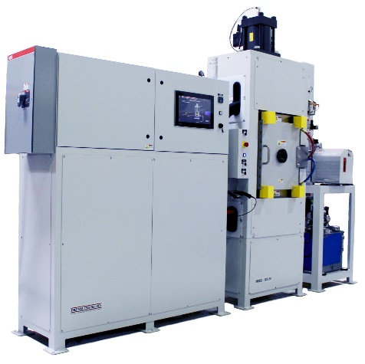
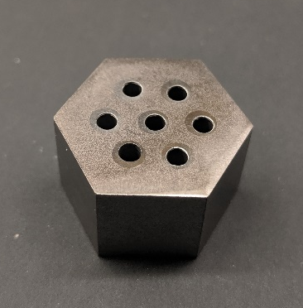
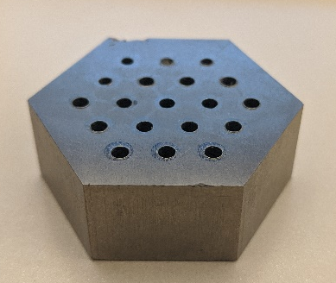
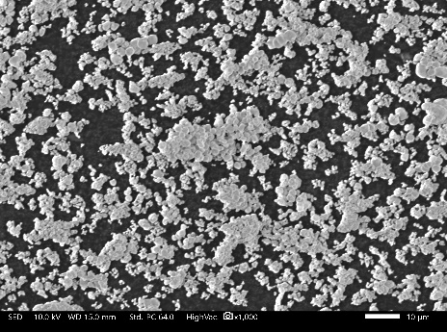
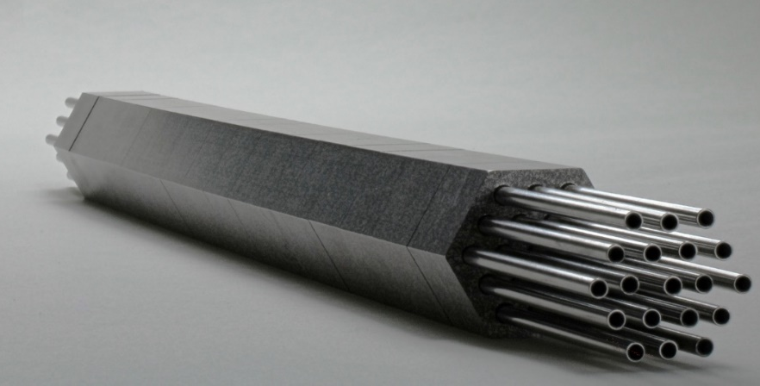
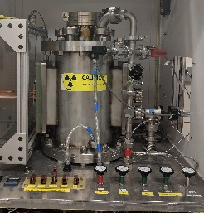
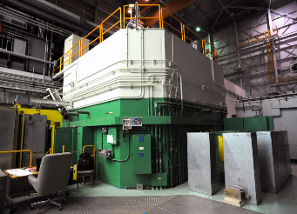
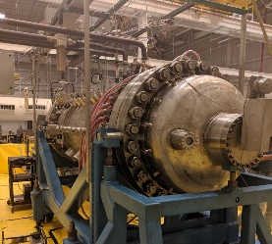
Nuclear Fuel Fabrication
Nuclear fuel wafer fabrication
Nuclear fuel powder feedstock preparation in radiological laboratory
Consolidation via Spark Plasma Sintering (SPS)
Nuclear Fuel Testing
CFEET (MSFC).
TREAT Reactor (INL).
Nuclear fuel article assembly with multiple wafers
NTREES (MSFC).

Slide 9
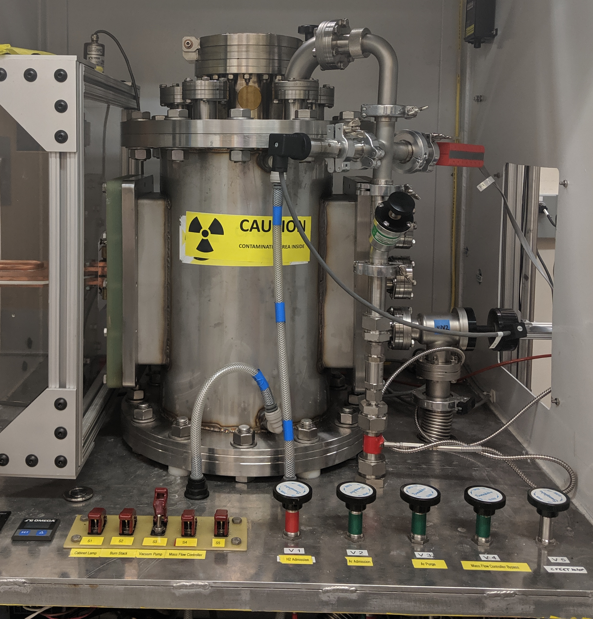

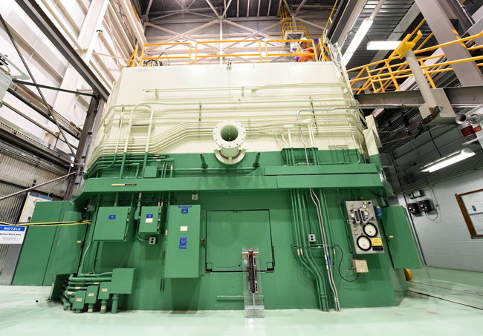
Nuclear Fuel Testing
CFEET – Compact Fuel Element Environmental Test (MSFC)
  Nuclear reactor temperatures, hydrogen rich environment
  Specimen size ~ 0.5-3” in length
NTREES – Nuclear Thermal Reactor Element Environmental Simulator (MSFC)
  Nuclear reactor temperatures and pressures, hydrogen environment
  Specimen size +20” in length
TREAT – Transient Test Reactor Facility at Idaho National Laboratory
  Nuclear Reactor temperatures and pressures
  Test nuclear fuel under severe reactor accident conditions
CFEET furnace - MSFC
NTREES Facility - MSFC
Transient Test Reactor Facility (TREAT).
Notes:
TREAT tests nuclear reactor fuels and materials under extreme conditions. It produces sudden bursts of energy that bring fuels to failure on a small scale in a very controlled way. This allows researchers to examine fuel performance under simulated accident conditions.

Slide 10
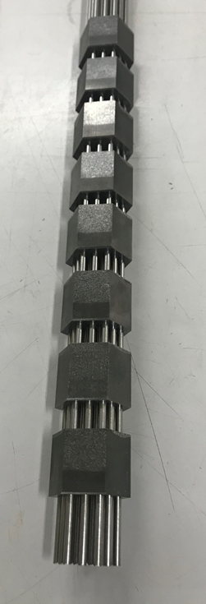
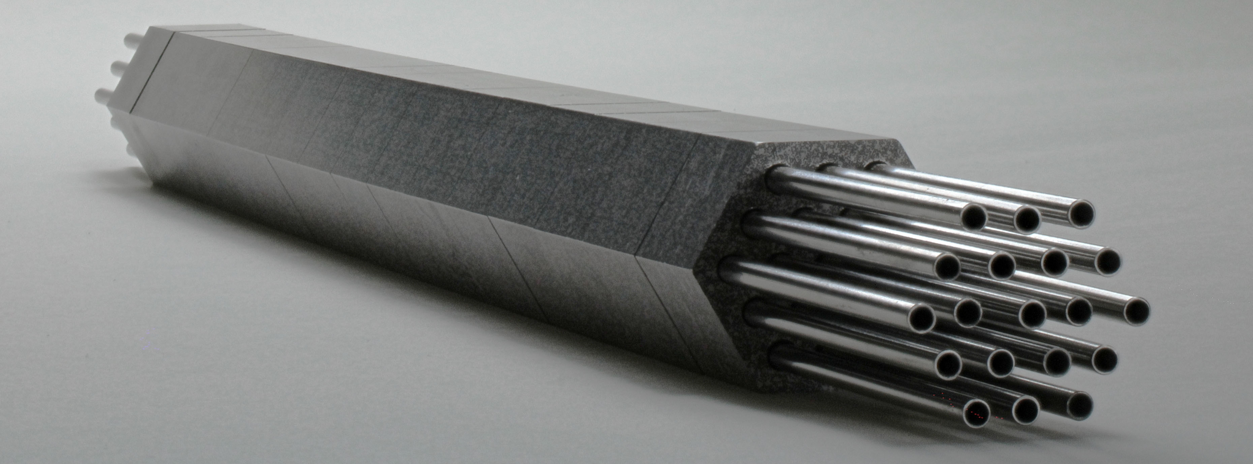
SPS-1 Surrogate Nuclear Fuel Article
Composed of ZrO₂ – Mo
Unbonded concept
Molybdenum cooling channels
16” long composed of 16 wafers
Fabricated via spark plasma sintering (SPS)
SPS-1 used as a path-finder in preparation for a uranium bearing test article
5 cm
5 cm
SPS-1 Surrogate nuclear fuel article.

Slide 11

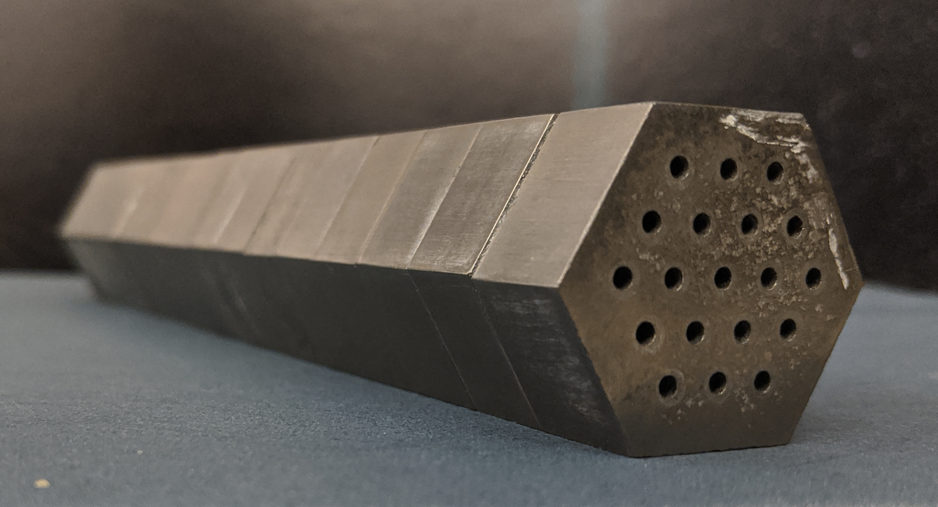
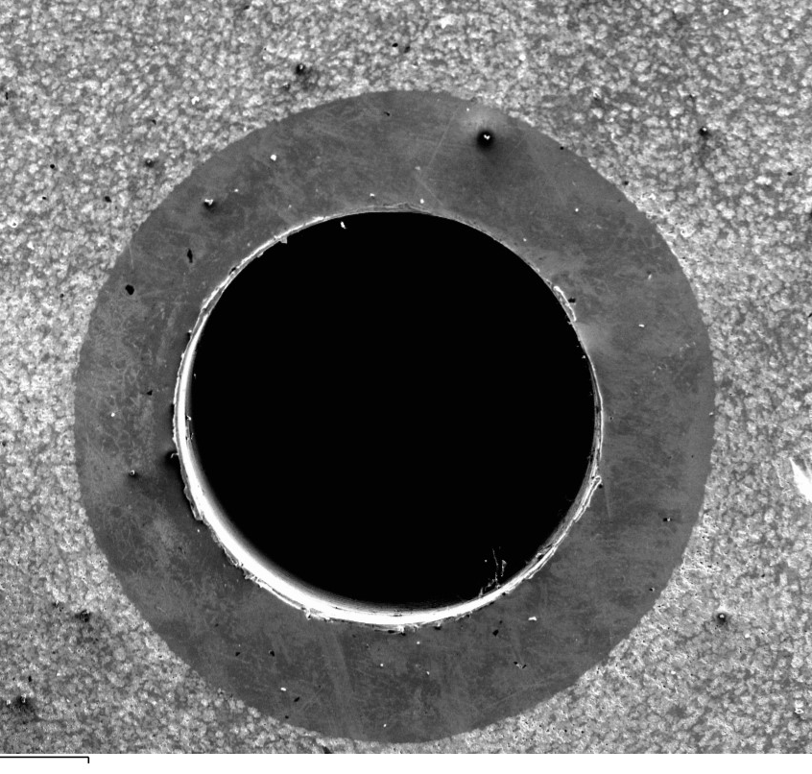
SPS-2 Surrogate Nuclear Fuel Article
Composed of HfN – Mo/W
Bonded concept
Embedded molybdenum cooling channels
8” long composed of 16 wafers
Fabricated via spark plasma sintering (SPS)
Cermet fuel
Molybdenum cooling channel
Void
5 cm
1 mm
Embedded cooling channels provide optimum heat transfer in fuel.

Slide 12
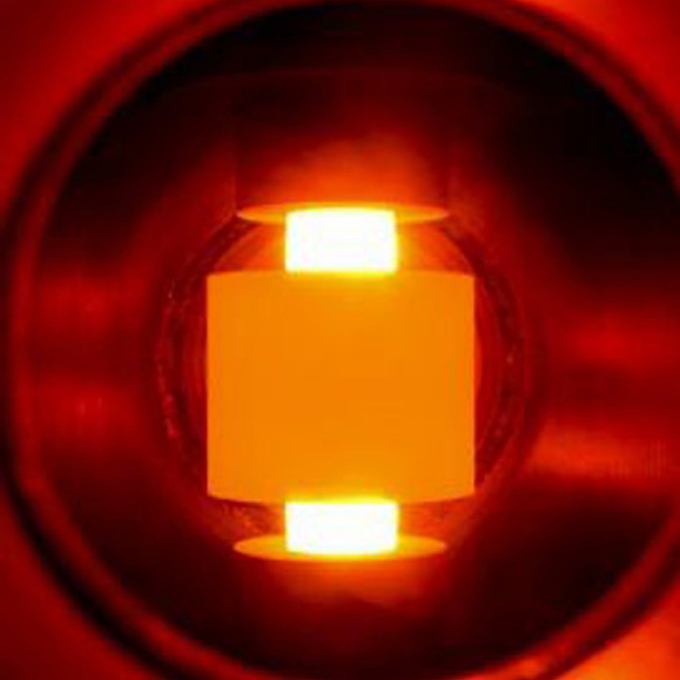
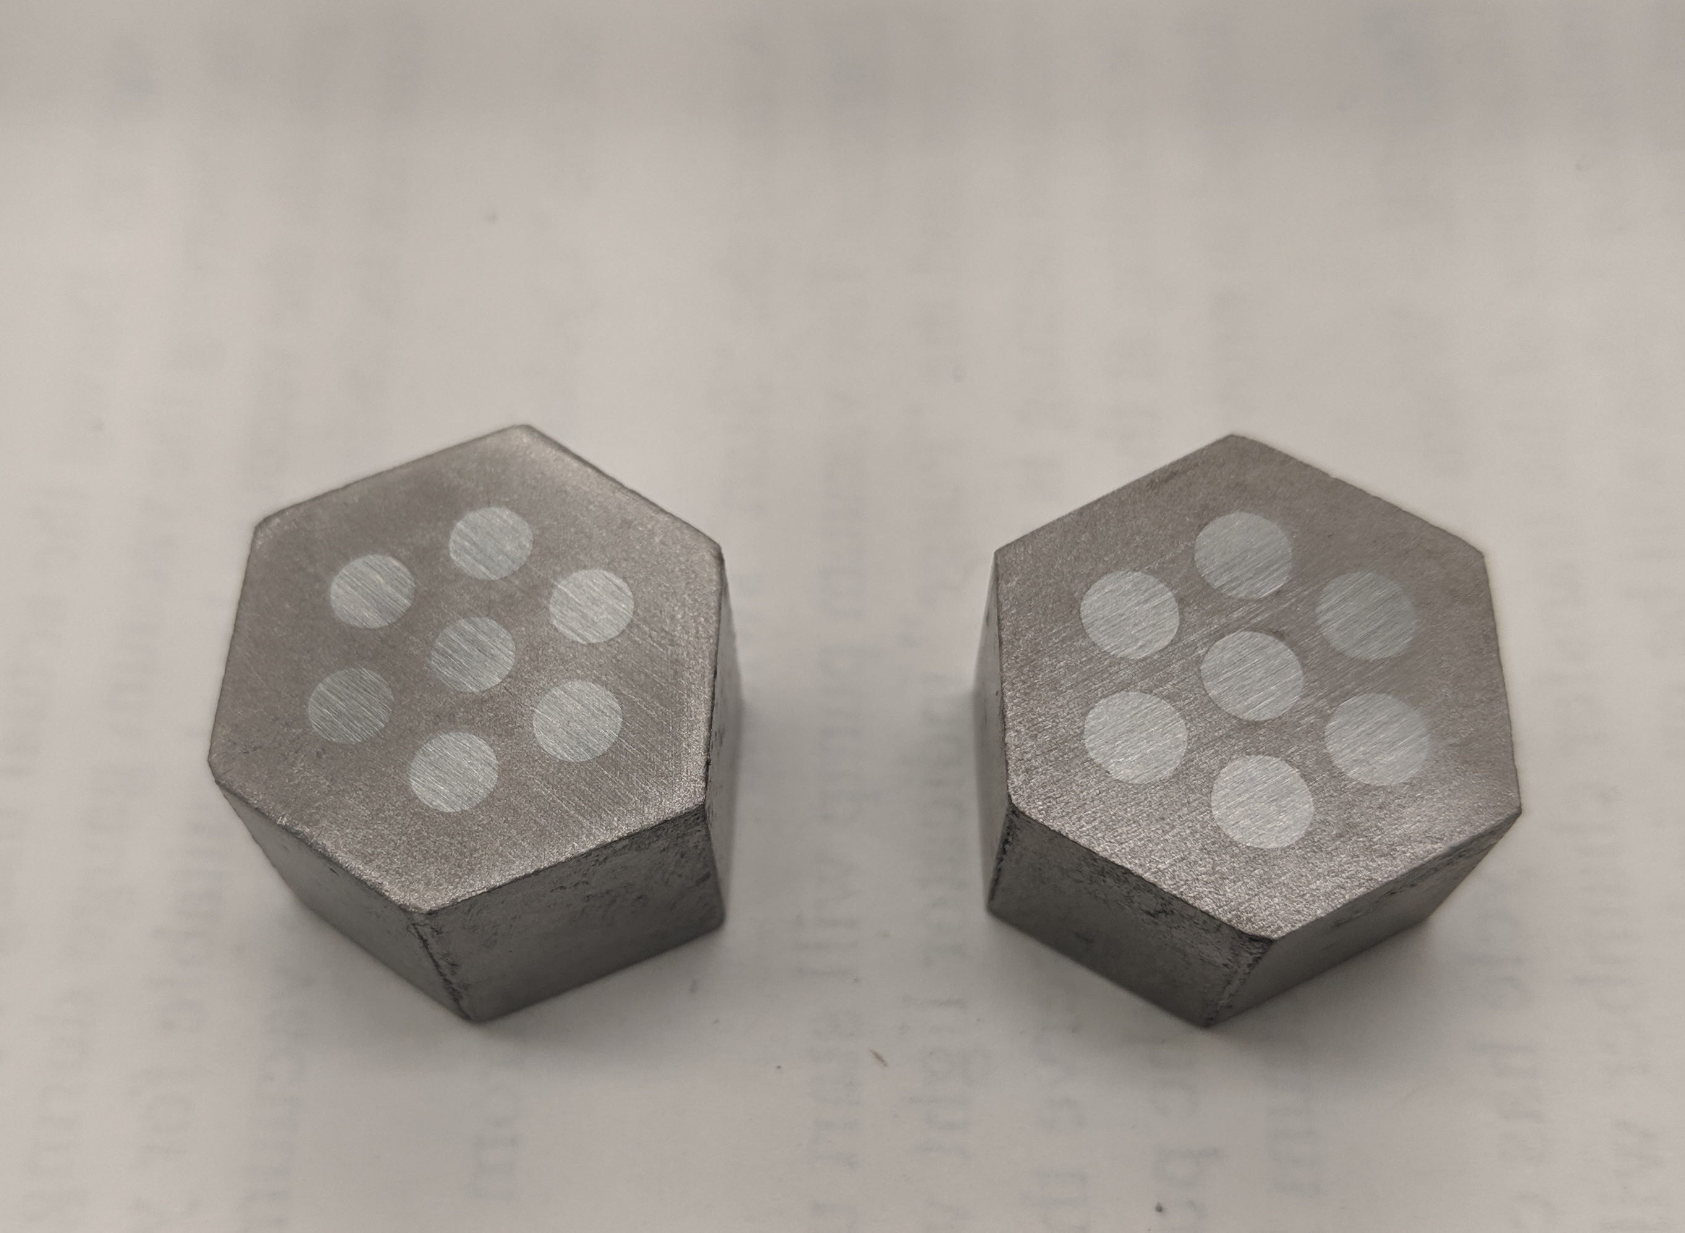
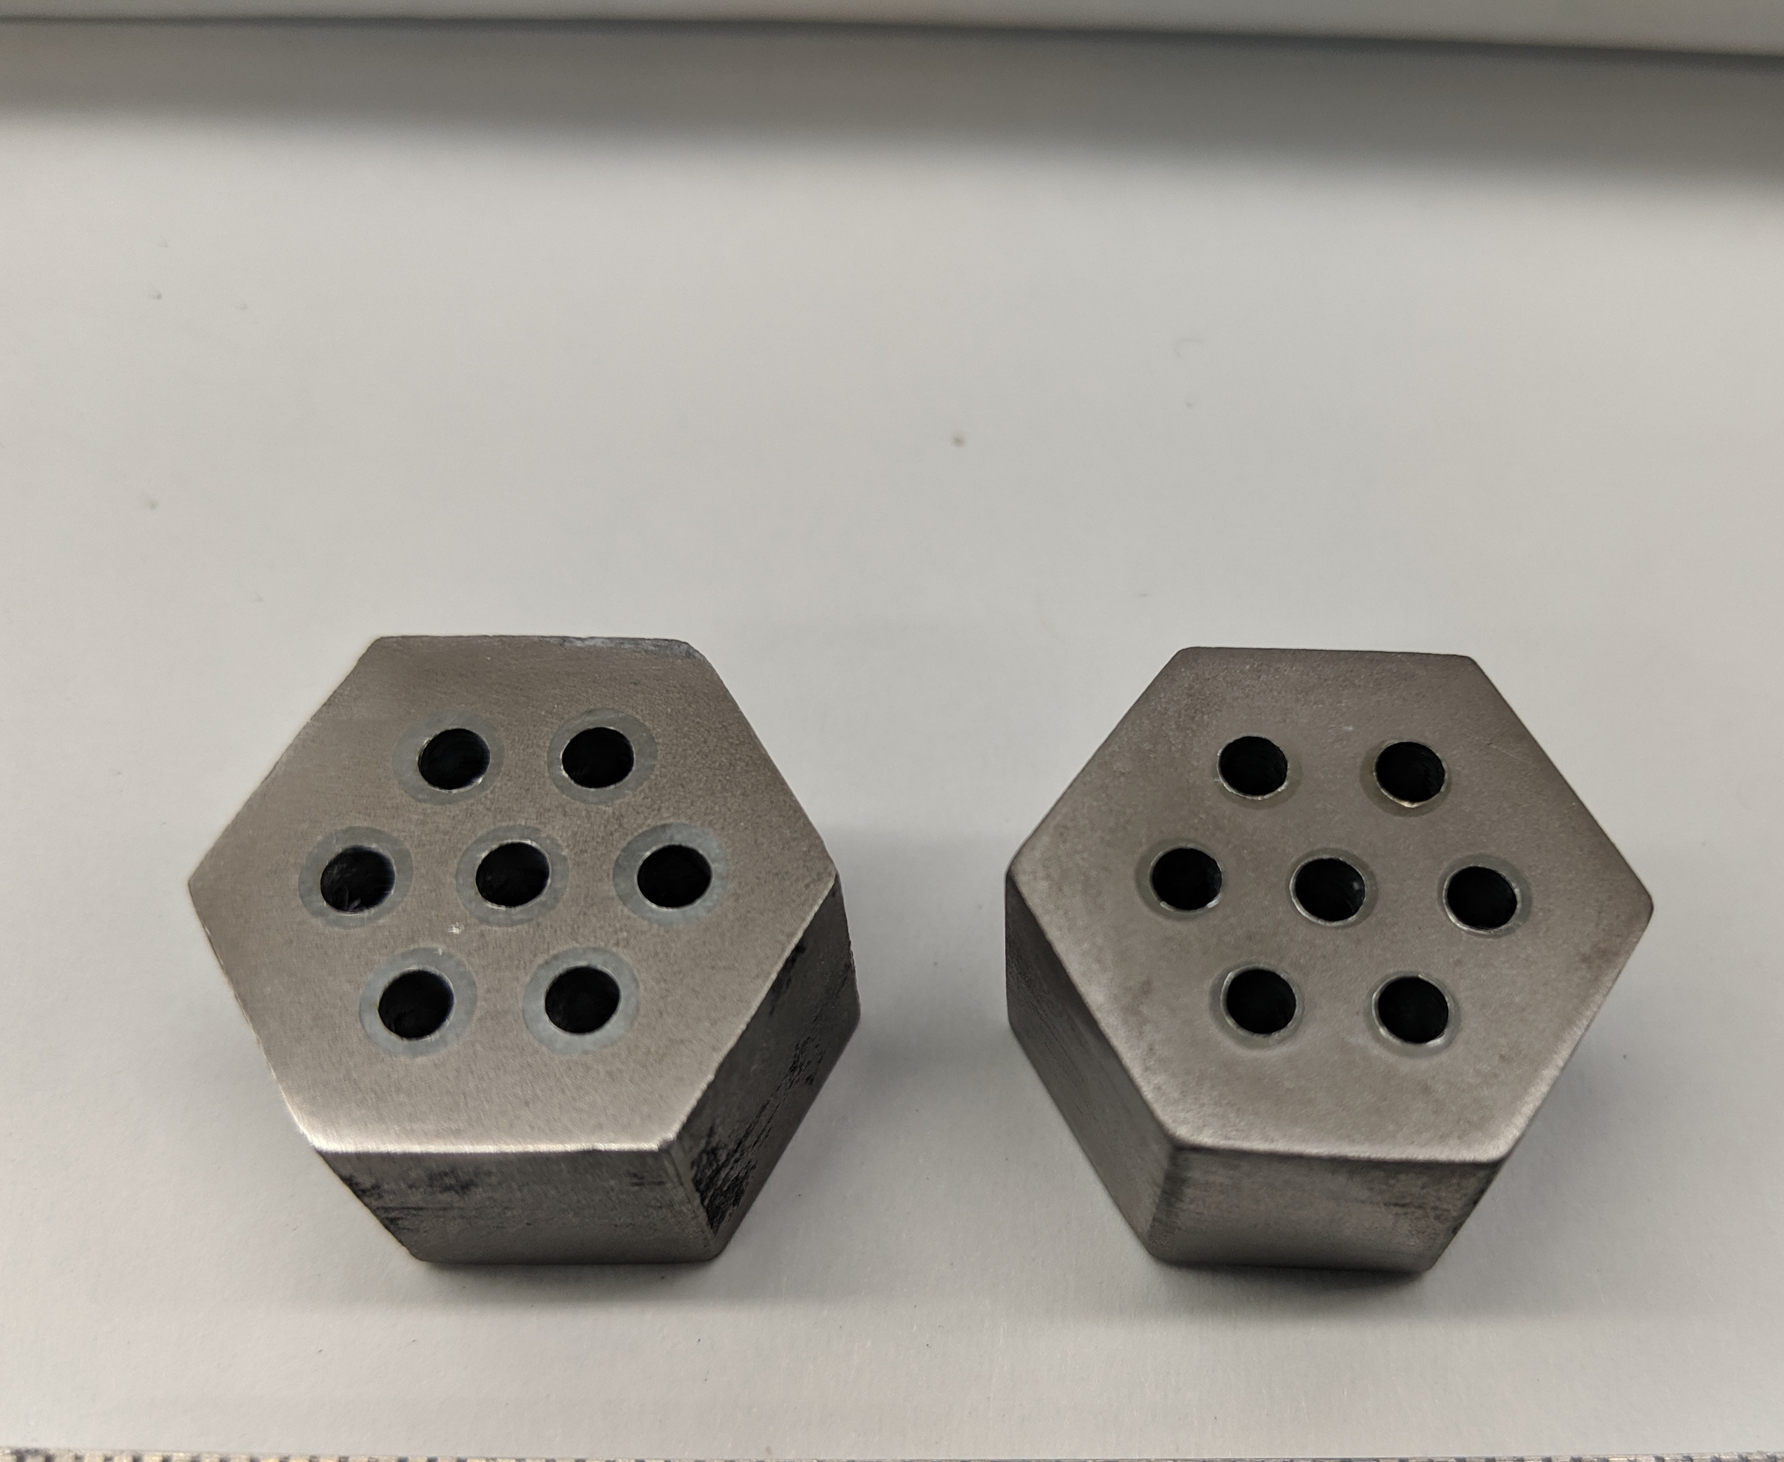
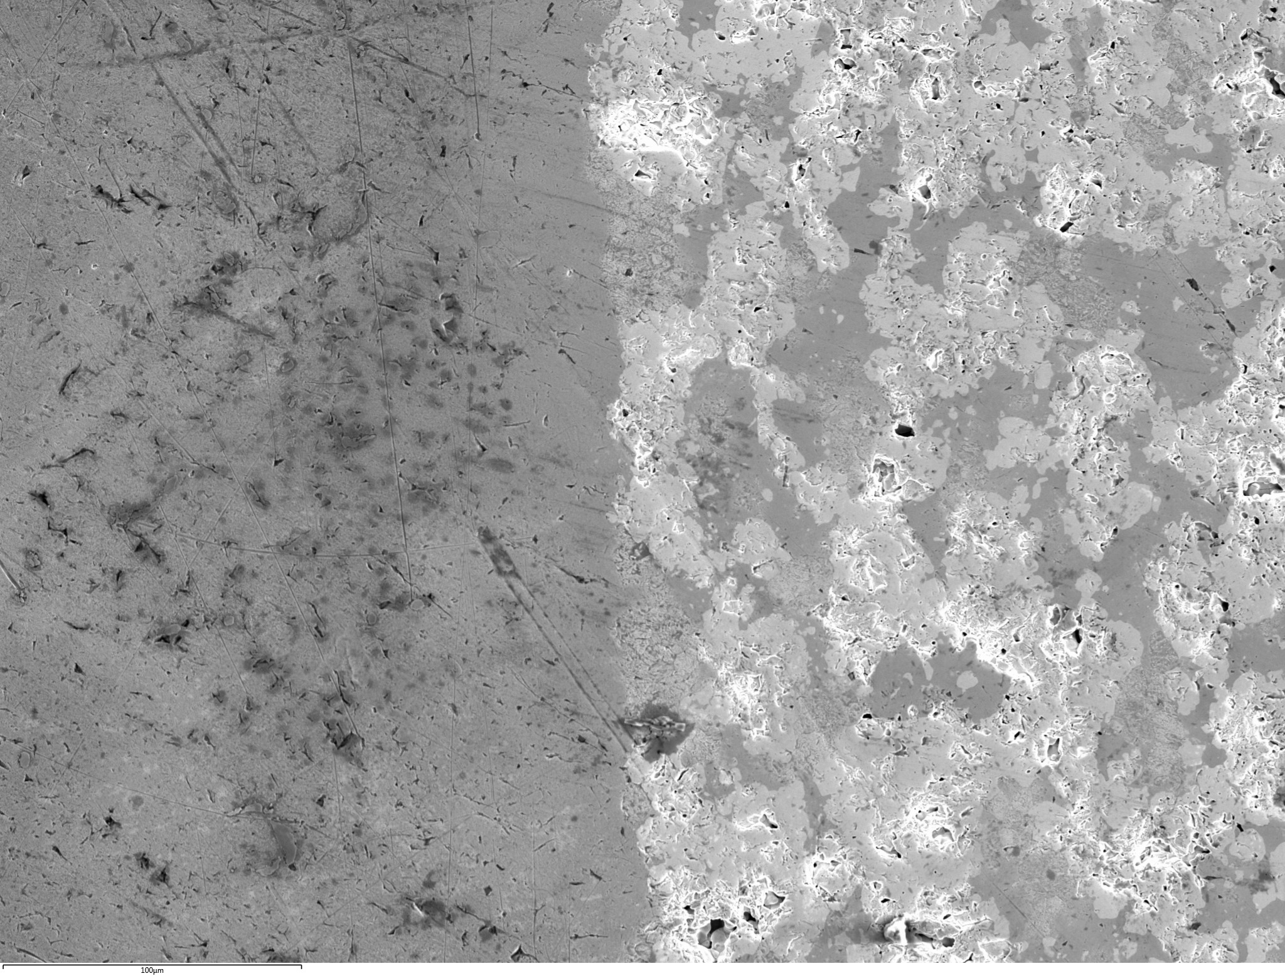
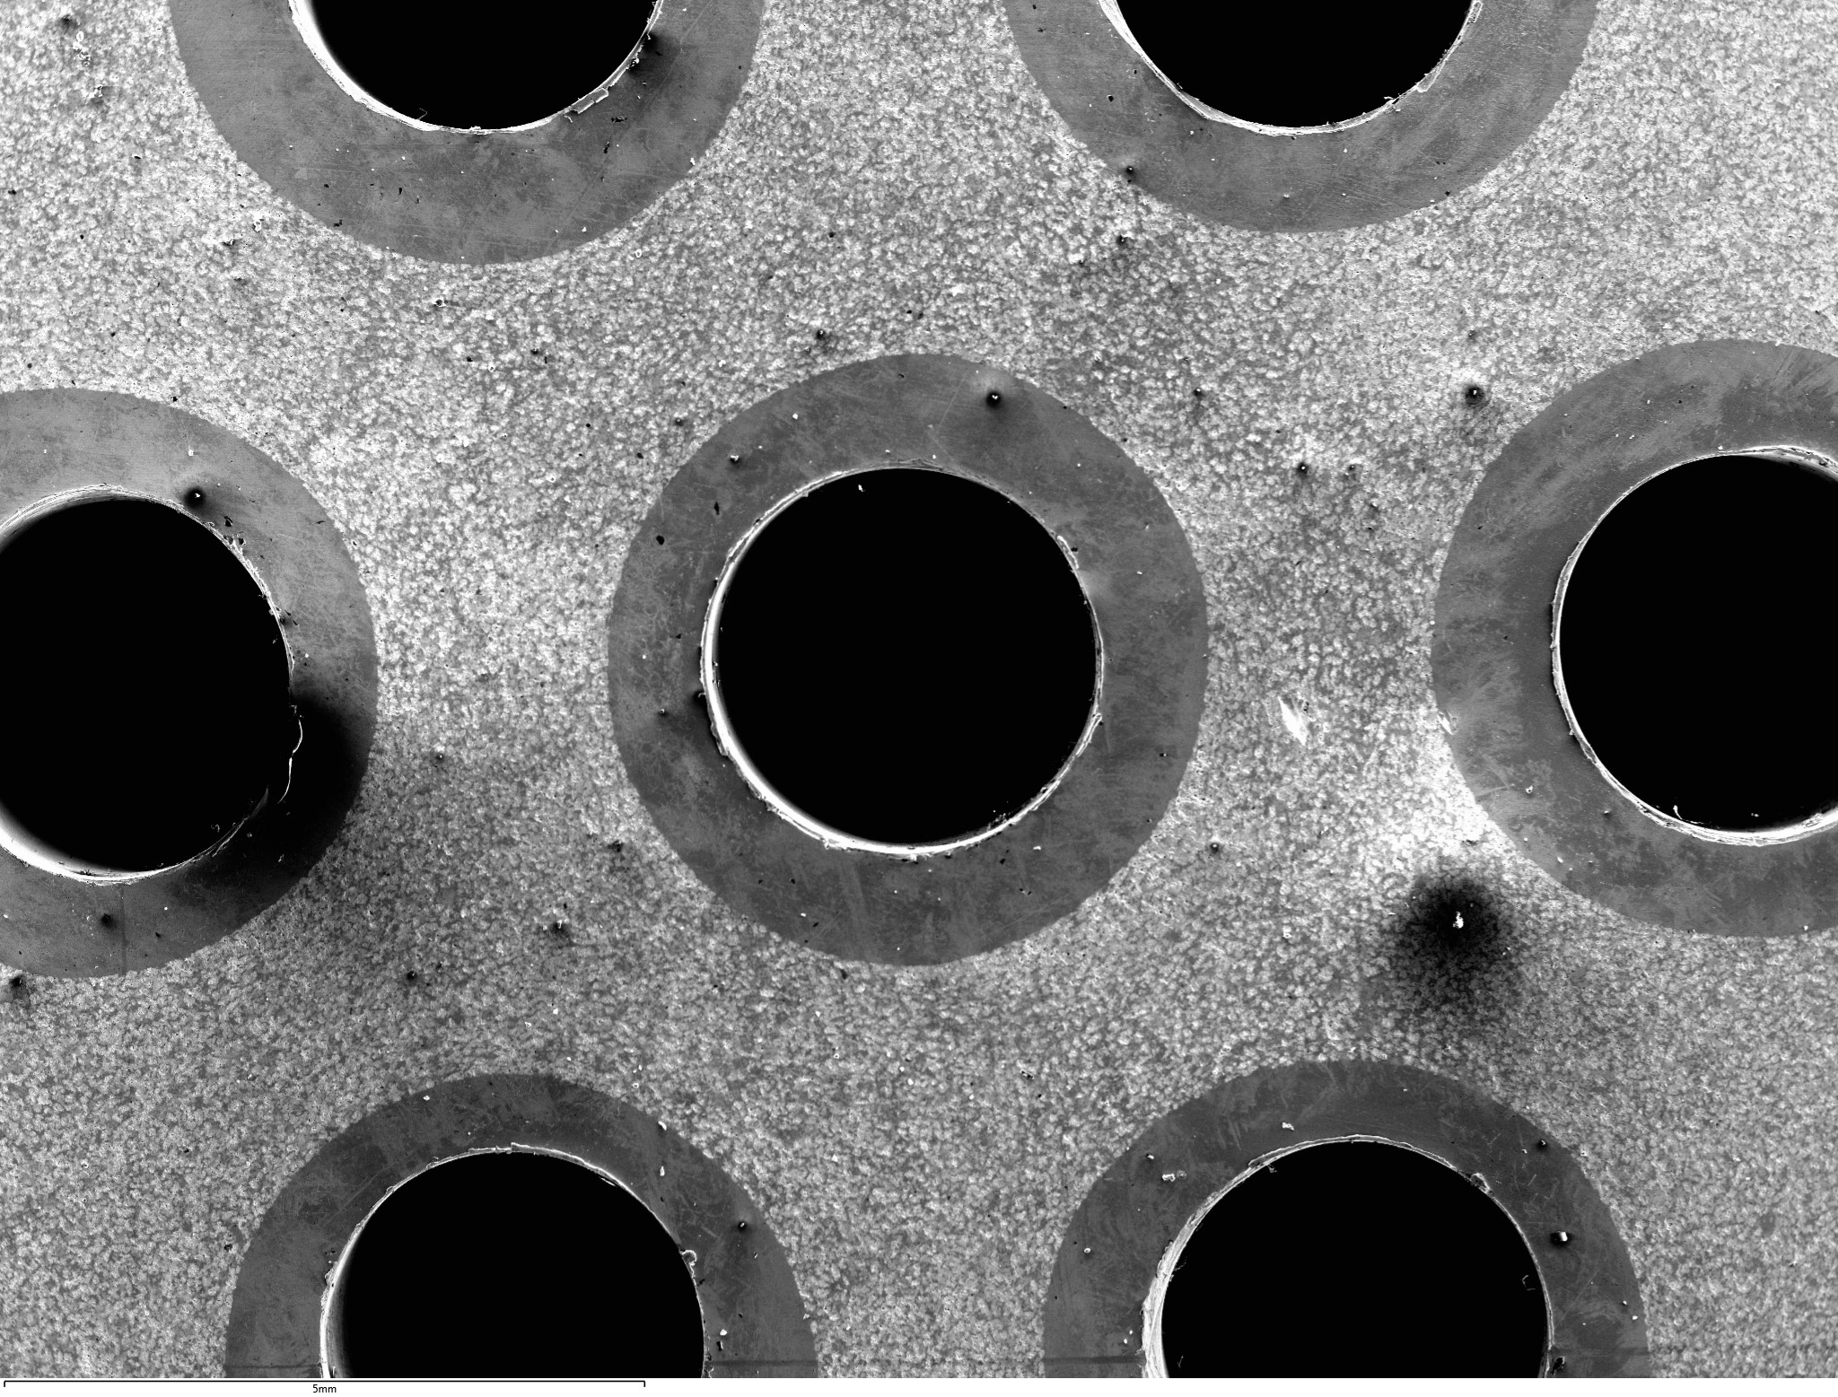
Embedded Cooling Channels in Cermet Fuel
1cm
1cm
Spark Plasma Sintering.
As fabricated samples UN-Mo/W.
UN-Mo/W samples after cooling channel drilling.
close contact
A NASA Proprietary Process via SPS
  Allows for sintering built in cooling channels
  Provides close contact between fuel and cooling channel
  Optimizes heat transfer from the fuel
Mo Clad
Cermet Fuel
100 µm
Nuclear fuel interface with cooling channel.

Slide 13
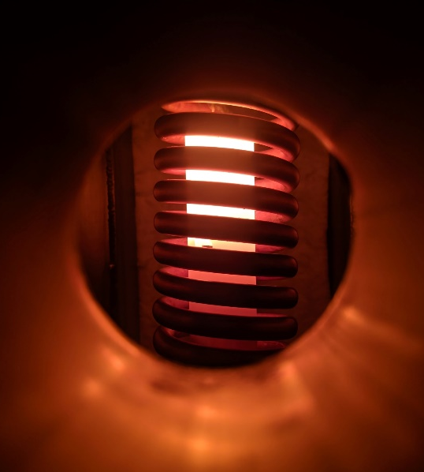
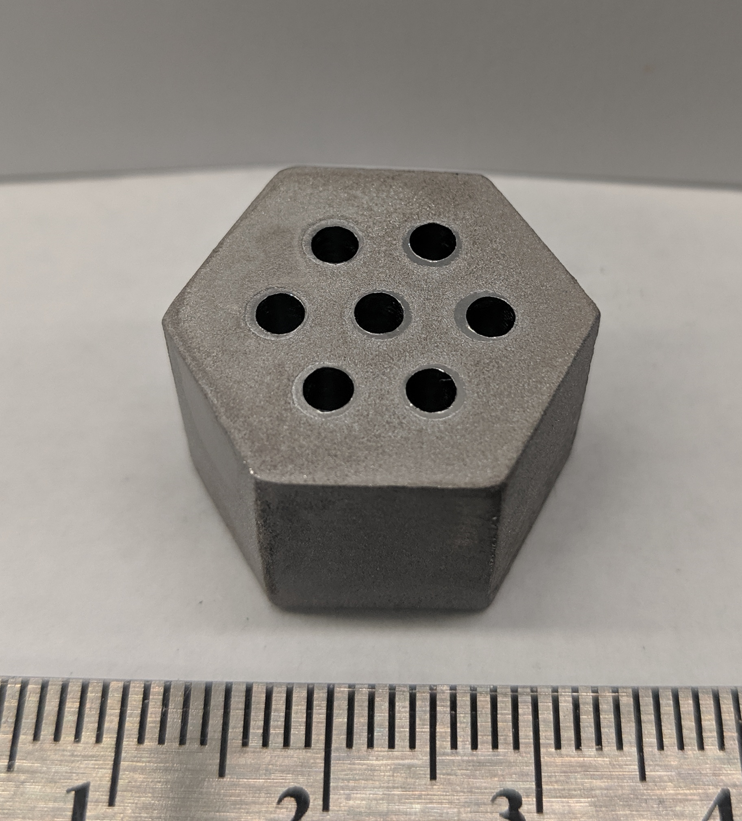
Hot Hydrogen Testing on Nuclear Fuel
  dUN-Mo/W cermet tested at 1,976 ºC (2,250 K) for 20 minutes under hot hydrogen
  Hydrogen flow at 0.5 standard liters per minute
  Reported mass loss ~ 0.13%
  Approximate mass loss rate: 2.47x10⁻⁶ g/cm² s
UN-Mo/W sample undergoing a hot hydrogen test inside CFEET.
UN-Mo/W post hot hydrogen test.

Slide 14
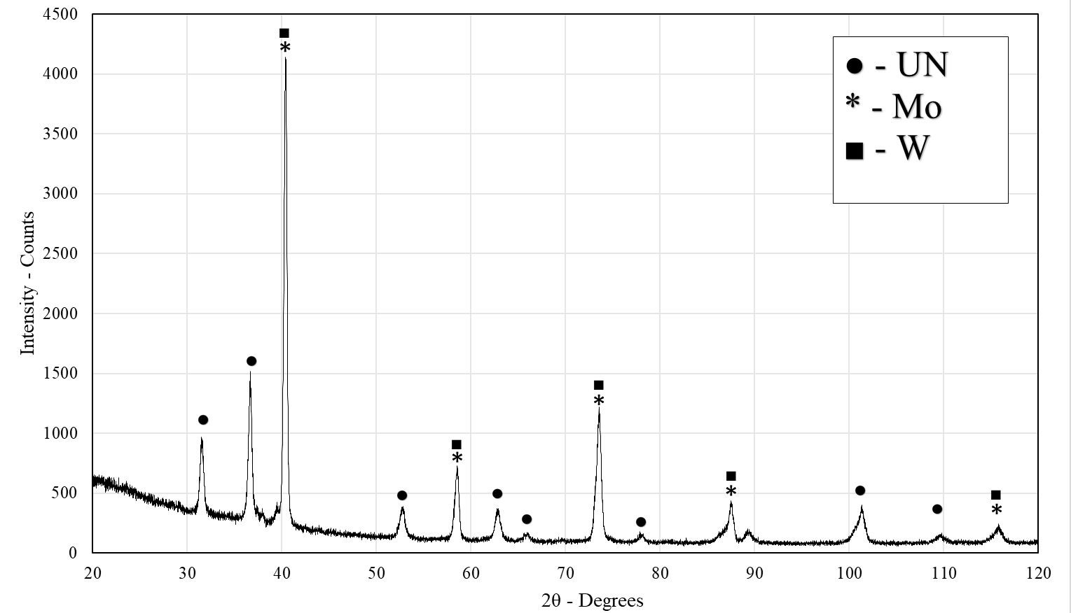

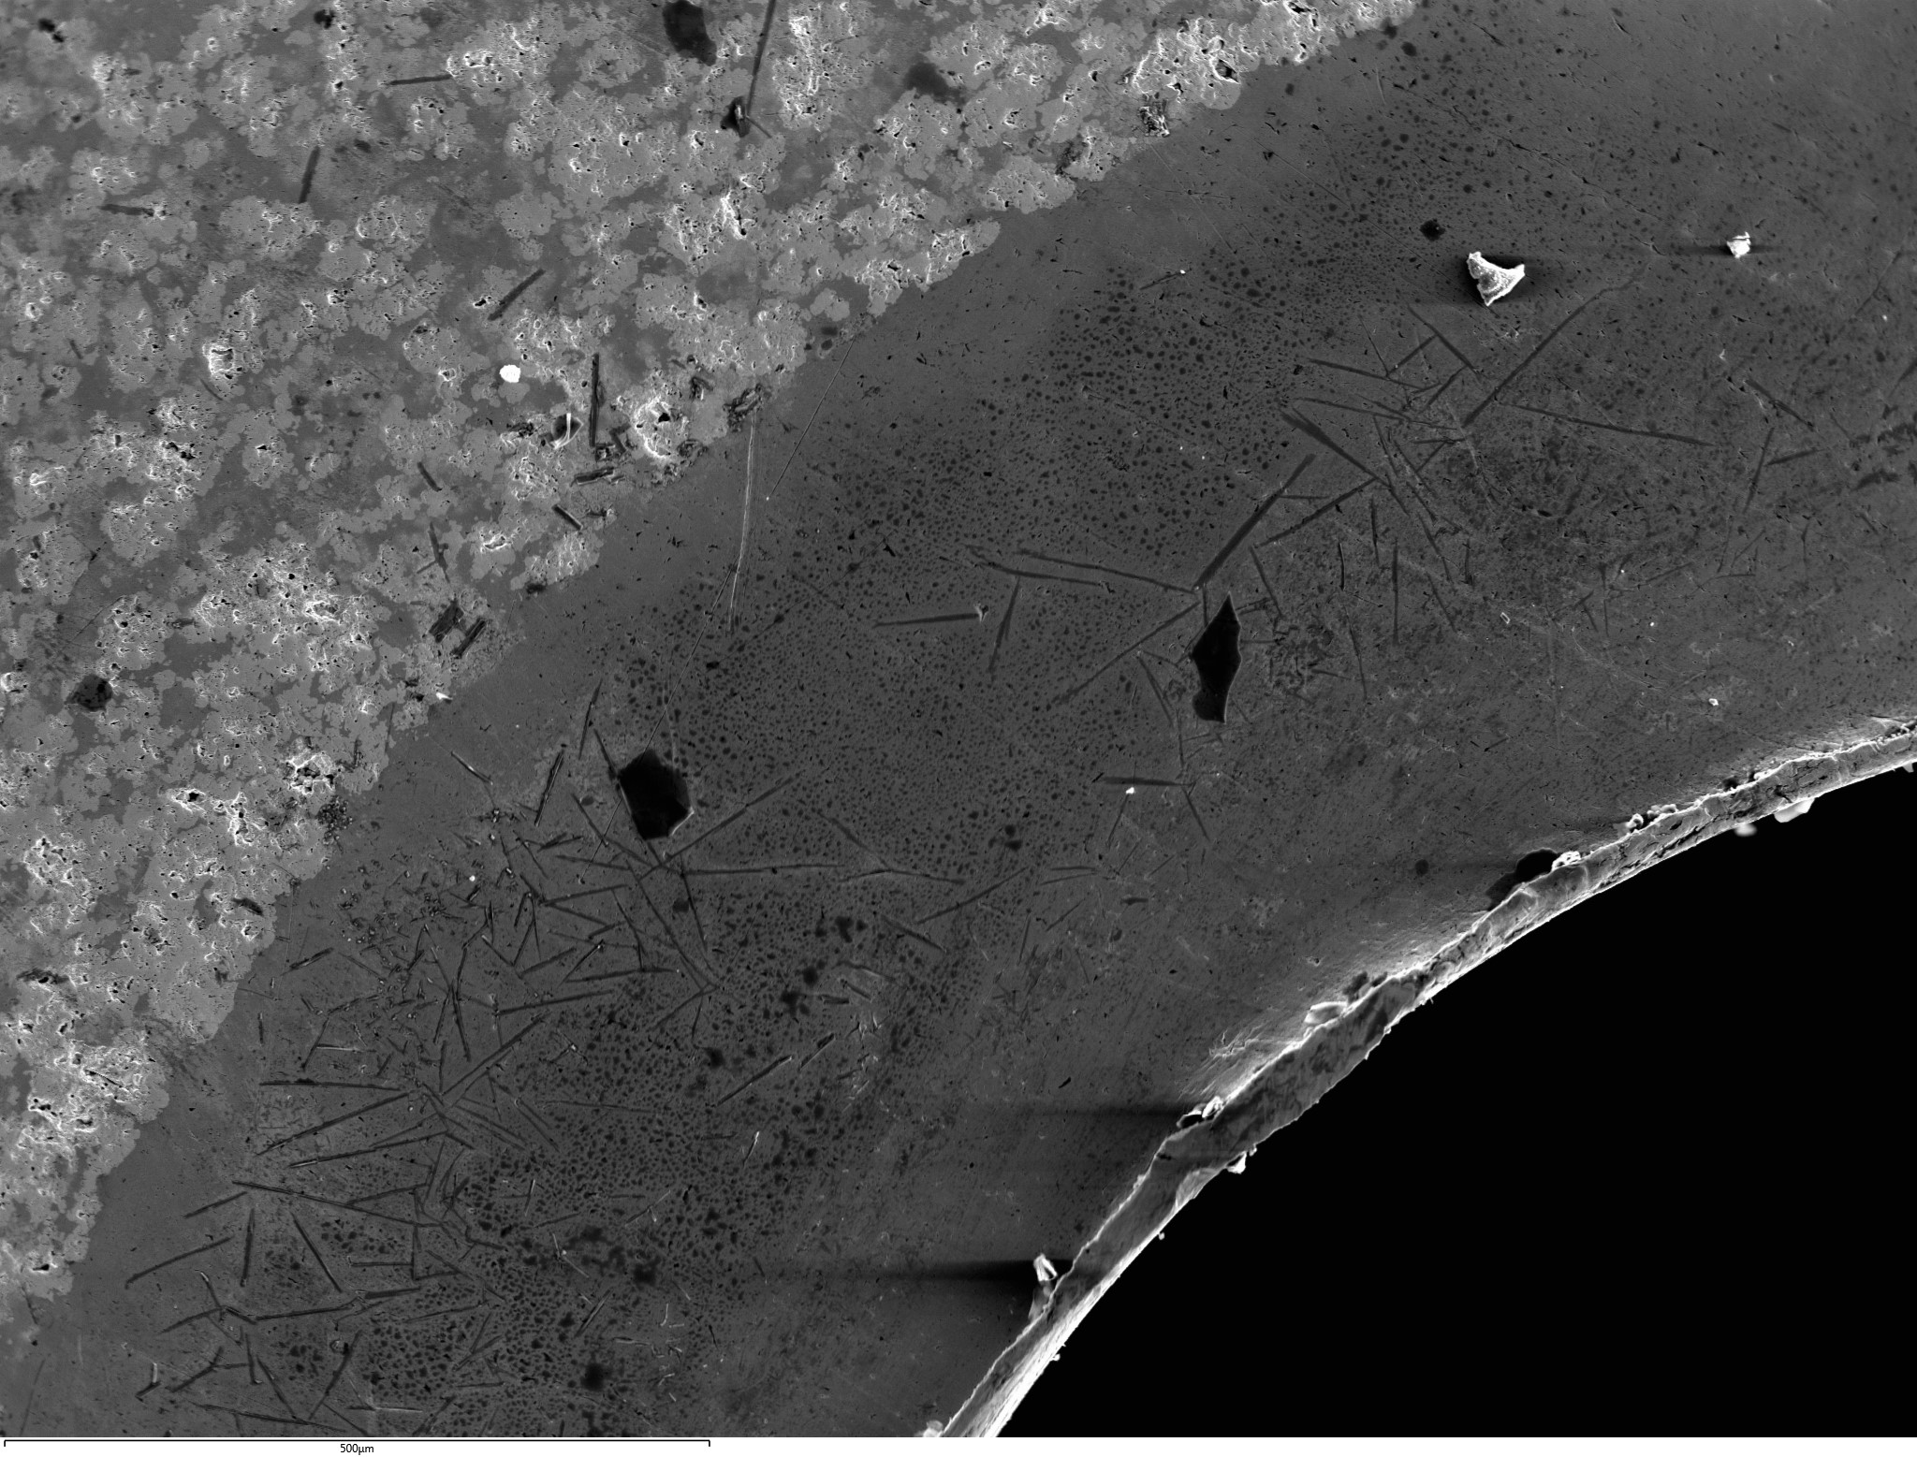
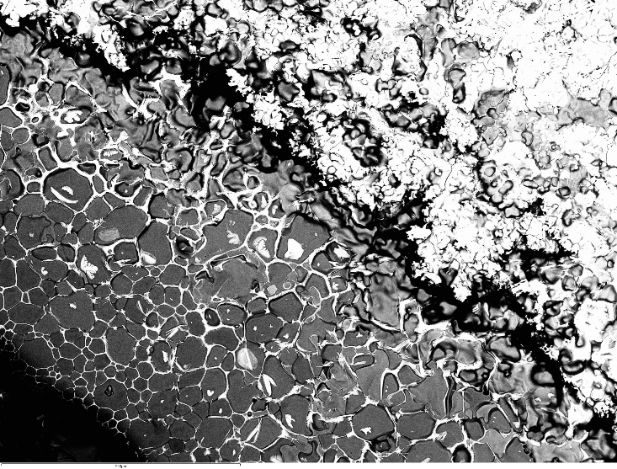
Post-Test Characterization
Fuel Sample (no cladding)
  UN-Mo/W sample experienced hot hydrogen exposure at 1,976 ºC (2250 K) for 20 min
  Crystallographic analyses suggest that initial elements and compounds were still present upon completion of test (UN, Mo, and W)
  Uranium migration occurred at molybdenum – UN interface
  Exposure to hydrogen is detrimental during fuel performance [2].
  Cladding and particle coating will be crucial to mitigate hydrogen attack
X-ray Diffraction pattern on UN-Mo/W sample after hot hydrogen test.
Uranium migration
100 µm
100 µm
After hot hydrogen test [2].

Slide 15
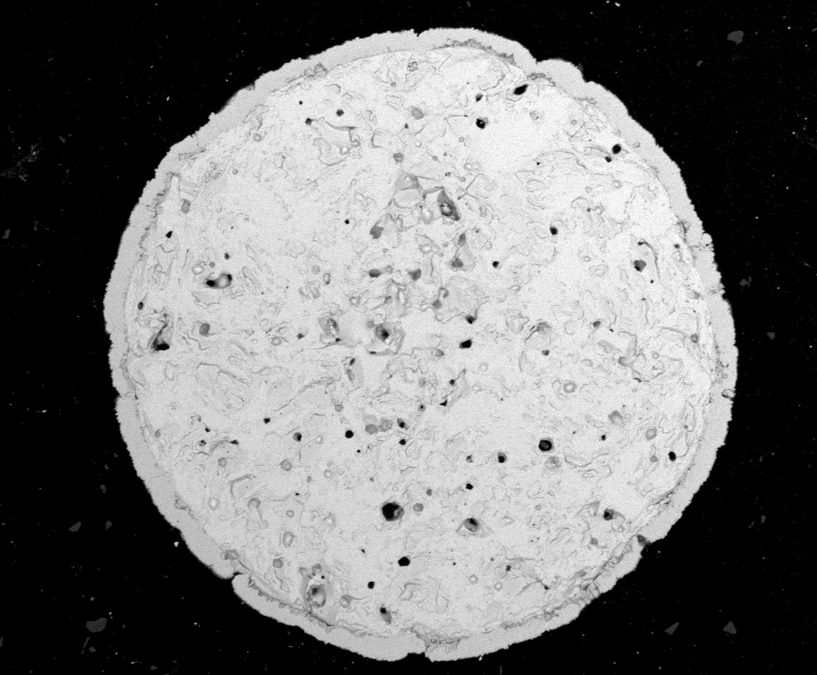
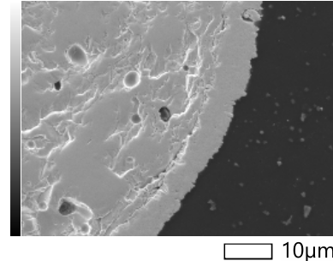
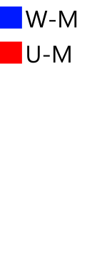
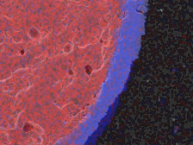
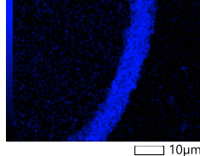
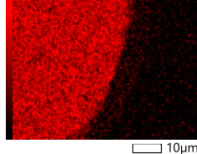
Current Work
Current Cermet Fuel
  Spheroidized UN fuel
  Coated with tungsten layer (~5 µm)
  Tungsten coating to prevent H₂ attack to fuel during operation
  Future testing under hot H₂ includes:
    Testing of loose fuel kernels (Integrity of W layer)
    Testing of consolidated fuel in Mo30W alloy
    Consolidated cermets at densities above 90% TD
  Custom molybdenum-tungsten (Mo30W) alloy matrix
    Will allow the fuel to operate at elevated temperatures
50 µm
Spherical UN fuel with a W-coating.
  Novel fuel architecture to be implemented on future test articles (CFEET, NTREES, TREAT)
  Most advanced cermet configuration developed to date
Tungsten
coating
Tungsten
coating
100 µm
100 µm
Energy dispersive spectroscopy map of UN fuel kernel.
SEM micrograph of tungsten coating around UN kernel.

Slide 16
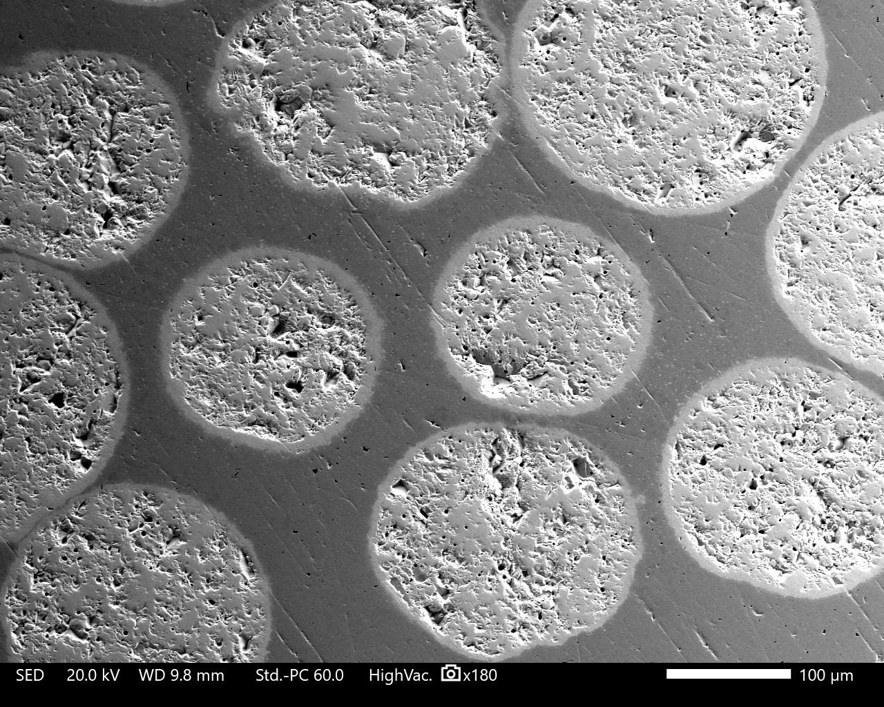
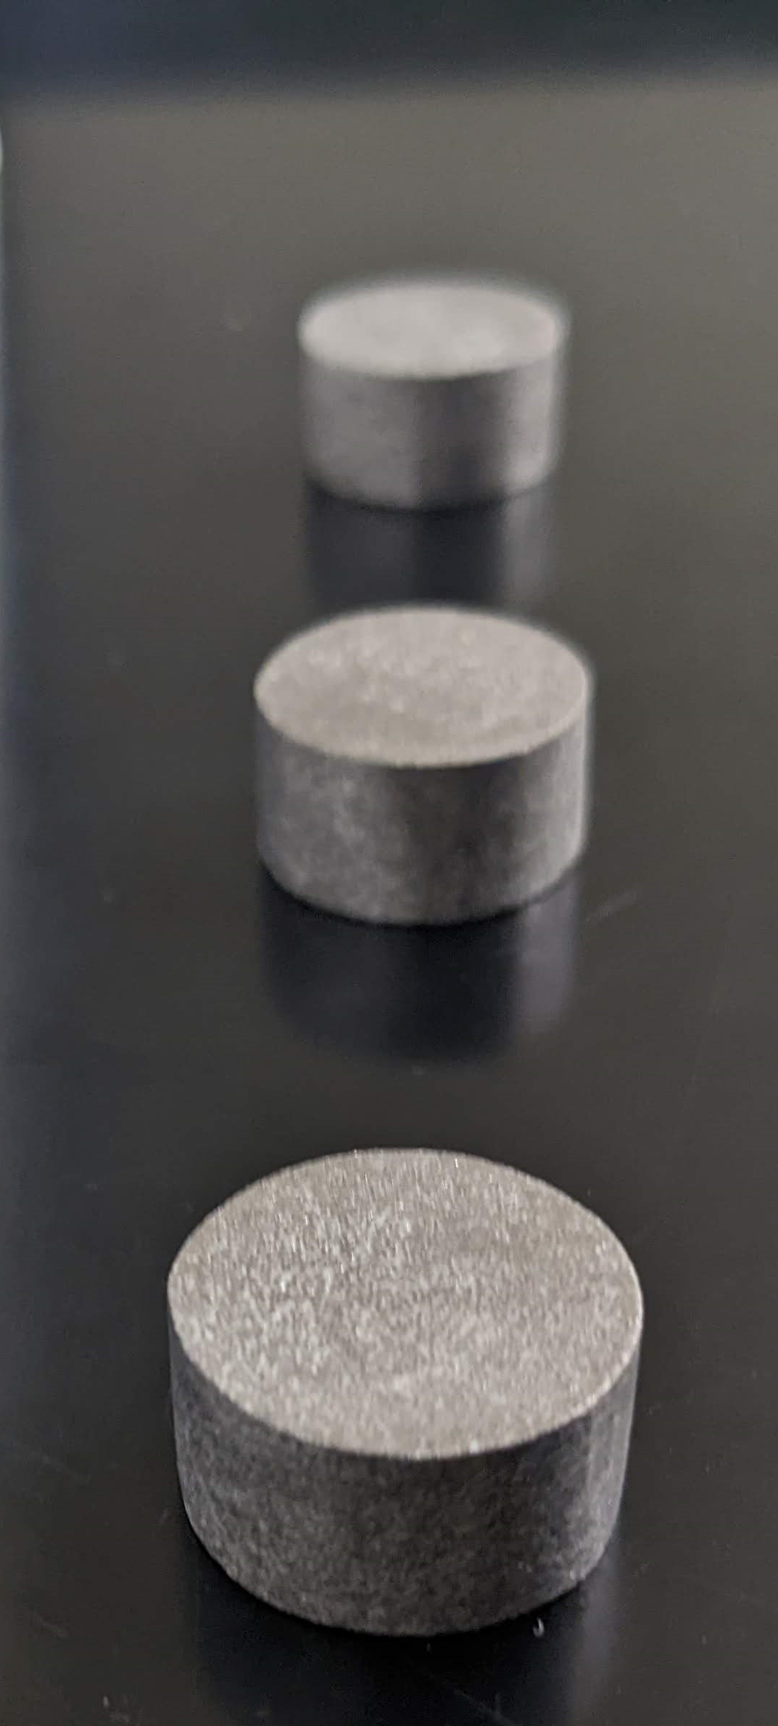
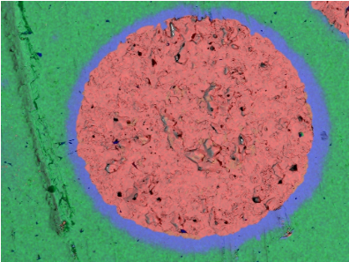
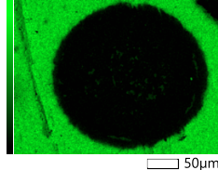

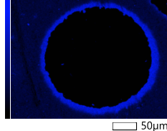
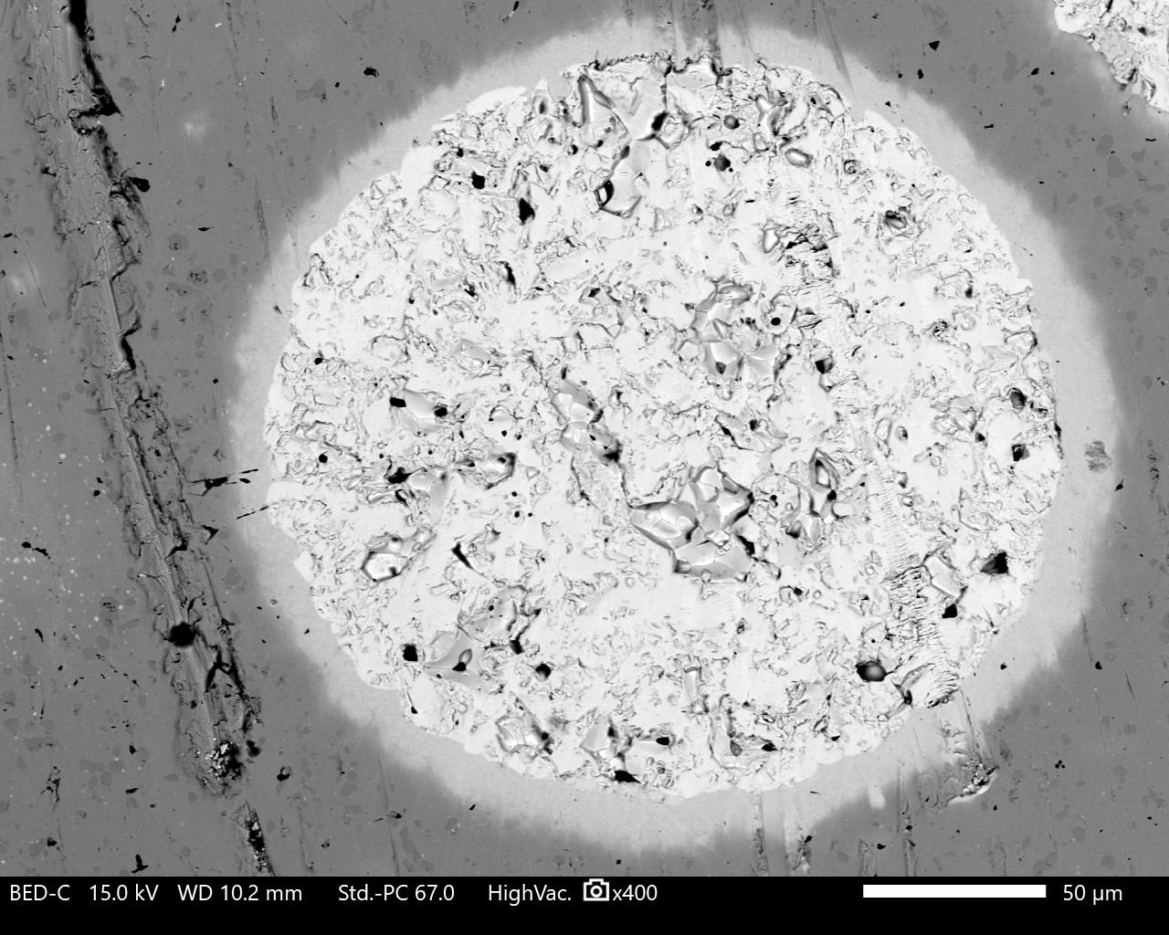
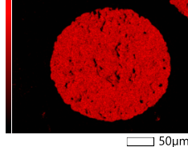
Consolidation of Spherical UN fuel
Parameter Development to Consolidate W-coated Spherical UN Fuel
  Powder feedstock mixing to ensure homogeneous UN kernel distribution in Mo30W alloy matrix
  Develop sintering parameters in Spark Plasma Sintering (SPS) furnace
  Initial development occurred in surrogate material
  Process parameters established and met fuel specifications:
    Sample densities above 90% TD
    Homogenous distribution of kernels
    Preserve W coating on kernels
  Successfully developed a repetitive process to consolidate this fuel configuration meeting fuel specifications
100 µm
20 mm
Consolidated UN kernels in Mo30W matrix
Consolidated cermets. W-coated UN-Mo30W alloy matrix
Energy dispersive spectroscopy maps displaying chemical elements in UN kernel in a Mo30W matrix
50 µm
W-coated UN kernel in Mo30W matrix

Slide 17
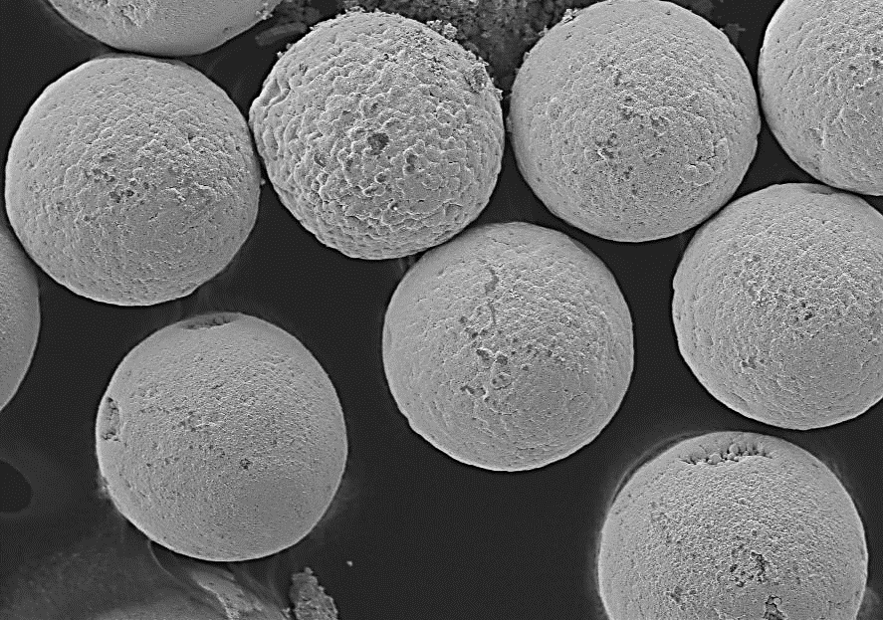
Case Study
Effects of Hot H₂ on W-coated Cermet Fuel for Space Nuclear Propulsion
Interest in cermet as a promising nuclear fuel concept due to enhanced properties:
  Increased thermal conductivity
  Increased mechanical properties
  Ductility and toughness
Objective - Test W-coating integrity under hot H₂
  Kernels tested under H₂ flow at CFEET (Compact Fuel Element Environmental Test) facility at NASA-MSFC
  Test intends to simulate environment inside a nuclear thermal engine
Characterization analyses : SEM,EDS, XRD
100 µm
As fabricated W-coated UN fuel kernels. Average diameter ~ 200 µm.
Preliminary testing results showed that the W-coating protected the fuel from hot H₂
The integrity of the kernels and the coatings were preserved at the temperatures tested
The study foresees improved fuel protection when kernels are consolidated/sintered in MoW alloy matrix

Slide 18


Case Study
Experimental Setup
Spherical UN kernels ~ 200 µm diameter
W-coating ~ 5 µm diameter
Kernel density ~ 80% TD
Temperature of interest : 1800 and 2000 ºC
The crucible was heat treated and carburized at 2370 ºC for 30 min – carbon black
Reduce probability of the crucible bonding with the W-coated kernels
50 µm
SEM micrograph of a W-coated UN kernel prior to testing in hot H₂.
20 mm
Tungsten crucible (upper left) to hold the sample kernels on top of the tungsten pedestal. The tungsten susceptor (right) sits on the rim of the part below the pedestal during testing, surrounding the sample.

Slide 19

Case Study
Hot Hydrogen Testing
The UN kernels were heated in flowing H₂
H₂ flow at 0.5 standard liters per minute
Peak temperature ~2000 ºC for 30 minutes
Temperature was measured directly from samples using a two-color pyrometer
Kernels were cooled down under Ar at room temperature
Characterization included:
  Mass loss
  Scanning electron microcopy
  Energy dispersive spectroscopy
  X-ray diffraction
Diagram of the induction heating assembly within the CFEET (compact fuel element environmental test) furnace [2].

Slide 20



Case Study
Results
Based on visual inspection:
  As Fabricated : grey loose kernels
  1800 ºC : visually unchanged
  2000 ºC: visually unchanged – some kernels sticking to crucible wall
Microscopy
  SEM imaging confirmed the integrity of the kernels at both temperatures
  Fuel kernels preserved their shape along with the tungsten coating
  Minimum to no damage of kernels during hot H₂ exposure
Testing Temperature | Sample Mass (g) | Mass Loss (mg) | Mass Loss (%) | Observation
1800 ºC | 2.13128 | 14.5 | 0.68 | Kernels visually unchanged
2000 ºC | 2.12834 | 15.0 | 0.70 | Kernels visually unchanged Some kernels sticking to crucible wall
a)
b)
As Fabricated
1800 C
2000 C
c)
200 µm
200 µm
200 µm
SEM micrographs of UN kernels. a) As fabricated kernels. b) Kernels tested at 1800 ºC under hot H₂. c) Kernels tested at 2000 ºC under hot H₂.

Slide 21






Case Study
As Fabricated
Microscopy (continued)
  Energy dispersive spectroscopy also confirmed the coating integrity at 1800 and 2000 ºC
1800 ºC
  Microstructural features included minimum etching of both tungsten and UN grains
  Tungsten coating thickness remained intact for kernels inspected
  No porosity or detachment of tungsten coating
2000 ºC
  Increased etching of tungsten grains
  Tungsten coating thickness reduction. Tungsten loss is attributed to low vapor pressure of tungsten
  Tungsten coating layer remains protecting the kernels
20 µm
1800 C
20 µm
Energy dispersive spectroscopy confirmed integrity of tungsten layer at 2000 ºC
2000 C
20 µm
SEM image of W-coated UN kernels. a) As fabricated. b) Tested at 1800 ºC in H₂. c) Tested at 2000 ºC in H₂.
Notes:
Hydrogen molecules enter along grain boundaries, further propagating pre-existing cracks within single fuel particles and inducing cracking between interconnected UO₂ microspheres.
corroborated by the layer of radioactive material
coating the CFEET chamber after exposure

Slide 22

Case Study
X-ray Diffraction
  As fabricated kernels displayed only tungsten peaks, confirming presence of the tungsten coating
1800 ºC
  Besides tungsten, traces of UN and uranium metal were found. Attributed to broken kernels during the experimental set up
  Traces were found at small concentrations ≤1%, where W peak was 100%
2000 ºC
  W, traces of UN, and uranium metal
  Possible traces of a hexagonal tungsten nitride phase WN_{0.91} [4]. Attributed to potential reaction between W and N, as by biproduct of UN dissociation
Testing Temperature | Phases
As Fabricated | W
1800 ºC | W, traces of UN and γ-U
2000 ºC | W, traces of UN, γ-U, traces of tungsten nitride [4].
X-ray diffraction patterns.
Based on diffraction data, W is the predominant phase in all samples evaluated Negligible traces appeared and will be investigated during consolidation

Slide 23
Conclusions
The results of the previous study along with ongoing research efforts, both highlight the destructive effects of the harsh environment where nuclear fuel and materials must perform
Despite the use of an advanced processing techniques and the production of dense fuel cermets, there is a need for further mitigation strategies, such as cladding, and fuel particle coating to minimize H₂ exposure
Future hot hydrogen tests are intended on kernels consolidated in a MoW alloy matrix using spark plasma sintering (SPS), to further protect the fuel
Further testing of consolidated W-coated fuel kernels will aid to determine operational limits of this novel fuel configuration
NASA MSFC intends to collaborate with industry and academia on future efforts involving design and development of nuclear fuels to support deep space exploration missions

Slide 24
References
Koening, Daniel. “Experience Gained from the Space Nuclear Rocket Program (ROVER).” Los Alamos National Laboratory. LA-10062-H. May 1986.
Hirschhorn, Jacob, Floyd Hilty, Michael R. Tonks, and Jhonathan Rosales. "Review and Preliminary Investigation into Fuel Loss from Cermets Composed of Uranium Nitride and a Molybdenum-Tungsten Alloy for Nuclear Thermal Propulsion Using Mesoscale Simulations." JOM 73, no. 11 (2021): 3528-3543.
Cureton, William F., James Zillinger, Jhonathan Rosales, Ryan P. Wilkerson, Maik Lang, and Marvin Barnes. "Microstructural evolution of Mo-UO2 cermets under high temperature hydrogen environments." Journal of Nuclear Materials 538 (2020): 152297.
Wriedt, H. A. "The NW (nitrogen-tungsten) system." Bulletin of Alloy Phase Diagrams 10, no. 4 (1989): 358-367.
NASA Staff Involved in this work
Arne Croell, Ph.D
Christopher McKinney
Omar Mireles, Ph.D
Jhonathan Rosales, Ph.D
Brian Taylor
Martin Volz, Ph.D
Kenny Webster
Ryan Wilkerson, Ph.D
Jamelle Williams, Ph.D

Slide 25

Questions ?

