Slide 1
HUMAN LANDING SYSTEM
Dr. Kent Chojnacki
Manager, Systems Engineering
& Integration (SE&I) Office
Notes:
LRO image

Slide 2
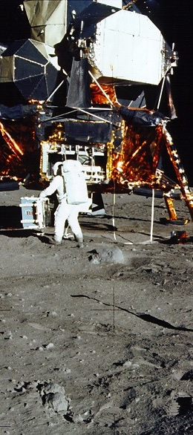

Human Landing System
The first human landing systems in history to be developed by U.S. industry will take astronauts from lunar orbit to the surface and back again.
Carries crew to the lunar surface and returns them to lunar orbit
Serves as a habitat on the lunar surface for early Artemis missions
Houses equipment for surface activities including moonwalks, sample collection, and scientific experiments

Slide 3
HLS Acquisition Structure
App E: 11 contractors performed early architecture and trade studies for a human lander
App H:
  Base Period: 3 contractors:
    Adjudicate standards (CBR in August 2020)
    Preliminary design-tailored (CR in December 2020)
  Option A award 2021: DDT&E through first flight based on 2024 requirements, demo mission
  Option B includes the DDT&E, un-crewed demonstration, and crewed demonstration for sustaining design & transportation between Gateway and the Lunar surface
App N:
    Transportation services risk reduction for industry
App P:
  Includes the DDT&E, un-crewed demonstration, and crewed demonstration for sustaining design & transportation between Gateway and the Lunar surface
App P (Sustained)
App H
Option B
Option A
App E
Base Period
App N
Req
Initial
Sustain
Study
Study
Sustain
2019
2020
2021- ~2027
2021-2022
2023

Slide 4
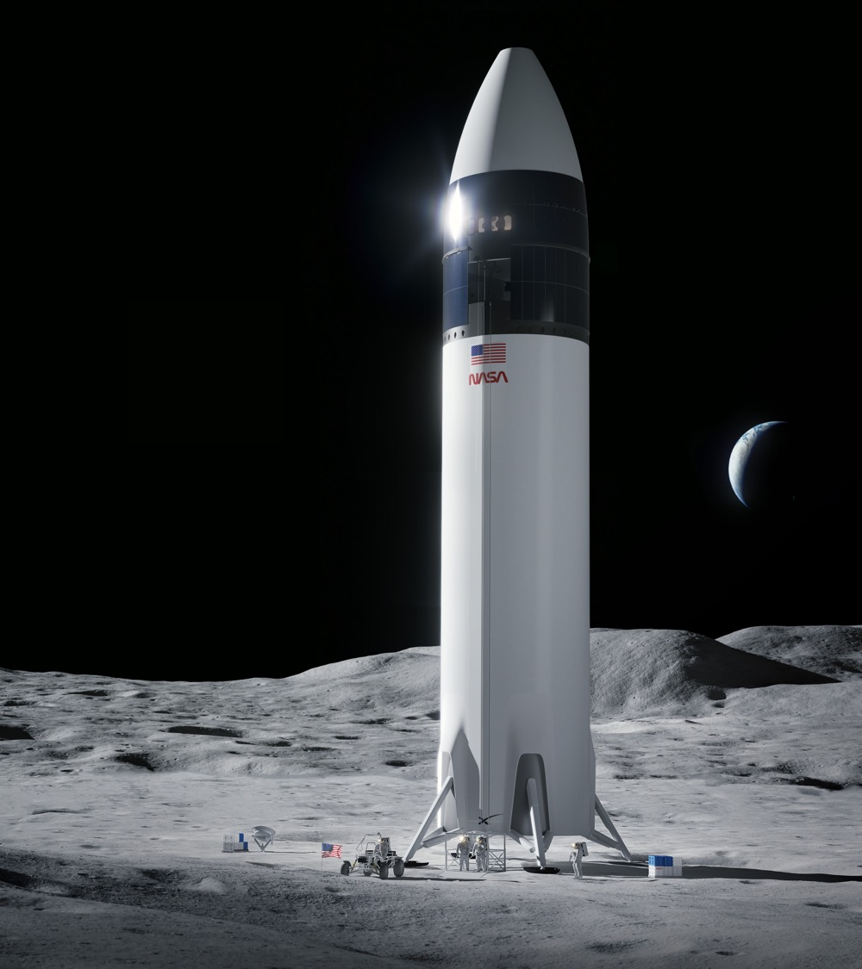
Initial Human Landing System
Uncrewed demo and first Artemis crew landing
APR 2020 |  | Base Period Selections Announced
MAY 2020 |  | Base Period Contracts Awarded
AUG 2020 |  | Contractor Certification Baseline Reviews
OCT 2020 |  | Option A Solicitation Issued
DEC 2020 |  | Contractor Continuation Reviews
APR 2021 |  | SpaceX selected for Option A Design Development Test and Evaluation (DDT&E) and a Crewed Demo Mission*
JULY 2021 |  | Option A Contract Award**
NOV 2021 |  | US Court of Federal Claims Upholds SpaceX Selection, Progress Resumes
Close-up of Apollo Astronaut's Footprint in Lunar Soil
Image Credit: SpaceX
Notes:
NASA has awarded SpaceX a contract to develop the human landing system that will put the next two Americans on the surface of the Moon.
The contract includes one uncrewed and one crewed demonstration mission, the first surface landing of Artemis.

Slide 5
Requirements Development Themes
Minimize number of requirements – what not how
Iterate with industry to ensure intent is understood
  Draft RFPs
  BAA feedback
  Milestone Reviews
Standards adjudication early in the program
  Made more difficult by conducting three parallel efforts during App H base period

Slide 6
HLS Program - Requirements (Context Level)
HLS Requirements
Launch Vehicle/ Ground Systems
(Partner Specific)
HLS System Requirements Documents (SRD)
Appendix B: Safety
Appendix C: Health & Med
Appendix D: Design & Construction
HLS to Mission Systems IRD
(HLS-IRD-004)
Government Furnished
Property (GFP) IRD
Crew Staging Vehicle*
Gateway IRD, HLS Annex
(GP 10031-01) &
HLS to Orion IRD
(HLS-IRD-005)
* Bilateral Agreement
Suit Systems*
HLS EVA Systems IRD
(EVA-EXP-0067)
HLS EVA Compatibility IRD
(EVA-EXP-0070)
*Bilateral Agreement
data interface
IRD – Interface Requirements Document GW – Gateway EVA – Extra Vehicular Activity
physical interface

Slide 7
BAA established need for D&C S&MA and HMTA Adjudication Process
4.3.1.1 General Proposal Instructions Regarding HLS Integrated Lander Design Proposal
As described in the BAA, “HLS Requirements (Attachment F) has multiple Appendices that provide detailed technical standards. These standards set forth a potential approach for how NASA would design, build, certify, and operate an HLS. These detailed standards are provided to the Offeror by NASA as a starting point for the Offeror’s proposal for all work to be performed through the end of the contract.
The Offeror’s proposal shall:
  (1) Demonstrate that the proposal meets or exceeds each NASA standard;
  (2) Employ an alternative approach to a standard that the Offeror asserts is equivalent in outcome, with a thorough explanation of such equivalency and a rationale in support of this approach in lieu of NASA’s specification (i.e., a “meets the intent of” approach); and/or
  (3) On a case-by-case basis, provide an approach that does not meet a particular NASA standard or its intent, but results in a demonstrably better approach that is more likely to achieve one or more of NASA’s overarching objectives (SOO) or functional performance requirements.”

Slide 8
D&C Standards Process (ATP plus 17 weeks)
1)ATP Coordination (2wk):
1. Provider submittal of Standards and Plans.
2. Provider personnel on-board
3. NASA personnel data access approval.
4. Start Exercise (initial conversations)
2)Review Phase (5wk):
1. Initiate review/kick off.
2. 4wk Contractor/NASA SME detailed D&C review. Face to Face (F2F) if needed.
3. 1wk to prepare final findings and prepare for focused review.
3)Focused Review (3wk):
1. 1wk Review per Contractor
-Findings
-Identify Disagreements
-Verification Approach
-1wk extra review post Reviews
2. Pre-screen by SEI
3. NASA SME and Contractors present
4)Screening, TA, and HLS Program Disposition (2wk):
1. Organize/screen Review results
2. Develop TA Positions
3. HLS Program Decision (HCB)
(Prepare Board Package)
(Estimated Price/Schedule/Risk)
NASA Only
5)Provider HCB Session (1wk):
1. Contractor review HLS program recommendations.
2. Program review contractor response.
3. If needed, contractor prepare dissenting opinion to Final Board.
4. POCs & SMEs communicate to appropriate management.
6)D&C Standards Final Board (1wk):
1. Review Findings/reclamas
2.Program/Engineering/S&MA/HMTA (Hqtrs, Centers, Crew, Standing Review Board) representation.
3. Decision (no further reclama).
4. Document.
7)Final Adjudicated Standards Submitted(3wk):
1. Provider submits final standards and plans (2wk)
2. NASA performs final check for adjudication completeness (1wk)
3. Process completed.
8

Slide 9
BAA established need for D&C S&MA and HMTA Adjudication Process
4.3.2 Acquisition Strategy Impact on Adjusted Proposals for Option A
• While each Offeror’s Performance Work Statement and technical design proposal will be incorporated into the contract at time of award if awarded a Base CLIN, NASA will work with each HLS Contractor during the Base period to arrive at a unique, final set of agreed-to HLS specifications and standards that each Contractor will be required to meet if the Contractor’s Option A CLIN is exercised. • If the final set of agreed-to HLS specifications and standards is different than those specifications and standards proposed by the Offeror in its initial proposal, the Offeror will be permitted to update its technical and/or management volumes for the Option A scope of work before NASA evaluates whether to exercise Option A for that particular Contractor. In addition, if such changes to standards or specifications warrant an increase or decrease to the Offeror’s originally-proposed firm fixed price for the Option A CLINs, NASA will permit the Contractor to submit an adjusted firm fixed price for the Option A scope of work before NASA evaluates whether to exercise Option A.

Slide 10
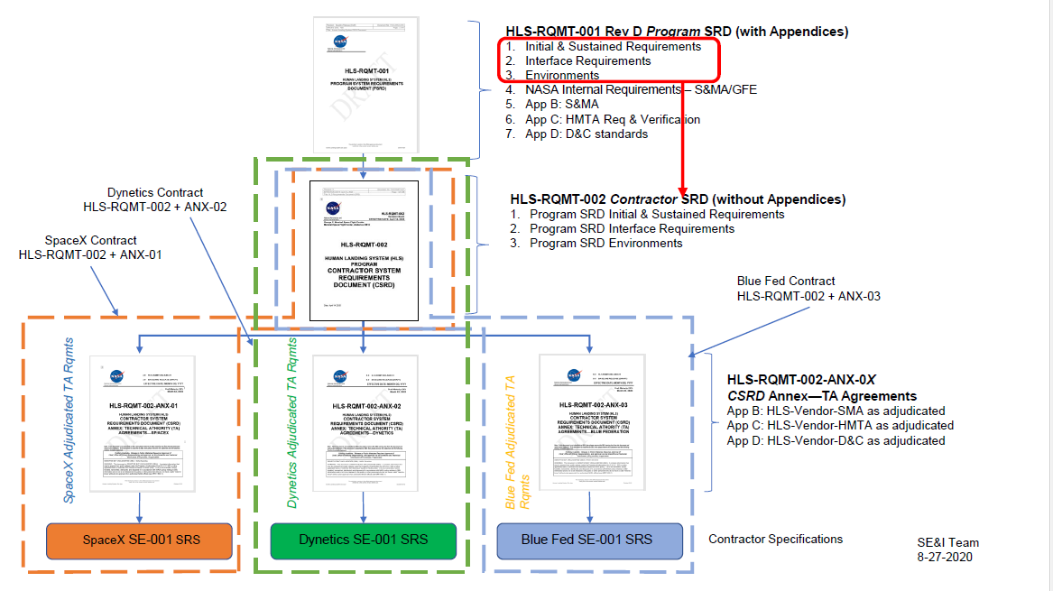
HLS Requirements –Doc Tree Appendix H Base Period

Slide 11

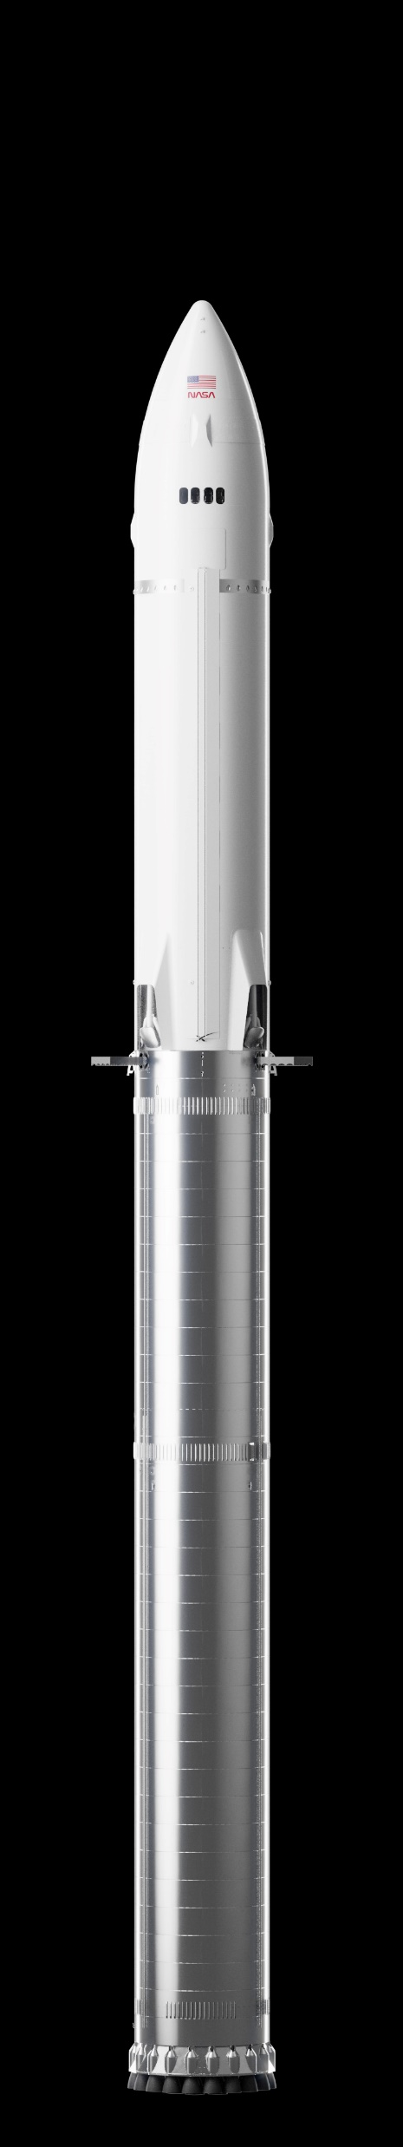

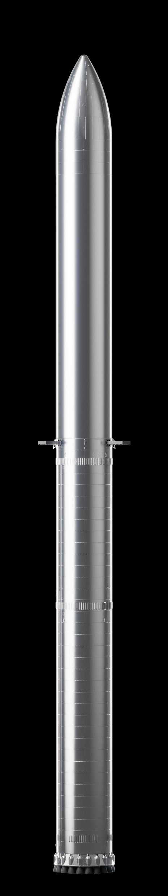
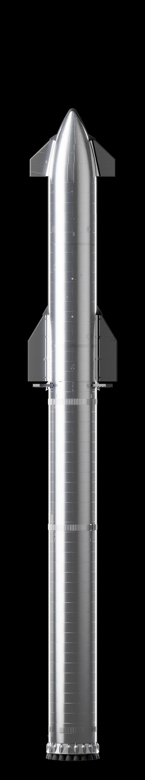


Artemis III Concept of Operations
Moon
NRHO
Loiter
Fast TLI
Crew transfer
Crew transfer
Earth
Orbit
Propellant fill
Crew returns
to Earth
Earth
Propellant
aggregation
HLS Starship
launches
Extended loiter if needed
Orion launch
Variable
Stay on the Moon
Crew returns to
Orion

Slide 12
Risk Based Insight Leading to CoFR
Three types of interaction between the NASA and Contractor teams
  Collaborative work requested and directed by the contractor
  Joint Mission and Ops planning
  Insight into contractor activities
HLS is performing risk-based insight:
  Participating in contractor in-line forums where decisions are made.
  Formal Product Reviews (DRDs, Lifecycle Reviews)
  Targeted areas for deeper penetration
    Identified as part of insight
    Independent V&V on higher risk areas
    Verification spot check on lower level verifications; informs certification
HLS is buying a service – we never accept the hardware
  Insight is focused on ensuring that the program has enough data and confidence in that data to sign the Certificate of Flight Readiness (CoFR)

Slide 13
Robust Risk Assessment and Monitoring:
…at varying degrees of urgency and severity
 | Controlled | Mitigation
Risks High urgency and/or severity of consequences to program success | Program Level: approves the creation of a new program risk, receives regular status on risk and mitigation progress | Program may direct funds to mitigate risks or may direct contractor activities to affect risk
Watch Items Medium urgency and/or severity, or less defined, somewhat unclear | Office Level: approves the creation of a new office watch item, receives regular status on watch items. | Address Office Watch items through focus insight activities, reallocation of office resources
Concerns Lower urgency and/or severity, or unclear, more information needed to assess significance | Discipline or team level: identifies and monitors concerns within the team | Gather more information, focus team or discipline insight activitites. Determine if elevation is appropriate

Slide 14
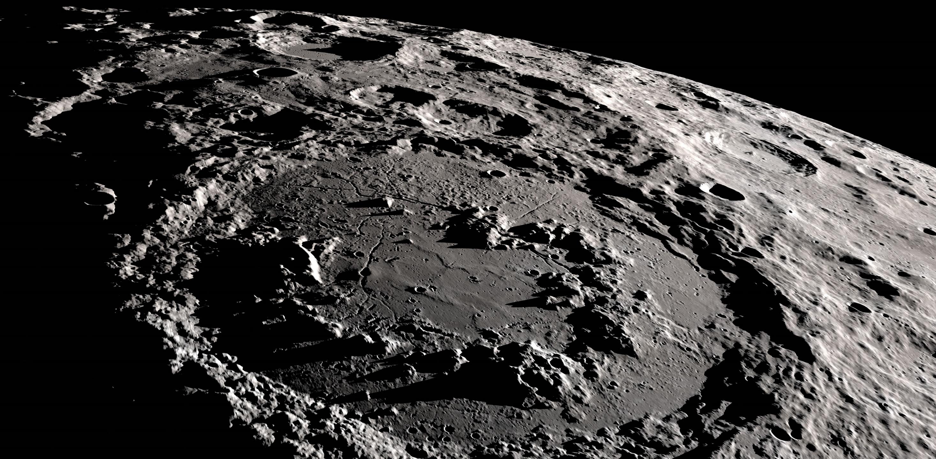
NASA Maintains Ultimate Authority
Certification of Flight Readiness
Risk-Based Insight
Collaboration
& GTAs
Joint Operations
Development
Resident Office
Provider’s Design
NASA
Reqmts
Certification of Flight Readiness is based on:
  Design Certification built on NASA-Approved Hazard Controls, Verification Objectives and Verification Closures against NASA-mandated requirements
  Provider compliance to NASA-Approved Design and Certification Standards
  Provider processes and NASA process controls as ascertained by NASA risk-based insight

Slide 15
Conclusions
HLS has solicited significant input from industry as we built our approach and requirement set
Locking down Design and Construction standards, S&MA and HMTA requirements early was a major success
HLS has established a risk-based insight strategy leading to CoFR

Slide 16
QUESTIONS?
Notes:
LRO image

Slide 17
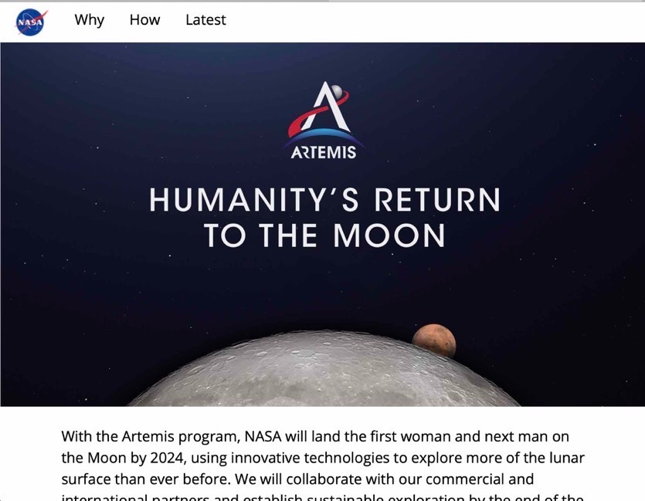




Version suggested for wide public audiences and general topics
Update handles and web links to match your topic
Stay Connected
@NASAArtemis
@NASAArtemis
@NASAArtemis
blogs.nasa.gov/artemis
Sign up for updates at nasa.gov/subscribe
nasa.gov/artemis

Slide 18

Sustainable Human Landing System Studies and Risk Reduction
Recurring HLS development and services for all subsequent Artemis crew landings
APR 2021 |  | Sustainable HLS Request for Information (RFI) Issued
JULY 2021 |  | NextSTEP Appendix N BAA Issued: Sustainable Human Landing System Studies and Risk Reduction
SEPT 2021 |  | Lunar Exploration Transportation Services (LETS) RFI Issued
 |  | NextSTEP Appendix N BAA Awards
MARCH 2022 |  | Sustainable HLS Draft Request for Proposals (RFP) Issued to U.S. Industry
In preparation for LETS, NASA selected five providers to develop lander design concepts, evaluate mission requirements, and mitigate risks by conducting critical component tests and advancing the maturity of key technologies
Blue Origin Federation of Kent, WA
Dynetics (a Leidos company) of Huntsville, AL
Lockheed Martin of Littleton, CO
Northrop Grumman of Dulles, VA
SpaceX of Hawthorne, CA
18

