Slide 1
Automating Model Selection and Tuning for Multifidelity UQ (MFUQ)
James Warner¹, Geoffrey Bomarito¹, Gianluca Geraci², Michael Eldred², Marten Thompson^{1,3},
John Jakeman², Patrick Leser¹, Paul Leser¹, Alex Gorodetsky⁴
NASA Langley Research Center, Hampton, VA
Sandia National Laboratories, Albuquerque, NM
University of Minnesota Twin Cities, Minneapolis, MN
University of Michigan, Ann Arbor, MI
MS77: Advanced Multilevel and Multifidelity UQ Strategies: Applications,
Generalized Model Hierarchies, and Data-Driven Approaches
SIAM Conference on Uncertainty Quantification
April 13th, 2022

Slide 2
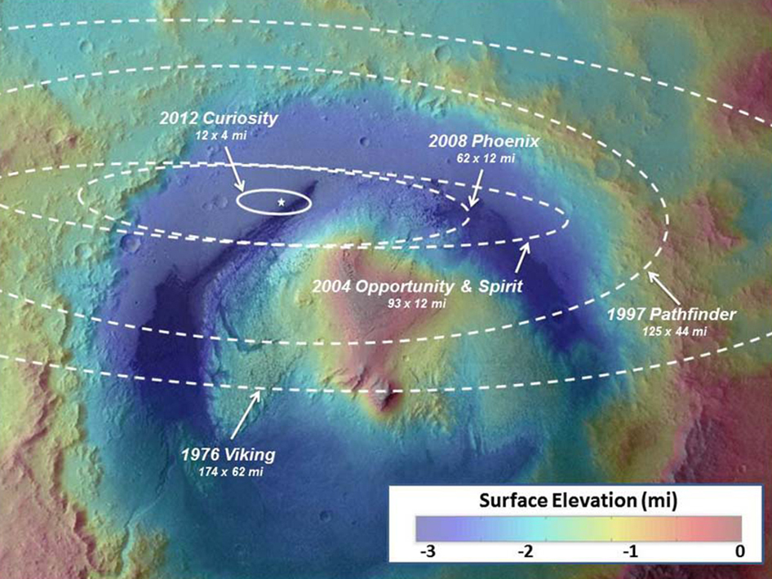
Motivation: Trajectory Guidance
Orders of magnitude improvement in landing precision required to enable human Mars missions
  Long-term goal: robust trajectory optimization under uncertainty
Mars landing precision over time

Slide 3

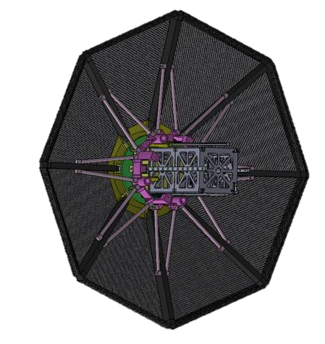
Motivation: Trajectory Guidance
Current focus: uncertainty propagation for high-fidelity trajectory simulation
  High dimensional inputs – e.g., atmosphere conditions, vehicle state
  Multiple quantities of interest (QoIs) – e.g., landing location, flight time
  Model: Program to Optimize Simulated Trajectories II (POST2)
Monte Carlo (MC) simulation
Heatshield
Payload

Slide 4
Motivation: Trajectory Guidance
Current focus: uncertainty propagation for high-fidelity trajectory simulation
  High dimensional inputs – e.g., atmosphere conditions, vehicle state
  Multiple quantities of interest (QoIs) – e.g., landing location, flight time
  Model: Program to Optimize Simulated Trajectories II (POST2)
MFUQ
Heatshield
Payload
High-fidelity (hi-fi) model
Medium-fidelity (med-fi) model
Low-fidelity (lo-fi) model
High-fidelity: timestep = 0.001
Mid-fidelity: timestep = 0.01
Low-fidelity: timestep = 0.1

Slide 5
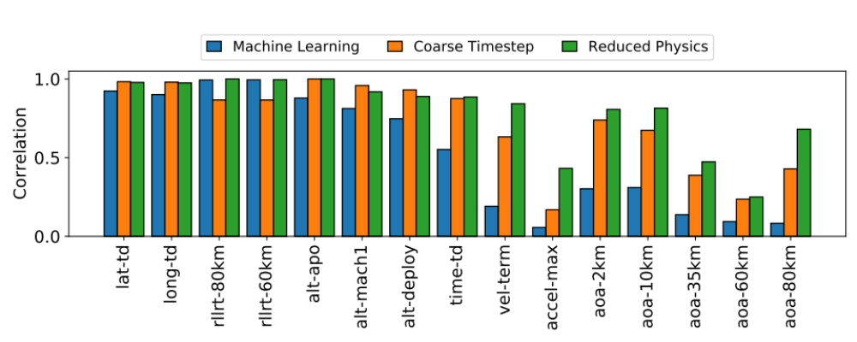

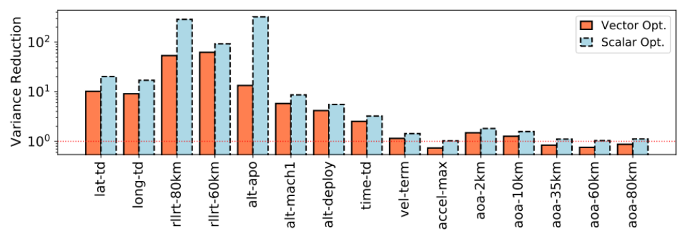
Motivation: Trajectory Guidance
Current focus: uncertainty propagation for high-fidelity trajectory simulation
  High dimensional inputs – e.g., atmosphere conditions, vehicle state
  Multiple quantities of interest (QoIs) – e.g., landing location, flight time
  Model: Program to Optimize Simulated Trajectories II (POST2)
MFUQ
AIAA SciTech 2021[1]:
Heatshield
Payload
Lo-Fi Correlation With Respect to Hi-Fi for Each Trajectory QoI
Lo-Fi 1
Lo-Fi 2
Lo-Fi 3
Variance Reduction for Each Trajectory QoI
High-fidelity (hi-fi) model
Medium-fidelity (med-fi) model
Low-fidelity (lo-fi) model
[1] J. E. Warner et al. AIAA SciTech 2021.
Sub-optimal lo-fi models = sub-optimal MFUQ
High-fidelity: timestep = 0.001
Mid-fidelity: timestep = 0.01
Low-fidelity: timestep = 0.1

Slide 6
Outline: Model Tuning for MFUQ
Model tuning is important
How we can do it optimally (In Progress)
Application to trajectory simulation
  Optimal time step selection for lo-fi models
Heatshield
Payload
High-fidelity (hi-fi) model
Medium-fidelity (med-fi) model
Low-fidelity (lo-fi) model

Slide 7
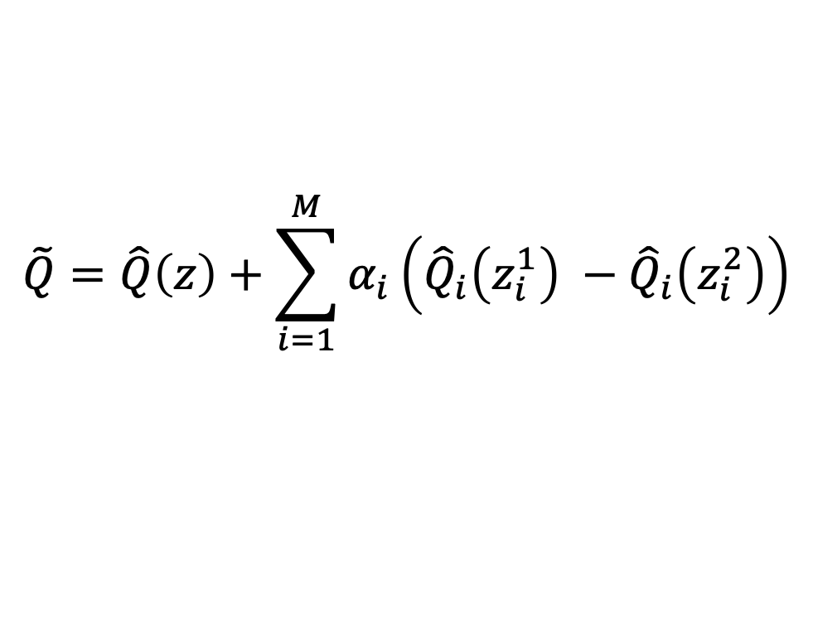
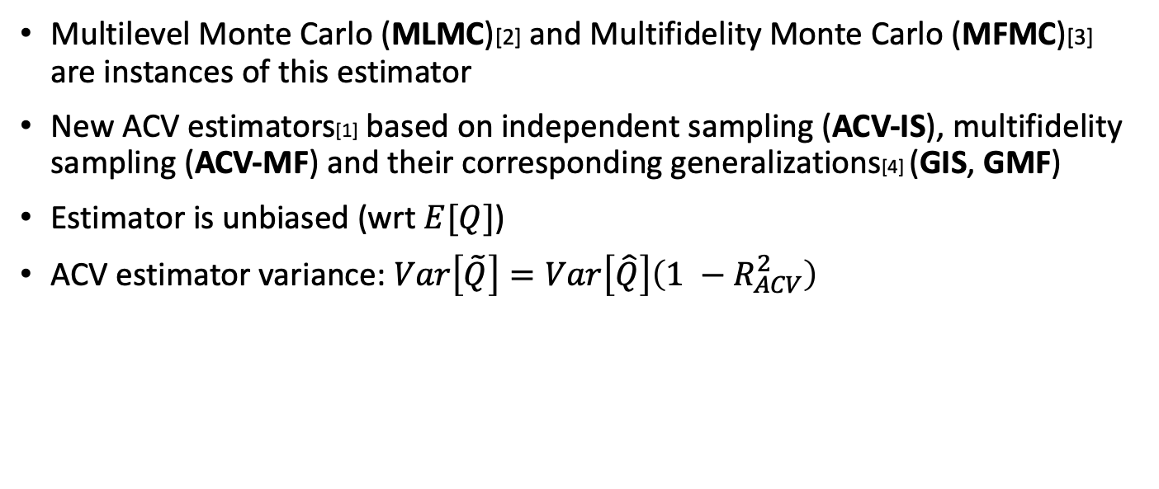
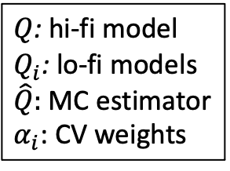
Approximate Control Variates (ACV)[1]
$$\tilde{Q}=\hat{Q}\left(z\right)+\sum_{i=1}^{M}{α_{i}\left({\hat{Q}}_{i}\left(z_{i}^{1}\right) −{\hat{Q}}_{i}\left(z_{i}^{2}\right)\right)}$$
$Q$: hi-fi model
$Q_{i}$: lo-fi models
$\hat{Q}:$ MC estimator
$α_{i}$: CV weights
Multilevel Monte Carlo (MLMC)[2] and Multifidelity Monte Carlo (MFMC)[3] are instances of this estimator
New ACV estimators[1] based on independent sampling (ACV-IS), multifidelity sampling (ACV-MF) and their corresponding generalizations[4] (GIS, GMF)
Estimator is unbiased (wrt $E[Q]$)
ACV estimator variance: $Var\left[\tilde{Q}\right]=Var\left[\hat{Q}\right]\left(1 −R_{ACV}^{2}\right)$
[1] Gorodetsky, A A., et al. Journal of Computational Physics (2020) [3] Peherstorfer, B, et al. SIAM Journal on Scientific Computing (2016)
[2] Giles, M B. Operations Research (2008) [4] Bomarito, G. F., et al. Journal of Computational Physics (2022)

Slide 8
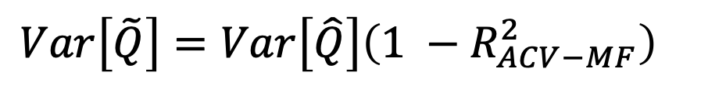
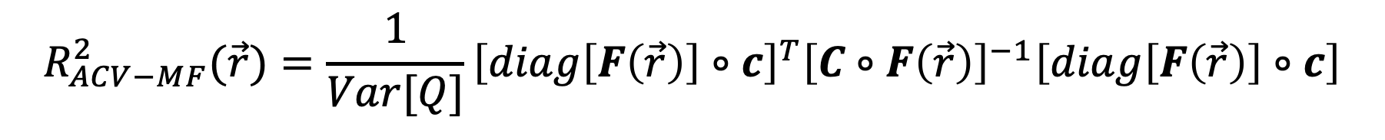

ACV-MF Estimator Variance
$$Var\left[\tilde{Q}\right]=Var\left[\hat{Q}\right]\left(1 −R_{ACV−MF}^{2}\right)$$
cov of lo-fi models w.r.t. each other
cov of lo-fi models w.r.t. hi-fi
sampling ratios
$$R_{ACV−MF}^{2}(\vec{r})=\frac{1}{Var[Q]}{\left[diag\left[F\left(\vec{r}\right)\right]∘c\right]}^{T}{\left[C∘F\left(\vec{r}\right)\right]}^{−1}\left[diag\left[F\left(\vec{r}\right)\right]∘c\right]$$
Matrix representing ACV-MF sampling strategy
Variance minimization for sample allocation:
argmin $Var\left[\tilde{Q}\right]\left(N,\vec{r}\right)$ s.t. ${ W}^{total}\left(N,\vec{r}\right)≤W^{target}$
$$N,\vec{r}$$
Estimator cost
Computational budget

Slide 9
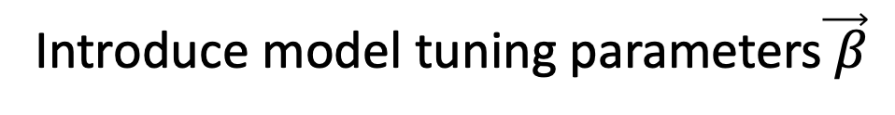
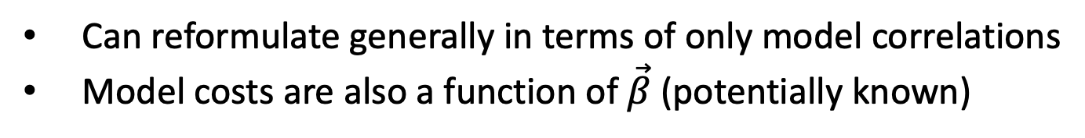
ACV-MF Estimator Variance
Introduce model tuning parameters$\vec{ β}$
cov of lofi models w.r.t. each other
cov of lofi models w.r.t. hifi
$$R_{ACVMF}^{2}(\vec{r}, \vec{β})=\frac{1}{Var[Q]}{\left[diag\left[F\left(\vec{r}\right)\right]∘c(\vec{β})\right]}^{T}{\left[C(\vec{β})∘F\left(\vec{r}\right)\right]}^{−1}\left[diag\left[F\left(\vec{r}\right)\right]∘c(\vec{β})\right]$$
In general, these are not known a priori and must be estimated
Can reformulate generally in terms of only model correlations
Model costs are also a function of $\vec{β}$ (potentially known)

Slide 10
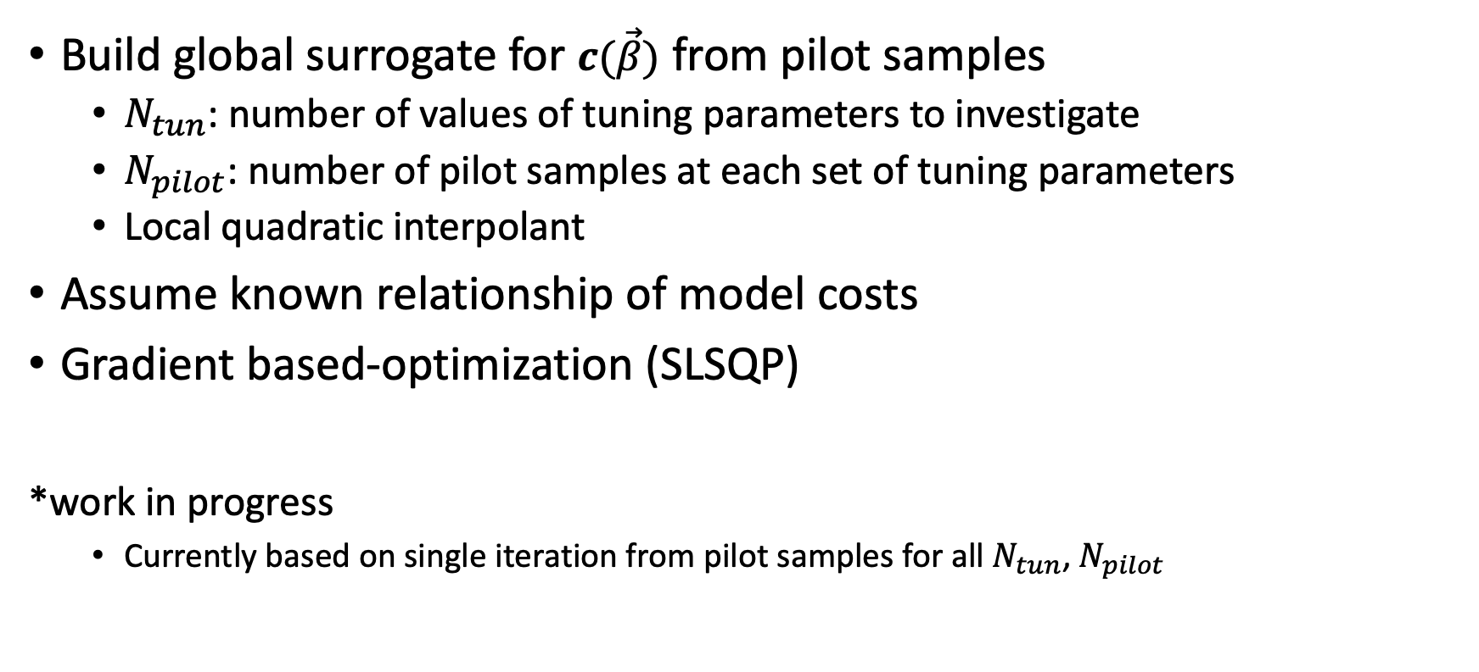

Optimization Approach*
argmin $Var\left[\tilde{Q}\right]\left(N,\vec{r,}\vec{β}\right)$ s.t. ${ W}^{total}\left(N,\vec{r},\vec{β}\right)≤W^{target}$
$$N,\vec{r},\vec{β}$$
Build global surrogate for $c(\vec{β})$ from pilot samples
  $N_{tun}$: number of values of tuning parameters to investigate
  $N_{pilot}$: number of pilot samples at each set of tuning parameters
  Local quadratic interpolant
Assume known relationship of model costs
Gradient based-optimization (SLSQP)
*work in progress
  Currently based on single iteration from pilot samples for all $N_{tun}$, $N_{pilot}$

Slide 11
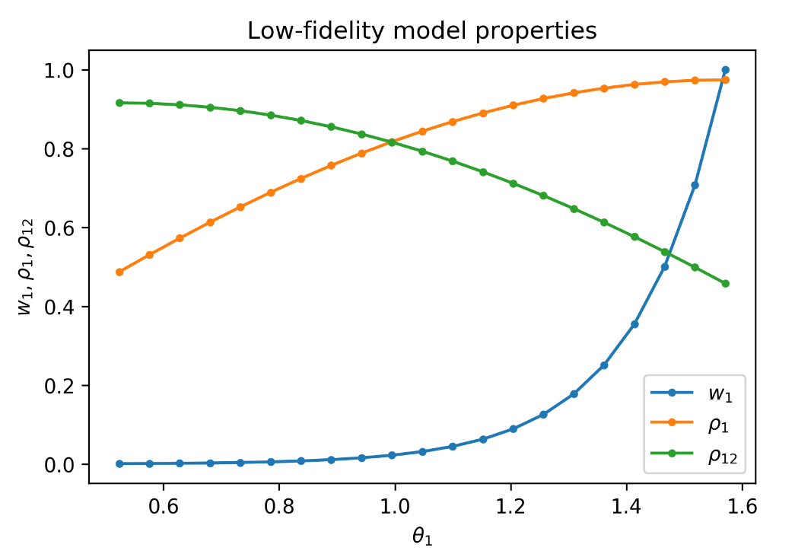
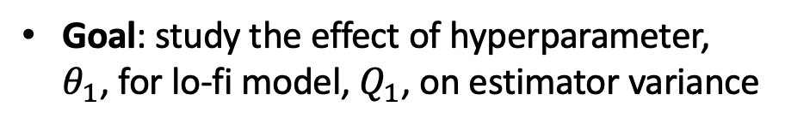

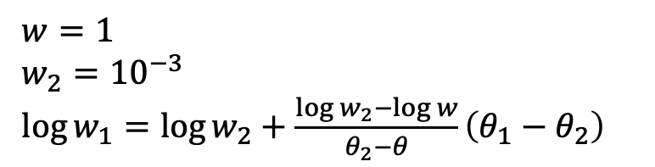
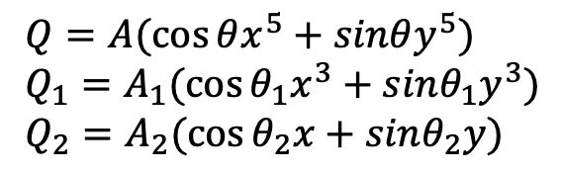
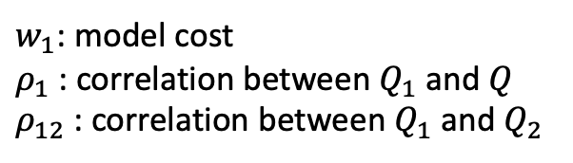
Analytical Example[1]
Goal: study the effect of hyperparameter, $θ_{1}$, for lo-fi model, $Q_{1}$, on estimator variance
Hi-fi and lo-fi models
$Q=A(\cos{θx^{5}+sinθy^{5})}$
$Q_{1}=A_{1}(\cos{θ_{1}x^{3}+sinθ_{1}y^{3})}$
$Q_{2}=A_{2}(\cos{θ_{2}x+sinθ_{2}y)}$
Model costs:
$w=1$
$w_{2}={10}^{−3}$
$\log{w_{1}=\log{w_{2}+\frac{\log{w_{2}−\log{w}}}{θ_{2}−θ}}}\left(θ_{1}−θ_{2}\right)$
$w_{1}$: model cost
$ρ_{1}$: correlation between $Q_{1}$and $Q$
$ρ_{12}$: correlation between $Q_{1}$and $Q_{2}$
$A$,$A_{1}, A_{2},θ, θ_{2}$ are constants
[1] Gorodetsky, A A., et al. Journal of Computational Physics (2020)
Notes:
W1 varies between cost of lowest fidelity model & high fidelity model
Mimics case where hyperparameter makes Q1 more correlated to HiFi but at price of exponentially increasing cost zzz

Slide 12
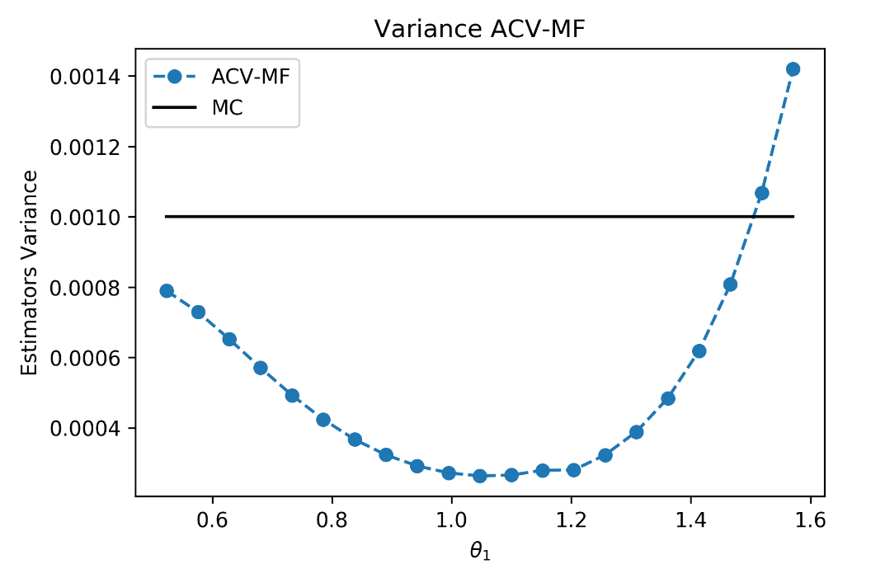
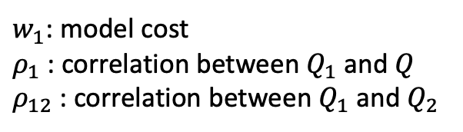
Analytical Example[1]
$w_{1}$: model cost
$ρ_{1}$: correlation between $Q_{1}$and $Q$
$ρ_{12}$: correlation between $Q_{1}$and $Q_{2}$
Model tuning can greatly affect estimator variance
[1] Gorodetsky, A. A., et al. Journal of Computational Physics (2020)

Slide 13
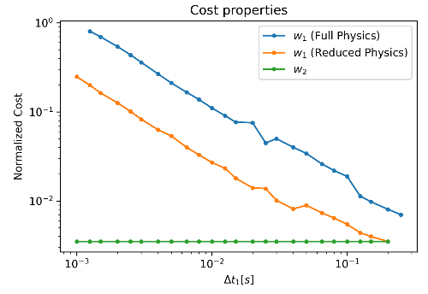
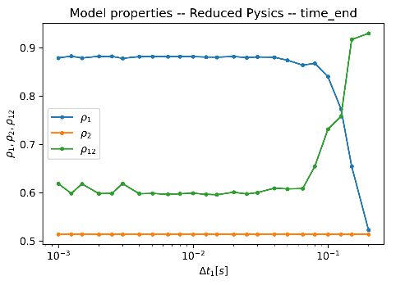


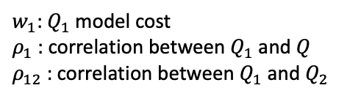

Trajectory Simulation Example
Goal: Predict the flight time of an umbrella heatshield reentering the Earth’s atmosphere within computational budget
Model Cost vs. Time Step
Heatshield
Payload
Model Correlation vs. Time Step
High-fidelity ($Q)$: timestep = 0.001
Mid-fidelity ($Q_{1}$): timestep = $0.001≤Δt_{1}≤0.25$
Low-fidelity ($Q_{2}$): timestep = 0.25
$w_{1}$: $Q_{1}$model cost
$ρ_{1}$: correlation between $Q_{1}$and $Q$
$ρ_{12}$: correlation between $Q_{1}$and $Q_{2}$

Slide 14
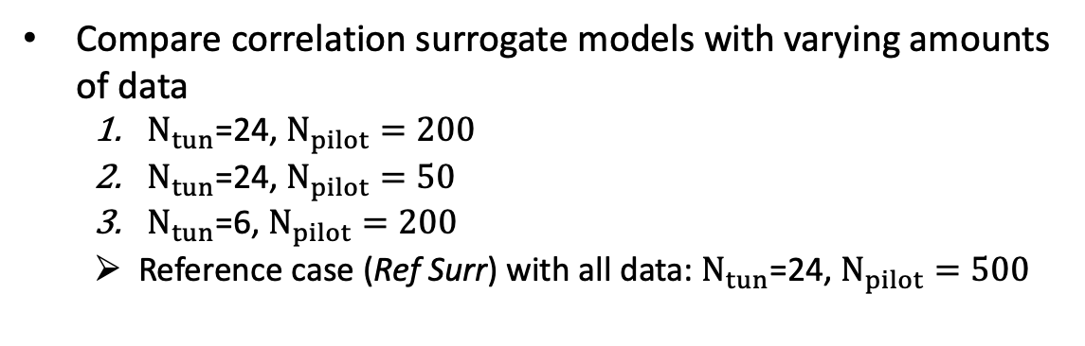

Trajectory Simulation Example
Goal: Predict the flight time of an umbrella heatshield reentering the Earth’s atmosphere within computational budget
Model Cost vs. Time Step
Determine mid-fidelity time step through joint optimization:
argmin $Var\left[\tilde{Q}\right]\left(N, r_{1}, r_{2},Δt_{1}\right)$ s.t. ${ W}^{total}\left(N, r_{1}, r_{2},Δt_{1}\right)≤W^{target}$
$$N, r_{1}, r_{2},Δt_{1}$$
Compare correlation surrogate models with varying amounts of data
  $N_{tun}$=24, $N_{pilot}=200$
  $N_{tun}$=24, $N_{pilot}=50$
  $N_{tun}$=6, $N_{pilot}=200$
  Reference case (Ref Surr) with all data: $N_{tun}$=24, $N_{pilot}=500$
Model Correlation vs. Time Step
$w_{1}$: $Q_{1}$model cost
$ρ_{1}$: correlation between $Q_{1}$and $Q$
$ρ_{12}$: correlation between $Q_{1}$and $Q_{2}$

Slide 15
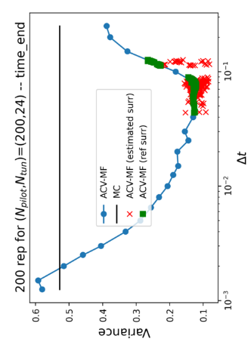
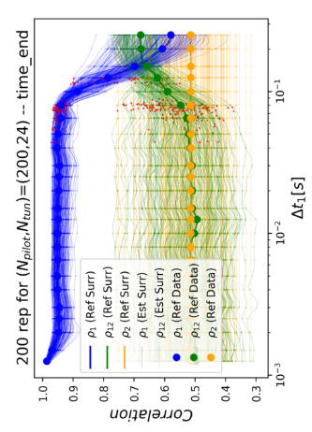
Results: Most Accurate Surrogate
  Optimization using $N_{tun}=24$, $N_{pilot}=200$ to build correlation surrogate models; 200 random trials
Estimator Variance vs. Time Step
Estimated Model Correlation vs. Time Step
Optimal model tuning is achievable using surrogates for correlation

Slide 16
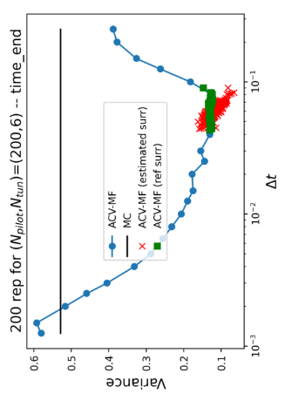
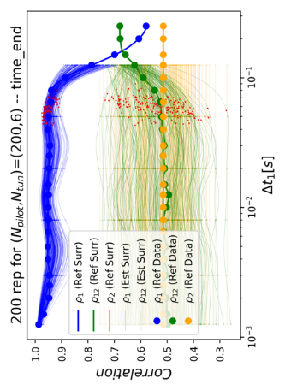
Results: Sparser Grid
  Optimization using $N_{tun}=6$, $N_{pilot}=200$ to build correlation surrogate models; 200 random trials
Estimator Variance vs. Time Step
Estimated Model Correlation vs. Time Step
Smoothness is important for gradient-based optimization
Notes:
Overfitting with local surrogate / interpolation

Slide 17
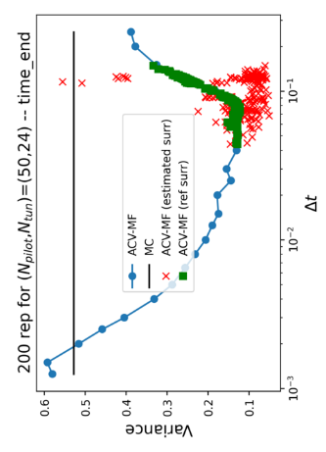
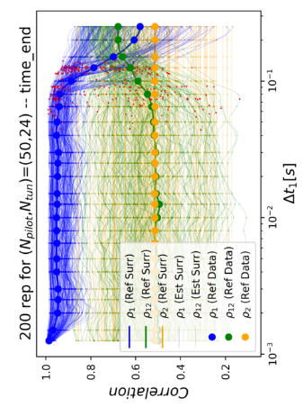
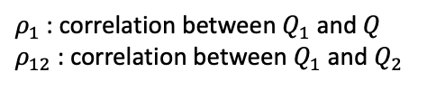
Results: Fewer Pilot Samples
  Optimization using $N_{tun}=24$, $N_{pilot}=50$ to build correlation surrogate models; 200 random trials
Estimator Variance vs. Time Step
Estimated Model Correlation vs. Time Step
Statistical variability impacts optimization
$ρ_{1}$: correlation between $Q_{1}$and $Q$
$ρ_{12}$: correlation between $Q_{1}$and $Q_{2}$
Notes:
Call out high statistical variability w/ fewer pilot samples; overlap between rho’s

Slide 18
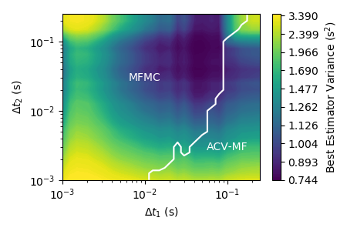

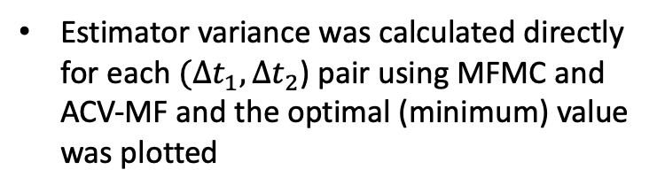


Results: Two Tunable Lo-Fi Models
Optimal Estimator Variance vs. Time Step Sizes
High-fidelity ($Q)$: timestep = 0.001
Mid-fidelity ($Q_{1}$): timestep = $0.001≤Δt_{1}≤0.25$
Low-fidelity ($Q_{2}$): timestep = 0.001 <= $Δt_{2}≤0.25$
Estimator variance was calculated directly for each $(Δt_{1}, Δt_{2}$) pair using MFMC and ACV-MF and the optimal (minimum) value was plotted
Optimal ACV method (model graph) can be function of hyperparameters

Slide 19
Conclusions
Model tuning can greatly affect estimator variance
Optimization requires estimation (or knowledge) of correlations/costs as a function of tuning parameters
Quality of the correlation surrogate is an important factor in tuning parameter optimization
Future Work:
  Automating sample allocation + model tuning optimization – implementation in Dakota
  Global optimization with adaptive surrogate refinement
  All-at-once optimization with model hierarchy

Slide 20
Questions?
Email: james.e.warner@nasa.gov
Reference:
  G. F. Bomarito, G. Geraci, J. E. Warner, P. E. Leser, W. P. Leser, M. S. Eldred, J. D. Jakeman, A. A. Gorodetsky. Improving Multi-Model Trajectory Simulation Estimators using Model Selection and Tuning. 2022 AIAA Scitech Proceedings. January 2022. https://doi.org/10.2514/6.2022-1099.
Acknowledgement:
  NASA researchers supported by the Entry Systems Modeling (ESM) project

