Slide 1
TDRWP Error at Discrete Altitudes
Nathan Curtis (Nathan.L.Curtis@nasa.gov)
Spring 2022 NEDOLWG
19-20 April

Slide 2
Background
MSFC Natural Environments (NE) has completed operational acceptance assessments for the Tropospheric Doppler Radar Wind Profiler (TDRWP) in both the SLS* and Effective Vertical Resolution (EVR)** modes
For the SLS mode assessment, TDRWP wind component RMS error was provided at both discrete altitudes and for integrated altitude ranges
However, for the EVR mode assessment, wind component RMS error was only provided for integrated altitude ranges
If wind component error is needed to account for TDRWP accuracy in launch vehicle trajectory/load assessments, RMS error at discrete altitudes needs to be used
This presentation provides TDRWP wind component errors at discrete altitudes using data from the 2020 EVR Operational Acceptance Test (OAT)**
*https://ntrs.nasa.gov/citations/20190000737
**https://ntrs.nasa.gov/citations/20205001984

Slide 3
Data
AMPS LR and TDRWP data were collected between 30 January 2020 and 16 April 2020.
  No data were collected between 18 February 2020 and 4 March 2020 due to a power outage at the TDRWP site.
  110 comparisons were utilized.
RMS values were calculated using differences in the TDRWP and AMPS LR measurements, while accounting for AMPS LR/TDRWP spatial separation and different resolutions between datasets.*
Followed the same approach as used in SLS TDRWP Certification*
*https://ntrs.nasa.gov/citations/20190000737

Slide 4
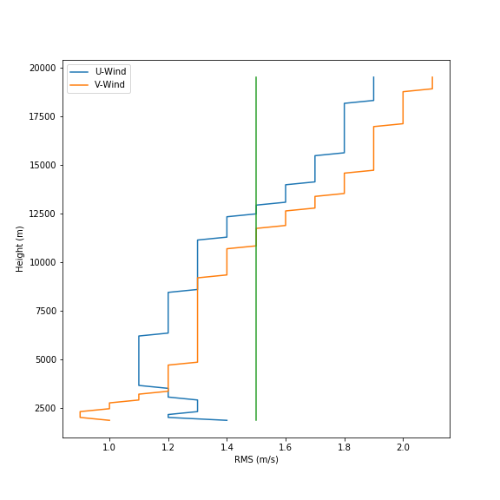
EVR OAT Reported RMS Error
The EVR OAT reported wind component error as an integration of RMS values with altitude to assess TDRWP performance over a range of altitudes.
  For example: The RMS value at the first range gate is just the error there, at the 2nd range gate it’s the RMS value of a combination of the 2nd and 1st gates, then 3rd through 1st, and so on.
  Same approach as used in SLS TDRWP Certification
This methodology was used to get an RMS value up to a specific height.
MSFC Natural Environments (NE) defined a cutoff RMS error of 1.5 m/s (green line).
MSFC NE can only use TDRWP profiles up to ~11.9 km when in EVR mode. In SLS mode, TDRWP profiles are valid up to 19.3 km
This dataset is not a determination of RMS error at a discrete altitude.

Slide 5
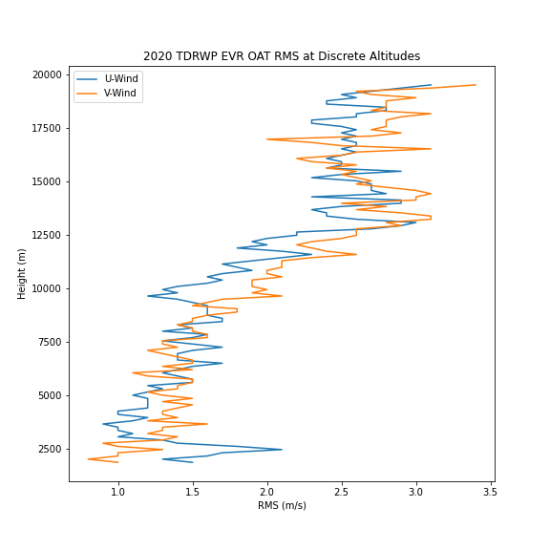
RMS Error at Discrete Altitudes
Using data from the EVR OAT, RMS error was calculated at discrete altitudes
This dataset can be used for assessments requiring error values to be known at individual points/altitudes.

Slide 6
Forward Work
The data used in this analysis were from late winter to early spring where it would be expected to see higher wind speeds and thus higher spatial separations.
Forward work is to expand the EVR OAT dataset to increase sample size and to account for year-round variations

