Slide 1
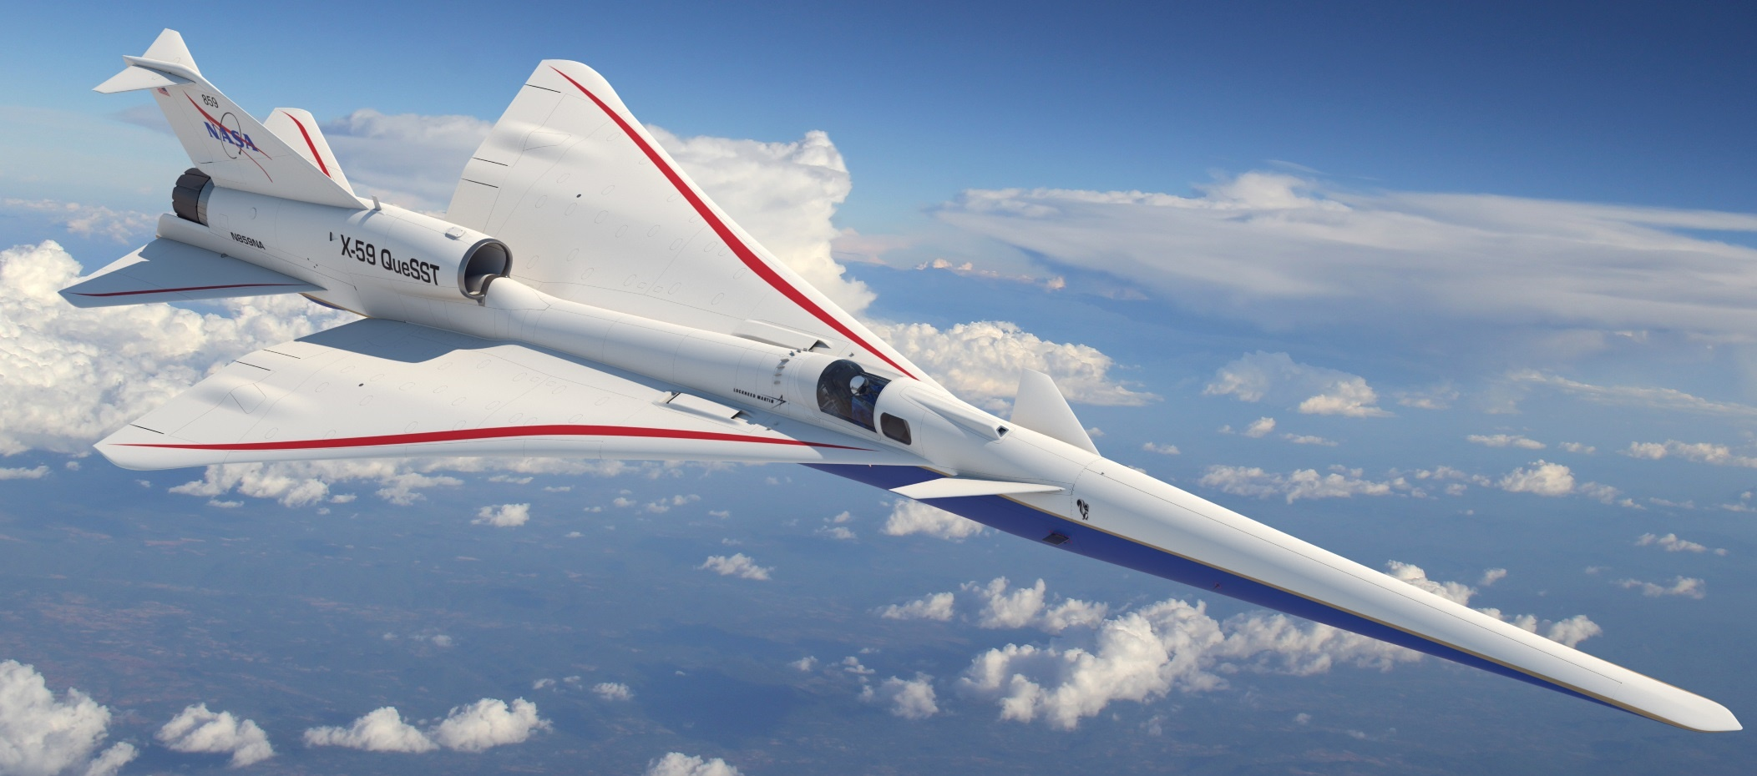
Redo Title Slide
An Overview of NASA’s Low Boom Flight Demonstration
DATAWorks 2022
Alexandria, VA
April 28, 2022
Jonathan Rathsam, NASA Langley Research Center
Notes:
Good morning, my name is Jonathan Rathsam, and I’m from NASA Langley Research Center in Hampton, Virginia.
I’m the Technical Lead for Survey Design and Analysis in NASA’s Low Boom Flight Demonstration Mission.
I’m excited to share this presentation with you today. Thank you so much to the organizing committee for this opportunity.
https://dataworks.testscience.org/full-agenda/

Slide 2
Acknowledgments
Peter Coen, Juliet Page, Alexandra Loubeau
Notes:
This presentation draws from other overview presentations given by my colleagues Peter Coen, Juliet Page, and Alexandra Loubeau.

Slide 3
Outline
Introduction
1) Source and Path
  What is a sonic boom?
  How is a sonic boom quieted?
2) Receiver
  How will the public react?
3) NASA’s Low Boom Flight Demonstration
  Status
  Challenges and strategies
Summary
Notes:
In terms of an outline, noise control problems are often broken down into source, path, and receiver components. The first part of this talk briefly considers the source and path components of supersonic flight and sonic booms. The second part takes a more in-depth look at public reactions, or the receiver. The third portion describes NASA’s Low Boom Flight Demonstration.

Slide 4
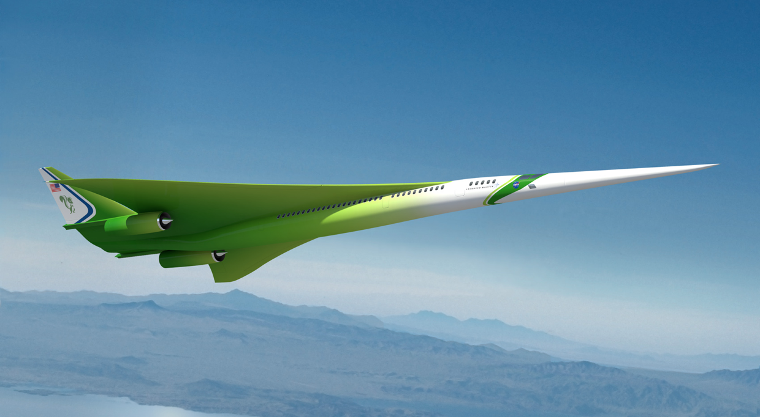
The vision for commercial supersonic flight
Overland Flight Restrictions based on unacceptable sonic boom noise are viewed as the main barrier to this vision
An emerging potential market has generated renewed interest in civil supersonic aircraft
Evidenced by the appearance of several commercial programs despite lack of standards for en route noise or landing and takeoff noise
National Research and Policy agencies play a central role in developing the data needed for the regulation change that is essential to enabling this new market
The vision of the Supersonics Community is a future where fast air travel is available for a broad spectrum of the traveling public
Future supersonic aircraft will not only be able to fly overland without creating an “unacceptable situation” but compared to Concorde and SST will be efficient, affordable, and environmentally responsible
Credit :Lockheed Martin
4
Notes:
My family and I live in Virginia, and my parents live 3000 miles away in Oregon. Flying from coast to coast means a long day of travel. The goal of commercial supersonic flight is to get travelers to their destinations faster so grandparents can spend more time with grandkids.
There is an emerging potential market for commercial supersonic aircraft as evidenced by several commercial supersonic programs despite the lack of standards for supersonic overflight noise or landing and takeoff noise.
NASA’s vision is a future where fast air travel is broadly available to the traveling public. Future supersonic aircraft will not only fly overland without creating an “unacceptable situation”, but they will be efficient, affordable, and environmentally responsible, especially compared to Concorde.
The main barrier to this vision is the restriction on overland supersonic flight.
National research agencies, like NASA, and policy agencies, like the Federal Aviation Administration, play a central role in developing the data needed for the regulation change that is essential to enabling this new market.

Slide 5
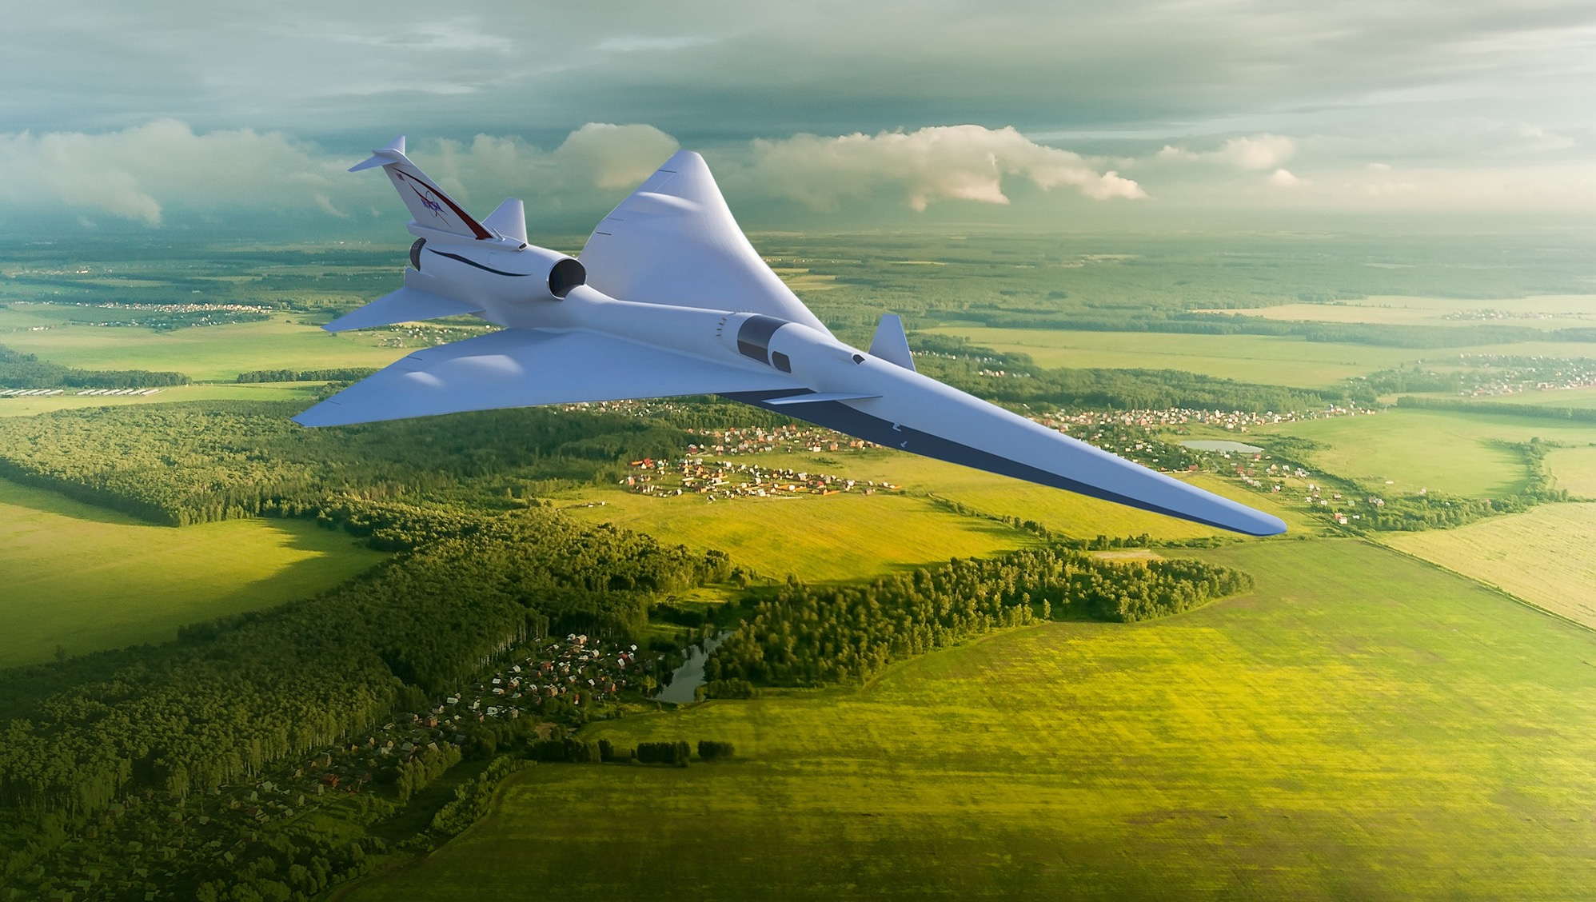
Overcoming the barrier to overland flight
The Low-Boom Flight Demonstration Mission is specifically planned to generate key data for success in NASA’s Critical Commitment to support development of en route certification standards based on acceptable sound levels
New environmental standards are needed to open the market to supersonic flight
An en route noise standard is the biggest challenge
  Requires proof of new design approaches
  Must replace current prohibitions
  No relevant data exists to define limits
    Community data from large, diverse population is a requirement
  Standard must be accepted internationally
5
Notes:
To open the market to supersonic flight, new environmental standards are needed.
The en-route noise standard is viewed to be the biggest challenge. Not only does it require proof of new design approaches, but it has to replace the current prohibitions.
There is no relevant data that exists. The sounds in community response tests from 1960s were too loud to be remotely acceptable.
Data from a large, diverse population is a requirement.
Of course, any standard related to supersonic flight needs to have international support
The Low Boom Flight Demonstration was proposed to generate data specifically to support en route certification standards, not based on speed, but based on acceptable sound levels.

Slide 6
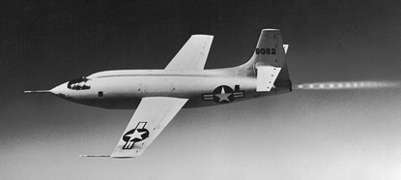
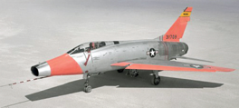
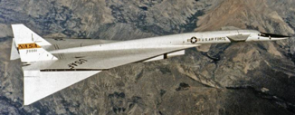
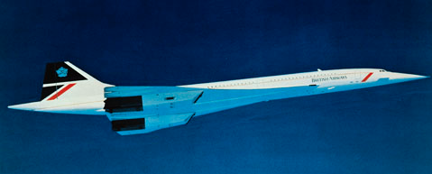
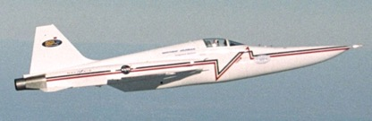
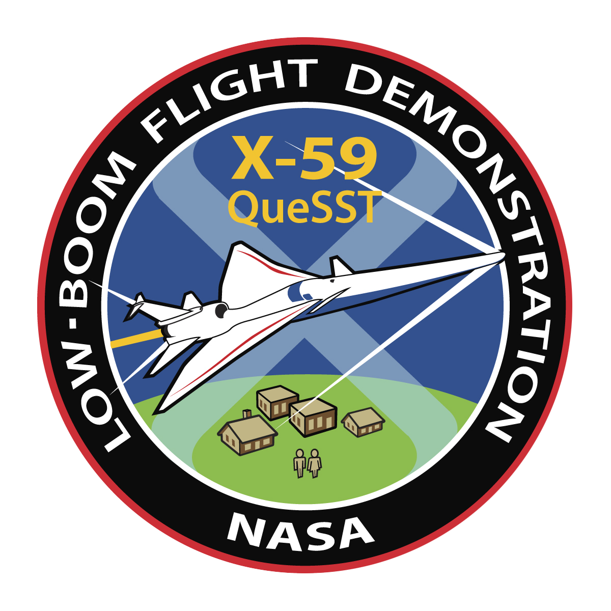
Supersonic Flight and Sonic Boom: A Brief History
1947 First supersonic flight
Sonic boom a novelty
1950s Rapid development of supersonic military aircraft
Noise and damage concerns
1960s Supersonic commercial aircraft proposed
Community studies determine sonic boom exposure is unacceptable
1973 US federal ban, international limits
1976 – 2003 Concorde commercial service
Supersonic operations only over the ocean
2003 DARPA-NASA Shaped Sonic Boom Demonstration
First flight demonstration of sonic boom “shaping” theory
2018 – 2026 NASA’s Low Boom Flight Demonstration First flight demonstration of quiet supersonic design
    Community studies to gauge public reaction
Bell X-1
F-100
XB-70
Concorde
SSBD
X-59
Notes:
Supersonic flight has been around for over 70 years.
In the 1960s supersonic commercial aircraft were proposed, and several major community studies occurred. Supersonic aircraft were flown over communities and a social survey was conducted to learn how the community responded to sonic booms. The results of the tests showed that conventional sonic booms created an “unacceptable situation.”
In 1973 commercial supersonic flight was banned overland.
From 1976—2003 Concorde flew passengers supersonically over water, but had to slow down over land.
Presently, NASA’s Low Boom Flight Demonstration is building an experimental aircraft, the X-59, which will be used to collect data on public reactions to quiet supersonic flight.

Slide 7
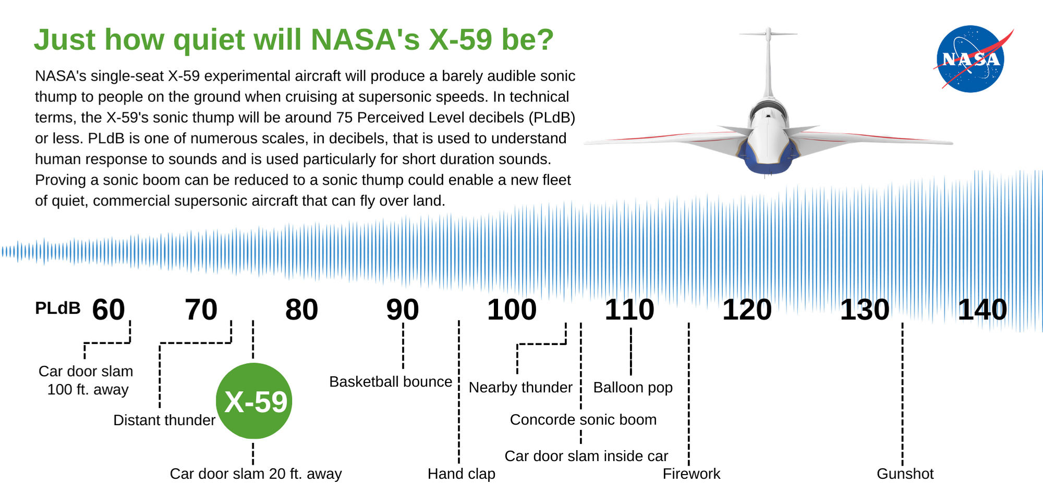
PL (dB)
W. Doebler and J. Rathsam, Proc. Mtgs. Acoustics 36, 040005 2019.
Notes:
For context, the conventional sonic booms from Concorde or other aircraft used in the 1960s community tests were on the order of 105 dB Perceived Level [*show on chart*], which is comparable to nearby thunder or a car door slam from inside the car. It’s worth noting that nearby thunder and door slams can be very startling when you are not expecting them.
By contrast, X-59’s sonic thump is designed to be 75 dB, which is comparable to distant thunder, or a car door slam from 20 feet away.

Slide 8
Source—Path—Receiver
  What is a sonic boom?
  How is a sonic boom quieted?
Notes:
The first part of this presentation briefly describes a sonic boom and how it is quieted.

Slide 9
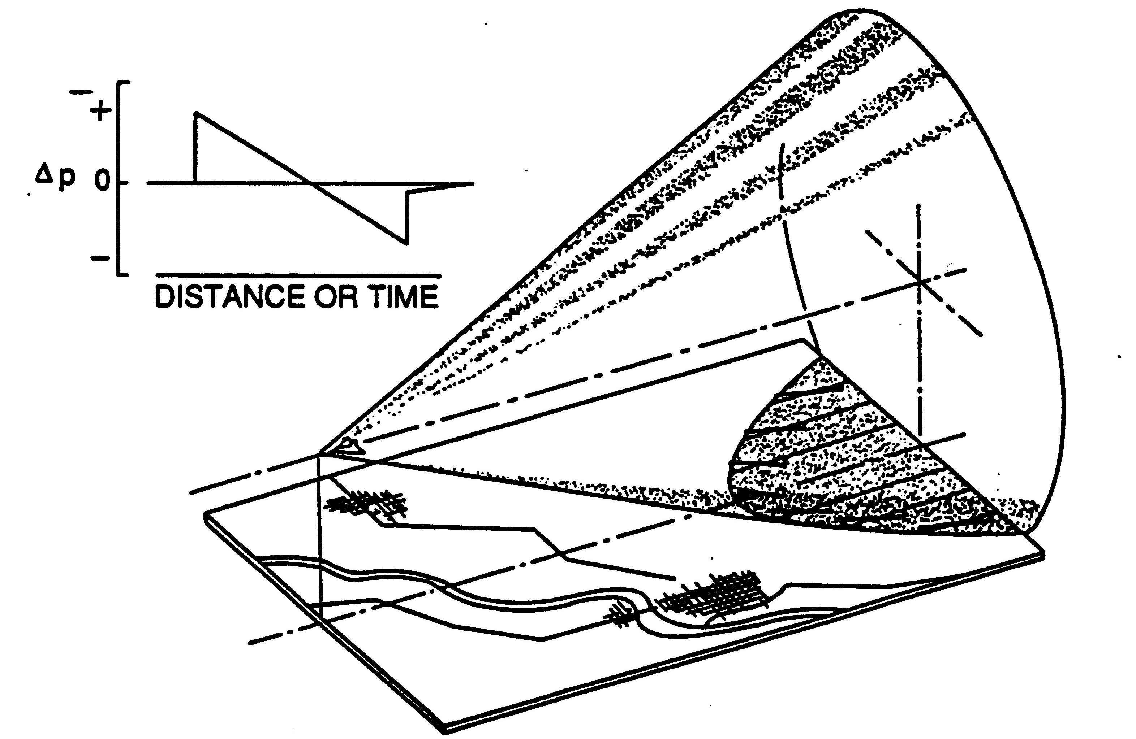
What is a sonic boom?
aircraft
D.J. Maglieri, et al. NASA-SP-2014-622.
Notes:
A sonic boom is the sound of a shock wave, or pressure disturbance, created when an object travels faster than the speed of sound. Sonic booms are typically caused by supersonic aircraft, but occur from meteors or spacecraft as they enter earth’s atmosphere, falling rocket boosters, supersonic bullets and missiles, and even bullwhips.
As shown on the left, when an aircraft flies faster than the speed of sound, it creates a pressure disturbance that emanates in all directions. The most important thing to remember is that sonic booms move with the aircraft like the wake from a boat for as long as the aircraft is flying supersonically.
The plot on the right shows the pressure-time history of the disturbance at various stages between the aircraft and the ground. A pressure-time history is something you would measure with a microphone. As it travels away from the aircraft, the waveform goes through a process called “nonlinear steepening” because the higher amplitude components travel faster than the lower amplitude components. The steepening process is key to quieting a sonic boom.

Slide 10
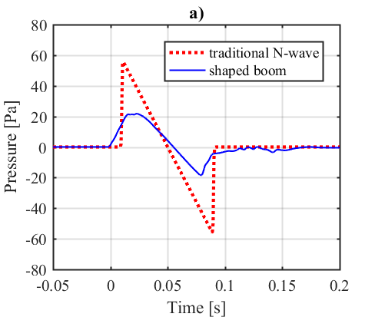
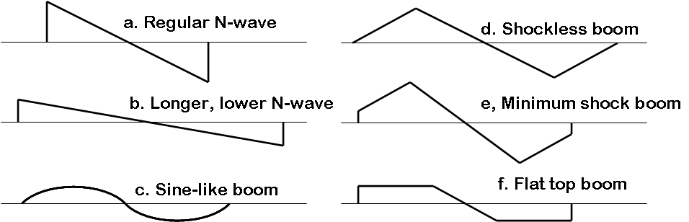
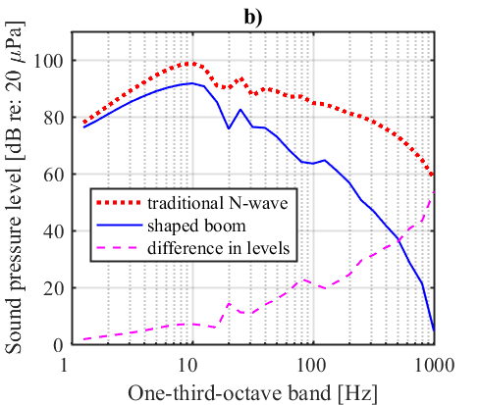
How is a sonic boom quieted?
Originally, all supersonic signatures were thought to be far field N-waves
  minimization focused on going from (a.) to (b.)
In 1965, McLean discovered that supersonic signatures could be mid field (so not necessarily N-waves)
Led to development of a family of optimum shapes booms:
Waveforms
Frequency Spectra
F. E. McLean, NASA TN-D-2877, June 1965.
Notes:
Originally, it was thought that all supersonic signatures were far field N-waves. The early efforts at sonic boom minimization concentrated on producing longer-duration, lower amplitude N-waves (going from panel a to panel b). Panel (a) sounds like “BOOM BOOM”, whereas panel (b) sound more like Boom…Boom.
In 1965, McLean discovered that if an aircraft at altitude was long enough, the supersonic signature arriving to the ground could still be in the midfield and did not have to be an N-wave. This led to the development of a family of optimum non-N-wave solutions, all of which would be quieter than N-waves. An idealized limit would be a signature like a sine wave shown in panel c, which eliminates much of the high frequency energy from the signal.
The plots on the right show the waveforms and frequency spectra for an N-wave in red and a shaped boom in blue. The bottom right plot illustrates how much sound energy is reduced, especially at high frequencies, when going from the red N-wave to the blue shaped boom.

Slide 11
Source—Path—Receiver
How did the public react historically?
How do we study human response?
What data are needed for noise standards development?
Notes:
This second part of the presentation will focus on the receiver, and what the research shows about human response to sonic boom.

Slide 12
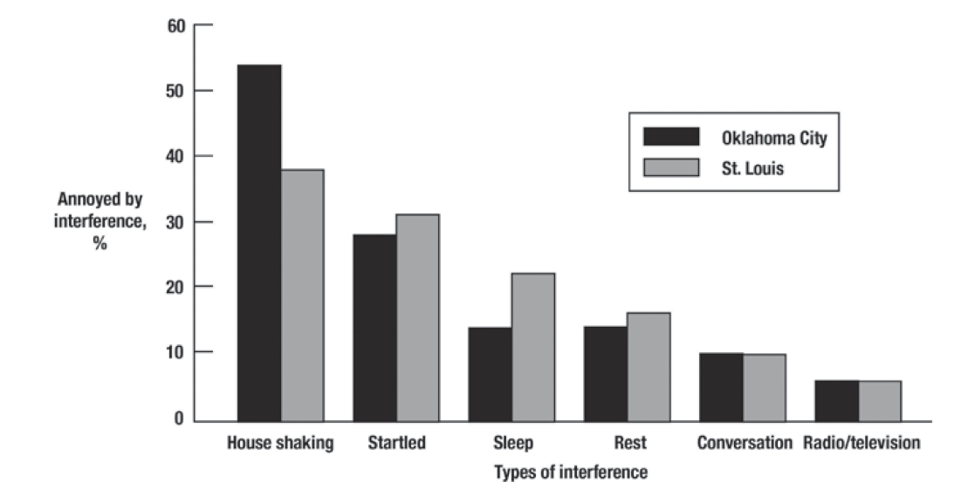
How did the public react historically to sonic booms?
Nixon and Borsky, AMRL-TR-65-196, 1965
Notes:
In the 1960s two major community overflight tests occurred in St. Louis and Oklahoma City. Each test lasted half a year. In St. Louis there were 76 booms, and in Oklahoma City there were upwards of 1200 booms.
This figure shows the percent of participants annoyed by various types of interference.
Ultimately the results showed that conventional sonic booms would not be acceptable. With sonic booms on the order of 2 psf, the sound levels were comparable to nearby thunder or a car door slam inside the car.
An important result from the community overflights was that indoor annoyance was the key driver of non-acceptability.

Slide 13
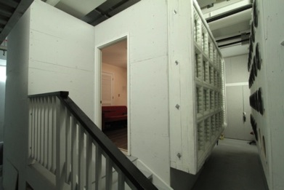
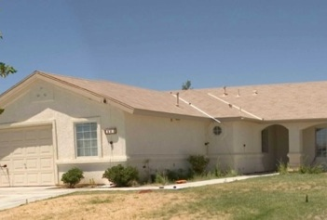
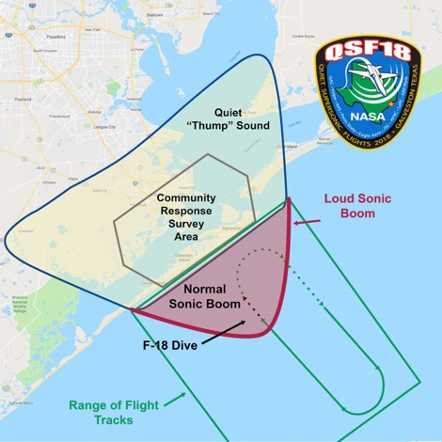


Why do we think the “thump” is quiet enough?
Human response and annoyance, particularly indoors, is the key concern.
Quiet Supersonic Flights 2018
Galveston, Texas
Laboratory Tests
Small Community Test
Large Community Test
Tests of increasing complexity have provided preparation and confidence
Ready to take the next step with flight testing over very large communities
Notes:
Why does NASA think that the current designs are quiet enough?
With indoor annoyance as the key concern, NASA conducted laboratory tests, tests in small communities, risk reduction tests in larger communities, all of which were tests of increasing complexity which show, in general, that the threshold of acceptable noise levels had been reached, preparing NASA to take the next step with flight tests over very large communities.
In the interest of time, I am going to skip the lab test results and focus on community tests only.

Slide 14
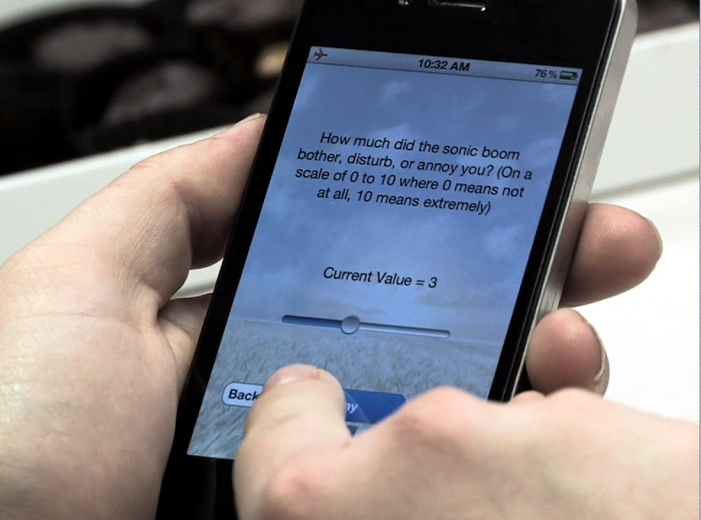
Low Boom Community Response Testing
Identify, minimize, and/or mitigate risks for future X-59 community testing
Quiet Supersonic Flights 2018 (QSF18)
  Low-amplitude sonic boom community test in Galveston, Texas on November 5-15, 2018
  Test methodologies in a city not used to hearing sonic booms
  Low-boom dive maneuver
    4 - 8 “sonic thumps” daily (52 total)
  500 members of public recruited to participate in survey
    Background, single event, and daily surveys
  25 audio sensors set up to measure sound levels in survey area
  Public engagement (elected officials, general public, respondents)
  Lessons learned
    Methods and planning
    Test Execution
    Data analysis
Page et al., NASA/CR-2020-220589, 2020.
Notes:
In parallel with laboratory testing, NASA has also been working to identify and minimize risks associated with community testing. A community test exposes entire communities to sounds while only surveying a sample of residents on their perceptions of the sounds. In 2018 NASA conducted a large community test using an F-18 research aircraft performing a low-boom supersonic dive to simulate the sounds of quiet supersonic overflight.
In terms of Community Engagement, communications had to be tailored to many different audiences, such as:
Elected officials many months prior; residents that would be exposed to sonic thumps via newspapers, press conferences, and via local governments; mariners exposed to higher level sonic booms, survey participants, local students via STEM engagement.
In terms of flying the NASA research aircraft beyond a test range, an Air Traffic Control “Assigned Airspace” had to be prearranged and Environmental Review had to be conducted.
In terms of ground measurements of the signatures, 25 ground recording units were spread across the 60 sq. mile survey area and linked via cellular network to a host station. The field crew deployed, calibrated, and retrieved the units daily.
In terms of the social survey, the web-based survey had to be developed, pass governmental survey review, pass research ethics review, and participants had to be recruited via postal mail and enrolled in the survey.
One of the key lessons learned involved the need to automate and streamline data analysis post test in order to meet the swift cadence needed for X-59 community tests.
Most importantly, this large community test showed that NASA could successfully engage with a community to conduct community response testing.
Next we’ll spend a few moments discussing what data is needed for aircraft noise standards development.

Slide 15
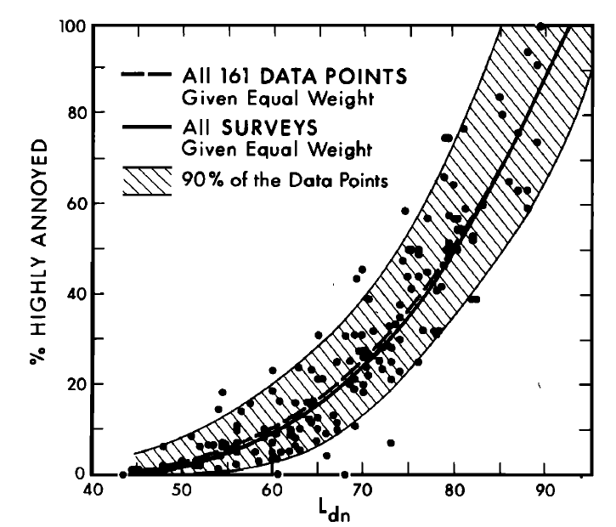
What data is needed for aircraft noise standards development?
Notional Data
Historical Precedent
Response Metric
(annoyance level)
Data needed
Dose Metric (noise level)
T.J. Schultz, J. Acoustical Soc. Am. 64(2), 377-405. 1978.
Notes:
For more than half a century, community noise survey data has been plotted as shown here: a response metric (like annoyance level) vs. a dose metric (noise level). This is known as a dose-response (or exposure response) relationship, and has roots in other fields such as psychophysics, pharmacology, toxicology, and epidemiology. For context, the plot on the right comes from the seminal community noise paper on dose-response.
In order to develop standards for supersonic flight overland, two dose-response relationships will be developed. The first will be a curve for single flyover events. This curve will directly inform standards for certifying aircraft. The second will be a curve for cumulative sound levels from multiple flyover events. This second curve will inform guidelines for limits on supersonic operations.
The primary noise annoyance questions and response scales have been standardized (and translated to other languages to enable comparability among surveys internationally). The definition of the response metric as “percent highly annoyed” was chosen to keep the regulatory focus on those most affected by the noise.

Slide 16
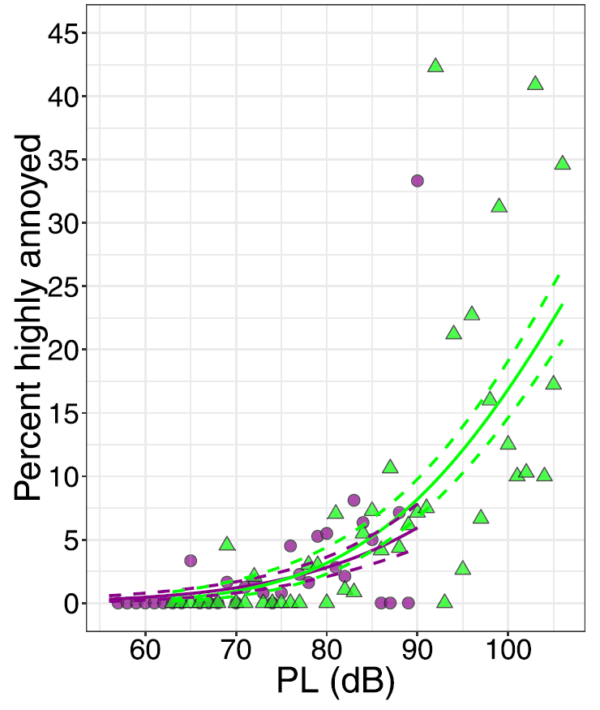
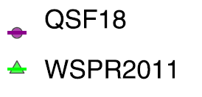
Dose-Response Curves from Past NASA Tests
Large Community Test
Small Community Test
J. Lee, et al. J. Acoustical Soc. Am., 147:2222, 2020.
Notes:
Sample single event dose response curves resulting from previous NASA community tests are shown here.
The first thing to note is the high degree of scatter in the data, which is typical of social survey data.
The second thing is that in both tests, 75 dB is associated with a very low percent highly annoyed.
As a matter of practicality, the sonic boom community tests have all been “panel surveys,” in which a panel or group of survey respondents responds multiple times. It simply is not practical recruit a member of the public and then only request a single response, especially when responses are needed promptly after each overflight. A consequence of having panel studies is the need for statistical models that account for the correlation among multiple observations from the same person.
So, let’s shift gears from talking about the past to talking about the future!

Slide 17
NASA’s Low Boom Flight Demonstration Mission
  Status
  Challenges and strategies
Notes:
We have set the stage to talk about NASA’s plans for a series of community tests involving the X-59 aircraft.

Slide 18

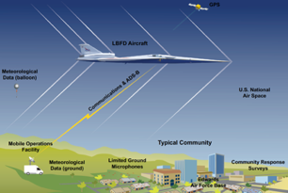
What is NASA’s Low Boom Flight Demonstration?
Phase 1 – Aircraft Development
In progress (FY18-23)
  Design, fabricate a quiet supersonic research aircraft
  Prove performance in test range flights
  Prove safety for flights in normal airspace
Systematic Approach Leading to Community Testing
Phase 2 – Acoustic Validation
Preparation in progress (FY18-23), Execution FY23-24
  Prove the acoustic characteristics match design targets
  Detailed in flight and ground measurements in test range
Phase 3 – Community Response Testing
Preparation in progress (FY19-23), Execution FY24-27
Conduct community tests
  Select communities
  Outreach and engagement (including STEM)
  Obtain necessary approval
  Plan surveys and recruit participants
  Collect ground measurements
Notes:
With the knowledge that we could design a supersonic aircraft, and the knowledge that we could conduct a relevant demonstration with a research aircraft, NASA set out on the Low Boom Flight Demonstration mission. It’s a systematic approach leading to testing of community response to sounds of quiet supersonic overflight.
Phase 1 is aircraft development, and it’s currently going on with Lockeed Martin in Palmdale, California with the design, fabrication, and ground test of the X-59. When ready we’ll conduct a series of envelope expansion flights proving that the airplane is ready and safe to fly outside of the test ranges in the national airspace system.
After that we’ll stay in the test ranges to conduct the acoustic validation, which is Phase 2. Here we’ll be proving that the acoustic signature of the airplane matches what we set out to design. We’ll conduct detailed inflight and ground measurements of the signature of the airplane in preparation for community testing.
Phase 3, which is the payoff of the mission. That phase will be executed over 2-3 years staring in 2024 and will consist of several tests over different communities in the US and possibly abroad.

Slide 19
Will a demonstrator represent future larger aircraft?
Demonstrator needs to match acoustic characteristics that cause annoyance
Demonstrator
Transport design 1
Transport design 2
Transport design 3
Analysis of noise spectra for different designs
Low Frequency sound – causes rattle
  High sound energy below 10 Hz
Similar annoyance at a range of sound levels
Annoyance comparison from Interior Noise Simulator
Notes:
Even though the demonstrator will be a small aircraft, lab studies and design work make us confident that the demonstrator will match the acoustic characteristics that are responsible for annoyance from sonic booms sound. In particular, as shown in the top right plot, the demonstrator matches low frequency sound that causes vibration and rattle in the range below 10 Hz.
At the bottom left is a plot of data from a laboratory study in our NASA indoor sonic boom simulator. It shows that annoyance to the demonstrator is similar to larger aircraft in the range of sound levels used in community testing.

Slide 20
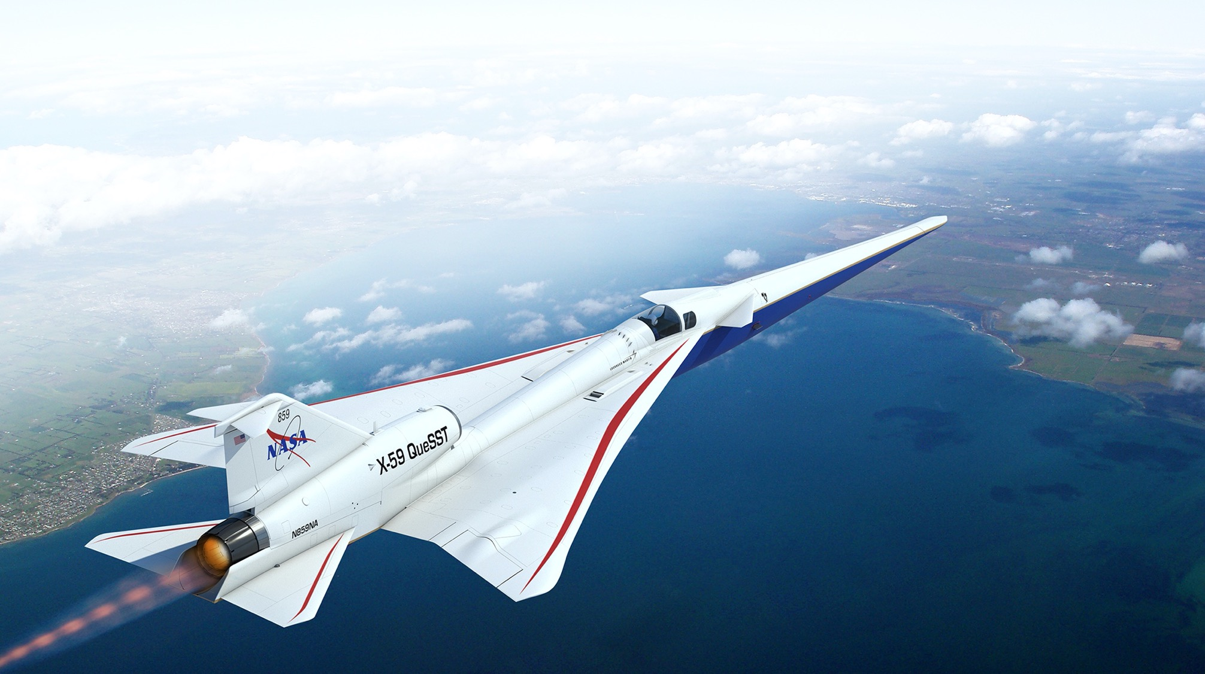

The X-59 QueSST (Quiet SuperSonic Technology) Aircraft
Key requirements drive X-59 design
The acoustic signal of the X-plane must effectively replicate that of future larger supersonic commercial aircraft.
The X-plane must conduct community overflight tests using normal commercial aircraft flight maneuvers.
Design Parameters
Length: 99’ 7” ft
Span: 29’ 6” ft
Speed: Mach 1.4 (925 mph)
Altitude: 55,000 ft
Design Features
New, unique airframe design with acoustic signature shaping
Many components from existing aircraft to reduce cost
Payload capacity: single pilot/flight test instrumentation
Notes:
Our aircraft is driven by the idea of meeting a minimum set of requirements that meet our mission. The acoustic signal must replicate a future, larger aircraft. We must be able to operate the airplane using normal flight maneuvers that would be expected for commercial supersonic aircraft. You can see some of the performance and geometry features. It’s important to note that it’s a new and unique airframe design to accomplish the signature shaping, but it uses many components from existing aircraft to reduce cost. It’s a research aircraft, so the payload is just a single pilot plus flight test instrumentation.

Slide 21
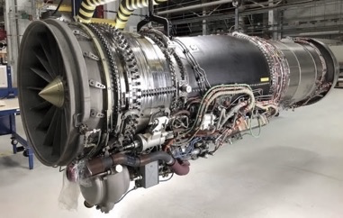
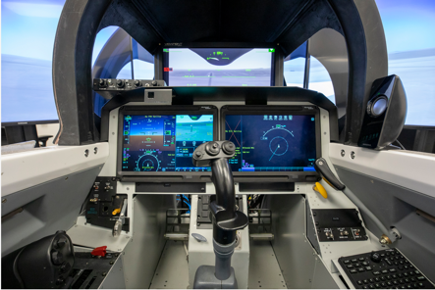
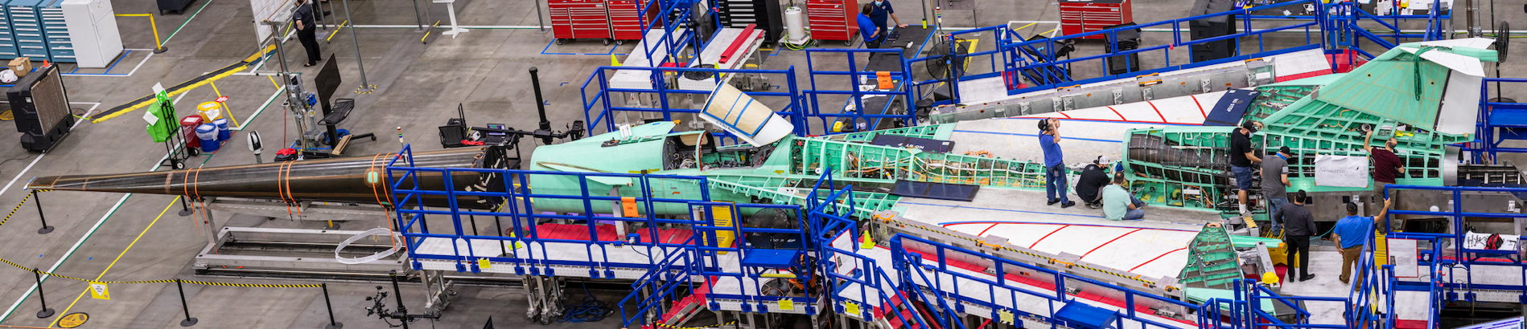
X-59 QueSST Aircraft Development Status
Lockheed Martin is the lead for manufacturing
  Major airframe components mated
  Systems installation and checkout in progress
    NASA supplied systems delivered
    Engine delivered
Ground testing in Texas
First flight later this year
GE F414 engine
Simulator with External Vision System (XVS)
Manufacturing progress at Lockheed-Martin
Notes:
Here are some images of the airplane in fabrication. Some systems are supplied by NASA such as the External Vision System, which enables forward vision without a forward facing canopy window. The airplane is powered by an existing fighter aircraft engine. The aircraft recently underwent ground testing in TX and should be back in California by the end of April. Target first flight is later this year.

Slide 22
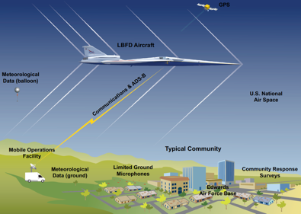
Community Overflight Testing Creates Response Data
Objective: Create a dose-response relationship between level of sound exposure and community annoyance
Large, diverse representative population sample
Tests in multiple U.S. locations and ideally at least one international location
Sufficient test duration to establish effect of repeated exposure
Account for test aircraft operational limitations
  Airfield facilities
Engage the local community to create a trust environment for test
  Public and STEM engagement opportunities provided by NASA
Engage the international research and regulatory community to ensure data acceptance
Notional Dose-Response Relationship
Notes:
Our focus is conducting community overflight tests to create the dose-response relationship between the level of sound exposure and community annoyance. In order to define an international standard, a large diverse and representative population must be tested. The test must be long enough to establish the effect of repeated exposure. Although we’d like to test in unlimited locations, we need to account for the fact that we do have an X-plane with operational limitations which drive our selection of airfields for use. Part of our planning efforts involve engaging the local community to create a trusting environment for the test. We plan a variety of public and STEM engagement opportunities as part of the overall approach. Even though our focus is on testing in the US, we know that international acceptance of the effort is important, so we are seeking to engage the international and regulatory community to ensure that the data is acceptable.
Because DATAWorks is about collecting and analyzing data, the next few slides summarize some of the key challenges on this project, as well as some strategies to overcome them.

Slide 23
National Representativeness
Challenge
Strategy
X-59 overflights cannot be conducted everywhere in the US
Mission plan is for a maximum of 5 community tests in different locations lasting 30 days each
Achieve qualitative (not quantitative) representativeness
  “like or typical of others of the same class”
Purposive sampling of test sites
  rely on test site “characteristics of interest” determined most important by stakeholders
    Geographic diversity
    Race/Ethnicity diversity
    Urbanicity diversity (population density)
    Age diversity
    Income diversity (or education level or homeownership)
Random sampling of households at each test site
Notes:
The goal is the collect nationally representative data. If this were a standard survey like a political poll, we might begin with a list of all U.S. households and select a random sample to recruit for the survey.
That approach won’t work here for several reasons. X-59 can only operate from certain airfields and its range is limited. Also, the survey participants need time to get used to the sound of X-59 supersonic overflights (weeks). To measure noise exposure, about 100 ground recorders need to be placed across the survey area (it’s large, it’s 1500 square miles, which is the size of the state of Rhode Island). Finally, the total number of flight hours on X-59 is limited.
In light of these constraints, the mission plan is for a maximum of 5 community tests in different locations around the country. Each test will last about 30 days.
So, what is NASA’s strategy to collect nationally representative data from a maximum of 5 community test sites?
The strategy is to achieve qualitative, not quantitative, national representativeness. This mirrors the dictionary definition of representative as “like or typical of others of the same class.”
The test sites will be chosen based on “characteristics of interest” in a process known as “purposive sampling.” Together the test sites must be diverse in terms of: geography, race/ethnicity, urbanicity, age, and income. Because the sampling of test sites is purposive rather than random, the representativeness is qualitative rather than quantitative. Within each test site, households will be randomly sampled for recruitment into the survey.

Slide 24
Sparse Data
Challenge
Strategy
Low sounds levels lead to sparse “highly annoyed” observations
Sparse “highly annoyed” observations may point to a high degree of public acceptability, but can lead to questions about the survey instrument and modeling technique.
How can sparse binary response data be modeled effectively?
The ordinal response scale permits other dichotomizations, like % moderately+ annoyed and %slightly+ annoyed where data is less sparse
  Additional assumption required to generalize results from other dichotomizations to % highly annoyed
Increasing the dose range may be possible by generating higher sound levels, but may also involve risk to public perception about quiet supersonic flight
Notes:
Because the sound level of sonic thumps is quite low, very few survey responses from risk reduction testing were “highly annoyed.” That means we’re on the lower tail of the dose-response curve, close to 0 %. While that may indicate a high degree of public acceptability, it can also lead to questions about the effectiveness of the survey instrument and modeling techniques.
How do you effectively model binary response data when the observations are concentrated in the lower tail of the distribution?
Here are a couple of strategies. The first is on the modeling side, and the second is on the experimental design side.
The response scale is ordinal, so other dichotomizations of the scale can be considered (% moderately+ annoyed, or %slightly+ annoyed). These would require some assumptions in order to generalize back to % highly annoyed.
On the experimental design side, it may be possible to get more highly annoyed responses by generating higher sound levels. However, that approach has some risk in terms of potential misconceptions of X-59 as a loud rather than quiet supersonic aircraft.
One of the complexities is that we won’t know just how far down on the dose-response curve the data sit until we start collecting data.

Slide 25
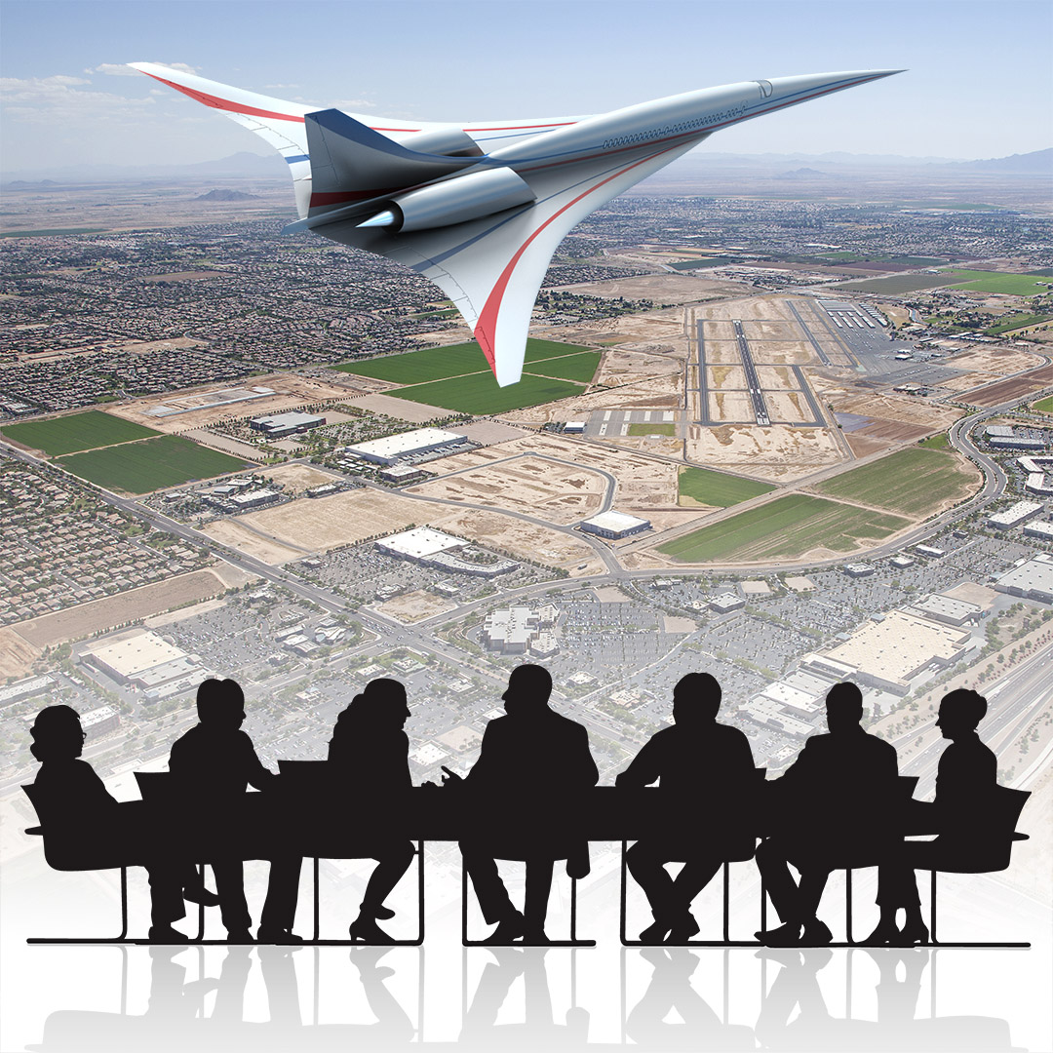
Organizational Challenges
Challenge
Strategy
Long Time Span
  2018 – 2024: Planning Stage
  2024 – 2026: Execution Stage
Many resources to manage
Diverse Stakeholders
  Multiple NASA Centers
  Contractor Teams
    Ground Recording System
    Community Response Testing Support (8 companies)
  International Civil Aviation Organization (UN) and Federal Aviation Administration
  Federal, state, and local government
  The public (participant in community tests)
Communication
Active stakeholder engagement
Notes:
The project also has non-technical challenges, including a long timespan, many resources to manage, and diverse stakeholders.
Just within NASA, the project is being worked at multiple NASA centers. There are also a number of contractor teams involved. One contractor team is building the ground recording system, and another is responsible for supporting NASA to plan and execute community tests. The community test contractor team involves 8 companies with diverse skillsets such as conducting surveys and estimating noise exposure by combining measurements and predictions.
In terms of regulatory bodies, not only is the Federal Aviation Administration a stakeholder, but also its international counterpart, the International Civil Aviation Organization.
To execute community response tests, coordination is required with all levels of government, including federal, state, and local.
Most importantly the public is a stakeholder, because the public will not only participate in community response tests, but will live beneath future supersonic flight paths and fly on future commercial supersonic aircraft.
The primary strategy for the organizational challenges is communication, early and often. Active stakeholder engagement is necessary to keep everyone informed well in advance. Points of contact change over time so it’s important to identify new stakeholders early and bring them up to speed.

Slide 26
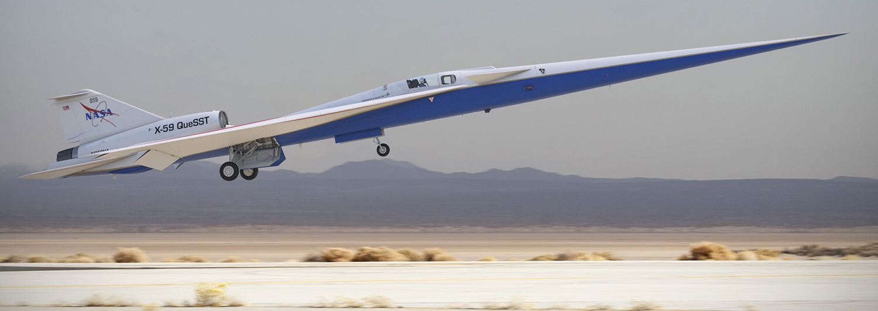
Summary
Technology and design improvement has created the possibility for future supersonic commercial aviation that is quiet and sustainable
Quiet overland flight is vital for achieving broad market success
NASA’s Low Boom Flight Demonstration Mission will provide key needed data
The X-59 QueSST aircraft is designed to meet the requirements for highly relevant acoustic data
X-59 build is well under way, with a first flight planned for 2022
Community testing will begin in 2024 and deliver dose response data from overflight of US communities
NASA seeks broad engagement with the international community to ensure acceptance of the community test results
Notes:
To summarize, technology and design improvements have led us to the point where we can envision a possible future for supersonic commercial aviation that is quiet and sustainable.
Quiet overland flight is vital for achieving airline operations and eventual broad market access for the traveling public.
NASA’s Low Boom Flight Demonstration mission was created to provide key data needed to define standards for acceptable quiet supersonic overland flight
The X-59 QueSST aircraft is a unique design created specifically to meet the requirements to gather highly relevant acoustic data.
The build of the aircraft is well underway and we expect to be flying it later this year.
The mission will culminate in community testing to begin in 2024. It will deliver dose response data from overflights of the US and possibly international communities.
NASA is seeking broad interaction and engagement with the international community to ensure that the results are acceptable and lead to the adoption of international standards.

Slide 28
Backup
Notes:
This presentation draws heavily from overview presentations given in the past by Peter Coen, Juliet Page, and Alexandra Loubeau
I will cover a lot of material in a very short time in trying to present the essence of sonic boom research,
I will gloss over many details and simplify descriptions for the sake of clarity
In many cases, I tried to cite just one representative publication from the open literature even when there are several publications were relevant
The linear retelling of the story is only an approximation…

Slide 29
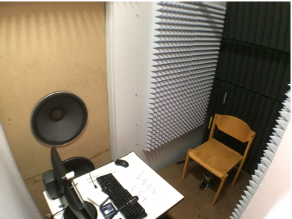
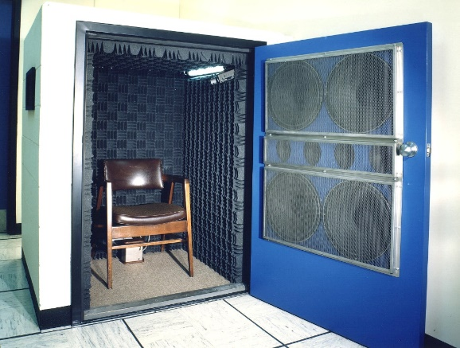
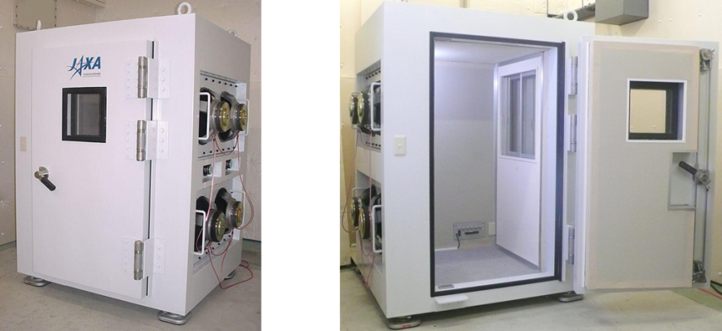
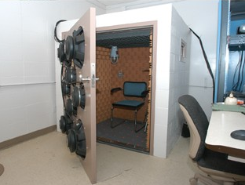
Sonic Boom Simulators: Outdoor Environment
NASA
Overpressure
Oldenburg
Rise Time
Duration
Key results
Annoyance increases with peak overpressure.
Annoyance decreases with rise time.
Annoyance does not change with duration.
Results are consistent whether subjects rate “annoyance” or “loudness.”
JAXA
L.J. Shepherd and W.W. Sutherland. NASA CR-1192. 1968.
Lockheed Martin
Notes:
The first simulators built as early as the 1960s focused on outdoor sonic boom waveforms. Here are pictures of simulators from NASA, JAXA (Japanese Aerospace Exploration Agency), Lockheed Martin, and Oldenburg University.
The key results from these tests can be summarized in terms of three fundamental quantities of a supersonic signature: overpressure (in green), rise time (in orange), and duration (in blue).
First, annoyance increases with peak overpressure.
Second, annoyance decreases with rise time. (this is why we saw earlier that the family of optimum curves tend to increase rise time.)
Third, annoyance does not change with duration.
Fourth, the results are consistent whether subjects rate “annoyance” or “loudness.”
BUT, people spend most of their time indoors, and the waveforms experienced indoors are much more complex. After all, indoors is exactly where the dynamics of the structure influence the human experience of sound and vibration. So, how is indoor response studied in the lab?

Slide 30
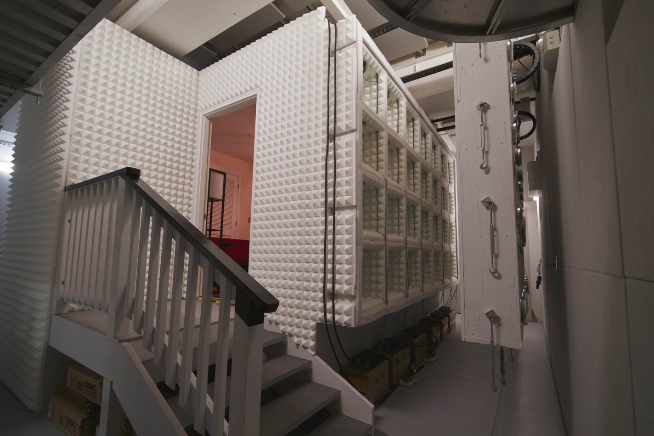

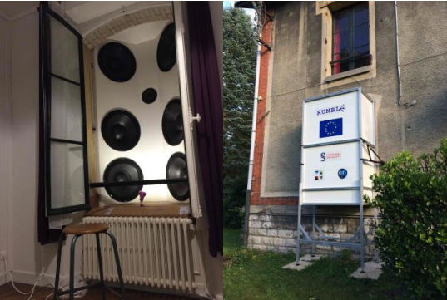
Sonic Boom Simulators: Indoor Environment
Typical NASA Psychoacoustic Test
Participants from surrounding community
  Diversity in age and gender
  Must pass hearing tests
Generally, 30-40 participants
  2-3 participants tested at a time
Familiarization and practice sounds
NASA
JAXA
X
X
Sorbonne
Notes:
Over the past decade, several indoor sonic boom simulators have been built. Designing an indoor sonic boom simulator is a challenge because replicating high energy, low frequency signals indoors requires specialized equipment and/or techniques. Shown here are some simulators constructed by NASA, JAXA, and Sorbonne University.
A typical test in an indoor simulator at NASA uses paid volunteers recruited from the local community. For each test, the pool of subjects should represent a range of ages and be balanced in terms of gender. All subjects must pass a hearing test. Test subjects are tested in groups of 2 or 3, and the total number of subjects is 30 – 40. Testing generally lasts an hour or less with one or more breaks. At the beginning, the subjects get a chance to listen to sample sounds and the practice using the input device prior to starting the actual test. Some example rating screens from previous tests are shown.

Slide 31
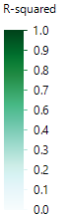
Acoustic Metrics for Noise Certification
Six candidate metrics for certification identified via meta-analysis of studies from different simulators
  All metrics highly correlated with one another
  A. Loubeau, et al. J. Acoustical Soc. Am., 144: 1706, 2018.
Growth of annoyance with acoustic metrics is similar regardless of aircraft size
  Confirmation that exterior Perceived Level (PL) can be used to describe indoor annoyance regardless of aircraft size
  A. Loubeau. J. Acoustical Soc. Am., 136(4): 2223, 2014.
D=Demonstrator
1=Business Jet
2=Small Airliner
3=Large Airliner
Notes:
One important function of psychoacoustic lab studies is to help identify acoustic metrics that best describe human response. Metrics are needed so that limits can be set and developed into standards for aircraft noise certification.
The plot on the top right shows results from a meta-analysis that helped downselect a large list of candidate metrics for supersonic signatures down to 6 metrics. All 6 metrics are highly correlated with one another and with human response. Downselecting to a single representative metric is challenging because human perception is complex and multifaceted.
Another useful result from a psychoacoustic lab study is shown in the lower plot. The results show that annoyance ratings for signatures from a demonstrator-sized supersonic aircraft are comparable to signatures from much larger supersonic aircraft. This result helps define the traceability of results from X-59 to future airliners.

Slide 32
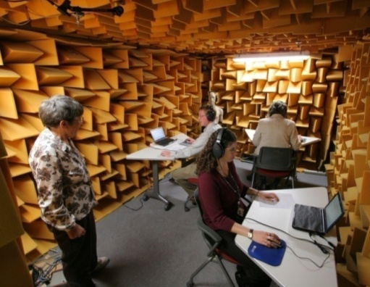

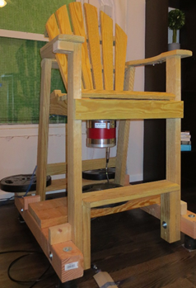
Rattle and Vibration Studies
Objective
  Explore result from community studies that rattle and vibration affect perception of sonic booms
Approach
  3 rattle studies using headphones with 40 binaural rattles
  2 rattle studies in IER to validate headphone study results
  2 vibration studies in IER using isolators on chair and shakers attached to seat
Key results & significance
  “Large” (windows, walls, doors) rattle sounds more annoying than small ones
  Rattle and vibration increase indoor annoyance (penalties of 3-10 dB)
Headphones
NASA Indoor
J. Rathsam, et al. J. Acoustical Soc. Am., 143(1): 489-499, 2018. (just one representative paper of several)
Shaker mounted
Notes:
The community noise literature shows that contact-induced rattle sounds and vibration are among the top contributors to indoor annoyance. A number of studies were conducted in the lab to quantify the effects of rattle and vibration. One finding was that rattle sounds emanating from large objects seemed to be more annoying than rattle sounds from smaller objects. Also, the presence of rattle and vibration tended to carry a penalty on the order of 3 – 10 dB. In other words, adding vibration and rattle make sounds as annoying as sounds 3 – 10 dB louder.

Slide 33
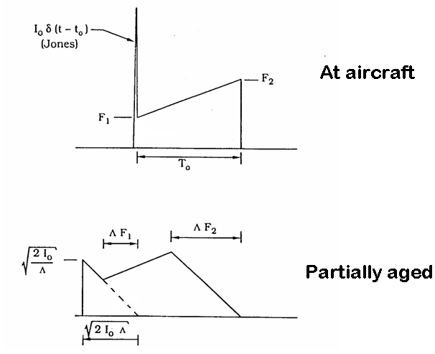
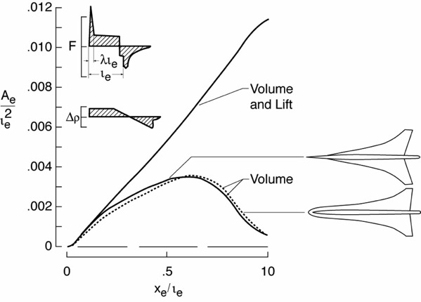
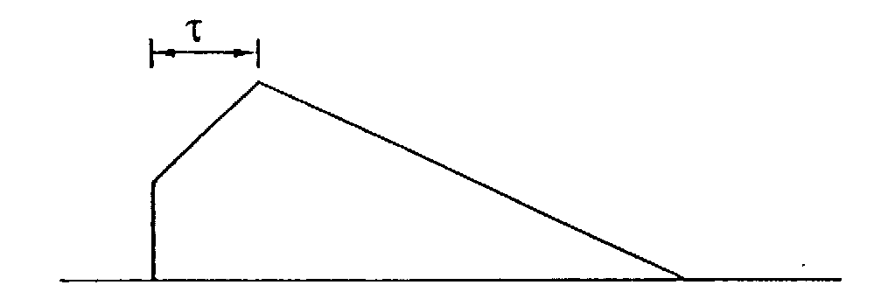
Minimum Bow Shock Solution
Concentrated load at nose (bluntness or canard) for Jones delta
Long and slender, highly swept wings, for isentropic expansion
Fully aged
A.R. George, AIAA J. 7(8) 1542-1545.
Notes:
The series of figures on the left show a sample F-function that ages to produce an optimum signature at the ground. On top, labeled “at the aircraft”, the F-function starts with a so-called “Jones delta” function, followed by a slope that is gentle enough not to steepen into a shock. As this signature ages on the way to the ground, the shock from the delta function and the gentle slope gradually tend to intersect, or match, at the point with the green arrow. The fully aged signature resembles the minimum shock boom from the previous slide. Increasing the delay between the start of the shock and the peak overpressure (this delay is known as the “rise time”) makes for a quieter signature, as we will see again later.
The figure on the right shows an example of an equivalent area distribution, including the F-function and ground signature. In simple terms, some concentrated load is needed at the nose to produce the Jones’s delta function. It could be a blunt nose or a canard for extra lift. The rear of the aircraft tends to be much more difficult. The biggest challenge is accommodating the engines and tails while still controlling the F-function.

Slide 34
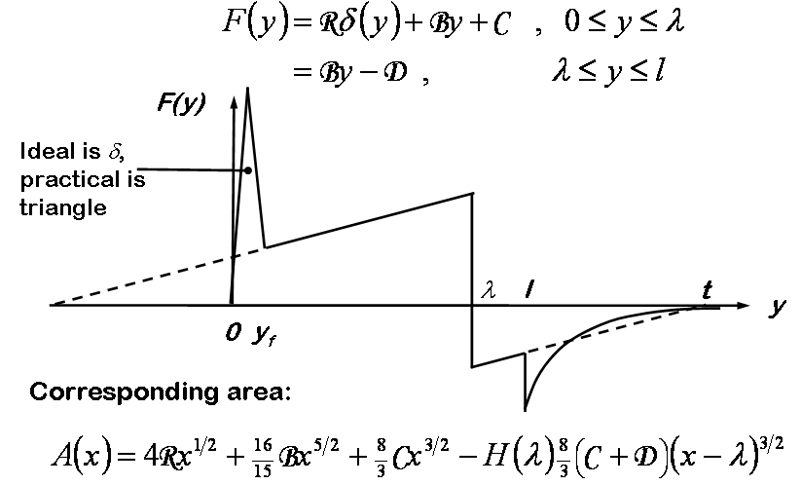
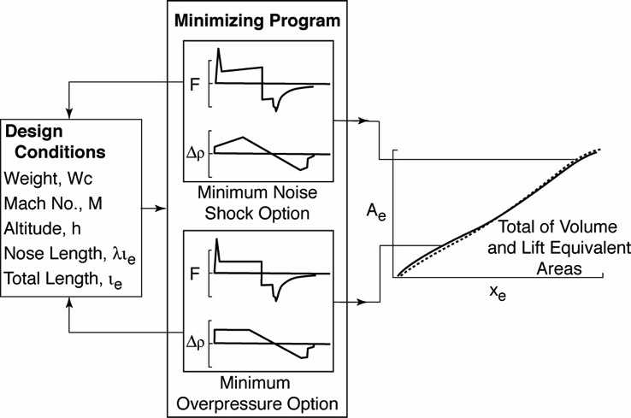
Full George-Seebass Solution
Concentrated load at nose (bluntness or canard) for Jones delta
Long and slender, highly swept wings, for isentropic expansion
A.R. George and A.R. Seebass, AIAA Journal, 9 (10), Oct. 1971.
C. Darden and R. Mack, AIAA-79-0652, 1979.
Notes:
The full optimum solution, developed by George and Seebass working together, does include the rear shock. The rear is more complicated because it inherits the flow from the forward part of the aircraft and must accommodate the wake associated with a finite vehicle in axisymmetric flow.
Using linear flow theory, this F-function is directly related to the equivalent area distribution. Back when aerodynamic design was done with linearized flow, this closed the design loop. Today, computational fluid dynamics (or CFD) is used for design, so the relation between the F-function and the configuration is not as explicit. So, the design process must iterate or use some type of local optimization scheme.

Slide 35
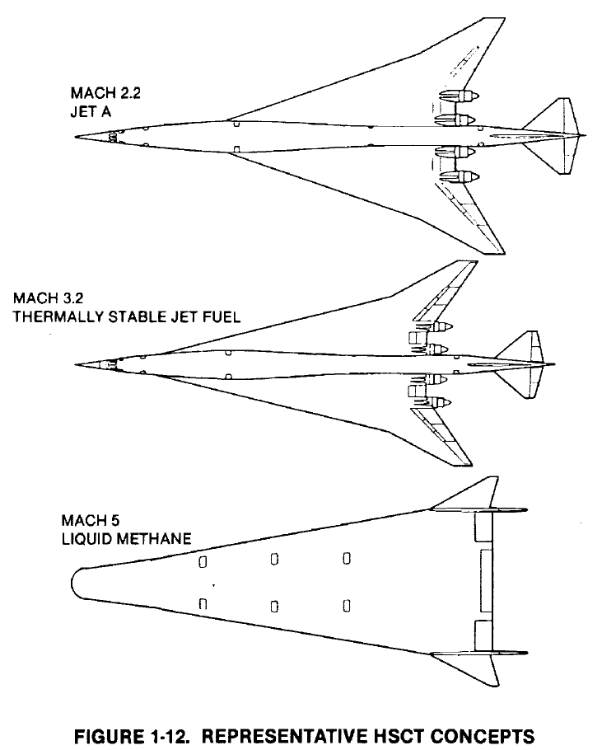
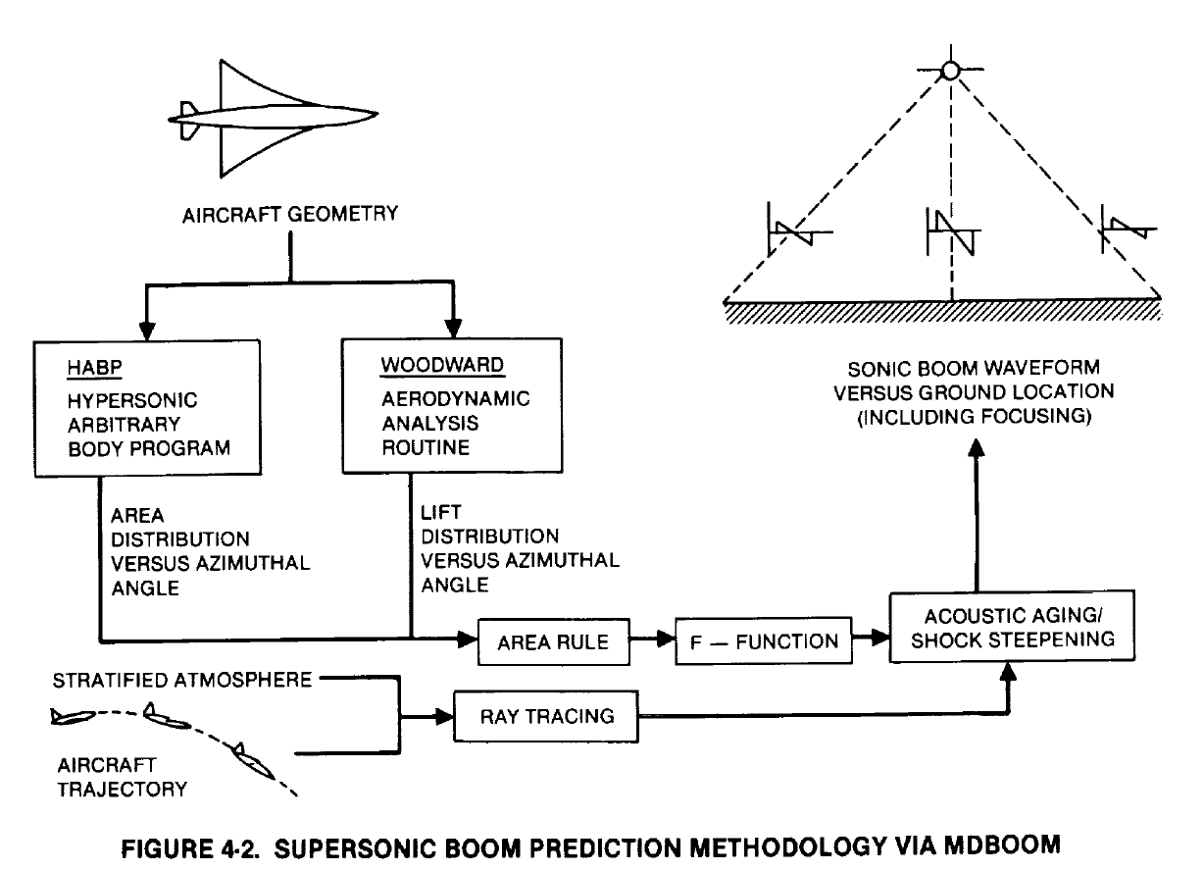
Sonic Boom Minimization and the HSCT Program
NASA High Speed Civil Transport Program
Early stages modeling used simple sonic boom area and lift modeling
Methods to incorporate CFD into sonic boom prediction were developed in the early 1990s.
Douglas Aircraft Company, NASA CR-4235, 1989.
Notes:
The NASA High Speed Civil Transport program leveraged the George-Sebass principles and began to explore low boom designs using equivalent areas. The output from the linear volume and lift design tools were combined into F-functions for sonic boom evaluation.

Slide 36
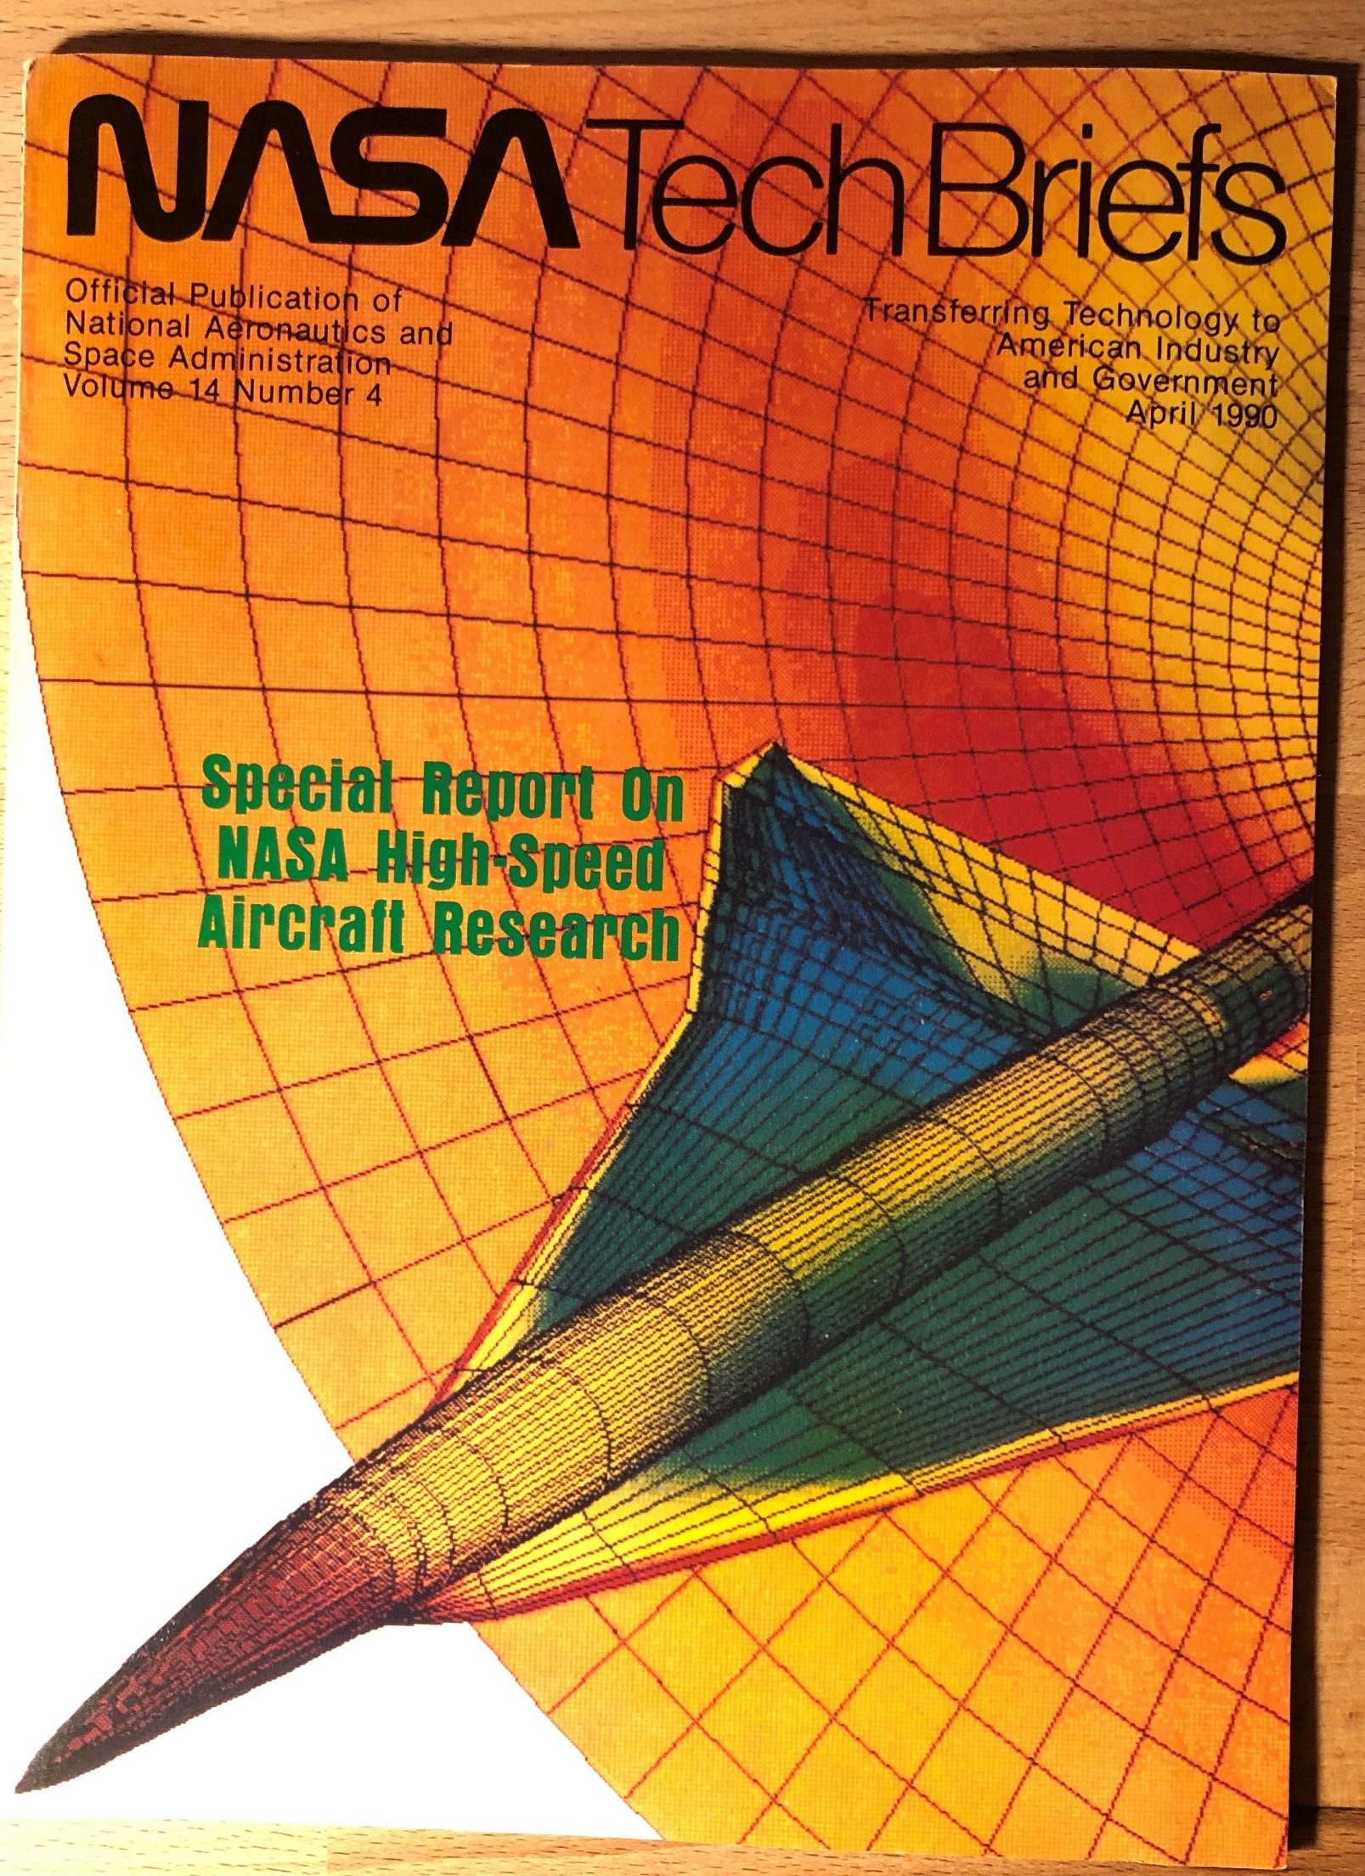
Incorporating Computational Fluid Dynamics (CFD)
Required off-body pressures
  Grid clustering and shock fitting schemes refined for sonic boom analysis
Was fueled in part by major CFD advancement due to supercomputer development and the National AeroSpace Plane (NASP) program
Early CFD analysis was conducted remotely on a Cray X-MP via
dial-up modem
NASA Tech Briefs, Vol. 14, No.4, April 1990.
J.A. Page and K.J. Plotkin, AIAA-91-3275, 1991.
Notes:
In the early 1990s, Computational Fluid Dynamics began to be incorporated into sonic boom prediction, as shown here. It looks archaic compared to today’s CFD, but it was a major advancement at the time. The early CFD results were very encouraging that low boom flight could be possible. There were also a lot of wind tunnel results that showed it would work. Of course, it had yet to be proven in flight in a real atmosphere.

Slide 37
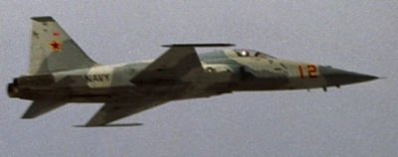
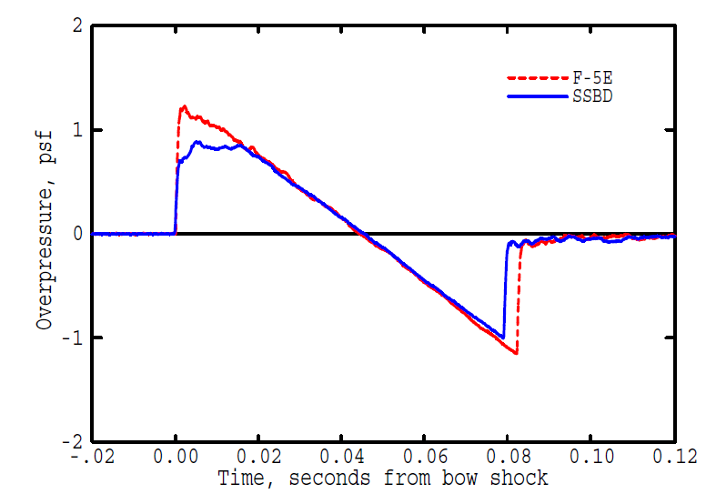
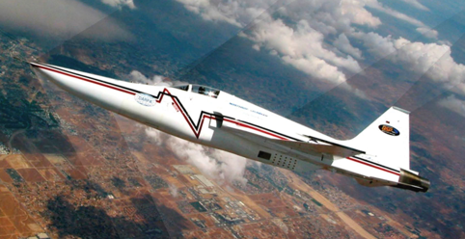
Sonic Boom Shaping Proven in Flight
SSBD Flat Top and F-5E N Wave Sonic Booms
August 27, 2003, 0645, Harper Lake, Mach 1.36, 32,000 Ft
SSBD and F-5E Signatures Recorded Back-to-back
F-5E
First Ever Shaped Sonic Boom
Shaped Sonic Boom Demonstrator (SSBD)
SSBD Flight 9
August 27, 2003
6:46:32.7602 PDT
NASA Dryden
BADS West
J. W. Pawlowski, et al. AIAA-2005-0005.
Notes:
Proof of sonic boom shaping theory in flight finally came in 2003. The program was initiated by the DARPA (Defense Advanced Research Projects Agency) and eventually joined by NASA. Using CFD for aircraft design, Northrop Grumman successfully redesigned the nose of an F-5 to create a flat top front half of the waveform. This was panel f of the family of optimum shaped signatures.
This wasn’t quiet supersonic overflight because the aft portion was still a loud shock. However, the real advance was proving that sonic boom shaping would persist as the signature traveled 6 miles from the airplane to the ground. It was a huge advance for low boom design, as well as for quiet supersonic flight.

Slide 38



New Approach to Target Signature Selection
Signature at 3 Body Lengths for Trijet 1/18/11
Extracted from 1.0 BL
Extracted from 0.5 BL
Li, et al. J. Aircraft 48(4), 2011.
Morgenstern, et al. NASA CR 2013-217820, 2013.
Notes:
Since 2003, a wealth of research has been done to figure out the best target signature, which includes accounting for what happens off-track, or at sideline angles not directly below the aircraft. Design processes that incorporate 3D aircraft shaping and more analytically intensive computational techniques have advanced rapidly. They include sonic boom propagation to the ground within the design loop, including details physics of sound propagation including molecular relaxation. Also, more sophisticated acoustic metrics have been added to the optimization schemes such as Stevens Mark VII Perceived Level, which we’ll return to in the second part of this talk.

Slide 39


Improved CFD and Design Processes
Advances in Computational Methods and Technology have facilitated optimization of low-boom designs
Adaptive Gridding
Magee, et al. NASA CR 2013-217797, 2013
dL/dn
Optimum
Adjoint Solutions
Optimum
Baseline
Li, AIAA-2015-2581, 2015.
Notes:
The CFD design process has also advanced considerably, including the development of low boom adjoint solutions and optimization tools which consider full 3D flow field around the aircraft, not just the simple equivalent area techniques that were used in the early days.
So the research showed that aircraft designs were getting quieter in supersonic flight. The key missing piece was whether an integrated quiet supersonic airliner design was feasible: an airplane quiet not only during cruise, but quiet during take-off and met all of design constraints required for actual airline operations.

Slide 40


Is a quiet supersonic airliner feasible?
Analysis vs Test
Technology, tool and design approach improvements in the early 2000s
Key missing piece: Is an integrated quiet supersonic airliner feasible?
NASA sponsored system design studies
  Consider all design aspects for a small supersonic airliner, but with quiet cruise
  Improve other environmental impact (LTO noise and high-altitude emissions) and efficiency
  Validate boom mitigation through wind tunnel test
Test Uncertainty
Notes:
In early 2010s NASA sponsored system design studies asking partners to design a quiet supersonic aircraft considering all aspects of a successful design. The challenge was to make aircraft quieter during supersonic cruise, but also improve other environmental impacts like landing and takeoff noise, high altitude emission, and efficiency as well.
This slide shows the successful validation of boom mitigation through wind tunnel testing. The figure at the top right shows the analysis of a configuration prior to test compared to the wind tunnel test results. The y-axis shows pressure and the x-axis shows distance for the CFD grid or pressure sensors.
Not only did the wind tunnel measurements match predictions very well and show that the design would produce a quiet signature, but also showed that test results were quite consistent and repeatable. The photo shows the model in the wind tunnel at NASA’s Ames Research Center including the blade rail of pressure sensors.

Slide 41


Validated approaches to integrated low boom design
Breakthrough Knowledge Advancement
Methodologies for the development of aircraft with shaped sonic boom signatures, particularly in the aft end of the vehicle where complex interaction between lift and volume effects takes place, have been applied to integrated systems level designs and validated through wind tunnel testing. Low boom targets have been met for small airliner type aircraft; but methods are applicable to larger and smaller vehicles.
Notes:
These system level studies represented a breakthrough in supersonic design. Methods had finally been developed to enable the design of aircraft with quiet supersonic cruise signatures, particularly at aft end of configuration where you have a complex interaction of various features that make the design challenging.
The tools had been applied in an integrated fashion, so you had designs that were quiet but also well-rounded: they performed a nominal supersonic airliner mission in terms of low boom targets, while landing and takeoff noise targets as well as emissions targets were all shown to be within reach. Furthermore, the methods were shown to apply to larger and smaller vehicles as well.
The next logical step was to evaluate the new design technology in flight.
Before we get to the Low Boom Flight Demonstration, let’s first discuss what is known about human response to sonic booms.

Slide 42



What is a sonic boom?
D.J. Maglieri, et al. NASA-SP-2014-622.
Notes:
A sonic boom is the sound of a shock wave, or pressure disturbance, created when an object travels faster than the speed of sound. Sonic booms are typically caused by supersonic aircraft, but occur from meteors or spacecraft as they enter earth’s atmosphere, falling rocket boosters, supersonic bullets and missiles, and even bullwhips.
As shown in the top left diagram, when an aircraft flies faster than the speed of sound, it creates a pressure disturbance that emanates in all directions. The most important thing to remember is that sonic booms move with the aircraft like the wake from a boat for as long as the aircraft is flying supersonically.
The plot on the right shows the pressure-time history of the disturbance at various stages between the aircraft and the ground. A pressure-time history is something you would measure with a microphone. Close to the aircraft, in the Near field, the disturbance is related to the shape and aerodynamic loads of the aircraft. In the Far field, the disturbance has evolved into a classical N-wave, named because the weaveform looks like the letter ‘N’.
The waveform evolution process is also shown in the lower left, this time for a shape much simpler than a real aircraft. It separates very neatly into three components:
Curve 1, the highest curve, shows the near field pressure. It is usually represented in a normalized form called the F-function.
Curve 2, the lower curve on the right, is the mid field pressure. It is generally modeled via ray tracing using geometrical acoustics
Curve 3, the curve with components to the left of 0, is the far field pressure where shocks have formed at the front and back via “Whitham’s rule.” The shocks are the vertical legs of the letter “N”.
Between Curve 2 and Curve 3, the waveform goes through a process called “nonlinear steepening” because the higher amplitude components travel faster than the lower amplitude components. The result is that the positive and negative peaks of the waveform slant and a shock forms wherever the pressure would be “double-valued” since that is not physically realizable.
The steepening process is key to quieting a sonic boom…

