Slide 1
Tribology Induced Water Pump Bearing Failure
Dr. Christopher DellaCorte
University of Akron
Department of Mechanical Engineering
And
Dr. S. Adam Howard
NASA Glenn Research Center

Slide 2
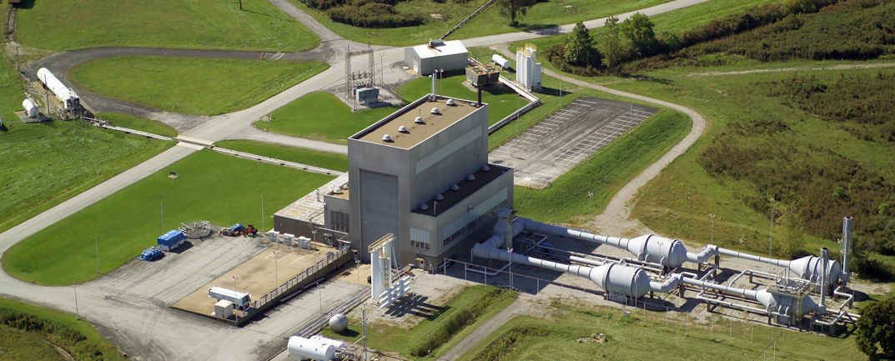
Facility Background-NASA Arnold Test Facility

Slide 3
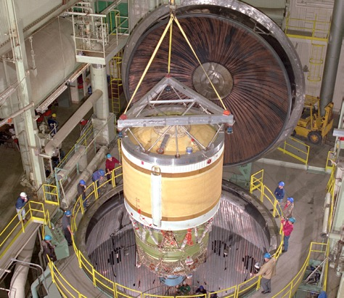
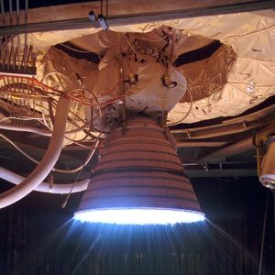
Inside: Big, Deep Chamber where Rockets are:
Installed
Fired in Vacuum
Creates a space like test environment on the ground.

Slide 4
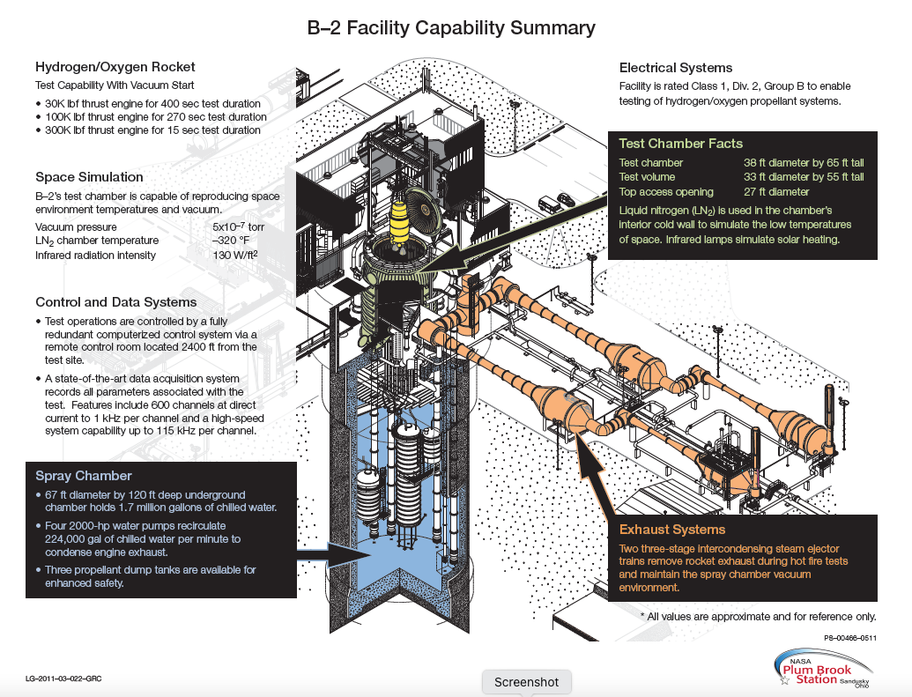
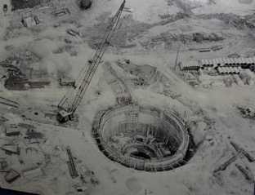
Large and Unique Space Test Facility: Built in the Apollo era
1960’s Construction of concrete water chamber. 40 meters into the earth

Slide 5
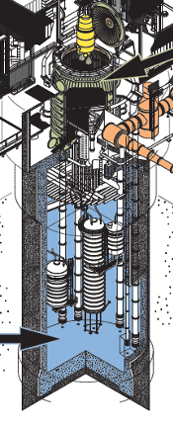
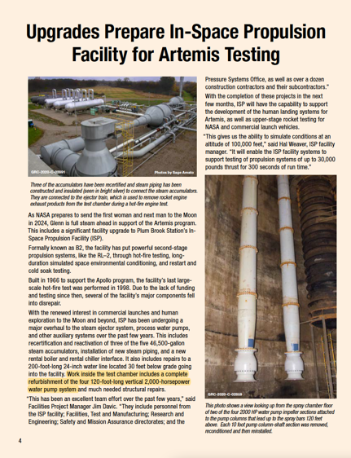
General Operation Statistics and Current Status
Rocket exhaust expelled into the cooling chamber, 67 ft in diameter by 120 ft deep, located immediately below the vacuum chamber containing 1.75 million gallons of chilled water.
Four 2000hp vertical turbine water pumps team with three smaller 1000 hp pumps to feed 250,000 gallons of water per minute to a water spray system that cools rocket exhaust gases.
Steam ejector pump (outside facility at ground level) maintains vacuum in the chamber during rocket engine firing.
2000 hp water pumps

Slide 6
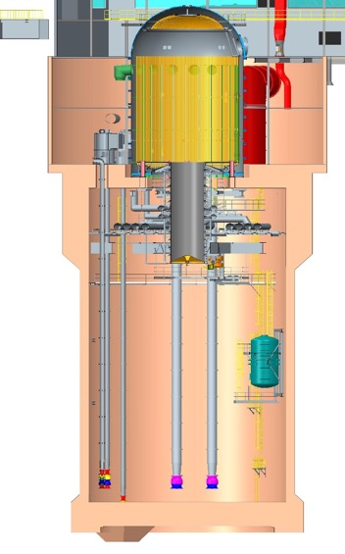
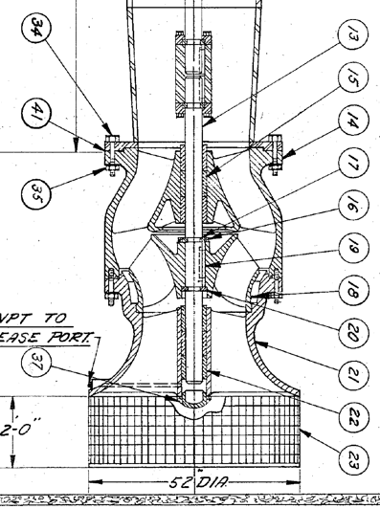
Facility Cross Section
2000hp Pump: bowl close-up
Drive Shaft Coupling
Stainless Steel Shaft (4-inch OD)
Bronze Bearings (bushings)
Pump Impellor
~65 meters
~4 meters

Slide 7
Failure and Investigation Timeline:
2017-2019: All four 2000hp pumps removed and completely refurbished (new bearings, shafts, coatings, etc.).
Fall 2019: Pumping test conducted. Initially, two pumps (#1 & 2) were started and run for ten-minutes to demonstrate stable operation. Then the other two pumps (#3 & 4) were also started.
#3 pump showed increased motor current after one minute, then a drop in current and complete loss of water output flow despite continued motor rotation. #4 pump was shut down after 90 seconds as a precaution.
Later, it was discovered that #4 pump shaft was locked and could not be turned by hand (using the standard long lever arm).
Inspection of pump #3 revealed a broken shaft.
Tribology & Rotating Machinery SME was called in to investigate (January 2020).

Slide 8
2000hp Pump #3: Location of shaft failure
Drive Shaft Coupling
Stainless Steel Shaft (4-inch OD)
Location of Shaft Failure
Bronze Bearings (bushings)
Pump Impellor

Slide 9

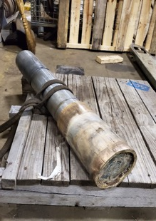
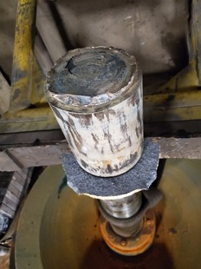
Pump #3: Broken shaft
Upper Shaft Segment
Lower Shaft Segment
Location of Shaft Failure
Seized Bearings
Bearing retention lip (broken shard)
Pump Impellor
Bearings: Parameters
Shaft: 4-inch (100mm) diameter, 416 stainless steel (ductile and strong).
Bearings: 18” (~0.5m) long, Cast bronze, 0.005” (0.2mm) clearance.
Lubrication/Cooling: Natural aspiration of process fluid (water).

Slide 10
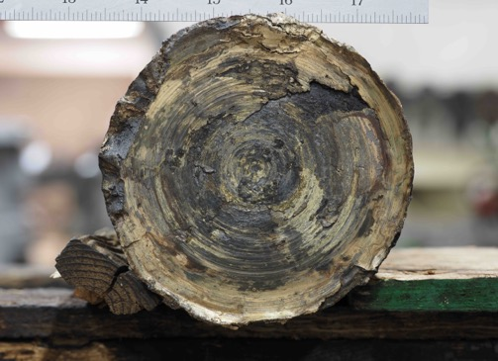
Forensic Inspection: Bearings and Shaft Surfaces
Observations:
Deep scoring indicative of sliding contact.
Evidence of complete melting near shaft break
Despite being submerged in water, failure area was very hot.
Observations:
Flat (not angular failure) failure surface rules out shaft cracking as root cause.
Melted bronze and sheared steel shaft indicates high local temps(+1700ºF)
Consistent with thermal seizure and shear overload.

Slide 11
Investigation Scenario Development: How did the bearing get so hot and why?
Vertical shaft machine, axial flow turbine which produces large flow but near zero-pressure rise: virtually zero radial loads on bearings.
All shafting and rotating components are balanced.
All axial loads are carried by oil-lubed thrust bearings located “topside” in drive motors.
Bearings were machined carefully (and inspected) as part of refurbishment process.
Pump rebuild company is highly experienced but indicates that such “infant mortality” failures do happen.
Two of the four pumps ran fine.
Chamber environment is cold, wet, dirty and rusty.
#4 pump was locked but the shaft was not broken into two pieces.
#4 pump bearing-shaft assembly was carefully removed by internal machining to preserve bearing contact surfaces.

Slide 12
Common Lore: Pumps were good-debris in chamber ruined them
Vertical shaft machine, axial flow turbine which produces large flow but near zero-pressure rise: virtually zero radial loads on bearings.
All shafting and rotating components are balanced.
All axial loads are carried by oil-lubed thrust bearings located “topside” in drive motors.
Bearings were machined carefully (and inspected) as part of refurbishment process.
Pump rebuild company is highly experienced but indicates that such “infant mortality” failures do happen.
Two of the four pumps ran fine.
Chamber environment is cold, wet, dirty and rusty.
#4 pump was locked but the shaft was not broken into two pieces.
#4 pump bearing-shaft assembly was carefully removed by internal machining to preserve bearing contact surfaces.
Myth Busting: Did dirt in the chamber ruin perfectly good pump bearings?

Slide 13
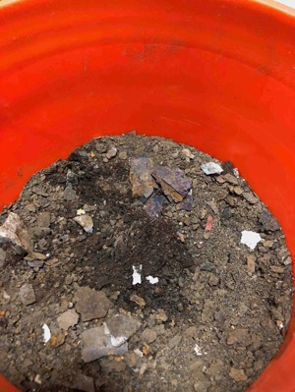
Forensic Inspection: Evidence(?) dirt in chamber
Tons of dirt on chamber floor
~65 meters
Common thinking:
Corrosive wet environment led to a very dirty chamber floor just above pump inlets.
Lore accepted as fact: Debris clogged bearings and led to failure.

Slide 14

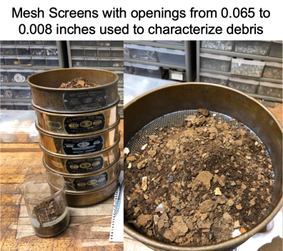
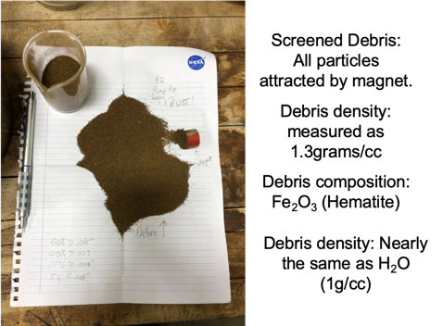
Forensic Inspection: ”Dirt” found to be rust
Common thinking: WRONG!
Dirt found to be nearly pure rust, 30% denser than water.
Centrifugal water motion pushes dense rust particles to pump periphery, away from bearings (located at center).
Pump design actually prevents heavy dirt from entering bearing.
Conversely, air bubbles in water preferentially directed towards bearings.

Slide 15
Forensic Inspection: Pump #4-Seized Shaft
Observations:
Deep scoring indicative of sliding contact.
Evidence of complete melting near shaft break
Despite being submerged in water, failure area was very hot.
Observations:
Flat (not angular failure) failure surface rules out shaft cracking as root cause.
Melted bronze and sheared steel shaft indicates high local temps(+1700ºF)
Consistent with thermal seizure and shear overload.

Slide 16
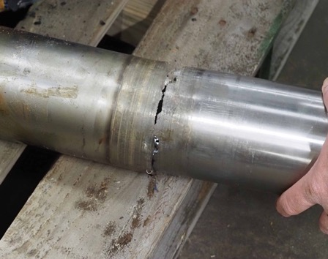
Forensic Inspection: Pump #4-Seized Shaft
Note: cut shaft due to forensic testing, not part of pump failure
Observations:
Shaft seized in bearing but not broken
Circumferential score marks only in lower (left) section
Debris absent from bearing and bearing inlet
Consistent with thermal runaway
Early stage of complete seizure and shaft shear failure

Slide 17
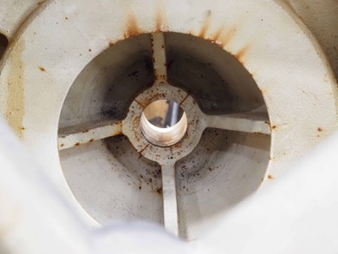
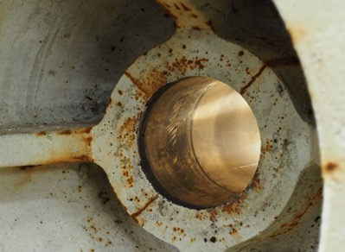
Pump #4: bearing housing-viewed from below
Note: Cracks in cast bearing housing
Note: Rubbing only on lower bearing section
Observations:
Circumferential rub area extends only as far up as hollow casting cavity
Stress cracks between spars
Consistent with thermal runaway and seizure

Slide 18
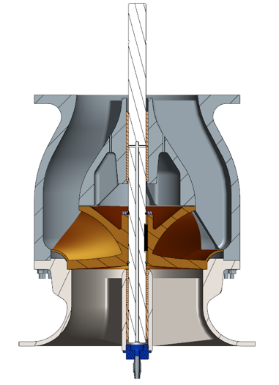
Pump #4: bearing housing-compare to cross section
Note: Housing cracks and rub extent are at same vertical location as casting cavity
Observations:
Alignment of rub extent, housing cracks with cavity in housing is no coincidence.
Housing cavity likely traps air inhibiting good cooling.

Slide 19

Pump #3 & 4: Failure Scenario
Bearing gets warm, expands and pinches shaft
Hollow cavity
(traps air)
Failure Path:
Air pocket resides in hollow cavity-hinders housing cooling
Normal shear friction heats bearing
Inadequate water flow (blocked by grease)
Bearing expands into the shaft until clearance is zero
Rubbing contact leads to thermal runaway and shaft failure

Slide 20
Recovery Path: Improved Bearing Cooling
New vent holes allow trapped air to escape
New forced water cooling system added
Primary steps:
Positive bearing cooling flow, not normal aspiration
Drill vent holes to eliminate trapped air in cavity to assure water-metal contact
Minimize or eliminate debris and air ingestion into bearings

Slide 21
Summary Remarks:
Though accepted as common lore, the debris filled environment was not the cause of bearing failure.
Sporadic operations and challenging location inhibited earlier diagnosis of root cause leading to repeated and costly failures.
Careful disassembly of seized pump revealed true failure mode.
Pump bearings failed by thermal seizure despite operating under submerged conditions.
Reliance on natural aspiration of bearing cooling flow was the primary contributing factor to the failures.
The use of heavy grease lubrication as an assembly lubricant likely exacerbated the lack of cooling water flow.
Recovery included the installation of a forced cooling water system and the drilling of vent holes to remove trapped (insulating) air pockets.
The facility water pumps are now ready for the next half century of service!

