Slide 1
Experiment Design and Visualization Techniques for an X-59 Low-boom Variability Study
Will Doebler, Sara Wilson, and Alexandra Loubeau
NASA Langley Research Center
DATAWorks
Session 5B: DOE Applications
April 28, 2022
Notes:
Abstract: This presentation outlines the design of experiments approach and data visualization techniques for a simulation study of sonic booms from NASA’s X-59 supersonic aircraft. The X-59 will soon be flown over communities across the contiguous USA as it produces a low-loudness sonic boom, or low-boom. Survey data on human perception of low-booms will be collected to support development of potential future commercial supersonic aircraft noise regulatory standards.
The macroscopic atmosphere plays a critical role in the loudness of sonic booms. The extensive sonic boom simulation study presented herein was completed to assess climatological, geographical, and seasonal effects on the variability of the X-59’s low-boom loudness and noise exposure region size in order to inform X-59 community test planning. The loudness and extent of the noise exposure region make up the “sonic boom carpet.” Two spatial and temporal resolutions of atmospheric input data to the simulation were investigated. A Fast Flexible Space-Filling Design was used to select the locations across the USA for the two spatial resolutions. Analysis of simulated X-59 low-boom loudness data within a regional subset of the northeast USA was completed using a bootstrap forest to determine the final spatial and temporal resolution of the countrywide simulation study. Atmospheric profiles from NOAA’s Climate Forecast System Version 2 database were used to generate over one million simulated X-59 carpets at the final selected 138 locations across the USA.
Effects of aircraft heading, season, geography, and climate zone on low-boom levels and noise exposure region size were analyzed. Models were developed to estimate loudness metrics throughout the USA for X-59 supersonic cruise overflight, and results were visualized on maps to show geographical and seasonal trends. These results inform regulators and mission planners on expected variations in boom levels and carpet extent from atmospheric variations. Understanding potential carpet variability is important when planning community noise surveys using the X-59.

Slide 2
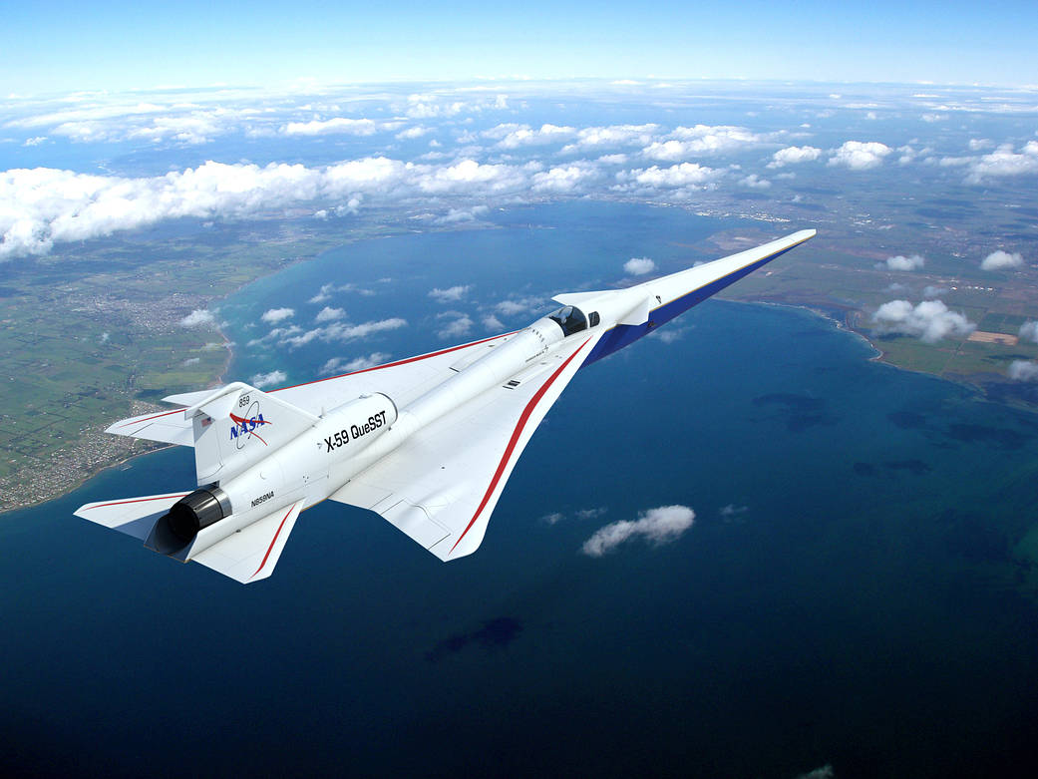

Presentation Overview
Sonic Boom Background Info
X-59 Mission
Outline of the Sonic Boom Simulation Goals
DoE Approach
for X-59 Sonic Boom Simulation
Simulation Results and Visualizations
Notes:
I will first give some background info on sonic booms, then outline the X-59 low-boom flight demonstration mission. Next I’ll be presenting goals and experiment design of a sonic boom simulation study to assess loudness and variability at locations across the USA. Finally I will present our key results and visualization techniques for presenting summary details about large amounts of simulated data.

Slide 3
Presentation Overview
Sonic Boom Background Info
X-59 Mission
Outline of the Sonic Boom Simulation Goals
DoE Approach
for X-59 Sonic Boom Simulation
Simulation Results and Visualizations

Slide 4
Brief and abbreviated history of civilian supersonic flight
1947 Yaeger breaks the sound barrier in the X-1
1964 “Operation Bongo II” in Oklahoma City
1973 FAA Prohibits Civilian Supersonic Flight Over Land
1976 Concorde Supersonic Over Water Routes
2003 Concorde Retires
2005 Shaped Sonic Boom Demonstrator
2020 FAA Notice of Proposed Rulemaking Regarding Supersonic Flight
2024 X-59 Low-boom Community Noise Surveys
Notes:
Here is a very abbreviated summary of some highlights regarding civilian supersonic transportation. In 1947, the sound barrier was first broken by Chuck Yaeger. Supersonic aircraft were rapidly developed thereafter. The entire time an aircraft is flying faster than the speed of sound it produces a sonic boom, which can be heard on the ground. There were sonic boom community noise tests in the 1960s, one of which was conducted over Oklahoma City and coined “Operation Bongo”. The city was subject to over 1,200 sonic booms over six months with up to 8 booms per day. Members of the communities were asked to report their annoyance to the booms. Many reported disruption and annoyance from the booms. By 1973, the FAA finalized a prohibition of civilian supersonic flight over land in part due to the annoyance from sonic boom noise. However, supersonic flight over-water routes were still acceptable, which is what Concorde did to serve the US market.
Despite the prohibition there will likely always be some demand for high speed transportation for example to conduct cross-country in person meetings or to extend the range of organ transplants. And in the meantime, there were key developments in reducing the loudness of sonic booms. One such advancement was in 2005 with the NASA/DARPA Shaped Sonic Boom Demonstrator program. This experiment proved that an aircraft shape could be modified to change the character of a sonic boom and reduce its loudness. More recently, the FAA was charged by Congress to re-evaluate the supersonic prohibition in light of such advancements. The main focus of this presentation is on NASA’s X-59 aircraft, which is designed to have low loudness sonic boom or low-boom. It will be used to collect community noise survey data to assess how residents of communities across the US perceive low-loudness sonic booms. This data will be provided to the FAA and the ICAO to aid in the creation of potential future supersonic aircraft noise standards.
https://www.faa.gov/newsroom/supersonic-flight
https://www.norc.org/PDFs/publications/NORCRpt_87.pdf
https://www.norc.org/PDFs/publications/NORCRpt_101.pdf

Slide 5
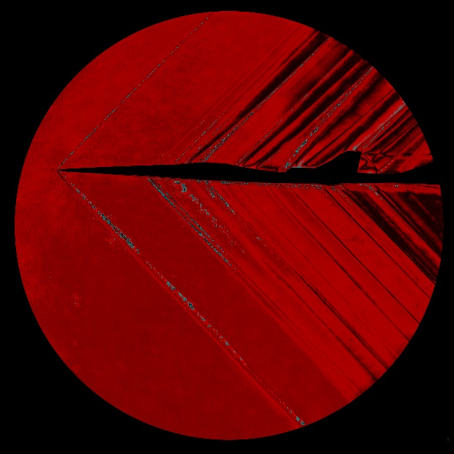
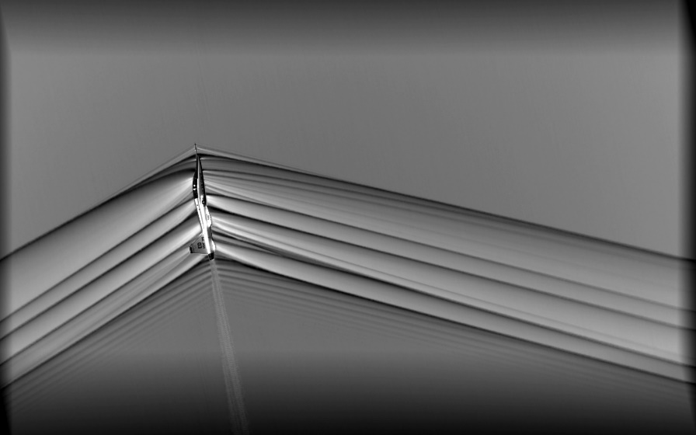
Traditional N-wave Sonic Booms and Shaped Low-Booms
Traditional
Low-boom
Shocks near the aircraft merge together to form an “N-wave” with strong bow and tail shocks
Clever aircraft shaping prevents shocks from merging, which significantly reduces the loudness
Sound arrives at the ground
Bang!
Thump
Bang!
Thump
Pressure
Pressure
Time
Time
Notes:
What is the difference between a traditional sonic boom and a low-loudness sonic boom? The images show the pressure disturbances near a traditional aircraft on the left and a shaped aircraft on the right. As the pressure disturbance moves through the atmosphere, the traditional aircraft’s shocks merge forming strong shocks at the front and rear of the pressure signature, which the human ear perceives as a pair of loud bangs. For a low-boom aircraft, the shocks do not merge, and the waveform increases in pressure more smoothly. This results in supersonic capabilities with a greatly reduced noise level.
Images
https://www.nasa.gov/centers/armstrong/features/shock_and_awesome.html
https://www.nasa.gov/image-feature/x-59-wind-tunnel-testing-at-nasa-glenn

Slide 6
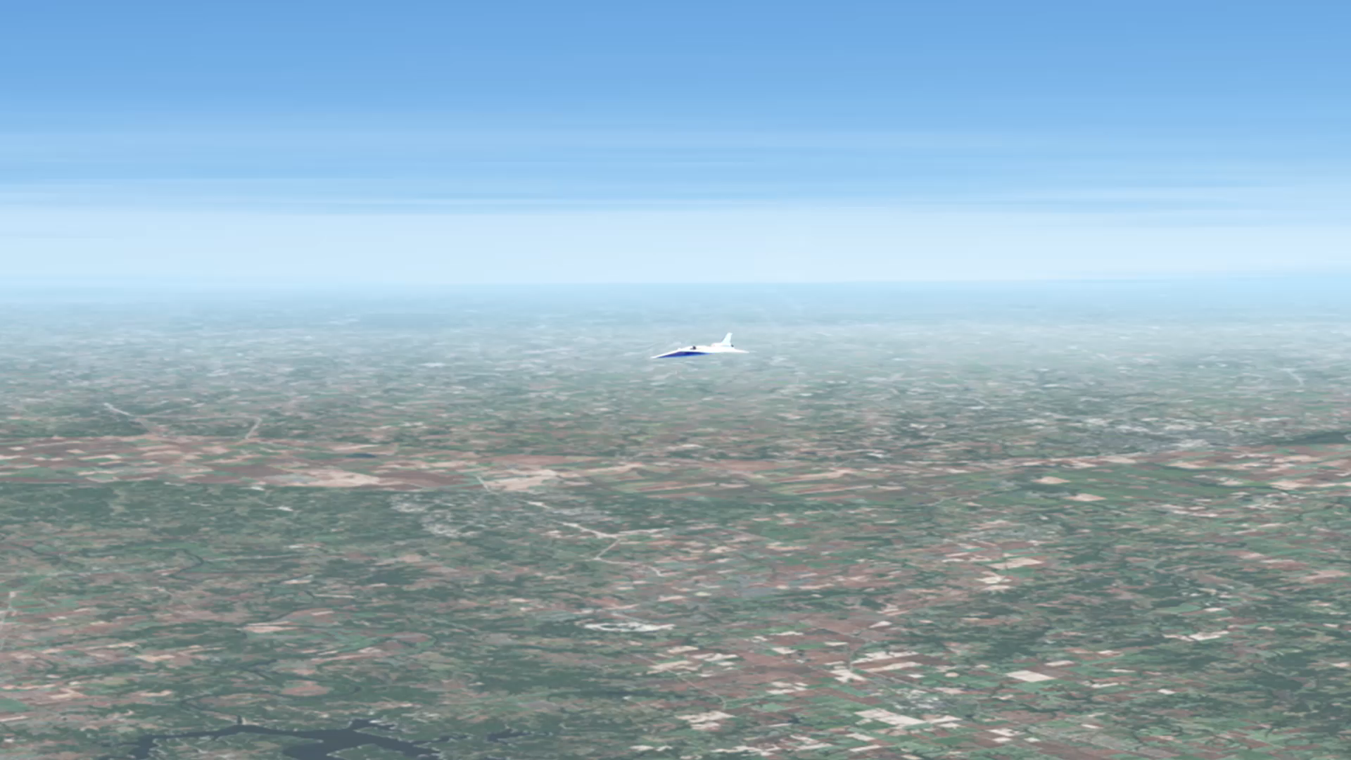
Sonic Boom Exposure Region Size
Notes:
As the aircraft flies supersonic it is dragging a “carpet” of sound behind it that can be 20 to 50 miles wide depending on the altitude and the weather of the day. With flight paths that can be thousands of miles long creating a noise that can be heard across 50 miles can potentially affect a lot more people than subsonic aircraft whose noise is generally localized near airports.
The loudness of the X-59 sonic boom and the size of the exposure region are topics of interest for this presentation as they can change due to the weather of the day.

Slide 7
Presentation Overview
Sonic Boom Background Info
X-59 Mission
Outline of the Sonic Boom Simulation Goals
DoE Approach
for X-59 Sonic Boom Simulation
Simulation Results and Visualizations
Notes:
Next we will talk more about X-59’s mission

Slide 8

X-59 Mission Introduction
Low-boom Community Noise Survey Tests to start in 2024
  Four to six community tests are being planned
    X-59 will fly supersonic over a community creating a low-boom of a prescribed loudness chosen by experimental design
    Noise monitors will record the low-booms
    Survey participants will report their annoyance
  Boom level vs. annoyance data (dose-response curves) will be provided to
    International Civil Aviation Organization (ICAO)
    US Federal Aviation Administration (FAA)
    for consideration in noise certification standards
How will the X-59 noise exposure region size and loudness change across the US due to prevailing atmospheric conditions?
  Simulation study was conducted to aid in planning community tests
X-59 QueSST
Quiet SuperSonic Technology Demonstrator
Mach 1.4 at 53,200 ft
Low-boom Perceived Level (PL): 75 dB
Notes:
The X-59 is currently being built. It is designed to fly at Mach 1.4 and produce a low-loudness sonic boom measuring about 75 decibels on the Perceived Level scale, which is different than other decibel scales in that it correlates to human perception of impulsive noise. The aircraft will be flown over 4 to 6 communities across the US to collect perceptual data from community residents. Noise monitors will measure the loudness of the low-booms, and members of the communities will be recruited to respond to surveys describing their perception of the low-booms. The perceptual data will be provided to the ICAO and FAA to aid in potential future aircraft noise certification standards.

Slide 9
Presentation Overview
Sonic Boom Background Info
X-59 Mission
Outline of the Sonic Boom Simulation Goals
DoE Approach
for X-59 Sonic Boom Simulation
Simulation Results and Visualizations
Notes:
Next I’ll outline the simulation study that we undertook to understand the X-59’s sonic boom loudness variability

Slide 10
Goals of Sonic Boom Propagation Simulation
Assess nationwide X-59 low-boom
  Loudness and variability
  Exposure region size and variability
due to:
  Climate
  Season
  Flight direction
  Time of day
  Geographical location
  Ground elevation
balancing:
  Computational constraints
  Project schedule
Aircraft Trajectory Information
Computational Fluid Dynamics Acoustic Data
Atmospheric Model Data
PCBoom
Acoustic Propagation Model
Size of the region exposed to noise
Low-boom Loudness
Notes:
For this work, we set up a large acoustic propagation simulation. The goal of the simulation was to understand the X-59’s low-boom loudness, the variability in loudness, the exposure region size, and the variability in exposure region size. The data form the simulation would aid in X-59 community test planning, and also make sure that the X-59’s low-boom would stay quiet in non-standard atmospheric profiles
The factors of interest driving the variability were climate, season, flight direction, time of day, location, and ground elevation. Most of these can be purposefully chosen when planning when, where, and how to fly the X-59.
Some of our constraints were on computation time and meeting project schedule goals.
The flow diagram of the basic simulation is shown on the right. We provide our PCBoom acoustic propagation model with information about the aircraft trajectory, the sound pressure near the aircraft, and a large set of atmospheric profiles that include pressure, temperature, winds, and humidity. The output of the PCBoom model is a large set of sonic boom waveforms, their loudness, and the size of the noise exposure region.

Slide 11
Presentation Overview
Sonic Boom Background Info
X-59 Mission
Outline of the Sonic Boom Simulation Goals
DoE Approach
for X-59 Sonic Boom Simulation
Simulation Results and Visualizations
Notes:
Next I’ll give more information about how we set up the design of the simulation.

Slide 12
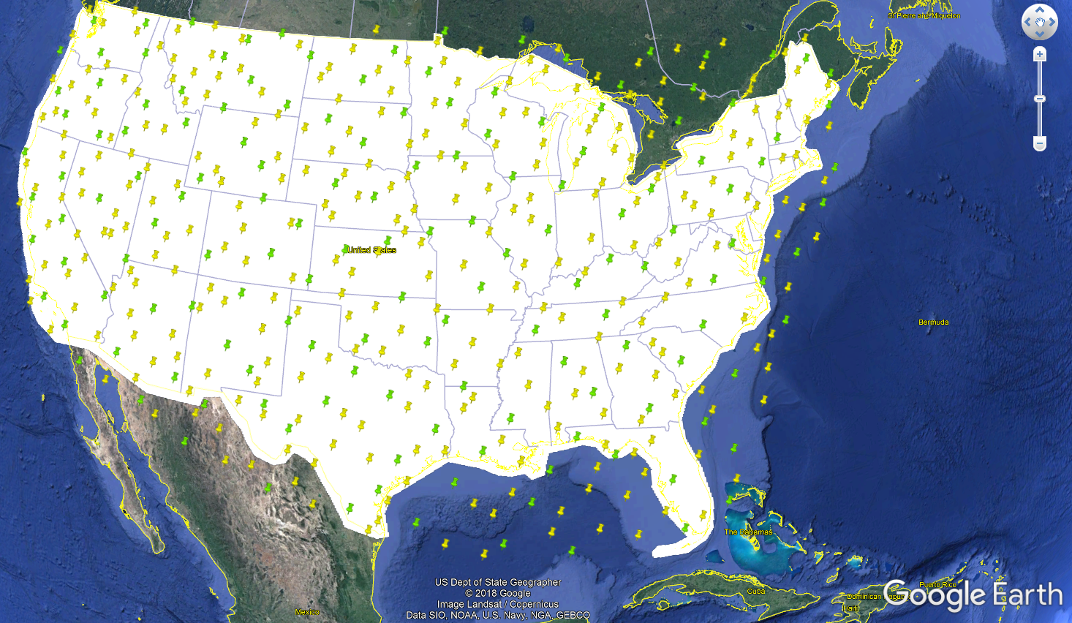
Design of Experiments Approach
Need to determine appropriate locations and times of atmospheric profiles
through which to propagate
Locations across USA chosen using Fast Flexible Filling Design
  Provides good space filling properties and can accommodate irregular shapes like the contiguous USA
Two spatial resolutions:
  150 and 450 locations across USA
Lekivetz, R. and Jones, B., (2015) “Fast Flexible Space-Filling Designs for Nonrectangular Regions,” Qual. Reliab. Engng. Int., 31(5), 829-837
Notes:
We needed to determine the locations at which to propagation the X-59’s low boom that would span the USA. We used a Fast Flexible Space filling design to choose locations at two spatial resolutions. The green points are the coarse resolution, and the green and yellow points together are the fine resolution.

Slide 13
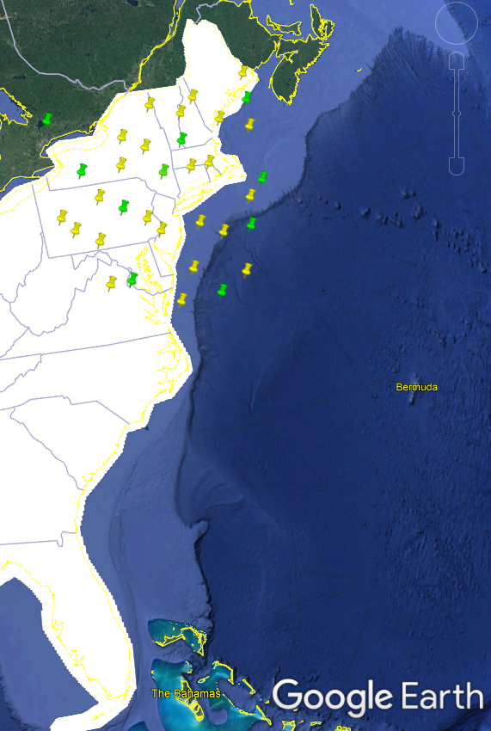
Subset analysis to determine simulation resolution
Completed propagation simulation for subset of locations in the Northeast
Compared results of designs with higher and lower spatial and temporal resolutions
  34 vs. 10 locations in Northeast
  4 vs. 1 atmospheric profiles per day
5 years of atmospheric profiles, 4 aircraft headings
Subset storage size
  About 1.5 TB total for nearly 1 million carpets
Notes:
We did not have the computational resources to conduct the analysis on the entire fine resolution, so we chose a subset in the northeast US. The northeast was chosen because it will have some seasonal variability and PA is predicted to be one of the most heavily overflown states by supersonic aircraft due to its proximity to NYC, Boston, and Philadelphia for example.
We propagated the X-59 sonic boom through 5 years of atmospheric profiles collected 4 times per day, and compared the coarse and fine spatial resolutions. We also compared the results for 4 atmospheric profiles per day to one atmospheric profile per day.
The resulting waveforms took up a substantial amount of storage space.

Slide 14
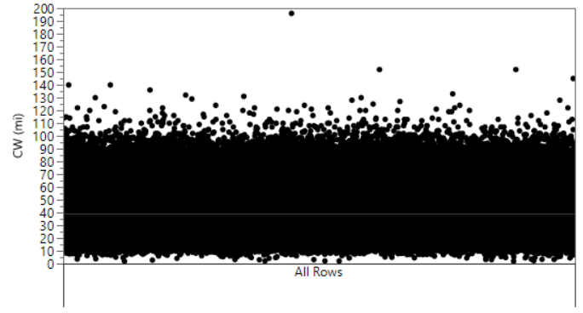
To determine importance of input factors, used decision tree and bootstrap forest analysis
Input factors (predictors)
  Heading
  Latitude/longitude
  Season
  Datetime
  Ground elevation
Carpet quantifiers
  Exposure Region Size
    “Carpet width”
  Undertrack Perceived Level (PL)
  Range of PL
All Data
Example decision tree data for CW
  Carpet Width (miles)
All Data
Notes:
To decide the resolution, a bootstrap forest of decision trees was used.
*describe the decision tree process over the next 4 slides, splitting on different factors to explain variability in the observations*

Slide 15
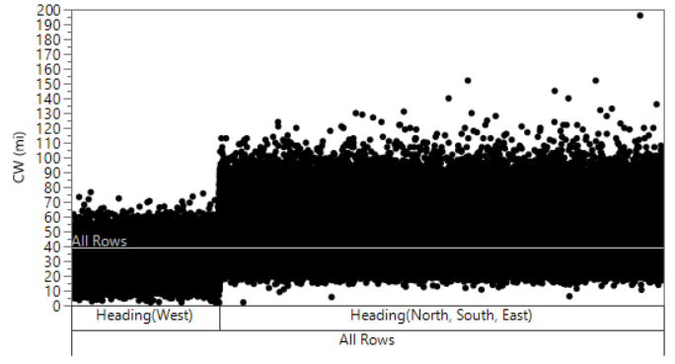
To determine importance of input factors, used decision tree and bootstrap forest analysis
Input factors (predictors)
  Heading
  Latitude/longitude
  Season
  Datetime
  Ground elevation
Carpet quantifiers
  Exposure Region Size
    “Carpet width”
  Undertrack Perceived Level (PL)
  Range of PL
All Data
Example decision tree data for CW
  Carpet width (miles)
All Data

Slide 16
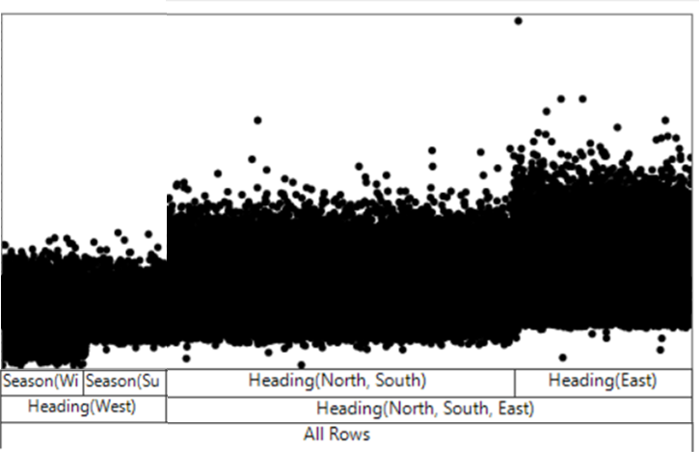
To determine importance of input factors, used decision tree and bootstrap forest analysis
Input factors (predictors)
  Heading
  Latitude/longitude
  Season
  Datetime
  Ground elevation
Carpet quantifiers
  Exposure Region Size
    “Carpet width”
  Undertrack Perceived Level (PL)
  Range of PL
All Data
Example decision tree data for CW
  Carpet width (miles)
All Data

Slide 17
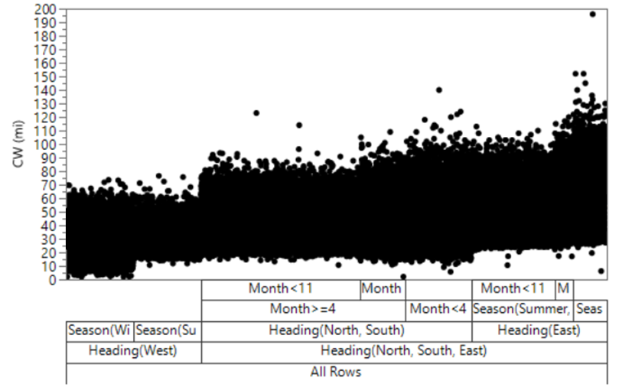
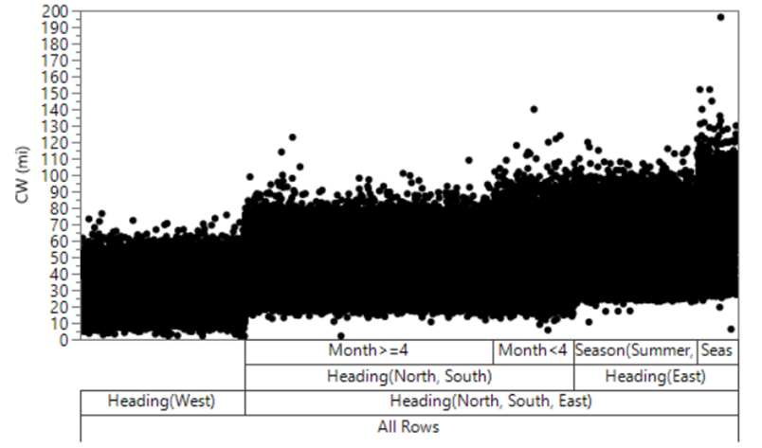
To determine importance of input factors, used decision tree and bootstrap forest analysis
Input factors (predictors)
  Heading
  Latitude/longitude
  Season
  Datetime
  Ground elevation
Carpet quantifiers
  Exposure Region Size
    “Carpet width”
  Undertrack Perceived Level (PL)
  Range of PL
All Data
Example decision tree data for CW
  Carpet width (miles)
All Data

Slide 18
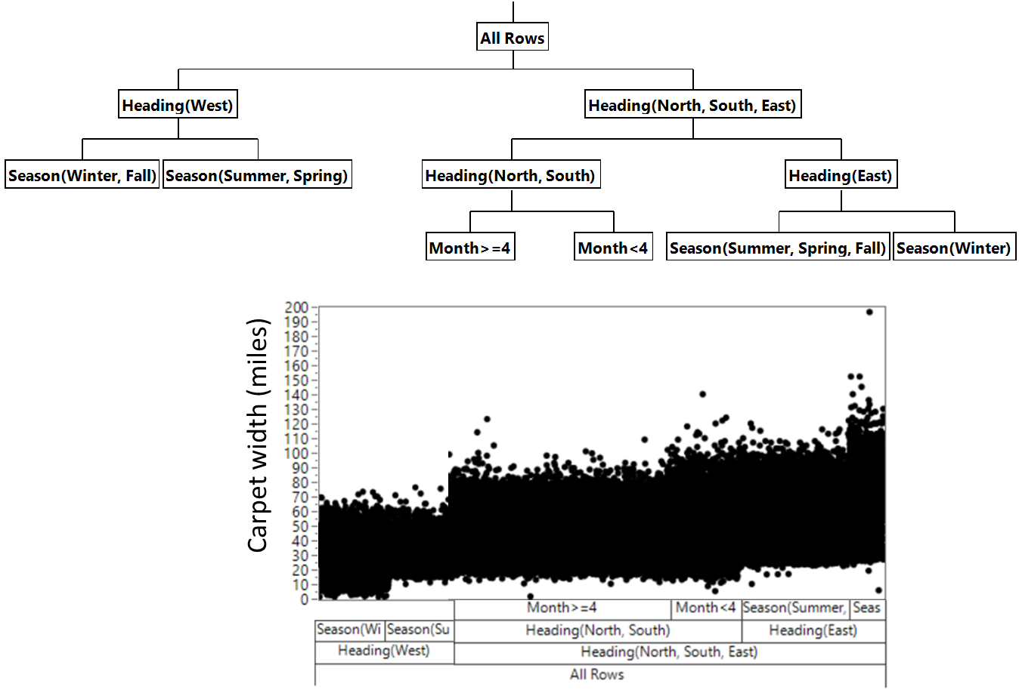
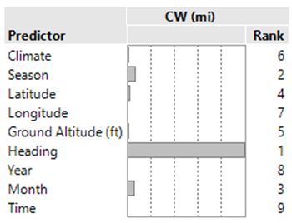

Bootstrap forest analysis description
Bootstrap forest analysis was conducted to evaluate spatial and temporal resolution
  Randomly sampled from the dataset to build 100 decisions trees
  Statistical decision tree recursively partitioned data according to the relationship between predictors and response variables
  Contribution of each predictor was then ranked
All Data
$×$ 100
All Data
Notes:
The bootstrap forest was made up of 100 decision trees. Predictor screening was used to determine the most important factors.
Heading is important for CW because of prevailing winds.

Slide 19
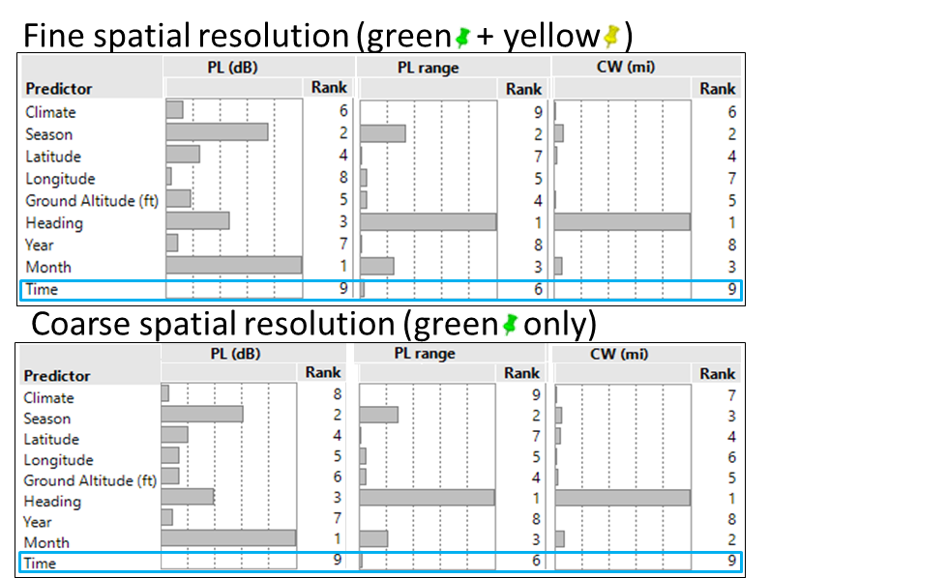
Bootstrap forest results
Time of day was not important
Equivalent predictor importance for both spatial resolutions
Notes:
One important outcome from the bootstrap forest analysis was that time of day was not an important factor. Because of this we were able to simply use 1 atmospheric profile per day instead of 4 for the nationwide study.
The predictor importance was roughly the same for the fine and coarse spatial resolution, which is one clue that the coarse resolution would be adequate.
*Make transition to geographical carpets plots*

Slide 20
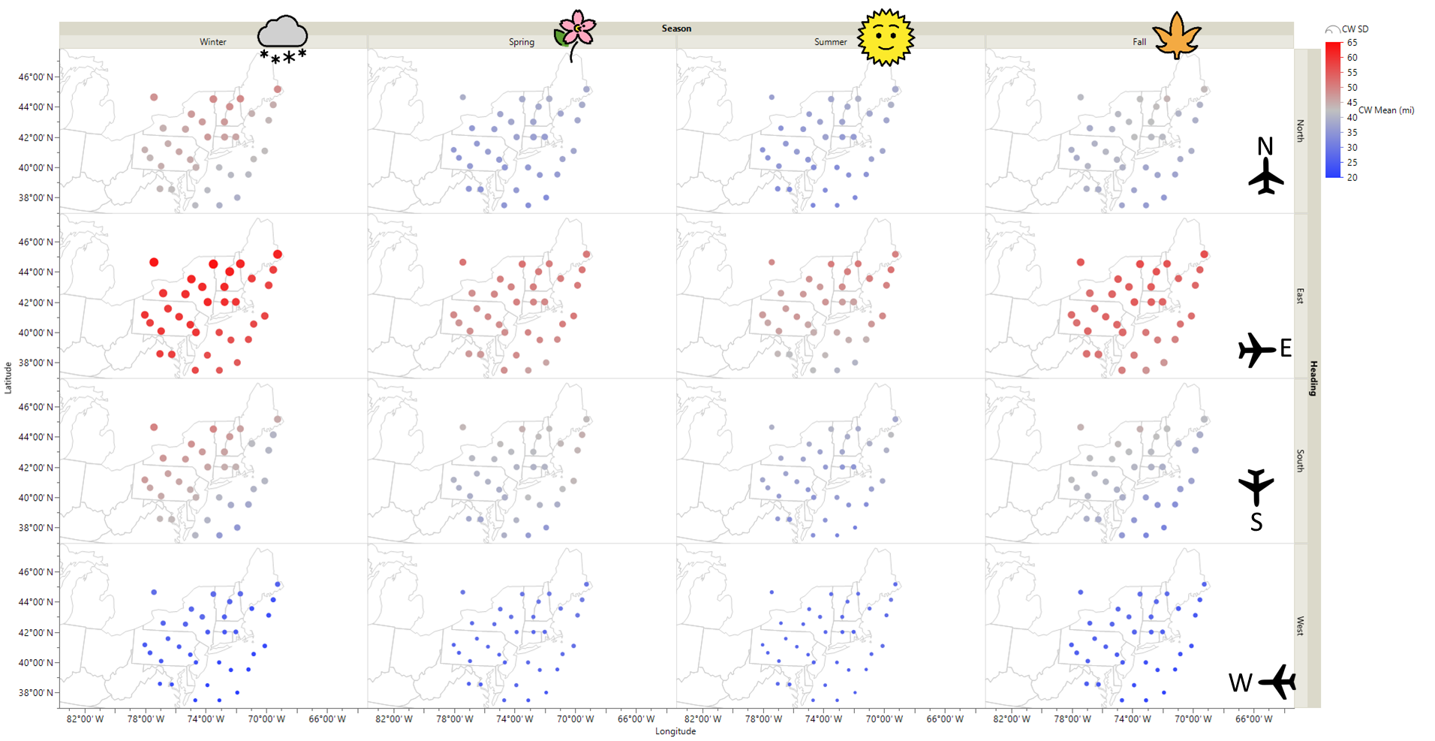
Carpet width (CW) mean and standard deviation (SD) results
  Dot color indicates mean
  Dot size indicates standard deviation (SD)
Range of CW SD:
3.8 to 14.8 mi
(6.1 to 23.8 km)
(105 km)
Mean CW (miles)
Values vary smoothly between nearby points
(32 km)
Notes:
Now I’m briefly going to show some results that indicate visually that the coarse spatial resolution is adequate while teasing some of the visualization techniques we used.
Smoothly varying values indicate either resolution is adequate

Slide 21
Final Design
Inputs
  134 locations separated by about 200 km
  5 years of atmospheric data at each location
  One time per day, 1800 UTC, 11 AM to 2 PM local
  4 cardinal aircraft headings
Results
  Over 1 million X-59 sonic boom exposure region sizes
  Over 18 million X-59 sonic boom waveforms
Follow-on analysis
  Multiple linear regression models to estimate quantities in intermediate locations
Notes:
Here is the final simulation design. We used the coarse spatial resolution, which has 134 locations across the US. The X-59’s low-boom was propagated through 5 years of atmospheric profiles, one per day at each location and at four aircraft headings. The results were over 1 million sonic boom exposure region sizes and over 18 million low-boom waveforms.
To estimate the loudness, variability, and exposure region sizes away from the test points, multiple linear regression models were fit to the data using the same predictors as the bootstrap forest. These models have roughly 50 km spatial resolution.

Slide 22
Presentation Overview
Sonic Boom Background Info
X-59 Mission
Outline of the Sonic Boom Simulation Goals
DoE Approach
for X-59 Sonic Boom Simulation
Simulation Results and Visualizations
Notes:
Finally I’ll share the results of the X-59 low-boom propagation simulation and some of the ways we visualized the data.

Slide 23
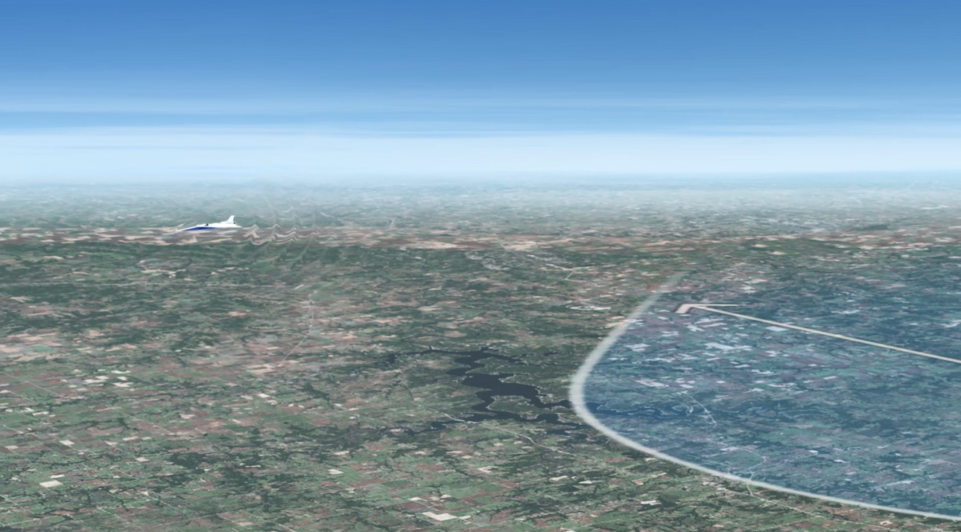
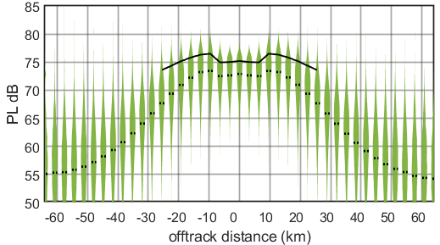
Visualization Techniques: Violin Plots for Loudness
Notes:
The first technique we used were violin plots. The plot on the right shows the loudness vs offtrack distance. The violins are peak-normalized probability density functions at each offtrack location. Black line is a standard atmosphere. Dashed line is the median of each violin.

Slide 24
Visualization Techniques: Violin Plots for Climate Results
Season
Notes:
*describe the Dept of Energy Building America climate zones*
*describe the violins same as previous slide but split by climate zone and season*
Note the loudness typically is higher in the colder regions. Similar seasonal patters for Cold, Very-Cold, and Marine; Hot-dry, mixed dry, hot-humid, and mixed humid

Slide 25
Visualization Techniques: Map plots for Loudness and Variability
Notes:
Describe dot size = SD, dot color = mean loudness. Note the loudness increase in the north and in mountainous regions.

Slide 26
Visualization Techniques: Map plots for Season and Heading
Notes:
Describe splitting on heading and season. Allows estimates of loudness and variability for various times of year and flight conditions, which aids in deciding when, where, and how to fly the X-59

Slide 27
Visualization Techniques: Map plots for multiple linear regression
Notes:
Describe that the multiple linear regression models allow us to estimate the PL anywhere given the ground elevation, lat/lon, climate zone, season, and heading. This chart has 0.5 deg resolution.

Slide 28
Summary
X-59 will be flying over US communities starting in 2024
to collect community noise data on low-booms
A simulation study was conducted to assess the impact of climate, heading, season, time of day, and geographical location on low-boom loudness, variability, and exposure region size
  Fast-flexible filling design was used to decide the locations
  A bootstrap forest of decision trees was used to decide the final temporal and spatial resolution
  Results included millions of sonic boom waveforms and exposure region sizes
Multiple linear regression was used to estimate loudness, variability, and exposure region size at intermediate locations
  Results were visualized using violin plots and on maps to show trends induced by climate, heading, season, and location
The simulated data will be used to aid X-59 community test plans
Notes:
Key results: CW is widest with east heading due to prevailing easterly wind. X-59 booms will be slightly louder and less variable in the colder climates and with greater ground elevation. For the climate results the CW did not change considerably except in for the Marine climate zone.
The simulated data will be used to decide when, where, and how to fly the aircraft to achieve test goals. They also aid in the claim of national representativeness of X-59 community tests because we will sample areas with varying loudness across the country.

Slide 29
Thank you
Season

