Slide 1
How Environmental and Operational Considerations Guide Requirements Development for Clinical Decision Support Beyond Low Earth Orbit
Barbara K. Burian, PhD NASA Ames Research Center
Brian Russell, PhD Auckland University of Technology and Contempo Lab
Dana Levin, MD Weil Cornell Medical Center Department of Emergency Medicine and The Exploration Medicine Company
AsMA 2022 Annual Scientific Meeting
May 26, 2022

Slide 2

Disclosures
Disclosure Information
92nd Annual Scientific Meeting
The Authors and Presenters have no conflicting financial relationships to disclose
The Authors and Presenters will not discuss off-label use and/or investigational uses for existing products
Notes:
This slide has been attested to by all presenters. The presenters have no conflicting financial interests with this work nor presentation

Slide 3

Purpose
To briefly:
  review what is meant (generally) by “context-specific Clinical Decision Support System (CDSS)”
  discuss the difference between “context-specific” and “context of use”
  provide an overview of phases of development
  review some challenges for developing a space-based context-specific CDSS (requirements)

Slide 4
Space CDSS Must Be Context-Specific
CDS Users
  Novice vs “expert”
  Specialties of expert
  Recency/amount of training
  Personal factors (fatigue/wellness factors, recent mission activities)
Clinical Need
  Number of patients/caregivers
  Condition(s) type/severity
  Patient vitals
  Time criticality
  Types of available assessment methods/treatments
CDS Knowledge Base
  Includes space-specific conditions/ treatments
Patient’s Medical History (i.e., Precision-Based Medicine)
  Past, as well as recent, medical history
  Current/recent wellness factors (diet, exercise)
  Other personal factors (recent mission activities)
Physical Environment
  Type/size of area
  Location (inside/EVA)
  Safety (air quality, toxicity, radiation, space debris)
  Access to medical equipment and supplies
Mission Parameters
  Mission type and related response options (evacuation)
  Occurrence relative to mission time-line
Notes:
Notes to reviewers – I expect that many folks in the audience will already know these things – including this review to make sure all have a common understanding before moving to rest of the presentation

Slide 5
Space CDSS Must Be Context-Specific
CDS Users
  Novice vs “expert”
  Specialties of expert
  Recency/amount of training
  Personal factors (fatigue/wellness factors, recent mission activities)
Clinical Need
  Number of patients/caregivers
  Condition(s) type/severity
  Patient vitals
  Time criticality
  Types of available assessment methods/treatments
CDS Knowledge Base
  Includes space-specific conditions/ treatments
Patient’s Medical History (i.e., Precision-Based Medicine)
  Past, as well as recent, medical history
  Current/recent wellness factors (diet, exercise)
  Other personal factors (recent mission activities)
Physical Environment
  Type/size of area
  Location (inside/EVA)
  Safety (air quality, toxicity, radiation, space debris)
  Access to medical equipment and supplies
Mission Parameters
  Mission type and related response options (evacuation)
  Occurrence relative to mission time-line
Notes:
Note to reviewers: point of this slide it to illustrate that many of these are inter-related or coupled
I am only showing a few of these inter-relationships – don’t want to spend the talk drawing arrows all over the place

Slide 6
Context of Use
What?
Used by Whom?
How?
When?
Where?
Why?
Under What Conditions?

Slide 7
Space CDSS - Context of Use
CDS Users
  Novice vs “expert”
  Specialties of expert
  Recency/amount of training
  Personal factors (fatigue/wellness factors, recent mission activities)
Clinical Need
  Number of patients/caregivers
  Condition(s) type/severity
  Patient vitals
  Time criticality
  Types of available assessment methods/treatments
CDS Knowledge Base
  Includes space-specific conditions/ treatments
Patient’s Medical History (i.e., Precision-Based Medicine)
  Past, as well as recent, medical history
  Current/recent wellness factors (diet, exercise)
  Other personal factors (recent mission activities)
Physical Environment
  Type/size of area
  Location (inside/EVA)
  Safety (air quality, toxicity, radiation, space debris)
  Access to medical equipment and supplies
Mission Parameters
  Mission type and related response options (evacuation)
  Occurrence relative to mission time-line
How many users at the same time?
Same or different conditions?
If same, parallel or serial actions?
Flexibility for different numbers of users with different KSAs?
How many patients at the same time?
Same or different conditions?
What types/sizes of CDSS Displays?
Where are displays located/can they be used?
Lighting, vibration, gravity?
Degree/types of passive astronaut monitoring?
Specific equipment that will integrate with CDSS and their capabilities?
Approach to treatment based on event location & type/size of area?
Should CDSS = MD re: assessment/ treatment approach?
Treatable vs. non-treatable conditions: guidance and support
Autonomy vs. autonomously
Push vs pull, functionality & behavior

Slide 8
Development Phases
Conception
Assess Use as per Conception
Determine Content
Revise Content
Revise & Update Content
Design and Functionality
Revise Design & Function.
Revise & Update Design & Functionality
Testing & Validation
Re-test & Validate
Training
Re-training
Re-training
Re-training
Implementation and Use

Slide 9
NASA Modified Development Phases
Conception
Assess Use as per Conception
Determine Content
Revise Content
Revise & Update Content
Design and Functionality
Revise Design & Function.
Revise & Update Design & Functionality
Testing & Validation
Re-test & Validate
Training
Re-training
Implementation and Use

Slide 10
Development Phase: Conception
Conception
Assess Use as per Conception
Determine Content
Revise Content
Revise & Update Content
A multidisciplinary team must be involved throughout the whole process, especially during Conception
Design
Revise Design
Revise & Update Design & Functionality
Testing & Validation
Re-test & Validate
Training
Re-training
Re-training
Re-training
Implementation and Use
Conception:
Identify resources and limitations (for development process, for deployment/use); identify risks
Determine concept of use (what, by whom, how, when, where, why, under what conditions)
Determine clinical needs, treatable conditions
Determine specific goals for functionality and use
Determine usability requirements
Identify additional capabilities needed from external equipment to augment CDSS
Determine goals for redundancy, graceful degradation, and back-up for total failure; identify risks
Determine governance: who is responsible and who has authority for developing, revising, and updating CDSS
Notes:
Note to reviewers: point of this slide is to illustrate just a few of the many tasks associated with each phase – started with “Conception” because it is the first phase and also because many tasks within it are often skipped, performed late, etc.
Presentation does not include this type of task delineation for other phases because of time limitations. Such a delineation of tasks for each phase will be covered in the CDSS White Paper I am writing in FY22.

Slide 11
Why is This So Hard?
Many issues and decisions are highly inter-related – hard to know where to start
Limitations for development, deployment, and use are not always clearly articulated or, sometimes, known in advance
Some issues to be covered during conception are skipped, addressed late, or addressed incompletely (e.g., how many and what type of displays, where located?)
Goals for use are often not clearly identified with adequate specificity
Goals for use can change as stakeholder/development team members change
Representatives from all major development specialties (human factors engineers, software engineers, etc.) not involved in all aspects of development
  Human Factors (HF), in particular, often seen as add-on, involved too late or only peripherally
Notes:
Doesn’t include all the challenges – just some of the most common and problematic

Slide 12

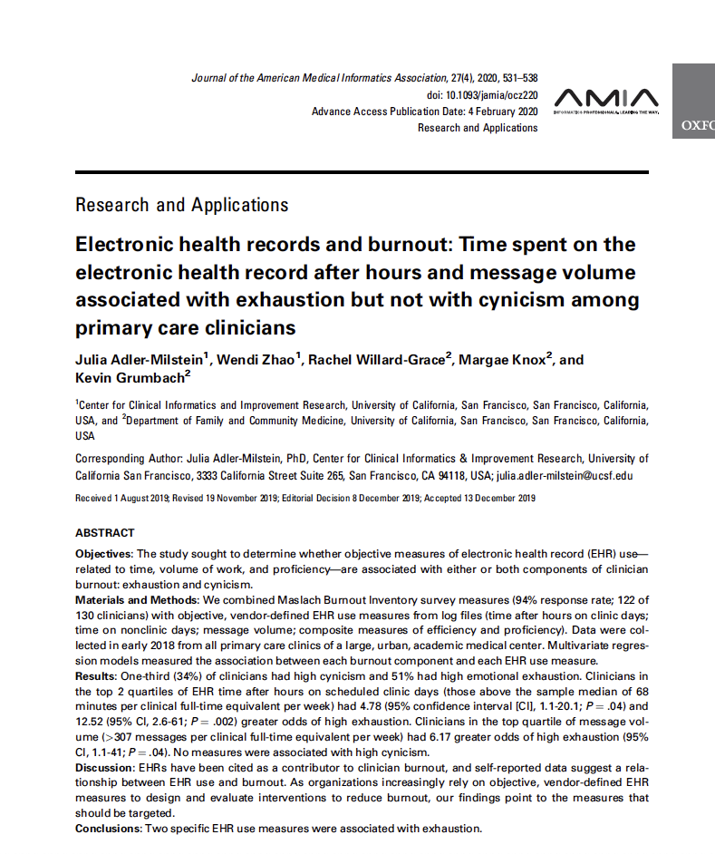
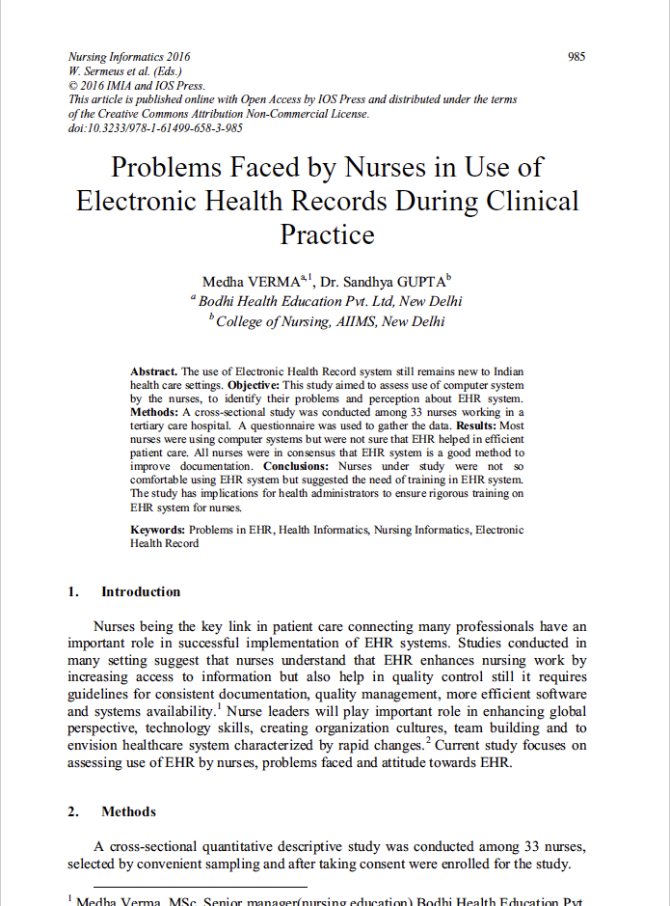
Interlude: Challenges of EHR Systems
Notes:
Point of this slide is to illustrate what can happen when HF Engineers are not included (or not included early enough) in the development and design of technology for use by humans.

Slide 13
Why is This So Hard? (continued)
Available resources fluctuate over time
System will need to be highly integrated with a lot of different types of data/ information from different sources:
  Multiple dependencies, tightly-coupled system = increased risk of failure
We lack some space-specific health and medical data/information
Specific risks associated with data integration, fusion, access, updating, and management, and CDSS functionality and user errors are not clearly identified or understood, in advance
  Adequate mitigations are not developed
Some development, design, functionality, and use requirements cannot be identified in advance
Testing and validation sometimes inadequate; validating AI is difficult

Slide 14
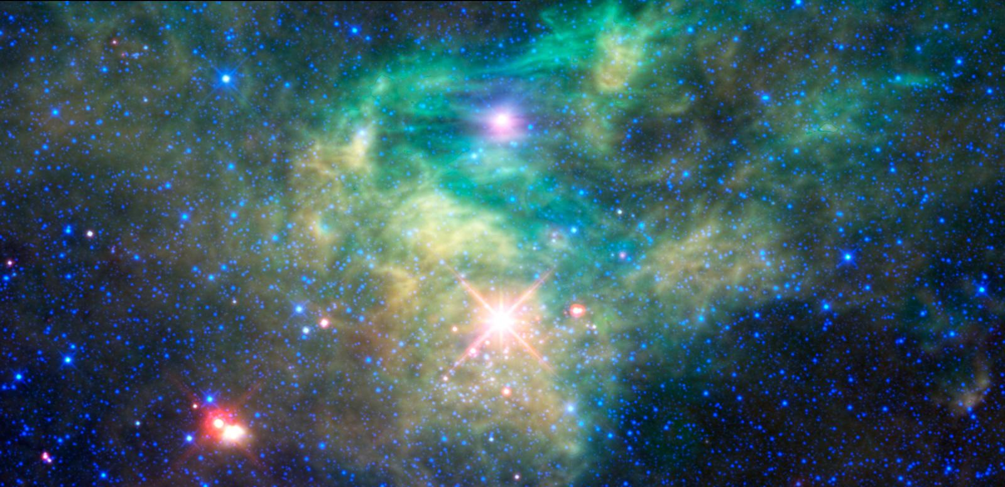
Despite these many challenges, a space CDSS is not only necessary, but is clearly the future of medical and wellness care as human space exploration expands.
Notes:
This photo in the background is taken from the NASA Website and is publicly available: https://www.nasa.gov/mission_pages/WISE/multimedia/gallery/neowise/gallery-index.html

Slide 15
Thank You!
Questions?
Barbara.K.Burian@nasa.gov https://hsi.arc.nasa.gov/flightcognition/

