Slide 1
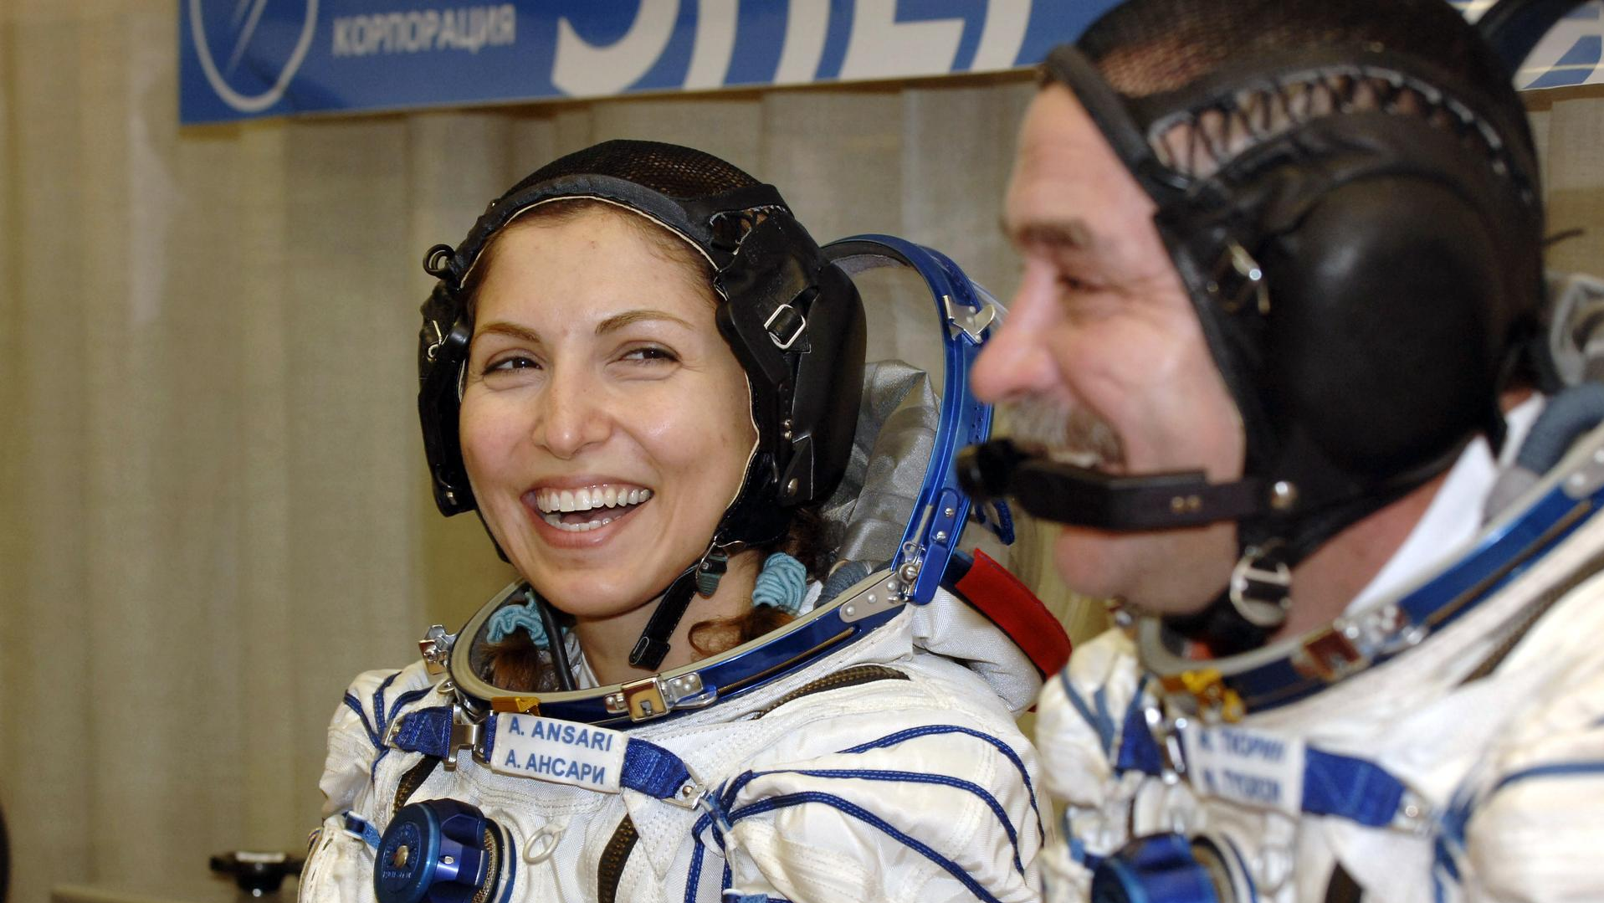

Humor and Team Dynamics
Melissa Vazquez, Ph.D.
DePaul University
Suzanne Bell, Ph.D.
NASA
Photo credit: NASA
Research supported by the National Aeronautics and Space Administration (NASA) Grant ILSRA NNX16AQ48G (PI = Bell)

Slide 2
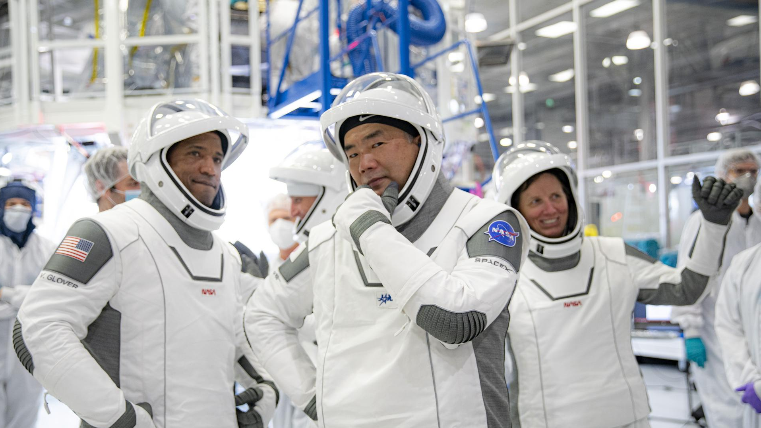
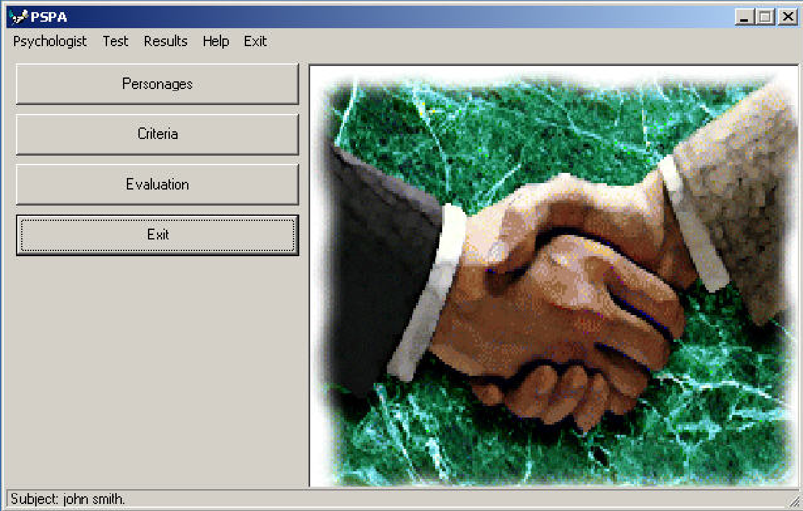
Building social bonds
Psychological safety
Team engagement
Disagreeing with others
WHY IS HUMOR IMPORTANT?
Giving feedback
Positive emotions
Challenging tradition to innovate
Photo credit: NASA
Diagram produced by the PSPA data showing psychological distance between individuals

Slide 3
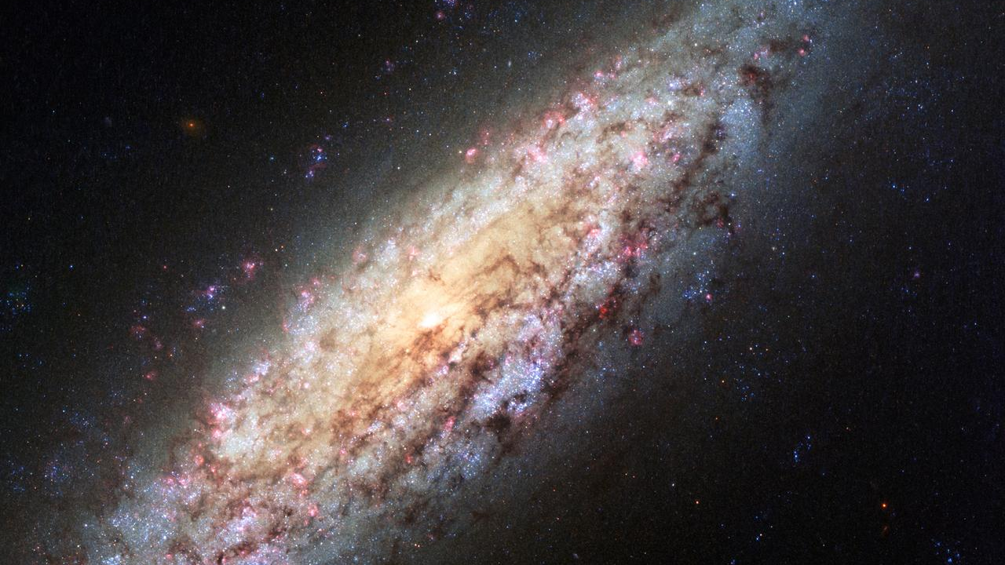
Study Aims
Aim 1: Examine how individual differences in humor styles relate to the expression of humor
Aim 2: Examine the impact of humor training on observed humor use
Aim 3: Better understand how the structure of activity impacts humor use over time
Photo credit: NASA

Slide 4
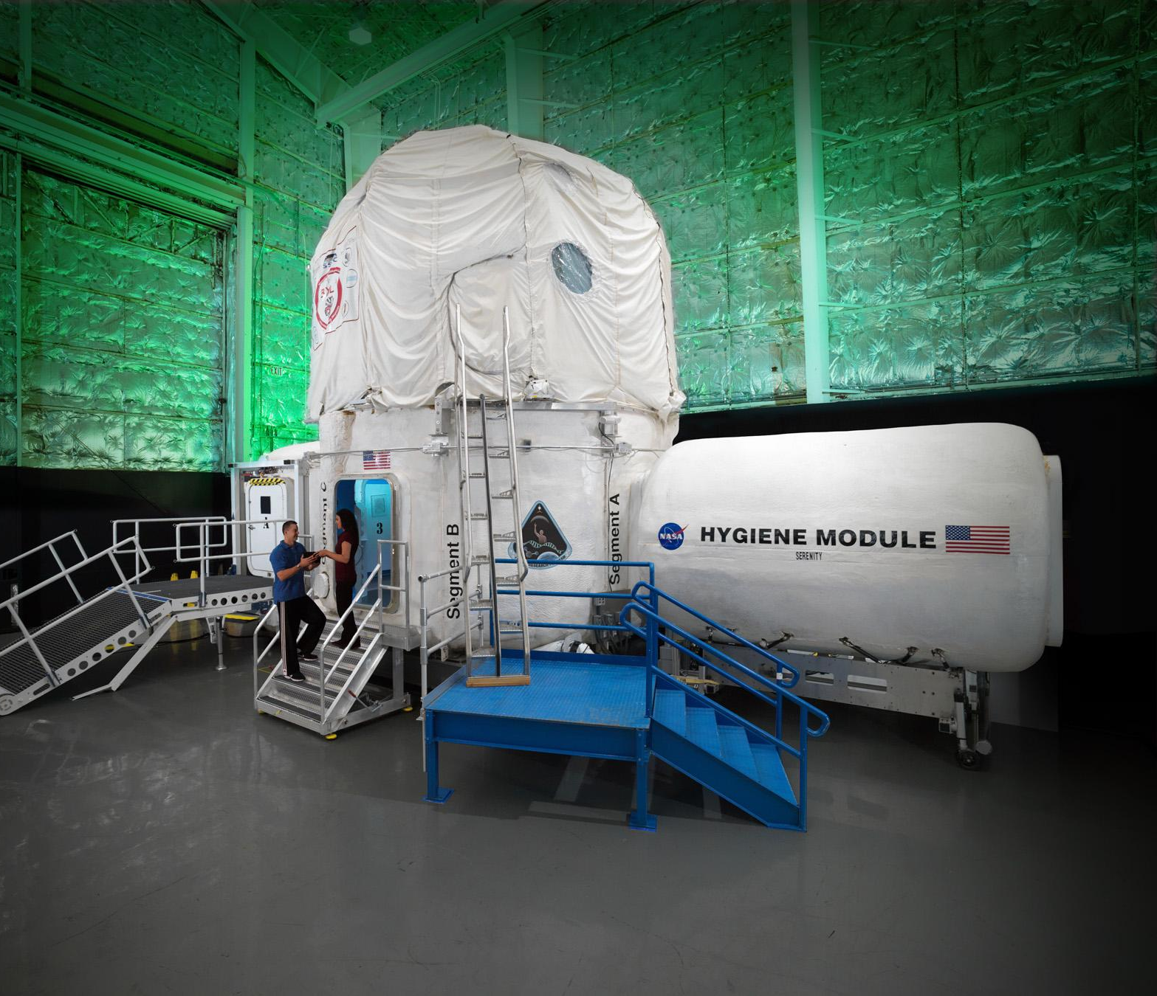
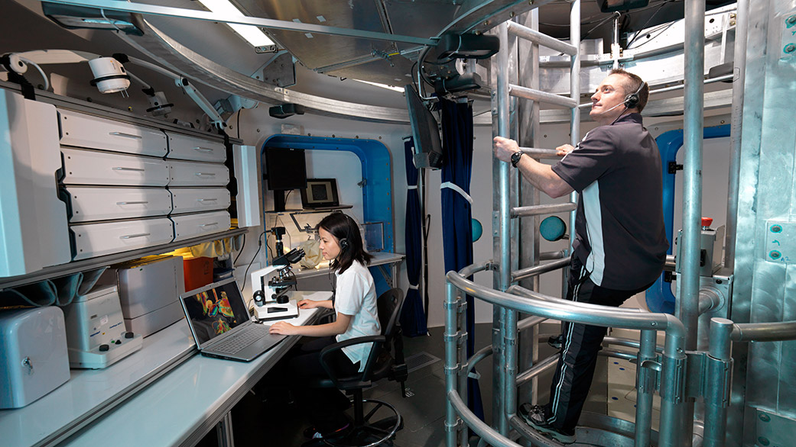
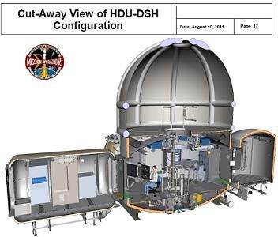
Up to 45 days in Isolation!
9, 4 person teams
Campaign IV: 5 crews
Campaign V: 4 crews*
Human Exploration Research Analog (HERA)
*Note: An interpersonal relationship training was given that incorporated humor education, exercises, and strategies for using positive vs. negative humor
Photo credits: NASA

Slide 5
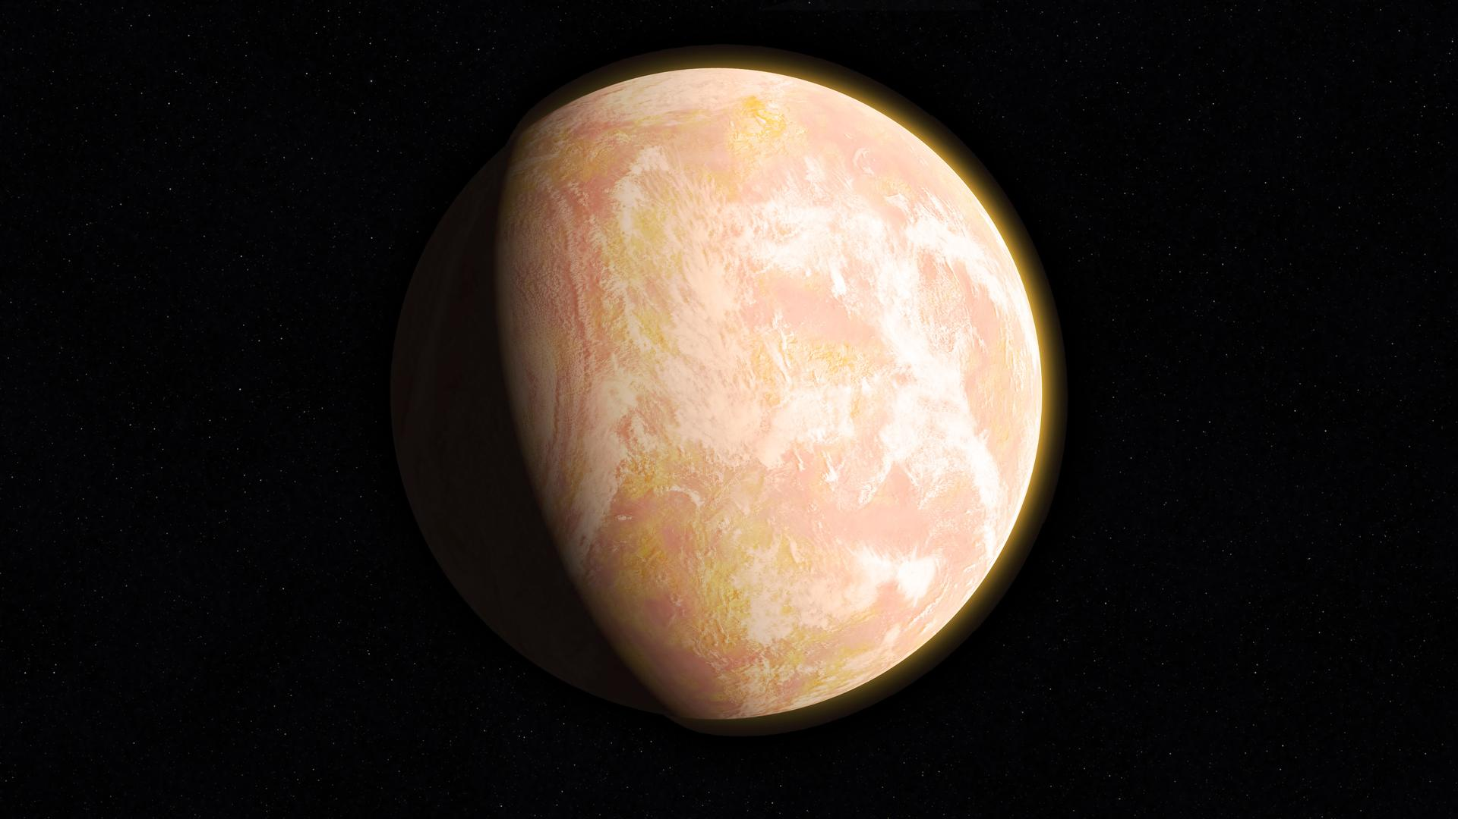
Procedures
Pre- Isolation
Humor Style Questionnaire (HSQ)
Isolation
Team Interaction Batteries 2-5
Lunches
Team Interaction Battery 1
Photo credit: NASA

Slide 6
Procedures
Pre- Isolation
Humor Style Questionnaire (HSQ)
Isolation
Team Interaction Batteries 2-5
Lunches
Team Interaction Battery 1
Team Interaction Batteries (structured team activity)
Decision Making Task
Right Stuff Task
  Lunches (unstructured activity)
Photo credit: NASA

Slide 7
Procedures
Pre- Isolation
Humor Style Questionnaire (HSQ)
Isolation
Team Interaction Batteries 2-5
Lunches
Team Interaction Battery 1
Team Interaction Batteries (structured team activity)
Decision Making Task
Right Stuff Task
  Lunches (unstructured activity)
Coding Humor:
Direction
Others
Self
Positive
Affiliative | Self-Enhancing
Aggressive | Self-Defeating
Valence
Negative
Photo credit: NASA

Slide 8
Procedures
Pre- Isolation
Humor Style Questionnaire (HSQ)
Isolation
Team Interaction Batteries 2-5
Lunches
Team Interaction Battery 1
Team Interaction Batteries (structured team activity)
Decision Making Task
Right Stuff Task
  Lunches (unstructured activity)
Coding Humor:
Direction
Others
Self
Positive
Affiliative | Self-Enhancing
Aggressive | Self-Defeating
Valence
Negative
Analyses included multilevel modeling (i.e., negative binomial models)
Photo credit: NASA

Slide 9
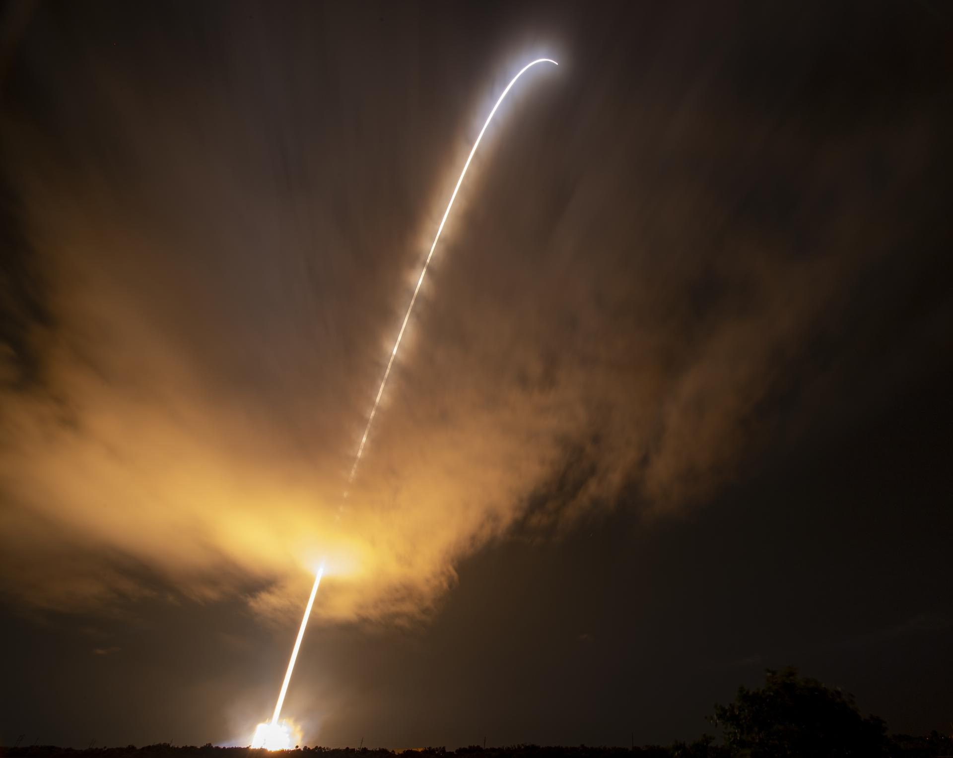
Study Results
Aim 1: Examine how individual differences in humor styles relate to the expression of humor
  Aggressive humor style was related to the use of negative humor over time
  Affiliative humor style was related to the use of positive humor over time
Individual differences in humor styles (e.g., aggressive humor): level-1 fixed effects
Crew & campaign: level-2 fixed effects
Activity (time-varying covariate): level-1 fixed effect
Outcomes: frequency of positive and negative humor use per time point
Note: 2 separate models were run & data were nested within-person (random intercept for each person)
Photo credit: NASA
Notes:
Standardized I.V

Slide 10
Study Results
Aim 2: Examine the impact of humor training on observed humor use
Crew: level-2 fixed effect
Activity (time-varying covariate): level-1 fixed effect
Campaign: dummy coded as moderator (fixed effect)
Outcome variables: frequency of aggressive and affiliative humor use per time point
  Those who were trained used less aggressive humor and also less affiliative humor (so that was the opposite of what we predicted)
Note: 2 separate models were run & data were nested within-person (random intercept for each person)
Photo credit: NASA

Slide 11
Study Results
Aim 3: Better understand how the structure of activity impacts humor use over time
Individual differences in humor styles (e.g., aggressive humor): level-1 fixed effects
Crew & campaign: level-2 fixed effects
Activity: (time-varying covariate): level-1 fixed effect; also, dummy coded and entered as an interaction (fixed effect)
Outcome variables: frequency of humor use per time point
  Compared to The Decision-Making Task, during lunch, the relationship is stronger between affiliative humor style and affiliative humor use
Note: 4 separate models were run & data were nested within-person (random intercept for each person)
Photo credits: NASA

Slide 12
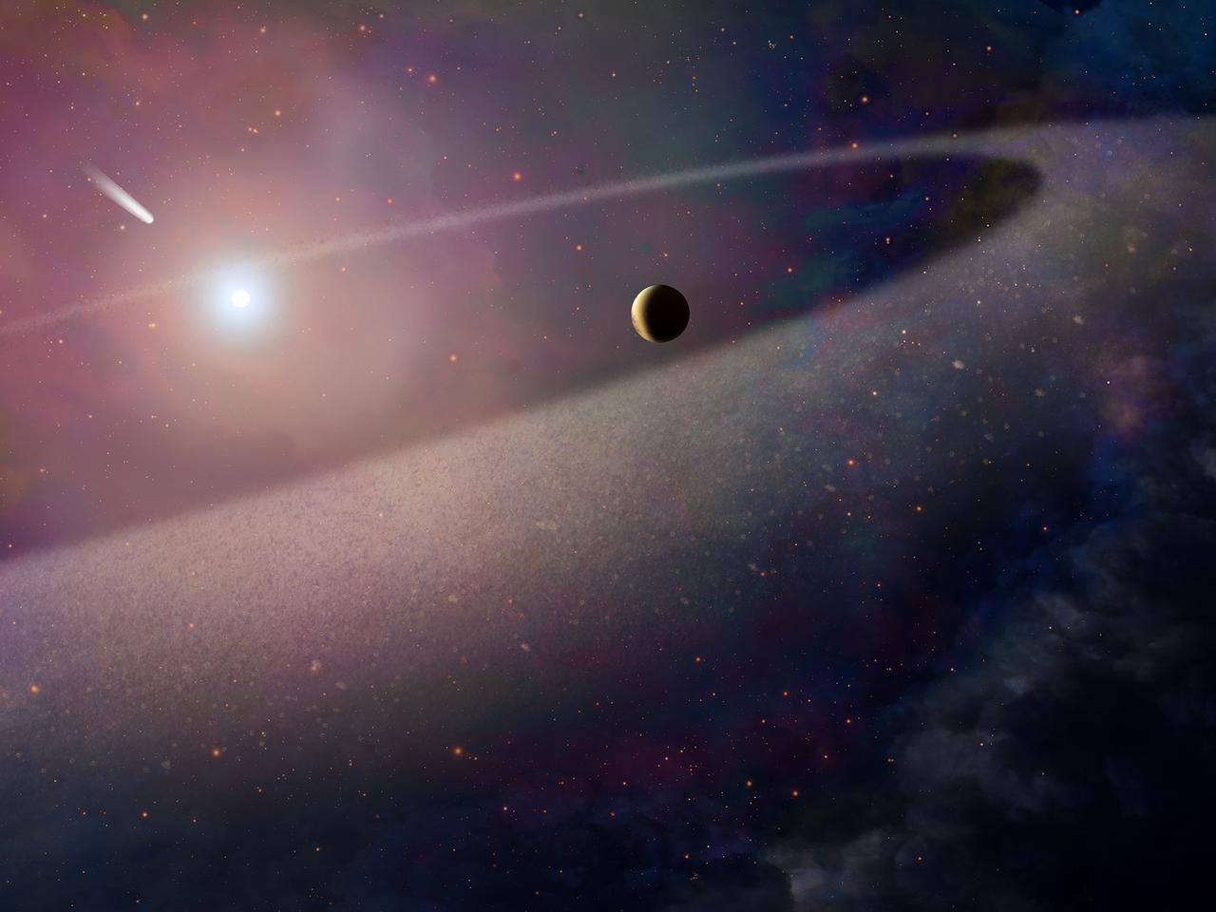
Implications
Preliminary validation of HSQ → measuring humor styles to capture behaviors
Could humor training be the future?
Humor seems to be context specific
MORE RESEARCH IS NEEDED TO GENERALIZE
Photo credit: NASA
Photo credits: NASA

Slide 13

“I think we all agree at this point that this isn't a high stress environment, at least not for the four of us. I can definitely see where for people, it could be, quite easily. I just find that in my experiences, if you're not laughing and having a good time, then there's really no point in doing it. And generally, when [things are] the worst, is when the laughing is the most important.”
-HERA crewmember
Photo credits: NASA

Slide 14
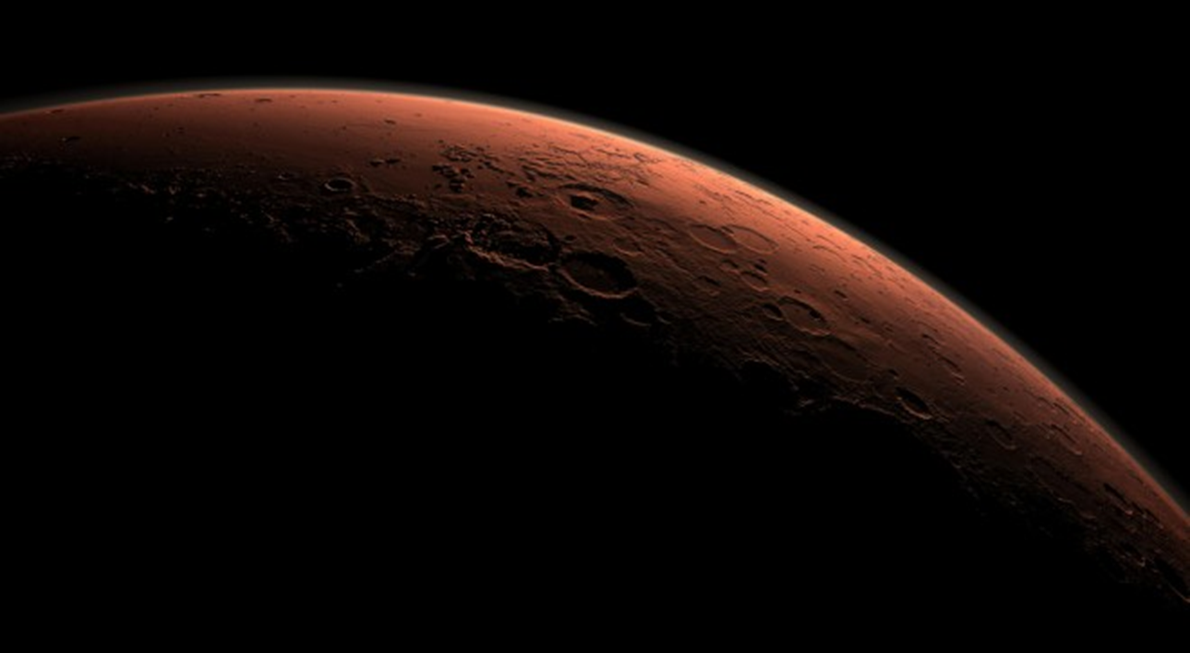
Special Thank You To:
National Aeronautics and Space Administration (NASA) Grant ILSRA NNX16AQ48G (PI = Suzanne Bell)
Co-PI: Dr. Leslie DeChurch, Northwestern University
Co-PI: Dr. Noshir Contractor, Northwestern University
Dr. Jane Halpert, Dr. Shelly Rauvola, Dr. Goran Kuljanin, Dr. Erich Dierdorff
Graduate Coders: Kiana King & Lora Bishop
Dr. Ivan Hernandez
Photo credits: NASA

