Slide 1
Impact of Sex on Effects of Environmental Exposures During Space Exploration
S. Robin Elgart, Ph.D.
Space Radiation Element Scientist
NASA Human Research Program

Slide 2
Overview
Human Research Program
Spaceflight Exposures and Effects on the Human Body
Introduction to Space Radiation
Sex Differences and Space Radiation Responses
Summary

Slide 3
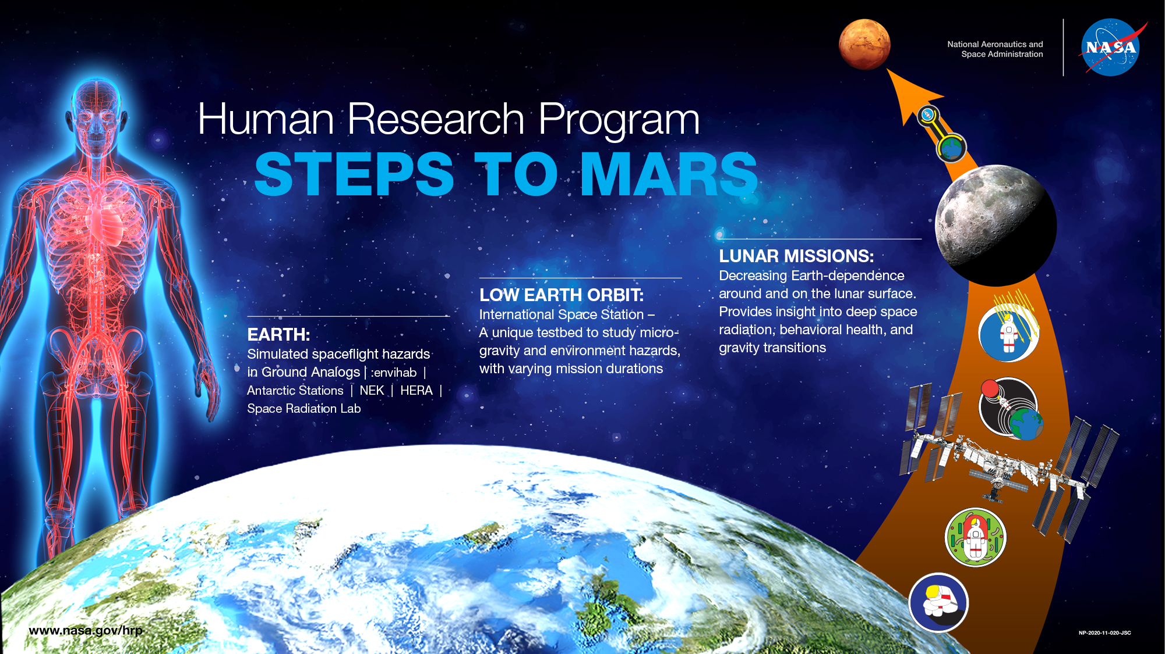
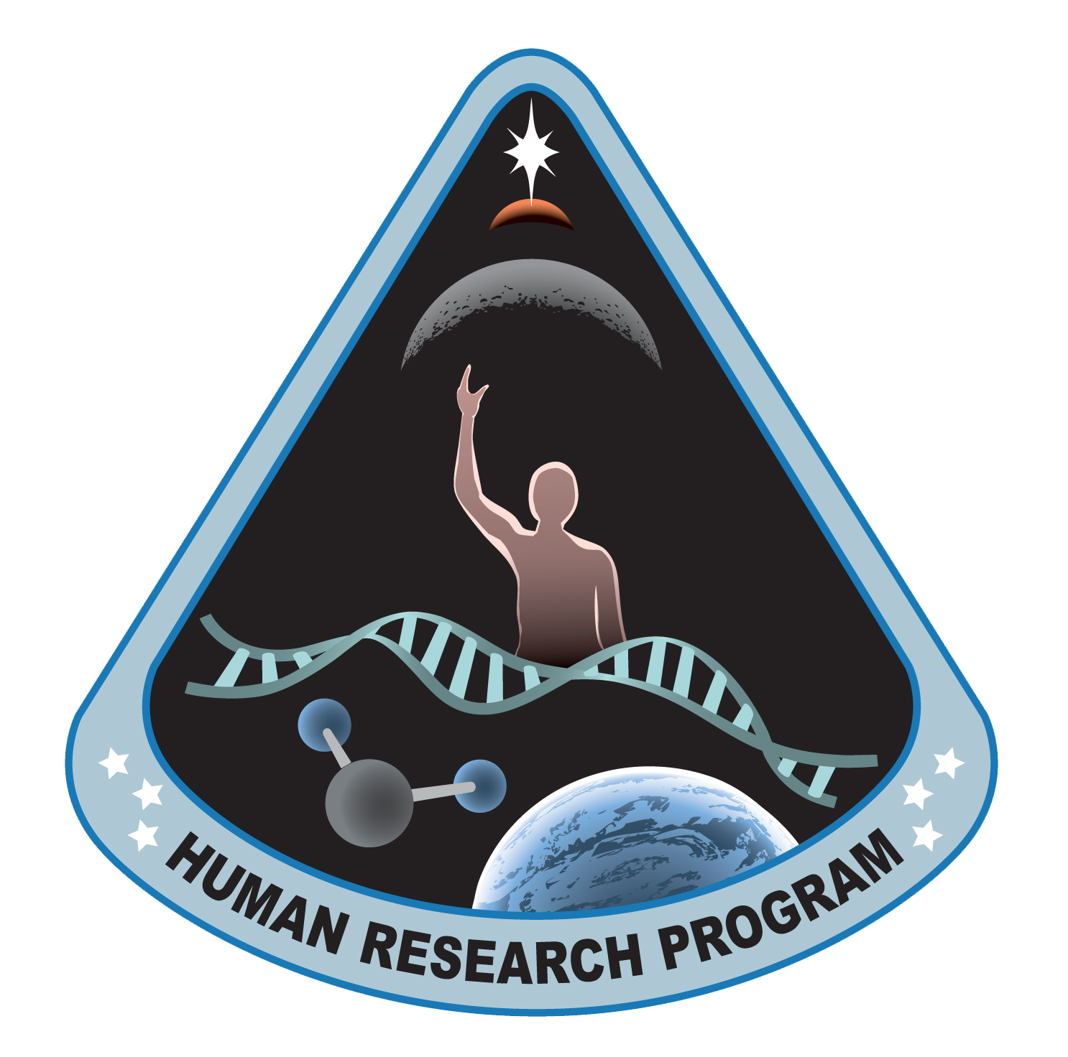
3

Slide 4
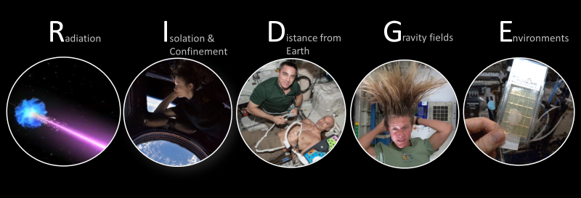
Spaceflight Exposures

Slide 5
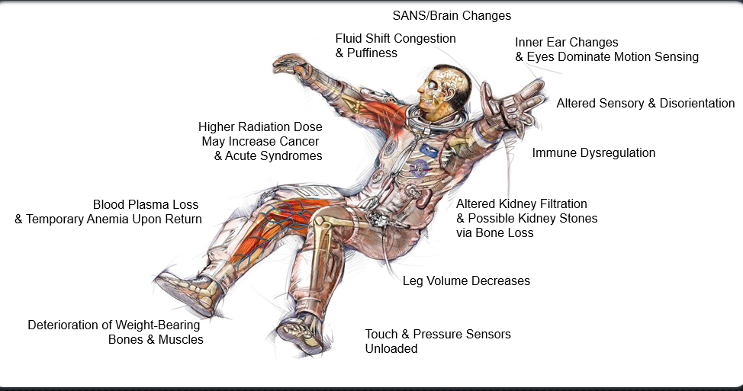
Effects of Spaceflight on the Human Body
Human Space and Ground Analog Research Subjects
Investigations with Equal Male : Female Subjects
Data Accumulates Slowly
Multiple Variables to Consider – Sex is Just One
Goal to Focus on "Individual"
Exploring Role of Sex in Multiple Systems and Outcomes
Bone and Muscle
Immune
SANS
Sensorimotor
Cardiovascular and Orthostatic Intolerance
Carcinogenesis
Countermeasures
5

Slide 6
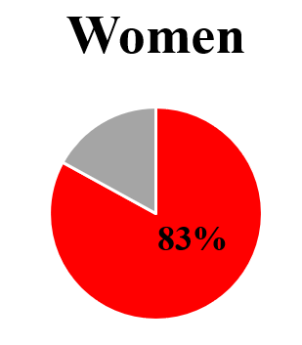
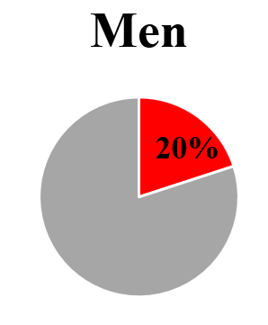
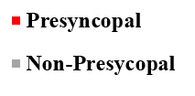
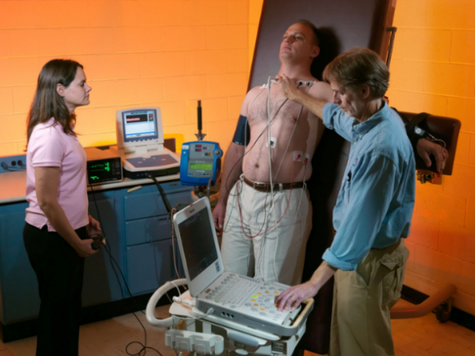
Orthostatic Intolerance
Large % astronauts have Orthostatic Intolerance upon return to Earth’s gravity
Women more affected
Upcoming research:
Response at Moon and Mars gravity levels
G_{z} loads during ascent from the lunar surface may pose an additional risk
Only limited data on countermeasure effectiveness (compression garments) in female astronauts to date
Source: NASA
Stenger et al. 2013. Aviat Space Environ Med.
6

Slide 7
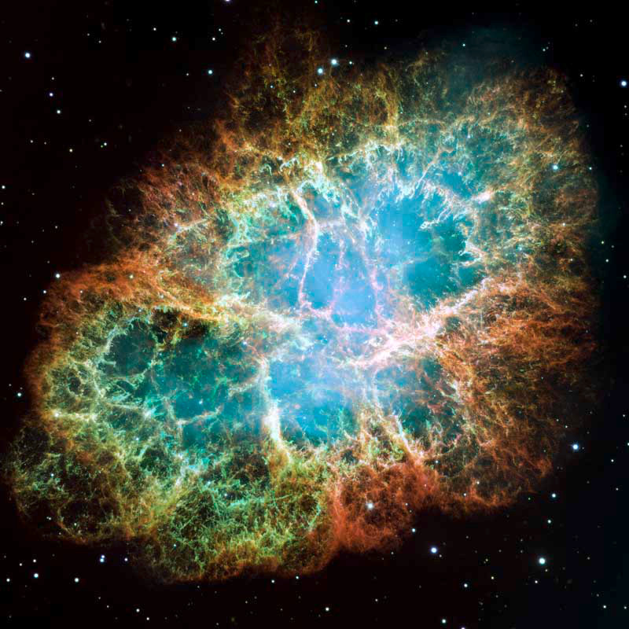
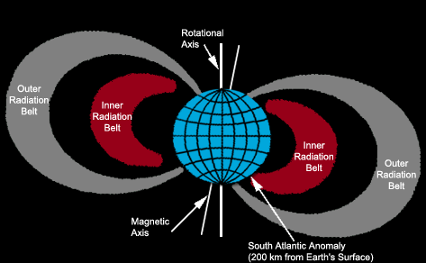
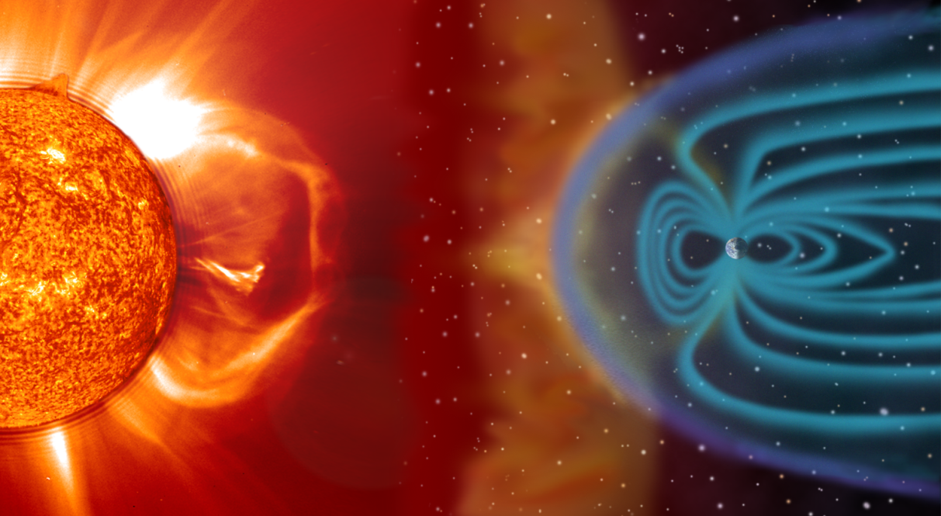

Space Radiation
NASA/ESA/Arizona State University
Why does NASA care about radiation?
Space is a “radiation environment” → Workplace hazard
Astronauts are radiation workers
Space radiation is different than terrestrial radiation
Accelerated high-energy particles
Galactic Cosmic Rays (GCR)
Trapped Radiation
Solar Particle Events (SPE)
Crab Nebula
More information about space radiation:
gif by Crazy Picture CC BY-SA 3.0
https://martzobservatory.org/dr-robin-elgart/

Slide 8
The Space Radiation Environment
Doses depend on mission and solar parameters
Duration
Trajectory and shielding
Determine source exposure
Effects “quality factor”
EVAs
Solar cycle
11-year cycle
Modulates GCR and trapped radiation fluence, as well as SPE likelihood
Each crew member is badged
Active radiation area monitoring
Exposure Type | Dose Rate or Dose
ISS – IV: 51.6° @ 400 km | 300 – 450 μGy/day
GCR in “free space” in water CRaTER (2009 to present) | 250 – 550 μGy/day
1972 event – IV “free space” | 200 – 400 mSv
Sheltered 1972 event | ~ 80 mSv
IV: Intravehicular (Inside a vehicle or habitat)

Slide 9

Historical NASA Crew MISSION Doses
Badge Dose, mGy
650 mSv
NCRP Lifetime Radiation Worker Guidance for 65yo
600 mSv
NEW NASA Career Radiation Limit
Effective Dose, mSv
Mars Mission
1000
Mars Mission, mSv
Skylab, Mir and ISS
100
50 mSv/yr
Annual NRC Radiation Worker Limit
Hubble Missions
10
Apollo and Shuttle
Mission Dose
Gemini
3.6 mSv
Annual Average US Background Dose
Mercury
1
NOTE: Log Scale
0.1
0
200
400
600
800
Astronaut, i
Modified from Cucinotta et al. Radiat Res (2008)

Slide 10
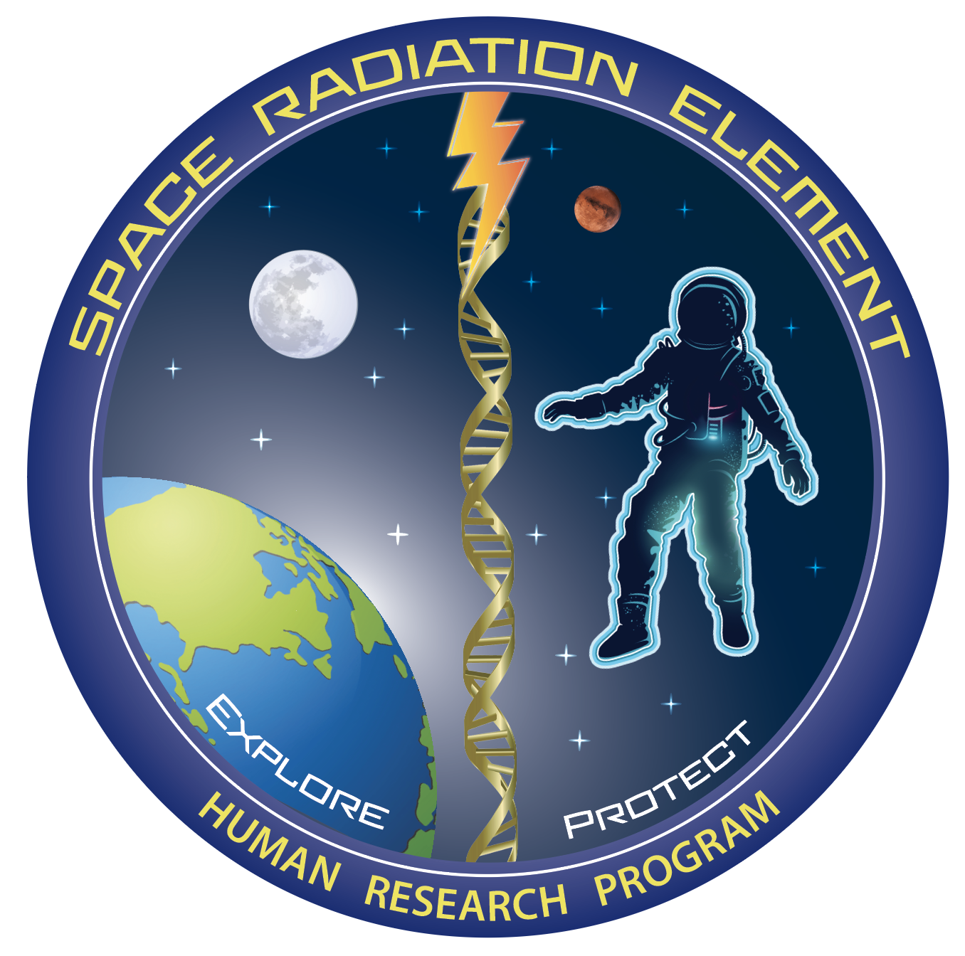
Space Radiation Element Research
Priority human health risks
Carcinogenesis
Cardiovascular and Immune
Central Nervous System
Characterization |  | Mitigation
Dose and Dose Rate Effects | Biomarkers | Countermeasure Identification
Radiation Quality | Individual Susceptibility | Countermeasure Validation
Cross-Species Translation | Combined Stressors
https://humanresearchroadmap.nasa.gov/

Slide 11
Sex-specific radiation cancer risk
Single largest contribution to differences in risk between men and women is estimates of excess risk of LUNG cancer
Based on observations in the atomic bomb survivor cohort
Other epidemiological evidence is less clear
Animal studies of sex-differences have not yet provided clarity
Ongoing research interrogates sex-differences in lung and other cancers following space radiation exposure

Slide 12
Sex-Specific Lung Cancer
The study of Japanese atomic-bomb survivors, exposed briefly to radiation, finds the risk of radiation-induced lung cancer to be nearly three times greater for women than for men.
Golden, Presented at the Million Person Study
Virtual Symposium 11/6/2020

Slide 13
2022 NASA Standard 3001 Vol 1 RevB
Shifted from a RISK limit to a DOSE limit
Anchored using the 3% MEAN REID for a 35-year-old female case
Individual sex- and age-dependent risk is still reported and used for decision making
Crew
Flight Control Team
Agency
4.8.2 Career Space Permissible Exposure Limit for Space Flight Radiation
[V1 4030] An individual astronaut’s total career effective radiation dose due to space flight radiation exposure shall be less than 600 mSv. This limit is universal for all ages and sexes.
https://standards.nasa.gov/sites/default/files/standards/NASA/B//2022-01-05-NASA-STD-3001-Vol1-Rev-B-Final-Draft-Signature-010522.pdf

Slide 14
Summary
Astronauts face a number of spaceflight exposures in mission
Responses impact mission success and long-term health
Understanding sex-differences is critical to inform crew and the agency of risks for long-duration missions
Mars missions will exceed established radiation limits – requires informed decision making
Shift to the new radiation dose limit does NOT change how individual astronaut risk is reported

Slide 15
Thank you for your attention!
jsc-hrp-space-radiation-element@mail.nasa.gov

Slide 16
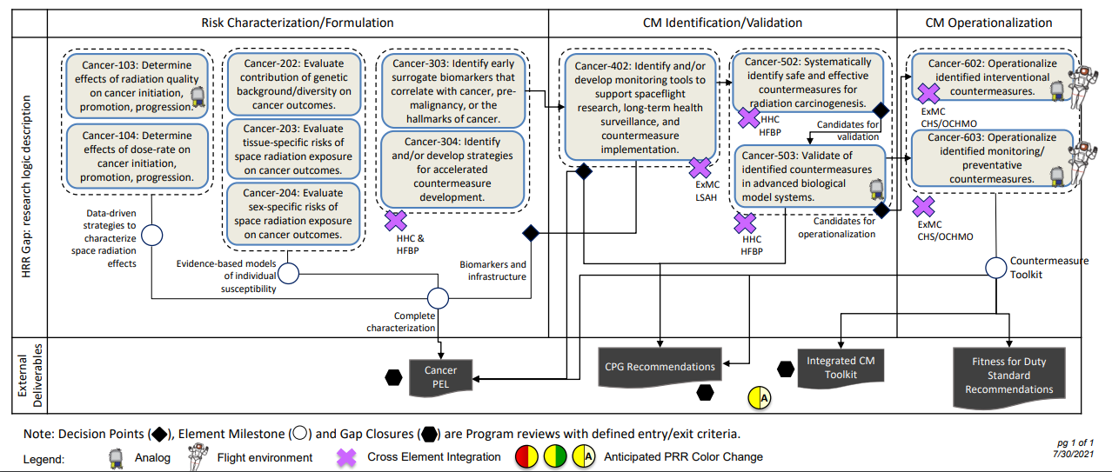
Cancer Risk Strategy
https://humanresearchroadmap.nasa.gov/schedules/?i=96

Slide 17
More Resources
Space Radiation Element
https://www.nasa.gov/hrp/elements/radiation
NASA Human Research Roadmap – link to risks, gaps, and funding priority (green = low, red = high)
https://humanresearchroadmap.nasa.gov
www.nasa.gov/hrp/research
NASA Task book – Summaries of current and previously funded projects
https://taskbook.nasaprs.com/tbp/welcome.cfm
Life Science Data Archive – Can request past data and search tissue repository
https://lsda.jsc.nasa.gov/
https://lsda.jsc.nasa.gov/Biospecimen
Instructions – https://www.nasa.gov/hrp/elements/radiation/tissue-sharing
NASA GeneLab – Space-related omics database. Users can upload, download, share, store, and analyze spaceflight and spaceflight-relevant data from experiments.
https://genelab.nasa.gov/
NASA Technical Reports Server: Access to NASA metadata records, full-text online documents, images, and videos
https://ntrs.nasa.gov/
The Health Risks of Extraterrestrial Environments (THREE) – Open access space radiation literature
https://three.jsc.nasa.gov

