Slide 1
TechEdSat-13: The First Flight of a Neuromorphic Processor
CubeSat Developers Workshop
April 26, 2022
Marcus Murbach¹
Alejandro Salas¹
Michael Lowry¹
Eric Barszcz¹
Janette Briones²
Peter Schemmel²
Michael Mercury³
Tarek Taha⁴
TES-n: C. Priscal¹, R. Ntone-Johansen¹, S. Zuniga¹, J. Alvarellos¹, A. Brock¹, S. Krzesniak¹, K. Boateng¹, S. Schisler¹, T. Stone¹
Intelligent Systems: R, Alena¹, J. Schumann¹, K. Kannan¹,
Cognitive Communication: A, Gannon², R, Dudukovich², J. Downey², C. Doxley², D. Chelmins²
¹NASA Ames Research Center, ²NASA Glenn Research Center, ³Exploration Institute, ⁴Brisk Computing

Slide 2
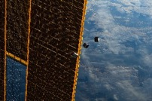
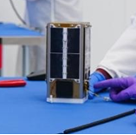
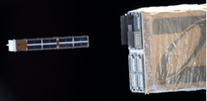
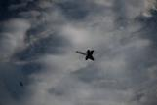
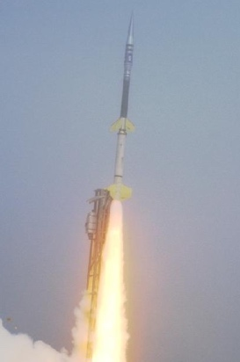
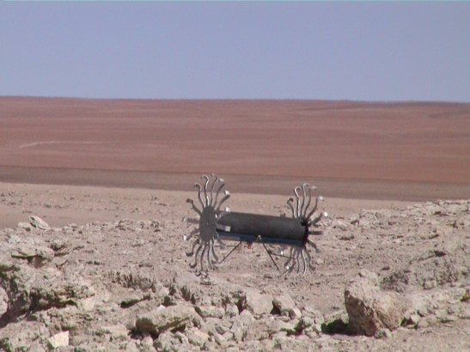
TechEdSat-N / Nano Orbital Workshop
Who we are:
Innovative flight project focused on rapid design and innovation
2-3 flights a year
Low cost, ISS standards
90% experiment success rate
Over 25 years developing platforms/concepts
Balloon: VAST, BEST-N
Sub-Orbital: SOAREX-N
Orbital: TES-N /NOW [Nano-Orbital Workshop]
Lunar/Mars exploration proposals
TES-1: 1st off ISS
TES-7: In orbit
Key Innovations:
Communication
Iridium for quick command and control
Custom Lunar and Mars SDR radios
Exo-Brake
Exo-atmospheric braking device focused on targeted reentry
Machine Learning
GPU and Neuromorphic processing test bed
TES-10: Mission of Year, targeted de-orbit
Notable Missions:
Active: TES-7 (2U), TES-13 (3U)
Upcoming: TES-11 (6U), TES-12 (3U), TES-14 (12U)
SOAREX-7
MARVIN Cubesat Rover
Support: ARC, STMD/SSTP, GRC, AFRL

Slide 3
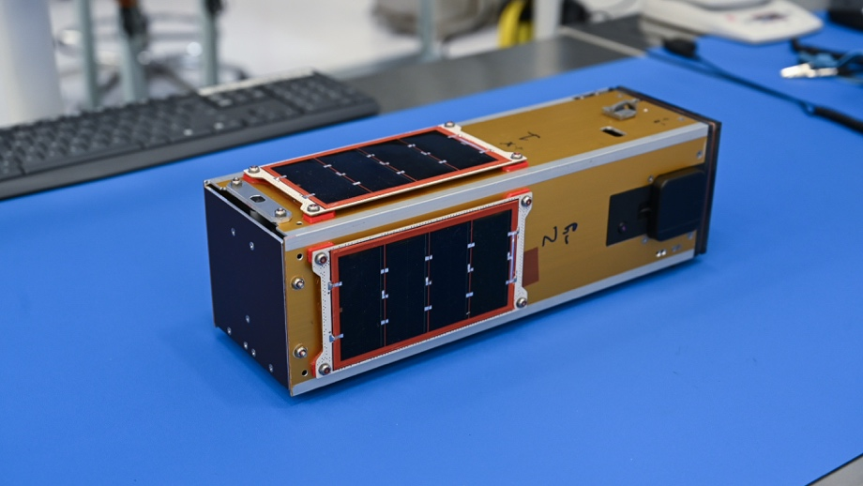
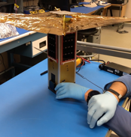
TechEdSat-13
Launched January 13, 2022
Virgin Orbit Above the cloud mission
Status:
Satellite is fully operational and has already achieved mission comprehensive success
Experiments:
Updated Non-Targeting Exo-Brake design
Updated custom S-Band lunar radio
Intel Loihi neuromorphic processor
Developed, tested, and integrated in 12 weeks
Virgin Orbit
Non-Targeting Exo-Brake

Slide 4
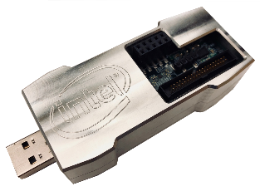
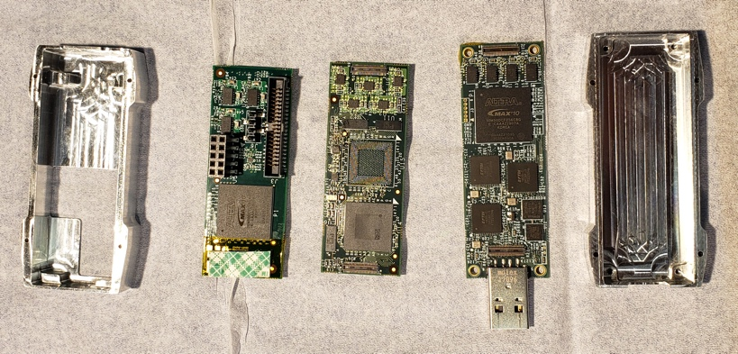
First AI/ML Neuromorphic Test
Interest:
Potential to greatly improve nano-satellite data processing while decreasing power consumption
Processor: Intel Kapoho Bay
Contains a Loihi neuromorphic chip modeled after the spiking behavior of neurons, characterized by very low power consumption and learning rules inspired by how the brain learns
TES-13 Objectives:
Establish the hardware, electrical, and software interfaces necessary to build an on-orbit neuromorphic platform
Run simple AI/ML applications that utilize the Intel Kapoho Bay
Intel

Slide 5
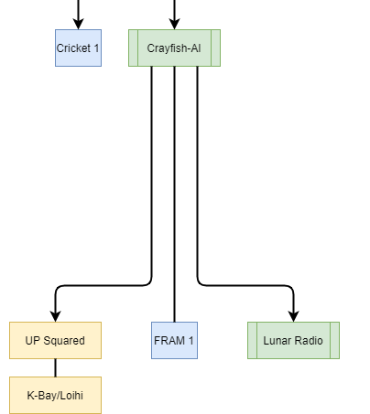
Developing an AI/ML Payload
Crayfish-AI (Command and data)
Interfaces TES with AI/ML payload
Dedicated Iridium for command and control of payload, and downlinks a short summary of application results
Memory to store payload data
Temperature, IMU, Magnetometer sensors to monitor payload health
Up Squared (Payload flight computer)
Interfaces with the Kapoho
Manages the AI/ML applications runs and post processes any data
Intel Kapoho Bay (Payload processer)
Runs the AI/ML Applications
Lunar S-Band Radio (Data downlink)
Downlinks the fully detailed AI/ML application result logs

Slide 6
Hardware and Avionics Interface
Up-Squared Driver
Kapoho Bay
Crayfish/AI
Lunar Radio
(S-band; WFF/AWS
(S. Zuniga)
Iridium
(1of 3; L-band)

Slide 7
Software Interface
Crayfish-AI interfaces with the Up board over a UART connection
Lunar Radio interfaces the Up board over a local WiFi connection
(E. Barszcz et. al)
Experiment Parameters:
Run Time: total time to run AI/ML applications
UART Transfer Time: time to transfer data to Crayfish-AI
WiFi Transfer Time: time to transfer data to Lunar Radio

Slide 8
Software Environment
Up Board and Kapoho Bay
OS: Linux (Ubuntu 18.04)
Two virtual environments
One for running AI/ML applications
One for monitoring the power
Three programming languages and about 11K lines of code (Including comments and white space)
Shell Script, C, Python
(E. Barszcz et. al)
Crayfish-AI
Environment: Arduino
Two programming languages and about 1K lines of code
C/C++

Slide 9
AI/ML Applications
ID | Processor | Execution Time | Description
A | Kapoho Bay | 5.22 Minutes | Y but on Kapoho Bay
B | Kapoho Bay | .5 Minutes | Cognitive radio online learning
C | Kapoho Bay | .6 Minutes | Cognitive radio on simulated data
O | Kapoho Bay | 13.8 Minutes | Online learning on spacecraft anomaly data
T | Kapoho Bay | 0.5-4 Minutes | Online learning with spacecraft health
W | UP | 0.5-4 Minutes | Validates any data generated with T
X | Up | 1.56 Minutes | Y but without SNN
Y | Up | 4.8 Minutes | Simulated SNN on a CPU
Z | Kapoho Bay | .9 Minutes | SNN anomaly detection on test spacecraft data
(M. Mercury et. al)
SNN – Spiking Neural Network

Slide 10
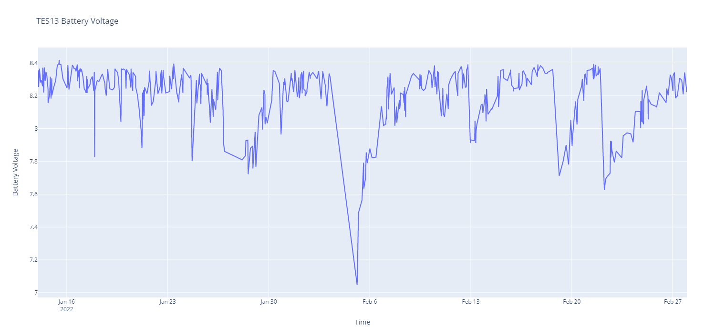
Initial Results: Spacecraft Health
AI/ML: 30min
AI/ML: 41 min
AI/ML: 180min
AI/ML: 45 min
AI/ML: 225min
Total Packets:
Iridium 1: 1500
Iridium 2: 1000
Iridium 3: 1300
GPS/Data collection
GPS/Data Collection, SP test
AI/ML: 226min
Successfully run the AI/ML experiment for 225 minutes or ~2.5 Orbits

Slide 11
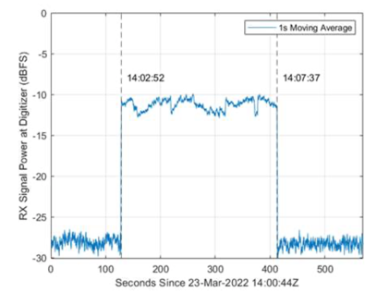
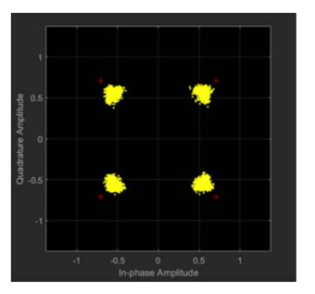
Initial Results: Lunar Radio Downlink
TES-13 data received through AWS connection.
(A. Gannon et. al)
(C. Priscal)
Successful Phase1 OPS
Analyzing data to extract key radio/link parameters including S/N, data rate
Demodulation and data transfer protocol being developed
Passes limited to 50MB. (data per pass dependent on derived data rate; 1-1.2 Mbs; 400Mb requires 330-400s)
Commercial S-band data downlink experiment through Amazon Web Services (AWS) Ground Station
One 5-minute pass has downlinked 51MB of data
Operation plan for next few passes
Evaluate current data set
Commence production experimental runs ( a 2.5 orbit/225 min run/Extended Run will generate about 5MB of data)

Slide 12
Initial Results: Application statistics
ID | Date | T_Sched | T_UART | T_WIFI | Tot Packets | Num H | Num A | Num B | Num C | Num O | Num T | Num W | Num X | Num Y | Num Z | Success Rate
1 | 1/14/2022 | 4 | 2 | 0 | 2 | - | - | - | - | - | - | - | 1 | - | - | 50%
2 | 1/14/2022 | 6 | 2 | 0 | 5 | - | - | - | - | - | - | - | 1 | - | - | 20%
3 | 1/16/2022 | 4 | 2 | 0 | 7 | - | - | - | - | - | - | - | 1 | - | - | 14%
4 | 1/17/2022 | 30 | 10 | 0 | 12 | - | - | - | - | - | - | - | 1 | 1 | - | 17%
5 | 1/18/2022 | 15 | 5 | 0 | 6 | 1 | - | - | - | - | - | - | - | - | - | 0%
6 | 1/19/2022 | 19 | 5 | 0 | 9 | 2 | - | - | - | - | - | - | - | - | - | 0%
7 | 1/21/2022 | 41 | 10 | 0 | 10 | 3 | - | - | - | - | - | - | - | - | - | 0%
8 | 1/24/2022 | 45 | 10 | 0 | 21 | 3 | - | 1 | 1 | - | - | - | - | - | - | 11%
9 | 1/25/2022 | 65 | 20 | 15 | 19 | 5 | - |  | 1 | - | - | - | - | - |  | 7%
10 | 1/30/2022 | 65 | 20 | 0 | 40 | 4 | 1 | 5 | 2 | - | 2 | 2 | - | - | 2 | 39%
11 | 2/7/2022 | 95 | 30 | 0 | 66 | 7 | 2 | 6 | 4 | - | 13 | 13 | - | - | 6 | 75%
12 | 2/10/2022 | 96 | 30 | 0 | 35 | - | 3 | 6 | 5 | - | - | - | 6 | 4 | 6 | 86%
13 | 2/12/2022 | 180 | 45 | 0 | 67 | - | 5 | 12 | 9 | 5 | - | - | 10 | 8 | 11 | 90%
14 | 2/22/2022 | 225 | 50 | 0 | 159 | 15 | 4 | 18 | 17 | - | 34 | 34 | - | - | 14 | 84%
15 | 3/4/2022 | 226 | 60 | 0 | 61 | - | 5 | 5 | 5 | 2 | - | - | 9 | 8 | 6 | 66%
(E. Barszcz et. al)
Each application generates a status packet identifying if the application succeeded or failed
Success Rate: the number of successful application packets out of the total application packets received, disregarding any health packets

Slide 13
Next Steps
Summary:
TES-13 may represent the first AI/ML flight test of the Intel Loihi neuromorphic processor
All AI/ML applications have successfully executed on the Kapoho Bay, including online machine learning using SNN
TES-13 will operate on orbit for the next few years and the team will continue to conduct AI/ML experiments to better characterize the hardware
Advances in computing represented by AI/ML neuromorphic processors is a harbinger of the future applications and makes it very suitable for power constrained systems.
Experiment verified TES-13’s compatibility with AWS which will be leveraged for future experiments (Cognitive Communications; UIS/User Initiated Service)
Observations:
First generation Kapoho chip takes time to warm up and operate successfully
Starting experiment temperature is around -5 deg C
Future versions of the software should incorporate timekeeping and better use of command scheduling
Future Flights:
TES-11 (Late Summer 2022), and TES-12 (Early 2023) will fly the next version of this experiment
Includes several software and electrical improvements
Improved TES Interface board and next generation Intel Kapoho Bay module
Cognitive Communications – fully automated User Initiated Service (UIS) with two commercial providers (AWS and Iridium), this allows a spacecraft to schedule on-demand communications services with a ground station or space relay.

Slide 14
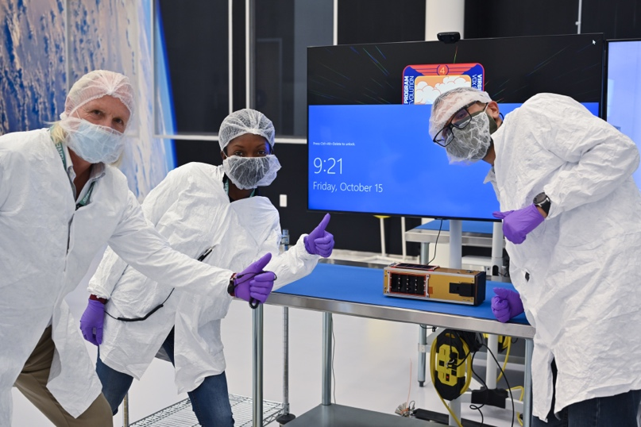
Thank You!
Marcus Murbach, , Alejandro Salas
Add team masked members!

Slide 15
Back-Up Slides

Slide 16
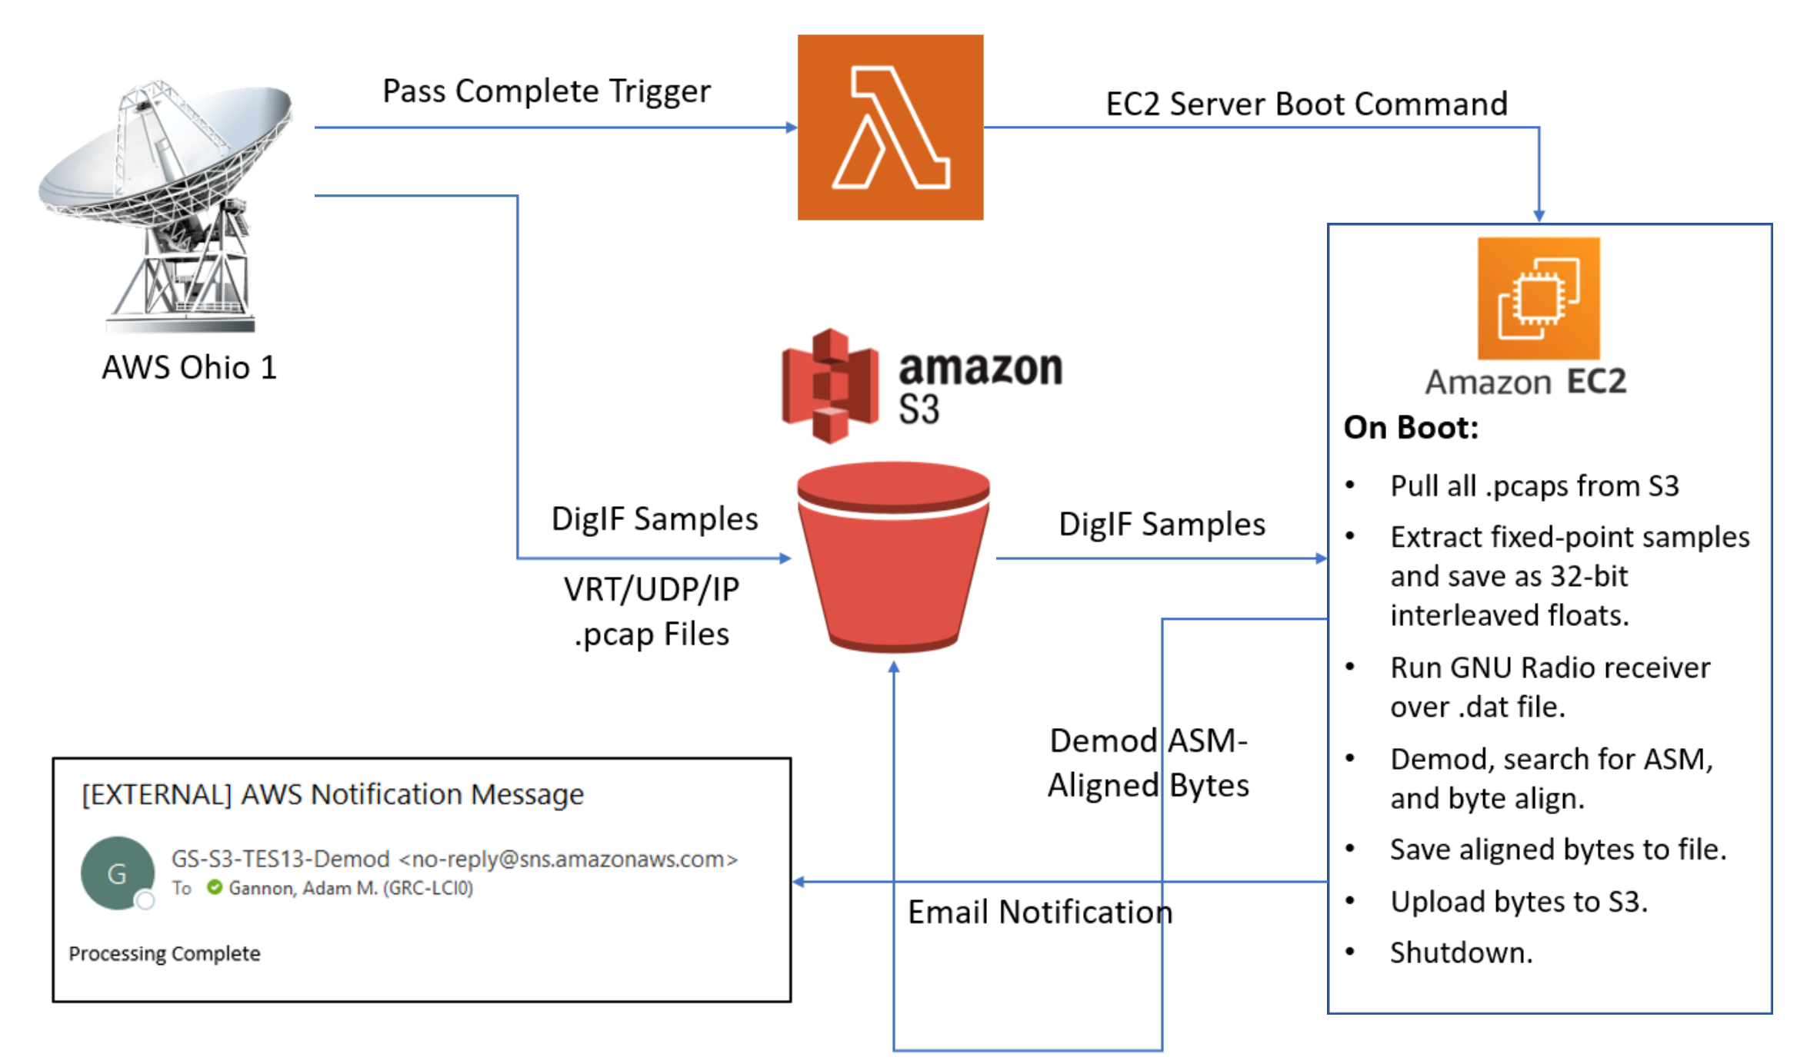
AWS Processing Flow

Slide 17
Abstract
Neuromorphic processors, inspired by the wiring of the brain, permit certain classes of Artificial Intelligence/Machine Learning (AI/ML) algorithms to run far more efficiently. Ultimately, such systems will make the small- and nano-satellite platforms even more useful in terms of greatly improved power, communication and internal data management. In addition, on-board processing of images and data will help to not only rapidly interpret the information, but also reduce the amount of data that needs to be transmitted to ground stations. This initial flight experiment uses the Intel/ Loihi processor combined with a custom interface board and three communication channels to run the AI/ML scripts. These will vary with increasing length and complexity during the course of the mission. The algorithms will use the (at first) limited sensor data to ‘learn’ - with comparisons to similar architecture in comparable ground experiments. Some of the applications for successor flights in the TES-n flight series include Cognitive Communications, whereby the overall communication system is optimized per overflight – by optimizing timing and data transmission functions. Lastly, the performance of the Loihi 14nm process technology will be monitored for performance in the LEO radiation environment, thus looking for induced hardware and software errors. This information will help guide future radiation protection techniques to extend the lifetime and overall utility. The TES-13 is a 3U nanosat successfully launched by the Virgin Orbit Launcher-1 on January 13, 2022, and will presage more flights and AI/ML applications to come.

Slide 18
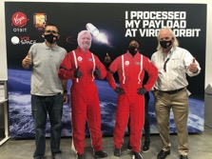
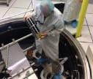
TES10, TES7, TES11, TES13, TES-n [Nano-Orbital Workshop: NOW!]
Objectives
I. Advanced ‘open’ flight development platform with facile interfaces (NOW).
II. Accurate Drag-based de-orbit (Exo-Brake modulation targeting) and subsequent EDL experiments; Disposal Exo-brake
III. Advanced COM/Avionics/GPU platform (Lunar/ Mars radios),
IV. Training platform for Next Gen NASA/Industry.
Technology Need:
Open flight development platform to easily include ‘Experiment/Sensor/Sub-systems for NASA, SSTP, and Gov/academic partners [‘Umbrella’ SAA in place]
Unique targeted de-orbit (safe/non-propulsive) for sample return, EDL material/concept testing.
Advanced COM/Avionics permits NEN-compatible COM architecture, Iridium/Globalstar test, large on-board processing/compression (NVIDIA/TX2 with 200:1 compression (Virtual Reality exp; AI in the sky/ML proposal). 150W-hr power system ) - highest of NASA nano-sats
Education Outreach through university participation, internships, critical young-career dev.
Significant Accomplishments
TES-10 achieved comprehensive success: Series of successful NOAA transmissions, PhoneSat successfully took a picture. March 15, 2021 End of mission SMALLSAT MISSION OF THE YEAR
TES-7: COMP Success; VO 1-17, 2021 – OPS Extended
TES-11: CDR, in-development; ILC Sept 22, 2022
TES-13: COMP Success – OPS Extended
TES-12: In-development; MMO 28Bravo Mission Dec, 2022
Approach
Leverage the TechEdSat team to deliver satellites in a cost effective rapid manufacture approached
Utilized the expertise of senior Engineers and PIs to develop and test state of the art hardware and race TRLs .
Project Incremental Flights (In Current Flight Order; Approved Slots)
TES10: July 15 [6U] ; CAL-Sat. [VO BALLAST OPPORTUNITY TES9 WAS ‘LOST’]
NVIDIA GPU; Lunar Radio/NEN-radio compatible at 5Mbs; Mars radio/NOAA; Internal wifi COMP SUCCESS
July 13, 2020 deployment from ISS; OPS under way;
TES7: January 17, 2021 [2U; CSLI Virgin Orbit; 500km 45° orbit ]. In Orbit!
FIRST ‘disposal’ Exo-Brake’ from 500km; possible debris soln; high alt Iridium test; laser diode test
Launch from Virgin Orbit (First payload flight on VO);
TES11: June 15, 2021 [6U-W; CSLI L9EFS 500km Polar]. ILC Sept 22, 2022
NOAA/Mars Radio-3; NVIDIA GPU; AFOSR COM test; Adv COM experiment/DVBS-2; Encrypt
Constant-Q propulsion; X-band radio proposal
TES-13: Jan 13, 2022 launch [3U on AFRL VOX flight] AI/ML Success
Advanced COM/ML (GRC); adv exo-brake; Autonomous guidance experiment
TES-15: May X, 2022 [Firefly Vberg; 200°/300km circ]
Advanced COM/ML (GRC); HOT exo-brake; Autonomous guidance experiment-2
Upcoming Major Activities
TES-15: Firefly Launch - Mid May, 2022

