Slide 1


The Dragonfly Entry and Descent System
Presentation – UIUC
May 5, 2022
Michael Wright (Dragonfly EDL Phase Lead)
Notes:
APL led
Partners include : several NASA centers, Penn State, Honeybee Robotics, JPL, and Lockheed Martin.

Slide 2
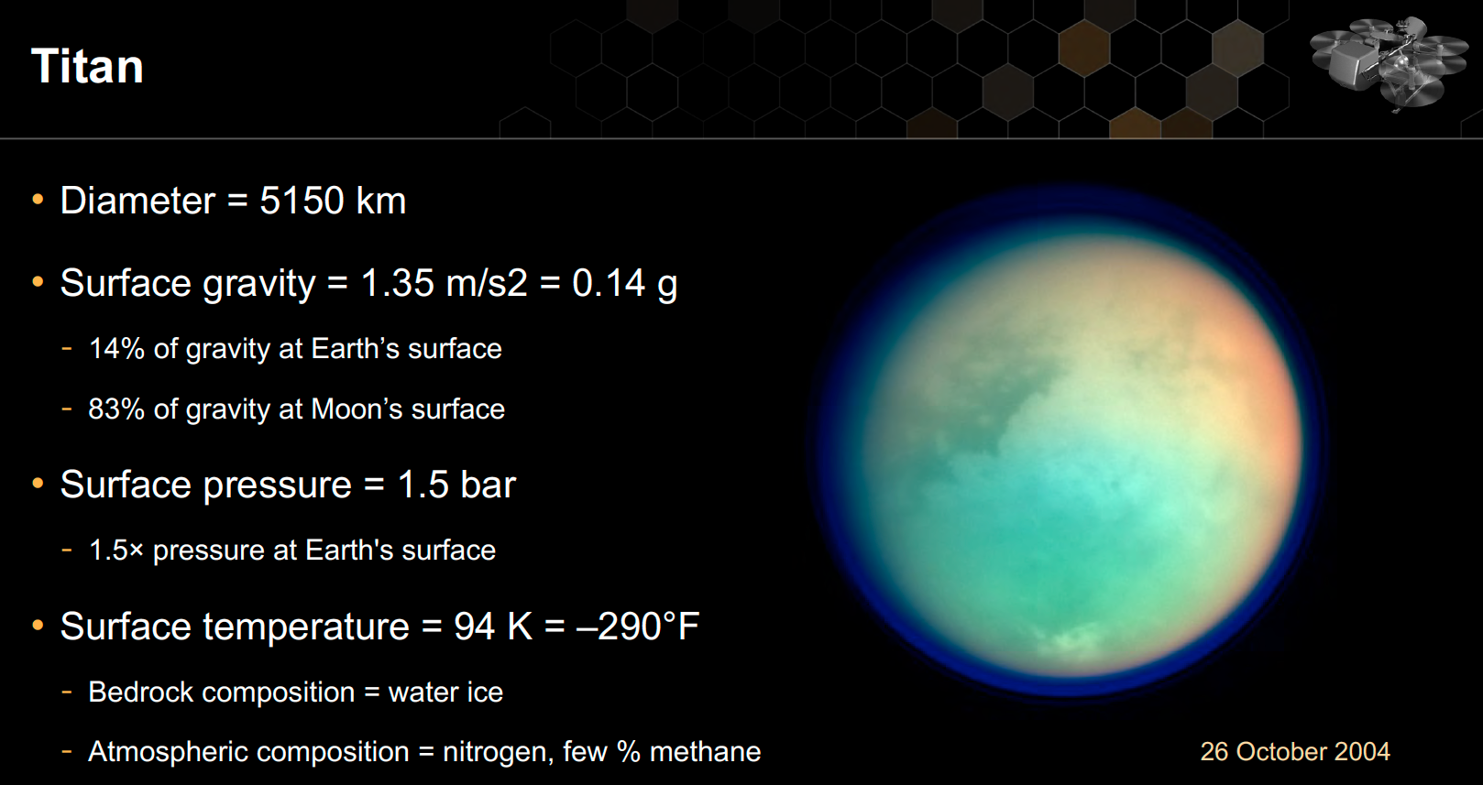
: Largest of Saturn’s Moons
(4× density)
2
Notes:
At Titan temperatures, water is a rock

Slide 3
Why Titan?
3

Slide 4
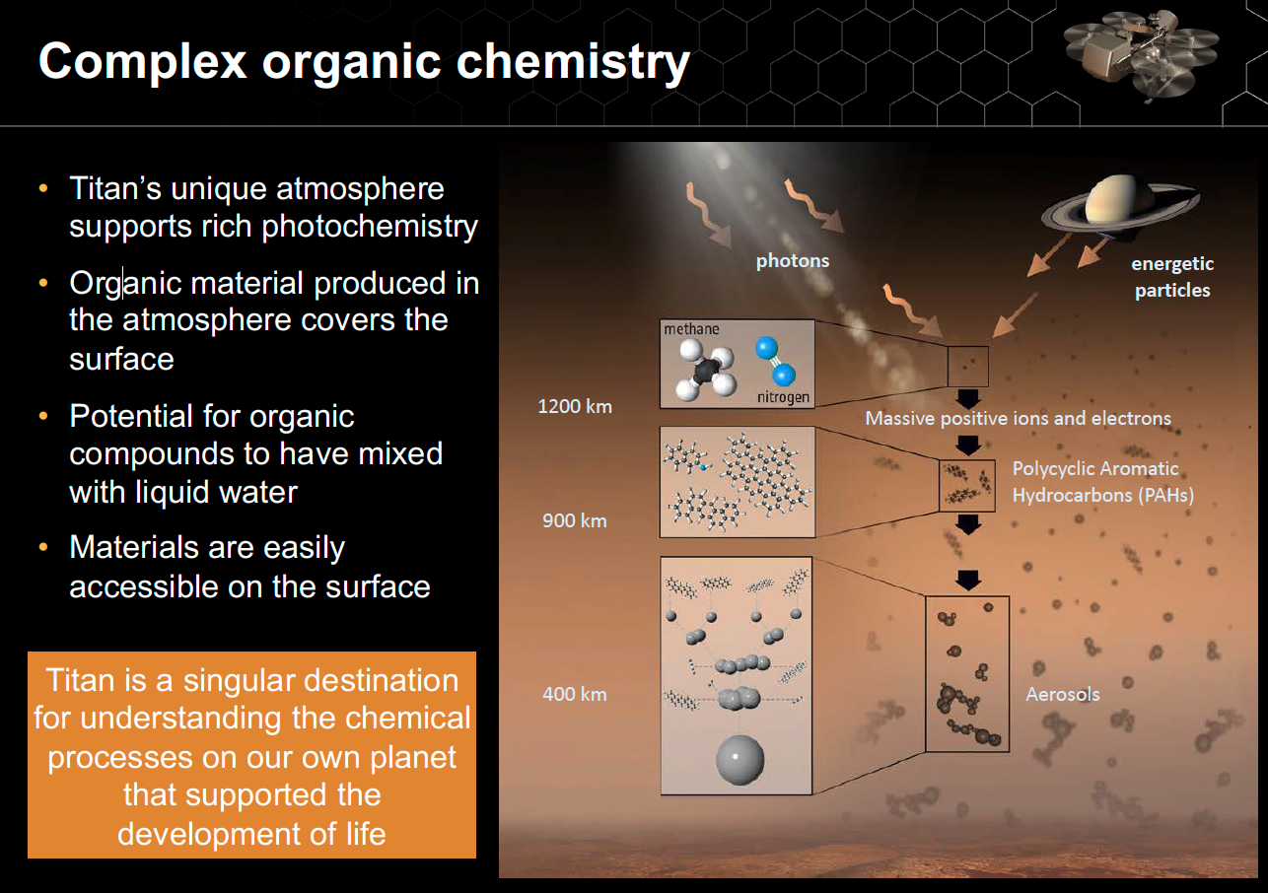
4

Slide 5
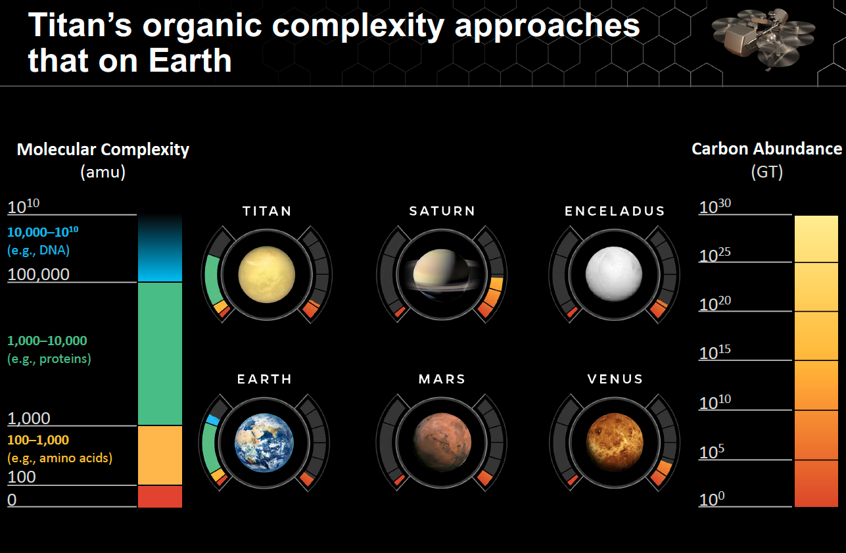
5

Slide 6
Why a Relocatable Lander?
6

Slide 7
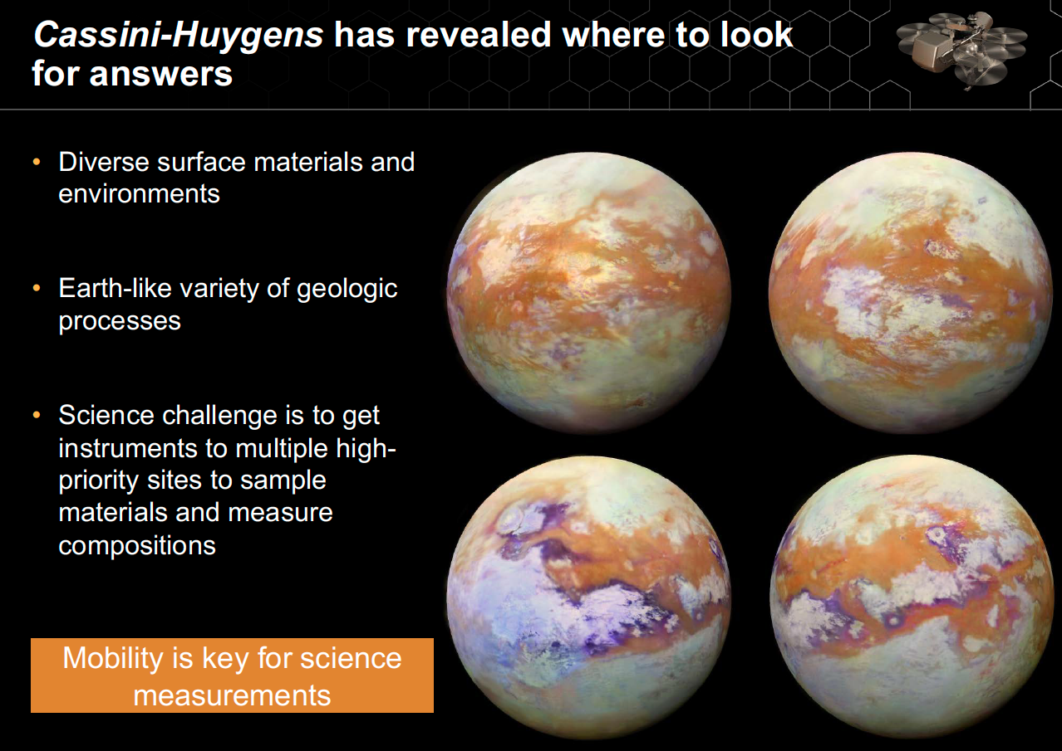
7

Slide 8
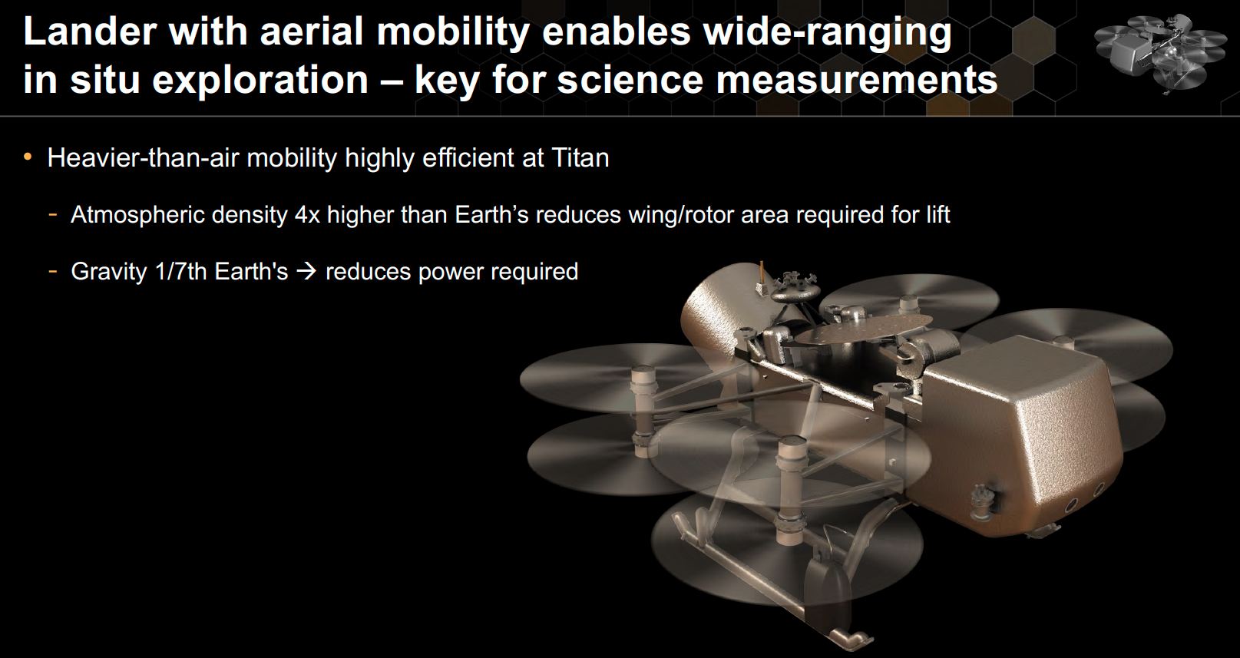
8

Slide 9
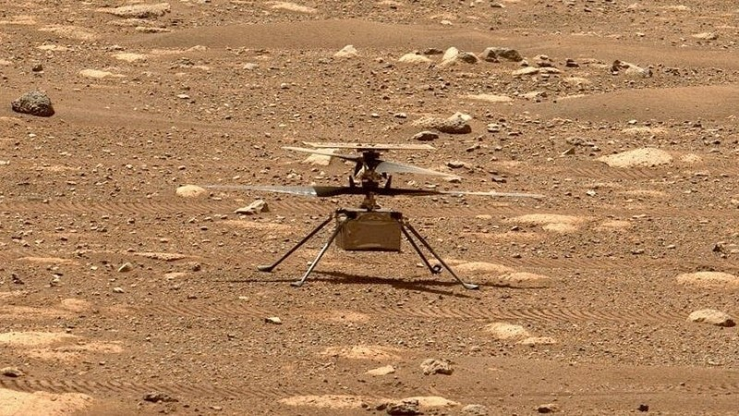
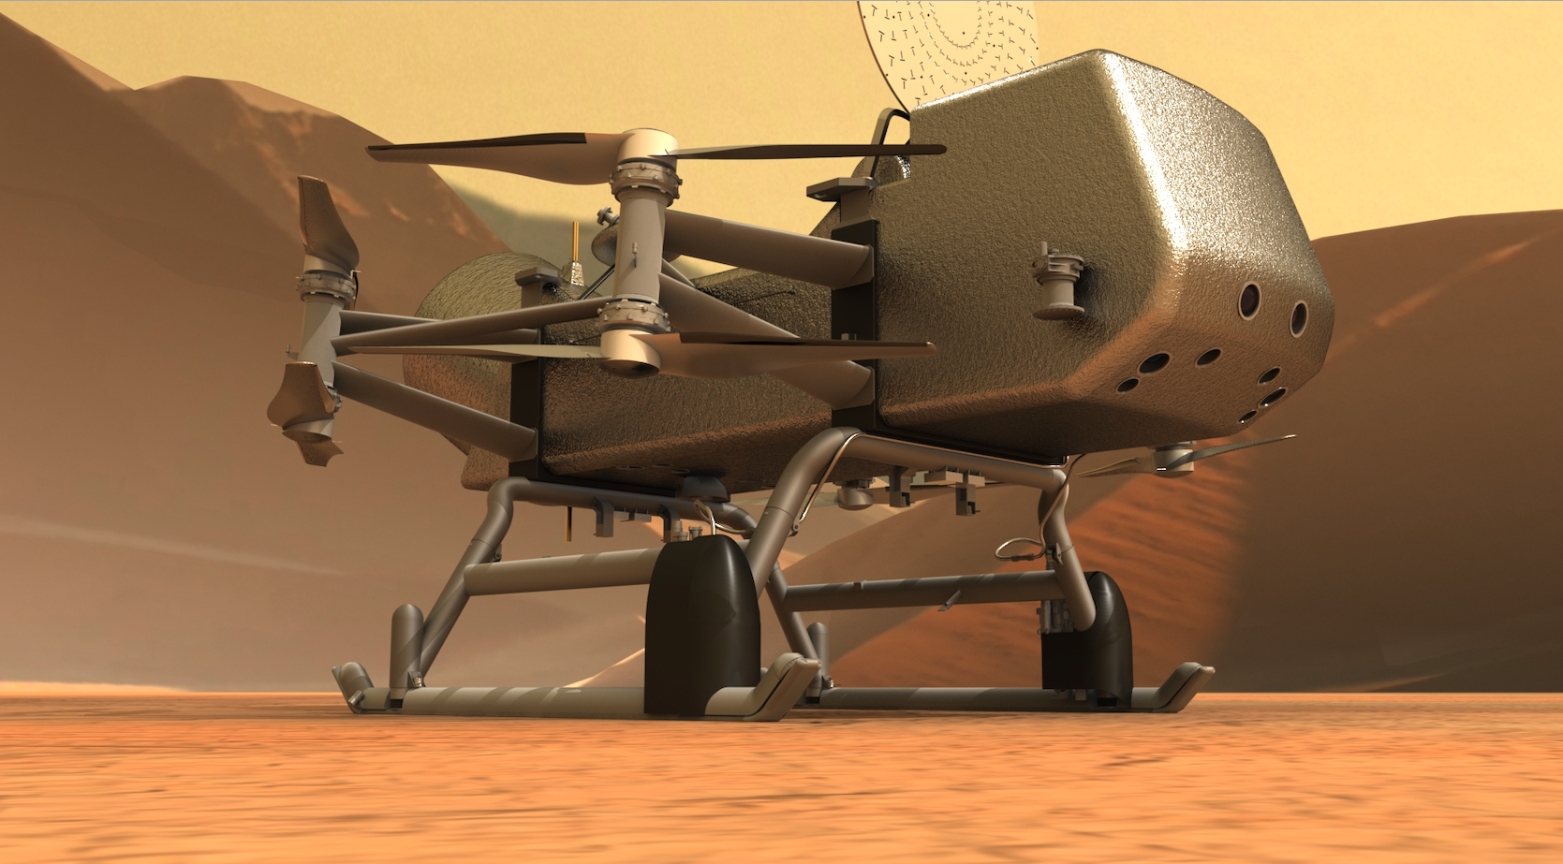
A Note on Scale
Ingenuity
Dragonfly
Key Dimensions:
Fuselage: 13.6x19.5x16.3 cm
Rotor Diameter: 1.2 m
Total Mass: 1.8 kg
Key Dimensions:
Fuselage: ~3.85 m long
Rotor Diameter: ~1.35 m
Total Mass: ~900 kg
9

Slide 10
A Note on Scale
10
Notes:
Assuming 3.85m length for DF vs 1.2m rotor diameter for Ingenuity

Slide 11
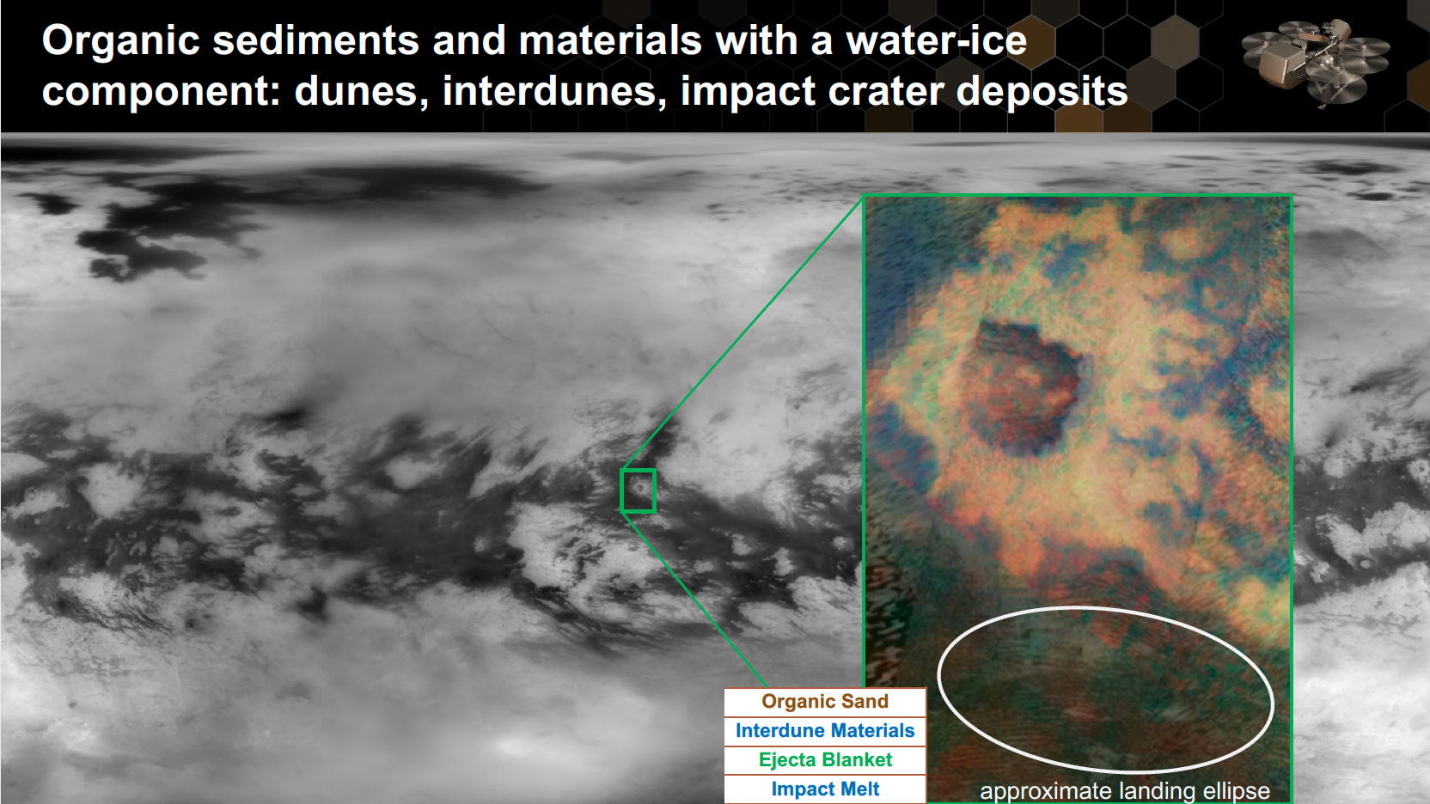
Selk Crater
11
Notes:
Namib dunes provide a clear terrestrial analog
Interdune region tends to be flat and clear of hazards

Slide 12
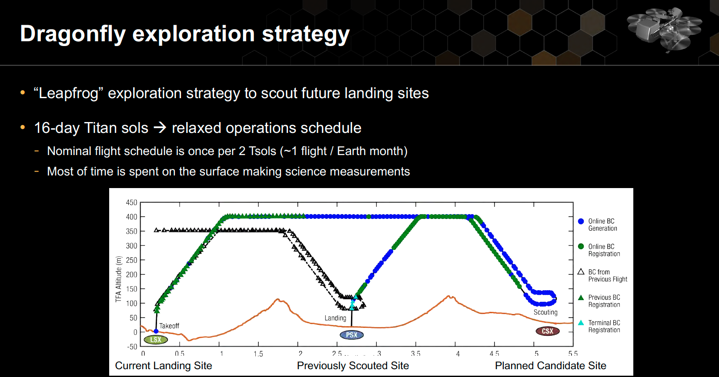
12
Notes:
Terrain relative navigation from about 75m
Flash LIDAR, stereo nav cam
3-4 km between dune peaks
3.25 year baseline mission; 180km traverse
Landing terrain safety : 10° slope, 0.25m rock
Important: although you frequently hear “Nuclear powered” we actually fly on battery. The MMRTG trickle charges the battery, and waste heat is internally circulated to keep the warm parts warm.

Slide 13
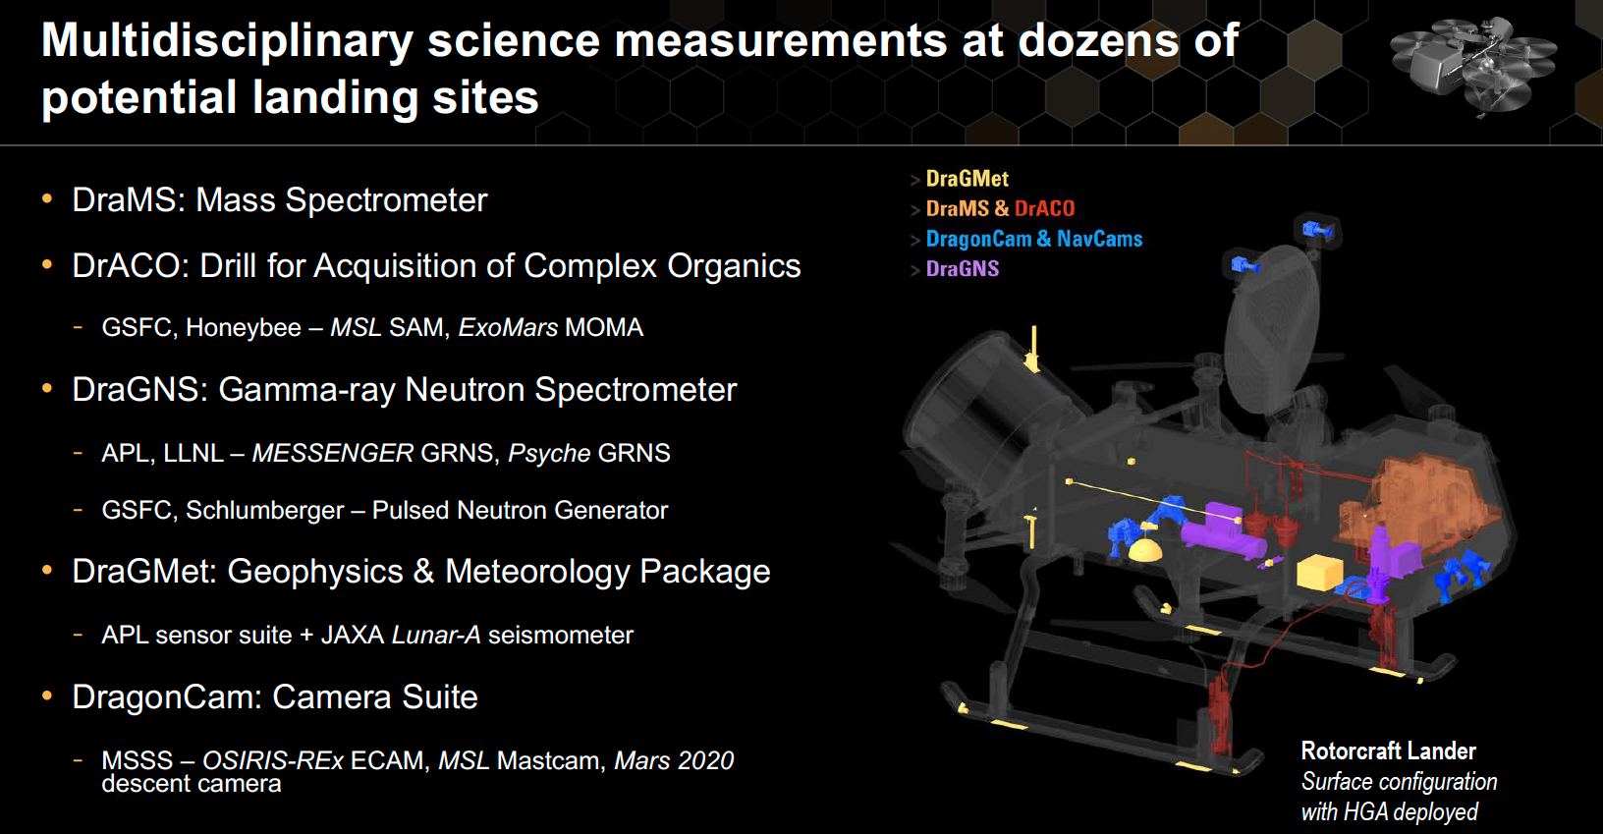
13

Slide 14
How Will We Get it There?
14

Slide 15
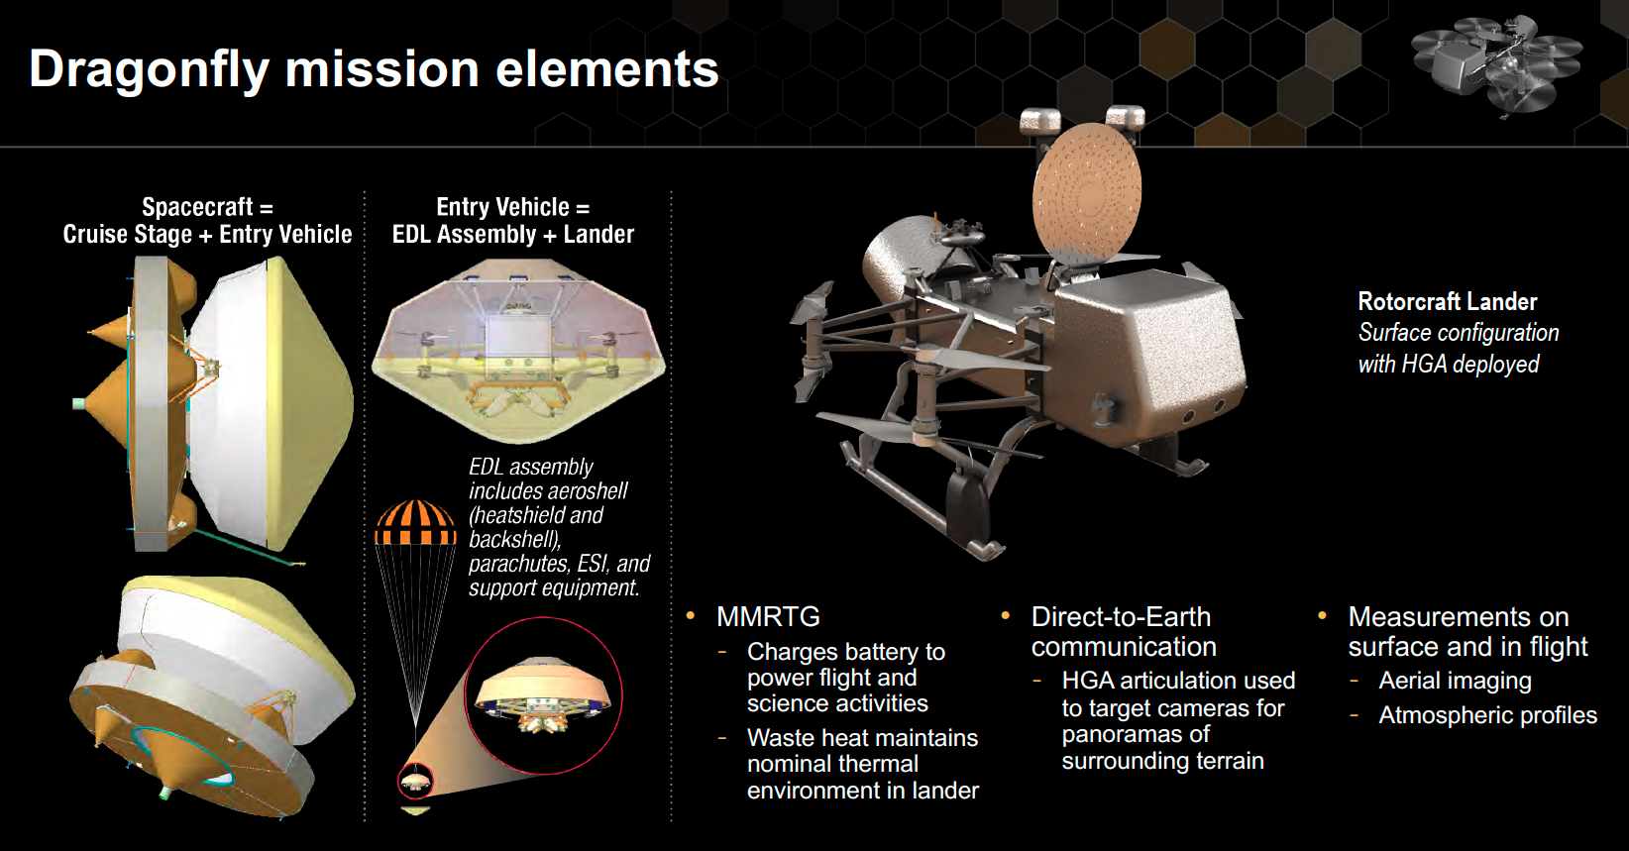
15
Notes:
4.5 meter diameter, 60° sphere cone, roughly scaled from Genesis

Slide 16
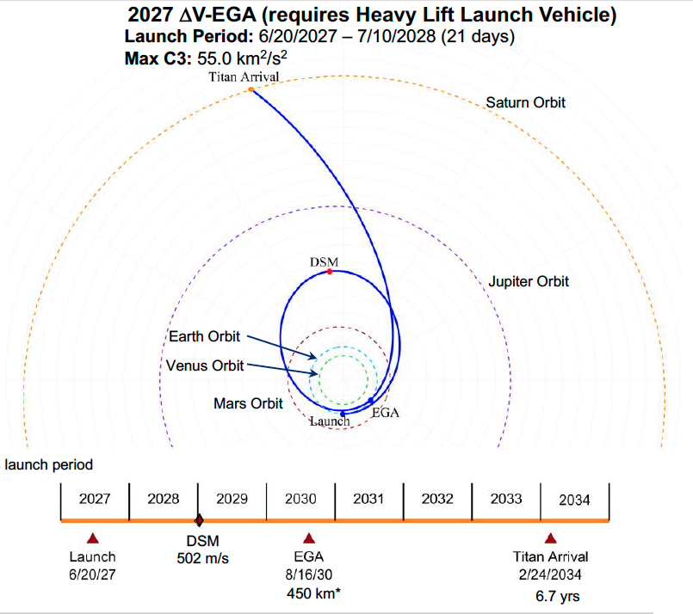
Interplanetary trajectory
16
Notes:
Dragonfly was originally selected based on a 2025 launch with a 2034 arrival.
Launch delayed to 2026 on selection, then to 2027
Added bonus: MMTRG arrives with more charge
Replace an EVEEGA with a DV-EGA ; no visit to Venus!
A major part of arrival velocity at Titan is that imparted by falling into Saturn’s gravity well.

Slide 17
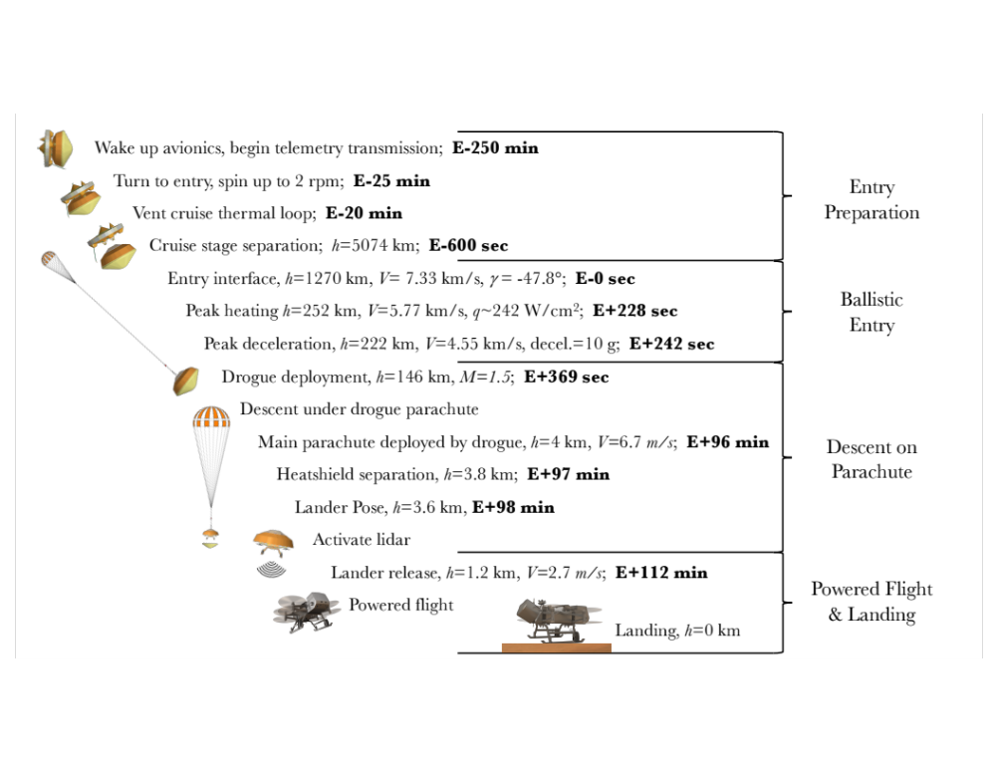
EDL Concept of Operations
Entry Interface 1270 km
  Spin-stabilized to 2 rpm
Entry heat pulse: 260 sec.
  Peak heat flux >280 W/cm² (margined)
Drogue deploy E+6 min, ~Mach 1.5.
  More than 90 minutes spent on drogue
Main chute deploy E+96 min.
  Low velocity (6.7 m/s) & low opening load
Lander Release E+112 min.
  Plenty of time to stage heatshield separation,
  pose the lander, and activate lidar
Notes:
Plenty of time to stage heatshield separation after opening dynamics subsite and activate radar when there is no chance of spoofing from released heatshield
MSL parachute design for peak load of 286 kN as opposed to 10.1 kN for the drogue and 6.1 kN for the main
Drogue:5.4m DGB; Main 14.78 m DGB (M2020 fabric, Kevlar lines)
Peak deceleration of 11G < MSL
Times on drogue: M>1.4: 7 seconds, M>1.0: 31 seconds, M>0.8: 60 seconds

Slide 18
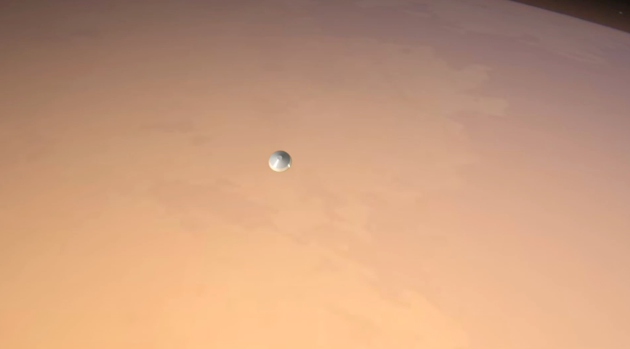
EDL Video
18

Slide 19
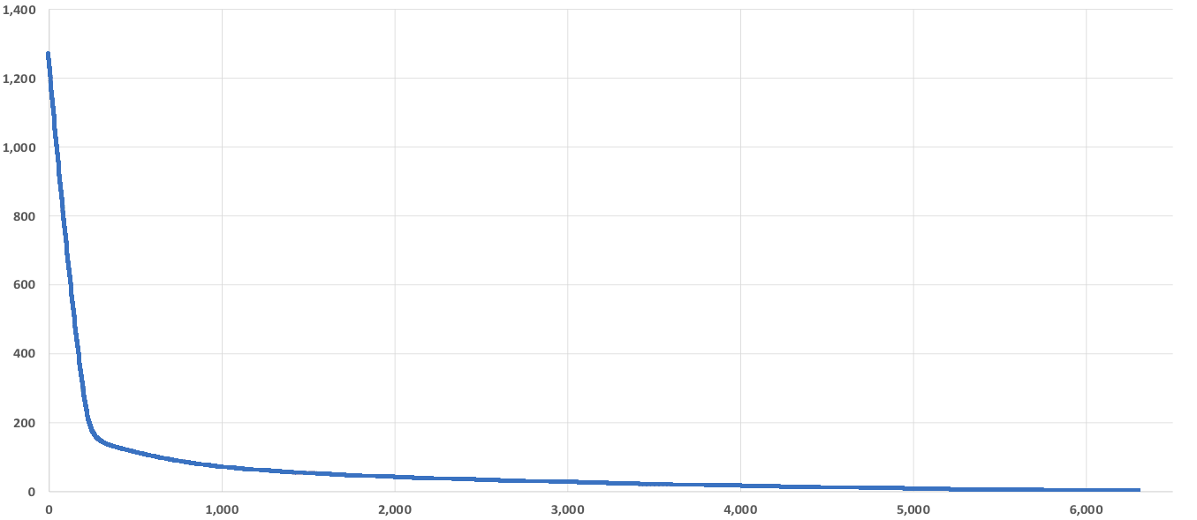
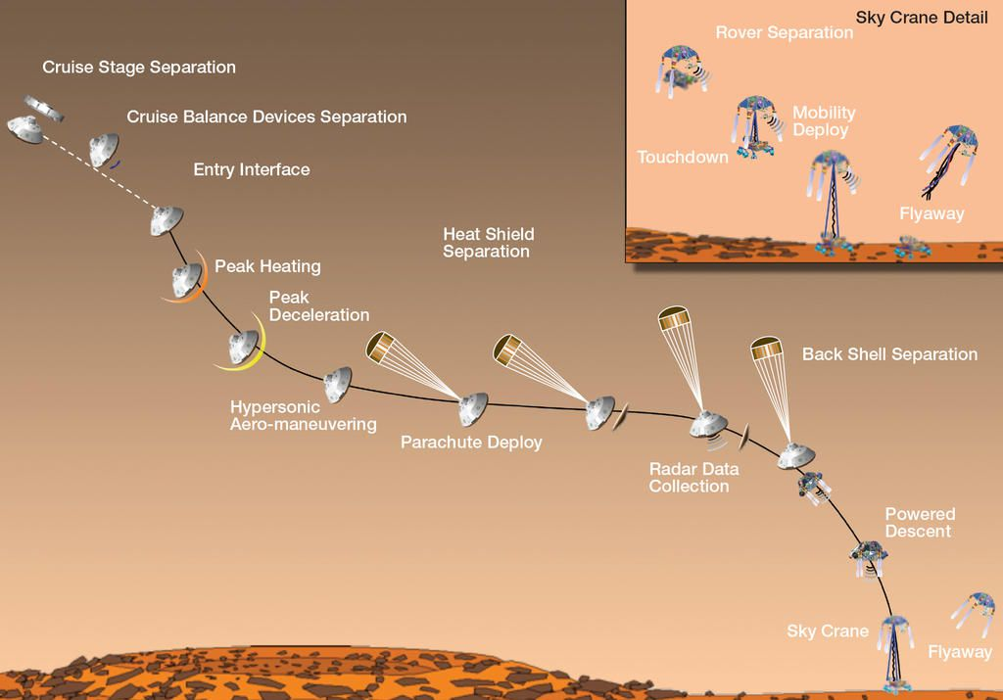
EDL Timeline Comparison
Altitude (km)
Max Deceleration
This is MSL…
Drogue Deploy
Lander Release
Main Chute
Time (s)
Notes:
Seven minutes of terror vs 2 hours of discomfort

Slide 20
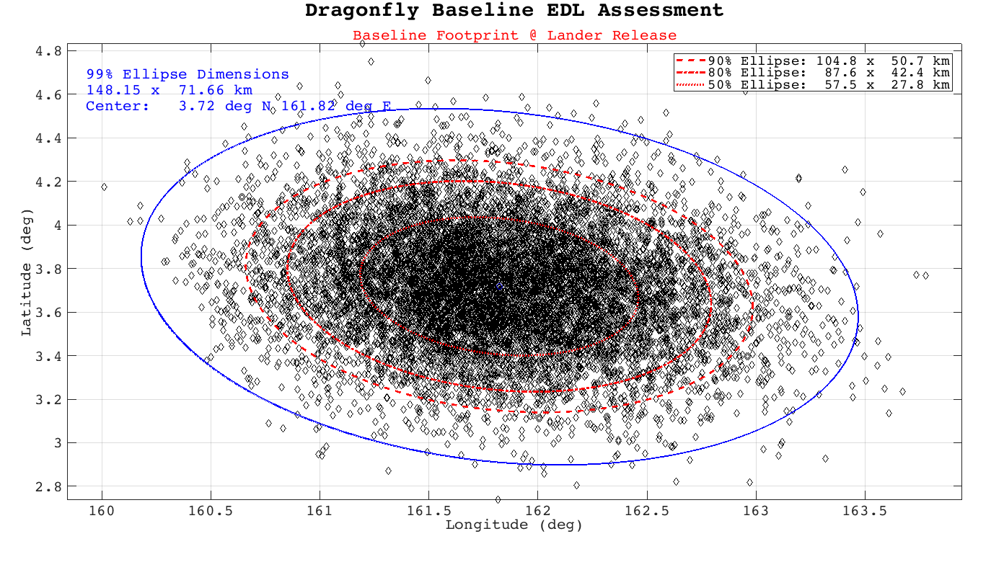
EDL Monte Carlo Analysis
Full analysis in POST2 from entry interface to lander release
Delivery accuracy ~149x72 km at release
  Affords lander sufficient accuracy to navigate to selected landing zone
Dispersions sources
  Latitude: arrival navigation errors
  Longitude: on-chute winds
20
Notes:
Atmosphere inputs (nominal and dispersed from Ralph Lorenz); Entry navigation inputs from JPL; Mass properties from LM
POST2 is the Agency’s standard EDL FM tool

Slide 21
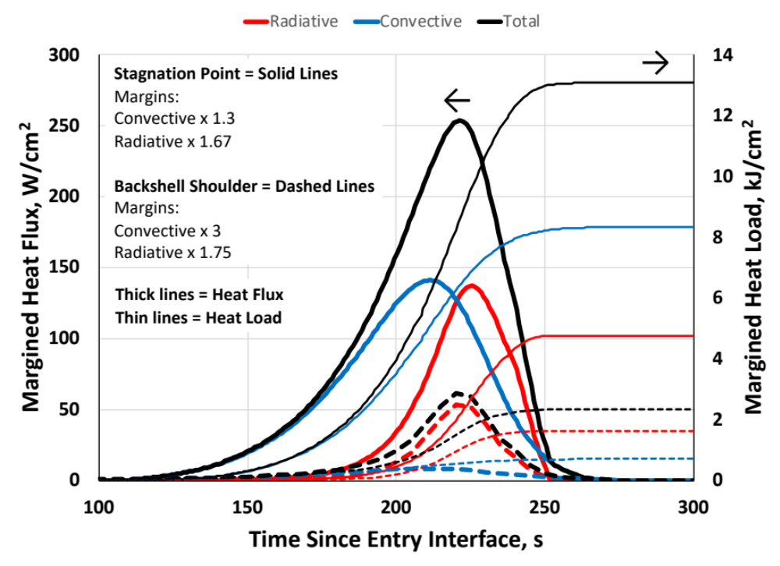
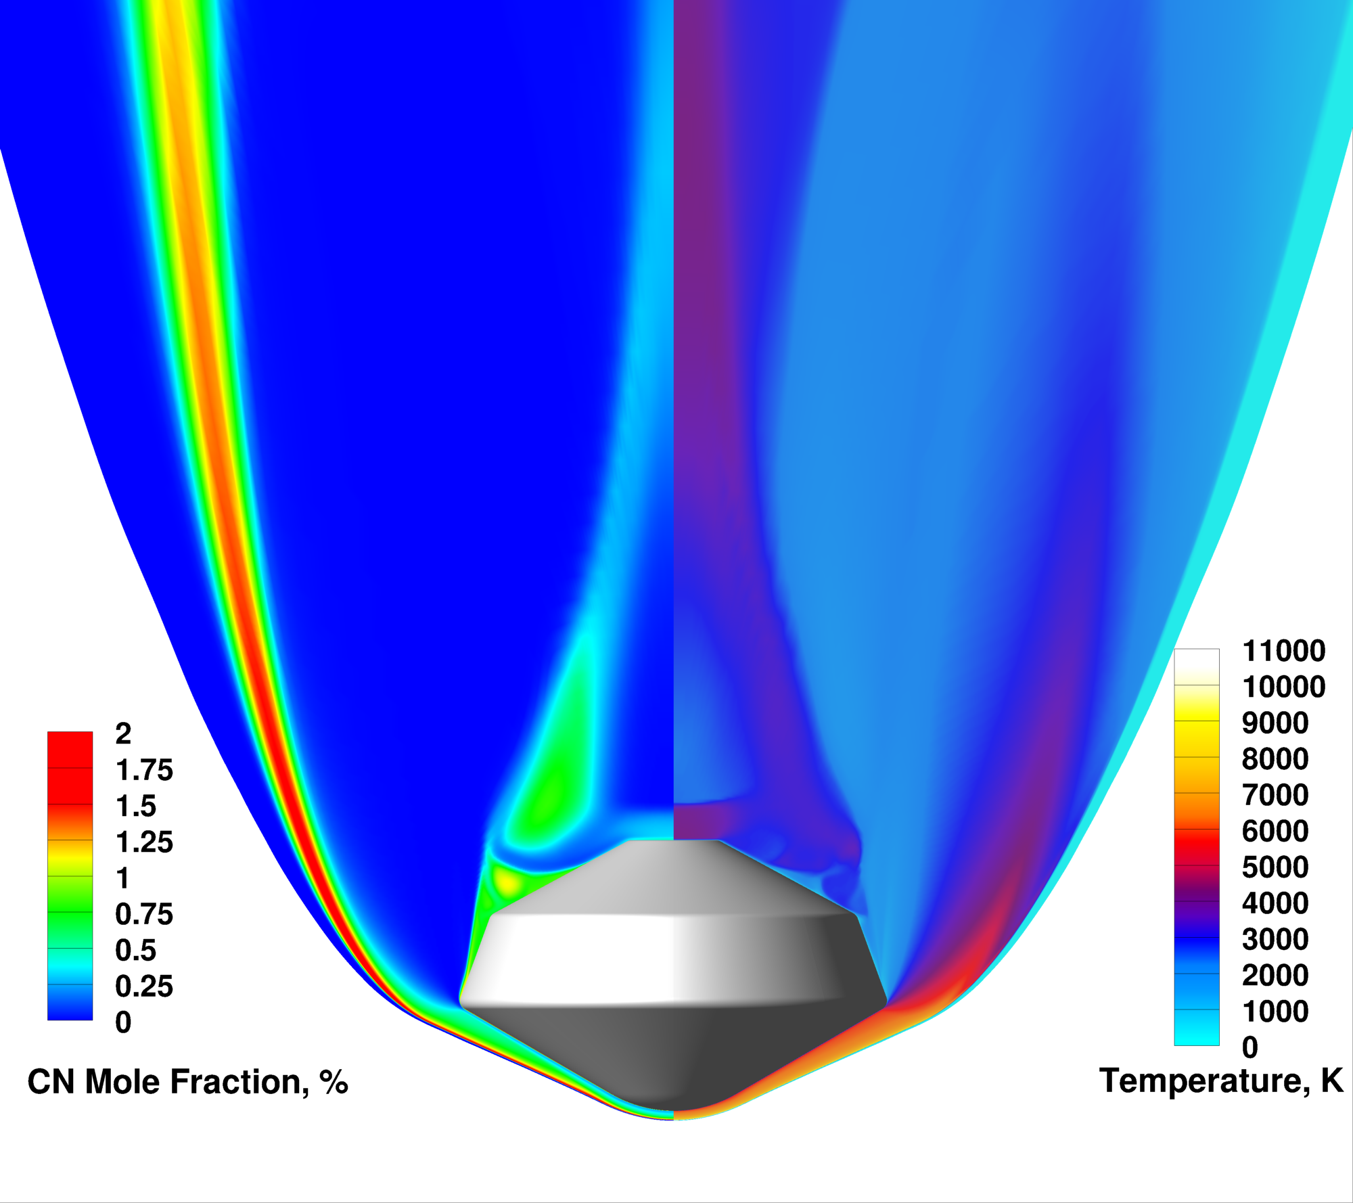
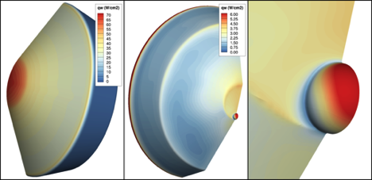
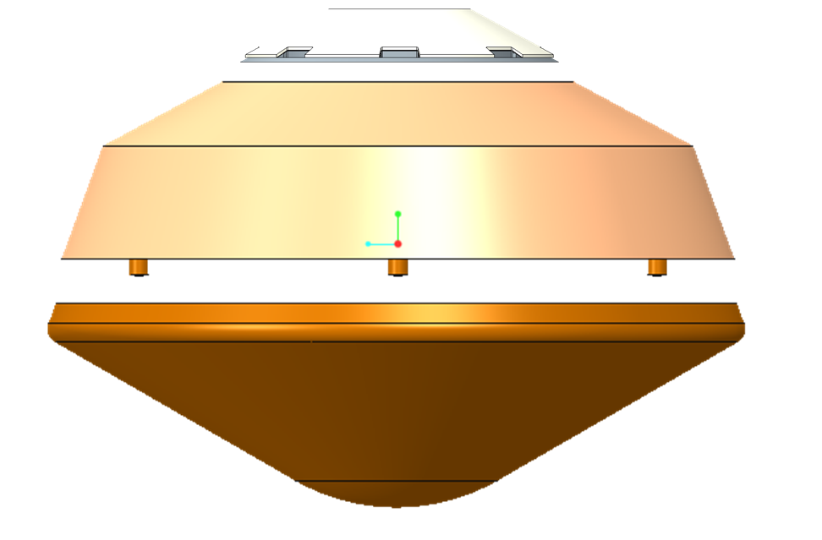
Aerothermodynamics
NASA standard aerothermal models tuned for Titan entry conditions
  Much of the heating comes from radiation due to methane
Total heating calculated over entire aeroshell
  Conservative margins applied
  Margined values within tested limits for chosen TPS
Notes:
Peak margined heating 280 W/cm2 combined; Peak margined heat load 13.1 km/cm2 combined (MSL design 220 & 6.4)
Backshell: 62/2.4; Aft cover 22/1.2; LGA 26/1.5
Radiation about 1/3 of total load at stag point, but about 2/3 of total on much of backshell
Methane is a trace constituent, but provides a source of carbon, which combines with the nitrogen to make a very strong radiator : CN

Slide 22
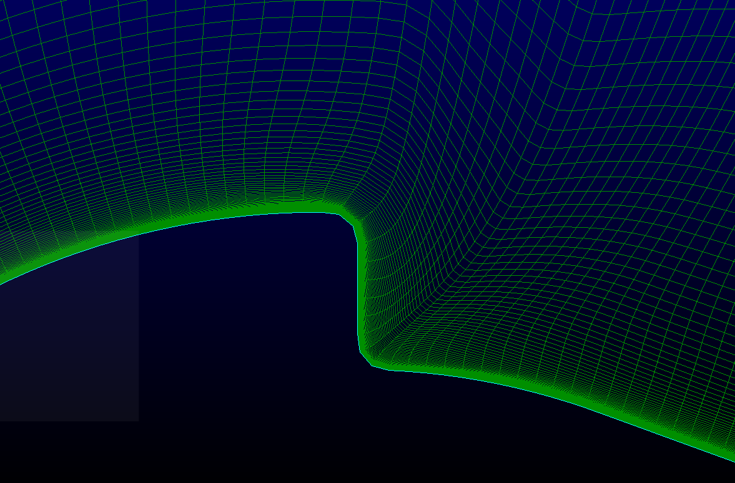
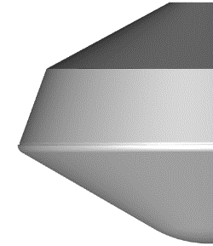
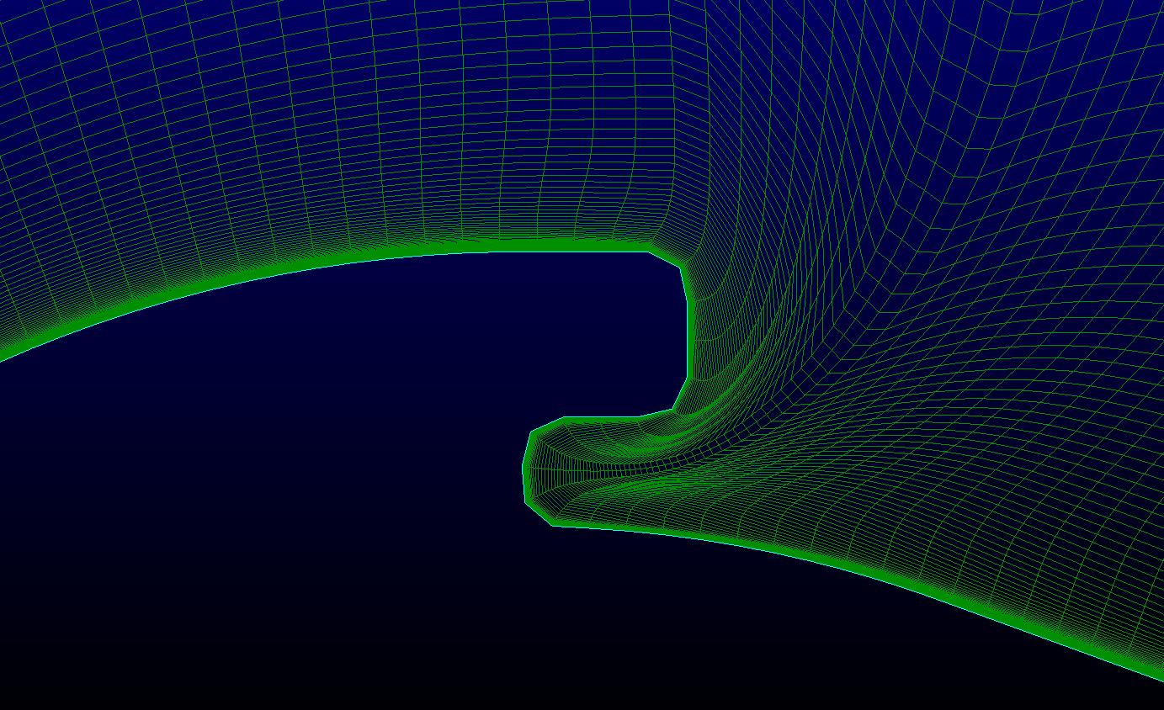
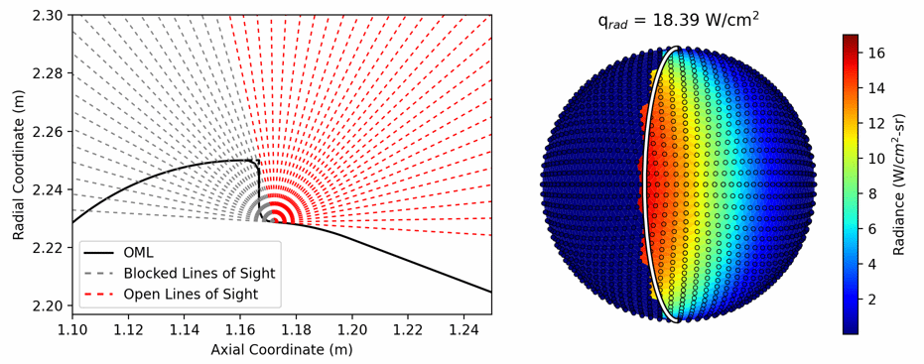
Main Seal Aerothermal (1/2)
Main seal is the separation plane for the HS and BS
Titan offers unique challenges; analysis predicts relatively high radiative heating at seal location
No Tooth
Seal
Three mitigations underway simultaneously
  Aerothermal “pencil sharpening”; can we better define environment and reduce uncertainty?
  Extension testing; can the seal withstand these higher environments?
  Protection; can we shelter the seal from the radiation?
Tooth
Seal

Slide 23
Main Seal Aerothermal (2/2)
Essentially all of the energy is coming from the shock layer near the shoulder
Combination of high CN mole fraction and high temperature
Conclusion: this is still a compressive flow (expanding flow radiation not a major contributor)
Therefore we can target with traditional testing in EAST shock tube
  Need to test at equivalent normal shock conditions (V=3-4 km/s)
  This test is underway now, sponsored by Entry Systems Modeling

Slide 24
Thermal Protection System
Three TPS materials:
  High TRL and used well within tested limits
  Arc jet testing confirms performance
  SMD funded PICA-D is a near drop-in replacement for heritage PICA; fabrication of DF billets well underway
TPS sizing & margin analysis uses mature processes developed during MSL/Orion
  Design thicknesses carry unallocated margin
TPS manufacture, testing, qualification and assembly follow standard procedures developed at LM and NASA ARC
Aft Cover
0.6” SLA-220
Backshell
0.5” SLA-561V
Heatshield
1.25” Tiled PICA-D & RTV Gap Filler
Notes:
SLA220 has heritage on Phoenix & InSight; ground tested to 68 W/cm2

Slide 25
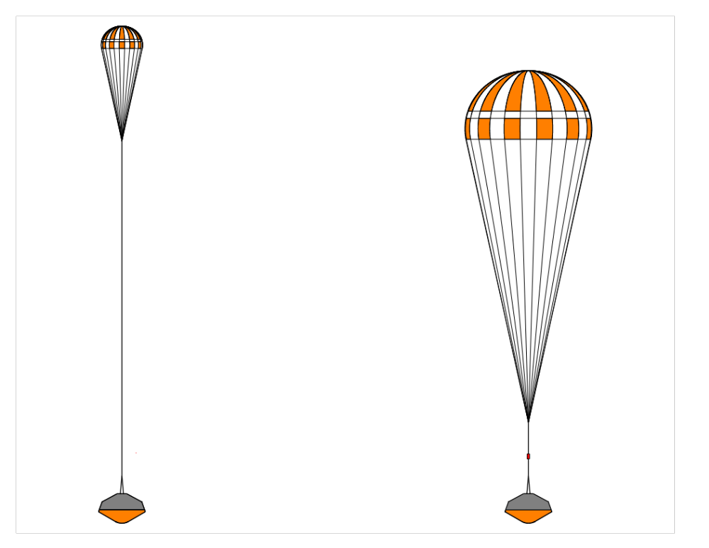
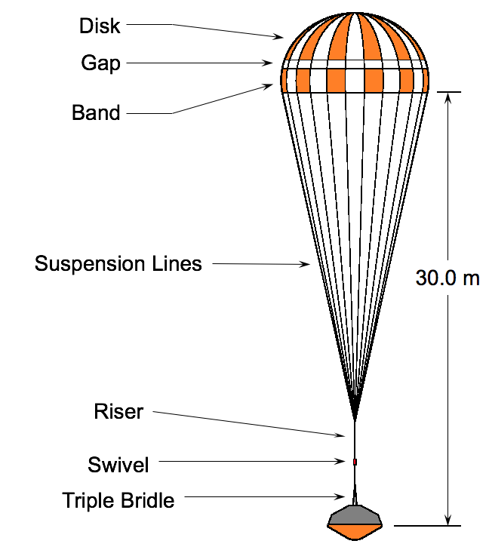
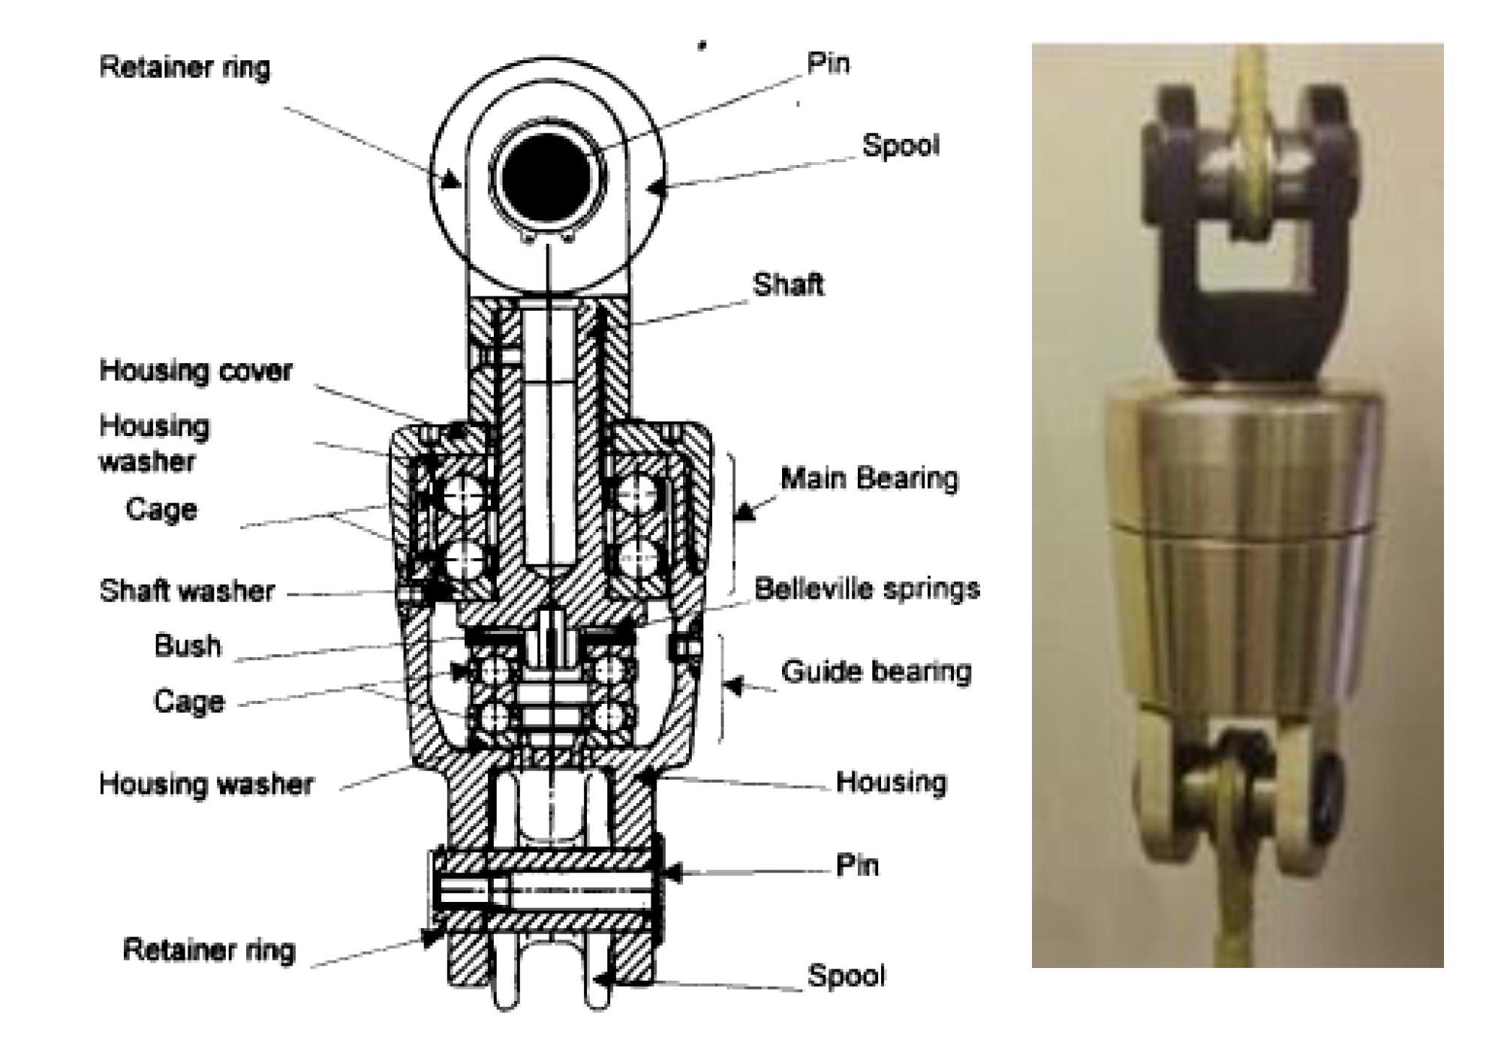
Parachute Deceleration System
Drogue Parachute (5.4 m DGB)
  Mortar deploy via trigger at Mach 1.5
  Functions: stabilize capsule, decelerate through atmosphere, extract main chute
Main Parachute (14.78 m DGB)
  Low speed subsonic deploy
  Possible anti-inversion netting
36.0 m
45.0 m
37.5 m
Huygens heritage swivels prevent line twisting
Notes:
MSL parachute design for peak load of 286 kN as opposed to 14.1 kN for the drogue and 6.1 kN for the main
Drogue:4.5m DGB (M2020 fabric, Kevlar lines, 10 diameter trailing distance); Main 14.78 m DGB (M2020 fabric, Kevlar lines, 8 diameter trailing distance)
Swivel: Molybdenum disulphide dry film lubricant

Slide 26
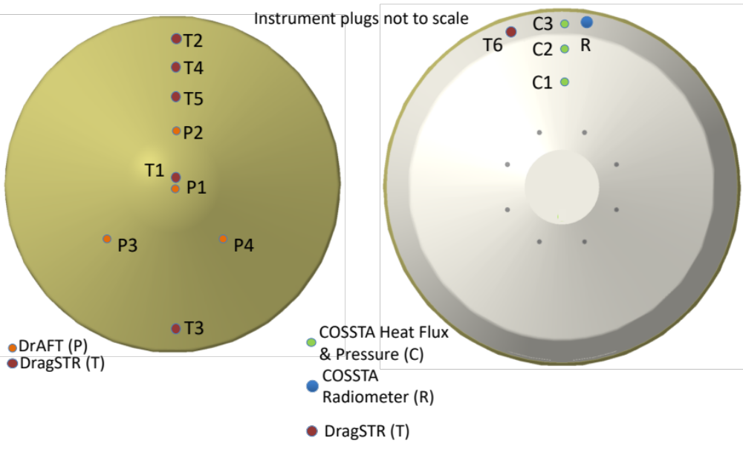
DrEAM: Preliminary Sensor Layout
Dragonfly Sensors for Thermal Reconstruction (DragSTR):
  5 forebody TC plugs, 1 aftbody TC plug
Dragonfly Atmospheric Flight Transducers (DrAFT):
  4 forebody pressure transducers
COmbined Sensor System for Titan Atmosphere (COSSTA):
  3 combined total heat flux, pressure and temperature sensors
  1 radiometer

Slide 27
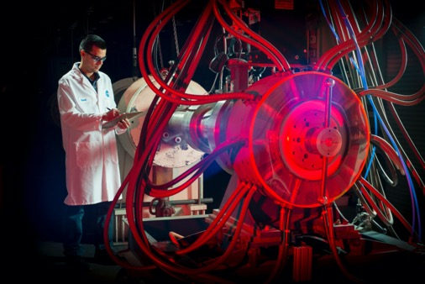
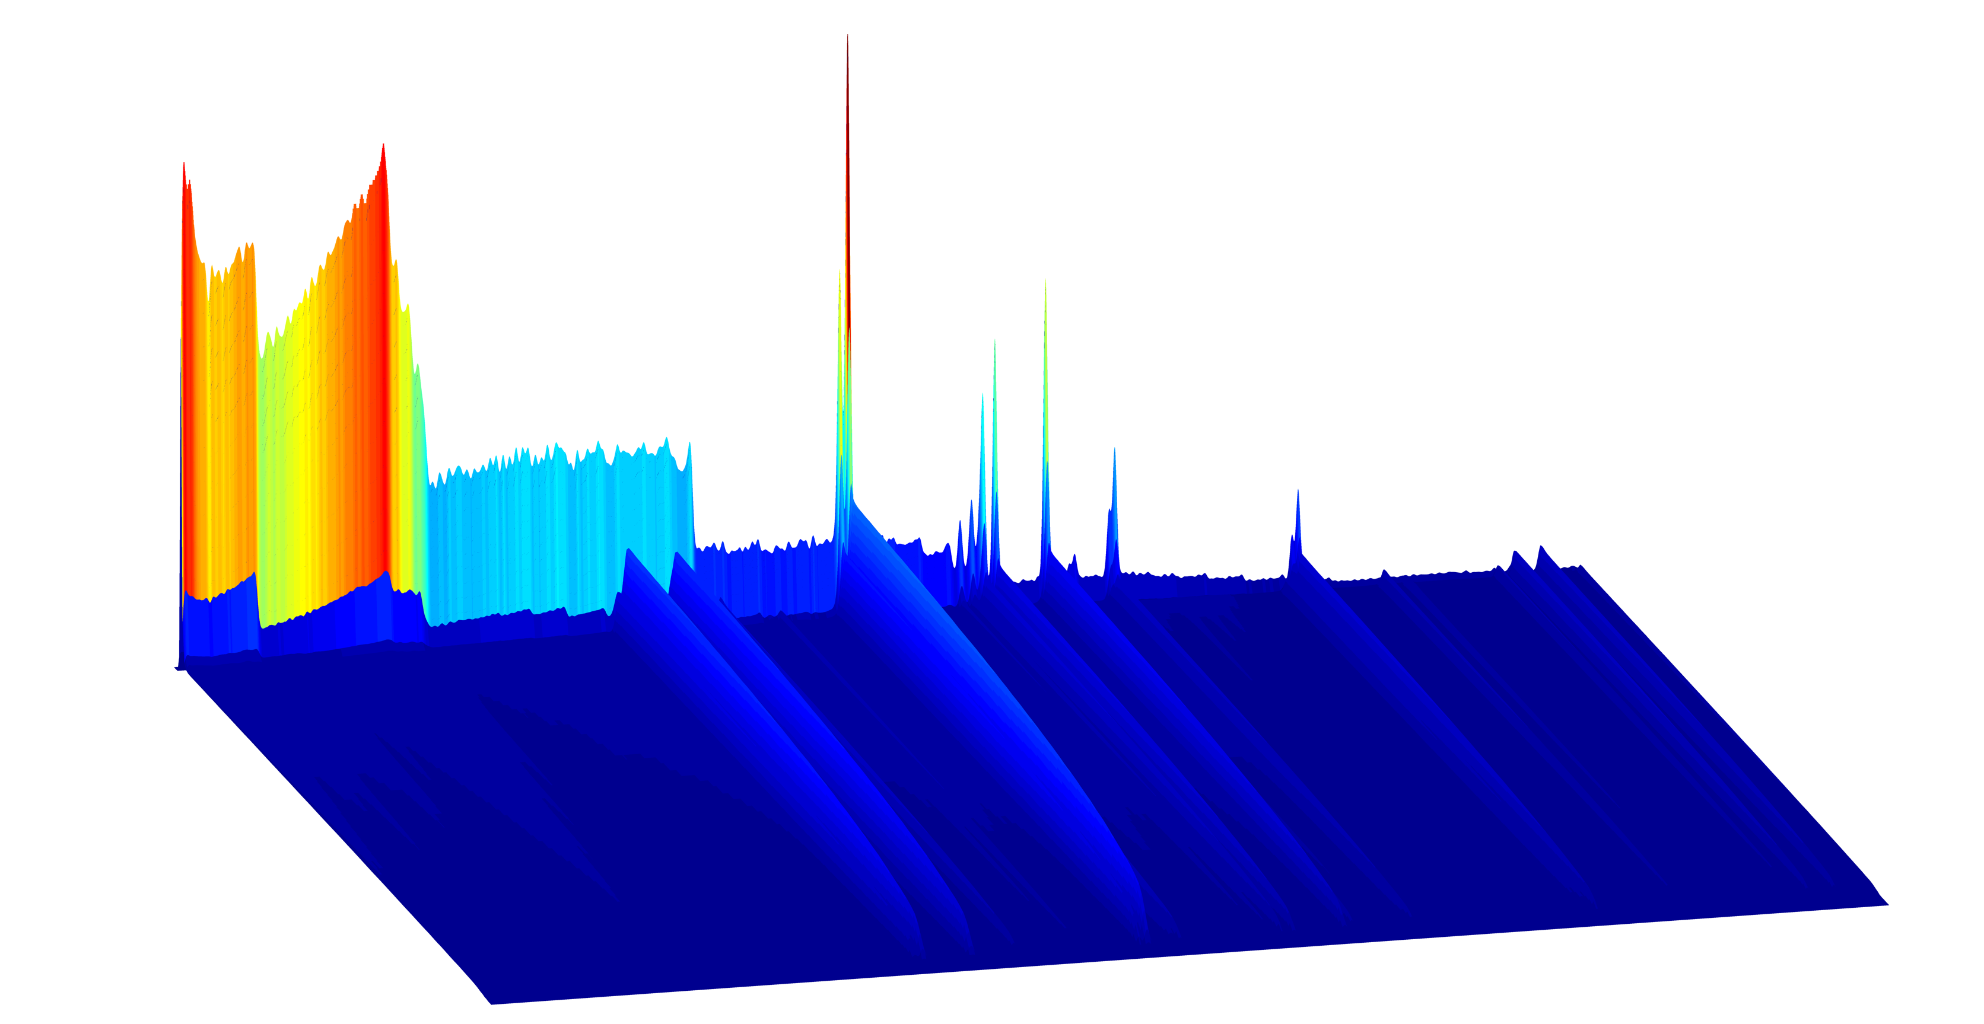
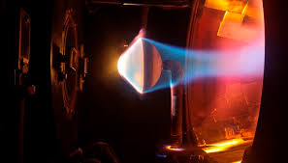
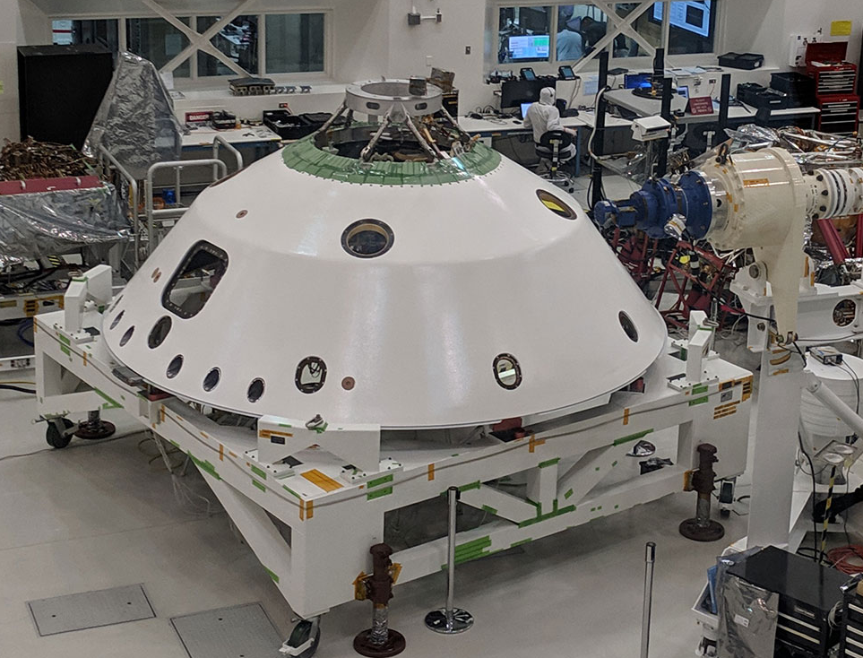
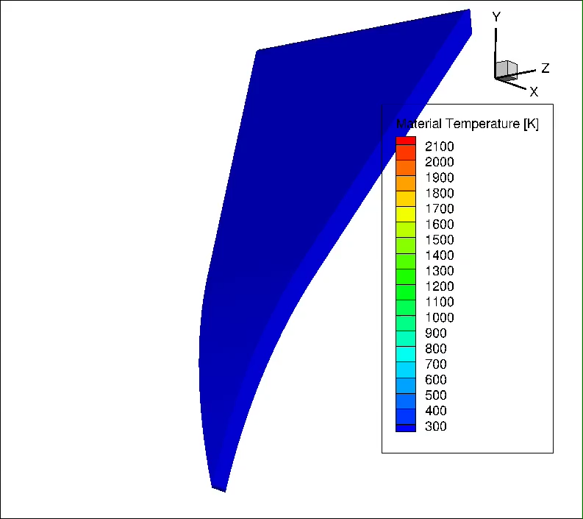
Key Entry Phase Challenges
Quantifying heating due to shock layer radiation
  dominated by CN-red and violet emission
  Less validated than air or CO2
  NASA/ESM has begun a test series in EAST focused on refining shock tube informed bias uncertainties.
TPS material qualification
  Non-oxidizing environment, radiation dominated heating
  Performance of RTF gap filler in such an environment
Singularities
  Radiative heating on main seal
  RF transparency of radome materials
  Heating on sep. nut closeouts
EDL Phase thermal analysis
  Long descent time, cryogenic exterior,
  internal heat source
EAST Testing*
Arc Jet / Lamp Testing
3D Material Response*
*ESM Capabilities
M2020 Closeouts

Slide 28
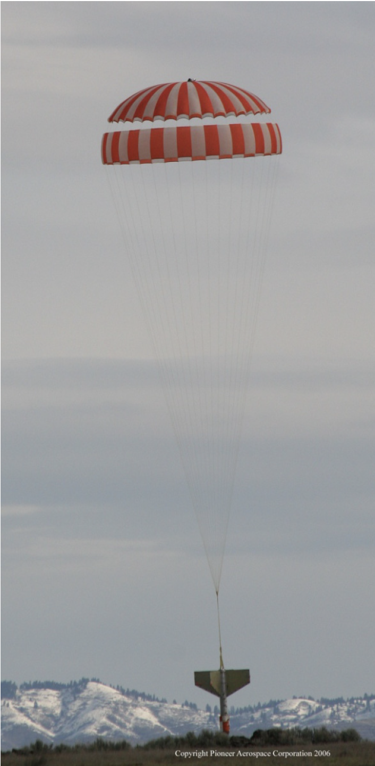
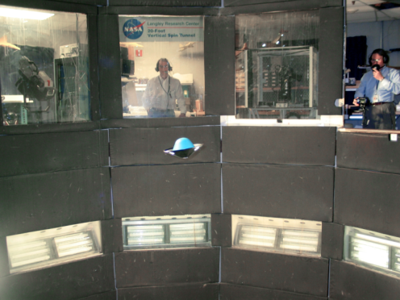
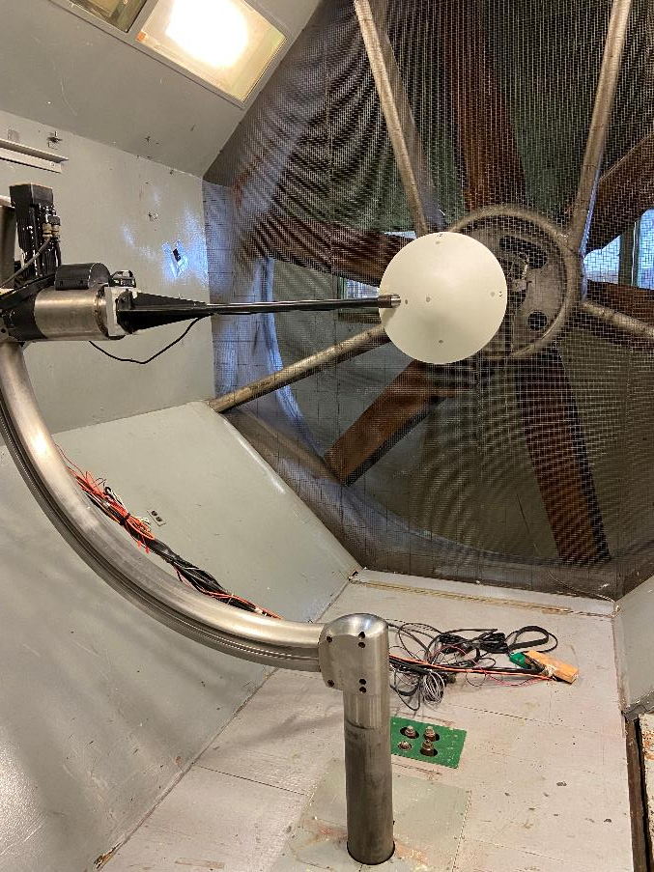
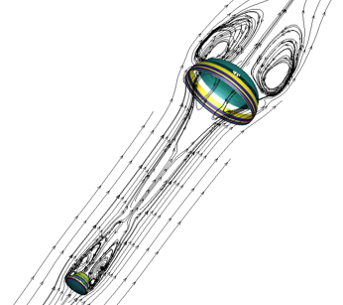
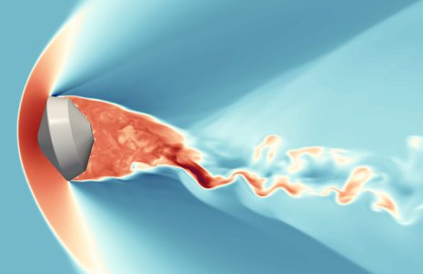
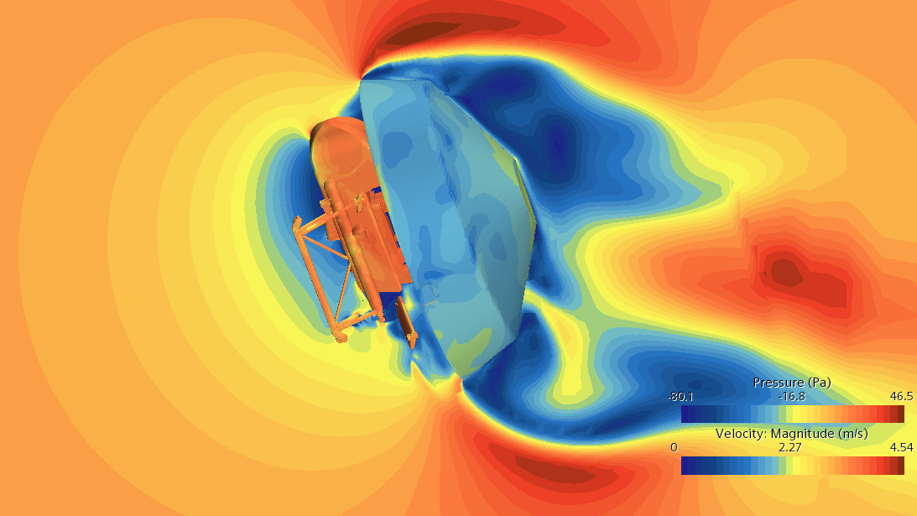
Key Descent Phase Challenges
Roll Coupling
  Initial roll rate of 2RPM, but over 100min for that to change
  Very difficult to assess potential sources of pitch-roll coupling
Transonic-subsonic aerodynamics
  Drogue chute is relatively smaller than that for Genesis
  Initial analysis shows that capsule dynamics dominates
  system dynamics
  Heritage ADB is not high fidelity in this speed regime
Very long inflation time and possible high
angle of attack at deploy for main chute
  Anti-inversion netting baselined
  Drop testing is planned
Lander Pose and Transition to Powered Flight
  Lander will be lowered ~1m while on backshell
  Rotors will be used to null residual roll
  Lander will be released and “fly away”
VST/TDT/121” Testing
Drop Test
Parachute FSI*
Free Flight CFD*
TPF CFD
*ESM Capabilities

Slide 29
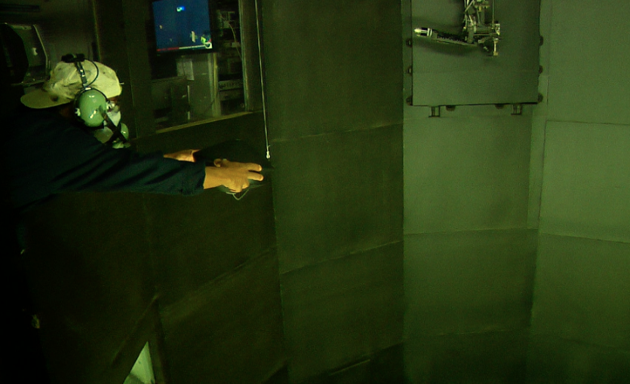
Vertical Spin Testing – Drogue Chute Dynamics
29

Slide 31
Backup
31

