Slide 1
Machine Learning for Uncertainty Quantification (UQ): Trusting the Black Box
James Warner, Geoffrey Bomarito, Patrick Leser, Paul Leser
NASA Langley Research Center
Hampton, Virginia
Defense and Aerospace Test and Analysis Workshop (DATAWorks) 2022
April 27th, 2022

Slide 2

Motivation: Modeling & Simulation
…
Model
Inputs
Outputs

Slide 3
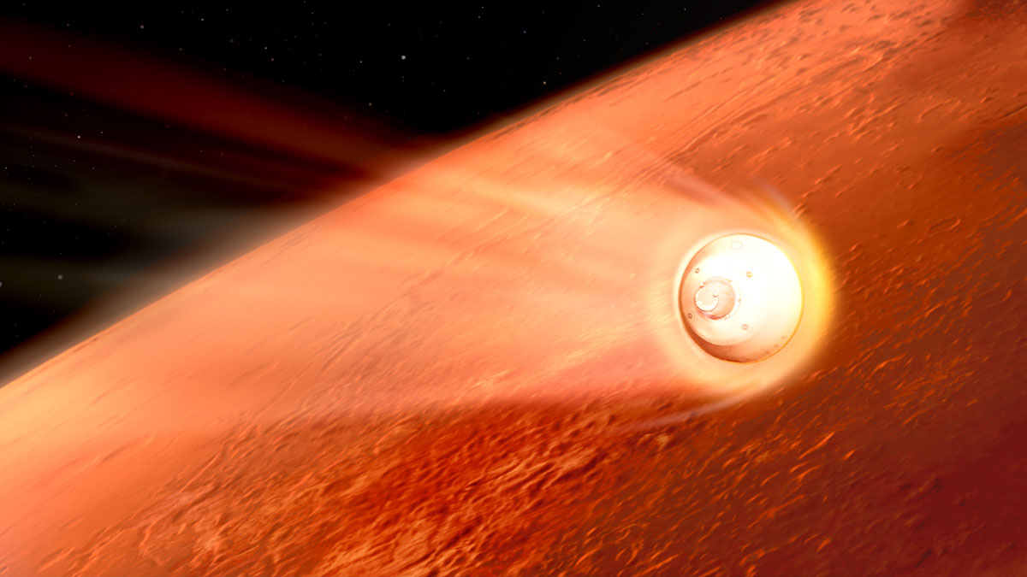
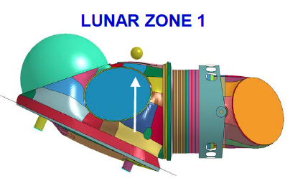
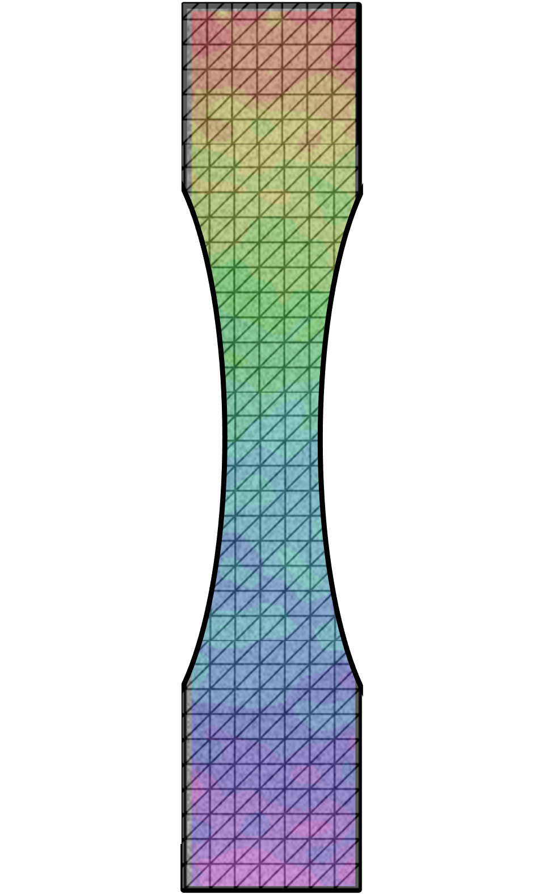
Motivation: Modeling & Simulation
Model
Inputs
Outputs
Trajectory Simulation
Spacesuit Impact Model
Mechanical Testing Simulation
Atmospheric conditions
Mass properties
Impact velocity
Lunar regolith properties
Applied load
Material properties
Landing location
Max contact force
Deformation, Stress, Strain
Notes:
EDL – D205
Aero – D308

Slide 4







UQ for Modeling & Simulation
Repeated Evaluations
Model
Inputs
Outputs
Trajectory Simulation
Spacesuit Impact Model
Mechanical Testing Simulation
Atmospheric conditions
Mass properties
Impact velocity
Lunar regolith properties
Applied load
Material properties
Landing location
Max contact force
Deformation, Stress, Strain

Slide 5

UQ for Modeling & Simulation
Statistical estimators
Repeated Evaluations
Model
Inputs
Outputs
Trajectory Simulation
Spacesuit Impact Model
Mechanical Testing Simulation
Atmospheric conditions
Mass properties
Impact velocity
Lunar regolith properties
Applied load
Material properties
Landing location
Max contact force
Deformation, Stress, Strain
Expected landing location

Slide 6
UQ for Modeling & Simulation
Confidence/credible intervals
Repeated Evaluations
Model
Inputs
Outputs
95% Probability
Trajectory Simulation
Spacesuit Impact Model
Mechanical Testing Simulation
Atmospheric conditions
Mass properties
Impact velocity
Lunar regolith properties
Applied load
Material properties
Landing location
Max contact force
Deformation, Stress, Strain
Expected landing location
95% confidence landing ellipse

Slide 7


UQ for Modeling & Simulation
Percentiles & Rare event probabilities
Repeated Evaluations
Model
Inputs
Outputs
Trajectory Simulation
Spacesuit Impact Model
Mechanical Testing Simulation
Atmospheric conditions
Mass properties
Impact velocity
Lunar regolith properties
Applied load
Material properties
Landing location
Max contact force
Deformation, Stress, Strain
Expected landing location
95% confidence landing ellipse
Probability of failure
Notes:
Mention inverse problem

Slide 8


UQ for Modeling & Simulation
Estimated input probability density functions (PDFs),
Inverse problem
Measurements,
Repeated Evaluations
Model
Inputs
Outputs
Trajectory Simulation
Spacesuit Impact Model
Mechanical Testing Simulation
Atmospheric conditions
Mass properties
Impact velocity
Lunar regolith properties
Applied load
Material properties
Landing location
Max contact force
Deformation, Stress, Strain
Expected landing location
95% confidence landing ellipse
Probability of failure
Calibrated material parameter PDFs
Notes:
Mention inverse problem

Slide 9
UQ for Modeling & Simulation
Inverse problem
Inferred input PDFs,
Measurements,
Repeated Evaluations
Model
Inputs
Outputs
Trajectory Simulation
Spacesuit Impact Model
Mechanical Testing Simulation
Atmospheric conditions
Mass properties
Impact velocity
Lunar regolith properties
Applied load
Material properties
Landing location
Max contact force
Deformation, Stress, Strain
Expected landing location
95% confidence landing ellipse
Probability of failure
Calibrated material parameter PDFs
Notes:
Mention inverse problem

Slide 10
UQ for Modeling & Simulation
Number of Model Evaluations O(10³-10⁶)
UQ with high-fidelity, physics-based models can be computationally intractable
Model
Inputs
Outputs
Trajectory Simulation
Spacesuit Impact Model
Mechanical Testing Simulation
Atmospheric conditions
Mass properties
Impact velocity
Lunar regolith properties
Applied load
Material properties
Landing location
Max contact force
Deformation, Stress, Strain
Computation Time: O(mins-hours)
Computation Time: O(hours-days)
Computation Time: O(sec-mins)

Slide 11
Modeling for UQ
Physics-Based Modeling
Data-Driven Modeling
Conservation laws
Constitutive Models
Boundary conditions
Physics Simulation
Data
Physics Simulation
Machine Learning*
Inputs
Outputs
Inputs
Outputs
Interpretable predictions
Theoretically rigorous
Historically-proven legacy codes
Computationally intensive
Slow development & deployment
Efficient predictions
Fast deployment
Widely available libraries
Lack interpretability (“Black Box”)
Ineffective for extrapolation/ sparse datasets
*Surrogate model, response surface, reduced-order model, kriging, metamodel, …….
Notes:
Strengths/weakness compliment eachother ;
ML fast deployment a double edged sword

Slide 12
Outline: Machine Learning for UQ
Using machine learning surrogate models responsibly
Combining physics-based modeling & machine learning
  Multi-model Monte Carlo simulation
    Application: Trajectory simulation for entry, descent, and landing (EDL)
  Physics-informed generative adversarial networks (PI-GANs)
    Application: Material characterization for additive manufacturing
  Active learning with Gaussian Process models
    Application: Spacesuit reliability analysis
Summary

Slide 13












Surrogate Modeling
scikit-learn with Python:
from sklearn import <alg>
X,y = load_data()
mod = <alg>.fit(X, y)
y_new = mod.predict(X_new)
High-Fidelity
Inputs
Outputs
Model
Input
Training Data
Output
Training Data
Offline
Machine Learning
Gaussian processes
Neural networks
Polynomial Chaos
….
…
…
Surrogate
Orders of magnitude computational speedup possible
Online
Model

Slide 14
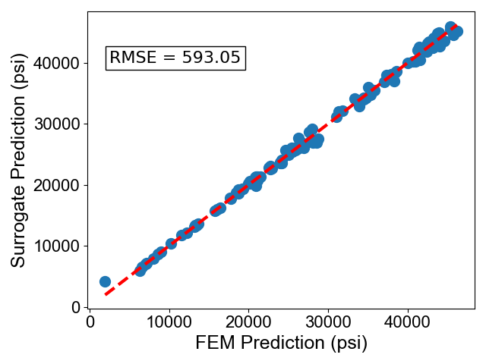




Surrogate Model Validation
Always create a separate dataset for testing that is not used for training
  Guards against the problem of overfitting
A third validation dataset is often used during training to tune machine learning hyperparameters (e.g., # layers, nodes in neural network)
If surrogate model error is non-negligible, it can be factored into total uncertainty when making probabilistic predictions
Training
Testing
Surrogate Model
…
…
Surrogate Prediction
…
…
High-Fidelity Model
Training
Hi-Fi Prediction
Validation
Notes:
Analogous to calibrating a FEM model & validating on other test data

Slide 15
Surrogate Modeling Pitfalls & Challenges
Not validating the effectiveness of surrogate prior to deployment
  Or validating the model using the training data!
Not accounting for (or correcting) surrogate errors when they are non-negligible
  Surrogate models yield biased estimators
Using surrogate model to extrapolate outside the range of training data
Training surrogate models from sparse training data
  Common when high-fidelity model is expensive to run
Notes:
advanced ML approaches can address some of these challenges

Slide 16
Combining Physics & Machine Learning (ML)
Multi-model Monte Carlo
Physics-informed deep learning
Active Learning
Data
Physics Equations
Physics Simulation
Data
Data
Machine Learning
Inputs
Outputs
Machine Learning
Machine Learning
Outputs
Inputs
Outputs
Inputs
Physics Simulation
Fuse predictions from ML and physics-based models
Integrate physical laws into the training of ML models
Guide physics-based training data generation using ML Model
1. Multilevel Monte Carlo. Giles et al. 2015
2. Multifidelity Monte Carlo. Peherstorfer et al. 2016
3. Approximate Control Variates. Gorodetsky et al. 2019
4. Physics-informed neural networks. Raissi et al. 2019.
5. Physics-informed generative adversarial networks Yang et. al. 2018
6. Active learning in practice. Settles 2011.
7. Active learning for reliability analysis. Bichon et al. 2008.
Application: Trajectory simulation for EDL
Application: Material characterization for additive manufacturing
Application: Spacesuit reliability analysis
Notes:
Data-driven / physics-based synergy

Slide 17
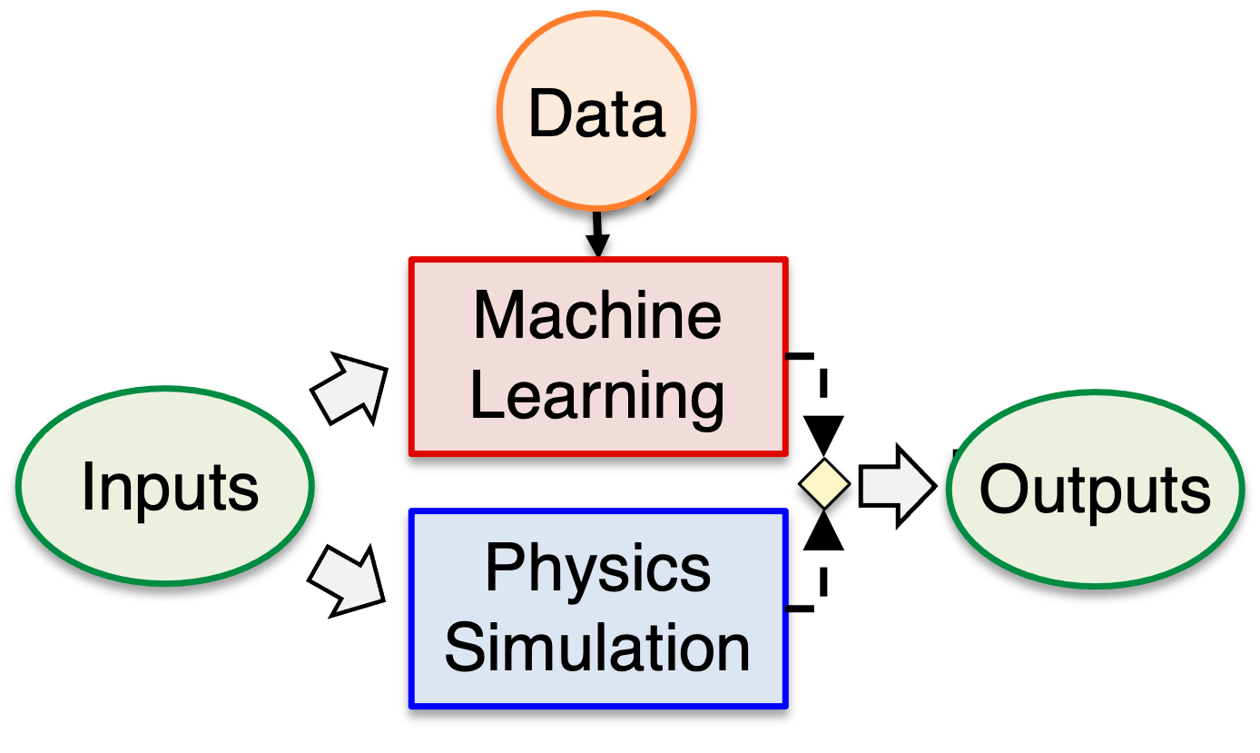

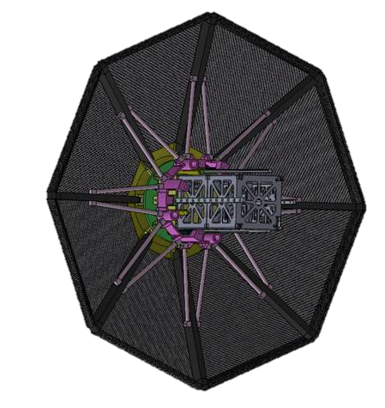


Multi-Model Monte Carlo (MC) for Trajectory Simulation
Motivation: high-precision guidance software for EDL
Challenge: enabling fast & accurate uncertainty propagation
  Using high-fidelity (Hi-Fi) trajectory simulations can be too slow
  Using low-fidelity (Lo-Fi) surrogate models lead to biased estimators
Approach: Combine predictions from a Hi-Fi model with Lo-Fi model(s) using multi-model MC to estimate trajectory state statistics
Trajectory Simulation Uncertainties
Predicted landing location
Prob
Hi-Fi Model
Prob
Atmosphere
Aerodynamics
Low-Fidelity (Lo-Fi) Model
Prob
Lo-Fi Model
Low-Fidelity (Lo-Fi) Model
Mass Properties
Collaborators: Anthony Williams (NASA), Som Dutta (NASA), Justin Green (NASA), Luke Morrill (NASA), Sam Nieomoeller (UCLA)

Slide 18
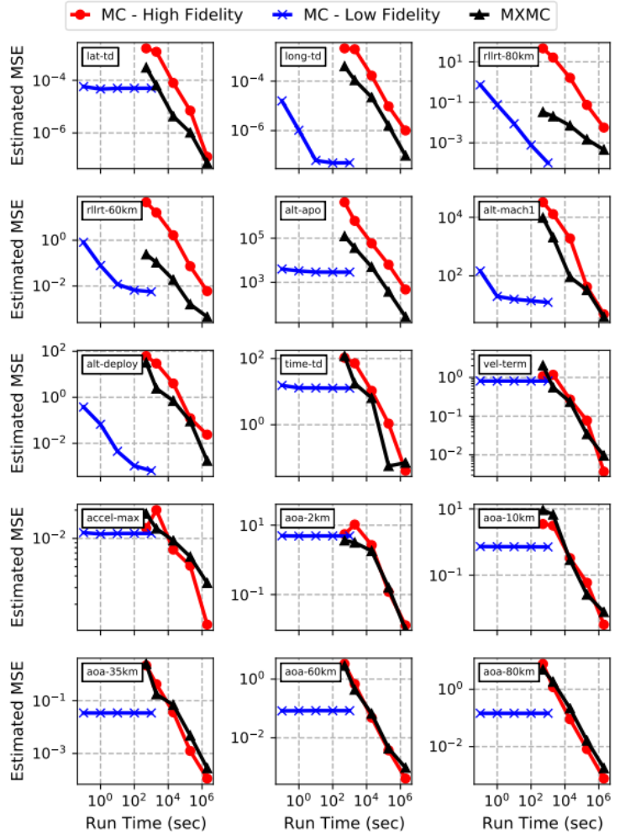
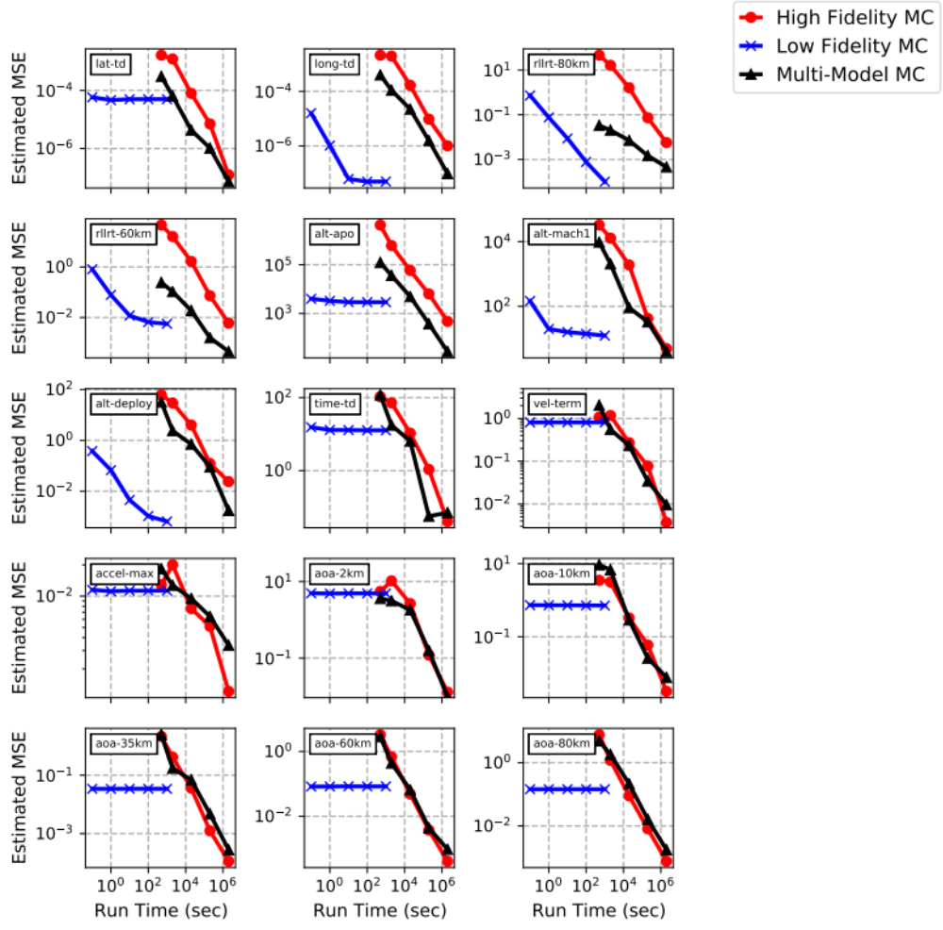
Multi-Model Monte Carlo (MC) for Trajectory Simulation
Example: predicting the expected landing location for an umbrella heatshield reentering the Earth’s atmosphere*
Error versus Run Time for Expected Landing Location
Models:
Hi-Fi: Program to Optimize Simulated Trajectories II (POST2)
Lo-Fi: Support vector machine (SVM)
Hi-Fi MC
Lo-Fi MC
Multi-Model MC
High-fidelity MC requires the most run time for accurate estimators
Low-fidelity MC has irreducible error due to estimator bias
Multi-model MC is more efficient than high-fidelity MC & is unbiased
*J. E. Warner et al. Multi-Model Monte Carlo Estimators for Trajectory Simulation. AIAA SciTech. 2021.

Slide 19
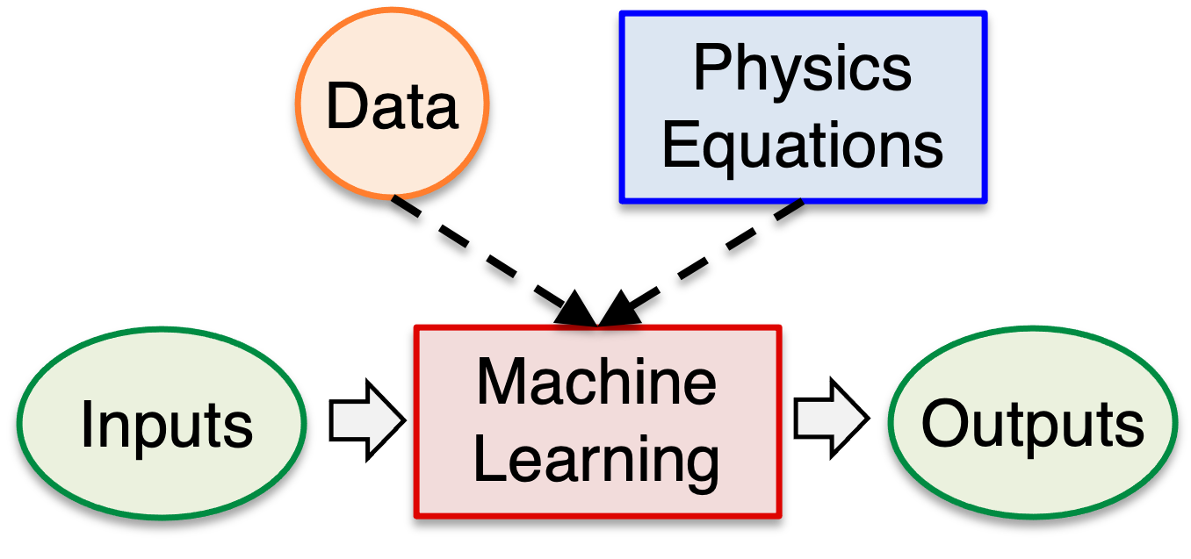
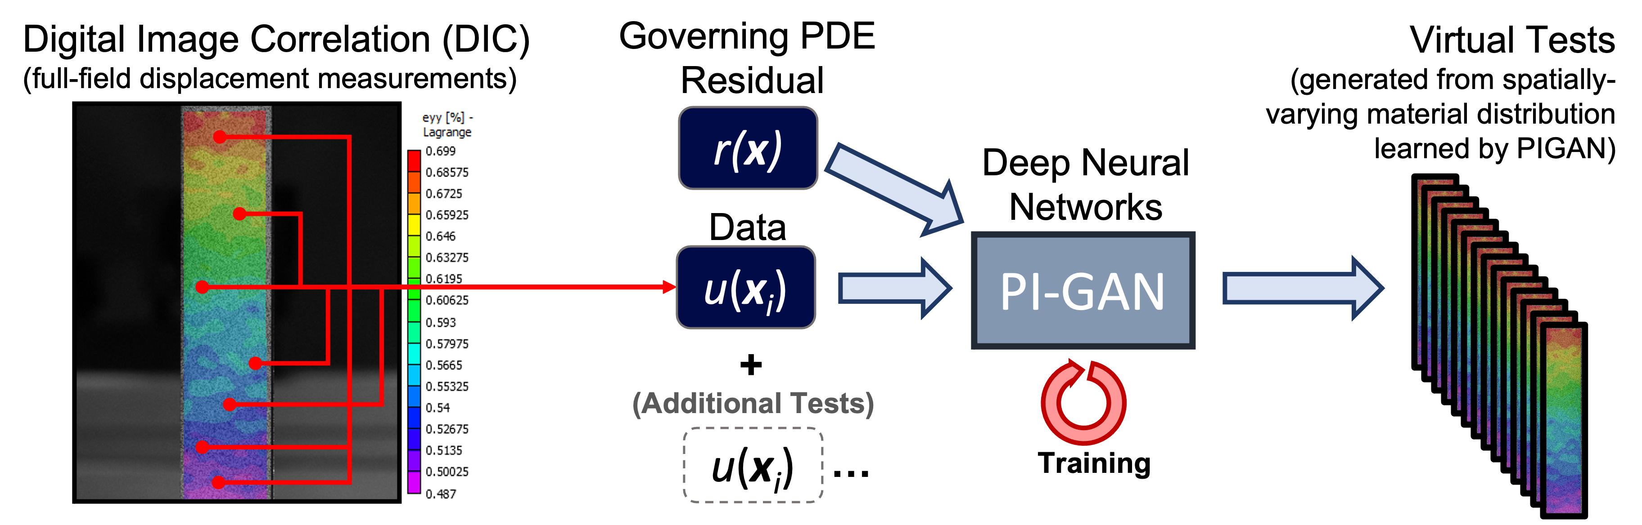
Physics-Informed ML for Material Characterization
Motivation: Material characterization for additive manufacturing
Challenge: solving high-dimensional, probabilistic inverse problems
Approach: Implement physics-informed generative adversarial network (PIGAN) capable of estimating random material property fields from limited test data
  GANs: state-of-the-art deep neural networks to learn distributions from data
  Physics-informed: enables indirect estimation of material properties, use of smaller datasets
Collaborators: Julian Cuevas (U. Puerto Rico), Ted Lewitt (USC), Sean Lai (Portland State U.) – student interns at NASA

Slide 20
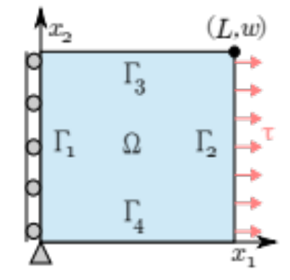

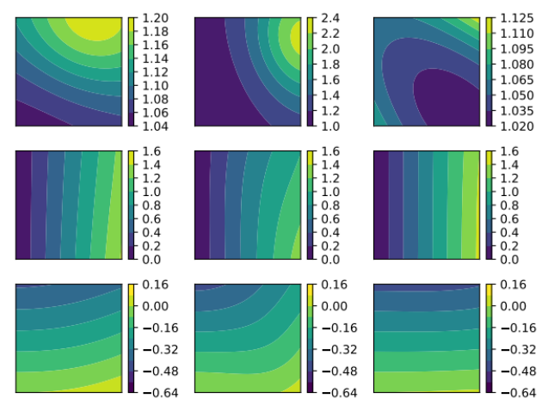
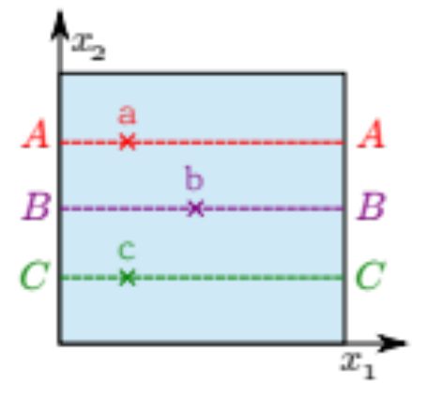
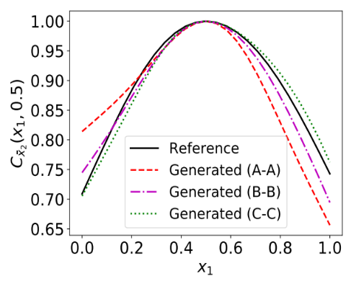
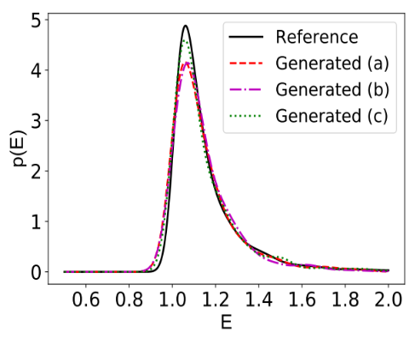
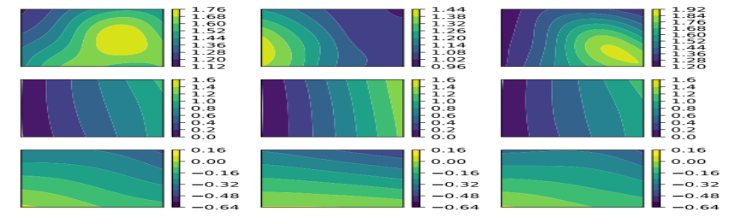
Physics-Informed ML for Material Characterization
Example: Train PIGAN to generate samples of a lognormally-distributed, spatially-varying material stiffness using only deformation data*
  Synthetic DIC deformation data generated using the finite element method
Problem Domain
Synthetic Deformation Data
…
Sample 1
Sample 2
Sample 1000
X₁ Def.
…
X₂ Def.
Sensors
Solution Reference
Stiffness Samples
Stiffness Spatial Correlation
Stiffness Pointwise Probability Density
Sample 1
Sample 2
Sample 3
Reference
PIGAN
*J. E. Warner et al. Inverse Estimation of Elastic Modulus Using Physics-Informed Adversarial Networks. NASA TM 2020-5001300. 2020.

Slide 21
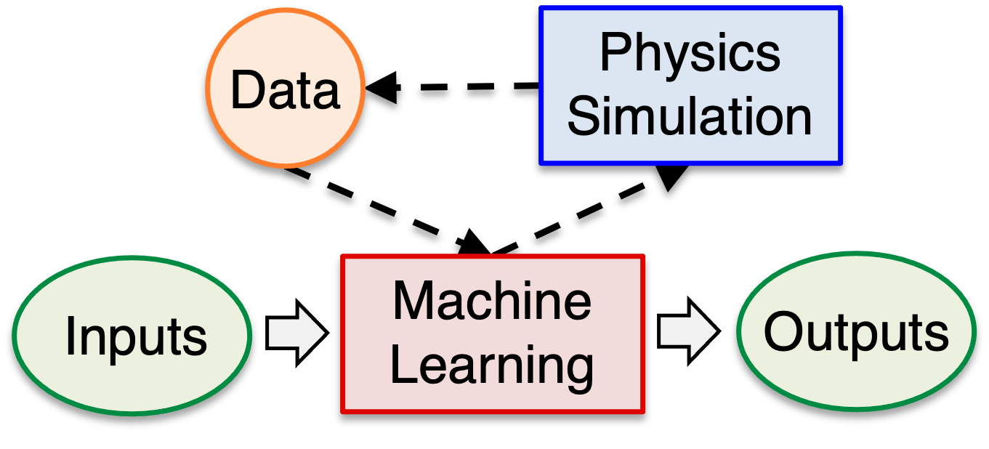
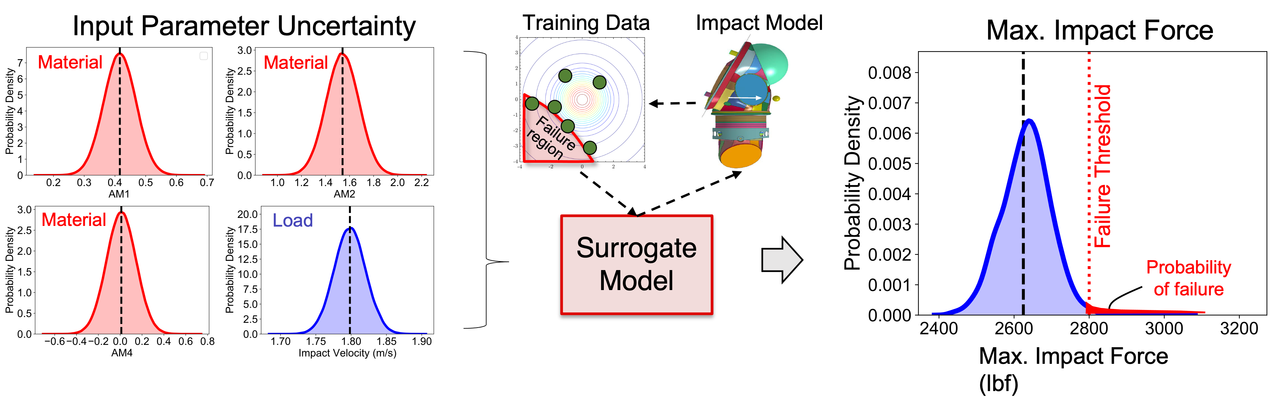
Active Learning for Reliability Analysis
Motivation: reliability analysis of the xEMU spacesuit
Challenge: predicting small failure probabilities with expensive damage simulations
  Standard surrogate models are inaccurate for predicting extreme behavior (failure) with limited training data
Approach: use active learning to train Gaussian Process (GP) surrogate models that are tailored for accurate failure predictions
Collaborators: Robert Gramacy, Austin Cole, Annie Sauer (Virginia Tech)

Slide 22
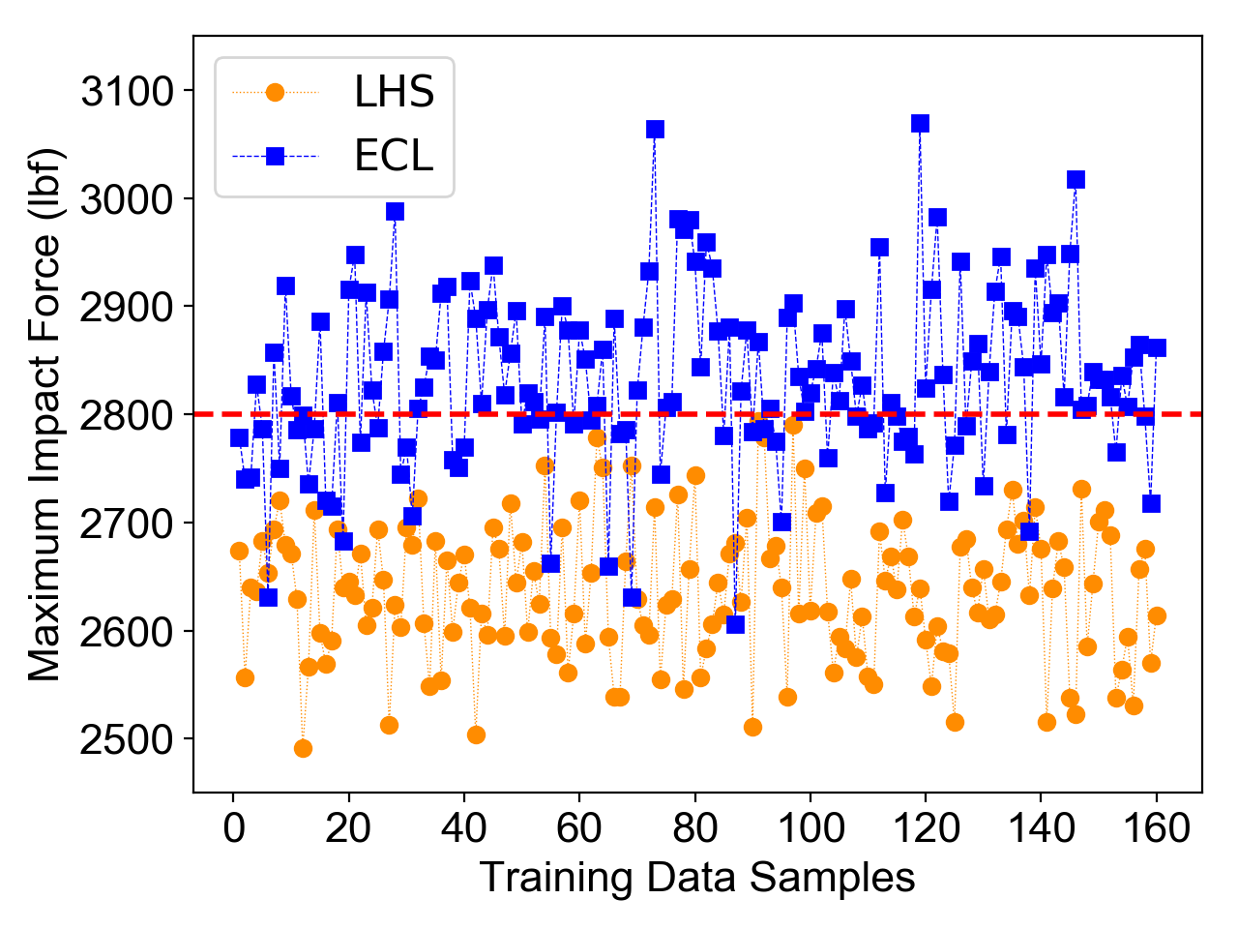
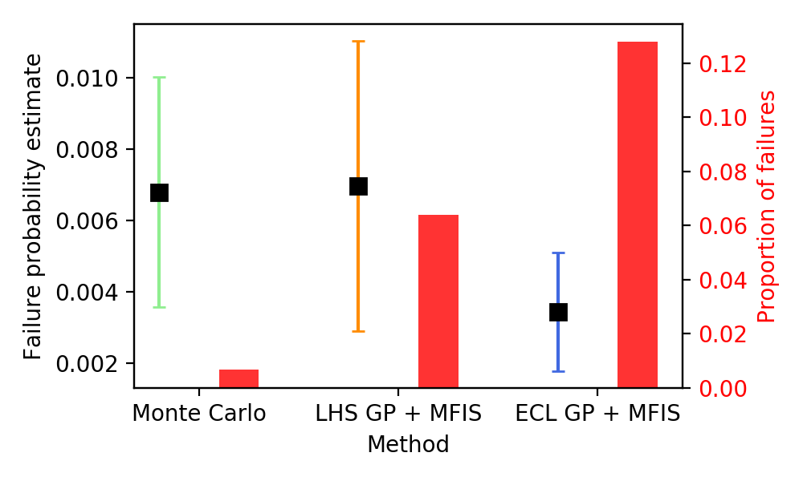
Active Learning for Reliability Analysis
Example: Estimate the probability of impact failure in the spacesuit under material/impact velocity uncertainty*
Compare surrogate-based solutions from:
  LHS GP – trained from random Latin Hypercube samples
  AL GP – trained using Active Learning targeting failure region
Training Data Selection: LHS vs. ECL
Probability of Failure Estimate Comparison
LHS
AL
Failure Threshold
Hi-Fi LHS GP AL GP
2500 model evaluations
450 model evaluations
450 model evaluations
* D. A. Cole et al. Entropy-Based Adaptive Design for Contour Finding and Estimating Reliability. Journal of Quality Technology. 2022.

Slide 23
Summary
Trusting machine learning models for UQ:
  Use surrogate models responsibly:
    Always validate using a separate testing dataset
    Avoid extrapolation outside training data range
    Account for non-negligible surrogate errors in analysis
  Combine physics-based & data-driven approaches:
    Multi-model Monte Carlo: fuse predictions from ML with physics-based models for unbiased trajectory simulation estimators
    Physics-informed machine learning: integrate physical laws into the training of ML models for material characterization
    Active learning: guide physics-based training data generation using ML models for spacesuit reliability analysis

Slide 24
References
Multi-model Monte Carlo
Physics-informed Deep Learning
Active Learning
Data
Physics Equations
Physics Simulation
Data
Data
Machine Learning
Inputs
Outputs
Machine Learning
Machine Learning
Outputs
Inputs
Outputs
Inputs
Physics Simulation
J. E. Warner, G. F. Bomarito, L. Morrill, P. E. Leser, W. P. Leser, R. A. Williams, S. Dutta, S. Nieomoeller. Multi-Model Monte Carlo Estimators for Trajectory Simulation. 2021 AIAA SciTech Conference.
G. F. Bomarito, P. E. Leser, J. E. Warner, W. P. Leser. On the Optimization of Approximate Control Variates with Parametrically Defined Estimators. Journal Paper. Journal of Computational Physics. February 2022.
G. F. Bomarito, J. E. Warner, P. E. Leser, W. P. Leser, L. Morrill. Multi Model Monte Carlo with Python (MXMCPy). NASA TM 2020-220585. May 2020.
J. E. Warner, J. Cuevas, P. E. Leser, G. F. Bomarito, W. P. Leser. Inverse Estimation of Elastic Modulus Using Physics-Informed Adversarial Networks. NASA TM 2020-5001300. May 2020.
D. A. Cole, R. B. Gramacy, J. E. Warner, G. F. Bomarito, P. E. Leser, W. P. Leser. Entropy-Based Adaptive Design for Contour Finding and Estimating Reliability. Journal of Quality Technology. In Review (Preprint available). 2021.
B. K. Stanford, K. E. Jacobson, A. Sauer, J. E. Warner. Gradient-Enhanced Reliability Analysis of Transonic Aeroelastic Flutter. 2022 AIAA Scitech Proceedings.
Email: james.e.warner@nasa.gov

