Slide 1
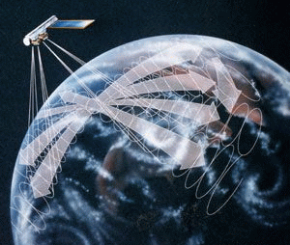
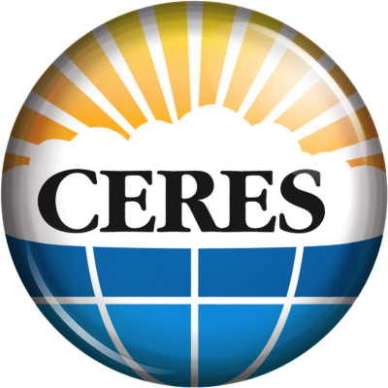
CERES Angular Distribution Model Working Group Report
Wenying Su
Wenying.Su-1@nasa.gov
NASA LaRC, Hampton VA
Lusheng Liang Zachary Eitzen Sergio Sejas
SSAI, Hampton VA

Slide 2
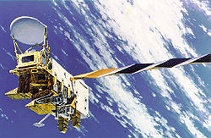
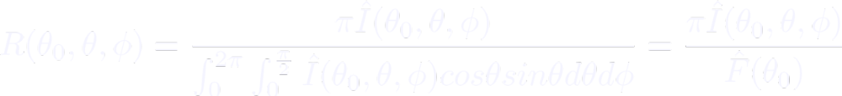

From radiance to flux: angular distribution models
Sort observed radiances into angular bins over different scene types;
Integrate radiance over all θ and ϕ to estimate the anisotropic factor for each scene type:
For each radiance measurement, first determine the scene type, then apply scene type dependent anisotropic factor to observed radiance to derive TOA flux:
θ
θ₀
ϕ
rotating azimuth plane

Slide 3
Snow and ice fraction used for scene identification
Microwave-based snow/ice fraction from NSIDC/NESDIS
  The NSIDC (National Snow and Ice Data Center) snow/ice map is from the Near-Real-Time SSM/I-SSMIS EASE-Grid Daily Global Ice Concentration and Snow Extent product (Near-real-time Ice and Snow Extent, NISE).
  NESDIS snow/ice map is also produced using microwave data. It is only used when NSIDC data is not available.
Imager-based snow/ice fraction from cloud mask algorithm
  Snow/ice tests only apply to clear MODIS pixels
  Snow/ice detection algorithms were developed separately for polar and non-polar regions using combinations of reflectance at 0.6 µm, 1.38 µm, 2.1 µm, and temperatures at 3.7 µm, 11 µm, 12 µm.
Notes:
NISE provides daily, global near-real-time maps of sea ice concentrations and snow extent using passive microwave data from the Special Sensor Microwave Imager/Sounder (SSMIS) on board the Defense Meteorological Satellite Program (DMSP) F17 satellite.
Sea ice concentration is determined using the NASA Team Algorithm (NTA).
Snow presence is determined using a modified version of the algorithm from Chang et al. (1987) and is detailed in Armstrong and Brodzik (2001).

Slide 4
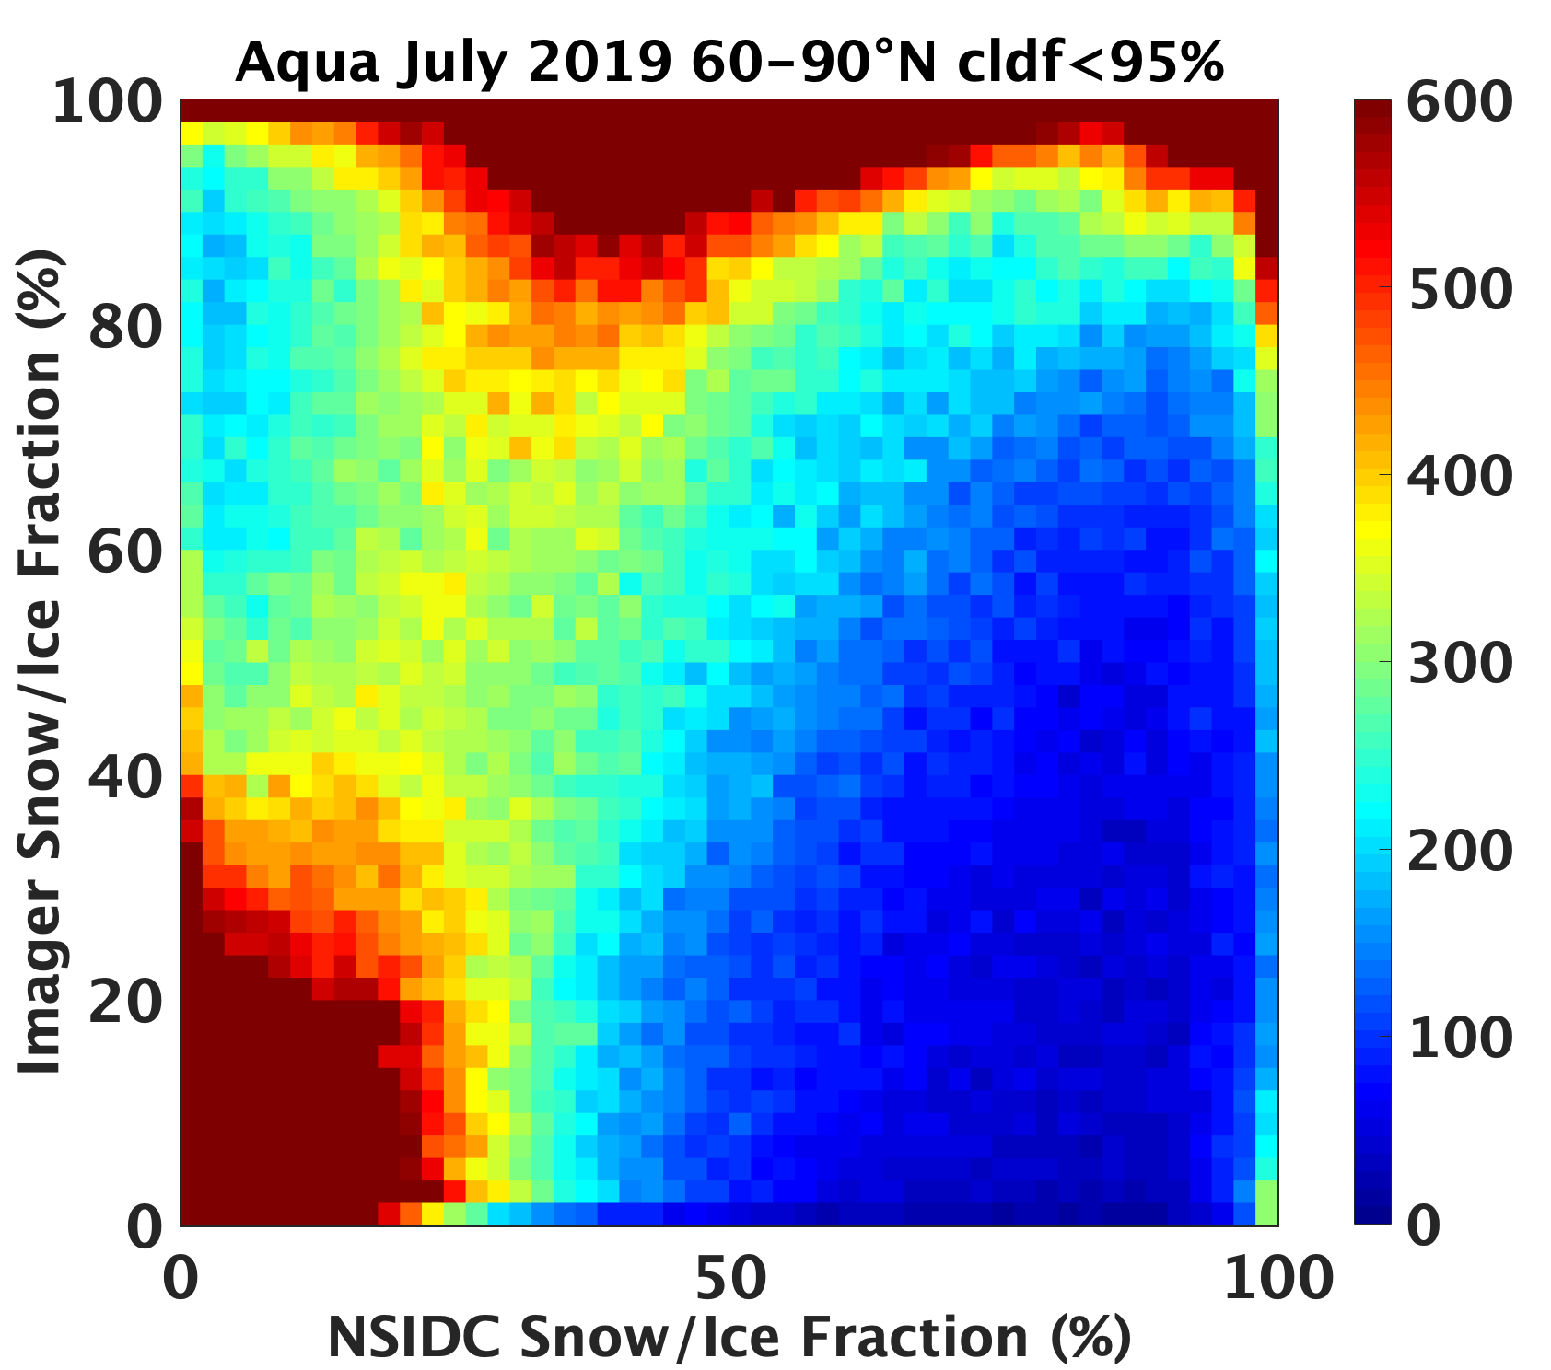
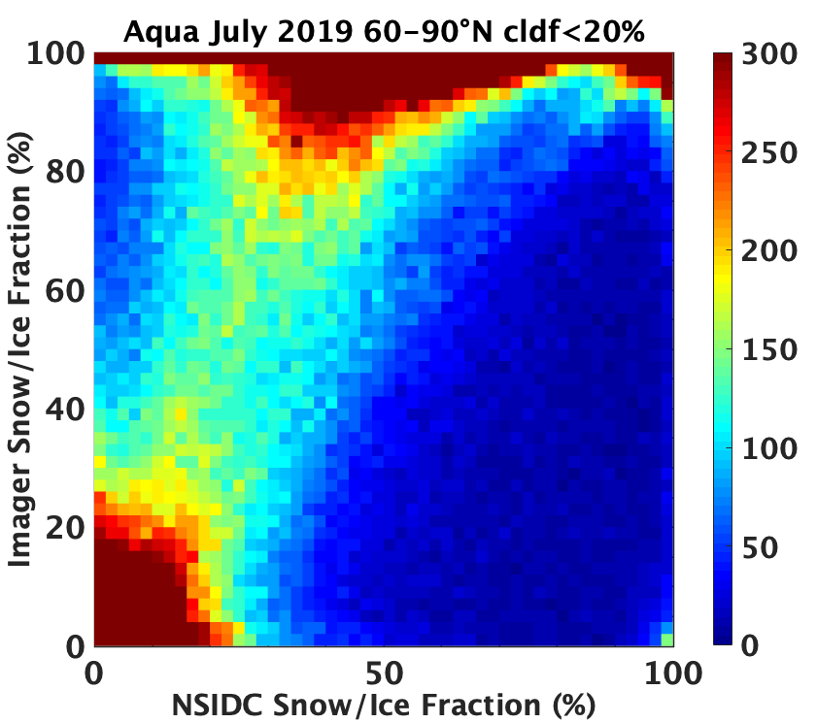
NSIDC and imager-based snow ice fraction differ
NSIDC mean=67.3%
Imager mean =84.5%
RMSE=30.6%
NSIDC mean=73.2%
Imager mean =87.3%
RMSE=25.4%
Notes:
Using data from 60-90N, only includes FOVs that both NSIDC and imager indicate snow/ice presence.
Output is under ‘wsu/ADM/Main_Ed4/SnowIce_60-90N_Aqua-FM3-MODIS_Ed4A_201907.dat’, using “density_plot” to generate the plots.

Slide 5
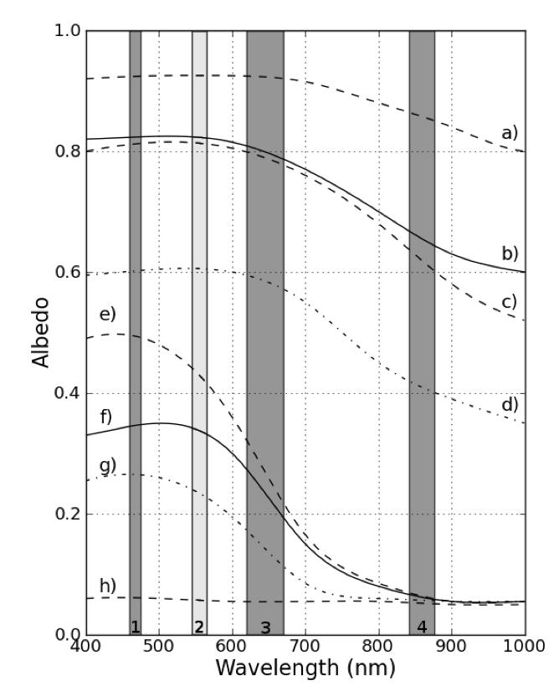
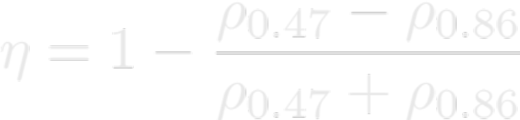
Use sea ice brightness index to classify clear-sky ADMs
High sea ice index
Snow
~0.8-1.0
Bare ice
Wet snow
Melting first year ice
Young melting pond
Melting ponds
~0.1-0.5
Open water
Low sea ice index
Rosel et al 2012, surface values

Slide 6
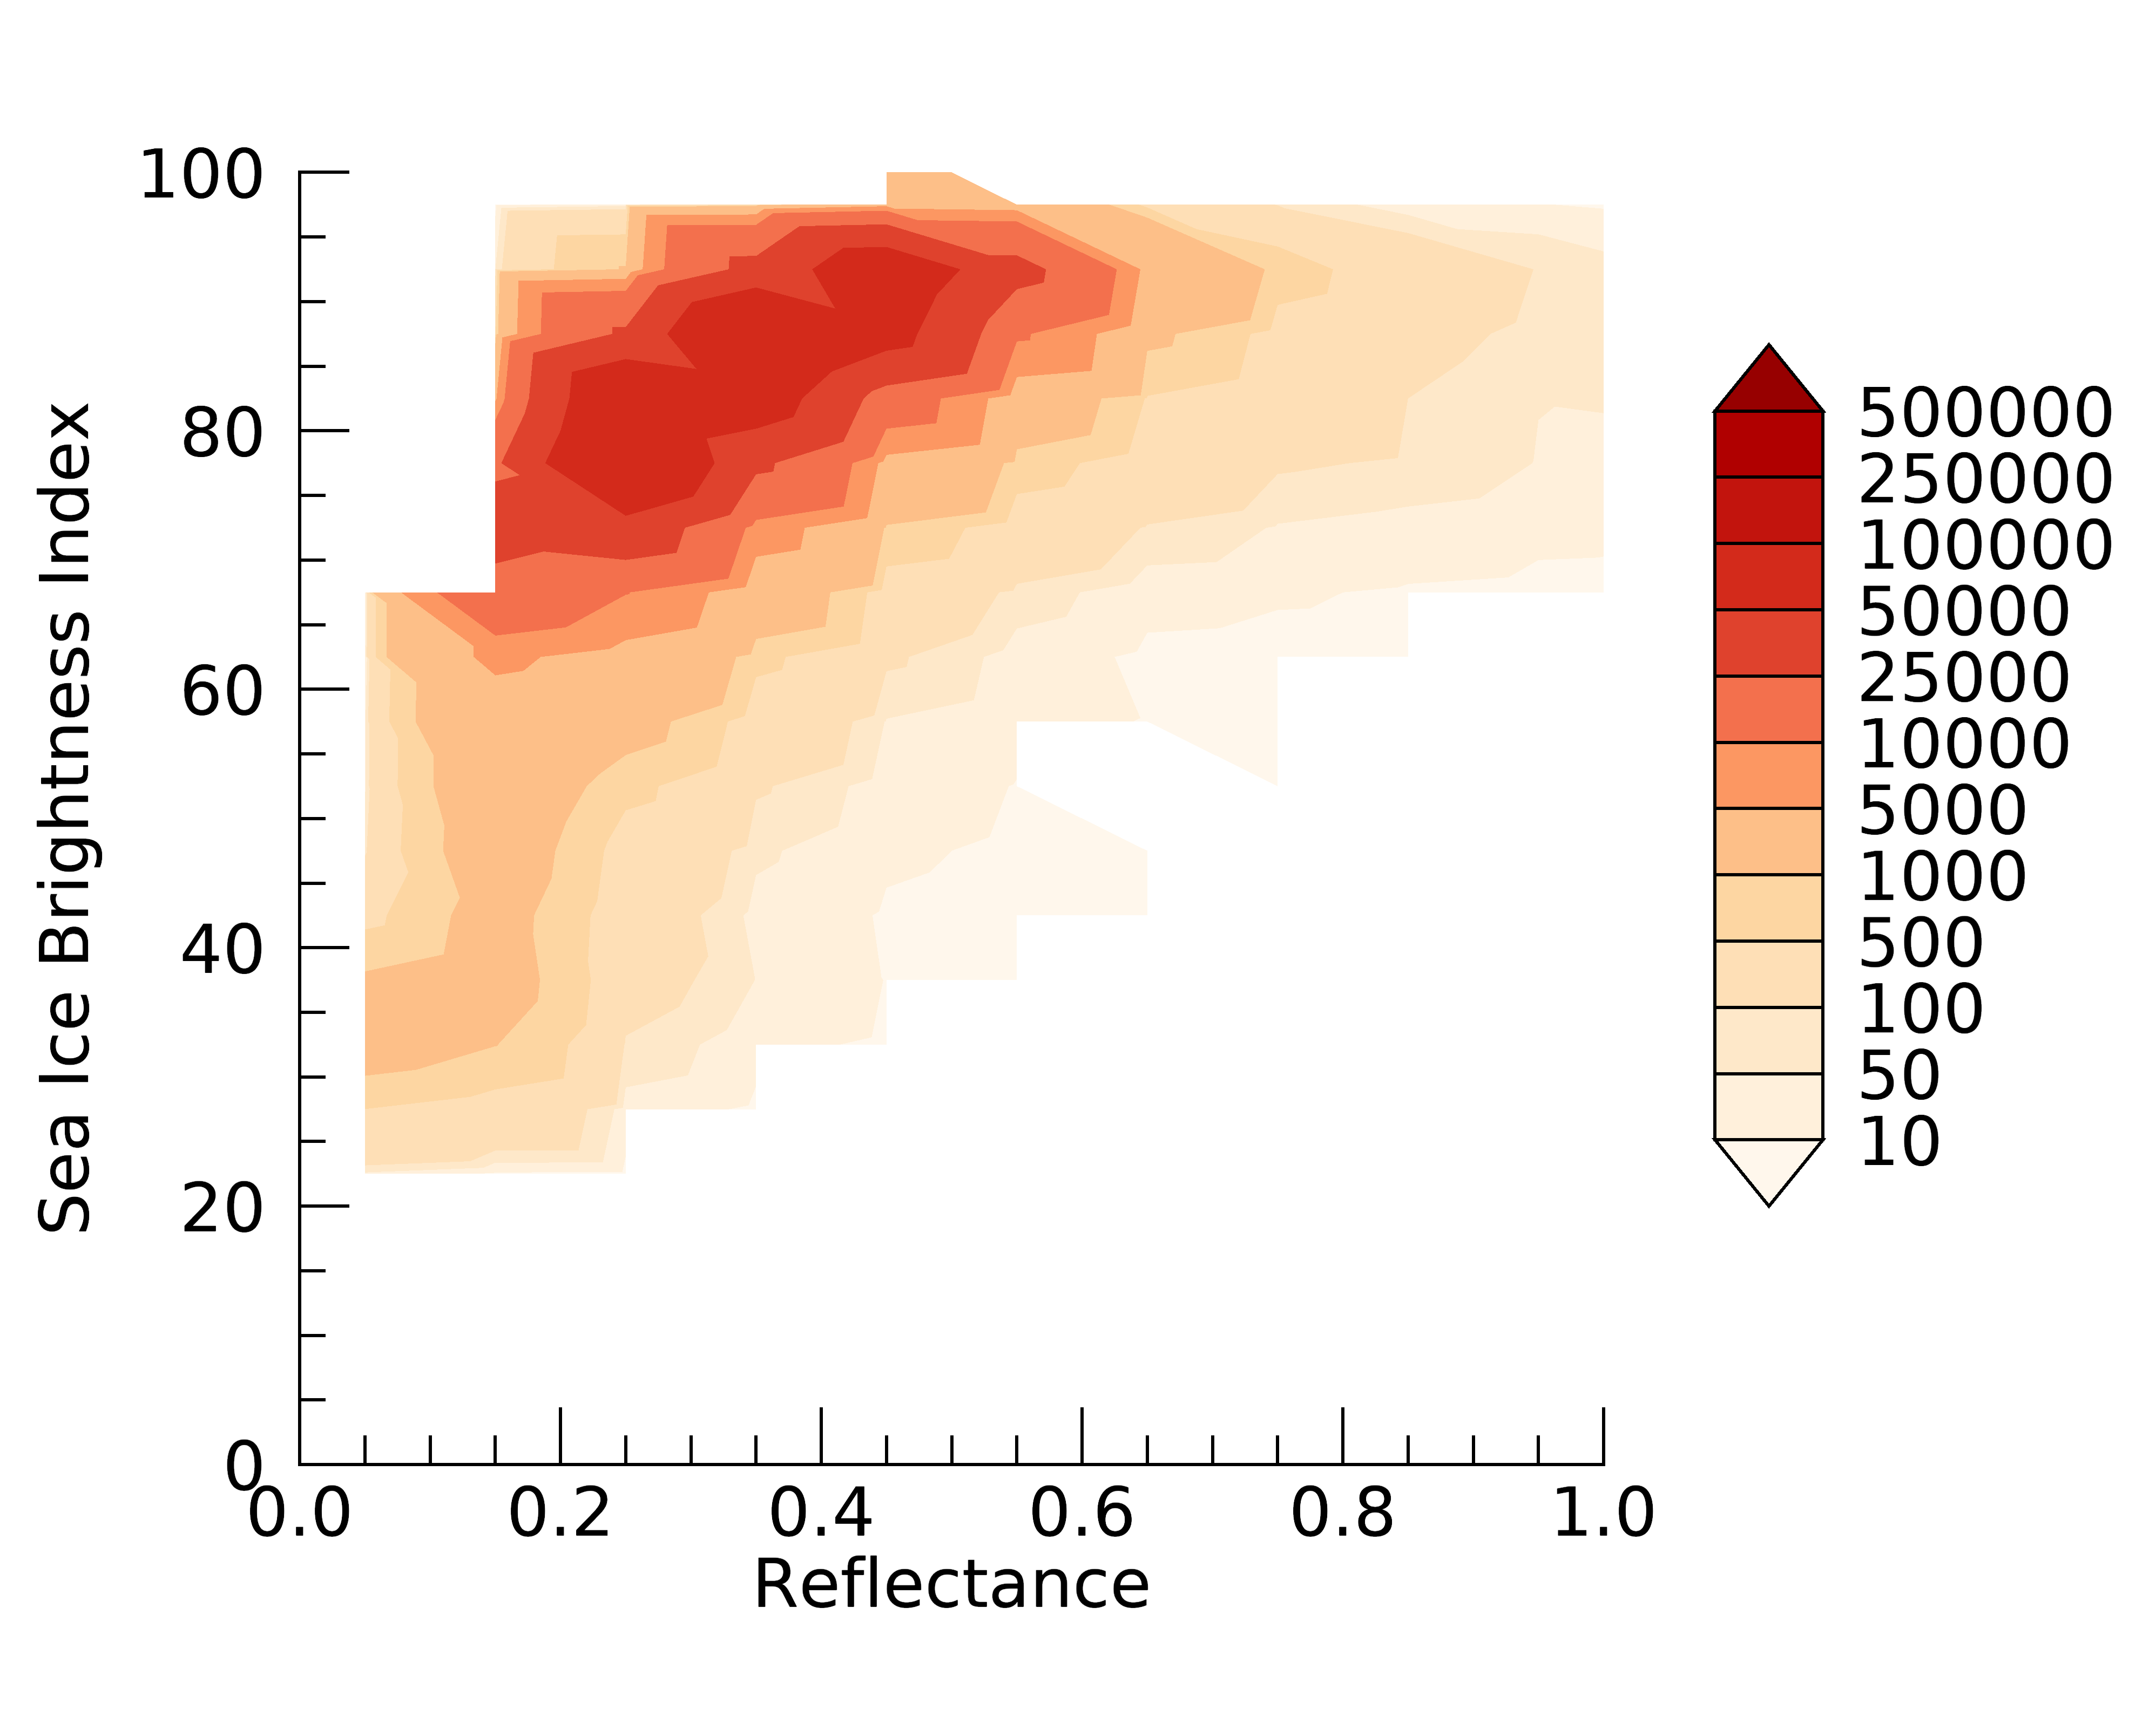
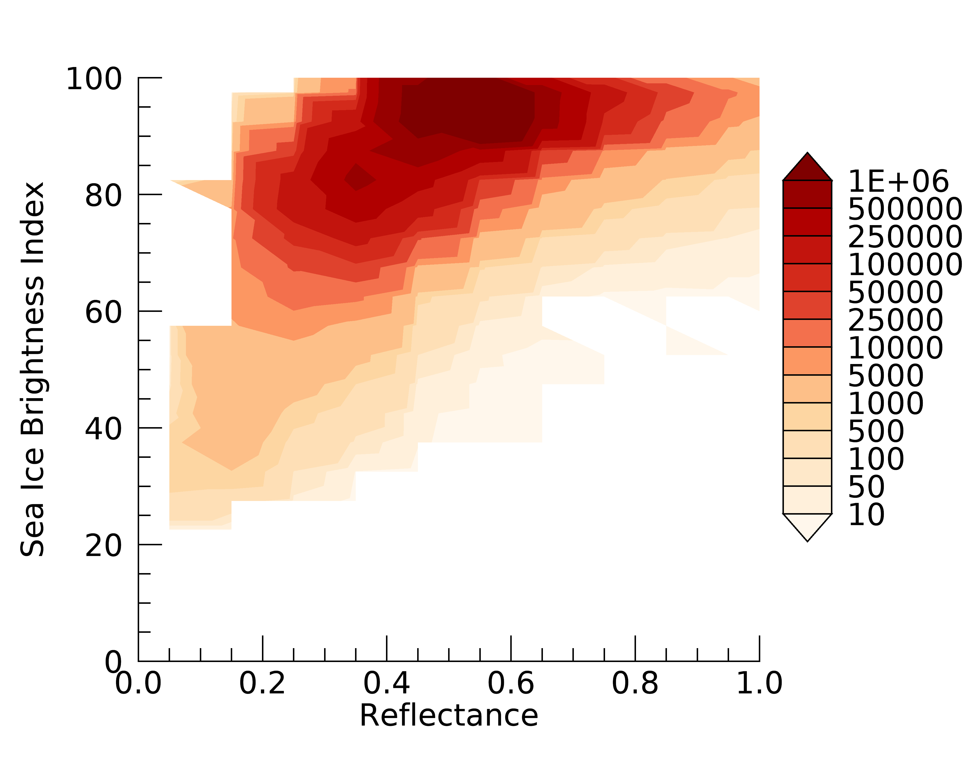
Can use SIBI to further classify scenes within each sea ice fraction bin
test
SIC: 75-99%
SIC: >99%
Using SIBI to classify the clear-sky sea ice ADMs increases flux consistency for clear sea ice scenes.

Slide 7
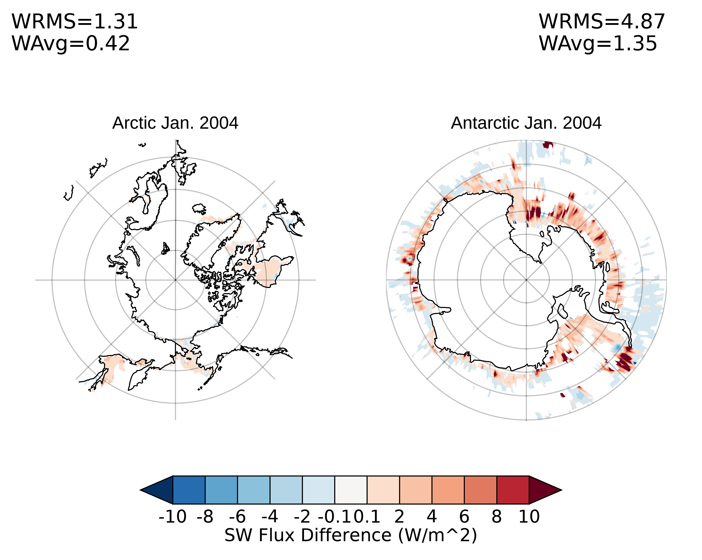
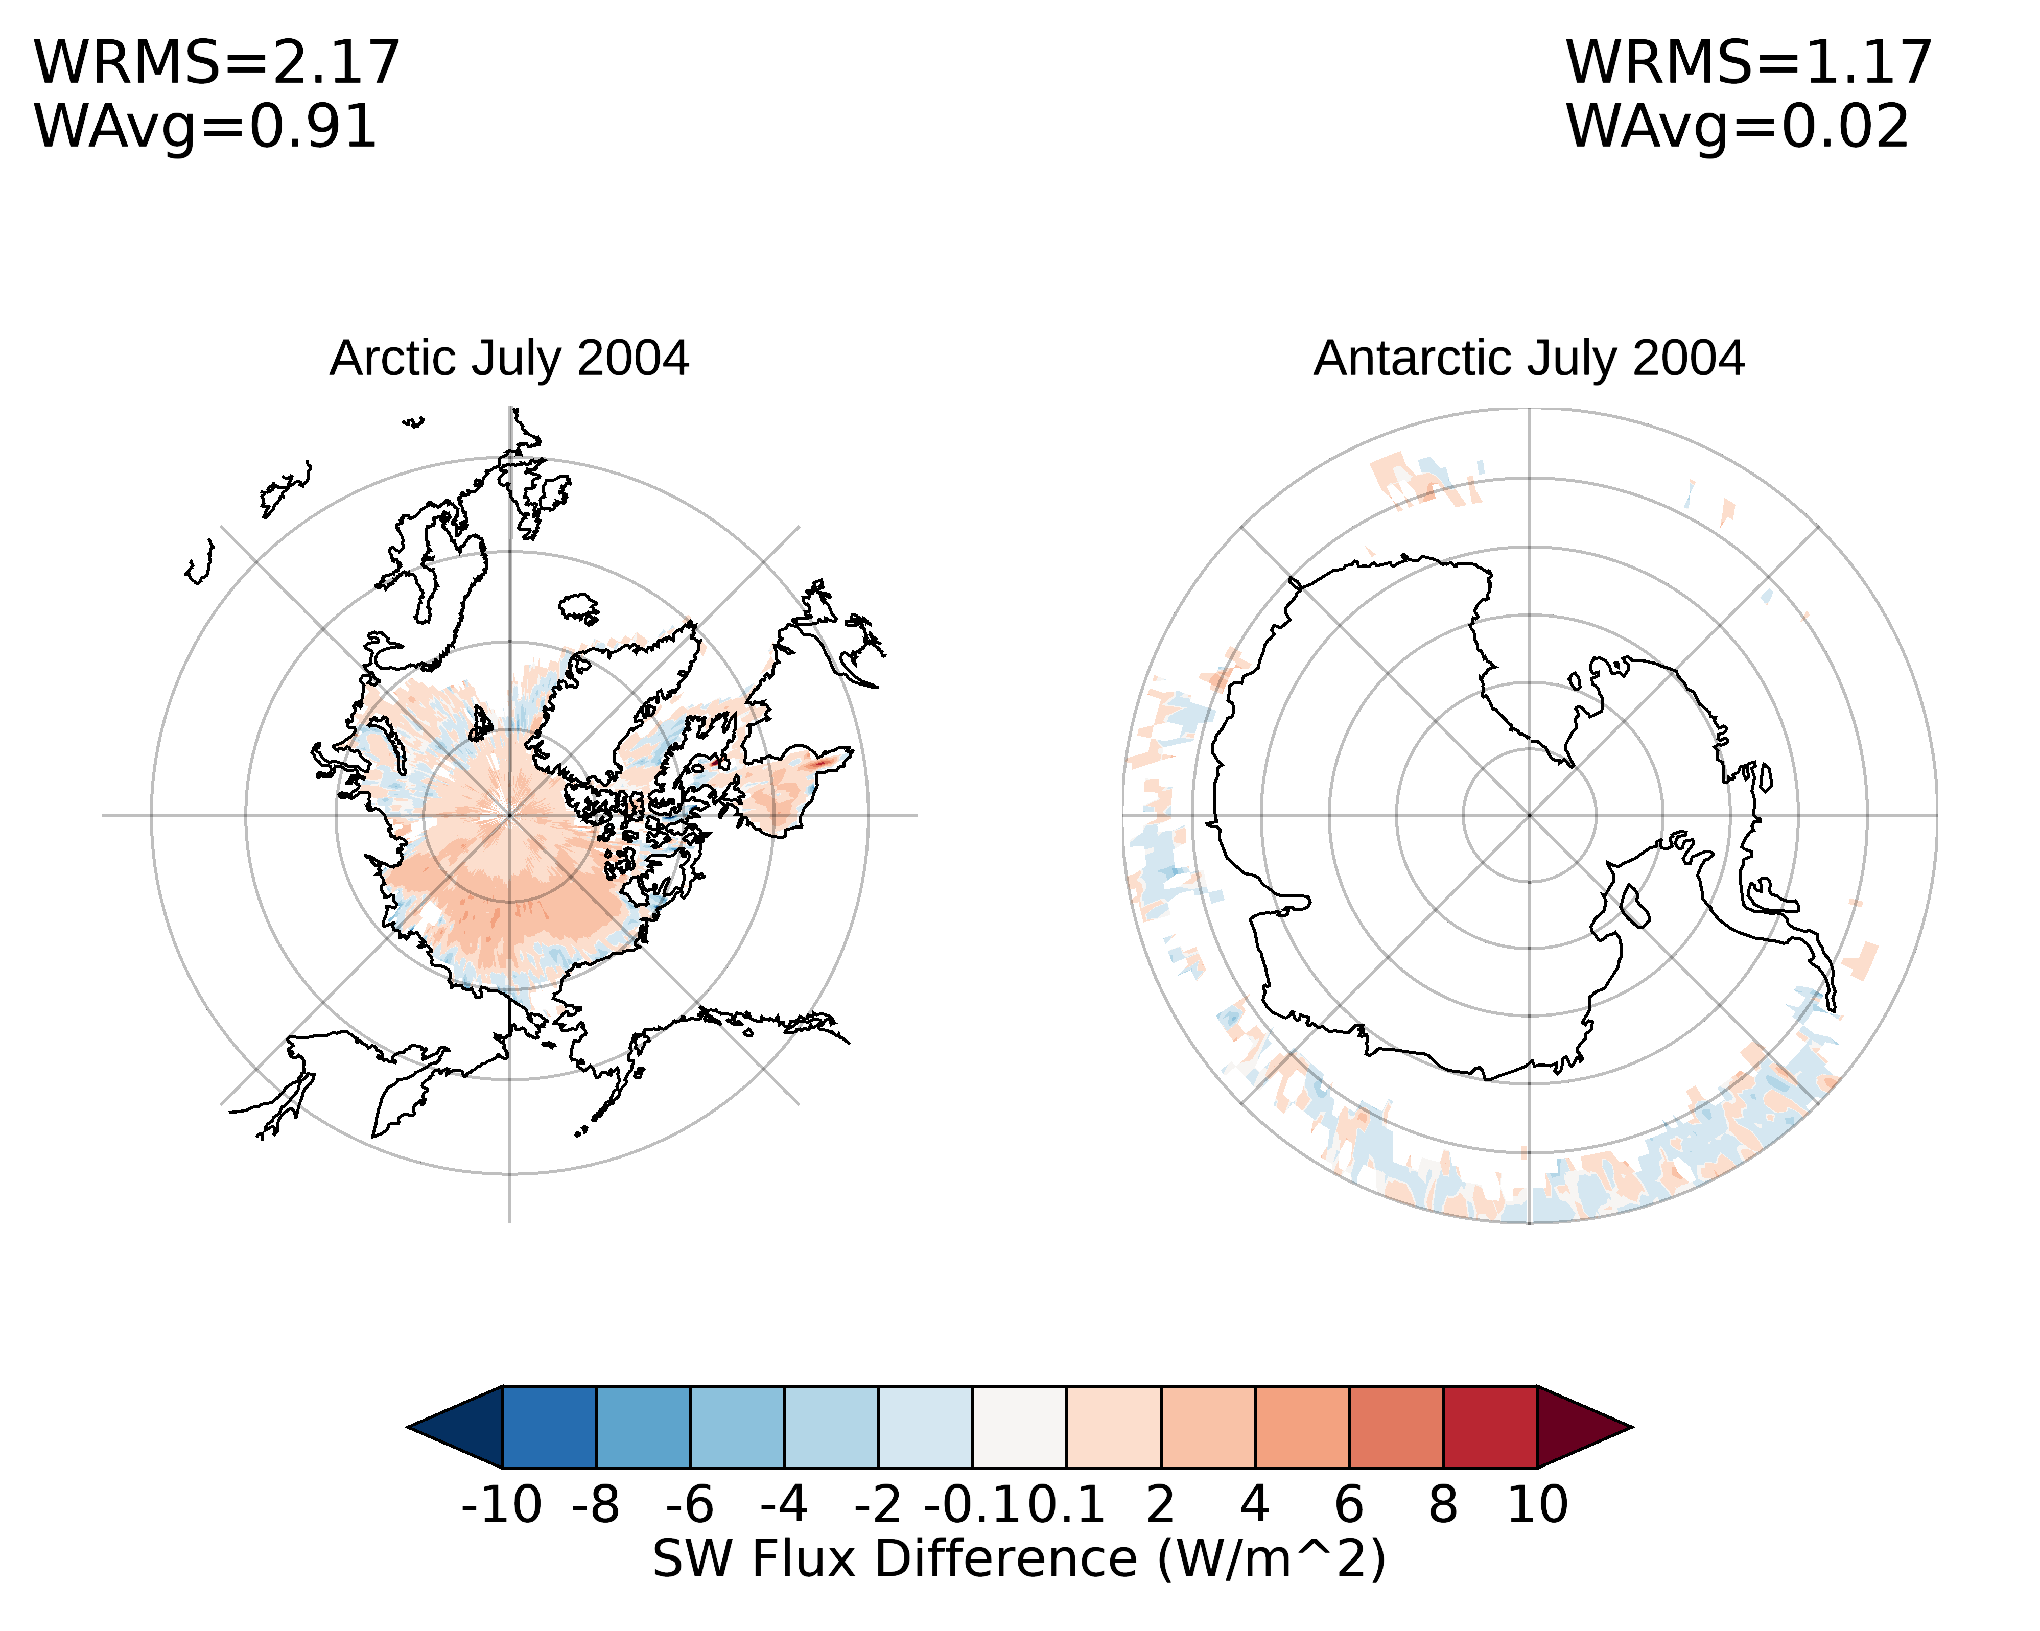
Impact on clear-sky sea ice fluxs

Slide 8
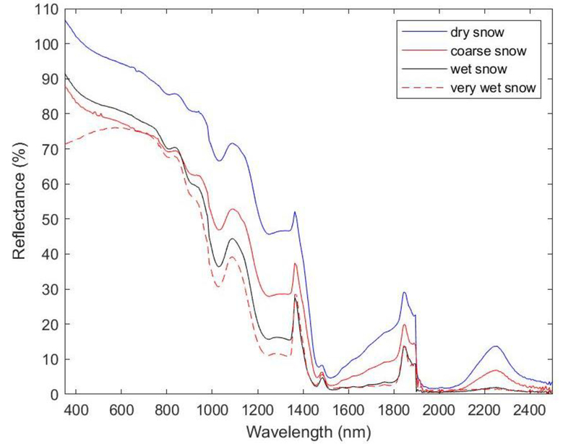
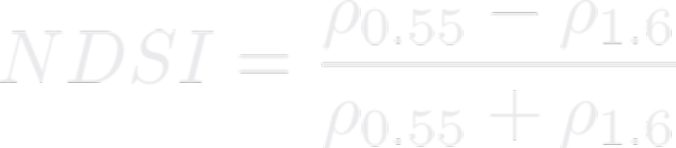
Normalized difference snow index
Snow has a high reflectance in visible band and a low reflectance in near infrared band.
MODIS team defined the following NDSI to monitor snow cover:
Selj and Mikkelsen (2012)

Slide 9
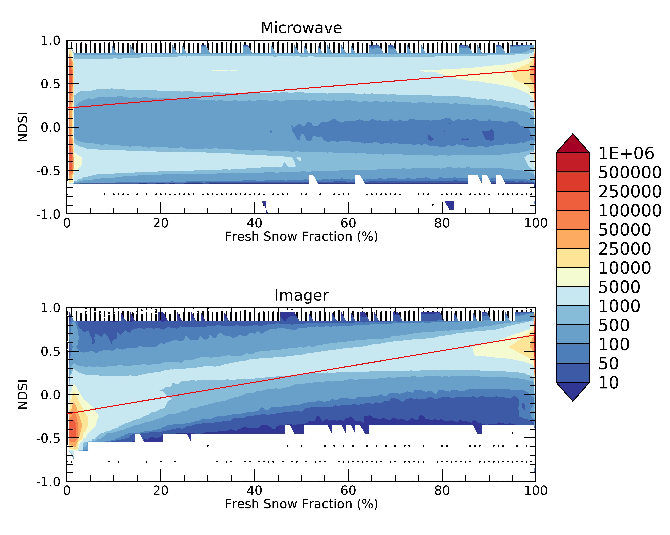
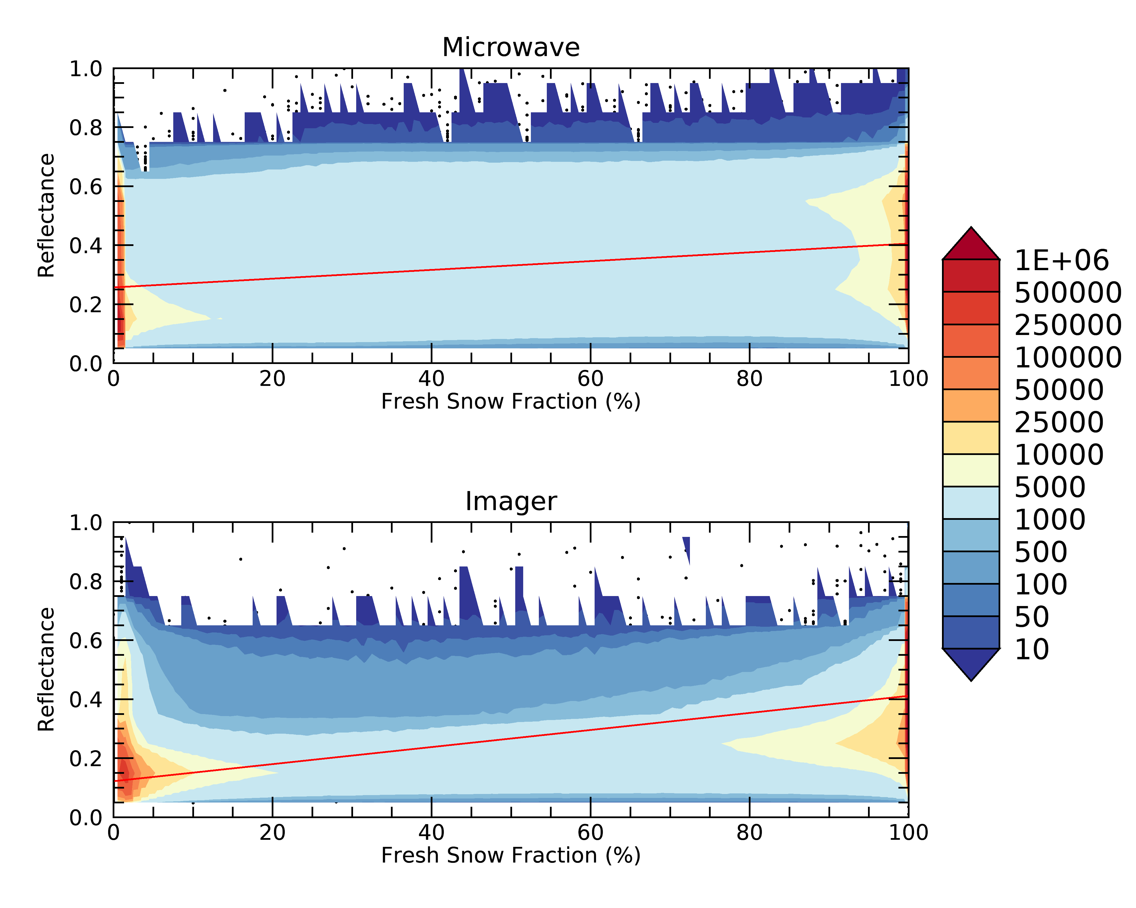

Slide 10
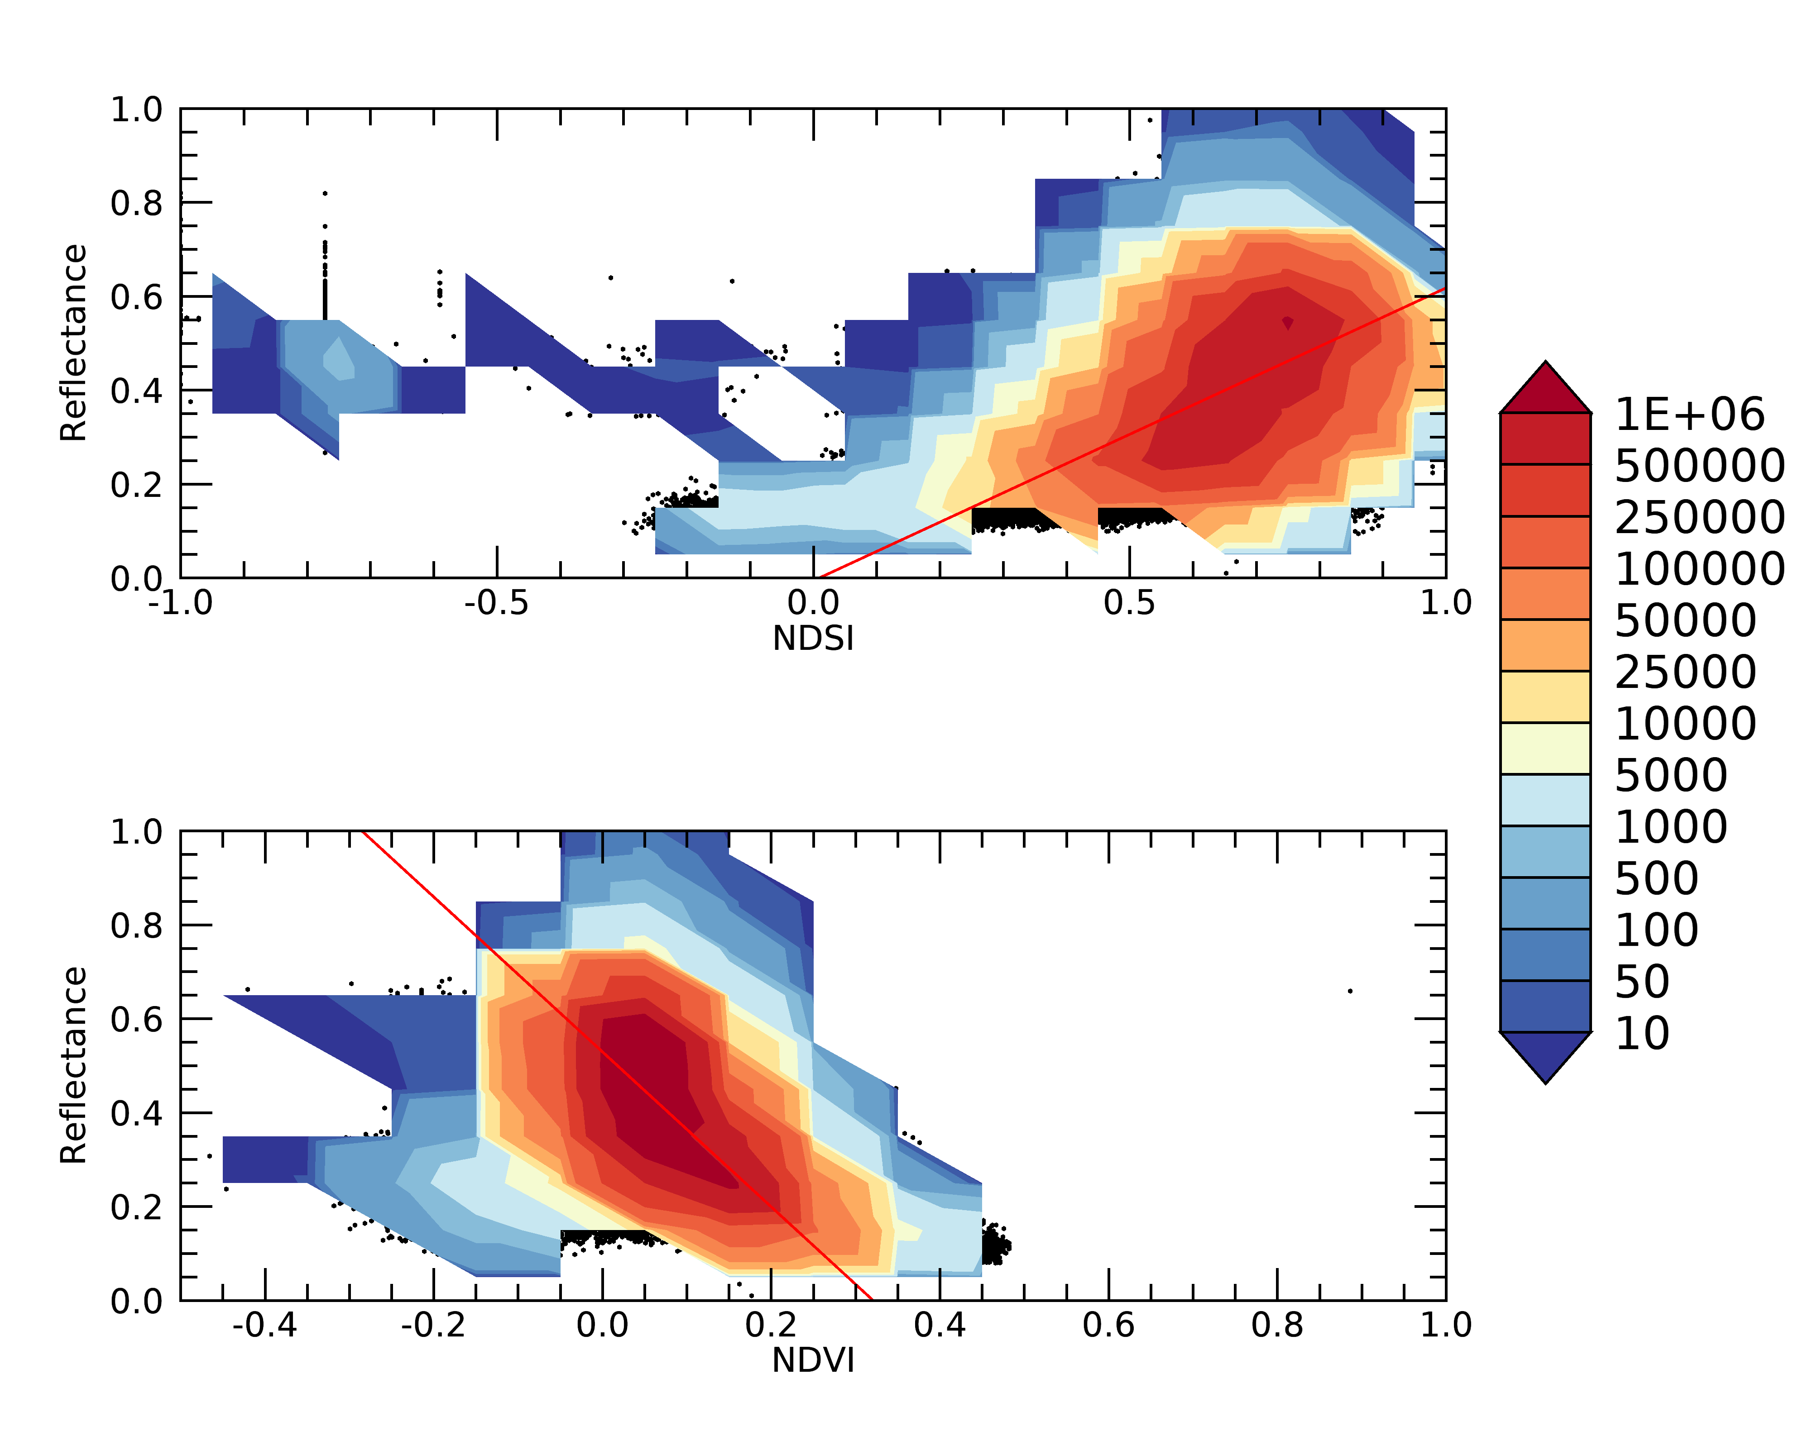
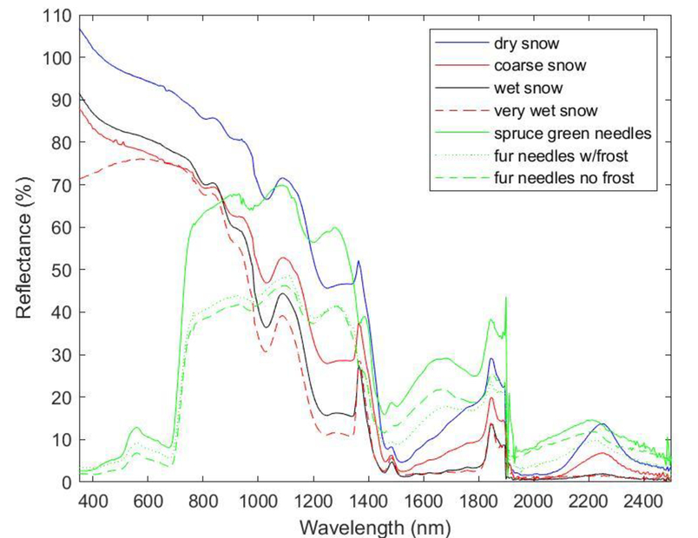
Imager Fresh Snow = 100%

Slide 11
IGBP classification from USGS (Belward, 1996, Loevland et al. 2000)
The 1 km global land cover database was developed through a continent-by-continent unsupervised classification of 1 km monthly AVHRR NDVI composites covering 1992-1993.
AVHRR NDVI data were formed into the bimonthly composite images to derive the maximum NDVI composites. Every composite image was manually checked for navigation accuracy by comparing the mapped data to a reference coastline for every continent.
The maximum value NDVI composite dataset were produced without any atmospheric correction except during El Chichon and Mt Pinatubo volcanic stratospheric aerosol periods.
Cloud screening was provided by using a thermal mask from 10.8µm channel, 0°C was used for all continents except Africa, where a cloud mask of 10°C was used.
Maximum value compositing was used to simultaneously minimize atmospheric and directional reflectance effects.
Monthly maximum NDVI composites were clustered using an unsupervised classification strategy based on the K-Means technique.
This dataset is no longer available for download!

Slide 12
MODIS Land Cover Product (Sulla-Menashe et al. 2019)
Collection 6 MODIS Nadir BRDF-adjusted Reflectance (NBAR) products and ancillary information (NDSnowI, EVI, NDWaterI, ect.) are used as inputs.
The C6 NBAR product provides cloud-screened and atmospherically-corrected daily surface reflectances that have been adjusted to provide consistent view and solar geometry in the seven MODIS ’land’ bands.
The System for Terrestrial Ecosystem Parameterization (STEP) database provides high quality training examples that are representative of each land cover type in the MODIS land cover product.
Land cover classifications were performed using the Random Forests.

Slide 13
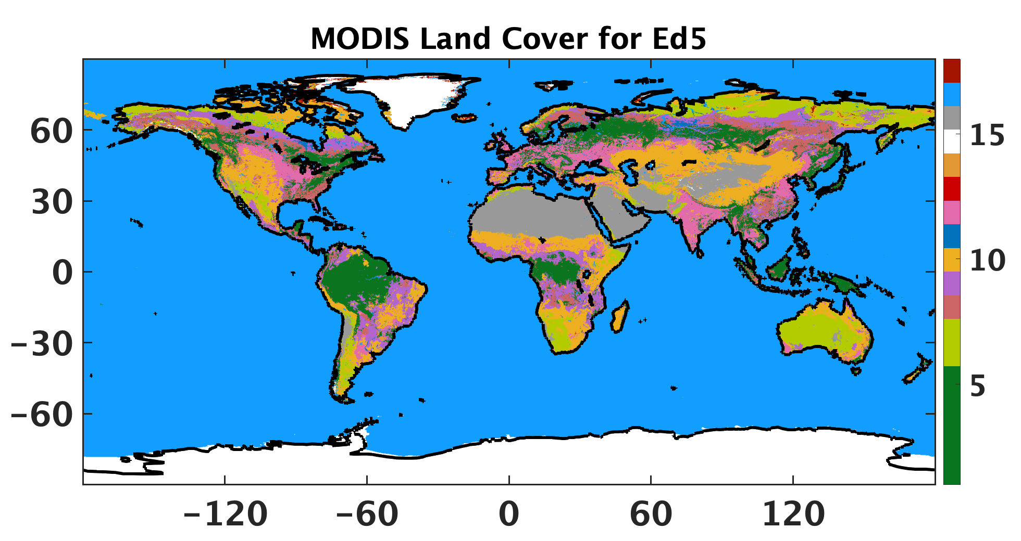

Using data from 2001 to 2020, and the mode of each grid is assigned as the land cover climatology.
Average the MODIS 0.05° land cover data into 1/6° resolution to maintain consistence.
Reassign barren land cover over high latitude (>50°N) to tundra as we did for the original land cover map.

Slide 14
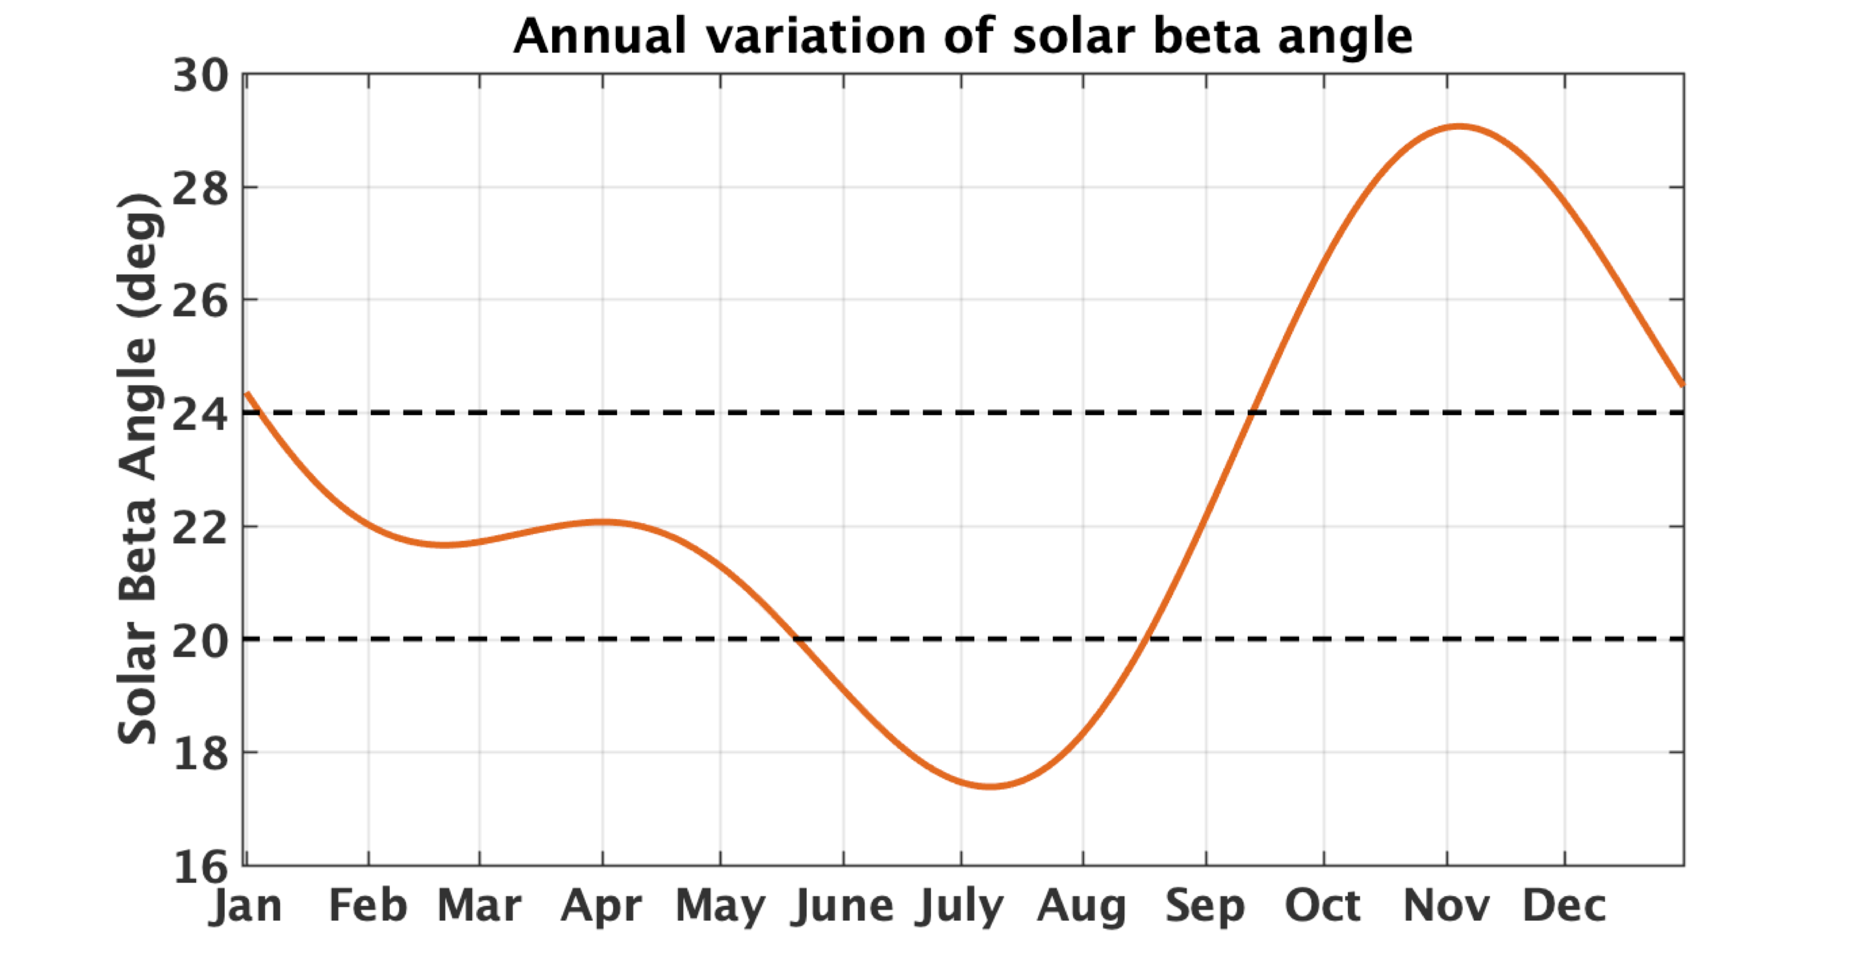
CERES S-NPP is in full RAP scan mode
CERES instrument on S-NPP is in full biaxial scan since March 24, 2020.
As biaxial scan was not planned for CERES instrument on NPP, CERES instrument doesn’t have an unobstructed view from all angles.
There is an antenna that needs to be avoided at clock angle of ~20° on S-NPP.
For solar beta angle < 24°:
  Clock angle: 25°-169°, cone angle: 0°-64°
  Clock angle: 205°-349°, cone angle: 0°-64°
For solar beta angle ≥ 24°
  Clock angle: 25°-180°, cone angle 0°-64°
  Clock angle: 205°-360°, cone angle 0°-64°
Notes:
The clock angle is the azimuth angle of the instrument view vector from the satellite to the Earth point relative to the inertial velocity vector.
The cone angle is the angle between a vector from the satellite to the center of the Earth and the instrument view vector from the satellite to the Earth point.
The clock angle and the cone angle define the direction of the instrument view vector to the Earth point.

Slide 15
LW ADMs for CERES on S-NPP
Construct S-NPP LW ADMs based on the same methodology that we developed for Ed4 Aqua ADMs using all available cross-track and RAP data from CERES NPP (Feb. 2012 to Nov. 2021).
Using these S-NPP LW ADMs to invert LW fluxes from S-NPP CERES observations and compare with the S-NPP CERES LW fluxes inverted using Aqua ADMs.

Slide 16
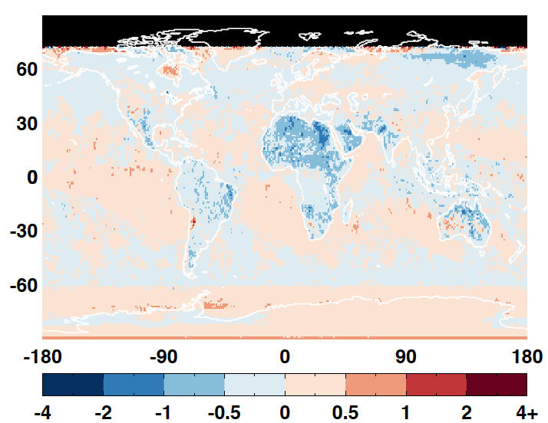
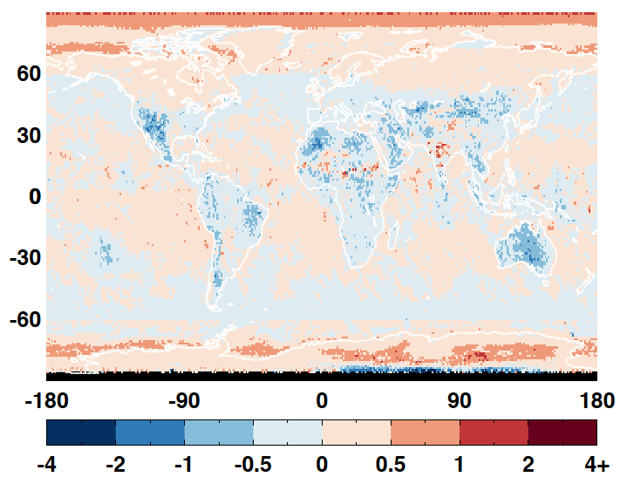
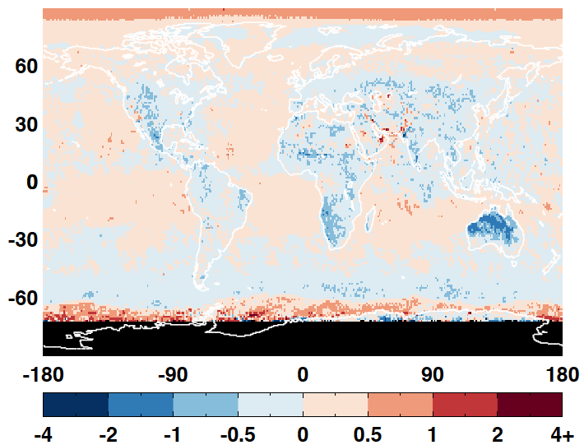
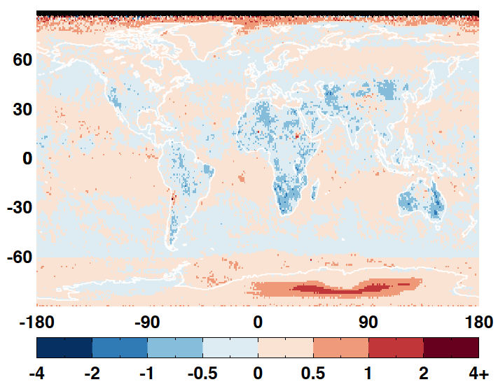
All-sky daytime LW flux difference
201801 201804
201807 201810

Slide 17
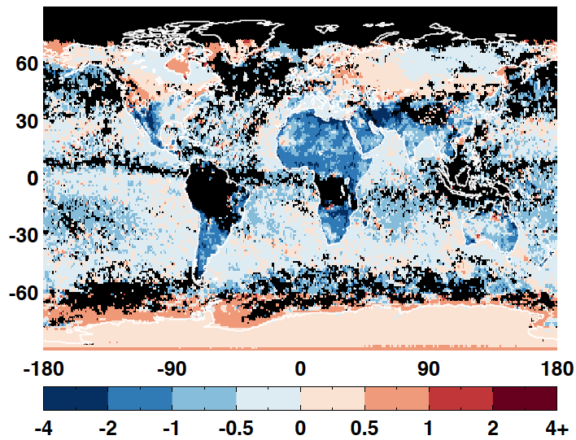
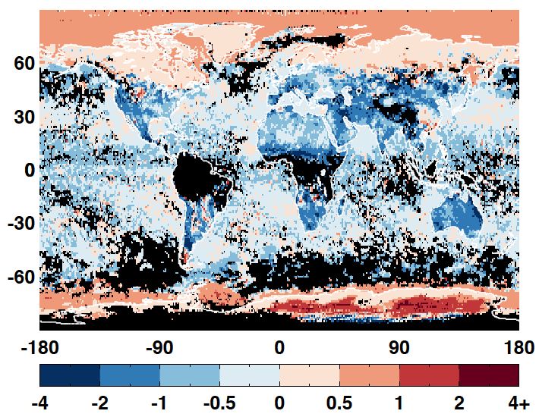
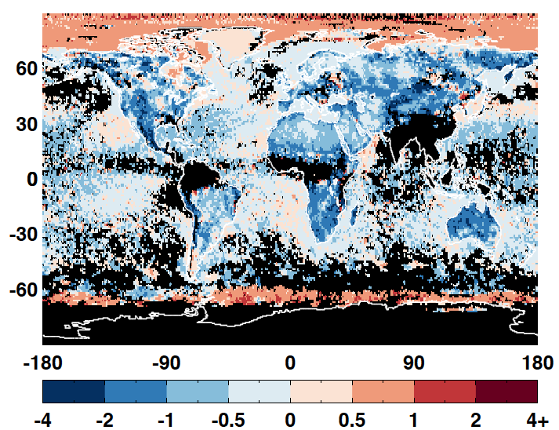
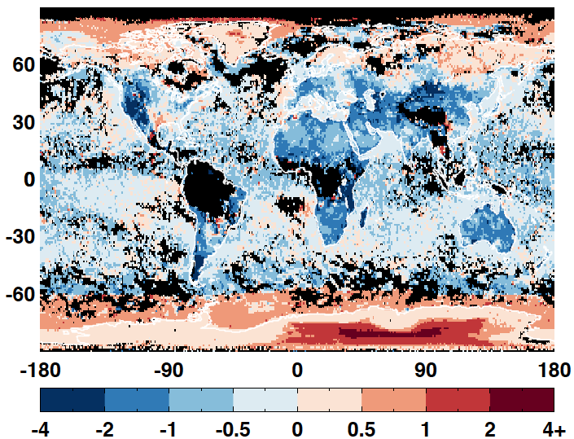
Clear-sky daytime LW flux difference
201801 201804
201807 201810

Slide 18
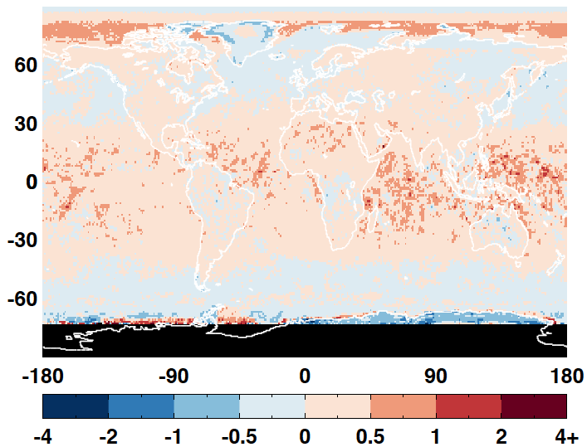
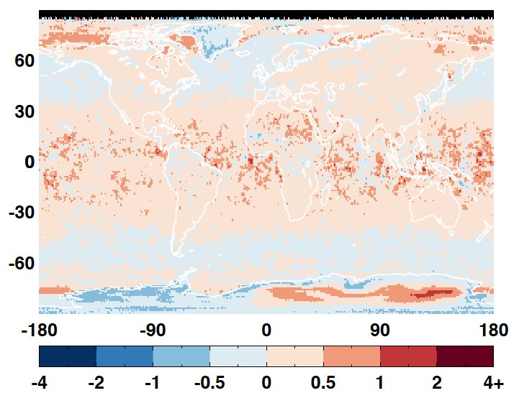
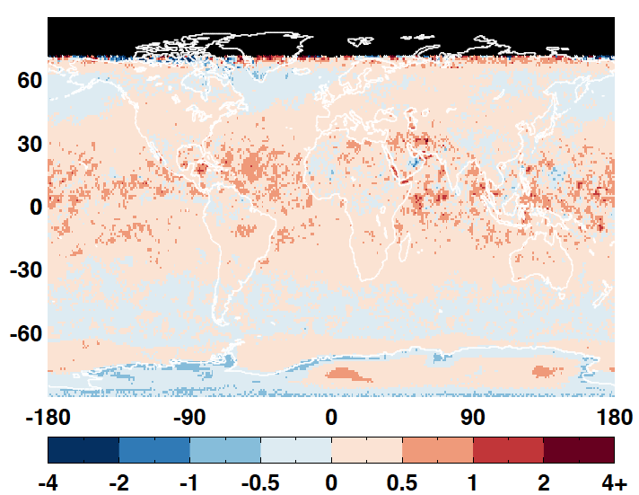
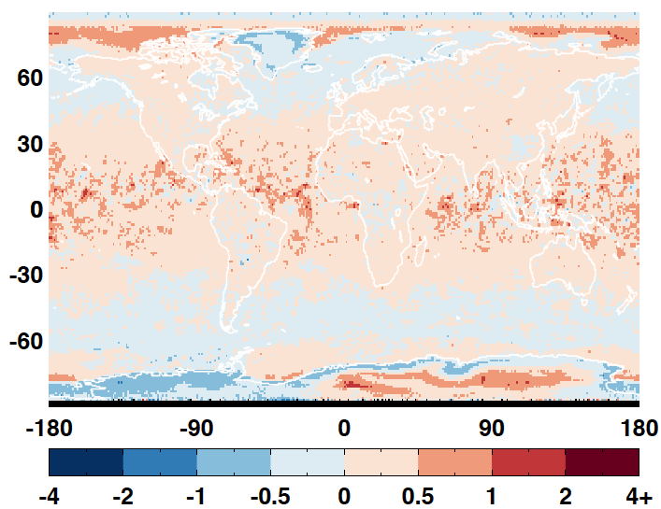
All-sky nighttime LW flux difference
201801 201804
201807 201810

Slide 19
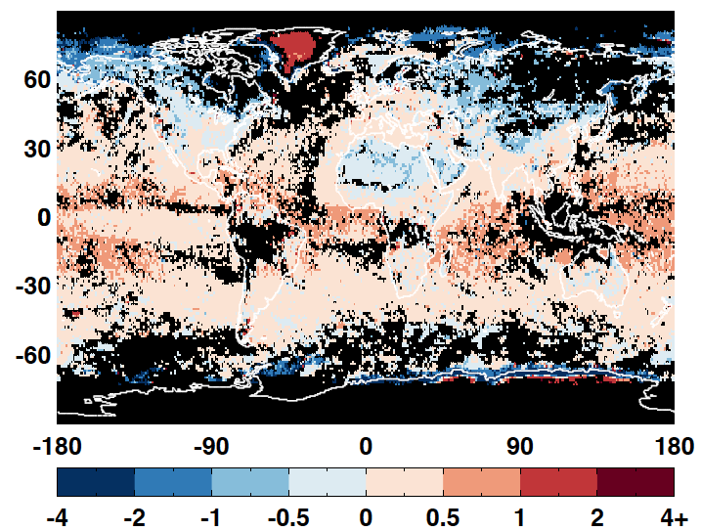
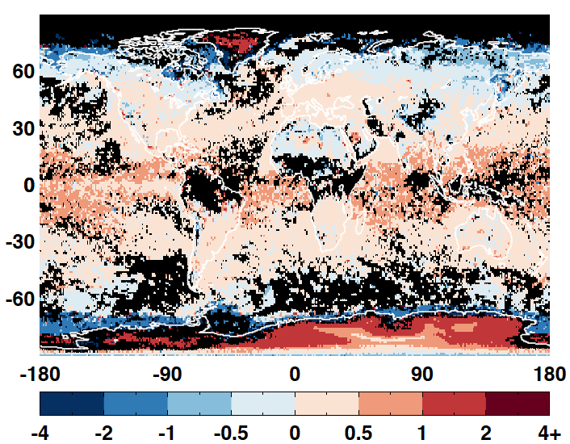
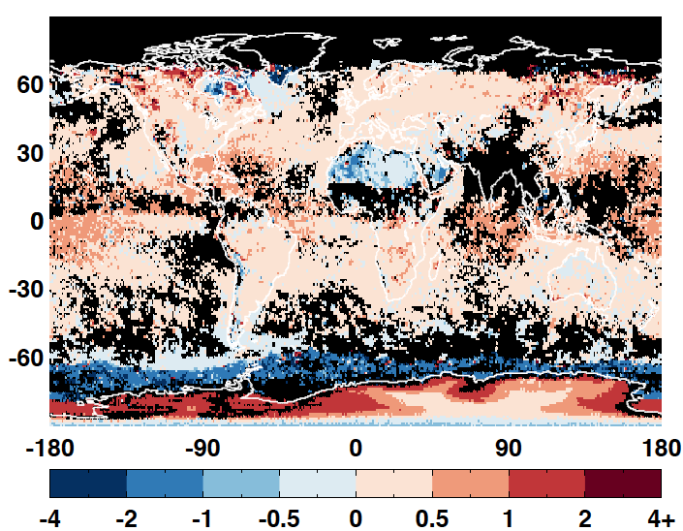
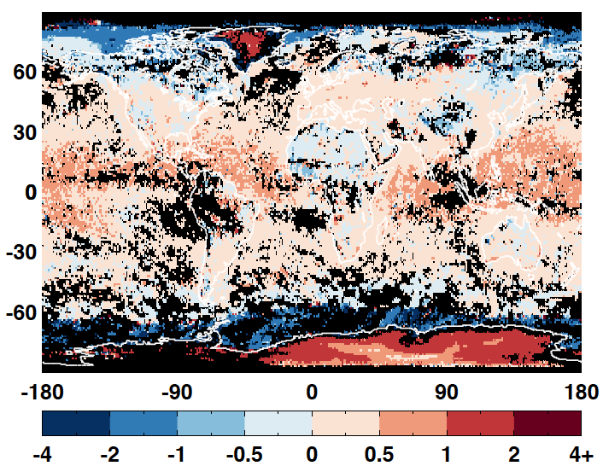
Clear-sky nighttime LW flux difference
201801 201804
201807 201810

Slide 20
Visible ADMs for Libera
Libera has a split-shortwave channel (0.7-5 µm), in addition to the traditional shortwave (0.3-5 µm), longwave (5-50 µm), and total (0.3-100 µm) channels.
Radiances in the visible band (0.3-0.7 µm) can be derived by subtracting split-shortwave radiances from shortwave radiances.
Need visible ADMs to derive visible band fluxes.

Slide 21


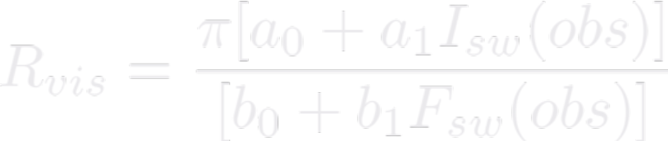
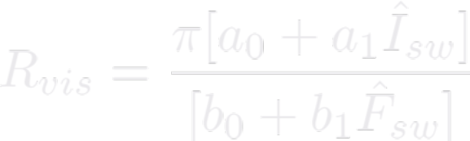
Derive visible ADMs from CERES SW ADMs
Using radiative transfer model (MODTRAN 5.4) simulations to determine the following relationships for different sun-viewing geometries and scene types:
Using observed I_{sw} and F_{sw} to determine the visible band anisotropic factor for each footprint:
Alternatively, we can also use the SW ADM radiance and flux to determine R_{vis}:

Slide 22
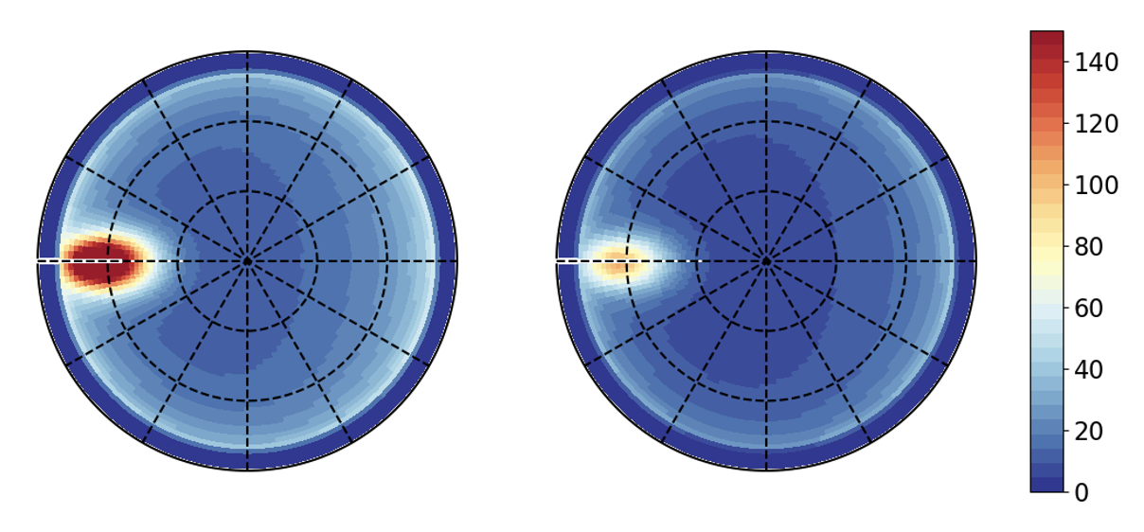
Clear ocean simulation
Use MODTRAN5.4 to calculate the spectral radiances from 0.25 µm to 100 µm at 2° angular bins for SZA, VZA, and RAA.
Fluxes for the shortwave and visible band are also calculated.
Atmospheric profile | Aer. type | AOD @0.55um | Surface BRDF | Wind speed(m/s)
tropic | None | 0 | Cox-munk | 5
tropic | Maritime | 0.09 | Cox-munk | 5
tropic | Maritime | 0.30 | Cox-munk | 5
tropic | Maritime | 1.17 | Cox-munk | 5
SZA=55° SW radiance Visible band radiance

Slide 23
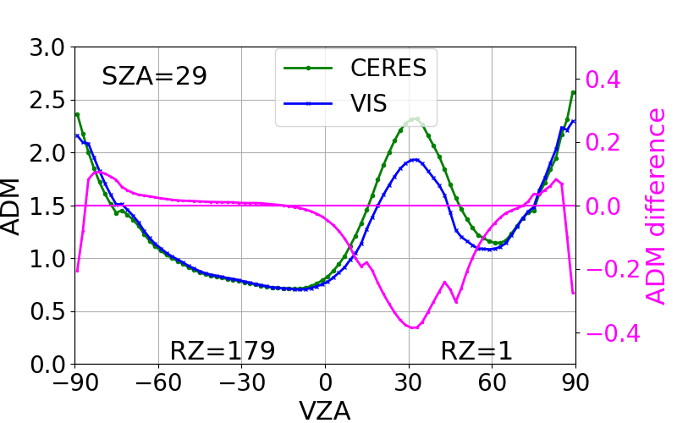
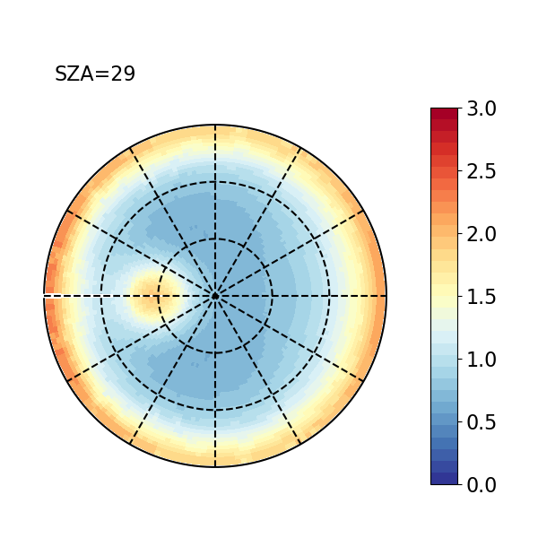
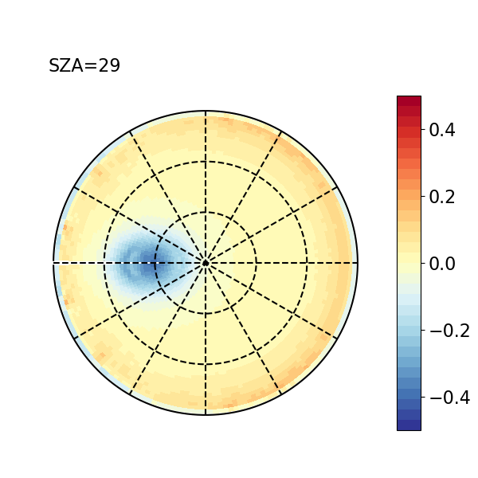
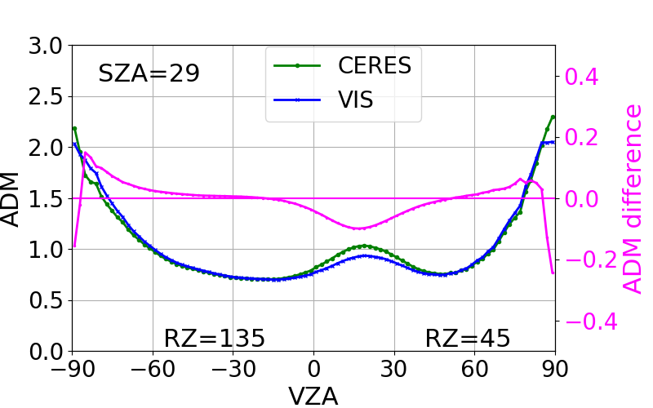
Apply the radiative transfer model derived regressions to CERES SW ADM radiance and flux:
Visible band ADM Visible-SW

Slide 24
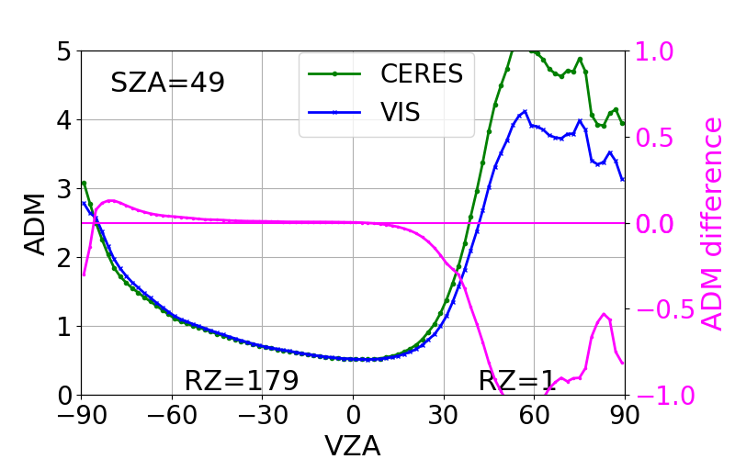
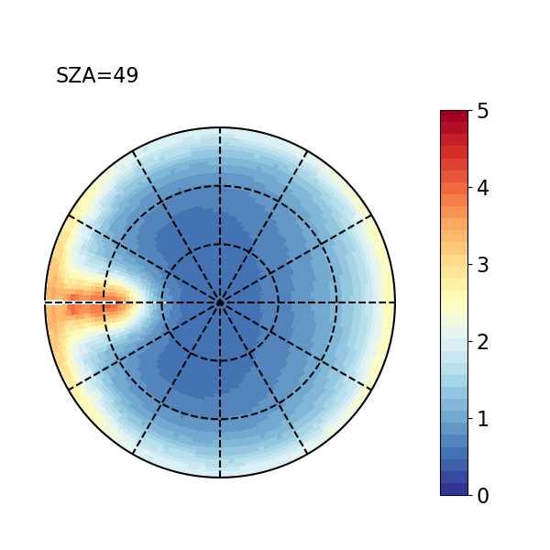
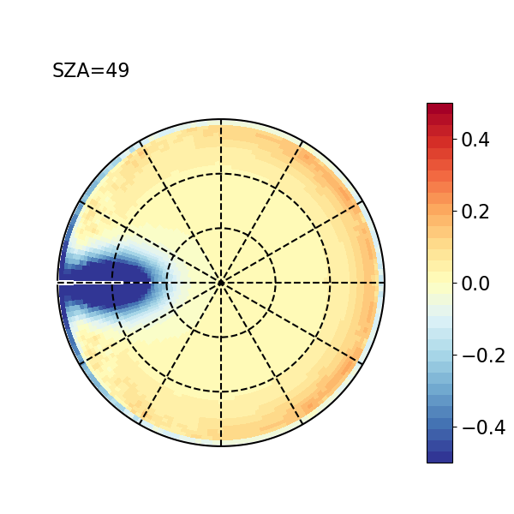
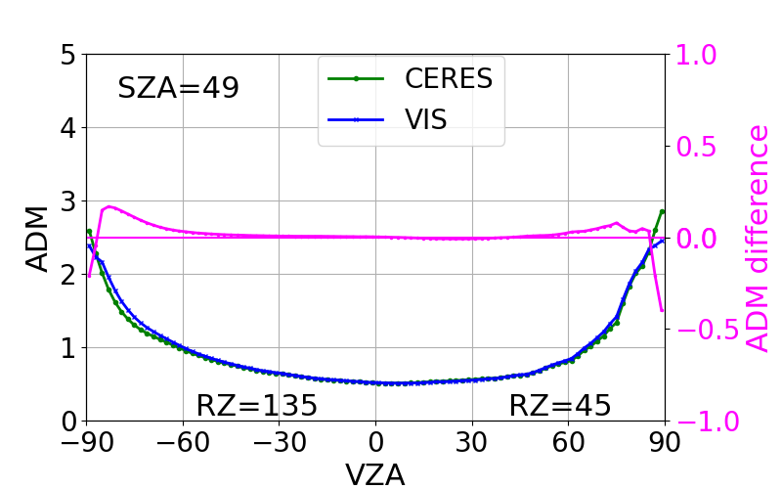
Visible band ADM Visible-SW

Slide 25
Summary
The current NSIDC sea ice concentration used in CERES data processing underestimates sea ice concentration by about 10%.
Sea ice brightness index is used to mitigate this issue. NOAA sea ice concentration CDR is considered for Ed5.
MODIS land cover data will be used in the Ed5 processing for land surface type classification.
Using Aqua ADMs for NPP flux inversion has negligible impact on global mean all-sky daytime and nighttime LW fluxes but can lead to >2 Wm-2 bias for monthly gridded mean LW flux.
Using Aqua ADMs for NPP flux inversion underestimates global mean clear-sky daytime LW flux by 0.4 Wm-2 and nighttime LW fluxes by 0.2 Wm-2 with monthly gridded mean LW flux biases exceeding 4 Wm-2.
Developed a method to derive visible ADMs from CERES SW ADMs.

