Slide 1
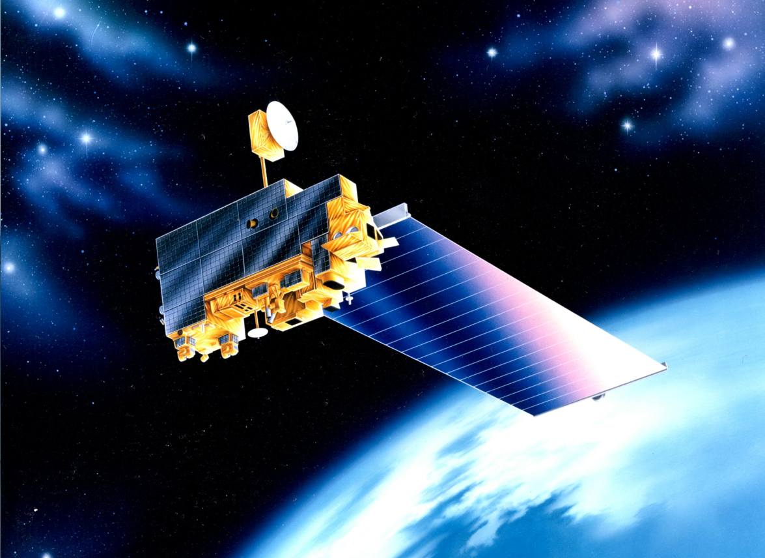
EOS Terra
Constellation Exit Review
MOWG - Virtual (GSFC)
May 16-19, 2022
Dimitrios Mantziaras
Terra Mission Director - Code 428
phone 301-614-5234
Dimitrios.C.Mantziaras@nasa.gov

Slide 2
Topics
Overview/Purpose
Spacecraft Subsystems Summary
Constellation Exit Plan Description
FDS Preparations & Analysis
FOT Preparations & Analysis
Contingencies
Summary
Backup Slides

Slide 3
Goal of Presentation
Goals
Explain Terra’s plan and readiness for exiting the constellation safely
Show analysis and preparation activities performed by FDS and FOT
Describe possible contingencies and predetermined response
Demonstrate that Terra is ready to safely exit the constellation

Slide 4
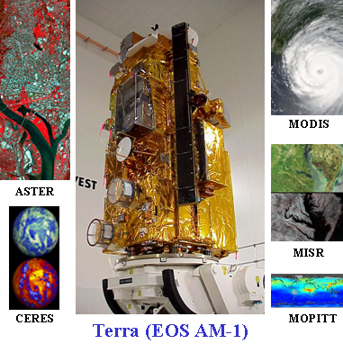
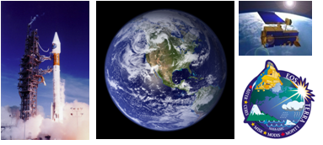
Terra Mission Overview
Terra Features
Launch Date: December 18,1999 (Atlas IIAS, VAFB)
Orbit: 705 km, Sun-synchronous polar, 98.2º Inclination, 10:30 AM MLT descending node
Instrument Payload:
  ASTER (SWIR, TIR & VNIR) - Advanced Spaceborne Thermal Emission and Reflection Radiometer (Japan)
  CERES (Fore & Aft) - Clouds and the Earth's Radiant Energy System (USA – Langley)
  MISR - Multi-angle Imaging Spectro-Radiometer (USA – JPL)
  MODIS - Moderate Resolution Imaging Spectro-radiometer (USA – GSFC)
  MOPITT - Measurement of Pollution in the Troposphere (Canada)
Project Management: Earth Science Mission Operations (ESMO)
Spacecraft Flight Operations: Contracted by GSFC to KBR team and supported by NASA NENs and TDRSS
Instrument Operations and Science Data processing: Performed at respective Instrument Locations where developed
Mission Duration: Successfully completed Prime mission of 5 years. Currently in Extended Operations.
Distributed Active Archive Centers: LP DAAC – MODIS, ASTER; Langley DAAC – CERES, MISR, MOPITT
Science
The primary objective of the Terra Mission is to simultaneously study clouds, water vapor, aerosol, trace gases, land surface and oceanic properties, as well as the interaction between them and their effect on the Earth’s energy budget and climate.

Slide 5
Terra Spacecraft Status
All subsystems on Primary Hardware except as noted
Command & Data Handling (CDH) – Nominal
  Solid State Recorder (SSR) – holds ~1 orbit of data
  58 of 58 SSR Printed Wire Assembly now operational (All 16 offline boards were recovered)
    SSR Reset successfully performed on 09/22
Communications (COMM) – Nominal
  DAS Modulator Failure on 05/29/2008 (Operating on Redundant)
  Use K-Band primarily, X-Band as needed for Science Playback
Electrical Power System (EPS) – Good
  Battery Cell and Heater Controller Anomaly (10/13/2009)
  3 of 24 Solar Panel Failed (9/24/2000, 01/17/2022 & 03/22/2022)
Flight Software (FSW) – Nominal
Guidance, Navigation & Control (GN&C) – Nominal
  IRU-B powered down due to rising temp and current trend (recommendation from Kearfott)
    Not used for nominal operations (IRUs A & C used for ops and no signs of degradation)
    Audit of all references to IRU-B completed, prime updates completed prior to turn-off, remaining items being worked
  Minor loss of sensitivity in SSSTs – updated tracker biases to compensate
Propulsion (PROP) – Nominal
Thermal Control System (TCS) – Nominal
Instruments (INST) – Nominal
  Only ASTER SWIR failed, all other instruments are taking science

Slide 6
Spacecraft Component Status
Subsystem | Component | Design | Current | Capability | Comments
EPS | Solar Array | 24 Shunts | 21 Shunts | 88% | No impact to operations. Additional failures will require reducing load or EPS configuration change. Fully capable of supporting mission thru 2027 unless multiple future failures occur
 | Batteries | 108 Cells | 107 Cells | 99% | BBAT cell #50 failed on 10/15/09.
 | Batteries | 36 Heater Controls | 28 Heater Controls | 77% | BBAT heater control failed on 4 of 9 heater groups on primary, redundant, and survival. Battery cell charging/discharging and the remaining heater groups are preventing cells from freezing. PBAT heater control performance is nominal.
TCS | MOPITTCPHTS | 2 | 2 | Full | Performance is nominal
 | SWIR CPHTS | 2 | 2 | Full | Performance is nominal
 | TIR CPHTS | 2 | 2 | Full | Random temperature fluctuations. Performance within requirements.
SCC | SCC | 2 | 2 | Full | Performance is nominal
COMM | HGA | 2 | 2 | Full | MDA BITE failures occur 2-3/week due to SEU. Recoverable
 | X-Band | 2 | 1 | 75% | DAS Modulator 1 failed (50%). Solid State Power Amplifier redundancy still available (100%).
 | CTIU | 2 | 2 | Full | Performance is nominal
 | OMNI | 2 | 2 | Full | Performance is nominal
CDH | MO | 2 | 2 | Full | Drift rate changes have occurred since 10/3/10. Performance is within requirements.
 | SFE | 2 | 2 | Full | SFE SEU occur 1-2/year. Recoverable
 | SSR | 59 PWA | 59 PWA | 100% | Successful SSR Reset on 09/22/21 recovered all 15 previously offline Printed Wire Assemblies
GNC | IRU | 3 | 2 | Full | Performance is nominal. IRU-B powered off. Yaw axis still redundant.
 | TAM | 2 | 2 | Full | Performance is nominal
 | SSST | 2 | 2 | Full | Minor loss of sensitivity in SSSTs – tracker biases updated
 | CSS | 2 | 2 | Full | Performance is nominal
 | ESA | 2 | 2 | Full | Performance is nominal
 | FSS | 1 | 1 | Full | Performance is nominal. Not currently used
 | RWA | 4 | 4 | Full | Performance is nominal. 3 for 4 redundancy
 | MTR | 3 | 3 | Full | Performance is nominal
Prop | REAs | 16 | 16 | Full | Performance is nominal
Instruments | ASTER - SWIR | 2 | 2 | 0% | Cooler is unable to maintain detector temperature. Science Data is unusable (Fully Saturated) and is no longer being recorded. Still collecting and monitoring Engineering data.
 | ASTER - TIR | 2 | 2 | Full | Performance is nominal
 | ASTER - VNIR | 2 | 2 | Full | Performance is nominal
 | CERES - Aft | 1 | 1 | Full | Performance is nominal
 | CERES - Fore | 1 | 1 | Full | Performance is nominal
 | MISR | 2 | 2 | Full | Performance is nominal
 | MODIS | 2 | 1 | 50% | Power Supply #2 failed, Formatter A degraded, cross-strapped. All Science is nominal.
 | MOPITT | 2 | 1 | 50% | Displacer B and Chopper Motor failed. Loss of redundancy only. All Science is nominal.

Slide 7
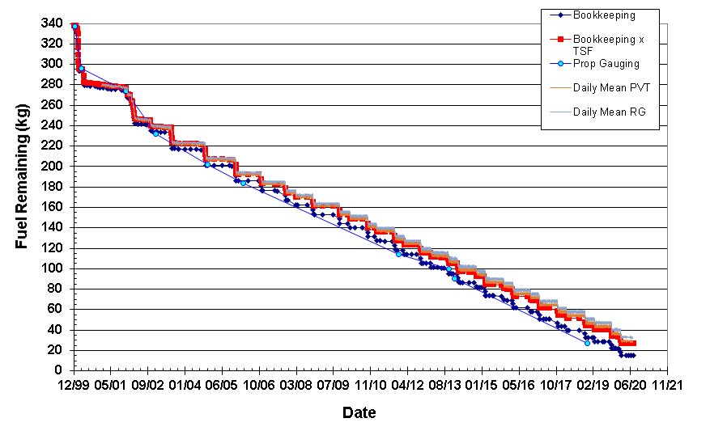
Lifetime Estimates
Fuel Remaining
Fuel Reserve = 12kgs
12 kg
Fuel estimates have been reviewed by ETD, S/C Manufacturer and FOT
  Bookingkeeping x TSF & PVT methods believed to be most accurate
  Most conservative Bookkeeping used as trigger for constellation exit

Slide 8
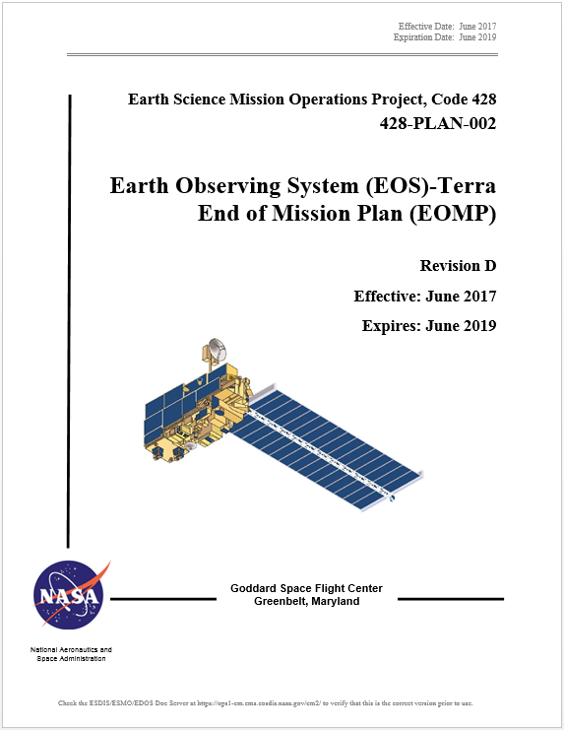
Terra End-of-Mission Plan
  Document Status
  Rev D - End-of-Mission Plan Document has been revised and under review cycle
  APPROVED - NASA HQ Signed in October 2018
  Rev E – Generated and working its way through signatures
    Minor updates to numbers based on 3 years since Rev D
  Content
  Terra continued normal operations through October 2020
  Following that timeframe, MLT has been allowed to drift towards 10:15 AM
  October 2022, Terra exits constellation (Rev E)
  Remaining fuel will be used to lower perigee prior to spacecraft passivation
  Exit plan is consistent with the current Constellation Operations Coordination Plan

Slide 9
Terra Lifetime Maneuvers
Spring 2022 Update
Remaining Orbit Maintenance Maneuvers
Mission Year | Inclination Maneuvers | DMU Maneuvers | Fuel Used (kg) | Fuel Remaining (kg)
2018 | 1 Spring, 2 Fall | 4 | 10.783 | 44.998
2019 | 1 Spring, 2 Fall | 5 | 10.752 | 34.245
2020 | 2 Spring, 0 Fall | 3 | 6.890 | 27.066
2021 | 0 Spring, 0 Fall | 6 | 0.344 | 26.503
2022 | 0 Spring, 0 Fall | 5 | 0.381 | 24.594
Constellation Exit and Deorbit Maneuvers
Mission Date | Maneuver Type | Fuel Used (kg) | Fuel Remaining (kg)
10/12/2022 | CEM #1 | 3.365 | 21.229
10/19/2022 | CEM #2 | 3.347 | 17.883
2/25/2026 | PLM #1 | 3.328 | 14.554
3/04/2026 | PLM #2 | 3.310 | 11.244
3/11/2026 | PLM #3 | 3.293 | 7.951
3/18/2026 | PLM #4 | 3.276 | 4.675
3/25/2026 | PLM #5 (59.5%) | 1.974 | 2.701

Slide 10
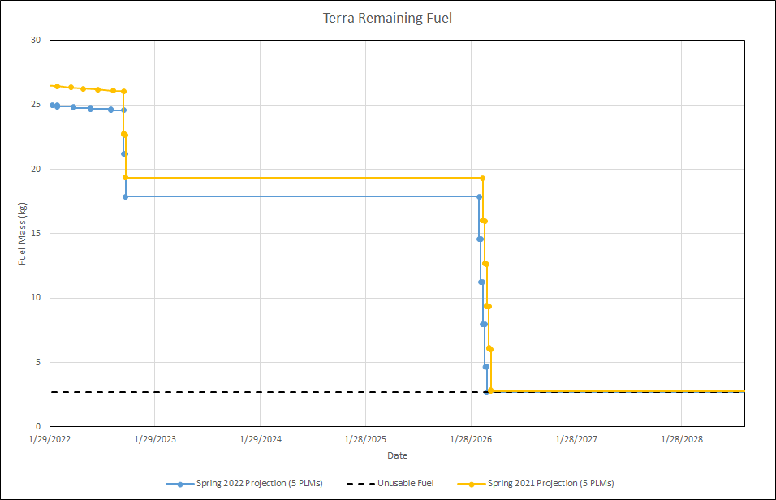
Terra Fuel Usage
Constellation Exit, October 2022
Perigee Lowering, February 2026
Unusable Fuel Buffer (2.7 kg)
Partial 5th PLM
Updated based on Spring 2022 Lifetime Analysis

Slide 11
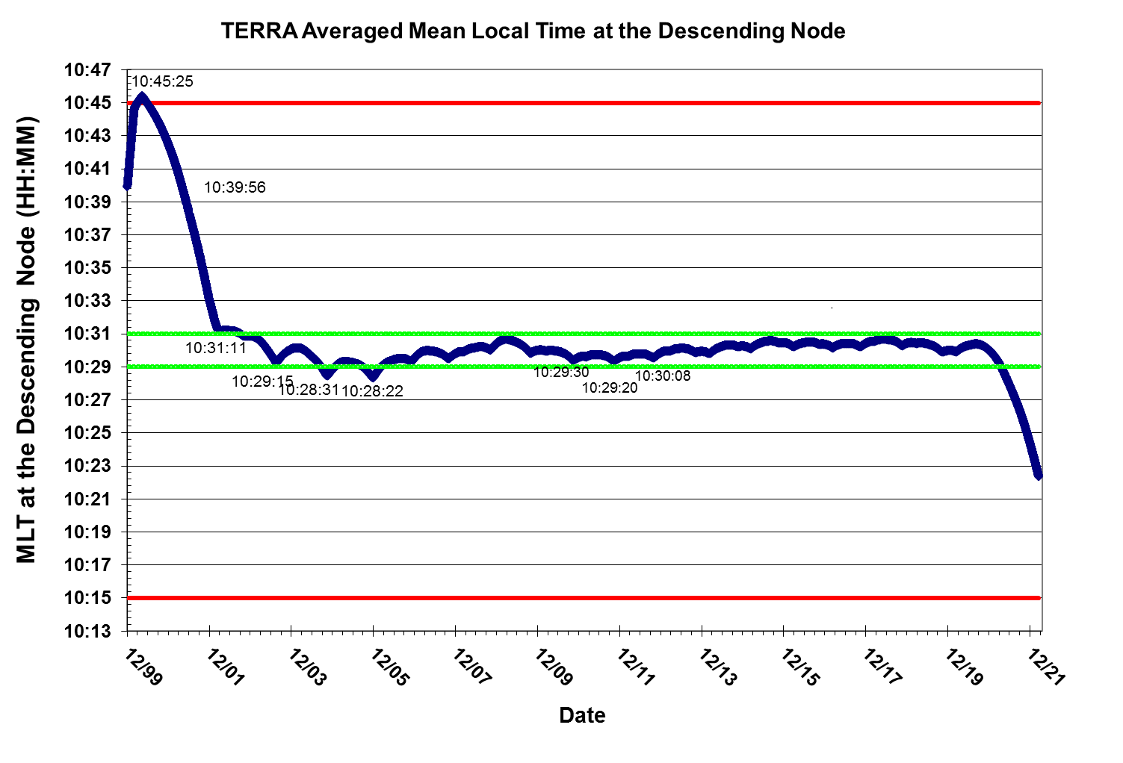
Current Mean Local Time

Slide 12
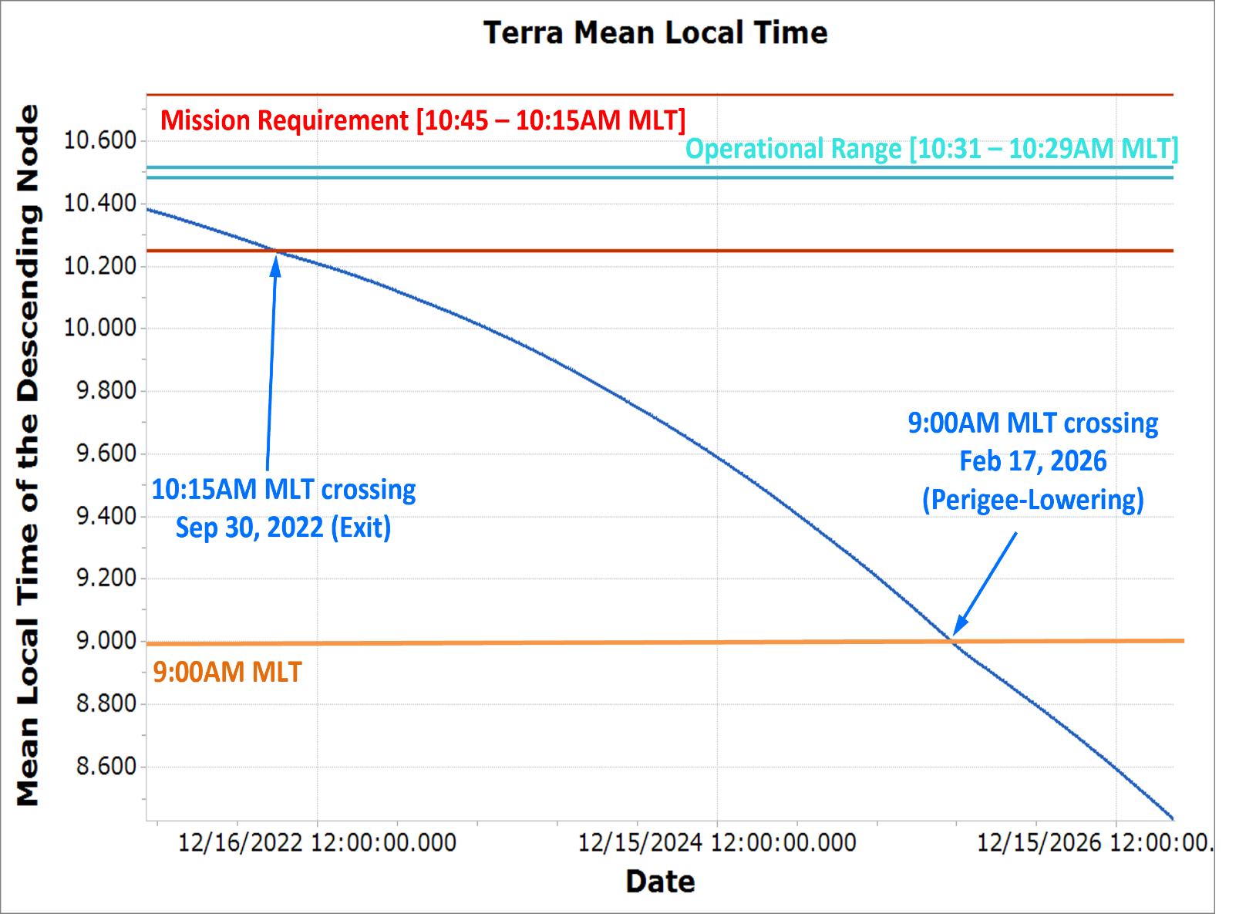
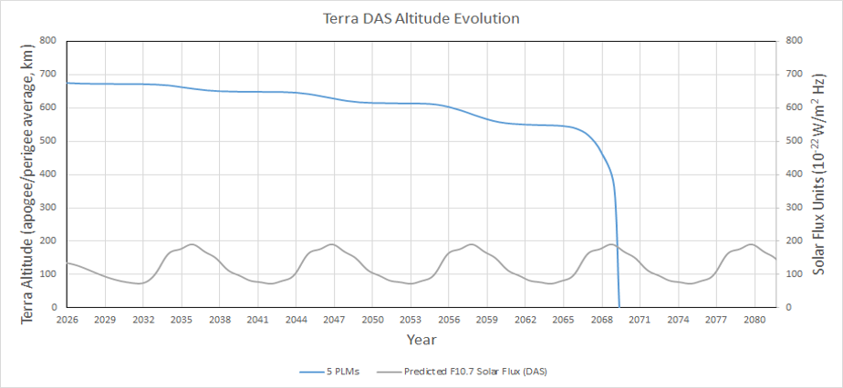
Terra Lifetime Maneuvers
MLT and Altitude Predictions
Decommissioning Plan | Exit Year | Deorbit Year | De-orbit Burns (#) | Apogee at Depletion (km) | Perigee at Depletion (km) | End of Mission (EOM) | EOM to Reentry (years) | Reentry Date
Baseline (4 x 320-sec burns + 1 x 191-sec burn) | 2022 | 2026 | 5 | 694.97 | 655.75 | 2026 | 43.25* | 2069.5
Updated based on Spring 2022 Lifetime Analysis
*Note: Terra launched prior to the 25-year re-entry requirement

Slide 13
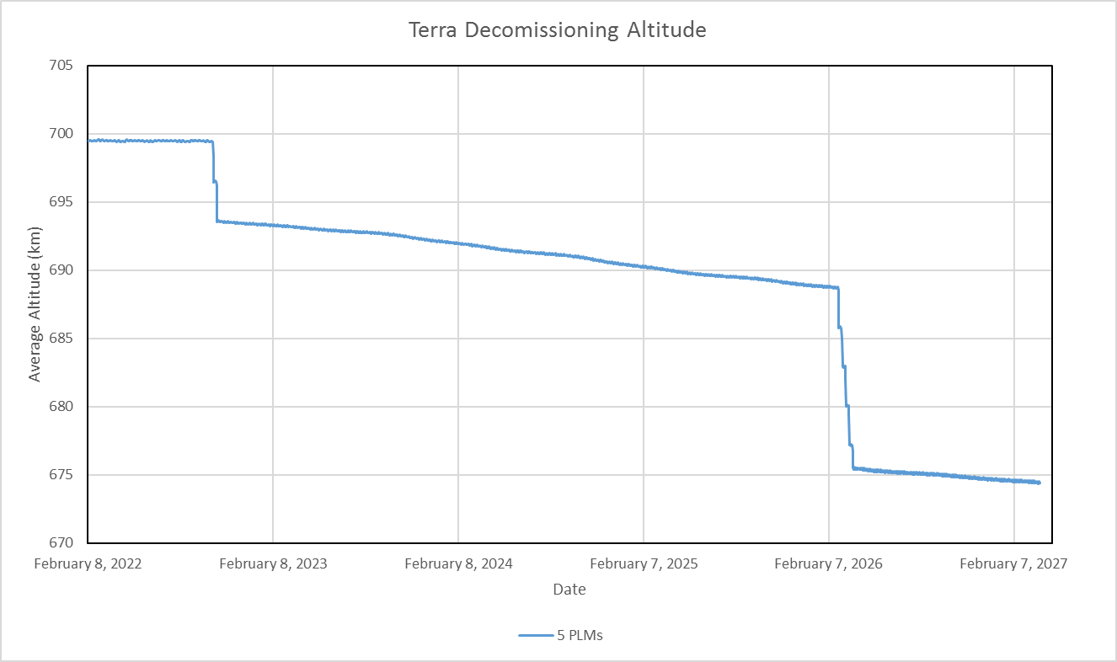
Final Average Height
(semi-major axis minus Earth radius)
Perform DMUs until
October 2022 (699.4 km)
Drift to 688.7 km
February 2026
Exit to 693.6 km
October 2022
Lower orbit to 675.5 km
March 2026
Updated based on Spring 2022 Lifetime Analysis

Slide 14
Retrograde Maneuver Development
Terra was not designed to execute retrograde maneuvers
Exit Constellation and Perigee Lowering requires Retrograde maneuvers
Large effort undertaken to develop the capability
Retrograde Working Group started on 09/25/2018
  Short duration retrograde maneuver – Completed on 5/31/19
    Used in case large RMM needed that caused ground track to violate constraints
    Short retrograde maneuver could undo large posigrade RMM effects
  Long duration retrograde maneuver – Completed on 12/17/19
    Used for Constellation Exit/Perigee Lowering Maneuvers
    Fully complete and on the shelf
      Had to be review in light of IRU-B power off
Retrograde Capability to perform Constellation Exit is onboard and ready to go

Slide 15
Overall Status
Spacecraft is healthy
EOMP and Constellation Coordination Plan are consistent with Terra’s exit plans
Retrograde maneuvers have been developed, tested and CMed
Constellation Exit Working Group stood up to refresh retrograde maneuvers with the team and ensure readiness for exit in October
  Kick meeting held on 3/18
  Master action items list compiled (FDS & FOT)
  Continue to meet regularly to work off action items and ensure readiness

Slide 16
FDS preparations and Analysis
Presented by: Keshav Swaminathan, FDS Terra POC

Slide 17
FDS CER Package Contents
Exit Plans
  Dates, sizes, orbit changes, fuel margin, visualizations
Exit Criteria and Frozen Orbit Analysis for the Contingency Scenarios
  Nominal exit
  CEM #1 Abort case
  CEM #1 only case
Exit and Contingency Scenarios Orbital Safety
FDS Process and Software Readiness

Slide 18
FDS Terra Exit plan
Presented by: Keshav Swaminathan, FDS Terra POC

Slide 19
Exit Plan Agenda
Introduction
Fuel Margin
Constellation Exit Maneuvers
Perigee Lowering Maneuvers
Summary

Slide 20
Fuel Margin – Exit Criteria
Terra stopped maintaining its mean local time (MLT) at the descending node via Inclination Adjust Maneuvers (IAMs) in 2020 in order to save fuel for CEMs and PLMs
  Final IAM series performed in February 2020, including IAMs 57 and 58 on 02/20/2020 and 02/27/2020 respectively
  Terra’s operational MLT is +/- 1 minute around 10:30:00 at the descending node
  Terra violated its operational MLT in March of 2021 and has continued to drift earlier
Terra will exit the constellation when its mean local time at the descending node reaches 10:15:00.
  Terra is estimated to cross 10:15:00 MLT in late September 2022
Drag predictions and remaining fuel predictions show that Terra will not have sufficient fuel to achieve a dwell time less than 25 years after Perigee Lowering Maneuvers (PLMs).
  Terra launched prior to the NASA 25 year re-entry requirement and is therefore “grandfathered” into not having to meet this requirement

Slide 21
Fuel Margin Assumptions
Current estimates predict 24.6 kg of fuel remaining at beginning of CEMs
  Estimate is based on DMU fuel usage predictions and an average of Pressure-Volume-Temperature (PVT) estimates and Bookkeeping x Thrust Scale Factor values.
    This method was determined to be the most accurate method to approximate Terra’s fuel by the spacecraft manufacturer and propulsion experts.
  This value corresponds to a true bookkeeping fuel remaining of approximately 14.0 kg.
Spacecraft vendor estimates an unusable propellant/ullage of 2.7 kg
  1.5 kg best-case scenario, 3.9 kg worst-case scenario, 2.7 kg average
  With worst case fuel ullage and conservative estimate of 7kg fuel usage for CEMs, Terra needs 10.9kg of fuel to safely exit, less than the already conservative bookkeeping value.
Terra will cease to perform DMUs after CEM 1, and has already ceased IAMs
Risk Mitigation Maneuvers (RMMs) will be performed as needed between CEMs and PLMs.
  Any fuel used for RMMs during this time will be taken from the reserved PLM fuel.
Once PLM criteria is reached, Terra will perform PLMs until it has no usable fuel remaining.
  This is when the estimated fuel remaining is roughly 2.7 kg

Slide 22
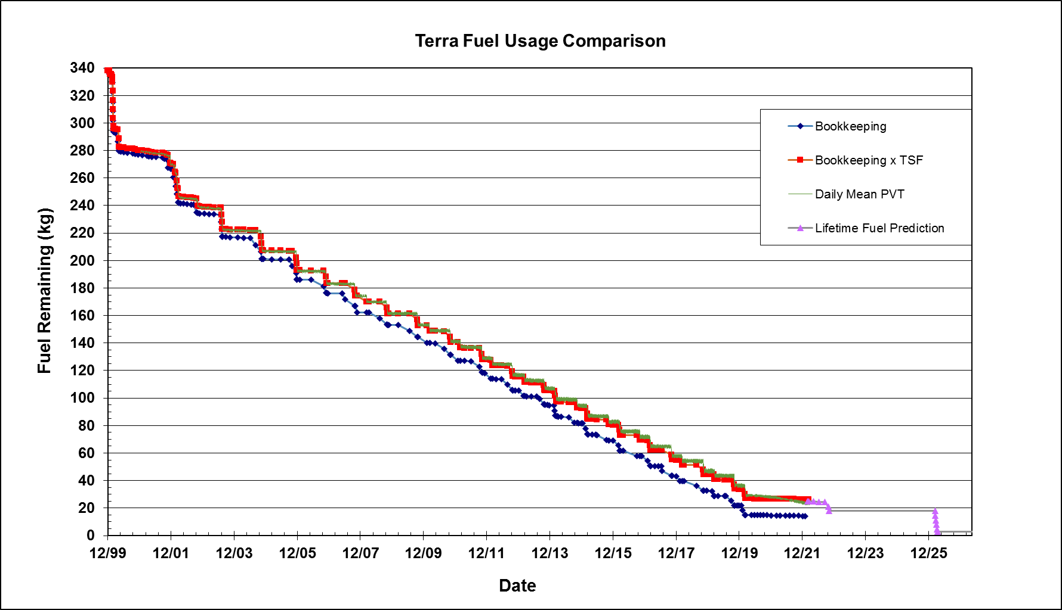
Fuel Margin and Predictions
The large steps between the start of nominal operations and 2020 correspond to Inclination Adjust Maneuver series.
CEMs, Oct 2022
PLMs, Feb-Mar 2026

Slide 23
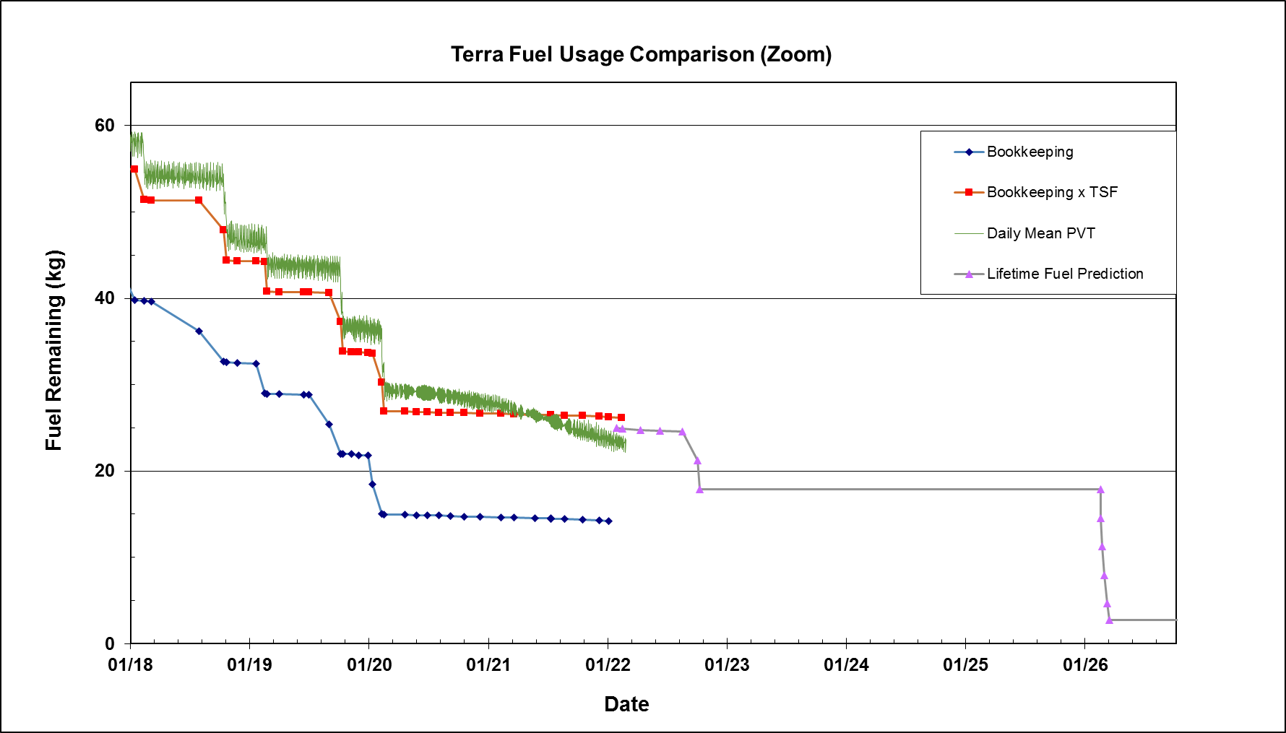
Recent Fuel Margin
The large steps between the start of nominal operations and 2020 correspond to Inclination Adjust Maneuver series.
CEMs
PLMs

Slide 24
CEM Parameters
Terra will perform two Constellation Exit Maneuvers (CEMs) which will put Terra outside of the morning constellation by at least 4 kilometers as defined by the constellation envelope equation
  Current exit plan achieves 4.676 km
CEMs will be retrograde maneuvers, and will use Terra’s historic inclination maneuver burn duration of 320 seconds
CEMs will begin to be executed one week after Terra reaches 10:15 MLT at the descending node
  Most recent lifetime analysis predicts Terra will cross the threshold on September 30th, 2022
CEMs will be performed one week apart at spacecraft local midnight and local noon
  Maneuvers will be spaced one week apart, occurring on a Wednesday or Thursday. CEM 1 will be performed at SC midnight, CEM 2 will be performed at SC noon.

Slide 25
Constellation Exit Maneuvers
Below are the maneuver parameters for Terra CEMs 1 and 2
  The fuel use estimate below includes slew out and slew back, all other parameters are for the main burn only
Maneuver | Burn Epoch | Burn Duration (sec) | Orbit Location | Estimated Delta SMA (km) | Estimated Delta V (m/s) | Estimated Fuel Use (kg)
CEM 1 | Oct 12 2022 14:39:52.000 | 320 | Orbit Midnight | -2.9850 | 1.5411 | 3.3651
CEM 2 | Oct 19 2022 22:04:57.000 | 320 | Orbit Noon | -2.8970 | 1.5360 | 3.3465

Slide 26
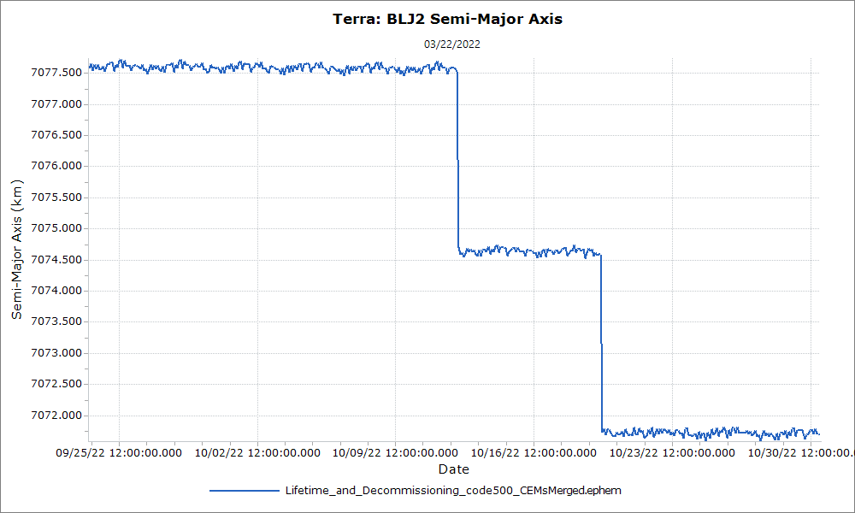
CEM 1 and 2 Delta SMA
CEM 1
CEM 2

Slide 27
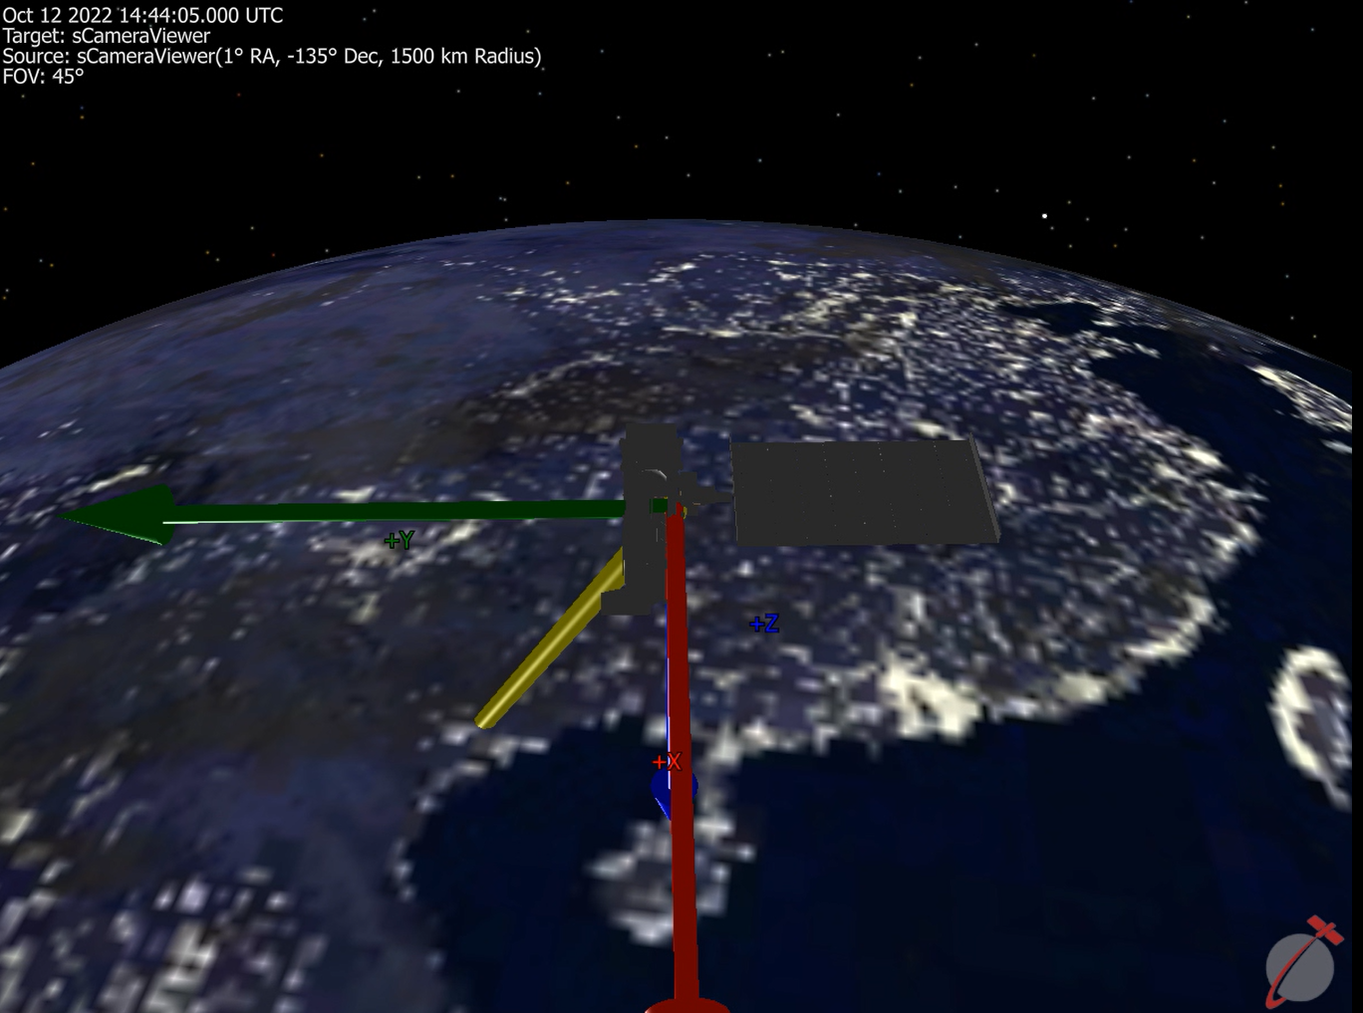
CEM Visualization
FDS has generated a visualization of CEM 1 (not attached to this presentation)

Slide 28
CEM Visualization
FDS has generated a visualization of CEM 2 (not attached to this presentation)

Slide 29
Exit Plan Summary
An October 2022 Constellation Exit is predicted to use two CEMs to exit the constellation safely.
After constellation exit, Terra will drift for about three and a half years before expending the remainder of its fuel on PLMs.
  Terra is expected to re-enter in July of 2069, 43 years after the final PLM

Slide 30
FDS Terra constellation exit Maneuver Burn Separation Analysis
Presented by: Keshav Swaminathan, FDS Terra POC

Slide 31
Table of Contents
Purpose
Methodology
Burn Separation Results
Burn Location Results
Conclusions

Slide 32
Purpose
The Purpose of this analysis was to evaluate ways to re-center frozen orbit if significant delays are expected between nominal CEM burns
  High-interest events (HIEs), high-risk post-maneuver conjunctions of concern (PMCOC), or unexpected ground system problems could delay CEMs
  Explored the effects of separating the burns by multiple days.
  Explored the effects of not centering CEMs at apogee or perigee.

Slide 33
Methodology
Terra’s decommissioning burn analysis FreeFlyer script was modified to observe the results of changing the time and/or phasing between burns.
First, the script was modified so that the burns occurred several days apart from each other.
  Ran the script with 0-9, 14, 21, and 28 days of separation.
Modified the same script to change where on the orbit each burn would occur.
  Changed the location of the second burn while holding the first burn at apogee to show the impact of adjusting the phasing between each burn.
  Changed length of time between the first and second burn to evaluate the frozenness effects of separation between burns

Slide 34
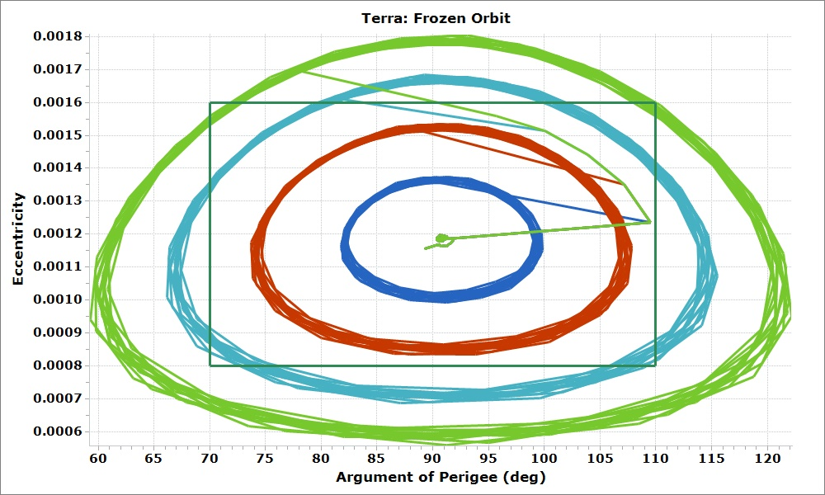
Separation Between Burns
With 1-2 weeks of separation between each burn, the frozenness is maintained.
With 3+ weeks of separation between each burn, the frozen orbit bounds will be violated.
1 week separation
2 weeks separation
3 weeks separation
4 weeks separation

Slide 35
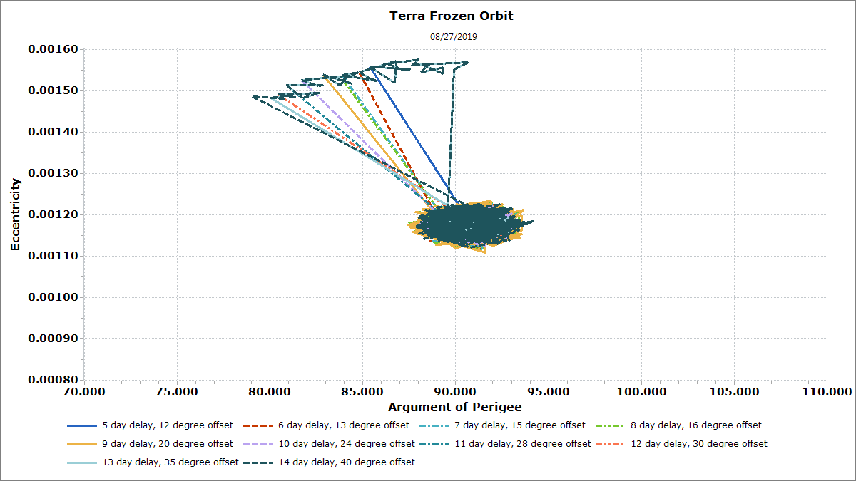
Re-Centering the Frozen Orbit
If significant time was spent between each burn, the second burn could be purposely phased to re-center Terra’s frozen orbit. Should any unexpected delays occur, this technique can be used to restore the frozen orbit.
The graph shows burns separated by 5 through 14 days with the second burn offset to restore the tight frozen orbit.

Slide 36
Conclusion
While the spacing between an apogee and perigee constellation exit burn does have a significant effect on Terra’s frozen orbit, Terra remains within the frozen orbit requirement bounds for a separation of up to 2 weeks.
Shifting the phasing of the second burn has a significant effect on Terra’s frozen orbit.
  Should the second burn be delayed by a significant amount of time, the second burn location can be adjusted to tighten Terra’s frozen orbit.

Slide 37
FDS Contingency Exit Criteria and Frozenness analysis
Presented by: Keshav Swaminathan, FDS Terra POC

Slide 38
Content
Purpose
Methodology
Contingency Cases
  First CEM burn aborted (50% Abort Burn)
    Frozenness/envelope status with varying 2nd burn separations
    Frozenness/envelope status with a 3rd trim burn for the nominal 1 week separation and the 4 week separation
  First CEM burn only
    Frozenness/envelope status
Conclusions

Slide 39
Purpose
The Purpose of this analysis was to observe the effects of the nominal and contingency cases on Terra’s frozen orbit and post-CEM exit envelope.
To evaluate the effectiveness of performing a 3rd trim burn to help fix frozenness and envelope status for a partial 1st burn

Slide 40
Methodology
Member missions’ long-term ephemerides (Jan 2022- Jan 2024) are pulled from Constellation Coordination System (CCS) to compare against Terra’s decommissioning ephemeris
Terra’s decommissioning script was modified to produce ephemerides for each of the contingency cases
Aqua’s nominal Jan 2022 4.4 km exit plan ephemeris was used for Aqua analysis

Slide 41
Methodology
Cases analyzed:
  Nominal: A nominal October 2022 exit with maneuver parameters from latest lifetime run (June 2021)
  First Burn Aborted (50% Partial Burn): The first CEM burn starts at the same time as the nominal case, but only lasts half as long, simulating a burn that is aborted halfway through. The second noon CEM is modeled to perform at various weeks of separation (1-4 weeks separation)
  First burn only (No 2nd CEM): The first CEM burn is performed nominally, but no other burns are performed
The plots span from Jan 01 2022 – Jan 01 2024
  Post maneuver envelope status taken directly after last CEM maneuver

Slide 42
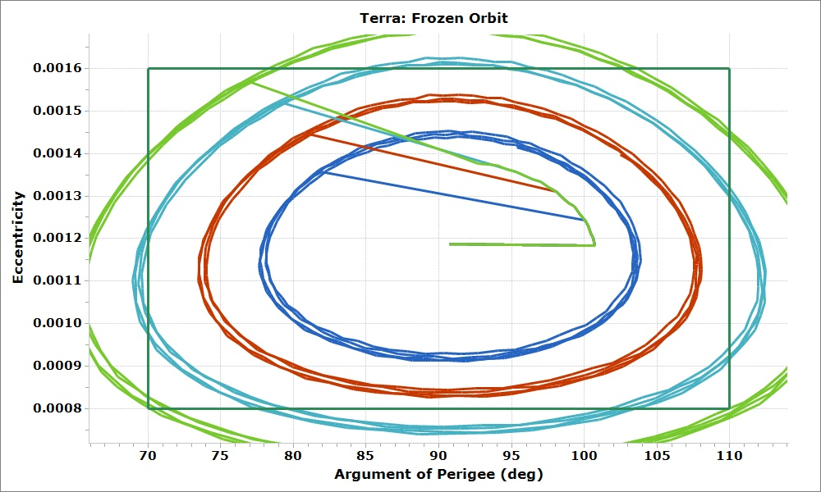
Post-CEM Frozenness:
Partial First Burn Case
1 Week Sep
2 Weeks
Sep
3 Weeks
Sep
4 Weeks
Sep
Frozenness plots for the partial burn scenarios with varying separation between the 1st 50% aborted midnight burn and the 2nd noon burn
1-2 weeks separation does not violate frozenness, >= 3 weeks does violate

Slide 43
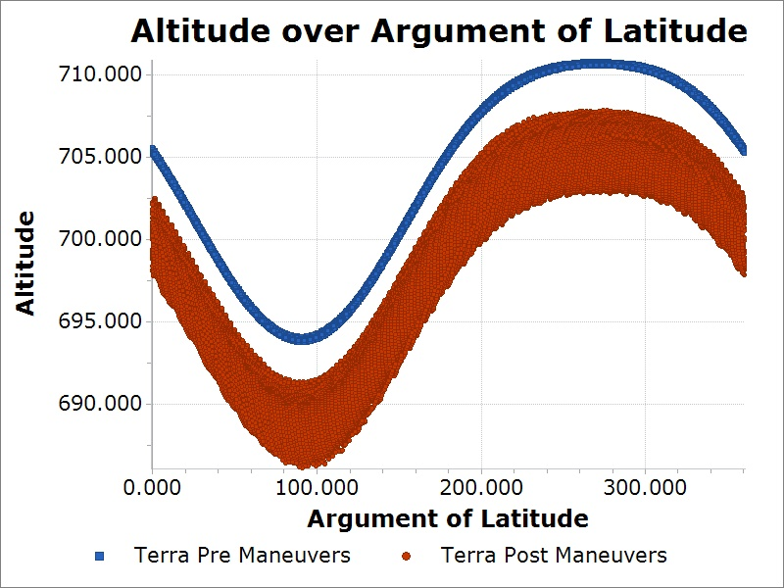
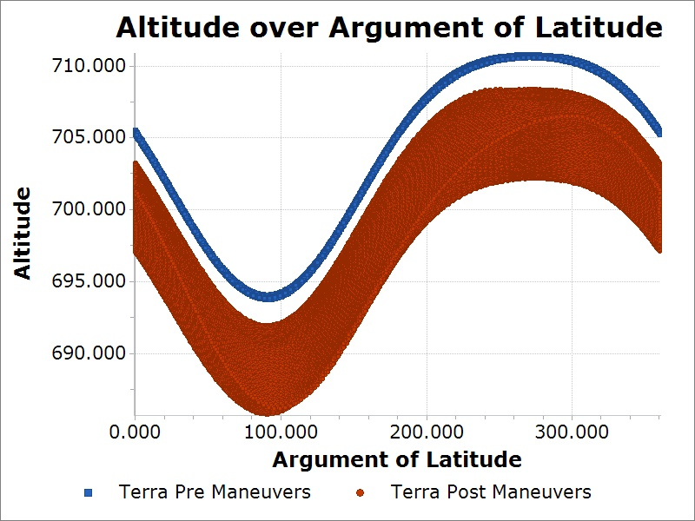
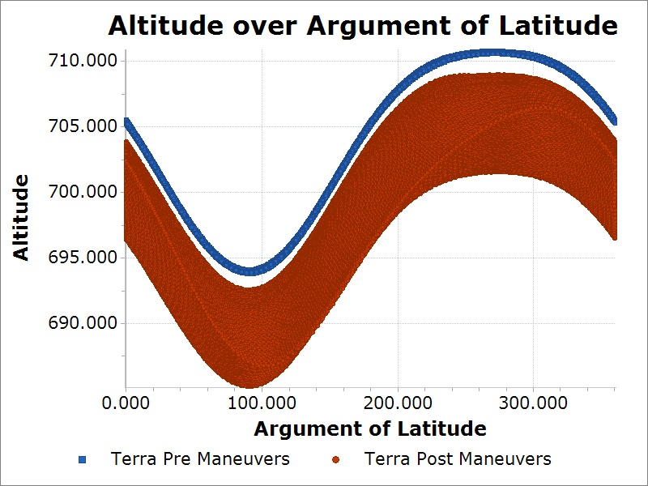

Partial Burn – 1-4 Week Separation
Terra post-CEM maneuver envelope status between the 50% aborted midnight CEM and full noon CEM:
  2.853 km 1 week sep
  2.285 2 week sep
  1.710 3 week sep
  1.211 4 week sep
4 partial burn scenarios were analyzed with varying degrees of separation between CEM#1 and CEM#2
Exit status was analyzed directly after CEM#2 for all cases
For all 4 scenarios, exit envelope status is not achieved. 3rd Trim burn would resolve this issue
1-week Envelope Status (km)
2.853 (<4.0)
2-week Envelope Status (km)
2.285 (<4.0)
3-week Envelope Status (km)
1.710 (<4.0)
4-week Envelope Status (km)
1.211 (<4.0)

Slide 44
Partial Burn- Trim Burn
For all scenarios of a 50% Aborted 1st CEM burn, Terra does not adequately achieve the exit status of 4.4 km
For 3-4 weeks separation between the CEM burns, frozenness is not maintained within operational requirements
Additional analysis was performed to verify whether a 3rd trim burn can fix envelope status and frozenness
  For 1 week separation scenario, modeled a single 80 sec retrograde midnight burn
  For 4 week separation scenario, modeled a single 320 sec retrograde midnight burn

Slide 45
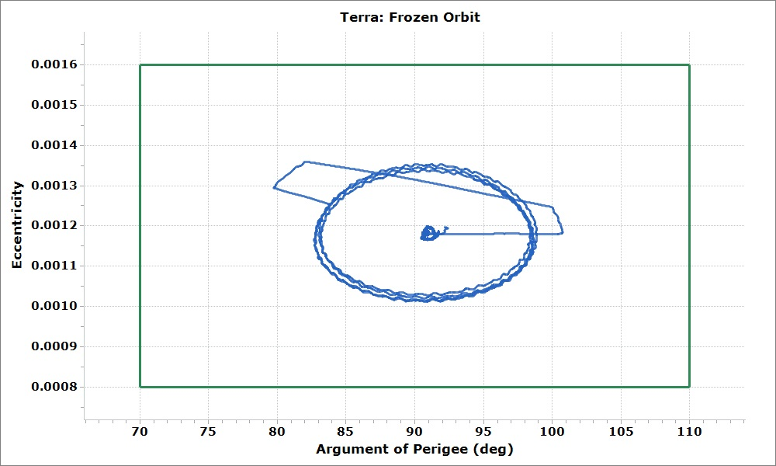
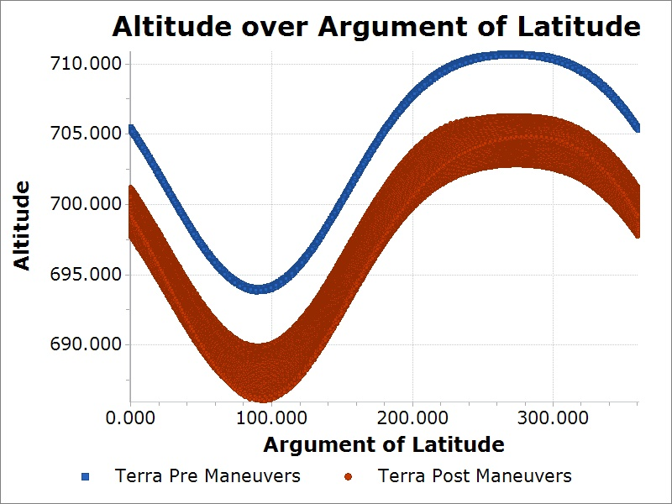
Partial Burn- Trim Burn (1 Week Separation)
Frozenness is improved with 3rd targeted 80s midnight retrograde trim burn
Simultaneously, envelope status improves past the defined requirement (4.0 km)
  Burns modeled at orbit midnight/noon/midnight respectively, did not shift phasing for optimal frozen orbit re-centering
CEM#3
CEM#2
CEM#1
Post-Maneuver Envelope Status (km)
4.4136 (>4.0)

Slide 46
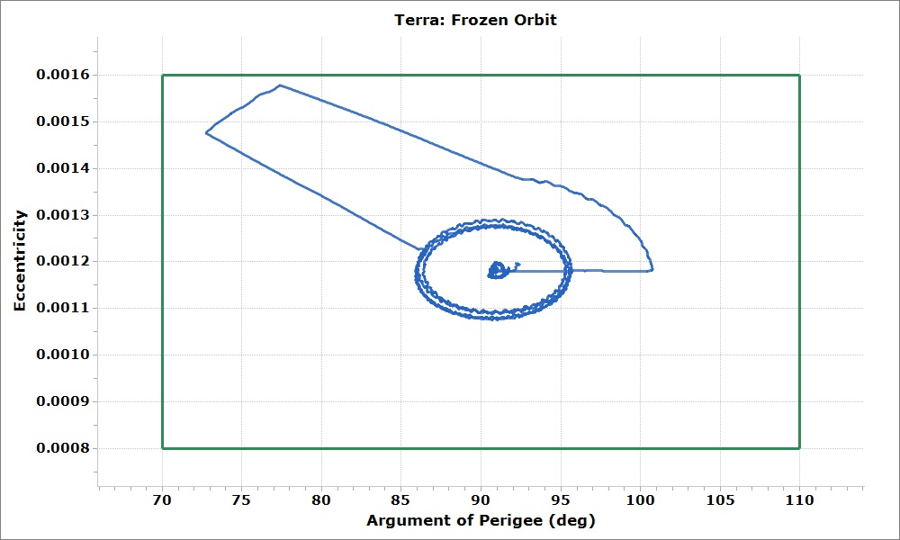
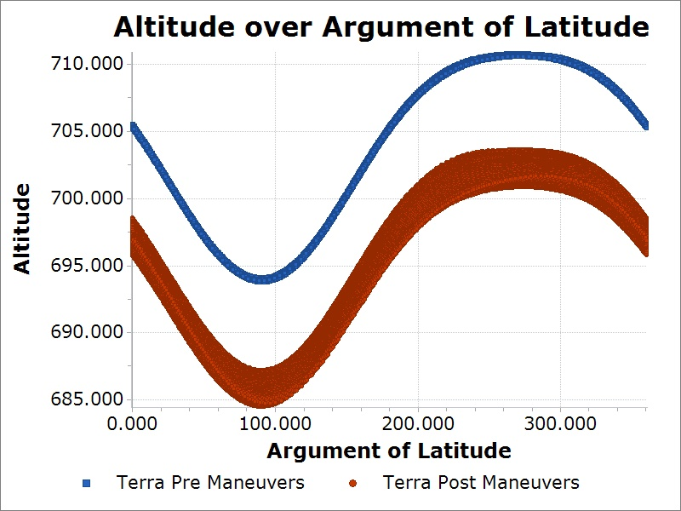
Partial Burn - Trim Burn (4-Week Separation)
Frozenness is greatly improved with 3rd targeted 320s midnight retrograde trim burn
Simultaneously, envelope status improves well past the defined requirement (4.0 km)
  Burns modeled at orbit midnight/noon/midnight respectively, did not shift phasing for optimal frozen orbit re-centering
CEM#3
CEM#2
CEM#1
Post-Maneuver Envelope Status (km)
7.2106 (>4.0)

Slide 47
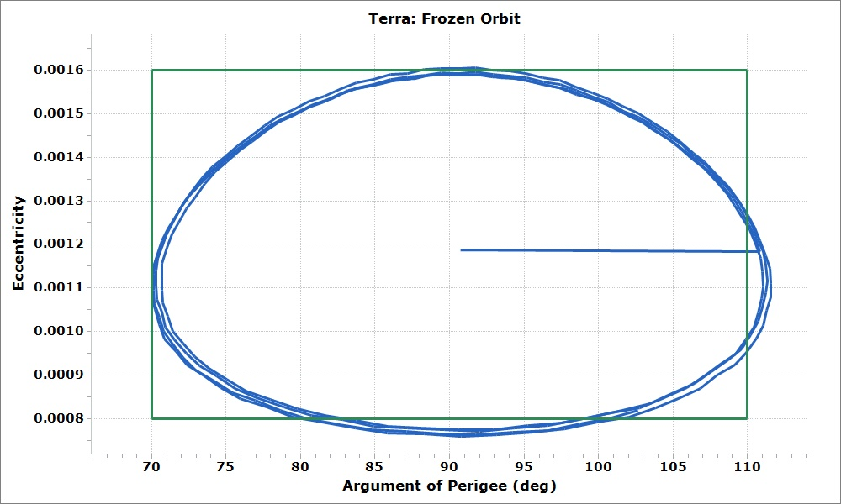
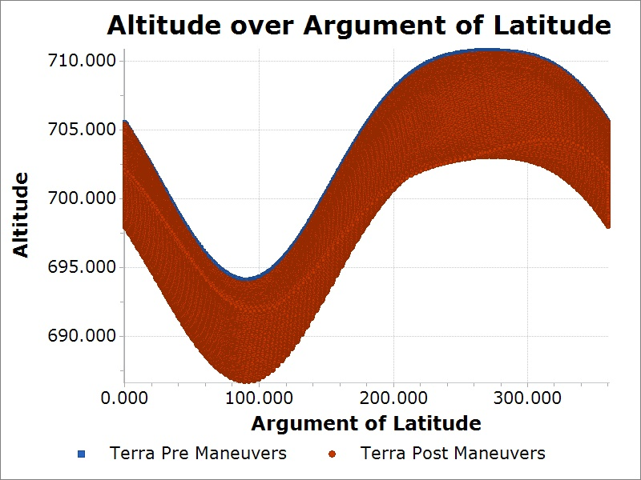
No 2nd CEM Burn Frozenness and Envelope Status
Frozenness is violated if no 2nd CEM burn is performed
The post-maneuver envelope status is also well below the mission exit requirement (4.4 km)
Post-Maneuver Envelope Status (km)
-0.00201 (<4.4)

Slide 48
Conclusions
If Terra has to abort its first midnight CEM burn, this will negatively affect the frozenness and envelope status
  Envelope status decreases over separation length
  Trim burn can be used to satisfy exit criteria and improve orbit frozenness
If no 2nd CEM is performed, Terra will violate the frozen orbit constraints and will not achieve the desired post-maneuver envelope status
  However, as long as a second CEM is performed within 2 weeks, there will be no safety concerns

Slide 49
FDS Orbit safety analysis
Presented by: Keshav Swaminathan, FDS Terra POC

Slide 50
Content
Purpose
Methodology
Nominal
  Radial/Time buffers
  Crossings
  Min RSS Separation for Landsat 8 and 9
Partial Burn (CEM1 50% Abort)
  Radial/Time buffers
  Crossings
  Min RSS Separation for Landsat 8 and 9
No 2nd CEM
  Radial/Time buffers
  Crossings
  Min RSS Separation for Landsat 8 and 9
Conclusions

Slide 51
Purpose
The Purpose of this analysis was to verify the orbit safety of Terra with respect to various constellation members
  The nominal, partial first burn, and no 2nd CEM cases were evaluated against the A-Train, the Morning Constellation, and the C-Train (CALIPSO) from Sep 01 2022 – Jan 01 2024

Slide 52
Methodology
Member missions’ long-term ephemerides (Jan 2022-Jan 2024) are pulled from Constellation Coordination System (CCS) to compare against Terra’s decommissioning ephemeris
Aqua’s nominal free-exit no burn plan ephemeris was used for Aqua analysis

Slide 53
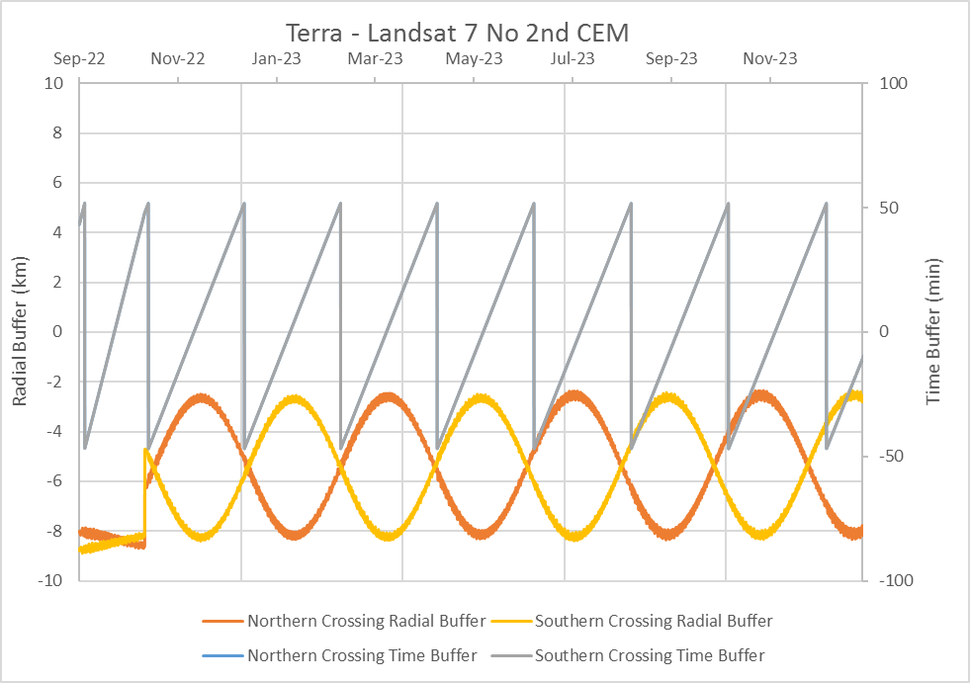
Methodology
Radial/Time Buffer versus Time plots are used for A-Train, L7, and CALIPSO missions to illustrate the risk of southern/northern polar crossing opportunities, when the time buffers are zero
  Terra analyzed as Primary
Radial separations were found at the times
when time buffers were zero and tabulated. (Below is the data for No 2nd CEM vs L7)
Terra/L7 Crossings
Epoch | Radial Sep (km)
Sep 23 2022 | -8.4 (N)
Nov 11 2022 | -2.8 (N)
Jan 10 2023 | -2.8 (S)
Mar 10 2023 | -2.7 (N)
May 09 2023 | -2.6 (S)
Jul 08 2023 | -2.7 (N)
Sep 06 2023 | -2.7 (S)
Nov 06 2023 | -2.8 (N)
Terra is Above L7

Slide 54
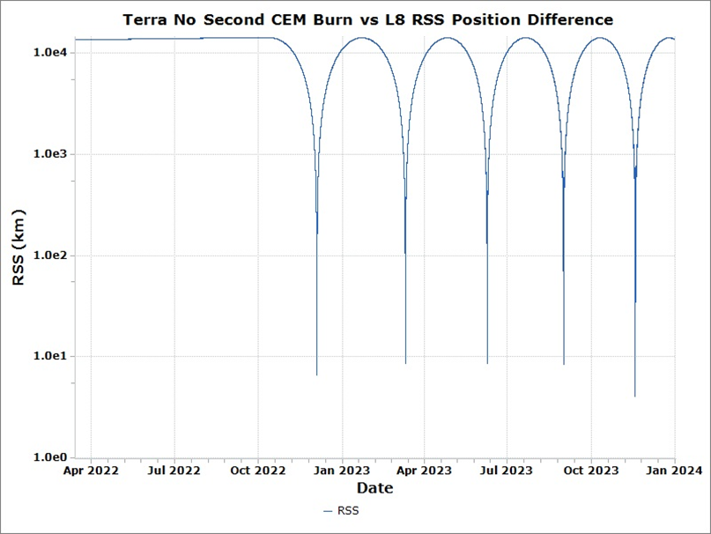
Methodology (L8 and L9)
Closest approach events between the contingency case and secondary mission were analyzed for L8 and L9 based on the RSS separations
  This was chosen because the orbit planes are similar so close approaches are possible outside of the polar crossings
  Example table shown below for Terra vs L8 (No 2nd CEM)
Terra is ahead of
L8
Landsat 8 RIC
Epoch | Radial Sep (km) | In-Track Sep (km) | Cross-Track Sep (km) | Min RSS (km)
Dec 04 2022 | 0.5 | -6.5 | -0.3 | 6.6
Mar 11 2023 | 0.5 | -8.5 | -0.04 | 8.6
Jun 09 2023 | 3.3 | -7.9 | 0.2 | 8.6
Aug 31 2023 | 6.8 | -4.9 | 0.1 | 8.4
Nov 18 2023 | 3.3 | -2.4 | 0.1 | 4.1
Terra is below L8
Terra is left of
L8

Slide 55
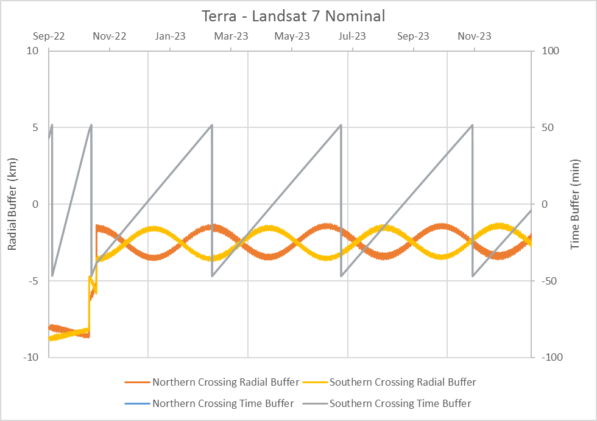
Buffers/Crossings – Nominal: Morning Constellation
Terra/L7 Crossings
Epoch | Radial Sep (km)
Sep 23 2022 | -8.4 (N)
Dec 08 2022 | -1.8 (S)
Apr 15 2023 | -1.6 (S)
Aug 23 2023 | -2.0 (S)

Slide 56
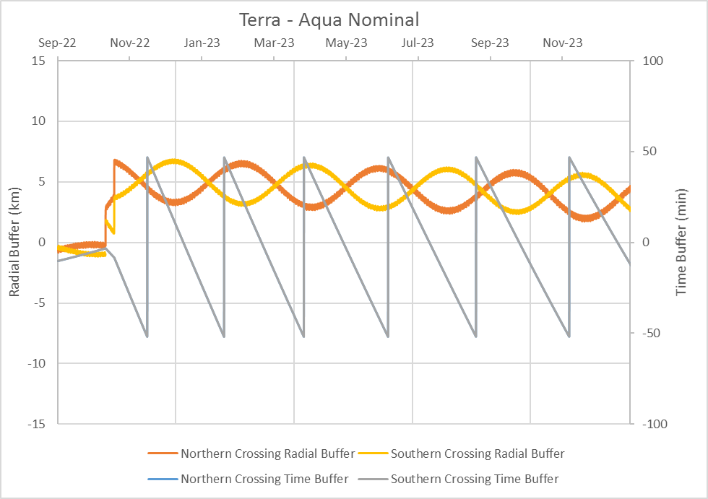
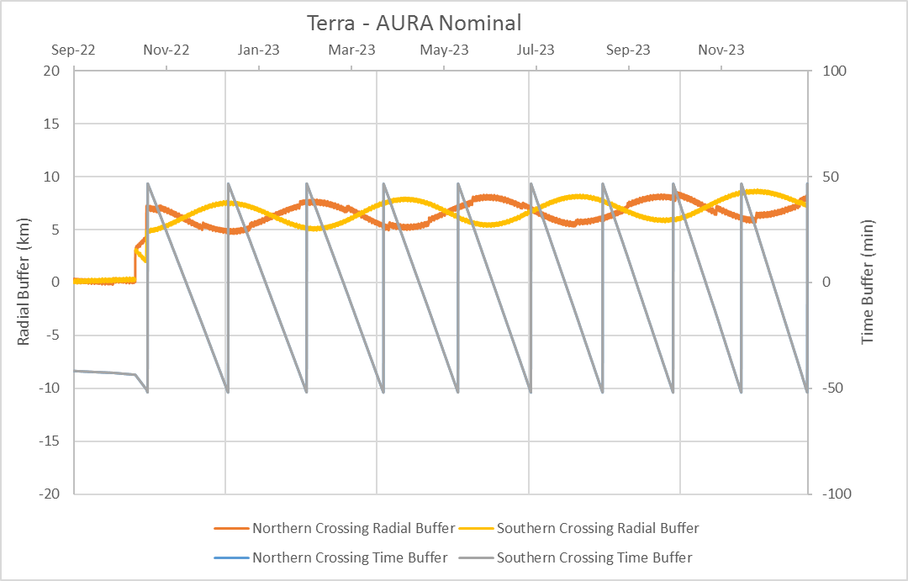
Buffers/Crossings – Nominal: A-Train
Terra/Aqua Crossings
Epoch | Radial Sep (km)
Dec 17 2022 | 3.5 (N)
Feb 21 2023 | 3.8 (S)
May 01 2023 | 4.2 (N)
Jul 13 2023 | 3.2 (N)
Sep 27 2023 | 2.5 (S)
Dec 19 2023 | 3.3 (N)
Terra/Aura Crossings
Epoch | Radial Sep (km)
Nov 15 2022 | 5.9 (N)
Jan 06 2023 | 6.0 (N)
Feb 26 2023 | 5.8 (S)
Apr 17 2023 | 5.2 (N)
Jun 05 2023 | 5.5 (S)
Jul 23 2023 | 5.7 (N)
Sep 07 2023 | 6.5 (S)
Oct 23 2023 | 7.1 (N)
Dec 07 2023 | 6.6 (N)

Slide 57
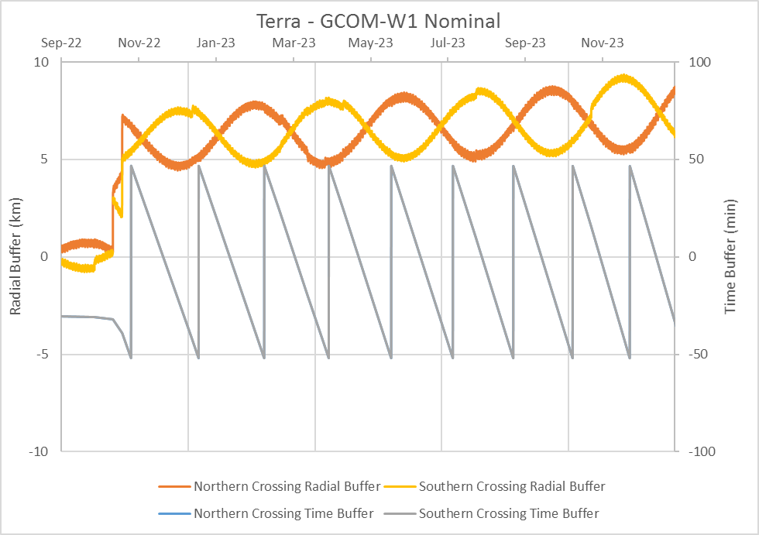
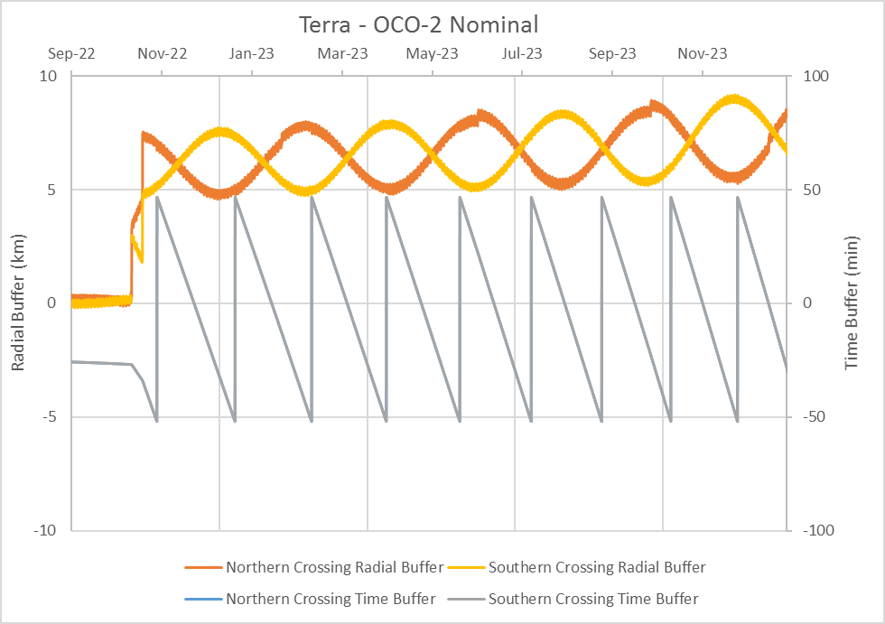
Buffers/Crossings – Nominal: A-Train (cont.)
Terra/GCOM-W1 Crossings
Epoch | Radial Sep (km)
Nov 21 2022 | 5.0 (N)
Jan 12 2023 | 5.6 (S)
Mar 05 2023 | 6.2 (N)
Apr 24 2023 | 6.2 (N)
Jun 12 2023 | 5.5 (S)
Jul 30 2023 | 5.1 (N)
Sep 15 2023 | 5.4 (S)
Nov 01 2023 | 6.2 (N)
Dec 15 2023 | 7.2 (N)
Terra/OCO-2 Crossings
Epoch | Radial Sep (km)
Nov 23 2022 | 5.3 (N)
Jan 15 2023 | 5.8 (S)
Mar 07 2023 | 6.3 (S)
Apr 26 2023 | 6.0 (N)
Jun 14 2023 | 5.5 (S)
Aug 01 2023 | 5.2 (N)
Sep 18 2023 | 5.3 (S)
Nov 03 2023 | 6.5 (N)
Dec 17 2023 | 6.8 (N)

Slide 58
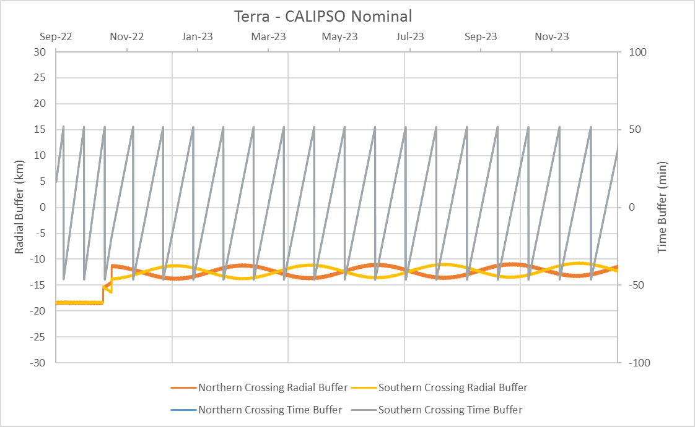
Buffers/Crossings – Nominal: C-Train
Terra/CALIPSO Crossings
Epoch | Radial Sep (km)
Sep 16 2022 | -18.3 (S)
Oct 04 2022 | -18.2 (N)
Oct 24 2022 | -11.4 (N)
Nov 19 2022 | -12.3 (S)
Dec 15 2022 | -11.3 (S)
Jan 10 2023 | -12.3 (S)
Feb 05 2023 | -11.2 (N)
Mar 03 2023 | -11.9 (N)
Mar 29 2023 | -11.3 (S)
Apr 24 2023 | -11.6 (S)
May 20 2023 | -11.4 (N)
Jun 16 2023 | -11.1 (N)
Jul 12 2023 | -11.6 (S)
Aug 08 2023 | -11.1 (S)
Sep 03 2023 | -11.8 (N)
Sep 29 2023 | -10.8 (N)
Oct 26 2023 | -12.1 (N)
Nov 22 2023 | -10.8 (S)
Dec 19 2023 | -11.5 (S)

Slide 59
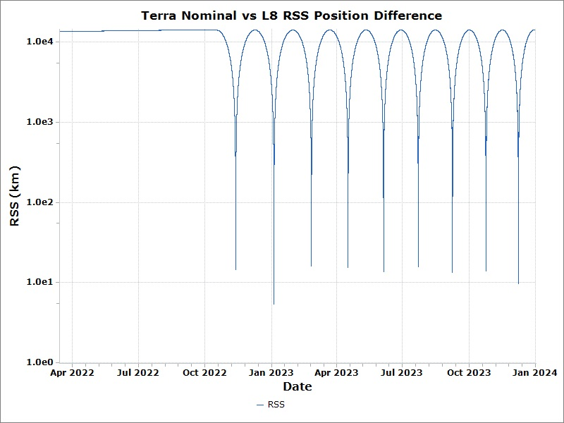
Min RSS Separation – Nominal: Landsat 8
Landsat 8 RIC
Epoch | Radial Sep (km) | In-Track Sep (km) | Cross-Track Sep (km) | Min RSS (km)
Nov 12 2022 | 6.2 | -12.5 | 4.0 | 14.6
Jan 04 2023 | 5.2 | -1.4 | -0.5 | 5.4
Feb 25 2023 | 5.2 | 15.1 | -1.6 | 16.1
Apr 16 2023 | 7.7 | 13.2 | -1.6 | 15.4
Jun 05 2023 | 8.0 | -11.0 | -0.9 | 13.7
Jul 23 2023 | 7.7 | -13.6 | 0.8 | 15.7
Sep 08 2023 | 6.6 | 11.6 | -0.6 | 13.4
Oct 24 2023 | 6.5 | -12.3 | 0.8 | 13.9
Dec 08 2023 | 8.5 | 4.5 | -0.2 | 9.6

Slide 60
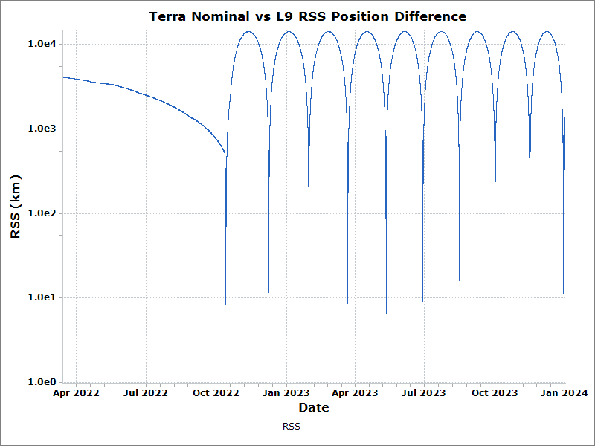
Min RSS Separation – Nominal: Landsat 9
Landsat 9 RIC
Epoch | Radial Sep (km) | In-Track Sep (km) | Cross-Track Sep (km) | Min RSS (km)
Oct 13 2022 | 2.6 | -7.9 | -0.4 | 8.3
Dec 09 2022 | 6.7 | 6.9 | -6.5 | 11.6
Jan 30 2023 | 7.1 | 3.8 | 0.6 | 8.1
Mar 22 2023 | 6.0 | 6.1 | 0.6 | 8.5
May 11 2023 | 6.5 | -0.7 | -0.2 | 6.6
Jun 29 2023 | 6.0 | 6.9 | -0.3 | 9.1
Aug 15 2023 | 5.7 | 14.9 | 0.7 | 16.0
Oct 01 2023 | 8.4 | -1.3 | -0.2 | 8.5
Nov 16 2023 | 6.3 | 8.5 | 0.5 | 10.6
Dec 30 2023 | 7.7 | -8.0 | -0.7 | 11.1

Slide 61
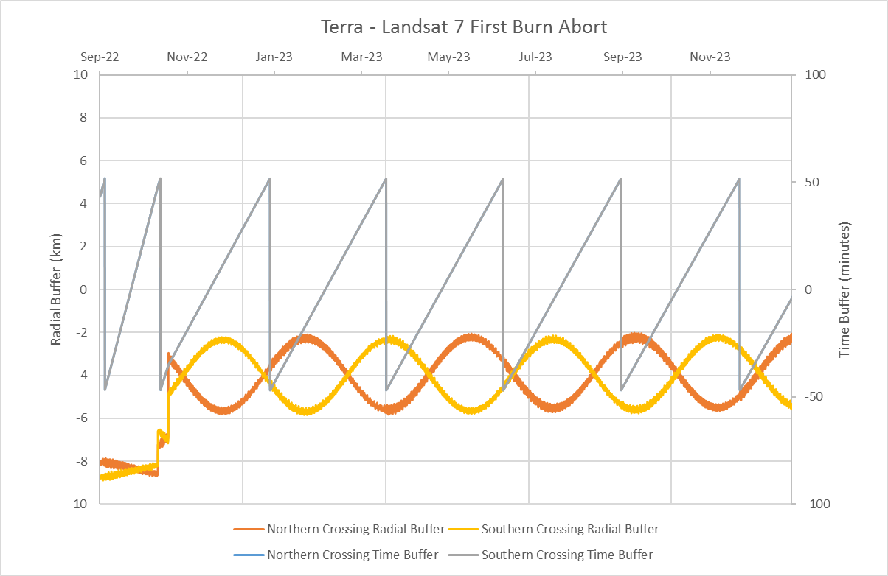
Buffers/Crossings - Partial Burn: Morning Constellation
Terra/L7 Crossings
Epoch | Radial Sep (km)
Sep 23 2022 | -8.4 (N)
Nov 17 2022 | -2.6 (S)
Feb 06 2023 | -2.7 (N)
Apr 29 2023 | -3.2 (N)
Jul 20 2023 | -2.3 (S)
Oct 11 2023 | -3.8 (S)

Slide 62
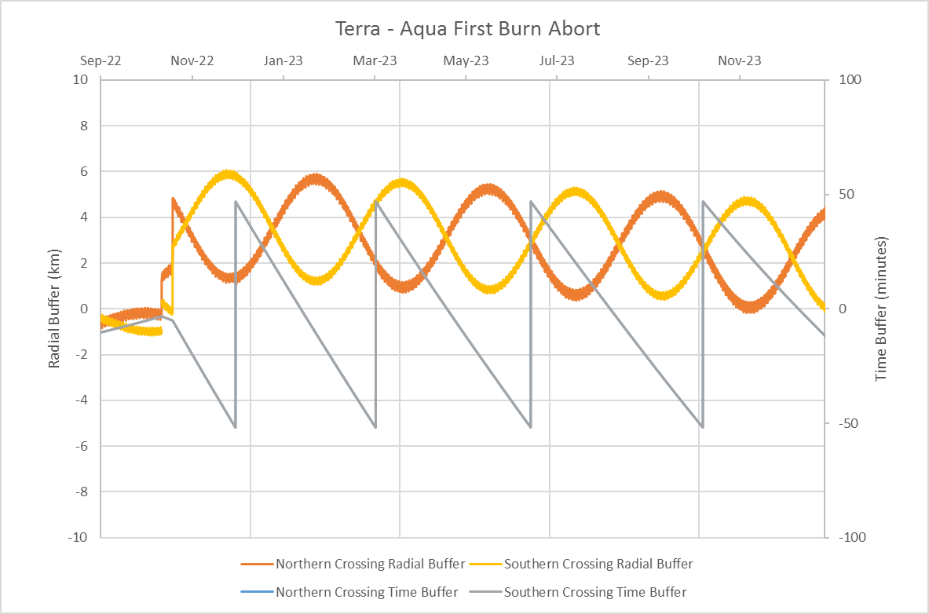
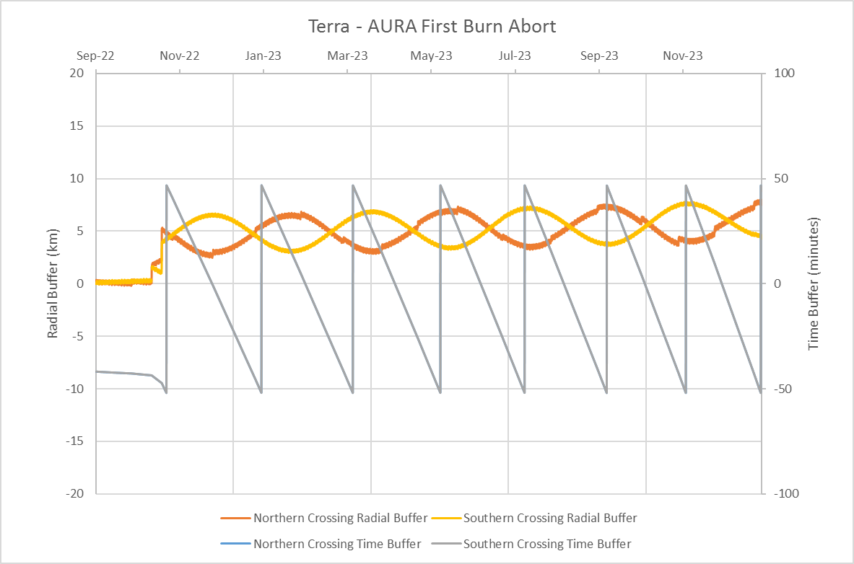
Buffers/Crossings - Partial Burn: A-Train
Terra/Aqua Crossings
Epoch | Radial Sep (km)
Jan 13 2023 | 1.5 (S)
Apr 21 2023 | 3.0 (S)
Aug 08 2023 | 2.1 (N)
Dec 12 2023 | 1.7 (S)
Terra/Aura Crossings
Epoch | Radial Sep (km)
Nov 25 2022 | 2.6 (N)
Feb 01 2023 | 3.3 (S)
Apr 07 2023 | 4.0 (N)
Jun 08 2023 | 4.8 (S)
Aug 08 2023 | 5.2 (N)
Oct 06 2023 | 5.3 (S)
Dec 01 2023 | 5.7 (N)

Slide 63
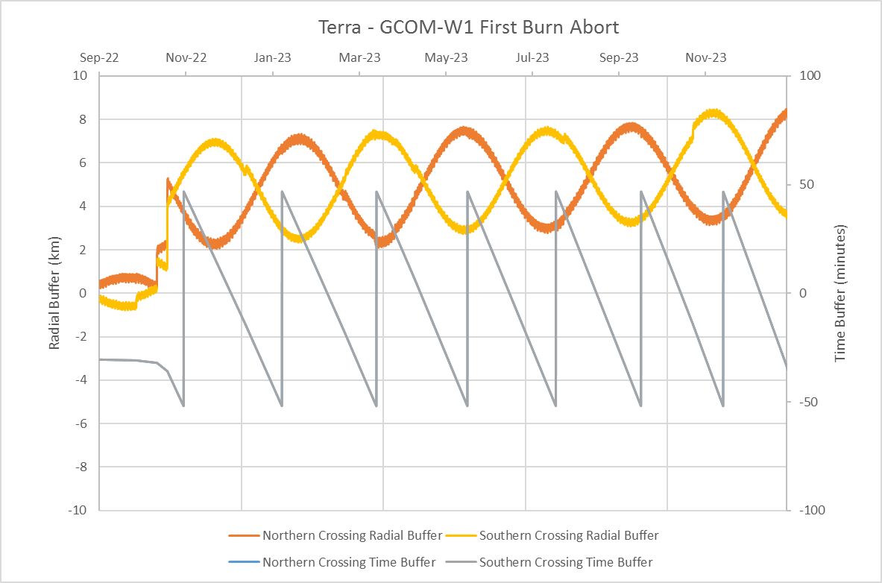
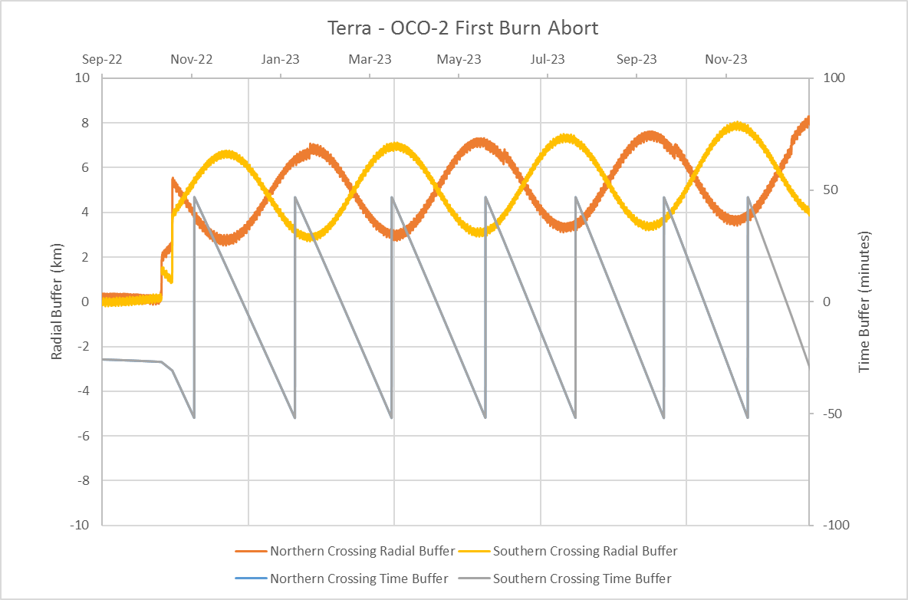
Buffers/Crossings - Partial Burn: A-Train (cont)
Terra/GCOM-W1 Crossings
Epoch | Radial Sep (km)
Dec 03 2022 | 2.7 (N)
Feb 09 2023 | 3.7 (S)
Apr 16 2023 | 5.0 (N)
Jun 17 2023 | 4.9 (N)
Aug 18 2023 | 4.8 (S)
Oct 16 2023 | 4.7 (N)
Dec 11 2023 | 5.3 (S)
Terra/OCO-2 Crossings
Epoch | Radial Sep (km)
Dec 06 2022 | 3.1 (N)
Feb 12 2023 | 4.0 (S)
Apr 18 2023 | 4.9 (N)
Jun 20 2023 | 5.0 (N)
Aug 20 2023 | 4.6 (S)
Oct 19 2023 | 5.0 (N)
Dec 14 2023 | 5.3 (S)

Slide 64
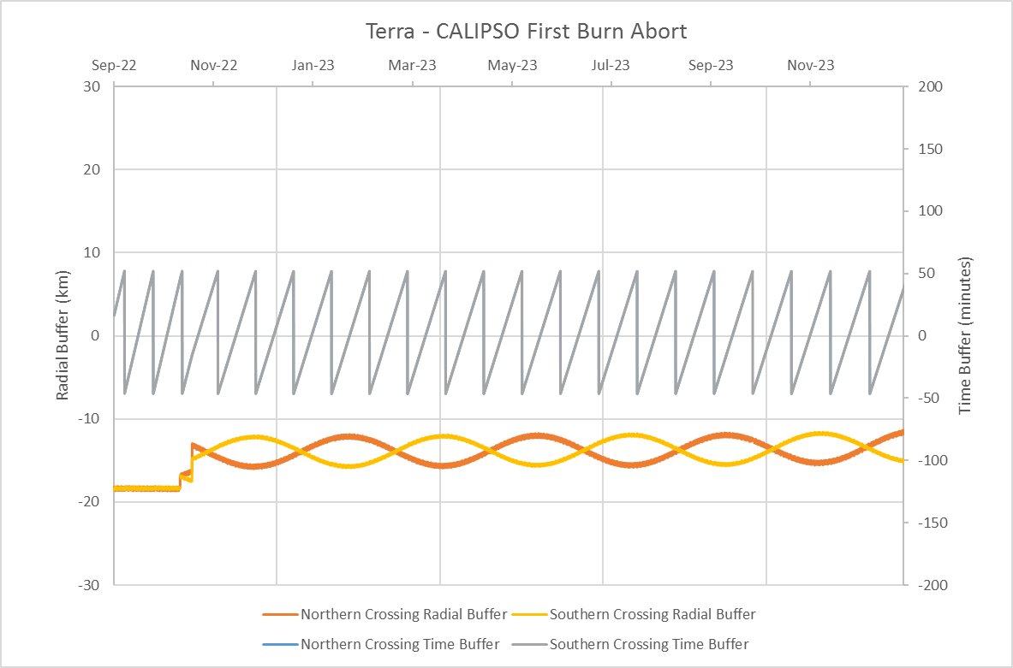
Buffers/Crossings - Partial Burn: C-Train
Terra/CALIPSO Crossings
Epoch | Radial Sep (km)
Sep 16 2022 | -18.4 (N)
Oct 04 2022 | -18.2 (N)
Oct 23 2022 | -13.4 (N)
Nov 15 2022 | -12.3 (S)
Dec 08 2022 | -12.4 (S)
Jan 01 2023 | -13.3 (N)
Jan 24 2023 | -11.8 (N)
Feb 16 2023 | -13.6 (N)
Mar 12 2023 | -12.4 (S)
Apr 04 2023 | -12.4 (S)
Apr 27 2023 | -13.0 (N)
May 21 2023 | -11.9 (N)
Jun 13 2023 | -13.3 (N)
Jul 07 2023 | -12.1 (S)
Jul 30 2023 | -12.3 (S)
Aug 23 2023 | -12.8 (N)
Sep 16 2023 | -12.0 (N)
Oct 09 2023 | -13.4 (N)
Nov 02 2023 | -11.9 (S)
Nov 26 2023 | -12.3 (S)
Dec 20 2023 | -12.0 (N)

Slide 65
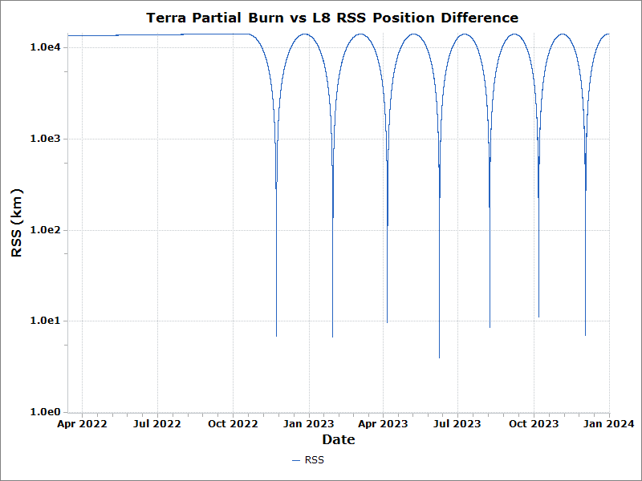
Min RSS Separation - Partial Burn: Landsat 8
Landsat 8 RIC
Epoch | Radial Sep (km) | In-Track Sep (km) | Cross-Track Sep(km) | Min RSS (km)
Nov 22 2022 | 6.3 | -2.4 | -1.3 | 6.9
Jan 29 2023 | 6.6 | 1.6 | 0.3 | 6.7
Apr 06 2023 | 3.5 | 9.0 | 0.4 | 9.7
Jun 08 2023 | 3.9 | -0.6 | 0.1 | 4.0
Aug 08 2023 | 6.3 | -5.7 | 0.1 | 8.5
Oct 07 2023 | 6.4 | 9.0 | 0.5 | 11.1
Dec 02 2023 | 6.7 | 1.9 | -0.3 | 7.0

Slide 66
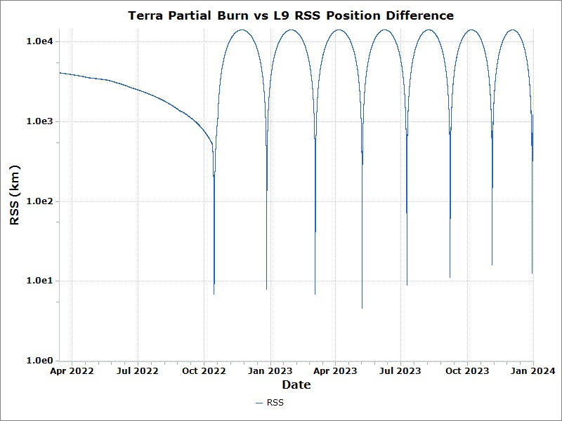
Min RSS Separation - Partial Burn: Landsat 9
Landsat 9 RIC
Epoch | Radial Sep (km) | In-Track Sep (km) | Cross-Track Sep (km) | Min RSS (km)
Oct 14 2022 | 1.0 | -6.8 | -0.1 | 6.9
Dec 26 2022 | 3.5 | -7.0 | -1.3 | 7.9
Mar 04 2023 | 5.1 | 4.6 | -0.3 | 6.9
May 08 2023 | 4.0 | -2.3 | 0.1 | 4.6
Jul 09 2023 | 4.0 | -7.9 | -0.4 | 8.9
Sep 07 2023 | 7.1 | -8.6 | -0.4 | 11.1
Nov 04 2023 | 7.4 | 14.2 | -0.8 | 16.1
Dec 30 2023 | 7.6 | -9.9 | -0.4 | 12.5

Slide 67
Buffers/Crossings – No 2nd CEM: Morning Constellation
Terra/L7 Crossings
Epoch | Radial Sep (km)
Sep 23 2022 | -8.4 (N)
Nov 11 2022 | -2.8 (N)
Jan 10 2023 | -2.8 (S)
Mar 10 2023 | -2.7 (N)
May 09 2023 | -2.6 (S)
Jul 08 2023 | -2.7 (N)
Sep 06 2023 | -2.7 (S)
Nov 06 2023 | -2.8 (N)

Slide 68
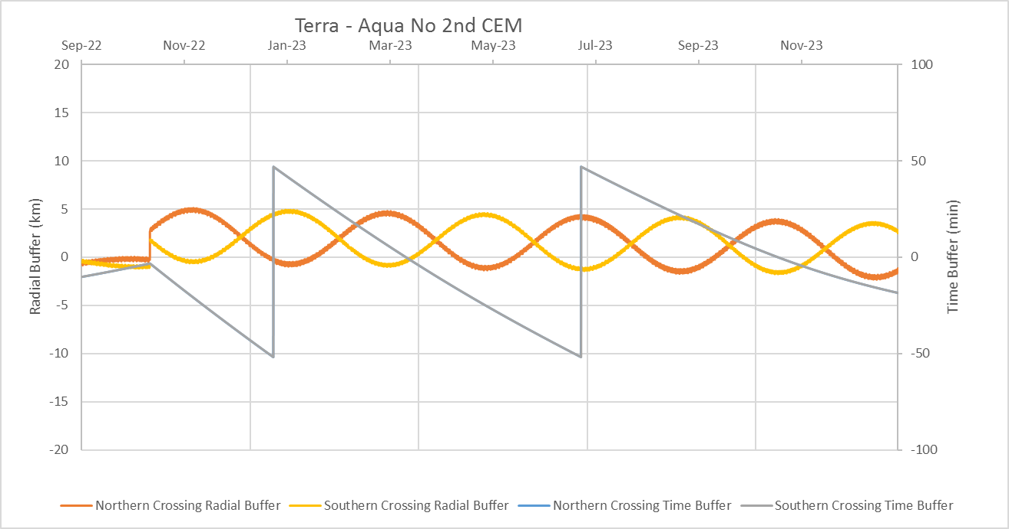
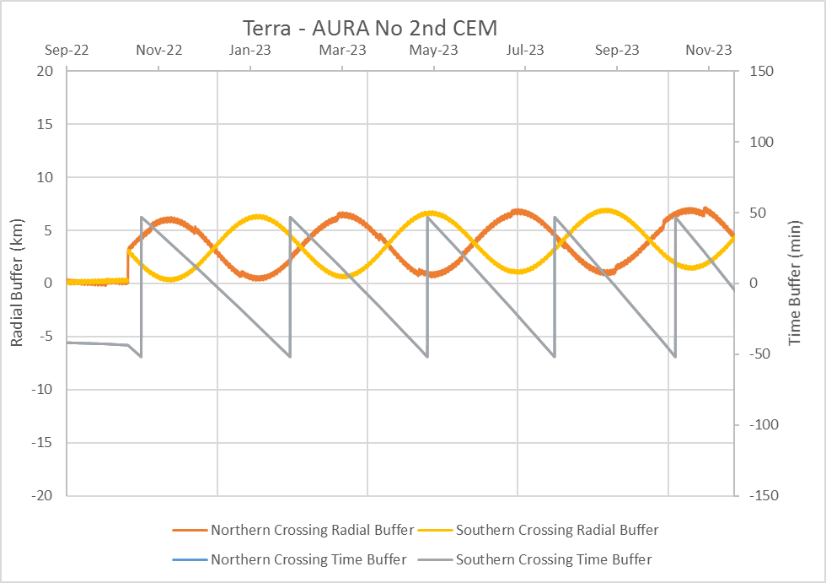
Buffers/Crossings – No 2nd CEM: A-Train
Terra/Aqua Crossings
Epoch | Radial Sep (km)
Mar 13 2023 | -0.4 (S)
Oct 20 2023 | -1.7 (S)
Terra/Aura Crossings
Epoch | Radial Sep (km)
Dec 08 2022 | 3.3 (S)
Mar 13 2023 | 1.0 (S)
Jun 09 2023 | 2.5 (S)
Aug 31 2023 | 1.1 (N)
Nov 16 2023 | 3.7 (S)

Slide 69
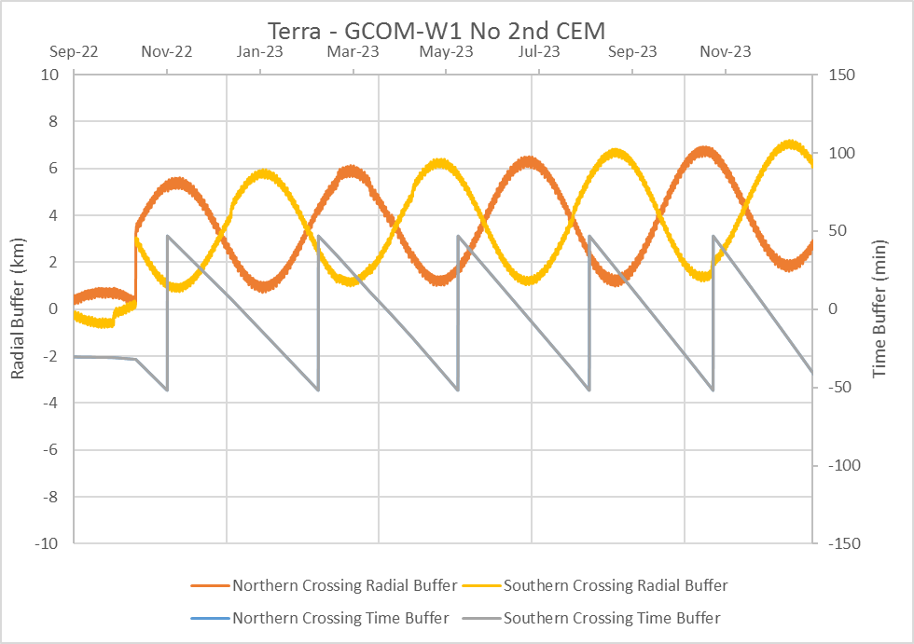
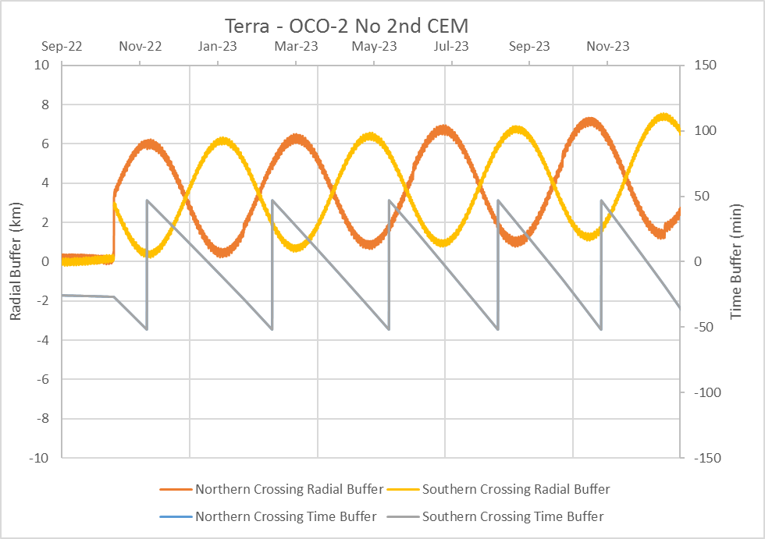
Buffers/Crossings – No 2nd CEM: A-Train (cont)
Terra/GCOM-W1 Crossings
Epoch | Radial Sep (km)
Dec 20 2022 | 1.6 (N)
Mar 25 2023 | 2.7 (S)
Jun 21 2023 | 1.3 (S)
Sep 13 2023 | 2.7 (N)
Nov 30 2023 | 2.6 (N)
Terra/OCO-2 Crossings
Epoch | Radial Sep (km)
Dec 24 2022 | 1.0 (N)
Mar 29 2023 | 3.0 (S)
Jun 26 2023 | 0.9 (S)
Sep 17 2023 | 3.2 (N)
Dec 04 2023 | 2.1 (N)

Slide 70
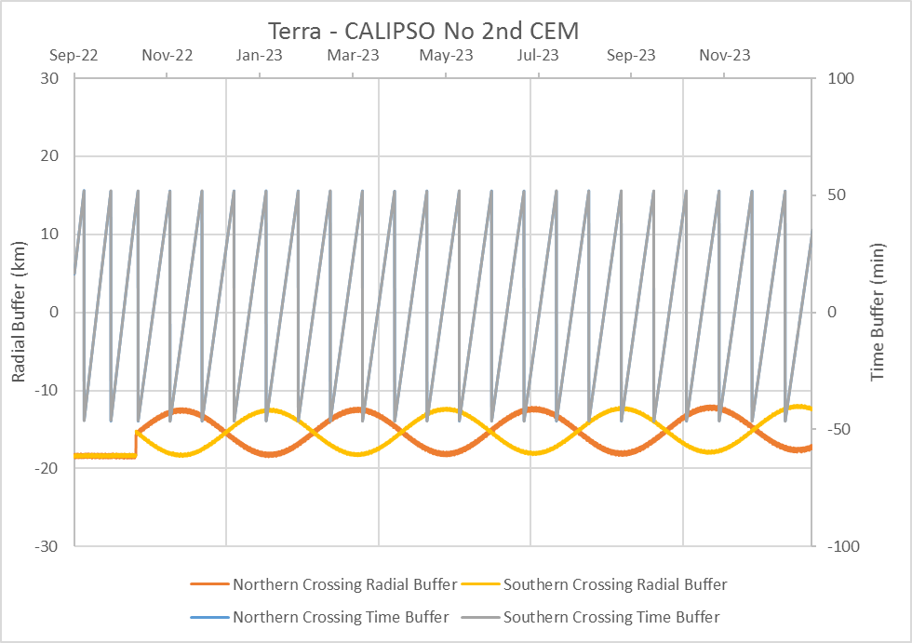
Buffers/Crossings – No 2nd CEM: C-Train
Terra/CALIPSO Crossings
Epoch | Radial Sep (km)
Sep 16 2022 | -18.3 (S)
Oct 04 2022 | -18.2 (N)
Oct 23 2022 | -13.8 (N)
Nov 13 2022 | -12.4 (N)
Dec 04 2022 | -14.4 (N)
Dec 25 2022 | -13.1 (S)
Jan 15 2023 | -12.6 (S)
Feb 06 2023 | -15.3 (S)
Feb 27 2023 | -12.7 (N)
Mar 20 2023 | -13.0 (N)
Apr 10 2023 | -14.4 (S)
May 01 2023 | -12.3 (S)
May 22 2023 | -13.6 (S)
Jun 13 2023 | -13.6 (N)
Jul 04 2023 | -12.2 (N)
Jul 25 2023 | -14.7 (N)
Aug 16 2023 | -12.9 (S)
Sep 06 2023 | -12.6 (S)
Sep 27 2023 | -14.9 (N)
Oct 19 2023 | -12.3 (N)
Nov 09 2023 | -13.1 (N)
Dec 01 2023 | -13.5 (S)
Dec 23 2023 | -12.2 (S)

Slide 71

Min RSS Separation– No 2nd CEM: Landsat 8
Landsat 8 RIC
Epoch | Radial Sep (km) | In-Track Sep (km) | Cross-Track Sep (km) | Min RSS (km)
Dec 04 2022 | 0.5 | -6.5 | -0.4 | 6.6
Mar 11 2023 | 0.5 | -8.5 | -0.04 | 8.6
Jun 09 2023 | 3.3 | -7.9 | 0.2 | 8.6
Aug 31 2023 | 6.8 | -4.9 | 0.1 | 8.4
Nov 18 2023 | 3.3 | -2.4 | 0.1 | 4.1

Slide 72
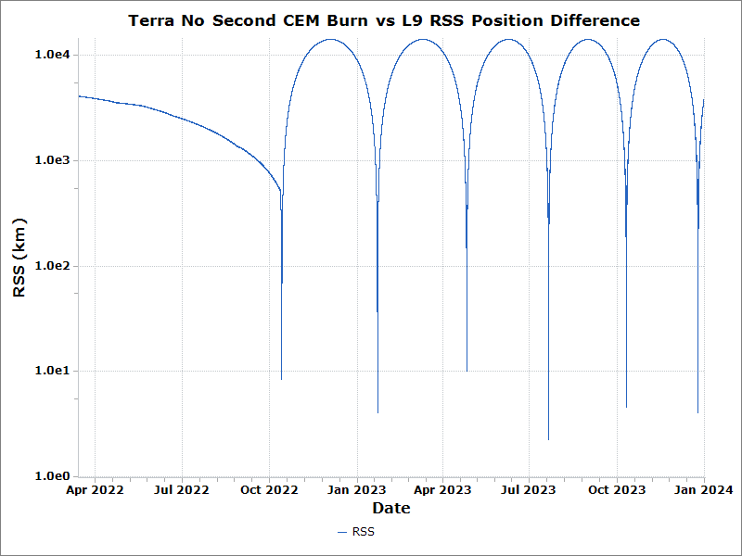
Min RSS Separation– No 2nd CEM: Landsat 9
Landsat 9 RIC
Epoch | Radial Sep (km) | In-Track Sep (km) | Cross-Track Sep (km) | Min RSS (km)
Oct 13 2022 | 2.6 | -7.9 | -0.4 | 8.3
Jan 22 2023 | 0.7 | 4.0 | 0.01 | 4.0
Apr 26 2023 | 1.1 | -10.1 | -0.2 | 10.1
Jul 21 2023 | 2.1 | 0.8 | -0.1 | 2.3
Oct 10 2023 | 2.3 | 3.9 | -0.01 | 4.5
Dec 25 2023 | 1.7 | 3.7 | 0.3 | 4.1

Slide 73
Safety Analysis Conclusions
There are no safety concerns for the nominal case or the partial burn case
If Terra doesn’t perform the 2nd CEM, there are predicted polar crossings with Aqua, Aura, and OCO-2 with <=1 km radial separation (1 each)
All cases have no safety concerns for L8 and L9

Slide 74
FDS Process and Software Readiness
Presented by: Keshav Swaminathan, FDS Terra POC

Slide 75
Updated FDS Software/Processes/Docs
All needed work items for CEM and PLM support have been identified and are either in progress or have already been completed
Items | Status
Test product generation cases with CEMs/PLMs | Complete
Simulate Terra CEM/PLM FDS Maneuver Activities | 2 Sims Complete - Additional sims will be performed for analyst proficiency & process testing
CEM/PLM Standard Operating Procedures | Nearly Finalized - Pending any updates that may come from sim findings or meetings with the FOT
Provide Sample CEM/PLM Products and Communicate any Differences From IAM Products | Complete
Create Automations to Support CEM/PLM Operations and Trending | Complete
Produce Generalized Covariance That Can Be Extended to CEMs/PLMs | In Progress
2022.1 FDS Software Release: Includes CEM/PLM Software Bug Fixes and Software Enhancements | In Progress

Slide 76
FDS Conclusions
Terra has no concerns with the nominal exit plan
Contingency plans have been evaluated and can be adequately resolved to provide that Terra’s frozenness and exit criteria are still reached
FDS feels adequately prepared for Terra’s Constellation Exit maneuvers and will continue making progress on process and software updates

Slide 77
FOT preparations and Analysis
Presented by: Jason Hendrickson, Terra Flight Systems Manager

Slide 78
Agenda
Background
Design Considerations
  Maneuver Constraints & Options
  CEM Separation Analysis
  Instrument Configurations
  Spacecraft Load Estimations
  Slew Direction
Design Verification
  HGA Blockage/Slew Rate Analysis
  Power Profile – Noon & Midnight
Novel Design Features
  Slew Logic
  TMON 1 Patch
Maneuver Products
  Planning Tool
  Performance Evaluation Tool
  New & Updated Procs
Final Design
  Maneuver Outline
  Maneuver Contact Layout
Planning and Execution
  Preparation Timeline
  Operational Tables and Stored Commanding
  Sample Script
  Maneuver Alarms
Simulation Telemetry
PPCRs
Contingencies
  Manual Abort Response
  Response Timeline
Simulations Performed
Maneuver Product Development
CEM Development Benchmarks
Remaining Actions
Perigee Lowering Maneuver Development
Go/No-Go Poll
Backup Slides
  Development Action Items
  CEM CAM Package

Slide 79
Background
Constellation Exit Maneuver (CEM) definition:
  A CEM is a Long-Duration Retrograde maneuver designed to lower Terra’s Orbit by at least 4Km in order to exit the “Morning (AM)” Constellation
  CEMs are further defined as Noon or Midnight CEM, with respects to burn location relative to Terra’s orbit
Long-Duration Retrograde (LD-Retro) maneuver definition:
  Long-Duration
    DV-Burn duration of 320 seconds
    Long relative to a Short Duration Retrograde, which will have a DV-Burn duration of 30 seconds or less
  Retrograde:
    DV-Burn occurs with negative X-side of S/C pointing in the direction of velocity
    Pitch direction is opposite of normal flight pitch
  Will be utilized in Terra’s end-of-mission Perigee Lowering Maneuvers
Objective of the CEMs:
  Achieve a post-exit Semi-Major Axis (SMA) at least 4Km below AM-Constellation members’ SMA
  Maintain a frozen orbit after exiting the constellation, as defined by pre-existing frozen orbit criteria
    Achieved by performing two CEMs at opposite nodes of the orbit
    The FOT/FDS has designed the CEMs to be executed at spacecraft Noon and Midnight, one week apart
Limitations of CEMs
  Sunlight exposure on the +y side (cold side) of the spacecraft
  Depth of discharge of the batteries

Slide 80
Design Considerations
Maneuver Constraints & Options
Major maneuver window timing constraints:
Initially considered two CEM options for achieving constellation exit:
Constraint | Description
Sun-Angle constraint | Maximum 15 minutes of sun exposure on cold side (+Y) (equivalent time of normal) as upper bound – defined as limit for LDSC *Note: By nature of CEMs at opposite sides of the orbit along with a required –x orientation, sunlight exposure on cold side is inevitable
Battery State of Charge | Historic lowest BBAT SOC (62% observed in IAM 36) as lower threshold
Maneuver Phasing | CEMs must be phased 180 degrees apart to maintain frozen orbit
Option | Burn Location | Pros | Cons
1 | Noon & Midnight | - Allows for maneuver timing to be set relative to S/C Orbital Events - Combined least impact on EPS & sunlight impingement - Maneuver can be planned around any orbit with viable TDRS coverage | Requires slew schemes different from IAMs & non-intuitive slew commanding
2 | Apogee & Perigee | - Original plan for CEMs - Least impact on frozen orbit | - Not ideal for minimizing sunlight impingement or battery depth of discharge - Fewer ideal maneuver orbit opportunities

Slide 81
Design Considerations
Instrument Configurations
IOT | Configuration | Notes
MODIS | Remain in Science Mode Space View & Nadir doors closed Non-essential components powered off | Door Closure addresses sun exposure concerns on +y side of S/C
MISR | Taxi-Off Mode | Nominal “night” mode (No Science Record)
CERES | CONTAM Safe for both CEA and CEF | Same as other maneuvers
MOPITT | Safe Mode
ASTER | Contamination Safe Mode: Standby | Contam. Safe parks mirrors to mitigate ASTER sun exposure concerns on +y side of S/C
INST Engineer polled and confirmed preferred Instrument configurations from all IOTs
The same configurations apply to both Noon and Midnight CEMs

Slide 82



Design Considerations
Slew Direction
Noon CEM
Test cases were examined at various dates over the year to make design choices applicable to any day of the year
  Minimizing battery depth of discharge
  Minimizing sun impingement on +y side
Noon CEM best performance utilizes two positive 180° slews
Midnight CEM best performance utilizes two negative 180° slews
Midnight CEM

Slide 83


Design Verification
HGA Blockage/Slew Rate Analysis
LDR – Midnight:
275 provides good coverage for maneuver contact (~55 minutes)
S/C midnight concurrent with local noon allows for maneuver to take place during typical business hours
LDR – NOON:
TDW or 171 provides good coverage for maneuver contact (~53 minutes)
S/C noon concurrent with ~5:30pm local allows for maneuver to take place during extended business hours (optimal option)
2.5 minute gap in this example takes place during the return slew

Slide 84

Design Verification
Power Profile – Noon CEM
Solar Array Park
Solar Array 3w
Solar Array Closed Loop Control
First Slew Start
Second Slew Start
+Y Sun Exposure only ~5 mins (well within 15 min. requirement)
Estimated Min SOC 71% on BBAT, Batteries returns to 100% post-maneuver
No concerns with Noon CEM execution profile

Slide 85

Design Verification
Power Profile – Midnight CEM
Solar Array 3w
Solar Array Park
Solar Array 3w
Solar Array Closed Loop Control
First Slew Start
Second Slew Start
No +Y Sun Exposure
Estimated Min SOC 64% on BBAT, Batteries and returns to 100% post-maneuver
No concerns with Midnight CEM execution profile

Slide 86
Novel Design Features
Slew Logic
Terra Slews are commanded in the Forward or Reverse directions
  Forward (FWD) :
    Re-initializes to Orbital Reference Frame (ORF)
      Sets initial commanded offset to 0˚ on all axes
    Initiates Slew in (+ 1) * Slew_Rate direction
      Slew_rate uplinked in Table 126 prior to slew
  Reverse (RVS) :
    Initiates slew in (- 1) * Slew_Rate direction
Historic slews (e.g. IAMs) would slew out in FWD direction then use RVS to slew return
Retro Slew concept requires 2 slews in the same direction (minimize Sun exposure)
  2 FWD Slews can’t be used
    Re-initializes to ORF at the start, which prevents using a FWD to return from a slew offset
    2nd FWD slew would induce a 180˚ yaw error
  Design will use 2 RVS slews
    Need to uplink a Slew_rate with the opposite sign direction
    i.e. Slew in (-) direction requires uplink of (+) Slew rate table and vis versa
IAM
- 90˚ Yaw out
+ 90˚ Yaw return
Midnight Retro
- 180˚ Yaw out
- 180˚ Yaw return
Noon Retro
+ 180˚ Yaw out
+ 180˚ Yaw return
Slew Out – Blue
Slew Return – Orange

Slide 87
Novel Design Features
TMON 1 Patch
TMON 1 will terminate a DV-Burn if attitude rate errors are ~1/2 OA FDIR limits to prevent SH
  Actually monitors rate, rather than rate errors
Retro pitch rate is opposite normal flight pitch rate (+0.06 dps instead of -0.06 dps)
TMON 1 FSW patch developed for Retro Pitch Rate
TMON 1 patch and backout are in CM and have been rigorously tested on SSIM
Proc was developed for SD-Retro to patch and backout TMON 1, and has been incorporated in maneuver script
  No changes were required for LD-Retro application
  Update required following IRU-B power off; Changes verified and testing on SSIM
In operations, TMON1 will be patched for retro limits during set-up, and backed out to nominal limits during maneuver clean-up
Nominal TLS | Retro TLS
Nominal pitch limits: +0.04°/s > X > -0.16°/s for 3 EOS sec | Pitch rate limit: +0.16˚/s > X > -0.04˚/s for 3 EOS sec

Slide 88
Maneuver Product Development (FOT Products)
Product | Category | Description | Progress | FOT CCR #
LDR_FIRST_SLEW_START.3.act | Activity Definition | Begins First Slew in ATC | - Complete | Terra_ccr_4234
LDR_SECOND_SLEW_START.2.act |  | Begins Second Slew in ATC | - Complete | Terra_ccr_4235
LDR_SA_3w_PREBURN_MIDNIGHT.1.act |  | SA Pre-Burn Configuration in ATC | - Complete | Terra_ccr_4236
LDR_SA_PREBURN_NOON.1.act |  | SA Pre-Burn Configuration in ATC | - Complete | Terra_ccr_4237
LDR_SA_3w_POSTBURN_MIDNIGHT.1.act |  | SA Post-Burn Configuration in ATC | - Complete | Terra_ccr_4238
LDR_SA_3w_POSTBURN_NOON.1.act |  | SA Post-Burn Configuration in ATC | - Complete | Terra_ccr_4239
LDRYaw_Midnight_mmddyyvn.txt | FDS Config. File | Used to build Slew FDD products | - Complete | Terra_ccr_4240
LDRYaw_Noon_mmddyyvn.txt |  | Used to build Slew FDD products | - Complete | Terra_ccr_4241
am_gnc_st_mnvr_ldretro.idf | IDF | Maneuver performance mnemonics for ITPS | - Complete | Terra_ccr_4242
AM1_TBL_126_ATTITUDE_SLEW_TBL_LDR_MIDNIGHT_ACCEL001_01_OF_01.dat | Table Load | Slew table for Midnight CEM | - Complete | Terra_ccr_4243
AM1_TBL_126_ATTITUDE_SLEW_TBL_LDR_NOON_ACCEL001_01_OF_01.dat |  | Slew table for Noon CEM | - Complete | Terra_ccr_4244
adc_fsw_LDR_abort.prc | Proc | Abort CEM at various points pre-burn | - Complete | Terra_ccr_4245
fs1_exec_ldretro_cleanup.prc |  | FSW cleanup | - Complete | Terra_ccr_4246
prp_dv_preburn_catchk.prc |  | CEM pre-burn FSW checks | - Complete | Terra_ccr_4247
QUEUE_LDR_MIDNIGHT_YY_DDD_01.txt | Command Queue | Maneuver Queue | - Complete | Terra_ccr_4248
QUEUE_LDR_NOON_YY_DDD_01.txt |  | Maneuver Queue | - Complete | Terra_ccr_4249
OFL_TERRA_CEM_nn_SCRIPT_yyyy_ddd_Vv.xlsm | Tool | Planning Tool | - Complete | Terra_ccr_4256
OFL_GNC_CEM_nn_yyyy_ddd_Vn.xlsm |  | Performance Tool | - Complete | Terra_ccr_4257
ofl_am_144_mnvr_power_profile.docx | SOP | Maneuver Power Profile SOP | - Complete | Terra_ccr_4251
ofl_am_153_comm_hga_blockage_profile.docx |  | HGA blockage/slew rate analysis SOP | - Complete | Terra_ccr_4252
ofl_am_177_spacecraft_maneuver_notification.docx |  | Maneuver Logistics SOP | - Complete | Terra_ccr_4253
ofl_am_185_LDRM_CEM_Planning_and_Preparation.docx |  | Maneuver planning SOP | - Complete | Terra_ccr_4254
ofl_am_186_LDRM_CEM_Execution.docx |  | Maneuver execution SOP | - Complete | Terra_ccr_4255
Terra_CEM_nn_CAM_yyyy_ddd_vv.pptx | Slide Package | CAM package template | - Complete | Terra_ccr_4250
Terra_CEM_ORR_V1.pptx |  | ORR slide package | - Complete | TBD

Slide 89
Final Design
Maneuver Outline
First Slew
  Start time: 19:13-min before burn
  Midnight: First slew begins ~2 minutes before DAY/NIGHT
  Noon: First slew begins ~13 minutes after NIGHT/DAY
  Direction: Noon: positive yaw (+X towards +Y) | Midnight: negative yaw (+X away from +Y)
  Magnitude: ~180˚
  Duration: 17:13-min
  S/C Cold side (+Y) / sun angle: <90˚ in DAY
DV-Burn
  Post-slew hold: 2-min
  Burn location: Either S/C Noon or Midnight
  Burn duration: 320 seconds
  Duty cycle: 100%
  Post-burn hold: 2:30-min
Second Slew
  Start time: 2:30-min post-burn
  Direction: Noon: positive yaw (+X towards +Y) | Midnight: negative yaw (+X away from +Y)
  Magnitude: ~180˚
  Duration: 17:13-min
  Noon: Second slew complete prior to DAY/NIGHT
  Midnight: Second slew complete ~8 minutes after NIGHT/DAY (no sunlight on +y side)

Slide 90
Final Design
Addressing Constraints
Constraint | Requirement | Design Compliance
Sun-Angle constraint | < 15 minutes of equivalent direct/perpendicular sun exposure on cold side (+Y) | Midnight : No expected +Y Sun exposure Noon : Max estimated full sun <10 minutes
Battery State of Charge* | Power Profile demonstrates recovery to 100% SOC after maneuver | Various seasons and scenarios reviewed and were power positive generally above historic min of 64% BBAT SOC
Maneuver Phasing | CEMs must be phased 180 degrees apart to maintain frozen orbit | FDS assessed Midnight/Noon paring to maintain frozen orbit on exit
* - If conditions require, FOT can adjust loads to minimize impact to SOC
Actual maneuver plan will be checked against constraints as part of Planning

Slide 91

Final Design
Maneuver Contact Layout
Midnight CEM
Noon CEM

Slide 92

Planning and Execution
Preparation Timeline

Slide 93
Planning & Execution
Operational Tables and Stored Commanding
FOT Tables
FDS Tables
# | Table | Description
126 | Attitude Slew | Resides in CM with a slew direction and magnitude of ±180.04° Slew
106 | Delta V Parameters | Resides in CM with the Burn Duration of 320 seconds
107 | Delta V Offset Parameters | Resides in CM with 0 biases for all 3 axes
N/A | TMON 1 Patch/De-Patch TLS | Retro: +0.16˚/s > pitch rate > -0.04˚/s for 3s Nominal: +0.04°/s > pitch rate > -0.16°/s for 3s
# | Table | Description
201 | Post Maneuver EOS OE Table | Provides Backup to State Vectors Held on-board until after Maneuver
257 | Thruster Table | Forces Calibrated after last Maneuver Enables propagation through CEM
263 | EOS Model Table | S/C Mass Only Loaded Post Maneuver
Onboard FSW Commanding
Commanding | Description
Slew Inhibit IDs | RTCS 159 – Activated via FS1_EXEC_RETRO_SETUP.prc Clears Inhibit ID’s 104 & 102 (slew). FS1_EXEC_RETRO_SETUP calls RTCS 159 & also clears Inhibit IDs (in this order) 104, 103, 100, 106, 109, 58, 34, 102, & 104 (104 twice)
EPS Solar Array | RTCS 147 – Patch SAD to closed loop timing for 25 min or 43 min TMON 2 – Patch SAD Park Angle to ~330°
Propulsion Cleanup | RTCS 175 Enables the 5 LB catbed heaters prior to DV maneuver If loss of contact catbed heaters turned off after 2 hours

Slide 94
Planning & Execution
Maneuver Alarms
Suppressed Alarms (Maneuver Setup Proc)
terra_alarm_setup_maneuver(‘retro_setup’)
Expected Yellow Alarms
Mnemonic | Limit Violation | Expected Value | Note
FS_SS_ALOG_ERR | Upper Y | Error | Accompanies TMON 65 trip
Various Ground System SD Status alarms | Upper Y | 1 | Results from ConfigMon alarming
FS1_SS_FILT_CONV_IN | Lower Y | TONS_FILTER_NOTCONV | Possible during burn
Mnemonic | Limit Change | Mnemonic | Limit Change
PMS_BR_1LBCATODD_ENA | Alarming Disabled | PMS_TR_REA_1 | Upper yellow → 100
PMS_BR_1LBREAODD_ARM |  | PMS_TR_REA_3
PMS_BR_1LBREAODD_ENA |  | PMS_TR_REA_5
PMS_BR_5LBREAODD_ARM |  | PMS_TR_REA_7
PMS_BR_REA1N3_ENCAT |  | PMS_TR_REA_9
PMS_SR_PMEA1_LASTWD |  | PMS_TR_REA_11
PMS_SR_PMEA1REA1_ON |  | PMS_TR_REA_13
PMS_SR_PMEA1REA3_ON |  | PMS_TR_REA_15
PMS_SR_PMEA1REA5_ON |  | FS1_NS_ERROR_DEG_X | Lower yellow → -1
PMS_SR_PMEA1REA7_ON |  | FS1_NS_ERROR_DEG_Y
PMS_SR_PMEA1REA9_ON |  | FS1_NS_ERROR_DEG_Z
PMS_SR_PMEA1REA11_ON |  | FS1_NS_WCMD_Z | Upper/lower yellow → +/- 0.004
PMS_SR_PMEA1REA13_ON |  | FS1_NS_WIRU_Y
PMS_SR_PMEA1REA15_ON |  | FS1_NS_WIRUF_Y
PMS_TR_CAT_BED_S01 | Upper yellow → 900 Lower yellow → -1000 | FS1_SS_ACTSAFE | Alarming Disabled
PMS_TR_CAT_BED_S03 |  | GNC_SD_SYSMOM_Z | Upper/lower yellow → +/- 85
PMS_TR_CAT_BED_S05
PMS_TR_CAT_BED_S07
PMS_TR_CAT_BED_S09
PMS_TR_CAT_BED_S11
PMS_TR_CAT_BED_S13
PMS_TR_CAT_BED_S15
Possible Yellow Alarms
Mnemonic | Limit Violation | Possible Value | Note
FS1_SS_IRU_CNG2_P | Upper Y | >0.25 | May violate lim for 1 update when NM transition is commanded
FS1_NS_ERROR_DEG_X | Lower Y | >1 | Possible though unlikely during burn
FS1_NS_ERROR_DEG_Y | Lower Y | >1 | Possible though unlikely during burn
FS1_NS_ERROR_DEG_Z | Lower Y | >1 | Possible though unlikely during burn
FS1_SS_MSMT_RES_EDIT | Upper Y | EDIT | N/A
MOD_TR_* | Upper Y |  | Due to non-nominal configuration
AST_BR_S_MIRROR | Upper Y | 1 | Post-Maneuver, SWIR mirror pos. Possible after SWIR mirror reset

Slide 95


SIM Telemetry
Midnight CEM SIM TLM
Noon CEM SIM TLM

Slide 96

PPCRs

Slide 97
Simulations Performed
Scenario | Category | Outcome
ATC Activity Definition Assessment [Noon & Midnight] | Nominal Test Cases | Successful, Activity Definitions performed as expected
Full-Team [Midnight] | Nominal Test Case | Successful, minor updates to procs & overall script based on results. Verified new/updated procedures.
Pre-Slew Abort | Contingency | Successful, full recovery to NM
Pre-Burn Abort (no LV commanding) | Contingency | Successful, full recovery to NM
Terminate DV-Burn | Contingency | Successful, full recovery to NM
FDIR trip at 180˚ | Contingency | Successful, Verified Safe, Stable EPSH configuration
Noon and Midnight CEM “Run for Record” | Nominal Test Cases | Successful, final verification of all maneuver products (table loads, activity definitions, procs, queues, planning & evaluation tools)

Slide 98
CEM Development Benchmarks
July 16th 2019 – Kick-off Working Group
  Reviewed FDS Lifetime Analysis and CEM objective
  Preliminary design choices
August 7th 2019 – Working Group #2
  Design bounded by sun exposure on +y side & battery minimum state of charge
  CEMs must be executed at opposite nodes of orbit to maintain a frozen orbit
September 3rd 2019 – Working Group #3
  Two CEMs will be executed at opposite points of orbit: Noon & Midnight
September 24th 2019 – Working Group #4
  Reviewed FDS analysis of burn phase and separation on frozen orbit – Bounds for CEM separation were determined
  Reviewed CEM Slew scheme – Two Reverse Slews to slew twice in the same direction
November 5th 2019 – Working Group #5
  FDS/FOT HGA blockage analysis was completed and bounded preferable CEM orbits and TDRSS
  SA Commanding and new Activity Definitions
  Contingency responses
November 14th 2019 – Full Team SIM Completed
November 26th 2019 – Working Group #6
  Planning Tool / finalized script
December 6th 2019 – Contingency SIMs Completed
December 11th 2019 – Pre-ORR Status Meeting
December 13th 2019 – Run for Record SIMs
December 17th 2019 – CEM ORR
December 18th 2019 – CEM Products Boarded at CCB

Slide 99
FOT 2022 Readiness Preparation
Updates from Original Development
  IRU-B power off Updates
    IRU-B was only used as Back-up Sensor in case of IRU-A or IRU-C failure
    Assessed Execution Process with IRU-B off
      Overall process unaffected
    TMON-1 updated to remove IRU-B status check
    Developing alternate IRU-A/C back-up rate estimator
      IRU-B may still be powered back on in contingency
      ESA based estimator in development being assessed against CEM
  SSU Failures
    Update Power Profile Tool
      Expected lower minimum State of Charge
      Impact not expected to be significant

Slide 100
FOT 2022 Readiness Preparation
FOT Proficiency Simulations
  Midnight/Noon CEM Sims have been performed for product revalidation
    Retrograde TMON -1 update for IRU-B power off successfully tested
  Multiple CEM Simulations performed as part of testing for ESA based rate estimator
  CEM Contingency SIMs to be reperformed prior to final “run for record” simulation
    Pre-Slew Abort
    Pre-Burn Abort (no LV commanding)
    Terminate DV-Burn
    FDIR trip at 180˚
  Full team “run for record” simulations to be performed prior to CAM (target September 2022)

Slide 101
Contingencies

Slide 102

Contingencies
Manual Abort Response
Pre-slew abort criteria (same as IAM and SD-Retro):
Slew abort criteria (same as IAM and SD-Retro):
  None
  Allow FDIR to command SH if necessary
    FDIR evaluated in CDR for all S/C orientation
  No ground LV command response
    LV response has not been evaluated at Yaw Offset < -110˚*
Pre-burn abort criteria (same as IAM and SD-Retro):
  External cause for waive-off (e.g. HIE)
  No criteria based on slew performance
Burn abort criteria:
  Burn duration exceeds commanded duration
Burn abort response:
  Activate RTCS 146 via FS1_EXEC_RTCS_ACT(146)
  Terminates the burn

Slide 103

Contingencies
Response Timeline
Set-up Contacts & ATC configuration observing contacts
First Slew
Maneuver & DV-Burn Contact
DV-Burn
Second Slew

Slide 104
Contingencies Summary
Maneuver Waive-off/Abort Scenarios simulated
Mid-Slew (high rate) FDIR trip (Safe) Simulated
Aborted first burn
  Maneuver can be rescreened for CA concerns
  Adjustments to 2nd burn can be made as needed
Delayed second burn
  Can be delayed up to 4 weeks between burn 1 and 2 with no issues to circular orbit
HIE waive-off
  Stand down and replan for following week
Other??

Slide 105
FOT Conclusions
FOT Planning and Execution Process is well defined and developed
  All initial development completed
    All products/documentation tested and CM’ed
  Minor Updates in progress and nearly completed
FOT executing proficiency Simulations to ensure readiness
  Includes both nominal and contingency paths
FOT will be ready to execute the Constellation Exit Maneuvers in October 2022

Slide 106
Overall Summary/Conclusions
Terra has a good, safe plan to exit the Constellation
  Mets guidelines given in the Constellation Coordination Plan
  Location of burns has been analyzed and determined
  Thermal concerns have been addressed
  Comm/HGA analysis has been completed
The plan has been tested, reviewed and CMed
Contingencies have been analyzed and predetermined responses are ready to go
Terra is a GO to execute the constellation exit maneuvers

Slide 107
Backup Slides
Constellation Envelope Definition
Perigee Lowering Maneuver Info
Slew Logic Flow
FOT Planning Aids & Tools
Maneuver Script
Waiver Email

Slide 108

Constellation Envelope Definition
Constellation exit is defined as a mission being completely outside the Constellation “envelope” and is represented by the following equation*:
  Equation variables:
  sma_{R} = Mean semi-major axis
  of the 705km
  Reference Orbit
  e_{R} = Mean eccentricity of the
  705km Reference Orbit
  Margin = 2.5 km
  Frozen Orbit Tolerance = 1.5 km
  and is based on a maximum eccentricity deviation of 0.0002
  B subscript references the
  satellite in question (e.g. Terra)
*Source: 2014 Operations Coordination Plan for the Morning and Afternoon Constellations

Slide 109
PLM Parameters
Terra will perform Perigee Lowering Maneuvers (PLMs) until all remaining fuel is exhausted
PLMs will be retrograde maneuvers, and will use Terra’s historic inclination maneuver burn duration of 320 seconds
  Current estimates indicate Terra will have enough fuel to perform 4 full PLMs and one 190.5 second PLM
PLMs will begin to be executed once Terra reaches 09:00 MLT at the descending node
  Most recent lifetime analysis predicts Terra will cross the threshold on February 17th, 2026
PLMs will be performed one week apart and will all occur at spacecraft local midnight
  Maneuvers will occur at standard preferred maneuver times, between 15:00-17:00 UTC on Wednesday or Thursday
  Midnight maneuvers will reduce sunlight exposure during PLMs

Slide 110
Perigee Lowering Maneuvers
Below are the maneuver parameters for predicted Terra PLMs
  The fuel use estimate below includes slew out and slew back, all other parameters are for the main burn only
Maneuver | Epoch | Burn Duration (sec) | Orbit Location | Estimated Delta SMA (km) | Estimated Delta V (m/s) | Estimated Fuel Use (kg)
PLM 1 | Feb 25 2026 17:12:37.000 | 320 | Orbit Midnight | -2.7250 | 1.5259 | 3.3284
PLM 2 | Mar 04 2026 16:48:21.000 | 320 | Orbit Midnight | -3.0430 | 1.5210 | 3.3105
PLM 3 | Mar 11 2026 16:17:58.000 | 320 | Orbit Midnight | -2.8690 | 1.5137 | 3.2930
PLM 4 | Mar 18 2026 17:19:55.000 | 320 | Orbit Midnight | -2.8570 | 1.5065 | 3.2758
PLM 5* | Mar 25 2026 16:37:23.000 | 190.5 | Orbit Midnight | -1.7180 | 0.8936 | 1.9744
*There is estimated to be 0.0006 kg of usable fuel remaining after PLM 5.

Slide 111

Post-PLM Drift
Once Terra completes its PLMs, it will cease to maneuver
The plot below shows the evolution of Terra’s apogee and perigee for one year after the final PLM

Slide 112

Re-Entry
Terra is estimated to re-enter in July of 2069
Reentry:
July 26th 2069

Slide 113
Perigee Lowering Maneuver Development
The FOT Assessed the CEM process against the PLM
  FOT and FDS determined CEM process can be used for PLMs
    Verified with FDS usage of Noon or Midnight for PLMs
  Differences between PLM and CEM
    PLMs would all be executed on one side of the orbit
    Expectation that fuel will run out and impact performance of final PLM
FOT verified PLM process on simulations
  Including simulating loss of thruster authority for final PLM
The FOT generated PLM specific tools, based on CEM tools
  PLM specific Planning and Execution SOPs
  PLM Planning Tool and Script
  PLM Template Command Authorization meeting Slides
All other CEM products were directly applicable to the PLM
PLM process development completed in 2020

Slide 114



Novel Design Features
Slew Logic
Slew Code Flow Diagram
DV Burn + Post Burn Cleanup via Activity Definition
Takeaways:
Table 126 will include a negative slew rate to achieve +y direction slews
Table 126 will include a positive slew rate to achieve –y direction slews
The two CM’d Table 126’s include Noon/Midnight nomenclature to avoid confusion
FDS will manually flip the sign convention in the generated FDD file to model a 360 degree slew in AutoProducts in the correct direction
Following an Spacecraft Computer Reset, a typical slew activity (FWD/RVS) must be performed first

Slide 115
Maneuver Products
New & Modified Procs
Proc Function | Proc Name | Proc Description | Proc Details
Pre-Burn Catbed and FSW check | Prp_dv_preburn_catchk | Loads forward and backward TMON 1 Pitch Rate TLS patch for maneuver setup/cleanup | Updated procedure to accept ‘retro_long’ argument with a appropriate checks
Retro Cleanup Proc | fs1_exec_ldretro_cleanup | Cleans up FSW after LD-Retro | Disable RTCS 175 and 147. Clears TMON 2
Retro Abort Proc | adc_fsw_ldr_abort | If run pre-Slew Out, sets Inhibit IDs to prevent Slew Out/Burn/Slew Back If run post-Slew Out/pre-Burn, sets Inhibit ID to prevent Burn, allow slew Back via ATC
All procs have been tested, are reflected in SOPs and are ready to go

Slide 116

Maneuver Products
Planning Tool Overview

Slide 117


Maneuver Products
Planning Tool (1/3)
Maneuver Year/DOY
Import Orbital Events FDD
Select Noon or Midnight
Select Corresponding Orbit
Tank Pressure
FDS Tables (201/257)
CERES Commanding Constraint checks
CEM Script & Contingency PPCRs
The order of key events is auto-configured via Noon or Midnight selection

Slide 118


Maneuver Products
Planning Tool (2/3)
EPS Engineer will re-verify the EPS inputs when planning for the CEM
  S/C Load
  SA Current
  Misc. EPS Parameters

Slide 119


Maneuver Products
Planning Tool (3/3)
The order of ATC activity definitions is auto-configured via Noon or Midnight selection
This excludes Instrument ATC Commanding which will be scheduled by the IOTs

Slide 120

Maneuver Products
Performance Evaluation Tool
Note: Example shown created with telemetry from Midnight SSIM

Slide 121

Planning & Execution
Sample Script (1/4)

Slide 122

Planning & Execution
Sample Script (2/4)

Slide 123

Planning & Execution
Sample Script (3/4)

Slide 124

Planning & Execution
Sample Script (4/4)

Slide 125
OSMA Official Direction
From: Aleman, Suzanne M. (HQ-GD000)
Sent: Wednesday, November 02, 2016 11:37 AM
To: Yuhas, Cheryl L. (HQ-DK000) <cheryl.l.yuhas@nasa.gov>
Cc: Liou, Jer-chyi (JSC-XI411) <jer-chyi.liou-1@nasa.gov>; Hull, Scott M. (GSFC-5920) <scott.m.hull@nasa.gov>
Subject: FW: Terra need for Orbital Debris waivers
Hi Cheryl,
I received you voice mail regarding the question on whether a waiver is needed for the 25 year rule for TERRA.
I consulted with J. C Liou on this question we have concluded that a waiver is not needed. Please see the e-mails below.
Please let me know if you have any questions.
Best regards,
Sue Aleman
NASA HQ OSMA
MMOD Program Executive

