Slide 1
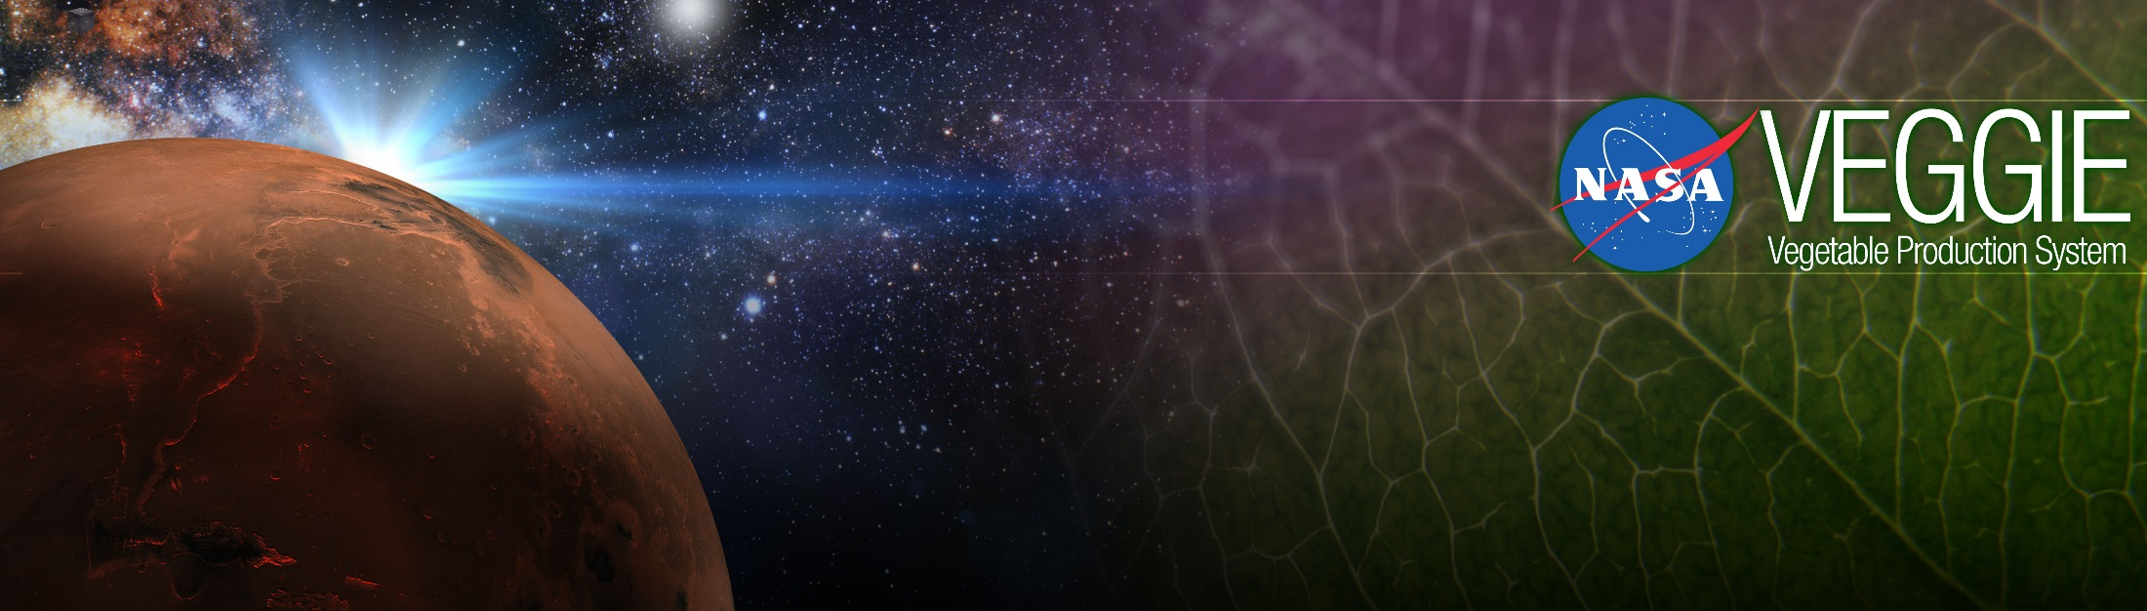
Plants in Space, Veggie, and Space Crop Production
Gioia Massa
NASA, Kennedy Space Center, FL, USA

Slide 2


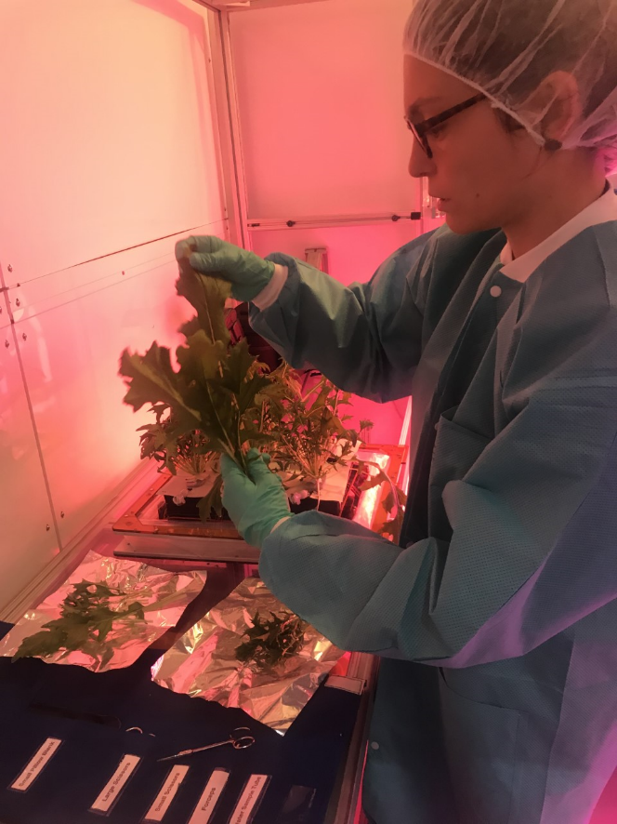
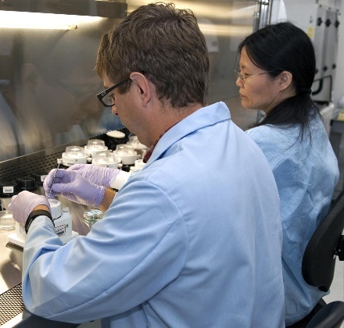
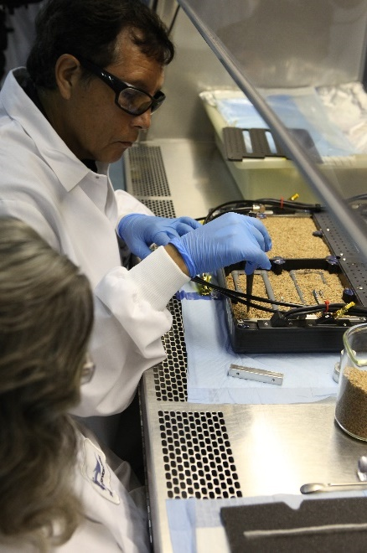
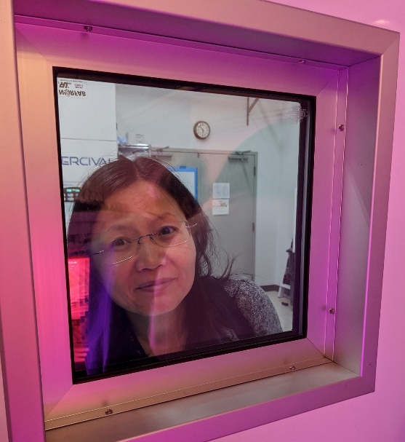
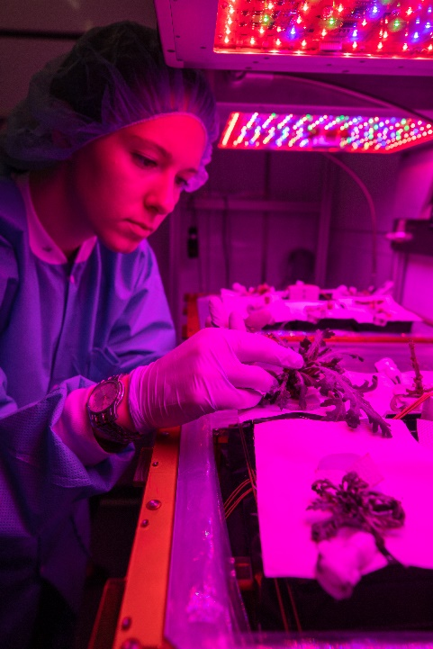
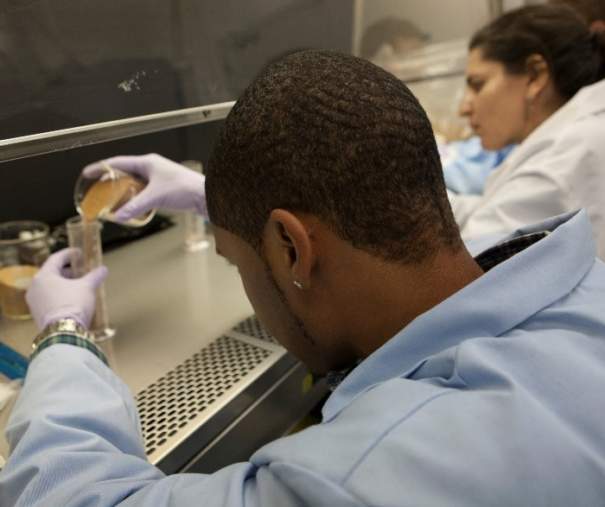
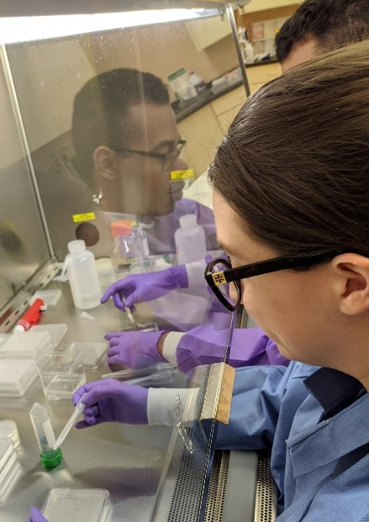

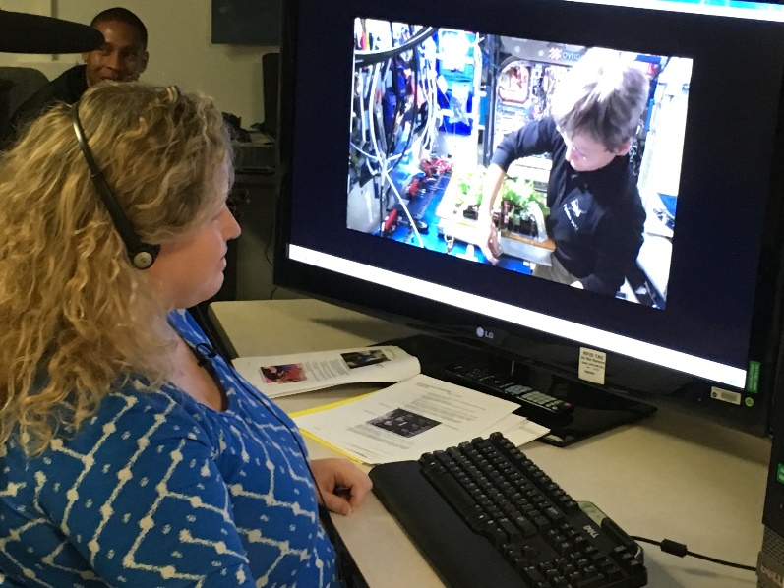
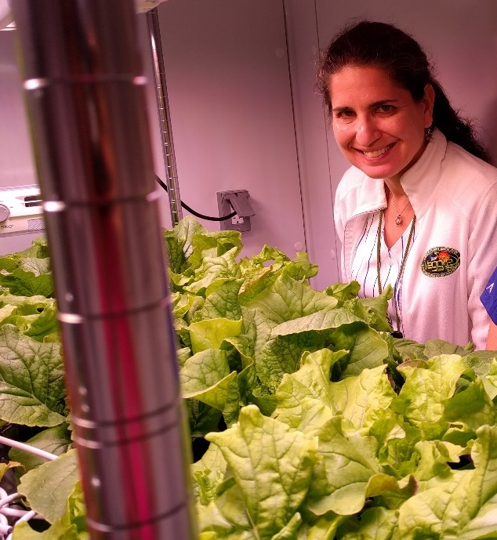
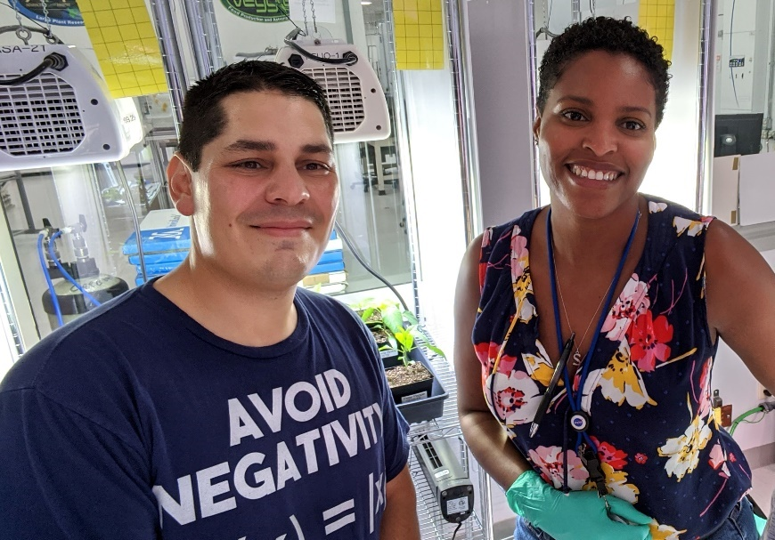
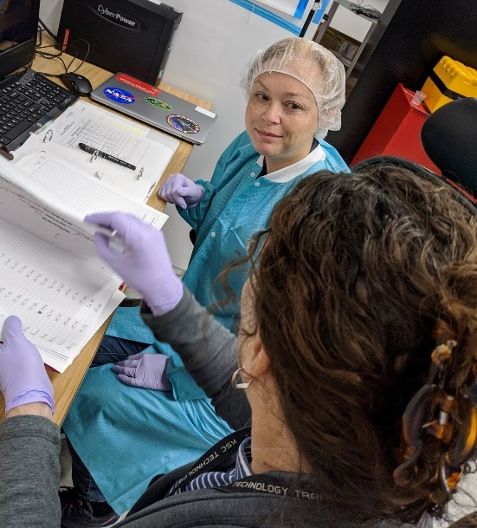

Slide 3
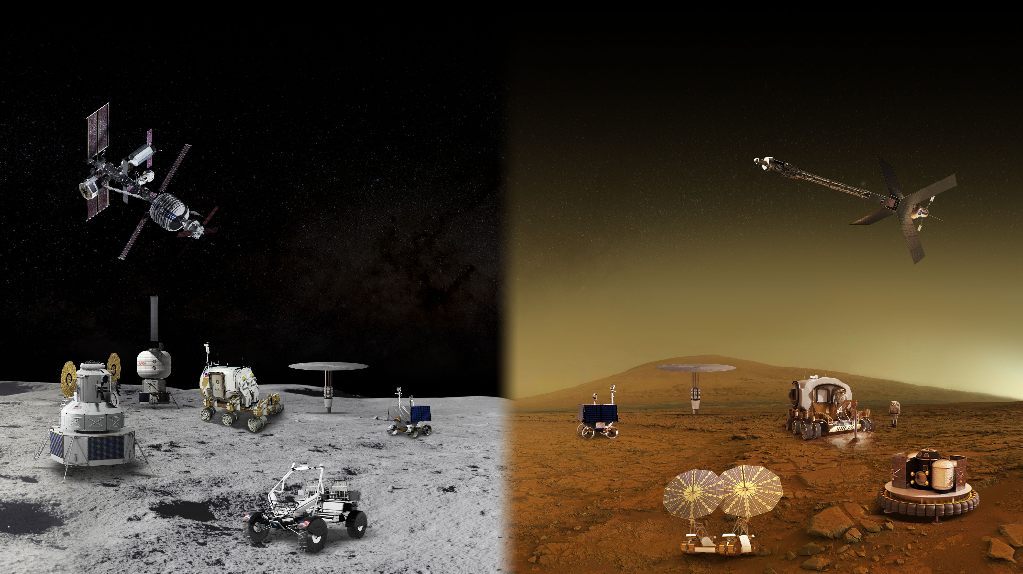
MOON AND MARS EXPLORATION
Operations on and around the Moon will help prepare for the first human mission to Mars
GATEWAY
Long Durations in Zero Gravity
TRANSIT HABITAT
and mars transit
Crew Size
Mobile Expedition Duration
Mobile Exploration Range
Surface
Habitat
Pressurized rover
Surface Fission Power
In-Situ Resource Utilization
Partial Gravity Operations
Human Landing system
Lunar
Terrain
vehicle
Autonomous Robotics Systems & Contingency Crew Transportation

Slide 4
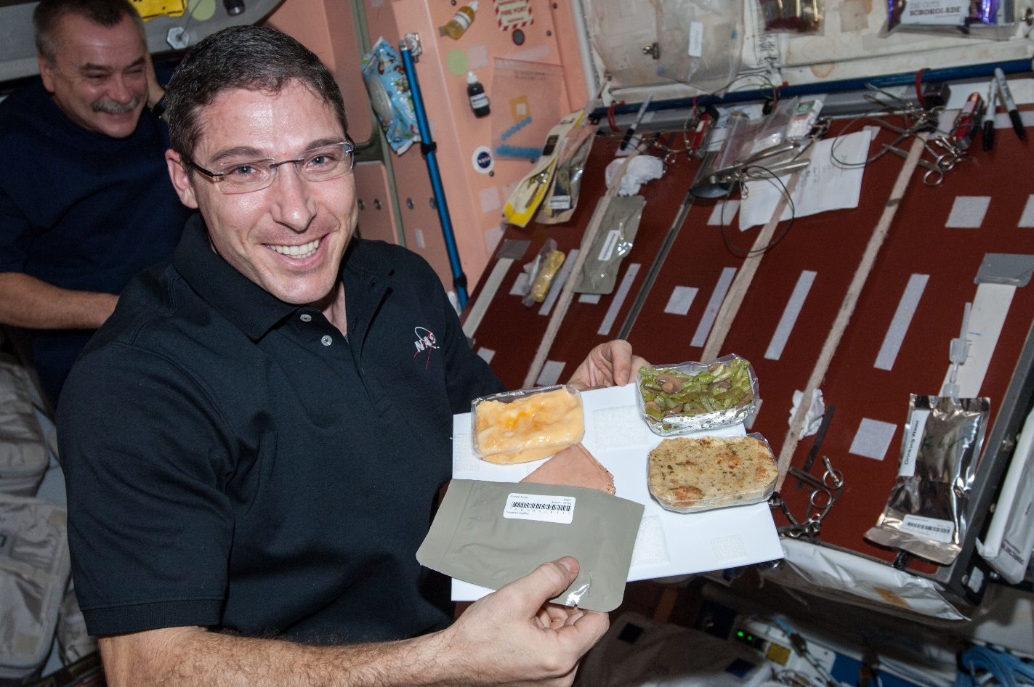
Why grow plants in space?
Food
Psychological well being
Atmosphere
Water

Slide 5
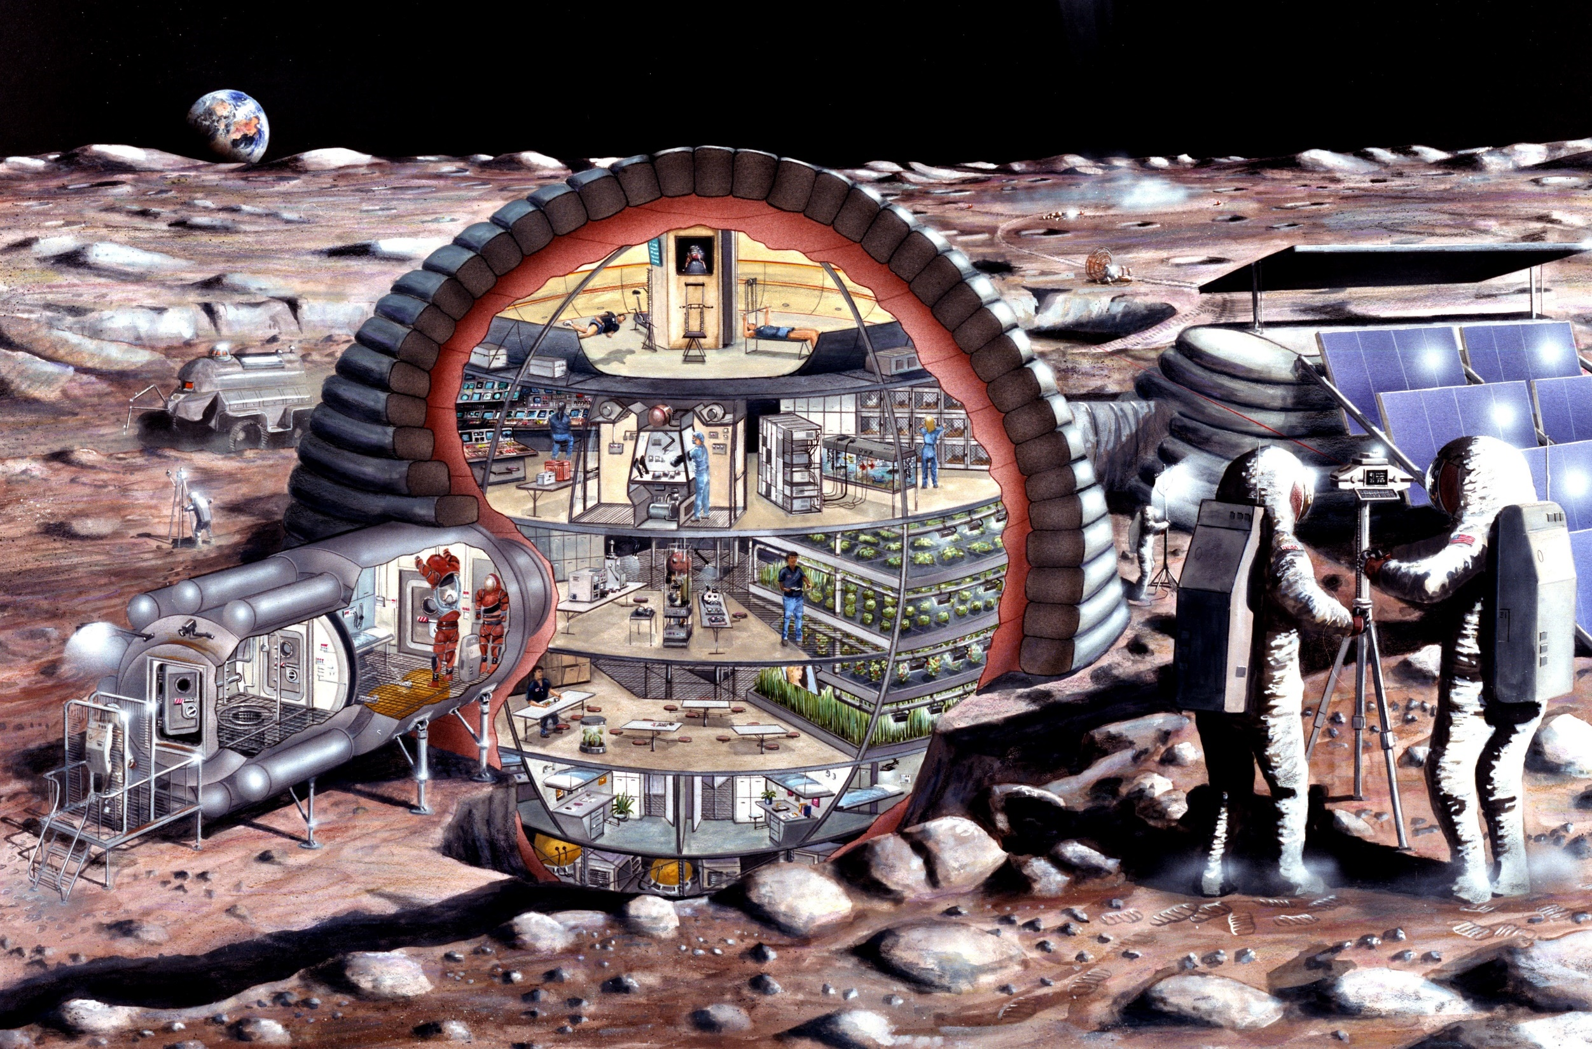

Slide 6
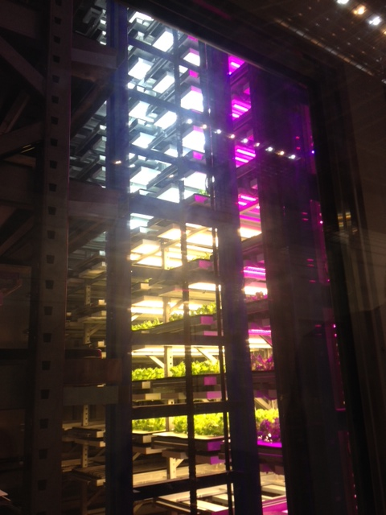
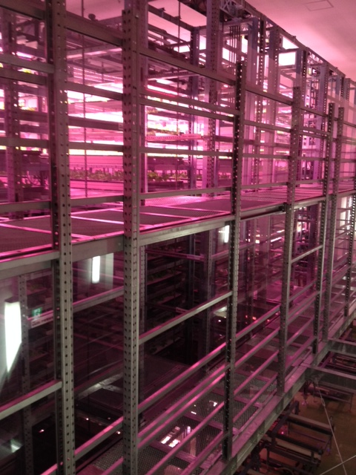
Plant Factories
Photos of Osaka Prefecture University training facility courtesy of Ray Wheeler

Slide 7
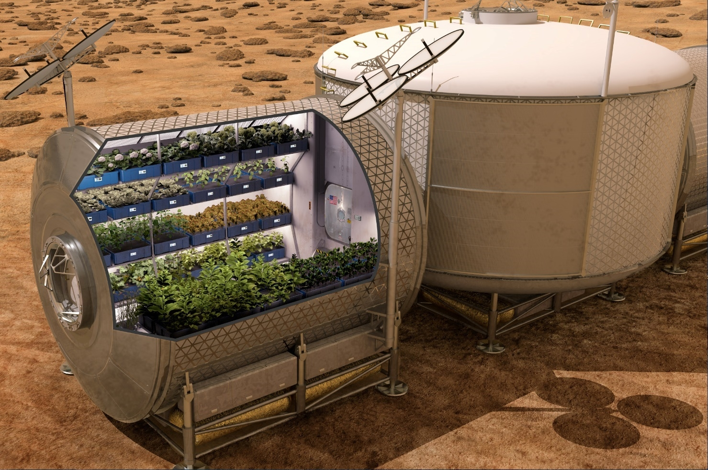

Slide 8
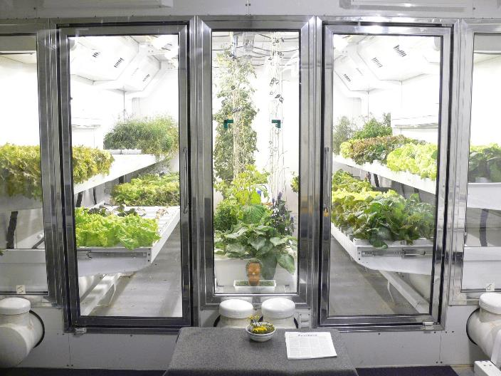
South Pole Greenhouse
Photo courtesy of Lane Patterson

Slide 9
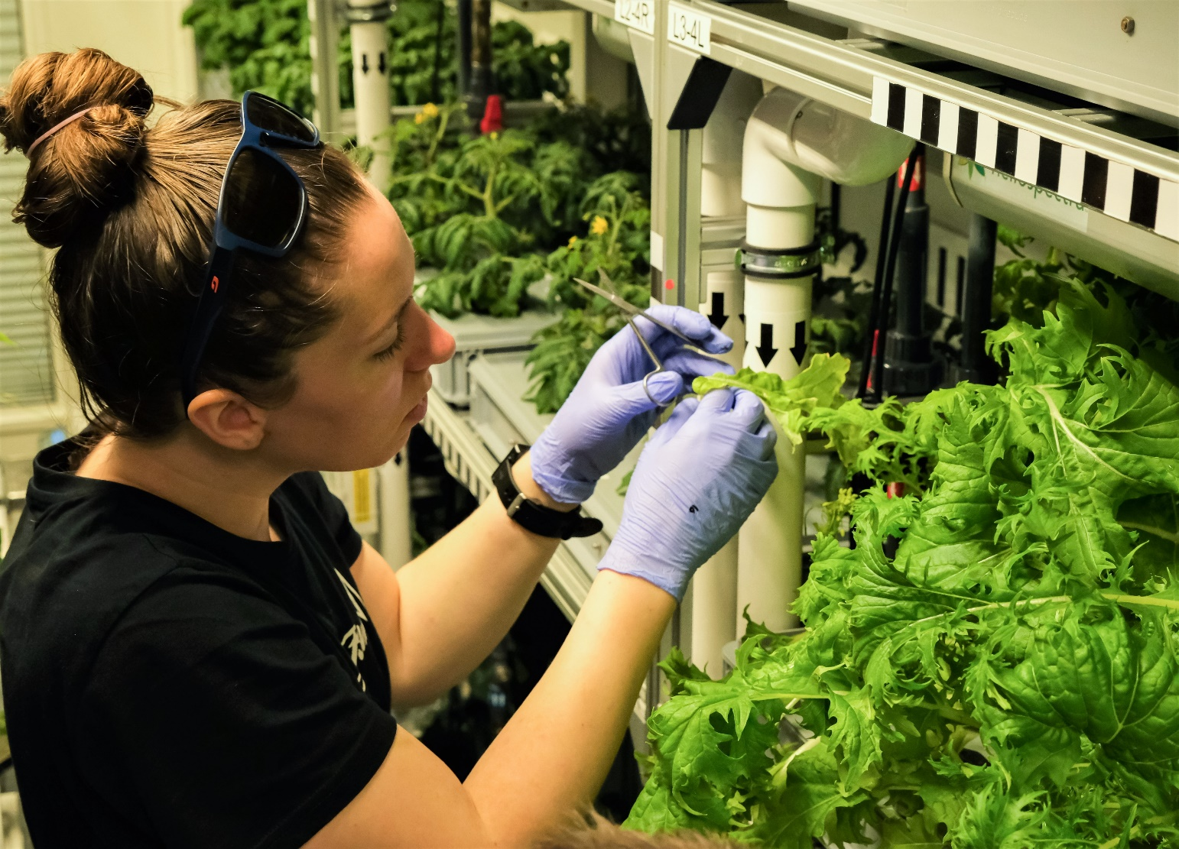
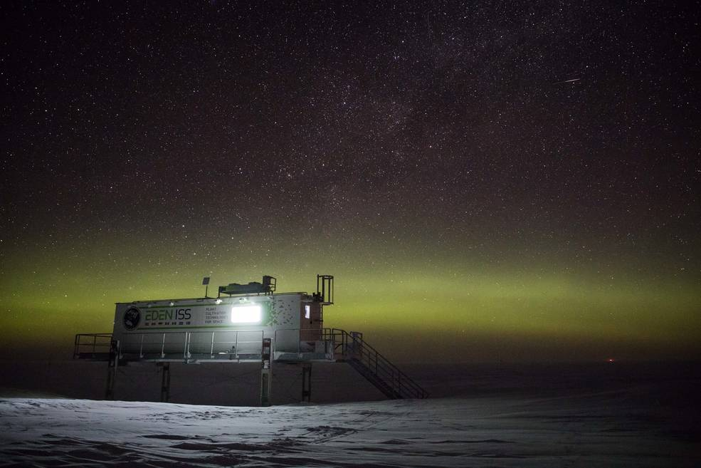
EDEN ISS Antarctic Greenhouse
The EDEN ISS greenhouse, developed by the German Aerospace Center; DLR, in Antarctica since 2018.
Credit: Hanno Müller, AWI
Jess Buncheck – KSC scientist – Tending plants in EDEN ISS, 2021
Notes:
It was created to conduct research into food production in deserts and cold regions, as well as exploring the possibility of growing fresh food in the hostile conditions on the Moon or Mars.

Slide 10
The Space Crop Production Vision
Ensure Food System Security on Long Duration Missions Beyond LEO
Near-Term Goal
Nutrient Supplementation of Prepackaged Food
Long-Term Goal
Caloric Replacement to Move Towards Earth Independence
Notes:
Ralph
Ensure Food System Security on Long Duration Missions Beyond Low Earth Orbit (LEO)
Food and nutrition are the first line of defense for crew health and performance
Provide safe, nutritious and acceptable fresh food
Add variety to crew diet
Enhance morale
* Food security is the condition in which crew have continuous access to sufficient safe and nutritious food which meets both their dietary needs and food preferences in order to maintain peak health and performance.
Nutrient Supplementation of the Prepackaged Food System - Needed for: Deep Space Transport
Fresh produce supplements vitamins (B₁, K, C) and bioactive compounds that degrade in the stored food system on multi-year exploration missions
“Pick-and-Eat” crops that require no processing and minimal preparation will provide variety, customization, and psychological appeal
Enable testing and demonstration of dependable crop production before reliance on system.
Limiting factors are vehicle resources mass, power, volume, water, air, crew time
Caloric Replacement to Facilitate Earth Independence - Needed for: Long duration Surface missions on the Moon and Mars
Reduce up-mass associated with pre-packaged food
In addition to “pick and eat” crops, include staple crops that require processing and preparation
Bioregenerative capability will be required for long duration surface missions

Slide 11


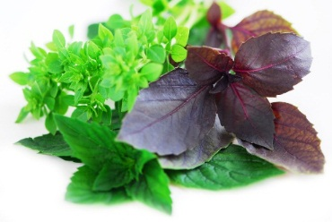
Space Crop Production Candidates
Salad
Leafy Greens
Tomato
Pepper
Radish
Strawberry
Green Onion
Pea
Carrot
Lettuce, Chinese cabbage, Swiss chard, Mizuna, Spinach
Staple Crops
White Potato
Sweet Potato
Rice
Wheat
Dried Bean
Soybean
Peanut
MINIMAL PREPARATION / COOKING
SIGNIFICANT PREPARATION / COOKING
CONSUMED FRESH WITHOUT PROCESSING
Herbs
Basil
Mint
Chives
Dill

Slide 12
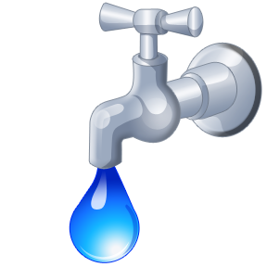
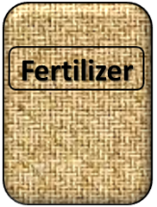

Plant Growth and the Environment
5 Cardinal Factors of Plant Growth…..
O₂

Slide 13
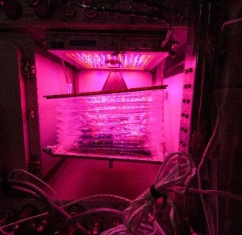
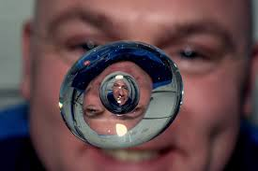


The Space Environment
….and how these work with and without Gravity!
Humans like white light, but plants may grow well with other wavelengths
No convection in space so need to mix the air
O₂
Water forms a ball, and water and air don’t mix well, and roots need both!
Fertilizer is heavy to launch so we need to learn how to recycle plant waste

Slide 14
Space Crop Production Challenges
Deep Space
Water
Recycling
Radiation
Pressure
Micrometeorites
Surface
Microgravity
Fluid movement
No convection
Dust
Partial gravity
Plant Size
High CO₂
Food Safety & Microbiome
Nutrient output
Sustainability
Abiotic stresses
Vehicle resources
Crew time
Waste
Productivity
Stress tolerance
Environmental optimization
Crop scheduling
Crop

Slide 15


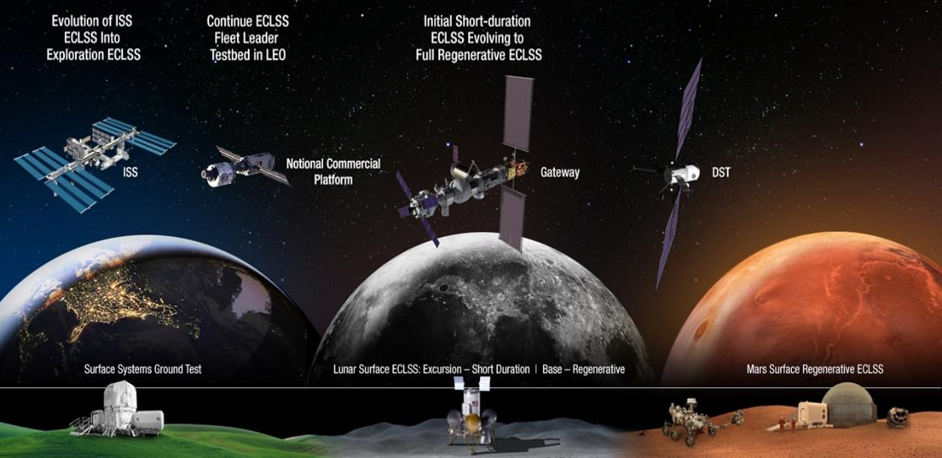


Space Crop Production Roadmap For Exploration
MARS TRANSIT (Crop Production)
GATEWAY (Plant Research)
Operational µg Food Production capability for pick-and-eat crops to supplement crew diet
ISS (Plant Research and H/W Technology)
Proving ground to study the effect of deep space radiation on pick-and-eat crops in µg
Identify challenges and solutions for growing pick-and-eat crops in µg to support crew nutrition
Scale: One to Two EXPRESS Racks (8-16 Lockers)
Scale: Single Locker
Scale: Single Locker to EXPRESS Rack (8 Lockers)
LUNAR SURFACE (Research/Production)
Ground (Plant Research and H/W Technology)
Develop and deploy operational partial gravity systems for both nutritional support and caloric replacement as both a source of food for long duration lunar missions and as a demonstration for Mars
MARTIAN SURFACE (Production)
Develop space crop production concepts and strategies in support of destinations along the exploration roadmap
Leverage Lunar Surface experience in Food Production systems to extend Earth Independence for Mars missions
Scale: Single Locker to Module
Scale: Single Locker to Module
Scale: Single Locker to Module

Slide 16
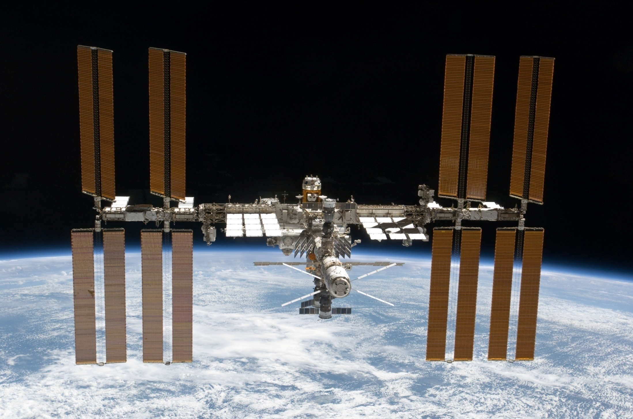
The International Space Station

Slide 17
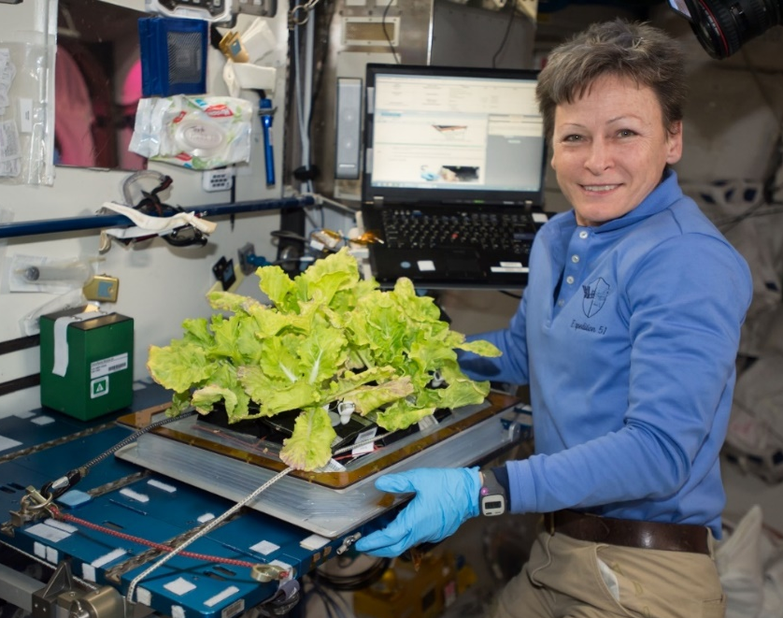
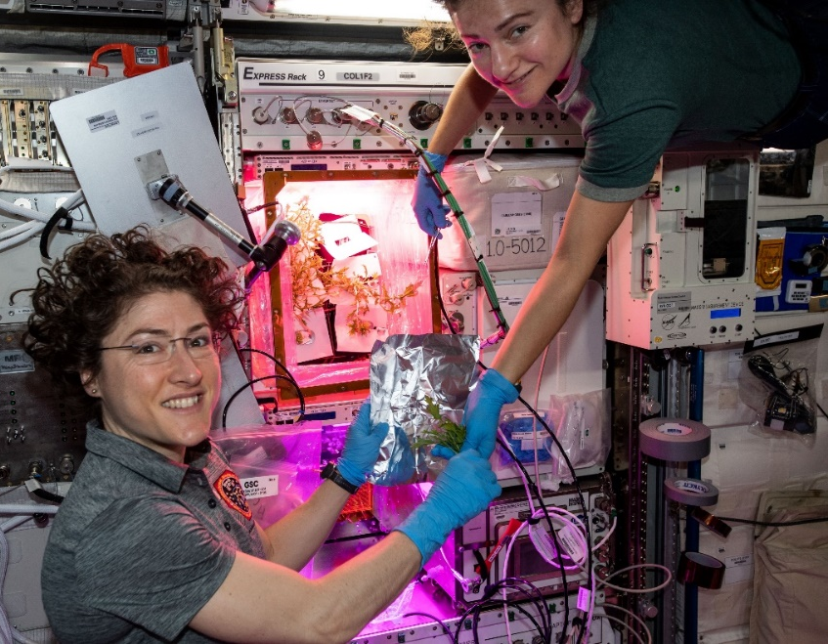
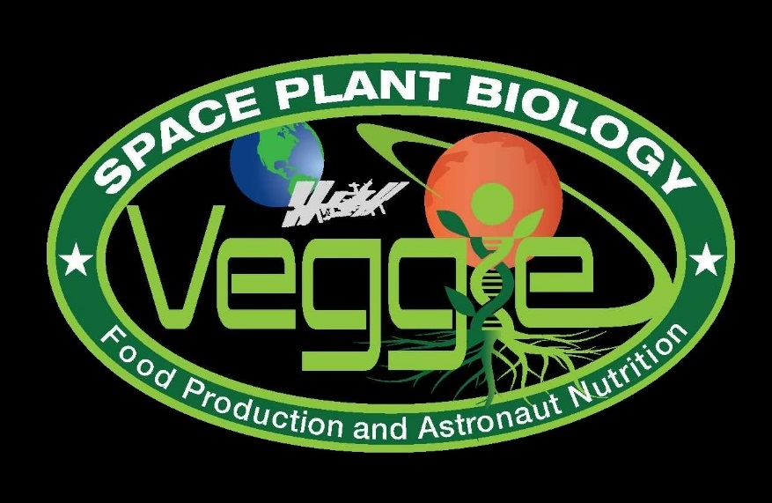
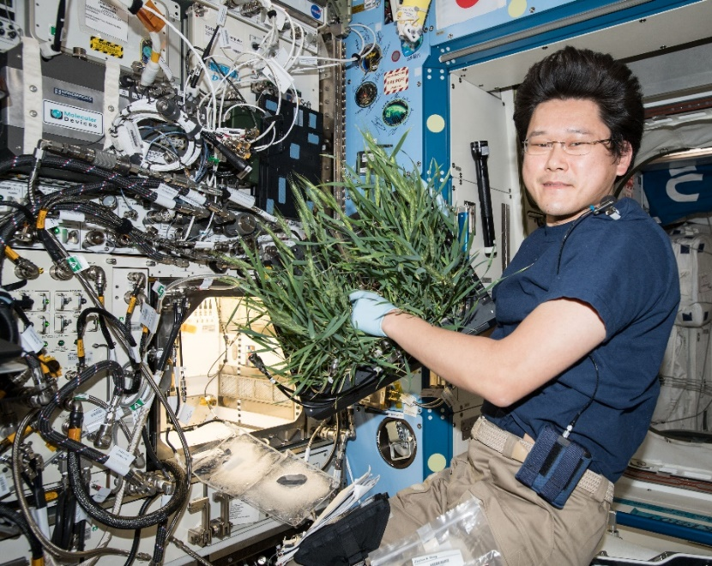
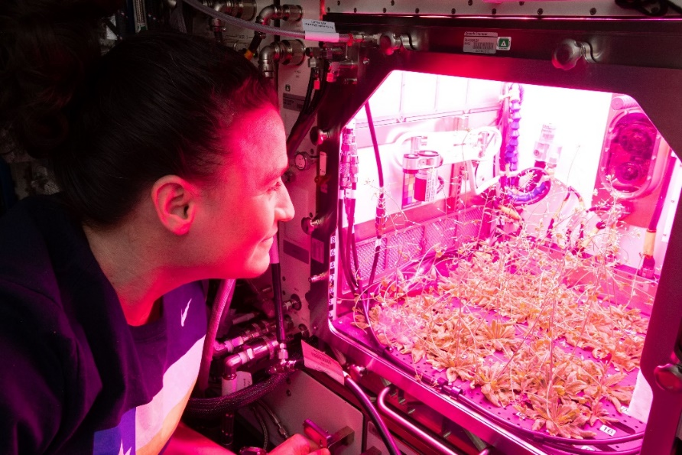

Current NASA Large Plant Research Capabilities On ISS
Notes:
Veggie and the Advanced Plant Habitat

Slide 18
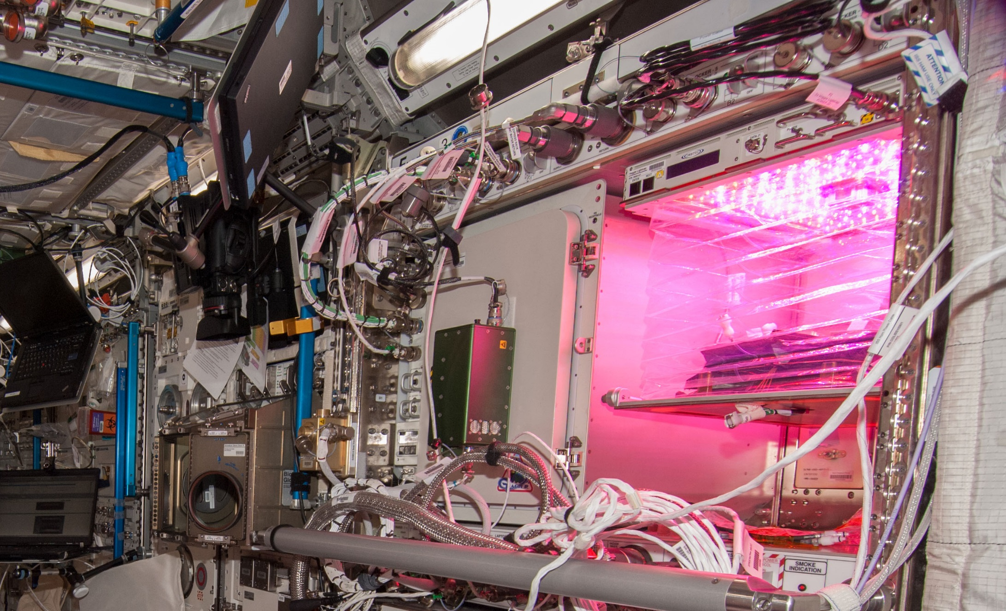
Veggie on ISS

Slide 19
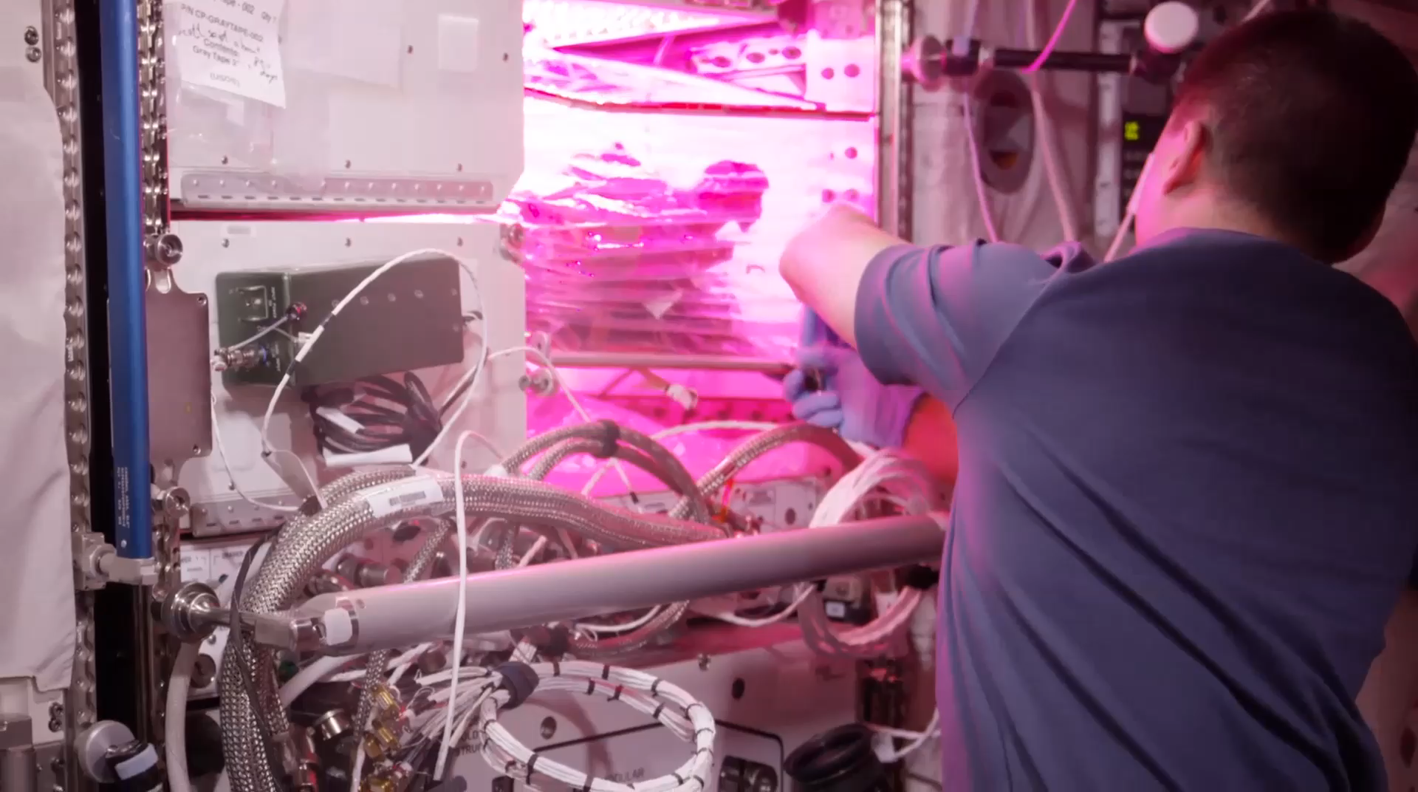
VEG-01B Harvest (August 2015)
Notes:
Veg-01 second crop, first consumption

Slide 20
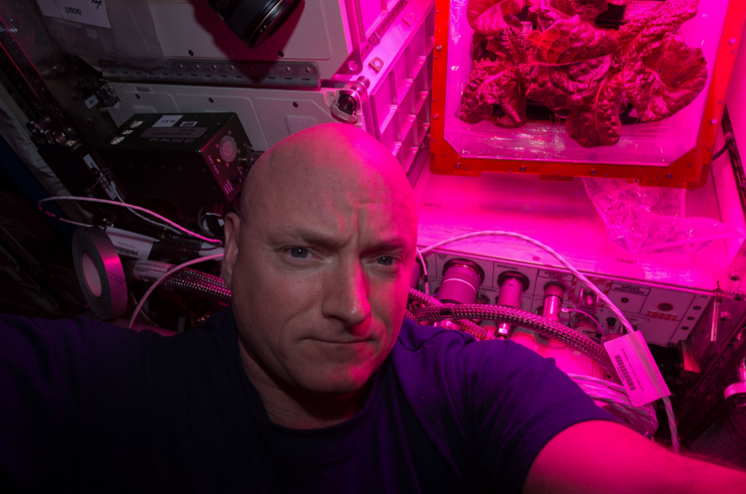
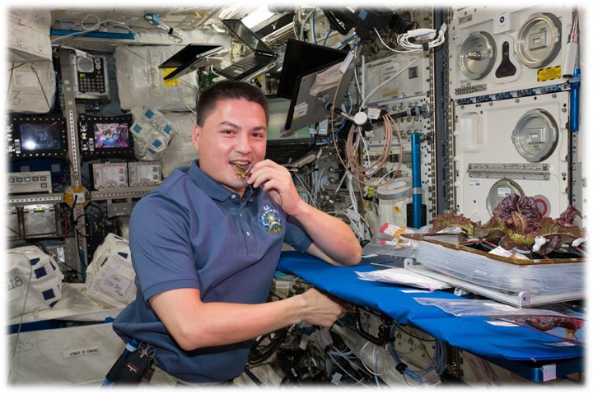
Astronaut Comments
Scott Kelly
  the logistical complexity of having people live and work in space for long periods
  the supply chain that is required
  For Mars, need a space craft that is more self-sustainable with regards to its food supply
Kjell Lindgren
  benefit of eating the fresh food
  contribution that plants have to the ISS ecosystem
  psychological benefit - it’s really fun to see green growing things in the sterile environment of the ISS

Slide 21
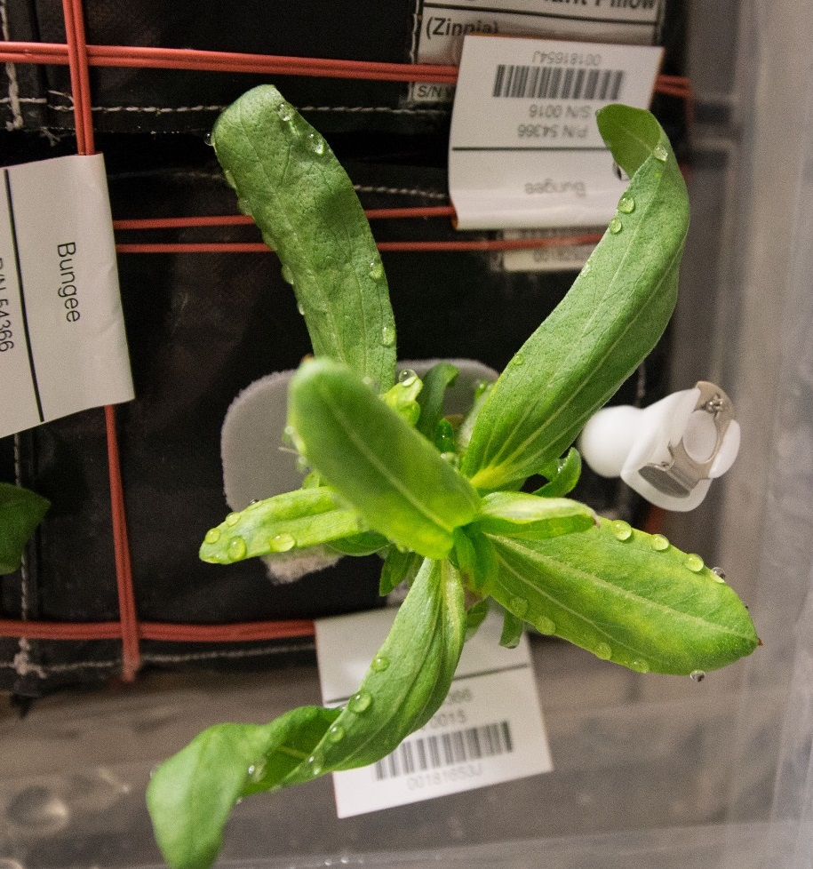
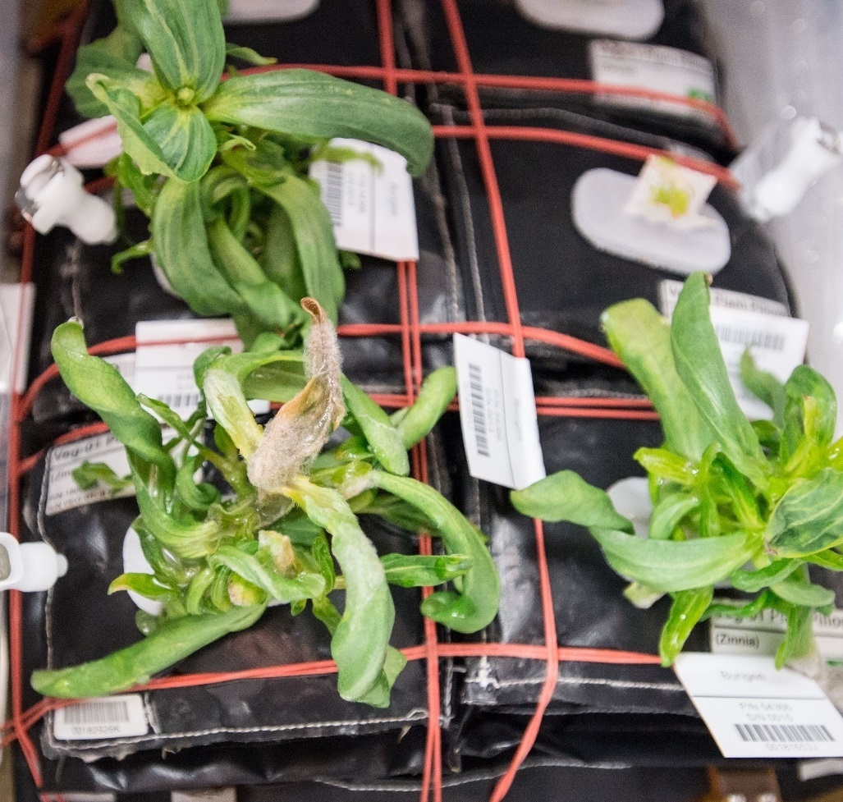
Ventilation and Water Issues & Consequences in Zinnia
Guttation and Leaf Curling
Fungal Development & Abnormal Growth

Slide 22
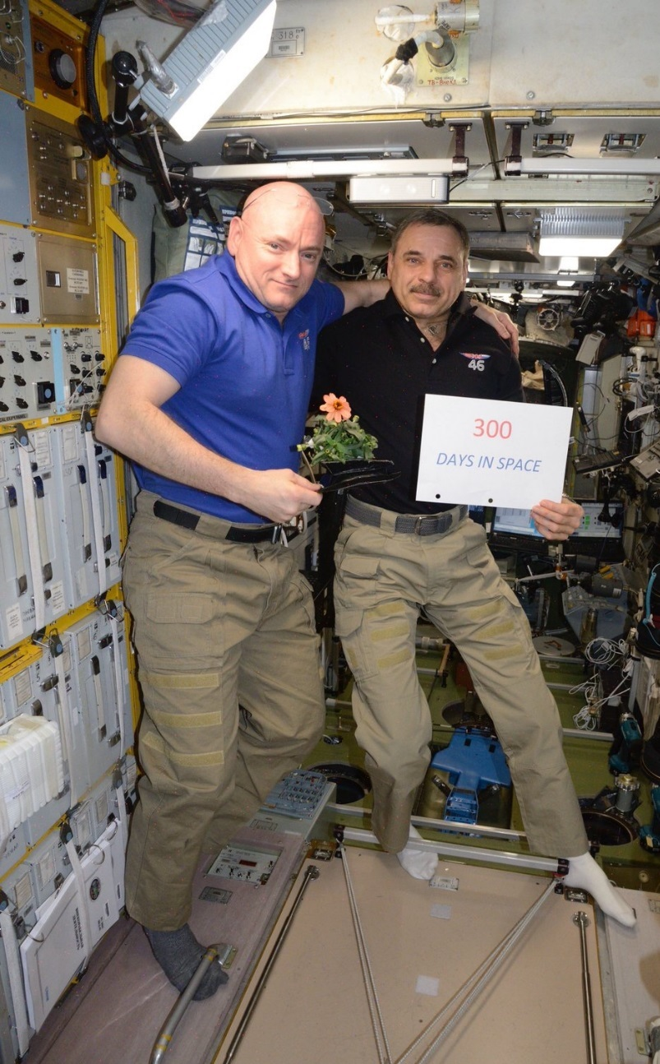
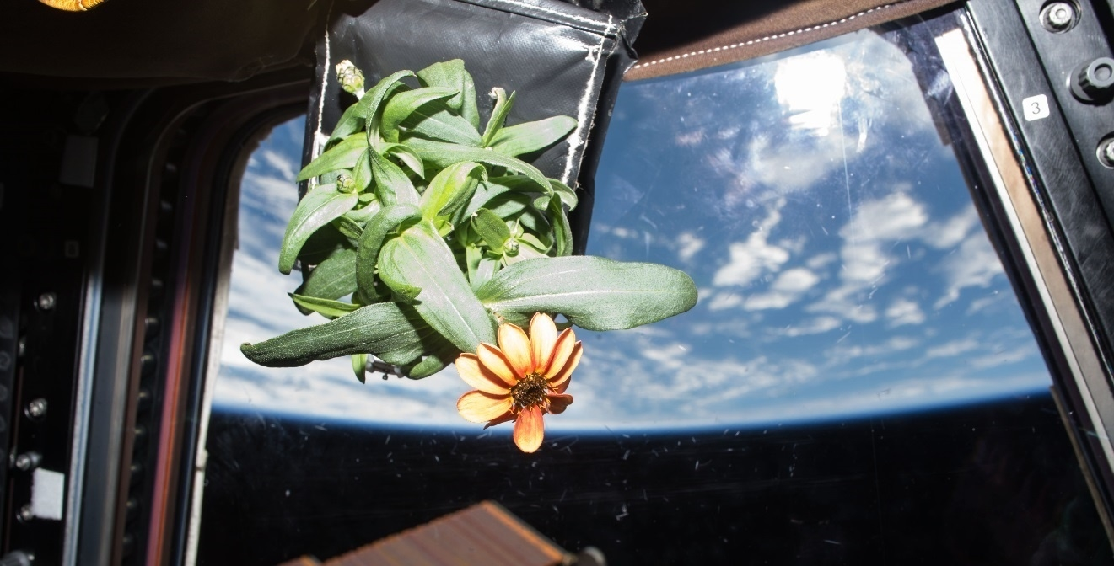
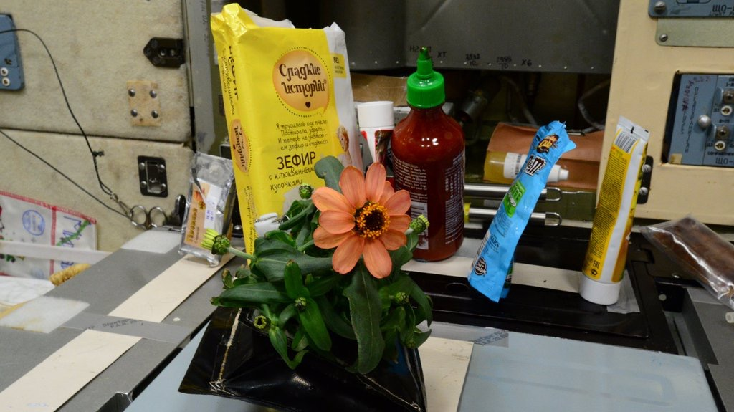
Zinnia Action Shots

Slide 23
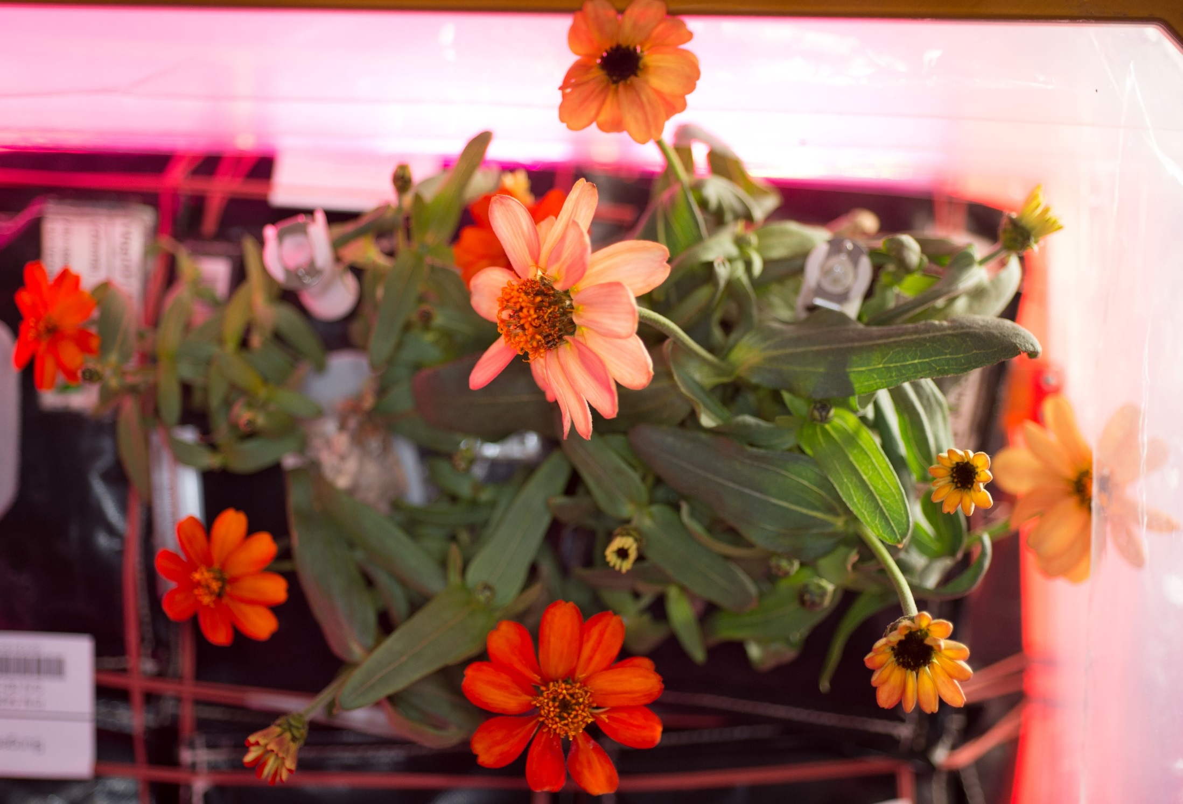
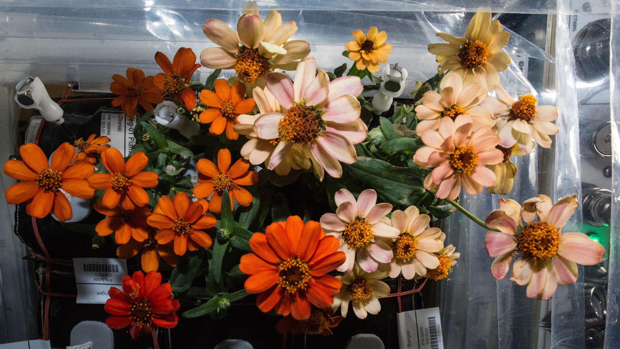
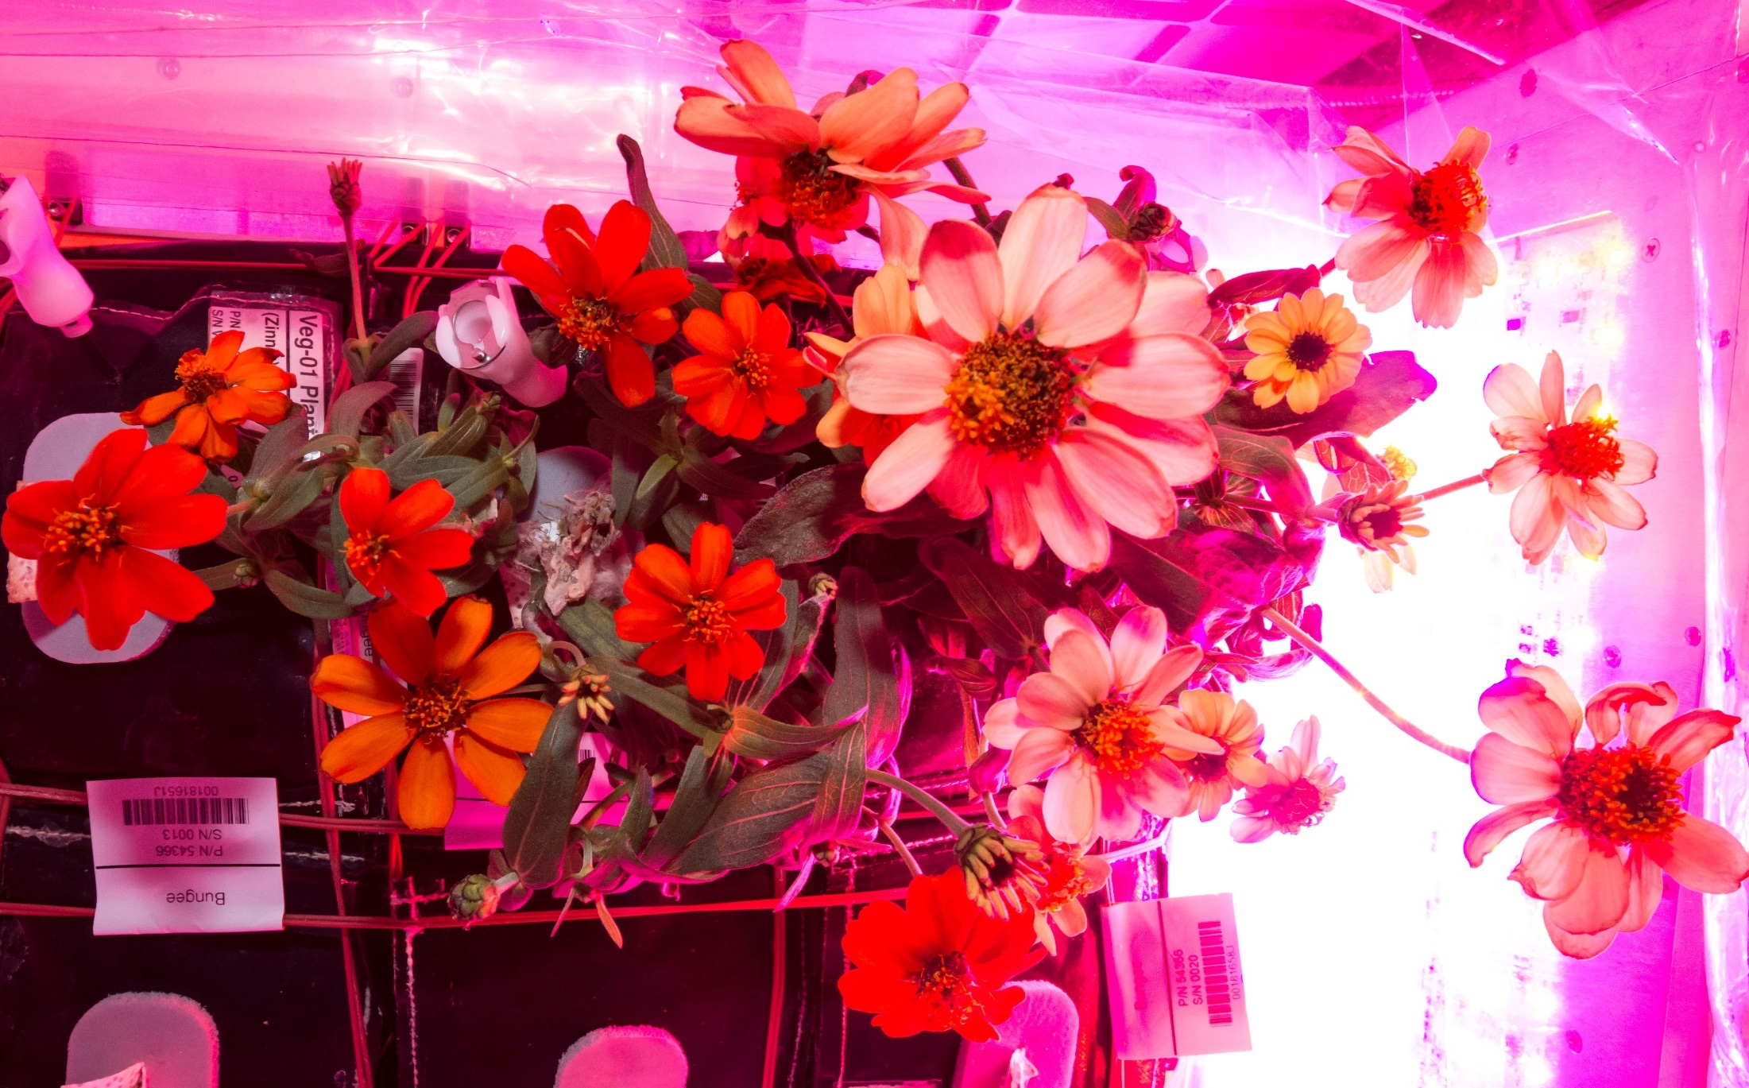
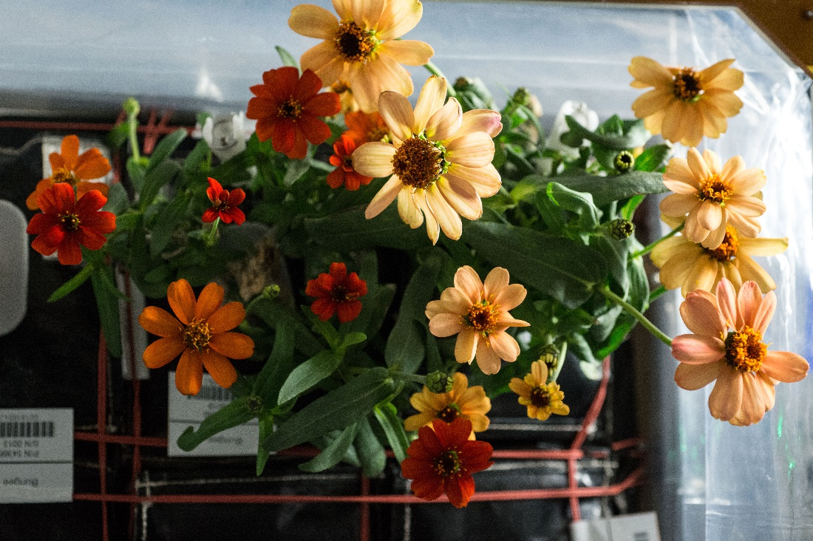
And they bloomed, and bloomed...
77 DAI
80 DAI
71 DAI
87 DAI

Slide 24
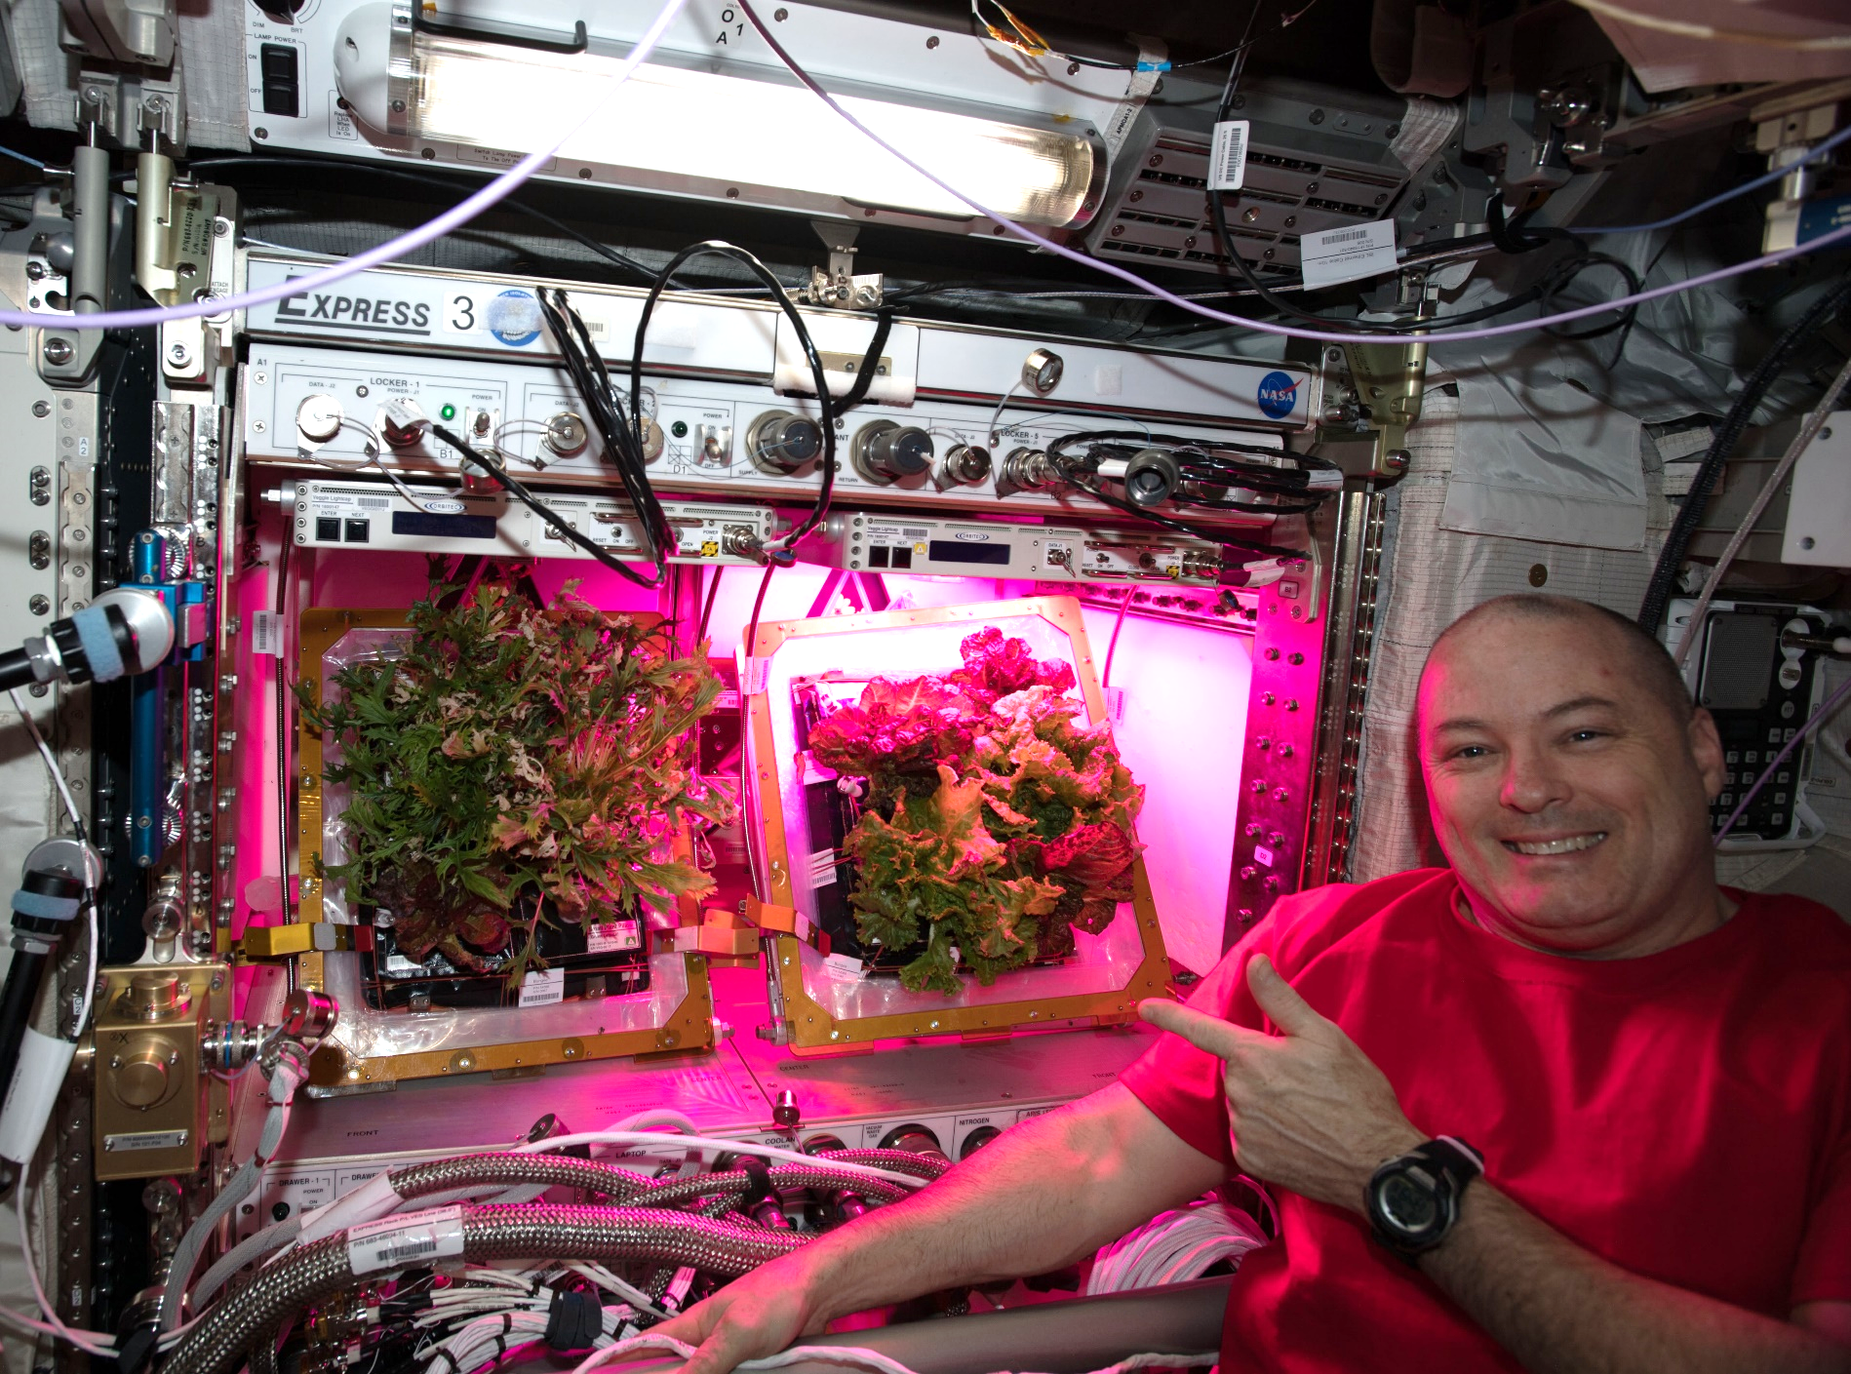
A Tale of Two Veggies

Slide 25
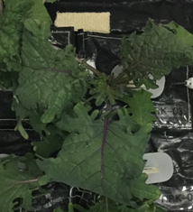
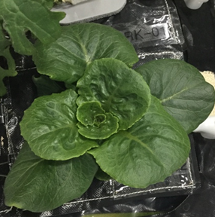
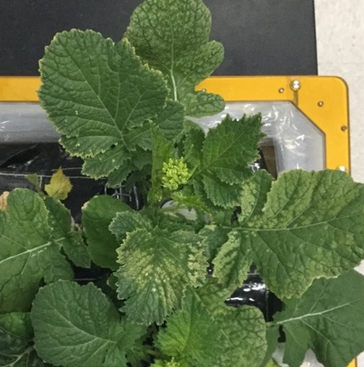


VEG-03 Crop Testing
Red Russian Kale
*Dragoon Lettuce
Wasabi Mustard
*Extra Dwarf Pak Choy
Amara Mustard
*= Student Selected Crops!

Slide 26


VEG-04
Research to study the impacts of Red: Blue: Green light ratios on Mizuna crop growth, nutrient composition, organoleptic appeal and microbial food safety with additional assessments of crew behavioral health.
Collaboration between KSC, JSC, Purdue University and Sierra Space

Slide 27



VEG-04 Crew Engagement

Slide 28


Plant Aromas Also Enhance Astronaut Experiences

Slide 29


Recent ISS Crop Research
Transplanting 10 Days after initiation
Original
Transplant
Harvest at 29 days
Successful transplanting of ‘Extra Dwarf’ Pak Choi in VEG-03 I

Slide 30


Recent ISS Crop Research
Seed Film technology tested successfully in VEG-03 J

Slide 31


APH Crop Research
PH-02 Radish Experiment
PI Karl Hasenstein – University of Louisiana, Lafayette

Slide 32




Space Chile!
Española Improved Hatch Chile Peppers in APH
PH-04 mission July – Nov. 2021
Red or Green?

Slide 33

Space Chile!

Slide 34

Next up – dwarf tomato for VEG-05!

Slide 35

Thank you!
Veggie, APH, and Space Crop Production teams
NASA’s astronauts
NASA’s Space Biology Program, ISS Program, Human Research Program

Slide 36
Backup

Slide 37

Selection Factors for Space Plants
Targeted breeding areas could fall into several categories:
Plant Growth and Development
Plant Physiology
Produce Nutrition
Produce Organoleptic Acceptability
Postharvest

Slide 38

Plant Growth and Development
Compact size (low height and volume)
High yield
High edible/inedible biomass ratio (harvest index)
Reliable germination
Rapid growth to first yield
Uniform growth and development between individuals
Propagules with long shelf stability (seeds, cuttings)
Sustained production capability over long duration (e.g. repetitive fruiting, or cut-and-recut leafy production)
Low debris formation (leaves, flowers, pollen, seeds, etc., remain attached)
Custom microbiome of plant protective and growth promoting microorganisms

Slide 39
Plant Physiology
Stress tolerance (esp. water stress)
Ability to grow well under conditions of:
  Elevated CO₂
  Low relative humidity
  Uniform temperature of 20-23°C
  Narrow spectrum electric lights
  Short photoperiods (to save lighting energy) or long/continuous photoperiods (to speed growth)
  Tolerance of broad environment range
  Tolerance of reduce pressure
No dormancy requirements
Low or pleasing aroma
Low release of volatile organics
High sodium tolerance (e.g. urine recycling)
Preference for ammonia nitrogen sources (e.g. urine recycling)

Slide 40

Produce Nutrition
High normal levels of antioxidants
High normal levels of beneficial phytonutrients (e.g. lutein, zeaxanthin, lycopene, phenolics, anthocyanins)
For fresh produce to supplement a packaged diet:
  High normal levels of Potassium and Magnesium
  Low normal levels of Iron
  High normal levels of Vitamins, especially C, B₁, and K
Low levels of antinutrients

Slide 41

Produce Organoleptic Acceptability
Postharvest
Excellent flavor
Intense flavors
Good texture
Good appearance, color, aroma
Good produce shelf life or storage on the plant
Reduced processing (e.g. seeds easy to remove from seed coats)
Easy composting/digestion of inedible plant material for nutrient reclamation (and possibly less structure in micro/partial g)
Use of waste as resources for other food system components (e.g. fish, edible fungus, cellular ag feedstocks)
Other useful materials produced from waste (e.g. life support, shielding, building, fuel, medicinal compounds)

