Slide 1
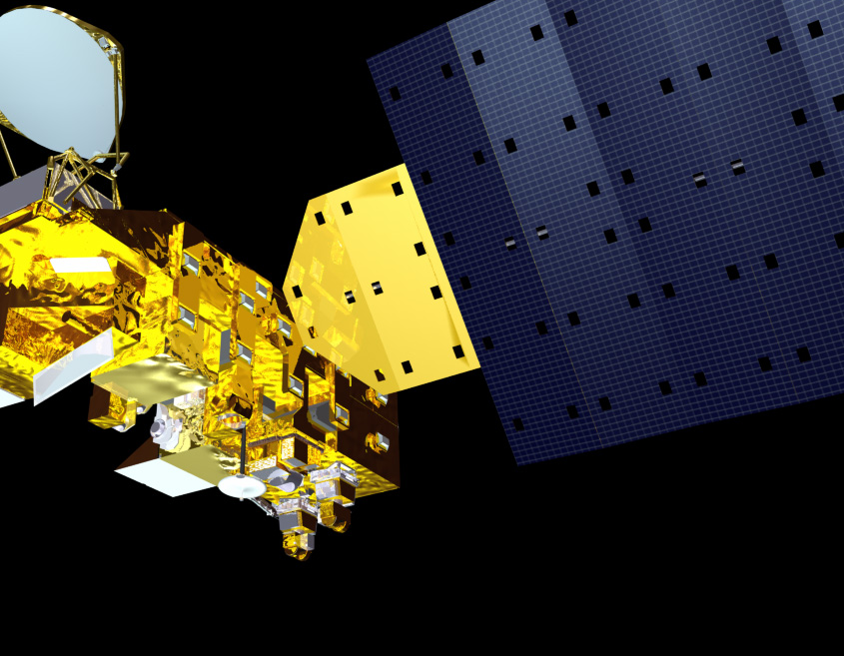
CERES Data Management Team Working group report
CERES Spring Science Team Meeting
Kathleen Dejwakh
April 26, 2022

Slide 2
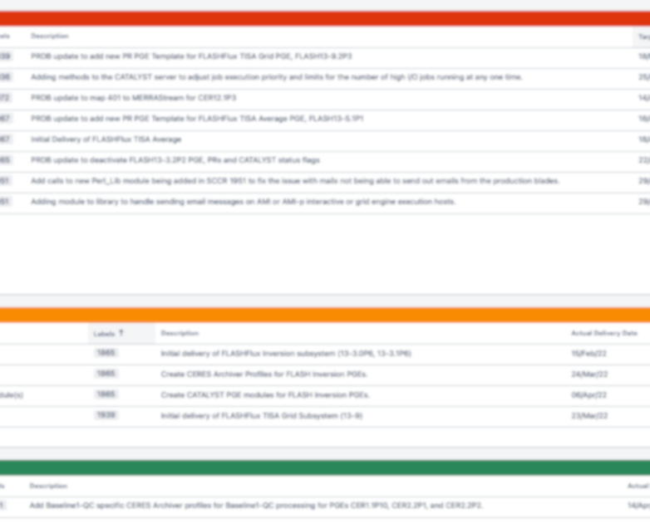
Outline
Team
Highlights
Code Re-architecture
Systems

Slide 3
Data Management Team
Dale Walikainen
Jeremie Lande
Tom Caldwell
Sunny Sun-Mack
Ricky Brown
Steve Kohler
Yan Chen
Elizabeth Heckert
Rita Smith
Walt Miller
SSAI Management:
Walter Miller
Susan Thomas
Victor Sothcott
Igor Antropov
Josh Wilkins
Cathy Nguyen
Ed Kizer
Beau Branch
Denise Cooper
Thomas Grepiotis
Hunter Winecoff
Dianne Snyder
Dale Walikainen
PC Sawaengphokhai
Jay Garg
Hunter Winecoff
Nelson Hillyer
Tammy Ayers
Dennis Keyes
Carla Grune
Liz Heckert

Slide 4
HIGHLIGHTS
Team Activities & Code Deliveries

Slide 5
Ed1B NOAA-20
&
Ed2A S-NPP
Data products released April 1, 2022
Notes:
Production started in late Summer/early Fall 2021:
NPP Clouds in late August; Inversion in late September.
NOAA-20 Clouds in late Sep and Inversion in late October.

Slide 6
Deliveries
Code supporting finalization of new editions:
  Ed2A S-NPP
  Ed1B NOAA-20
CATALYST server automatic restart
Prompt PHP security upgrades
  CERES PR Tool
  CERES Website
Application of Deep Blue aerosols over land to SSFs (except NOAA-20)
Notes:
No more CLASS Snow & Ice EDR dataset due to DMSP-15 failure

Slide 7
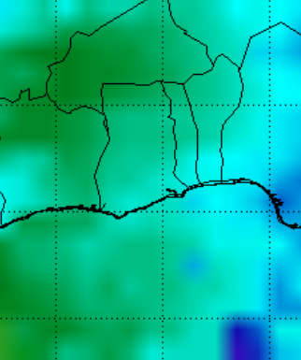

Snow & ice data loss mitigation:
  557th Weather Wing – supplementary data
  “ice age” value and snow & ice map
Production support for upcoming
EBAF 4.2 Surface
Daily albedo coverage fix for FluxByCldTyp

Slide 8
Deliveries
Incorporation of MERRA2 and GEOS-IT capabilities into MOA
Current and backwards compatibility with new ASDC ingest system, Dark Horse
PIV-M compatibility
FLASHFlux:
  3 out of 8 PGEs delivered
  MOA, Clouds and Inversion now in production

Slide 9
Ed 4 Product Availability
Product | Platform | Processed Thru | Publicly Available?
BDS | Terra, Aqua | Jan. ‘22 | Yes
SSF
SSF1deg-Hour
SSF1deg-Day/-Month
SYN1deg-1Hour/MHour | Terra+Aqua | Jan. ‘22
SYN1deg-Day/-Month

Slide 10
Ed 4 Product Availability
Product | Platform | Processed Thru | Publicly Available?
CldTypHist | Terra+Aqua | Dec. ‘21 | Yes
FluxByCldTyp |  | July ‘21
EBAF |  | Nov. ‘21
EBAF ToA |  | Jan. ‘22

Slide 11
S-NPP Product Availability
Edition | Product | Platform | Processed Thru | Publicly Available?
Ed2A | BDS | S-NPP | Jan. ‘22 | Yes
 | SSF
 | SSF1deg-Hour |  | Feb. ’19*
 | SSF1deg-Day/-Month
Ed1A | SYN1deg-Hour/MHour | Terra+S-NPP | Nov. ’17*
 | SYN1deg-Day/-Month
* L3 processing stopped. Instrument in RAPS mode.

Slide 12
Ed 1B NOAA-20 Product Availability
Product | Platform | Processed Thru | Publicly Available?
BDS | NOAA-20 | Jan. ‘22 | Yes
SSF
SSF1deg-Hour
SSF1deg-Day/-Month

Slide 13
Libera Data Mgmt Working Group
Ad hoc meetings
Libera team presented high-level plan for
  Science Data Center design
  Science Processing Plan
Working Libera-RBSP ICD soon
Notes:
VIIRS code takes longer

Slide 14
CODE RE-ARCHITECTURE
TISA & Clouds

Slide 15
TISA Code re-architecture
Code
re-architecture
Object-Oriented-"like” Interpolation & Averaging
Fortran
Object-Oriented Gridding
C++
Gridding containers, zones, regions
Property containers
JSON property configuration files

Slide 16
TISA Code re-architecture
Modularity
Readability
More commenting
Using variables instead of magic numbers

Slide 17
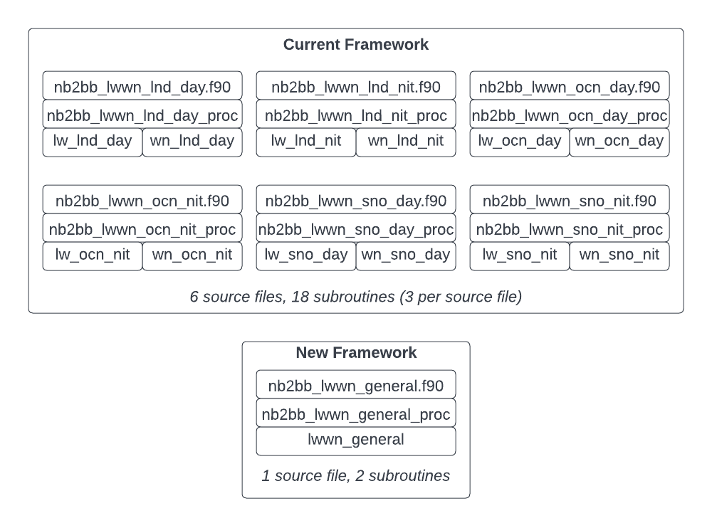
TISA Code re-architecture
X
X
X

Slide 18
TISA Code re-architecture
Software Lines of Code
Original Code |  | Refactored Code
nb2bb_lwwn_lnd_day | 255 | nb2bb_lwwn_general | 156
nb2bb_lwwn_lnd_nit | 253
nb2bb_lwwn_ocn_day | 258
nb2bb_lwwn_ocn_nit | 255
nb2bb_lwwn_sno_day | 256
nb2bb_lwwn_sno_nit | 245
Total | 1522
 | Difference: 1366 lines | Difference
90% code reduction!

Slide 19
TISA Code re-architecture
Binning for look-up tables re-designed:
  netCDF4
  Boundaries and centers stored
  Weighting separate from indexing, genericized functions
Significant “magic number” removal

Slide 20
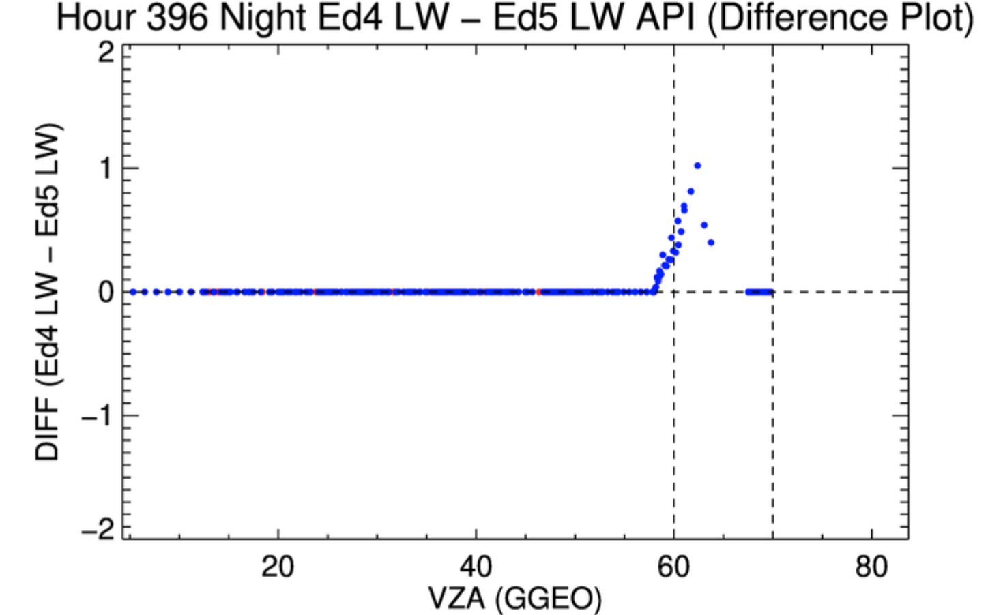
TISA Code re-architecture
No edge case interpolation:

Slide 21
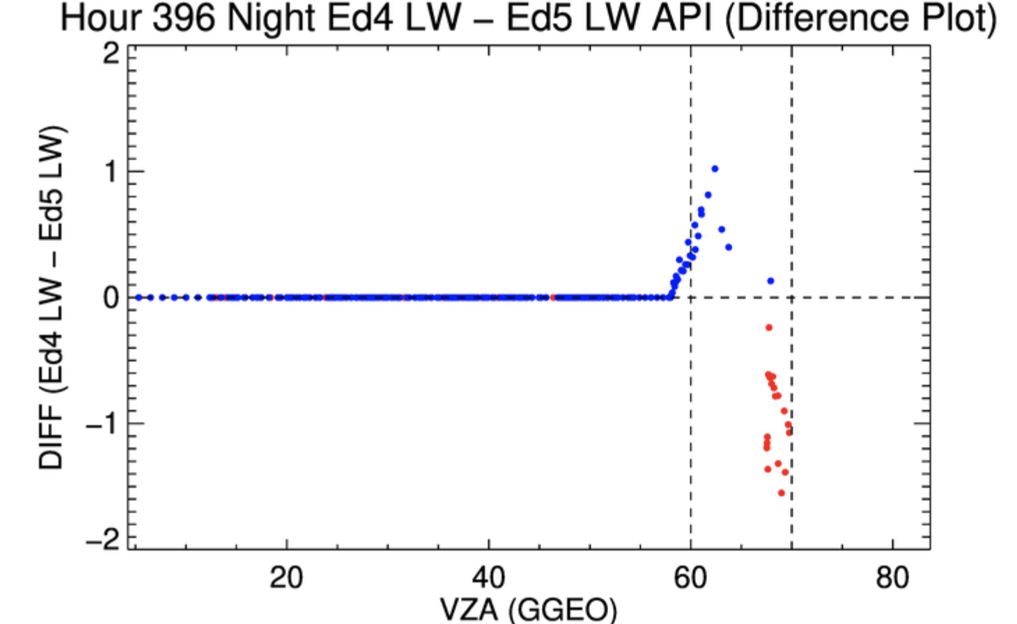
TISA Code re-architecture
Edge case interpolation:

Slide 22
Clouds code re-architecture
cloud mask code refactoring

Slide 23
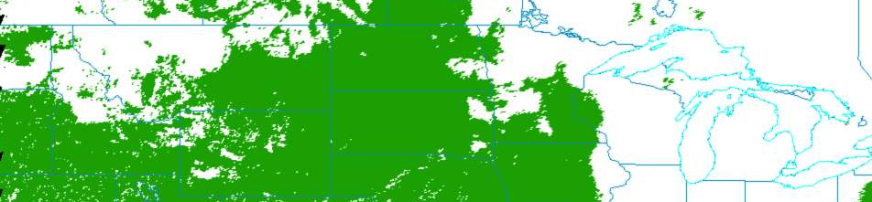
Clouds Code re-architecture
Focus on CERESmask – cloud mask
Powerful code, conditional statements
  cloud, no cloud
  other classification types

Slide 24
Clouds Code re-architecture
Maintainability challenges:
  7,121 lines of code
  Direct memory access
  Inputs generated within codebase
New features with refactoring:
  Object-oriented programming
    Parent/child inheritance of methods
    Less code duplication
    Enables unit testing
  Configuration files – easier to tune repeated values, don’t touch source code

Slide 25
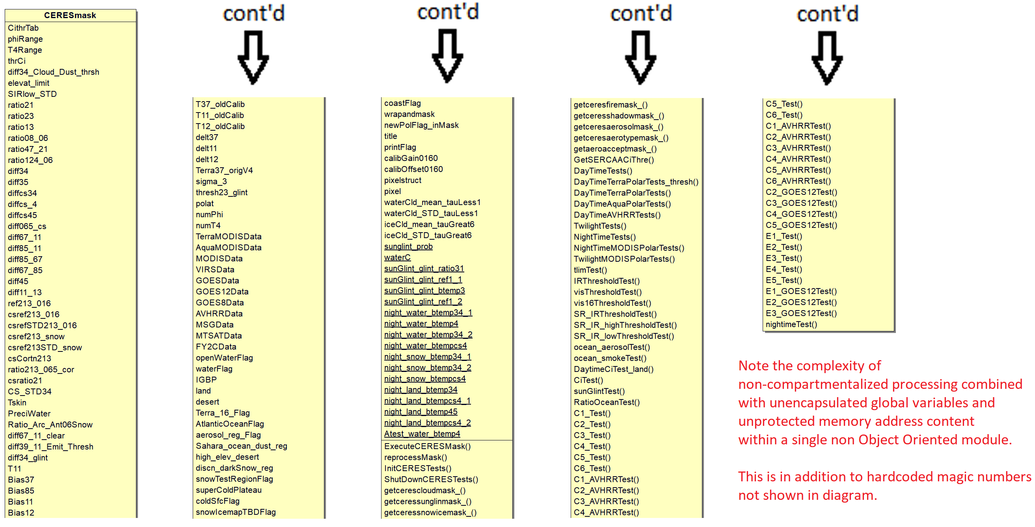
Clouds Code re-architecture
Current listing of variables and functions

Slide 26
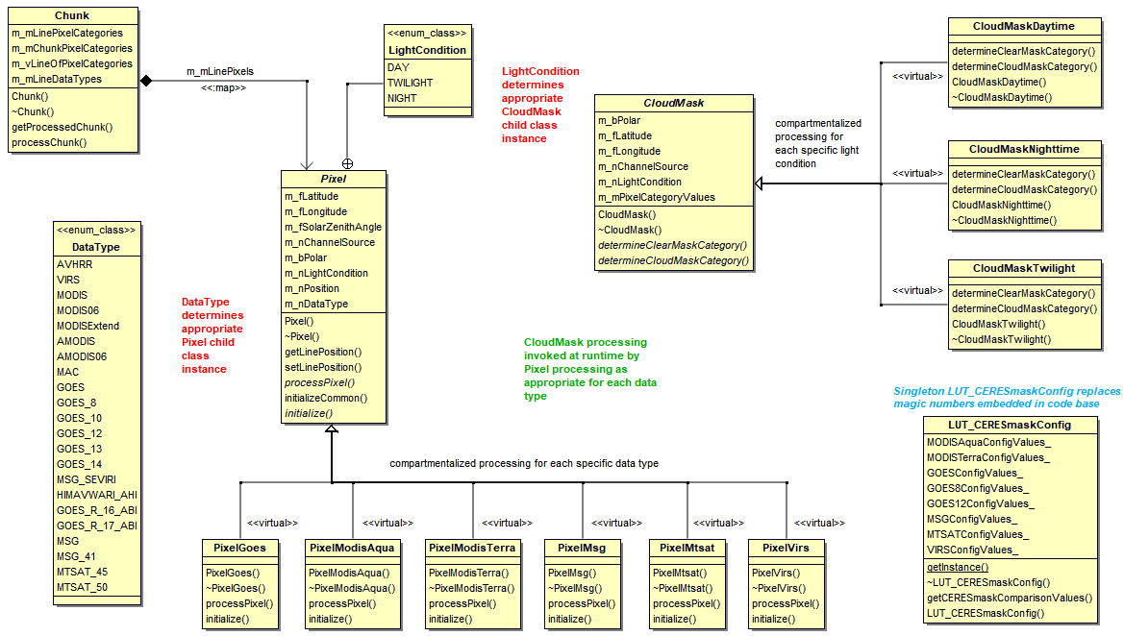
Class structure – refactored mask code

Slide 27
Clouds code re-architecture
Serverless architecture experiment

Slide 28
Clouds Code re-architecture
Goal: Run CURRENT CERES Clouds code in AWS
Motivations:
  Refactoring (new code) – long timeline
  1 week of processing / 1 year of data
  Currently working CERES Edition 5 development – iterate
Build capacity on CERES for running
  In Docker
  On AWS
  With “serverless” architecture – lambdas
Notes:
VIIRS code takes longer

Slide 29
AWS lambda: compute service to run code WITHOUT provisioning or managing servers
lean
ephemeral
docs.aws.amazon.com
scalable
Notes:
Modular, clearly delineated inputs and outputs

Slide 30
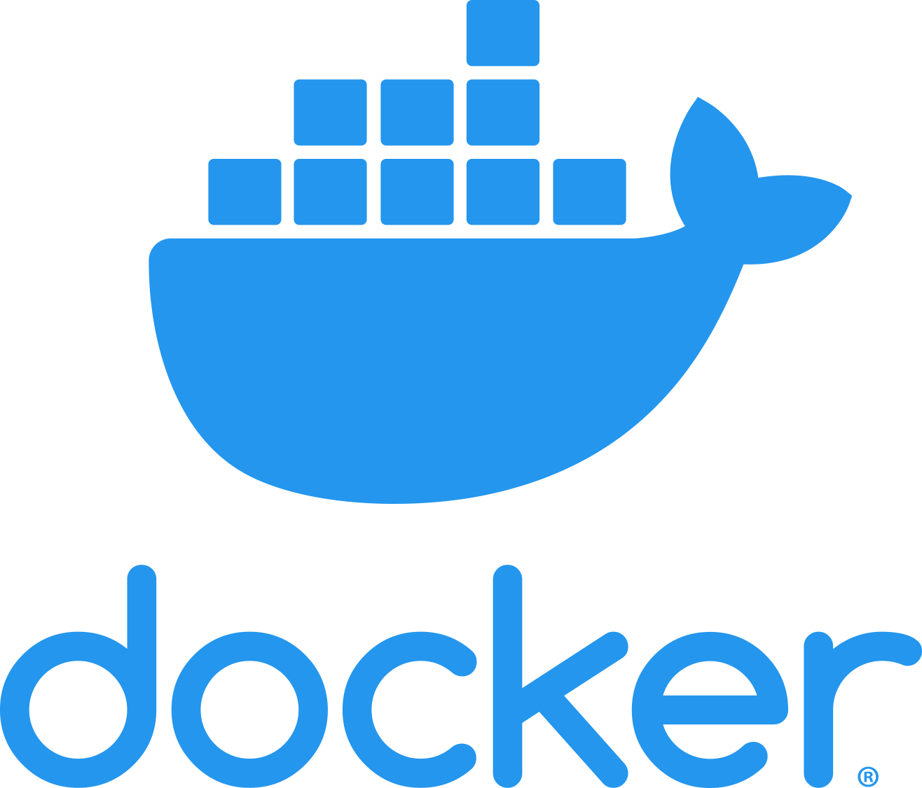
Clouds Code re-architecture
Previous work: “Dockerization”
Docker images for 2 product generation executables (PGEs):
  Clouds main – “1P6”
  Clouds clear radiance history (CRH) – “2P5”
Enabled:
  Building Clouds binaries
  Executing Terra/Aqua test plans
  System agnostic
Code
Libraries

Slide 31
Clouds Code re-architecture
Current work: Build and run Clouds docker images in AWS
Docker images for 2 product generation executables (PGEs):
  Clouds main
  Clouds clear radiance history (CRH)
Git “hook” (pushing code to CodeBuild) triggers build:
    Builds binaries
    Kick off unit tests – failed tests cause code rejection
    Creates and stores Docker images in AWS:
    → launching and running as lambda function
Code
Libraries
Notes:
Ask about Docker for launching lambda vs. lambda being updated with updated Docker images

Slide 32
Clouds Code re-architecture
Developer Workstation
CodeBuild Instance
Compute Environment
Pull Source Code
Build Step
AWS Service
CodeCommit
CodeBuild
Build Executables
Build Docker Images
Deploy Docker Images
Elastic Container Registry
Update Lambdas
Lambda Functions
Notes:
Ask about Docker for launching lambda vs. lambda being updated with updated Docker images

Slide 33
Clouds Code re-architecture
Current design:
  Employ lambda functions for creating PCFs and running PGEs
  Functional: launch-lambda for one PGE: 1P6
  (can also launch via command line)
  STDOUT text going to CloudWatch log streams
  Output data stored in S3 or EFS
Notes:
*retrieval and footprint are actually separated

Slide 34
Clouds Code re-architecture
Simple Storage Service
Elastic Filesystem
1P6 Hourly Retrieval Instance
1P6 Hourly Footprint Instance
1P6 Hourly Retrieval Instance
1P6 Hourly Footprint Instance
Command with run parameters
Launch 1P6
1P6 Hourly Retrieval Instance
1P6 Hourly Footprint Instance
Launch 2P5...
1P6 Hourly Retrieval Instance
1P6 Hourly Footprint Instance
Lambda Instance
Data Storage Service
1P6 Hourly Retrieval Instance
1P6 Hourly Footprint Instance
Notes:
EFS = Elastic File System
Command with run parameters = 48 1P6 hourly instances specified by JSON file config. etc.

Slide 35
Clouds Code re-architecture
Serverless Architecture
Advantages
Caveats
No infrastructure maintenance
Pricing based on compute time
Encourages modular architecture
Automated build/test/deploy
1P6 and 2P5 instances can run in parallel - 1,000 simultaneous lambdas!
Increased vendor lock-in – AWS-specific
Steeper learning curve
Not viable for every computing scenario
15 min. maximum runtime
10 GB memory/512 MB local storage limit
Filesystem read-only (other than /tmp directory)
Notes:
EFS = Elastic File System

Slide 36
SYSTEMS
Ordering Tool & Hardware

Slide 37
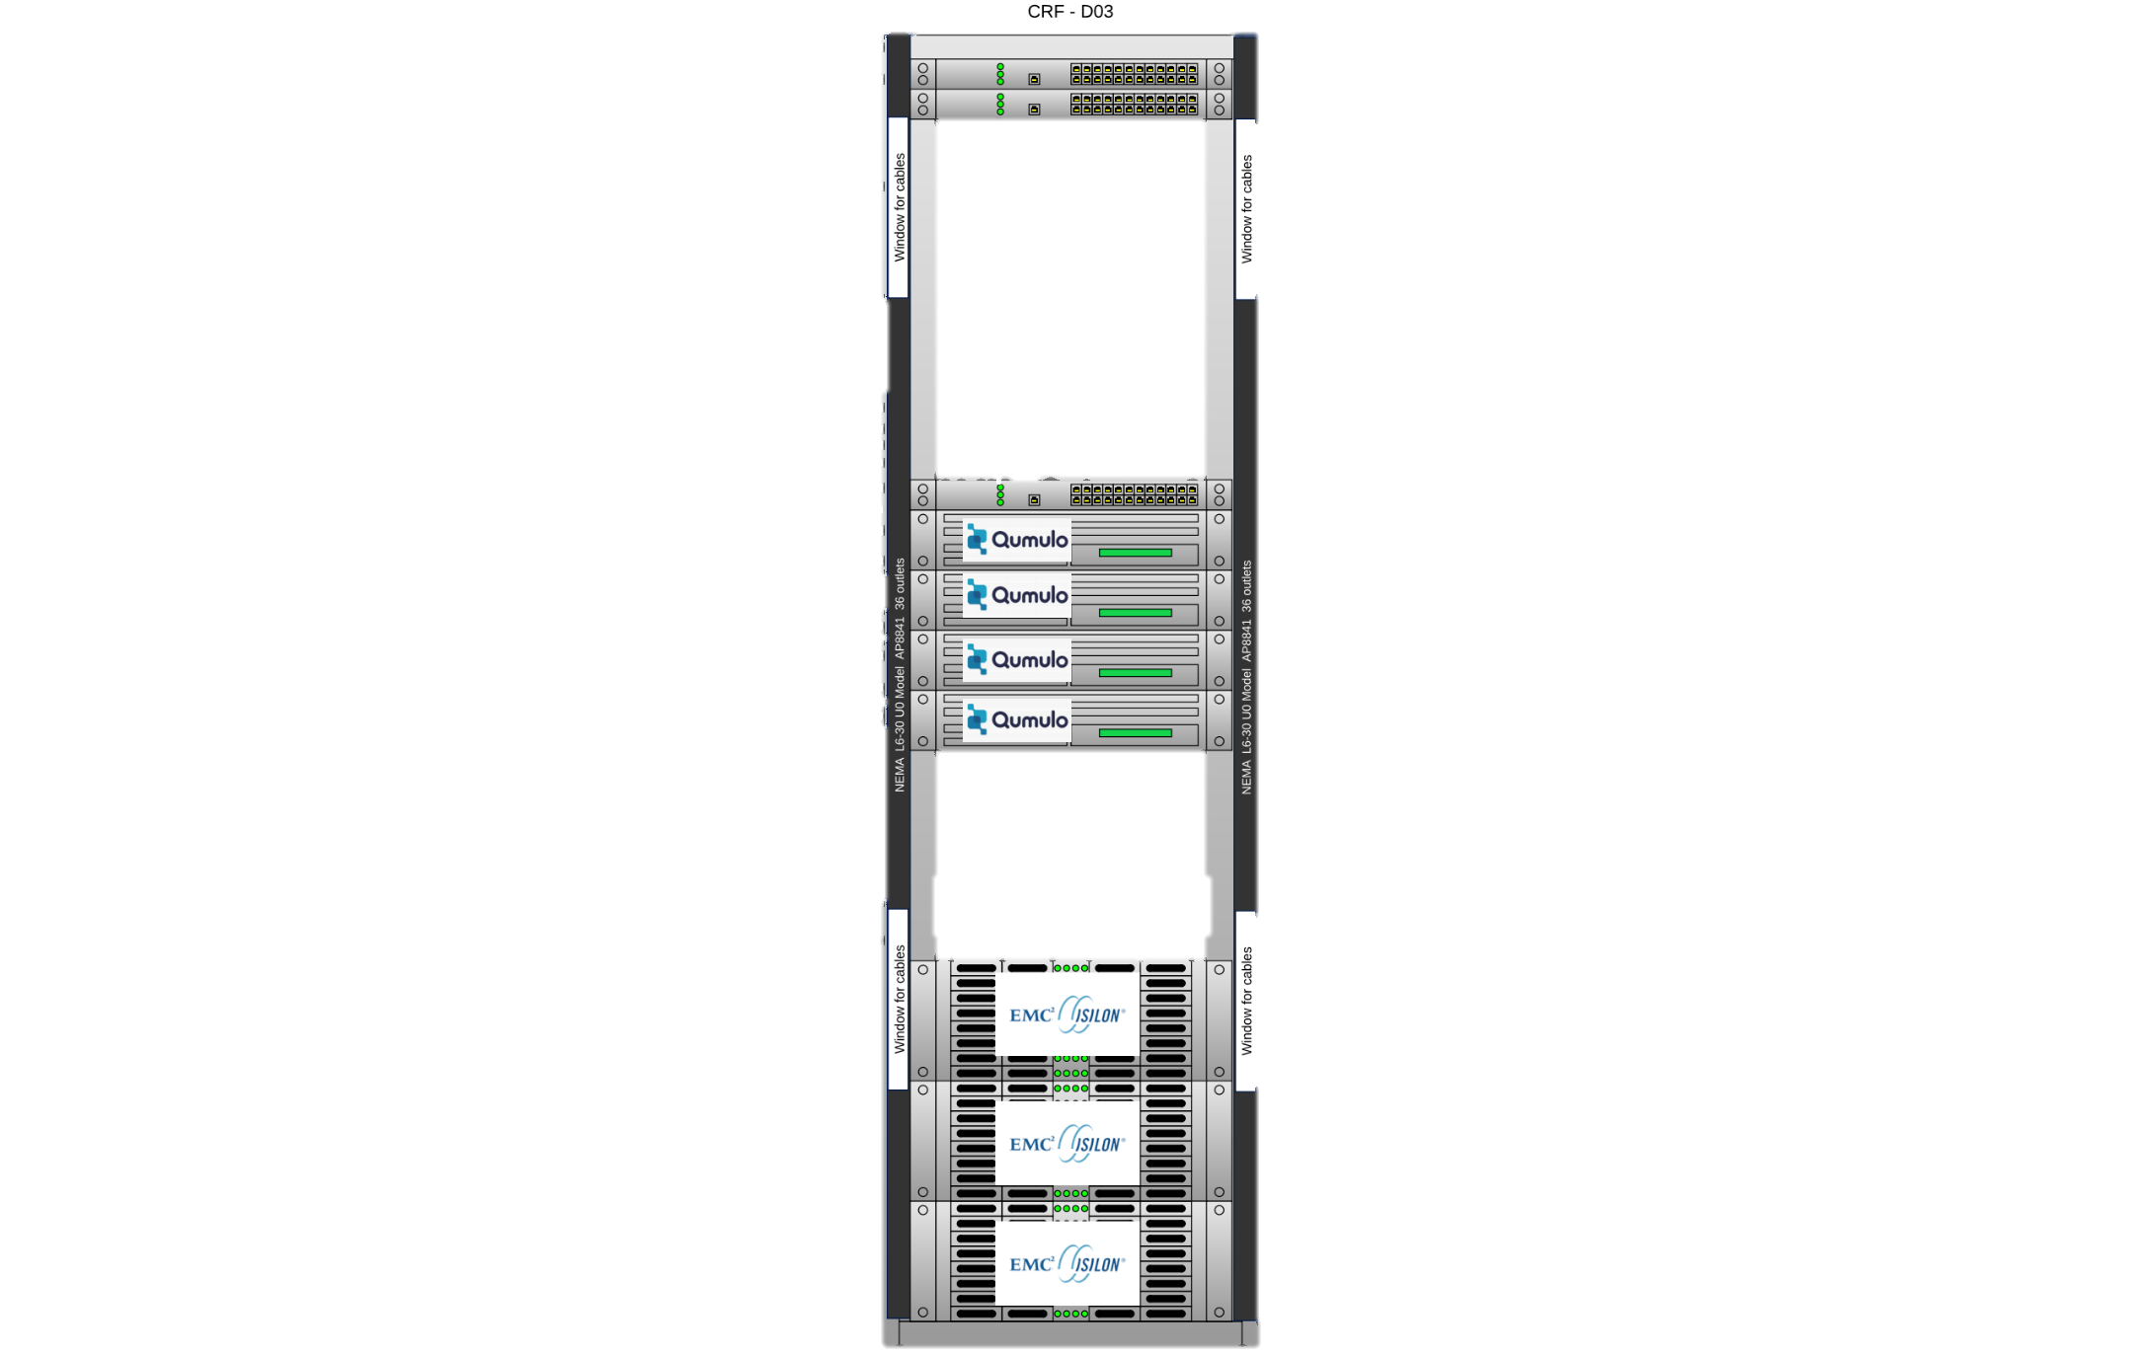
HARDWARE
First HPE w/ Qumulo purchase
  5 nodes in 2020
  1 PB usable space
Second HPE w/ Qumulo purchase
  5 nodes in late Summer 2021
  1 PB usable space
Additional 2 node purchase
  Allows more usable space
  Restriping
Updated total usable space:
~3.2 PB

Slide 38
CERES Ordering tool
Pamela Mlynczak
Churngwei Chu
Babak Samani
Develops and maintains custom, CERES
visualization subsetting and ordering tool
Internal and public versions
Public ordering tool on virtualized hardware

Slide 39
CERES Ordering tool
Converting
QA tool to virtual machines
NOV 2021
Successfully tested subsetting in new physical location - Computational Research Facility (CRF)
DEC 2021
Released new version of CCCM (D1)
Transitioned to PIV-M authentication
APR 2022
Released NOAA-20 Ed1B and NPP Ed2A for ordering and subsetting
UP NEXT
FEB 2022
Quickly mitigated log4j vulnerability

Slide 40
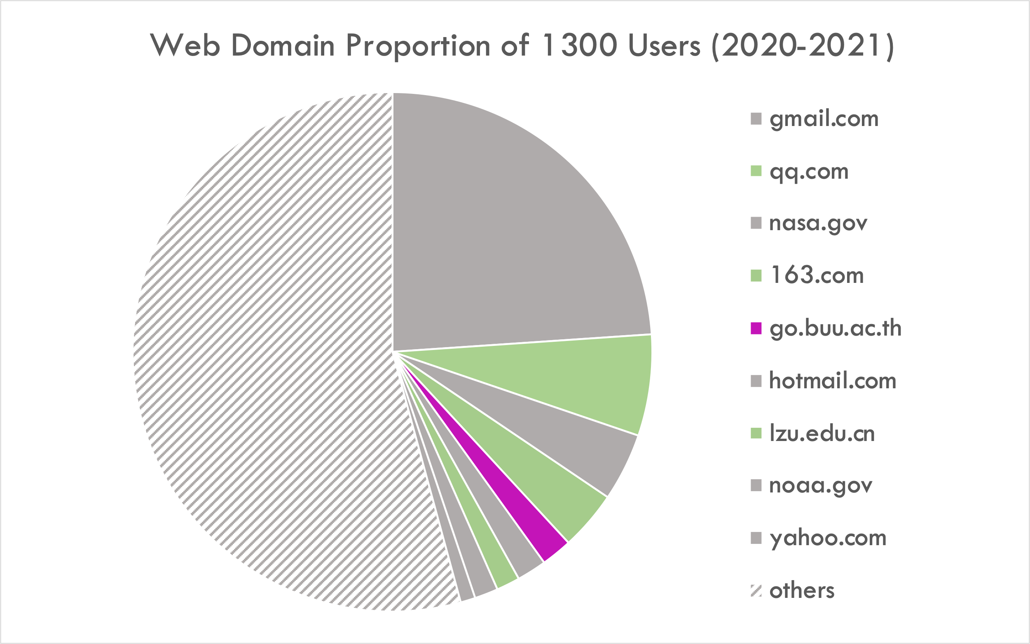
CERES Ordering tool
311
12

Slide 41
Summary
Ed1B NOAA-20 and Ed2A NPP editions released
Building capacity to run in AWS
  Facilitates Edition 5 development
  Anticipates “SIPS in the Cloud”
New hardware boosts project storage
Actively working with Libera Data
Management Working Group

