Slide 1
MOWG Missions vs TanSat
Long-Term Analysis
May 16 – May 19, 2022
Brian Woodson Jr, Pearl River Technologies
EOS FDS, gsfc-eos-fds@eoc.ecs.nasa.gov
Notes:
4

Slide 2
Agenda
Background
Predicted Passings
Semi-Major Axis (SMA) Comparison
BLJ2 Inclination Comparison for A-Train Missions
TanSat vs A-Train Missions – Orbit Frozenness
Apogee-Perigee Comparison
Synodic Period
Conclusions

Slide 3
Background
This analysis compares TanSat's orbit to the orbit of the A-Train, C-Train, and Morning Constellation Missions
  The analysis spans through January 01, 2024.
TanSat Ephemeris
  Generated by propagating state file from Mar 15 2022.
  State propagated for 3 years with November 2021 Schatten solar flux profile:
    Mean, Nominal (mean uncertainty with nominal timing for next solar maximum)
  Assumption of no maneuvers
MOWG Missions
  Ephemerides delivered to CCS for the “2-Year ephemeris” Terra Constellation Exit Review (CER) request and analysis were used
Aqua, Aura, and Terra use most up to date EOSFDS Long Ephemerides

Slide 4
Background – A-Train Missions
Aqua Lifetime Ephemeris
  Aqua_Lifetime_Code500.ephem
    No-Burn ephem generated Mar 21 2022
    Does not include Constellation Exit Maneuvers (CEMs) or Perigee Lowering Maneuvers (PLMs)
Aura Lifetime Ephemeris
  Aura_Lifetime_Code500.ephem
    Generated after the Spring 2022 IAM series on Mar 23 2022
    Models DMUs to maintain Ground Track Error
    Does not include CEMs (currently planned for Fall 2024) or PLMs
GCOM-W1 Ephemeris
  SOEMP-MAN-LONG.GCOMW1.F20220101.000000.T20240101.FFephem
    Delivered to CCS on Feb 28 2022
OCO-2 Ephemeris
  OC2_EXTENDED_LONGPRED_EPHEM_2021_11_06_01.e
    Delivered to CCS on Nov 05 2021

Slide 5
Background – Morning Constellation
Landsat-7 Ephemeris
  L72021328LONGTERM.e
    Delivered to CCS on Nov 24 2021
Landsat-8 Ephemeris
  506_FDS_LongPredEphem_2022073120000_2024001000000_OPS.Ffephem
    Delivered to CCS on Mar 16 2022
Landsat-9 Ephemeris
  L09_OBS_FDS_LongPredEphem_2022073120000_2024148120000_2022074201500.ffephem
    Delivered to CCS on Mar 21 2022
Terra Lifetime and Decommissioning Ephemeris
  AM1_EOSEPHM7_039_2022_01.ephem
    Generated on Feb 18 2022
    Models DMUs to maintain Ground Track Error
    2 CEMs
      Fall 2022 CEMs
      Burn durations: 320 sec
    5 PLMS (not in analysis span)
      Spring 2026 PLMs
      Burn durations: 320 sec (Final PLM: 190.5 sec)

Slide 6
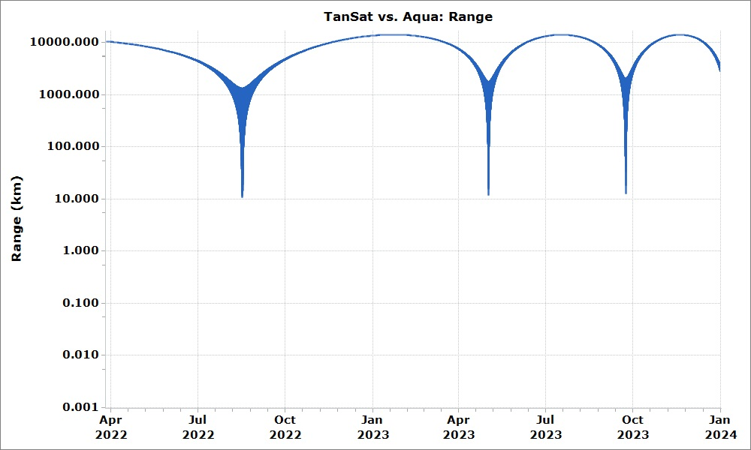
Predicted Passings – A-Train Range Plots (1/2)
Aqua has 3 predicted passings with TanSat before Jan 01 2024
The minimum range (rss position difference) is predicted to be 10.5km on Aug 16 2022
The cadence between passings is predicted to shorten as Aqua continues to drift down
  First period is 259 days with the second being 144 days
Passing dates
Aug 16 2022
May 02 2023
Sep 23 2023
*All range plots are logarithmic

Slide 7
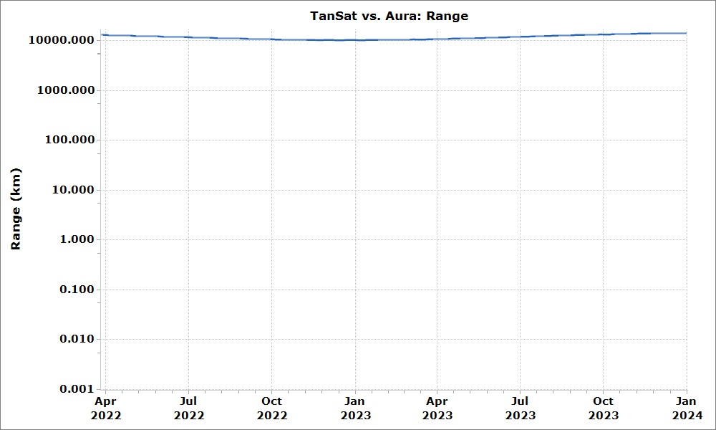
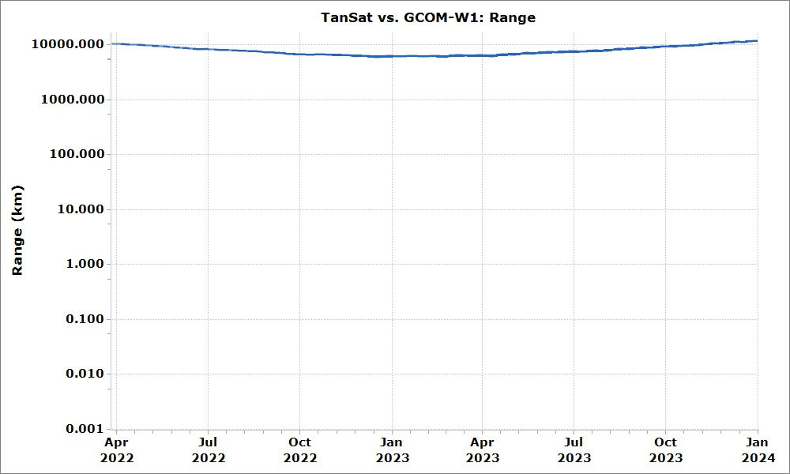
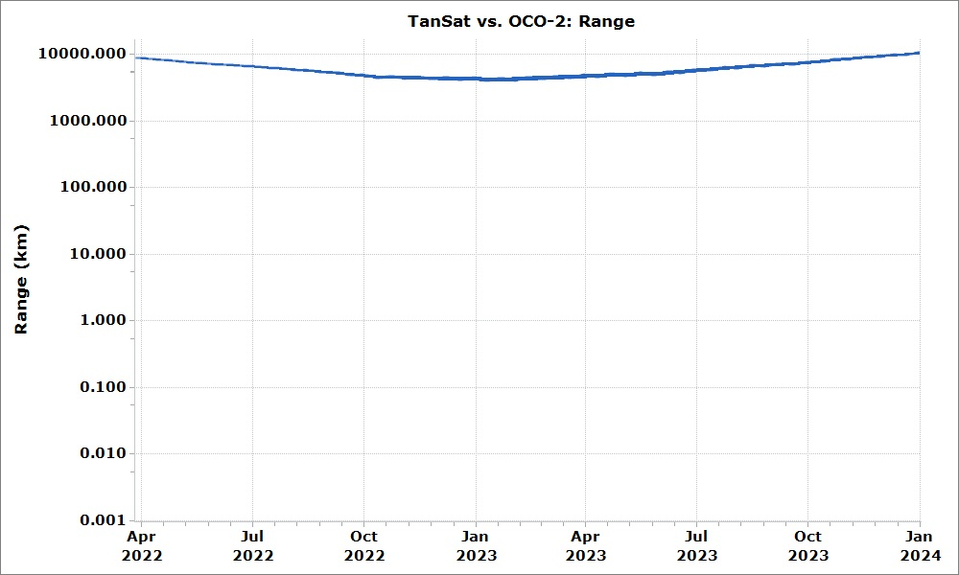
Predicted Passings – A-Train Range Plots (2/2)
Aura, OCO-2, and GCOM-W1 have no predicted passings with TanSat in the analysis span
Aura’s range is predicted to remain over 10000 km
GCOM-W1 is predicted to have a minimum range of around 5900 km around Dec 2022
OCO-2 is predicted to have a minimum range of around 3900 km around Jan 2023

Slide 8
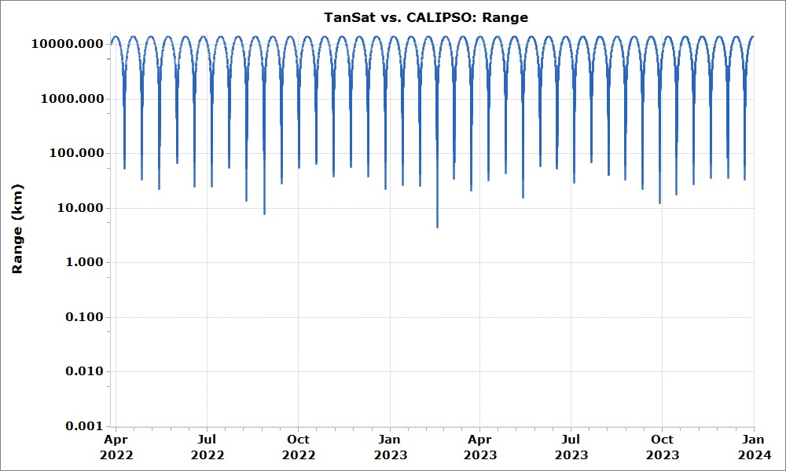
Predicted Passings – C-Train Range Plot
The prediction shows CALIPSO having a high cadence of passings with TanSat in comparison to other missions, with the closest passing having a range of 4.3km on Feb 16 2023
2 of the predicted 37 passings (before 2024) have a range under 10 km.

Slide 9
Predicted Passings – C-Train
Passing dates (1/3)
Apr 09 2022
Apr 26 2022
May 14 2022
Jun 01 2022
Jun 18 2022
Jul 06 2022
Jul 23 2022
Aug 09 2022
Aug 27 2022
Sep 13 2022
Oct 01 2022
Oct 18 2022
Nov 04 2022
Passing dates (2/3)
Nov 22 2022
Dec 09 2022
Dec 27 2022
Jan 13 2023
Jan 30 2023
Feb 16 2023
Mar 06 2023
Mar 23 2023
Apr 09 2023
Apr 26 2023
May 14 2023
May 31 2023
Jun 17 2023
Passing dates (3/3)
Jun 17 2023
Jul 04 2023
Jul 21 2023
Aug 07 2023
Aug 25 2023
Sep 11 2023
Sep 28 2023
Oct 15 2023
Nov 01 2023
Nov 18 2023
Dec 05 2023
Aug 07 2023
The TanSat - CALIPSO passings are predicted to occur about once every 17 days

Slide 10
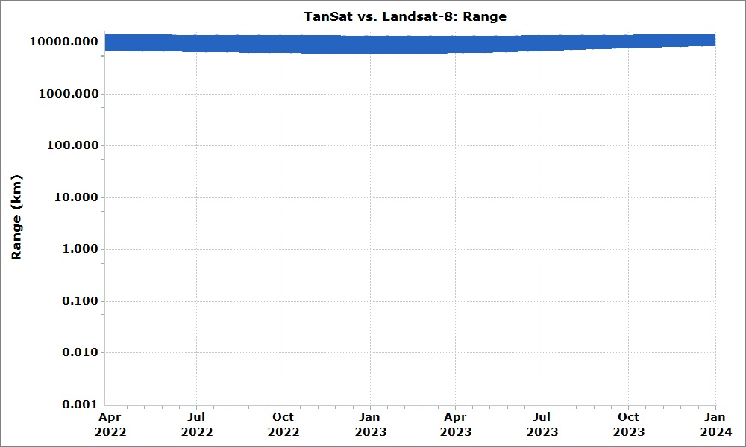
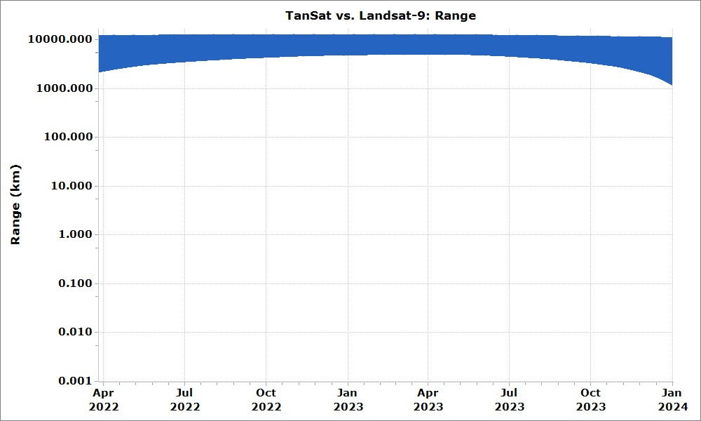
Predicted Passings – Morning Constellation
Range Plots (1/2)
Landsat-8 and Landsat-9 have no predicted passings with TanSat in the analysis span
Landsat-8’s range is predicted to remain above 6100km
Landsat-9’s range is predicted to remain above 1188km

Slide 11
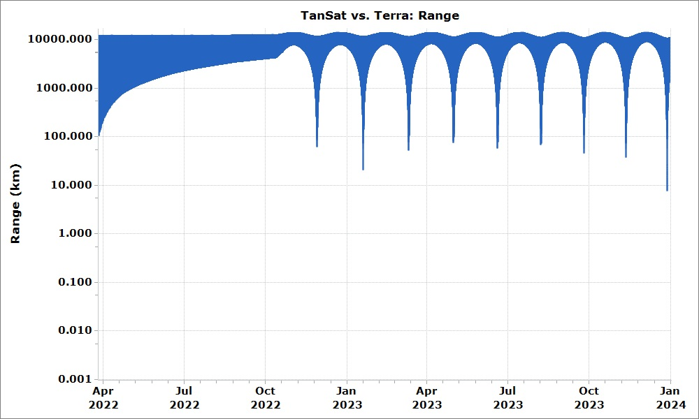
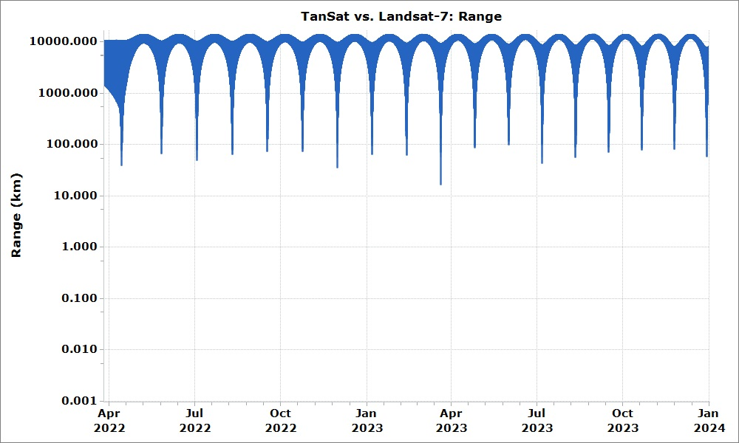
Predicted Passings – Morning Constellation
Range Plots (2/2)
After Terra’s Constellation Exit Maneuvers (CEMs) in October 2022 the profile of the separation between Terra and TanSat will change
Predicted lowest range of 7.6km on Dec 28 2023
After Landsat-7’s CEMs in April 2022 the profile of the separation between Landsat-7 and TanSat will change
Predicted lowest range of 16.4km on Mar 20 2023

Slide 12
Predicted Passings – Morning Constellation
Terra Passing dates
Nov 28 2022
Jan 19 2023
Mar 11 2023
May 01 2023
Jun 19 2023
Aug 07 2023
Sep 25 2023
Nov 11 2023
Dec 28 2023
Terra is predicted to have passings occur every 52 days immediately following CEMs, with the time between passings falling to around once every 47 days in late 2023
Landsat-7 Passing dates (1/2)
Apr 14 2022
May 26 2022
Jul 03 2022
Aug 10 2022
Sep 16 2022
Oct 24 2022
Nov 30 2022
Jan 06 2023
Feb 12 2023
Landsat-7 Passing dates (2/2)
Mar 20 2023
Apr 26 2023
Jun 01 2023
Jul 06 2023
Aug 11 2023
Sep 16 2023
Oct 21 2023
Nov 25 2023
Dec 29 2023
Landsat-7 is predicted to have passings occur every 42 days immediately following CEMs, with the time between passings shrinking to around once every 34 days by late 2023

Slide 13
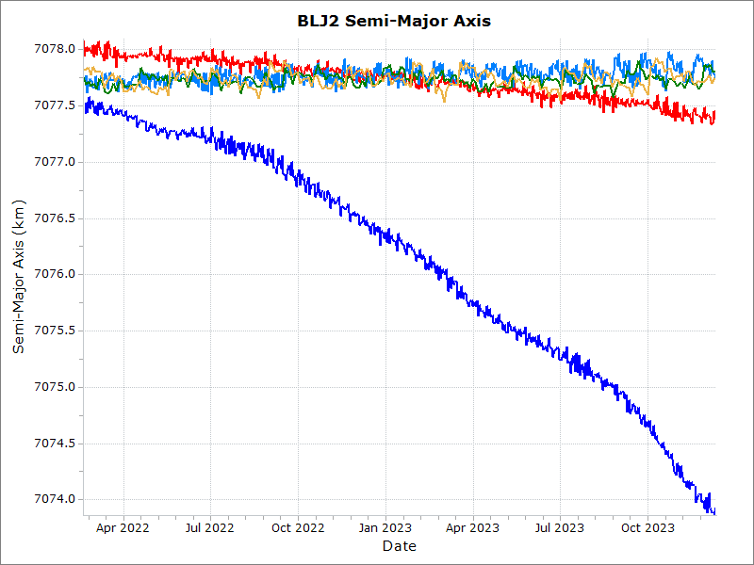
SMA Comparison – A-Train (1/2)
TanSat
Aqua
Aura
OCO-2
GCOM-W1

Slide 14
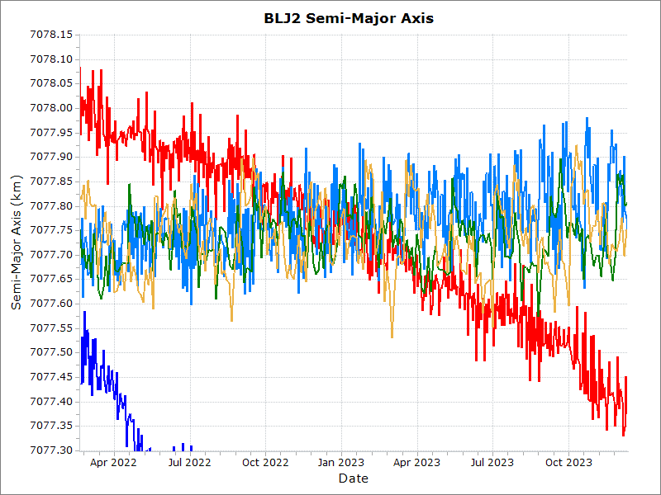
SMA Comparison – A-Train (2/2)
TanSat is predicted to drift below the A-Train (Aura, OCO-2, and GCOM-W1) in Late 2022/Early 2023
TanSat
Aqua
Aura
OCO-2
GCOM-W1

Slide 15
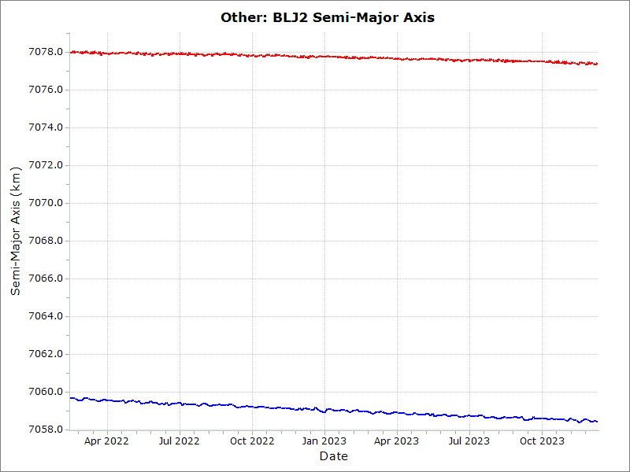
SMA Comparison – C-Train
TanSat
CALIPSO

Slide 16
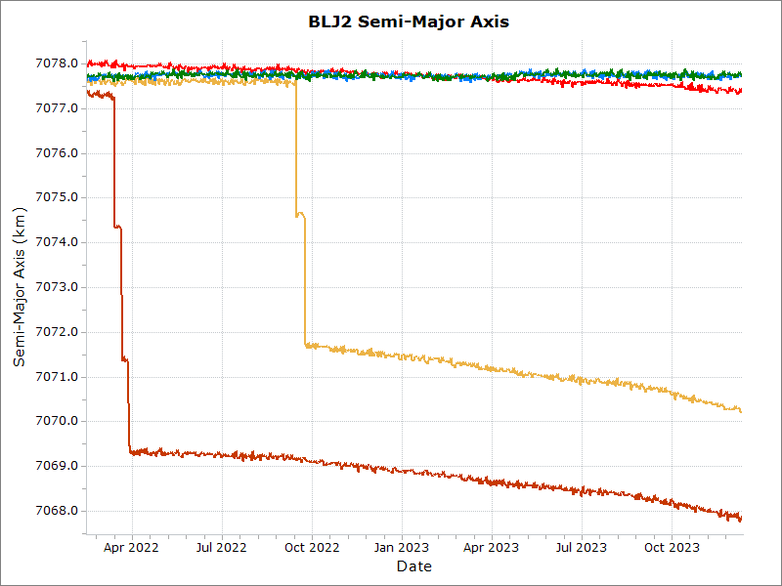
SMA Comparison – Morning Constellation (1/2)
TanSat
Landsat-7
Landsat-8
Landsat-9
Terra

Slide 17
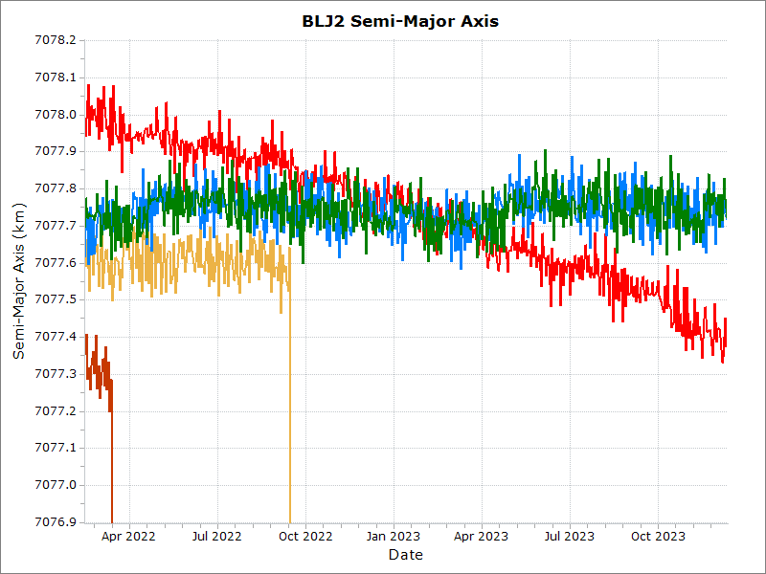
SMA Comparison – Morning Constellation (2/2)
TanSat is predicted to drift below the Morning Constellation (L8 and L9) in Late 2022/Early 2023
TanSat
Landsat-7
Landsat-8
Landsat-9
Terra

Slide 18
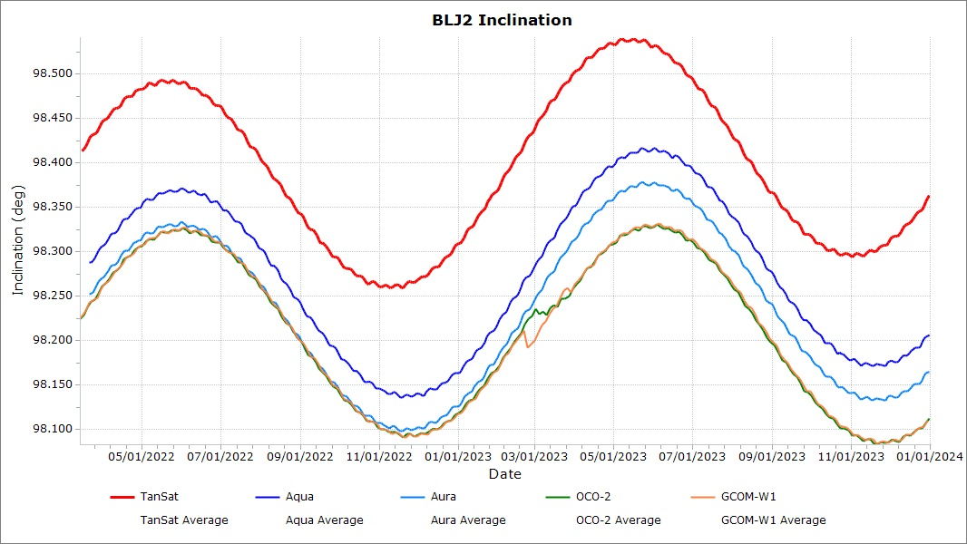
BLJ2 Inclination Comparison with A-Train Missions
TanSat
Aqua
Aura
OCO-2
GCOM-W1

Slide 19
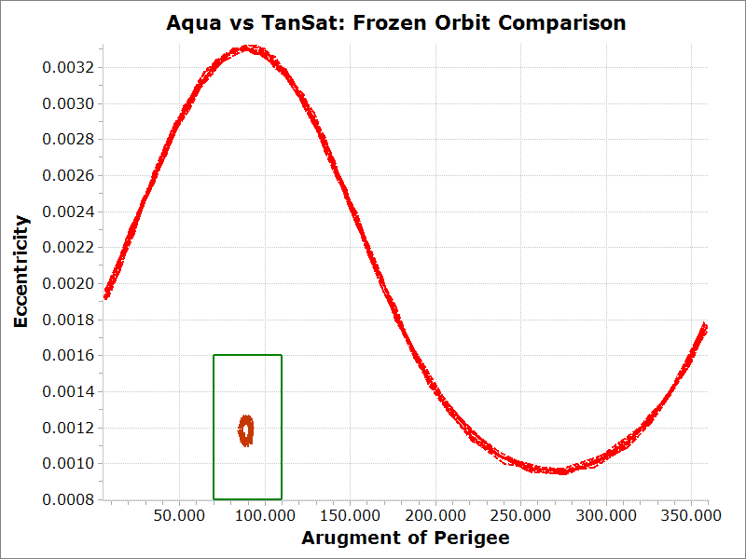
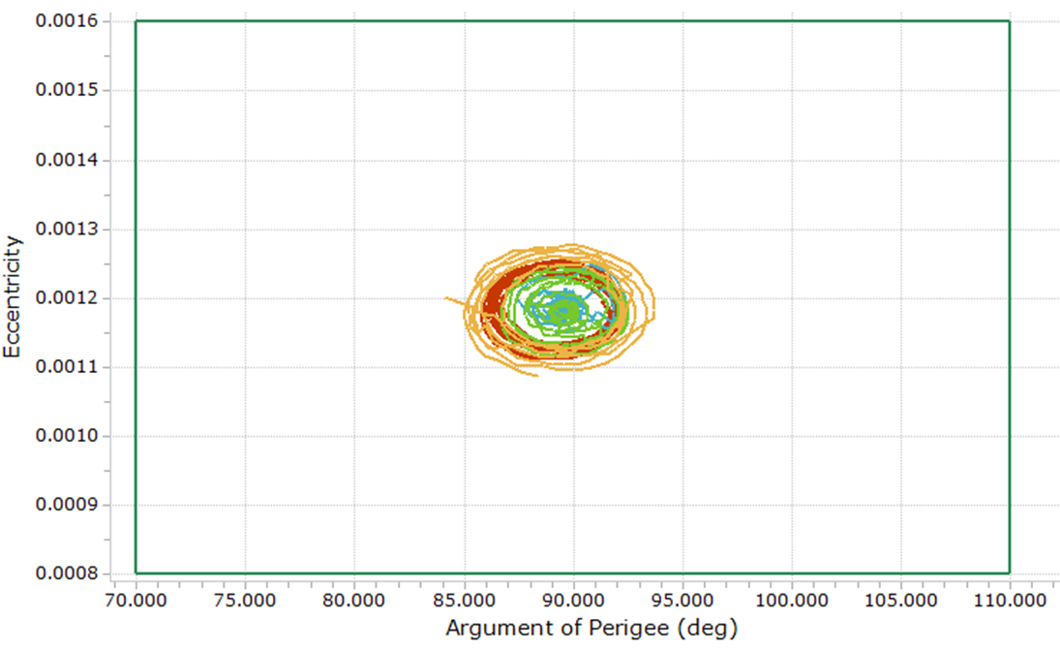
TanSat vs A-Train Mission – Orbit Frozenness
Mar 2022 – Dec 2023
TanSat
A-Train Missions
Aqua
Aura
OCO-2
GCOM-W1
Frozen Orbit Requirement
Aqua

Slide 20
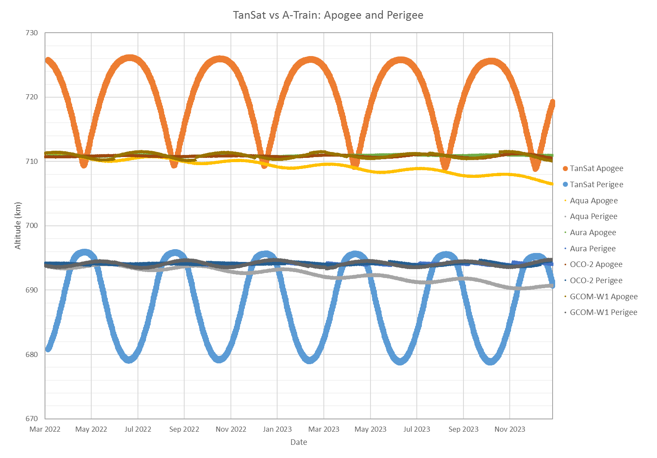
Apogee-Perigee Comparison – A-Train
Aqua
TanSat
OCO-2
GCOM-W1
Aura

Slide 21
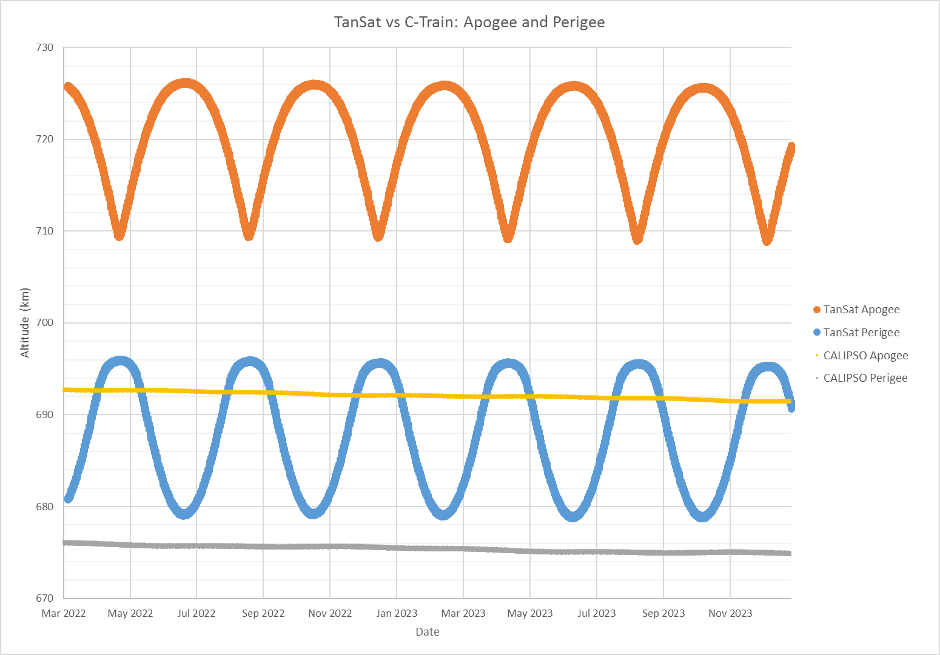
Apogee-Perigee Comparison – C-Train
TanSat
CALIPSO

Slide 22
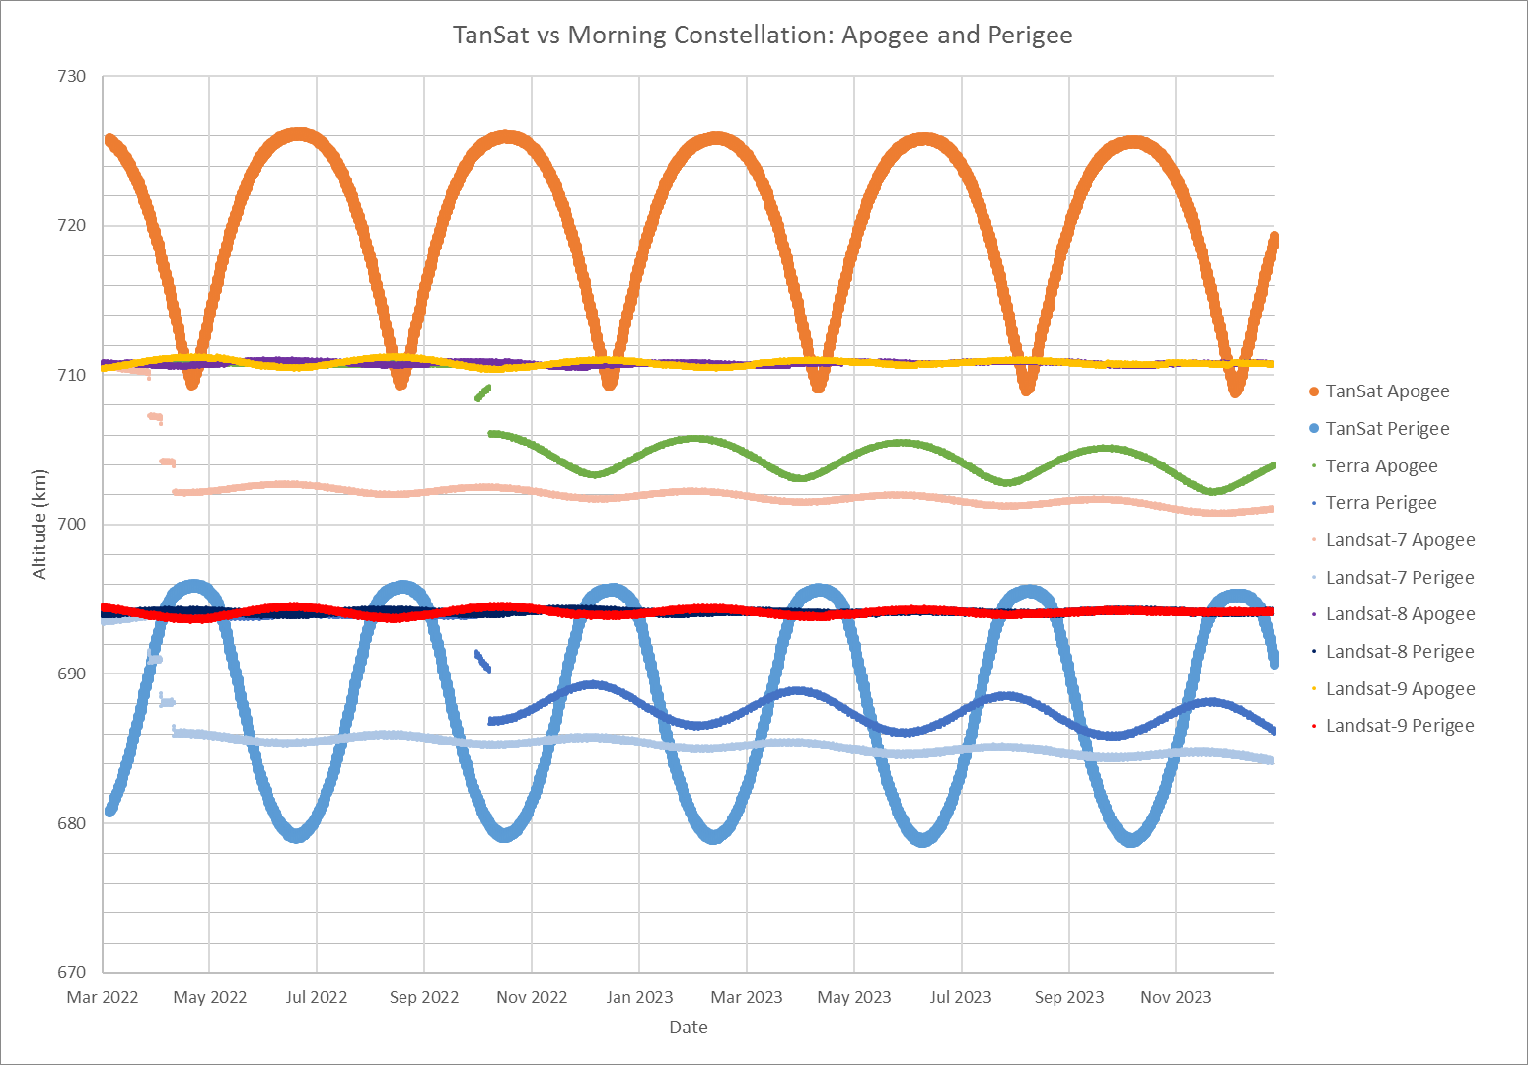
Apogee-Perigee Comparison – Morning Constellation
TanSat
Landsat-9
Landsat-8
Terra
Landsat-7
Landsat-7 CEMs
Terra CEMs

Slide 23
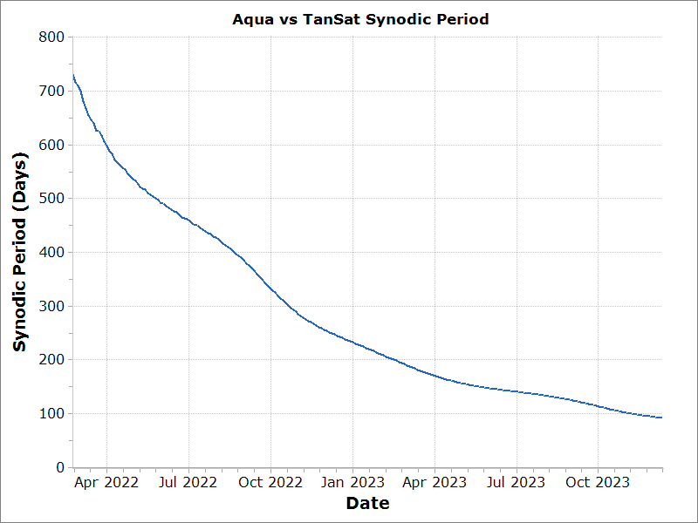
Synodic Period – Aqua
Aqua
Mean Nominal Synodic Period is approximately 91 days in December 2023

Slide 24
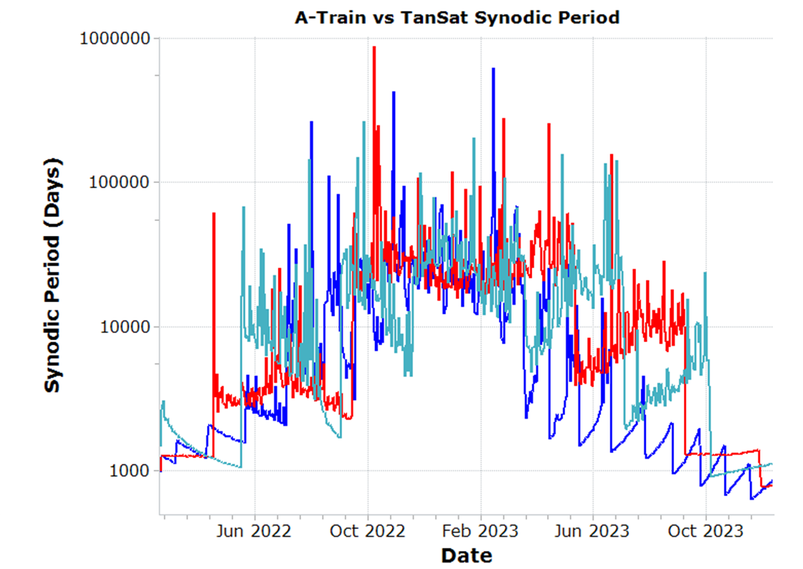
Synodic Period – A-Train
Aura
OCO-2
GCOM-W1
* y-axis is Logarithmic

Slide 25
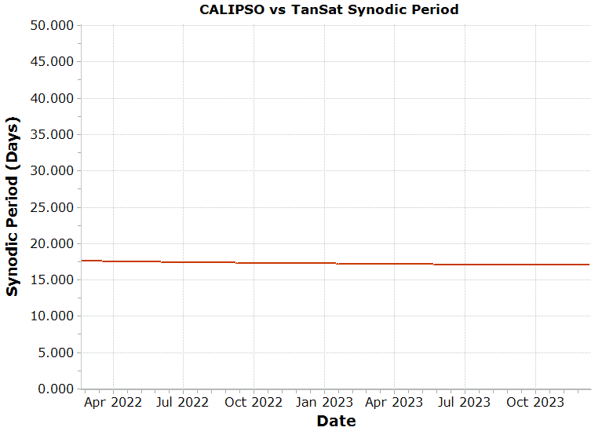
Synodic Period – C-Train
CALIPSO
Mean Nominal Synodic Period is approximately 17 days

Slide 26
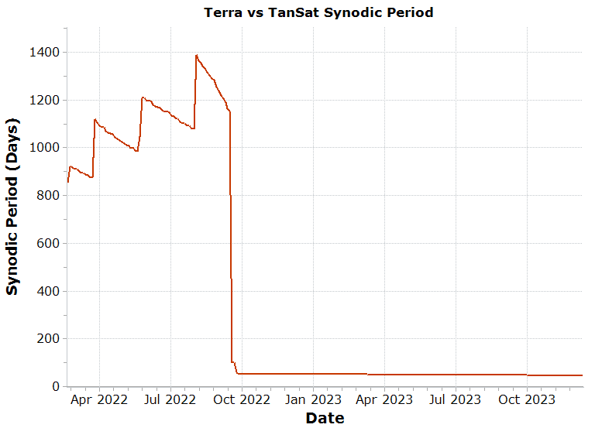
Synodic Period – Terra
Mean Nominal Synodic Period at Constellation Exit is approximately 1150 days
Terra
Mean Nominal Synodic Period is approximately 52 days after Terra Fall 2022 CEMs

Slide 27
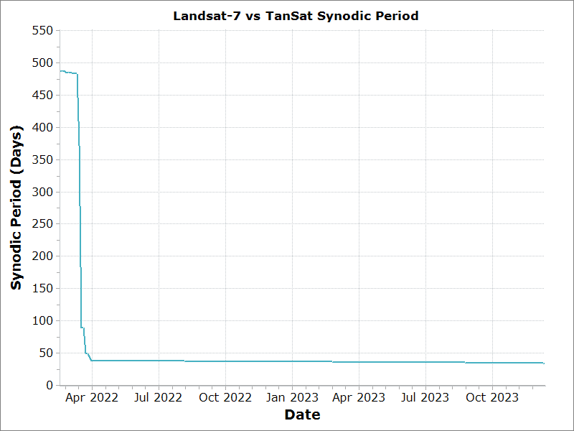
Synodic Period – Landsat-7
Mean Nominal Synodic Period at Constellation Exit is approximately 484 days
Landsat-7
Mean Nominal Synodic Period is approximately 42 days after Landsat-7’s 2022 CEMs

Slide 28
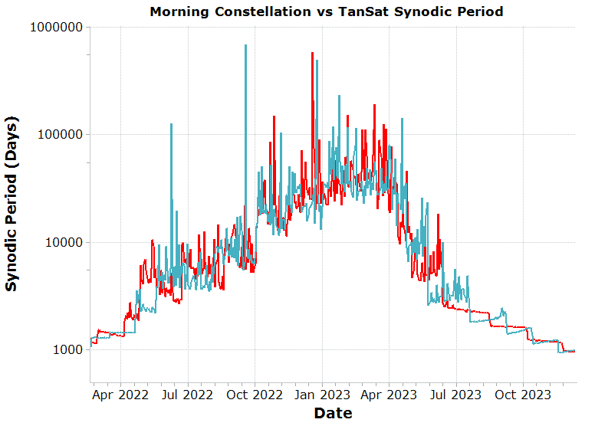
Synodic Period – Morning Constellation
Landsat-8
Landsat-9
* y-axis is Logarithmic

Slide 29
Summary
TanSat continues to drift without maneuvers
Aura, OCO-2, GCOM-W1, Landsat-8, and Landsat-9 have no predicted passings with TanSat in the analysis span
The range and frequency of Terra and Landsat-7's passings is predicted to change following each spacecraft's CEM series
Minimum predicted miss distances:
Mission | Date | Range (km)
Aqua | Aug 16 2022 | 10.5
CALIPSO | Feb 16 2023 | 4.3
Terra | Dec 28 2023 | 7.6
Landsat-7 | Mar 20 2023 | 16.4

