Slide 1

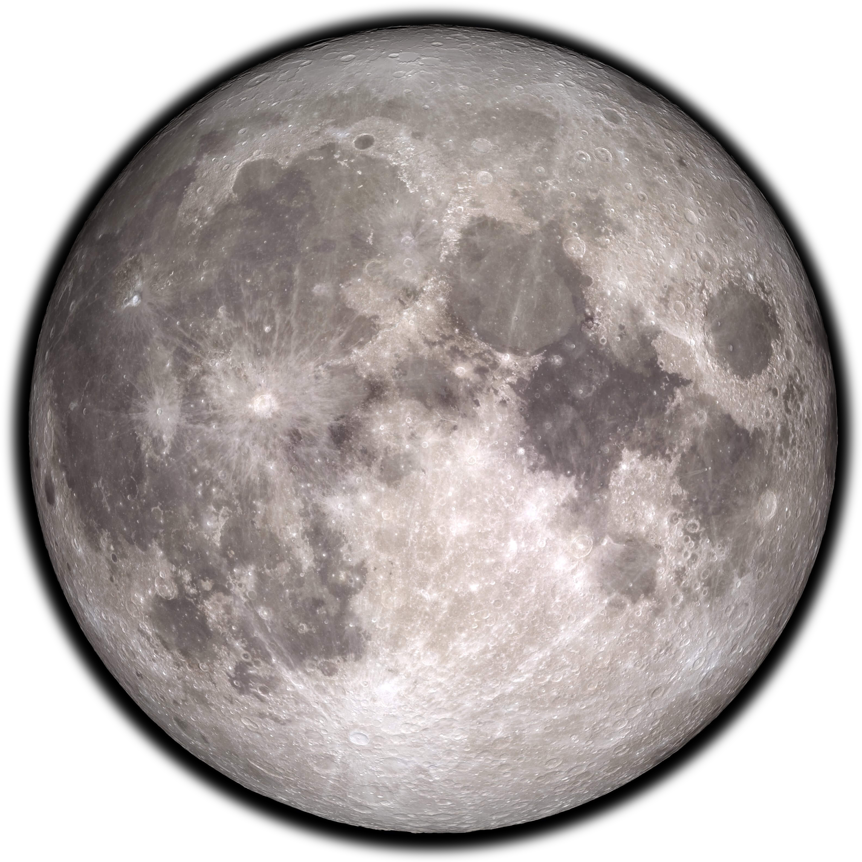
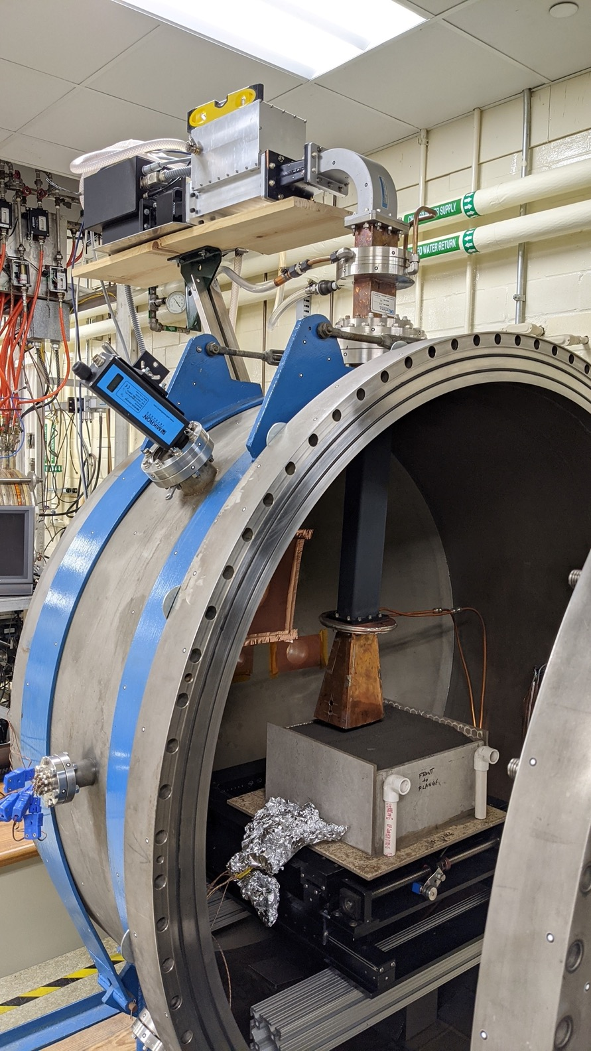
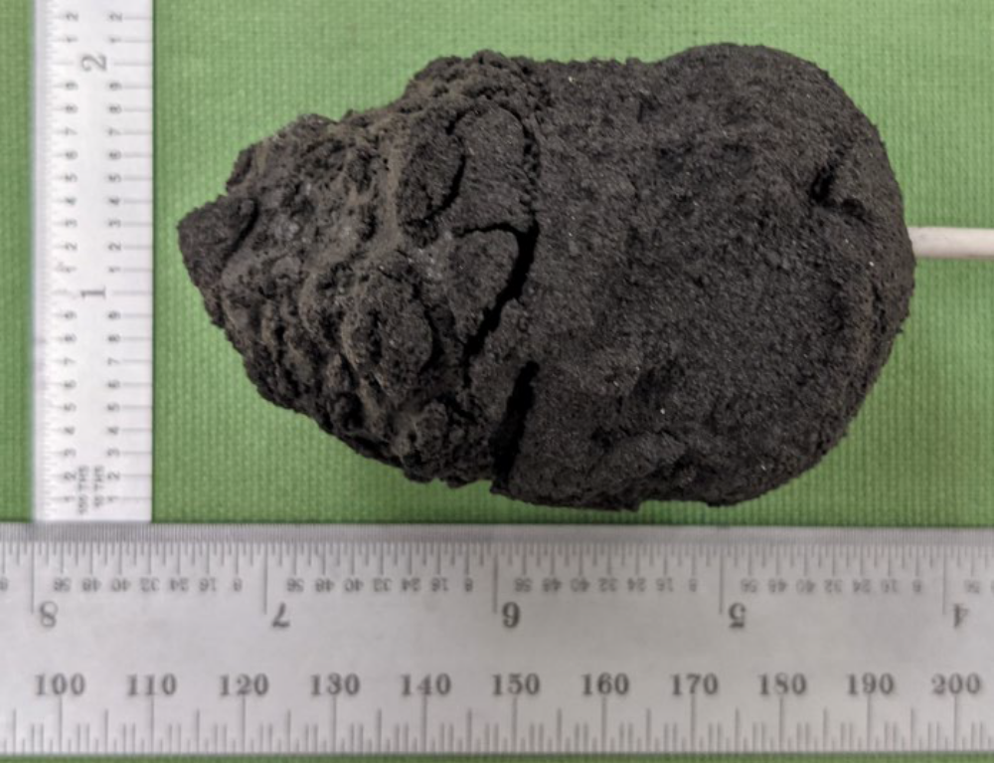
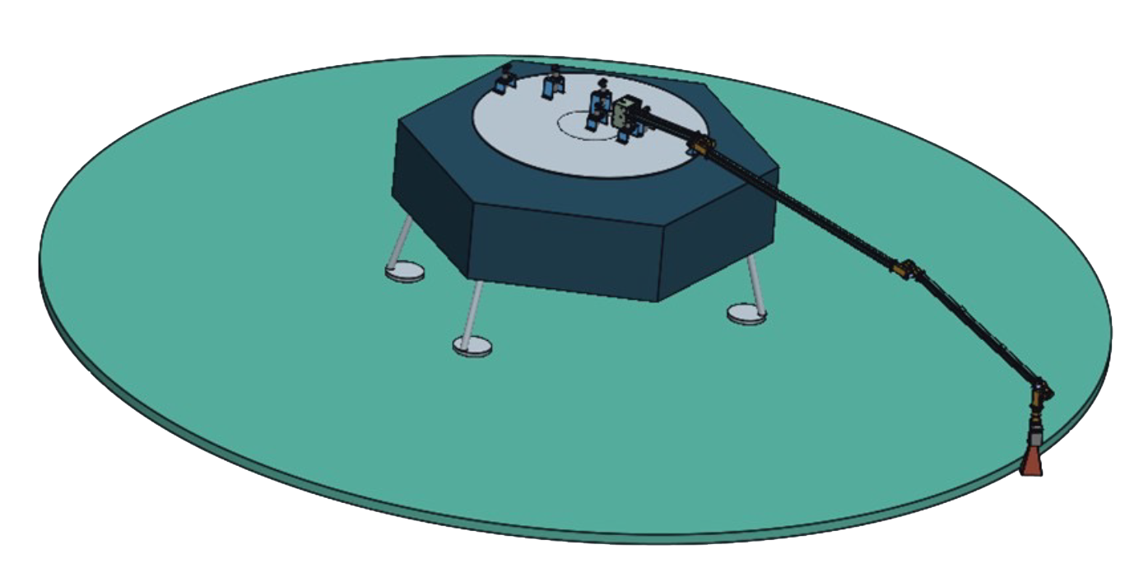
Microwave Structure Construction Capability for the Moon
National Aeronautics and
Space Administration
Michael Effinger
Paving & Brick Making
Approaches
Development Overview
Hardware Evaluation
Magnetron & Solid-state Microwave Energy Sources
Horns, Leaky Wave Guide, Array, Near Field, etc. Applicators
ConOps
Characterize Regolith
Site Preparation
Regolith Preparation
Microwave Sintering & Process Monitoring
Product Verification
Microwave Sintering
Small Scale at NASA Jet Propulsion Lab
Large Scale at Alfred University & NASA Marshall Space Flight Center (MSFC)
Full Scale at NASA MSFC
Testing
DTA, TGA in vacuum and inert, particle size, particle shape, surface area, microscopy, mass spectrometry with respect to temperature in vacuum and inert, chemical analysis, computed tomography, mechanical properties, etc.
Simulants
High-temperature Bakeout
Highlands Composition with Glass
References
[1] R.G. Clinton, et al. ASCEND 2021.
[2] M.R. Effinger, et. al. Lunar Surface Innovation Consortium Fall Meeting, November 4, 2021.
[3] Doug Rickman, Holly Shulman, Matthew Creedon, & Mike Effinger. 53rd Lunar and Planetary Science Conference, March 7–11, 2022.

