Slide 1


Surface Atmosphere Radiation Budget (SARB) working group update
Seiji Kato¹, Fred G. Rose², David A. Rutan²,
Seung Hee Ham², Alexander Radkevich², Thomas E. Caldwell²
Antonio Viudez-Mora², Tyler J. Thorsen¹, Ryan C. Scott²,
David Fillmore³, and Xianglei Huang⁴
¹NASA Langley Research Center
²Science System & Applications Inc.
³NCAR
⁴University of Michigan
CERES Science Team Meeting
April 26-28, 2022

Slide 2
Outline of this talk
Edition 5 plan
  MATCH aerosol
  Langley Fu-Liou code update
  MOA (temperature, specific humidity, and ozone profiles)
Skin temperature impact on surface irradiance

Slide 3
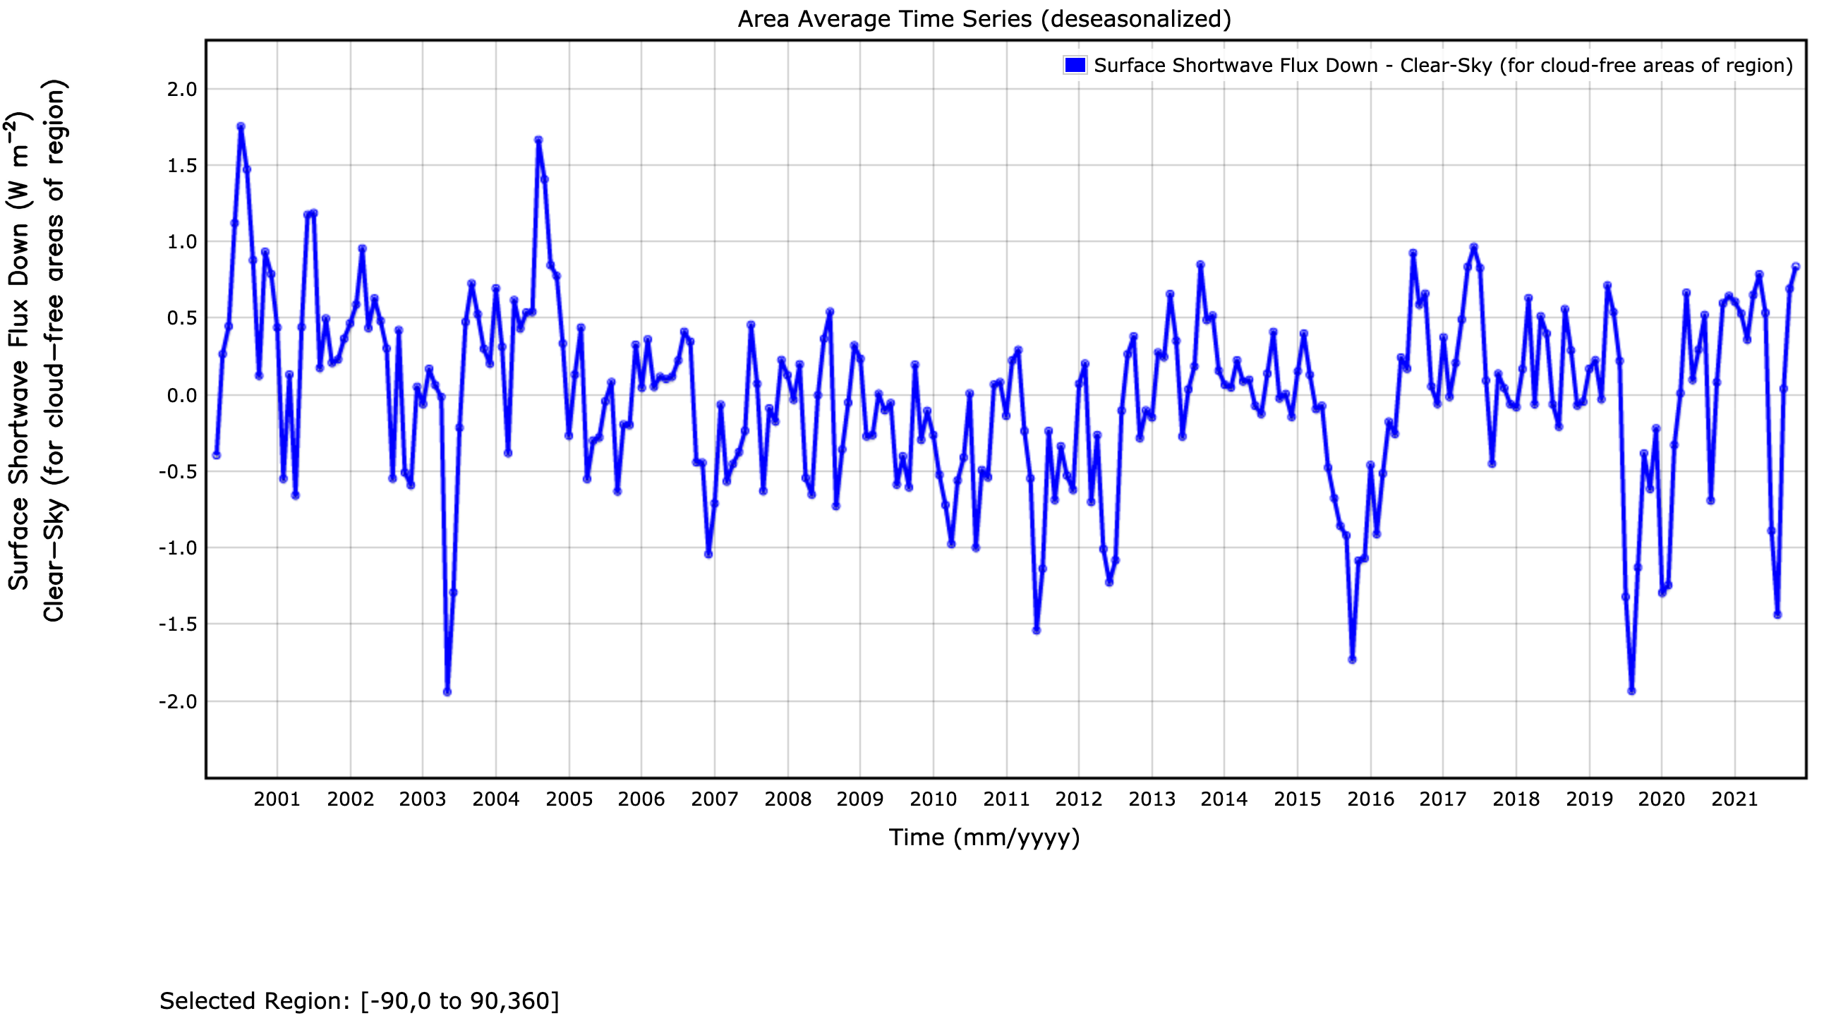
Global monthly surface clear-sky downward shortwave anomalies
August 2000
missing Terra data
May 2003
Siberian forest fire??
August 2019
Siberian wildfire
January 2020
Australian fire
August 2021
Siberian wildfire
June 2011
Canadian smoke
October 2015
Indonesian smoke
Standard deviation = 0.59 Wm⁻²
Number of month > 2𝝈: 14 (out of 261)
8 occurred after 2010
5 occurred after 2019
Notes:
Over arctic, we need a good model.
Instrument, satellites consistency, no AERONET assimilation. Use AERONET as an independent validation. Adjust fine/coarse modes independently
TOA clear-sky EBAF anomalies

Slide 4
Edition 4 MATCH
Clear-sky total aerosol optical thickness is constrained by MODIS derived aerosol optical thickness (dark target and deep blue).
Modeled dust optical thickness is too large
  Modeled dust optical thickness is adjusted by MODIS optical thickness when MODIS optical thickness is available
  Sometimes dust aerosol is used for smoke.
Large fraction of sulphate and small fraction of sea salt over ocean.
MATCH provides aerosols over polar regions
  Transport of aerosol to polar regions is important.
Aerosol under cloudy conditions largely depend on model but affects clear-sky cloud removed irradiances.

Slide 5
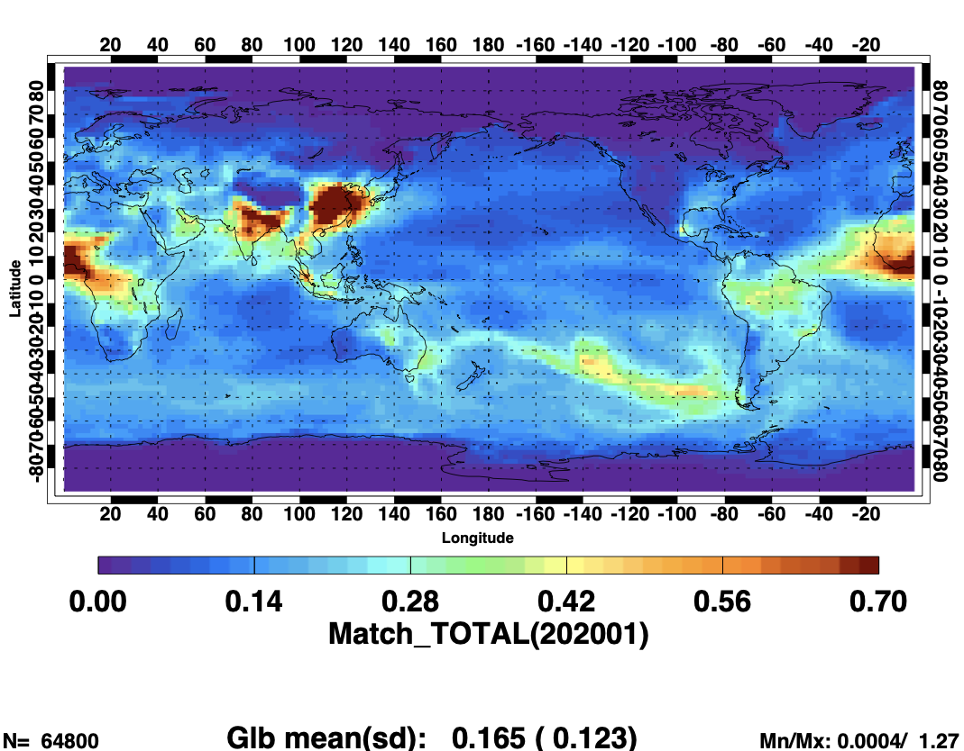
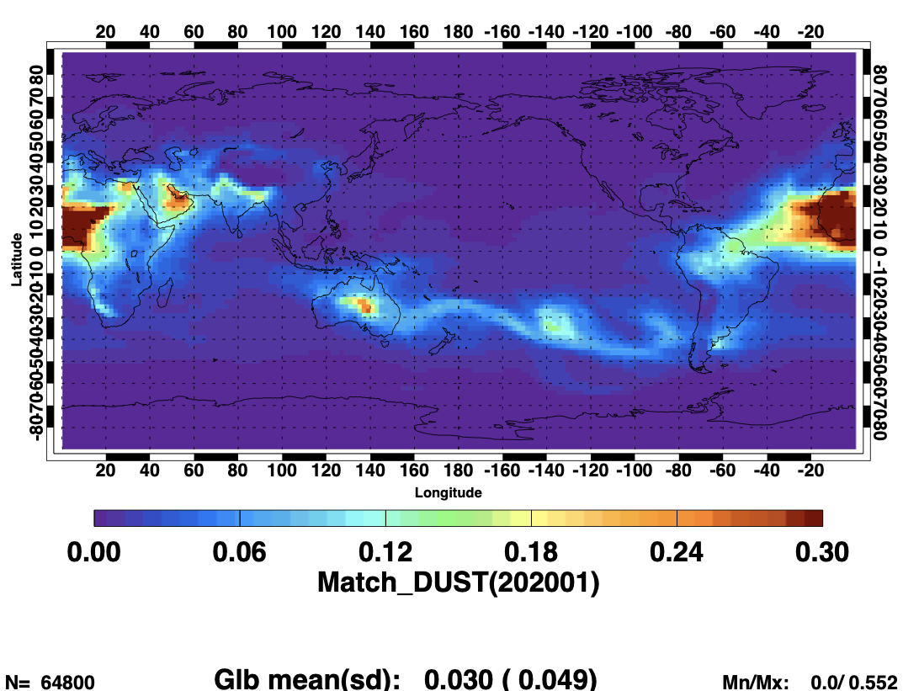
Australian fire event (January 2020)
Total aerosol optical thickness
Dust aerosol optical thickness

Slide 6
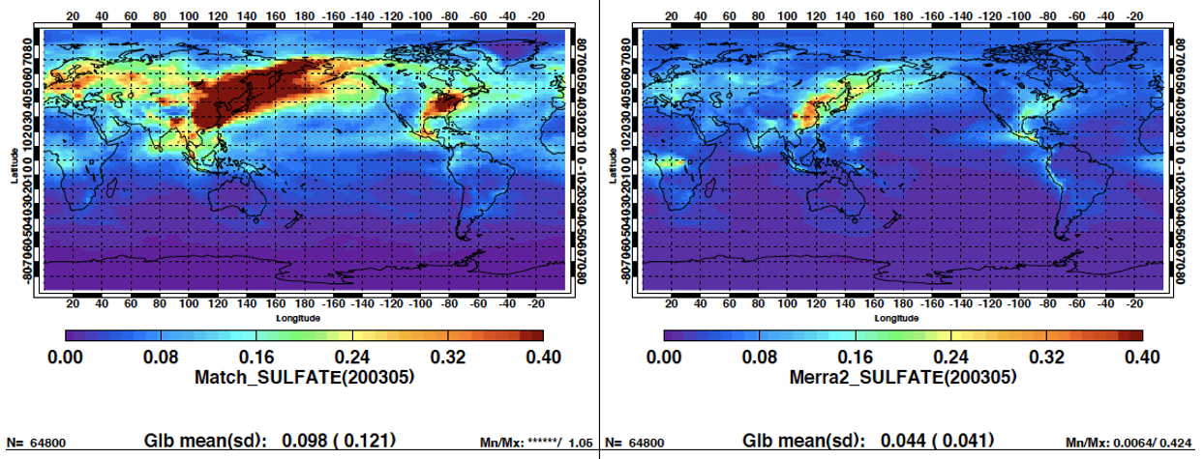
Edition 4 sea salt and sulfate aerosols
MATCH
MERRA-2

Slide 7
Edition 5 MATCH
A MODIS/VIIRS aerosol optical thickness assimilation module is going to be developed for NCAR Community Earth System Model (CESM), Community Atmosphere Model (CAM) 6
Use 3-mode modal aerosol representation (MAM3, internal mixing) in CAM 6
  Aitkin (SO4, SOA, and SS), accumulation (SO4, POA, SOA, BC, SS, and DST), coarse (SO4, SS, and DST).
  Species include SO4 sulfate, SOA secondary organic aerosol, SS Sea-salt, POA primary organic aerosol, BC black carbon, and DST mineral dust.
  Stratospheric aerosol (TBD)
  Optical property of species in 4D (+ wavelength) are provided by CAM6 and used in Edition 5 Langley Fu-Liou RT model (Changes from Edition 4).
Winds (u and v components) and T and q are nudged 3 hourly using GEOS.
Current plan is to assimilate total AOT, fine and coarse mode fractions and/or AOT at multiple wavelengths.
A Back-up plan is to use 4D aerosol fields and optical property form GEOS

Slide 8
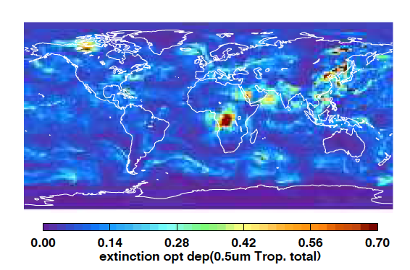
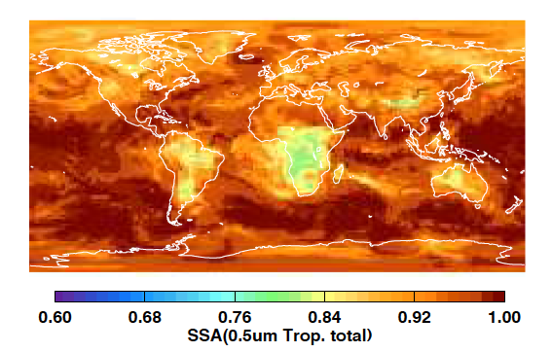
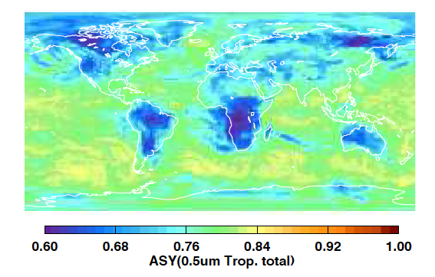
Optical property input to Langley Fu-Liou code
These aerosol properties come from MATCH (CAM6)
But can be replaced by GEOS-IT or R21C

Slide 9
Edition 5 MOA
1 deg by 1 deg (can be changed later)
Vertical levels (same as GEOS product or TBD)
Use hourly mean surface skin temperature
Include GEOS cloud fraction

Slide 10
Langley Fu-Liou RT code: gaseous absorption update
Absorption cross sections are updated with HITRAN 2012 (line by line code, lblrtm v12.8, outputs were made by Lusheng Liang)
Includes absorption by H2O, CO2, O3, O2, and CH4
  CO2 absorption with variable CO2 concentrations can be computed for both shortwave and longwave
Current version is participating in Correlated k-Distribution Model Intercomparison (CKDMIP, Hogan and Matricardi 2020)

Slide 11
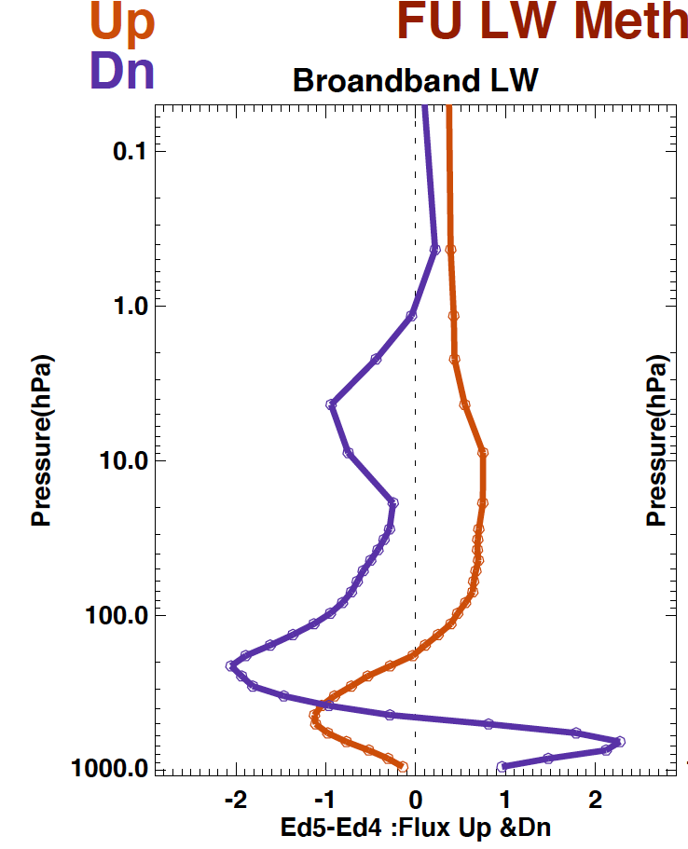
Longwave Edition 5 vs. Edition 4 n(average of tropical, MLS, MLW, SAS, and SAW)
Longwave

Slide 12
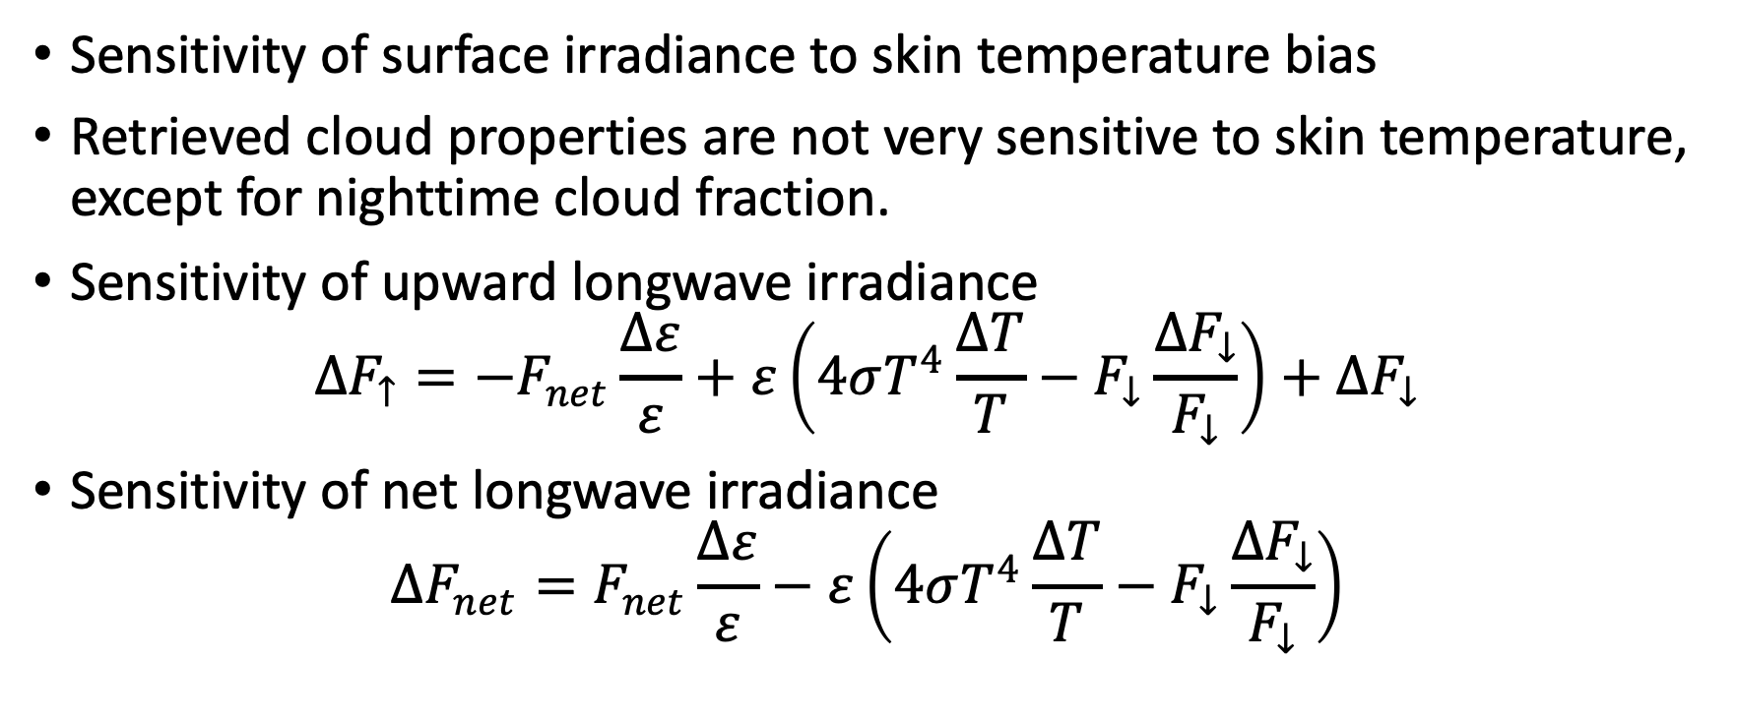
Surface skin temperature
Sensitivity of surface irradiance to skin temperature bias
Retrieved cloud properties are not very sensitive to skin temperature, except for nighttime cloud fraction.
Sensitivity of upward longwave irradiance
$$∆F_{↑}=−F_{net}\frac{∆ε}{ε}+ε\left(4σT^{4}\frac{∆T}{T}−F_{↓}\frac{∆F_{↓}}{F_{↓}}\right)+∆F_{↓}$$
Sensitivity of net longwave irradiance
$$∆F_{net}=F_{net}\frac{∆ε}{ε}−ε\left(4σT^{4}\frac{∆T}{T}−F_{↓}\frac{∆F_{↓}}{F_{↓}}\right)$$

Slide 13
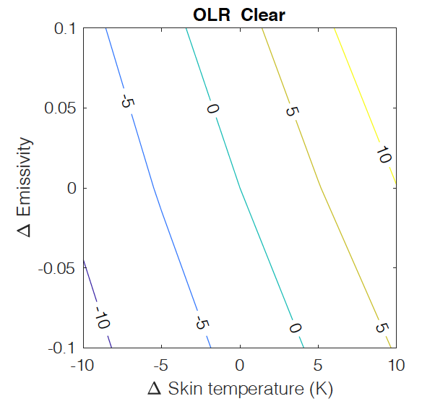
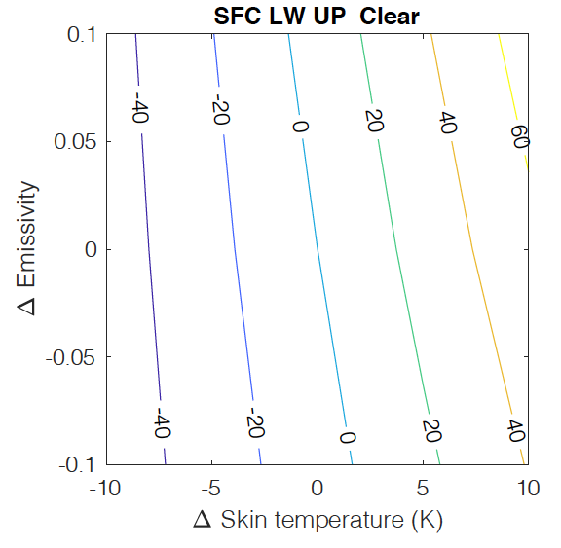
TOA and surface upward longwave irradiance
Mid-latitude summer atmosphere
Surface skin temperature = 295 K
Surface emissivity = 0.90
Notes:
Sensitivity of OLR to emissivity error is small. But the emissivity error affect skin temperature retrieval. So what we need is accurate skin temperature in window region.

Slide 14
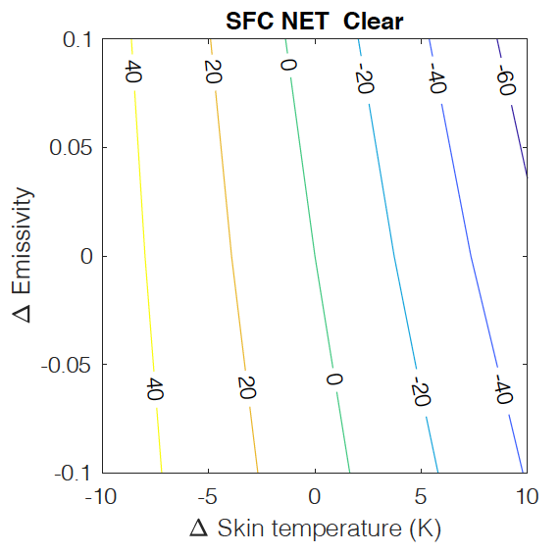
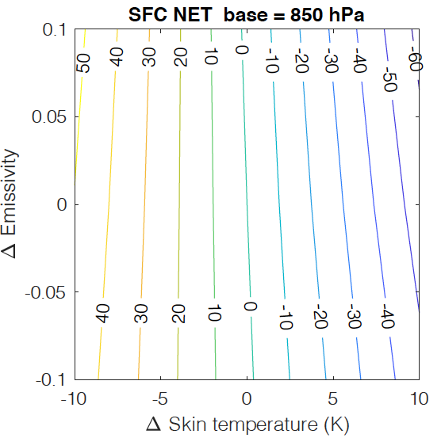
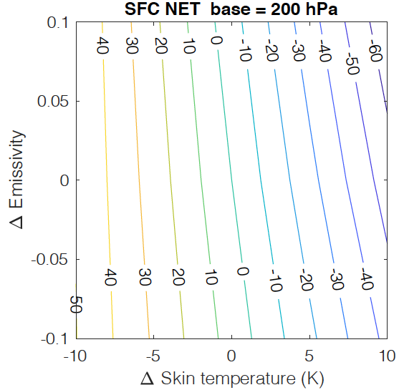
Clear-sky and all-sky surface net longwave irradiance

Slide 15
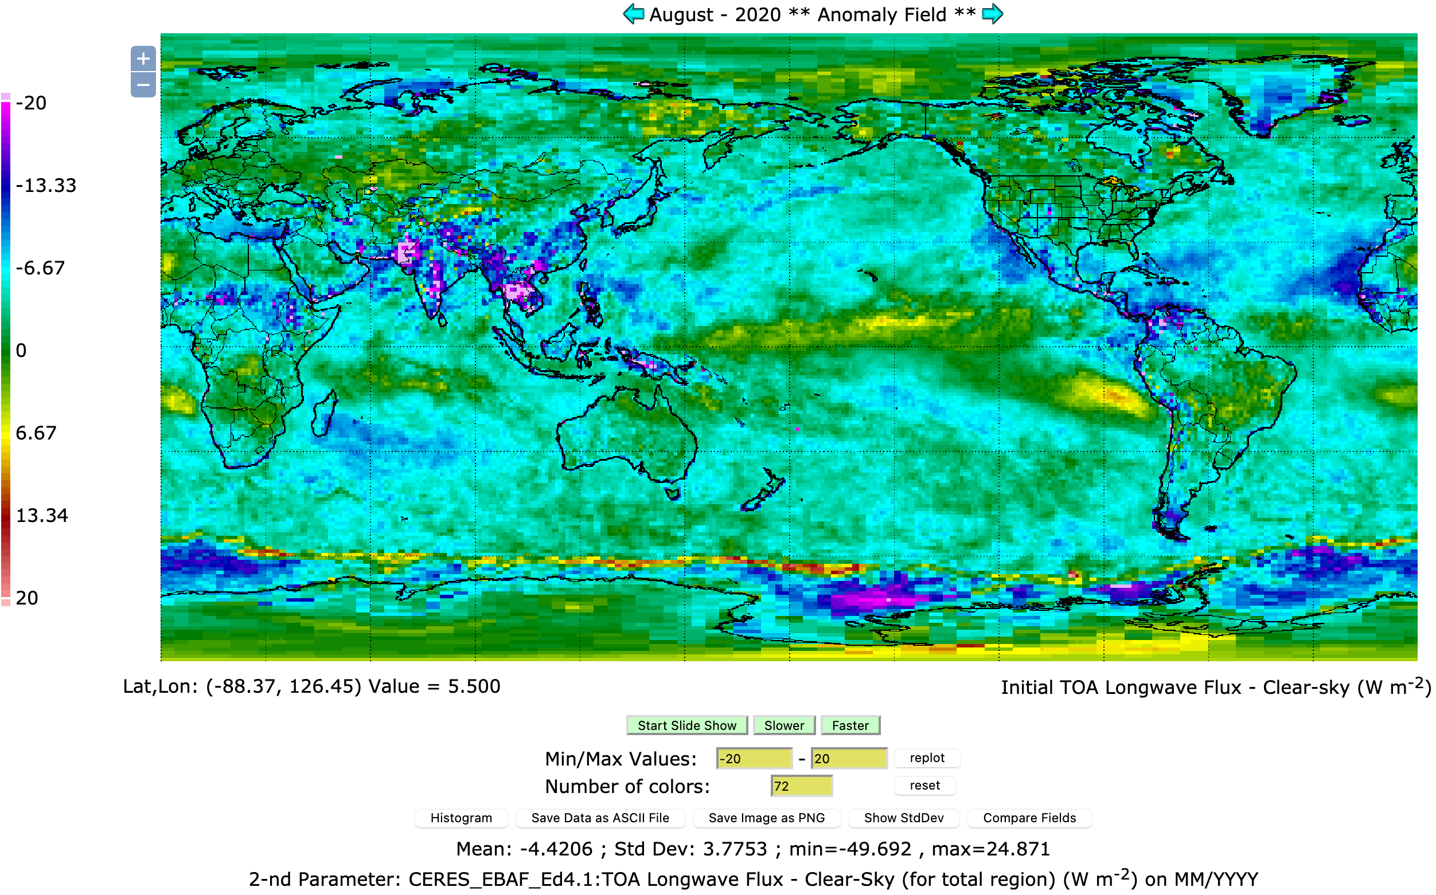
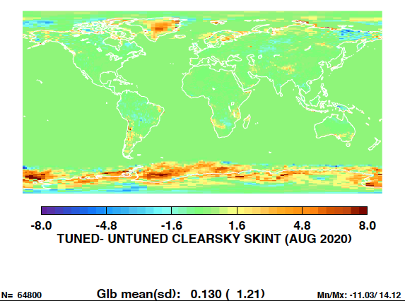
Clear-sky (total area) OLR: Computed (Ed.4 SYN) – Observed (EBAF)
Smaller OLR difference over desert
Day-night skin temperature bias might partially cancel out
Humidity bias, GEOS-541 upper tropospheric humidity has a positive bias
Dust aerosol layer optical thickness and height (negative bias over ocean)
Adjusted skin temperature
Need to determine bias and correct bias error (work with the cloud working group)

Slide 16
Summary
Treatment of gaseous absorption in Langley Fu-Liou code is updated for Edition 5 production
  Newer HITRAN database (2016) and SW absorption varies with CO2 concentration.
One of objectives of Edition 5 MATCH development is to improve aerosol type (fine and coarse mode)
Importance of aerosols in computing clear-sky radiation budget change is emphasized
  Large aerosol loading events occur more often
  Transport of aerosol to polar regions and aerosol under cloudy conditions largely depend on model.
Work with the cloud group to improve the impact of GEOS surface skin temperature bias to surface irradiance.

Slide 17
Publications
Ham, S.-H., S. Kato, F. G. Rose, N. G. Loeb, K.-M. Xu, T. Thorsen, M. G. Bosilovich, S. Sun-Mack, Y. Chen, and W. F. Miller, 2021: Examining Cloud Macrophysical Changes over the Pacific for 2007–17 Using CALIPSO, CloudSat, and MODIS Observations, J. Appl. Meteo. Clim., 60(8), 1105-1126, DOI: 10.1175/JAMC-D-20-0226.1.
Fillmore, D. W., D. A. Rutan, S. Kato, F. G. Rose, and T. E. Caldwell, 2021: Evaluation of aerosol optical depths and clear-sky radiative fluxes of the CERES Edition 4.1 SYN1deg data product, submitted to Atmospheric Chemistry and Physics.
Ham, S. H., S. Kato, F. G. Rose, S. Sun-Mack, Y. Chen, W. F. Miller, and R. Scott, 2022: Combining cloud properties from CALIPSO, CloudSat, and MODIS for top-of-atmosphere (TOA) SW broadband irradiance computations: impact of cloud vertical profiles, submitted to J. Applied Meteorology and Climatology.
Scott, R. C., F. G. Rose, P. W. Stackhouse Jr., N. G. Loeb, S. Kato, D. R. Doelling, D. A. Rutan, and P. C. Tayler, 2022: Clouds and the Earth’s Radiant Energy System (CERES) Cloud Radiative Swath (CRS) Edition 4 data product, submitted to Journal of Atmospheric and Oceanic Technology.

Slide 18
Back-ups

Slide 19
Edition 5
Fu-Liou code
  Edition 4 versus Edition 5 gaseous absorption
MATCH
MOA
  1deg by 1deg(?)
  Cloud also uses hourly mean skin temperature (i.e. not instantaneous skin temperature
Skin temperature impact on surface irradiance
D1 CCCM (Seung-Hee Ham)

Slide 20
Recent activities
Released Edition 4.1 EBAF through November 2021
Released D1 version (revised from B1) of CCCM (jointly with the cloud working group)
Generated MOA using GEOS-IT
Implemented the algorithm and modernized (.pro to .py) to use AFWA ice age product after CLASS ice age product was terminated in August 2021
Developed the SYN algorithm that uses no geostationary satellite data.
Developed Edition 4 CRS production code and evaluated instantaneous surface fluxes

Slide 21
Validation
Evaluated Edition 4 MATCH aerosol optical thickness (paper is under review) using AERONET, MODIS, and MERRA-2 aerosol optical thickness.
Evaluated twilight cloud properties derived from geostationary satellites and their effects to surface fluxes
Evaluated time series of surface flux anomalies derived from Aqua only (i.e. no geostationary satellite derived clouds) SYN.
Validated CRS instantaneous footprint-scale Arctic surface downwelling broadband radiative fluxes against measurements conducted at the MOSAiC drifting observatory.
Updated surface validation input files from binary files to netCDF files and developed a python code to generate the input files from surface observations.

Slide 22
Aqua only noGEO, Terra only no GEO, and Terra+Aqua noGEO SYN analysis
Edition 4.2 EBAF uses SYN noGEO product
  Adjust Terra only and NOAA 20 only climatology based on Terra+Aqua.
  Use Terra only, NOAA20 only, and Terra+Aqua anomalies.
Difference in climatology and anomalies
Difference in surface irradiance trends
Surface validation

Slide 23
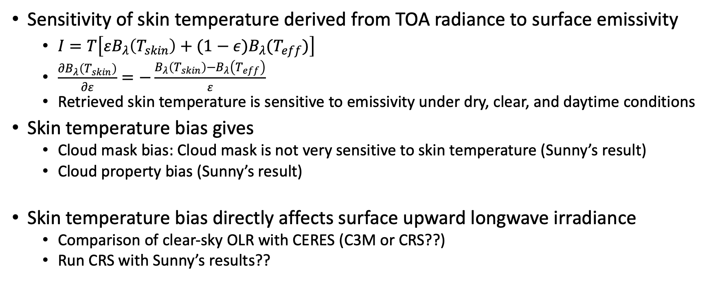
Effect of skin temperature bias on the surface upward longwave irradiance
Sensitivity of skin temperature derived from TOA radiance to surface emissivity
  $I=T\left[εB_{λ}\left(T_{skin}\right)+(1−ε)B_{λ}(T_{eff})\right]$
  $\frac{∂B_{λ}\left(T_{skin}\right)}{∂ε}=−\frac{B_{λ}\left(T_{skin}\right)−B_{λ}\left(T_{eff}\right)}{ε}$
  Retrieved skin temperature is sensitive to emissivity under dry, clear, and daytime conditions
Skin temperature bias gives
  Cloud mask bias: Cloud mask is not very sensitive to skin temperature (Sunny’s result)
  Cloud property bias (Sunny’s result)
Skin temperature bias directly affects surface upward longwave irradiance
  Comparison of clear-sky OLR with CERES (C3M or CRS??)
  Run CRS with Sunny’s results??

Slide 24
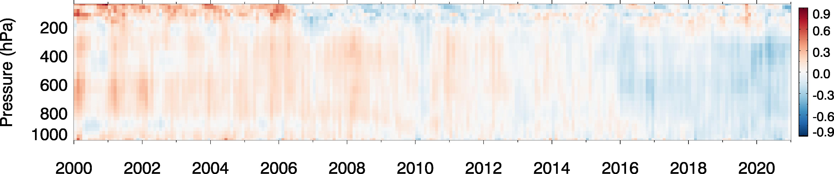
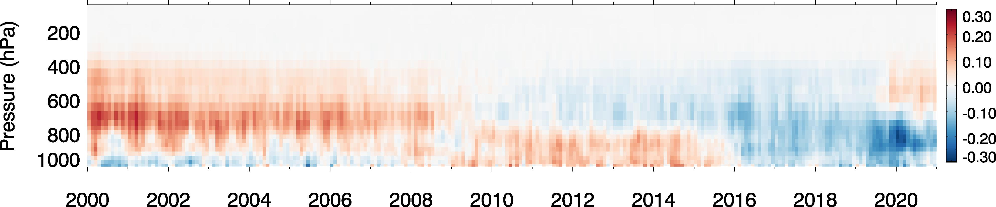
60S-60N Land+Ocean
Area weighted; climatology is obtained using 2003-2020
[G-5.4.1 Anomalies] – [ERA-5 Anomalies]
Temperature (K)
Kelvin
Loss of MHS
(microwave humidity sounder)
November 2019
Fewer instruments are assimilated so that the impact is larger in GEOS-5.4.1
Water Vapor (g/kg)
End of SSM/I
Tropical standard ATM
Water vapor mixing ratio @ 400 hPa
~0.6 g/kg
~20 to 30% drift
g/kg
The differences between G541 and ERA5 are similar to those between G541 and MERRA-2.
This implies that the differences are mainly driven by G541 problems.
Notes:
Issues in MHS on Metop-A?
(microwave humidity sounder)
November
https://www.ospo.noaa.gov/data/messages/2020/MSG045230402.html
We can control instruments used for assimilation but no control of instrument dropping out.

Slide 25
