Slide 1




Commercial Lunar Payload Services (CLPS)
For Lunar Science
Julie Schonfeld
CLPS Integration Manager
julie.schonfeld@nasa.gov
Lunar Biology Technology Workshop (LBTech)
April 20, 2022
1

Slide 2


Commercial Lunar Payload Services (CLPS)
CLPS is an innovative, service-based, competitive acquisition approach that enables rapid, affordable, and frequent access to the Lunar surface via a growing market of American commercial providers
14 domestic vendors are on contract to CLPS and eligible to bid for Task Orders defined in a Request for Task Order Proposal (RFTOP)
Lunar delivery service task orders are firm fixed price (FFP) for the full scope of delivery: from payload hand-over to delivery (and often operation) on the lunar surface
o All payload requirements must be captured in the originating RFTOP
NASA wants to be one of many customers for CLPS services
CLPS deliveries are CLPS Vendor missions (not NASA missions)
CLPS systems/facilities are owned or contracted by the CLPS Provider (not NASA)
CLPS launches are commercial launches provided via the CLSP provider (not LSP) and
approved/licensed by the FAA and other agencies (not NASA)
Payloads are manifested through the CLPS Manifest Selection Board
  Chaired by SMD with representatives from the other NASA Mission Directorates
3

Slide 3

Payload Accommodations
CLPS Providers are required to “accommodate” the needs of the payloads.
  Paradigm shift to specify to the spacecraft what is needed rather than to “deal
with” what is available.
  Utilities: power, data, commanding, etc.
  Mounting: fields of view, alignments, co-locations, etc.
  Environments: thermal, vibe, emi/emc, etc.
  Operations: conops, mission phases, etc.
Affordability is taken into account
Firm Fixed Price (FFP) Task Orders necessitate mature and stable definition of interfaces and requirements PRIOR to release of the Request for Task Order Proposal (RFTOP).
  If it is not defined in the RFTOP then it is defined de facto by the CLPS provider,
or else is a “new” requirement at a cost.
  If requirements cannot be finalized, RFTOP should specify an achievable
Envelope (boundary) for both sides to work to (e.g. thermal).
Payload development will preceed CLPS vendor mission development
4

Slide 4
Things to Consider
The Mission belongs to the selected CLPS Task Order Vendor
  They own and execute the mission; any payload requirements (including operational) must be specified up front
  Each Vendor will have their own unique payload integration process
  Vendors will specify payload deliverable “Need Dates” which may vary but typical near term deliverables will include 3D CAD, Mass, Thermal, & FEM Models; Power & Data Connector info; Command & Telemetry Definitions
  The CLPS role is to ensure successful payload integration, lunar delivery, and payload science success
Payloads should strive to be self-sufficient and operationally simple as practical without sacrificing the payload primary objectives
Payload integration requirements interfaces guided by contractual boundaries (payload to funding org; CLPS to mission provider)
Shared Accommodations
  In general, assume there will be multiple payloads or suites of instruments for each CLPS task order

Slide 5
More Things to Consider
Currently expecting that CLPS vendors will need 28 – 32 months to get payloads to the Moon once a task order has been awarded
  Payload requirements have to be fully defined 30 – 34 months prior to landing
  The maturity of the payload requirements is critical to getting good proposals
  Hardware needs to be ready for flight integration 8 – 10 months prior to launch
  Transit time is determined by the vendor (unless specified in RFTP), typically 5-10 days but as long as 3 months depending on the landing site and time of year
Talking to Vendors
The ESSIO office will facilitate discussions between the CLPS providers and NASA mission directorates, other government agencies, and international contributions.
Remember that the vendor for each CLPS task order is competitively selected in response to the RFTP (black out period apply).
Payloads that are designed to match a specific vendor’s lander design may end up de-manifested if that vendor doesn’t win the task order competition.

Slide 6
Accommodability & Compatibility
When payloads are proposed to fly on CLPS mission to the CMSB, the CLPS office will meet with the payload teams for an accommodability and compatibility assessment and provide feedback
  PRISM payloads are evaluated as part of the PRISM proposal evaluation process
Accommodability | How well do the needs of this payloads fit what we know about CLPS lander capabilities?
Compatibility | Would the payload’s unique mission needs impact the other payloads?
Cost Impact | Will the unique needs of this payload be a significant cost driver for the task order?
Schedule Impact | How does the payload’s delivery date align with future CLPS manifest dates?
4

Slide 7
Payload Types
CLPS can carry a wide variety of payloads
The metrics we manage are mostly bound by:
  Mass: typically less than 50 kg for SMD PRISM calls
  Volume: (varies, but landers are typically 1-2 m in diameter)
  Power*: 28V, less than 150W steady state, 1-2 channels preferred (1 power, 1 survival heaters)
  Bandwidth/Data Volume*: average ~300 kpbs using RS 422 interface
  Thermal:
    Adiabatic interface (payload responsible for its own thermal management);
    Conductive is possible, but dissipation must be defined
Other constraints
  Field of View
  Interference (of various types, workspace or deployables are common)
  Deployment needs (if any)
  Mission duration*: lunar day currently; 1st lunar night survival earliest in 2026
  Payload Ops timeline
  Payload Delivery (typically L-9 months)*
  Structural: fundamental mode > 100 Hz (preferred); tested to GEVS
All of the above must be defined before a vendor is tasked for the NASA payload lunar delivery
*Has the potential to significantly drive up the cost of the mission

Slide 8
Environmental Constraints
Standard aerospace practices with particular specifications from the vendors will apply in the following areas:
  EMI/EMC
  Off-gassing
  Safety/hazards
  Cleanliness (vendors and payloads may have requirements)
  Thermal Vac testing
  Vibration testing (no fundamental frequency below 100 Hz)
NASA payloads must meet NASA internal standards for planetary protection.
Susceptibility to plume exposure must be evaluated by payloads and requirements established up front on any accommodations
Payload developers are responsible for all engineering aspects of a self-sufficient payload ready to operate in the lunar environment (temperature, radiation etc.)

Slide 9
Other
Sample Return
  None of the commercial vendors have demonstrated they are anywhere near this capability
Pre-positioning of payloads for crew intervention
  CLPS is discussing with HEO, but there is not currently a solution for how to sustain the viability of the payload (power, thermal, etc) during the wait.

Slide 10
Typical RFTP Payload Requirements
Mass
Dimensions
Mechanical mounting/Orientation
  Brackets/bolt hole pattern
  Position relative to horizon
  Height above surface
  Obstruction free area for movement/other
Field of View
  Keep out zone
  Sun exposure
Thermal interface conductance
Payload temperature range
Operations
  Description of function(s)/objectives
  Phases/rough timeline of operation
  Coordination/cooperation with other payloads
Functional checkout requirements/phase
Electrical
  # Power channels, Watts/channel/phase/DC voltage supply
  Data Channels
Data
  Number of channels
  Connection (wired/wireless)
  Connector pinouts for existing hardware
  Type of wire communication (RS-422 standard)
  Communication protocol/data format
  Rates and timeline for commanding & downlink
  Data volume for downlink
  Phases and purpose of communication
  Synchronization needs
  Timestamp needs

Slide 11


Exploration Science Strategy and Integration Office (ESSIO)
Dr. Joel Kearns
Deputy Associate Administrator
for Exploration
Associate DAAX (Vacant)
Program Executives
Program Scientists
Jay Jenkins
Angela Melito
Dr. Zachary Pirtle
Dr. Brad Bailey
Dr. Debra Needham
Dr. Sarah Noble*
Dr. Ryan Watkins
PSD
PESTO (NPLP & DALI):
  Ryan Stephan
PMPO (LRO, LSITP, PRISM)
JSC
CLPS Office:
Chris Culbert
Mission (Payload) Managers
Integration Managers
Procurement
Legal
*Joint ESSIO/PSD
2

Slide 12


Slide 13
Power
Power
  28VDC is commonly provided by vendors
  Provided on the pad as long as it is a requirement upfront.
  During transit: at least 100 W fairly typical (shared across payloads as needed)
  During descent: don’t count on much
  On the surface: Can be as high as up to 900 W but 150 to 200 W more typical (most likely shared across payloads)
  Vendors can probably accommodate higher power but at a cost
  Duration will depend on location
    Likely to have power as long as the lander has sunlight
    None of the commercial vendors have demonstrated the ability to survive lunar night or operate during lunar night; one vendor currently offering ~6- 10 hours of after-dark ops at the end of the mission.
    Landing site dependent on payload requirements.
  More than 1 or 2 power channels per payload can be very expensive to accommodate

Slide 14
Communications
Type
  Wired RS-422
  Wireless: 2.4 GHz IEEE 801.11n
During transit
  Expect lower rates; < 10 kilobits per second available for short durations (shared)
  Unlikely to get extended periods of real time comm; store and dump is the likely model
During descent
  Don’t count on any data transmission, but collecting and storing data may be possible if power is available
On the surface
  Most vendors are offering an average of ~ 250 -300 kilobytes per second shared downlink
  May be able to get up to a few Megabytes per second of shared bandwidth for finite durations but may result in a higher cost
  Duration
    Will depend on landing location and line of sight to Earth
    DSN access should not be assumed; Commercial ground availability and costs developing
    Continuous comm is an unrealistic expectation and extended real time comm is likely to be very expensive

Slide 15
Launch and Landing Loads
Vendors are typically developing the lander and subcontracting out the launch vehicle
It is currently a standard clause for vendors to constrain mission loads (in all phases) for payloads to that of GEVS (Appendix A specifies levels)
- These are both lander and launch vehicle dependent and not always known up front, hence the requirement.
Payload Typical Deliverables (during execution)
EMI/EMC RE102 and CE102
Material Outgassing Test Report
Vibration Test to GEVS; Fundamental Mode
Hazards Information
CAD Model with geometry, CG, mass, range of motion (if applicable)

Slide 16

















CLPS: Rapid Affordable Frequent Access to the Lunar Surface
6

Slide 17
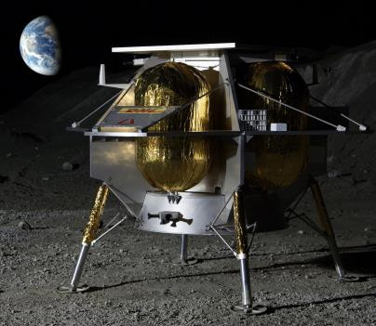
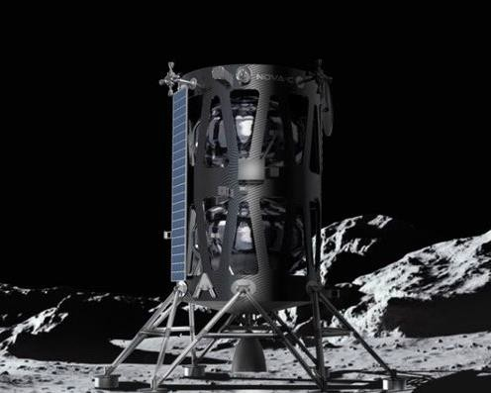
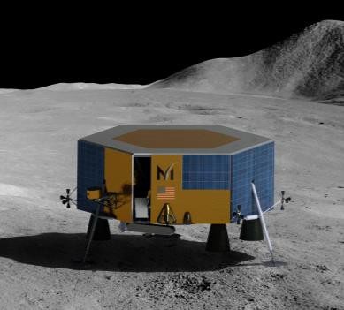
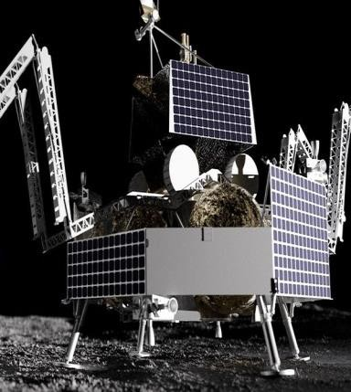
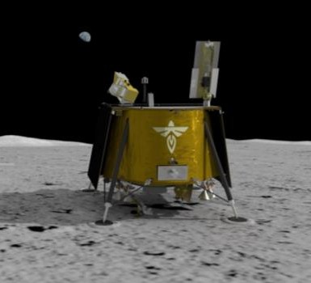
CLPS Current Portfolio
Competition open to U.S. commercial providers of space transportation services, consistent with National Space Transportation Policy and Commercial Space Act
Structured for NASA as one of many customers of commercial service
On ramps to the CLPS contracts will be used to provide
additional capabilities as made available
14 domestic companies eligible to compete for Lunar surface
delivery task orders
6 awarded lunar surface deliveries actively in work with initial deliveries as soon as November 2021.
First Round CLPS companies (Nov 2018):
Astrobotic
Deep Space Systems
Draper
Firefly Aerospace
Intuitive Machines
Lockheed Martin Space
Masten Space Systems
Moon Express
Orbit Beyond
First On-Ramp (Nov 2019):
Blue Origin
Ceres Robotics
Sierra Nevada Corporation
SpaceX
Tyvak Nano-Satellite
Systems, Inc.
TO2
Astrobotic
Peregrine
TO2/20C
Intuitive Machines
NOVA-C
TO PRIME-1
Intuitive Machines
NOVA-C
TO19C
Masten
XL-1
TO20A
Astrobotic Griffin
TO19D
Firefly Aerospace Blue Ghost
7

Slide 18
Project Scientist Responsibilities
Pre-Ops
Syn-Ops
Post-Ops
Start of Work: Manifest selection
Compile payload requirements for RFTP
Host science team meetings
Coordinate landing site selection
Develop data archiving plan
Review Vendor ConOps
Develop Contingency Ops
Manage participating scientists
Coordinate international
payloads
Promote data sharing
Guide development of Rules of
the Road
Monitor operations
Contingency operations
Conflict management
Coordinate with ESSIO, PAO to direct media inquiries to appropriate instrument sources
Support synergistic science
analyses
Coordinate data archiving
Enforce Rules of the Road for publications
End of Work: ~6 months post- ops depending on mission complexity
9

Slide 19
CLPS Manifest Selection
CLPS delivery manifests are selected through the CLPS Manifest Selection Board (CMSB)
  The CMSB includes representatives from SMD, HEOMD, STMD, OIIR, and the CLPS Project Office
Selected payloads are chosen from among solicitations to the community, directed work, and international contributions; payloads are based on priorities and available budget from each respective Mission Directorate
  International Partner payloads are generally represented by a “sponsoring” or “representative” mission directorate.
SMD will primarily use the Payloads and Research Investigations on the Surface of the Moon (PRISM) solicitation, planned approximately annually.
  PRISM solicitations are open to HEOMD/STMD and will state the location for each delivery, allowing PIs to propose science optimized for those locations
    High-value ‘location agnostic’ instruments and network science will be in future calls
    International contributions to PRISM investigations may be included at up to 30% the total cost of the investigation
  PRISM will also call out previously identified payloads for a particular delivery in order to solicit for complementary investigations and reduce redundancy

