Slide 1


Edition 4.2 EBAF (surface)
Seiji Kato, Norman G. Loeb, Fred G. Rose, David A. Rutan, Tyler J. Thorsen, Seung-Hee Ham
¹NASA Langley Research Center
²Science System & Applications Inc.
CERES Science Team Meeting
April 26-28, 2022

Slide 2
Edition 4.2 EBAF process (surface irradiances)
Bias correction of upper tropospheric (200 hPa to 500 hPa) temperature and humidity is based on MERRA-2 and AIRS L3 (possibly with CLIMCAPS) differences
  Revision of radiative kernel is TBD
Cloud fraction correction is based on MODIS and CALIPSO/CloudSat difference
Radiative kernels used for Lagrange multiplier are produced with MODIS clouds and MERRA-2
Climatological irradiance correction is applied to Terra only and NOAA-20 only periods.
Temperature and humidity diurnal cycle (MERRA-2), and solar zenith angle change are considered. Only missing diurnal cycle is cloud diurnal cycle.
Notes:
All improvements need to be included but we need to maintain the deadline.

Slide 3
Two underlying assumptions in producing noGEO EBAF
Basing concept of noGEO EBAF is that TOA and surface irradiances consist of climatological mean and anomalies. The difference of irradiances derived from Terra, Terra+Aqua and NOAA20 is caused by the difference in climatological means.
Assumptions are:
1) Terra+Aqua noGEO provides correct regional monthly mean surface irradiance (not necessarily have a correct cloud diurnal cycle, Edition 4.1 Syn provides diurnal cycle).
2) noGEO (Terra only, Terra+Aqua, and NOAA20) provides correct anomaly variabilities.

Slide 4
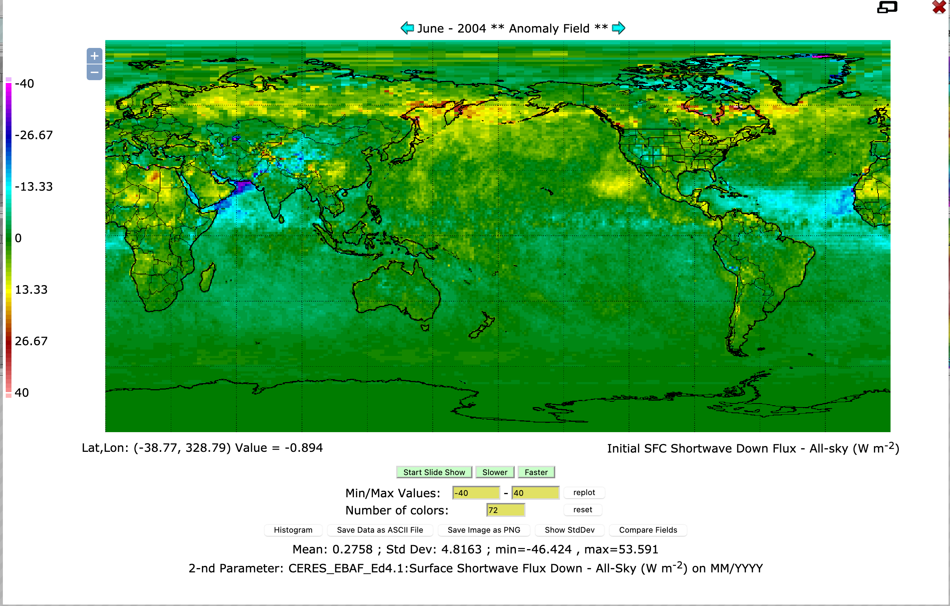
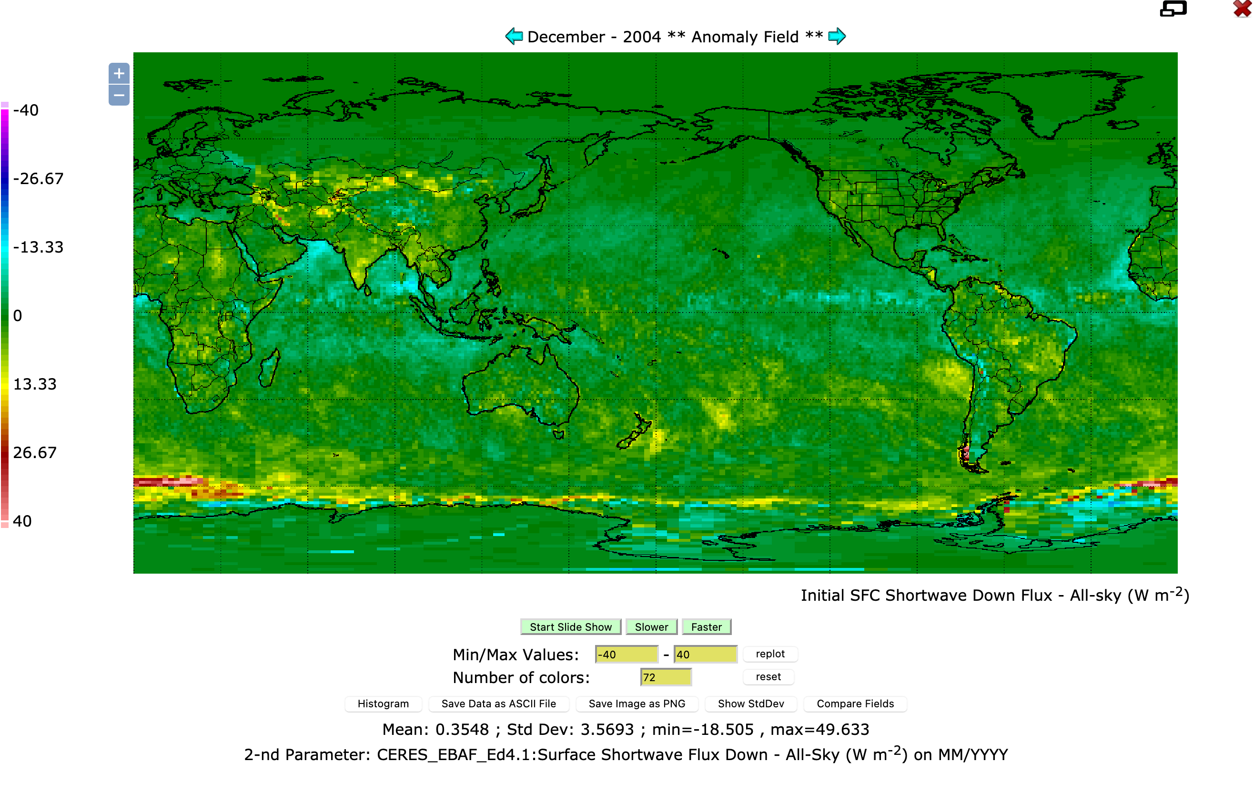
Does Terra+Aqua noGEO give correct monthly mean SW irradiances?
Difference of shortwave downward irradiance from Terra+Aqua SYN noGEO and Edition 4.1 EBAF
June 2004
December 2004
Notes:
Difference of Terra+Aqua noGEO SYN and Edition 4.1 EBAF

Slide 5
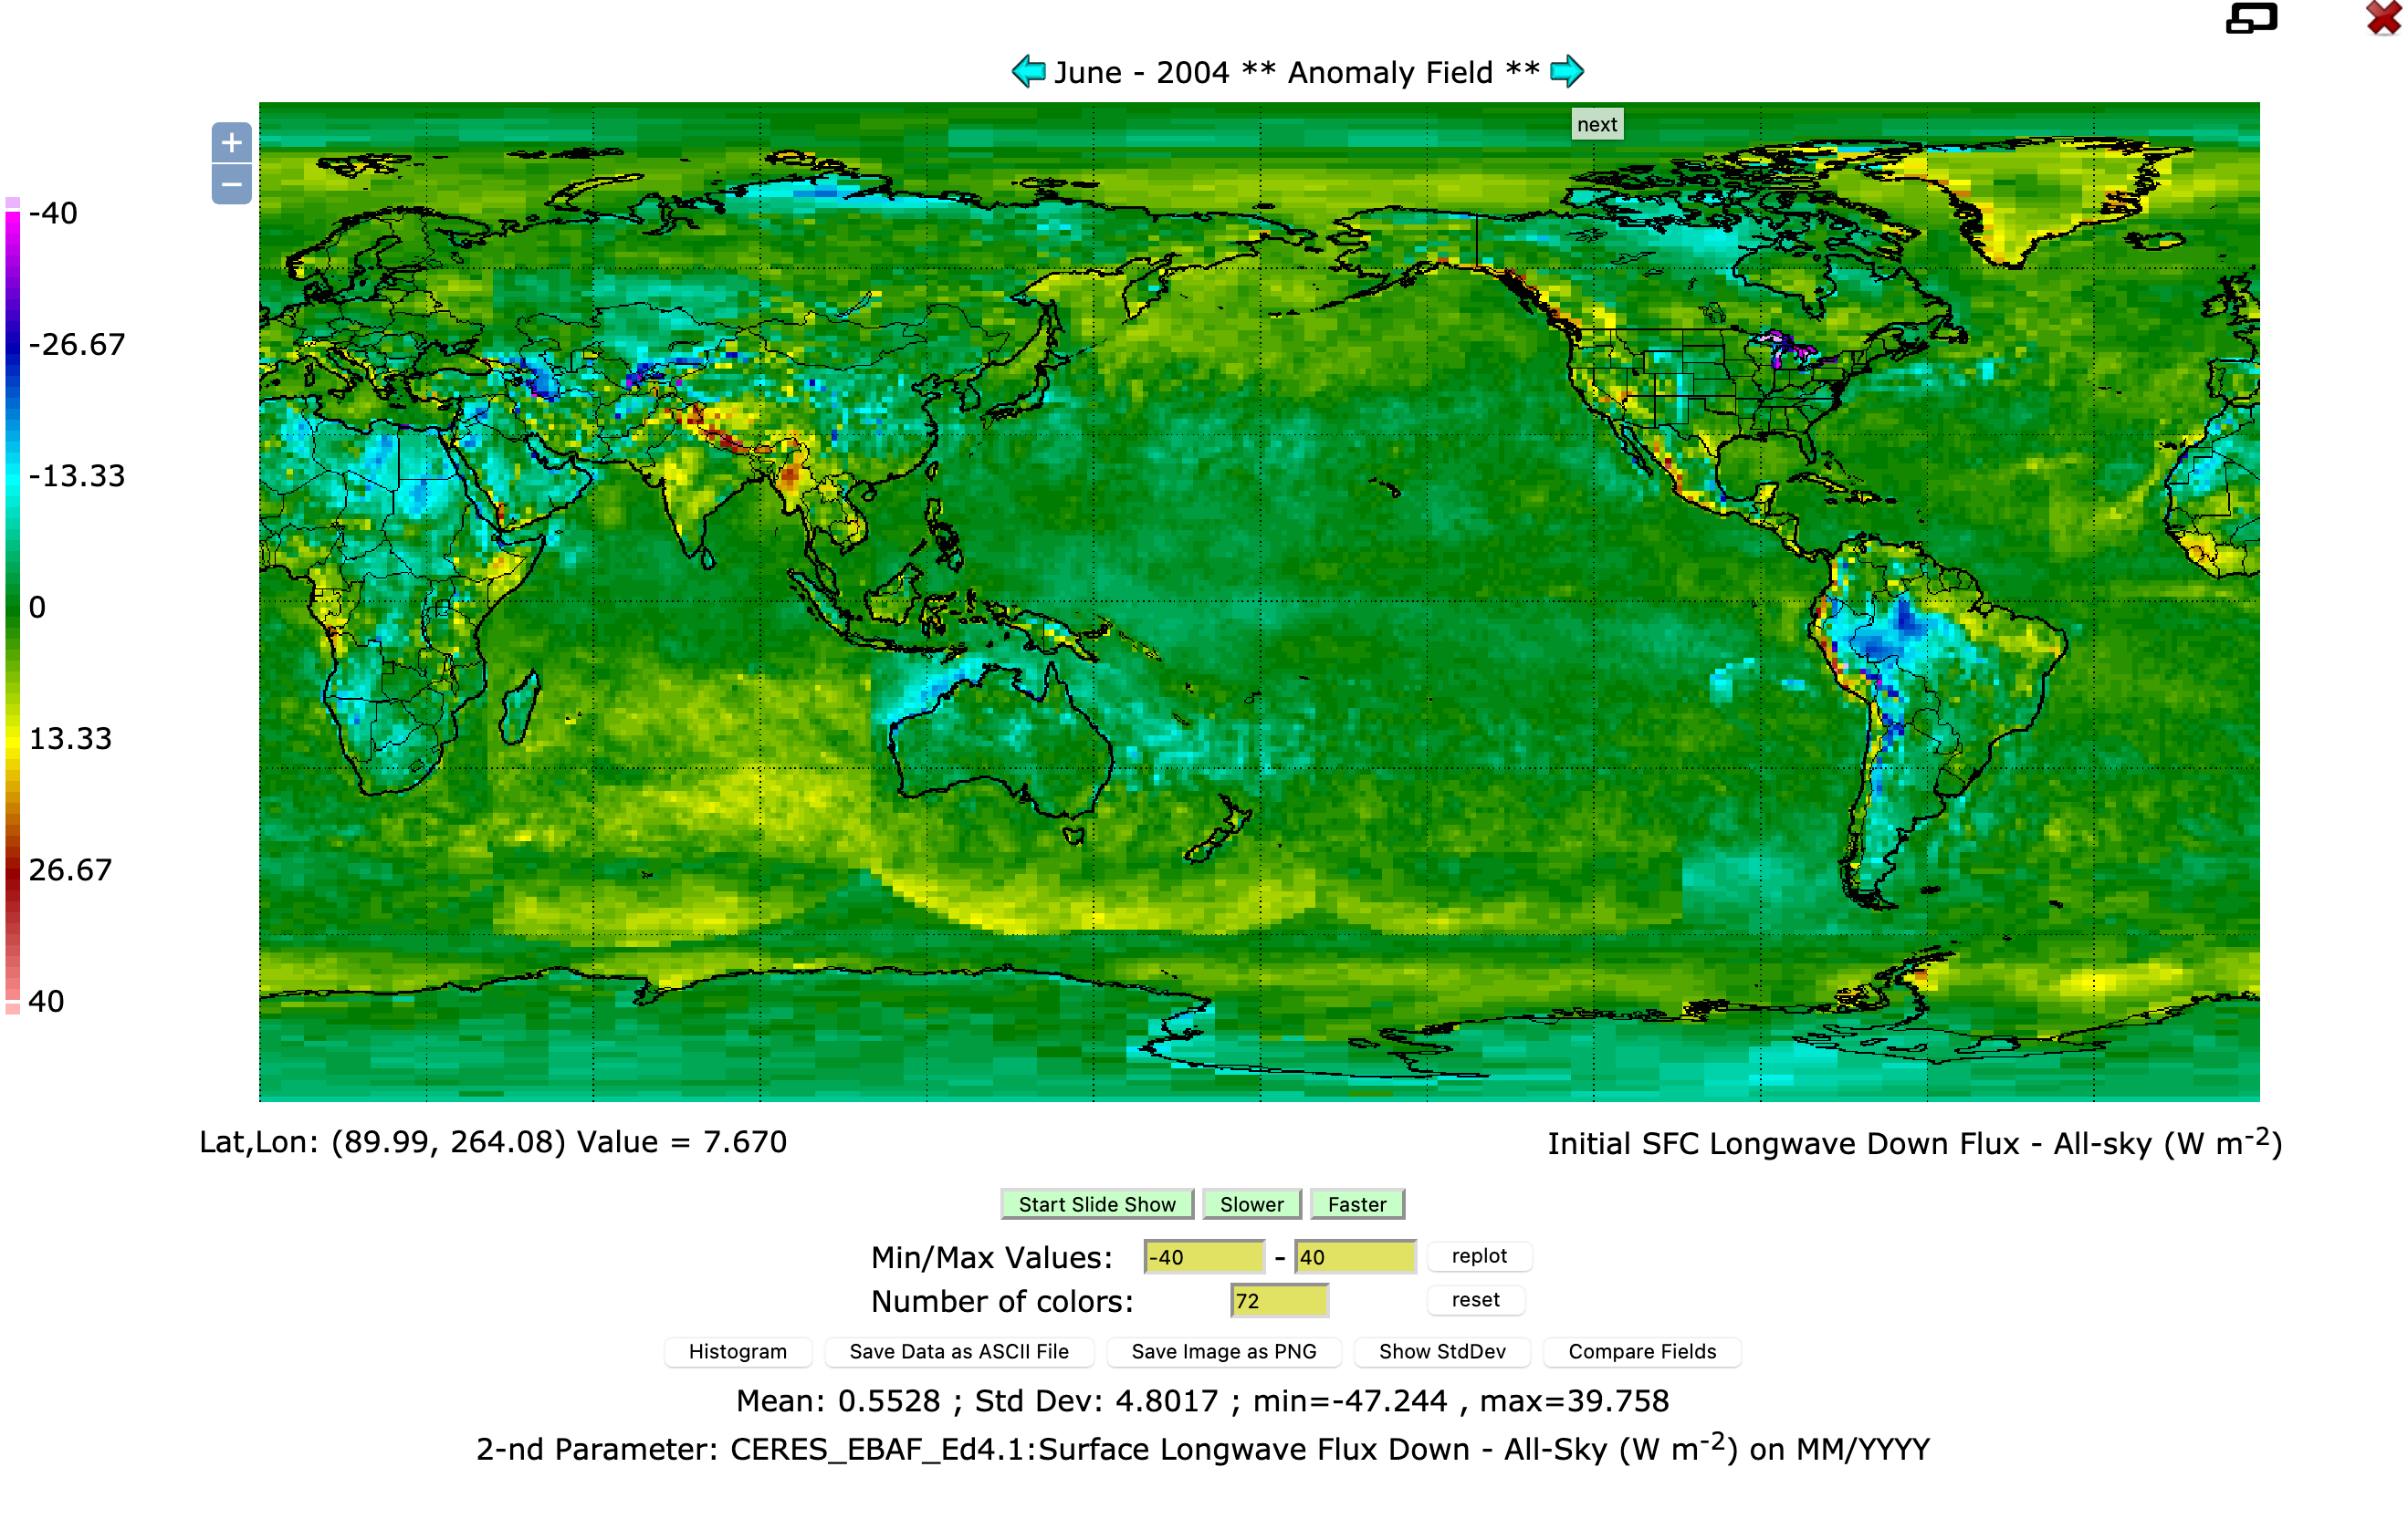
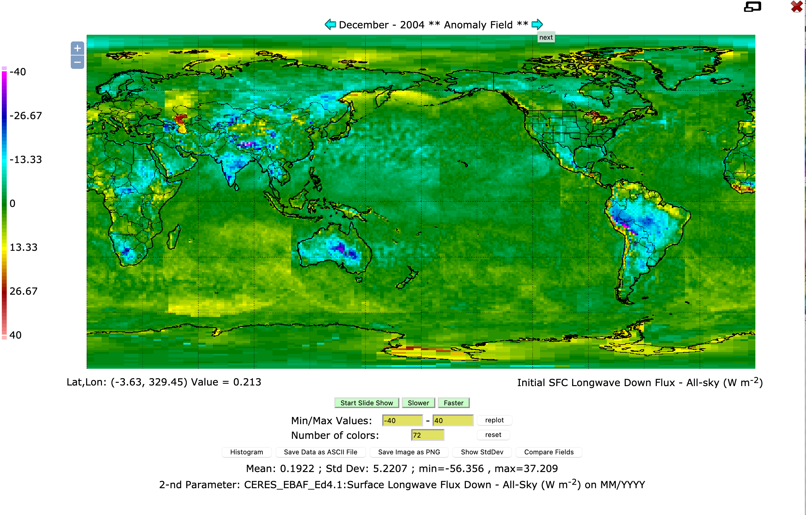
Does Terra+Aqua noGEO give correct monthly mean LW irradiances?
Difference of longwave downward irradiance from Terra+Aqua SYN noGEO and Edition 4.1 EBAF
June 2004
December 2004

Slide 6
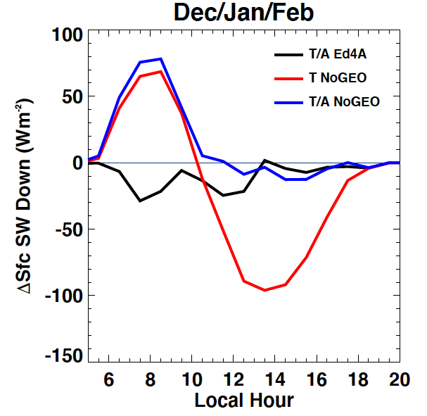
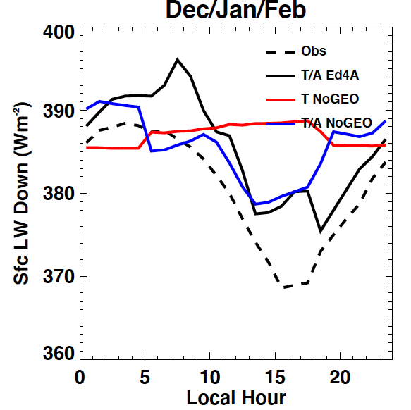
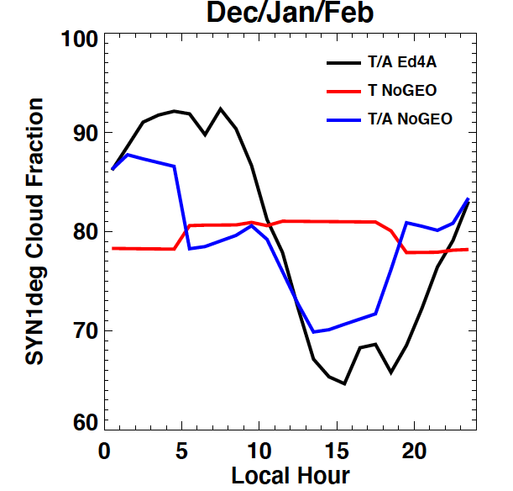
Cloud diurnal cycle at WHOI stratus buoy
Notes:
Focus on a specific region

Slide 7
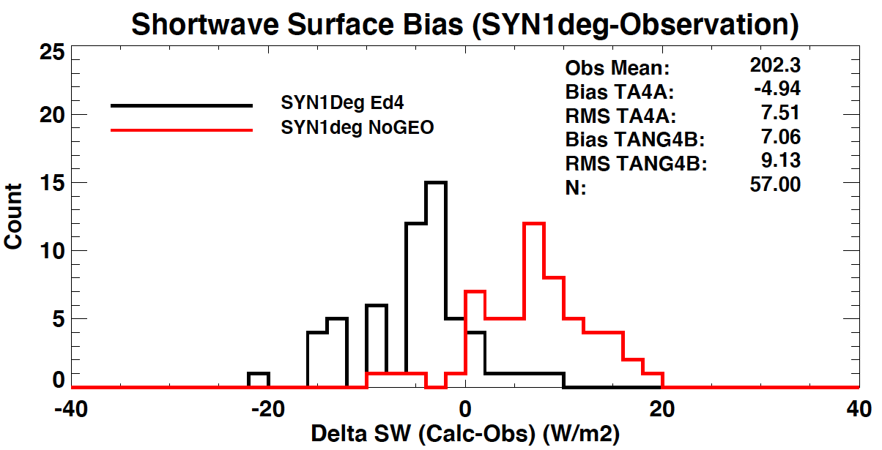
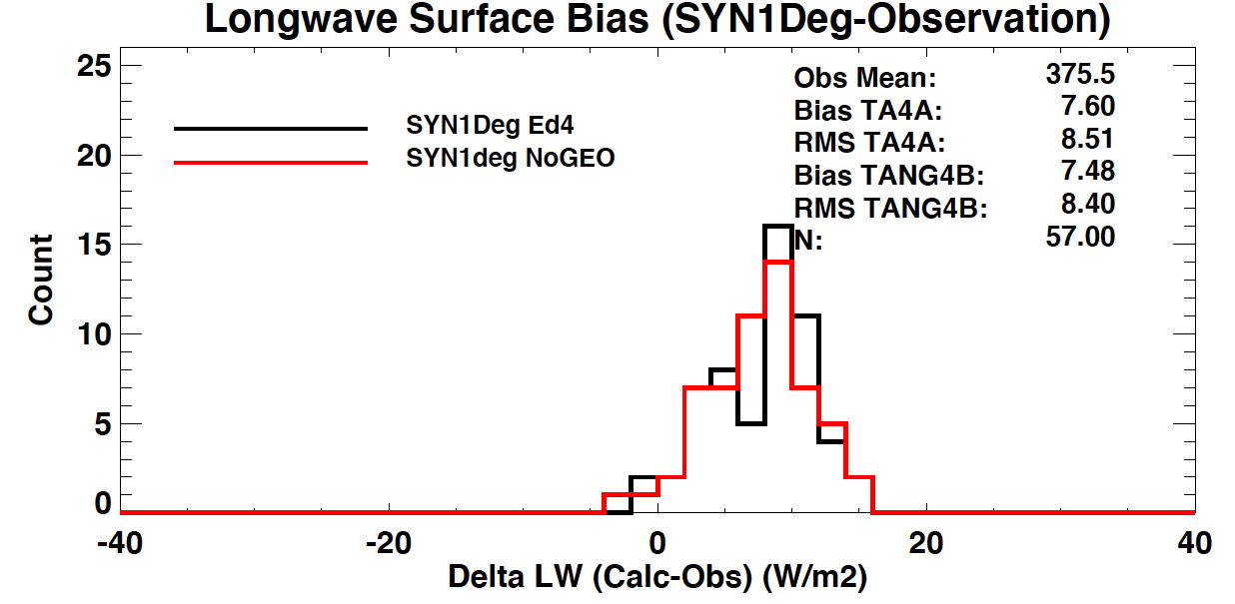
Comparison with monthly mean observed downward surface irradiance
WHOI Stratus Buoy

Slide 8
Monthly mean flux difference table
 | Downward Shortwave (Wm-2) Uncertainty ( 12 Wm⁻² land, 11 Wm⁻² ocean) | Downward Shortwave |  | Downward Longwave (Wm-2) Uncertainty (10 Wm⁻² land, 5 Wm⁻² ocean) | Downward ongwave
 | Obs. mean | T+A noGEO | T+A+GEO (SYN 4A) | Obs. mean | T+A noGEO | T+A+GEO (SYN 4A)
WHOI stratus buoy | 202.3 | 7.1 (9.1) | -4.9 (7.5) | 375.5 | 7.5 (8.4) | 7.6 (8.5)
ARM E13 | 189.7 | 0.9 (7.2) | 0.4 (3.6) | 335.2 | -6.9 (9.0) | -2.3 (5.1)
Alice Spring Australia | 259.9 | 4.3 (8.2) | 2.1 (6.7) | 360.7 | -4.2 (6.8) | -0.7 (8.3)
De Aar, South Africa |  |  |  | 315.2 | -7.2 (8.6) | -0.8 (5.6)
Table mountain CO |  |  |  | 187.6 | 3.1 (11.8) | -3.0 (10.5)
Numbers in parenthesis are RMS
Notes:
Bias tends to be larger with noGEO especially for longwave but mostly within the uncertainty.

Slide 9
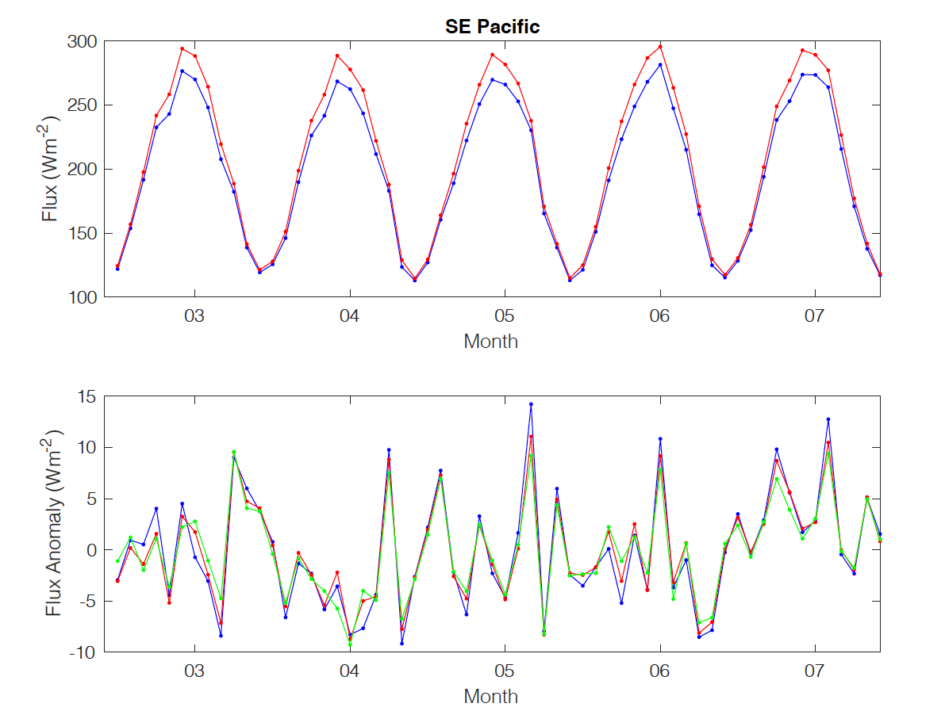
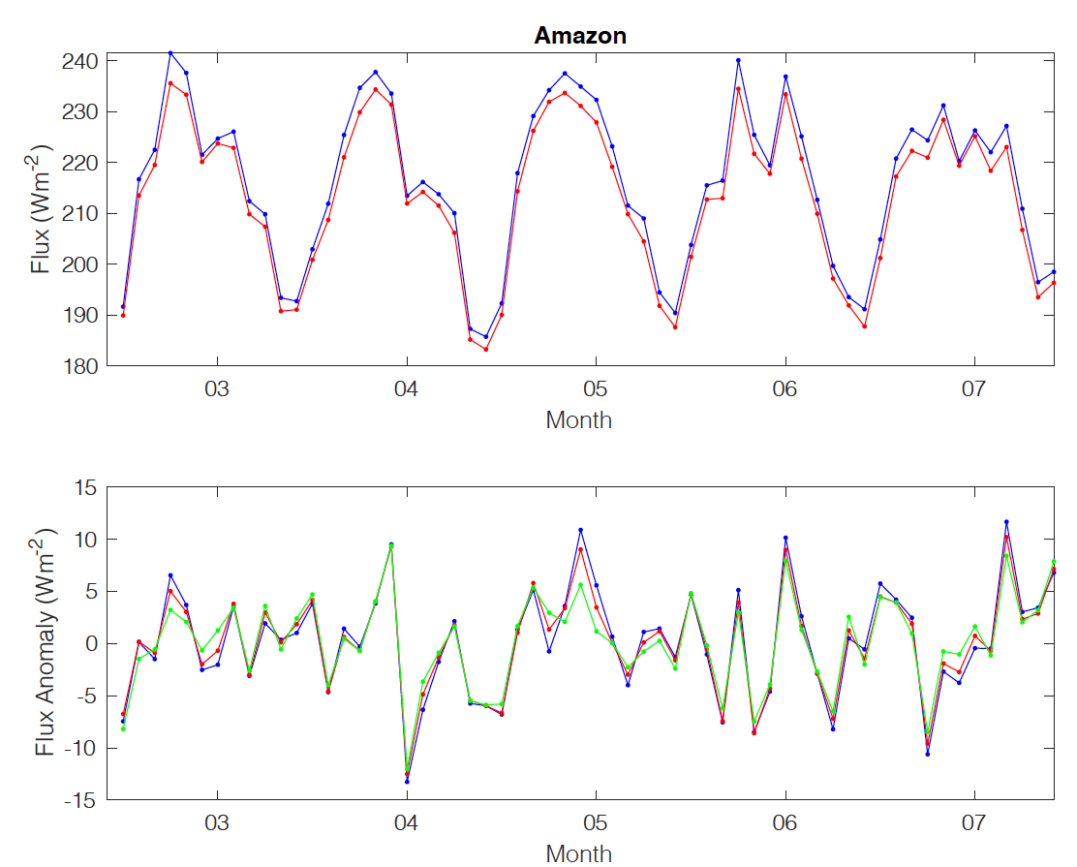
Regional anomaly time series, downward shortwave
Blue: Terra only, Red: Terra+Aqua, Green Aqua only
Southeastern Pacific (Lat 15:35, Lon 270:290)
Tropical South America (Lat 0:20, Lon315:345)
Year
Year

Slide 10
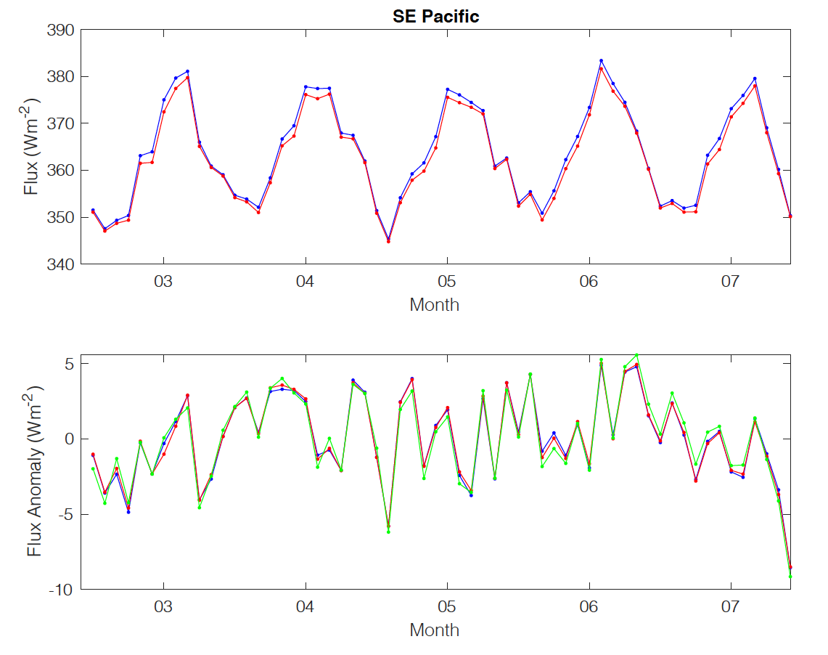
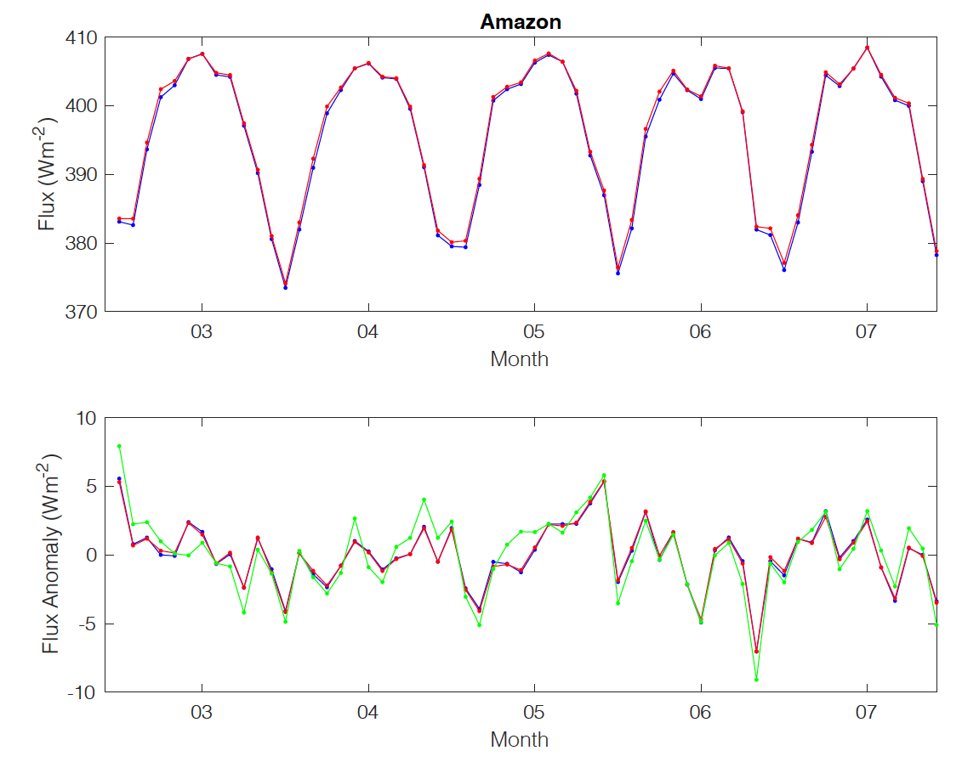
Regional anomaly time series, downward longwave
Southeastern Pacific (Lat 15:35, Lon 270:290)
Tropical South America (Lat 0:20, Lon315:345)
Year
Year
Blue: Terra only, Red: Terra+Aqua, Green Aqua only
Aqua only was produced with GEOS-5.4.1

Slide 11
Summary
Although cloud diurnal cycles are not captured by Terra+Aqua (stratocumulus region), monthly mean is not significantly biased compared with Terra+Aqua+GEO Edition 4.1 SYN.
Regional anomaly time series derived from Terra only and Terra+Aqua agree well.
Afternoon satellite can provide continuation of regional surface irradiance anomalies.

