Slide 1
Evidence Book Knowledge Graph
Susana B. Zanello, Ph.D.
NASA Human Research Program
Chief Scientist Office
KBR/NASA Johnson Space Center

Slide 2




Human Research Program (HRP)
Mission
HRP Evidence Book
To enable space exploration beyond Low Earth Orbit by reducing the risks to human health & performance through:
Basic, applied and operational research
Development of human health, performance, habitability standards, countermeasures and support technologies
Synthesis of the current available knowledge risks
Communication of our knowledge about the risks to stakeholders
Guidance for HRP science direction and for extramural NASA-funded researchers
INFORMATION: EVIDENCE BOOK

Slide 3
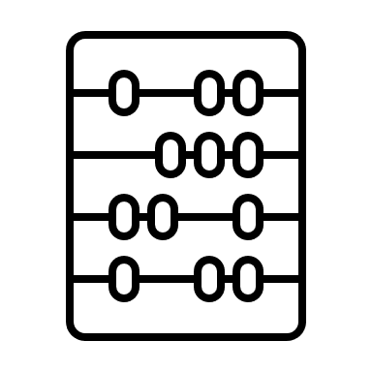



Evidence Book Knowledge Graph Value Proposition
DATA
Structure
INFORMATION
Experience
KNOWLEDGE
Inferences
Processing
Insights
Intuition
RESULTS
Decision Making
Actionable Measures
Gain actionable insights
Promote a culture of information-driven decisions: smarter/accurate/unbiased insights, evidence-based decisions

Slide 4
Building connections from evidence (example)
The NASA “Integrated Immune” study, an integrated assessment of immune, viral, and stress parameters during short- and long-duration spaceflight was one of the first studies to collect blood and saliva samples on-orbit and return these samples to earth for evaluation. For this study, to understand the effects of short-duration spaceflight on immunity, a single in-flight sample was collected from 19 short-duration Shuttle crewmembers. Because live cells are required for immune functional measures, samples were collected immediately prior to Shuttle landing in a nutrient-containing anticoagulated blood tube that ensured 48-72 hour viability. In addition to the in-flight sampling, both baseline and post-flight recovery samples were collected.
Immune assays included peripheral immunophenotype, T cell function, cytokine profiles, viral-specific immunity, latent virus reactivation, and stress hormone measurements. The short-duration study data revealed that the constitutive distribution of most peripheral leukocyte subset populations was largely unaltered during flight (Crucian et al. 2013a; Mehta et al. 2013). Exceptions included a mild increase in levels of memory CD4+ T cells and a decrease in naïve CD8+ T cells, accompanied by a corresponding increase in central/effector memory CD8+ T cells. Various functional measurements were also assessed. Cytokine-producing T cells (intracellular measurement; both CD4+/interleukin-2+ and CD8+/interferon-γ+) were mildly reduced during flight and further reduced upon landing.

Slide 5
Building the KG
Platform ontology
Assay ontology
Risk
platform
assay
Model ontology
model
assay
publication
Sample ontology
sample
sample
assay
assay
assay

