Slide 1
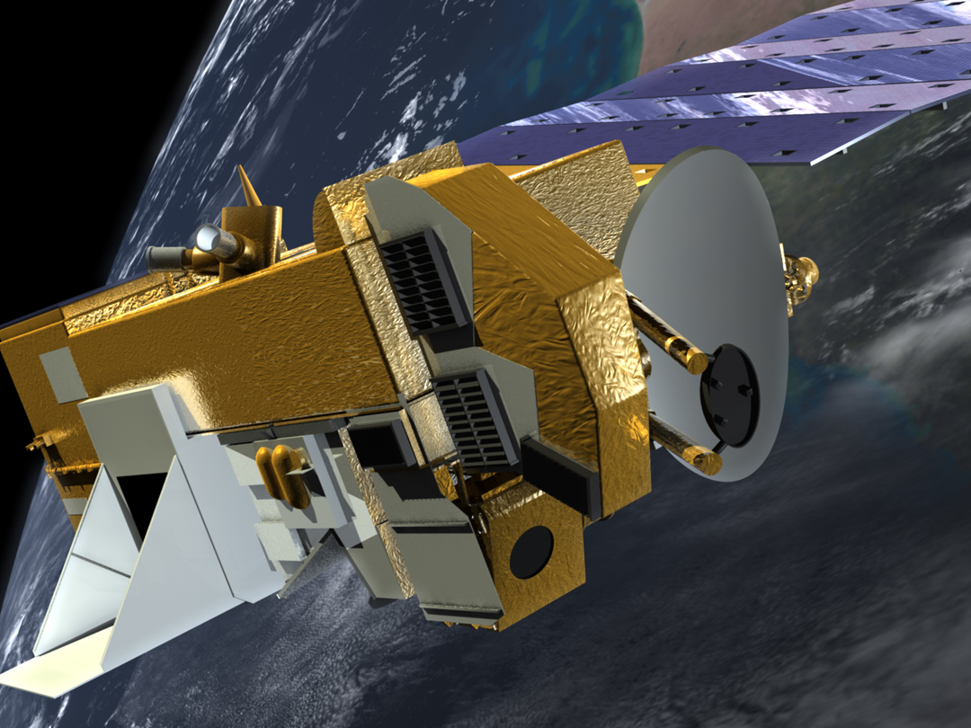
Mission Status for
Earth Science Constellation MOWG Meeting
(Hybrid)
EOS Aura
Dominic Fisher
Aura Mission Director
(Code 584 / Aerospace Corp.)
phone 301-286-3171
dominic.m.fisher@nasa.gov
May 17, 2022

Slide 2
Topics
Mission Summary
Spacecraft Subsystems Summary
Recent Activities
Planned Activities
Propellant Usage & Lifetime Estimates
Overall Summary
Additional Slides:
  Spacecraft Maneuvers & Ground Track History
  Conjunction Assessment
  Data Capture & Ops Error Statistics
  Extended Mission Plans

Slide 3
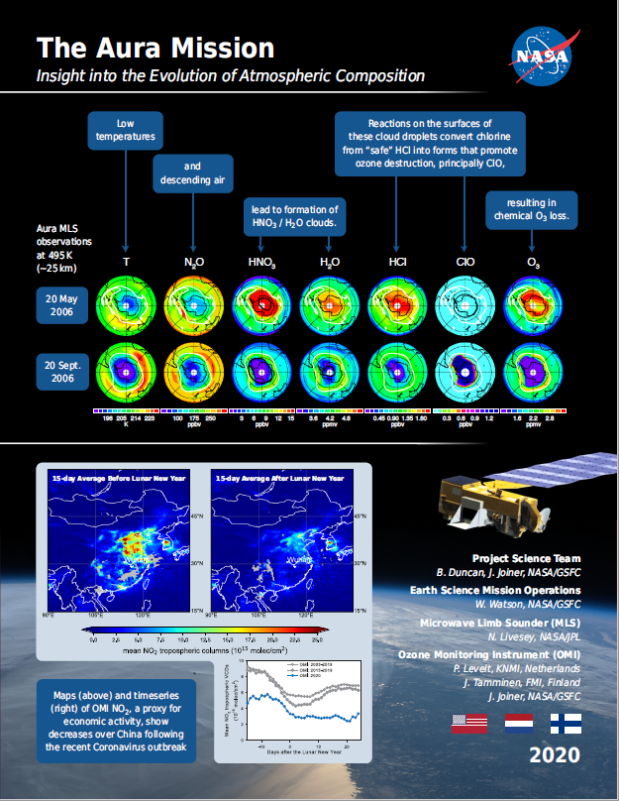
EOS Aura Mission Summary
(Updates since November 2021 MOWG (Virtual))
07/15/04: Launch
  6-Year Design Life
09/30/10: End of Prime Mission Review
09/18/15: 2015 Mission Extension Senior Review Proposal Panel Report
03/03/17: Senior Review Proposal #5
03/03/20: Senior Review Proposal #6
07/10/20: Senior Review Earth Science Subcommittee Presentation
  ‘Excellent’ Science Overall Finding
10/01/20: NASA HQ Senior Review Guidance Letter
  Extends Ops through at least FY23
  Response to letter included updated Phase F Plan and EOMP status (03/30/21)
07/15/21: Aura 17-Year Anniversary
02/01/22: ESMO Annual Review #15

Slide 4
Aura Extended Mission Timeline
TODAY
2021
2022
2023
2024
2025
2026
Q1
Q2
Q3
Q4
Q1
Q2
Q3
Q4
Q1
Q2
Q3
Q4
Q1
Q2
Q3
Q4
Q1
Q2
Q3
Q4
Q1
Q2
Q3
Q4
Senior Review Cycle
2020 SR: FY21 – FY23
2020 SR: FY24 – FY26
2023
SRP
Spacecraft
& Instrument Activities
MLT & Beta Angle Drift
Fuel Threshold
IAMs
No more IAMs,
continue DMUs to maintain ~705 km altitude
CEMs / PLMs
IAMs
IAMs
INST Off
Passivate
Power Threshold
Meetings
& Milestones
Aura
CER
KDP-F
Aqua
20-Years
Aura
20-Years
DR
DRR
Senior Review Funding (Approved)
SRP – Senior Review Proposal
INST Off – Power down instruments
Senior Review Funding (Preliminary Guideline)
CER – Constellation Exit Review
Passivate – Spacecraft passivation
IAMs – Spring Inclination Adjust Maneuvers
DR – Decommissioning Review
IAMs – Fall Inclination Adjust Maneuvers
KDP-F – HQ Key Decision Point to proceed with Phase F
NOTE: Activity & Milestone dates dependent on spacecraft performance
(i.e., fuel and power limitations)
CEMs – Constellation Exit Maneuvers
DRR – Disposal Readiness Review
PLMs – Perigee Lowering Maneuvers

Slide 5
Aura Spacecraft Subsystems
(No changes since November 2021 MOWG (Virtual))
Command & Data Handling (CDH) – Nominal
  Formatter Multiplexer Unit (FMU) / Solid State Recorder (SSR) Anomaly
    Initial symptoms occurred December 4-18, 2007
    Newest symptoms started in January 2017 and remain active (impacting S-Band HK data capture)
Communications (COMM) – Nominal
  Transmitter-B Reflected Power Anomaly (10/17/17, 01/05/18)
Electrical Power System (EPS) – Nominal
  Array Regulator Electronics (ARE) Anomalies:
    Solar Panel Connector Anomaly – ARE-3C (01/12/05) – loss of 11 strings
    MMOD Strike – ARE-5A (3/12/10) – loss of 6 strings
  ARE Degradation (due to aging):
    ARE-1A (3/12/10, 11/5/11), ARE-1C (7/14/17, 12/22/17), ARE-2A (8/24/19), ARE-2C (8/18/17),
    ARE-4A (9/23/14, 12/8/14), ARE-4C (6/6/19), ARE-5A (4/25/13), ARE-5C (9/27/12, 2/4/13), and
    ARE-6A (9/14/13)
  Estimated that Aura has lost 33 strings of solar cells out of a total of 132 strings (~75.0% remain)
Flight Software (FSW) – Nominal
Guidance, Navigation & Control (GN&C) – Nominal
Propulsion (PROP) – Nominal
Thermal Control System (TCS) – Nominal
All subsystems configured to primary hardware

Slide 6
Recent Activities
(November 2021 – May 2022)
COVID-19 Response & Impacts
  Followed NASA / GSFC response framework
    Moved back into GSFC Stage 1 on 05/01/22
    No longer in a mandatory telework posture
    2+ years of Mission Operations in GSFC Stage 2, 3, or 4 status
  Operations teams were successful in minimizing on-site presence to only essential personnel
  Met mission requirements and performed critical activities with a majority of the staff working remote (i.e., maneuver monitoring & anomaly response)
GSFC Transition Dates
Stage 2
Stage 3
Stage 4
Stage 3
Stage 2
Stage 1
03/16/20
03/18/20
03/24/20
07/20/20
06/07/21
05/01/22

Slide 7
Recent Activities
(November 2021 – May 2022)
0 Spacecraft Bus Anomalies
3 Instrument Anomalies
  2 Microwave Limb Sounder (MLS) Anomalies
    01/04/2022: GHz Mirror Electronics (GME-B) Anomaly (Recovered 01/04/22)
    03/26/2022: MLS Receiver 2 Out-of-Limit Violations (Voltage Update on 03/28/22)
  1 Ozone Monitoring Instrument (OMI) Anomaly
    03/20/2022: OMI IAM Multi-bit Error & Warm Restart (Recovered 03/21/22)
9 Spacecraft Maneuvers
  6 Drag Make-up Maneuvers (DMUMs #149 – 154)
    Routine Maintenance: 12/02/21, 01/05/22, 01/26/22, 02/16/22, 04/06/22, 04/27/22
    0 Risk Mitigation Maneuvers (RMM)
  3 Inclination Adjust Maneuvers (IAMs #77 – #79)
    Spring 2022 IAMs: 03/02/22, 03/09/22, 03/16/22 (Last IAMs for the mission)
1 Instrument Maneuvers
  MLS Yaw #17 (Moon Scan) – 03/20/22
9 High Interest Events (HIEs) (Tiers 1-4) (As of 03/31/22 – More details in back-up)
  9 Tier 3 Events (T3) – Maneuver options planned and screened
  0 Tier 4 Events (T4) – Maneuver executed

Slide 8
Spring 2022
Inclination Adjust Maneuver Schedule
Sunday | Monday | Tuesday | Wednesday | Thursday | Friday | Saturday
27 | 28 | 1 March | 2 Aura IAM #77 | 3 | 4 | 5
6 | 7 | 8 | 9 Aura IAM #78 | 10 | 11 | 12
13 | 14 | 15 | 16 Aura IAM #79 | 17 | 18 | 19
20 MLS Yaw #17 EPS SOH Test | 21 | 22 | 23 | 24 | 25 | 26
27 | 28 | 29 | 30 | 1 April | 2 | 3

Slide 9
Recent Activities
(November 2021 – May 2022)
Aqua / Aura Maneuver Working Group (MWG)
  Aqua Delta Constellation Exit Review (ΔCER) Follow-up
    Per ESMO Management direction, followed the updated Aqua exit plan:
      No Aqua CEMs / PLMs in January 2022
      No more Aqua DMUs moving forward
    FDS generated Aqua passing predictions for GCOM-W and OCO-2
  Aqua / Aura Lifetime Analyses
    FDS presented ‘Aura Post-Fall 2021 IAM Series Lifetime and Decommissioning Analysis’
    FDS completed updates to Aqua & Aura lifetime documents
  Aura IAM Planning
    Consulted with Aura science and instrument teams regarding Aura lifetime analysis and IAM options for Spring 2022
    Selected Option #1 to perform 3 IAMs in Spring 2022 and maintain stable MLT for longer
  Retrograde Maneuver (RM) Capability Development
    FOT presented slides on current state of Aqua retrograde maneuver capabilities (response to Aqua ΔCER / MOWG action item)
  Propulsion Performance Monitoring
    FOT presented thruster swap preparation status in response to Aqua DMU #162 performance (35% HOT due to significant post-maneuver firings during attitude hold mode)

Slide 10
Recent Activities
(November 2021 – May 2022)
TES Laser End of Life (EOL) Testing [since decommissioning on 01/31/18]
  Phase 2 testing will alternate leaving Laser A or B ON for extended durations and characterize performance every 6 months
  Previous Phase 2 Testing:
    Round 1 (November 2018), Round 2 (April 2019), Round 3 (October 2019), & Round 4 (November 2021)
  Phase 2, Round 5 Testing:
    Planned for May 2022
    Testing to include characterizing Laser B and turning it OFF, then turning Laser A ON and characterizing

Slide 11
Planned Activities
Summer 2022: FDS Lifetime Analysis Updates
  Updates to incorporate Spring IAM performance and new solar flux predicts
Fall 2022: Aura End of Mission Plan (EOMP) Updates (Rev E)
  Updates to DAS inputs, lifetime analysis, and reliability assessment
Fall 2022: Earth Science Constellation (ESC) MOWG
  Present mission status and upcoming activities
Fall 2022: ESMO Decommissioning Peer Review (#2)
  End of Mission activity planning and spacecraft passivation sequence development
January 2023: ESMO Annual Review (#16)
Mid-to-Long-Term Plans:
  2023 Senior Review Proposal for Aura
    Include updated Aura EOMP (Rev E) and mission lifetime performance statuses
  Maneuver Working Group (MWG)
    Retrograde Maneuver (RM) capability development (CEM / PLM schemes)
  EOS Automation (EA) – automation of routine operations
    Complete the necessary FOT processes for 2-person EOS online operations
  Mission Operations Conjunction Assessment (MOCA)
    Continue to improve process - CRMS R10 delivery & checkout Summer 2022

Slide 12
Collision Risk Management System (CRMS)
Process Improvements
ESMO has developed ground system capabilities to autonomously identify and develop maneuver options to assist in Risk Mitigation Maneuver (RMM) / Debris Avoidance Maneuver (DAM) planning
Developed in response to an increased number of predicted close approaches with orbital debris and operational satellites
  More High Interest Events (HIEs) had led to more effort to plan mitigation maneuvers
  Concern is that updates to the US Air Force Space Fence will significantly increase the size of the Space Catalog
Key CRMS capabilities include:
  User defined collision risk thresholds
  Maneuver optimization for conjunctions with multiple secondary objects
ESMO developed MOCA CONOPS in support of CARA Devolution initiative
  Completed Parallel Ops test phase in Fall 2019 (09/26/19)
  MOCA CONOPS (v20) updated 09/01/21 to adhere to the NASA Interim Directive (NID)
EOC is operating with CRMS Release 9.1 (ORR 12/08/2021)
  CRMS R10 PSR & TRR held on 05/04/2022

Slide 13
Aura Propellant Usage
(Analysis Updated December 2021)
2006: Initial Aura lifetime fuel analysis
2008: Detailed Aqua & Aura lifetime analysis
  Presented to MOWG and at Aura End of Prime Mission Review in Sep 2010
2012 (September): Initial Aura Decommissioning Plan
  Included updated Lifetime Estimates
2013 (August): Updated Decommissioning Plan
  Included updated Constellation Exit Plan
2014 (September): Updated Decommissioning Plan
2015 (September): Decommission Plan Update Postponed
  Postponed to evaluate long-term plan and decommissioning maneuvers
2016 (January): Updated Decommission Plan (v1.2)
  Included hypothetical MLT drift analysis with LS-8
2017 (October): Updated Decommission Plan (v1.0)
2018 (July): Updated Decommission Plan (v1.0)
  Summer IAM required update to document and IAM Plans
  Included Appendix B with alternate plan to drift after 2019 IAMs
2018 (November): Updated Decommission Plan (v2.0)
  Updated definitive fuel usage & predicted solar flux levels
  Updated propellant estimates for IAMs w/ RWAs & DMUs
2019 (July): Updated Decommission Plan (v1.0)
  Update definitive fuel usage & predicted solar flux levels
2020 (November): Updated Aura Lifetime Analysis
2021 (January): Updated Decommission Plan (v1.0)
  Updated report with definitive fuel usage & predicted solar flux levels
2021 (July): Updated Aura Lifetime Analysis
2021 (December): Updated Aura Lifetime Analysis
2022 (February): Updated Decommission Plan (v1.0)
  Updated report with definitive fuel usage & predicted solar flux levels
  Updated propellant estimates for CEMs & PLMs
Final will be produced 60 days before start of decommissioning

Slide 14
Remaining Fuel Estimate
(Analysis Updated July 2021)
Long-term orbit simulations were run for Aura through 2025
  Used mean nominal Schatten solar flux predictions (November 2021)
  Estimated the frequency of drag make-up maneuvers to maintain Aura’s WRS-2 ground track requirements
  Estimated the required number of annual inclination maneuvers for Aura to maintain it’s mean local time (MLT) requirement
    With limited fuel remaining, Aura may pass MLT limits to extend A-Train operations life
  Did not include potential debris avoidance maneuvers
  Utilized FreeFlyer 6.10.0 which incorporated the solid earth tide model allowing greater accuracy for long term predictions of inclination, beta angle, and mean local time
Lifetime predictions for Aura shows that the spacecraft will have sufficient fuel to maintain its current orbit within the Afternoon Constellation through June 2024
Aura will hold sufficient fuel in reserve after exiting the constellation to lower perigee such that reentry will meet the NASA 25-year reentry requirement.
Analyses are updated annually by ESMO Flight Dynamics Team
  Currently developing a retrograde maneuver capability

Slide 15
Debris Assessment Software
(Analysis Updated December 2021)
The Debris Assessment Software (DAS) was created by the Orbital Debris Office at Johnson Space Center and is the Agency standard for end of mission life analyses and lifetime estimations (Version 3.1)
Solar Flux file from September 2021
DAS requires several inputs describing the spacecraft’s mission:
  Start apogee = 697.29 km (based on mean BLJ2 elements)
  Start perigee = 641.95 km (based on mean BLJ2 elements)
  Spacecraft Dry Mass = 2790.546 kg (includes 1.2 kg of unusable fuel and 4.8 kg of uncertainty)
  Tumbling Area = 46.1 m² (FDSS-II-07-0085_Aura Average Area _V1.0 (3/1/17))
  Area-to-Mass Ratio = Tumbling Area / Dry mass = 0.016513 m²/kg
  Start inclination = 98.37º
  Start RAAN = 169.57º
  Start Argument of Perigee = 87.59º
  DAS propagation Start Date = 08/01/2025
In turn, DAS outputs:
  If the mission is compliant with NASA requirements for limiting orbital debris
  A recommended apogee and perigee that will allow the spacecraft to reenter within a specific period and satisfy the NASA requirements
Aura has a waiver to the 30-years from launch requirement
Aura will hold sufficient fuel in reserve to meet the 25-year requirement

Slide 16
Fuel Usage: Actual & Predicted
(Analysis Updated December 2021)
2009
IAM Series
Constellation Exit and Perigee Lowering (July - Sep 2024)
2021 Fall
IAM Series
Fuel reserved to safely exit constellation, lower perigee and meet Agency 25-year reentry requirement is approximately 27.95 kg (including a 6.19-kg buffer)
2022 Spring IAM Series
Constellation Exit Fuel Limit

Slide 17
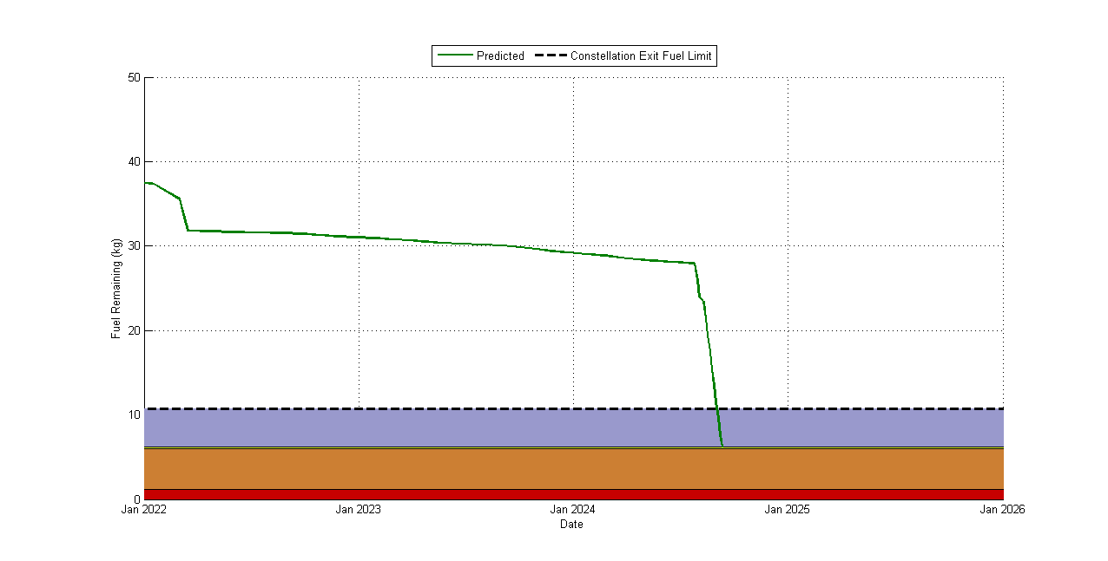
Aura Predicted Available Fuel
(Analysis Updated December 2021)
Available Fuel
Constellation Exit Fuel Limit (10.7 kg)
2022 Spring IAM Series
Fuel required to perform ~4.4 km constellation exit (4.51 kg)
RMM fuel buffer (0.19 kg)
Uncertainty in EOL fuel measurements (Estimate) (4.8 kg)
Unusable fuel in the propulsion system (1.2 kg)
Constellation Exit and Perigee Lowering Maneuvers (July - Sep 2024)

Slide 18
Aura Power Generation Predictions
(Analysis Updated December 2021)
Minimum Required Power for Loads and Battery Charging is 3177 W
Power Margin = 0 W when the Solar Array strings required equals the Solar Array strings remaining. Projected to occur with ~90 strings remaining and about 32.5° Beta Angle
Power Generation limit predicted to be reached in Summer 2025
Power Generation limit predicted to be reached in Aug 2025

Slide 19
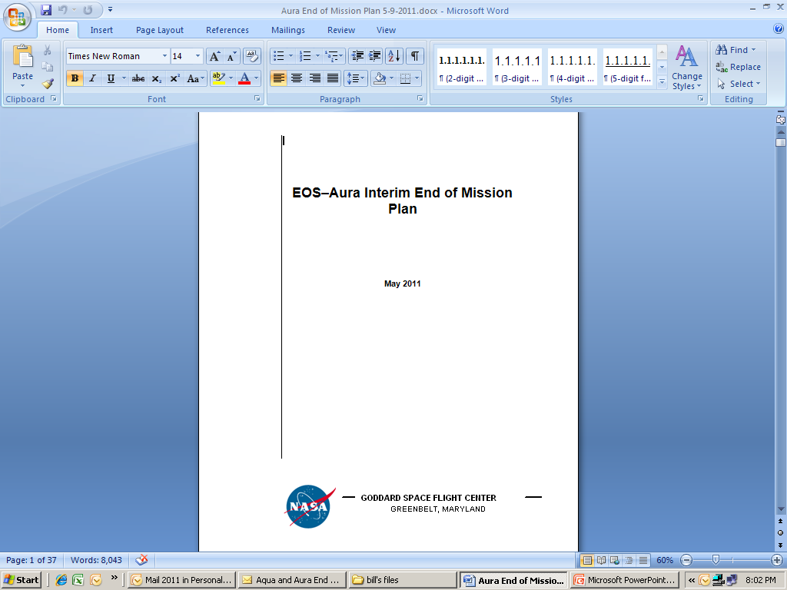
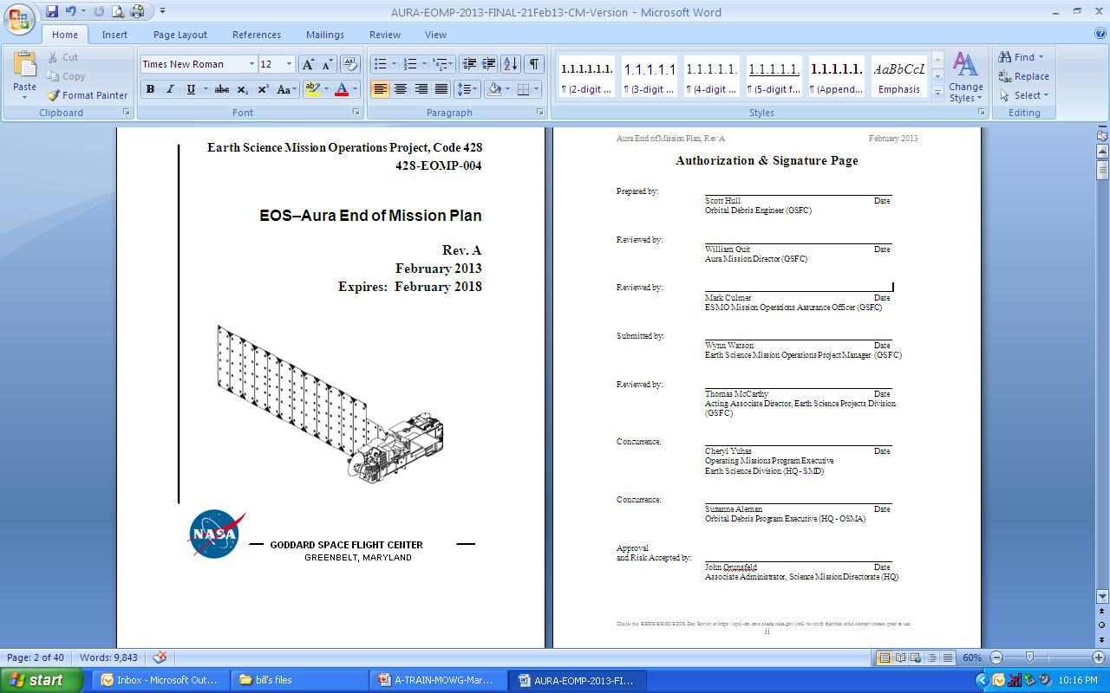
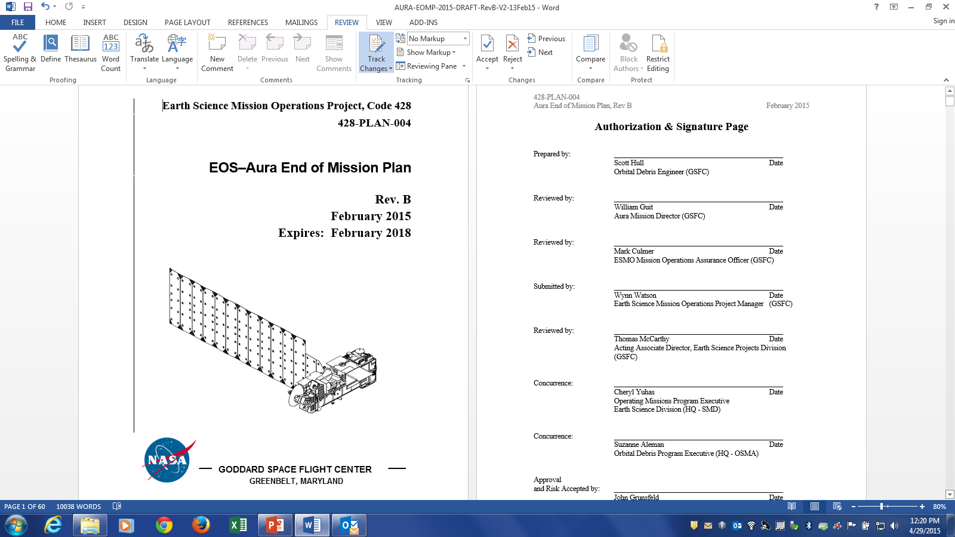
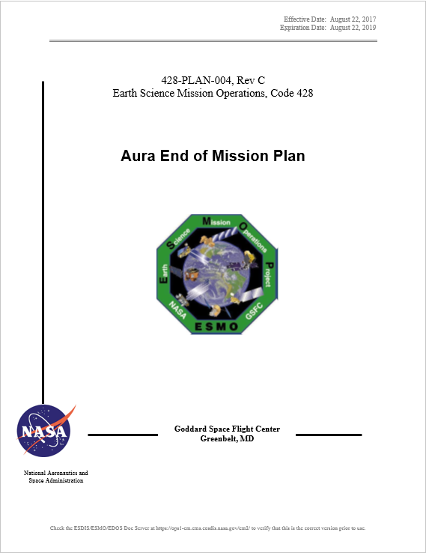
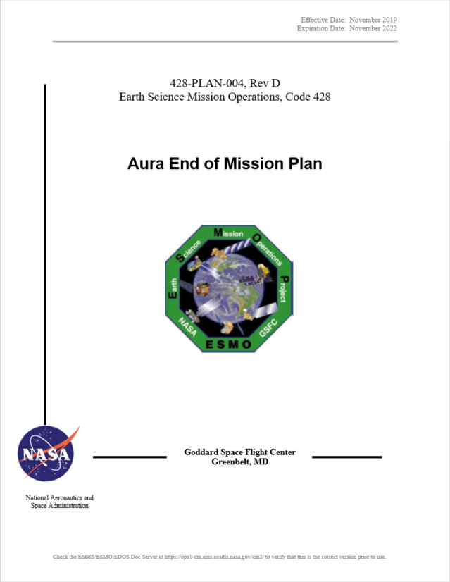
Aura End of Mission Plan (EOMP)
(No changes since May 2021 MOWG (Virtual))
Initial draft February 2009
Produced the first “Interim” End of Mission Plan (EOMP) in May 2011
  Approved by NASA HQ July 2011
Produced EOMP Rev A: February 2013
  Waivers were approved in May 2013
Produced EOMP Rev B: February 2015
  Updated Lifetime Estimate
Produced EOMP Rev C: August 2017
  Lifetime and Reliability estimates as of December 2016
Produced EOMP Rev D: November 2019
  Lifetime and Reliability estimates as of October 2019
  Signatures completed in March 2021
  Aura EOMP Rev D expires in November 2022
Content Synopsis:
  Safely exit the A-Train Constellation
  Passivate Aura to the extent possible for uncontrolled reentry
  Aura has five (5) approved waivers for passivation
    Pressurant Passivation, Large Object Collision Probability, Small Object Collision Probability, Orbital Lifetime (30-Year), and Re-entry Risk (Un-controlled)
Final will be produced 60 days before End of Mission

Slide 20
Summary
Spacecraft Status – GREEN
Instrument Status – GREEN
  HIRDLS: Chopper Stalled 03/17/08 – Not collecting science data
  MLS: Operating Normally –
    07/18/2019: 190 GHz Receiver-2 (R2) Anomaly (Recovered 07/24/19)
    12/08/2020: GHz Mirror Electronics (GME-B) Anomaly (Recovered 12/09/20)
    06/01/2021: GHz Mirror Electronics (GME-B) Anomaly (Recovered 06/01/21)
    01/04/2022: GHz Mirror Electronics (GME-B) Anomaly (Recovered 01/04/22)
    03/26/2022: Receiver-2 (R2) Out-of-Limits Violation (PLL Voltage Update on 03/28/22)
  OMI: Operating Normally
    05/30/2021: OMI IAM Warm Restart (Recovered 06/01/21)
    03/20/2022: OMI IAM Warm Restart (Recovered 03/21/22)
  TES: Instrument Decommissioned on 01/31/18
Data Capture/L0 Processing Status – GREEN
  SSR Data Capture to 03/31/2022: 99.9955693 %
Ground Systems – GREEN
  Responding to new security requirements and upgrades to obsolete hardware or COTS systems, as required
  10/14/2021: Online (Eclipse) Build 23.01 ORR
  02/02/2021: EOS Automation (EA) Release 3.4.2 ORR

Slide 21
Questions?

Slide 22
Additional Charts
Maneuvers & Ground Track History
Orbital Trends
Aura Conjunction Assessment
High Interest Events (HIEs)
Data Capture & Operations Errors
Extended Mission Plans
(Analysis Updates)

Slide 23
Orbit Maintenance
Mission Requirements: Perform Drag Make-Up Maneuvers (DMUMs) to maintain Ground Track Error (GTE) with respect to the World Reference System (WRS-2)
  Requirement: +/-20 km as measured at the Descending Node
To meet coincident viewing requirements, Aura’s initial ground track was offset from Aqua’s by one WRS path plus 25.4 km
  Aura was maintained -5.4 to -45.4 km west of Aqua until late 2007
  Since May 8, 2008, a new control box, +/- 10 km from a +18 km (east) offset of the Aqua WRS-2 path is used to maintain MLS-CALIPSO viewing request
Control Box Excursions: To date there have been 4 control box excursions
  3 on +10km front-side: 9/5/12 - 9/6/12, 03/23/15 - 04/17/15, and 12/31/21 - 01/11/22 (increase in drag)
  1 on -10km back-side: 2/12/13 to 3/13/13 (drop in drag after DMUM on 1/16/13)
To date a total of 154 Drag Make-up (DMU) maneuvers have been performed:
  07/19/2012: DMUM # 43 No Yaw Slew Maneuver (NYS) #1
  Last maneuver 04/27/2022 (DMU #154) – Next DMU (#155) planned for 05/__/22
  Variation in performance from –6.7% (cold) to +5.3% (hot)
To date a total of 79 Inclination Adjustment Maneuvers (IAMs) have been performed:
  Last maneuvers completed on 03/02/22 (IAM #77), 03/09/22 (IAM #78), and 03/16/22 (IAM #79)
  No more IAMs planned for the remainder of the mission
  Variation in performance from -7.2% (cold) to +3.5% (hot)

Slide 24
WRS Ground Track Error (GTE)
(As of April 10, 2022)
May 8, 2008
Re-Phase Maneuver
Updated Biannually for ESC MOWG Meetings

Slide 25
WRS Ground Track Error (GTE)
(As of April 10, 2022)

Slide 26
Aura Averaged MLT @ Ascending Node
(As of April 10, 2022)
Fall 2004
IAMs
Spring 2007
IAMs
Spring 2010
IAMs
Spring 2012
IAMs
Spring 2014
IAMs
Spring 2016
IAMs
Spring 2019 IAMs
Fall 2019
IAM
Spring 2021
IAMs
Fall 2021
IAMs
Spring 2018
IAMs
Fall 2006
IAMs
Spring 2011
IAMs
Spring 2020
IAMs
Fall 2020
IAMs
Spring 2009
IAMs
Spring 2013
IAMs
Spring 2017
IAMs
Summer 2018
IAM
Spring 2015
IAMs
Spring 2022
IAMs

Slide 27
Aqua/Aura Mean Local Time (MLT)
@ Ascending Node (As of April 10, 2022)
Upper Mission Limit (14:00:00)
Fall 2004
IAMs
Fall 2006
IAMs
Spring 2007
IAMs
Spring 2009
IAMs
Spring 2010
IAMs
Spring 2012
IAMs
Spring 2014
IAMs
Spring 2016
IAMs
Spring 2018
IAMs
Spring 2020
IAMs
Fall 2020
IAMs
Spring 2019
IAMs
Fall 2021
IAMs
Spring 2011
IAMs
Spring 2013
IAMs
Spring 2015
IAMs
Spring 2017
IAMs
Summer 2018
IAM
Fall 2019
IAM
Spring 2021
IAMs
Spring 2022
IAMs
Lower Mission Limit (13:30:00)
Aqua
Aura
Updated after Inclination Adjust Maneuvers

Slide 28
Aura Predicted Beta Angle
(With Yearly Inclination Maneuvers) (As of April 10, 2022)

Slide 29
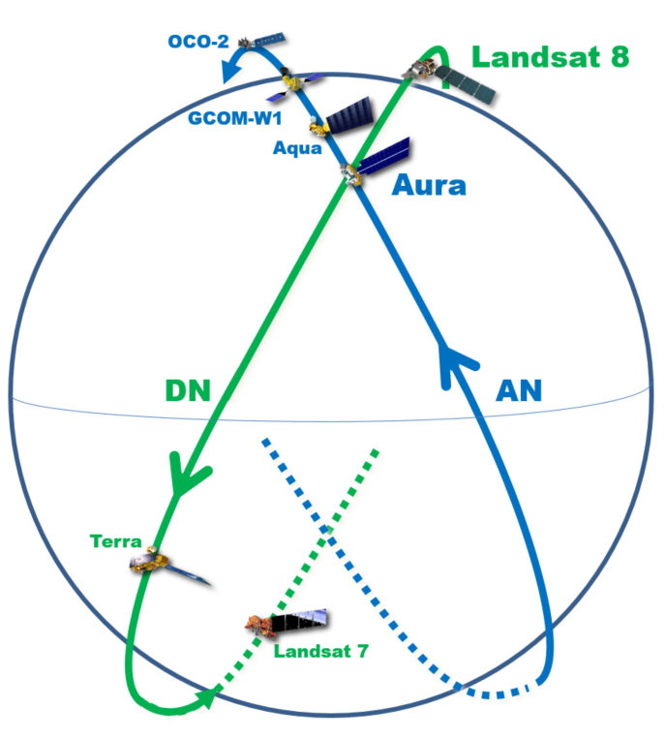
Aura and Landsat-8 (LS-8)
Orbit Phasing
Aura is predicted to cross LS-8 in August 2023
Aura is predicted to have 3 passings with Aqua in 2023
In 2021 there has been 255-312 seconds between Aura and LS-8
Terra ~ 41 min
behind LS-8
1 Orbit = ~ 100 minutes

Slide 30
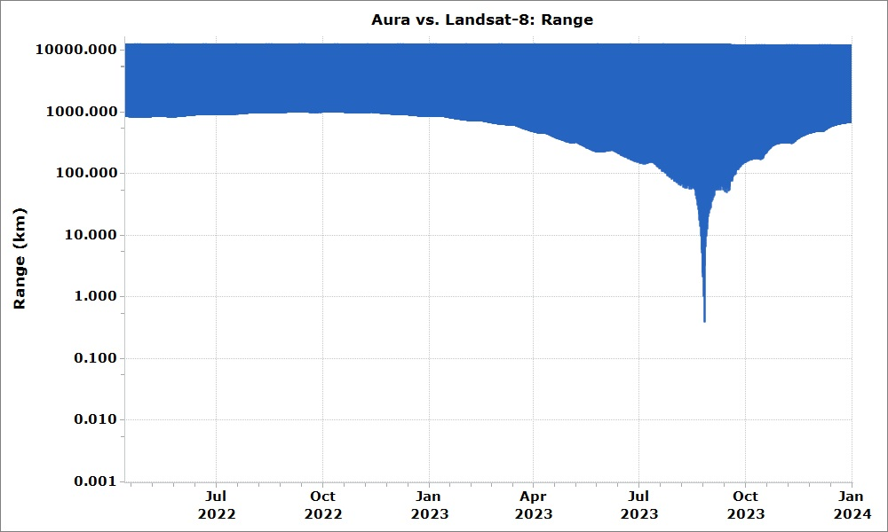
LS-8/Aura Range Prediction
(As of March 2022)
Uses March 2022 Landsat-8 and Aura ephemerides for range predictions.
Crossing
August 2023

Slide 31
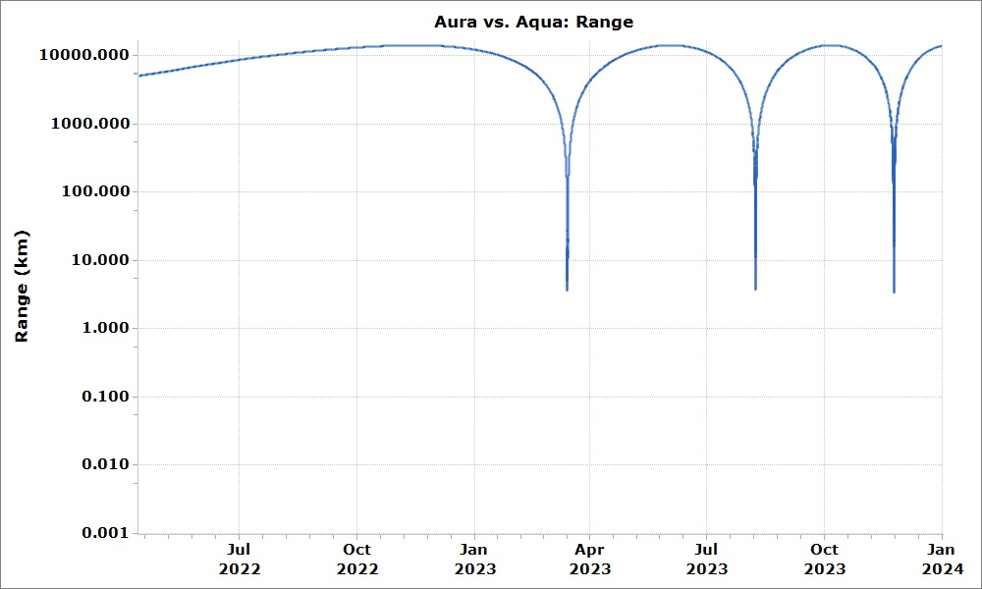
Aqua/Aura Range Prediction
(As of March 2022)
Uses March 2022 Aqua and Aura ephemerides for range predictions.
Passing
March 2023
Passing
August 2023
Passing
November 2023

Slide 32
Aura Conjunction Assessment
High Interest Events (HIEs)
 | Dec `21 | Jan `22 | Feb `22 | Mar `22 | Apr `22 | May `22 | Total
Tier 3 | 1 | 1 | 3 | 4 |  |  | 9
Tier 4 | 0 | 0 | 0 | 0 |  |  | 0
Total | 1 | 1 | 3 | 4 |  |  | 9
  2016: 24 CARA HIEs – 16 required significant action (T2-T4)
  2017: 19 CARA HIEs – 16 required significant action (T2-T4)
2018: 16 CARA HIEs – 16 required significant action (T2-T4)
2019: 15 CRMS HIEs – 3 required significant action (T4)
2020: 10 CRMS HIEs – 3 required significant action (T4)
2021: 12 CRMS HIEs – 1 required significant action (T4)
  12/12/2021: CA vs. 87183 at 04:47:21 GMT – DAMs planned and maneuver screened (T3)
2022: 8 CRMS HIEs – 0 required significant action (T4)
  01/18/2022: CA vs. 38527 at 10:13:53 GMT – DAMs planned and maneuvers screened (T3)
  02/06/2022: CA vs. 50600 at 02:47:38 GMT – DAMs planned and maneuvers screened (T3)
  02/14/2022: CA vs. 41845 at 22:57:56 GMT – DAMs planned and maneuvers screened (T3)
  02/18/2022: CA vs. 45489 at 09:55:29 GMT – DAMs planned and maneuvers screened (T3)
  03/11/2022: CA vs. 40472 at 17:31:17 GMT – DAMs planned and maneuvers screened (T3)
  03/12/2022: CA vs. 15615 at 17:28:23 GMT – DAMs planned and maneuvers screened (T3)
  03/24/2022: CA vs. 38000 at 22:49:14 GMT – DAMs planned and maneuvers screened (T3)
  03/26/2022: CA vs. 47070 at 23:24:25 GMT – DAMs planned and maneuvers screened (T3)
Tier 1 – Notify (email/phone), Tier 2 – Conduct Briefing,
Tier 3 – Plan Maneuver, Tier 4 – Execute Maneuver
NOTE: In 2019 the EOS missions transitioned from CARA HIE statistics to CRMS based HIE statistics

Slide 33
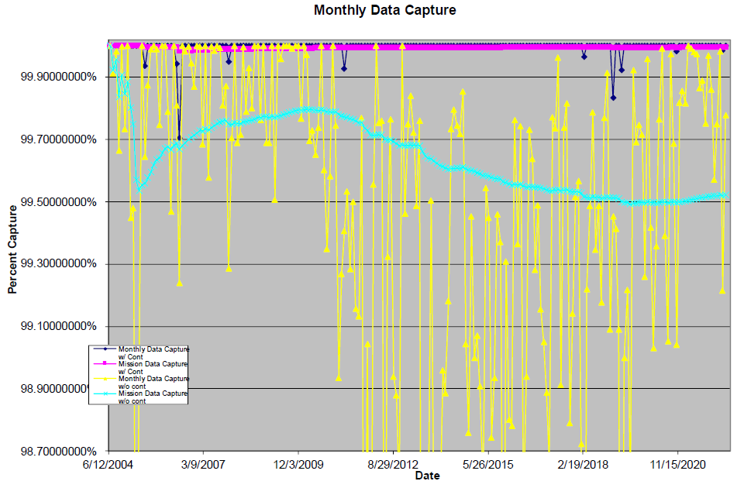
  Aura Monthly Data Capture
  SSR Data Capture to 03/31/2022: 99.9955693 %
Mission Capture Req. = 95%
37 months with no data losses
83 months with no data losses
SSR Anomaly (2007)
FOT Ops Errors
(2011, 2018, & 2019 (2))
EDOS Ops Error (2005)
Alaska Station Issues
(2020 & 2022)
Norway Communication
Outages (2006)

Slide 34
  SSR Data Losses – 2021 / 2022
Last Data Loss: February 2022 (Ground Station Issues)
- - - - - - - - - - - - 2021 - - - - - - - - - - - - - - - - - - - - -
December: None
- - - - - - - - - - - - 2022 - - - - - - - - - - - - - - - - - - - - -
January: None
February: Data Loss #1074 on DOY 034 (February 3rd, 2022)
  Late schedule changes followed by ground station issues resulted in 12 minutes 51 seconds of OMI loss
March: None

Slide 35
Operational Errors
(18-Months: October 2020 – March 2022)
Aura: 35 Months since last operational error (April 2019)
2+ years of Aura FOT Error Free Operations

Slide 36
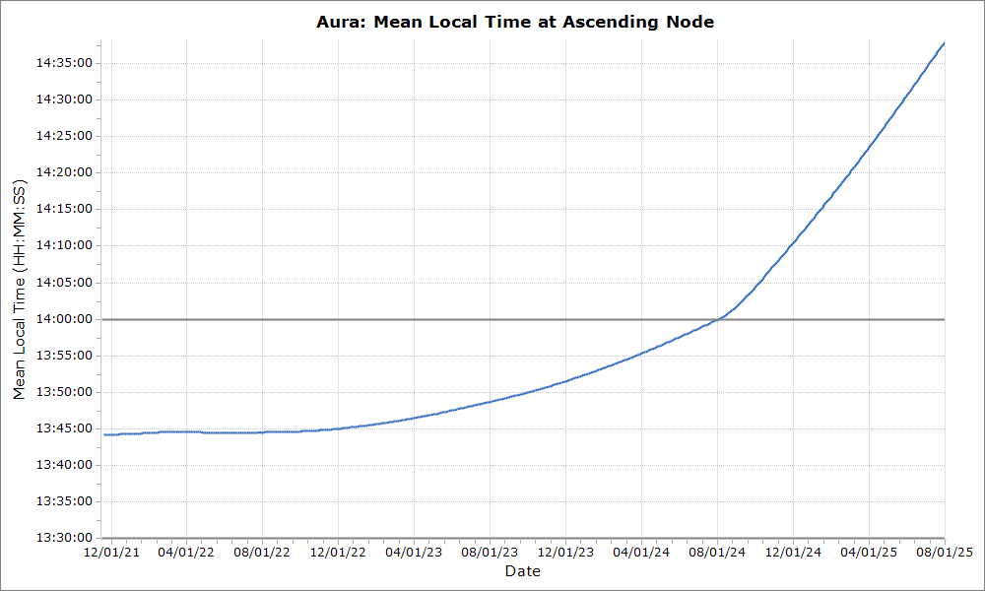
Aura Predicted Mean Local Time
(Analysis Updated December 2021)
Science Upper Limit (14:00:00)
Spring 2022
IAM Series
Constellation Exit & Perigee Lowering Maneuvers
(July - September 2024)
Turnaround
MLT: 13:44:27
(June 5, 2022)
Passivation
Aug 1 2025
Science Lower Limit (13:30:00)

Slide 37
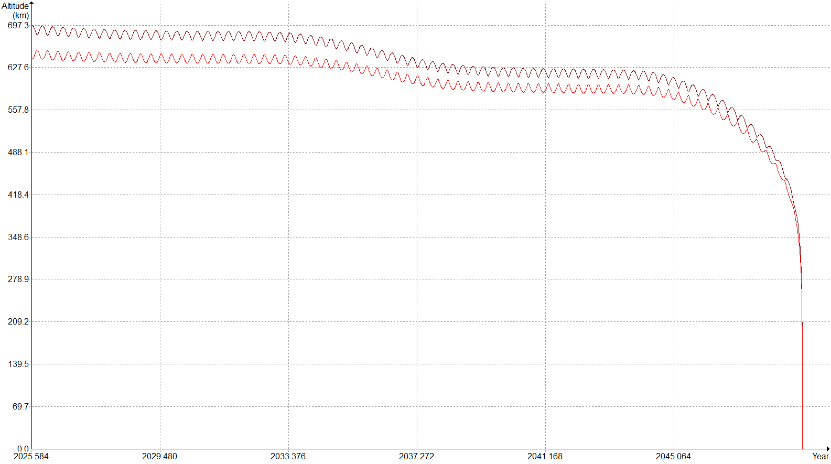
Aura Predicted Re-entry
(Updated December 2021– September 2021 DAS Solar Flux File)
DAS Predicted Apogee & Perigee
Nominal Passivation – August 2025
Apogee
Perigee
Reentry: Dec 2048
Dwell Time: 23.37 years

Slide 38
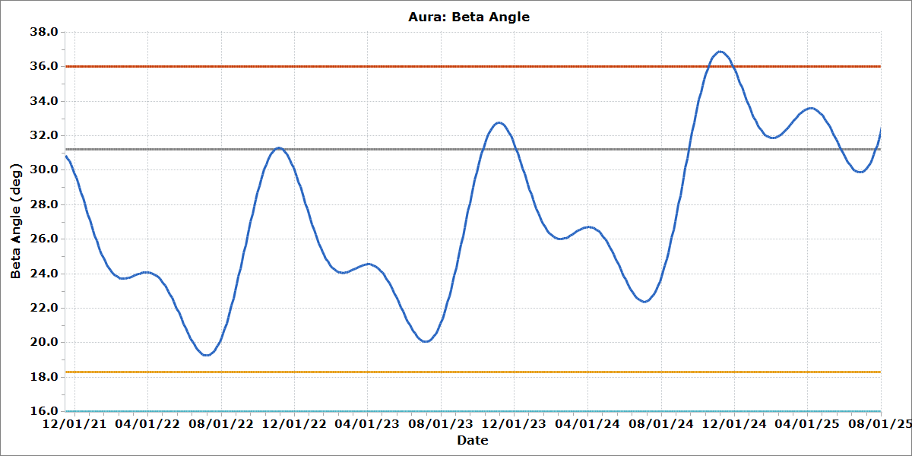
Aura Predicted Beta Angle
(Analysis Updated December 2021)
Science Upper Limit (36°)
OMI Range Upper Limit (31.2°)
OMI Beta Angle Violation
Sep 15 2024 – May 27 2025
Max Beta Angle: 36.9⁰
Science Limit also Violated
OMI Beta Angle Violation
Oct 9 2023 – Dec 4 2023
Max Beta Angle: 32.8⁰
OMI Beta Angle Violation
Oct 28 2022 – Nov 11 2022
Max Beta Angle: 31.3⁰
Constellation Exit
Jul 30 2024
Passivation
Aug 1 2025
OMI Range Lower Limit (18.3°)
ESC MOWG - November 2021
Science Lower Limit (16°)

Slide 39
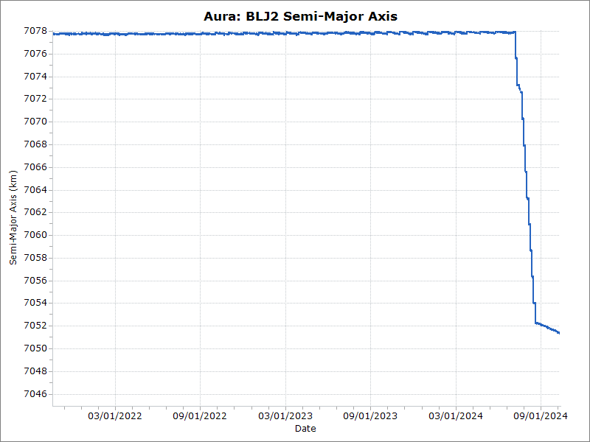
Aura Predicted Semi-Major Axis
(Analysis Updated December 2021)
CEMs
July
2024
PLMs
August – September 2024
Semi-Major Axis
Constellation: 7077.7 km ± 0.3 km

Slide 40
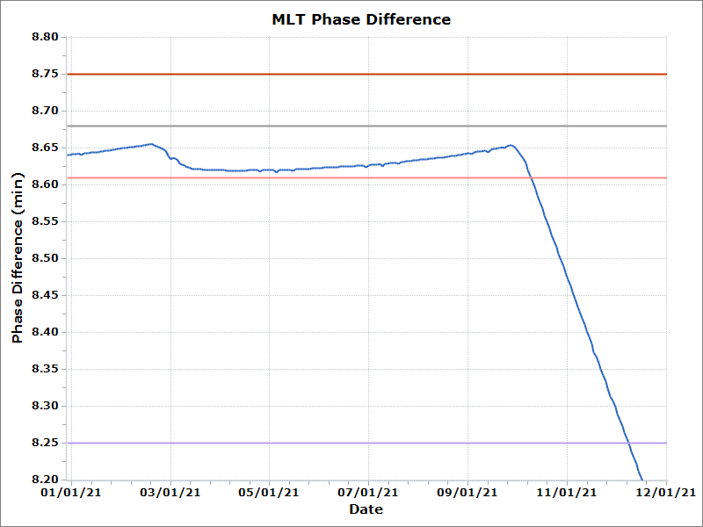
Aura MLT Phasing with Aqua
(2021 definitive data, plot generated March 2022)
Constellation Upper Limit (8.75 min)
Operational Upper Limit (8.68 min)
Operational Lower Limit (8.61 min)
Fall 2021 IAMs (Aqua did not maneuver)
Constellation Center (8.50 min)
Constellation Lower Limit (8.25 min)

Slide 41
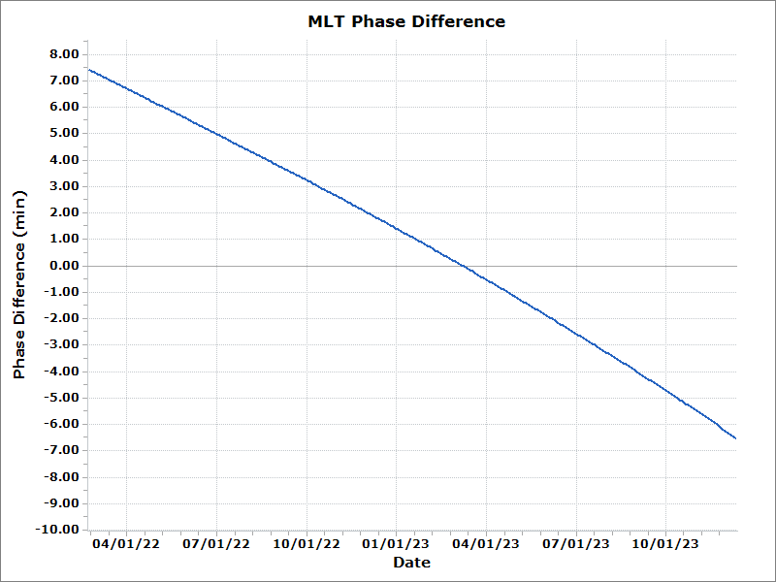
Aura MLT Phasing with Aqua
(as of March 2022)
Constellation Center (8.50 min)

Slide 42
Abbreviations / Acronyms List
  ARE – Array Regulator Electronics
  BLJ2 – Brouwer-Lyddane mean elements
  CA – Conjunction Assessment
  CALIPSO – Cloud-Aerosol Lidar and Infrared Pathfinder Satellite Observations
  CARA – Conjunction Assessment Risk Analysis
  CDH – Command & Data Handling
  CEM – Constellation Exit Maneuver
  ΔCER – Delta Constellation Exit Review
  COMM – Communications
  CONOPS – Concept of Operations
  COTS – Commercial-Off-The-Shelf
  CRMS – Collision Risk Management System
  DAM – Debris Avoidance Maneuver
  DAS – Debris Assessment Software
  DMUM – Drag Make-up Maneuver
  DR – Decommissioning Review
  DRR – Disposal Readiness Review
  EA – EOS Automation
  EDOS – EOS Data Operations System
  EOC – EOS Operations Center
  EOL – End of Life
  EOMP – End of Mission Plan
  EOS – Earth Observing System
  EPS – Electrical Power System
  ESC – Earth Science Constellation
  ESMO – Earth Science Mission Operations
  FDS – Flight Dynamics System
  FMU – Formatter Multiplexer Unit
  FOT – Flight Operations Team
  FSW – Flight Software
  FY – Fiscal Year
  GCOM-W – Global Change Observation Mission - Water
  GHz – Gigahertz
  GME – Gigahertz Mirror Electronics
  GMT – Greenwich Mean Time
  GNC – Guidance Navigation & Control
  GSFC – Goddard Space Flight Center
  GTE – Ground Track Error
  HIE – High Interest Event
  HIRDLS – High Resolution Dynamics Limb Sounder
  HK – Housekeeping
  HQ – Headquarters
  IAM – Interface Adapter Module
  IAM – Inclination Adjustment Maneuver
  INST – Instruments
  KDP-F – Key Decision Point to proceed with Phase F
  kg – kilogram
  km – kilometer
  L0 – Level-Zero
  LS – Landsat
  m – meters
  MLS – Microwave Limb Sounder
  MLT – Mean Local Time
  MMOD – Micrometeorite Orbital Debris
  MOCA – Mission Operations Conjunction Assessment
  MOWG – Mission Operations Working Group
  MWG – Maneuver Working Group
  NASA – National Aeronautics & Space Administration
  NID – NASA Interim Directive
  NYS – No Yaw Slew
  OCO-2 – Orbiting Carbon Observatory-2
  Ops – Operations
  OMI – Ozone Monitoring Instrument
  ORR – Operational Readiness Review
  PLL – Phase-locked Loop
  PLM – Perigee Lowering Maneuver
  PROP – Propulsion
  PSR – Pre-Ship Review
  PVT – Pressure Volume Temperature
  R2 – Receiver 2
  RM – Retrograde Maneuver
  RMM – Risk Mitigation Maneuver
  RWA – Reaction Wheel Assembly
  SOH – State of Health
  SR – Senior Review
  SRP – Senior Review Proposal
  SSR – Solid State Recorder
  TCS – Thermal Control System
  TES – Tropospheric Emissions Spectrometer
  TRR – Test Readiness Review
  US – United States
  W – Watts
  WRS – World Reference System

