Slide 1
Independent Reliability Assessment and Progress Review of the NASA GSFC Laser Transmitter for the LISA Program
Upendra N. Singh
NASA Technical Fellow for Sensors & Instrumentation
NASA Engineering & Safety Center (NESC)
NASA Langley Research Center
Anthony W. Yu and Kenji Numata
NASA Goddard Space Flight Center
21st Coherent Laser Radar Conference, Big Sky, Montana
June 26, 2022

Slide 2
Outline
LISA Program Background
LISA Laser Architecture
NESC Approach and Panel
NESC Methodologies
NESC Assessment
Conclusions

Slide 3
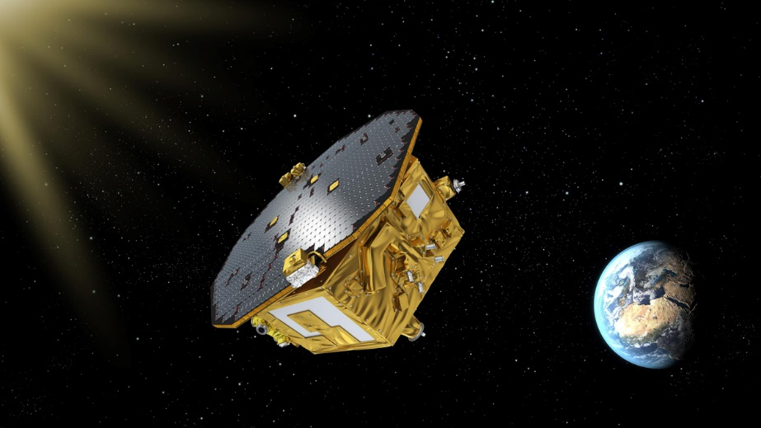
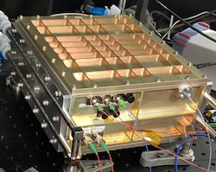
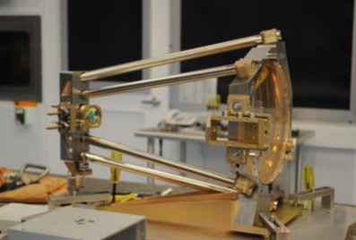
LISA Collaboration
Follow-on to LISA Pathfinder that demonstrated the concept and technology
LISA is led by ESA, and is a collaboration between ESA, NASA, and international consortium of member states
NASA and ESA are in negotiation regarding contributions from NASA. Potential major contributions are:
  Laser System
  Telescope System
  Charge Management System
Need TRL 6 by Mission Adoption (around end of 2023)
LISA Pathfinder Demonstrated in 2016 at L1
Telescope
Laser

Slide 4
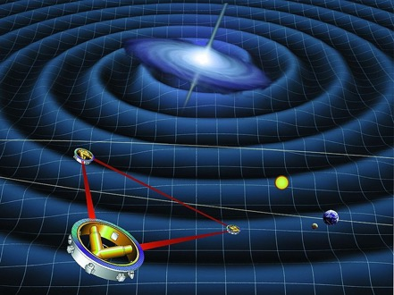
Gravitational wave detection
LISA (Laser Interferometer Space Antenna)
  ESA (European Space Agency)-led mission, ~2034 launch
  Displacement measurement between “free” masses
    Concept validated by the LISA pathfinder mission
  Laser system
    Candidate US (NASA) component contribution
Size of strain h
  h~10⁻²¹ for typical GW source
    L~2.5 x 10⁶km (LISA): L* h ~ 1 pm
LISA Mission Concept

Slide 5
Laser Systems for LISA and Redundancy Strategy
SC A
SC B
Each Spacecraft (SC) has one Laser System (LS)
  Each LS has two Laser Assemblies (LA) and one Frequency Reference System (FRS)
  Each LA has two Laser Heads (LH) - one hot and one cold redundancy
    4 LH per SC, 12 in the constellation.
  Each LH comprises a Laser Optical Module (LOM) and Laser Electrical Module (LEM)
    LOM is a Master Oscillator Power Amplifier (MOPA) laser
    1 Laser is the master and the remaining 5 are transponders.
One Frequency Reference System (FRS) per S/C
  Redundancy at constellation level (3 in the constellation)
LA
LA
LA
LA
LA
LA
SC C
FRS

Slide 6
Study description
Problem Description
  The LISA LS is the basis for the measurement system for the proposed LISA mission led by the ESA with a target launch date in ~2034. One of NASA’s possible contributions is the laser for the measurement system.
  The LISA measurement system is designed to measure Gravitational Waves from Massive Black Hole Binary star systems that deform space-time and can be detected as a change in the length of the interferometer arms (~10 pm/Hz^{1/2}).
  Ensuring the appropriate reliability for the LISA LS is a critical challenge. A key performance requirement for the final design ESA selects will be the simultaneous and stable in-orbit operation of 6 laser heads (LH) on three different spacecraft (SC) over a period of 5 years, with a goal 11 years, without any prolonged interruptions.
  This assessment is to determine if the LS design and development plan is on track to meet the requirements provided by ESA in the TRL 6 demonstrator requirements document.

Slide 7
Scope of Assessment
Scope
  NASA’s Goddard Space Flight Center (GSFC) requests that the NASA Engineering & Safety Center (NESC) assess the Technology Readiness Level (TRL) 6 design of the Laser System (LS) for the Laser Interferometer Space Antenna (LISA). The reliability assessment through this effort will, at a minimum, produce an evaluation of the LISA Laser Transmitter reliability, physics-of-failure analysis, identification of failure modes, and screening opportunities for laser components. The effort shall include the following tasks:
  Assess the design for weaknesses and suggest improvements to mitigate risks,
  Assess the laser reliability plan for weaknesses and suggest improvements to mitigate risks and improve effectiveness, and
  Assess the current redundancy plan on laser subsystems for weaknesses and suggest improvements to mitigate risks and improve effectiveness.

Slide 8
NESC Review panel

Slide 9
Top level Laser requirements
Dimensions 330 × 330 × 250 mm³
Mass 12kg
LH dissipated power <75W (TBR)
LH operating temperature 20±5°C (TBR)
LH non-operating temperature -20°C to +40°C (TBR)
LOM Output Power >2W on optical bench (OB) at end of life (EoL)
Wavelength 1064.50, -0.05/+0.10 nm
Polarization extinction ratio (PER) >20dB (TBC)
Lifetime >16 years
  6 years on ground with ~1 year for integration and testing, plus 5 years (TBC) of storage
  1.5 years TBC OFF state in operational environment (cruise phase)
  5 (TBC) years continuous operation in nominal science mode (nominal mission lifetime)
  11 (Goal) years continuous operation in nominal science mode (extended mission lifetime)

Slide 10
Master oscillator power amplifier (MOPA) Architecture & Requirement
Low frequency noise
Actively controllable to 300Hz/rtHz@mHz
Wavelength as a ruler
Low Intensity noise
Shot-noise limited RIN @heterodyne frequency
(5~20MHz)
Shot-noise limited performance
Phase lockable
Micro-cycle/rtHz accuracy @mHz
Measurement principle
Clock noise transfer
High side-band phase fidelity
(0.6mrad/rtHz @ ~2GHz)
Accurate clock jitter information exchange
Phase modulation
for cavity locking
PDH locking to cavity
Tunable offset
Frequency Stabilization
PN code for ranging
Data exchange
Fiber coupled
Intensity controllable
RIN down to 10⁻⁴/rtHz @mHz, 2W level
Low force noise on test mass through radiation pressure
Maintain sideband phase
Small differential RF phase noise (0.6mrad/rtHz @ 2GHz)
Accurate clock jitter information exchange
Master Oscillator
Phase Modulator
Power Amplifier
~150mW
~50mW
~2W

Slide 11
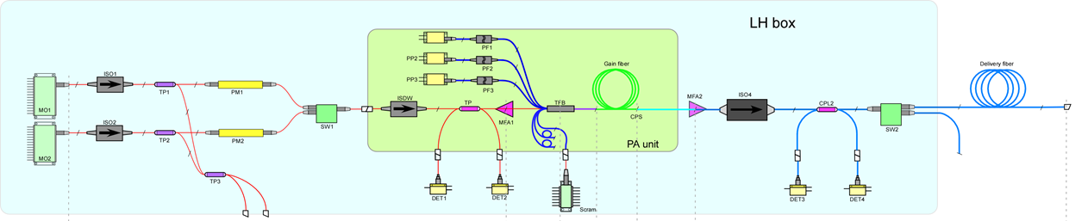
Lisa laser architecture
LD1
LD2
LD3
MO1
HPI
HPSwitch
LPSwitch
MO2
Scram
NASA GSFC LISA laser architecture is a Master Oscillator Power Amplifier (MOPA)
The Laser System has two Master Oscillators: MO1 and MO2 with each MO having two laser diodes and three Thermo Electric Coolers (TECs). The two MO’s are for redundancy.
MO1 and MO2 are coupled to the PA via 2x1 optical switch denoted as the Low-Power Switch (LPSwitch).
The PA uses three pump laser diodes, denoted as LD1, LD2, and LD3, and a TEC to control fiber spool temperature. The PA is also seeded with a “scram” laser to protect the amplifier in the event of MO loss of signal.
The PA output is transmitted to an output fiber via a high-power isolator (HPI) then a 1x2 output switch, denoted as High-Power Switch (HPSwitch).

Slide 12
Nesc methodologies
Approach
  The GSFC LISA design team formulated a set of specific technical questions (“Statement of Work” Questions) for each of the technology areas in the system to guide these tasks.
    The original assessment plan was to conduct these tasks in a serial fashion.
    However, as the SME and LISA design team came together and compared the technology-specific questions, the team decided to look at the tasks in parallel to permit greater synergy among the reviewers.
    This was accomplished by having team-wide meetings on specific topics during the assessment period.
    The team also held bi-weekly meetings that were recorded in Teams to update all members on progress and to determine topics for the team-wide technical topic meetings.
    These bi-weekly meetings were held in lieu of progress reports.
  Each technology sub-area drafted their initial reports to form the basis for the final report. These initial reports were circulated among the assessment team members for comment and technical enhancements.
  No experiments, independent texts, inspections, or associated analysis were performed by the assessment team. The team relied on design data provided by the LISA team at GSFC and open-source data available from manufacturers or the professional literature.

Slide 13
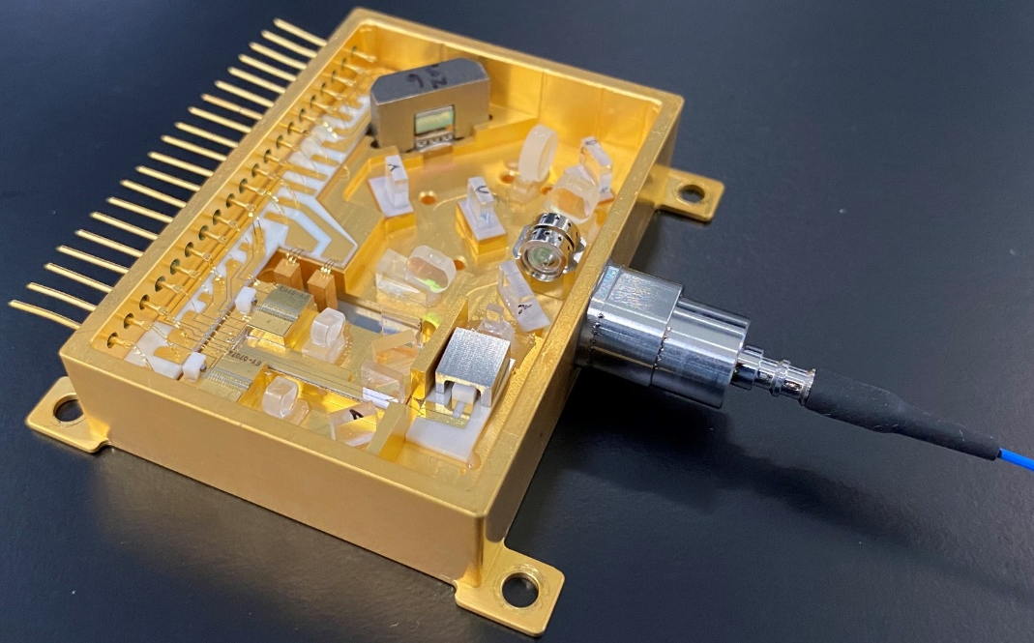
Master oscillator assessment
The MO is based on the non-planar ring oscillator (NPRO¹) design with a scaled down crystal resonator (~1/4 of original NPRO) packaged in a small, micro Non-Planar Ring Oscillator (μNPRO) assembly
The MO contains
  Two 808-nm pump diodes combined to pump the Nd:YAG crystal shaped in a NPRO monolithic resonator
  The crystal mounts on top of a single TEC for temperature regulation.
  A piezoelectric transducer (PZT) mounts on top of the Nd:YAG crystal for frequency tuning.
Ref 1 - Thomas J. Kane and Robert L. Byer, "Monolithic, unidirectional single-mode Nd:YAG ring laser," Opt. Lett. 10, 65-67 (1985)

Slide 14
Observations and findings on mo
Findings | Recommendations
The TRL 6 µNPRO design and operating point is being finalized (e.g., TBCs and TBRs). | Develop a specific set of requirements and hardware block diagrams representing the planned TRL 6 configuration against which design performance and any necessary changes can be tracked. Identify the target µNPRO operating current and determine if noise-eater circuitry will be included in the baseline design.
The TRL 6 units have challenging reliability and noise performance requirements that can be impacted by design decisions that have not been finalized. | The TRL 6 units should be tested functionally and environmentally to show compliance with requirements.
A reduced voltage needed to meet the required Doppler tuning range and resolution can have a significant impact on the PZT drive electronics indicating the selection of a thinned crystal may present a design risk. | Continue working with the µNPRO vendor to achieve a thinned crystal that will reduce the required PZT tuning voltage.
Observation:
Given the stringent intensity, frequency, and phase stability requirements, a small NPRO is ideal.

Slide 15
Power Amplifier Findings, Recommendations, and Observations
Findings | Recommendations
The reliability of the optical components in the MOPA design leverages other programs’ development. | Baseline the flight design and test of representative optical components at elevated operational levels.
There is a risk of optical fiber damage during I&T, which requires an increased fiber length to allow for damage repair. | Outline the test plan for integration of the fiber connectors with the optical head to ensure a low insertion loss and a high temperature rated fiber coating.
The gain fiber performance is sensitive to thermal management and potential radiation effects, and rad-hard fiber is only available from a non-US source. | Provide a thermal analysis of the gain fiber thermal management requirement to within 0.05°C.
Options exist for the PA 976-nm pump modules that are dependent on final LD vendor selection. A backup seed laser is being baselined for protection. A separate source, though improving reliability, adds complexity to the design. | Investigate the 976nm pump diode vendor options for the pumping architecture (e.g., number of diodes, sparing) and the baseline architecture. Perform a risk analysis of the seed laser dropout and test the shutdown timing with the SCRAM source.

Slide 16
Pump Diode Scope of Assessment
Aspects reviewed
  Design – Assess the design and usage of the 808-nm (MO) and 976-nm (PA) pump diodes in the NASA GSFC LS
  Reliability – Review the GSFC Reliability Plan, and test results to date
  Redundancy – Assess the current redundancy plan for the pump laser diodes
Design
  The current use of polarization-combined 808nm single-mode pumps enables the highest likelihood for achieving reliability requirements.
  Transition from 808-nm to 885-nm pumping, if commercially available, should increase reliability.
  The current use of spatially-combined 976-nm multi-chip pumps should enable excellent efficiency and reliability.
Reliability
  The 808-nm life test data to date demonstrate feasibility but are not yet adequate to prove acceptable reliability.
  There were no 976-nm life test data available, but based on industry experience, reliability should be adequate.
  There were no, or very little, environmental stress data available for either the 808-nm or 976-nm pumps.
Redundancy
  There is powerful redundancy built into the LS design for both 808-nm and 976-nm pumps.
  Opportunities should be explored to decrease the allowed FIT budget of other components or subsystems to enable a relaxation in the 808-nm diode FIT budget.
  There is likely opportunity to reduce the quantity of 976-nm pumps.

Slide 17
Radiation Susceptibility Findings and Recommendations
Findings | Recommendations
Ionizing dose susceptibility in the Yb gain fiber in a passively irradiated, high dose rate test is unclear | Repeat ionizing dose testing on flight lots to quantify variance of degradation and bound worst case analysis
Rad-hard electronics have not been selected for laser electronics module update and laser pre-stabilization system electronics | Enabling COTS components (e.g., PZT driver) have unknown susceptibility to radiation effects and no clear radiation hardened replacement. Conduct a SEE test campaign on enabling COTS components

Slide 18
General Observations and Recommendations
The LISA design team is a capable, experienced group that is actively working to validate the TRL 6 design and identify and burn down risks.
Challenges faced in transitioning from a TRL 6 design into a flight program include parts obsolescence - the necessary reliance on commercial fiber and electro-optic parts whose availability may change over time.
The LISA design team needs to create thorough documentation for all elements in the current program to form a clear basis for tech transfer to vendors in the future, and to be able to quickly evaluate needed changes.
There were no alternative viewpoints identified during the course of this assessment by the NESC team

Slide 19
Overall Assessment Summary
The overall SME team’s assessment conclusion is that there are no fundamental problems or major design issues that will prevent the LISA team from meeting the ESA requirements for the TRL 6 demonstrator.
It must be acknowledged that the LS design is challenging and there will be development risks that must be addressed moving forward. There are items that the SME assessment team believes need further consideration, including
  The LISA design team needs an improved tracking of requirements and hardware configuration in the LS subsystems, e.g., commercial off-the-shelf (COTS) versus radiation-hardened (rad-hard) parts, to ensure that the design closes
  Testing protocols for components and subsystems needs to be fully developed (e.g., functionality, aging, thermal, radiation, etc.) to ensure proper measurements are made and that the design is not affected
  The assessment team has two major concerns that will need oversight if ESA selects this design: (1) the TRL 6 design is primarily based on COTS parts and the performance specifications or operating characteristics of the replacement rad-hard parts for beyond TRL 6 may perturb the design, and (2) rad-hard part lead times and obsolescence may affect the design’s viability

Slide 20
conclusions
The NASA Laser Team acknowledges the assessment study performed by the NESC team.
This assessment was sponsored and funded by NESC from August 2020 to July 2021.
The laser team implemented changes and executing steps to address findings, observations and recommendations from the NESC team.
The laser team is moving forward to qualify the LS design to TRL6 by end of 2023 and prepare to deliver a unit to ESA for evaluation.

