Slide 1
LOCD-IN
LOcation Corrections through DIfferential Networks system
Evan Dill
Safety-Critical Avionics Systems Branch
NASA Langley Research Center
May 11th, 2022

Slide 2
Introduction
Applications for mobile devices with built in Global Navigation Satellite System (GNSS) receivers (e.g., cell phones, tablet computers, smart watches) have seen substantial increases:
Vehicle Navigation
Pedestrian Navigation
Gaming
However, the GNSS chipssets used in these devices are designed to minimize Size, Weight, Power and Cost (SWaP-C) and typically offer 5-20 meters of accuracy, prohibiting their use in higher precision applications:
Identifying zones for package delivery and pickup
Precision UAS operations
E 911 emergency rescue
Urban Air Mobility pickup locations
Can these applications be enabled without changing the hardware on existing mobile devices?

Slide 3
GPS Augmentation
LOcation Corrections through DIfferential Networks system (LOCD-IN)
$
Cheap Hardware /
Standard Techniques
Typically 5-20 meters expected error.
$0.10 - $50
Applications:
  Cell Phones
  Tablets
  UAS (Low end)
Cheap Hardware /
Advanced Techniques
1-5 meters expected error.
$0.10 - $50
Applications:
  UAS package delivery
  Precision UAS operations
  E911
  UAM pick up locations
Very little currently exists
LOCD-IN
Hardware Cost
Expensive Hardware /
Standard Techniques
Typically 1-5 meters expected error.
$50 - $10,000
Applications:
  Ground Vehicle Navigation
  UAS
Expensive Hardware /
Advanced Techniques
Sub-meter - millimeter level accuracy
$1,000 - $100,000 and above
Applications:
  Precision Agriculture
  Surveying
  High Accuracy Autonomous Vehicles
$$$
Standard
Advanced
Implementation Techniques

Slide 4
Standard Differential
Needed Satellite-Based GPS Measurements:
Pseudorange
Carrier Phase (if available)
Technique:
The user refines its position estimates using measurements or estimated corrections transmitted by a base station over an RF link.
Mobile GPS Receiver
Base Station
(Known Position)
Measurements/Corrections

Slide 5
LOCD-IN Concept
* Real-Time Kinematic (RTK)
^{Ŧ} Ground Based Augmentation System (GBAS)
Makes use of a network of internet connected base stations.
Technique Variants:
  Modified Differential
  Modified RTK*
  GBAS^{Ŧ}-like
Mobile Device (e.g., UAS, cell phones, tablets etc.)
Base Station
(Known Positions)
GPS Receivers (at least 2)
Base Station
(Known Position)
GPS Receiver
Internet Connection
Internet Connection
Internet Connection
Measurements/Corrections

Slide 6
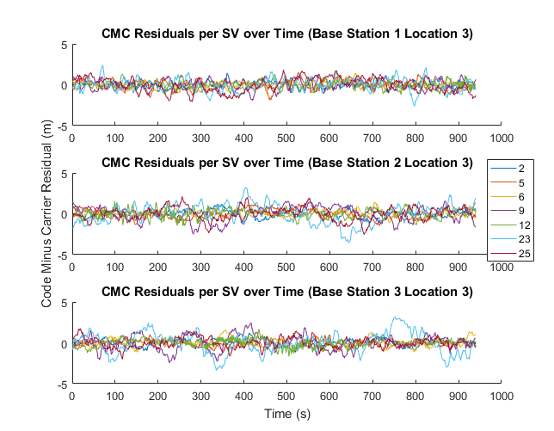
How to Choose the Best Base Station?
6
Code-Minus-Carrier (CMC) metric
Corrections that result in the largest error reduction come from the base station with the lowest summed average CMC residual values
This CMC selection criteria was used to select the base station for the other locations
Selected Base Station
 | Base Station 1 | Base Station 2 | Base Station 3
Average Lateral Error (Corrected) | 0.824 m | 3.696 m | 2.514 m
Average STD (Corrected) | North: 6.020 m East: 6.097 m | North: 6.060 m East: 6.035 m | North: 6.041 m East: 6.056 m
Sum of STD CMC residuals | 3.978 m | 4.721 m | 4.526 m

Slide 7
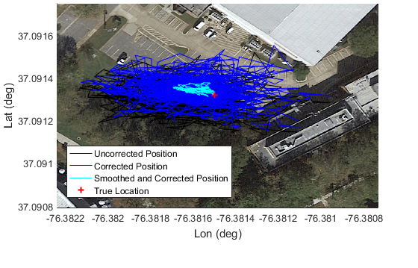
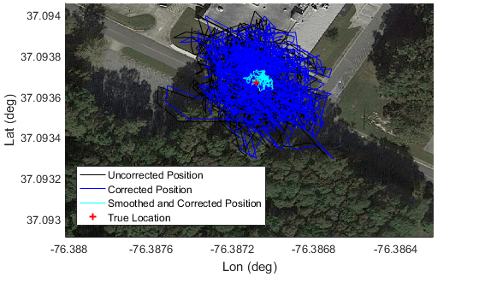
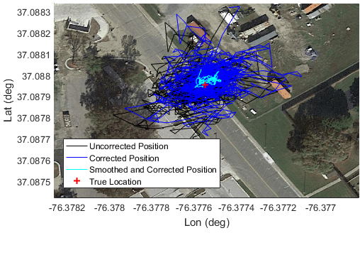
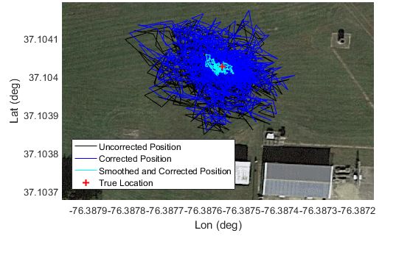
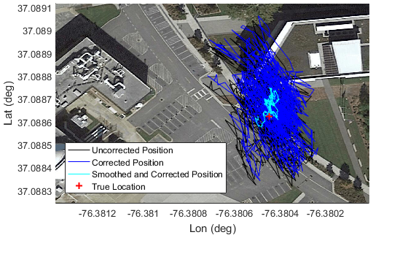
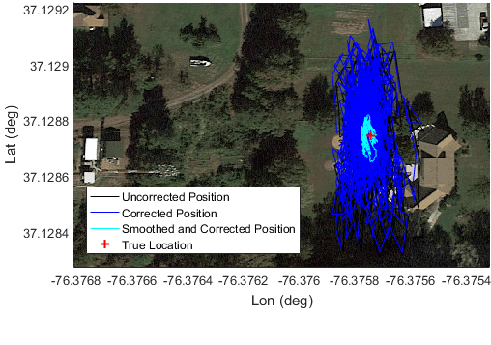
Results
Uncorrected Position
Processed position
Corrected Position
True Location
Uncorrected Position
Processed position
Corrected Position
True Location
Uncorrected Position
Processed position
Corrected Position
True Location
©2020 Google
©2020 Google
©2020 Google
©2020 Google
©2020 Google
©2020 Google
Uncorrected Position
Processed position
Corrected Position
True Location
Uncorrected Position
Processed position
Corrected Position
True Location
Uncorrected Position
Processed position
Corrected Position
True Location

Slide 8
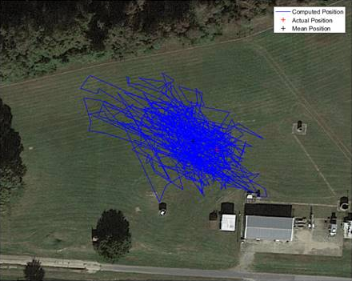
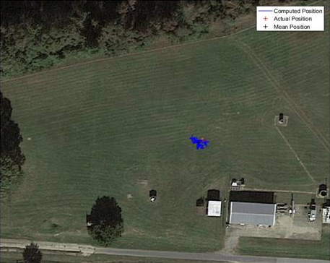
Conclusions
Average Improvement
LOCD-IN increases accuracy and reduces noise on cheap, networked GPS receivers without added SWAP-C
Accuracy
x4
Noise
x7
Computed Position
Actual Position
Mean Position
Computed Position
Actual Position
Mean Position
©2020 Google
©2020 Google
Error of Average Pose = 8.495 m
North SD: 9.03481 m, East SD: 9.40567 m
Error of Average Pose = 2.112 m
North SD: 1.31345 m, East SD: 1.37566 m
*US Patents - 11,112,50 and 11,119,223

Slide 9
BACKUP

Slide 10
GNSS Errors
  Clock Errors (10’s of cm)
  Satellite Orbit Errors (2-5 m)
  Atmospheric Errors (up to 10’s of m)
  Receiver Clock Bias (kms, typically estimated with solution)
  Multipath
  Receiver noise
One way to minimize these errors is through the use of measurements from nearby receivers (i.e., base stations)
Differencing can be done between:
  Satellites (single difference)
  Receivers (double difference)
  Time epochs (triple difference)
Common Errors cancel to the extent that they correlate.
  Errors decorrelate temporally and spatially.
SD
DD

Slide 11
Concept Using Adapted Differential Techniques
Needed Satellite-Based GPS Measurements:
Code Phase (receiver/base station)
Pseudorange (receiver/base station)
Technique:
The mobile device refines its position estimates using unprocessed measurements transmitted by the base station via an internet connection.
Mobile Device (e.g., cell phones, tablets, UAS, etc.)
Base Station
(Known Position)
GPS Receiver
Internet Connection
Internet Connection
measurements

Slide 12
Concept Using Adapted RTK Techniques
Needed Satellite-Based GPS Measurements:
Code Phase (receiver/base station)
Pseudorange (receiver/base station)
Carrier Phase (receiver/base station)
Technique:
The mobile device refines its position estimates using corrections for a local area computed and transmitted from the base station.
Mobile Device (e.g., cell phones, tablets, UAS, etc.)
Base Station
(Known Position)
GPS Receiver
Internet Connection
Internet Connection
corrections

Slide 13
Concept Using GBAS-like Techniques
Needed Satellite-Based GPS Measurements:
Code Phase (receiver/base station)
Pseudorange (receiver/base station)
Carrier Phase (receiver/base station)
Technique:
The mobile device refines its position estimates using corrections for a local area computed and transmitted from the base station.
Mobile Device (e.g., cell phones, tablets, UAS, etc.)
Base Station
(Known Positions)
GPS Receivers (at least 2)
Internet Connection
Internet Connection
corrections

