Slide 1
Bringing Scientists and Engineers Together for Technology Development
Carolyn R. Mercer, Ph.D.
Chief Technologist, NASA Science Mission Directorate
Panel: Partnerships and Mechanisms to Facilitate Development and Application of New Research Technologies
NSF Workshop on Technology Developments to Advance Antarctic Research
May 5, 2022

Slide 2
Bringing Scientists and Engineers Together for Technology Development
Joint Workshops
Future of the Search for Life (FoSL)
Accessing the Subsurface Oceans of Icy Worlds
Joint Goal Setting
Planetary Science Technology Office Quad Sheets
Funded Communities of Practice with
Open Access Testbeds
HOTTech, COLDTech
GEER, OWLAT/OCEANWaters

Slide 3
Joint Workshops
Future of the Search for Life (FoSL) workshop 4/2022
“The overarching goal of the workshop is to bring scientists and engineers together to collectively develop new and creative approaches to in-situ searches for life elsewhere in our solar system, 20 years, or more in the future.”
Accessing the Subsurface Oceans of Icy Worlds 10/2017
“Deep oceans are clearly not the easiest place to explore. Sending submarines into the ocean of either Europa or Enceladus requires getting access to the ocean. The goal of this workshop is to review the different technologies that have been developed and to define the technologies that are still required. Although Europa has got much attention on this topic, the study broadens its goal to Enceladus and other icy moons such as Titan where the ocean was once in contact with the rocky core and may still be.”

Slide 4
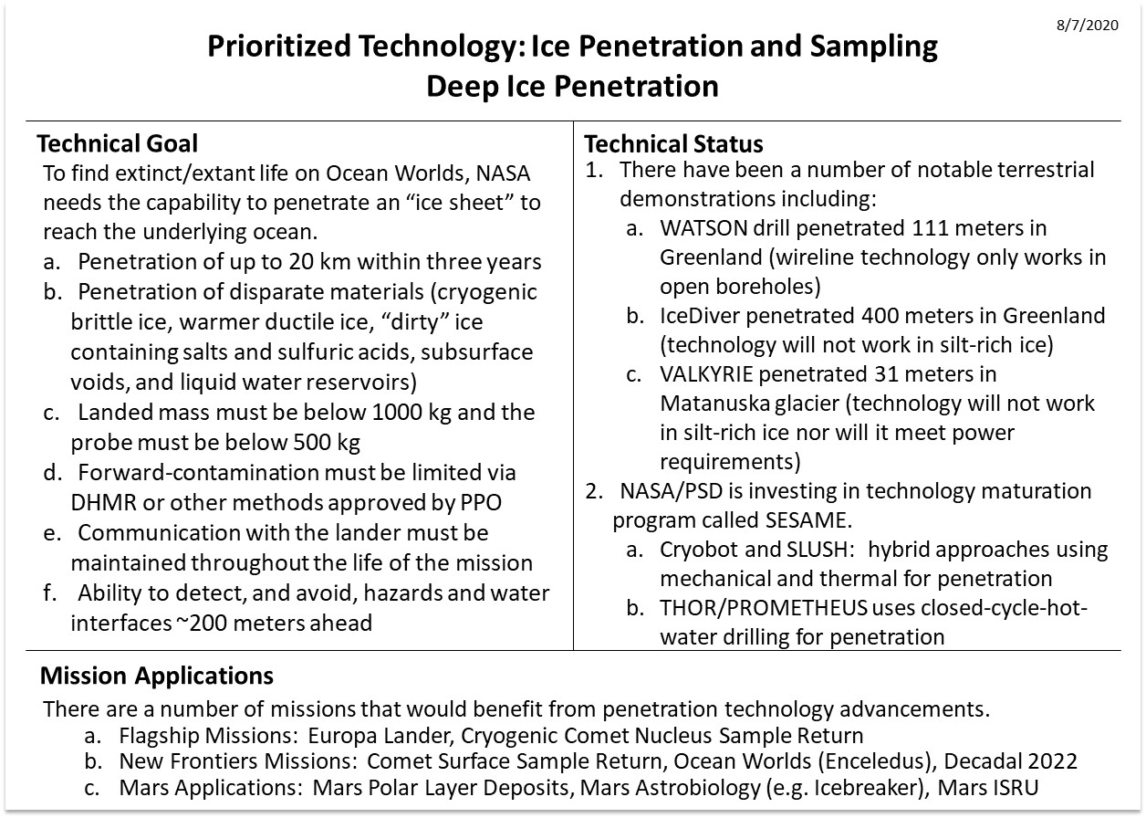
Joint Goal Setting
Planetary Science Technology Office (PESTO) Quad Charts

Slide 5
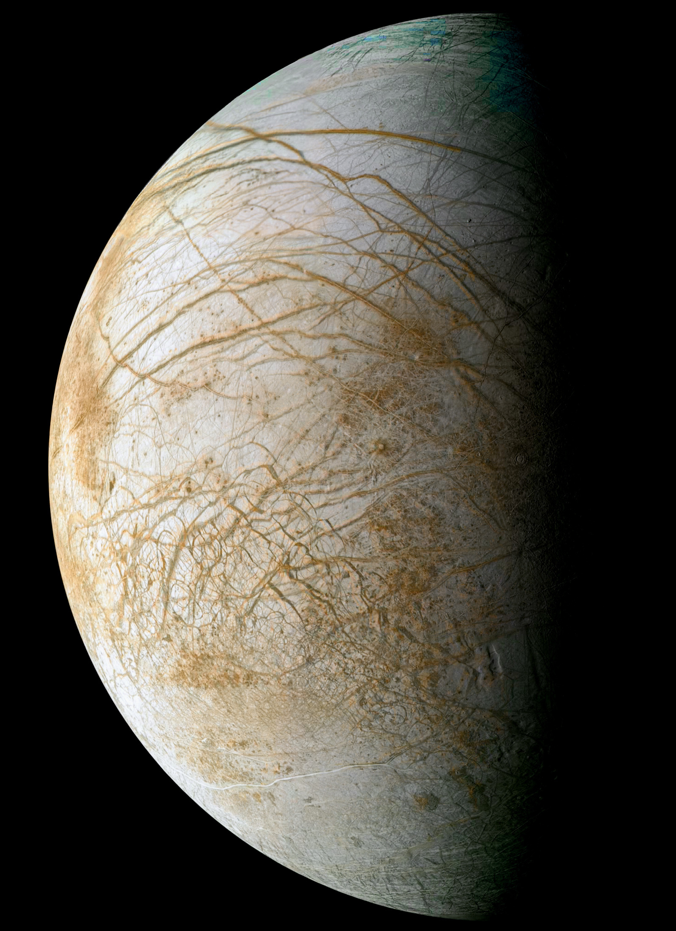
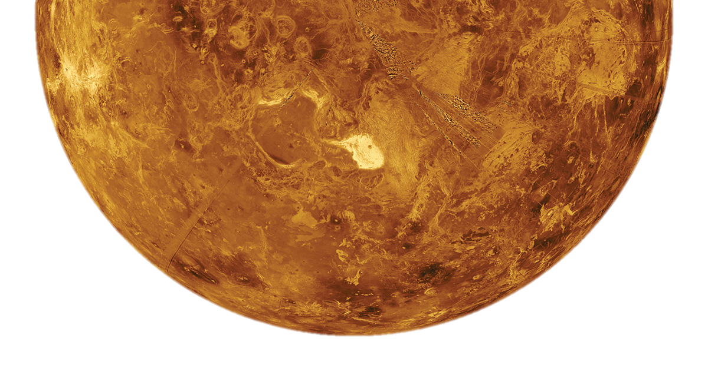
Funded Communities of Practice with Open Access Testbeds
ICY SATELLITES
Autonomy
ARROW and COLDTech-20 Autonomy PIs
NASA Testbeds (development/validation platforms)
    OWLET – physical testbed
    OceanWATERS – virtual testbed
Annual review with Europa Lander
Venus Surface
LLISSE Technical Integrator
  HOTTech-16
  HOTTech-21
  EPSCoR
GEER integrated testing
Radiation Hard Electronics
ColdTech-20 Radiation Hard Electronics PIs
ICEE-2 Instrument Developers
Annual review with Europa Lander
Communications
ColdTech-20 Communications PIs

Slide 6
Complementary knowledge sets:
Scientists and Engineers
Tech Developers and Mission Managers

