Slide 1
Space Radiation
May 3, 2022
Dr. Martha Clowdsley
NASA Langley Research Center

Slide 2
Outline
Types of Radiation
Health Effects
Space Environments
Space Weather
Measurement of Space Radiation
Radiation Exposure Quantities
Effectiveness of Shielding Materials
Radiation Protection Requirements and Suggested Design Goals
Radiation Analysis Methods
Protection Methods
Summary

Slide 3
Types of Radiation
Ionizing radiation: subatomic particles, ions, atoms, and electromagnetic waves with enough energy to detach electrons from atoms
  Sub-atomic particles:
    alpha particles (helium nuclei resulting from nuclear decay)
    beta particles (electrons and positrons resulting from nuclear decay)
    neutrons
    muons, mesons, etc.
    Charged ions (atoms spanning the periodic table, which have been stripped of their electrons)
  Electromagnetic waves:
    gamma rays
    x-rays
    higher end of the ultraviolet part of the electromagnetic spectrum
Non-ionizing radiation: electromagnetic waves, which can transfer energy to atoms, but do not have enough energy to detach electrons from atoms
  lower end of the electromagnetic spectrum including visible light, infrared, microwaves, radio waves, and the lower part of the UV spectrum

Slide 4
Types of Radiation
Ionizing radiation: subatomic particles, ions, atoms, and electromagnetic waves with enough energy to detach electrons from atoms
  Sub-atomic particles:
    alpha particles (helium nuclei resulting from nuclear decay)
    beta particles (electrons and positrons resulting from nuclear decay)
    neutrons
    muons, mesons, etc.
    Charged ions (atoms spanning the periodic table, which have been stripped of their electrons)
  Electromagnetic waves:
    gamma rays
    x-rays
    higher end of the ultraviolet part of the electromagnetic spectrum
Non-ionizing radiation: electromagnetic waves, which can transfer energy to atoms, but do not have enough energy to detach electrons from atoms
  lower end of the electromagnetic spectrum including visible light, infrared, microwaves, radio waves, and the lower part of the UV spectrum
Most important component of space radiation

Slide 5
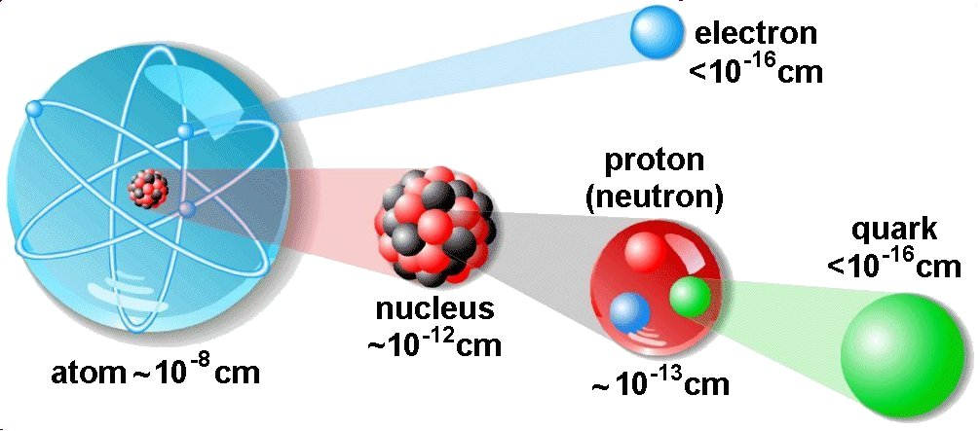
Charged Ions in the Space Environment
Charged ions making up the space environment are atoms spanning the periodic table, which have been stripped of their electrons.
As ions move through shielding materials and human tissue, they lose energy and nuclear collisions occur, producing secondary particles.

Slide 6
Health Effects of Radiation
Stochastic Effects:
Ionizing radiation can damage cells, and cellular DNA. This can cause cancer.
Hard to repair organs such as Central Nervous System and Cardiovascular System can also be damaged.
This damage is all ‘chronic’ – it occurs over a long time and is usually not an immediate health threat.
Acute Effects:
Large amounts of radiation can cause acute effects, this occurs when enough cells are killed in radiosensitive organs to impair function and cause radiation sickness or death.
Bone marrow, followed by the GI tract, are the most sensitive tissues.

Slide 7
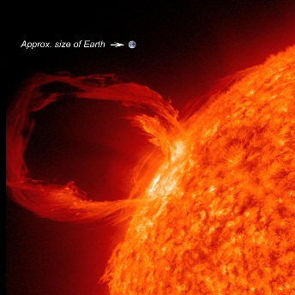
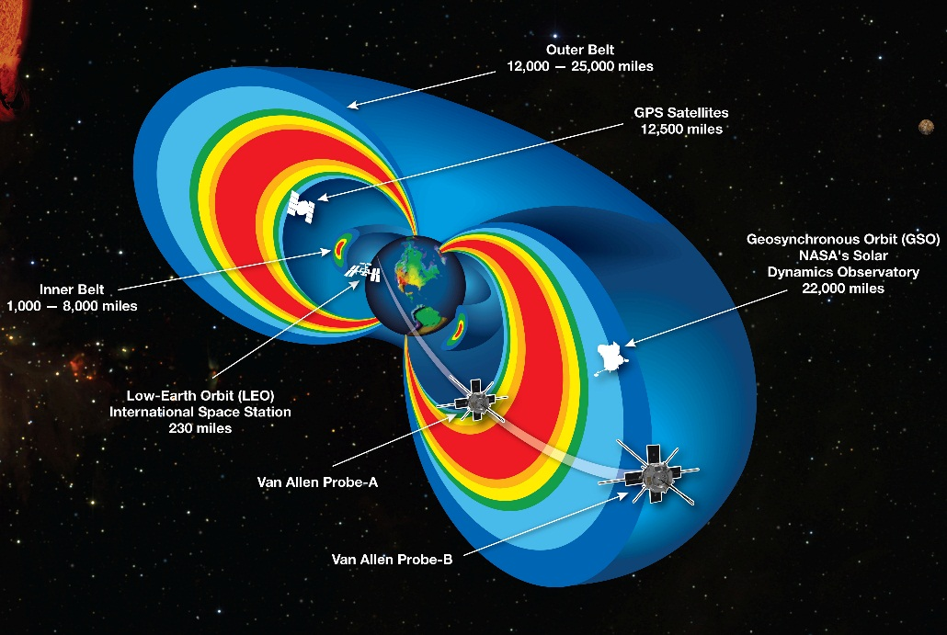
Space Radiation Environments
Galactic Cosmic Rays (GCR)
  Energetic charged ions spanning the periodic table
  Always present, but varies in intensity with the solar cycle
  Small daily exposure, but increases astronaut health risks for long duration missions
  Difficult to shield due to deeply penetrating particles
Solar Particle Events (SPEs)
  Low to medium energy protons (hydrogen ions)
  Associated with coronal mass ejections from the sun
  Large SPE are rare and short lived
  Size, spectral, and duration vary
  Effectively shielded but optimization needed to reduce mass
  Unshielded exposure could result in acute radiation syndrome
Trapped Radiation (Van Allen Belts)
  Low to medium energy protons and electrons
  Effectively mitigated by shielding
  Mainly relevant to ISS
  Minimal risk for missions beyond Earth Orbit, if transitions through the belts are short
Surface Environments
  The Lunar surface environment is approximately half that of free space, due to the protection provided by the Lunar surface
  The Martian environment provides some additional shielding for surface operations
    GCR and SPE ions lose energy
    Secondary particles are produced
  Secondary particles, primarily low energy neutrons, are produced in the Martian and Lunar surfaces
Coronal Mass Ejection
Van Allen Belts

Slide 8
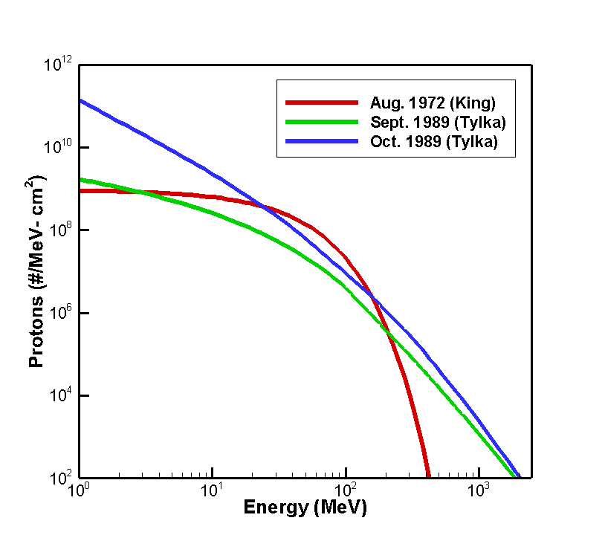
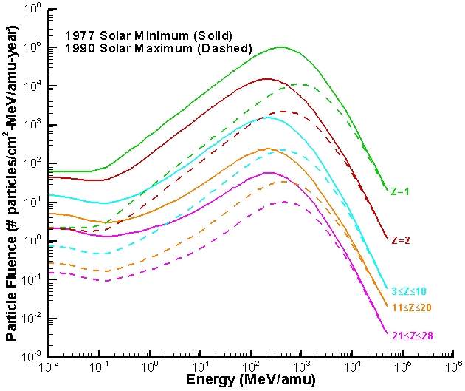
Free Space GCR and SPE Environments
Galactic Cosmic Rays
Solar Particle Events

Slide 9
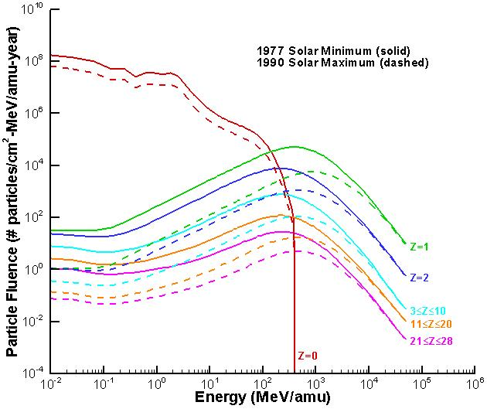
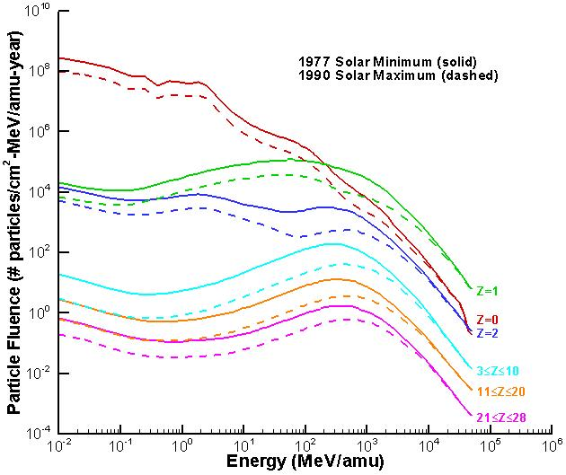
Surface GCR Environments
Lunar Surface GCR Environment
Mars Surface GCR Environment

Slide 10
Space Radiation Environments
 | Components | Effectiveness of Shielding* | Predictability | Primary Mitigation | Risks
GCR | High energy/penetrating | Low | Constant (ish) | Mission length | Chronic
Particle Belts (Van Allen Belts) | Low energy | High | Known quantity | Optimized trajectory | Chronic
SPE (Space Weather) | Low energy | High | Low Think extreme rare weather events | Forecasting/nowcasting Shelter | Potentially acute, especially if poorly shielded
*By shielding, we typically mean the protective ability of the materials already in the vehicle

Slide 11
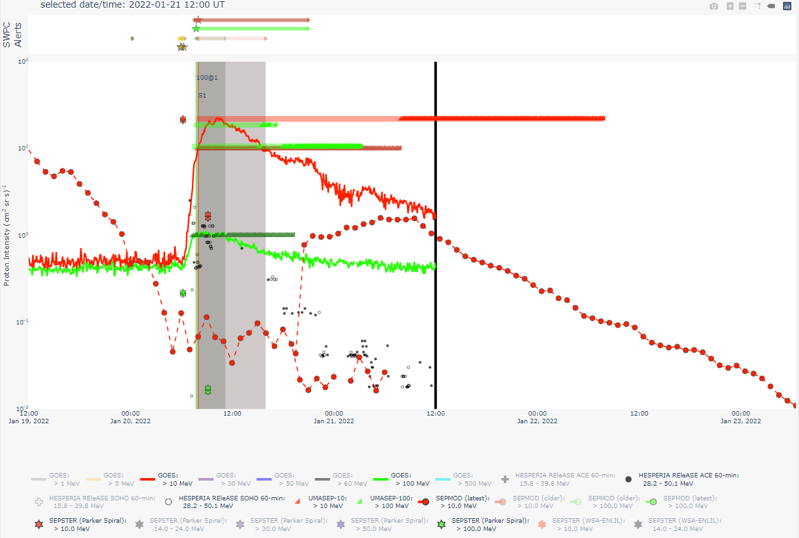
Space Weather Models
Space weather models are needed to alert crew to impending SPEs
  Tools for probability of occurrence, intensity prediction, and all-clear forecasting are needed
Intensity Scoreboard: Proton flux measurements (sold thin red/green lines) and model outputs of event intensity following the January 20, 2022 Energetic Solar Particle Event (ESPE)

Slide 12
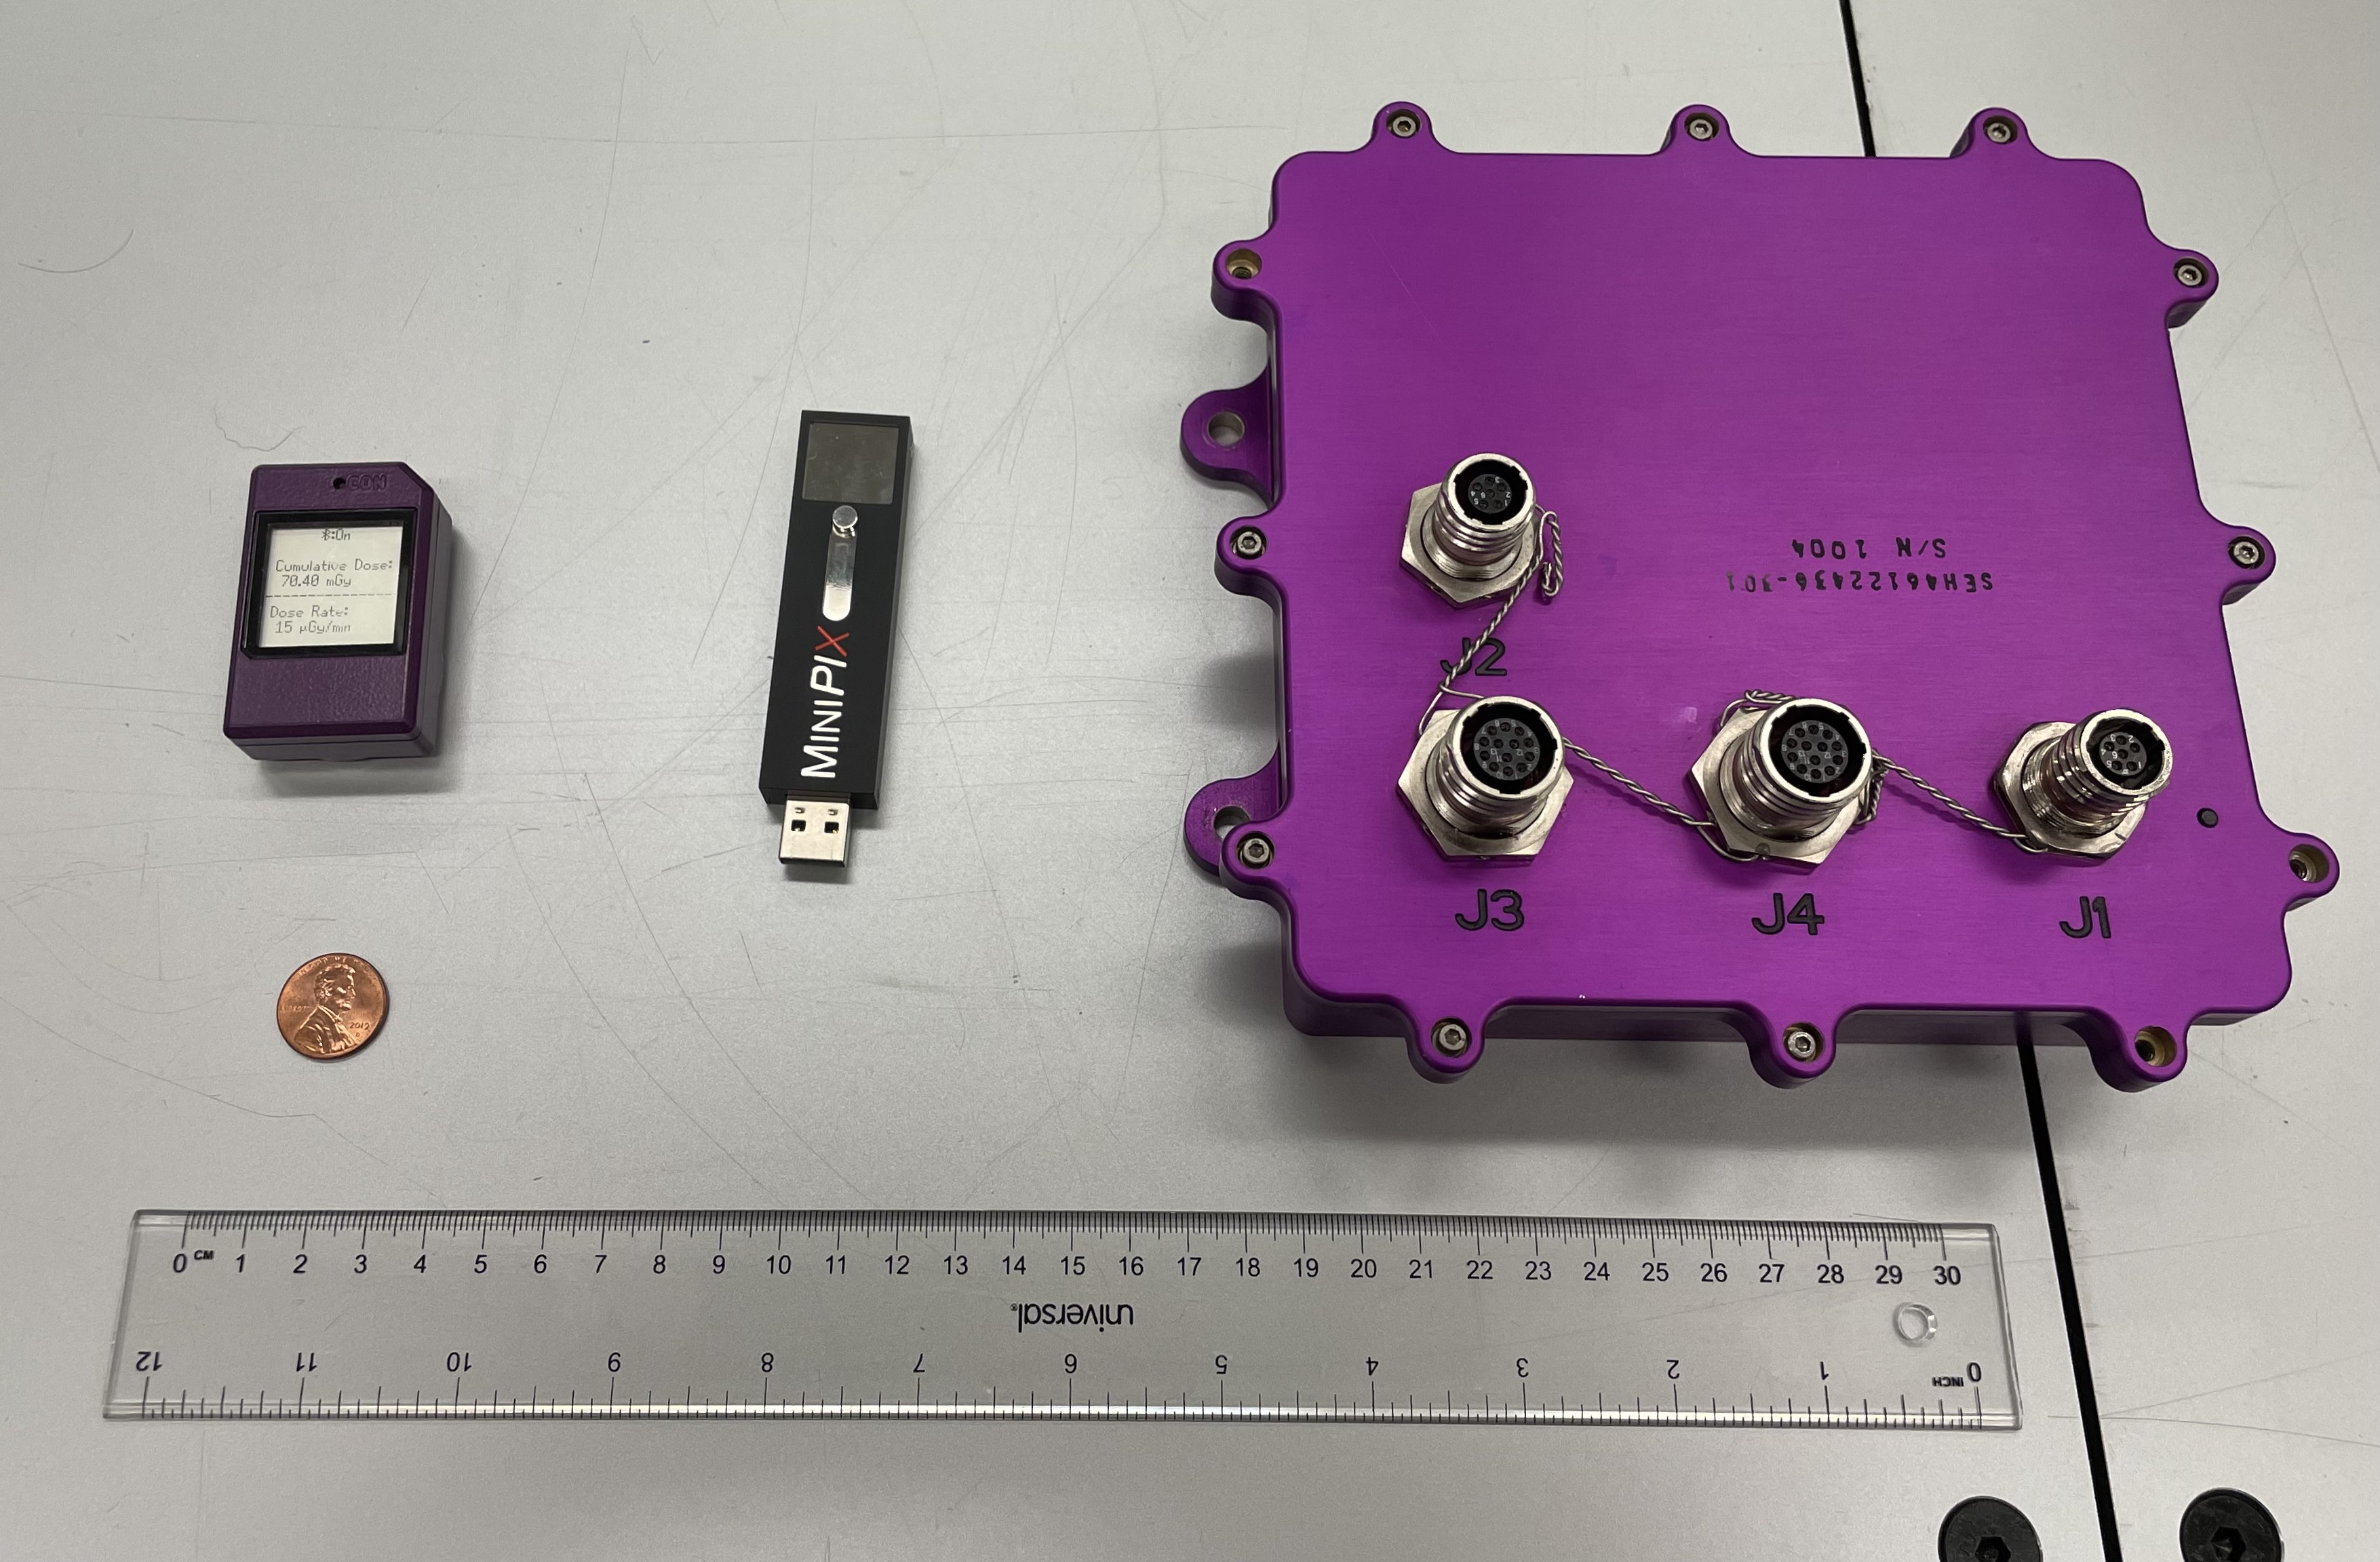
NASA Radiation Monitors for Crew Protection
Personal monitors - e.g. crew badges, CADS
Area monitors for charged particles - RAD, REM, HERA, ARES
Area monitors for neutrons - RAD and ANS
Space Weather monitors – Existing infrastructure and CEPS

Slide 13
Radiation Exposure Quantities
A variety of quantities are used to assess radiation exposure
In some cases, different quantities use the same units
The human body shields internal organs – Exposure quantities assessed in the human body will differ from point quantities
Dosimetric Quantities:
Dose (D) – measured in grays (Gy)
  Energy absorbed per unit mass of material
  Point quantity
Dose Equivalent (H) – measured in sieverts (Sv)
  Dose integrated with a quality factor, which accounts for the varying ability of different types of particles to produce cancer
  Point quantity
Organ/Tissue Averaged Dose Equivalent (H) – measured in sieverts (Sv)
  Assessment assumes the organ or tissue of interest is surrounded by a human body
Gray Equivalent (Gy-Eq) – measured in gray equivalent (Gy-Eq)
  Dose scaled by relative biological effectiveness (RBE) factors, which account for the varying ability of different types of particles to produce deterministic effects
  Point quantity
Organ/Tissue Averaged Gray Equiv. (Gy-Eq) – measured in gray equiv. (Gy-Eq)
  Assessment assumes the organ or tissue of interest is surrounded by a human body
Effective Dose (E) – measured in sieverts (Sv)
  A weighted average of dose equivalent to sensitive organs and tissues
  Whole body quantity
Risk of Exposure Induced Death (REID) – measured in percent (%)
  Probabilistic assessment of increased risk of dying of cancer due to radiation exposure
  Whole body quantity

Slide 14
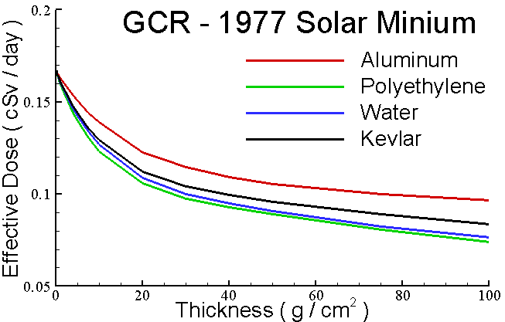
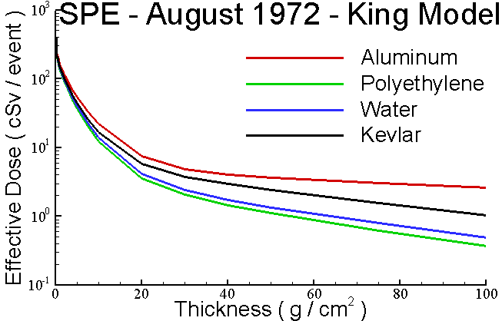
Effectiveness of Shielding Materials – Old Paradigm
Shielding materials are more effective for Solar Particle Events than for the GCR environment and hydrogen rich materials provide better protection.

Slide 15
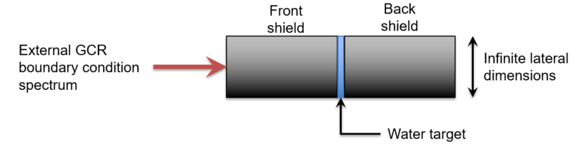
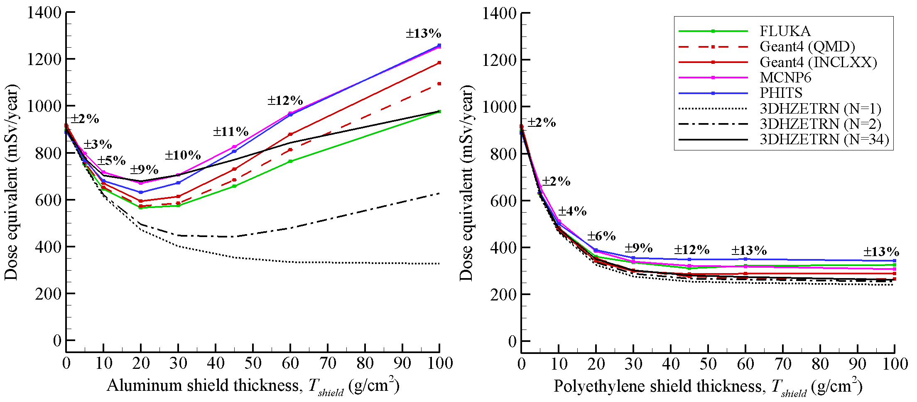
Effectiveness of Shielding Materials – New Paradigm
Calculations with 3DHZETRN and Monte Carlo Transport Codes show dose equivalent increases when non-hydrogenous shielding material beyond 20 g/cm² is added.
Slaba et al. LSSR (2017)

Slide 16
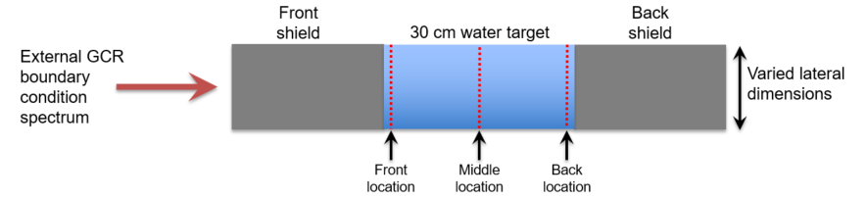
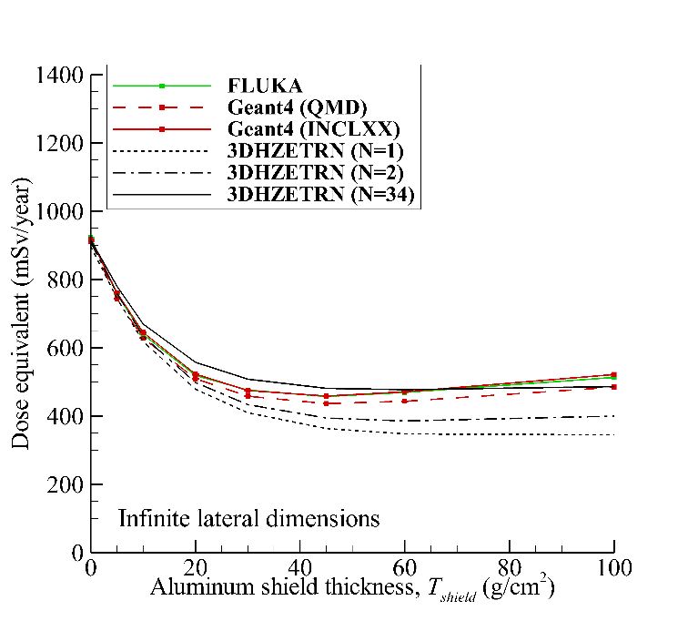
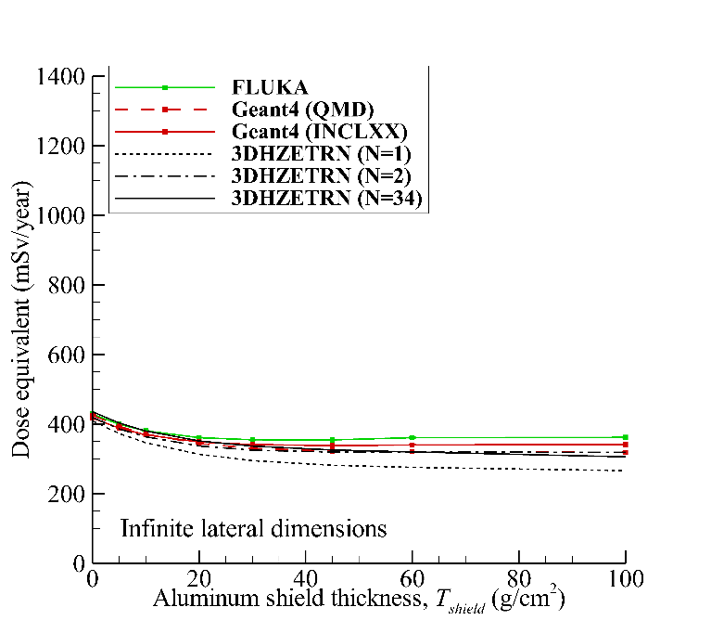
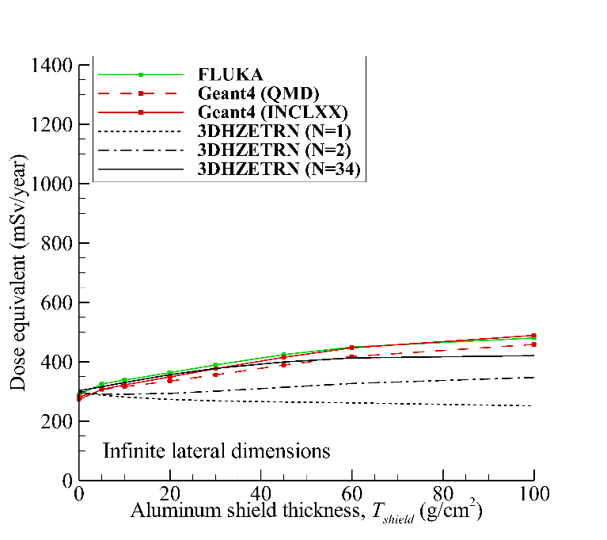
Effectiveness of Shielding Materials – New Paradigm
Front location
Middle location
Back location
Adding water (or human tissue) suppresses the optimal shield thickness, but adding shielding beyond 20 g/cm² is not a good way to reduce dose equivalent.
Slaba et al. LSSR (2017)

Slide 17
Radiation Protection Requirements
Permissible exposure limits (PELs) are defined in NASA Standard 3001.
  4.8 Space Permissible Exposure Limit for Space Flight Radiation Exposure
    The following standards define the Space Permissible Exposure Limits (PELs) for the following: astronaut total career exposure limits, short-term acute exposure limits and nuclear technology exposure limits. It is important to further minimize exposure from all sources of radiation below the following limits using the as low as reasonably achievable (ALARA) principle.
  As Low as Reasonably Achievable (ALARA) Principle
    All crew radiation exposures shall be minimized using the ALARA principle.
  4.8.2 Career Space Permissible Exposure Limit for Space Flight Radiation
    An individual astronaut’s total career effective radiation dose due to space flight radiation exposure shall be less than 600 mSv. This limit is universal for all ages and sexes.
  4.8.3 Short-Term Radiation Limits – Solar Particle Events
    The program shall protect crewmembers from exposure to the design reference solar particle event (SPE) environment proton energy spectrum (sum of the October 1989 events) to less than a NASA effective dose of 250 mSv.
  4.8.4 Crew Radiation Limits for Nuclear Technologies
    Radiological exposure from nuclear technologies emitting ionizing radiation to crewmembers (e.g., radioisotope power systems, fission reactors, etc.) shall be less than an effective dose of 20 mSv per mission year (prorated/extrapolated to mission durations) and utilizing the ALARA principle.
Mars Transit and Surface Habitat programs will establish design requirements to ensure that these PELs are not exceeded.

Slide 18
Suggested Radiation Protection Design Goals
Develop plan for SPE protection:
  The entire vehicle or habitat does not need to be shielded.
  Adequate protection can be provided through the use of a storm shelter and/or radiation protection garments.
  When the model has reached adequate maturity, perform radiation analyses to ensure that exposure limits are not exceeded and that astronaut exposure is kept As Low As Reasonably Achievable (ALARA).
    Note: It is not good enough to just meet the exposure limit, if there are reasonable steps that can be taken to further reduce astronaut exposure.
For GCR protection, focus on ALARA:
  Try to ensure that astronauts are completely surrounded by 20 g/cm² of shielding in all areas of the vehicle or habitat where they will spend time.
  If that is not possible, minimize the regions providing less than 20 g/cm² of shielding and make those regions as thick as is reasonably possible.
  Focus on using the mass that would already be in the vehicle or habitat.
  Do not add mass to go beyond 20 g/cm² of shielding, unless your concept involves adding meters of shielding (like a surface habitat buried in regolith).

Slide 19
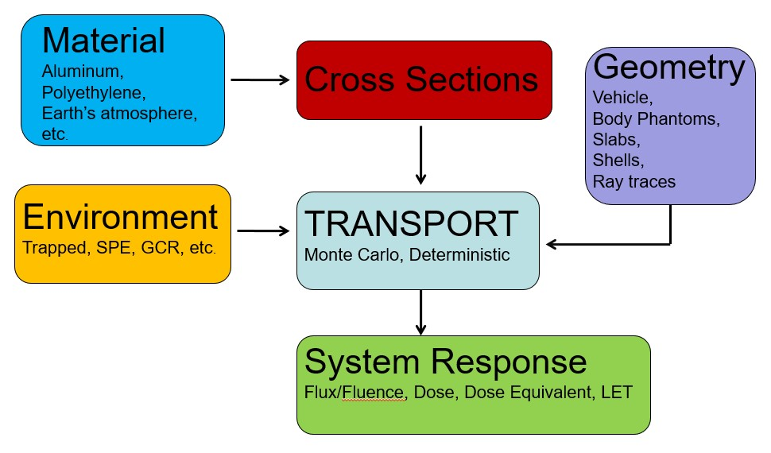
Tools Needed to Predict Crew Exposure

Slide 20
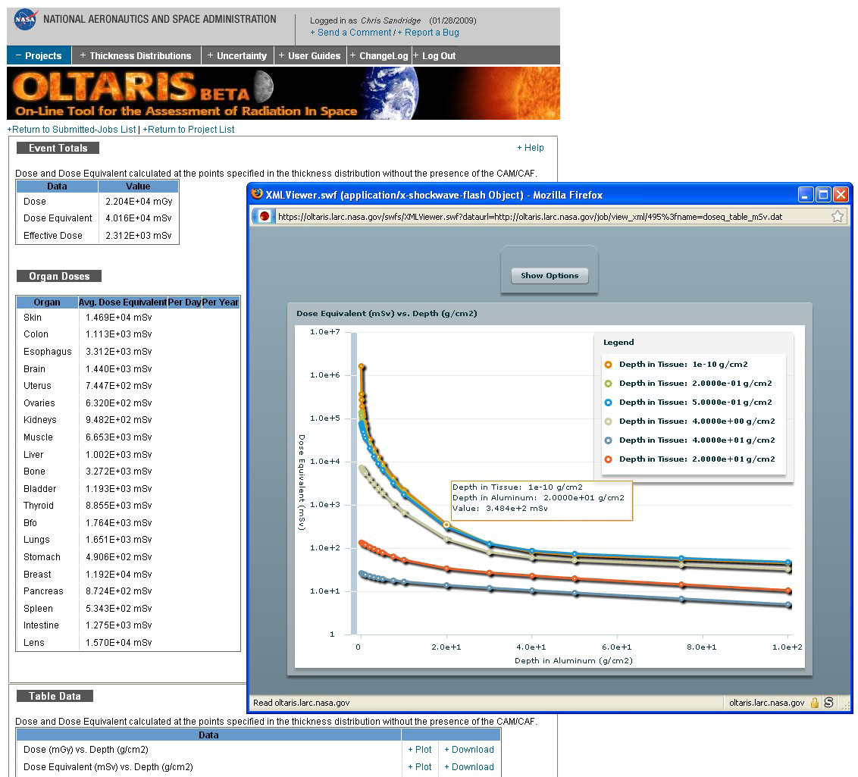
The On-Line Tool for the Assessment of Radiation in Space (OLTARIS)
OLTARIS is a web portal created to supply “best practices” in radiation shielding models, methods, and algorithms to the community.
It is rigorously developed in a modular framework that is easily maintained and updated.
It includes space environment models, transport algorithms, human body models, and response functions.
Users can define their own mission parameters and upload ray-traces of their spacecraft to assess the protection provided.
https://oltaris.nasa.gov
The OLTARIS website enables rapid exposure analyses for complex mission architecture.

Slide 21
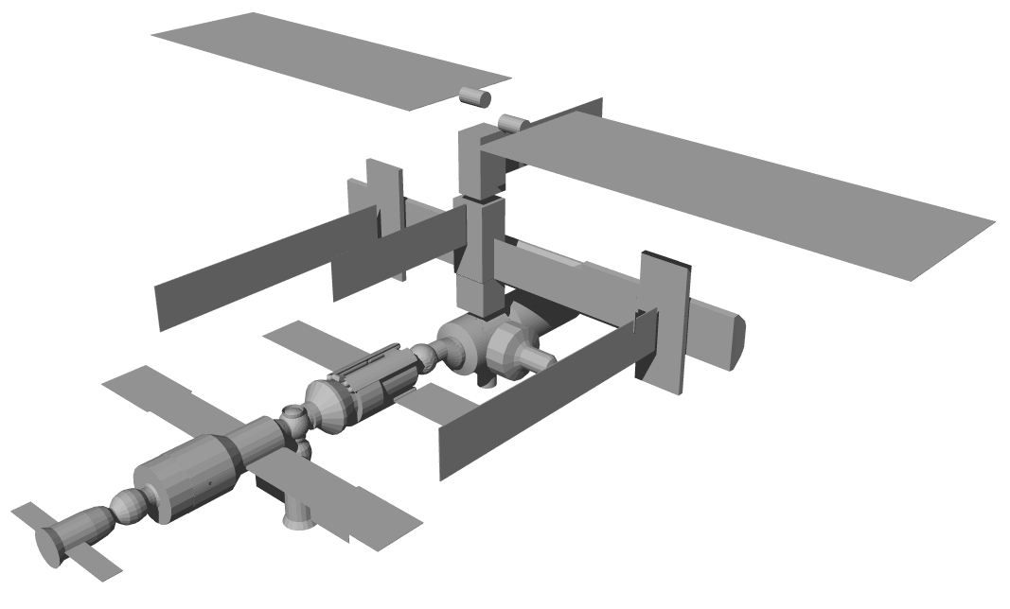
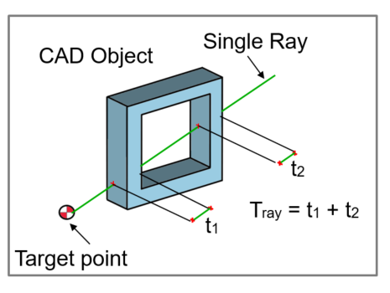
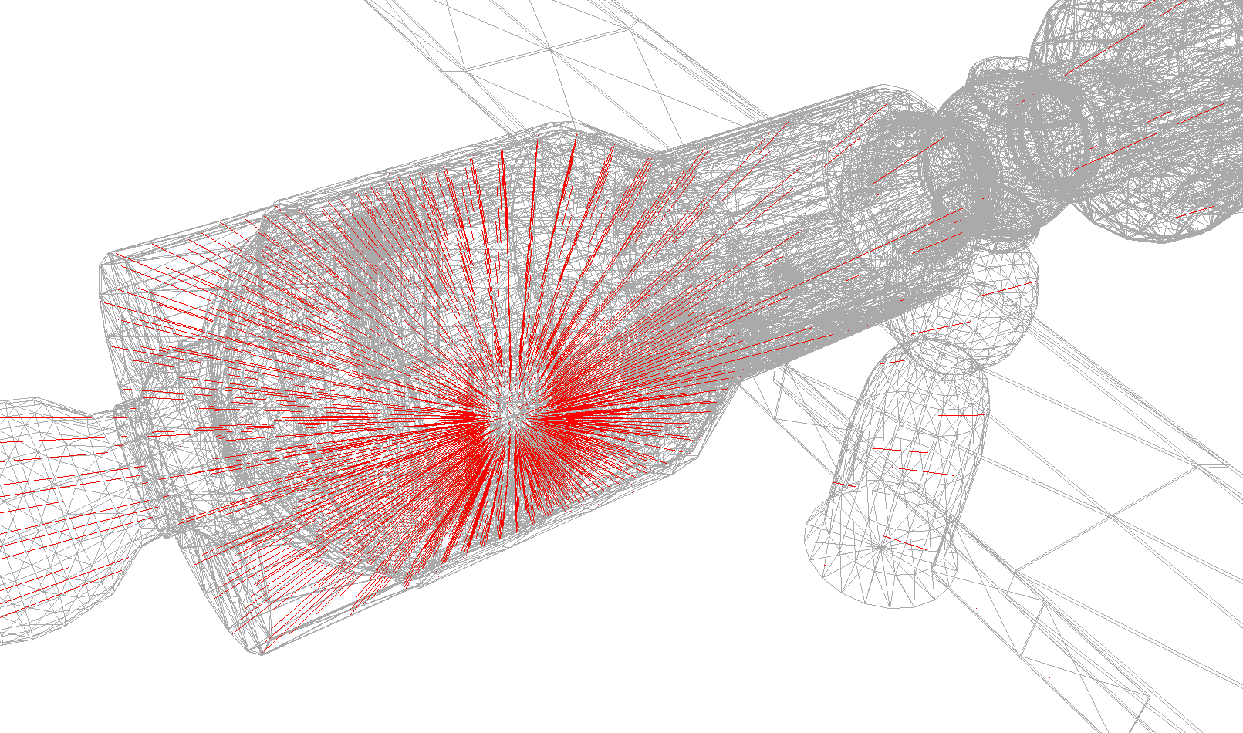
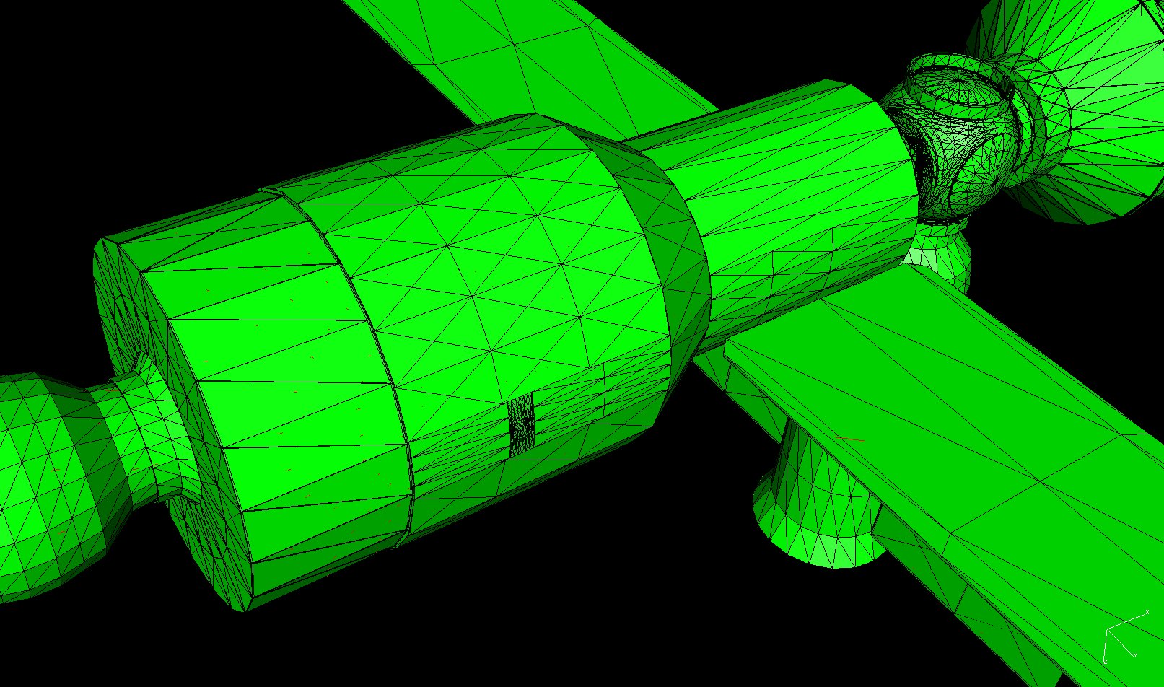
Analyzing Protection Provided by Complex Spacecraft Geometry – Ray Tracing
International Space Station (ISS)
Service Module Ray-Trace
Note:
All of the mass surrounding the astronauts (spacecraft structure, vehicle systems, supplies, fuel, other astronauts, etc.) must be included in the model.
Service Module

Slide 22
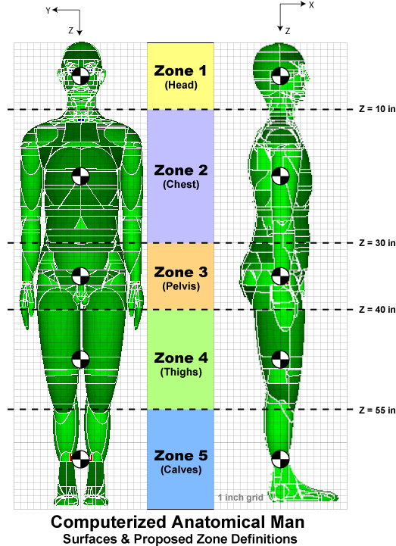
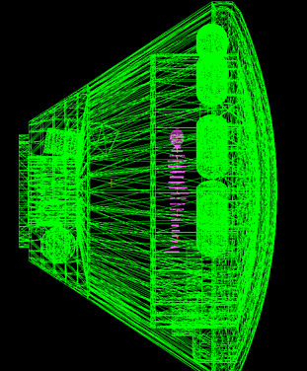
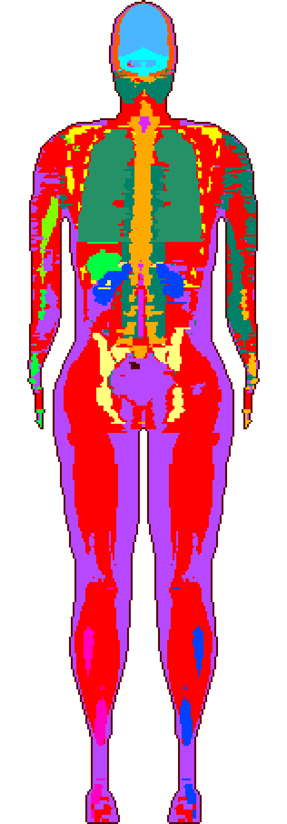
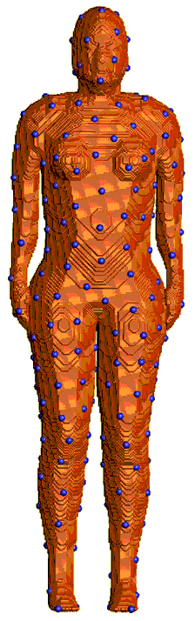
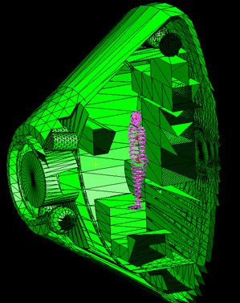
Analyzing Protection Provided by Complex Spacecraft Geometry – Incorporation of Body Models in Vehicle Geometry
Stored ray traces for ~1100 body points are combined with 5 Spacecraft ray traces
Female Adult voxel (FAX) Model
Skin Dose Points in the FAX
Computerized Anatomical Man (CAM)

Slide 23
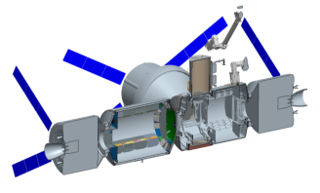
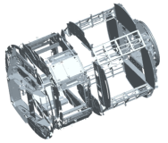
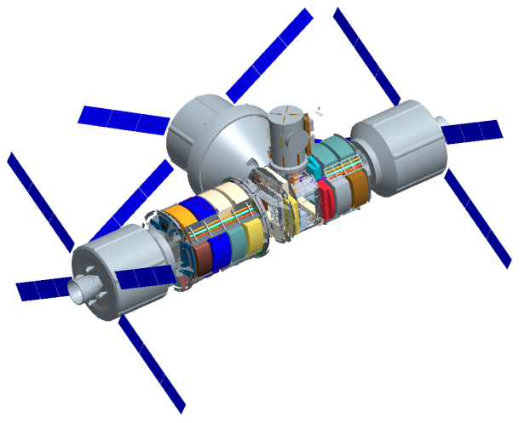
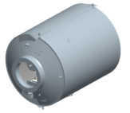
ISS-Derived Habitat Developed for AES RadWorks SPE Protection Study
CAD model creation can be an
intensive and time consuming effort

Slide 24
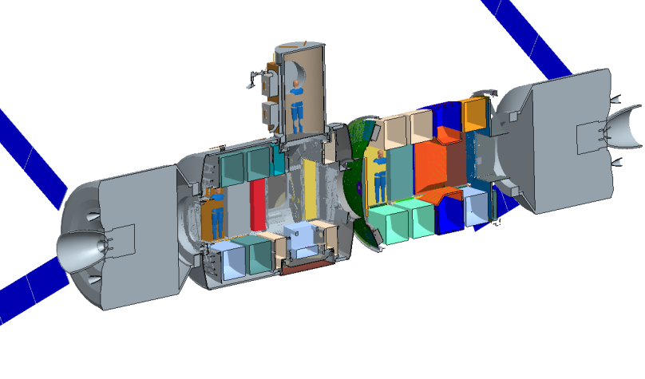
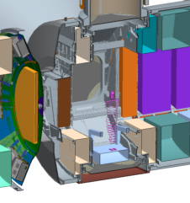
Locations Used for Baseline Analysis
Crew Lock
Waste Hygiene
Rack
Crew
Quarter
Tread Mill
Galley

Slide 25
Astronaut Effective Dose in the Crew Quarters
Astronaut effective dose was calculated at multiple vehicle locations for multiple space environments.
 | Aug `72 King | Aug `72 Band | Sept `89 OLTARIS | Sept `89 Band | Xapsos 95% Confidence | Oct `89 IMP
Top | 480 | 271 | 132 | 136 | 591 | 409
Bottom | 505 | 283 | 133 | 139 | 602 | 412
Left | 398 | 227 | 121 | 121 | 526 | 373
Right | 526 | 297 | 138 | 144 | 626 | 427

Slide 26
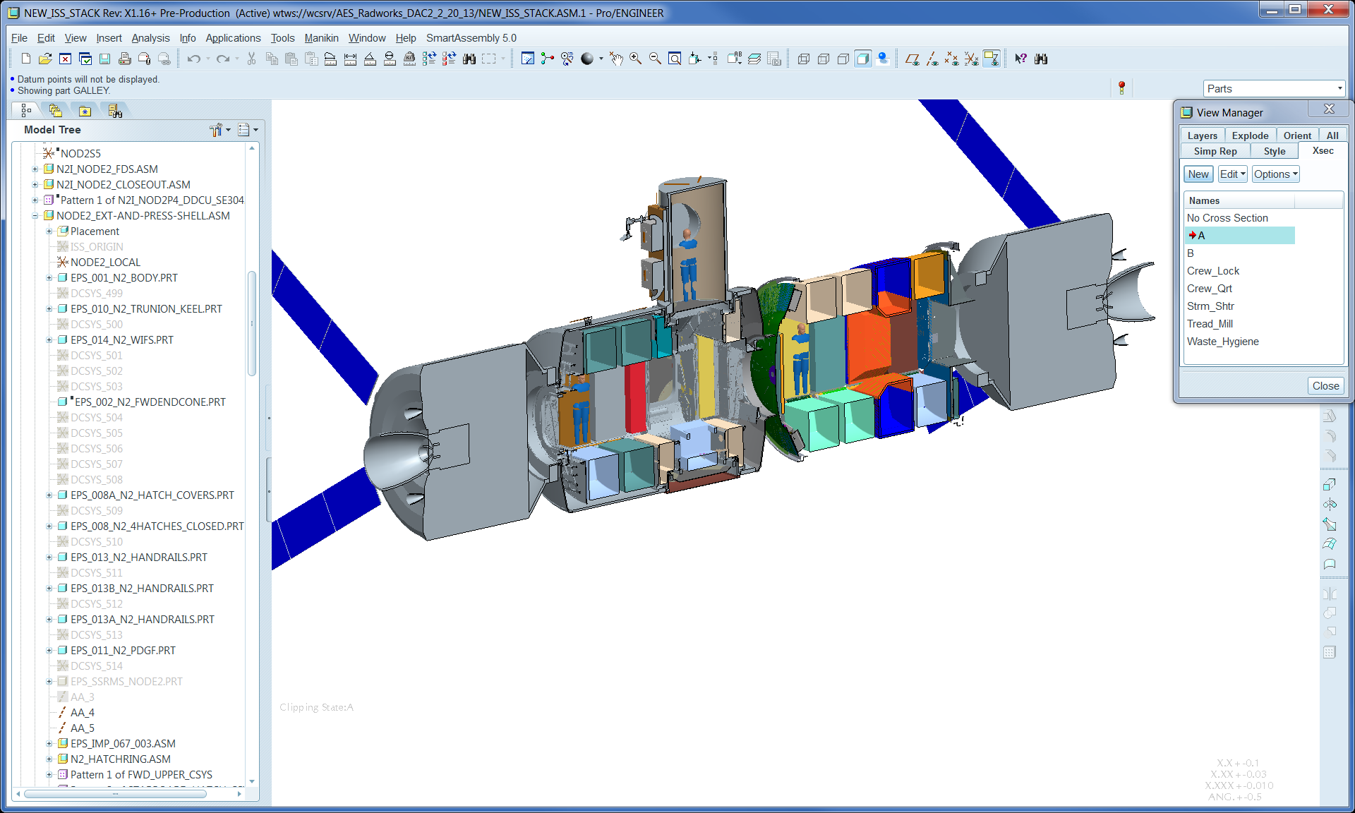
Astronaut Effective Dose at Other Locations
 | Aug `72 King | Aug `72 Band | Sept `89 OLTARIS | Sept `89 Band | Xapsos 95% Confidence | Oct `89 IMP
Treadmill | 161 | 108 | 71 | 63 | 275 | 221
Galley | 81 | 65 | 47 | 38 | 168 | 149
Hygiene | 133 | 98 | 74 | 63 | 282 | 229

Slide 27
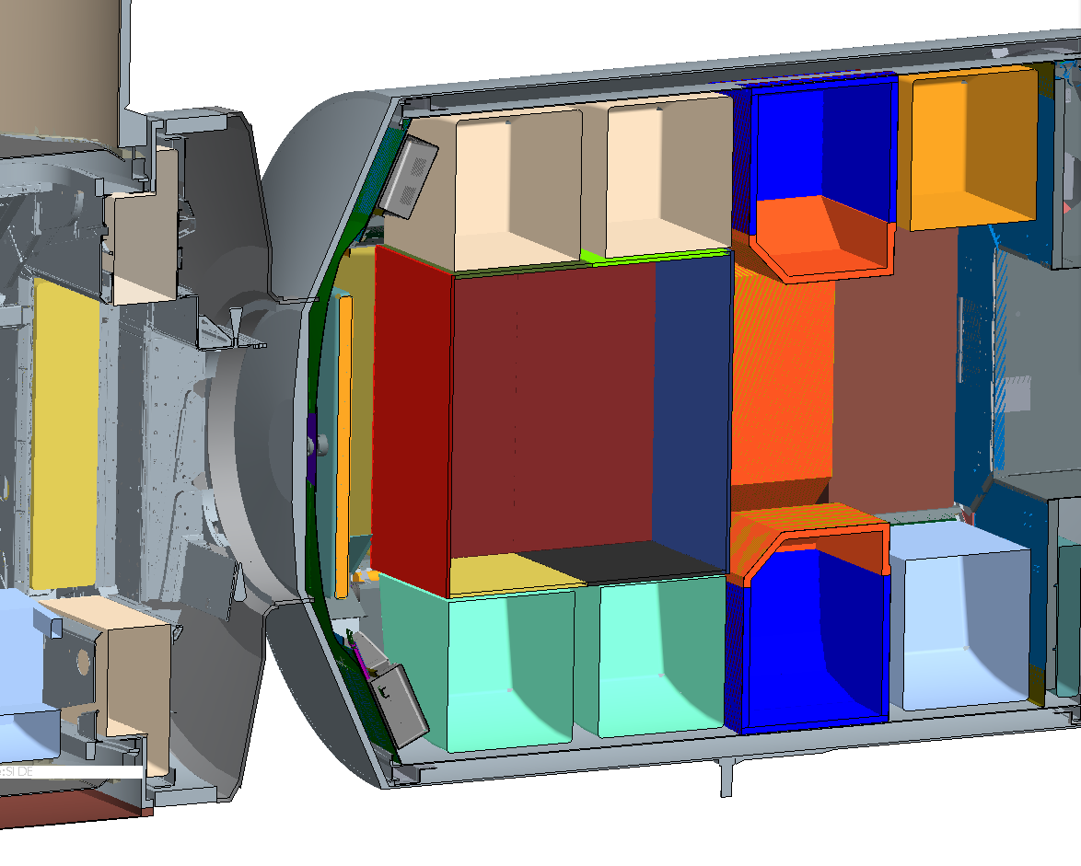
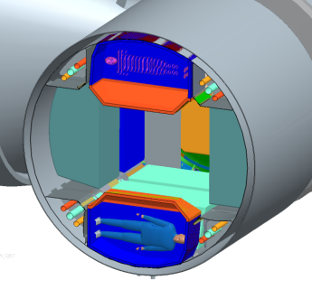
Two Storm Shelter Concepts Examined
Two Types of Storm Shelters Examined:
  Astronauts in the four crew quarters
  All four astronauts in a centrally located “Box”
Results:
  Too much mass was required to create storm shelters in all 4 crew quarters or in the large box shown
  Food, water, and supplies planned for this mission could be used to create storm shelter in 2 crew quarters with the astronauts “doubling up” or in a central box type shelter half the size shown
“Box”
Crew
Quarter

Slide 28
Effective Dose for GCR
Astronaut Location | Effective Dose (mSv/day)
CQ Top | 0.95
CQ Bottom | 0.95
CQ Left | 0.94
CQ Right | 0.95
Treadmill | 0.86
Galley | 0.82
Hygiene | 0.87
The interior locations (treadmill, galley, and hygiene) are better protected than the crew quarters (~10% reduction in effective dose).
Moving the crew quarters to more protected locations could result in more safe days in space.

Slide 29
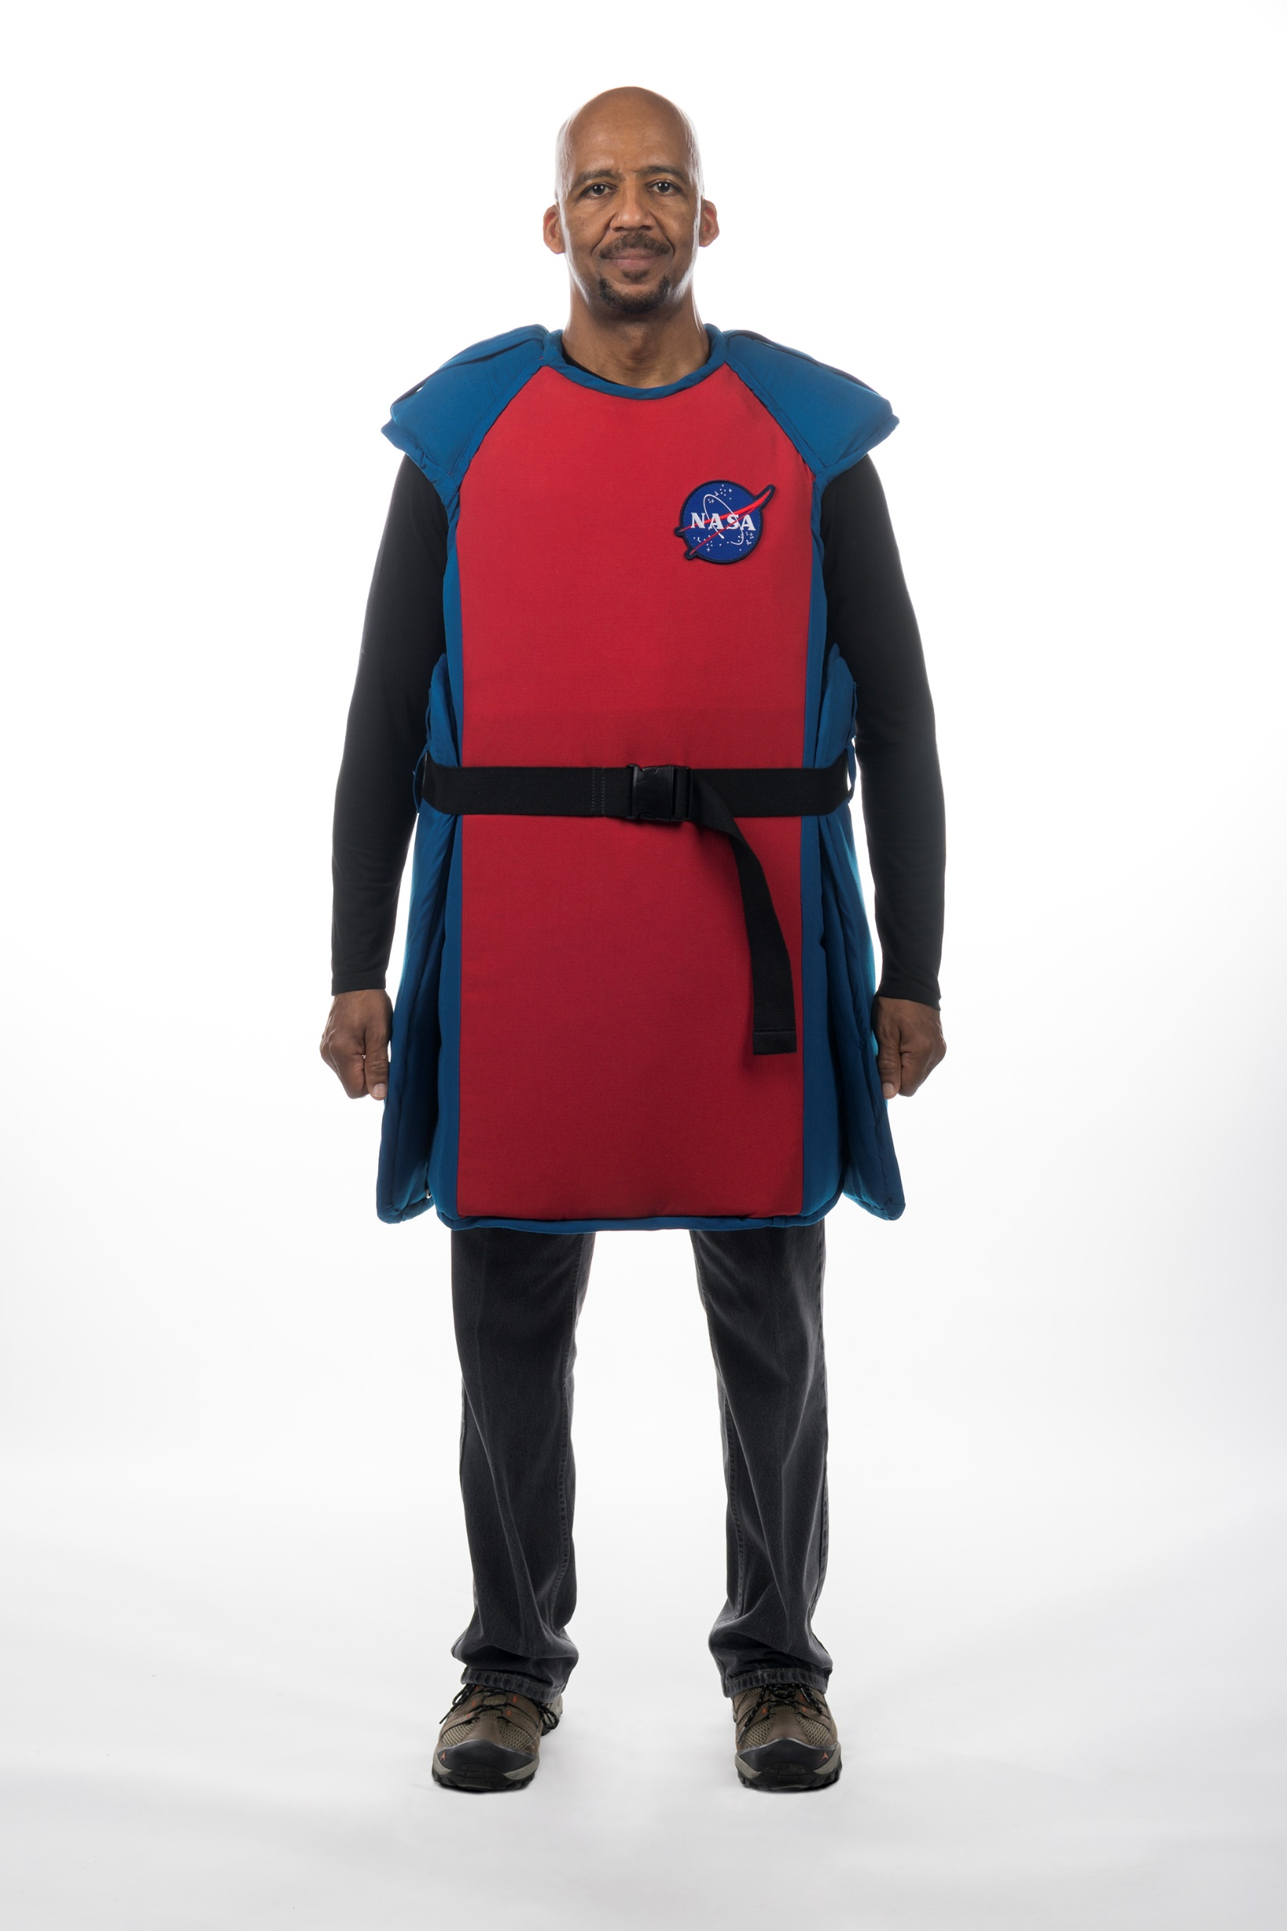
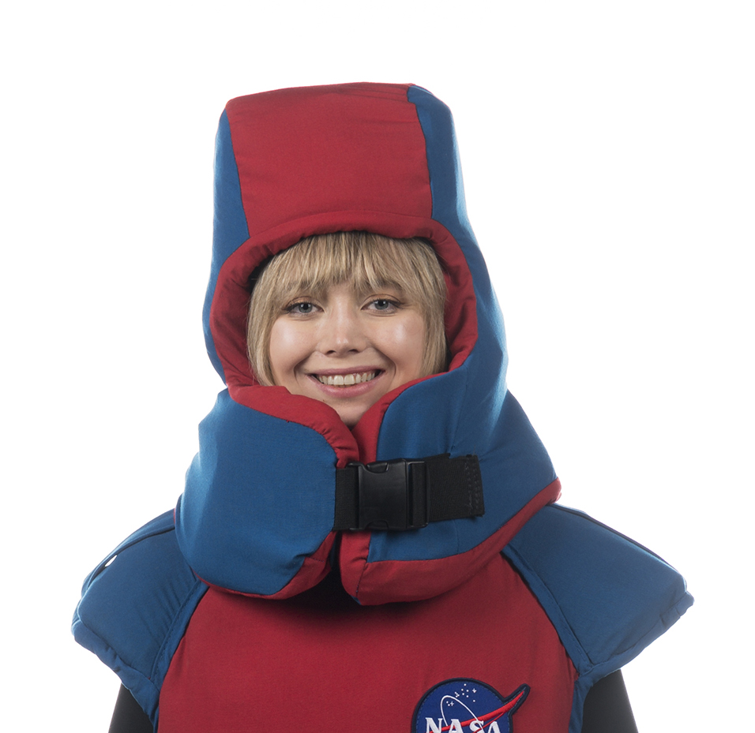
SPE Protection – Radiation Protection Garments
Pros:
Will allow crew members to continue moving around the vehicle
Can be used in vehicles which do not have enough onboard mass to provide adequate protection
Can be used in multiple mission segments (transit and surface ops)
Can be donned quickly – no set up time
Cons:
Require parasitic mass
Do not provide as much protection as a storm shelter, in most cases
Hybrid Approach:
For long duration missions, during which there could be many SPE warnings, a storm shelter/garment hybrid approach may be the best option
Crew members can don protection garments at the first sign of a SPE, and only confine themselves to a shelter, once it has been determined that a large SPE is underway.

Slide 30
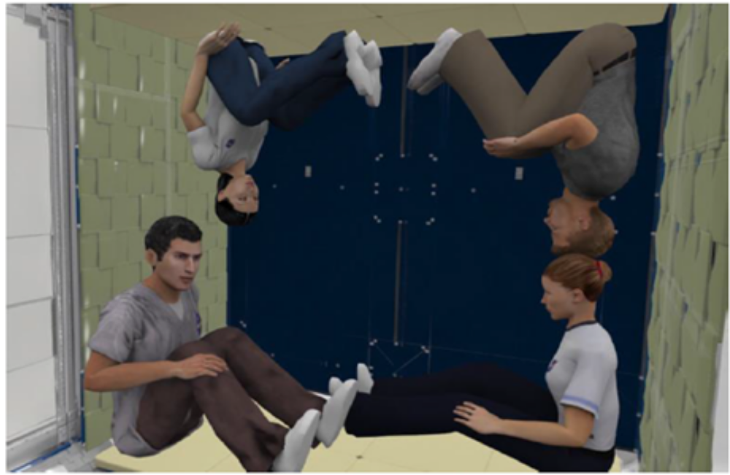
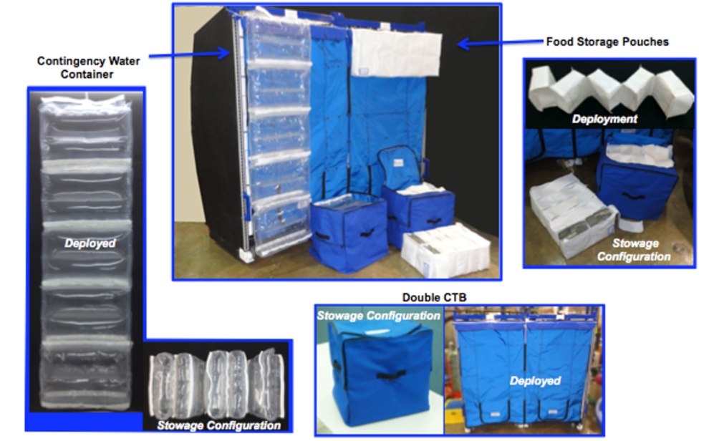
SPE Storm Shelters – Reconfigurable Logistics
Food, water, and supplies can be reconfigured to create a storm shelter.

Slide 31
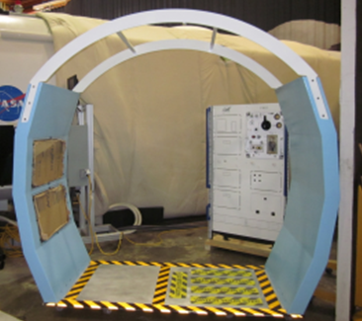
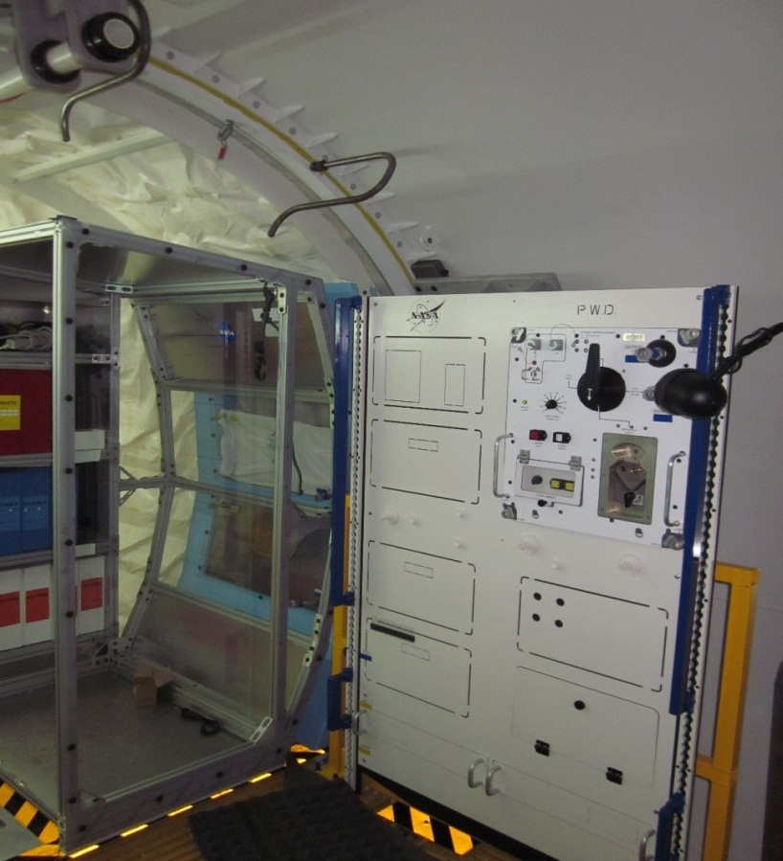
SPE Storm Shelters – Water Wall Systems
Water walls can be used to augment the shielding in the crew quarters.

Slide 32
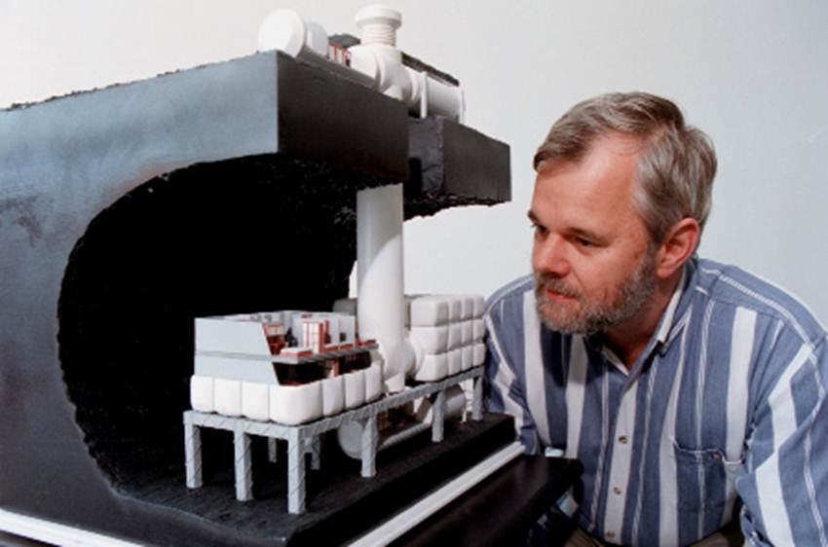
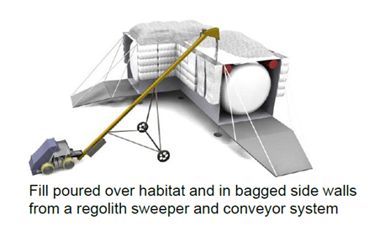
Use of Regolith to Shield Surface Habitats

Slide 33
Summary
Radiation detectors, space weather modeling, and radiation shielding all play important roles in protecting crew from space radiation.
Detectors are needed for alarming, to quantify crew exposure for risk evaluation, and for space weather nowcasting
  Charged particle detectors and neutron monitors are needed.
  Personal dosimetry, area monitors, and external detectors are needed.
Space weather models are needed to alert crew to impending SPEs
  Tools for probability of occurrence, intensity prediction, and all-clear forecasting are needed
Radiation protection should be designed using ALARA
  Spacecraft should provide SPE protection (storm shelter and/or wearables).
  Habitat designers for long duration missions should strive to surround astronauts with 20 g/cm² of hydrogen rich shielding for GCR protection.
    Adding more than 20 g/cm² is not helpful, unless you are adding meters of material.
  OLTARIS enables the assessment of protection provided by complex vehicle/habitat geometries.

Slide 34
Questions?

Slide 35
Back-Up

Slide 36
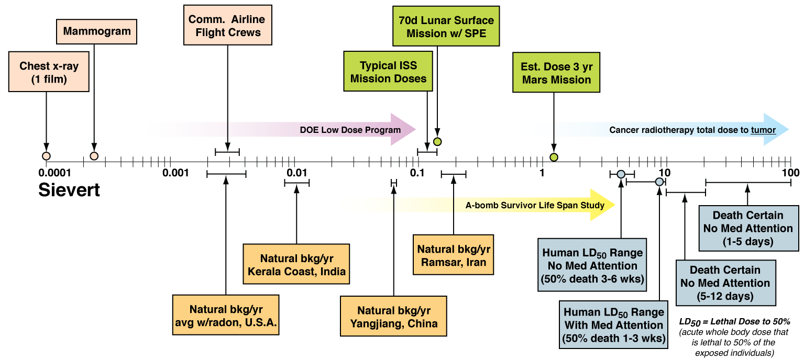
Space Radiation in Context
Large SPE
(in shelter)
Large SPE
(during EVA)
Threshold for Acute Effects

Slide 37
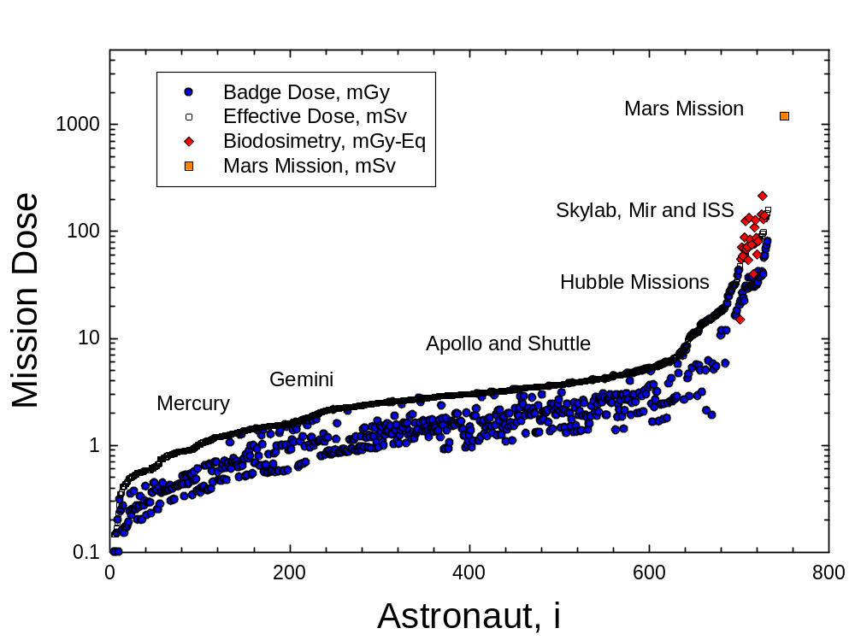
Crew Doses
Update from Cucinotta et al. Radiat Res (2008)

