Slide 1

Weather Considerations for Advanced Air Mobility
Virtual Air Traffic Control Workshop 2022
Timothy Bonin
3 May 2022
Image Credit: MIT LL

Slide 2
Legal Notices
Distribution Statement: Approved for public release; distribution is unlimited.
This material is based upon work supported by the National Aeronautics and Space Administration under Air Force Contract No. FA8702-15-D-0001. Any opinions, findings, conclusions or recommendations expressed in this material are those of the author(s) and do not necessarily reflect the views of the National Aeronautics and Space Administration .
Delivered to the US Government with Unlimited Rights, as defined in DFARS Part 252.227-7013 or 7014 (Feb 2014). Notwithstanding any copyright notice, U.S. Government rights in this work are defined by DFARS 252.227-7013 or DFARS 252.227-7014 as detailed above. Use of this work other than as specifically authorized by the U.S. Government may violate any copyrights that exist in this work.

Slide 3
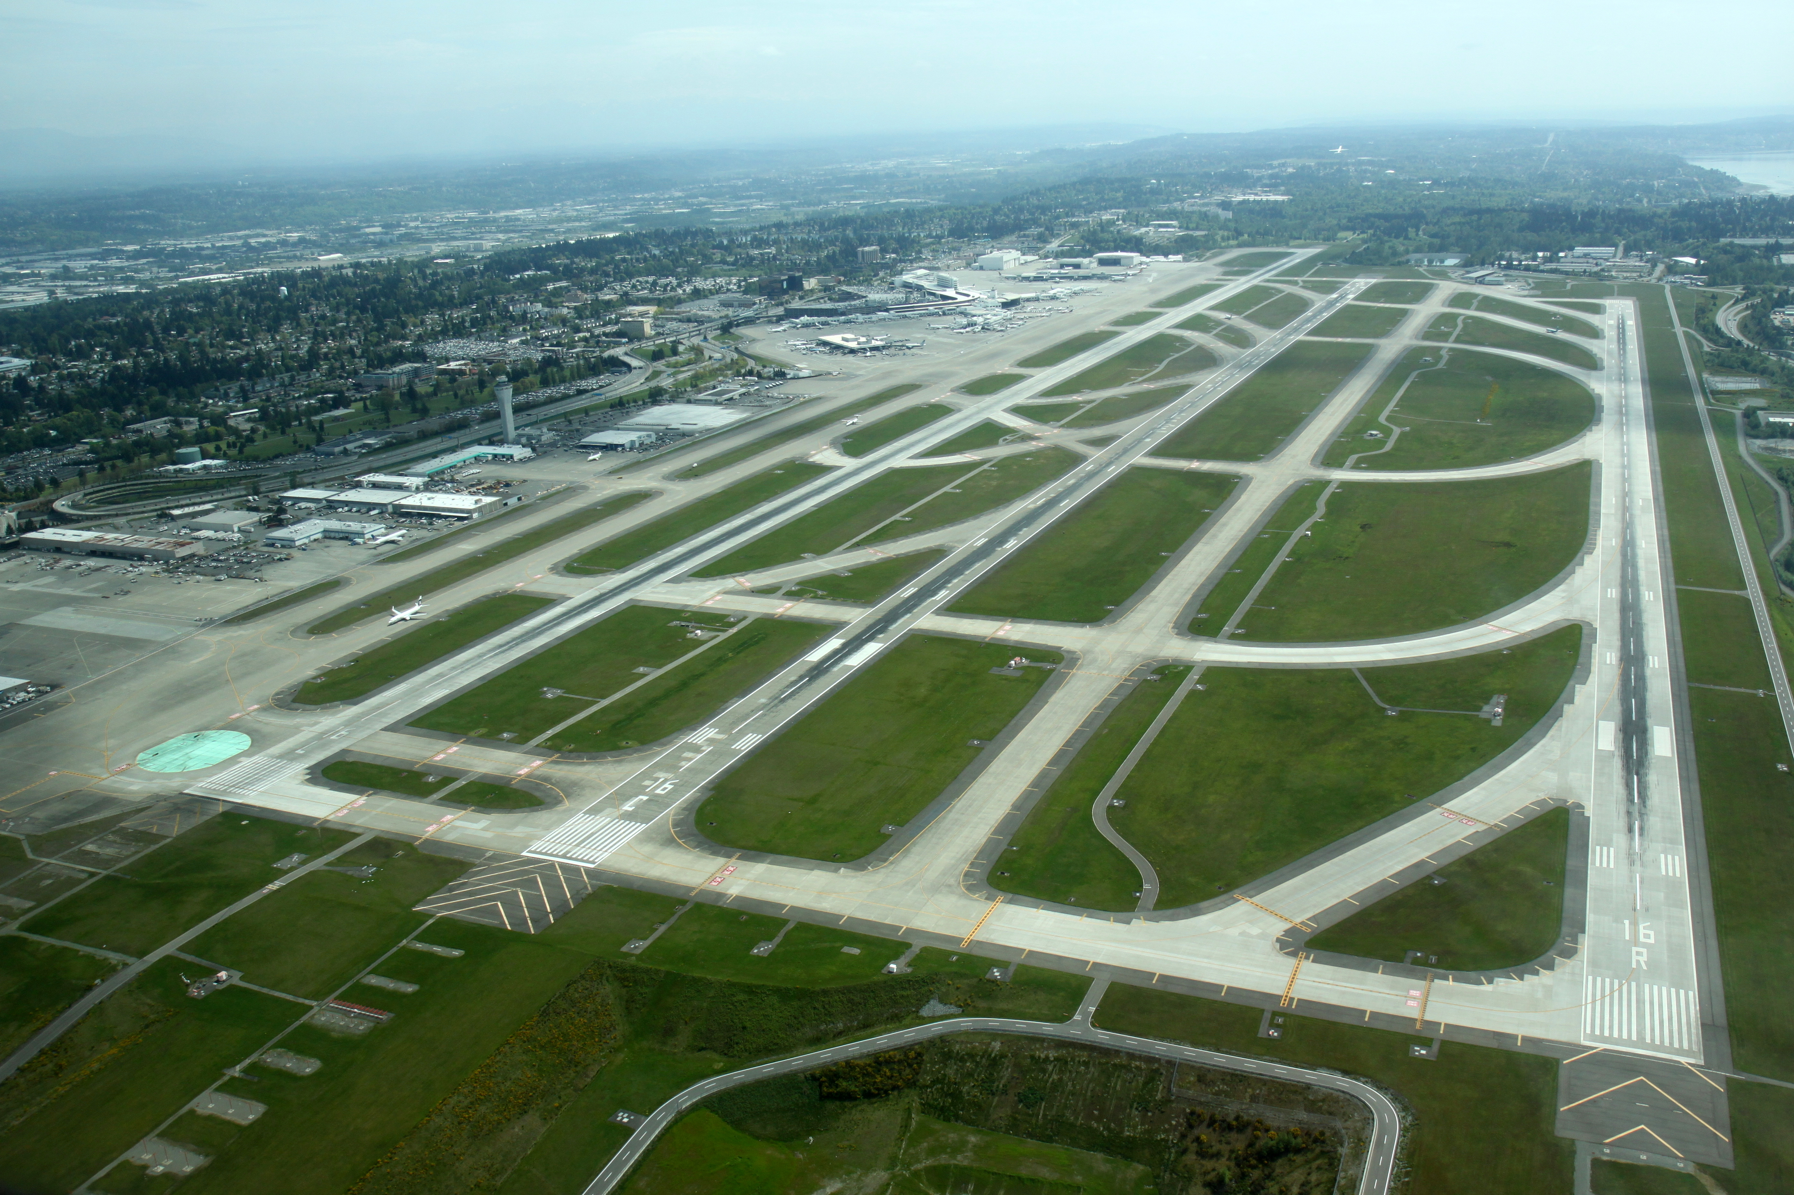


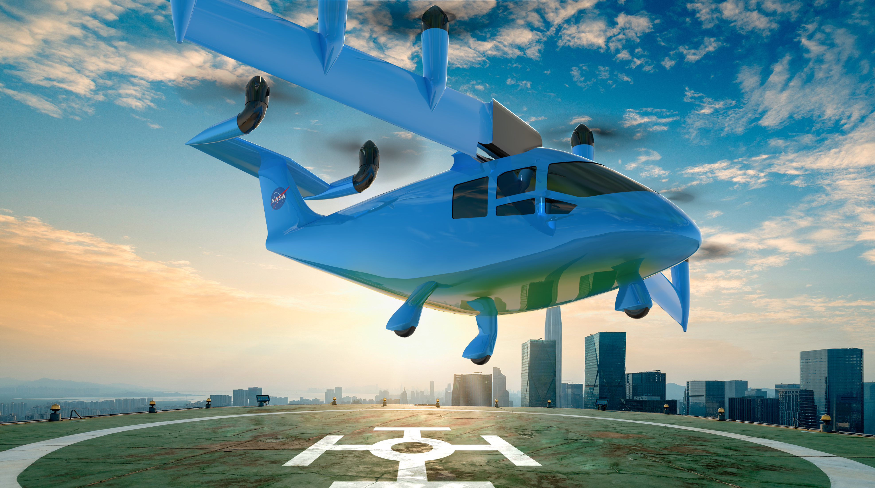
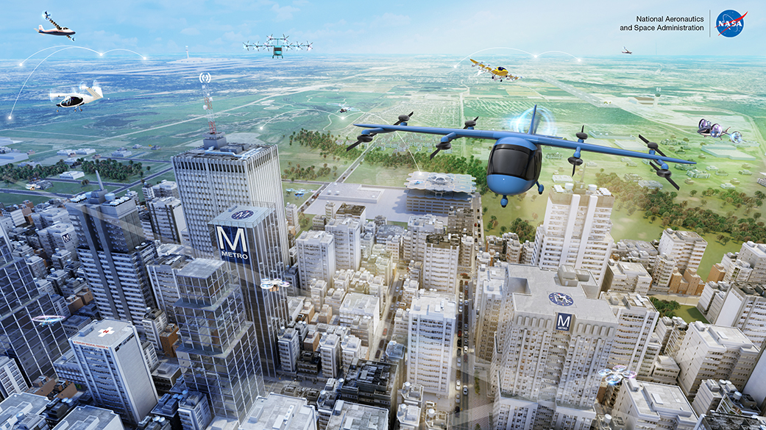

AAM Operations Differ from Conventional Aviation
Takeoff/Landing
Cruise Altitude
Vehicle Type
Conventional Commercial Aviation
CC Jelson25
CC oatsy40
CC longhairthai.com
Airports in open areas and heavily sensed
High-altitude above most weather
Fixed-wing with deicing capability
Advanced
Air Mobility
Vertiports in built up areas and little sensing
Low-altitude in the dynamic PBL
Mixed type of small vehicles with no deicing
Image Credits: Top: Creative Commons (CC)
Bottom: NASA
AAM = Advanced Air Mobility
PBL = Planetary Boundary Layer

Slide 4
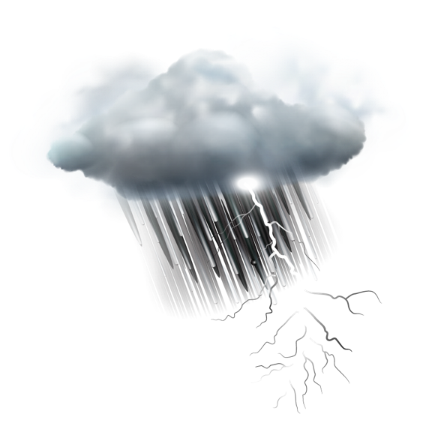

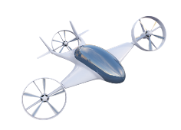


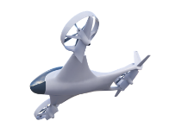






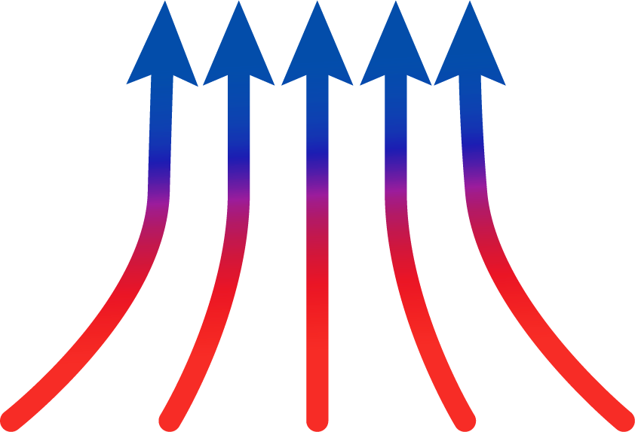
Primary Weather Conditions Impactful to AAM
Icing
Convection & Storms
Temperature
Precipitation
Reduced Visibility & Low Ceiling
Wind Shifts
Urban Canyons
Turbulence
Updrafts and Downdrafts
Wind Gusts
Wind Shear
Plethora of weather conditions phenomena impact AAM
Image Credit: MIT LL

Slide 5

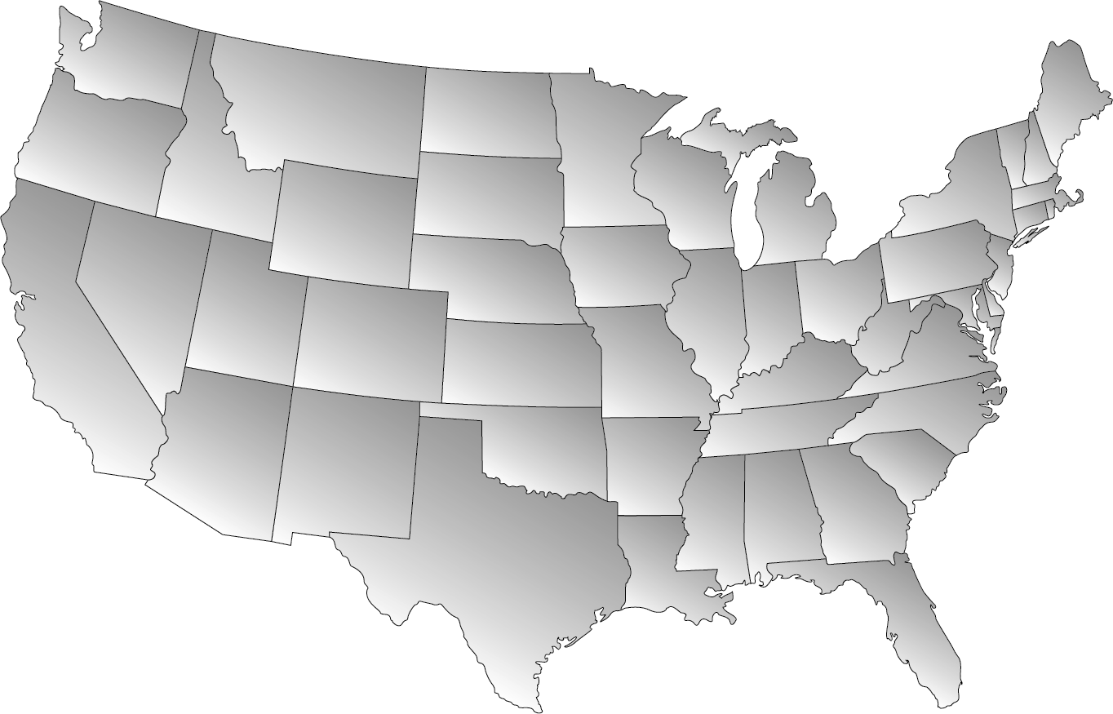



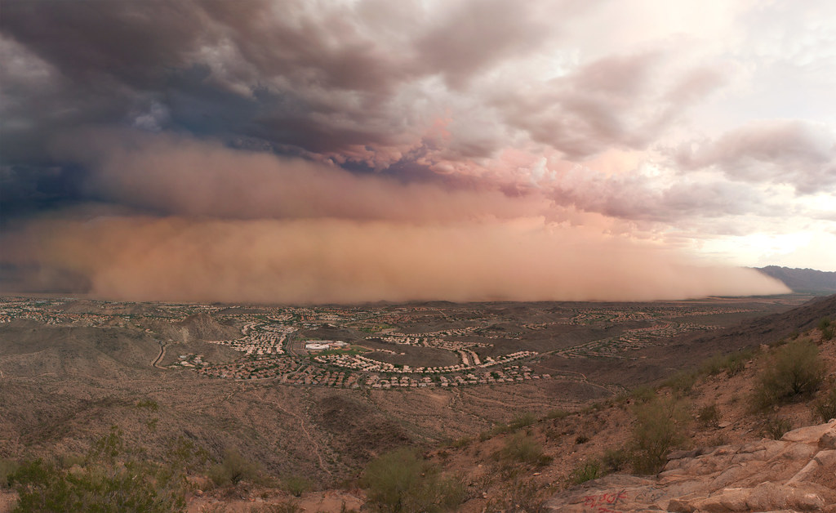
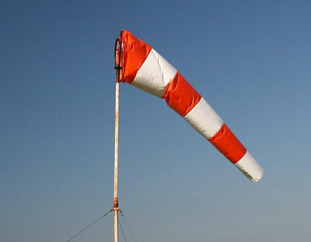
AAM Weather Challenges Vary by Location
CC dagpeak
CC rcolonna
Convection and Storms
Winter Weather and Icing
CC davidyuweb
CC squeaks2569
CC Matt Mercer
CC Richard Parmiter
Heterogeneous Low Clouds
Dust Storms
Strong Wind Shear
Sea and Lake Breezes
Local climates need to be considered to assess relevant weather information needs
Image Credits: Creative Commons (CC)

Slide 6
Outline
Anticipated Weather Challenges for AAM
Weather Information Gaps for AAM
  Weather impacts and needs
  Currently available products
  Weather gaps
Candidate Technology to Mitigate Gaps for AAM
Vision and Summary

Slide 7
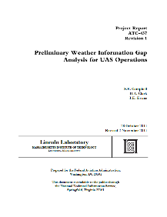
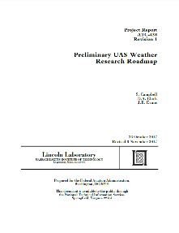
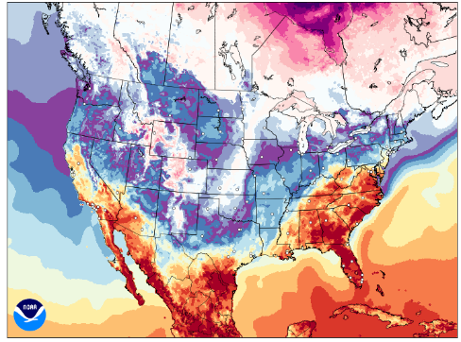
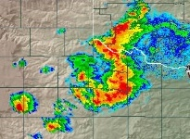
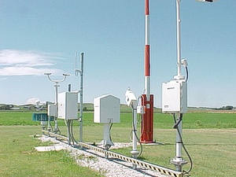
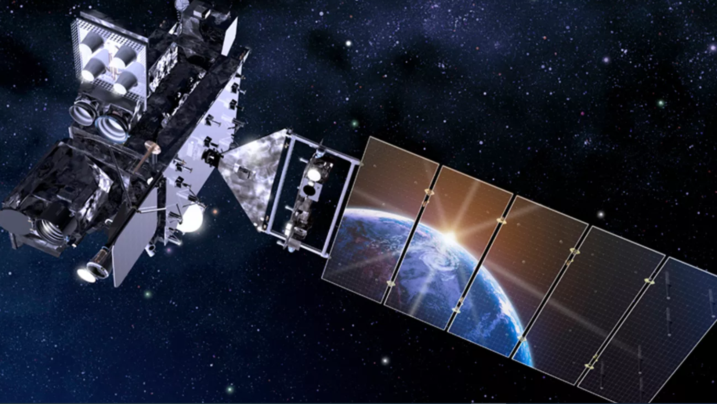
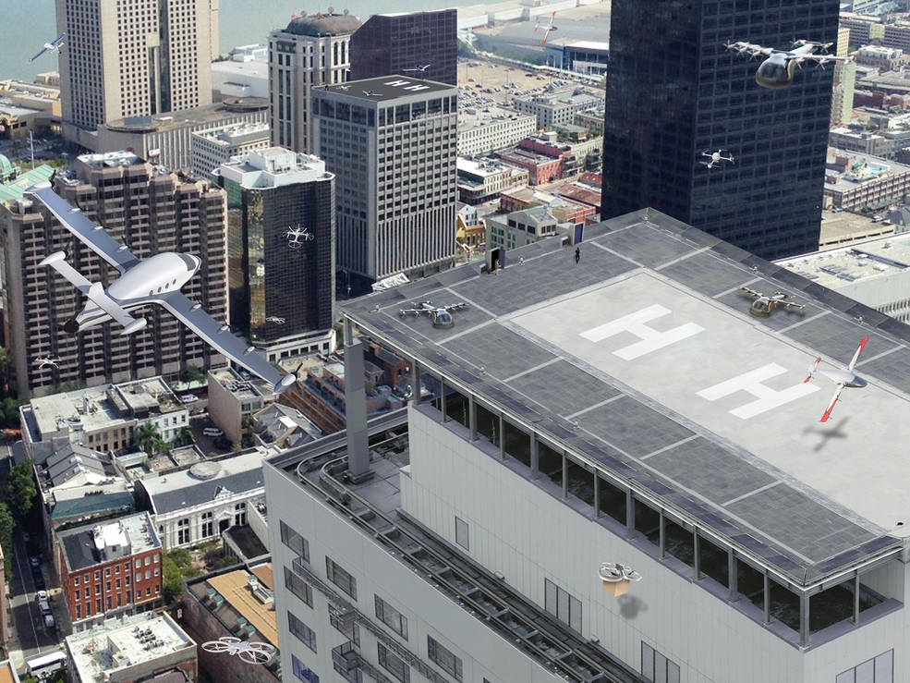

Process for Assessing AAM Weather Information Gaps
(Adapted from prior analysis process for UAS weather information)
UAS Weather Reports*
Current Weather Observations / Forecasts
Safety
Efficiency
Airspace design
Energy management
Passenger comfort
Operational AAM Considerations
UAM Operator Interviews
Image credit: NOAA
Image credit: NASA
AAM Weather Gaps
Weather
Need
Product(s)
Available
UAM ConOps
Surface Winds
Winds Aloft
Turbulence
Convection
Winter Precip
Temperature
Image credit: NASA
* FAA-sponsored reports by Campbell et al. (2017): ‘Preliminary Weather Information Gap Analysis for UAS Operations’ and ‘Preliminary UAS Weather Research Roadmap’
ConOps = Concept of Operations
UAS = Unmanned Aircraft System

Slide 8
Specific Weather Information Needs for AAM Operations
Weather Information Need | Primary Operational Impact
 | Safety | Efficiency | Airspace Design | Energy Management | Passenger Comfort
Icing | X
Ceiling & Visibility | X | X | X
Convection | X | X
Wind & Turbulence | X | X | X | X | X
Precipitation | X | X
Temperature |  |  |  | X | X
Expected operational impacts will evolve as ConOps matures
Uncertainty exists in the weather conditions that are necessary to know for decision making
Weather impacts the entire spectrum of AAM operations across the CONUS
CONUS = Contiguous United States

Slide 9

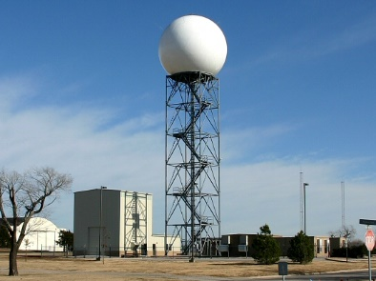
Current Observation Networks Compared to
AAM Weather Needs (Preliminary)
Sensor | Wind & Turbulence | Ceiling & Visibility | Precipitation & Storms | Winter Wx & Icing | Temperature & Humidity | General Comments
 |  |  |  |  |  | Sparse coverage Surface only
 |  |  |  |  |  | Sparse coverage Weather balloons only 2x daily
 |  |  |  |  |  | Coarse resolution
 |  |  |  |  |  | Wind observations only in echoes Poor low-altitude coverage at long ranges
Surface Stations
Upper Air In Situ
Mostly meets need
Partly meets need
Does not address need
Satellite
Weather Radar
Additional research required to understand specific AAM weather information needs
Image Credits: NOAA

Slide 10
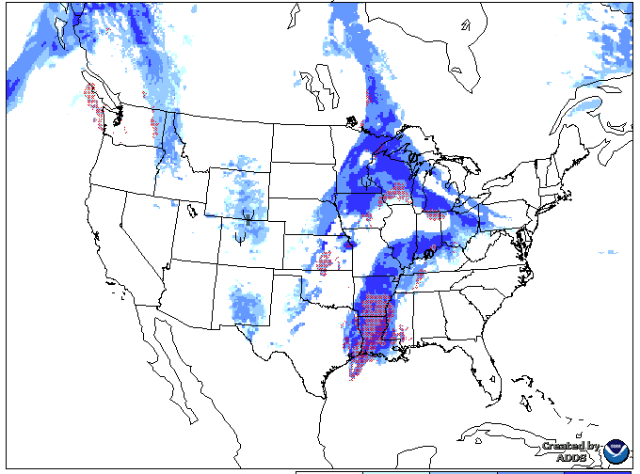
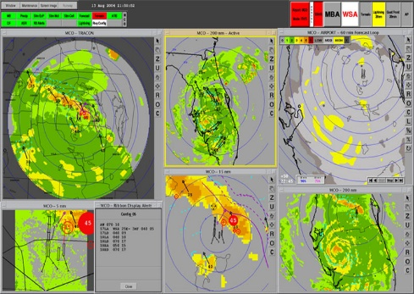
Current Forecast Products Compared to
AAM Weather Needs (Preliminary)
Product | Wind & Turbulence | Ceiling & Visibility | Precipitation & Storms | Winter Wx & Icing | Temperature & Humidity | General Comments
 |  |  |  |  |  | Accuracy in PBL and away from airports not known Location of storm cells often displaced
 |  |  |  |  |  | Forecasts too generalized Products may not represent AAM hazards
 |  |  |  |  |  | Forecasts too generalized Accuracy of low-level wind analyses not known
NWP Models
Aviation Weather
Products
Mostly meets need
Partly meets need
Does not address need
ITWS / NextGen Weather Processor
Current weather forecast products not expected to fully support AAM
Image Credits: NOAA
NWP = Numerical Weather Prediction
PBL = Planetary Boundary Layer
ITWS = Integrated Terminal Weather System

Slide 11
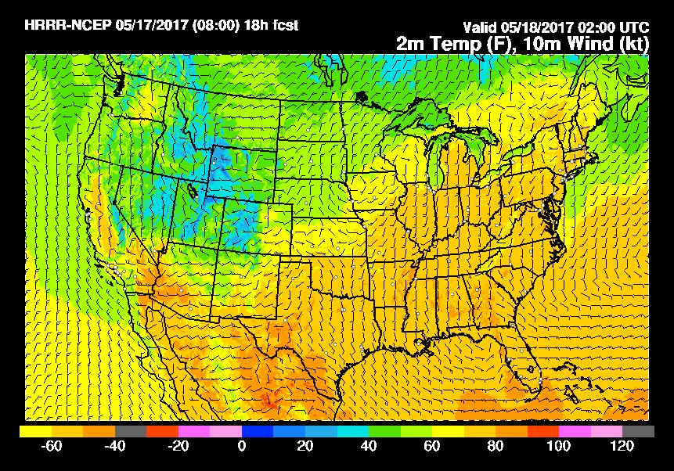


Preliminary Summary of Weather Gaps for AAM
Rank | Type | Prioritized ranking based on operational need*
1 |  | Numerical model performance is uncertain in off-airport areas and aloft
2 |  | Operationally available NWP products are too coarse to resolve impactful urban-scale phenomena
3 |  | Off-airport surface weather observations are sparse, particularly of wind, visibility, and ceiling
4 |  | Lack of measurements in the PBL, particularly of wind and turbulence, necessary to verify weather models and support AAM
5 |  | Forecasts lack accurate uncertainty metrics to support decisions
6 |  | Tactical convective weather products lack short-term storm forecasts, uncertainty, and are susceptible to latencies
7 |  | No method of alerting AAM operators of rapidly changing hazardous conditions (e.g., microbursts, gust fronts, convective growth)
8 |  | Given zero-tolerance for icing conditions, icing forecasts lack an uncertainty element
9 |  | Turbulence and icing models not designed for AAM
10 |  | Weather impact models for decision support do not exist for AAM
Prediction
Observation
Decision Support
Image Credits: NOAA
*Ranking modified from ‘Preliminary Weather Information Gap Analysis for UAS Operations’ report by Campbell et al (2017), considering differences between UAS and AAM operations

Slide 12
AAM Opportunities to Address Needs
Need
Opportunity
Denser and AAM-specific sensing coverage
Accurately fill gaps between observations
Ability to convey forecast confidence
Translate weather conditions to operational impacts given AAM constraints
Timely dissemination of pertinent weather information
Enhanced sensing networks and capabilities
ML-based fusion of observations and forecasts
Enhanced forecasts with uncertainty metrics
Decision support tools designed specifically for AAM
AAM-specific weather data exchange and architecture development
ML = Machine Learning

Slide 13
Outline
Anticipated Weather Challenges for AAM
Weather Information Gaps for AAM
Candidate Technology to Mitigate Gaps for AAM
  Sensing
  Forecasting
  Decision support
  Dissemination
Vision and Summary

Slide 14
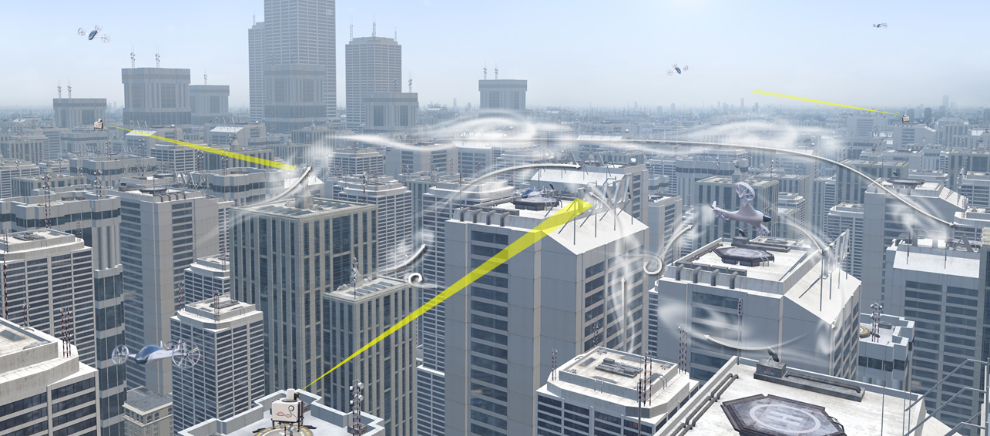
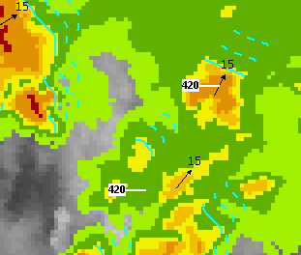
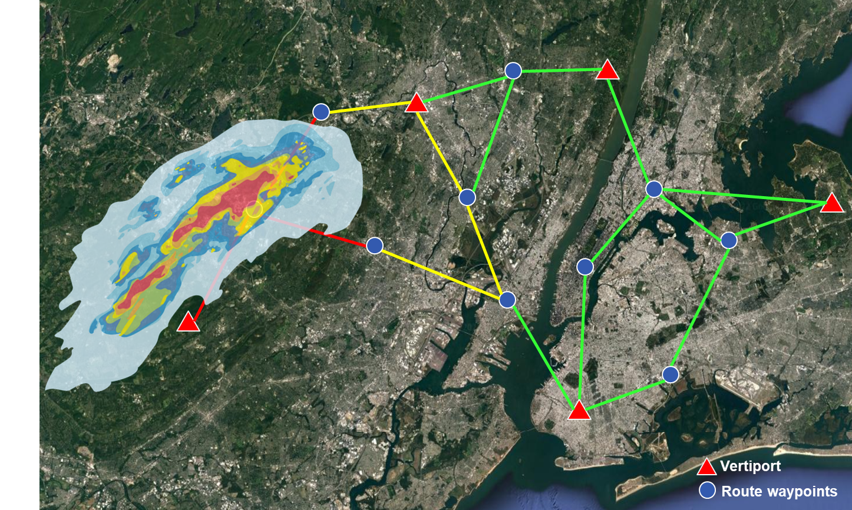
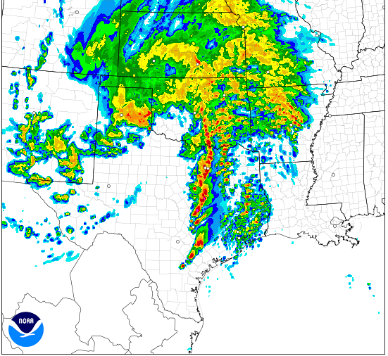
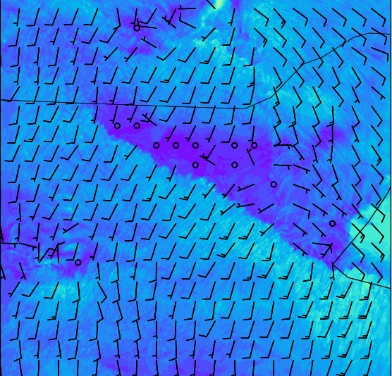
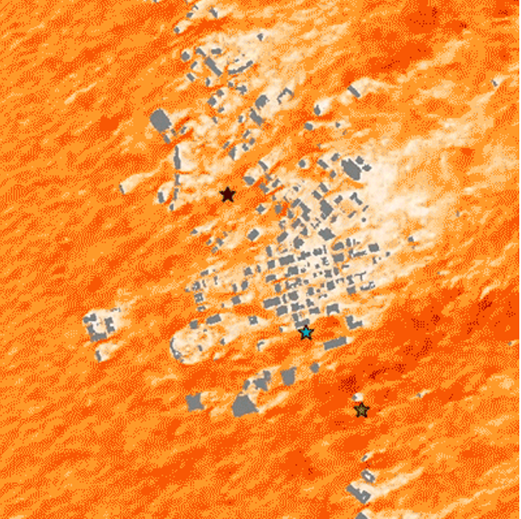
Weather Information Pipeline
Image Credit: MIT LL
Image Credit: MIT LL
Observations
Nowcasts (0 – 2 hr)
Image Credit: MIT LL
Weather Translation and Decision Support
Image Credit: NCAR
Numerical Weather
Prediction Models
Image Credit: NOAA
Forecasts (2+ hr)
NCAR = National Center for Atmospheric Research

Slide 15


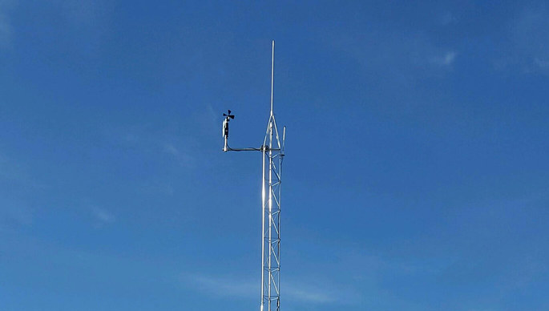
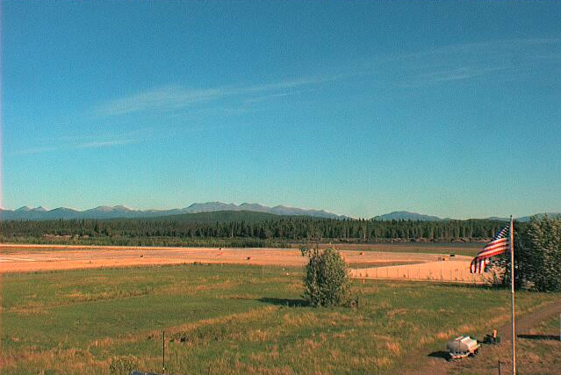

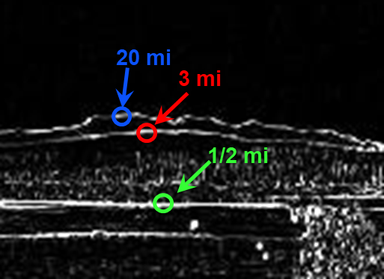
Example AAM
Weather Observation and Sensing Solutions
Observation
Systems
CC dreamcatcher-68
NASA
CC KSRE Photo
Mode S EHS Aircraft Observations
UAS & AAM Vehicle Observations
CC KSRE Photo
Mesonets
Remote Sensing Systems
Image Credit: MIT LL
Image Credit: MIT LL
CC basheertome
Wind Lidar
Cameras with AI Automation
Other Unconventional Sensing Methods
Multiple new sensing modalities may enable denser observation capability at ground level and aloft
EHS = Enhanced Surveillance
AI = Artificial Intelligence

Slide 16
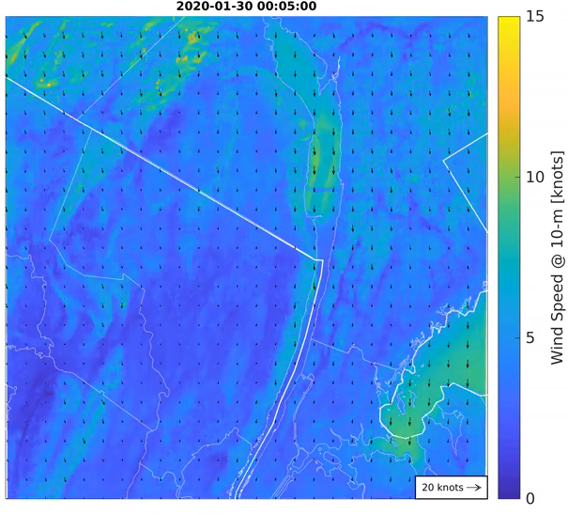

Candidate High-Resolution Weather Models
15
Hudson River
Valley
10
Wind Speed at 10 m [knots]
Wind Speed at 26.5 m [m s⁻¹]
5
Downtown Dallas
10 km
500 m
0
Weather Research and Forecasting Model
(90-m resolution, 81 x 81 km domain)
Large-Eddy Simulation*
(5-m resolution, 4 x 4 km domain)
Complementary modeling techniques can provide 4D weather information at AAM-relevant scales
*Large-eddy simulation shown here from FastEddy by National Center for Atmospheric Research (NCAR)

Slide 17

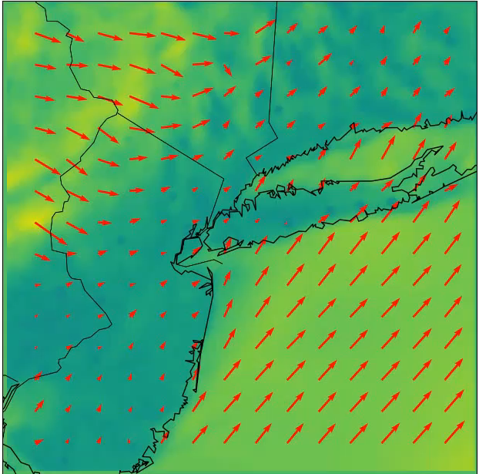
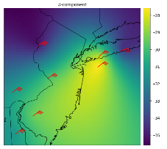
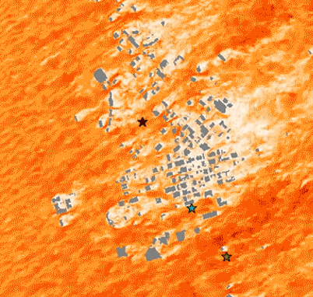
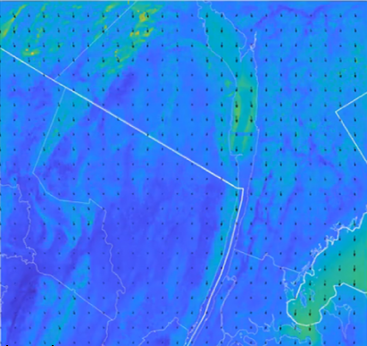
Potential AAM Winds Nowcasting Technology
Nowcasting solutions rely largely on data fusion
  Weather models
  Sparse observations
Dense high-quality measurements improves accuracy
Similar techniques can be used to nowcast other weather conditions
  Low clouds and fog
  Turbulent areas
  Convective storms
Wind Lidar
Display
Analysis &
Forecast
Mode S EHS
CC dreamcatcher-68
LES
Machine
Learning
Image Credit: NCAR
High-res WRF
Model
Machine learning fusion of observations and forecasts enable gap-filling and estimation of uncertainty
WRF = Weather Research and Forecasting
CFD = Computational Fluid Dynamics
LES = Large Eddy Simulation
NWP = Numerical Weather Prediction
Other Image Credit: MIT LL

Slide 18
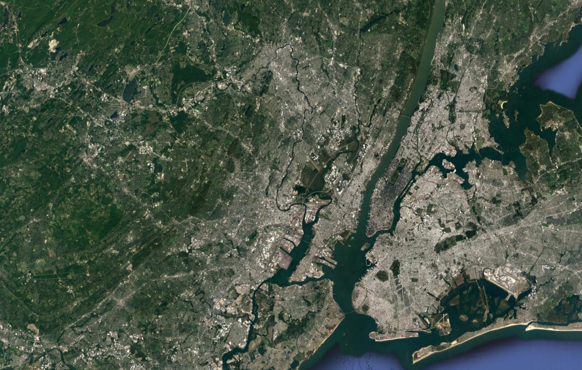
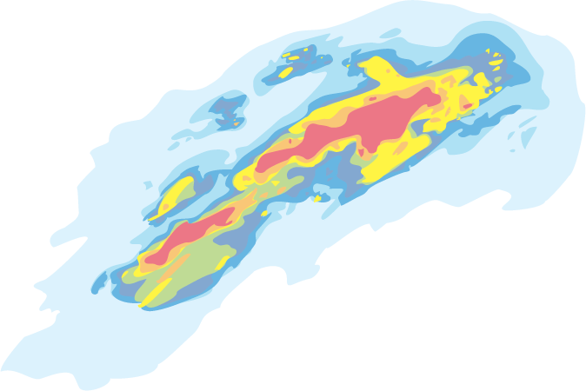
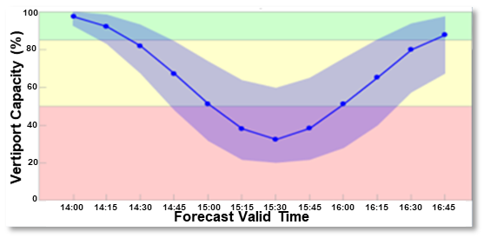
Weather Translation and Decision Support
Weather is translated to anticipated impact
  Incorporates:
    Operational constraints
    Weather uncertainty
  Supports informed decision making
Potential decision support tools
  Corridor/route capacity
  Vertiport operation rate
  Energy management
  Trajectory planning
  Contingency planning
NOTIONAL DECISION SUPPORT DISPLAY
Vertiport
Route waypoints
Image Credit: MIT LL

Slide 19
Outline
Anticipated Weather Challenges for AAM
Weather Information Gaps for AAM
Candidate Technology to Mitigate Gaps for AAM
Vision and Summary

Slide 20
Primary Weather Conditions Impactful to AAM
Icing
Convection & Storms
Temperature
Precipitation
Reduced Visibility & Low Ceiling
Wind Shifts
Urban Canyons
Turbulence
Updrafts and Downdrafts
Wind Gusts
Wind Shear
Image Credit: MIT LL

Slide 21












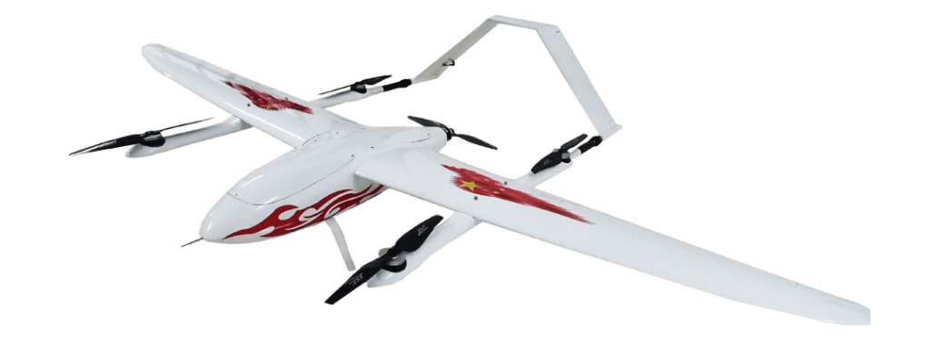
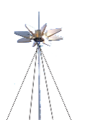

Vision for Multi-Modal Weather Sensing and Forecasting System for AAM
Meteorological Profiling UAS
Aircraft-Based Observations
UAM
Web Camera
Doppler Wind Lidar
Targeted Meteorological UAS
Mode S EHS
Mesonet
Data Collection
Data
Assimilation
Analysis
& Forecast
Weather Translation
Data Distribution
X-band radar
Image Credit: MIT LL

Slide 22

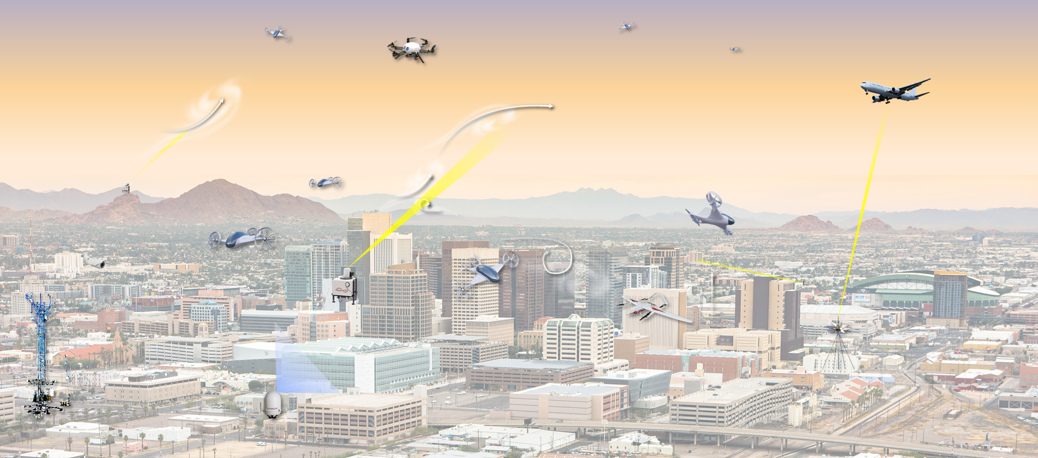
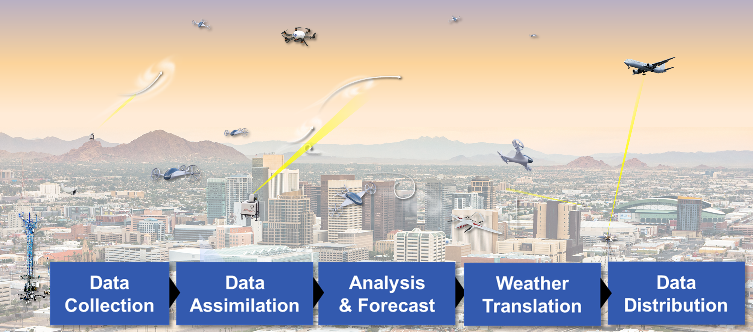
Timeline for Implementing Vision
Near-term
Mid-term
Long-term
FAA
Assess weather considerations on the entire AAM ecosystem
Define the high-level weather information requirements to support AAM integration
Create a roadmap for addressing weather information needs for AAM
Explore and develop weather sensing and forecasting technology to mitigate gaps
Start development of weather translation tools
Work with AAM end users to ensure weather information from novel technology meets needs
Continue to refine weather sensing and forecasting technology from increased understanding as AAM matures
Test and integrate tools and algorithms for AAM operations given weather constraints
Build out infrastructure scalable as tempo of operations increases
Other Image Credit: MIT LL

Slide 23

Need to Develop Weather Research Roadmap to Support UAM and AAM
Initial UAM Airspace Research Roadmap developed by NASA
  Currently a document
  Establishes a framework to help meet goal of evolving UAM airspace towards UML-4
UAM airspace is decomposed into discrete research elements and components
  A table of research requirements for each element at UML-2, UML-3, and UML-4
Currently in process of adding a weather element to roadmap
  Weather is expected to be a primary hazard
  Define high-level weather requirements to support safe, efficient, and high-tempo operations
UAM = Urban Air Mobility
UML = UAM Maturity Level

Slide 24
Summary
AAM presents novel weather challenge
  Low-altitude off-airport information at hyperlocal scales
MIT Lincoln Laboratory has been applying a framework to assess weather information requirements and identify technology gaps
An integrated multi-modal scalable weather system could facilitate safe and efficient AAM operations
  Potential to fill gaps between observation locations, provide more rapid updates, translate to AAM-specific constraints, and include forecast confidence information

Slide 25
Acknowledgements
NASA
  Ian Levitt
  Nancy Mendonca
  Tomorrow.io
  Joe Bartlett
  Wallace Hogsett*
  Luke Peffers
MIT Lincoln Laboratory
  Luis Alvarez
  Allison Chang
  Gabe Elkin
  Gabrielle Enea
  Jim Flavin
  James Jones
  Jim Kuchar
  Coralee Lazebnikova
  Tom Reynolds
  Emily Simons
  Irene Stapleford
*Currently at NOAA

