Slide 1

A Semi-Quantitative Approach To Building The Orion Spacecraft Medical Kit
National Aeronautics and Space Administration
Rubin, D¹, Ebert, D¹, Haas, C², Pavela, J², Nusbaum, D², Schmid, J³, Van Velson, C³, Reyes, D³
¹KBR, Houston, Texas
²Preventive Medicine and Population Health, University of Texas Medical Branch, Galveston, Texas
³Medical Operations Group, Johnson Space Center, NASA, Houston, Texas
92nd Annual Scientific Meeting, Aerospace Medical Association,
Reno, Nevada May 2022
www.nasa.gov

Slide 2
Disclosure Statement
92st Annual Scientific Meeting
We have no financial relationships to disclose
We will not discuss off-label and/or investigational uses

Slide 3
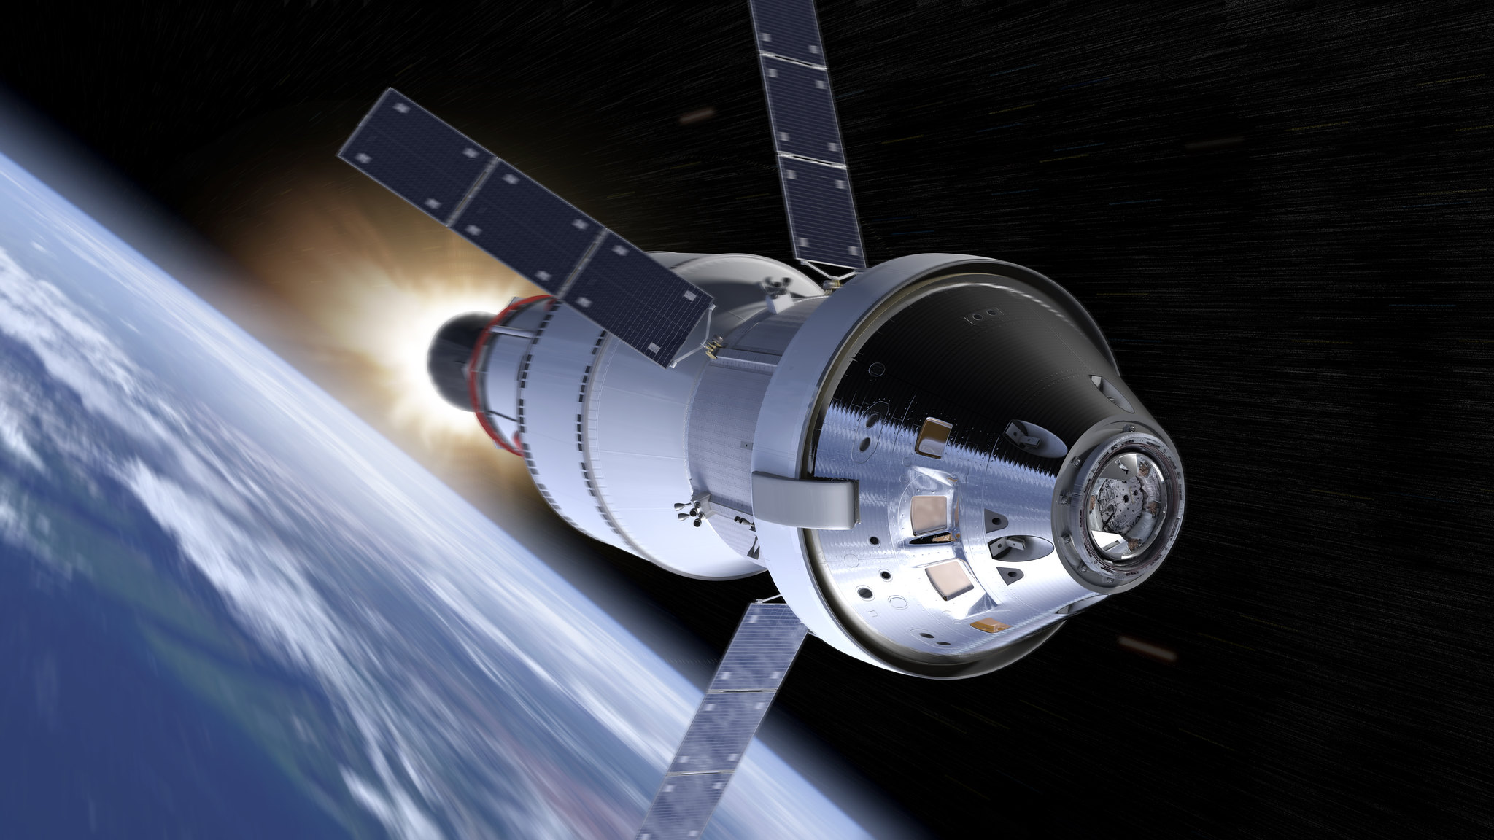
Lunar orbital mission
Orion vehicle
21 days
4 crewmembers
No extravehicular activities
What medical equipment
do we need?
National Aeronautics and Space Administration
National Aeronautics and Space Administration
Orion Spacecraft Medical Kit
https://www.flickr.com/photos/nasaorion/23128844405/in/album-72157633479431041/
Notes:
This is Orion. It’s going to take us from the Earth to the Moon (and back). For the purpose of this presentation, the mission we’re referring to is (partially) defined by what you see on the slide. The question we faced was: given these mission parameters, how do we determine what to include in the medical system?

Slide 4
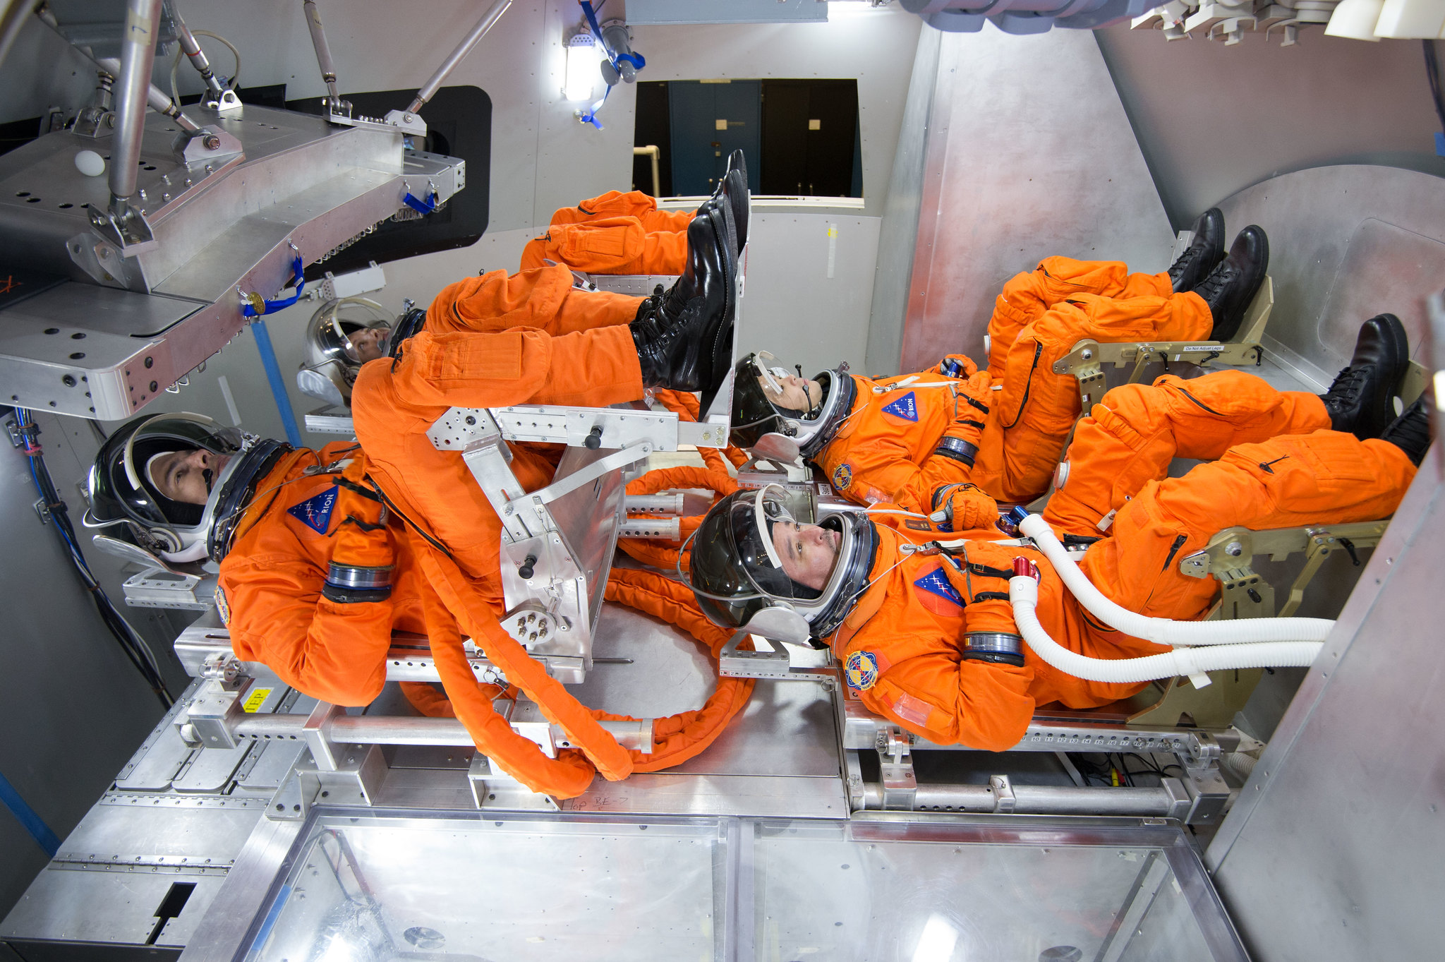
National Aeronautics and Space Administration
https://www.flickr.com/photos/nasaorion/15308076584/in/album-72157667625835980/
Notes:
We’re going to fly four crewmembers within this vehicle. This photos makes it look roomier than it is, especially because you’re seeing a “clean” cabin. In reality, the walls will be covered in equipment, including medical hardware.

Slide 5
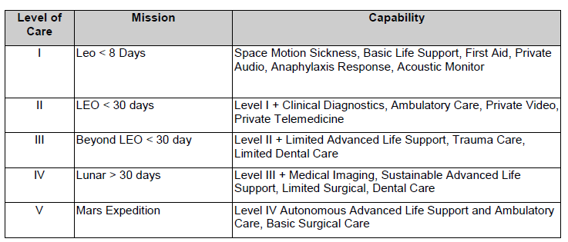
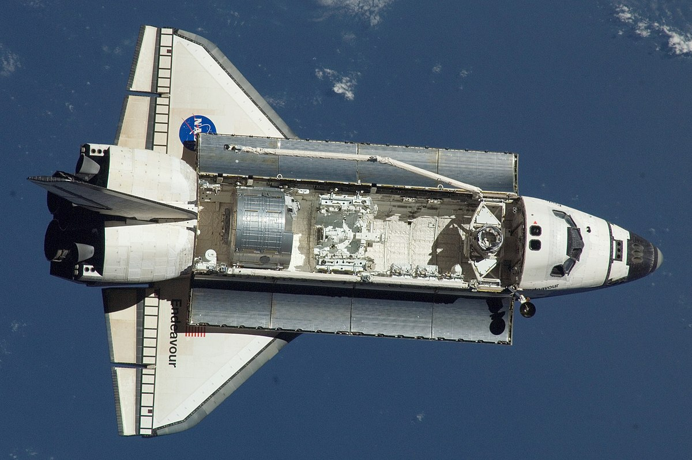
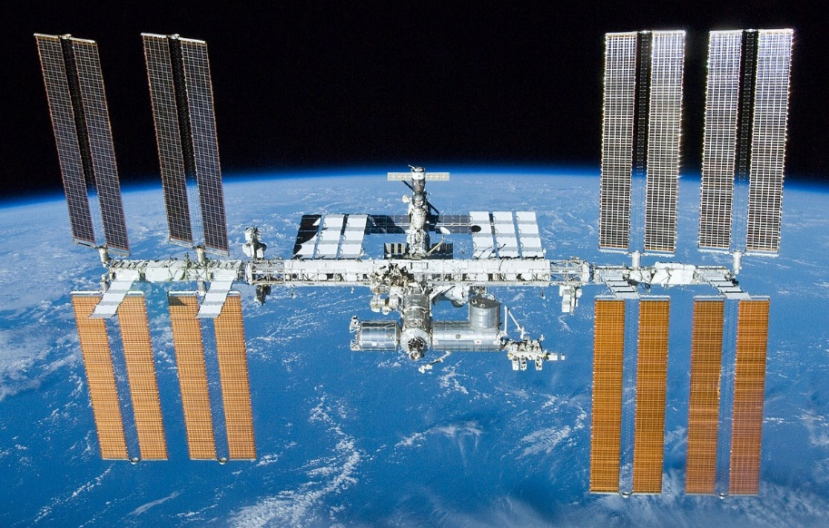
NASA Medical Care Standards
Notes:
This was the NASA standard for determine what “level” of medical care is required on a mission (but is still what Artemis II care is based on). The mission we’re talking about today falls under Level of Care III.
There is some precedent we can rely on. While shuttle missions fell into the Level of Care II category, they are more applicable to Orion than ISS (which technically doesn’t fall into any category) but had a different approach to medical care given mission duration (not to mention the relatively large mass/volume allocations).
Note: You may notice that these five categories do not cover the breadth and complexity of potential missions, especially those that include multiple vehicle and environments (e.g., lunar orbit and lunar surface). This standard is currently being updated to be more applicable to these complex missions. For now, though, this is the standard we’re using.

Slide 6

“Medical System” Components
“PRIME” MEDICAL KIT
Planned monitoring and unplanned events
  Medical Equipment
  Pharmaceuticals
POST-LAUNCH RESOURCES
PERSONAL MEDICAL ITEMS
CREW SURVIVAL KIT
Post-landing water ops
First Aid Subpack
Notes:
We’ve parsed out medical resources into four “kits”. The prime medical kit, which is the focus of this presentation, contains the bulk of the medical resources. It’ll be easier to explain what goes in there by explaining what doesn’t go in there.
Post-Launch Medication – we know the crew will need access to a short list of medication and other items immediately after launch (read: still in suits and strapped to seats).
Personal Medical Items – Like ISS and STS, the crew will have personalized medical items
Crew Survival Kit – This kit isn’t “medical”, but it does contain a first aid subpack, which our medical team helped design. This is strictly for post-landing use if the crew egresses the capsule onto the raft.
Everything else will belong to the prime kit (though stowage locations may be split due to volume constraints of the cabin-stowed kit).

Slide 7
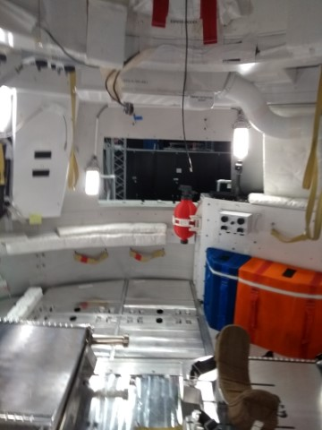
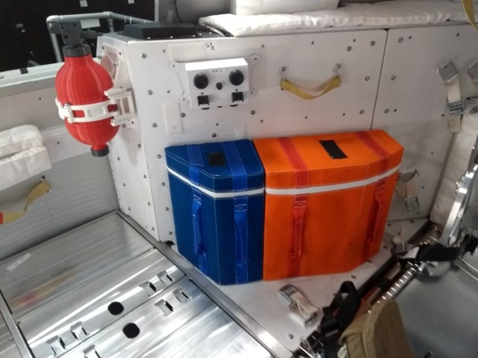
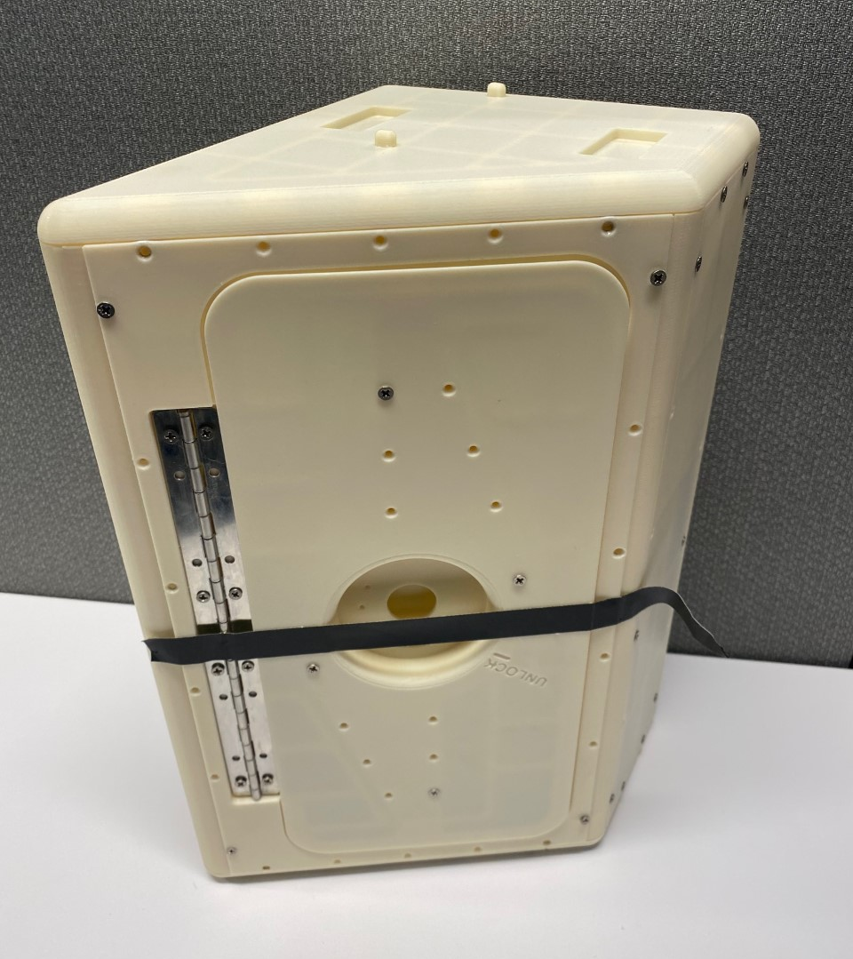
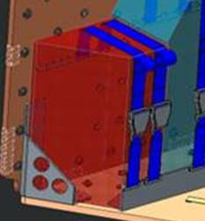
Prime Medical Kit Constraints
!
!
Interference Constraints
Mass Allocation:
30 lbs
Volume Allocation: ~1,116 in³
!
!
Open Cabin Constraints
Load Constraints
Mass/Volume Constraints
Notes:
Speaking of constraints…
Med Kit had to contend with various constraints:
Stowed in the open cabin (constrained volume, couldn’t infringe into certain areas)
Located next/near other hardware and vehicle components which could impede access/ability to destow kit
Had to be designed to withstand launch loads/contend with the manner in which it was secured in place
This resulted in the design of a hard-sided (i.e., metal) and removable kit
The kit itself actually takes up a significant part of the mass allocation

Slide 8








Deciding What Goes In the Prime Kit
We needed a process that could:
Assist in identifying high priority medical conditions to plan for during deep space missions.
Drive decisions related to what medical resources/capability will be available aboard future deep space vehicles.
Drive research related to the development of future spaceflight-related medical technologies.
Illustrate the rationale behind the decisions made re: kit contents
Account for our constraints
We needed a process that was:
Quantitative where possible
Repeatable (without repeating all the work)
Documented

Slide 9


Existing Tools
NASA’s “Integrated Medical Model”
Probabilistic Risk Assessment (PRA) using Monte Carlo simulations
Assesses mission risk due to in-flight medical events
Produces “optimized” kit based on:
Selected risk type
Mass & volume constraints
Preset resource list
Limitations:
  Pre-set Conditions List
  Prioritizes mass/volume over resources
  No resource bundling
  Condition likelihood based on small sample size
  Developed for ISS
Notes:
Already has a model that can produce an “optimized” medical kit
Probabilistic Risk Assessment (PRA) using Monte Carlo methodology to assess mission risk due to in-flight medical events
However, it has limitations:
Conditions
Considers outcomes for “only” 100 medical conditions (“best” + “worst” case) that have occurred/may occur in-flight
May miss conditions if they haven’t arisen by chance or adequately anticipated by SMEs
Optimized Kits
Produces an optimized kit with resources/quantities
May drop necessary resources for the sake of mass/volume
Can’t bundle items (e.g. IV tubing but no fluid, gel but no ultrasound machine)
Condition Likelihood
Incidence data from spaceflight medical events/analog and general populations
Small sample size may not accurately represent probabilities
Developed For ISS
Limited flexibility to apply to non-ISS missions

Slide 10
Existing Tools
NASA Human Research Program (HRP) Exploration Medical Capability (ExMC) Element “Accepted Medical Condition List” (AMCL) Process
  Scoping activity for deep space exploration
  Prototype method
  Used the Integrated Medical Model (IMM) to:
    Generate probability of occurrence
    Generate “optimized” medical kit
  Used the IMM condition list as a starting point
Notes:
A precedent has already been set within NASA: ExMC Accepted Medical Condition List (AMCL) Process
Prototype process

Slide 11
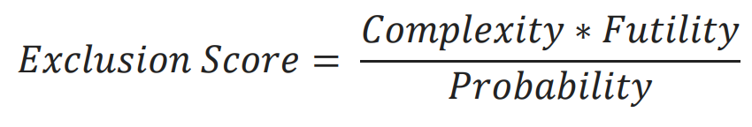
ExMC Method
ExMC Accepted Medical Condition List (AMCL) scoping activity for deep space exploration
  Prototype method
  Uses “Futility” and “Complexity” to rank conditions
  Uses the Integrated Medical Model (IMM) to generate probability of occurrence
    Leverages existing model database and processes

Slide 12
Method
GENERATE DATA FROM MODEL
RANK CONDITIONS
IDENTIFY RESOURCES
Probability of Occurrence
  Sources from IMM data set
Resource Mass & Volume
  Used Orion mass allocation
  Assumed no volume constraint
Optimized Kit
  Used as a guideline, not a solution
Excluded Condition
  Abdominal Injury
  Acute Compartment Syndrome
  Chest Injury
  Elbow Dislocation
  Head Injury
  Hip/Proximal Femur Fracture
  Lower Extremity (LE) Stress Fracture
  Lumbar Spine Fracture
  Shoulder Dislocation
  Neurogenic Shock
  Traumatic Hypovolemic Shock
Notes:
We started with a process developed within ExMC to identify an Accepted Medical Condition List.
Orion Space Medicine opted to pursue its own review of conditions and associated resources.
Used a modified version of the existing ExMC Process
Probability of occurrence is a valuable quantitative starting point
Assumed no volume constraint – this gave us a more comprehensive output
Excluded Condition
Excluded certain conditions due to vehicle size/limited movement/limited exercise, short duration mission, & no EVA)

Slide 13
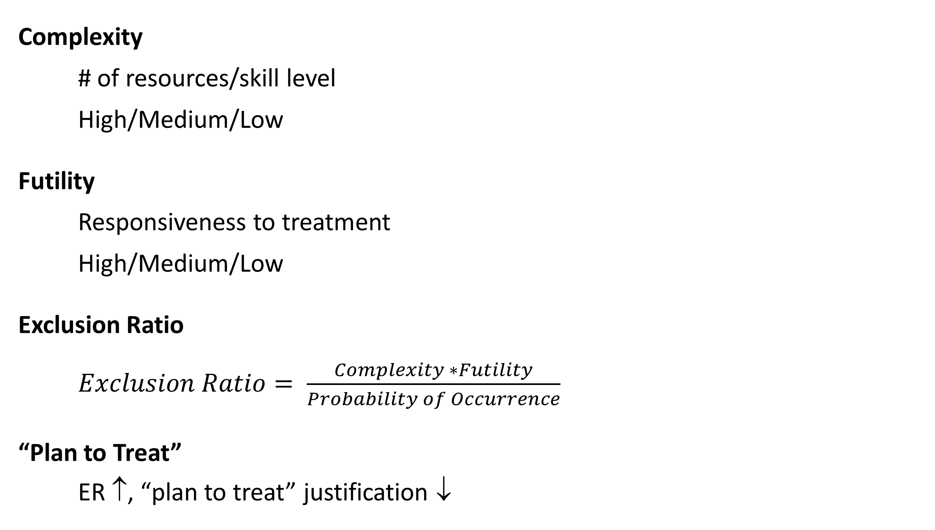
Method
GENERATE DATA FROM MODEL
RANK CONDITIONS
IDENTIFY RESOURCES
Complexity
  # of resources/skill level
  High/Medium/Low
Futility
  Responsiveness to treatment
High/Medium/Low
Exclusion Ratio
  $Exclusion Ratio= \frac{Complexity ∗Futility}{Probability of Occurrence}$
“Plan to Treat”
ER ↑, “plan to treat” justification ↓
Notes:
Probability of occurrence is a valuable quantitative starting point
Assumed no volume constraint – this gave us a more comprehensive output
Each condition was given a complexity and futility score
Complexity
High: Requires many resources and many specialized skills sets
Medium: Requires a moderate amount of resources and some specialized skill sets
Low: Requires few resources and no specialized skill sets
Futility:
High: Highly likely to result in death or incapacitation
Medium: Likely to result in death or incapacitation
Low: Unlikely to result in death or incapacitation
Probability came from IMM data set
The higher the ER, the weaker the justification for planning to treat a condition. However, ER is only an indication, not an absolute rule. It provided a guide but, ultimately, clinicians determined “plan to treat” status.

Slide 14
Method
Futility₁
Futility₂
Futility_{Avg}
Futility₃
Futility₄
Condition_{N}
Exclusion Ratio
Complexity₁
Complexity₂
Complexity_{Avg}
Complexity₃
Complexity₄
Probability of Occurrence
Notes:
Four physicians each provided complexity and futility scores for each condition. Those scores were averaged and those averages were used to computer the exclusion ration

Slide 15


Method
Condition₁
Yes
Yes
Yes
Yes
Yes
Condition₃
Yes
Yes
Yes
No
Maybe-Yes
Condition₄
No
No
No
Yes
Maybe-No
Condition₂
No
No
No
No
No
.
.
.
Maybe-Yes/
Maybe-No
Condition_{n}
Yes
Yes
No
No
Notes:
Best and worst cases for each condition were considered, IMM definitions were used as a rough guideline.
Four clinicians each independently provided a “plan to treat” determination (yes/no) for each condition case
These were reviewed as a group
Conditions that already had a consensus “yes” or “no” were not discussed
The “maybes” were discussed. In some cases, the outlier changed and consensus was achieved.
In some cases, consensus was not initially achieved. Team did not pursue further discussion at the time with the assumption that additional data (e.g., resource needs) would push consensus one way or the other.

Slide 16
Method
GENERATE DATA FROM MODEL
RANK CONDITIONS
IDENTIFY RESOURCES
  Based on terrestrial and spaceflight experience
  Considerations:
      Level of Care / Mission duration
      Mass/volume/power/geometry
      Items that treat a single condition
      PO versus IM/IV
      Complexity of use (skill/training required)
      Treat condition over symptom
      Mandatory resource inclusions
Notes:
Probability of occurrence is a valuable quantitative starting point
Assumed no volume constraint – this gave us a more comprehensive output
How we considered resources.
1. DRM – LoC III, 21 day, 4 crewmember, no EVA
2. Kit – Consider mass, volume, geometry
3. Crewmembers – Complexity of use (skils/training)
4. Form factors – ex., PO vs IM/IV
5. Redundancy – Reduced items that treat only a single condition
6. Too much – What resources are not plausible because they require too much overhead vs. what resources just don’t provide a big enough impact
7. Mandatory Inclusions: Acoustic Monitor / Salt Tablets(Fluid Loading) / 144-Hour Suited Contingency Medications

Slide 17
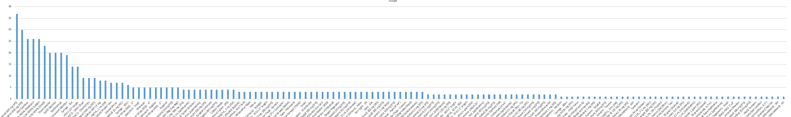
Results
GENERATE DATA FROM MODEL
RANK CONDITIONS
IDENTIFY RESOURCES
40
      506 unique resources considered
      2,832 unique resource-conditions pairings considered
      139 unique resources ultimately assigned to conditions
      623 unique resource-condition pairings selected
30
Count
20
10
0
Resources
Notes:
506 unique resources considered
2,832 unique resource-conditions pairings considered
139 unique resources ultimately assigned to conditions
623 unique resource-condition pairings selected
Histogram of resources. There’s a heavy lean towards a small number of resources. Those generally fall into the “we shall provide” category since they are so ubiquitous. More of the discussion falls as we move down on the histogram, since many of those resource are assigned to a small number of conditions.
Using the knowledge of which resources we ultimately felt should be in the kit (and how many we should provide) gave additional justification for whether we should “plan to treat” any of the “maybe” conditions. In some cases, kit constraints made it clear that we just wouldn’t be able to bring the medication/equipment that we needed. In other cases, some conditions we were on the fence for got pushed into the “yes” category because we were already providing the resources we needed for that condition due to needs of other conditions.

Slide 18
Results
GENERATE DATA FROM MODEL
Probability of Occurrence
Resource Mass & Volume
Optimized Kit
RANK CONDITIONS
Futility
Complexity
Exclusion Ratio
“Plan to Treat”
IDENTIFY RESOURCES
What we use terrestrially?
What do we need for the DRM?
What fits in the kit?
Of ~200 condition cases:
Initial “plan to treat”:
  No: 73
  Yes: 91
  Maybe: 42
Final “plan to treat”:
  No: 93
  Yes: 128
Notes:
Ultimately, this is what our clinicians derived. We had consensus on the vast majority of condition cases (either “no” or “yes”). Using the resource information (and the associated discussions) allowed us to eliminate the “maybes”. You’ll notice that the “initial” and “final” condition counts don’t align. That’s due to some variation in the conditions being considered through the process.

Slide 19
Summary of Key Findings
  Benefits
    Provides a framework for discussion
    Provides strong starting point for subject matter experts
    Highlights areas of agreement/discussion early in the process
    Provides a record of decision making
Notes:
SMEs ultimately make decision, not the process
Highlights areas of agreement early in the process and those conditions/resources that really need discussion

Slide 20
Summary of Key Findings
  Limitations
    “Semi-quantitative”, but still subjective
    No external validation
    Baseline condition list is not comprehensive
    Time and effort intensive
  Future efforts may rely on more advanced tools
Notes:
“Semi-quantitative”, but still subjective
Futility and Complexity are subjective, impacted by individual clinician biases
No external validation
Methodology focused on exclusion of conditions from mission planning and thus started from a baseline list of possible conditions.
Condition case definitions were often limited and do not represent the whole spectra of clinical sequelae for a given disease.
Not comprehensive/Baseline list may not be correct
Time and effort intensive
Not recommended for all use cases
Future efforts may be rely on the various ExMC tools being developed to contain medical evidence and resource data

