Slide 1
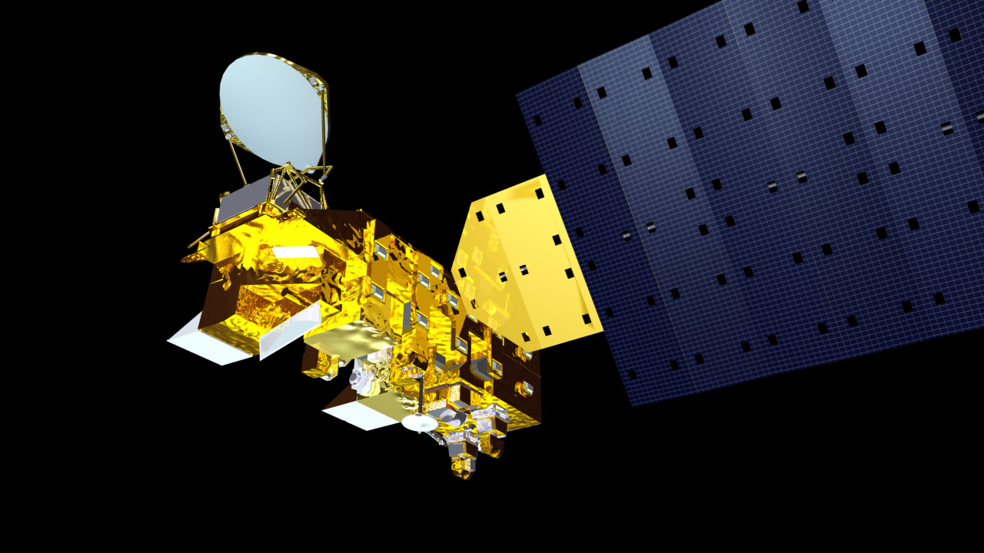
EOS Aqua
Mission Status
at the
Earth Science Constellation (ESC)
Mission Operations Working Group
(MOWG) Virtual
Meeting
May 17, 2022
Bill Guit
Aqua Mission Director - Code 584/428
Mission Validation and Operations Branch
Earth Science Mission Operations Project
NASA/Goddard Space Flight Center
William.J.Guit@nasa.gov

Slide 2
Topics
Changes since November 2021 MOWG Meeting are in blue
Mission Summary
Spacecraft Subsystems Summary
Recent and Planned Activities & Process Improvements
  Aqua A-Train Constellation Exit – Passing Events (Separate presentation)
  Aqua Solid State Recorder Anomaly Recovery
Propellant Usage & Lifetime Estimate & Orbital Decay
  Updated Aqua 2021 Lifetime and Decommissioning Analysis (2/10/2022)
  Aqua End of Mission Plan (EOMP) – Rev E Approved
After-the-A-Train Extended Mission (ATAT) Timeline
Aqua Decommissioning (Aug. 2026) – Needs Sr. Review Approval
Summary
Additional Slides:
  Orbit Maintenance Maneuvers
  Conjunction Assessment High Interest Events
  Ground Track Error & Mean Local Time History
  Spacecraft Orbital Parameters Trends & Predictions

Slide 3
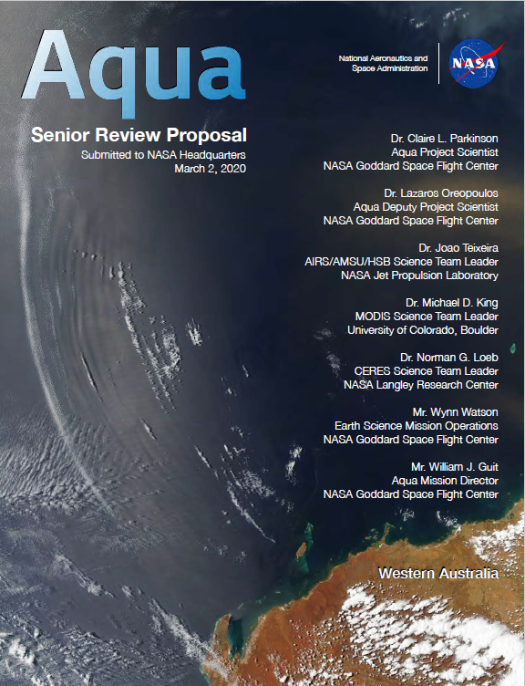
EOS Aqua Mission Summary
Changes since November 2021 MOWG Meeting in blue
05/04/2002: Launch (6-Year Design Life)
12/02/2008: End of Prime Mission Review
12/08/2015: End of AMSR-E Operations
11/17/2016: A-Train PS Teleconference
  Maintain tight Mean Local Time (MLT)
10/02/2018: Aqua Decommissioning Review
03/06/2020: Senior Review Proposal #7
  Reliability Estimates thru end of CY 2026
  Consumables through early CY 2022
  Proposed After the A-Train Extended Mission
07/08/2020: NASA Earth Science Senior Review Subcommittee Panel Presentation
10/20/2020: Received HQ Guidance
  Continue as baselined through at least FY23
03/24/2021: Updated Aqua Phase F Plan
02/01/2022: ESMO Annual Review #15
05/04/2022: Aqua 20-Year Anniversary

Slide 4
Aqua Spacecraft Subsystems
All subsystems configured to primary hardware
Changes since November 2021 MOWG Meeting in blue
Command & Data Handling (CDH) – Nominal (Solid State Recorder (SSR) holds ~2 orbits of data)
  12/2/2007: FOT SSR Operations Error Anomaly – fully recovered 1/28/2009
  8/16/2020: A Formatter Multiplexer Unit (FMU)/SSR anomaly – Fully Recovered on 9/2/2020
  2/22/2022: SSR Anomaly – Fully recovered 3/23/2022
Communications (COMM) – Nominal
Electrical Power System (EPS) – Nominal (Numerous solar array string failures)
  3/31/2022: Power Controller A (PC-A) Anomaly, Swapped to PC-B, Spacecraft transitioned to Safe Mode, Instruments to Safe, Unable to maneuver (Recovered maneuver capability 4/2)
    Recovered full spacecraft and instrument operations on 4/14/2022
  Solar Array Regulator Electronics (ARE) power drops and current fluctuations have occurred since 2004
  Most recent power drops: ARE-1A: 7/27/2021 (1 string), ARE-6C: 8/19/2021 (cracked cell)
  Summary: Estimated that Aqua has lost up to 23 strings of solar cells out of a total of 132 strings.
    Aqua continues to have significant power margin out until August 2026
  Battery Cell Anomaly (9/2/2005)
  Solar Array (SA) Panel #8 Thermistor #6 Failure (8/3/2009), SA Offset (Reported 1/17/09, Corrected 6/29/10)
Flight Software (FSW) – Nominal
Guidance, Navigation & Control (GN&C) – Nominal
Propulsion (PROP) – Nominal
  Dual Thruster Module (DTM-2) Heater Anomaly (9/8/2007)
Thermal Control System (TCS) – Nominal

Slide 5
Spacecraft Activities Summary
(January 2022 – 4/30/2022)
Changes since November 2021 MOWG Meeting in blue
NEW: Aqua A-Train Member Mission Passing-Crossing Events
  04/03/2022: GCOM-W1, NEXT: OCO-2 on 5/17/2022 – Separate presentation
8 CRMS High Interest Orbital Debris Events (HIEs): see slide 21
  8 Debris Avoidance Maneuvers (DAMs) PLANNED: 117 Maneuvers Screened
  8 Self-mitigated, No DAMs Executed, 2 Waived-off/Re-planned DMUM
3 Spacecraft Bus Anomalies: Ongoing solar array (SA) string losses
  No new string losses since last MOWG Meeting
    Aqua has lost up to 23 of 132 strings (Future Power Margin on slide 12)
  2/22/2022: Solid State Recorder Anomaly: Recovery on 3/23/2022
  3/31/2022: Aqua Safe Mode #2 (First since 9/12/2002) Recovered 4/14
0 Instrument Anomalies:
2 Spacecraft Maneuvers:
  2 Routine Drag Make-Up Maneuvers (DMUMs): Last DMUM # 162 on 12/1/2021
7 Instrument Calibration Maneuvers: (November 2021 – May 2022)
  7 Monthly MODIS Lunar Calibrations: #204(11/14/2021) thru #210 (5/12/2022)

Slide 6
2022 Completed Activities
(thru April 2022)
Completed since November 2021 MOWG Meeting in blue
12/01/2021: Last Aqua Drag Make Up Maneuver (DMUM #162)
12/09/2021: CRMS R9.1 Operations Readiness Review (ORR)
02/01/2022: ESMO Annual Review #15
02/02/2022: Supplemental EPS ARE State-of-Health Test
02/10/2022: 2021 Aqua Decommissioning & Lifetime Analysis (V1.0)
  Update from 11/12/2020-v3 Lifetime Analysis Presentation (Charts and Tables)
03/20/2022: Spring EPS ARE State-of-Health Test
03/23/2022: Solid State Recorder (SSR) Anomaly Recovery
04/03/2022: Aqua safely passed/crossed GCOM-W1
  Total Miss Distance = 1028 meters. Radial MD = 73 meters, Pc = 0
  Stand-alone presentation
04/14/2022: Aqua Safe Recovery – Instruments Returned to Science
05/04/2022: Aqua 20-Year Anniversary
  In-person Celebration at GSFC Visitors Center

Slide 7
Planned Activities
(Mid-to-Long-Term)
Aqua/Aura Retrograde Maneuver (RGM) Working Group
  Limited on-orbit retrograde capability by January 2022 (Emergencies)
  Free-Drift/Drag-Down Retrograde RMMs? Under Investigation
Collision Risk Management System (CRMS)
  CRMS Release 10.0 Targeted for May-2022
November 2022: EPS Performance Working Group Meeting
  Model Solar Array Strings losses using Weibull distribution.
  Estimate a probability Aqua Spacecraft Bus will function past 2026.
November/December 2022: Decommissioning Review
- - - - - - - - - - - 2023 - - - - - - - - - - - - - - - - - - -
January 2023: Extended Mission Reliability Assessment for 2022
January/February 2023: ESMO Annual Review
March: Senior Review Proposal due
Possible Re-fueling Mission – Unlikely – but not giving up hope

Slide 8
Ongoing
Process Improvements
Completed since November 2021 MOWG Meeting in blue
Aqua/Aura Maneuver Working Group: Reestablished in May 2016
  Develop retrograde maneuver capability [DONE – Limited emergency use only]
  Develop more fuel-efficient propulsive maneuvers (IAMs, CEMs & PLMs) [DONE]
    Next Step: Aura CEMs & PLMs using reaction wheels for attitude reorientation
EOS Automation (EA): Multi-year/Multi-phase development
  Version 3.4.2 FOT Automation in OPS since February 2021
  Next Step: 2-man “Fire Watch” – Implementation delayed by COVID-19
Collision Risk Management System (CRMS) – Initiated in 2015
  Operating with CRMS Release 9.1, Next Step: Release 10.0 May 2022
CARA Devolution: ESMO quasi-devolved since October 2019
  ESMO Pilot Program Parallel Operations: 3/26/2019 – 10/2/2019 [DONE]
NASA Guidance on Collision Avoidance: December 9, 2020
  NASA Interim Directive (NID) 7120.132 CA for Space Environment Protection
  Spacecraft CA and Collision Avoidance Best Practices Handbook
  11/23/2021: NASA Policy Requirement (NPR) for “NASA Spacecraft Conjunction Analysis and Collision Avoidance for Space Environment Protection”, intended to replace NASA Interim Directive (NID) 7120.132 (Version Draft 43 under review)

Slide 9
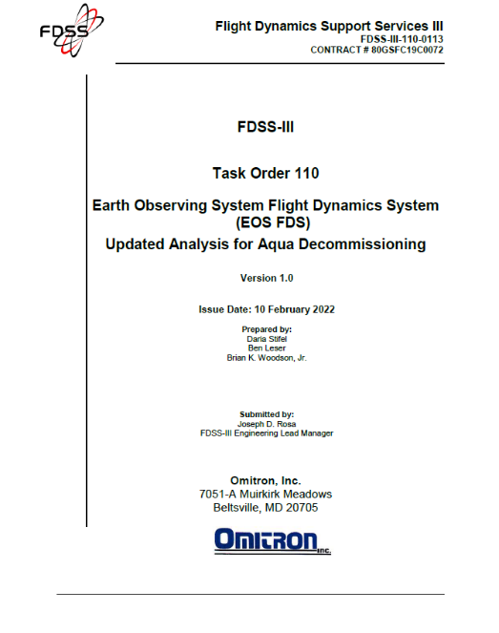
Aqua Propellant Usage
(February 2022)
Updated since November 2021 MOWG Meeting in blue
2006: Initial Aqua lifetime fuel analysis
2008: Detailed Aqua & Aura lifetime analyses
  Presented to A-Train MOWG and at Aqua EOPM Review
September 2012: Initial Aqua Decommissioning Plan
August 2013: Updated Decommissioning Plan
  Updated Constellation Exit Plan
September 2014: Updated Decommissioning Plan
December 2016: Updated Decommissioning Plan (V1.1)
November 2017: Updated Decommissioning Plan (V1.1)
July 2018: Updated Decommissioning Plan (V1.0)
  08/02/2018 IAM required update to document and IAM Plans
November 2018: Updated Decommissioning Plan (V2.0)
July 2019: Updated Decommissioning Plan (V1.0)
  10/02/2019 IAM required update to plots and figures only
July 2020: Updated Lifetime Analysis Presentation
  Updated DAS Solar Flux Models
February 2021: Updated 2020 Decommissioning Plan (V1.0)
  Updated definitive fuel usage & predicted solar flux levels
Summer 2021: Updated Lifetime Analysis Presentation
  9/2/2021: 2021 Lifetime Analysis (v1) – Plots & Tables
February 2022: Updated 2021 Decommissioning Plan (V1.0)
  Updated definitive fuel usage & predicted solar flux levels
Annual updates will be provided each Fall (started in 2017)
  Final will be produced 60 days before start of decommissioning
Version 1.0
Next Update: Fall 2022
(Full Document)

Slide 10
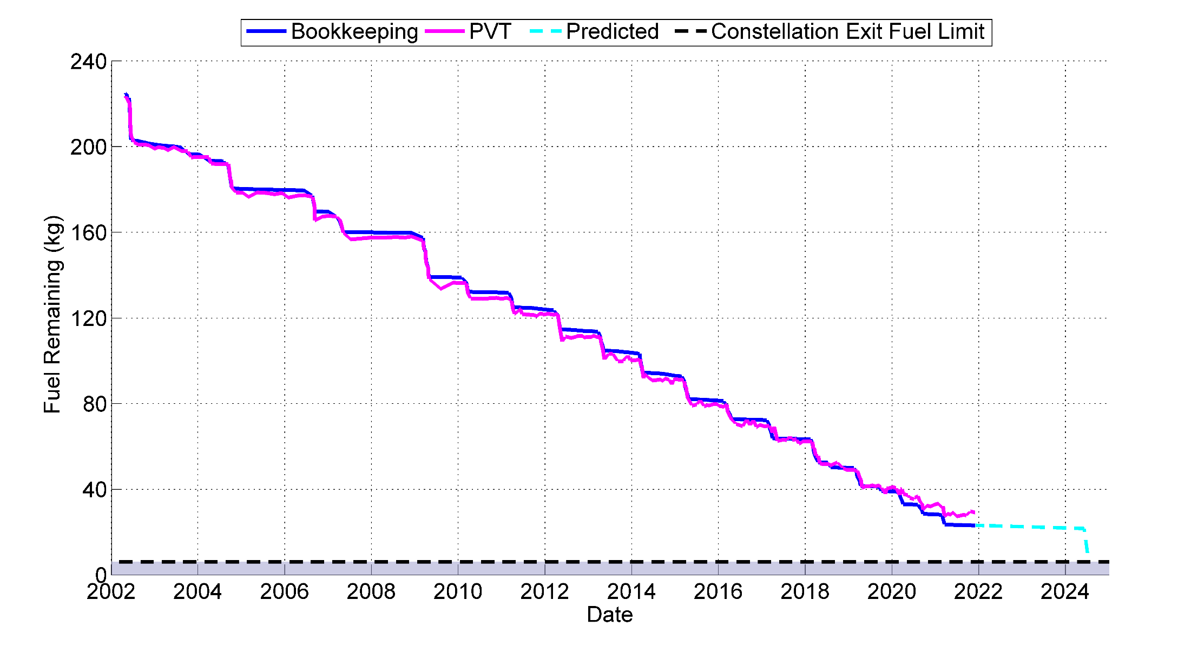
Fuel Usage: Actual & Predicted
(Updated April 2022)
Perigee Lowering (June 2024)
6.2-kg Estimated Fuel Buffer

Slide 11
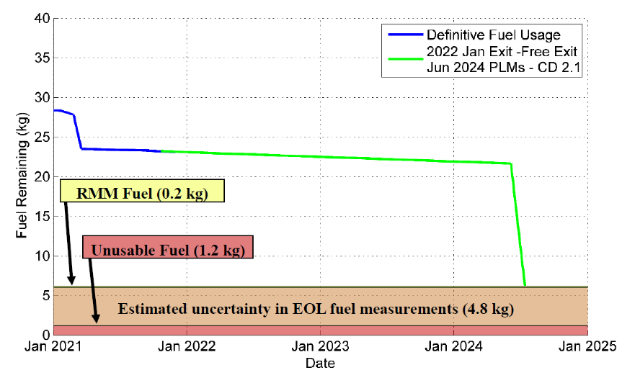
Fuel Usage: Predicted Available
No Exit in 2022, Free-Drift, PLMs in June 2024
(Updated February 2022)

Slide 12
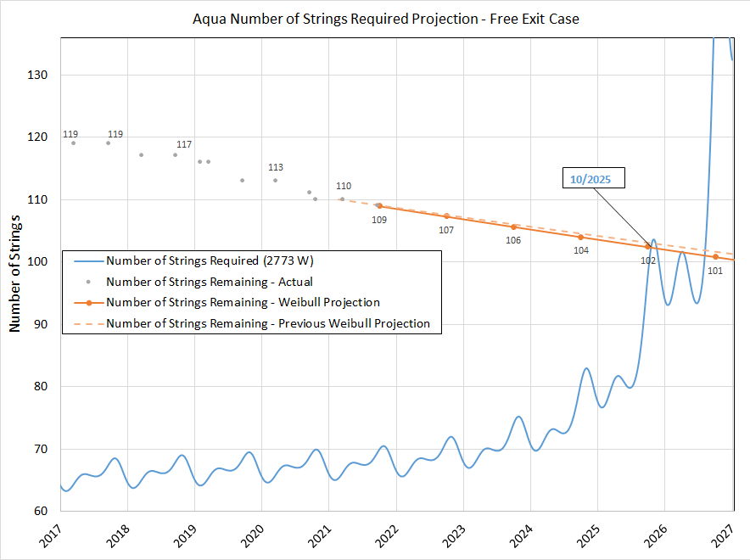
Solar Array Strings Required
Free-Drift, Drag-Down Exit
– No Changes –
The number of strings required depends on what power is need to meet the Power per String requirement
The Strings Remaining projection comes from the Code 371 Weibull Analysis with one string loss since previous update in February 2021 (updated 10/8/2021)
2773 W is the Minimum Required Power for Loads and Battery Charging
Power Generation Limit for this power load occurs in October 2025
  Occurs with ~101 strings
35-Watt load reduction needed to extend to August 2026
Reflects the 23 string losses observed to date and confirmed by the 9/22/2021 ARE State of Health Test

Slide 13
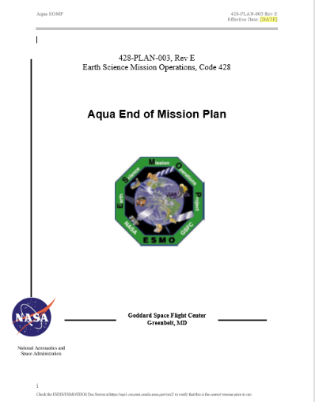
Aqua End of Mission Plan
KEY: Updates since November 2021 MOWG Meeting in blue
Initial draft February 2009
“Interim” End of Mission Plan: May 2011
End of Mission Plan (Rev A): February 2013
End of Mission Plan (Rev B): June 2015
  Safely exit the A-Train Constellation (19 km)
  Passivate to the extent possible for uncontrolled reentry
  Aqua has five (5) approved waivers for passivation
    Pressurant Passivation
    Large Object Collision Probability
    Small Object Collision Probability
    Orbital Lifetime (30-Year)
    Re-entry Risk (Un-controlled)
  Waivers were approved in May 2013
End of Mission Plan (Rev C): August 2017
  Includes ~4.4 km exit from A-Train in early 2022
End of Mission Plan (Rev D): November 2020
  Latest Annual Lifetime Estimate (November 2019)
  Retrograde maneuver slews on reaction wheels
  A-Train Exit January 2022, Immediately lower perigee
End of Mission Plan (Rev E): December 2021
  January 2022 Free-Drift Exit, Perigee Lowering June 2024
    End of Science Mission August 2026 (Decommissioning and Disposal)
Final 90 days before Decommissioning Review

Slide 14
– This version reflects the Aqua Over-Guide Budget Request –
Aqua After-the-A-Train
Extended Mission Timeline
Aqua 20-Years
Senior Review Proposal (SRP)
SRP
SRP
2020
2021
2022
2023
2024
2025
2026
2027
Q1
Q2
Q3
Q4
Q1
Q2
Q3
Q4
Q1
Q2
Q3
Q4
Q1
Q2
Q3
Q4
Q1
Q2
Q3
Q4
Q1
Q2
Q3
Q4
Q1
Q2
Q3
Q4
Q1
Q2
Q3
Q4
2017 SRP
FY18 – FY20
2017 SRP: FY21 – FY23
2020 SRP: FY21 – FY23
2020 SRP: FY24 – FY26
2023 SRP: FY24 – FY26
Operate WITHIN the A-Train
Operate slightly BELOW the A-Train
Free-drift, drag-down A-Train Exit
Operate ~20 km BELOW the A-Train operational orbit
4
IAMs
3
IAMs
4
IAMs
Power Concerns
August 2026 due to
Beta Angle Drift
Perigee Lowering Maneuvers
(PLMs) June/July 2024
Inclination Adjust Maneuvers
(IAMs)
Instruments OFF
Passivate
Spacecraft Disposal
KDP-F
5/17/2021
A-Train Exit
Review
DR
DRR
After the A-Train Extended Science Mission
Operate Instruments below A-Train operational orbit – Power Limited
TODAY
5/17/2022
DR – Decommissioning Review
KDP-F – HQ Key Decision Point to proceed with Phase F
DRR – Disposal Readiness Review

Slide 15
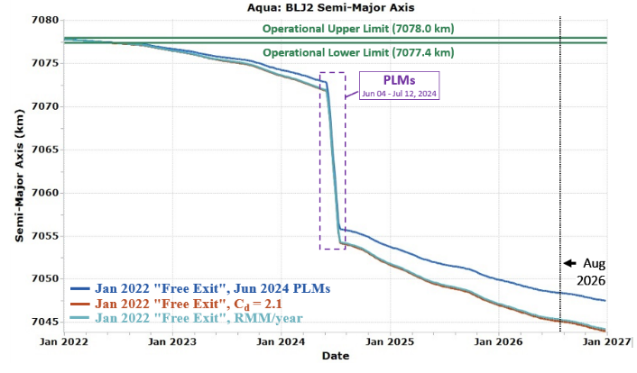
Semi Major Axis (SMA)
Free-Drift, Drag-Down Constellation Exit
June-July 2024 PLMs
Free-Drift, Drag-Down
Cd = 2.1
January 2022 “Free Exit” with June 2024 PLMs, Cd 1.76
Lifetime analysis that models one RMM per year has marginally higher SMA.
Credit:FDS-Free-Exit-Analysis-Update-v6-9Nov21

Slide 16
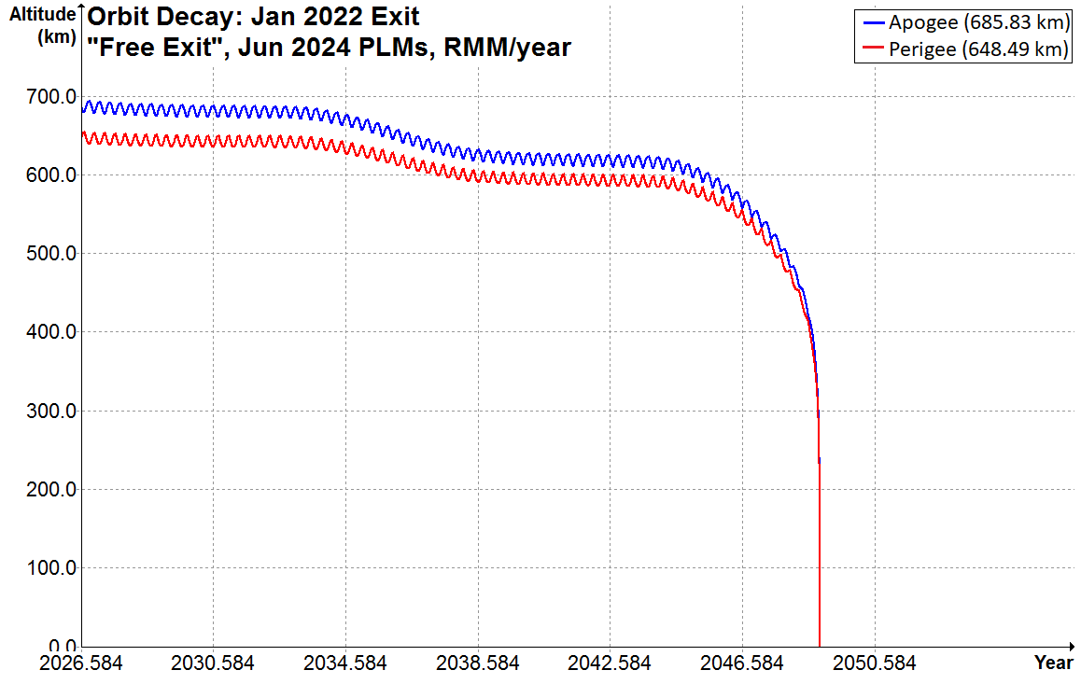

– No Changes –
January 2022 Free-Drift/No-Exit
June 4th – July 12th, 2024, PLMs
End of Science Mission: August 2026
Without 1 RMM/year
DAS predicts that Aqua will re-enter in November 2048.
22.3 years after passivation in August 2026.
In August 2026, during passivation and the end of the fuel life, we will perform fuel depletion burns with the fuel being held as uncertainty (4.8 kg) and any remaining fuel allocated for RMMs. This may provide additional perigee lowering to what is planned for the June 2024 PLMs.
Credit:FDS-Free-Exit-Analysis-Update-v6-9Nov21

Slide 17
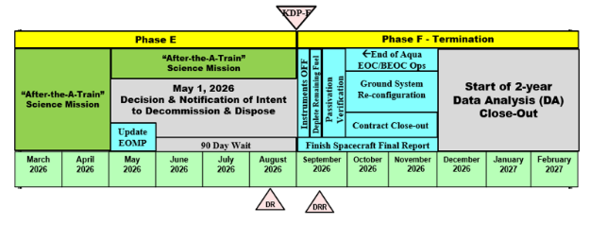
Aqua Decommissioning
(September 2025 → August 2026)
KEY: Updates since November 2021 MOWG Meeting in blue
Aqua Decommissioning Engineering Peer Review (DRAFT): October 2, 2018
Overview presented at Fall 2020 ESC Mission Operations WG Meeting
Aqua A-Train free-drift, drag-down Constellation Exit in January 2022
  Planned 4 plus years of extended science operations after constellation exit
  Planned Perigee lowering in June-July 2024 (Working to move to summer 2026)
  Project Scientist and ESMO Management agree to hold some fuel in reserve for Debris Avoidance Maneuvers (DAMs) during the extended “After the A-Train” science mission
Decommissioning and Disposal in late 2026 (see figure below)
  Aqua Spacecraft Decommissioning and Disposal outlined in End of Mission Plan
  Current EMOP: Revision E, December 2021
  Decommissioning and Passivation Readiness Review (Nov/Dec 2022)

Slide 18
Summary
KEY: Updates since November 2021 MOWG Meeting in blue
Spacecraft Status - GREEN
Instrument Status - GREEN
  AIRS and MODIS: Nominal Operations
  AMSU: Nominal Operations except for Channels 1, 2, 4, 5 and 7
  CERES: Nominal Operations except for CERES-Fore instrument
  AMSR-E: Powered Down 3/3/2016
  HSB: Survival Mode since 2/5/2003
Data Capture/L0 Processing Status – GREEN
  SSR Data Capture April 2022 100%
  SSR Data Capture to 04/30/2022: 99.98 → 99.83+%
Data Latency – Excellent
Ground Systems – Responding to new security requirements and upgrades to obsolete hardware or COTS systems, as required
  02/02/2021: EA 3.4.2 ORR currently in Operations,
  12/06/2021: Online Eclipse Build 23.01 + OS/COTS 2021.08 + Active MQ Patch in Operations
  01/11/2022: Latest FOT Automation Status

Slide 19
Additional Slides
  Orbit Maintenance Maneuvers
  Inclination Adjust Maneuver Performance
  Conjunction Assessment High Interest Events
  Ground Track Error & Mean Local Time History
  Spacecraft Orbital Parameters Trends & Predictions

Slide 20
Orbit Maintenance
– No Changes –
Mission Requirement: Perform Drag Make-Up Maneuvers (DMUMs) to maintain Aqua’s ground track error (GTE) with respect to the World Reference System (WRS-2) within +/-10 Km at the Descending Node (A-Train Requirement/Goal)
  Changed from +/-20 Km Mission Requirement with DMUM #19 (1/12/05)
  162 DMUMs have been performed to date (Last DMUM #162 on 12/1/2021 FINAL DMUM for Aqua
  Variation in performance from –20.9% (cold) to +27.1% (hot) #108 was 20.9% COLD, #162 was 35.2% HOT
Control Box Excursions: Since 2012 there have been 7 Control box Excursions
  4 on +10km front-side:
    11/4/12 to 11/14/12, 10/23/13 to 10/24/13, 3/6/14 to 3/10/14 and 3/16/2015 to 4/2/2015
  3 on -10km back-side: 11/7/13 to 12/14/13 (Emergency DAM on 10/24/13 and DAM on 11/28/13)
    4/2/2016 to 5/7/2016 and 7/29/2018 to 8/21/2018 (DAM on 7/12/2018)
Mission Requirement: Perform inclination adjust maneuvers (IAMs) to maintain the Mean Local Time (MLT) as measured at the Ascending Node between 1:30 and 1:45 MLT (Mission Goal starting in 2011: 13:35:45 +/- 45 seconds)
  73 Inclination Adjustment Maneuvers (IAMs) performed to date
    Fall 2003 (1), Spring 2004 (1), Fall 2004 (5), 2005 (NONE)
    Fall 2006 (4 of 6 - cancelled final 2 burns), Spring 2007 (4 - interrupted 2-weeks), Spring 2008 – NONE (per PARASOL request)
    Spring 2009 (9), Spring 2010 (3), Spring 2011 (3), Spring 2012 (4)
    Spring 2013 (4 with #3 being delayed 1-week), Spring 2014 (4), Spring 2015 (5)
    Spring 2016 (4 with one having to be re-scheduled), Spring 2017 (4)
    Spring 2018: (5 with one having to be re-scheduled due to PMCOC), Summer 2018 #61 on 8/2/2018
    Spring 2019: (4 planned on: 3/7 (#62), 3/14 (#63), 3/22 → 4/4 (#64), 3/28 → 4/11 (#65), Fall 2019: 10/02/2019 IAM #66
    Spring 2020 (4): 3/5 (67), 3/12 (68), 3/19 (69) →3/26 (PMCOC), 4/2 (70) – Yaw slew performed with reaction wheels
    Fall 2020 (3): 8/20 (#71), 8/27 → 9/10 (#72) & 9/3 → 9/17 (#73) – Yaw slew performed with reaction wheels
    Spring 2021 (4): 2/25 (#74), 3/4 (#75), 3/11 (#76) and 3/18 (#77) – Last IAMs for the Aqua Mission

Slide 21
Aqua Conjunction Assessment High Interest Events (HIEs) – 2022
2022 | Jan | Feb | Mar | Apr | May | Jun | Jul | Aug | Sep | Oct | Nov | Dec | Total
TOTAL | 3 | 0 | 5 |  |  |  |  |  |  |  |  |  | 8
Tier 1 | 0 | 0 | 0 |  |  |  |  |  |  |  |  |  | 0
Tier 2 | 0 | 0 | 0 |  |  |  |  |  |  |  |  |  | 0
Tier 3 | 3 | 0 | 5 |  |  |  |  |  |  |  |  |  | 8
Tier 4 | 0 | 0 | 0 |  |  |  |  |  |  |  |  |  | 0
2013: 28 CARA HIEs – 9 required significant action
2014: 34 CARA HIEs – 14 required significant action
2015: 26 CARA HIEs – 16 required significant action
2016: 21 CARA HIEs – 4 required significant action
2017: 16 CARA HIEs – 11 required significant action
2018: 19 CARA HIEs – 13 required significant action (T3 & T4), 18 DAMs Planned, 1 DAM Executed, 1 Maneuver (IAM #60) postponed (T4)
2019: 14 CARA HIEs – 11 required significant action (T3 & T4), 9 DAMs Planned, 1 DAM Executed, 1 Maneuver (IAM #64) postponed (T4)
2020: 16 CRMS HIEs – 12 required significant action (T3 & T4), 12 DAMs Planned, 0 DAMs Executed, 1 Maneuver (IAM #67) postponed (T4)
2021: 23 CRMS HIEs – 21 required significant action (T3 & T4), 21 DAMs Planned, 0 DAMs Executed, 2 Maneuver postponed (T4)
2022 thru 3/31/2022: (8 CRMS HIEs – 8 that required significant action (Tiers 3 & 4)
01/13/2022: CA vs. 41811 at 15:05:00 GMT – DAMs planned and screened (10), Self-mitigated (T3)
01/20/2022: CA vs. 40493 at 05:01:58 GMT – DAMs planned and screened (17), Self-mitigated (T3)
01/30/2022: CA vs. 38527 at 23:49:15 GMT – DAMs planned and screened (6), Self-mitigated (T3)
03/05/2022: CA vs. 39874 at 01:24:58 GMT – DAMs planned and screened (35), Self-mitigated (T3)
03/20/2022: CA vs. 48187 at 02:19:55 GMT – DAMs planned and screened (3), Self-mitigated (T3)
03/24/2022: CA vs. 51447 at 03:36:15 GMT – DAMs planned and screened (6), Self-mitigated (T3)
03/29/2022: CA vs. 42251 at 21:56:48 GMT – DAMs planned and screened (29), Self-mitigated (T3) NON-ACTIONABLE
03/30/2022: CA vs. 48188 at 09:32:00 GMT – DAMs planned and screened (11), Self-mitigated (T3)
Tier 1 – Notify (email/phone), Tier 2 – Conduct Briefing,
Tier 3 – Plan Maneuver, Tier 4 – Execute Maneuver
Tier 4 – Postponed and/or replanned Maneuver

Slide 22
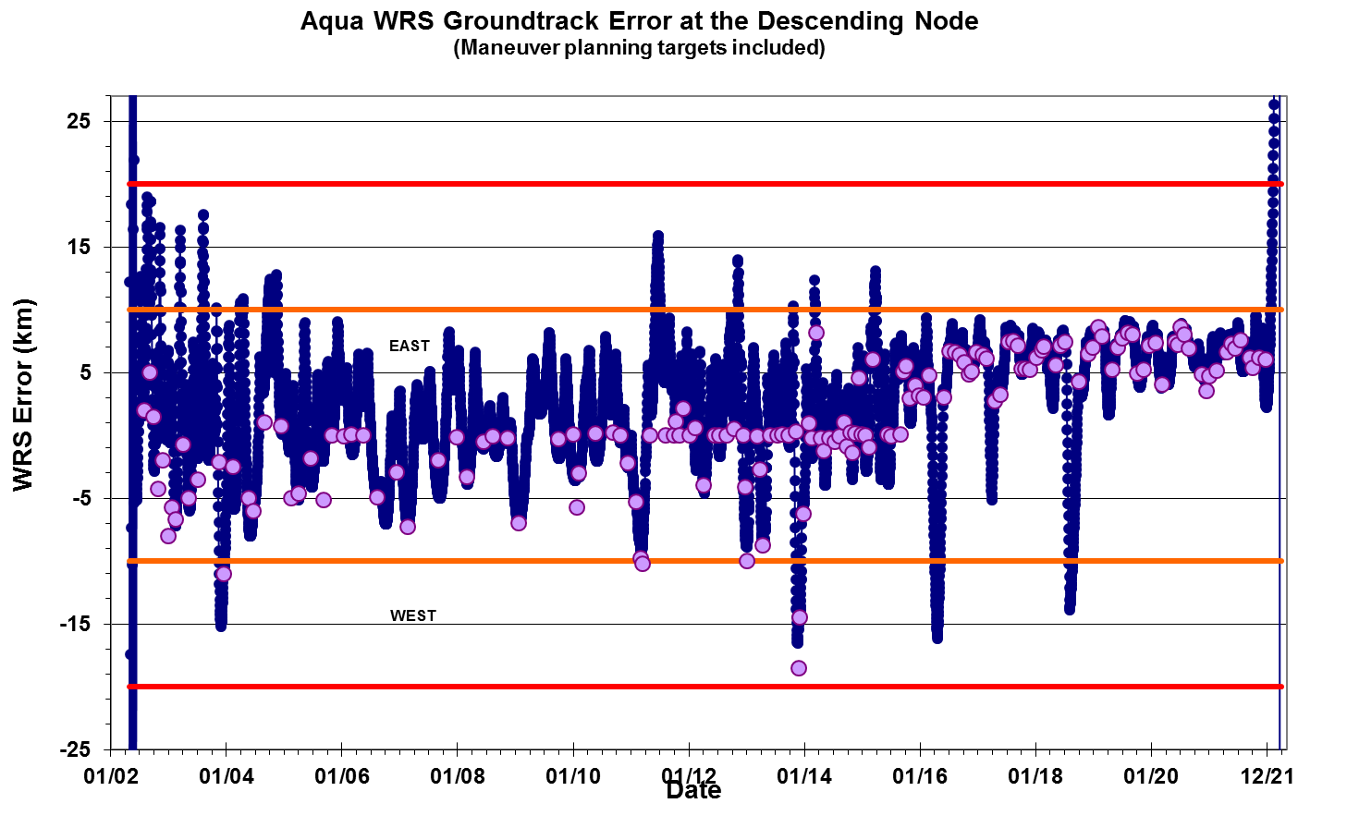
WRS Ground Track Error (GTE)
(As of March 31, 2022)
– Updated Quarterly –

Slide 23
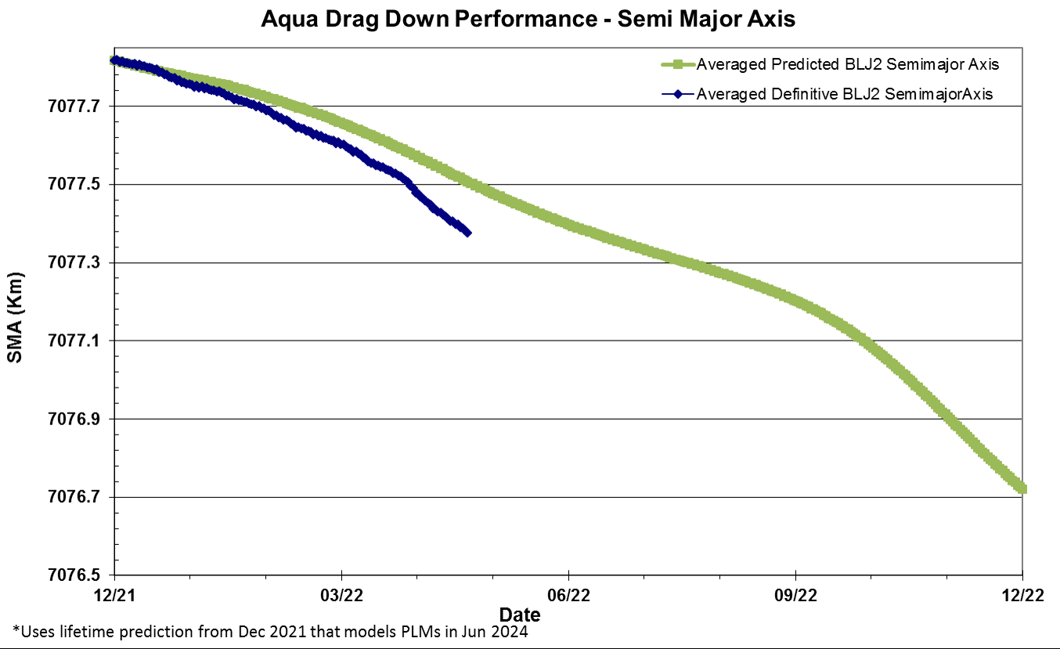
Semi Major Axis (SMA)
Free-Drift, Drag-Down Performance (as of 4/25)
Credit: FDS 4/25/2022

Slide 24
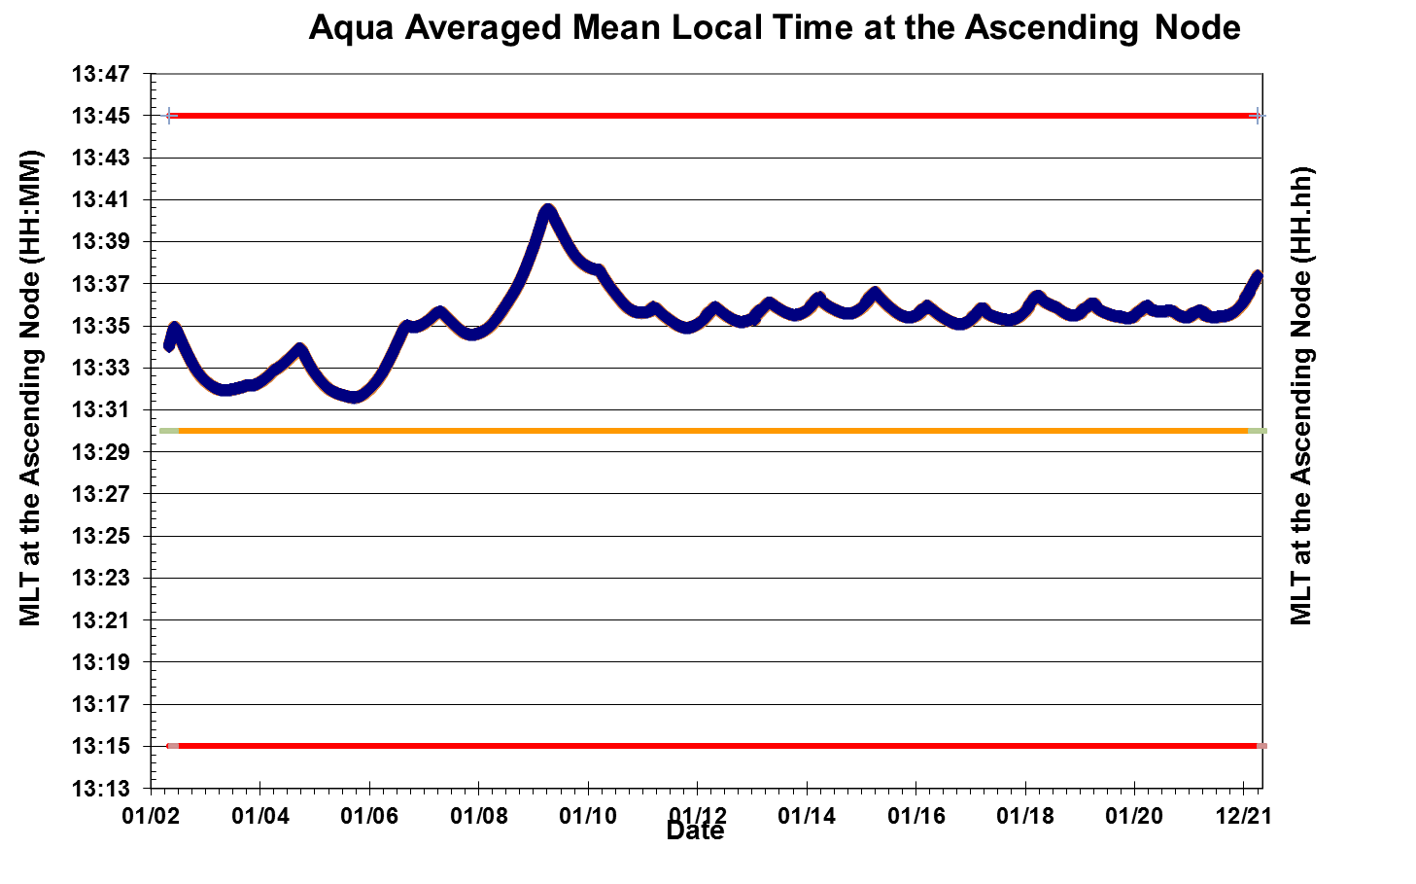
Aqua Mean Local Time (MLT)
@ Ascending Node
(As of March 31, 2022)
The current target MLT range for Aqua is 13:35:45 +/- 45 sec
Mission Operations Range for Aqua MLT is 13:30 – 13:45
– Updated Quarterly –
MLT Mission Requirement 13:30 +/- 15 minutes

Slide 25
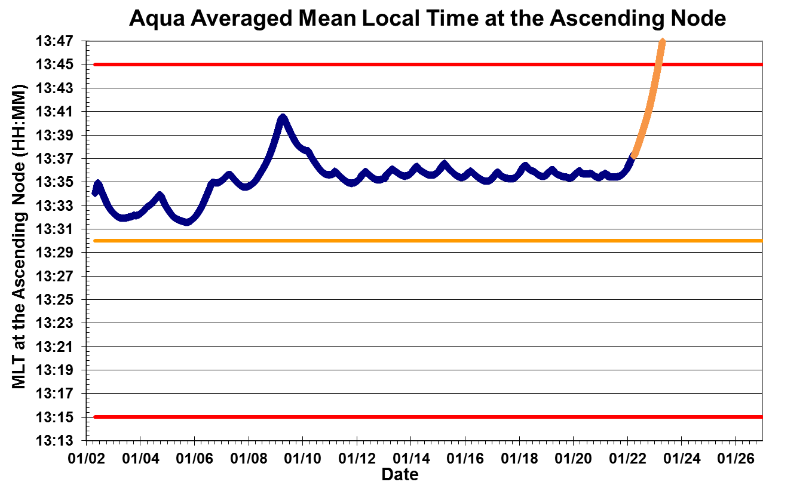
Aqua Definitive and Predictive MLT @ Ascending Node
(Updated April 2022)
Mission Operations Range for Aqua MLT is 13:30 – 13:45
Predicted
data
The current target MLT range for Aqua is 13:35:45 +/- 45 sec
Definitive Data
MLT Mission Requirement 13:30 +/- 15 minutes

Slide 26
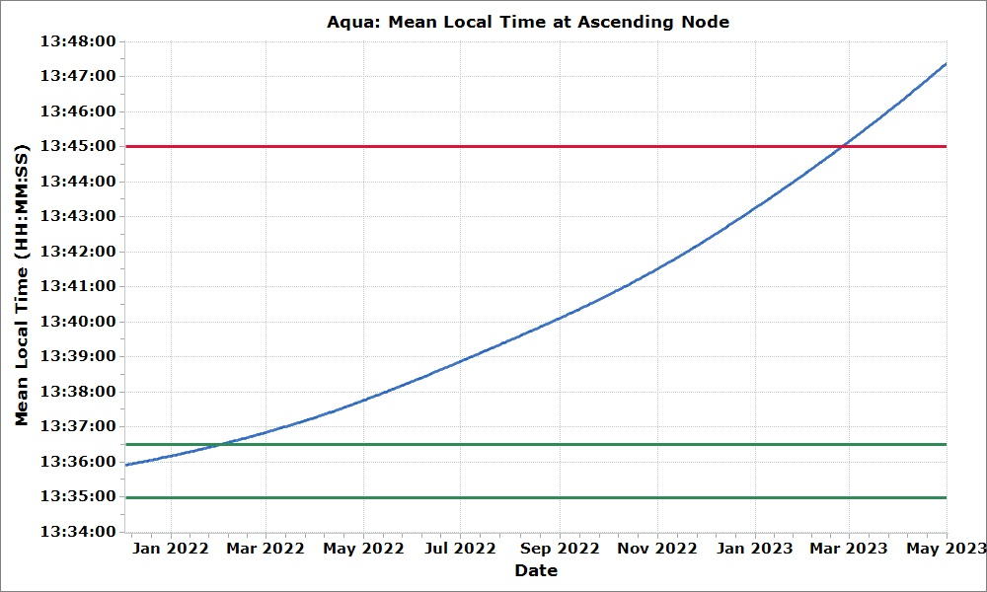
Aqua Predicted Mean Local Time (MLT) at Ascending Node
(Updated April 2022)
Feb 24, 2023
Mission Upper Limit (13:45:00)
Aqua’s MLT was maintained within the operational bounds through Jan 30, 2022, when the satellite began to drift according to the “Free Exit" approach. The upper mission bound is predicted be violated in Feb 2023. This plot shows MLT drift according to the "Free Exit" plan.
Jan 30, 2022
Operational Upper Limit (13:36:30)
Operational Lower Limit (13:35:00)

Slide 27
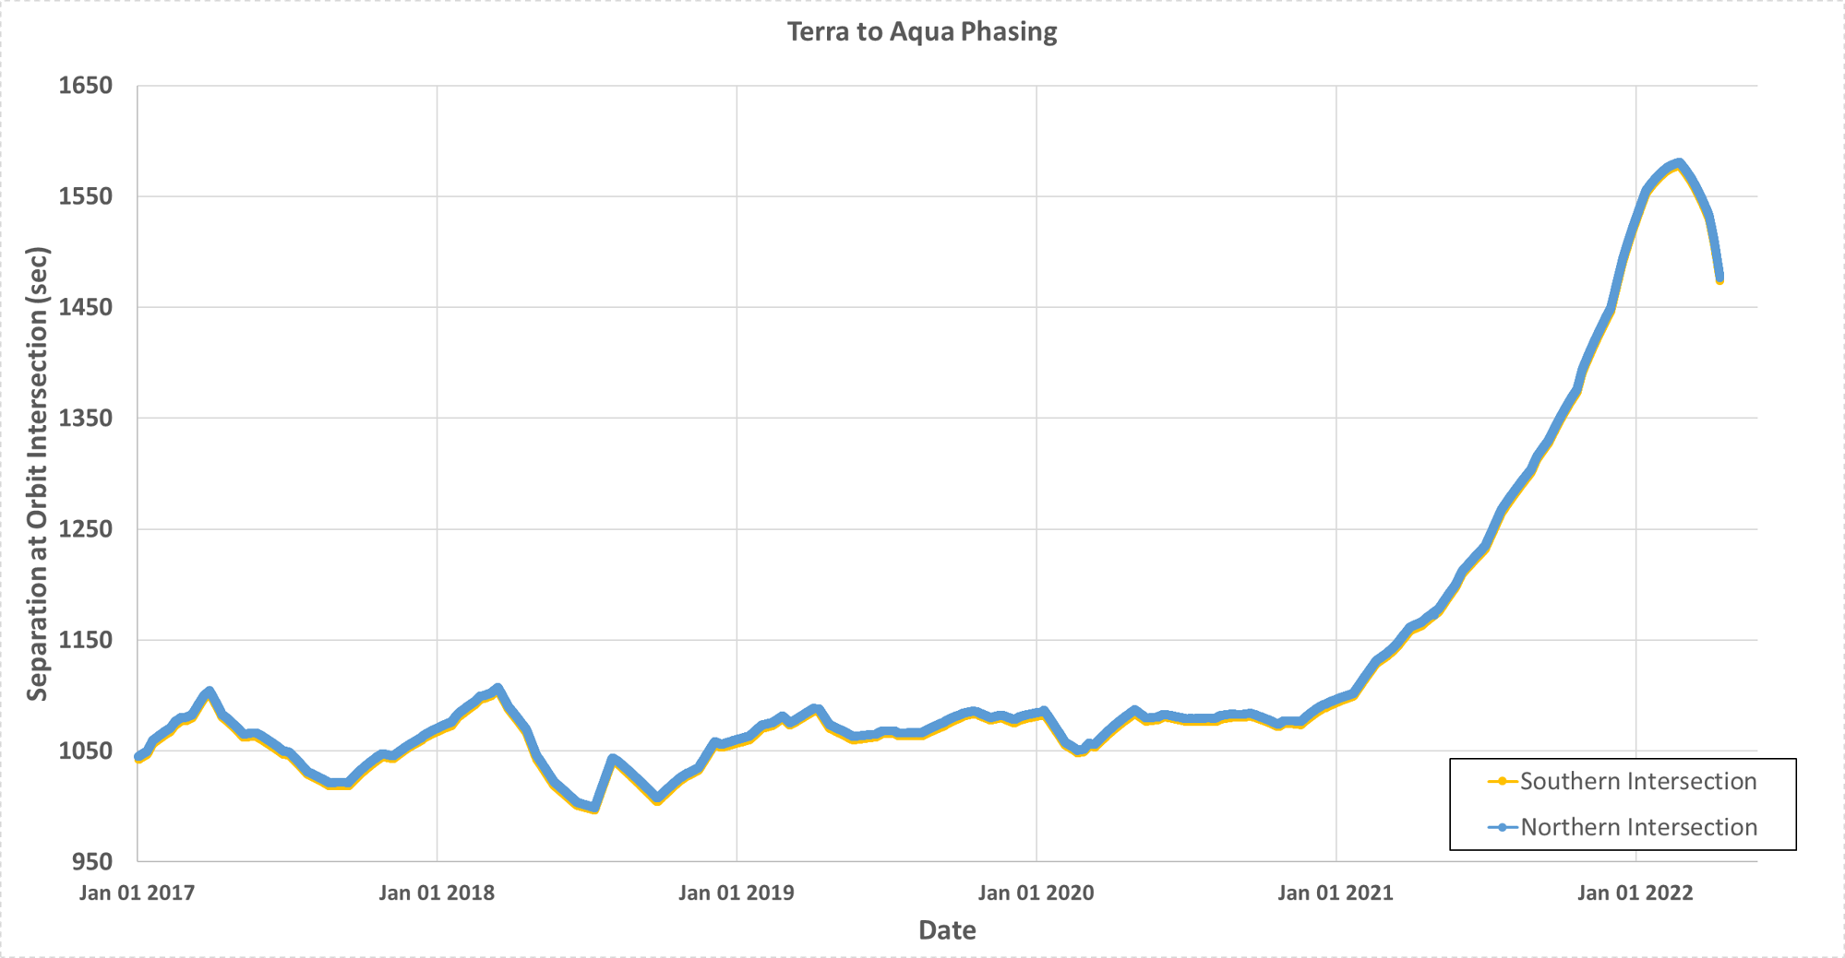
Terra to Aqua Phasing
(Updated April 2022)
Terra goes through orbital intersection point about 25.83-minutes (~1550-seconds) prior to Aqua.

Slide 28
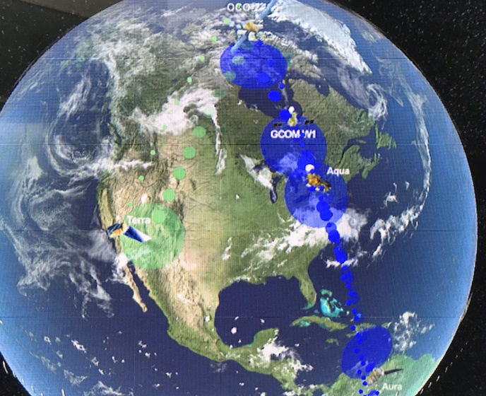
Questions ?
A-Train/Aqua on May 11, 2022, at 1:30pm EDT (Constellation Visualization Tool)

Slide 29
Abbreviations / Acronyms List
  AIRS – Atmospheric Infrared Sounder
  AMSR-E – Advanced Microwave Scanning Radiometer for EOS
  AMSU – Advanced Microwave Sounding Unit
  ARE – Array Regulator Electronics
  ASAT – Anti-satellite Weapon
  BEOC – Backup EOC
  BP – Best Practices
  CA – Conjunction Assessment
  CAM – Command Authorization Meeting
  CARA – Conjunction Assessment Risk Analysis
  CDH – Command & Data Handling
  CEF – CERES Fore
  CEM – Constellation Exit Maneuver
  CERES – Clouds and the Earth’s Radiant Energy System
  COTS – Commercial Off the Shelf
  CNES – Centre National d’Etudes Spatiales
  CRMS – Collision Risk Management System
  CVT – Constellation Visualization Tool
  DA – Data Analysis
  DAM – Debris Avoidance Maneuver
  DAS – Debris Assessment Software
  DMUM – Drag Make-up Maneuver
  DTM – Dual Thruster Module
  EA – EOS Automation
  EDT – Eastern Daylight Time
  EOC – EOS Operations Center
  EOL – End of Life
  EOM – End of Mission
  EOMP – End of Mission Plan
  EOPM – End of Prime Mission
  EOS – Earth Observing System
  EPS – Electrical Power System
  ESC – Earth Science Constellation
  ESMO – Earth Science Mission Operations
  FDS – Flight Dynamics System
  FDSS-III – Flight Dynamics Support Services III contract
  FOT – Flight Operations Team
  FSW – Flight Software
  FY – Fiscal Year
  GCOM-W1 – Global Change Observation Mission for Water (1)
  GMT – Greenwich Mean Time
  GN&C – Guidance Navigation & Control
  GPM – Global Precipitation Measurement
  GTE – Ground Track Error
  HIE – High Interest Event
  HQ – Headquarters
  HSB – Humidity Sounder for Brazil
  IAM – Inclination Adjustment Maneuver
  JAXA – Japan Aerospace Exploration Agency
  kg – kilogram
  km – kilometer
  L0 – Level-Zero
  m – meter
  min – minute
  MLT – Mean Local Time
  MMOD Micrometeorite Orbital Debris
  MOCA – Mission Operations Conjunction Assessment
  MODIS – Moderate Resolution Imaging Spectroradiometer
  MOU – Memorandum of Understanding
  MOWG – Mission Operations Working Group
  NASA – National Aeronautics & Space Administration
  NID – NASA Interim Directive
  OCO-2 – Orbiting Carbon Observatory-2
  Ops – Operations
  ORR – Operational Readiness Review
  PARASOL – Polarization & Anisotropy of Reflectances for Atmospheric Sciences coupled with Observations from a Lidar
  PLM – Perigee Lowering Maneuvers
  PMCOC – Post Maneuver Conjunction of Concern
  PROP – Propulsion
  PS – Project Scientists
  PVT – Pressure, Volume, & Temperature
  RMM – Risk Mitigation Maneuver
  RW – Reaction Wheels
  s or sec – second
  SA – Solar Array
  S/C – Spacecraft
  SEU – Single Event Upset
  SME – Subject Matter Expert
  SSR – Solid State Recorder
  TBC – To Be Confirmed
  TBD – To Be Determined
  TCS – Thermal Control System
  US – United States
  USGS – United States Geological Survey
  WRS – World Reference System

