Slide 1
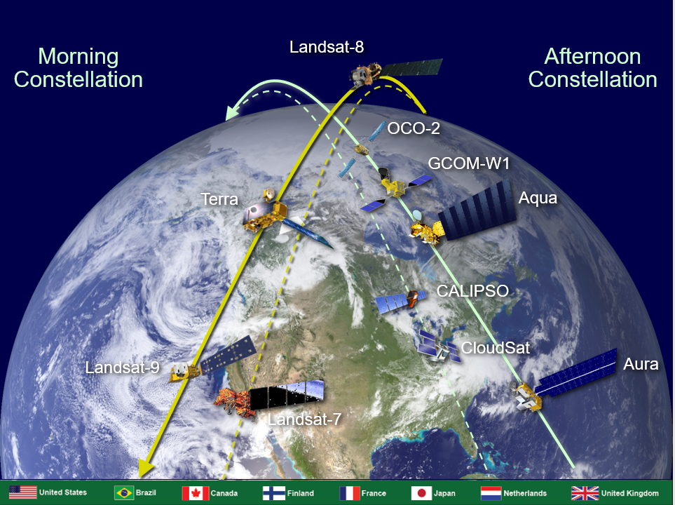
ESC MOWG Introduction May 2022
INTRODUCTION
INTRODUCTION
Michael J. Machado
Constellation Mission Operations Manager
Mission Validation and Operations Branch – Code 584
Earth Science Mission Operations (ESMO) Project – Code 428
NASA/Goddard Space Flight Center

Slide 2
Welcome
Welcome to all the members and invited guests of the Mission Operations Working Group (MOWG) of the International Earth Observing Constellations! Welcome back to those who have returned to onsite work!
Special thanks to Cindy Leaper, Nancy Herndon, Mark Heigh, and Bill Guit for helping with this 4th Virtual MOWG meeting.
Thanks to everyone who is supporting at unusual hours due to being in a different time zone
Welcome to our guests and first-time attendees.
THANK YOU as always for your support especially during this challenging time of pandemic and social unrest!
Notes:
Claire Parkinson (Aqua Project Scientist) is here to show Satellite Observations of Climate Change. This year Aqua marked a 15-year anniversary!
Some changes since last meeting (New faces or people returning):
Cheryl Yuhas is retiring; Greg Dell currently assigned as Program Executive
PJ Guske moved on: Mark Garcia new OCO-2 Project Manager
CALIPSO: Denis Perriot moved to a new position; Claude Audouy now head of the Application Mission Operation division; Franck Darnon took over as CALIPSO Mission Operations Manager
Landsat 9 attendees:
Don Dichmann here to observe and learn for LandSat 9 ascent planning
Del Jenstrom & Steve Pszcolka here to present Landsat 9
Flight Dynamics: Shane Stezelberger and Thomas Noyes
CARA: Dave Adams (Goddard Space Asset Protection Lead)
ESA: Kate Symonds
SNPP/S5P: Jose Davis & Bryan Mattfeld

Slide 3
Earth Science Mission Operations (ESMO)
External Matrix Support
FSW: Bob Lutz
FDF: Samuel Schreiber
CARA: Lauri Newman
CRMS: Matt Duncan (SpaceNav)
MOA: Russ DeHart
Project Manager
Wynn Watson
Deputy Project Manager – Operations
Jamie Pawloski
Deputy Project Manager – Technical
Eric Moyer
Deputy Project Manager – Resources
Tracy Parlate
Project Scientists
Earth Observing System (EOS) Senior Project Scientist & A-Train Project Scientist: Steven Platnick
Aqua: Claire Parkinson
Deputy - Lazaros Oreopoulos
Aura: Bryan Duncan
Deputy – Nick Krotkov
Terra: Kurt Thome
Deputy - Si-Chee Tsay
Deputy – Robert Wolfe
Project Admin
Selene Annadale
Diane Trakas
Project Support
Vickie Lopez
Ground Systems Manager
Shampa Wali
Ground Systems Deputy:
Phillip Caffo
Mission Directors / Managers
Aqua: Bill Guit
Aura: Dominic Fisher
Terra: Dimitrios Mantziaras
GPM/GEDI: Tony Scaffardi
ICESat-2: James Jaranyi &
Chol Chang
TSIS-1: Eric Moyer (acting)
POES/MetOP: Chol Chang
IT Security
Darnell Kemper
Chris Mishaga
EDOS: Terri Wood
Networks: Kevin Kranacs
Flight Dynamics
EOS Operations & Analysis Manager: Tiffany Hoerbelt
EOS Deputy: Becky Mesarch
Software Development (CCS): Tiffany Hoerbelt
Constellation Support
Mark Heigh
Earth Science Constellation Manager
Mike Machado
Notes:
Ask all teams for org charts

Slide 4
MOWG Charter
The Constellation mission teams
enable nearly simultaneous
science observations by
coordinating their operations and
cooperating with each other to
ensure the safety of the constellations.

Slide 5
Constellation History
A-Train Mission Operations Working Group (MOWG): Exploratory discussions between LaRC (John Stadler) and GSFC (Angie Kelly, Bill Guit and Lauri Newman) in 2002. Officially met for the first time in March 2003
Morning Constellation: Officially began with Landsat 7 (April 1999) and Terra (December 1999), followed by joint EO-1/SAC-C launch (November 2000)
Afternoon Constellation (A-Train): Began with the Aqua (May 2002) and Aura (July 2004), then PARASOL (December 2004), and joint CALIPSO/CloudSat launch (April 2006)
Later ESC missions followed:
  OCO (2010) and Glory (2011) launches failed
  GCOM-W1 (May 2012)
  Landsat 8 (February 2013)
  OCO-2 (July 2014)
  Landsat 9 (September 2021)
Formation of the C-Train:
  CloudSat exited A-Train on February 22, 2018
  CALIPSO exited A-Train in mid-September 2018
  C-Train operational orbit configuration achieved on November 1, 2018
Major Milestone Anniversaries:
  Aqua 20-Years (May 4); GCOM-W1 10-Years (May 18)
Notes:
As missions get older and use up fuel we need to help determine how the A-Train evolves; afternoon presentations will help show what is possible
TanSat launched above us and could join the A-Train
Landsat 7 investigates refueling and hope to overlap with Landsat 9

Slide 6
Significant Meeting Topics
Terra Constellation Exit Plans
Landsat 7 Orbit Lowering
Aqua 20-Year Anniversary and GCOM-W1 10-Year Anniversary
NASA Headquarters Perspective
Current State of the Missions
  Review A-Train’s Inclination Adjust Maneuver (IAM) Plans for 2022
  Aqua Anomaly and Passing Events with GCOM-W1 and OCO-2
  C-Train Status
Constellation Updates
  NOAA/JPSS Constellation Update
  ESA Update
  OneWeb Update

Slide 7
State of the Constellations
Morning Constellation
  Landsat 7, Landsat 8 and Terra are performing nominally.
  SAC-C stopped operations in August 2013
  EO-1 was decommissioned and passivated on March 30, 2017
  Landsat 9 launched successfully and is flying in the morning constellation!
Afternoon Constellation (A-Train & C-Train)
  Aqua, Aura, GCOM-W1, and OCO-2 are performing nominally
  Aqua anomaly (safe mode) and recovery on April 14
  CloudSat & CALIPSO operating in the C-Train (formed November 1, 2018) and continue to be Constellation MOWG family!
  CloudSat under-voltage condition and reaction wheel anomaly
  PARASOL exited the A-Train in 2013
Constellations are operating successfully while dealing with
some anomalies and producing valuable science data;
Excellent cooperation! Still evolving and learning!
Notes:
CloudSat Anomaly - Sun-Point-Spin mode; Reaction Wheels & Cloud Profiling Radar (CPR) have been turned off; Return to Do-Op late June at earliest

Slide 8
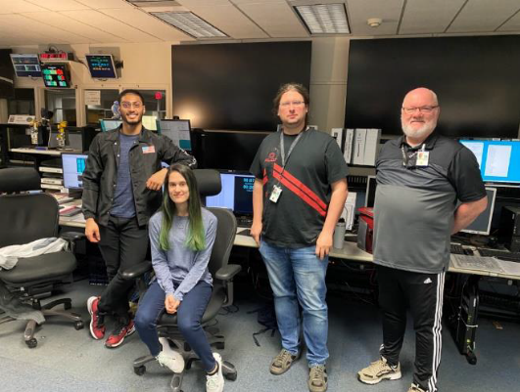
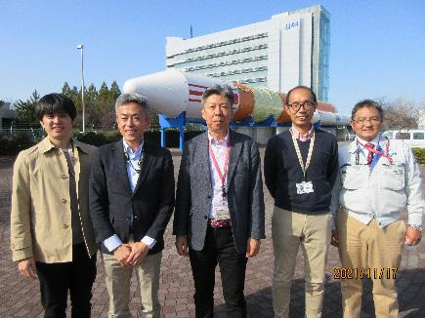
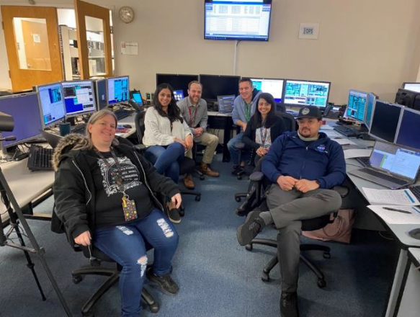
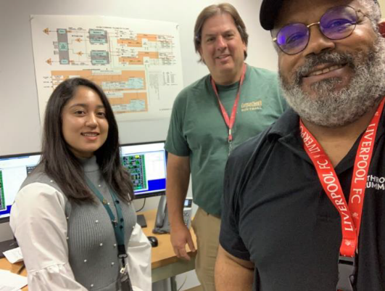
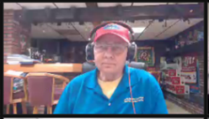
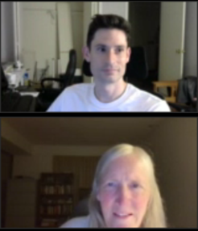
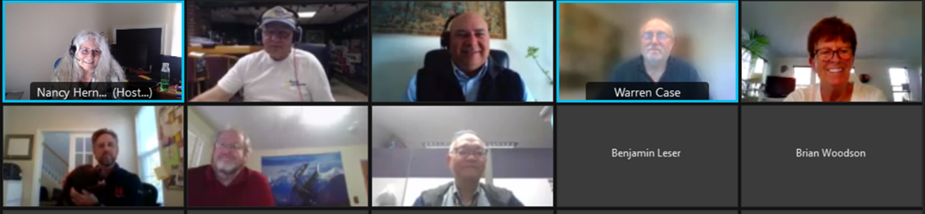
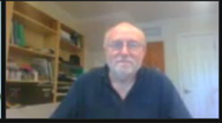
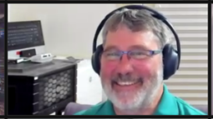
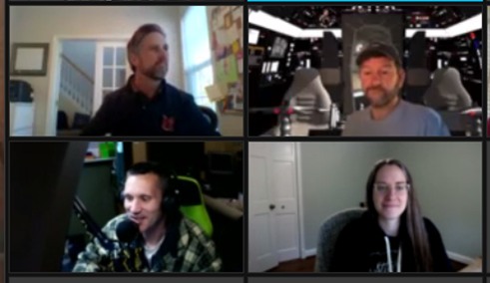
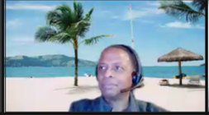
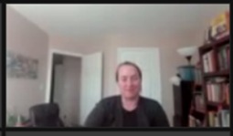
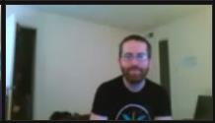


Slide 9
Since the last meeting . . .
  Landsat 9 successfully completed ascent maneuvers, an under flight of Landsat 8 and is on orbit!
  OCO-2 is now the A-Train Anchor mission used to define relative phasing with other A-Train missions
  A-Train successfully conducted it’s Spring 2022 Inclination Adjust Maneuvers (IAMs) with OCO-2, GCOM-W1 and Aura performing IAMs
  Aqua Constellation Exit CCR#20 approved. Aqua drifting in the A-Train and passed GCOM-W1 on April 3. Passes OCO-2 on May 17
  Landsat 7 successfully lowered orbit ~8km

Slide 10
Significant Events . . .
EVENT | DATE
2021 Fall MOWG Meeting (Virtual) | November 15-18, 2021
Landsat 9 Ascent Maneuvers 4 of 4 | October 22, 2021- December 1, 2021
A-Train Spring IAM Series | January 19, 2022 – March 16, 2022
Aqua Safe Mode Anomaly | March 31, 2022 – April 14, 2022
Aqua Crossing/Passing GCOM-W1 | April 3, 2022
Landsat 7 Orbit Lowering | April 12 – 26, 2022
Aqua 20th Anniversary | May 4, 2022
Aqua Crossing/Passing OCO-2 | May 17, 2022*
GCOM-W1 10th Anniversary | May 18, 2022
* To Be Confirmed (TBC)
Notes:
Still need a sponsor for FALL MOWG and decide on location.

Slide 11
Potential Future MOWG Meetings . . .
Virtual and/or Hybrid
Past Locations
Boulder/Ft. Collins, CO
KAFB, Albuquerque, NM
France
GSFC, MD
Gilbert, AZ
Japan
JPL/Pasadena area, CA
KSC area, FL
LaRC/Norfolk area, VA
Dulles, VA
Sioux Falls, SD
Other Locations Discussed
Alaska Ground Station Facility
JSC, TX
Host desired location or Virtual?
Sponsors
CALIPSO/CNES
CALIPSO/LaRC
CloudSat/JPL
CloudSat/KAFB
ESMO missions/GSFC
GCOM-W1/JAXA
Landsat/NGIS
Landsat/USGS
OCO-2/JPL
OCO-2/OSC ATK
NGC
Notes:
Still need a sponsor for FALL MOWG and decide on location.

Slide 12
Action Items from Fall 2021 MOWG
# | Assignee | Description | Status / Due Date
2111-01 | Aqua Team | Document Orbital Debris Program Office email agreeing with Aqua approach for calculating apogee/perigee altitudes, semi-major axis, and eccentricity. | CLOSED / November 15, 2021
2111-02 | Aqua Team | Explain the difference between 2 plots in the Aqua Delta-CER package slide 42 – why is right plot more eccentric? | CLOSED / December 3, 2021
2111-03 | Constellation Management team | Develop Crossing Plan documents. Start coordination, communication 2 months prior to crossing. | CLOSED / April 29, 2022
2111-04 | Aqua Team | What Retrograde Maneuver capability does Aqua have? | CLOSED / February 1, 2022
2111-05 | All Teams | Teams provide (via CCS) a long ephemeris for the purpose of Terra Constellation Exit Planning. 1/1/2022 – 1/1/2024, 60s step size, include maneuvers and drag environment | CLOSED / February 28, 2022
2111-06 | Mike Machado | Send Constellation Operations Coordination Plan out for signatures | OPEN / December 15, 2021
2111-07 | Terra Team | Send Landsat 7 team (via CCS) a long ephemeris file spanning 1/1/2022 – 1/1/2023, 60s step size, include maneuvers and drag environment | CLOSED / December 31, 2021
2111-08 | MOWG Leads | Provide feedback for CCR#21 (New Cornerstone Mission) | CLOSED / December 17, 2021

Slide 13
Action Items from Spring 2021 MOWG
# | Assignee | Description | Status / Due Date
2109-01 | All teams | Each team provide an email to Mike Machado and Bill Guit with concurrence to alternate Aqua plans (consisting of no longer performing Constellation Exit or Drag Makeup Maneuvers but reserving fuel for Risk Mitigation Maneuvers) until mid-2024 and then performing Perigee Lowering Maneuvers allowing continued science until ~August 2026 at which time passivation would occur) that were presented at the Interim virtual MOWG meeting on September 28, 2021. | CLOSED / October 5, 2021
2109-02 | Aqua team | Generate Constellation Change Request to document the change to Aqua exit plan. This will be the formal agreement between constellation members of the new plan. | CLOSED / October 6, 2021
2109-03 | All teams | Provide updated long ephemeris information (include DMU/IAMs) for Aqua Delta-CER planning. Time span: Jan 1, 2022 to Jan 1, 2025 | CLOSED / October 8, 2021
2109-04 | Aqua team | Analyze what happens to the long-term orbit evolution if Aqua performs a typical RMM-sized orbit raise ahead of predicted crossings with constellation members. What is the impact on dwell time? | CLOSED / November 15, 2021
2109-05 | Aqua team | For GCOM-W1, OCO-2, and Aqua, provide a snapshot of the current mean orbit elements (including the eccentricity, argument of periapsis, and semi-major axis). | CLOSED / November 15, 2021
2109-06 | Aqua team | For GCOM-W1, OCO-2, and Aqua, provide a plot of altitude with respect to a spherical Earth (or alternately radius) vs argument of latitude over one orbit. | CLOSED / November 15, 2021
2109-07 | Aqua team | Analyze the separation between Aqua and GCOM-W1. Provide the updated risk, miss distance, and probability of collision at the Delta-CER. Meet early to exchange information. Suggest T-2 months, T-1 month, then weekly until TCA. | CLOSED / February 15, 2022
2109-08 | All teams | Review Aqua CCR to change exit plans and drift in the constellation. Provide written concurrence after the delta-CER on November 16 or feedback as to why it is not acceptable. | CLOSED / November 16, 2021
2109-09 | Aqua team | Knowing all our NASA missions must go through the 2023 Senior Review for mission extension. If Aqua is not extended beyond 2023, will Aqua still be able to meet the 25-year re-entry requirement with this new plan or some variation of it? NOTE: this applies to NASA missions. | CLOSED / November 15, 2021

Slide 14
Updated Action Items from Spring 2021 MOWG
# | Assignee | Description | Status / Due Date
2105-04 | Mike Machado & A-Train Members | Draft CCR to identify requirements for new Cornerstone mission. Possible separate CCR for new Cornerstone mission. | CLOSED / December 1, 2021
2105-05 | All teams | What are the impacts to each mission if CCS is no longer maintained or goes away after Aqua and Aura exit the Constellation? | OPEN /May 17, 2022

Slide 15
Meeting Logistics
Presentations
  Please e-mail your presentation updates to michael.j.machado@nasa.gov, and mark.t.heigh@nasa.gov
  All the presentations will be made available after the meeting. NOTE: The large file transfer service has been decommissioned. Distribution for select (international and interagency) members via Box. Office 365 OneDrive option for internal partners. Download instructions will be sent.
  Presentations will be recorded! Let us know beforehand if your presentations are “not for public view”.
Webex meeting information:
  See Agenda or email announcement for Webex meeting links
Group photo Idea – Please send us a photo (selfie or group photo from a recent event). We can use these later to assemble into a MOWG photo collage!

Slide 16
ありがとうございます
Arigatou Gozaimasu
Merci
Thank you
Questions?
Notes:
Pronounce arigatou gozaimasu as ah-ree-gah-toh goh-zah-ee-mas.
State "arigatou gozaimasu."[4] This phrase essentially means "thank you very much."
You can use arigatou gozaimasu with people who have a higher status than you, including supervisors, family elders, teachers, and strangers or acquaintances who appear older than you.
You can also use this phrase to express formal or heartfelt gratitude to someone close to you.
In its non-romanized form, write 有難う 御座います.

Slide 17
Abbreviations / Acronyms List
  ACTTWO Attitude Control Through Two Wheel Operations
  AFRL Air Force Research Laboratory
  AIRS Atmospheric Infrared Sounder
  ALI Advanced Land Imager
  AMSR-E Advanced Microwave Scanning Radiometer for EOS
  AMSR2 Advanced Microwave Scanning Radiometer 2
  ASTER Advanced Spaceborne Thermal Emission and Reflection Radiometer
  CA Conjunction Assessment
  CAM Command Authorization Meeting
  CALIPSO Cloud-Aerosol Lidar and Infrared Pathfinder Satellite Observations
  CARA Conjunction Assessment Risk Analysis
  CARMA Conjunction Assessment and Risk Mitigation Automation
  CCR Configuration Change Request
  CCS Constellation Coordination System
  CNES Centre National d’Etudes Spatiales
  COVID-19 Coronavirus Disease 2019
  CRMS Collision Risk Management System
  CVT Constellation Visualization Tool
  DAM Debris Avoidance Maneuver
  DAS Debris Assessment Software
  DB Direct Broadcast
  DO-OP Daylight Only Operations
  EAR Export Administration Regulations
  EDOS EOS Data Operations System
  EO Earth Observation
  EO-1 Earth Observing-1
  EOMP End of Mission Plan
  EOS Earth Observing System
  EROS Earth Resources Observation and
  Science
  ESA European Space Agency
  ESACCS European Space Agency Constellation Coordination System
  ESC Earth Science Constellation
  ESDIS Earth Science Data and Information System
  ESMO Earth Science Mission Operations
  ETM+ Enhanced Thematic Mapper Plus (Landsat 7)
  FAQ Frequently Asked Question
  FDS Flight Dynamics System
  FOT Flight Operations Team
  FMU Formatter Multiplexer Unit
  FSW Flight Software
  FY Fiscal Year
  GEDI Global Ecosystem Dynamics Investigation
  GCOM-W Global Change Observation Mission – Water
  GMT Greenwich Mean Time
  GS Global Survey
  GSFC Goddard Space Flight Center
  HIE High Interest Event
  HQ Headquarters
  IAM Inclination Adjustment Maneuver
  ICESAT Ice, Cloud,and land Elevation Satellite
  ISRO Indian Space Research Organization
  ISS International Space Station
  ITAR International Traffic in Arms Regulations
  JAXA Japan Aerospace Exploration Agency
  JPL Jet Propulsion Laboratory
  JPSS Joint Polar Satellite System
  JSC Johnson Space Center
  JSpOC Joint Space Operations Center
  KSC Kennedy Space Center
  LaRC Langley Research Center
  MetOp Meteorological Ops Satellite
  MLT Mean Local Time
  MMOD Micrometeorite Orbital Debris
  MOWG Mission Operations Working Group
  NASA National Aeronautics & Space Administration
  NET No Earlier Than
  NGAS Northrop Grumman Aerospace Systems
  NISAR NASA-ISRO Synthetic Aperture Radar mission
  NOAA National Oceanic and Atmospheric Administration
  OCO Orbiting Carbon Observatory
  OIIR NASA Office of International and Interagency Relations
  ORR Operational Readiness Review
  POC Point Of Contact
  PS Project Scientists
  RMM Risk Mitigation Maneuver
  RWA Reaction Wheel Assembly
  SAC-C Satellite de Aplicaciones Cientificas (Scientific Application Satellite)
  SC Spacecraft
  S5P Sentinel-5 Precursor
  SNPP Suomi National Polar-orbiting Partnership
  SSR Solid State Recorder
  SWIR Short Wave Infrared
  TBC To Be Confirmed
  TBD To Be Determined
  TES Tropospheric Emission Spectrometer
  TSIS Total and Spectral Solar Irradiance Sensor
  USGS U.S. Geological Survey
  WRS World Reference System

