Slide 1
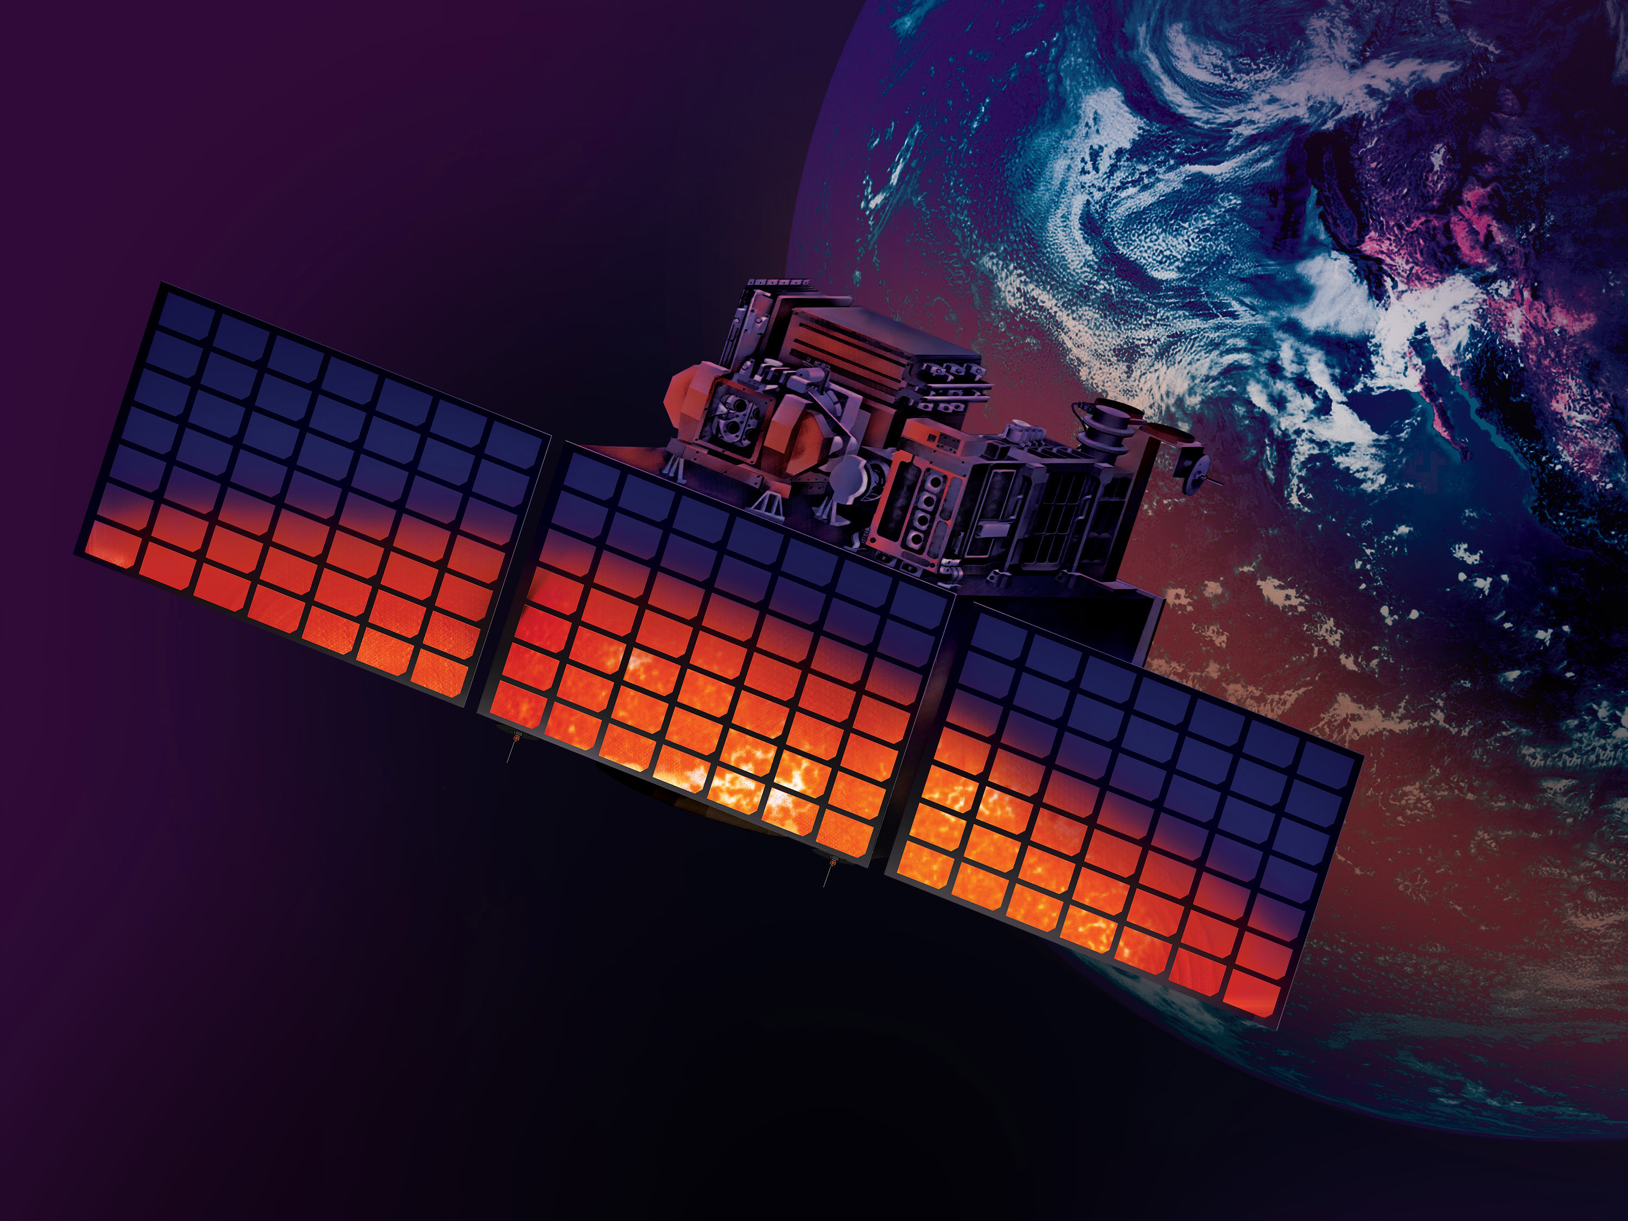
The TSIS-2 Mission
Susan Breon, Ron Hooker, Doug Rabin, Ronnice Wedge, Dong Wu
NASA Goddard Space Flight Center

Slide 2
TSIS-2 Mission Objectives
Acquire total solar irradiance (TSI) and spectral solar irradiance (SSI) measurements to determine the direct and indirect effects of solar radiation on climate
Extend a more than 40-year uninterrupted measurement record of TSI beyond ISS/TSIS-1
  Maintaining solar irradiance data continuity is one of the “Most Important” objectives in the 2017 Decadal Survey.
  Overlapping TSIS-2 with TSIS-1 is a high priority in NASA Earth Science Division mission development.
Provide accurate SSI measurements for better understanding of wavelength-dependent solar energy deposition in Earth’s atmosphere and surface

Slide 3
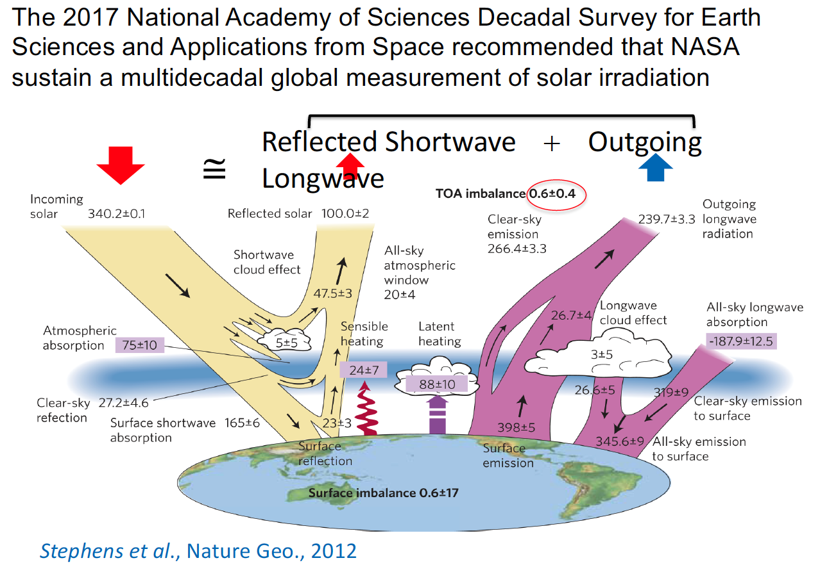
Global Energy Budget

Slide 4
How Much Does TSI Vary?
Large uncertainty remains in ﻿the reconstructed total solar irradiance (TSI) for quiet Sun back in the Maunder Minimum;
Variations could give significant changes to solar power input to Earth’s climate;
﻿Good consensus found between TSI observations since 1995 supports ﻿higher stability of the Total Irradiance Monitor (TIM) data.
Maunder
Minimum
0.5%
Lockwood and Ball (2020)
Notes:
dmr: I would make the verbal point that the lack of agreement between models highlights the importance of uninterrupted climate-quality measurements.

Slide 5
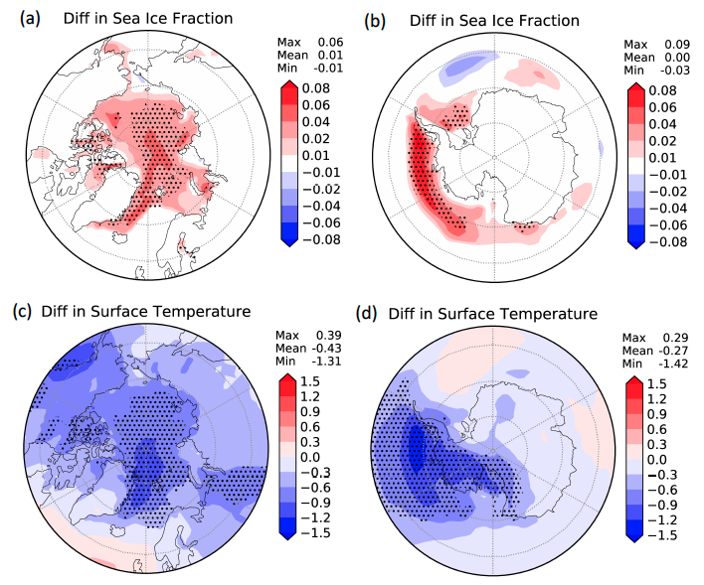
SSI Impact on Arctic Sea Ice
Arctic sea ice absorbs more solar radiation in near infrared (NIR) wavelengths than in visible (VIS) wavelengths => Importance of SSI distribution in wavelength
Method: The recent TSIS-1 mission has provided more accurate SSI observations than before. The SSI difference in a given VIS or NIR band can be as large as 4 W m^{–2}.
Impact: The results show that, due to different spectral reflectance of sea ice and water surfaces in the VIS and NIR, the set of simulation with more SSI in the VIS has less solar absorption by the high-latitude surfaces, ending up with colder polar surface temperature and larger sea ice coverage.

Slide 6
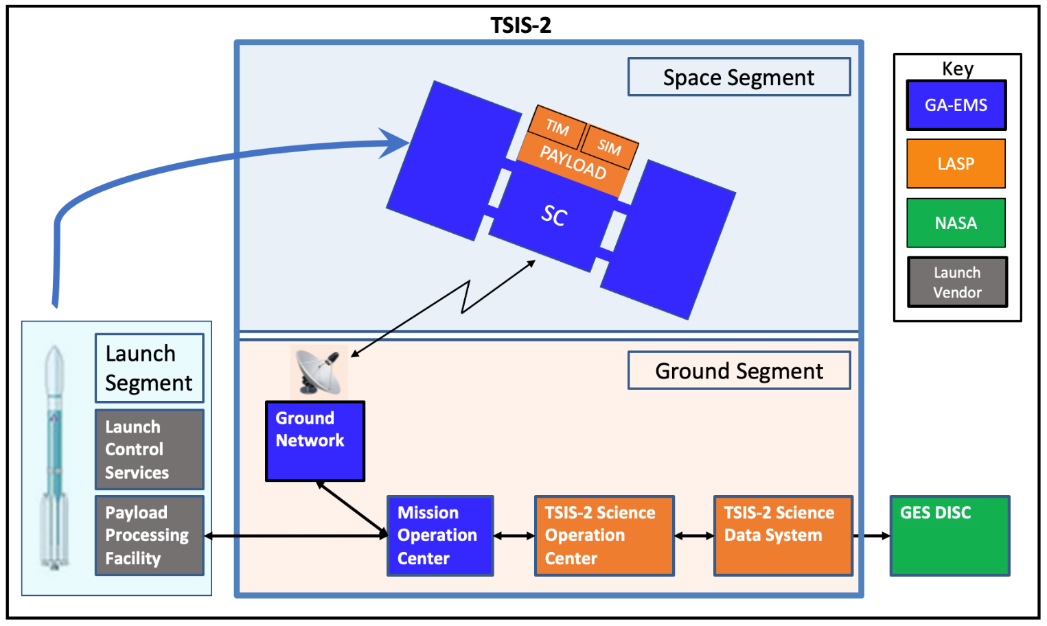
Mission Concept/Overview
Lessons learned from SORCE and TSIS-1 missions
Stand-alone spacecraft in LEO for solar irradiance observations
Same TSI and SSI measurement quality as TSIS-1
3-year mission lifetime

Slide 7
Level 1 Science Requirements
Provide continuity of TSI measurements and maximize the chance of overlap and intercomparison with existing on-orbit climate sensors
  TSI requires 3-month minimum overlap with TSIS-1 with a goal of 6 months
  SSI requires 6-month minimum overlap with TSIS-1 with a goal of 12 months
Put all measurements that make up the record on the same calibration scale
Parameter | TSI Requirement |  | SSI Requirement
 | Baseline | Threshold | Baseline | Threshold
Spectral Range | Total Integrated Spectrum |  | 200 – 2400 nm
Accuracy | ≤200 ppm | ≤350 ppm | ≤1.0% (200 – 400 nm) ≤0.5% (>400 nm) | ≤1.0% (over full spectral range)
Stability | ≤10 ppm/yr | ≤20 ppm/yr | ≤0.05%/yr (<400 nm) ≤0.01%/yr (>400 nm) | ≤0.1%/yr (<400 nm) ≤0.02%/yr (>400 nm)
Spectral Resolution | Not Applicable |  | ≤2 nm (<280 nm) ≤5 nm (280 – 400 nm) ≤45 nm (>400 nm)
Reporting Frequency | 4 six-hourly averages per day |  | 2 spectra per day, sampled every 12 hours
NOTE: 1 ppm – 0.0001%

Slide 8
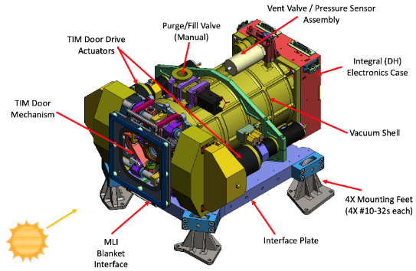
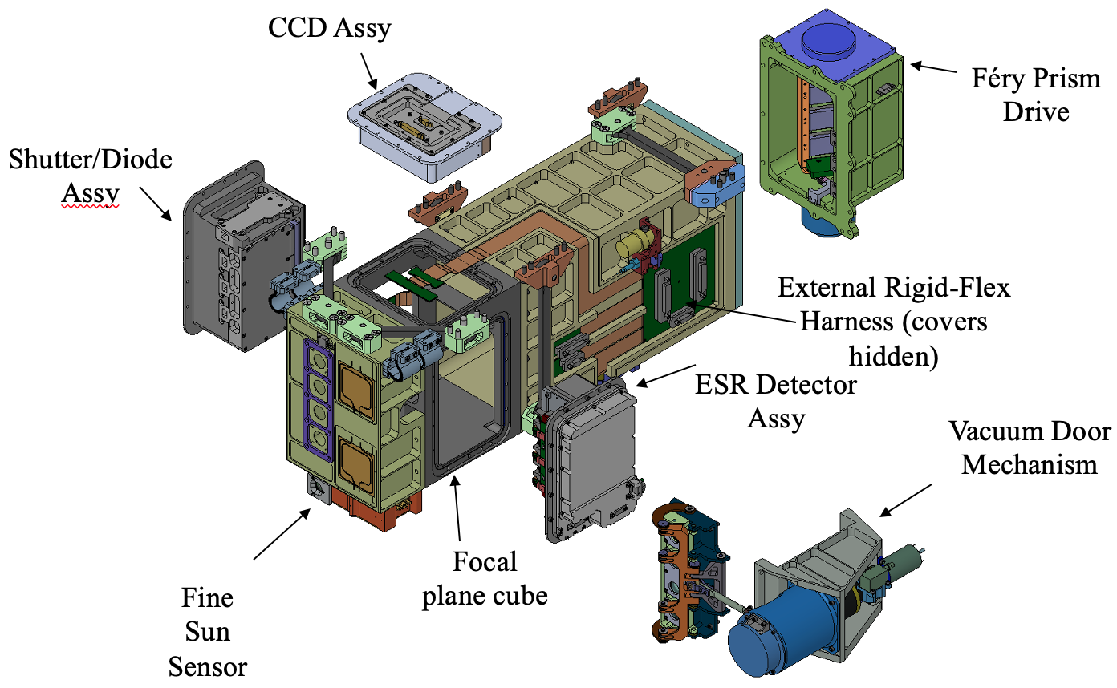

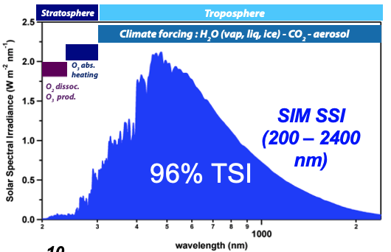
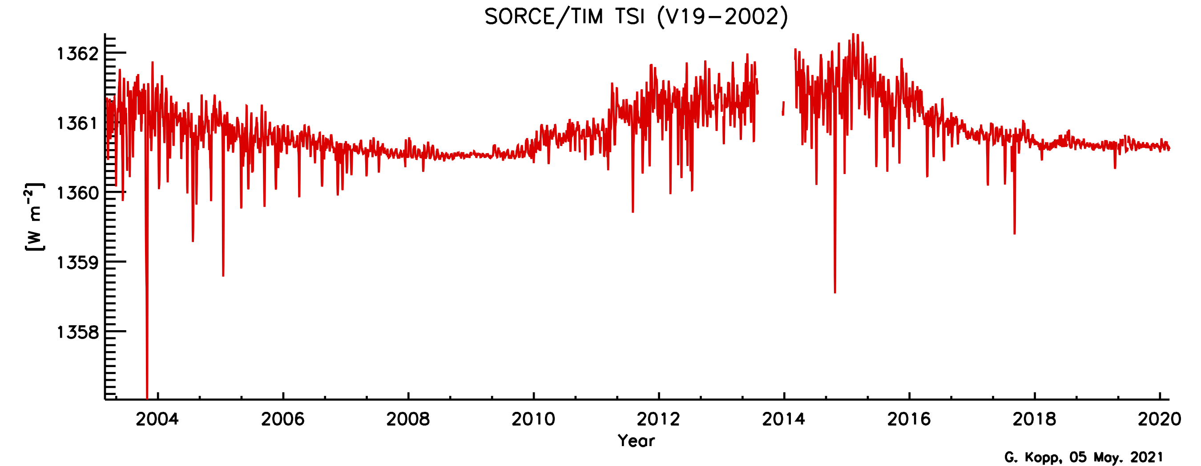
Payload
Total Irradiance Monitor (TIM)
TSI is Earth’s predominant energy source
TSIS-2 TIM will extend a 40-plus year uninterrupted measurement record of TSI
Spectral Irradiance Monitor (SIM)
High accuracy solar irradiance spectra for radiative transfer applications in climate research enables more realistic climate model simulations.

Slide 9

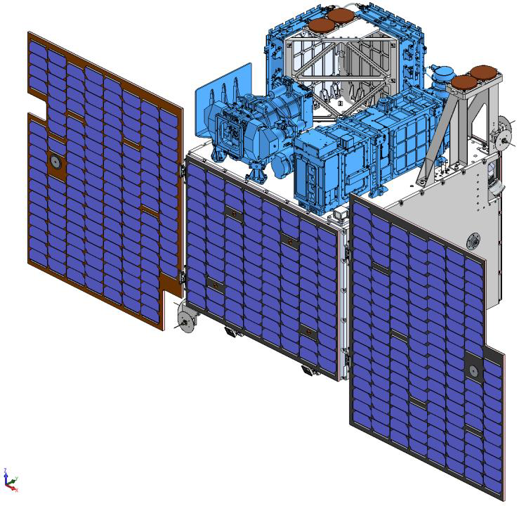
Observatory
Instrument Electronics
Instruments and instrument electronics are mounted on +Z deck of the spacecraft
Spacecraft Key Features
3-axis stabilized attitude control
  Actuators: Reaction wheels, magnetorquers
  Sensors: Star Trackers, Sun Sensors, Magnetometers, Gyros
S-Band Communications
Power generated by 4 solar panels
  2 deployable
  2 body mounted (1 for tumble only)
Passive and active thermal control
Payload, battery, and –z deck heaters
No propulsion
TIM Instrument
Spacecraft
SIM Instrument

Slide 10
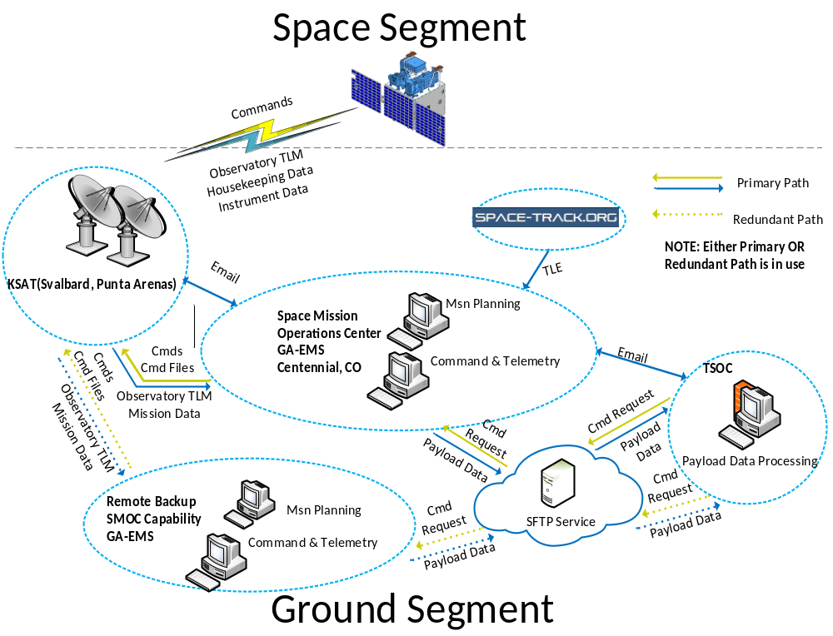
Ground System

Slide 11
Nominal Operations
Sun/Dark Pointing for Day-to-Day Operations
  Tracking the sun for payload observations when in sunlight
  Pointing to dark space for dark field calibration when in eclipse (or once per orbit if no eclipse conditions exist)
    Instruments pointed anti-velocity direction
Intermittent Payload Calibrations
  Cruciform Calibration for SIM and Field of View Map for TIM
  Sensor calibrations occur every 6 months
    Step and stare processes over several orbits
Transition to Safe Mode When Necessary
  Power and thermally safe Y-Thomson spin when a component fails or out of limit condition is triggered

Slide 12
TSIS-2 Status
Planned working launch date Aug. 2024
Laboratory for Atmospheric and Space Physics (LASP)
  SIM is fully integrated and has begun calibration testing
  TIM assembly is nearing completion
  TSIS-2 Science Operations Center (TSOC) and and TSIS-2 Science Data Center (TSDS) updates from TSIS-1 are on-going
General Atomics (GA)
  Spacecraft and Ground System CDR completed Apr. 2022
  All major subcontracts are in place
    Avionics—Surrey Satellite Technology, Ltd.
    Solar Arrays—Sierra Nevada Corp.
    Battery—Saft America
    Ground Station—Kongsberg Satellite Services (KSAT)
Launch Vehicle
  To be procured by Kennedy Space Center

