Slide 1
100 mN Green Monopropellant ASCENT Thruster Development
Tomas Hasanof, Tim McKechnie, Michael Zaluki, Mckenzie Kilcoin
Plasma Processes, Huntsville, AL, USA
Daniel Cavender
NASA Marshall Space Flight Center, Huntsville, AL, USA
Space Propulsion, Estoril, Portugal, 09-13 MAY 2022

Slide 2
Introduction
Green Monopropellants
Market Potential
100 mN Thruster Development History
Conclusions
Acknowledgement
Questions

Slide 3
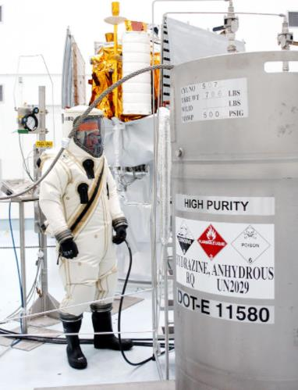
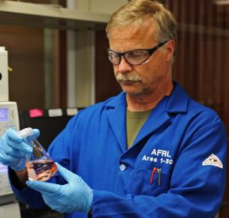
Green Monopropellants
Three main monopropellants
  Hydrazine (Not “green”; Highly toxic!)
  LMP-103S (Developed by ECAPS, Sweden)
  ASCENT, AKA AF-M315E (Developed by AFRL)
    Low hazard, Safe to handle, Storable, Low toxicity
Other green propellants
  Hydrogen Peroxide
  Nitrous Oxide
Fueling Hydrazine
Image credit: NASA
“A Green Alternative to Hydrazine” Image credit: Courtesy Photo

Slide 4
Green Monopropellants
Challenges
  High decomposition temperatures and aggressive combustion products
  Catalyst high-temperature sintering and loss of surface area
  Thermo-mechanical; Survive continuous injection of 20 ºC propellant decomposing and creating temperatures as high as 1850 ºC in the reactor
Benefits
  Low-hazard, Storable, Safe to handle, Low toxicity
  High performance (1.5 x Hydrazine)
  Reducing overall costs

Slide 5
Market Potential
ASCENT Propellant Technology
  Storable, Safe to handle, Low-toxicity, Low-hazard
    Significantly reduces loading costs, transportation costs, overall handling costs
    ASCENT Catalyst increases mission lifetime and mission capability
Properties | Hydrazine | LMP-103S | ASCENT
Density (g/cm³) | 1.00 | 1.24 | 1.47
Theoretical Isp | 236 sec | 252 sec | 272 sec
Practical Isp | 216 sec | 231 sec | 251 sec
Volumetric Isp | 236 sec | 312 sec | 391 sec
Thruster | Thrust (N) | Isp (sec) | Power (W)
ECAPS, 0.1 N | 0.03 – 0.10 | 196 - 209 | 6.3 – 8.0
Busek, 0.5 N | 0.5 | 220 - 225 | 20
PLASMA, 0.1 N | 0.03 – 0.22 | 200 - 235 | 7.0 – 9.0
Commercially Available Small Liquid Green Monopropellant Thrusters
Comparisons on Propellant Density

Slide 6
100 mN Thruster Development
Thruster Design Sequence
  Phase I – Concept, spec., draft drawings, analyze, build and test (TRL-2 to TRL-4)
  Phase II – Build and test of test reactor and prototype flight design thruster (TRL-4 to TRL-6)
  Phase II-E (Extension) – Refine thruster design and perform in-depth environmental and hot fire testing (TRL-6)
  Phase III – Qualification testing of thrusters and building of deliverable flight thrusters (TRL-6 to TRL-8)

Slide 7
100 mN Thruster Development
NASA SBIR Phase I (Typically 6 months)
  Mainly theoretical work
  Key practical work performed (flow tests and some initial hot fire tests)
100 mN Feed Tube Flow Tests
100 mN Phase I Prototype Thruster

Slide 8
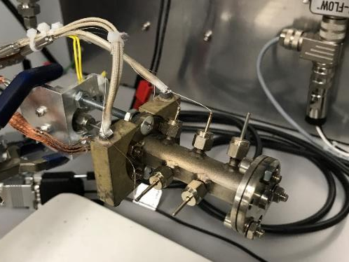
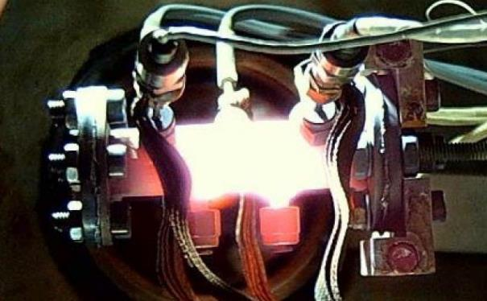
100 mN Thruster Development
NASA SBIR Phase II (Typically 24 months)
  Test Reactor Hot Fire Testing (fully instrumented, 7 ports)
    Determine reactor bed configuration
    Obtain axial temperature profiles
    Upstream and downstream pressures
ASCENT Test Reactor
ASCENT Test Reactor during Hot Fire Tests

Slide 9
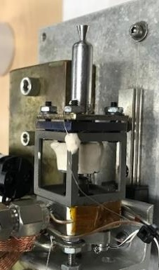
100 mN Thruster Development
NASA SBIR Phase II (Contd.)
  Prototype Thruster from Phase I modified and hot fire tested
    Flight-proven thrust chamber, injector and heater assembly
    Flight-like catalyst bed
    Poor thermal and structural design but used to verify catalyst bed configuration
100 mN Phase II Prototype Thruster
100 mN Phase II Prototype Thruster during Hot Fire Testing

Slide 10
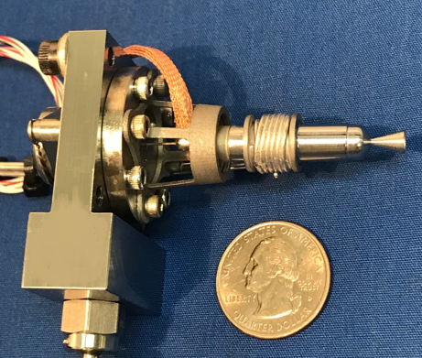
100 mN Thruster Development
NASA SBIR Phase II-E (12 months)
  Improved Thruster from Phase II
  Flight prototype design using some AM parts
  Good thermal and structural design
100 mN Phase II-E Thruster
100 mN Phase II-E Thruster during Hot Fire Testing

Slide 11
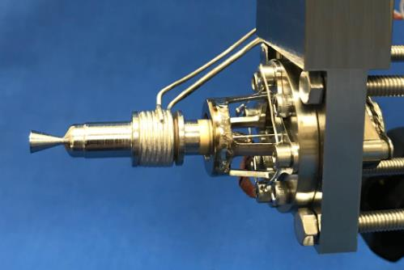
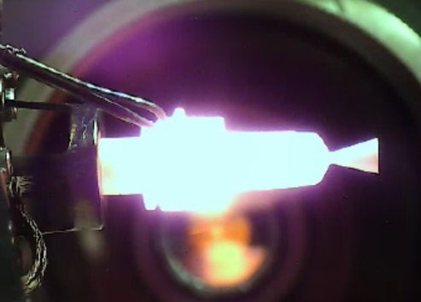
100 mN Thruster Development
NASA SBIR Phase III (12 months)
  Improved Thruster from Phase II-E
  Optimized catalyst and thermal standoff
  Flight thermal and structural design
Phase III 100 mN Flight Thruster
Phase III 100 mN Flight Thruster during Hot Fire Testing

Slide 12
100 mN Thruster Development
NASA SBIR Phase III (Qualification Tests)
  Qualification program performed together with NASA MSFC
  Two qualification articles, QA-1 and QA-2
    Based on the Lunar Flashlight mission profile
    QA-1 – Extensive Hot Fire Testing
    QA-2 – Environmental Tests and Hot Fire Testing
  Qualification of QA-1 took eight days in total
    NASA LFPS Mission Requirements
      Pulses: 5308, Throughput: 285 g
    Qualification Requirements
      Pulses: 8186, Throughput: 530 g

Slide 13
100 mN Thruster Development
NASA SBIR Phase III (Qualification Tests)
  Qualification Hot Fire Test Data
Properties | Requirement | QA-1 | QA-2
Thrust Level | 90 – 110 mN | 95 - 105 mN | 95 – 105 mN
Steady State Isp | > 190 sec | 210 sec | 205 sec
Pulse Mode Isp | > 190 sec | 200 sec | 205 sec
Minimum Impulse Bit | < 5 mNs | N/A | 3.6 mNs
Propellant Throughput | 530 g | 1242 g | 691 g
Accumulated Burn Time | 2.6 h | 6.2 h | 3.5 h
Longest Burn Duration | N/A | 101 min | 60 sec
Heater Power | < 10 W | 9 W | 9 W
Accumulated Pulses | 8186 | 18244 | 17058

Slide 14
100 mN Thruster Development
NASA SBIR Phase III (Qualification Tests)
  30 sec “Health Check” pulses fired every day during qual.
30 sec “Health Check” pulses
30 sec pulse @ nominal feed pressure

Slide 15
100 mN Thruster Development
NASA SBIR Phase III (Qualification Tests)
  50% Duty Cycle firing (500 ms ON – 500 ms OFF)
100 mN Flight Thruster during Hot Fire Tests
50% Duty Cycle Firing @ nominal feed pressure

Slide 16
100 mN Thruster Development
NASA Lunar Flashlight Mission
  To be launched on a SpaceX Falcon 9 in mid-late 2022
Lunar Flashlight Propulsion Module
(Image credit: NASA MSFC and Georgia Tech)
Lunar Flashlight Spacecraft
(Image credit: NASA MSFC and Georgia Tech)

Slide 17
100 mN Thruster Development
PLASMA and NASA MSFC performed all testing together
Properties | Flight Thruster Range (Demonstrated) | Comments
Thrust Level | 30 – 220 mN | Feed pressure range: 3 – 24 bar A
Steady State Isp | 200 – 235 sec | Depending on feed pressure
Pulse Mode Isp | 190 – 210 sec | Depending on feed pressure and duty cycle
Minimum Impulse Bit | 0.5 mNs | Using rapid valve with low dribble-volume
Propellant Throughput | > 1242 g | NASA to fund additional testing to reach 2.5 kg in total
Accumulated Burn Time | > 6.2 h | Thruster is still fully nominal with no degradation in performance
Longest Burn Duration | > 101 min | Ran out of propellant
Heater Power | 7 – 9 W | Nominal pre-heat temp is reached using 7 W, but it takes 30 min. 9 W enables the thruster to be fired in less than 7 minutes
Accumulated Pulses | > 18244 | Both QA-1 and QA-2 will continue to be hot fire tested
100 mN ASCENT Thruster Development Program | N/A | Duration: 4 years, Total propellant throughput: 4.9 kg, Accumulated burn time: 22 h, Total # pulses: 75076

Slide 18
Conclusions
100 mN ASCENT Thruster developed in only four years
First commercially available liquid green ASCENT monopropellant thruster
Qualification thrusters QA-1 and QA-2 broke all records and are still operating nominally with no signs of performance degradation!
Thruster design capable of wide range of feed pressures, enabling thrust levels of 30 mN to 220 mN
Continued testing needed to find lifetime and limitations of the 100 mN design

Slide 19



Acknowledgements
Plasma Processes would like to express our deepest appreciation and recognition to the following organizations for their support in making this thruster development possible in the short amount of time available
NASA MSFC, Huntsville, AL
AFRL/USSF, Edwards AFB, CA

Slide 20
Questions
Questions?

