Slide 1
Post-ISS LEO Ecosystem
Dr. Erica Rodgers
Office of Technology, Policy, and Strategy (OTPS)
Briefing to the National Academies
May 16, 2022

Slide 2
Meeting Agenda
Welcome and Introductions
Presentation on the LEO Study
5 Minute Break
Question 1: Briefings from Participants
Lunch (45 minutes)
Question 2: Briefings from Participants
Close
2

Slide 3
Presentation Outline
OTPS Introduction
Study Goals
Methodology
Meeting Objectives
NASA Role Post-ISS
Models
Scenarios and Activities
Analysis and Preliminary Outlook
3

Slide 4
Office of Technology, Policy, and
Strategy (OTPS) Stakeholders
Office of the Administrator
NASA
Centers
Administrator,
Deputy Administrator,
Associate Administrator
NASA
Mission Directorates
External Stakeholders
(e.g., White House Councils, Interagency Working Groups, Other Government Agencies)
Office of Technology, Policy, Strategy
Associate Administrator
Deputy Associate Administrator,
Agency Chief Technologist,
Center Chief Technologists, OTPS Team
Other Offices
Other Liaisons
4

Slide 5
OTPS Priorities
Support NASA’s strategic planning
Interface with external organizations at a political/strategic level
Perform data driven, rigorous analysis as requested by NASA leadership
Conduct economic and landscape assessments – of the space sector
Maintain deep knowledge to support NASA and its role in the broader space sector
Year 1 Strategic Priorities
Focus areas will evolve with Agency and senior leadership needs and priorities
Focus Area 1:
Moon to Mars
Focus Area 2:
Space Infrastructure and Logistics
Focus Area 3:
Sustainability
Focus Area 4:
Future of NASA and Other Areas
Every activity has technology, innovation, policy, and strategy components
5

Slide 6
OTPS Study Goals
This study will help inform NASA planning for a post-ISS future
What activities in LEO will remain critical for NASA and the Nation?
How do these activities change given the larger LEO ecosystem context?
Within this context how does NASA identify, prioritize, and support critical activities? (Inclusive of both ISS National Lab and NASA current activities.)
Study Questions:
Given the context of LEO activity in 2030s, what variety and to what degree should NASA support LEO activities?
What engagement models best enable these activities while helping NASA achieve its goals?
6

Slide 7
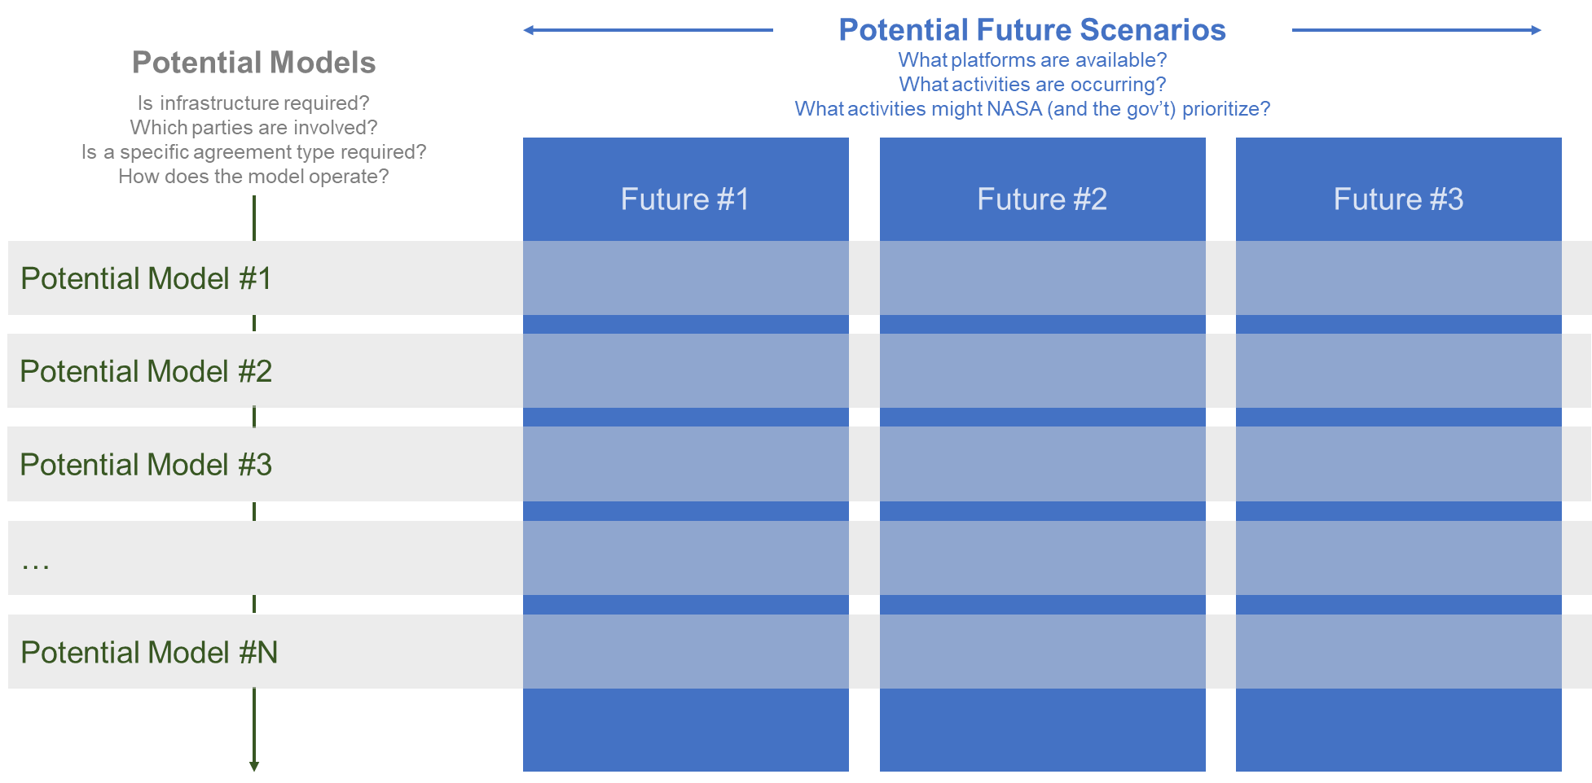
Project Plan and Methodology
Pre-Planning
Stakeholder Feedback: Phase I
National Academies (May 16th)
Stakeholder Feedback: Phase II
Data Integration
Final Deliverable
39 discussions to date (8 industry, 5+ASGSR academia/science, 13 NASA, 13 OGA)
7

Slide 8
National Academies Meeting Objectives
Key topics for National Academies Meeting:
What mechanisms, models, or combinations have you seen work well in supporting national objectives (research, exploration, economic growth, international cooperation)? We describe 6 representative models (slides 12 and 22-27), are there others we should be considering?
Do the model evaluation criteria (slide 17) appropriately characterize aspects that you find important? Are there additional criteria we should consider? What criterion is most relevant to your organization post-2030?
Mechanism: Approach or process to connect users with suppliers
Model: Collection of mechanisms and related organizational process and infrastructure that acts as government touchpoint in LEO ecosystem
Your feedback will provide critical context for this study and will help inform findings and recommendations.
8

Slide 9
NASA’s Role Post-ISS: What We Heard
Engaged individuals within stakeholder communities (NASA, other U.S. gov agencies (OGAs), industry, academia/science, international)
Roles for NASA were as diverse as stakeholders
we spoke with
Focused on:
  Create and share knowledge
  Demonstrate technology
  Springboard for Moon2Mars
  Foster economic growth
  Maintain and build relationships
Diplomacy
Knock down barriers
Pioneer, do things differently
Certification
Fund/perform research
Be a reliable customer
Help develop standards
Inspire
Ensure safety
Provide transparent data
Convener/consolidate activities
Continuity
Enable markets
Reduce risk
Permeate all facets of LEO
Reduce costs
9

Slide 10
Methodology Step 1: Models
Potential Future Scenarios
What platforms are available?
What activities are occurring?
What activities might NASA (and the gov’t) prioritize?
Potential Models
Is infrastructure required?
Which parties are involved?
Is a specific agreement type required?
How does the model operate?
Future #1
Future #2
Future #3
Potential Model #1
What models can enable LEO activities post-ISS?
What mechanisms are favored for research and micro-gravity activities?
What characteristics matter for a model?
Potential Model #2
Potential Model #3
…
Potential Model #6
10

Slide 11
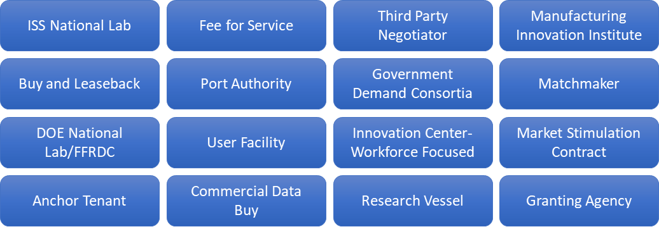
Model Trade Space & Characteristics
Distilled 16 unique approaches from discussion with stakeholders and literature reviews
Identified key characteristics
Infrastructure – What platforms, equipment, or systems are required?
Parties Involved – Who owns/operates, NASA’s role, other stakeholders included
Process – How it works, authorities needed, and supply/demand considerations
Agreement – Agreement type, length, level of NASA commitment
Consolidated to 6 representative models that allow for a robust trade space aligned with scenarios and activities
Comprehensive model (apples to apples)
No government-owned in-space platforms
NASA presence
Doesn't compete with commercial
11

Slide 12
Representative Models and Edge Cases
Model | Discriminator | Description
ISSNL (Baseline/Edge Case) | Reflects current operations | Third party agreement to manage 50% of ISS activities for national good. Like 3rd party models and a traditional FFRDC model, but with unique limitations.
1. Anchor Tenant | Long-term agreement | Long term financial relationship to lease space on/access to a commercial platform. Government percentage varies with estimates <30%-90%.
2. Research Vessel | Reconfigurable sorties | Assumes an M&O model like DOE Nat. Labs but applied to vessel launched from Earth. Vessel can be reconfigured for specific users (gov, academia, commercial).
3. Institute Network | Connecting related efforts | Gov-sponsored consortia of distinct but related efforts within LEO and terrestrially (e.g., Manufacturing USA.). Focus is on scaling and maintaining leadership.
4. Matchmaker/3rd Party | Targeted connections between users and supply | Matchmaker (an external party or program office) that helps match specific users to LEO opportunities. As appropriate provides recommendations to both sides.
5. Campus | Maintains skillsets and workforce | A terrestrial campus as a loadstone for microgravity research and operations. Maintains critical skills and promotes innovation within the capabilities of the ecosystem.
6. Grants and Data Buys | Leverages government research engine | A program office leveraging robust research funding mechanisms to support grants for niche research and commercial data buys to continue ISS datasets.
Fee-for-Service (Edge Case) | 100% transactional | A 100% commercial economy with commodity prices for most services and standard contracting pathways for niche services. Credit Card purchase model.
*For detailed models please see backup slides
12

Slide 13
Methodology Step 2: Scenarios
Potential Future Scenarios
What platforms are available?
What activities are occurring?
What activities might NASA (and the gov’t) prioritize?
Potential Models
Is infrastructure required?
Which parties are involved?
Is a specific agreement type required?
How does the model operate?
Future #1
Future #2
Future #3
Potential Model #1
Potential Model #2
What is the range of futures?
How does NASA’s priorities change?
What activities are important in each future scenario?
Potential Model #3
…
Potential Model #N
13

Slide 14




Potential Future Scenarios
Dynamic Growth
Steady State
Limited Growth
Successful commercial markets spur innovation and capital investment. Characterized by:
Diversified commercial services
Influx of venture capital
Dynamic "iPhone-like" tech refresh cycle
Complex, difficult to navigate unaided
Assumes a single commercial platform as the LEO center of gravity. Characterized by:
Prioritization of limited space
Some organic commercial market development
Common focus across stakeholder groups
Lack mature commercial platforms due to low demand or market disruption. Characterized by:
Single CLD in development with NASA monopsony
Most activities limited to short duration flights
High cost to close NASA gaps
Fractionated opportunities across orbital, suborbital, and analogs
Periodic Orbital Free Flyers and Multiple Commercial Platforms
Periodic Orbital Free Flyers and a Primary Commercial Platform
Periodic Orbital Free Flyers
Commercially available services increase with ecosystem growth
14

Slide 15
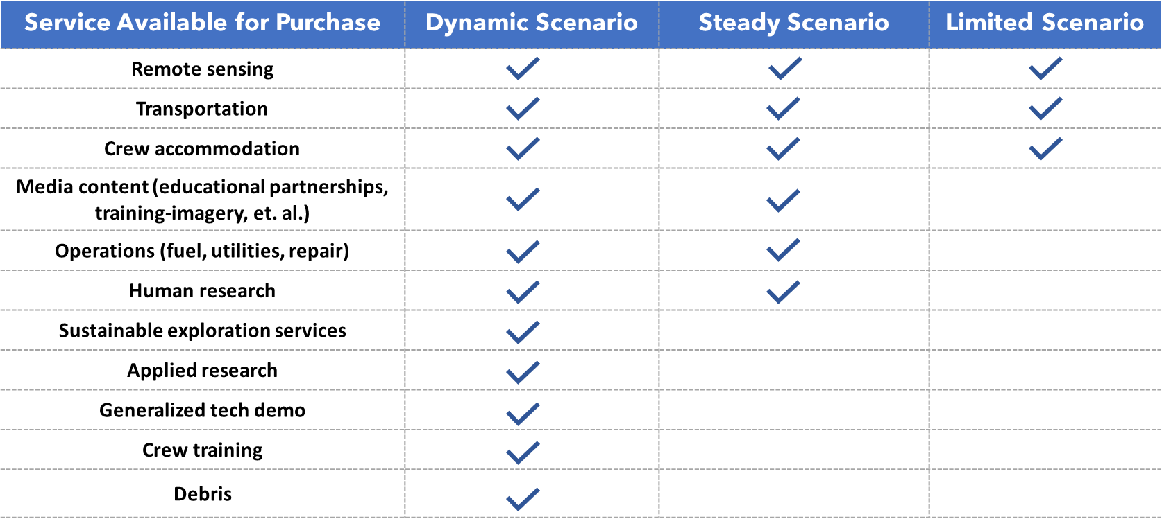
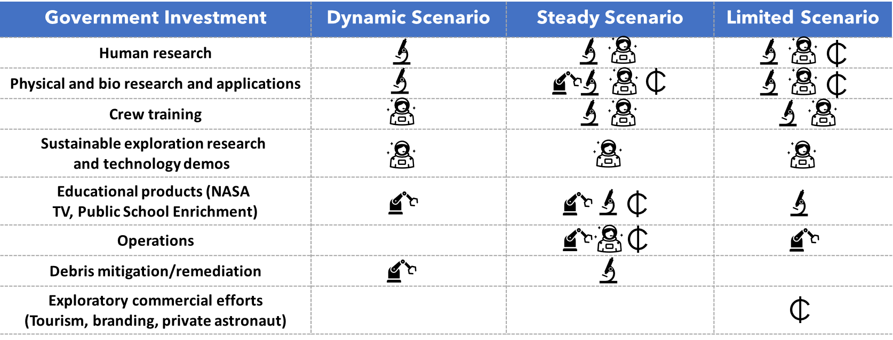
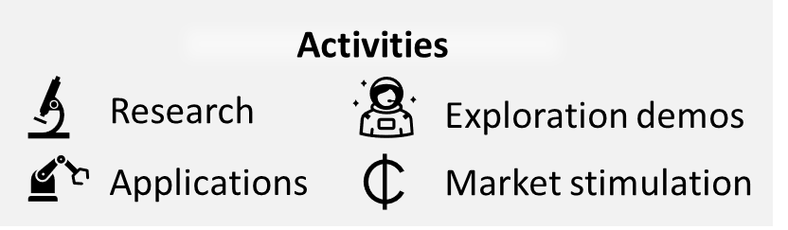
Future Scenarios Impact Government Priorities
The types of activities NASA and OGA support
in LEO change with the envisioned future scenarios
  Generally, commercially available services increase
  with ecosystem growth
  Each scenario includes details that
  impact (increase/decrease) activity
  importance to NASA and stakeholders:
    Market stimulation is a higher
    priority when markets are maturing
    New commercial services allow
    NASA to invest in niche applications
    Some activities (e.g. crew-training
    or systems demonstration) remain
    split between commercial services and government investment
We consider the mixture of activities within each scenario when
evaluating models
Preliminary
15

Slide 16
Methodology Step 3: Analysis
Potential Future Scenarios
What platforms are available?
What activities are occurring?
What activities might NASA (and the gov’t) prioritize?
Potential Models
Is infrastructure required?
Which parties are involved?
Is a specific agreement type required?
How does the model operate?
Future #1
Future #2
Future #3
Potential Model #1
How does each model perform within the context of each scenario?
What are the sensitivities?
What are the pros and cons?
Potential Model #2
Potential Model #3
…
Potential Model #6
16
Notes:
What’s in and what’s out, what’s in gray area,
In – NASA, OGA, university, and research
Out – purely commercial, filmmaking, tourism
Gray – incubation, accelerators, spur of market
PRESENTED BY GRACE

Slide 17
Assessing Models
How does each model perform within the context of each scenario?
Key model evaluation criteria
  Infrastructure capability
  User experience
  Ease of access
  Flexibility and scalability
  Priority activities
  Encourages market growth
Performance assessed based on model characteristics and feedback from user community
17

Slide 18

Preliminary* Model Outlook Across Scenarios
*Evaluation of criteria based on initial data and feedback
Model | Dynamic Scenario | Steady Scenario | Limited Scenario
Anchor Tenant
Research Vessel
Institute Network
Matchmaker/3rd Party
Campus
Grants and Data Buys
NA
DRAFT
NA
NA
Preliminary
Number indicates general suitability as a composite of model criteria.
(Inclusive of coverage of activities, user group participation/experience, and flexibility/scalability)
Increasing Value
18

Slide 19
Your Opportunity for Feedback
Are there any questions?
Balance of the meeting focused
on getting your input
  Opportunity for a vector check
  Topic 1: Understanding successful
  models and mechanisms
  Topic 2: Analysis criteria—are we
  looking at the factors that matter to
  you?
Thank you, this study is not possible without your help!
Key topics for National Academies Meeting:
What mechanisms or models have you seen work well in supporting national objectives (research, exploration, economic growth, international cooperation)? We describe 6 representative models, are there others we should be considering?
Do the model evaluation criteria appropriately characterize aspects that you find important? Are there additional criteria we should consider? What criterion is most relevant to your organization post-2030?
19

Slide 20
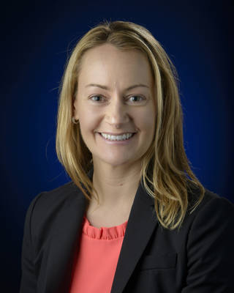
Thank you!
Questions, Comments, Feedback
Dr. Erica Rodgers
NASA, OTPS
Email: erica.m.rodgers@nasa.gov
Phone: 202.358.0063
https://www.nasa.gov/offices/otps/home/index.html
20

Slide 21
Backup

Slide 22




Model 1: Anchor Tenant
Assumed Infrastructure
Privately owned, NASA is major (potential primary) long-term customer
NASA may own equipment or hosted facilities, but does not own platforms
Assumes NASA is anchor tenant on only one platform
Pros
Encourages/supports market growth
Provides a dedicated LEO platform
Aligns well to user group needs
Parties Involved
Owned and operated by industry, who leases space to users
NASA program office coordinates user community activities
NASA contract considers demand from international partners
Cons
Relatively inflexible requirements
Not optimal for scalability
Scenario driven performance (steady)
Process
NASA prioritizes activities within the bounds of their agreement with CLD
New users contact NASA program office for access to NASA segment
Platform owner has final authority on standards and requirements
Preliminary evaluation of criteria based on initial data and feedback
Agreements
Government contract requiring long-term NASA commitment
Program office selects activities through proposals and top-down selection
Flexible within anchor tenancy, inflexible and does not scale beyond
22

Slide 23
Model 2: Research Vessel
Assumed Infrastructure
Research vessel with reconfigurable facilities and instrumentation
Assumes privately or university owned, potentially with gov assistance
Enables tailored sorties, does not involve permanent LEO hardware
Pros
Offers versatile capability options
Customizable user experience
Robust capability in limited future
Parties Involved
Ownership and operations could be one or multiple parties
Vessel owner has decision authority, may delegate to operations
Offers stakeholders tailored services, or lease model (assume some tailoring)
Assumes NASA leverages an advisory board across user communities
Cons
Limited ability to grow with ecosystem
Lacks continued LEO presence
Model leans toward research
Process
Flights funded through separate process (research grants, private funds)
Vessel operator works with user to tailor mission/terms of flight
For NASA funding, NASA sets requirements and coordinates user/operator
Potential for long-term lease to NASA
Preliminary evaluation of criteria based on initial data and feedback
Agreements
Long-term lease assumes a Management and Operations (M&O) model (DOE National Labs), otherwise tailored contracts
23

Slide 24
Model 3: Institute Network
Assumed Infrastructure
Network of related institutes provides facilities, hardware, or infrastructure
Network enables collaborative use of these facilities (both LEO and Earth)
Pros
Encourages market growth
Flexible option in a robust ecosystem
Platform agnostic/simultaneous activities
Parties Involved
A network of institutes, individually managed with multiple users
Assumes a nonprofit or consortium that forms a public-private partnership (PPP) to promote collaboration
May include co-investment from industry, universities, and government
Focused on building commercial/industrial base capability critical to US
Process
NASA/Gov consortium decides to fund newly created institutes
NASA (+ stakeholders) guide activities through institute selection
Could include hosted modules, independent CLDs, or terrestrial options
Users access network through topic related institutes
Cons
Requires a thriving market
Success driven by commercial users
Dependent on user participation
Agreements
New institutes solicited by Requests for Application and funded through cooperative agreements
Applications guarantee co-investment of private funding
Institutes have day-to-day management of activities
Preliminary evaluation of criteria based on initial data and feedback
24

Slide 25
Model 4: Matchmaker/Third Party
Assumed Infrastructure
Assumes commercial facilities, hardware, or infrastructure are available
Matchmaker manages process, no direct connection to infrastructure
Pros
Clearly connects supply to demand
Visible point of entry for new users
Streamlines process for all users
Adapts to changing ecosystem
Parties Involved
Although could be NASA office, model assume third party serves as an intermediary between government and user communities
Matchmaker connects users to best possible services
Acts as aggregator across user communities/clear demand signal
Nonprofit coordinates research activities, facilitates tech transfer/ fosters emerging companies, and supports multi-agency programs
Cons
Limited strategic oversight
Completely reliant on capabilities of the market
Process
Users approach matchmaker with an idea or need
Matchmaker provides expertise/supports user-supplier coordination
Adjusts activities based on ecosystem, available services, demand
In some cases, provides a mechanism to negotiate on behalf of gov
Preliminary evaluation of criteria based on initial data and feedback
Agreements
Involves flexible contracting mechanisms and other agreement types
May require MOUs or Congressional designation if negotiating on behalf of aggerated government demand or fostering emerging companies
25

Slide 26
Model 5: Innovation Campus – Workforce
Assumed Infrastructure
Assumes a terrestrial innovation center/campus/lab that attracts and aggregates a skilled workforce (likely from a university)
Pros
Supports diverse users/ideas
Easy point of entry/user satisfaction
Supports LEO activities through STEM education and skilled workforce
Provides tangible presence across all scenarios
Parties Involved
Government sponsor owns the center and may delegate day-to-day operations to a third-party (e.g., university, contractor, nonprofit)
Stakeholders contribute via academic exchanges and partnerships
Provides expertise to users looking to develop a LEO mission
Acts as innovation center for NASA with focus on in-space operations
Process
Activities and day-to-day management through center leadership
NASA provides strategic priorities and funds specialized divisions
Open door policy for gov, commercial, and international users
Provides support through design and development, leverages commercial services for flight
Cons
No direct connection to supply/flight opportunities
Shifts focus to terrestrial activities
Agreements
Overarching agreement for center management (likely M&O)
Individualized agreements (SAA, CRADA, contracts) for user engagements
Preliminary evaluation of criteria based on initial data and feedback
26

Slide 27
Model 6: Grants and Data Buys
Assumed Infrastructure
Assumes commercial facilities, hardware, or infrastructure are available
Funding mechanism for activities, no direct connection to infrastructure
Pros
Does not require infrastructure
Provides demand signal to industry
Offers flexibility based on changing NASA needs
Parties Involved
Stakeholders provide indirect input (decadal, advisory groups, et al.)
NASA contracts with commercial firms to purchase data with broad utility (human research and technology performance)
Uses grants for niche research/development (NASA only, or NASA/other government/International)
Cons
Limited by NASA budget
Bureaucratic process (not streamlined)
Indirect alignment to user communities
Limited focus on commercialization
Process
NASA gathers user community input and agency priorities to guide proposal/RFQ topics
Researchers and commercial firms propose directly to NASA
Data buy provide demand signal and leverage ecosystem activity
Agreements
Agreements available in the form of research grants or contract awards
Complex interagency/international agreements may be necessary for jointly sponsored topics
Preliminary evaluation of criteria based on initial data and feedback
27

