Slide 1

CryoMag Coupler
IMAGE REMOVED
Kole pickner
Advanced system development Branch
MentorS: Paul Bean & Shideh Naderi

Slide 2
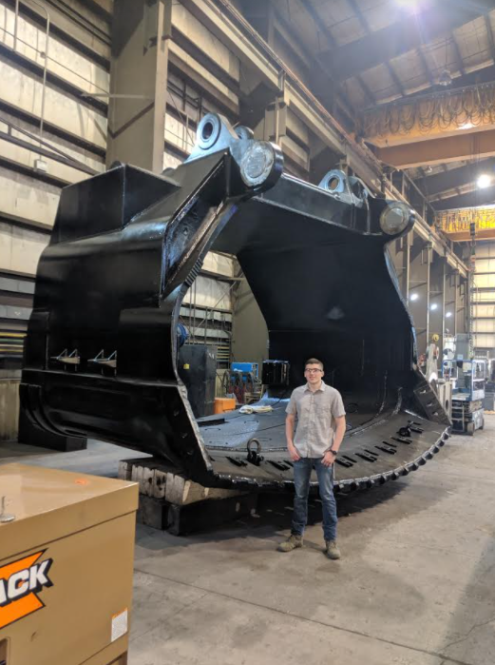

Kole Pickner
South Dakota School of Mines and Technology
Mechanical Engineering & Systems Engineering
Senior/Accelerated Master’s Student
Previous Work:
  Internship at L&H Industrial
Dark matter detector air filtration senior design project
Spring & Summer 2020 Internships at NASA LaRC;
Summer & Fall 2021 Internships at NASA AFRC
IMAGE REMOVED
Deep Underground Neutrino Experiment research project
Image courtesy of SDSM&T Physics Dept.
IMAGE REMOVED
Image courtesy of DUNEScience.org
Notes:
SDSM&T in Rapid City, mech Eng with minor in systems eng. I’m a senior but also starting my master’s degree in Mech eng. As well.
Previous work: 1st engineering internship at L&H. Mining but also refurbishing of crawler transporter for KSC.
LaRC: conceptual vehicle design. First was in reusable lunar lander shock absorbers, 2nd in collapsible/deployable lunar crane.
DUNE: design parts and experiments for cryogenic tolerance and fiber optic intensity, plan fiber optic routes.
I enjoy music a lot, I’ve been in several university bands and choirs, here’s a pic of me playing with some Langley interns last year. I enjoy hiking as I live at the base of the Black Hills National Forest. Here’s a pic I took this winter.

Slide 3
What is CryoMag Coupler?
A cryogenic coupler that:
  Enables transferring of cryogenic fluid from point A to point B in a lunar representative environment (temperature and dust loading)
  Uses passive magnets as the mating/demating mechanism
  Tolerates dust (Lunar regolith simulant); there is currently no acceptable method for coupling on the lunar surface due to regolith
  The final product is a functional prototype that is not flight or space rated
The Cryomag Coupler consists of the following subsystems:
  Magnetic (AFRC/CMR)
  Cryogenic Low Force Disconnect (LFD) Coupler (KSC)
  Dust Mitigation (AFRC)
Low Force
Disconnect
Coupler
IMAGE REMOVED
Dust Mitigation
Subsystem
Magnetic Subsystem

Slide 4
Project Background
  3 Subsystems
    Low Force Disconnect fluid coupler developed at KSC with modifications made by AFRC
    Passive, patterned magnets developed by Correlated Magnetics Research (CMR) to meet requirements set by AFRC
    Dust Mitigation mechanisms developed by AFRC
VIDEO REMOVED
IMAGE REMOVED
Notes:
LFD coupler works by redirecting flow at 90 degree angles, removing a lot of back pressure, decreasing the force required to hold it together.
The LFD coupler is one subsystem of the coupler. Another is dust mitigation, which involves the development of a mechanism to cover the ends of the probe and socket to protect them from regolith when not coupled. My involvement was mostly in the Magnetics Subsystem.
The patterned magnets are produced by a contractor, CMR. Unfortunately, to produce increasing the field strength also decreases the range.

Slide 5
Dust Mitigation Subsystem Preliminary Design Review
  Creation of animations demonstrating CONOPS:
  Mate:
    Dust cap latches opened
    Dust caps opened
    Coupler halves brought together
    Dust cap latches closed on opposite caps
VIDEO REMOVED
Notes:
LFD coupler works by redirecting flow at 90 degree angles, removing a lot of back pressure, decreasing the force required to hold it together.
The LFD coupler is one subsystem of the coupler. Another is dust mitigation, which involves the development of a mechanism to cover the ends of the probe and socket to protect them from regolith when not coupled. My involvement was mostly in the Magnetics Subsystem.
The patterned magnets are produced by a contractor, CMR. Unfortunately, to produce increasing the field strength also decreases the range.

Slide 6
Dust Mitigation Subsystem Preliminary Design Review
  Creation of animations demonstrating CONOPS:
  Demate:
    Lever is moved to demate position
    Dust cap latches released from opposite caps
    Coupler halves separated once magnetic attraction sufficiently reduced
    Dust caps closed
    Dust cap latches closed
    Lever stowed
VIDEO REMOVED
Notes:
LFD coupler works by redirecting flow at 90 degree angles, removing a lot of back pressure, decreasing the force required to hold it together.
The LFD coupler is one subsystem of the coupler. Another is dust mitigation, which involves the development of a mechanism to cover the ends of the probe and socket to protect them from regolith when not coupled. My involvement was mostly in the Magnetics Subsystem.
The patterned magnets are produced by a contractor, CMR. Unfortunately, to produce increasing the field strength also decreases the range.

Slide 7
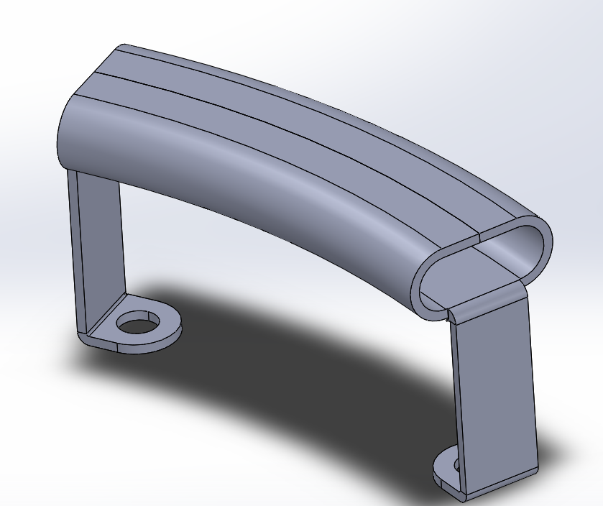
Handle Design
  Offers easier mate/demate actions by user
  Various handles investigated
  “Single sheet” handle designed
  Bent tube handle designed by Jonathan Lopez
IMAGE REMOVED
Notes:
LFD coupler works by redirecting flow at 90 degree angles, removing a lot of back pressure, decreasing the force required to hold it together.
The LFD coupler is one subsystem of the coupler. Another is dust mitigation, which involves the development of a mechanism to cover the ends of the probe and socket to protect them from regolith when not coupled. My involvement was mostly in the Magnetics Subsystem.
The patterned magnets are produced by a contractor, CMR. Unfortunately, to produce increasing the field strength also decreases the range.

Slide 8
Test Schedule UID Matching
  Schedule of tests for CryoMag updated with matched UID numbers corresponding to project actions
  Sample section:
IMAGE REMOVED
Notes:
LFD coupler works by redirecting flow at 90 degree angles, removing a lot of back pressure, decreasing the force required to hold it together.
The LFD coupler is one subsystem of the coupler. Another is dust mitigation, which involves the development of a mechanism to cover the ends of the probe and socket to protect them from regolith when not coupled. My involvement was mostly in the Magnetics Subsystem.
The patterned magnets are produced by a contractor, CMR. Unfortunately, to produce increasing the field strength also decreases the range.

Slide 9
Magnetics Subsystem Requirements
  The internal forces of the LFD from friction and springs were determined experimentally
  Requirement lines were developed from trendlines of the resistive force vs. the displacement of probe insertion
    These enable mating when assisted by the minimum human push from available data
    When demating, a different profile indicates the resistance against internal springs pushing the coupler apart
  The LFD has undergone modifications that reduce resistance peaks
    Further modifications are underway that will cause an anticipated ramp force and overall greater force
    New requirement lines were developed for the new modifications
Notes:
LFD coupler works by redirecting flow at 90 degree angles, removing a lot of back pressure, decreasing the force required to hold it together.
The LFD coupler is one subsystem of the coupler. Another is dust mitigation, which involves the development of a mechanism to cover the ends of the probe and socket to protect them from regolith when not coupled. My involvement was mostly in the Magnetics Subsystem.
The patterned magnets are produced by a contractor, CMR. Unfortunately, to produce increasing the field strength also decreases the range.

Slide 10
Magnetics Subsystem Requirements for Updated LFD
  Further modifications to the LFD coupler are underway
  These will lead to an increase of REMOVED lbf for data points after REMOVED in. REMOVED lbf was added to the profile to make it conservative
  Resistance of REMOVED lbf anticipated at the mated position. To reach this, linear ramp function added to the data after REMOVED in
  B is over the x interval between first seal peak and REMOVED in. Uses slope of trendline but intersects where first peak is subtracted by minimum user input from ergonomics data
  A begins at origin and meets B at first seal peak
  C meets B at REMOVED in and reaches 4x demate force at mate
  D uses slope of demate trendline but intercepts valley at REMOVED in to enable automatic demating
IMAGE REMOVED
Notes:
LFD coupler works by redirecting flow at 90 degree angles, removing a lot of back pressure, decreasing the force required to hold it together.
The LFD coupler is one subsystem of the coupler. Another is dust mitigation, which involves the development of a mechanism to cover the ends of the probe and socket to protect them from regolith when not coupled. My involvement was mostly in the Magnetics Subsystem.
The patterned magnets are produced by a contractor, CMR. Unfortunately, to produce increasing the field strength also decreases the range.

Slide 11
Automatic Mating
Requirements
  Alternate set of requirements for no user input for mating
  B is over the x interval between first seal peak and REMOVED in. Intersects first and second peaks
  A begins at REMOVED lbf and meets B at first seal peak
  C meets B at REMOVED in and reaches 4x demate force at mate
  D uses slope of demate trendline but intercepts valley at REMOVED in to enable automatic demating (remains the same as previous set of requirements)
IMAGE REMOVED
Notes:
LFD coupler works by redirecting flow at 90 degree angles, removing a lot of back pressure, decreasing the force required to hold it together.
The LFD coupler is one subsystem of the coupler. Another is dust mitigation, which involves the development of a mechanism to cover the ends of the probe and socket to protect them from regolith when not coupled. My involvement was mostly in the Magnetics Subsystem.
The patterned magnets are produced by a contractor, CMR. Unfortunately, to produce increasing the field strength also decreases the range.

Slide 12
Optimized CMR Magnets
  Requirement lines used by CMR to develop several magnet patterns
  Three patterns chosen by CryoMag team for further use
    One for automatic mating
    One for user-assisted mating
    One for borderline-automatic mating
IMAGE REMOVED
Notes:
LFD coupler works by redirecting flow at 90 degree angles, removing a lot of back pressure, decreasing the force required to hold it together.
The LFD coupler is one subsystem of the coupler. Another is dust mitigation, which involves the development of a mechanism to cover the ends of the probe and socket to protect them from regolith when not coupled. My involvement was mostly in the Magnetics Subsystem.
The patterned magnets are produced by a contractor, CMR. Unfortunately, to produce increasing the field strength also decreases the range.

Slide 13
Magnetic Subsystem Drawings and Diagrams
    For the Magnetic Subsystem Critical Design Review, part drawings and diagrams were created to show subsystem components (developed by Jonathan Lopez) and their dimensions
    Note: probe adapter plate is free to rotate around probe within REMOVED° keyway
Key
Collar (transparent here)
Hinge
Keyway
Demate Mode
Magnets
Lever
IMAGE REMOVED
Magnet Shunts
IMAGE REMOVED
Hinge w/ Clevis Pin
Mate Mode
Probe adapter plate
Adapter Plates
Notes:
LFD coupler works by redirecting flow at 90 degree angles, removing a lot of back pressure, decreasing the force required to hold it together.
The LFD coupler is one subsystem of the coupler. Another is dust mitigation, which involves the development of a mechanism to cover the ends of the probe and socket to protect them from regolith when not coupled. My involvement was mostly in the Magnetics Subsystem.
The patterned magnets are produced by a contractor, CMR. Unfortunately, to produce increasing the field strength also decreases the range.

Slide 14
Magnetic Subsystem Critical Design Review
  Socket Exploded View
  Probe Exploded View
IMAGE REMOVED
IMAGE REMOVED
Notes:
LFD coupler works by redirecting flow at 90 degree angles, removing a lot of back pressure, decreasing the force required to hold it together.
The LFD coupler is one subsystem of the coupler. Another is dust mitigation, which involves the development of a mechanism to cover the ends of the probe and socket to protect them from regolith when not coupled. My involvement was mostly in the Magnetics Subsystem.
The patterned magnets are produced by a contractor, CMR. Unfortunately, to produce increasing the field strength also decreases the range.

Slide 15
Magnetic Subsystem
User Force Requirements
  Friction will occur during demate rotation
  Contact surface between adapter plate and back of probe flange
  (worst case: friction will act at OD of this interface)
  Normal force = magnet attraction force at mated position
  Static and kinetic friction coefficients of 0.7 and 0.6 assumed respectively
  Multiply friction force by OD of contact surface to add friction “torque” to magnetic torque
    User must overcome this with lever to demate coupler
IMAGE REMOVED
Notes:
LFD coupler works by redirecting flow at 90 degree angles, removing a lot of back pressure, decreasing the force required to hold it together.
The LFD coupler is one subsystem of the coupler. Another is dust mitigation, which involves the development of a mechanism to cover the ends of the probe and socket to protect them from regolith when not coupled. My involvement was mostly in the Magnetics Subsystem.
The patterned magnets are produced by a contractor, CMR. Unfortunately, to produce increasing the field strength also decreases the range.

Slide 16
Magnetic Subsystem
User Force Requirements
    For v41, 48v49, and v58 magnets at temp. of REMOVED°C and separation of REMOVED in (mated), this analysis was applied to rotational offsets of 1° increments from 0°-5° and 5° increments to from 5°-65°
    Largest combined magnetic and static frictional torque (REMOVED in-lb) is from v41 at 5° offset
    Kinetic friction should be expected during rotation
    This requires a REMOVED-lb pull at the end of the REMOVED-in lever
    Weakest 5th percentile male push or pull is REMOVED lb at 90° or 60° elbow flexion
IMAGE REMOVED
Notes:
LFD coupler works by redirecting flow at 90 degree angles, removing a lot of back pressure, decreasing the force required to hold it together.
The LFD coupler is one subsystem of the coupler. Another is dust mitigation, which involves the development of a mechanism to cover the ends of the probe and socket to protect them from regolith when not coupled. My involvement was mostly in the Magnetics Subsystem.
The patterned magnets are produced by a contractor, CMR. Unfortunately, to produce increasing the field strength also decreases the range.

Slide 17
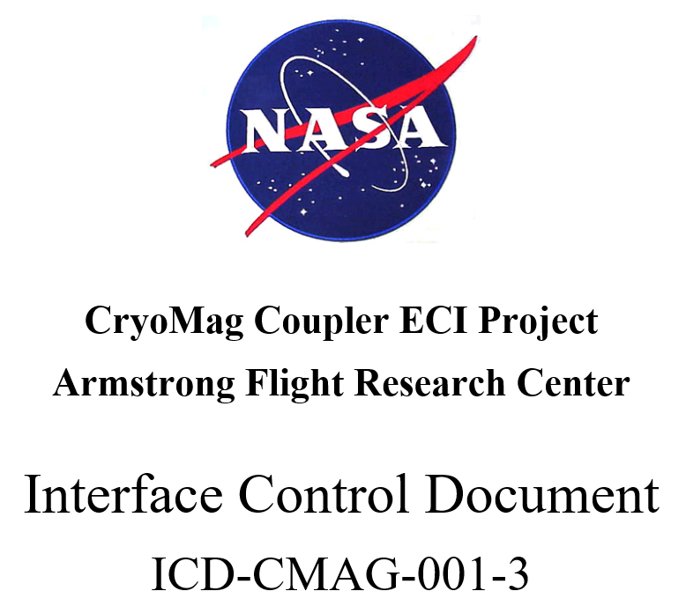
Interface Control Document
    Made revision to ICD including:
      Linked Tables of Contents and Figures
      Updated figures and part dimensions reflecting modifications to Magnetic Subsystem components
      Force profile requirement lines and optimized magnet pattern force profiles for interface context
      Detailed description of user requirements to overcome friction and magnetic torque
Notes:
LFD coupler works by redirecting flow at 90 degree angles, removing a lot of back pressure, decreasing the force required to hold it together.
The LFD coupler is one subsystem of the coupler. Another is dust mitigation, which involves the development of a mechanism to cover the ends of the probe and socket to protect them from regolith when not coupled. My involvement was mostly in the Magnetics Subsystem.
The patterned magnets are produced by a contractor, CMR. Unfortunately, to produce increasing the field strength also decreases the range.

Slide 18
Magnet Hazard Sign
Worked with Graphics and Safety departments to develop signs warning of magnetic field around magnets
CryoMag magnets can produce magnetic field of up to REMOVED Gauss at a distance of REMOVED” with the strength increasing exponentially as distance decreases
  This can disrupt electronics (including medical implants)
Ferrous metals in jewelry, belt buckles, etc. can be forcibly attracted to a magnet at REMOVED” or less.
IMAGE REMOVED
Notes:
LFD coupler works by redirecting flow at 90 degree angles, removing a lot of back pressure, decreasing the force required to hold it together.
The LFD coupler is one subsystem of the coupler. Another is dust mitigation, which involves the development of a mechanism to cover the ends of the probe and socket to protect them from regolith when not coupled. My involvement was mostly in the Magnetics Subsystem.
The patterned magnets are produced by a contractor, CMR. Unfortunately, to produce increasing the field strength also decreases the range.

Slide 19
Functional Flow Test Fixture
    Functional flow test will be carried out after integrating the LFD and Magnetic Subsystems
    Socket side will be mounted to a fixture in the Flight Loads Lab at AFRC
      Fixture is to be constructed with slotted aluminum extrusion, sheet steel, simple fasteners, and an existing fixture platform in FLL
    User will connect the probe side
    Once mated, water will flow from one side to the other to examine LFD flow function with magnetic mating
    Demating capability will be examined by using lever to rotate probe magnet
IMAGE REMOVED
IMAGE REMOVED
Notes:
LFD coupler works by redirecting flow at 90 degree angles, removing a lot of back pressure, decreasing the force required to hold it together.
The LFD coupler is one subsystem of the coupler. Another is dust mitigation, which involves the development of a mechanism to cover the ends of the probe and socket to protect them from regolith when not coupled. My involvement was mostly in the Magnetics Subsystem.
The patterned magnets are produced by a contractor, CMR. Unfortunately, to produce increasing the field strength also decreases the range.

Slide 20
Lessons Learned
Crunch time to meet project deadlines
Task prioritization
Application of SE fundamentals
Multitasking: full-time student and part-time intern
  Balancing academic and internship priorities
  Working around meeting scheduling conflicts with classes
IMAGE REMOVED
Notes:
Risks, Scheduling, Communicating with team members and other centers

Slide 21
Future
Returning to CryoMag in Summer
Continuing DUNE research
Graduated Mechanical Engineering BS with Systems Engineering Minor
Graduating Mechanical Engineering MS in December
IMAGES REMOVED

Slide 22
Acknowledgements
CryoMag Team – Paul, Shideh, Jonathan, Cliff, Scott, Nic, Jeanette, Andrew
CMR Team
Other MagSep Interns – Berny, Diya, Karelia, Michael, Stella
Maria Peters

Slide 23
Questions?

