Slide 1
Analysis of Materials International Space Station Experiment-10 (MISSE-10)
Thin-Film Solar Cells
Meghan Carrico (NASA MSFC)
Dr. John Carr (NASA MSFC)
Miria Finckenor (NASA MSFC)
Dr. Brandon Farmer (Nexolve)
DISTRIBUTION A. Approved for public release; distribution unlimited.

Slide 2


MISSE-10 Experiment
From April 26th, 2019, to March 12th, 2020 flew Inverted Metamorphic Multi-junction (IMM) and Copper Indium Gallium (di)Selenide (CIGS) solar cell samples on Materials International Space Station Experiment-10 (MISSE-10)
  Included bare and coated solar cells
  Zenith orientation
MISSE-10 thin film coatings include:
  IMM: Optinox®, Optinox® with POSS
  CIGS: CORIN®, CORIN® with Ceria, CORIN® with Glass
  Coatings were developed by Nexolve
Estimated ESH: 2,995.85 ESH
DISTRIBUTION A. Approved for public release; distribution unlimited.

Slide 3
MISSE-10 Experiment
Solar Cell Type | Coating | # of Flight | # of Control
CIGS | Bare | 3 | 3
CIGS | CORIN® | 3 | 3
CIGS | CORIN® w/ Ceria | 3 | 3
CIGS | CORIN® w/Glass | 3 | 3
IMM | Bare | 3 | 3
IMM | Optinox® | 3 | 3
IMM | Optinox® w/ POSS | 3 | 2
Solar cell type, coating, and number include:
Total of 41 samples
MISSE-10 experiment was conducted in support of the Lightweight Integrated Solar Array and anTenna (LISA-T) project
DISTRIBUTION A. Approved for public release; distribution unlimited.

Slide 4

LISA-T Overview
PI: Dr. John Carr (NASA MSFC)
Co-PI: Les Johnson (NASA MSFC)
Mission length and type: 2–4 month technology demonstration in low earth orbit
Technology objective is to enable the utilization of a deployable array
  Provides improved power and communications capabilities for small spacecraft (LEO and beyond)
The LISA-T project seeks to then demonstrate the deployment, operation, and survivability of this technology in LEO
Additional details:
  Tyvak 6U cubesat bus
  Technology for LISA-T array produced by Nexolve
  MSFC in charge of majority of payload such as structure, avionics, antenna, testing, etc.
  Tentative launch date: Feb 2023
DISTRIBUTION A. Approved for public release; distribution unlimited.

Slide 5
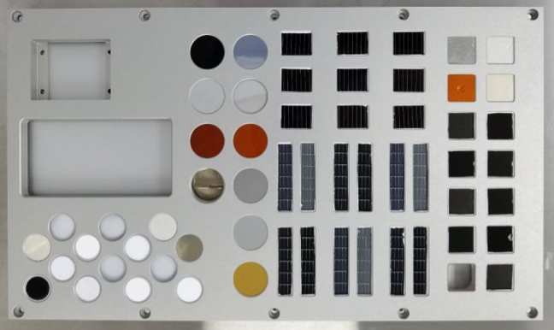

MISSE-10 Pre- and Post-Flight Operations
MISSE-10 pre- and post-flight measurements include:
  Power curve measurements
    Assisted Dr. John Carr during post-flight
  Solar absorptance, α
  Infrared emittance, ε
  Mass
Only post-flight:
  Solar cell total thickness and coating thickness
  SPENVIS radiation models
DISTRIBUTION A. Approved for public release; distribution unlimited.

Slide 6
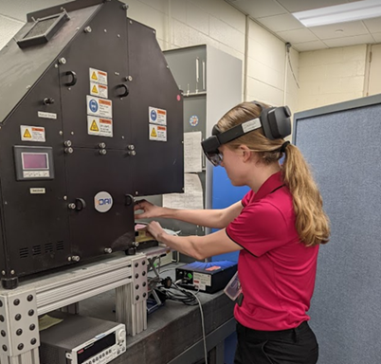
Power Curve Measurements
Pre- and post-flight power curve measurements were performed on all control and flight samples
  Assisted Dr. John Carr with post-flight measurements
Experiment included the use of an AM0 bench top solar simulator lamp
  Radiometer for calibration
For IMM and CIGS solar cell types, used (2) IMM and CIGS trays consisting of a tray control and a space to insert a given solar cell sample
Tray connections were completed using pins and sockets as labeled
  A vacuum was connected to the trays and used to hold the cells flat
Post-flight experiment set-up
DISTRIBUTION A. Approved for public release; distribution unlimited.

Slide 7
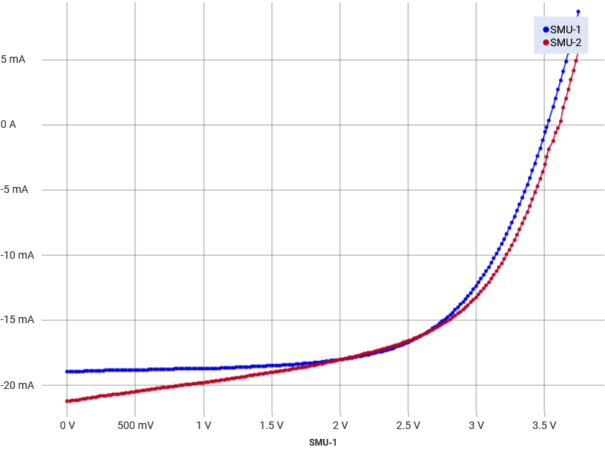
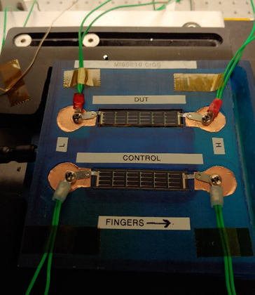
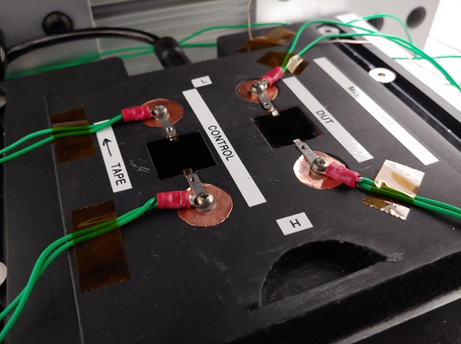
Power Curve Measurements
For each measurement → the solar simulator was opened briefly → Kickstart software ran to perform the IV sweep →solar simulator was closed
  During this process, time, temperature, and relative humidity was also recorded for each run
  Images of the power curves and raw data files were saved
CIGS and IMM trays (pre-flight image)
SMU-1 → MISSE-10 sample
SMU-2 → Tray control
Example of data output (CIGS CXLSG2/01191)
DISTRIBUTION A. Approved for public release; distribution unlimited.

Slide 8
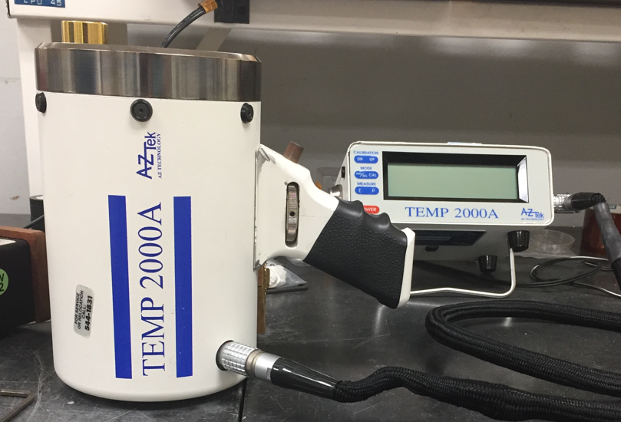
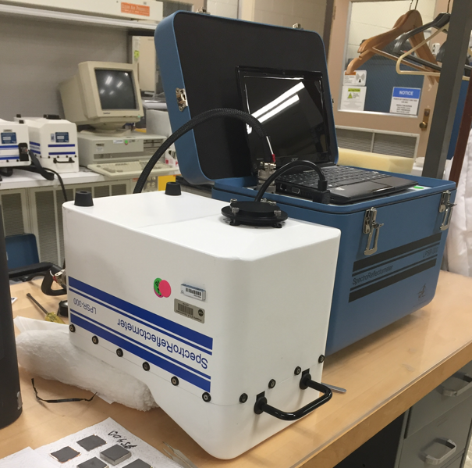
Optical Property and Mass Measurements
Solar absorptance was completed using the AZ Technology Laboratory Portable Spectroreflectometer (LPSR)
  Measured once per solar cell sample
Infrared emittance was performed with the AZ Technology TEMP 2000A Infrared Reflectometer
  Measured three times per solar cell sample and averaged
Mass measurements were completed using the Sartorius Balance and a small vacuum chamber
  Measured once per solar cell sample and found using linear regression (due to most samples being hygroscopic)
TEMP 2000A
LPSR
DISTRIBUTION A. Approved for public release; distribution unlimited.

Slide 9
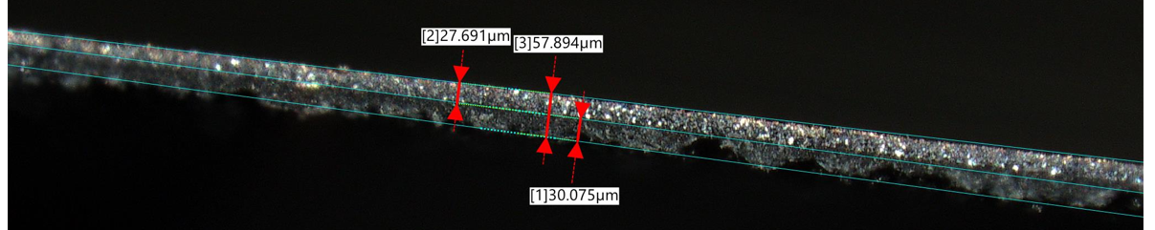
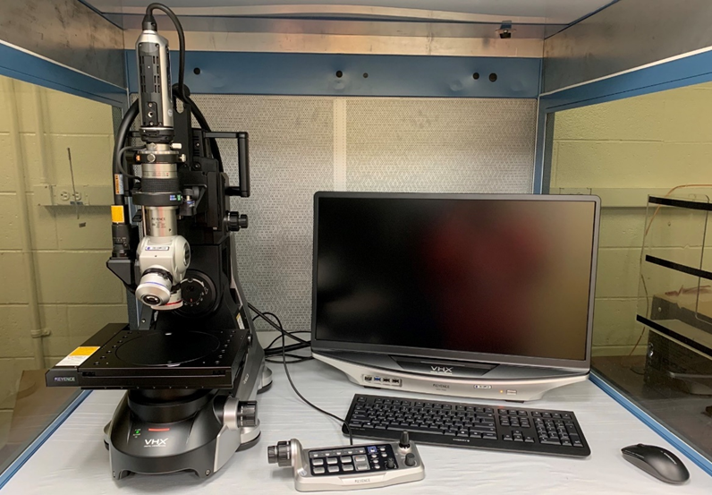
Thickness Measurements
Thickness measurements were completed post-flight using the Keyence VHX-7000
  Initially completed using a Micrometer
Needed coating thickness measurements to utilize in SPENVIS models
Ultimately cut a few control samples of each cell and coating type to determine coating thickness
  Took a few images/measurements and averaged
OSRP5 Fresh Cut
Keyence VHX-7000
DISTRIBUTION A. Approved for public release; distribution unlimited.

Slide 10
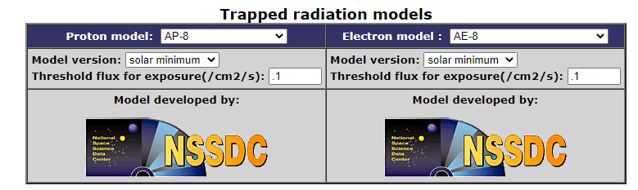
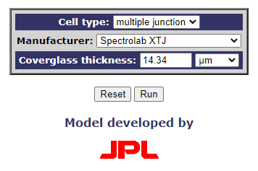
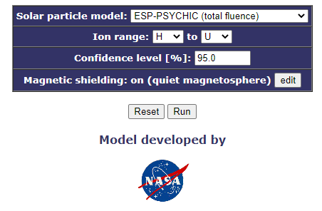
SPENVIS
SPENVIS was used to model radiation effects on the solar cell samples during the MISSE-10 experiment
  This provides useful comparison to ground simulations pre-flight
Models/Programs used:
  Spacecraft Trajectories
    Entered MISSE-10 orbital duration and estimated parameters
  Trapped radiation models
  Solar Particle Fluences
  Damage Equivalent Fluences for Solar Cells
    Coverglass thickness approximated using coating thickness and density
  Final result is a summary of 1 MeV equivalent electron fluences per cm^2
DISTRIBUTION A. Approved for public release; distribution unlimited.

Slide 11
Analysis/Summary of MISSE-10 Data: IMM
Average IMM Property | Bare Control | Bare Flight | Optinox® Control | Optinox® Flight | Optinox® w/ Poss Control | Optinox® w/ Poss Flight
Pre-Flight Infrared Emittance | 0.417 | 0.417 | 0.810 | 0.814 | 0.851 | 0.850
Post-flight Infrared Emittance | 0.409 | 0.417 | 0.805 | 0.799 | 0.853 | 0.848
Pre-Flight Solar Absorptance | 0.894 | 0.896 | 0.892 | 0.891 | 0.904 | 0.906
Post-Flight Solar Absorptance | 0.893 | 0.894 | 0.891 | 0.872 | 0.905 | 0.892
Mass Change [g] | -0.00848 | -0.00744 | 0.00001 | -0.00029 | -0.00002 | -0.00033
Pre-flight SA/ε | 2.15 | 2.15 | 1.10 | 1.09 | 1.06 | 1.07
Post-Flight SA/ε | 2.18 | 2.14 | 1.11 | 1.09 | 1.06 | 1.05
DISTRIBUTION A. Approved for public release; distribution unlimited.

Slide 12
Analysis/Summary of MISSE-10 Data: IMM
+0.0001
DISTRIBUTION A. Approved for public release; distribution unlimited.

Slide 13
Analysis/Summary of MISSE-10 Data: IMM
-21.73%
+0.56%
-20.99%
-0.35%
-23.01%
-0.17%
DISTRIBUTION A. Approved for public release; distribution unlimited.

Slide 14
Analysis/Summary of MISSE-10 Data: CIGS
Average IMM Property | Bare Control | Bare Flight | CORIN® w/ Ceria Control | CORIN® w/ Ceria Flight | CORIN® Control | CORIN® Flight | CORIN® w/ Glass Control | CORIN® w/ Glass Flight
Pre-Flight Infrared Emittance | 0.476 | 0.487 | 0.838 | 0.831 | 0.835 | 0.835 | 0.890 | 0.894
Post-flight Infrared Emittance | 0.574 | 0.528 | 0.836 | 0.829 | 0.834 | 0.837 | 0.889 | 0.886
Pre-Flight Solar Absorptance | 0.879 | 0.877 | 0.883 | 0.887 | 0.881 | 0.886 | 0.855 | 0.855
Post-Flight Solar Absorptance | 0.879 | 0.887 | 0.880 | 0.880 | 0.889 | 0.886 | 0.854 | 0.844
Mass Change [g] | 0.00001 | 0.00268 | 0.00003 | 0.00291 | -0.00015 | 0.00280 | -0.00022 | 0.00275
Pre-flight SA/ε | 1.87 | 1.81 | 1.05 | 1.07 | 1.06 | 1.06 | 0.96 | 0.96
Post-Flight SA/ε | 1.53 | 1.68 | 1.05 | 1.06 | 1.07 | 1.06 | 0.96 | 0.95
DISTRIBUTION A. Approved for public release; distribution unlimited.

Slide 15
Analysis/Summary of MISSE-10 Data: CIGS
+0.098
+0.04
+0.010
DISTRIBUTION A. Approved for public release; distribution unlimited.

Slide 16
Analysis/Summary of MISSE-10 Data: CIGS
-19.08%
DISTRIBUTION A. Approved for public release; distribution unlimited.

Slide 17
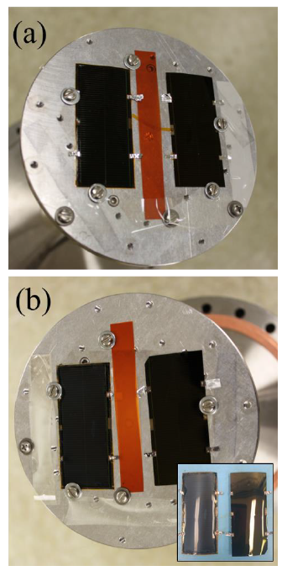
Ground Testing
LISA-T solar cell IMM and CIGS samples underwent environmental testing equivalent to Low Earth Orbit (LEO) conditions to attain Test Readiness Level (TRL) 6
Environmental tests included:
  Atomic oxygen (AO) exposure
  Particulate radiation
  Thermal cycling
  UV exposure
  Thermal extremes and cycles
  Rapid thermal cycling
  Thermal vacuum deployments
  Extended stowage
  Humidity
  Ascent vent
  High vacuum
Results points toward strong survivability for short term <1 year mission
Atomic oxygen before and after
DISTRIBUTION A. Approved for public release; distribution unlimited.

Slide 18
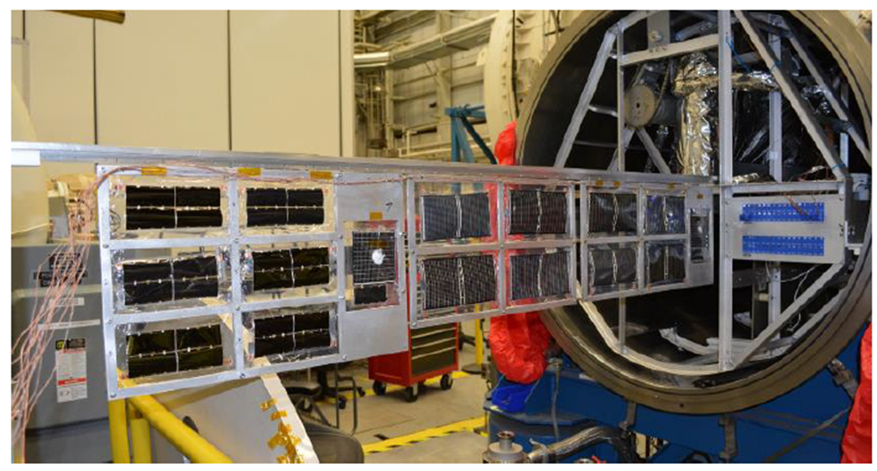
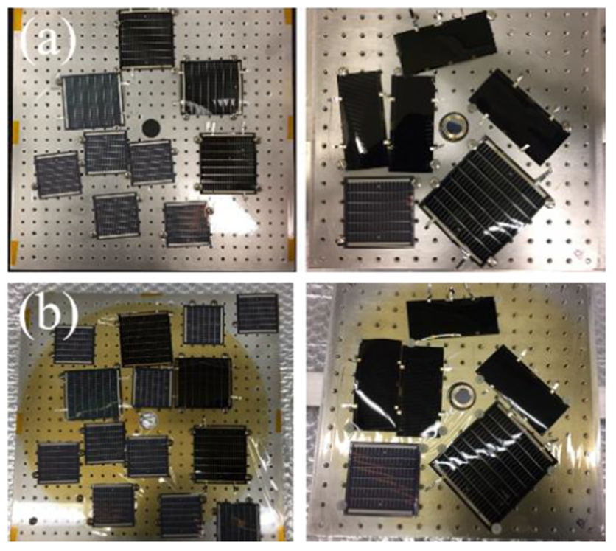
Ground Testing
Environmental Test | Parameters
Atomic Oxygen Exposure | 2.5E21 atoms/cm² for coated and uncoated solar cells
Particulate Radiation | For coated and uncoated cells: 1 MeV electrons @ 3E13-5E15 e-/cm2 50 keV, 100 keV, 500 keV, 700 keV protons- @ 7E10-1E15 p+/cm2
Thermal Cycling | 750 cycles 117°C to -68°C 750 cycles 7°C to -118°C 8 cycles 117°C to -118°C 100 rapid cycles 125°C to -55°C
UV Exposure | >2,000 Equivalent Sun Hours (ESH) @ middle and near UV
Thermal cycling
 | CIGS Bare | CIGS CORIN® | IMM Bare | IMM Optinox®
Predicted Power Remaining | 58.7% | 88.6% | 78.7% | 84.2%
MISSE Measured Power Remaining | 76.1% | 92.0% | 78.3% | 79.0%
M-NUV before and after
DISTRIBUTION A. Approved for public release; distribution unlimited.

Slide 19
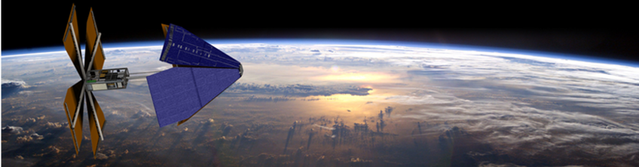
Future of Work/Moving Forward
Plan to continue to analyze MISSE pre- and post-flight results
In direct support of LISA-T, goal is to publish as a paper with Dr. John Carr
LISA-T tentatively launches Feb 2023 to demonstrate and enable advancements in small spacecraft technology within a LEO environment and beyond
DISTRIBUTION A. Approved for public release; distribution unlimited.

Slide 20
Sources
LISAT CDR-Zero-G and MISSE10 Results
The Lightweight Integrated Solar Array and anTenna: 3rd Generation Advancements, and Beyond
DISTRIBUTION A. Approved for public release; distribution unlimited.

