Slide 1
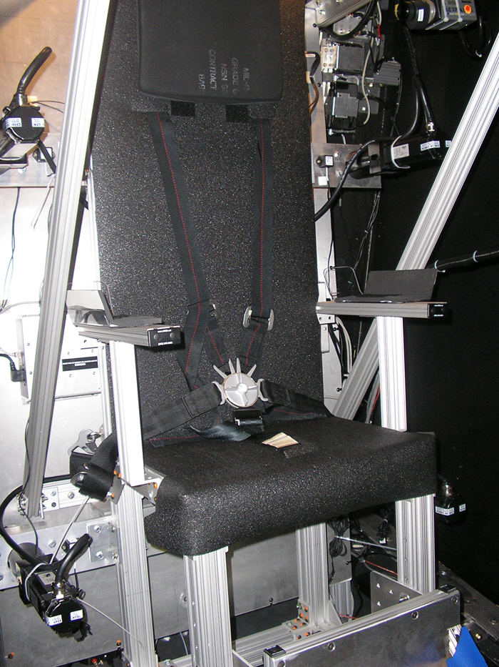
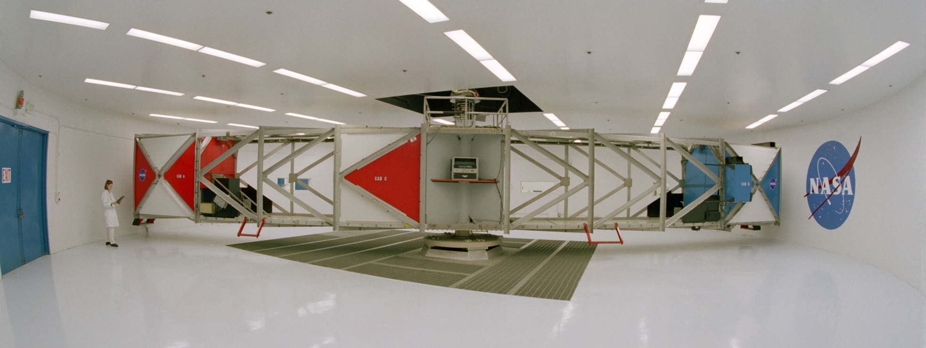
How One Functional Human Performance
Requirement Influenced a Rocket
NASA HSI Success Story
Dr. Cynthia H. Null, Technical Fellow (Human Factors)
NASA Engineering and Safety Center
NASA/TM—2009-215386
Notes:
https://ntrs.nasa.gov/citations/20150000242

Slide 2
Elements of success
Policy
Collaboration
Knowledge capture and sharing
Standards
Program requirements
History
Expertise (perception, loads and dynamics, mechanical engineering….)
Perseverance
Luck

Slide 3






NESC MISSION: To perform value-added independent testing, analysis, and assessments of NASA’s high-risk projects to ensure safety and mission success. The NESC engages proactively to help NASA avoid future problems.
NASA OFFICE OF THE CHIEF ENGINEER
NASA ENGINEERING & SAFETY CENTER CORE TEAM
Office of the Director
NASA Technical Fellows
NESC Principal Engineers (PE)
NESC ASSESSMENT PROCESS
Technical Leadership
& Management
NESC Chief Engineers (NCE)
NESC Integration Office (NIO)
Management & Technical Support Office (MTSO)
NESC Review Board
Approval
NESC Review Board
Peer Review + Approval
NESC REVIEW BOARD
Process,
Evaluate,
and
Accept
Request
Proceed with Assessment
Testing,
Data Collection,
Modeling, and
Analysis
TECHNICAL DISCIPLINE TEAMS
Submit
Request
(Anyone)
Form
Assessment
Team and
Develop and
Approve Plan
Document
Findings,
Observations,
and
Recommendations
Aerosciences
Avionics
Cryogenics
Electrical Power
Environmental Control &
Life Support
Flight Mechanics
GNC
Human Factors
Loads & Dynamics
Materials
Mechanical Systems
Nondestructive Evaluation
Nuclear Power & Propulsion
Passive Thermal
Propulsion
Sensors & Instrumentation
Software
Space Environments
Structures
Systems Engineering
Deliver Final
Report to Stakeholders
Technical Workforce
APPROXIMATELY 1,039 TDT MEMBERS
Assessment Team
NASA
75%
External Partners
Industry
20%
Academia
3%
Other Gov.
1%
Consultants
1%
NESC Core and Extended Team Members
Data as of January 3, 2022
Notes:
NESC assessment photos

Slide 4
Policy: NASA Human Rating
NASA first rockets were not originally developed for human occupancy
  “The concept of a man-rated space system entails the incorporation of those design features and requirements necessary to accommodate human participants within the system and thus provide the capability to safely conduct manned operations, including safe recovery from any credible emergency situation.
  Man-rating is the process of evaluating and assuring that the total system, both hardware and software, has the ability to meet prescribed, safety oriented design and operational criteria and requirements, and becomes involved in all program activities including design and development, test and verification, management and control and finally, certification for operational readiness”
In 2008, added to policy (NPR 8705.2B)
  "effectively utilizes human capabilities”
  Human-system integration team
Notes:
From: Bond, AC (1988) A review of Man-rating in past and current manned space flight programs.

Slide 5
Policy: Systems Engineering
NPR 7123.1 Systems Engineering
  Human performance criteria in 2007
  Add HSI Plan in 2013
  Required in 2022 all programs
SE Handbook
  2007 expands to cover use human system integration language in human engineering section
  2016 Expanded Handbook has HSI section

Slide 6
Development of Constellation Program Requirements in a multi-week workshop type environment for all disciplines
Human Systems Integration Requirements (HSIR) Working Group
  Derived from NASA-STD 3000 (now 3001)
  Focus on crew health and safety
  Focus on performance issues during a mission, specifically
    The human and system must function together
    Within the environment(s) and habitat(s)
    To accomplish tasks efficiently and effectively
    For nominal, off-nominal, emergency, and unexpected operations
    To ensure crew health, safety, and mission success

Slide 7
Acceleration Limits
(CxP 70024 -- SRR 2006)
Notes:
Directly from NASA-STD-3000
https://www.nasa.gov/offices/ochmo/human_spaceflight/standards101

Slide 8
But what about performance during or after vibration?
  Members of the Human Systems Special Interest Group (HSIG) wanted to develop additional requirements in Fall 2006, SRR time frame.
  Not viewed as an issue (POGO for Gemini/Apollo, vibration low for shuttle)
  Expectation that DOD had the necessary data and experience, if such a requirement would be needed

Slide 9
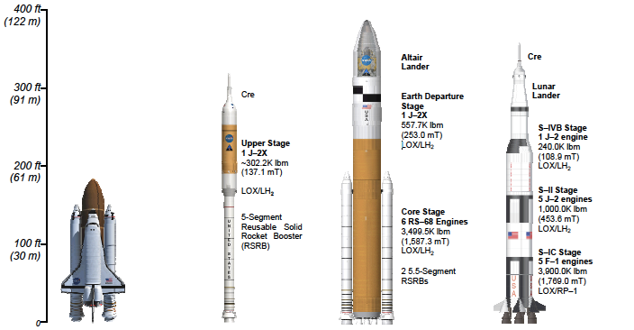
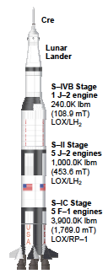
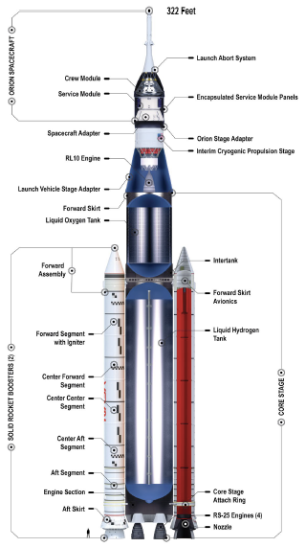
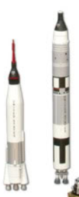
Notes:
SLS from SLS Reference Guide from https://www.nasa.gov/exploration/systems/sls/fs/sls.html
Shuttle picture from Cruzen, C., Chavers, G., & Wittenstein, J. (2009, March). Operational considerations and comparisons of the Saturn, Space Shuttle and Ares launch vehicles. In 2009 IEEE Aerospace conference (pp. 1-15). IEEE (NTRS ID 20090025418)
Mercury, Gemini, and Saturn 5 from: https://www.nasa.gov/sites/default/files/thumbnails/image/rocket_size_comparion_artwork.jpg
https://www.popsci.com/how-little-vibrations-break-big-rockets/
Thrust oscillation is common to solid-rocket motors, the casings of which tend to resonate like organ pipes as their propellant burns from the inside out.
POGO history Larsen, C. E. (2008, May). NASA experience with POGO in human spaceflight vehicles. In NATO RTO Symposium ATV-152 on Limit-Cycle Oscillations and Other Amplitude-Limited, Self-Excited Vibrations (No. RTO-MP-AVT-152).

Slide 10
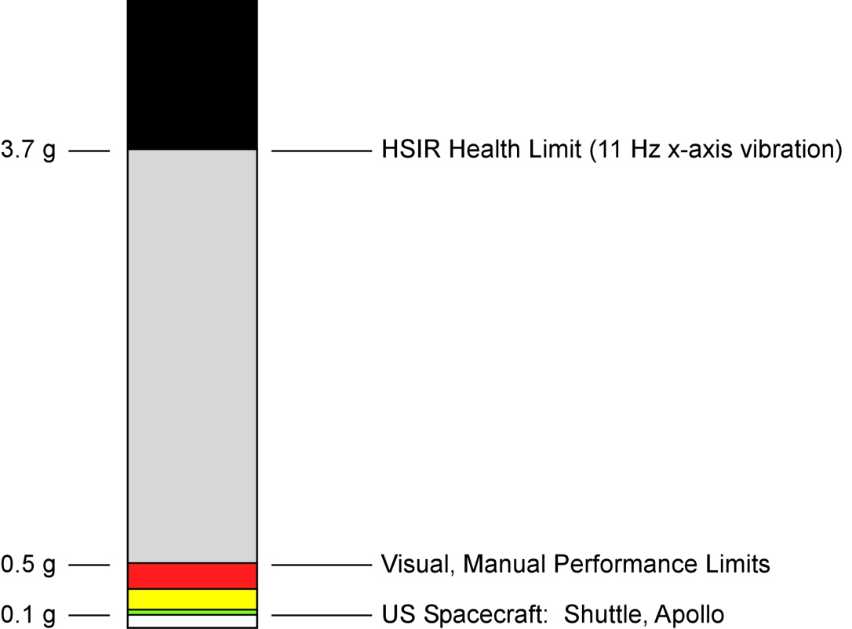
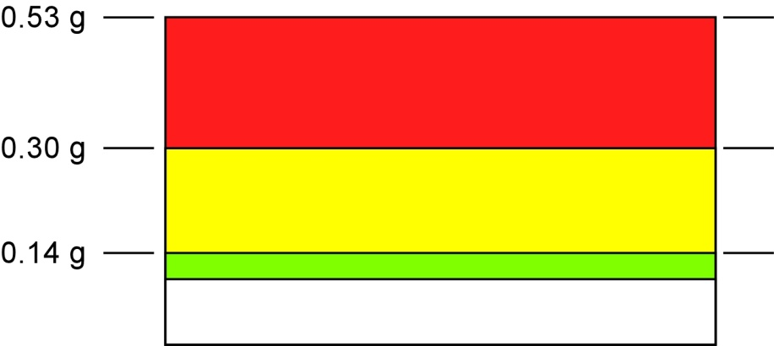
Historical Data/Guidelines/Requirements
Vibration Level
g (0-peak)
“Health Risks Likely”
—ISO 2631-1:1997
Historic Crew Performance
Vibration Limits (at “11 Hz”)
Possible Perceptual &
Physiological Aftereffects
Severe Performance
Degradation
1963 Gemini Centrifuge-Vibration Study
(Vykukal & Dolkas, 1966)
3.5 G_{x} (Chest-in) Bias
0.14-1.65 g_{x} vibration at 11 Hz***
Achievable Performance (Vykukal & Dolkas, 1966)
Simple visual & manual tasks only; Performance Degradation
Gemini crew spec (0.25 g)
Coarse visual & manual tasks; speech
Shuttle crew (0.1 g)?
Fine visual & manual tasks
12
Notes:
From NASA/TM—2009-215386

Slide 11
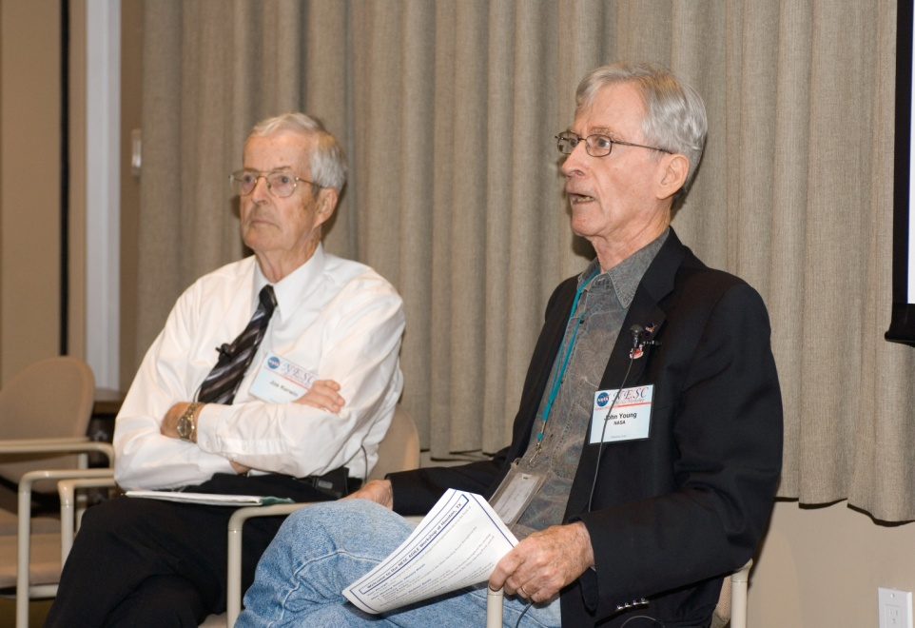
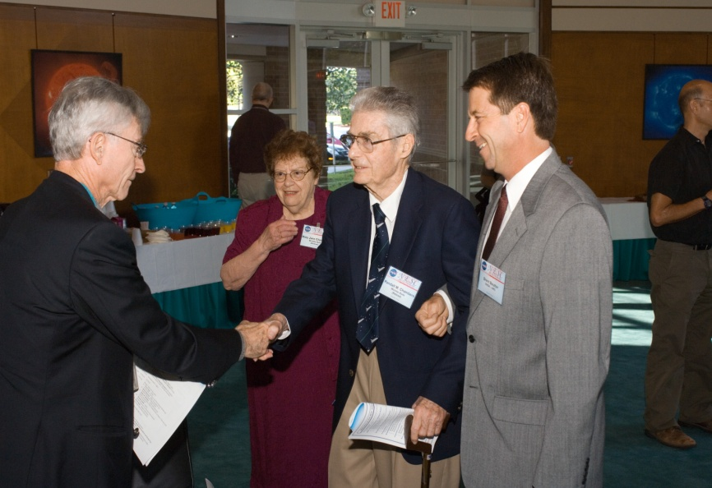
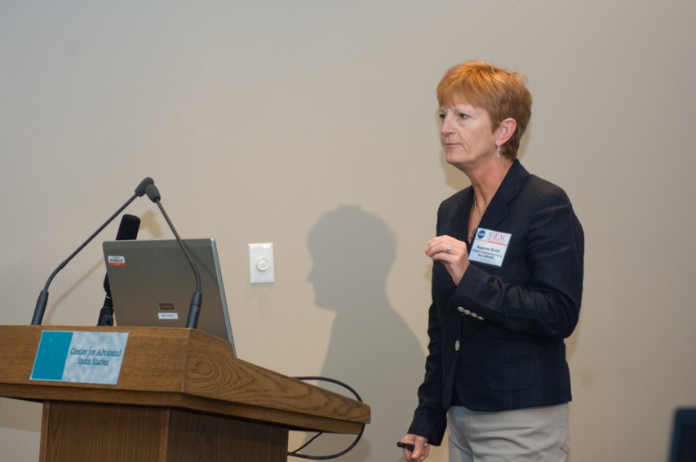
NESC AGILE Project (Oct 2007)
(Assessment of Gravito-Inertial Loads and Environments )
Literature Search
Workshop of Experts
  NASA
    Scientists (Human Performance, Medical)
    Engineers (Propulsion, Seats, Suits, etc)
    Astronauts (Apollo, Shuttle)
    CxP Projects
  DOD
  Industry
  University
Gap Analysis
Dr. Randell M. Chambers
Lead: Dr. Bernard Adelstein
Notes:
Photos taken by NESC personnel, at a public workshop

Slide 12
Thrust Oscillation (Nov 2007)
Issue raised at CxP Integrated Stack TIM
Thrust Oscillation Focus Team (TOFT) established
  Experts from several centers, many disciplines, industry
  1. Review the forcing functions, models and analysis results to verify the current predicted dynamic responses of the integrated stack
  2. Identify and assess options to reduce predicted responses
  3. Validate and quantify the risk to the Ares I vehicle, Orion spacecraft, crew, and other sensitive subsystems and components to the extent allowed by the Ares I/Orion design maturity
  4. Establish and prioritize mitigation strategies and establish mitigation plans consistent with the CxP integrated schedule
Notes:
From press reports in 2007.
https://spacenews.com/nasa-finalizes-ares-1-vibration-fix/

Slide 13
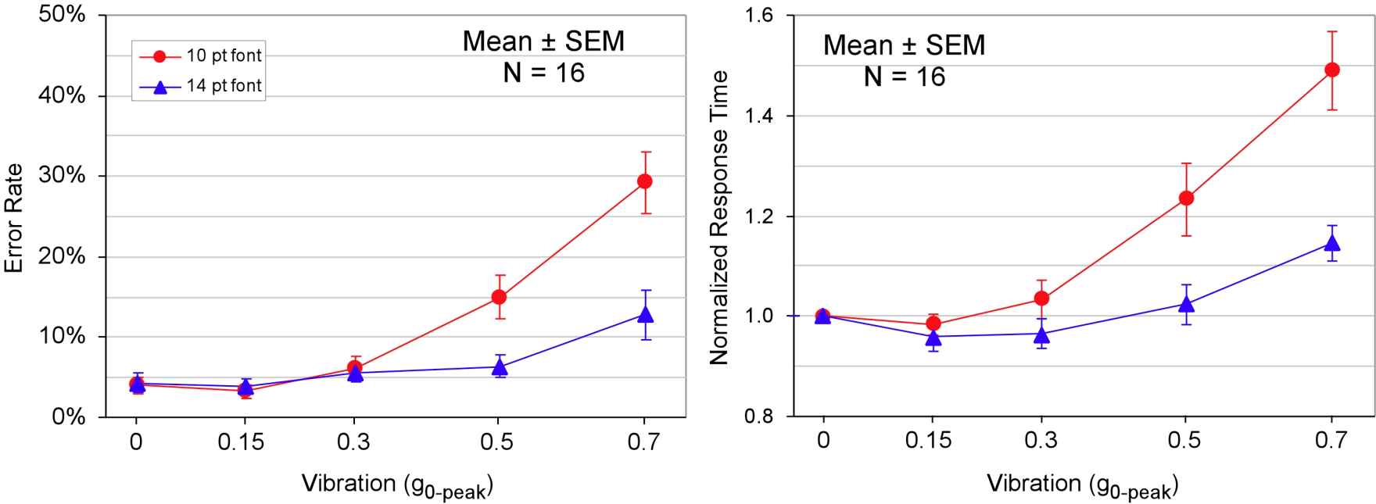
Vibration and Reading
(Stationary, 12 Hz Gx vibration)
NASA/TM—2009-215386

Slide 14
Expected G-loading effects on human performance
Impaired accommodation and decrease static visual acuity
Decreased visual sensitivity
Increased response time
Decreased field of view
Increased workload
Notes:
Two Critical Capabilities identified by Crew Office for thrust oscillation period:
Maintain situation awareness (SA) of vehicle state and vehicle status through processing Primary Flight Display (PFD) symbology
Manually steer (hand-fly) the vehicle immediately following exposure to vibration

Slide 15
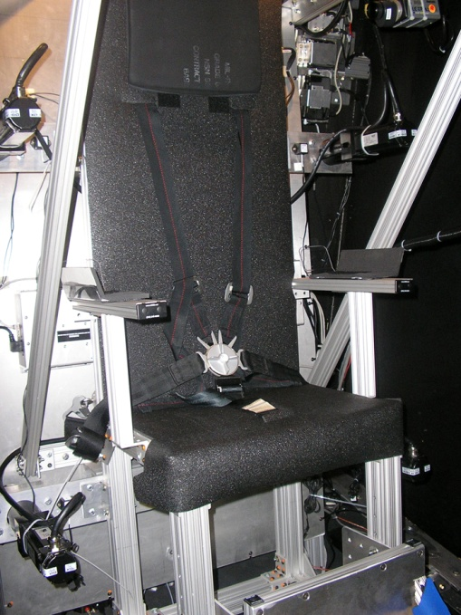
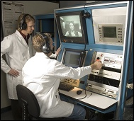
ARC 20-G Centrifuge Facility
Chair
reclining
at 15.3°
(fixed)
vibration chair
NASA/TM—2009-215386
20
Notes:
NASA photos from NASA/TM—2009-215386

Slide 16
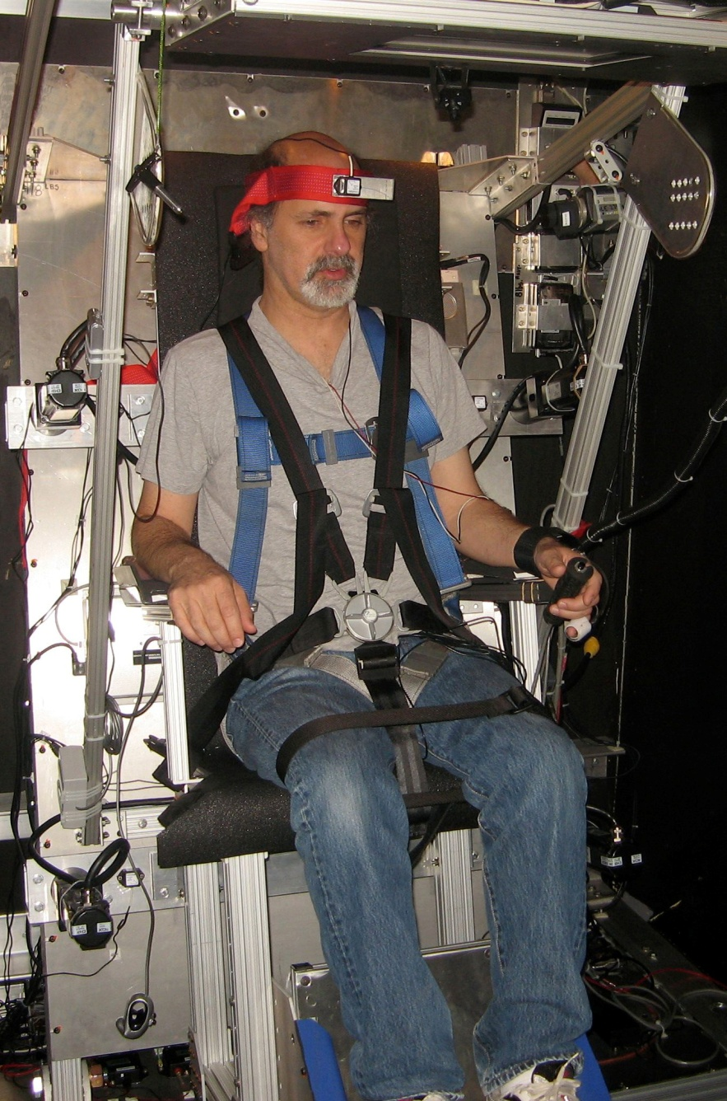
ARC 20-G Centrifuge Vibration Chair
Display
(raised)
Head Restraint
Dual triaxial
accelerometer
assembly
Head Rest
Vibration
Actuator
(1 of 4)
400 lb capacity each
1.5 in max stroke
Egress Harness
5-point restraint
Emergency
switch
2-button handheld
input device
NASA/TM—2009-215386
21

Slide 17
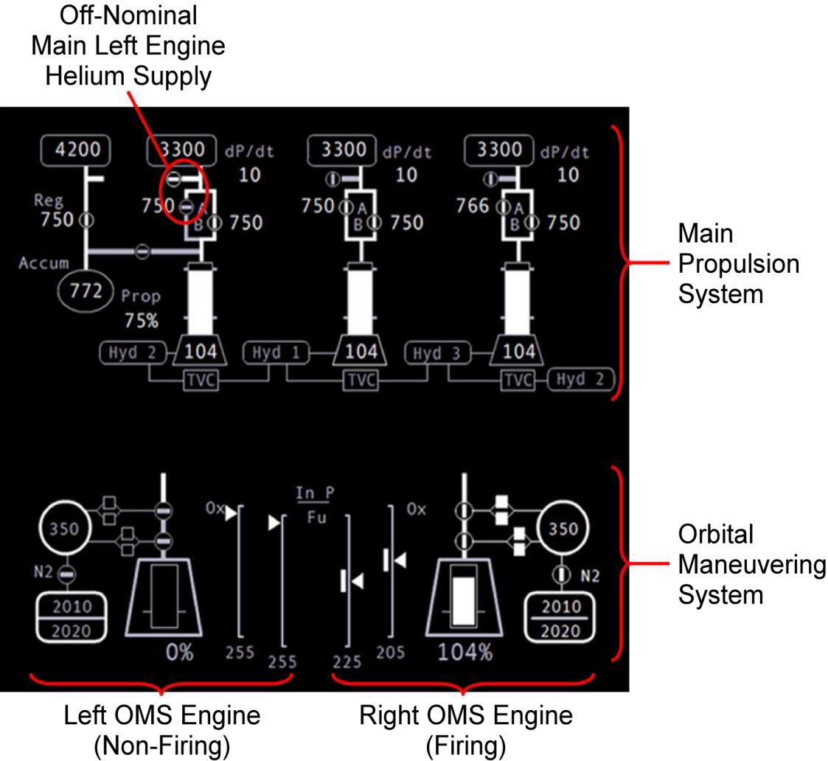
Display Usability Rating Study
(under 1-G and 3.8-G)
1-D Graphical Features
Crew participants rated their ability
to acquire information about the
state of system (e.g., valve state)
while ignoring the text
NASA/TM—2009-215386

Slide 18
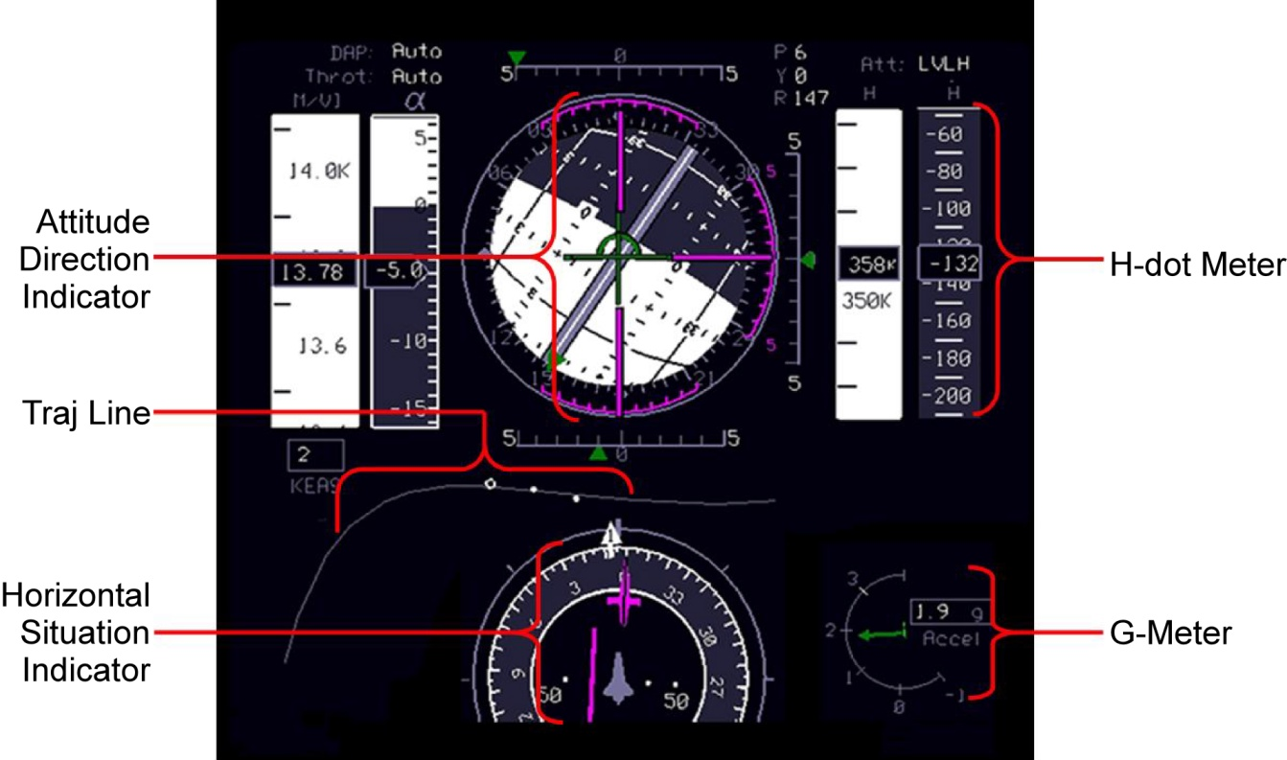
Display Usability Rating Study
(under 1-G and 3.8-G)
2-D Graphical Features
Crew participants rated their
ability to use the PFD
(while ignoring the text)
NASA/TM—2009-215386

Slide 19
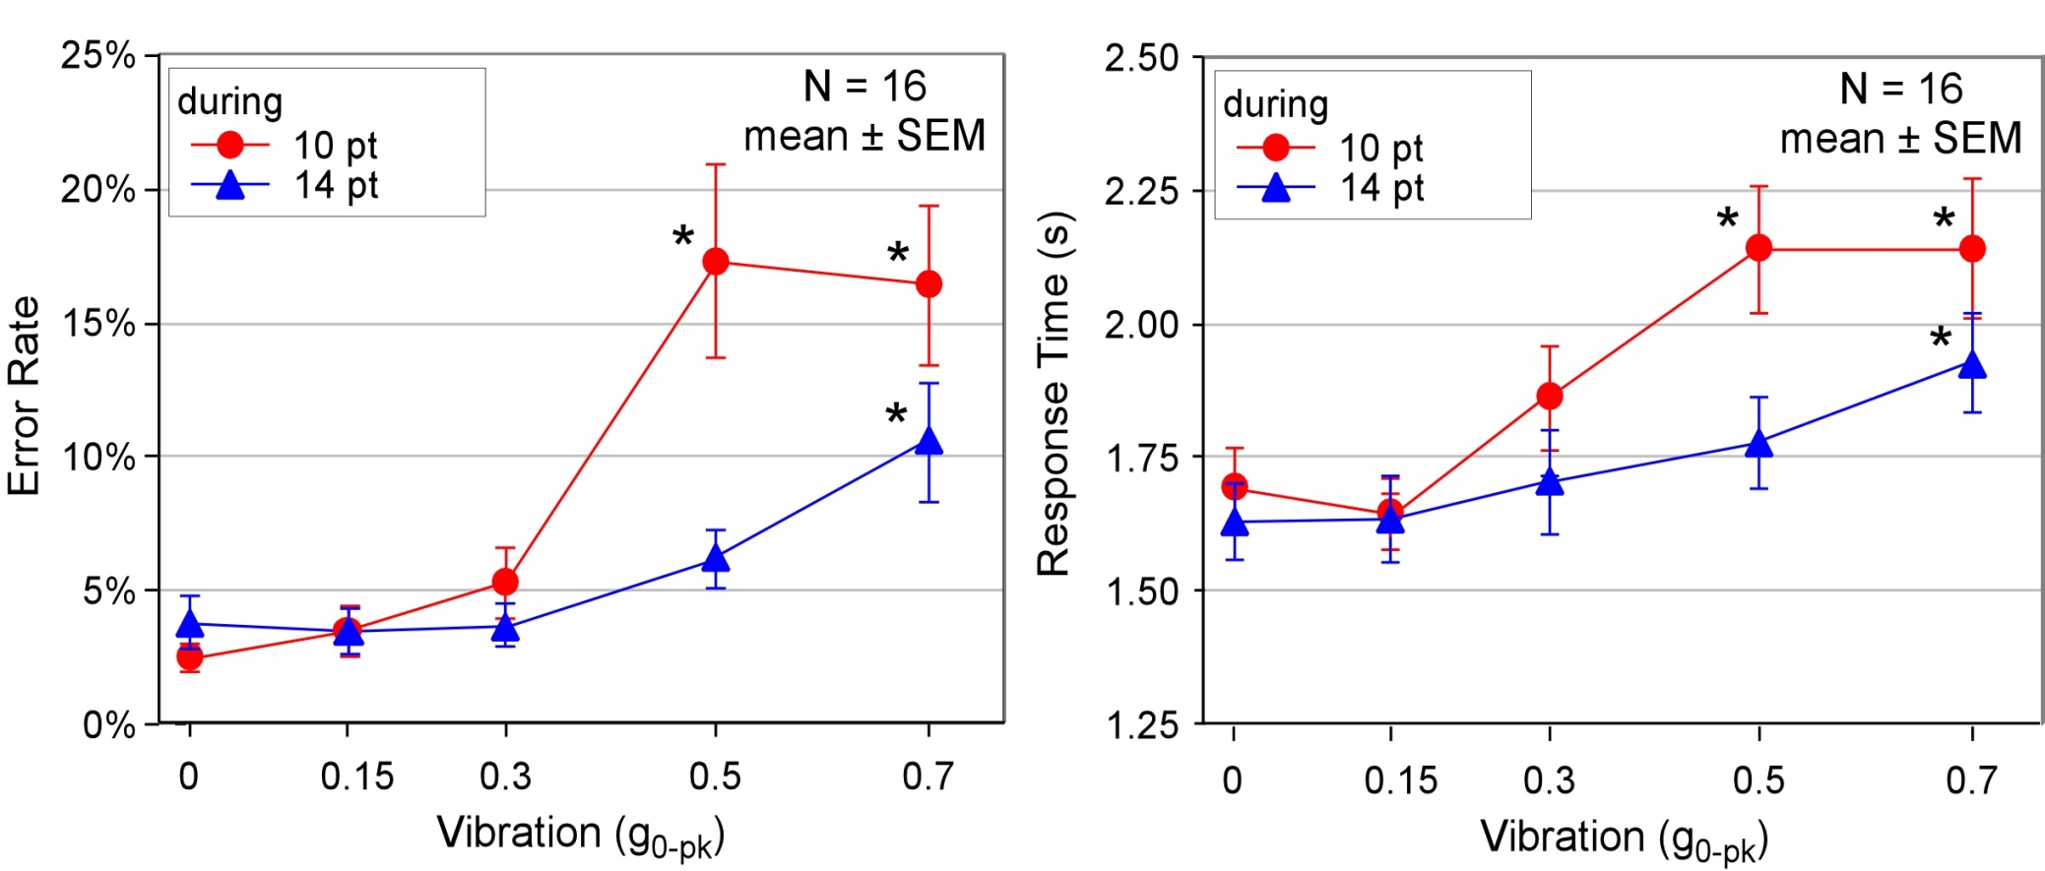
Centrifuge Study (3.8-G): Error Rates
And Response Times During Vibration
Error Rate (ER)
Response Time (RT)
Up to 7-fold increase in mean ER under some conditions (0.5 g for 10-pt)
Up to 450-ms increase in mean RT under some conditions (0.5 g for 10-pt)
NASA/TM—2009-215386
Notes:
Figures from NASA photos from NASA/TM—2009-215386

Slide 20
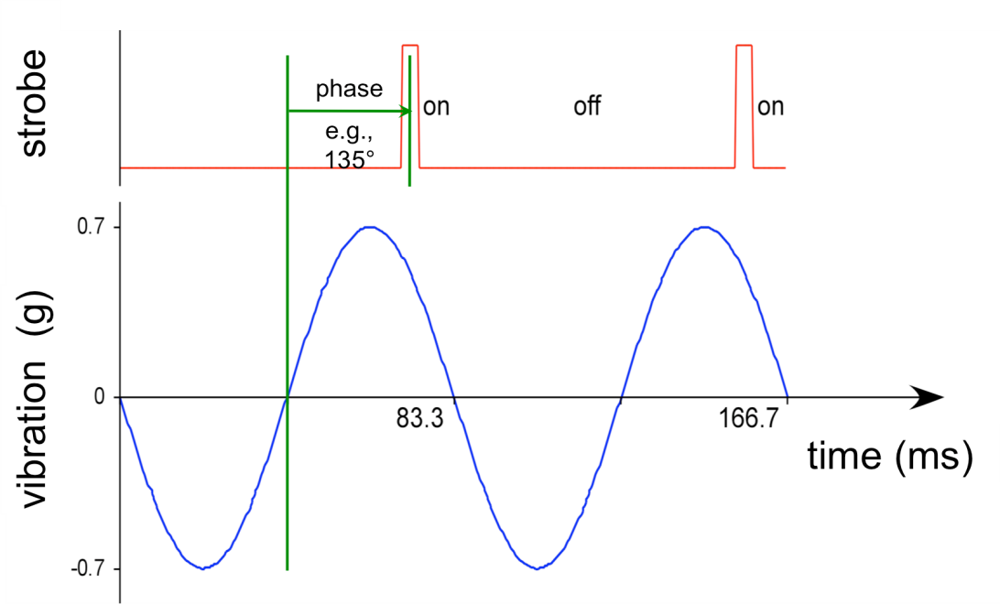
Countermeasure Validation
Inspired from stroboscopic techniques commonly employed for visual inspection of oscillating and/or vibrating machinery
Developed an LCD monitor backlit by an array of LEDs, which could strobe synchronizely with respect to the vibration pattern, adjusting its phase and duty cycle
NASA/TM—2009-215386
Notes:
Figures from NASA photos from NASA/TM—2009-215386

Slide 21
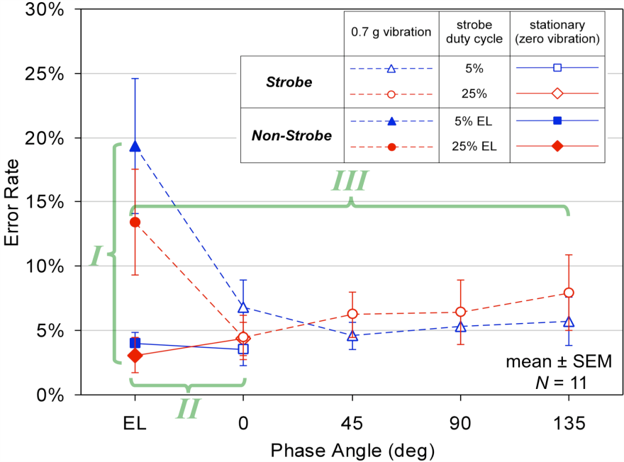
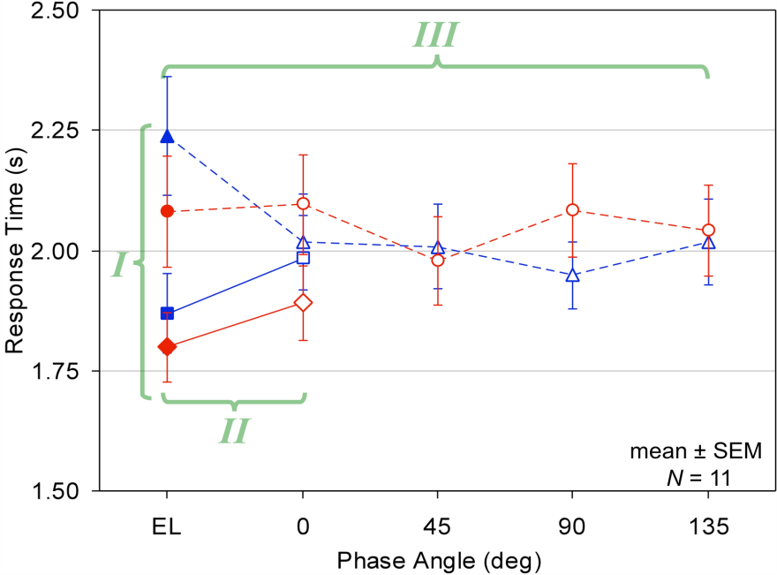
Display Strobe / Vibration Results
(Stationary, 0.7-gx 12 Hz vibration)
In the non-strobe condition, errors quadrupled (3.5% to 16.4%) and response times slowed by 325 ms with vibration, consistent with 0.7-g condition in previous studies. Lower constant luminance (EL) slowed response times by 110 ms.
In the zero-vibration condition, display strobing slowed response times by 110 ms versus a display with comparable constant luminance (EL).
Under 0.7-g vibration, display strobing at 5% duty cycle reduced error rates to ~5%, a level not significantly different than for zero vibration, and sped response times by 240 ms.
NASA/TM—2009-215386
Notes:
Figures from NASA photos from NASA/TM—2009-215386

Slide 22
Vibrations Studies
Study Team Scientists:
ARC/TH: B. Adelstein, B. Beutter, M. Kaiser, R. McCann, L. Stone
JSC/SK: W. Paloski
In Collaboration with:
ARC/TH: M. Anderson, F. Renema, B. Spence, M. Godfroy,
G. Flores, D. Munoz
ARC 20-G Centrifuge Facility: C. Wigley, N. Rayl, T. Purcell, J. Dwyer,
R. Ryzinga, P. Brown, T. Luzod, R. Westbrook, M. Steele, V. Post
ARC Engineering and Hazard Analysis: O. Talavera, M. Ospring, R. Phillips
ARC Chief Medical Officer & HRIRB Chair: R. Pelligra
JSC/CB: P. Root, T. Verborgh, M. Ivins, M. Kelly, L. Morin
JSC/SF: K. Holden
JSC/ILSM-SIG: (TOMCAT) E. Rayos, M. Samir
JSC Engineering: A. Sena, D. Gohmert, B. Daniel
JSC Medical Monitors: J. Jones, R. Scheuring, J. Clark
JSC Video: J. Blair, R. Markowitz
ESMD-HRP: B. Woolford, J. Connolly, D. Russo, D. Grounds
HSIG: J. Dory, J. Rochlis
NESC: C. Null
Orion Project: J. Fox, J. Falker
Participants from ARC community & JSC Crew Office

Slide 23
Conclusions
Human performance studies
  Initial analysis provided human performance requirement, but did not help the rocket
  Insights from human performance provided an ingenious mitigation (US Patent #8,711,462)
  In-house NASA HF expertise enabled Ares program to proceed
    Otherwise, vibration issue would have precluded human-rating of existing Ares I design
    Potential cost impact of hundreds of $Ms
  This and other related acceleration environments continue as risks in all human space flight programs.
Thrust Oscillation Focus Team (TOFT)
  C-spring isolators are intended to work like shock absorbers to detune the launcher
  LOX damper is expected to counter the vehicle’s acoustic response

Slide 24
Lessons Learned
Expertise is critical. Don’t confuse intelligence with expertise
System issues are solved though inclusion
  Cast a wide net
  Do not assume from where the solution will come
Archive data
Write up findings
Beware of solutions for a single condition
Systems management and systems engineering are NOT synonyms
Interconnections may not be obvious
Not everything that is critical for design (or operations) can be found in the requirement or interface documents

