Slide 1

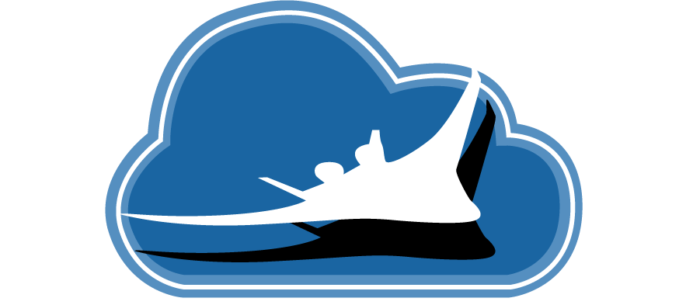

System-Wide Safety
Advanced Safety Management Systems
Business Aviation Safety Summit
May 11th, 2022
Dr. Kyle Ellis
System-Wide Safety Project
NASA Airspace Operations and Safety Program

Slide 2
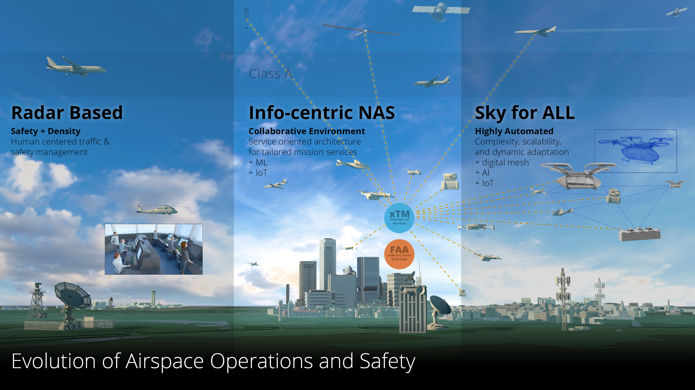
Innovating the Future of Aviation Safety

Slide 3
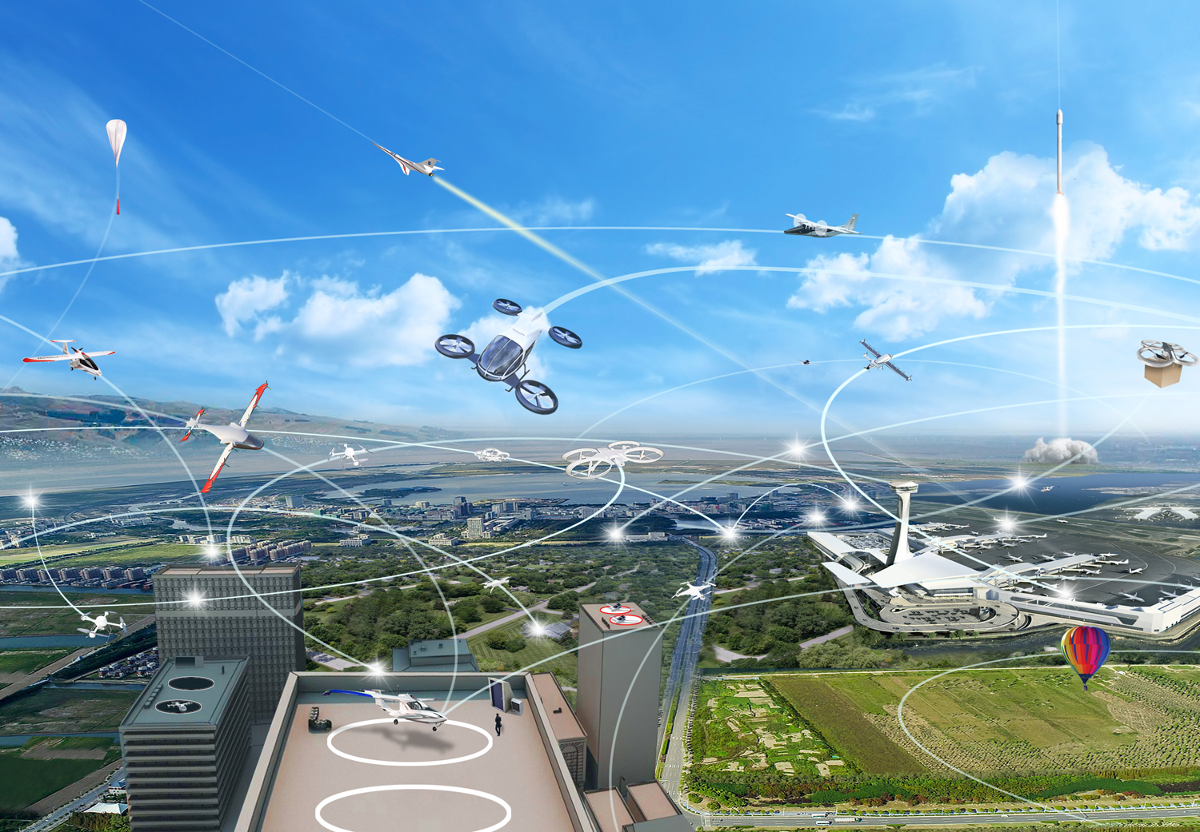
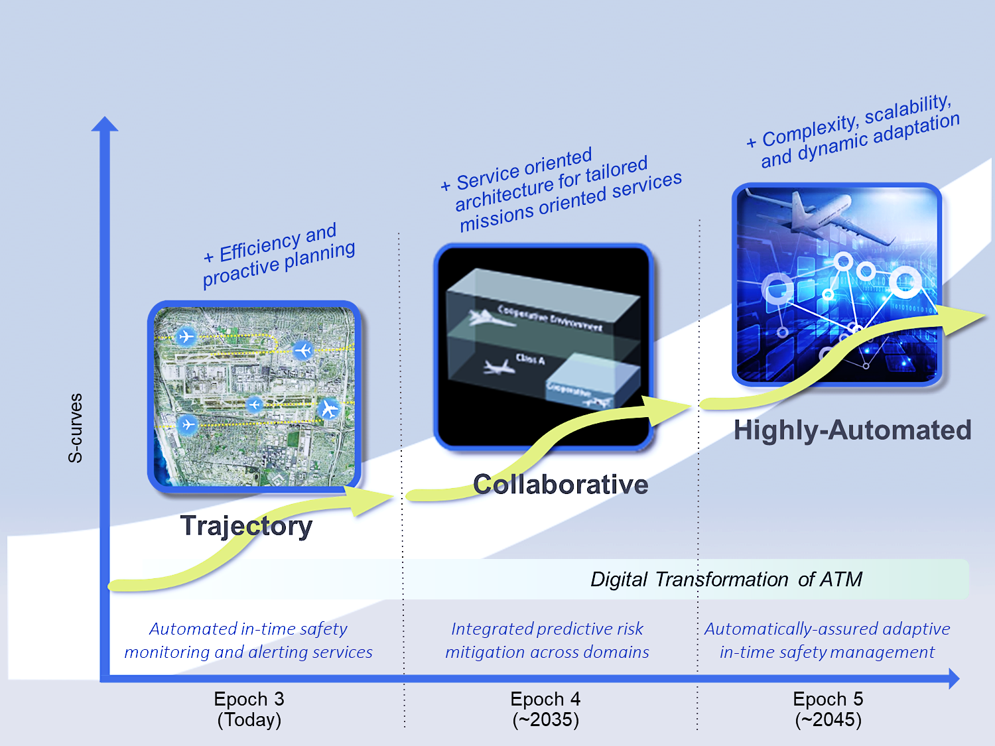
System-Wide Safety Project Goals
To explore, discover, and understand the impact on safety of growing complexity introduced by modernization aimed at improving the efficiency of flight, the access to airspace, and/or the expansion of services provided by air vehicles.
To develop and demonstrate innovative solutions that enable this modernization and the aviation transformation envisioned for the global airspace system through proactive mitigation of risks in accordance with target levels of safety.
Notes:
Future Airspace
Scalable
Accessible to all
Integrated safety
Environmentally friendly
Robust and resilient
Future NAS Operations will need to accommodate a broad range of new vehicles and missions and serve increasingly dense and more complex operations while maintaining or improving safety and efficiency
In order to address the diversity, complexity, density and volume of those operations, higher levels of automation will be required to meet the National Airspace System goals of safety, efficiency, throughput, capacity and individual user goals of mobility, flexibility, and autonomy.
Today’s system is human centric:
Aircraft are designed with human in loop for control, monitoring and safety
Airspace is designed/constrained to allow humans to actively control, ensure safety
The system is very safe, but is not scalable
The system must be highly interconnected and data-driven
Automation will be required to assist/offload humans, increase precision for air- and ground-based systems and perform system health monitoring and risk assessment

Slide 4
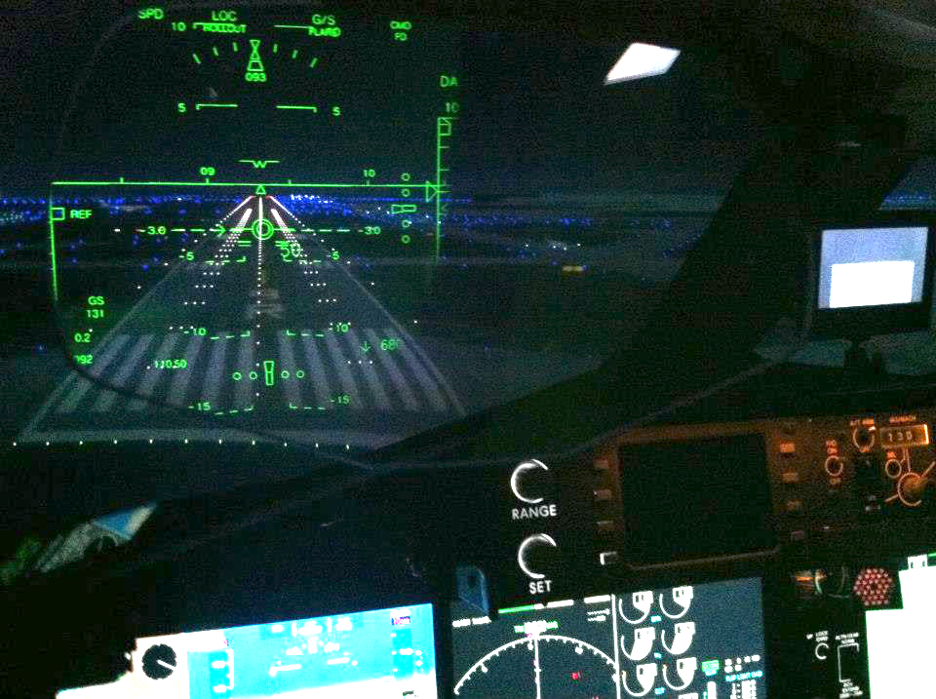
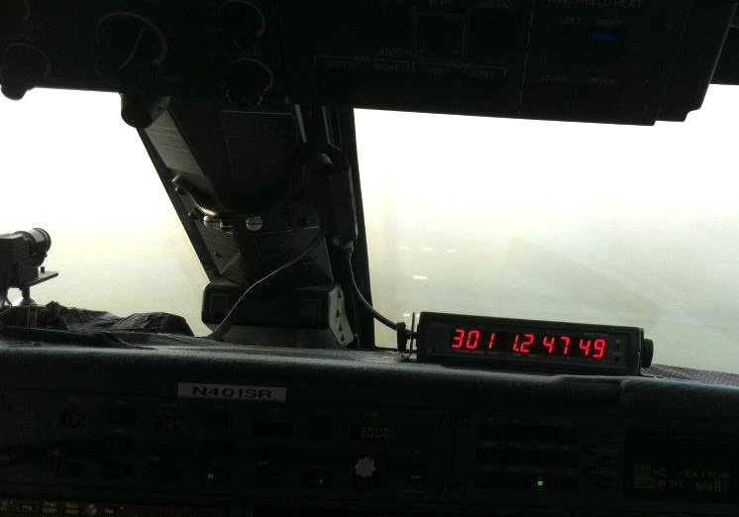
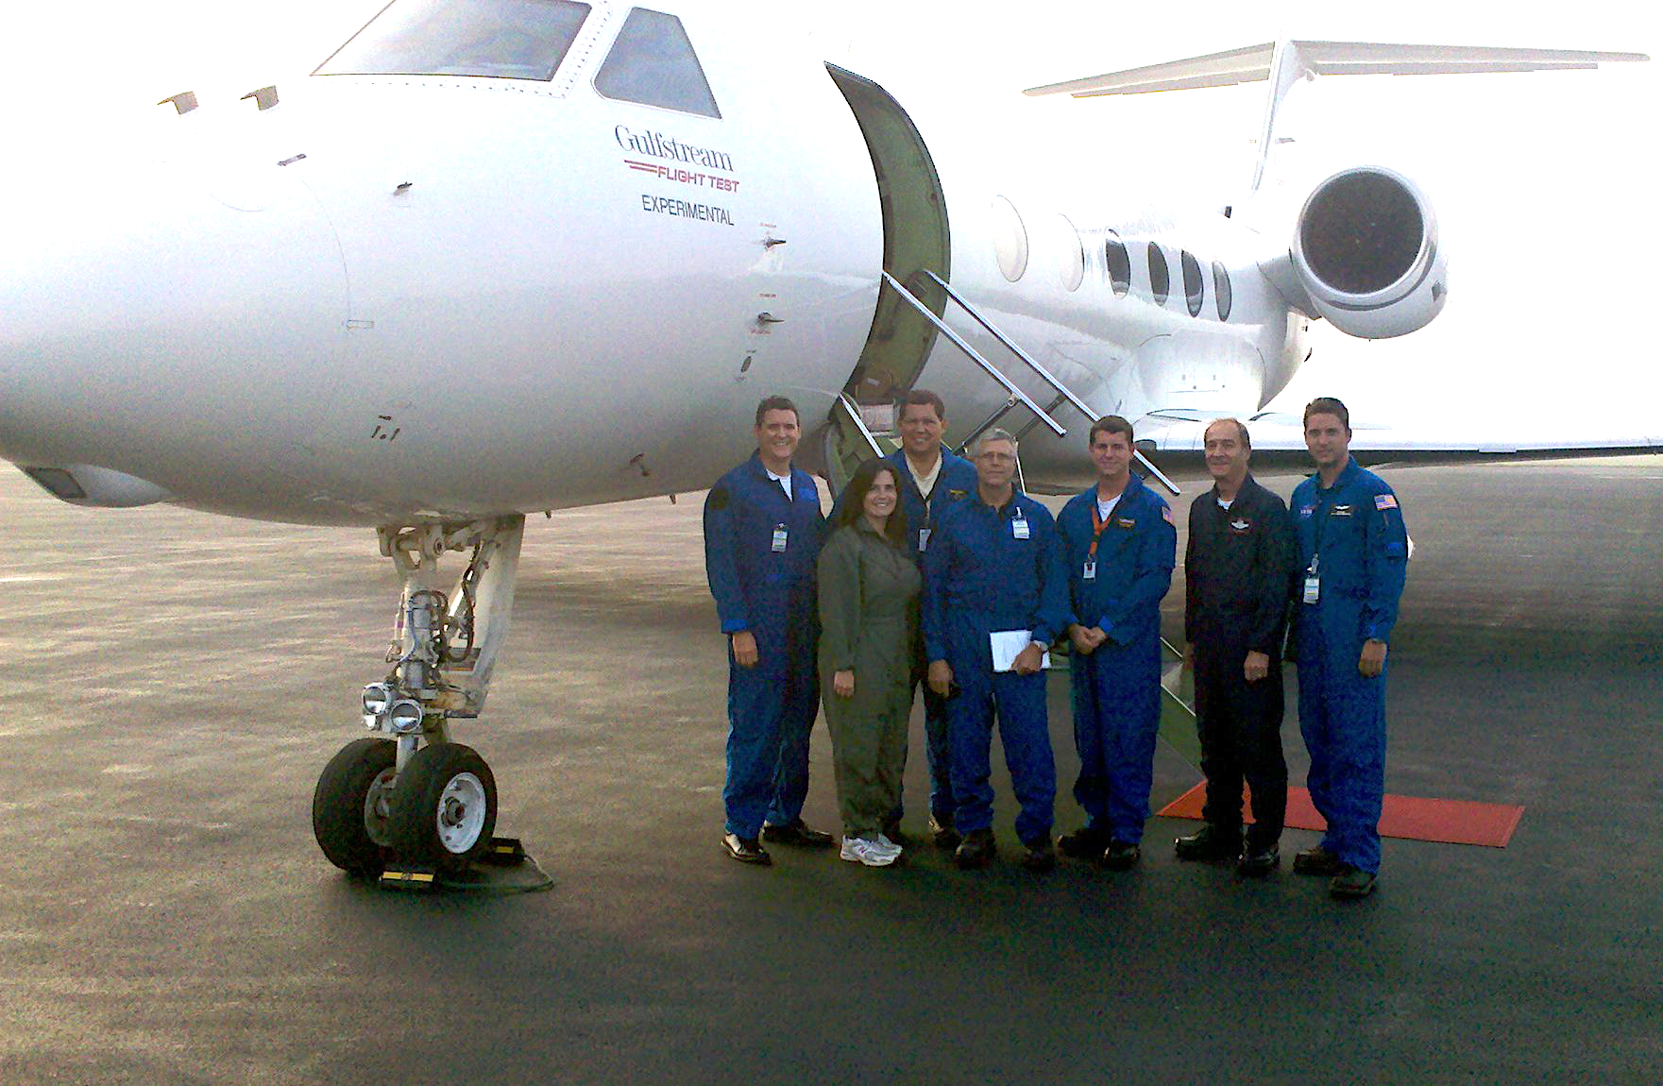
NASA and Aviation Industry
NASA and Industry have a long history of working together toward improving flight operations and aviation safety.
Numerous collaborative efforts have successfully contributed to new innovations in commercial aviation technologies and procedures.
Industry outlining the need has been essential to this success.
Notes:
Shuttle Carrier Aircraft N905NA, in American Airlines livery, with Enterprise in 1978
NASA 905 was built by Boeing in 1970, taking to the skies for the first time on Oct. 15 of that year before being delivered to American Airlines on Oct. 29. Prior to its acquisition by NASA in 1974, the 747 served as a commercial jet for American Airlines

Slide 5
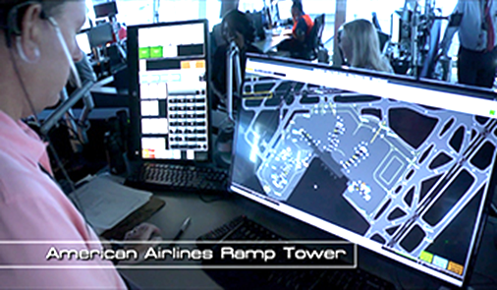
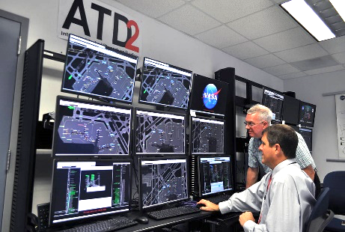
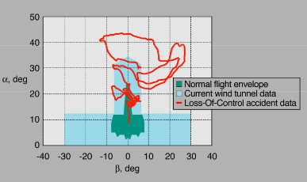
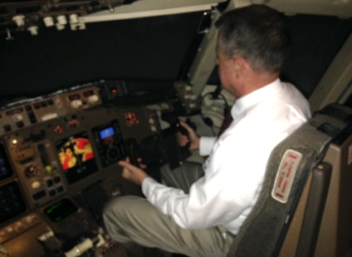
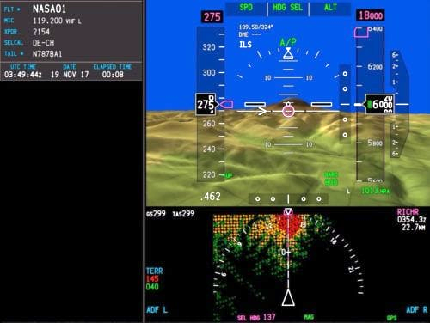
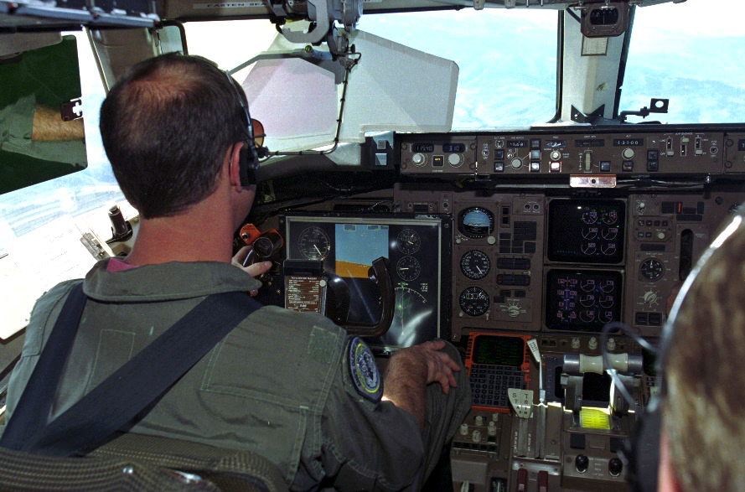
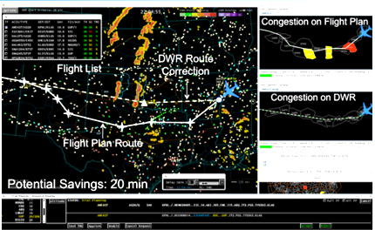
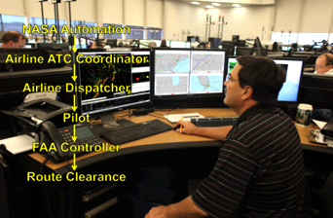
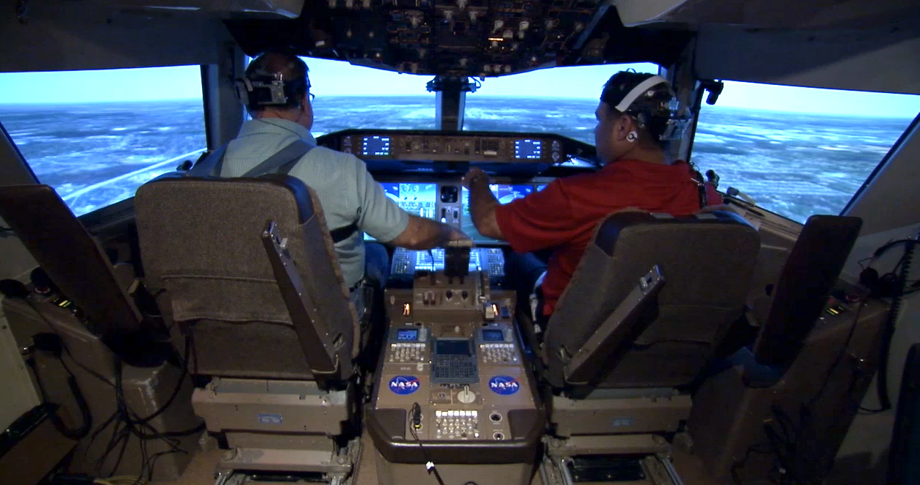
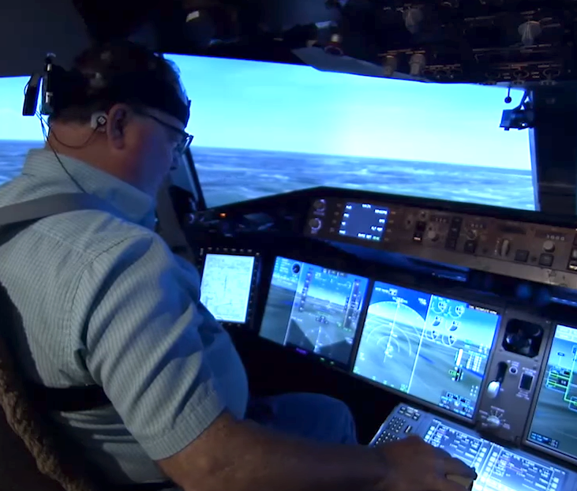
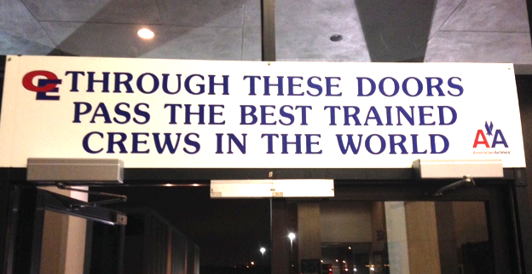
Long History of Working Together
Surface Operation Optimization
Extended Envelope Models
CFIT Mitigation
Integrated Operations Center Tools
Human Performance
LOC-I Mitigation
Pilot Training Development
A Few Examples of Collaborative Efforts (In the Past 10 years)¹
¹ Only Aviation Operations and Safety Program (AOSP) Examples Shown
Notes:
Air Traffic Management (ATM) Technology Demonstration2 (ATD-2) technologies, and tools such as the Spot and Runway Departure Advisor (SARDA) and the Precision Departure Release Capability (PDRC), which were demonstrated with live data from Charlotte Douglas International Airport. The tour also included a presentation on novel surveillance technologies for under-equipped airports, observation of PDRC in operational use at Fort Worth Air Route Traffic Control Center, and an American Airlines (AA) demonstration of the DWR tool at the AA Integrated Operations Center.
NASA researchers visited the American Airlines (AA) Ramp Tower at Charlotte Douglas International Airport North Carolina on April 14-15. Per the terms of a Space Act Agreement between NASA and AA, the NASA team discussed requirements for an operational test of NASA's Spot and Runway Departure Advisor (SARDA) technology. SARDA was developed to reduce taxi times and fuel emissions by monitoring gate delays and providing ramp controllers with departure pushback advisories. The technology has been tested in human-inthe-loop simulations at NASA’s Ames Research Center, most recently with participation from American’s ramp personnel.
ATD-2 surface benefits to AA:
Burned 3,101,434 less pounds of jet fuel. (Airlines measure fuel in pounds as the weight of a gallon of jet fuel can vary by temperature, but in general that figure represents about 462,000 gallons – enough to fill this writer’s Ford Explorer’s gas tank 23,000 times if the aviation fuel wouldn’t wreck the engine.)
Prevented the release of carbon dioxide equivalent to the 71,031 trees you would have to plant in an urban environment to otherwise offset that amount of emissions.
Reduced jet engine runtime by 2,448 hours, which can help increase engine life and lengthen time between scheduled maintenance.
Saved 414.4 hours of surface delay time, which is less time sitting going nowhere.
ATD by phases:
Phase One began in September 2017, introducing the tools and folding in the participation of the FAA’s various air traffic control and management facilities that oversee traffic in and out of Charlotte. Also involved was American Airlines, which directs aircraft surface movements near the airport’s terminal building on behalf of all the airlines there.
Phase Two expanded the scope of the demonstration to include the FAA’s Air Route Traffic Control Center based in Atlanta, which borders the Washington center based in Virginia that was included in Phase One. In addition to a geographic expansion of the demonstration, Phase Two also introduced five new technical capabilities.
Phase Three will focus on coordinating air traffic departing Dallas/Ft. Worth International airport and nearby Dallas Love Field airport and will see Southwest Airlines join American Airlines as participants. Phase Three officially began this month, although the system was put through its paces in a sort of “soft open” earlier in the year.
IOC collaboration: Dynamic Weather Routes (DWR) . continuously analyzes active flights in en route airspace and finds simple route corrections to achieve more time- and fuel-efficient routes around convective weather. A strong partnership between NASA, American Airlines (AA), and the Federal Aviation Administration has enabled testing of DWR in real-world air traffic operations. NASA and AA have been conducting a trial of DWR at AA’s Integrated Operations Center in Fort Worth, Texas since July 2012. Results indicate that AA flights with DWR in use realize about 20% more savings than non-AA flights. A weather forecast analysis examines the extent to which DWR routes rated acceptable by AA users remain clear of downstream weather. A sector congestion analysis indicates congestion could be reduced 19-38% if all flights fly DWR routes rather than nominal weather-avoidance routes. https://pdfs.semanticscholar.org/43b6/10b2883d7d2d14837253633b482be0ba8ff8.pdf

Slide 6
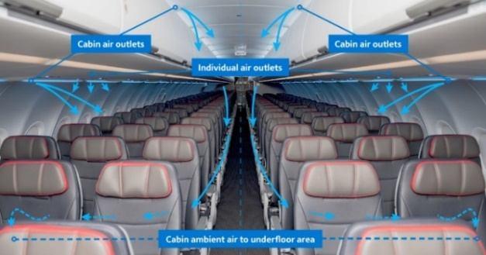
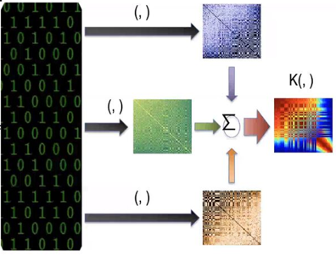
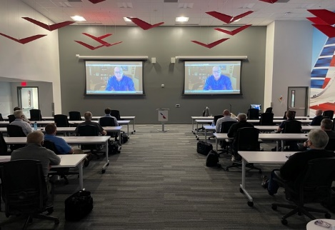

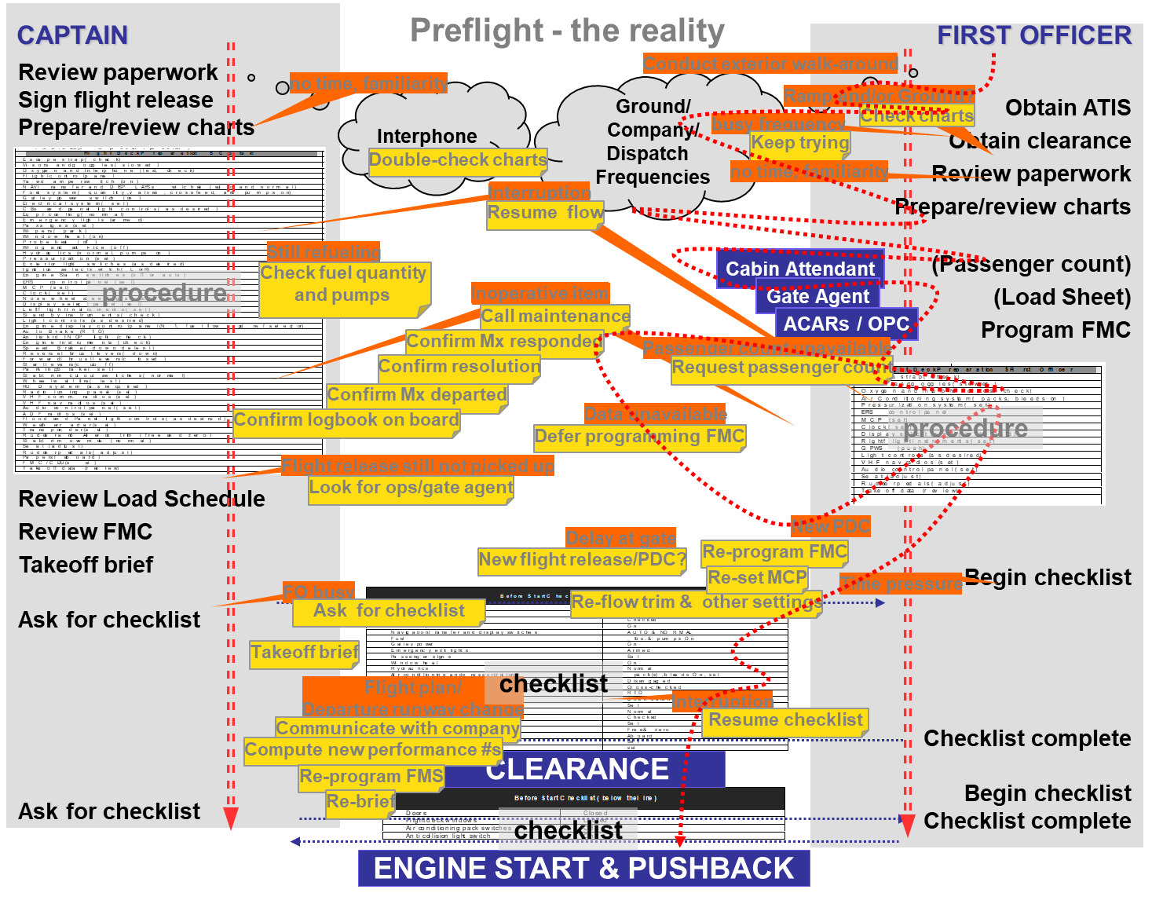


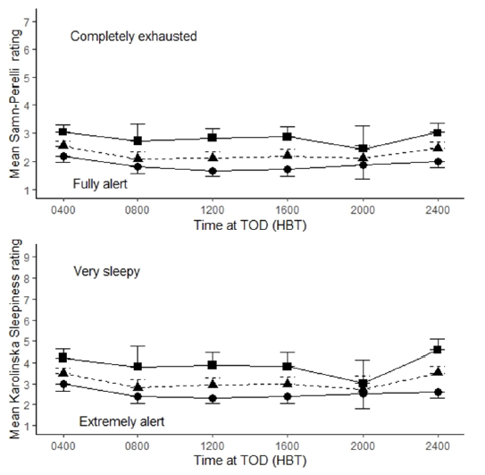
Current Collaborative Opportunities
NASA/AA/APA Training Video
Cabin Air Flow Models¹
Data Analytics (IOC/FOQA)
Training
Distractions (ASAP)
Air Charter Safety Foundation?
“Pilots Causing Safety”
(LOSA/LIT)
Fatigue (FRMS)
¹ Part of COVID-19 Return-To-Service Team w/ Computational Fluid Dynamics Group

Slide 7
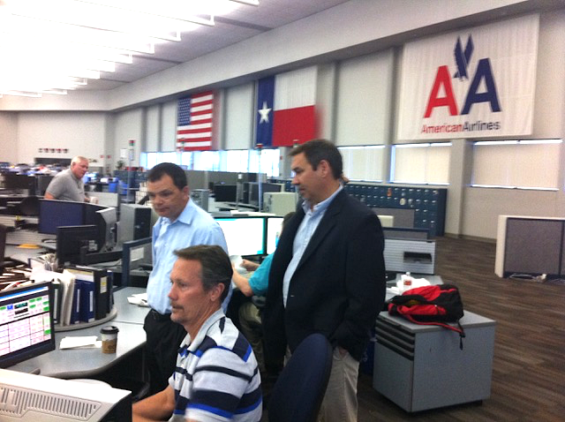
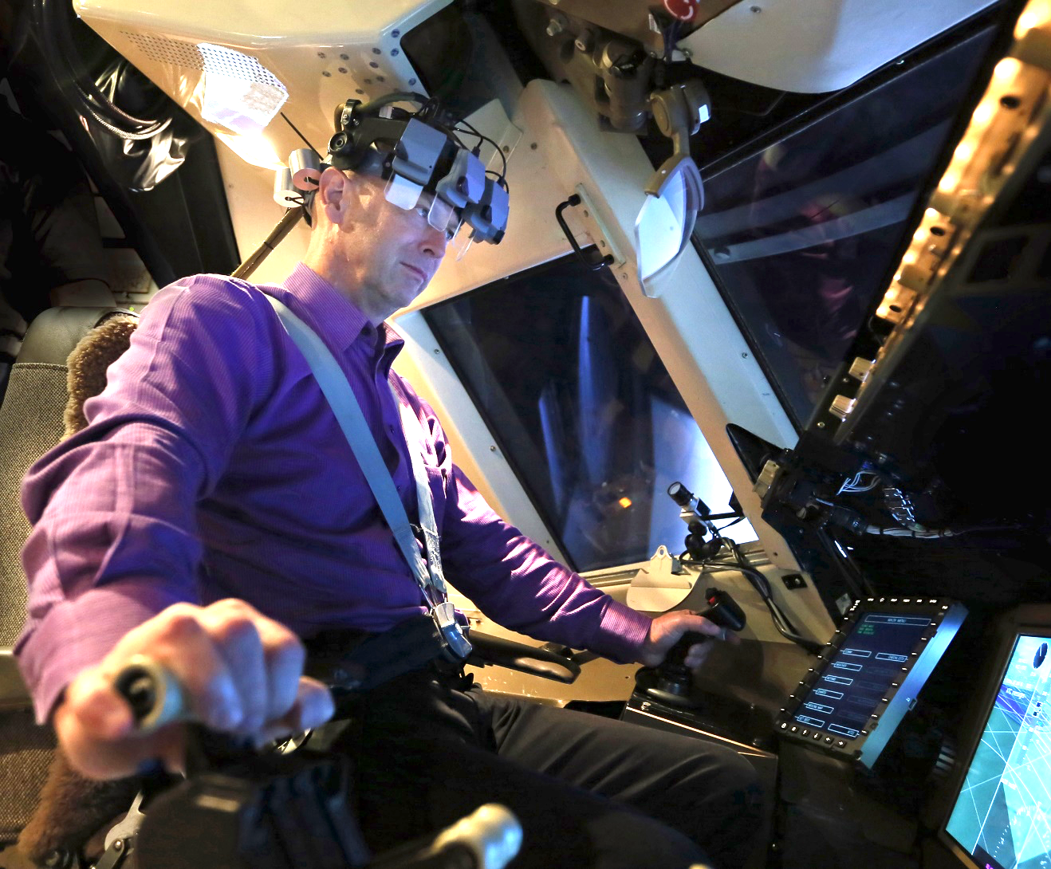

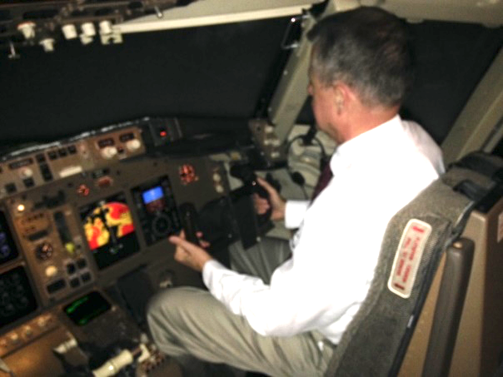
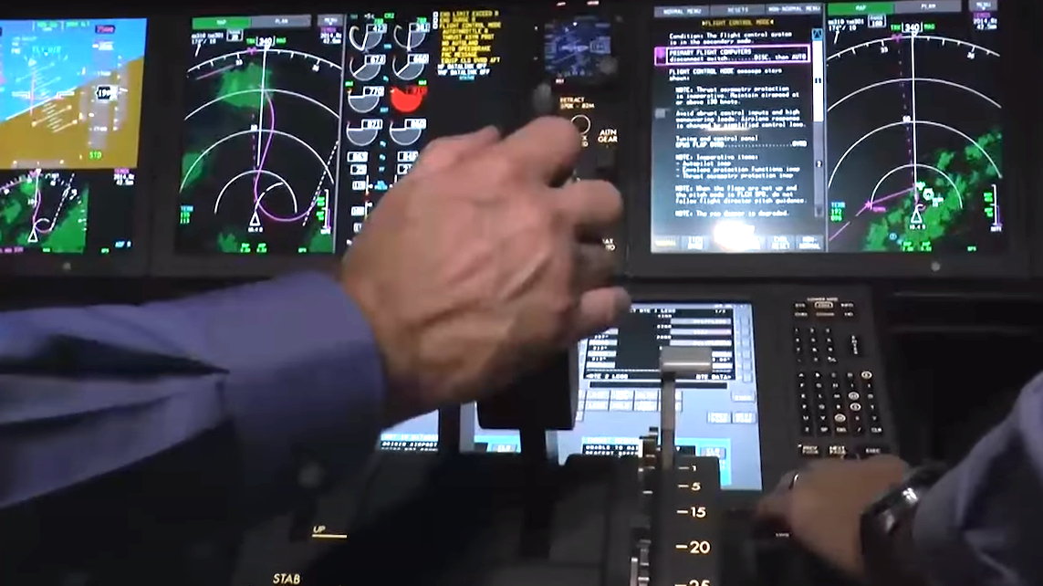
The Benefit to NASA
Collaborate with Professionals
Apply New Advances
Evaluate New Technologies
Observe Actual Practice
Subject Matter Experts
Scientific Data

Slide 8



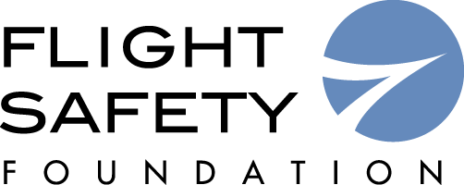

The Benefit To Industry
Continued Investments in
Safety Data Analytics
Continued Engagement in Research on Aviation Safety
Continued Leadership of
Safety Management Systems
Working Together on Collaborative Efforts To Advance Safety

Slide 9

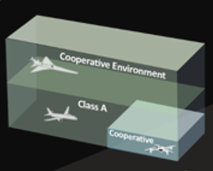
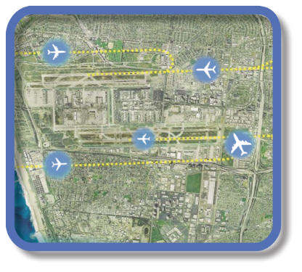

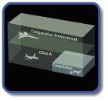


Evolution of Airspace Operations and Safety
+ Complexity, scalability,
and dynamic adaptation
+ Service oriented architecture for tailored mission-oriented services
+ Efficiency and proactive planning
S-curves
Highly-Automated
Collaborative
ML/AI – based dynamic, robust
performance and safety
Trajectory
Connected,
performance-based,
collaborative ATM
Machine-to-machine
interactions and humans collaborate
Know & exchange
current and planned a/c positions
Introduces 3rd-party
service providers
Digital Transformation of ATM
Automated in-time safety
monitoring & alerting services
Integrated predictive risk
mitigation across domains
Automatically-assured adaptive
in-time safety threat management
Epoch 3
Epoch 4
(~2035)
Epoch 5
(~2045)

Slide 10
From Reactive to Proactive to Predictive SMS
¹ https://www.faa.gov/about/initiatives/sms/explained/basis/
Responds to events that have already happened, such as incidents and accidents
PROACTIVE
(Present)
Analyzes system processes and environment to identify potential/future problems
REACTIVE
(Past)
Actively seeks the identification of hazardous conditions through the analysis of the organization’s processes
PREDICTIVE
(Future)
Adapted FAA Graphic¹

Slide 11
Achieving Aviation Safety Today
Air Transportation Safety
International Civil Aviation Organization, "Safety Management, Standards and Recommended Practices - Annex 19," in Convention on International Civil Aviation, 2nd Edition, 2016
Overall
Safety Management System
Safety Policy
Risk Management
Safety Assurance
Safety Promotion
Broad Safety Objectives
Hazard Identification
Data Collection
Safety Training
RM Controls
Data Analysis
Dissemination of Information
Responsibility & Accountability
Safety Performance
Resource Prioritization
Safety Culture
Labor intensive
Limited ability to scale
Not fast enough
Notes:
Use Loss of Control In-Flight (LOC-I) example with the work NASA did under the TASA sub-project
LOC-I was identified as leading cause of aviation fatalities (Boeing, 2010)
JSAT reviewed accidents for causal factors
JSIT identified 270 intervention strategies to address causal factors
CAST developed 15 Safety Enhancements to formalize efforts to assure safety going forward
NASA-led TRL advancement on 6 research Safety Enhancements
JIMDAT received NASA-led research on SE advancement and working with industry to implement
Process took 4+ years… which was considered fast

Slide 12
Near-Term Needs and Impact
Need: Wide variation of operator size and complexity of operations necessitates the development of tools and processes to quickly (in-time) mitigate risks and hazards effectively and economically.
Objective: Rapidly evaluate existing and discover new patterns in data that lead to negative outcomes before the next safety event occurs.
Impact: Improved speed and characterization of system-wide risk identification to augment existing SMS processes supporting risk management and safety assurance.
Notes:
Sometimes your precursor is in someone elses data.
Right now we can do it with single data sources. These technologies allow us to do something that nobody else can do right now and that is system-wide risk assessment.

Slide 13
How We Achieve Aviation Safety Tomorrow
Air Transportation Safety
International Civil Aviation Organization, "Safety Management, Standards and Recommended Practices - Annex 19," in Convention on International Civil Aviation, 2nd Edition, 2016
Safety Policy
In-Time System-Wide Safety Assurance
(ISSA)
Safety Promotion
In-Time Aviation Safety Management System (IASMS)
Services, Functions, Capabilities
Monitor
—
Assess
—
Mitigate
Broad Safety Objectives
Safety Training
Hazard Identification
Data Collection
RM Controls
Data Analysis
Dissemination of Information
Responsibility & Accountability
Safety Performance
Resource Prioritization
Safety Culture
Services, Functions, and Capabilities Help to Inform and Execute Risk Management and Safety Assurance Actions
Notes:
This is accomplished by developing Services, Functions, and Capabilities (SFCs) that perform the 6 key elements of Risk Management and Safety Assurance with reduced levels of human interaction and dramatically increased responsiveness (In-Time).

Slide 14
How We Achieve Aviation Safety Tomorrow
Air Transportation Safety
International Civil Aviation Organization, "Safety Management, Standards and Recommended Practices - Annex 19," in Convention on International Civil Aviation, 2nd Edition, 2016
Safety Policy
In-Time System-Wide Safety Assurance
(ISSA)
Safety Promotion
In-Time Aviation Safety Management System (IASMS)
Services, Functions, Capabilities
Broad Safety Objectives
Manage
Known
Operational Risks
Inform
Improved
System Designs
Safety Training
Identify
Unknown
Risks
Dissemination of Information
Responsibility & Accountability
Safety Culture
Quickly manage known operational risks at scale
Quickly identify unknown risks
Quickly inform design

Slide 15
Safety Intelligence & Learning Organization
Predictive Safety |  | Learning underlying relationships Machine learning with data analytics Human performance modeling Actionable safety data
Proactive Safety |  | Learning from everyday successes Continuous learning Diagnosis/prognosis of leading indicators/precursors
Reactive Safety |  | Learning from what went wrong Learning from few events Identify/mitigate causal factors to prevent reoccurrence

Slide 16

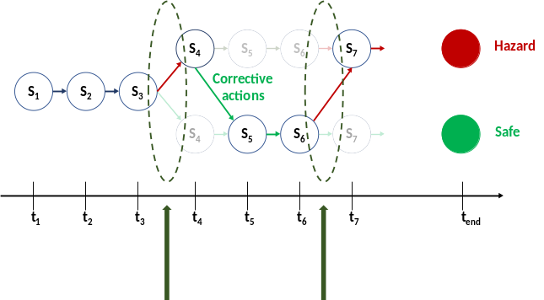
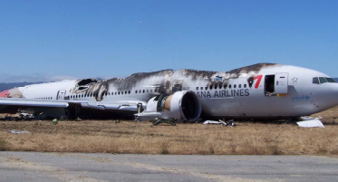

Expanding Our Safety Intelligence
Unknown Risk
Proactive Safety
Predictive Safety
Reactive Safety
FOQA
ASAP
LOSA
NTSB Asiana 214
report
Less Data
Limited Number
of Accidents
Current Numbers
Of Everyday Flights
Large Number
of Future Flights
More Data

Slide 17

In-Time Aviation Safety Management Systems
R&D Required:
Needs
Monitor
New Safety Databases
Non-traditional data
Data Fusion w/existing services
Required vs. Voluntary Data
Synthetic Data Generation
SRM
SA
In-Time Safety Risk Mitigation
Proactive -> Predictive Safety Management Systems
Adopt ML/AI for predictive analysis and advanced data mining
Build upon existing IT architectures for increased access to data and tools
Improve system agility and responsiveness
System
Description
(Analysis)
System
Monitoring
Description and Context
Hazard
Identification
Data
Acquisition
Specific
Information
Assess
ML/AI Anomaly Detection
Predictive Risk Assessment
Multi-Risk Safety Prognostics
Integrated Risk Assessments
Digital Twin Assessments
Data Exchange Architecture
Digital Information Service Integration
Risk
Analysis
Analysis of Data
Analysis
Risk
Assessment
System
Assessment
Assessment
Mitigate
Pre-Flight Mitigation
In-Flight Mitigation
Post-Flight Mitigation
Re-Design Consideration
Risk
Control
Corrective
Action
Action: Problem Resolution
5/5/22
Assure
Figure from FAA AC No: 120-92B, Safety Management Systems for Aviation Service Providers
Notes:
Future NAS Operations will need to accommodate a broad range of new vehicles and missions and serve increasingly dense and more complex operations while maintaining or improving safety and efficiency
In order to address the diversity, complexity, density and volume of those operations, higher levels of automation will be required to meet the National Airspace System goals of safety, efficiency, throughput, capacity and individual user goals of mobility, flexibility, and autonomy.
Today’s system is human centric:
Aircraft are designed with human in loop for control, monitoring and safety
Airspace is designed/constrained to allow humans to actively control, ensure safety
The system is very safe, but is not scalable
The system must be highly interconnected and data-driven
Automation will be required to assist/offload humans, increase precision for air- and ground-based systems and perform system health monitoring and risk assessment

Slide 18

Current Safety Management Systems Process
DATA COLLECTION
DISTILLATION & REVIEW

Slide 19
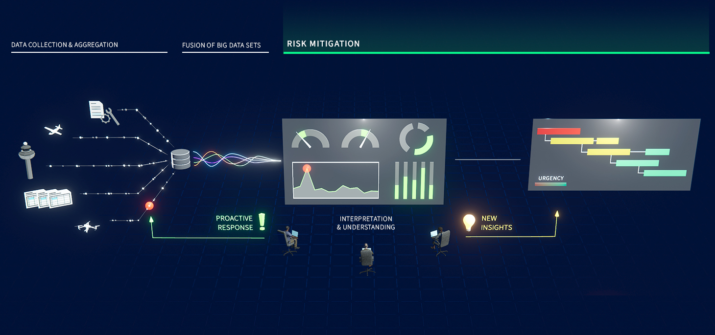
In-Time Aviation Safety Management Systems

Slide 20

20

