Slide 1
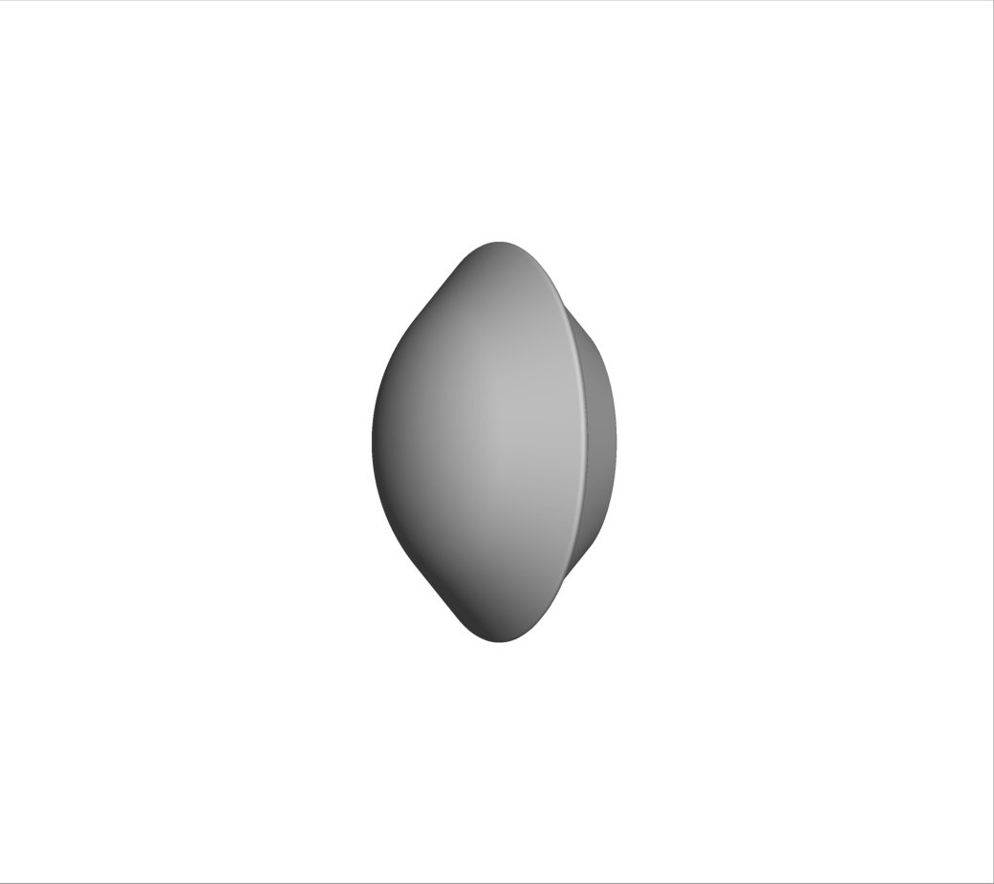
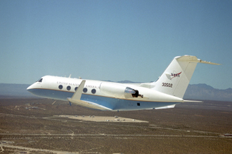
Simulations of Hayabusa2 Atmospheric Entry & Comparisons with Data from the Imaging Campaign
Dinesh K. Prabhu, David A. Saunders, Brett A. Cruden
AMA, Inc. at NASA Ames Research Center, Moffett Field, CA 94035, USA
Jay H. Grinstead
NASA Ames Research Center, Moffett Field, CA 94035, USA
Friday, July 1, 2022
This material is a work of the U.S. Government and is not subject to copyright protection in the United States.
Notes:
Hello all. Thank you for coming to this talk on simulations of the atmospheric entry of Hayabusa2 and comparisons with measured data acquired in an airborne imaging campaign
I am presenting this talk on behalf of my co-authors David Saunders, Brett Cruden, and Jay Grinstead – all from NASA Ames Research Center.
I’ll begin with a brief background and state what the objective is of the present work.

Slide 2
Problem Statement
Given:
  The best-estimated trajectory (BET) of the SRC [data provided by JAXA]
  Slant range and view angle (between observer/instrument and SRC) [data provided by NASA LaRC]
  Radiometrically calibrated irradiance measurements [data provided by Torch Technologies]
    Spectrally and temporally resolved data, but no spatial resolution
Compare against flight measurements:
  Irradiance computed using models, methods, and tools developed at NASA ARC
Afterthought:
  Validation (of models) might be too strong term to use in the present context
Methods and models would be of use in the future airborne imaging campaign for OSIRIS-REx
Notes:
Given 3 inputs: (i) BET, (ii) slant range and view angle, and (iii) measured spectral irradiance.
The objective is to compute and compare simulated irradiance with measurements
The techniques and models would be very useful for OSIRIS-REx

Slide 3
Steps of the Simulation Process
Flow field computation [Dplr]
Material thermal response to imposed aerothermal environments [Traj+Fiat]
Geometric construction of the imaging plane and lines of sight [Cfdtools]
High-resolution spectral radiance computations on imaging plane, incl. “adaptation” of lines of sight [Neqair]
Atmospheric transmission & (solid) angular integration to obtain high-resolution spectral irradiance [Neqair]
Convolution with slit function for final spectral irradiance [Neqair]
Complete details of methods/tools used are in the written paper
All tools (including atmospheric transmission) used in the simulation process have been developed in-house
Notes:
The 6 steps of the simulation process are listed here. These steps are discussed in detail in the written paper
The 22-species model accounts for CO2, Ar, and H2O – all trace species in the atmosphere. The intent is to see what impact atmospheric composition has on the results.

Slide 4
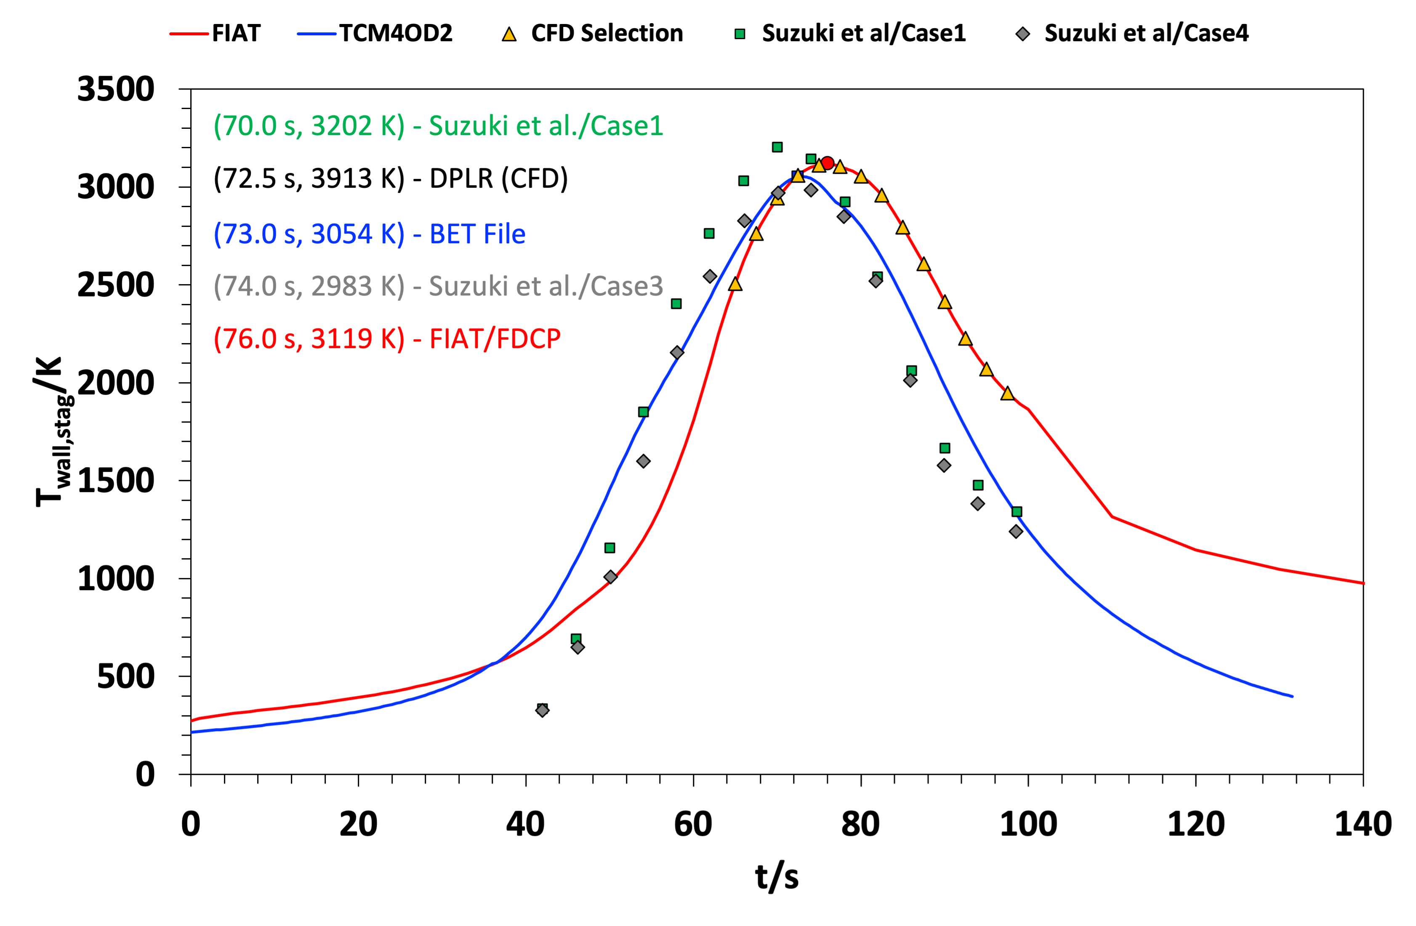
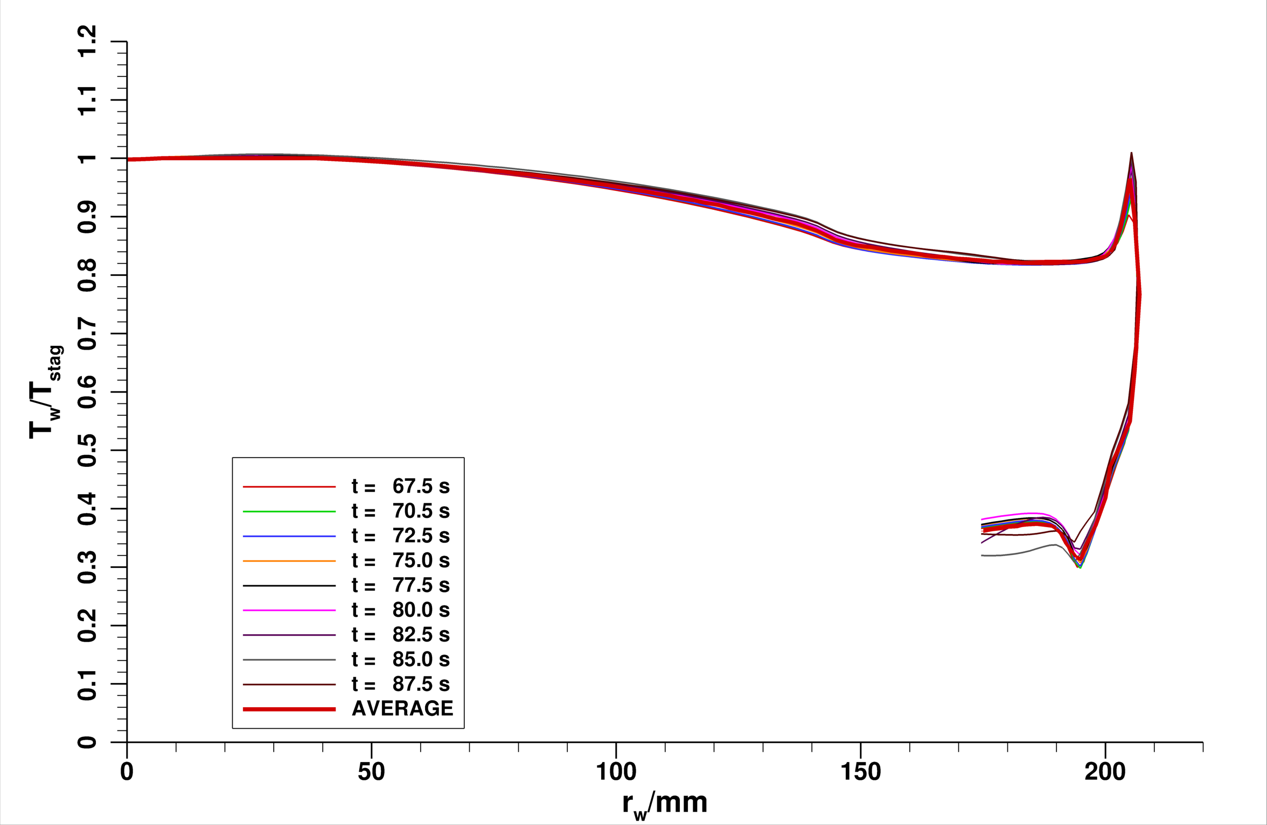
Approximate Material Thermal Response
Dplr predicted surface temperature
normalized by stag. point value
Stag. point temperature
Suzuki et al., JSR, 51(1), 2014
Normalize the surface temperature distribution at a time instant by the stagnation point value
  Flowfield is laminar, there is no shape change
Assume normalized surface temperature distribution is invariant in time
  Problem reduced to determining one variable – stagnation point temperature
Could use 1D material response code, Fiat, integrated into 3DOF trajectory code, Traj, for some choice of material, e.g., FDCP
  Mass densities of CFRP and FDCP are close, but emissivity (of char) is likely to be different
Notes:
Material response is a key step in the simulations.
There are papers on Hayabusa surface temperatures. Although useful, a true materials response solver would also provide information (number densities) of pyrolysis species, which must be included in radiance computations.
Seeing that the surface temperature distributions collapse around a mean when normalized, we assume the distribution to hold for all time. The problem then reduces to just the knowledge of temperature at the stagnation point.
In hindsight, we probably should have used the results of Suzuki et al. from Hayabusa imaging. However, we decided to use the combination of FIAT and TRAJ. TRAJ constructs the 3DOF flight trajectory of Hayabusa2 given the geometry and entry state. The built-in correlations for stagnation point aerothermal environments are then used to determine the thermal response of an assumed material, full-density carbon-phenolic in this case. The predicted stag. Temperature is then used with the normalized surface temperature distribution to construct a new surface temperature distribution. Flow computations are performed with this new distribution.

Slide 5
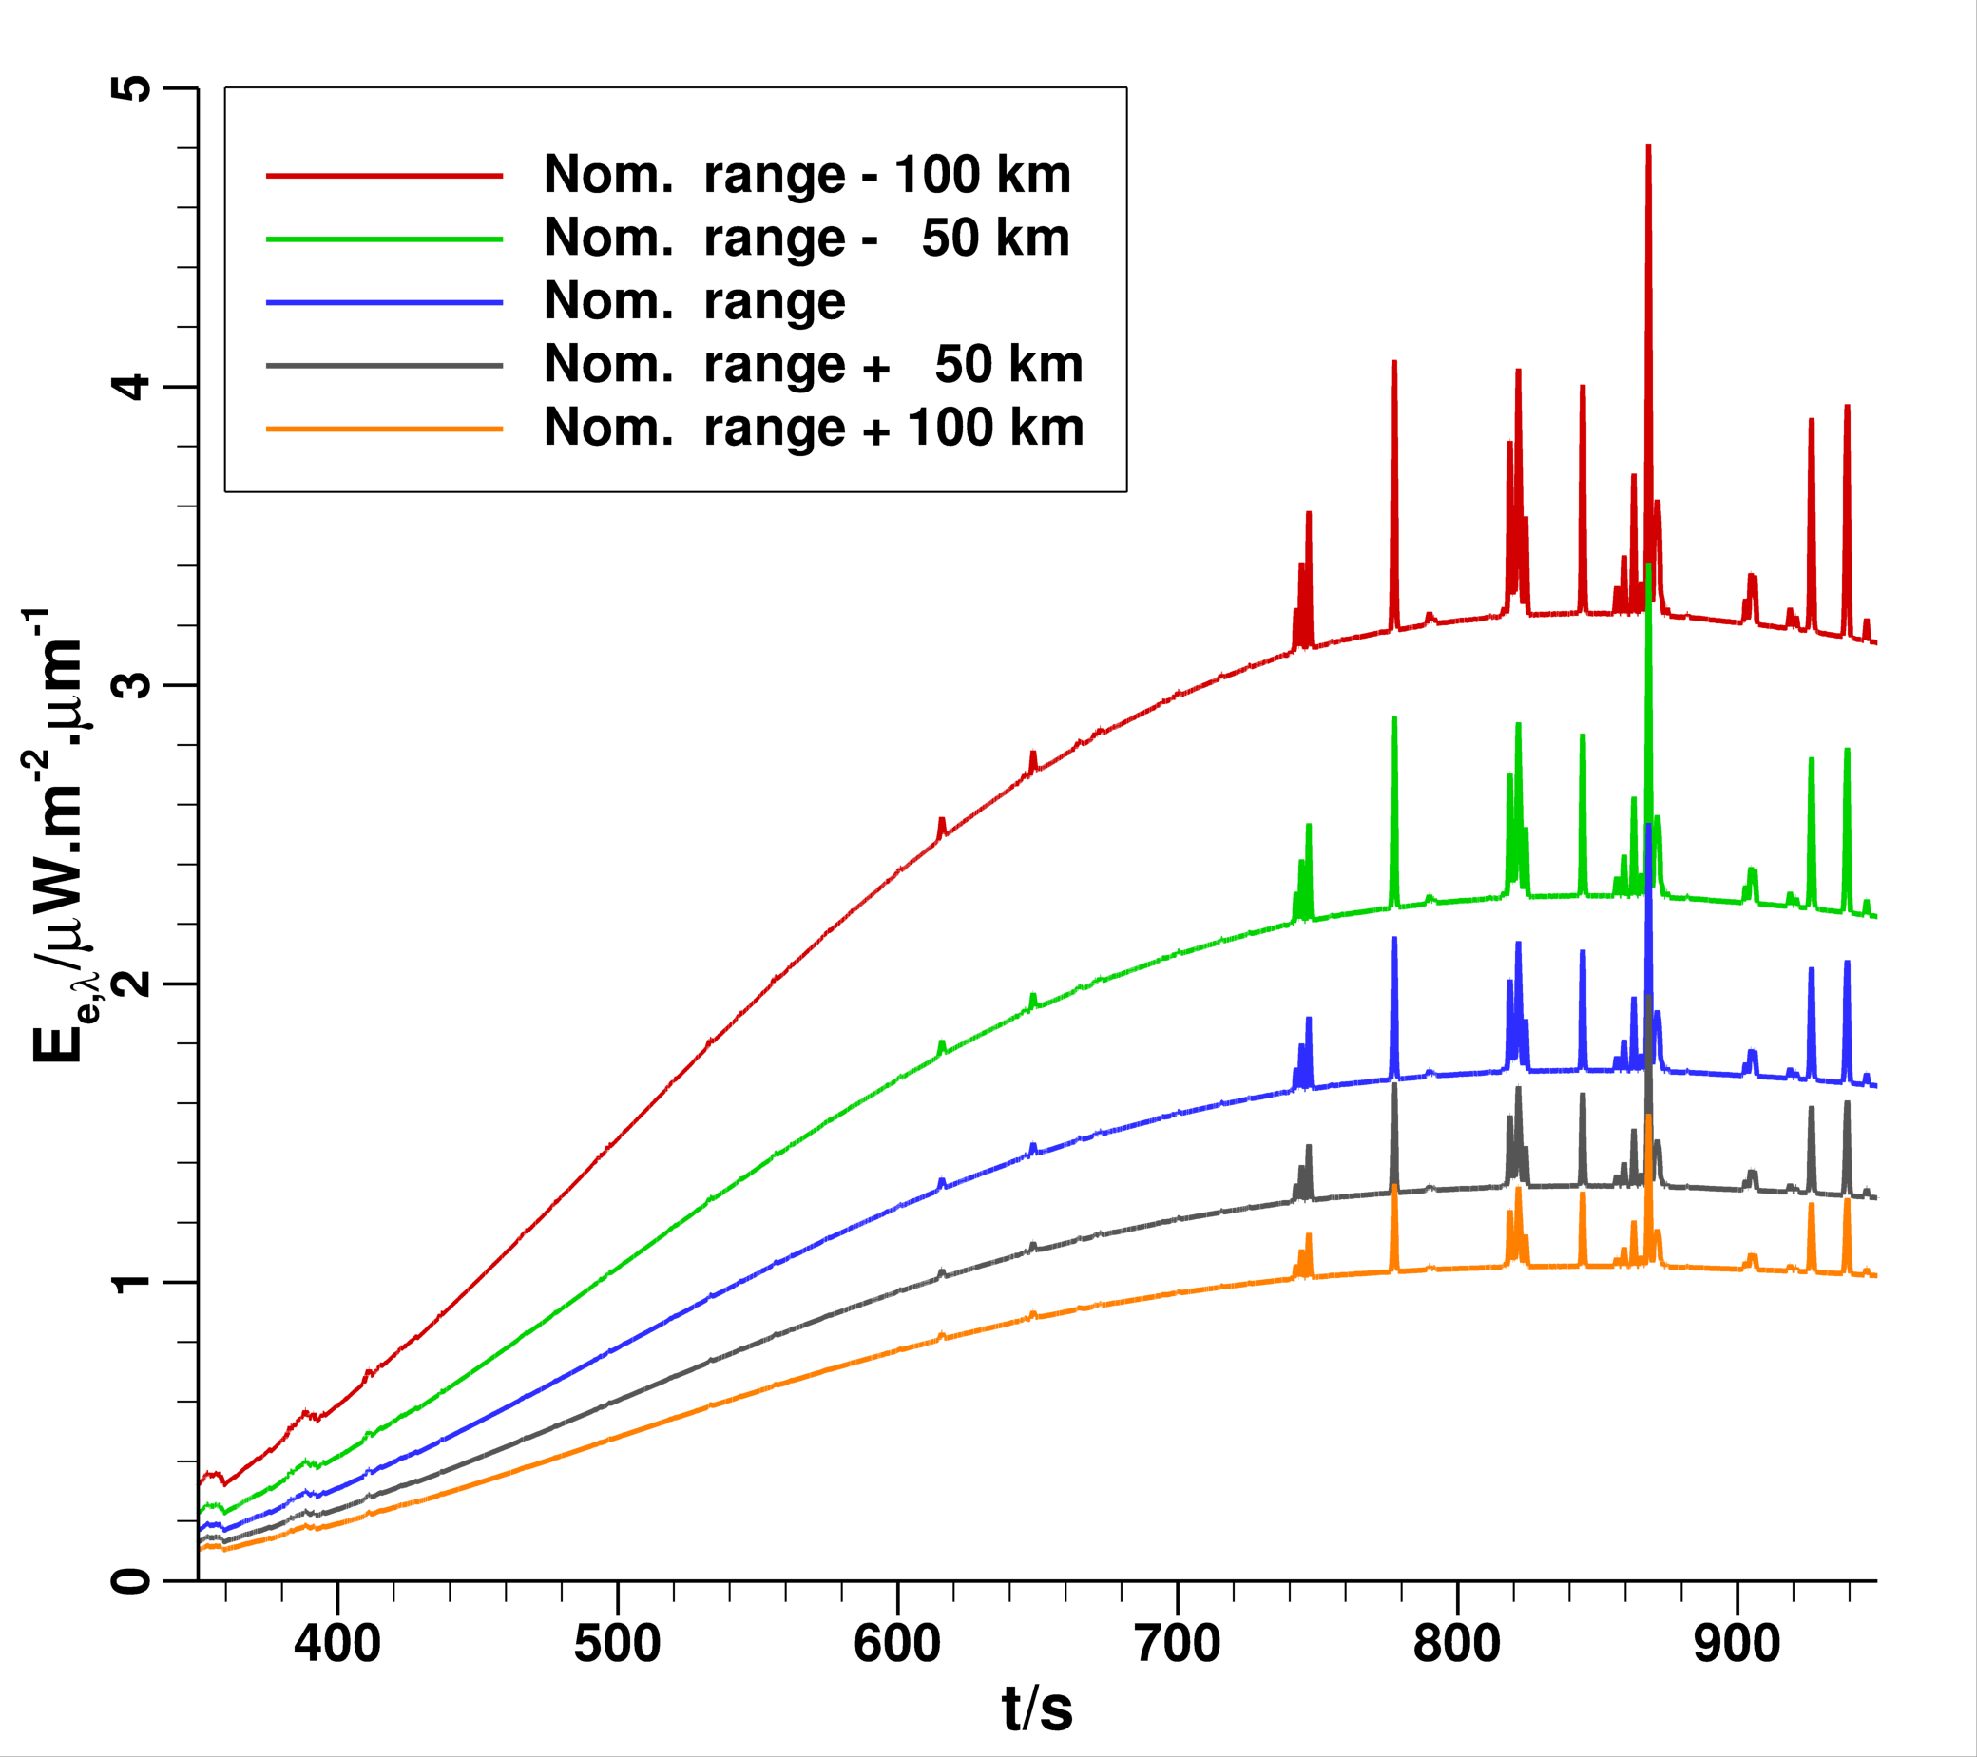
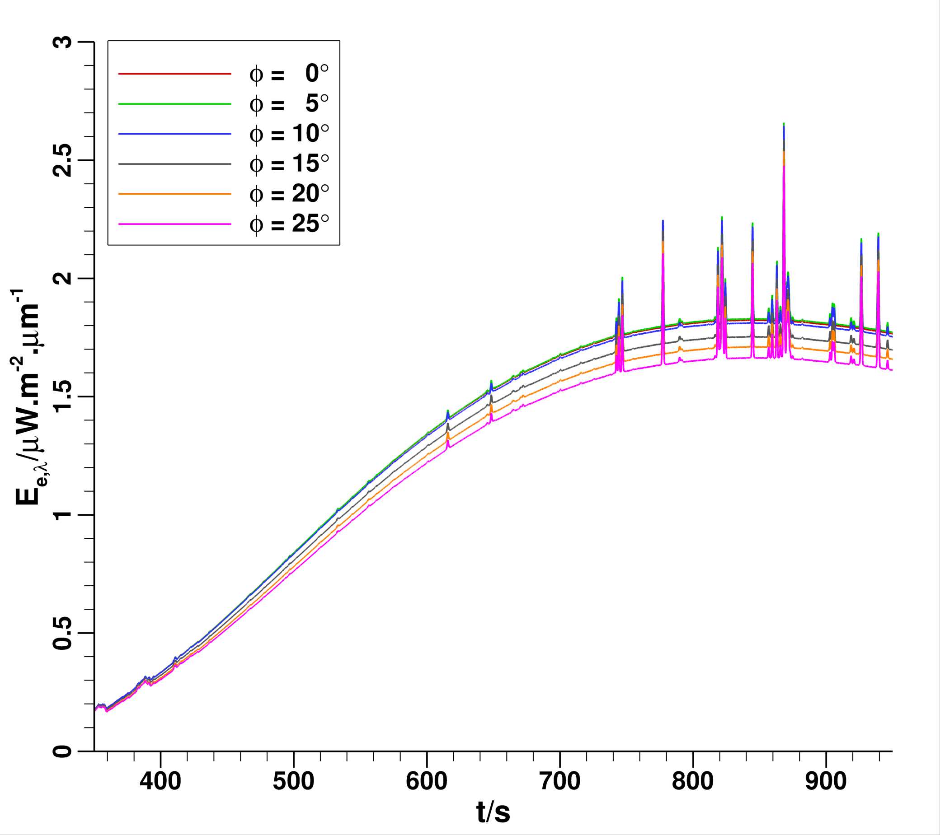
Preliminary Computations
22-species model
Sensitivity to slant range, t = 77.5 s, L_{nom} = 365.5 km
Sensitivity to view angle, t = 77.5 s, L_{nom} = 365.5 km
Computations assume surface emissivity is unity (ε_{w} = 1) and no atmospheric attenuation
Key takeaway: Range has obviously a larger (and nonlinear) influence on irradiance than does view angle
Notes:
The second computation is to establish the sensitivity of irradiance to slant range and view angle.
We consider the same condition as in the previous computation, i.e., CFD flow field solutions without any material response.
The figure on the left shows spectral irradiances for 5 values of slant range and a fixed view angle of 20° – nominal, nominal±50 km, and nominal±100 km. The impact is very clear – the farther away the source the dimmer it is. The increase in irradiance increases nonlinearly with decreasing slant range.
The figure on the right shows spectral irradiances for 6 values of view angle for a fixed slant range. From 0° to 5° irradiance increases slightly because the hot shoulder comes into view. After that the irradiance decreases with view angle because the area of the aeroheated surface presented to the imaging plane decreases
Overall slant range has a greater impact on irradiance – a fact that will come in handy when the observation time has to be shifted to synchronize with the SRC flight trajectory time.

Slide 6
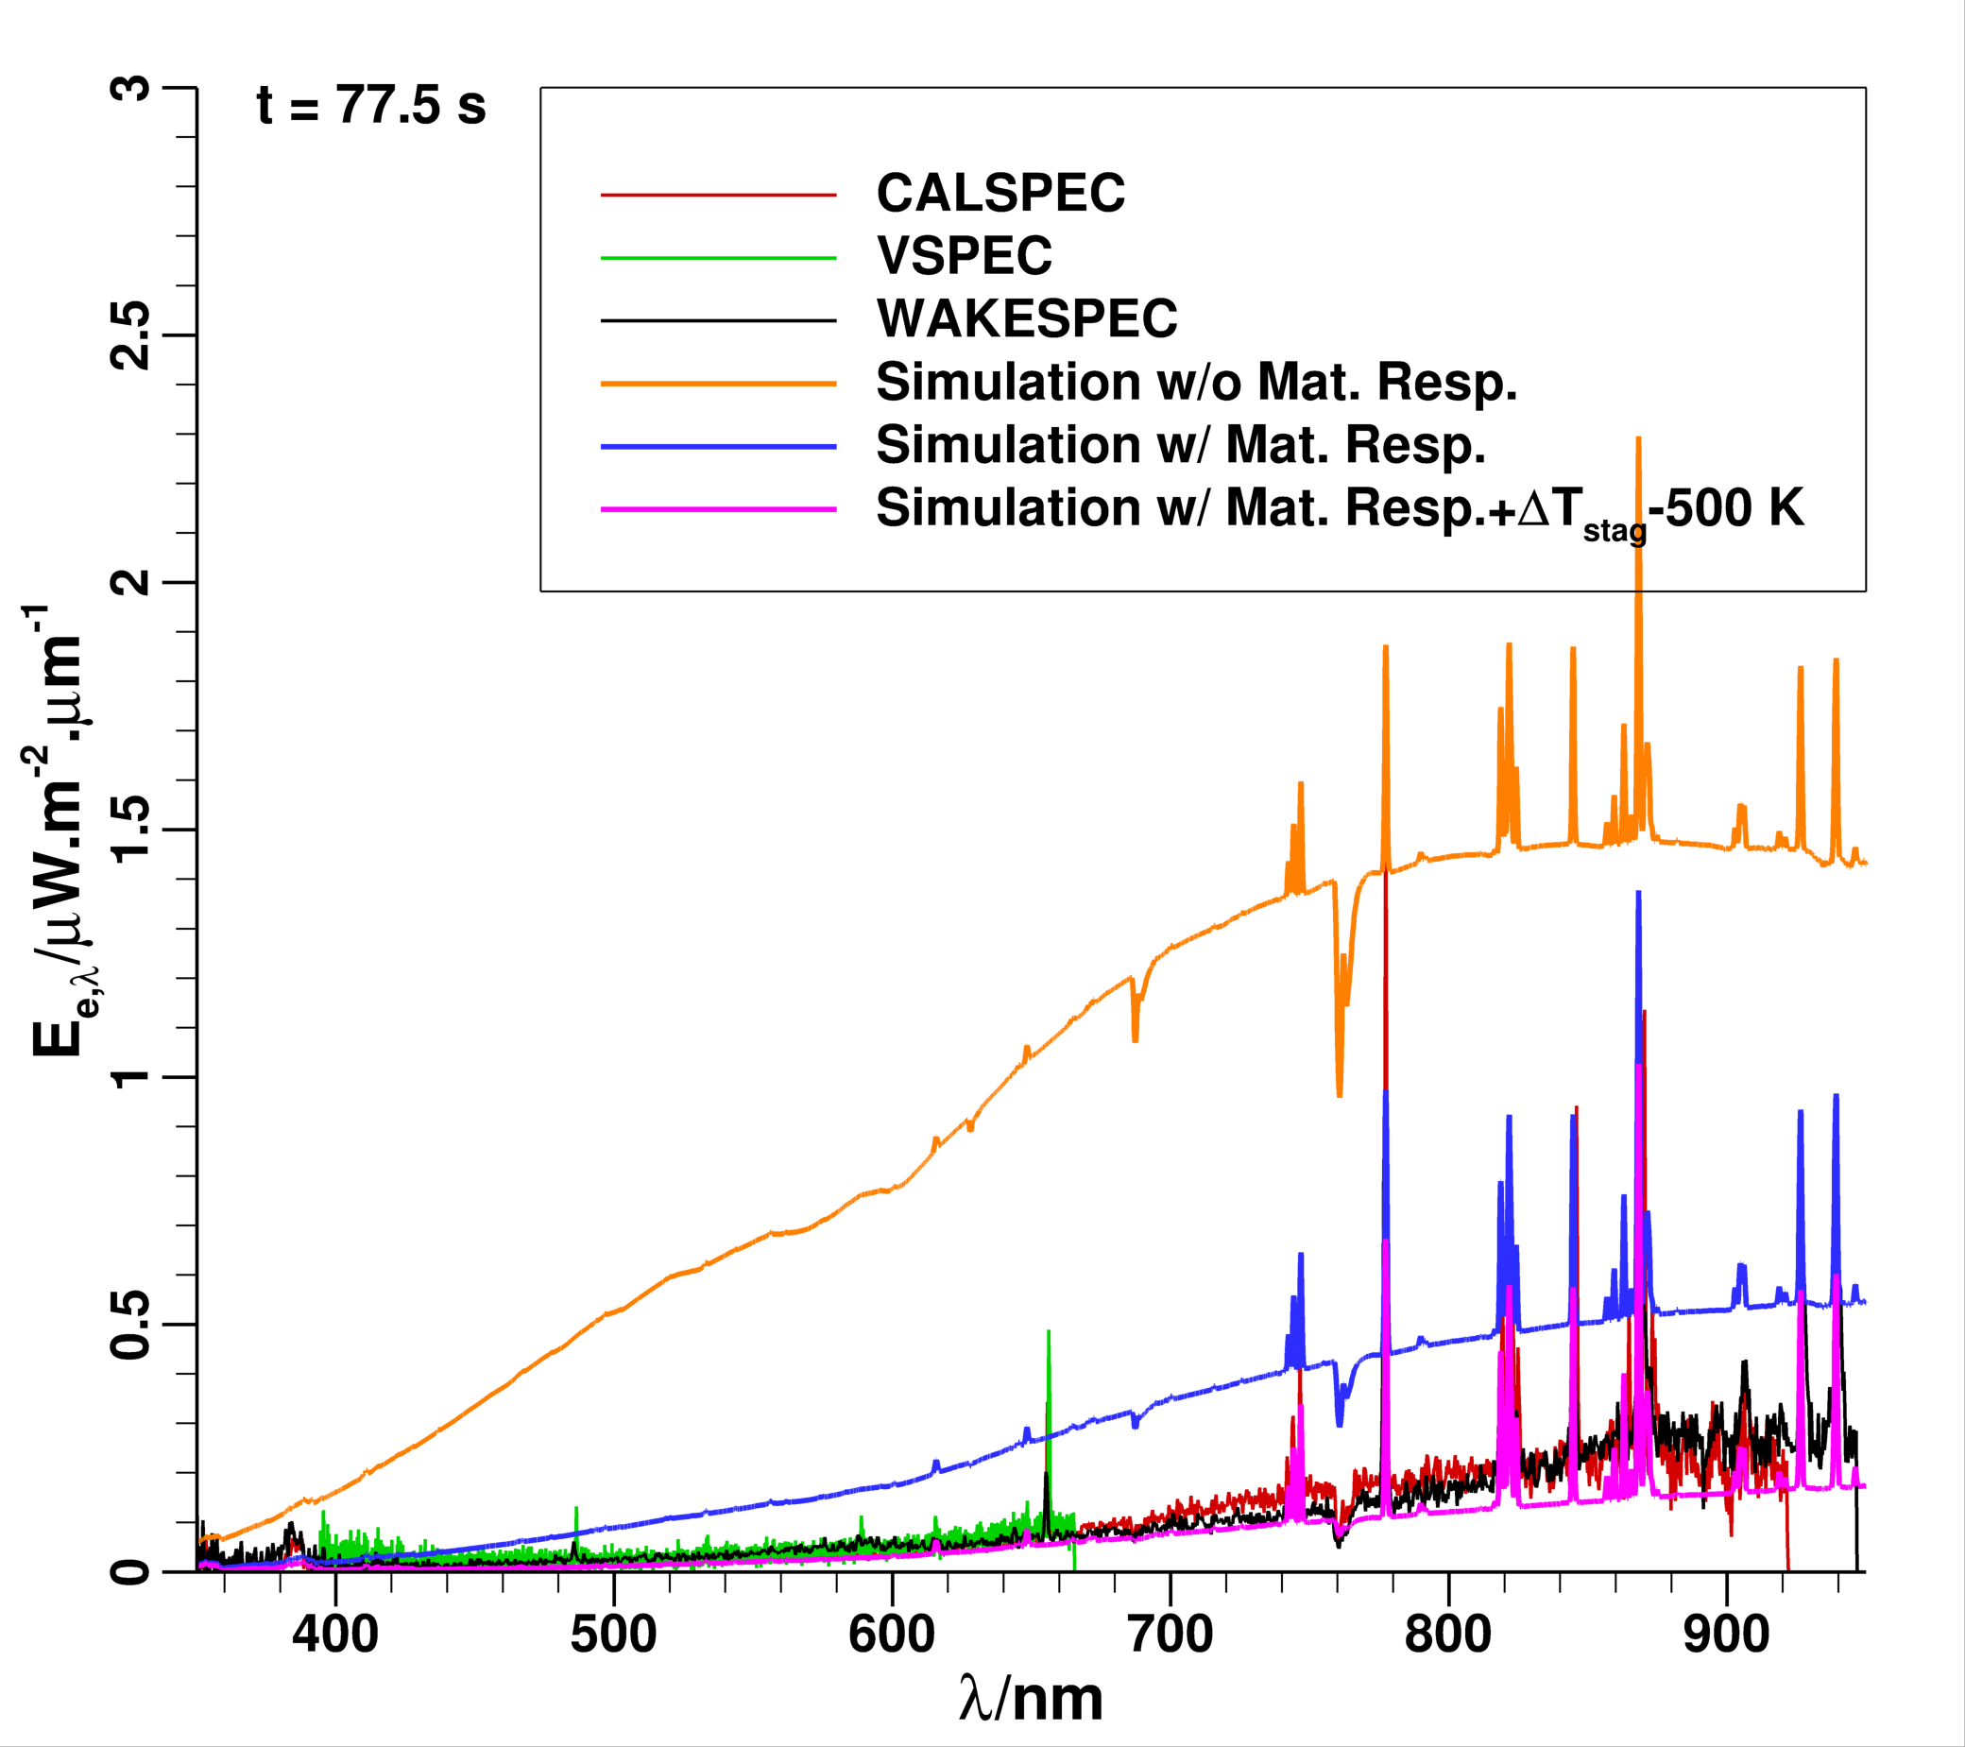
Sample Results at t = 77.5 s (BET)
No time shift of observed data, slant range, & view angle
Nominal case – no shift in observation time
Surface is a graybody with ε_{w} = 0.85
Atmospheric transmission included
CFD results used directly without any material response
  Predicted temperature is high (T_{stag} = 3902 K) because the surface can only re-radiate
CFD result with approximate material response, i.e., normalized surface temperature distribution scaled by stag. point temperature value of T_{stag} = 3104 K
  Predicted irradiance is still too high – high surface temp.
Same idea as above, but stag. point temperature lowered by 500 K, i.e., T_{stag} = 2604 K
  Stag. point temperature value does not agree with material response
Hypothesis #1: Time shift of measurement is necessary
Notes:
A sampling of results is shown in this slide. There are a lot more details in the written paper.
The orange curve is the CFD result without any material response. Atmospheric attenuation is considered here. Since the CFD boundary condition does not consider heat loss through the thickness of the material, the predicted surface temperature will be higher than actual.
The blue curve includes material response, in that it simply takes the stagnation point temperature value for the assumed FDCP material and computes a surface temperature distribution from the normalized curve shown previously. The predicted irradiance is still too high compared to measurement suggesting the surface temperature is too high.
To match measurement, one has to reduced the stagnation temperature by as much as 400-500 K to reduce the irradiance. The predicted irradiance for a stag. Point temperature decrease of 500 K is shown as the magenta curve.
The middle figure replaces the measured irradiance at t = 77.5 s (instrument time) with the measurement at t = 85 s. That is, we shift the measurement time by 7.5 s. While the match with prediction is improved in the visible wavelength range (350-700 nm), there is still disagreement in the longer wavelength region. The reason is that although the measurement is shifted by 7.5 s, the slant range and view angle are not shifted correspondingly.
The right figure now includes the changed slant range and view angle corresponding to the 7.5 s time shift – slant range decreases and view angle increases. However, the decrease in slant range has a bigger impact.
The precise amount of shifting necessary will depend on inclusion of pyrolysis species in the hot boundary layer. However, the trends are encouraging.

Slide 7
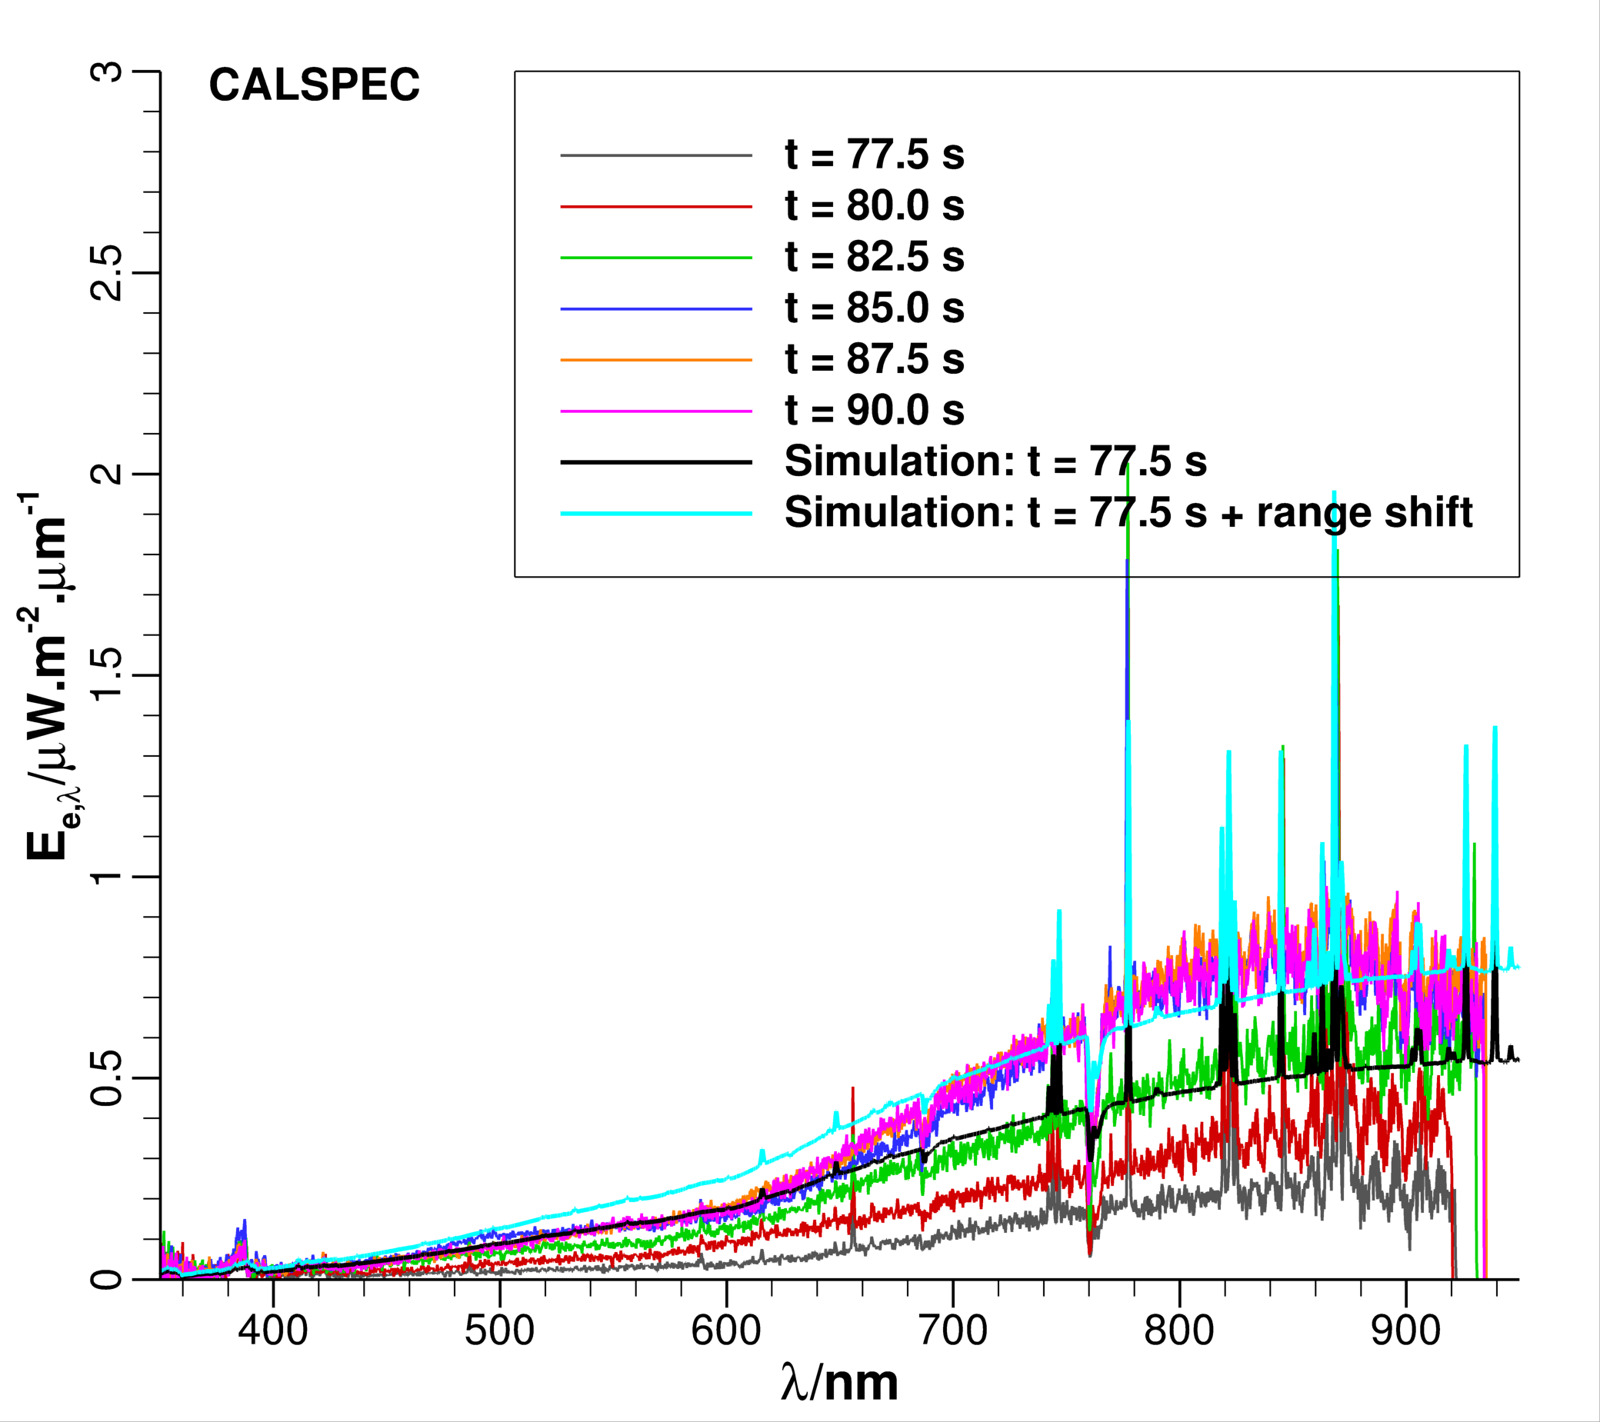
Time Shift in Measured Irradiance
Time of stagnation point temperature peak
Time/s | Temperature/K | Source
70.0 | 3202 | Hayabusa, Suzuki et al.*/Case1
72.5 | 3913 | Hayabusa2, CFD/Dplr
73.0 | 3054 | Hayabusa2, BET
74.0 | 3904 | Hayabusa, Suzuki et al.*/Case3
76.0 | 3119 | Hayabusa2, Traj+Fiat/FDCP
*Suzuki et al., JSR, 51(1), 2014
Hypothesis #2: Time shift of measurement also entails shift in slant range and view angle
  The aircraft and instrument clocks are synchronized
Assumed time shift of 7.5 s might be too large
  Simulation 77.5 s is in better agreement with measurement at 82.5 s => 5.0 s
  Precise shift, if any, remains to be determined
Notes:
We can also look at wavelength slices
The traces are smoothed to see when the spectral features peak – we need not yet be concerned about the absolute value of irradiance at this point
The timing of the peaks do tell us something about the flight
For instance, atomic N and O peak before the others. This suggests that these species are of shock-layer origin.
The Na and CN band head peak later and suggest that these species are of heatshield origin.
There is some ambiguity in the peak of H.

Slide 8
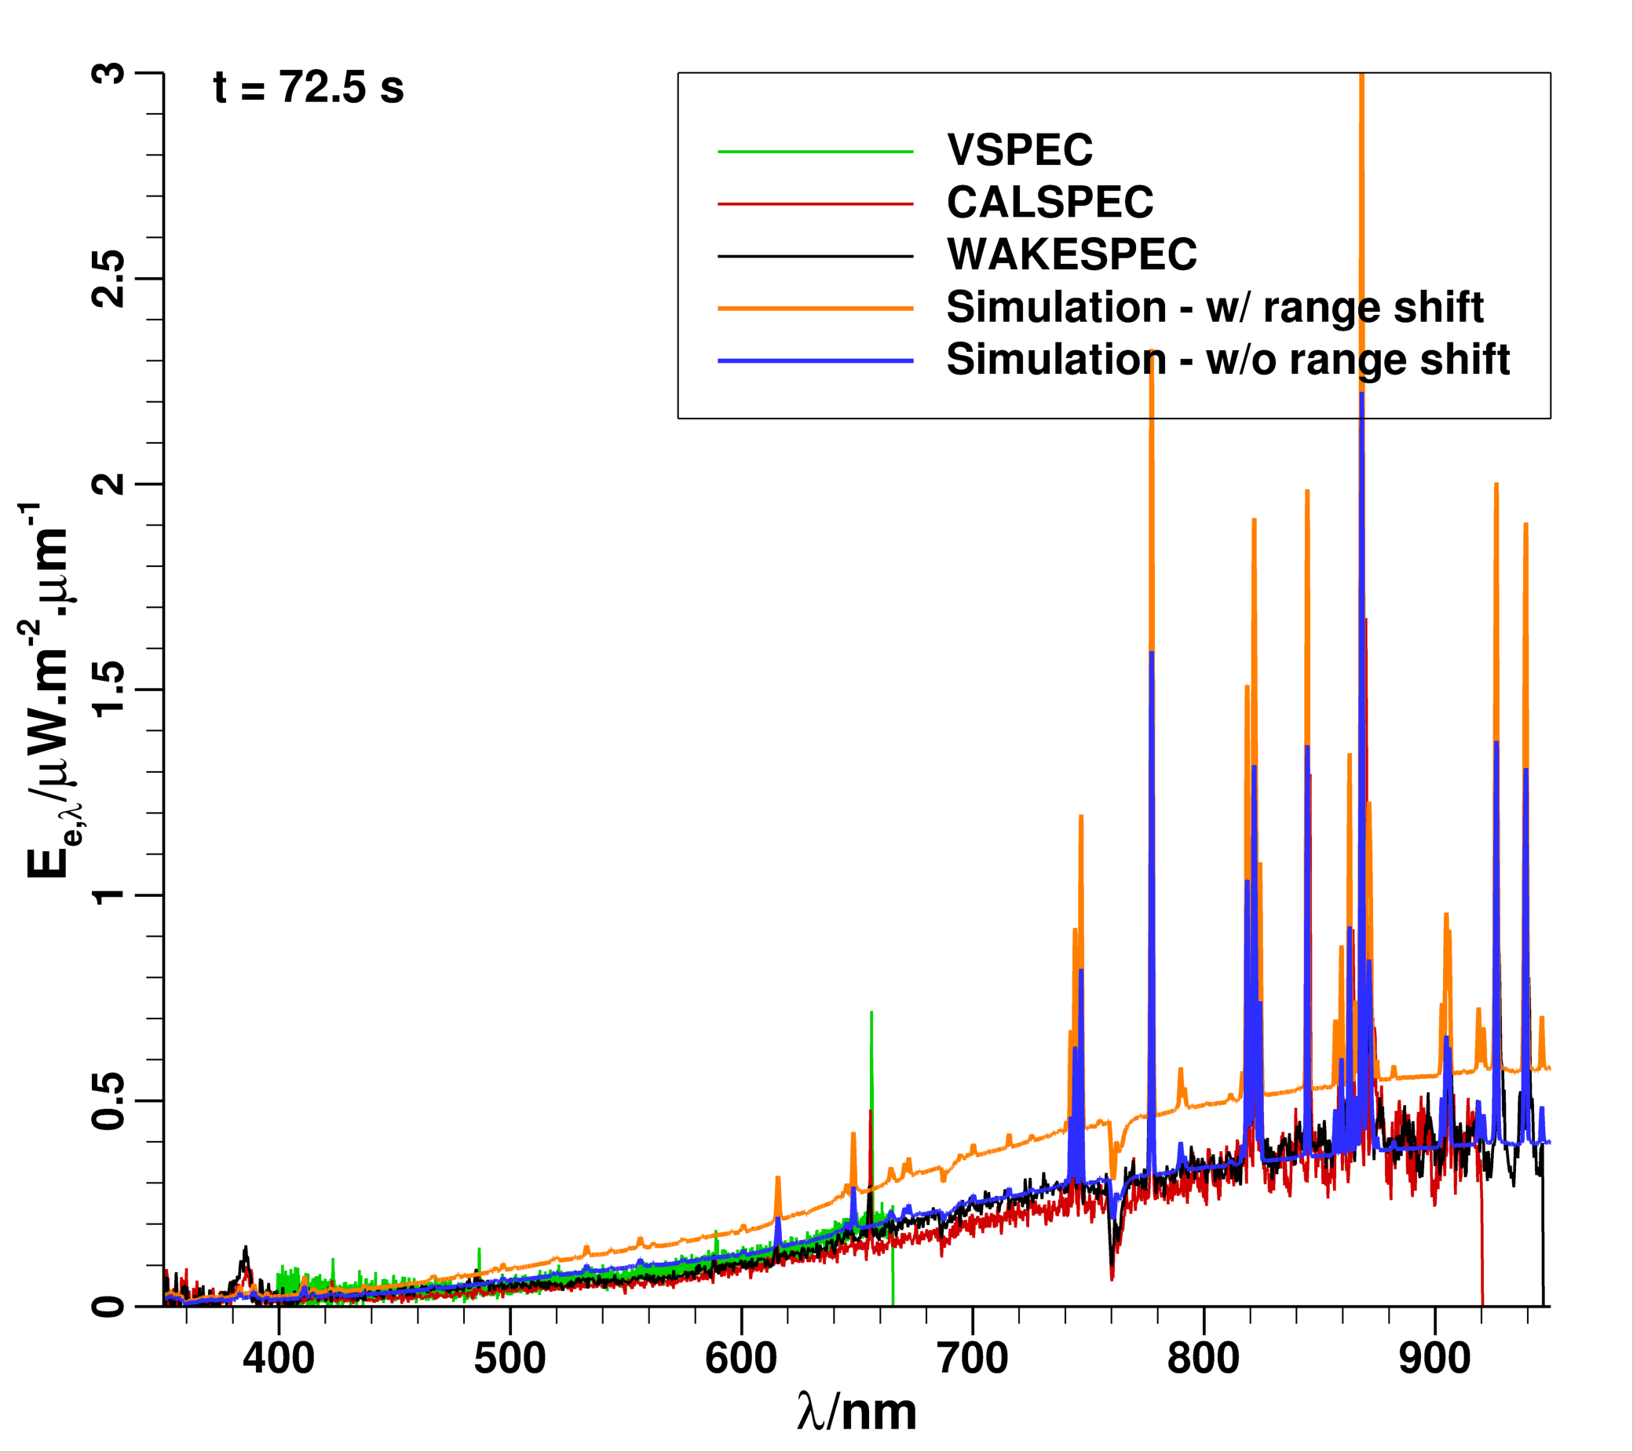
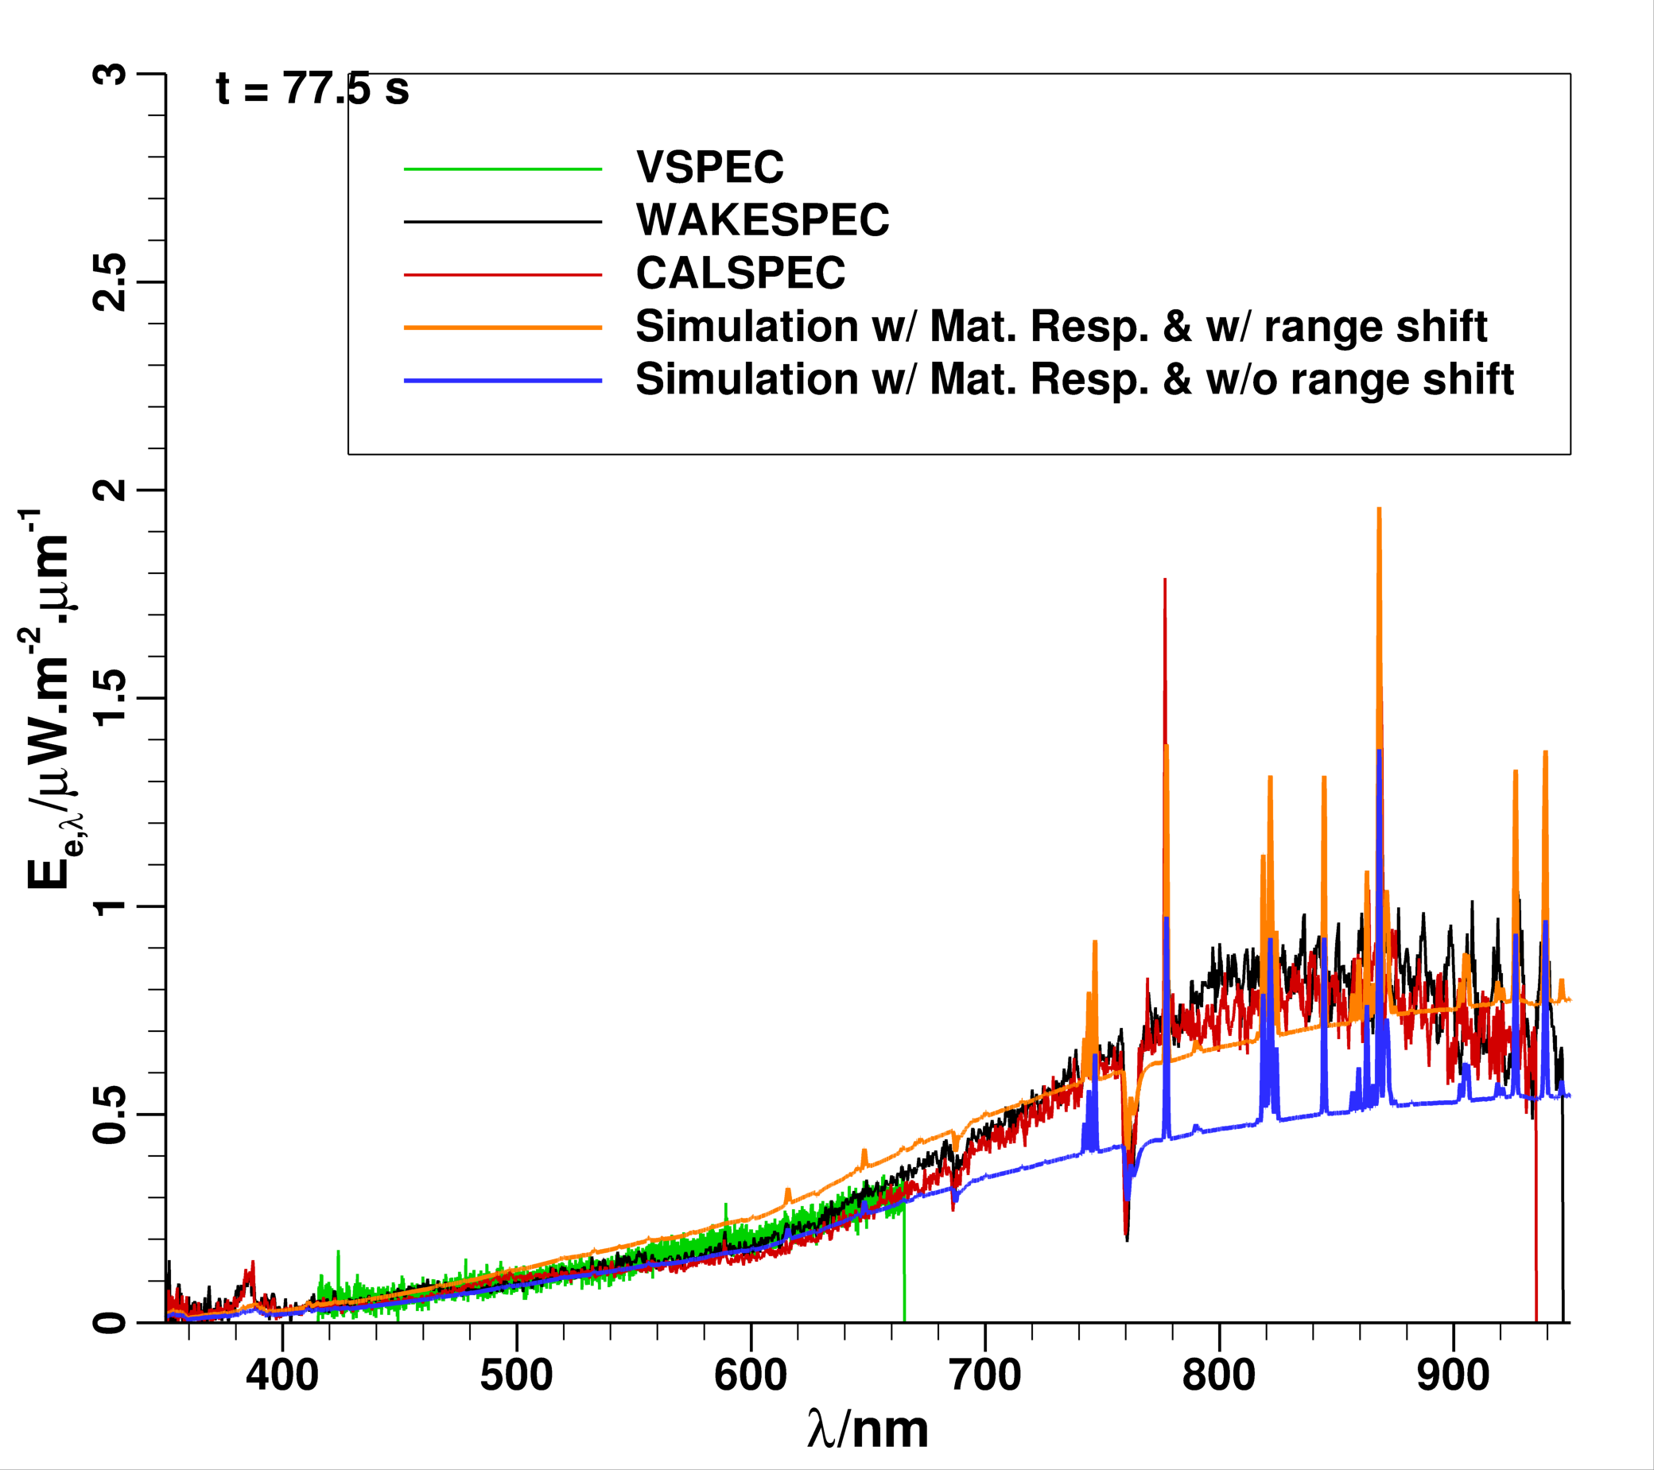
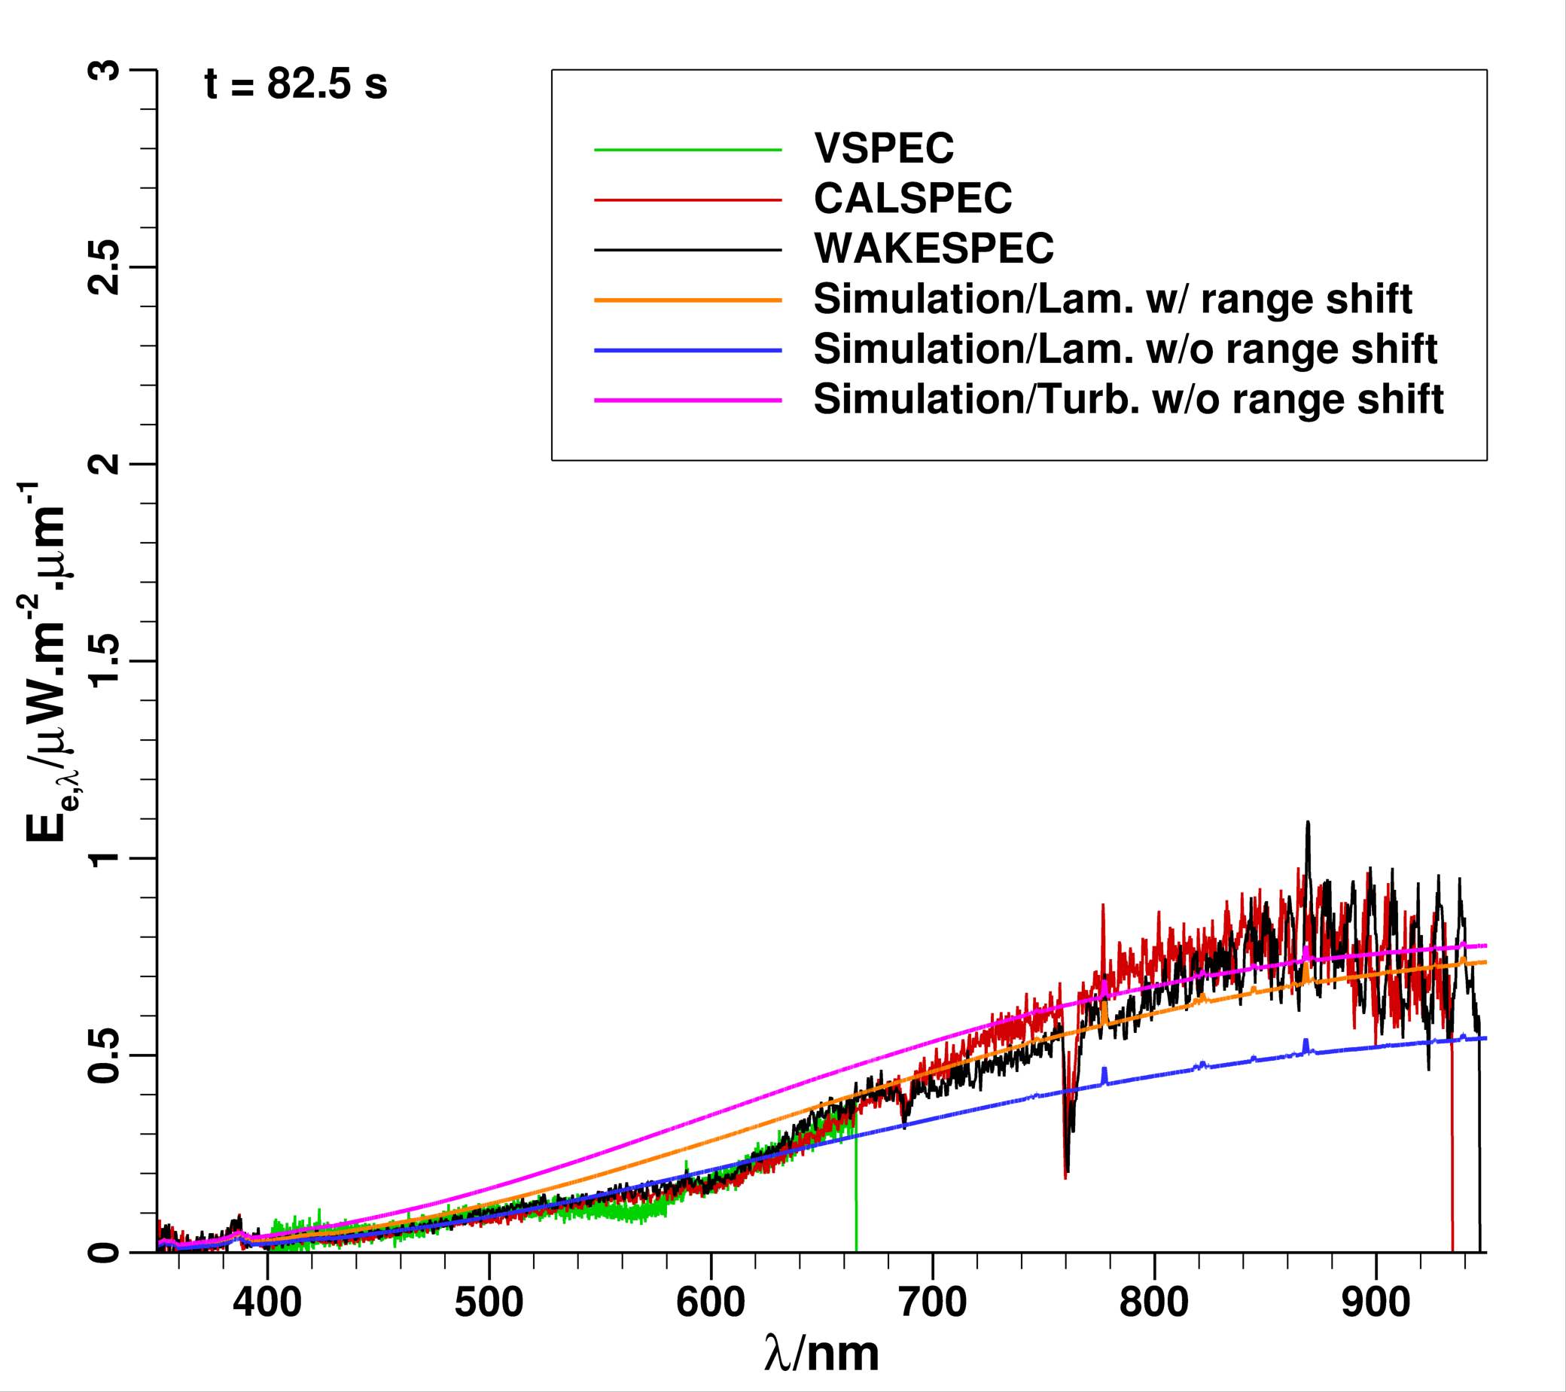
Sample Results
t = 72.5 s
t = 77.5 s
t = 82.5 s
When chemical activity diminishes significantly in the shock layer, irradiance distribution should be free of spectral lines
Several hypotheses remain to be examined:
  Augmented heating due to surface roughness
  Injection turbulence of pyrolysis gas
  Shape change due to ablation – nose bluntness increases

Slide 9
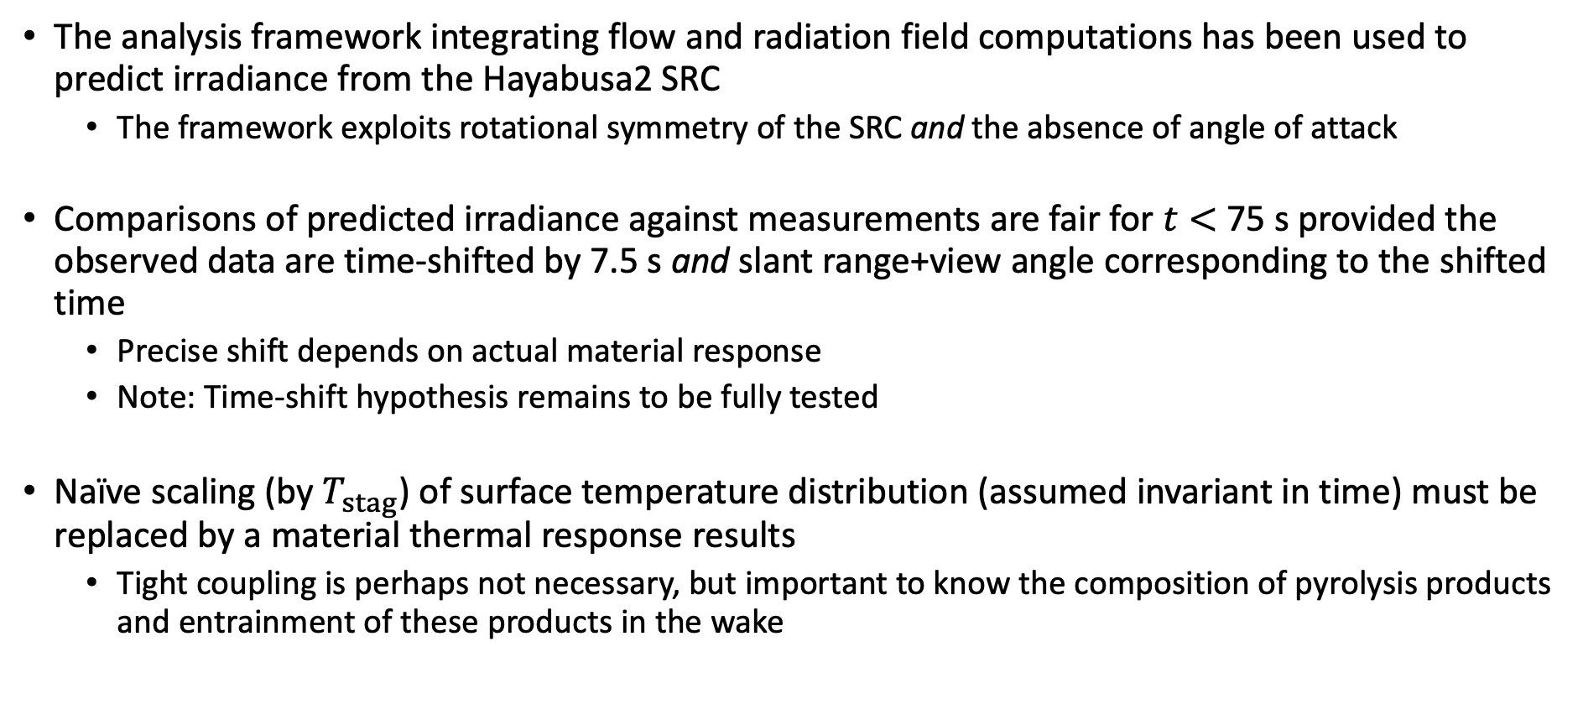
Summary
The analysis framework integrating flow and radiation field computations has been used to predict irradiance from the Hayabusa2 SRC
  The framework exploits rotational symmetry of the SRC and the absence of angle of attack
Comparisons of predicted irradiance against measurements are fair for $t<$75 s provided the observed data are time-shifted by 7.5 s and slant range+view angle corresponding to the shifted time
  Precise shift depends on actual material response
  Note: Time-shift hypothesis remains to be fully tested
Naïve scaling (by $T_{stag}$) of surface temperature distribution (assumed invariant in time) must be replaced by a material thermal response results
  Tight coupling is perhaps not necessary, but important to know the composition of pyrolysis products and entrainment of these products in the wake

Slide 10
Outlook
Validation of the current methodology requires revisiting Stardust – of relevance to OSIRIS-REx
  PICA properties are known, and thermal response can be computed
  No need for scaling surface temperature distributions using stagnation point environments
  Would be possible to separate out gas-phase, boundary layer, surface, and wake contributions to radiance
Need to explore sensitivity of radiance to view angle and/or slant range
  For OSIRIS-REx, view angles greater than 30° will expose the backshell and wake
  Will also help in planning a flight campaign
Current measurement approach is limited by
  Lack of spatial resolution
  Inability to explore the UV regime due to Earth’s ozone layer – need a stratospheric platform (can DoD’s “eyes in the sky” help?)
  Lack of in situ measurements – these can help supplement data acquired from airborne observations

Slide 11
Acknowledgments
The present work was supported under the ESTRAD contract (NNA15BB15C) from NASA Ames Research Center to AMA, Inc.
Thanks to the entire SCIFLI team for useful discussions and data sharing
Thanks to Ryan McDaniel (NASA ARC) for providing the generatrix of the Hayabusa capsule

Slide 13
Backup

Slide 14
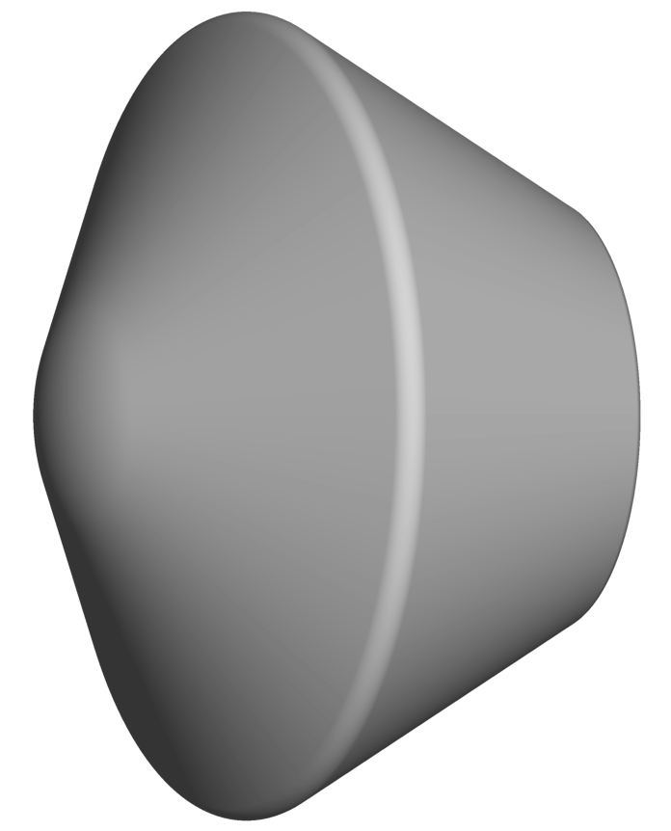
Airborne Imaging Campaigns
Hayabusa
Hayabusa2
(0.413 m dia/45° SC)
R_{n} = 0.207 m
V_{entry} = 11.8 km/s
γ_{entry} = -11.67°
Heatshield: CFRP
Stardust
OSIRIS-REx
(0.827 m dia/60° SC)
R_{n} = 0.23 m
V_{entry} = 12.8 km/s
γ_{entry} = -8.23°
Heatshield: PICA
Mission [Aircraft] | Atmospheric entry date [Landing site]
Stardust (NASA) [One DC-8] | January 15, 2006 [UTTR/Utah, USA]
Hayabusa (JAXA) [One DC-8] | June 13, 2010 [WPA/Woomera, Australia]
Hayabusa2 (JAXA) [Two Gulfstream3] | December 5, 2020 [WPA/Woomera, Australia]
OSIRIS-REx (NASA) [??] | September 24, 2023 [UTTR/Utah, USA]
Hayabusa and Stardust SRCs shown to the same scale
Notes:
Airborne imaging of the atmospheric passage of a sample return has been done three times now
Hayabusa2 is the latest in the series and OSIRIS-REx is expected next Fall.
There are only 2 configurations – 45° sphere-cone and 60° sphere-cone, with Hayabusa|2 being one half the diameter of Stardust.
The nose radii of the two configurations are very similar
We consider the concept of airborne imaging next

Slide 15
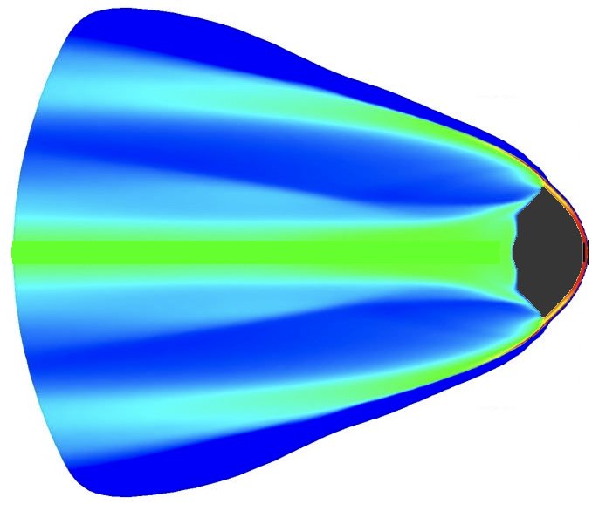

Airborne Imaging Concept
Emission sources:
  Shock layer around the SRC
  Aeroheated surface + pyro gas
Spectral radiance on pixel plane
Spectral radiance transported thru’ atmosphere (incl. absorption)
Integration of spectral radiance over solid angle (field of view) to get spectral irradiance
Point source imaging provides spectral and temporal resolution
Airborne platform in troposphere
  Unable to capture (V)UV content due to ozone layer
SRC is a point source
SRC diameter << distance to aircraft
Sample Return Capsule (SRC)
Projection (view) angle
SRC velocity vector
Angular field of view (FOV)
of imaging system
a/c Flight path
Pixellated imaging plane
gathers radiance
from SRC
Units of spectral radiance
W.cm⁻².μm⁻¹.sr⁻¹
Sight vector
Irradiance measured
by instrument on a/c
Observation aircraft (a/c)
Units of spectral irradiance
W.cm⁻².μm⁻¹
Notes:
The concept of airborne imaging is quite simple
The spectral radiance from SRC flowfield and surface is summed (integrated) into the the field of view of the sensor onboard the aircraft.
Transport of radiance from the imaging plane is attenuated by atmospheric absorption.
The net spectral irradiance at the sensor is convolved with the instrument or slit function to obtain the simulated result that can be compared directly against measurement
The two key variables are the slant range and the view angle
The primary drawbacks are: (i) lack of (V)UV access due to the ozone layer, and (ii) lack of spatial resolution of the SRC – point source on the scale of the problem.
More details are in the written paper.

Slide 16
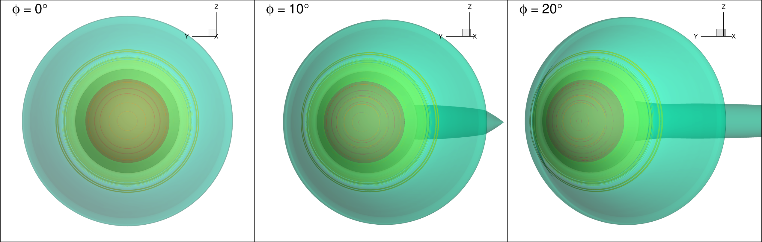
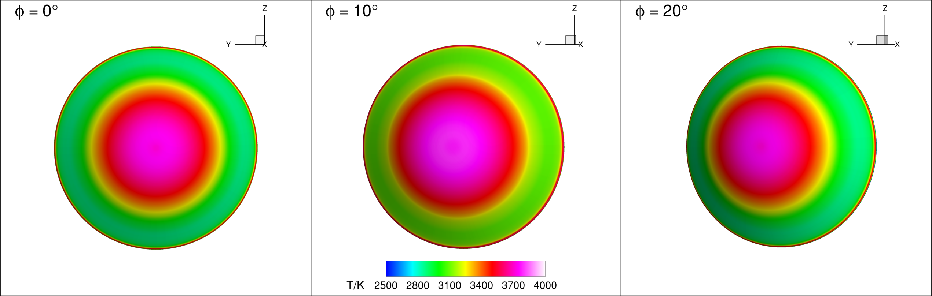
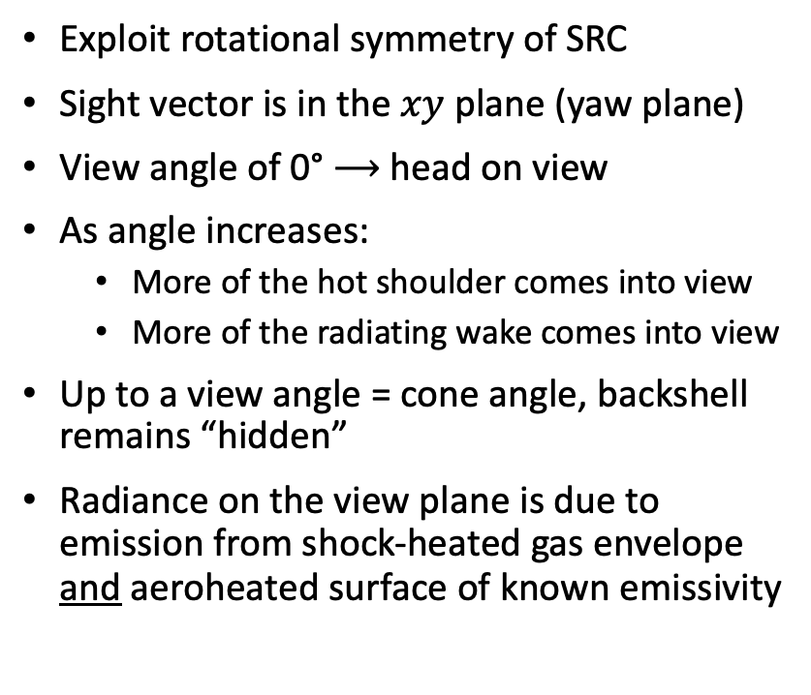
View Angle
TEMPERATURE ISOSURFACES (T = 4000 K, 9000 K, 14000 K)
Exploit rotational symmetry of SRC
Sight vector is in the $xy$ plane (yaw plane)
View angle of 0° $⟶$ head on view
As angle increases:
  More of the hot shoulder comes into view
  More of the radiating wake comes into view
Up to a view angle = cone angle, backshell remains “hidden”
Radiance on the view plane is due to emission from shock-heated gas envelope and aeroheated surface of known emissivity
SURFACE TEMPERATURE CONTOURS
Notes:
The view angle concept is easy to understand if we use the rotational symmetry of the SRC
Since radiance is from two sources – shock-heated gas mixture around the capsule and the surface of the capsule itself – isocontours of temperature are shown as representative of volumetric radiation, and surface temperature contours are shown as representative of surface radiation.
The frame around each figure is the imaging plane. Its normal is into the plane of the paper.
Increasing view angle then means increasing yaw of the capsule relative to the normal of the imaging plane.
We need three pieces of information to perform simulations.

Slide 17
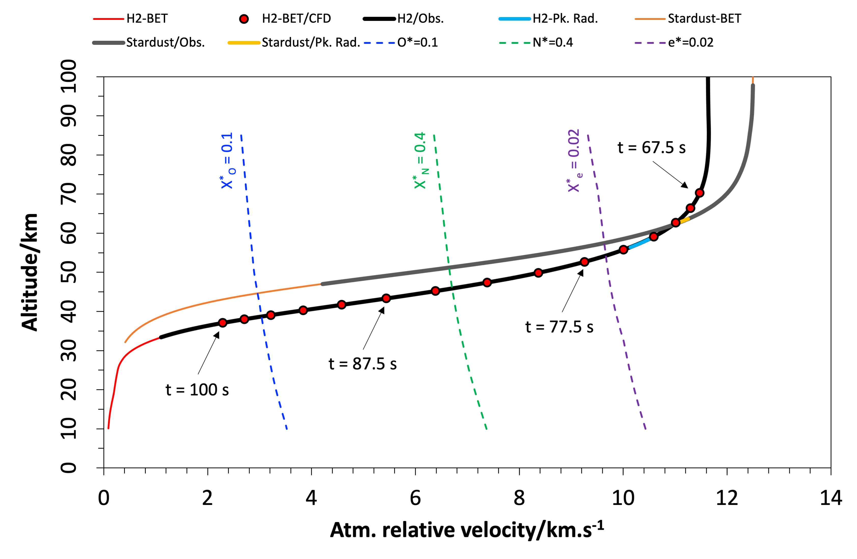
Best-Estimated Trajectory
(courtesy JAXA)
Best-estimated trajectories (BET) of Stardust and Hayabusa2 are shown
The thick dark lines overlaid on the altitude-velocity traces represent the observation period
  The thick light lines represent the approximate time period of peak radiative heating to the vehicle
The dashed lines represent equilibrium contours of O, N, and e– mole fractions
The closed symbols represent points along the BET
  Points are separated by a 2.5 s
  Flow computations at these points
  Imaging computations from t = 67.5 s to t = 87.5 s
Notes:
The first piece of information is the best estimated trajectory.
The BETs of Stardust and Hayabusa2 are compared in the altitude-velocity plot. The BETs are 3DOF and ballistic, i.e., no vehicle dynamics and no angle of attack.
The symbols are points selected along the Hayabusa2 trajectory for simulations. The points are space 2.5 s apart.
Continuum flow computations for times earlier than 67.5 s are not attempted because Knudsen numbers (based on nose radius) are large
The lack of flow solutions at earlier time causes problems in estimating material thermal response
Through the use of engineering correlations, one can determine the times are which radiative, total, and convective heating to the stag. point peak along the trajectory

Slide 18
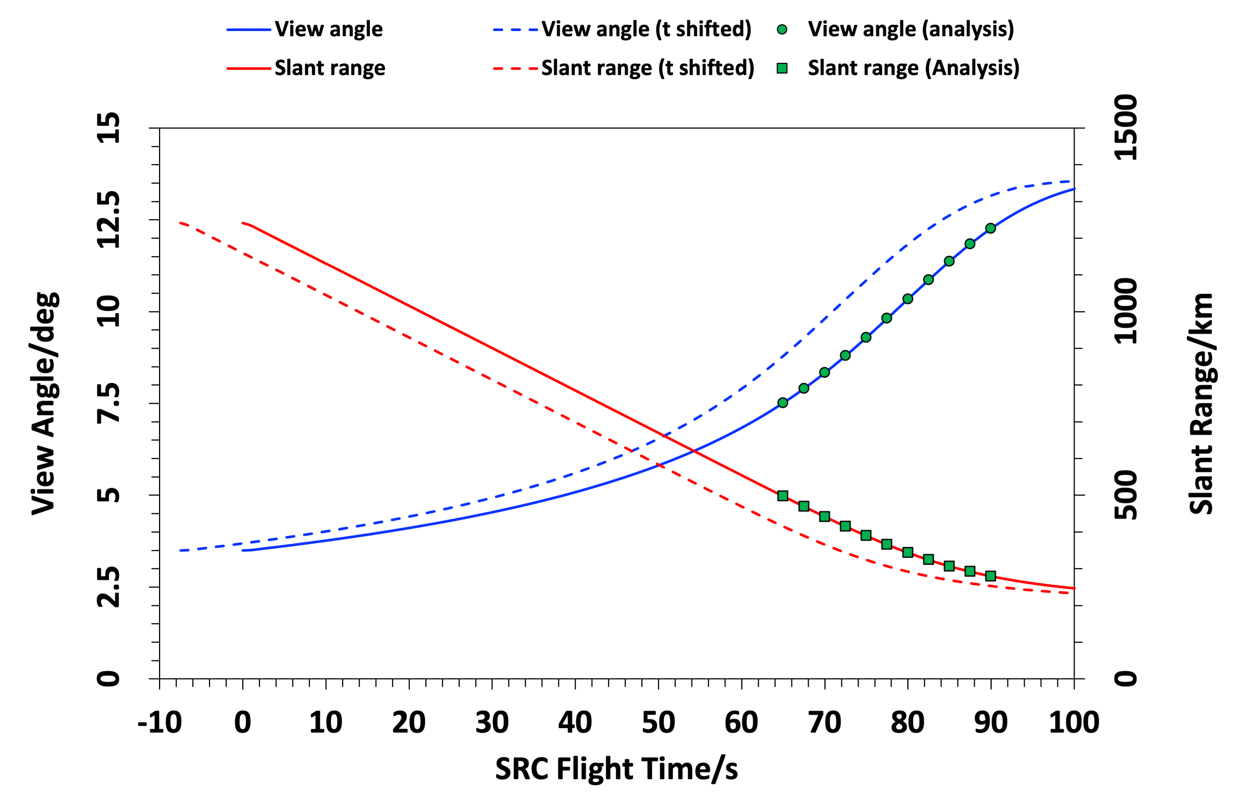
Slant Range & View Angle (N520)
(courtesy NASA LaRC)
IF SRC and aircraft clocks have been synchronized
Slant range varies from ≈500 km down to ≈200 km
View angle varies from ≈7° up to ≈13°
IF SRC and aircraft clocks have not been synchronized
Observation time may need shifting
Time shift means observation t = 0 is a few seconds after SRC hit entry interface
Time shift implies change in both view angle & slant range
  Slant range will decrease and cause SRC to appear “brighter”
Notes:
The second piece of information is the temporal variation of the slant range (from a/c to SRC) and the view angle.
Knowing the position of the SRC in an inertial frame and the position of the aircraft in the same inertial frame, the separation distance and the relative angles of the two can be computed
The traces shown as solid lines assume that the SRC and aircraft clocks are synchronized
If the instrument was turned on a few seconds after the SRC hit entry interface (200 km altitude), then traces will have to be shifted by the delay.
The shifted traces are shown as dashed lines; a delay of 7.5 s is assumed here
The consequence of the time shift is that both slant range and view angle change as well.

Slide 19
Measured & Calibrated Irradiance
(courtesy Torch Technologies)
Five instruments onboard NASA N520 aircraft
  Synchronization of observation and SRC clocks might need to be resolved
  Molecular bands of interest: N₂⁺ (1st Neg.), CN (violet), N₂ (1st and 2nd Pos.), CN (red)
  Atomic lines of interest: O I, N I, C I, H I, Ar I, …
    X I notation: X is the atomic element, I is the ionization stage
      X I => neutral (X), X II => 1st stage ionization (X⁺), X III => 2nd stage ionization (X⁺⁺), …
Spectrometer | Wavelength Range/nm | Resolution/nm | Comment
USPEC | 320 – 480 | 0.53 | Poor S/N; not used in present work
VSPEC2 | 380 – 670 | 0.77
CALSPEC | 320 – 950 | 0.85 | Primary focus of present work
WAKESPEC | 320 – 950 | 1.20
NIRSPEC | 570 – 1000 | 0.49 | Poor S/N; not used in present work
Notes:
The third piece of information that is needed is measurement results.
Of the 5 instruments that flew onboard the N520 aircraft, the CALSPEC instrument is the primary focus of this talk.
The molecular bands and atomic lines of interest are listed here.
In the X I notation, X is the symbol of the atomic element, and I is the ionization stage, I means neutral

Slide 20
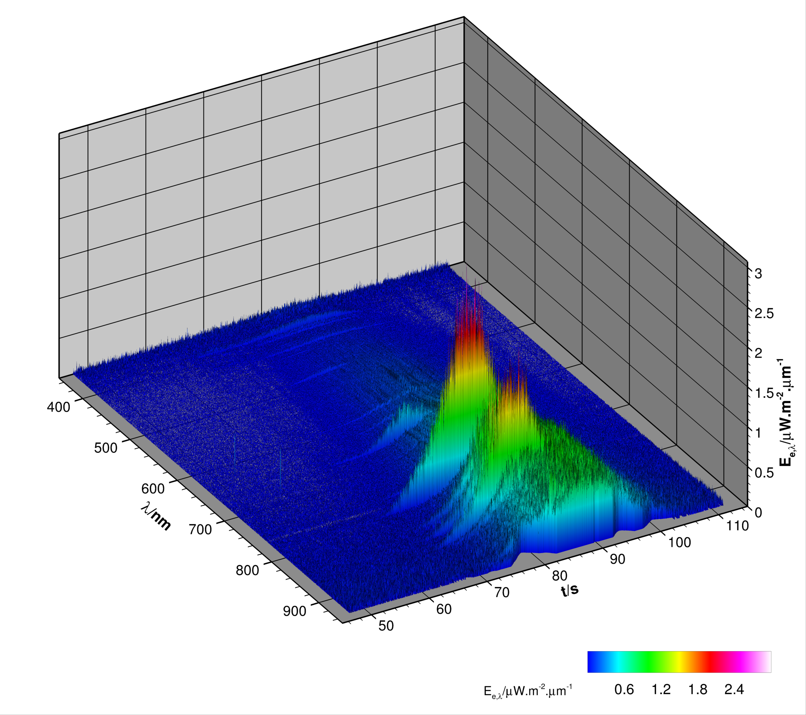
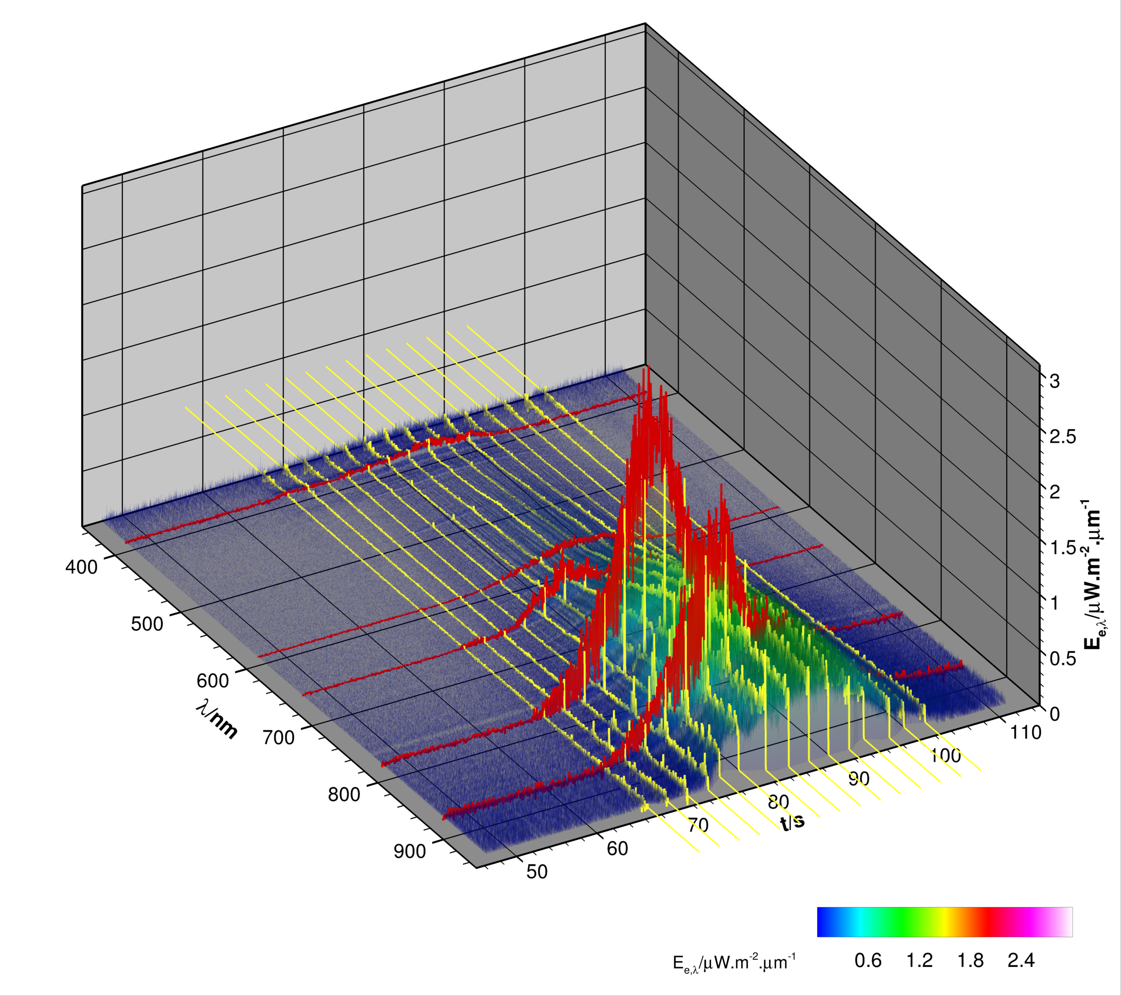
CALSPEC
MEASURED IRRADIANCE
TIME & WAVELENGTH SLICES
CALSPEC (320-960 nm)
CALSPEC (320-960 nm)
CN (violet)
Na (590 nm line)
H (α 656 nm line)
O (777 nm line)
N (869 nm line)
Irradiance is temporally and spectrally resolved, but not spatially resolved – SRC is a point source!
Notes:
The CALSPEC data – spectrally and temporally resolved irradiance – shown here as function of wavelength (in nm) and time (in s).
The 3D surface is painted by the magnitude of irradiance.
One can extract time and wavelength slices from this 3D map. Time slices are shown as yellow traces and wavelength slices are shown as red traces

Slide 21
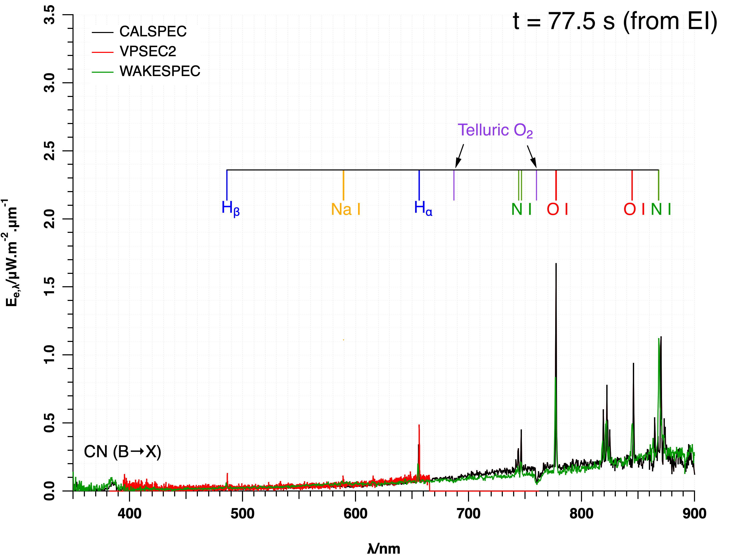
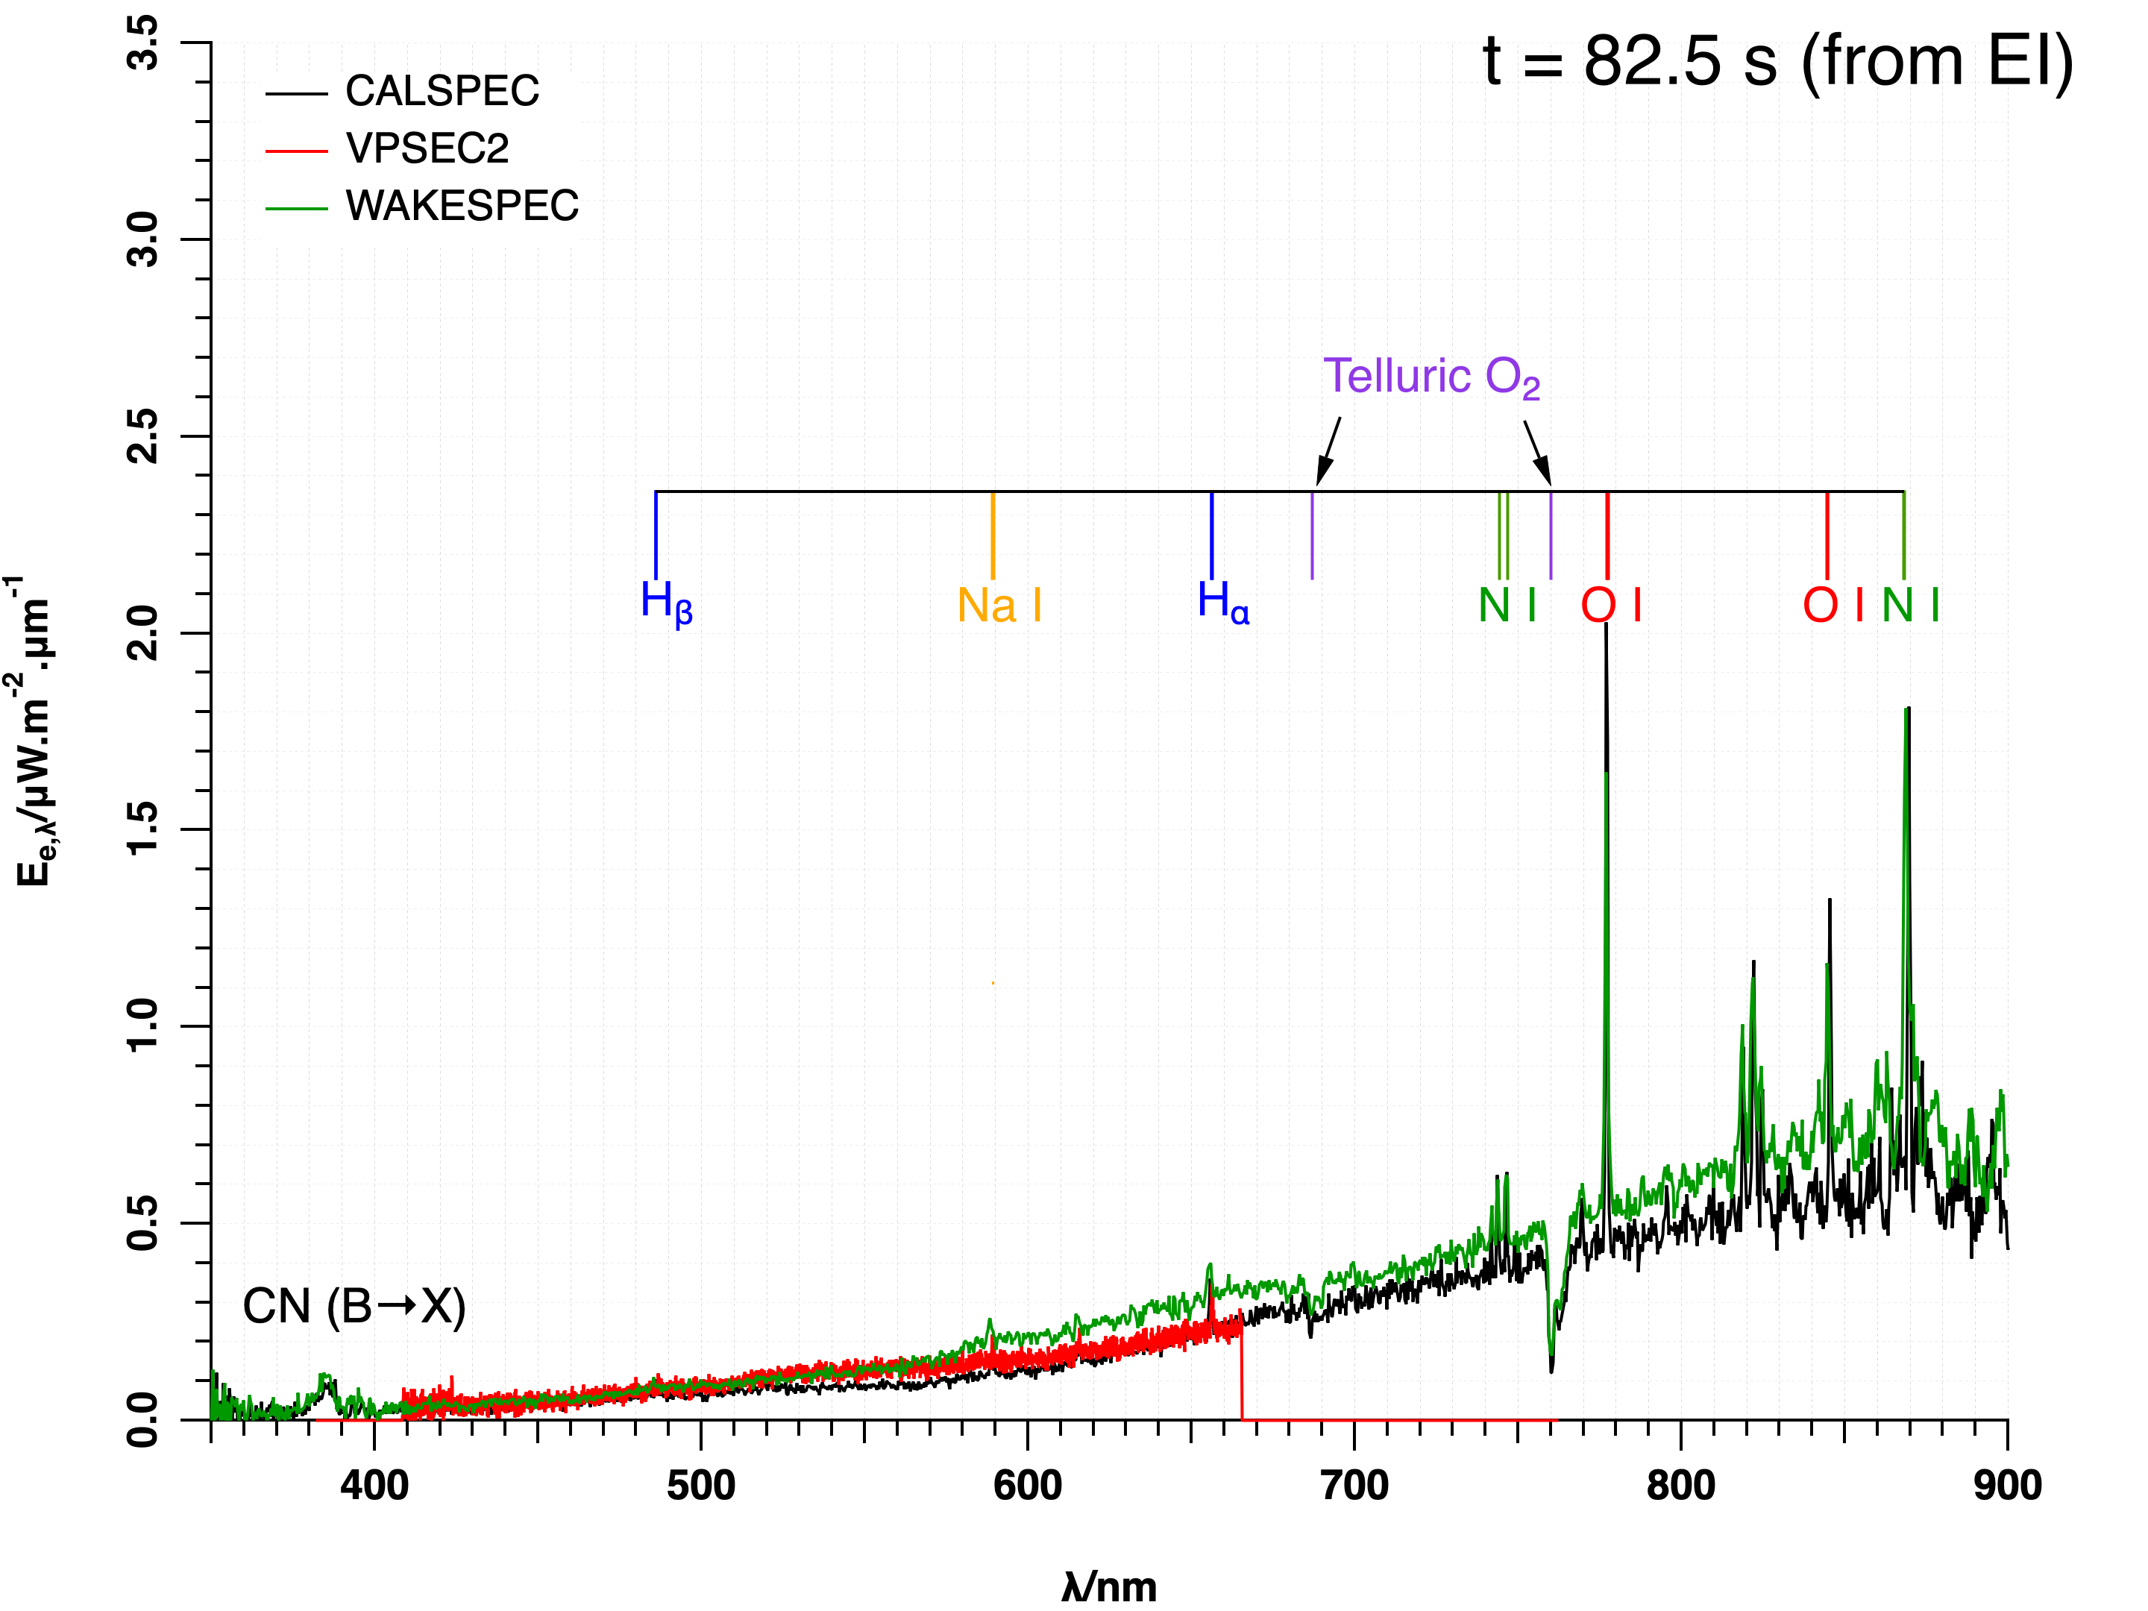
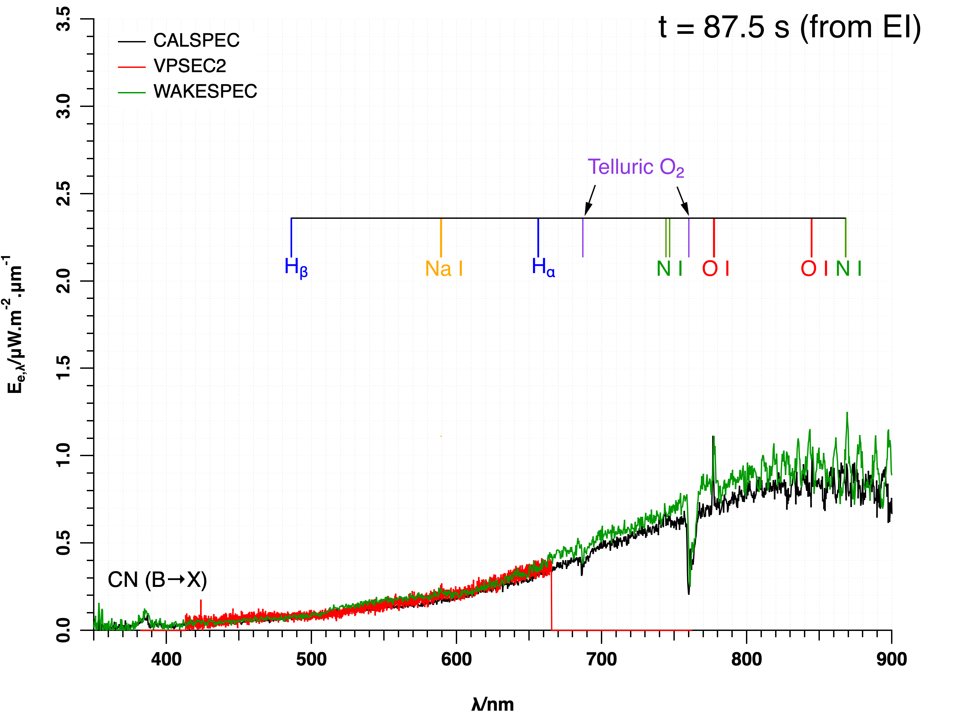
Persistent Lines/Bands
t = 77.5 s
t = 82.5 s
t = 87.5 s
Persistent lines are “strong lines” even at low number densities
Irradiance peaks at 87.5 s
  Does this correspond to an increase in surface temperature?
Notes:
Looking at 3 time slices
We can pick out the persistent lines of various atomic species
The absorption bands of atmospheric O2 are clearly seen
Persistent lines corresponding to Ar and C are not seen
Irradiance peaks at around 87.5 s
Need to know the cause of this. Most likely due to surface temperature

Slide 22
Steps of the Simulation Process
Flow field computation [Dplr]
  From t = 65 s to t = 105 s along the BET
Material thermal response to imposed aerothermal environments [Traj+Fiat]
  Stagnation point temperature scaling
Geometric construction of the imaging plane and lines of sight [Cfdtools]
  Revolve_grid, Stardust_Lines, Flow_Interp & Neqair_Data
High-resolution spectral radiance computations on imaging plane [Neqair]
  Wavelength range: 350 nm to 950 nm, with 3.3 x10⁻⁴ nm resolution
Atmospheric transmission & angular integration to obtain high-resolution spectral irradiance [Neqair]
  Combines EarthGram with HiTran & Leiden line lists & Rayleigh scattering (≈equivalent to Modtran)
Convolution with slit function for final spectral irradiance [Neqair]
  Gaussian slit function with specified FWHM
Complete details of methods/tools used are in the written paper
All tools (including atmospheric transmission) used in the simulation process have been developed in-house
The only missing piece in this process is information about the heatshield material
Notes:
The 6 steps of the simulation process are listed here. These steps are discussed in detail in the written paper
The 22-species model accounts for CO2, Ar, and H2O – all trace species in the atmosphere. The intent is to see what impact atmospheric composition has on the results.

Slide 23
Persistent Lines/Bands
Occurrences of persistent lines guide choice of model to employ in flow computations
Standard 11-species (N₂,O₂,NO,N₂⁺,O₂⁺,NO⁺,N,O,N⁺,O⁺,e–) model cannot explain presence of H, Na, CN
H, CN from atmospheric constituents? Expand species set to include CO₂, H₂O, and related products
H, CN from heatshield material? Must consider material thermal response to imposed aerothermal environments
  Need material elemental composition and properties (density, specific heat, conductivity, …)
Notes:
Looking at 1 time slice
We can pick out the persistent lines of various atomic species
The absorption bands of atmospheric O2 are clearly seen
Persistent lines corresponding to Ar and C are not seen
Irradiance peaks at around 87.5 s
Need to know the cause of this. Most likely due to surface temperature

Slide 24
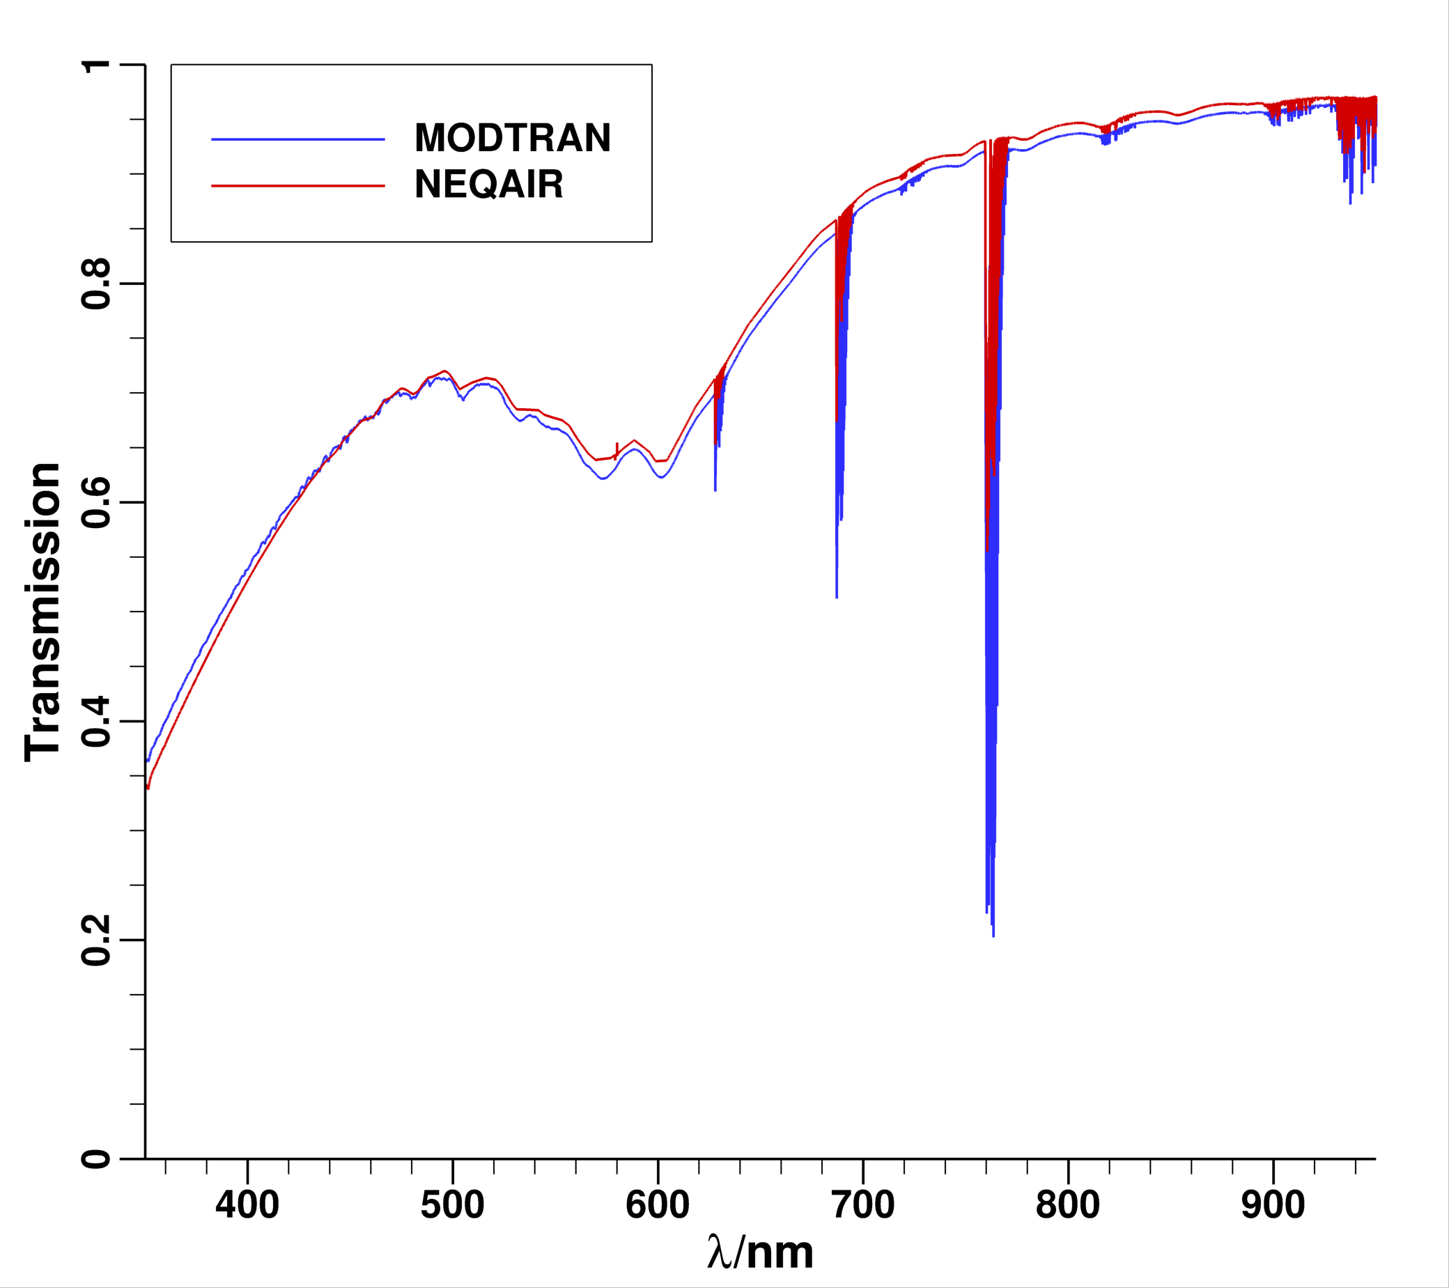
Radiance Computations, Atm. Transmission
Computational tool: v15.2 of Neqair
  Add and/or move lines of sight into areas of high radiance – an adaptive grid capability
  Treat a surface as a graybody
  Perform the angular integral over multiple lines of sight from a patch represented by the imaging plane, thus converting spectral radiances into spectral irradiance (requires slant range as input)
  Summed spectral radiance on the imaging plane must be transmitted through the intervening atmosphere down to the instrument
  In the present work, transmission coefficient computed using Neqair itself, in lieu of Modtran
Notes:
The other important steps are computation of radiance on the imaging plane and the conversion of spectral radiance into irradiance via angular integration over the instrument’s field of view.
Three key features of the latest version of NEQAIR are
Ability to add/move lines sigh in the imaging plane – adaptive gridding.
Ability to treat the capsule surface are a graybody of specified emissivity.
Ability to compute the atmospheric transmission in lieu of MODTRAN
NEQAIR’s transmission coefficient compares very well (within 1.5%) of MODTRAN
We thus have a self-contained set of simulation tools, tools that can be wired together to automate the simulation process.
We are now ready to apply all these steps/tools to develop simulated spectral irradiance.

Slide 25
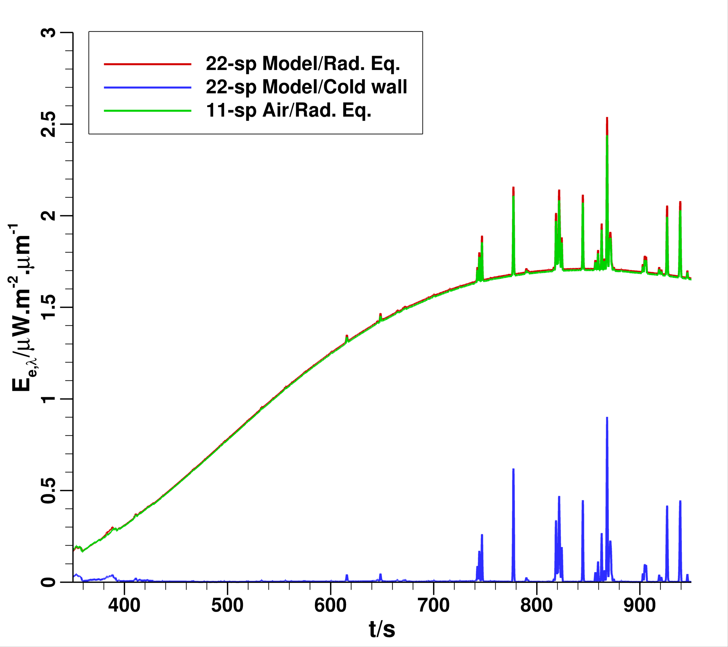
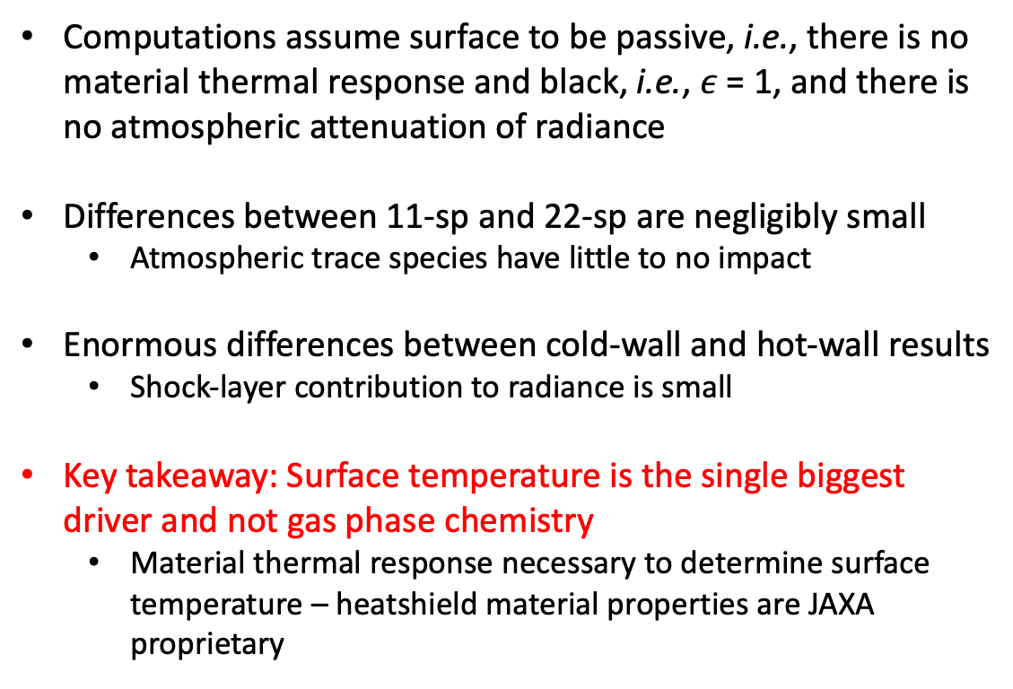

Preliminary Computations (1/2)
22-species model
t = 77.5 s, $φ$ = 20°, L = 365.5 km
Computations assume surface to be passive, i.e., there is no material thermal response and black, i.e., $ε$ = 1, and there is no atmospheric attenuation of radiance
Differences between 11-sp and 22-sp are negligibly small
  Atmospheric trace species have little to no impact
Enormous differences between cold-wall and hot-wall results
  Shock-layer contribution to radiance is small
Key takeaway: Surface temperature is the single biggest driver and not gas phase chemistry
  Material thermal response necessary to determine surface temperature – heatshield material properties are JAXA proprietary
Notes:
In a first preliminary computation, we simply take the CFD solutions without any material thermal response and use them in the 6-step simulation process.
The relative importance of shock-layer vs. surface emission is captured by the hot-wall vs. cold-wall result.
The interesting result is the negligible difference between 11-sp and 22-sp model with hot-wall. This says that the trace species included in the 22-sp model are not as important as originally thought.

Slide 26
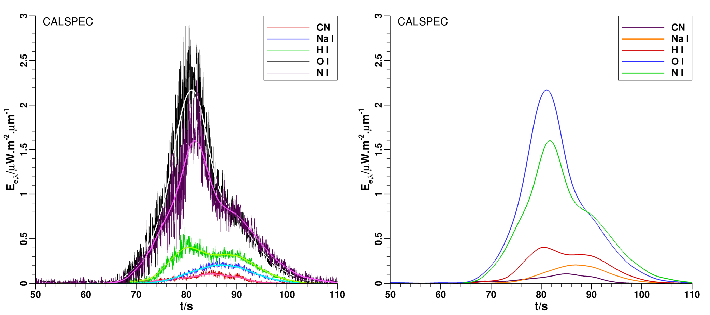
Temporal Variation of Irradiance
Time of line intensity peaks
 | CALSPEC | WAKESPEC
CN (violet) | 83.8 | 85.1
Na I (D line) | 87.1 | 85.2
H I (α line) | 80.5 | 86.8
O I (777 nm line) | 79.7 | 81.1
N I (860 nm line) | 81.7 | 83.1
Time traces smoothed to determine peak times of certain spectral features
Barring H I line (H_{α}), the peak times are within -1.9 s to + 1.4 s of each other
  Could H_{α} peak at t = 80.5 s be due to atmospheric H₂O or is this an anomaly?
Timings on O I and N I lines suggest shock-layer origin
Timings of CN (violet), Na D-line, and H_{α} suggest outgassing of pyrolysis products
Notes:
We can also look at wavelength slices
The traces are smoothed to see when the spectral features peak – we need not yet be concerned about the absolute value of irradiance at this point
The timing of the peaks do tell us something about the flight
For instance, atomic N and O peak before the others. This suggests that these species are of shock-layer origin.
The Na and CN band head peak later and suggest that these species are of heatshield origin.
There is some ambiguity in the peak of H.

Slide 27
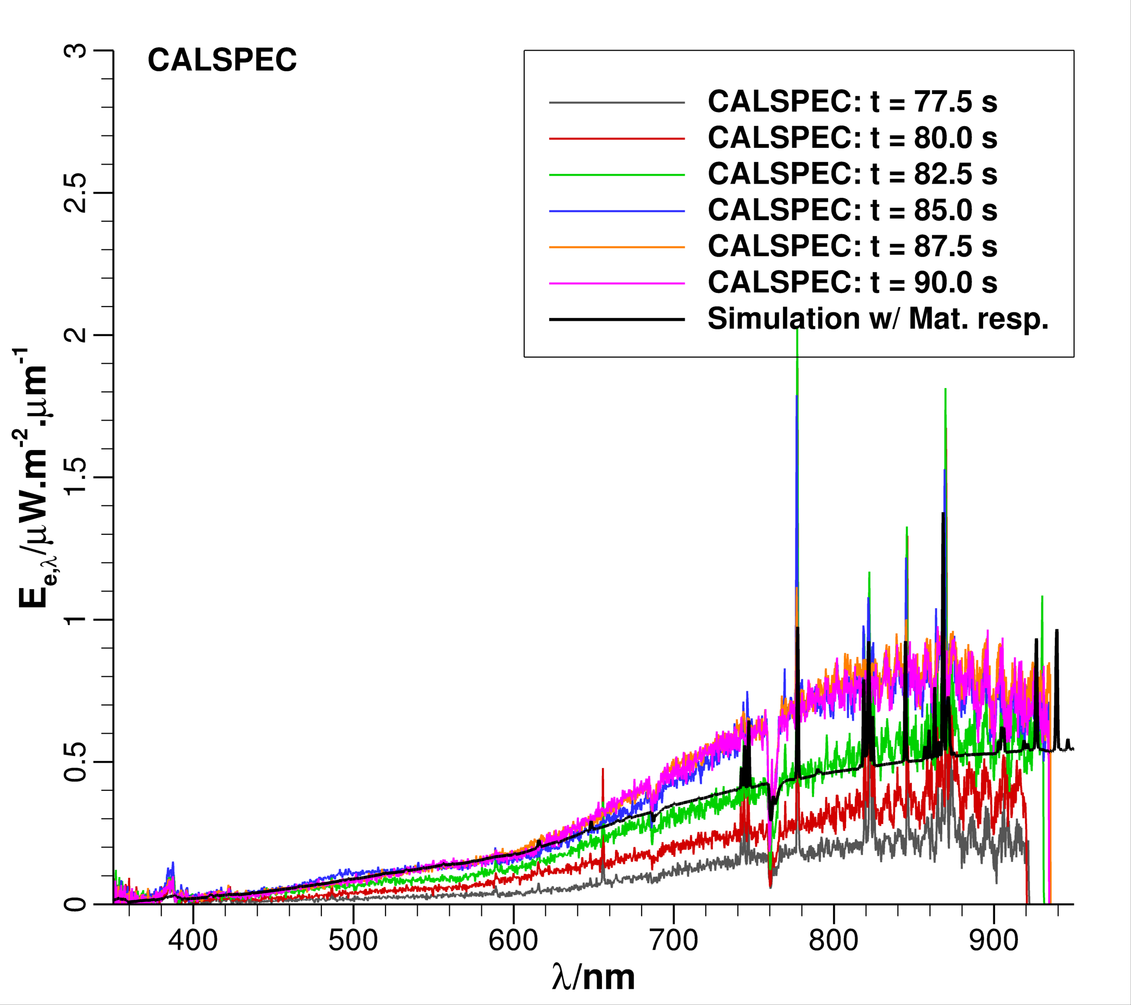
Temporal Variation of Spectral Irradiance
Time of stagnation point temperature peak
Time/s | Temperature/K | Source
70.0 | 3202 | Hayabusa, Suzuki et al.*/Case1
72.5 | 3913 | Hayabusa2, CFD/Dplr
73.0 | 3054 | Hayabusa2, BET
74.0 | 3904 | Hayabusa, Suzuki et al./Case3
76.0 | 3119 | Hayabusa2, Traj+Fiat/FDCP
Suzuki et al., JSR, 51(1), 2014
Simulated irradiance at t = 77.5 s matches measurement at t = 82.5 s (5 s shift)
  Shift in measurement does not consider change in range and view angle
Peak radiance determined by peak stag. pt. temperature
Measured irradiance peaks between 85.0 s & 87.5 s
Assume measurement need to be shifted by 7.5 s (∆t)
  Time shift => observation started after ∆t from EI
Notes:
We can also look at wavelength slices
The traces are smoothed to see when the spectral features peak – we need not yet be concerned about the absolute value of irradiance at this point
The timing of the peaks do tell us something about the flight
For instance, atomic N and O peak before the others. This suggests that these species are of shock-layer origin.
The Na and CN band head peak later and suggest that these species are of heatshield origin.
There is some ambiguity in the peak of H.

