Slide 1
Understanding the Drivers of Recent Top-of-atmosphere (TOA) Radiation Changes Observed by the Clouds and the Earth’s Energy System (CERES)
Norman G. Loeb¹, Seung-Hee Ham², Tyler Thorsen¹, Seiji Kato¹, and Ryan Scott¹
¹NASA Langley Research Center, Hampton, VA
²Science Systems & Applications (SSAI), Hampton, VA
International Radiation Symposium, July 4-8, 2022, Thessaloniki, Greece

Slide 2
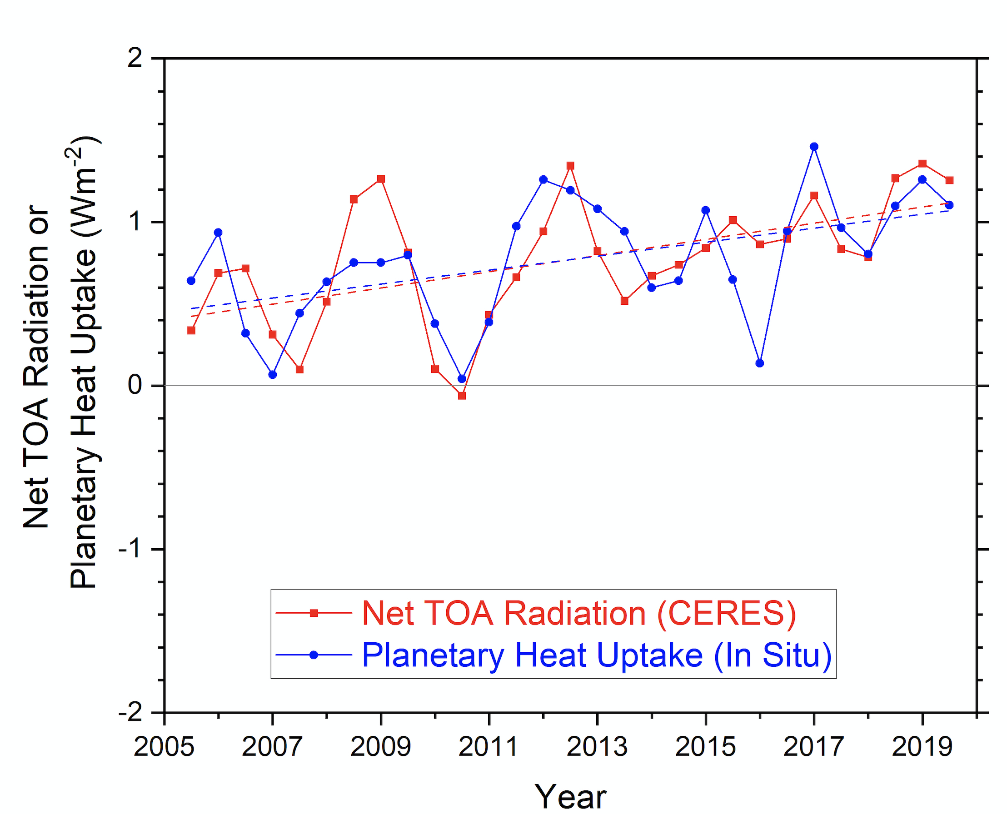
Annual Mean Net TOA Radiation & In-Situ Planetary Heat Uptake
(07/2005-06/2019)
CERES Net radiation & In-Situ PHU show consistent increasing trends with good agreement in year-to-year variability.
Trend and Uncertainty (Wm⁻² per decade; 5%-95% CI)
Trend : 0.50 ± 0.47
Trend Diff : 0.07 ± 0.29
R² = 0.49
Note: CERES and Argo+Altimeter are anchored to an EEI of 0.76±0.1 Wm⁻² for 2005-2020 based upon in-situ data.
Loeb et al. (GRL; 2021)

Slide 3
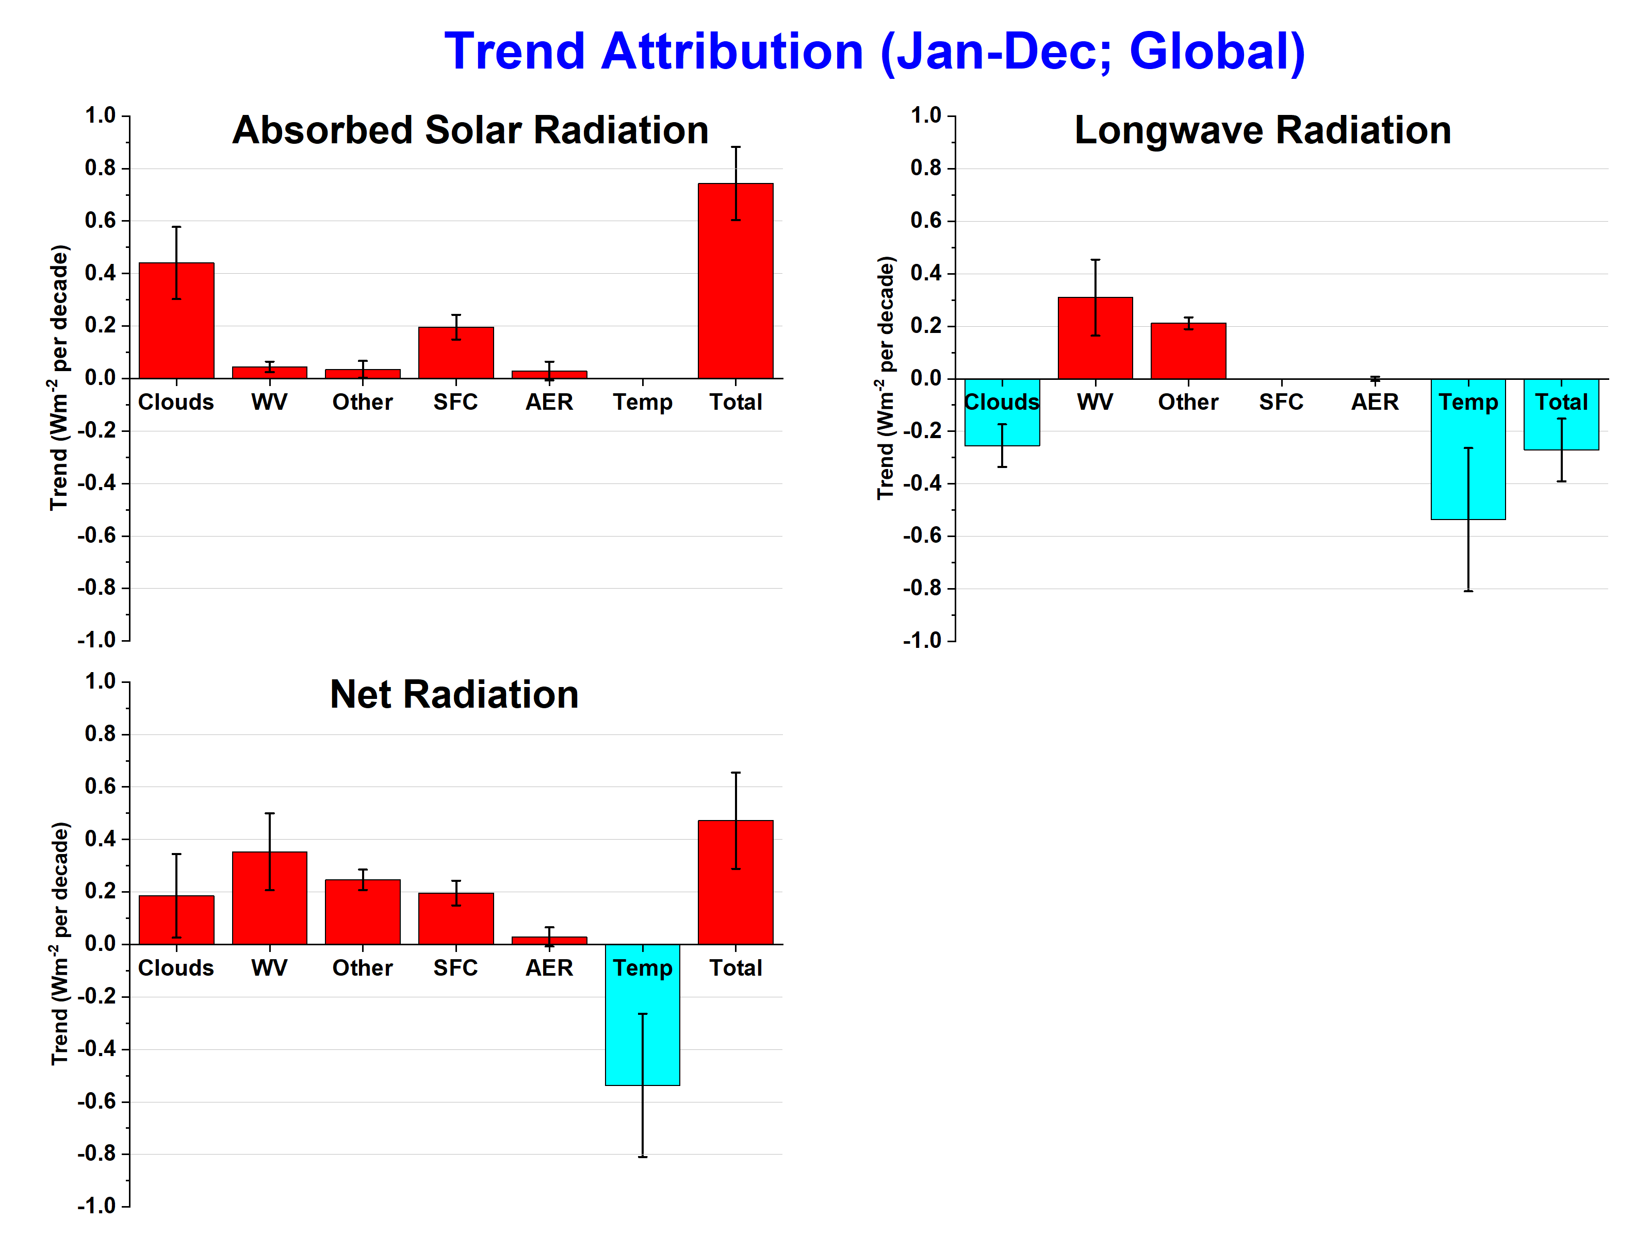
for 09/2002–03/2020
ASR trend mainly due to cloud and surface albedo changes.
Combined changes in clouds, sea-ice, WV and trace gases exceed influence from temperature changes, resulting in a positive overall trend in net TOA flux.

Slide 4
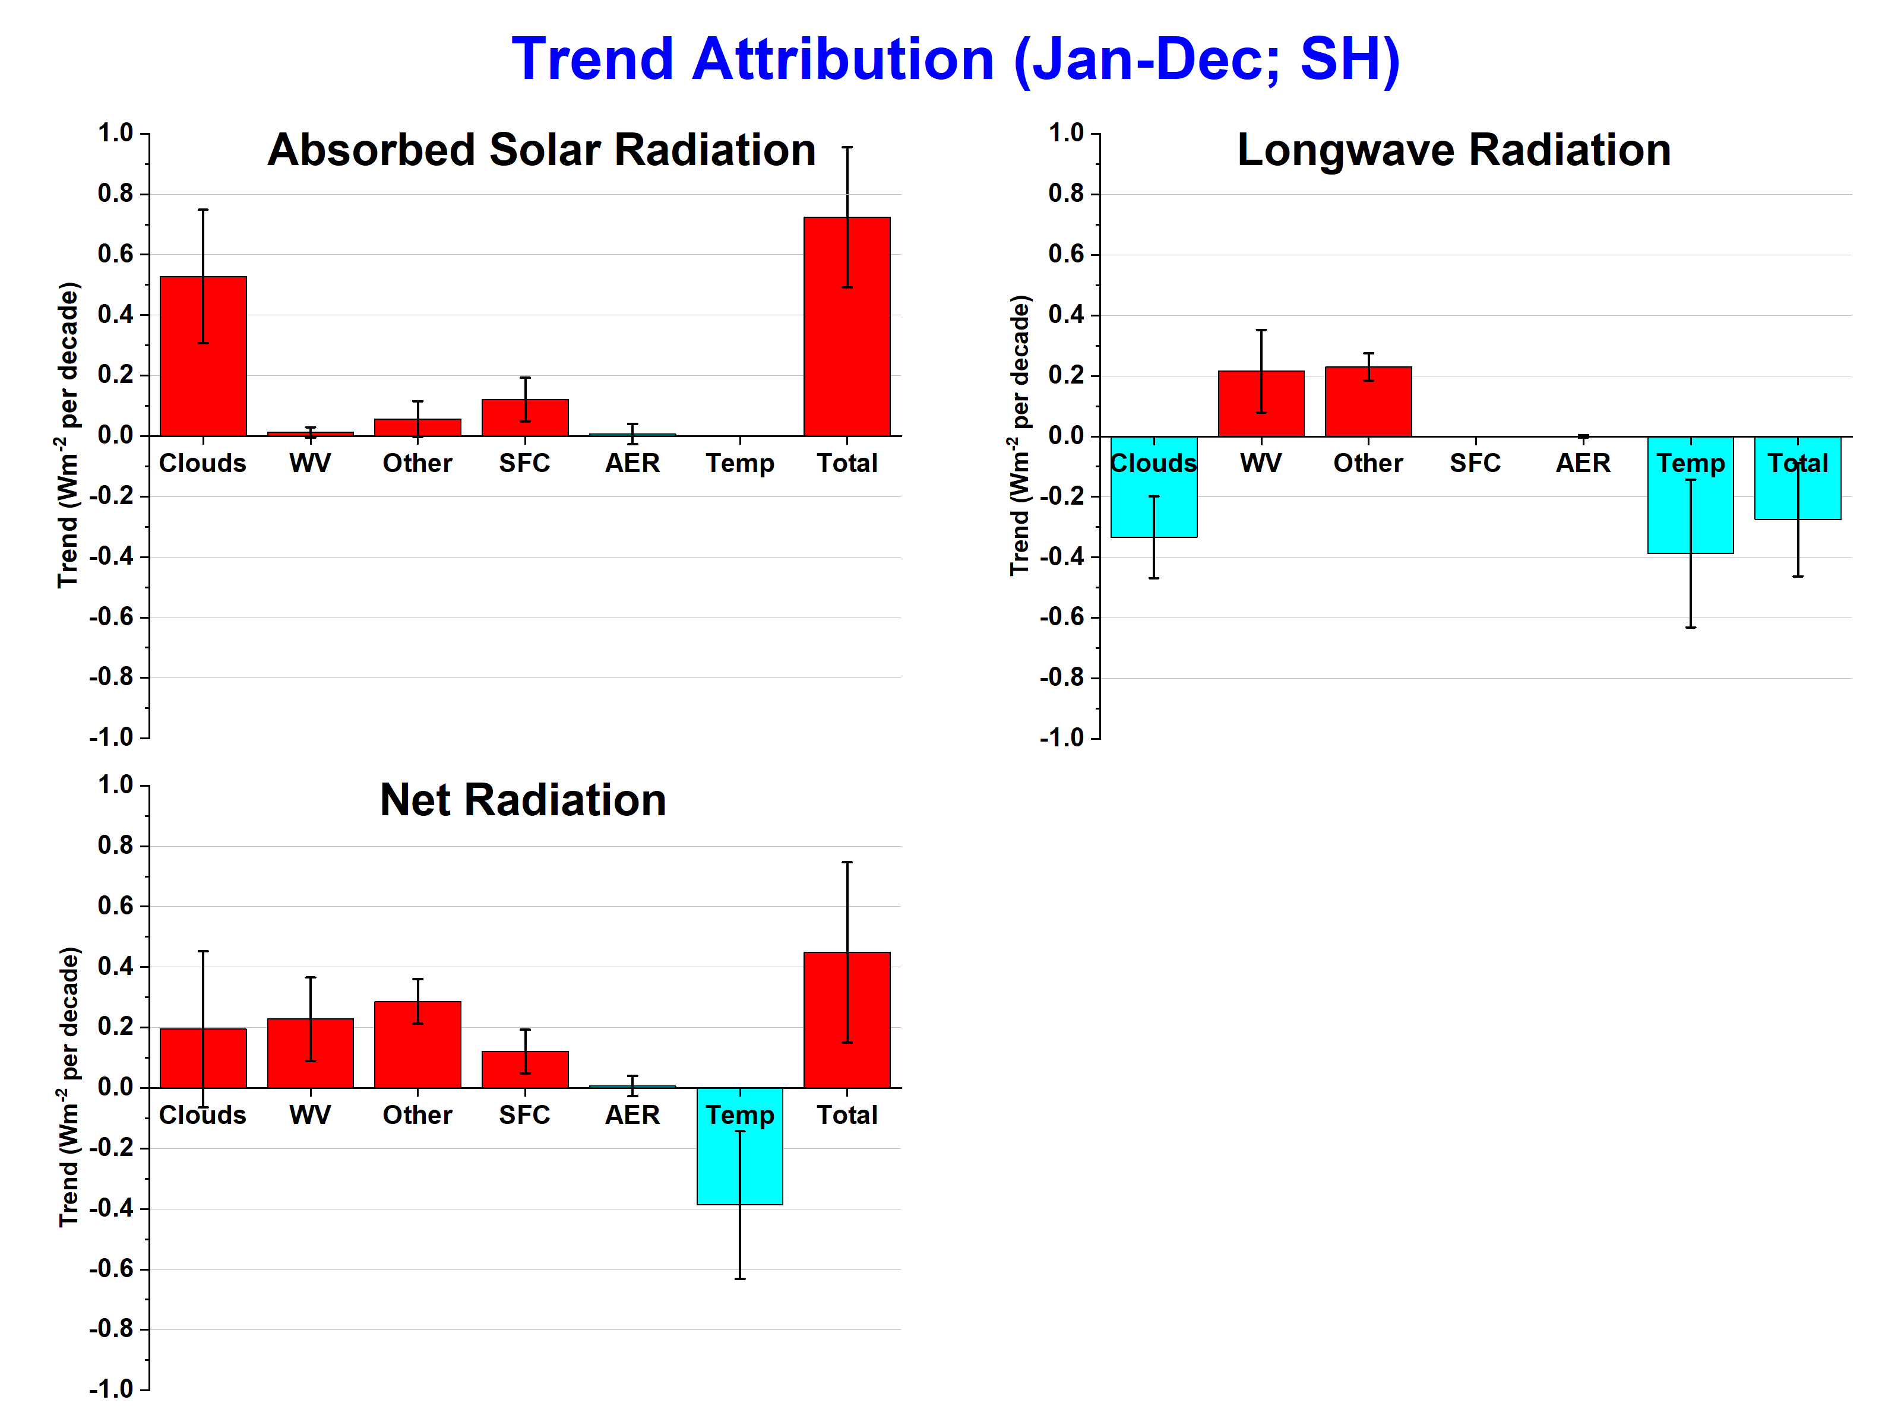
for 09/2002–03/2020

Slide 5
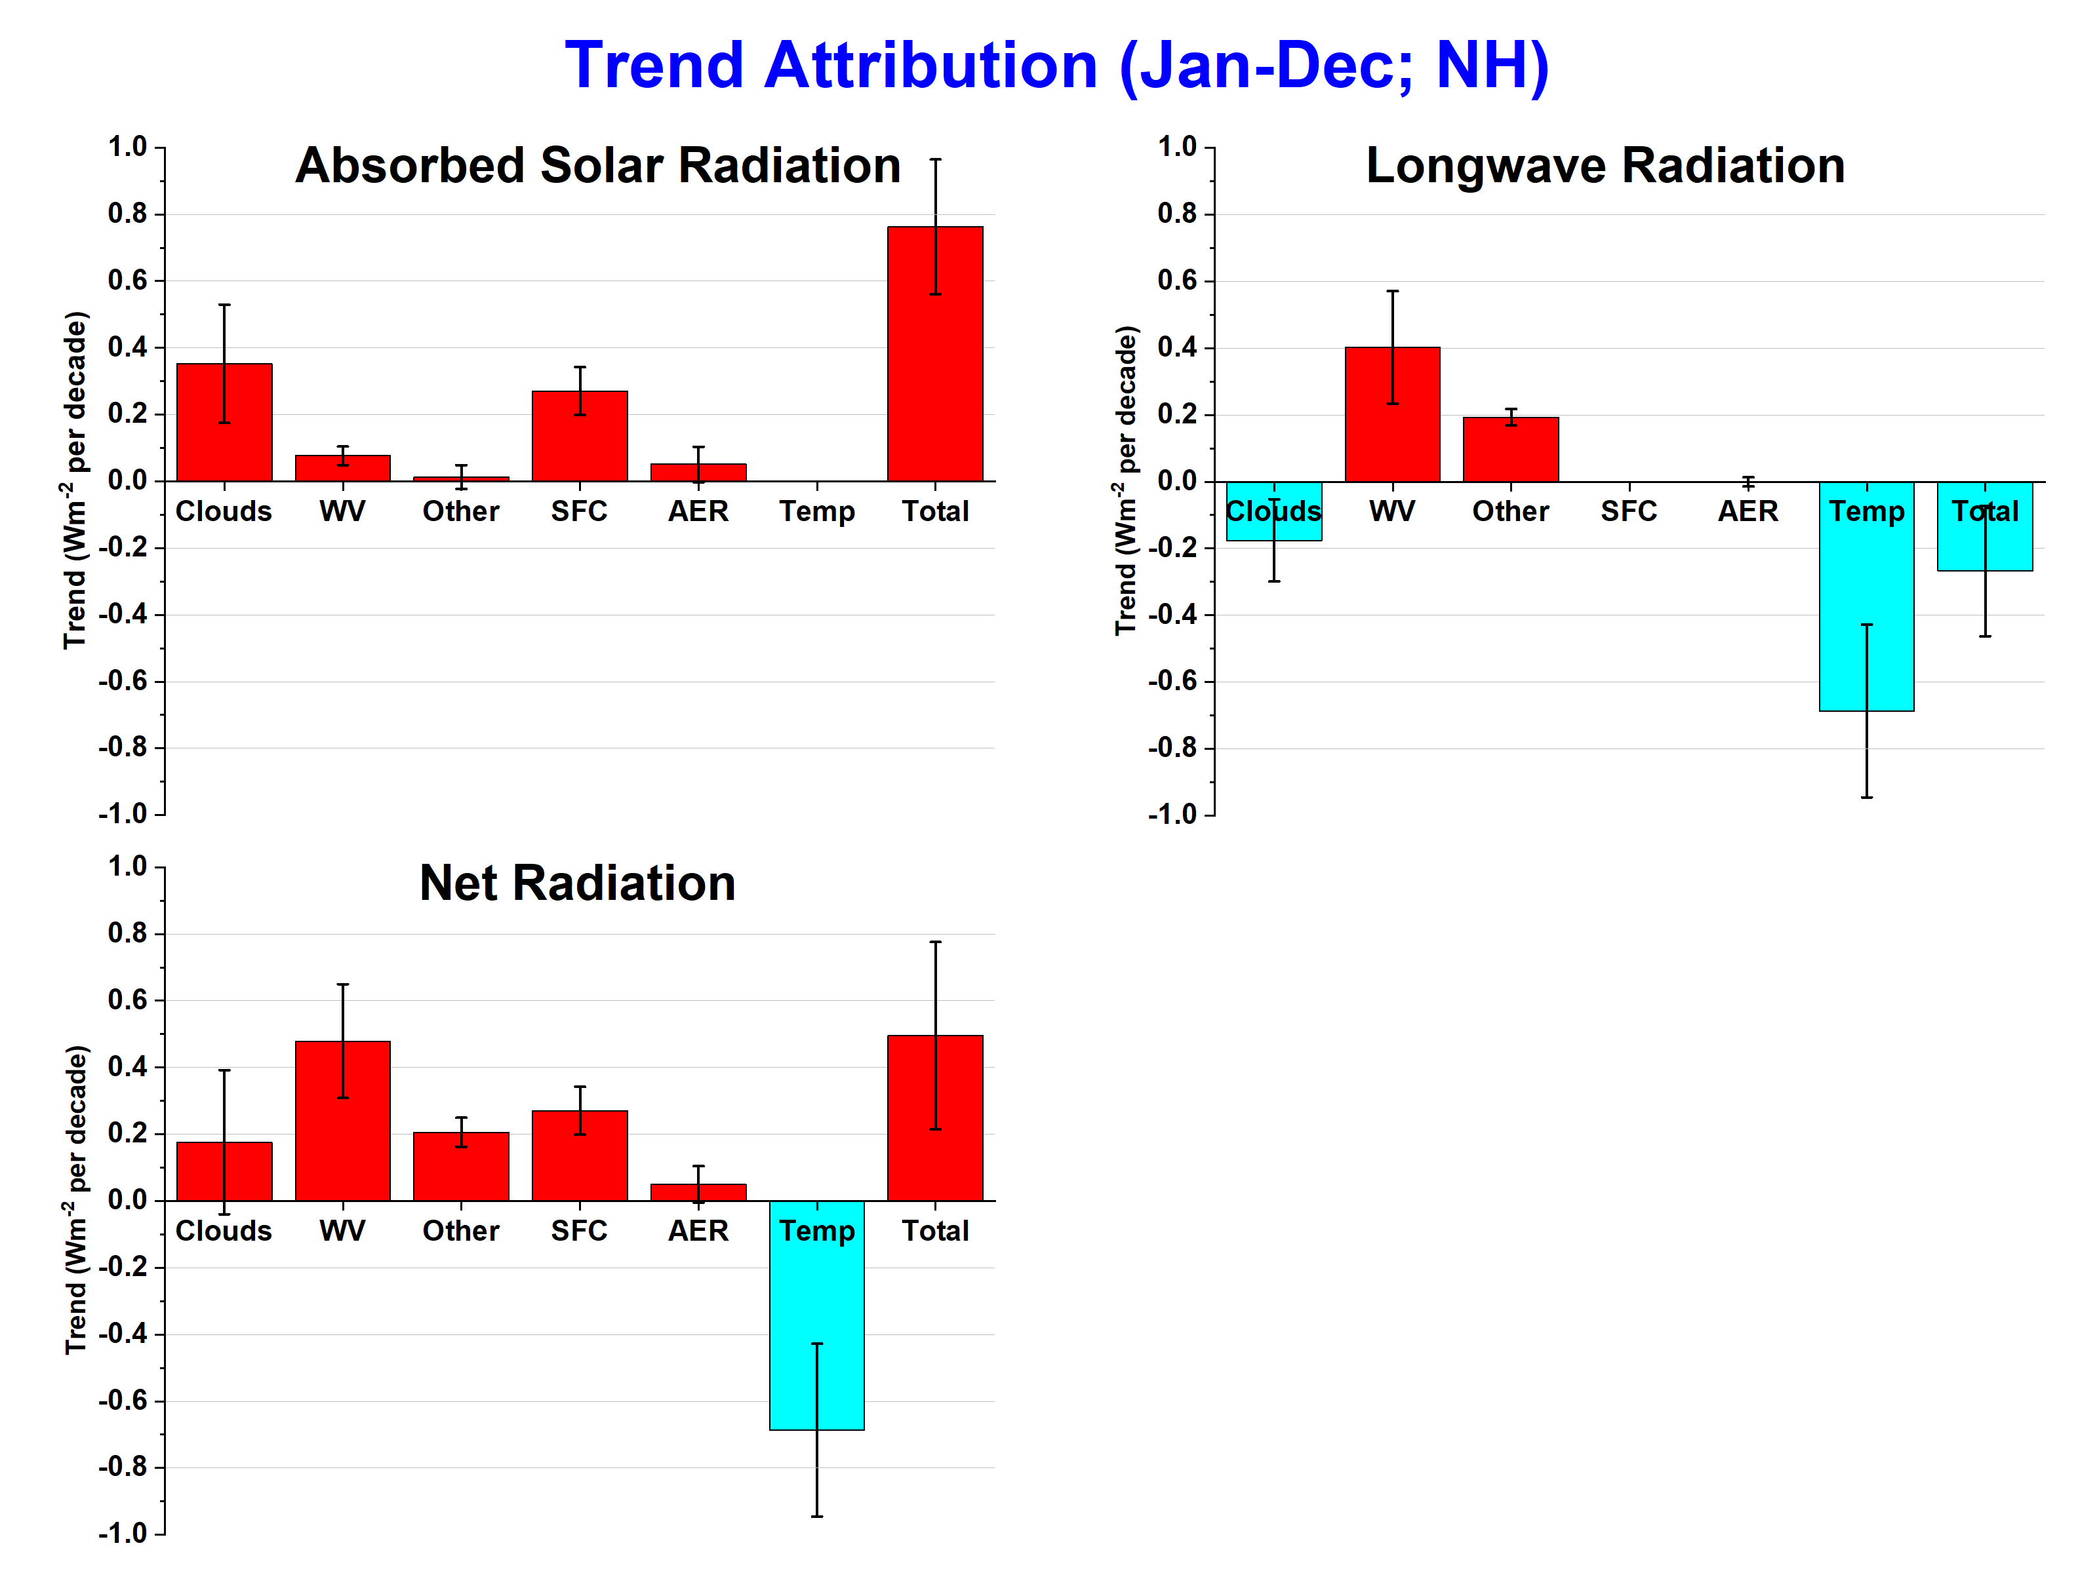
for 09/2002–03/2020

Slide 6
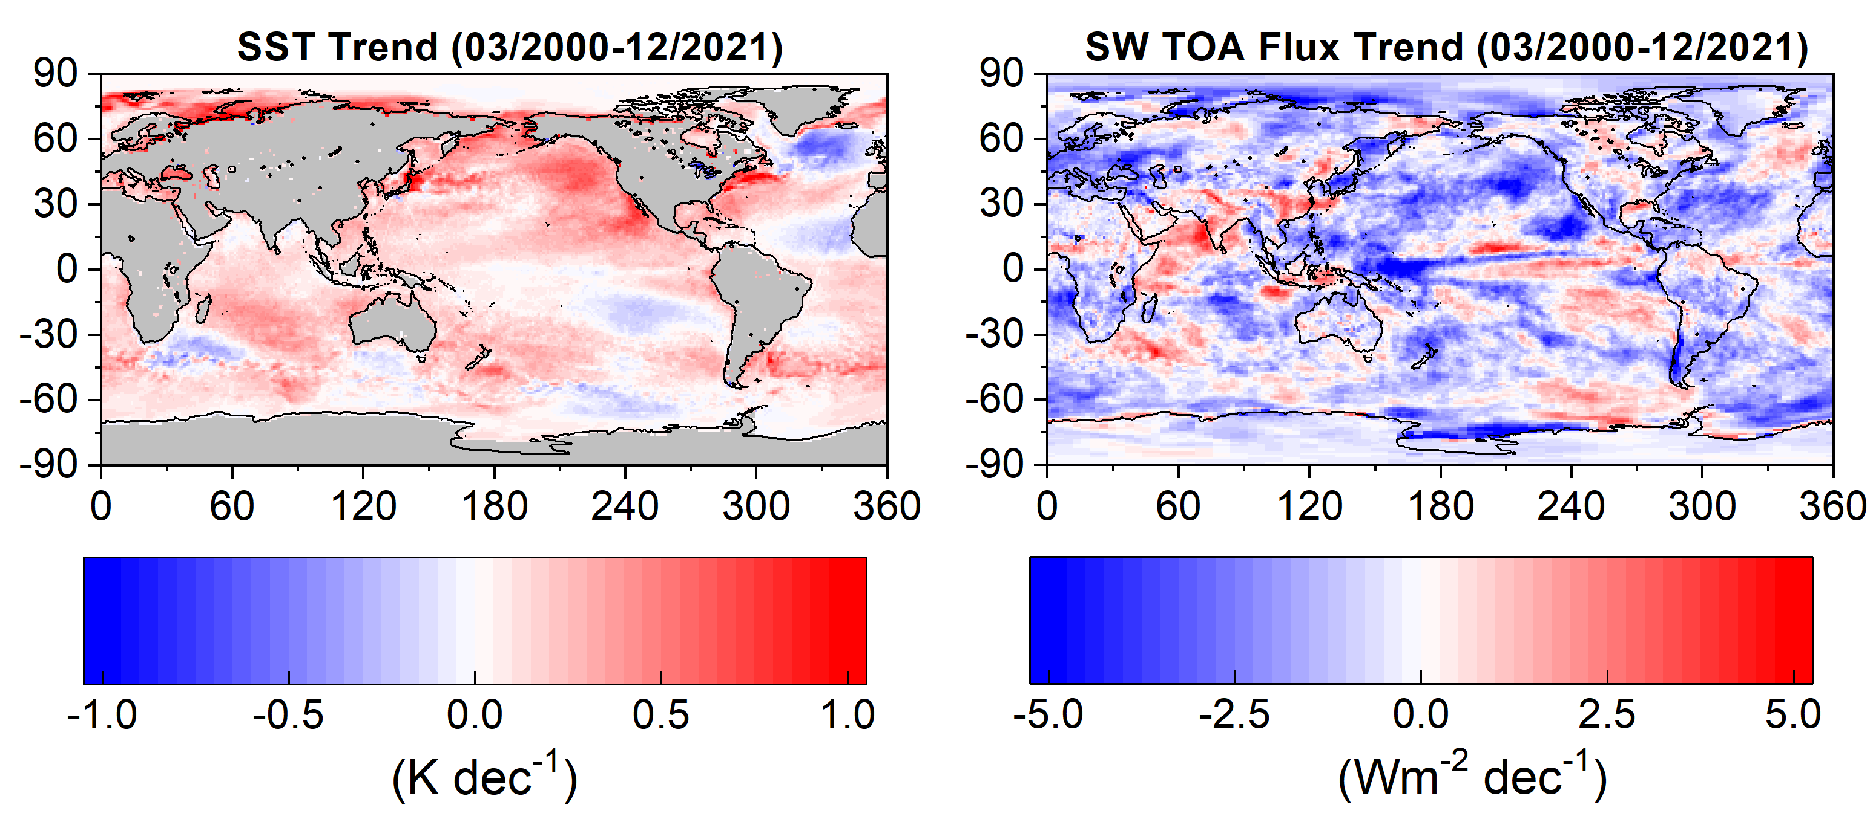
- Negative reflected SW TOA flux trends often found in regions with positive SST trends

Slide 7
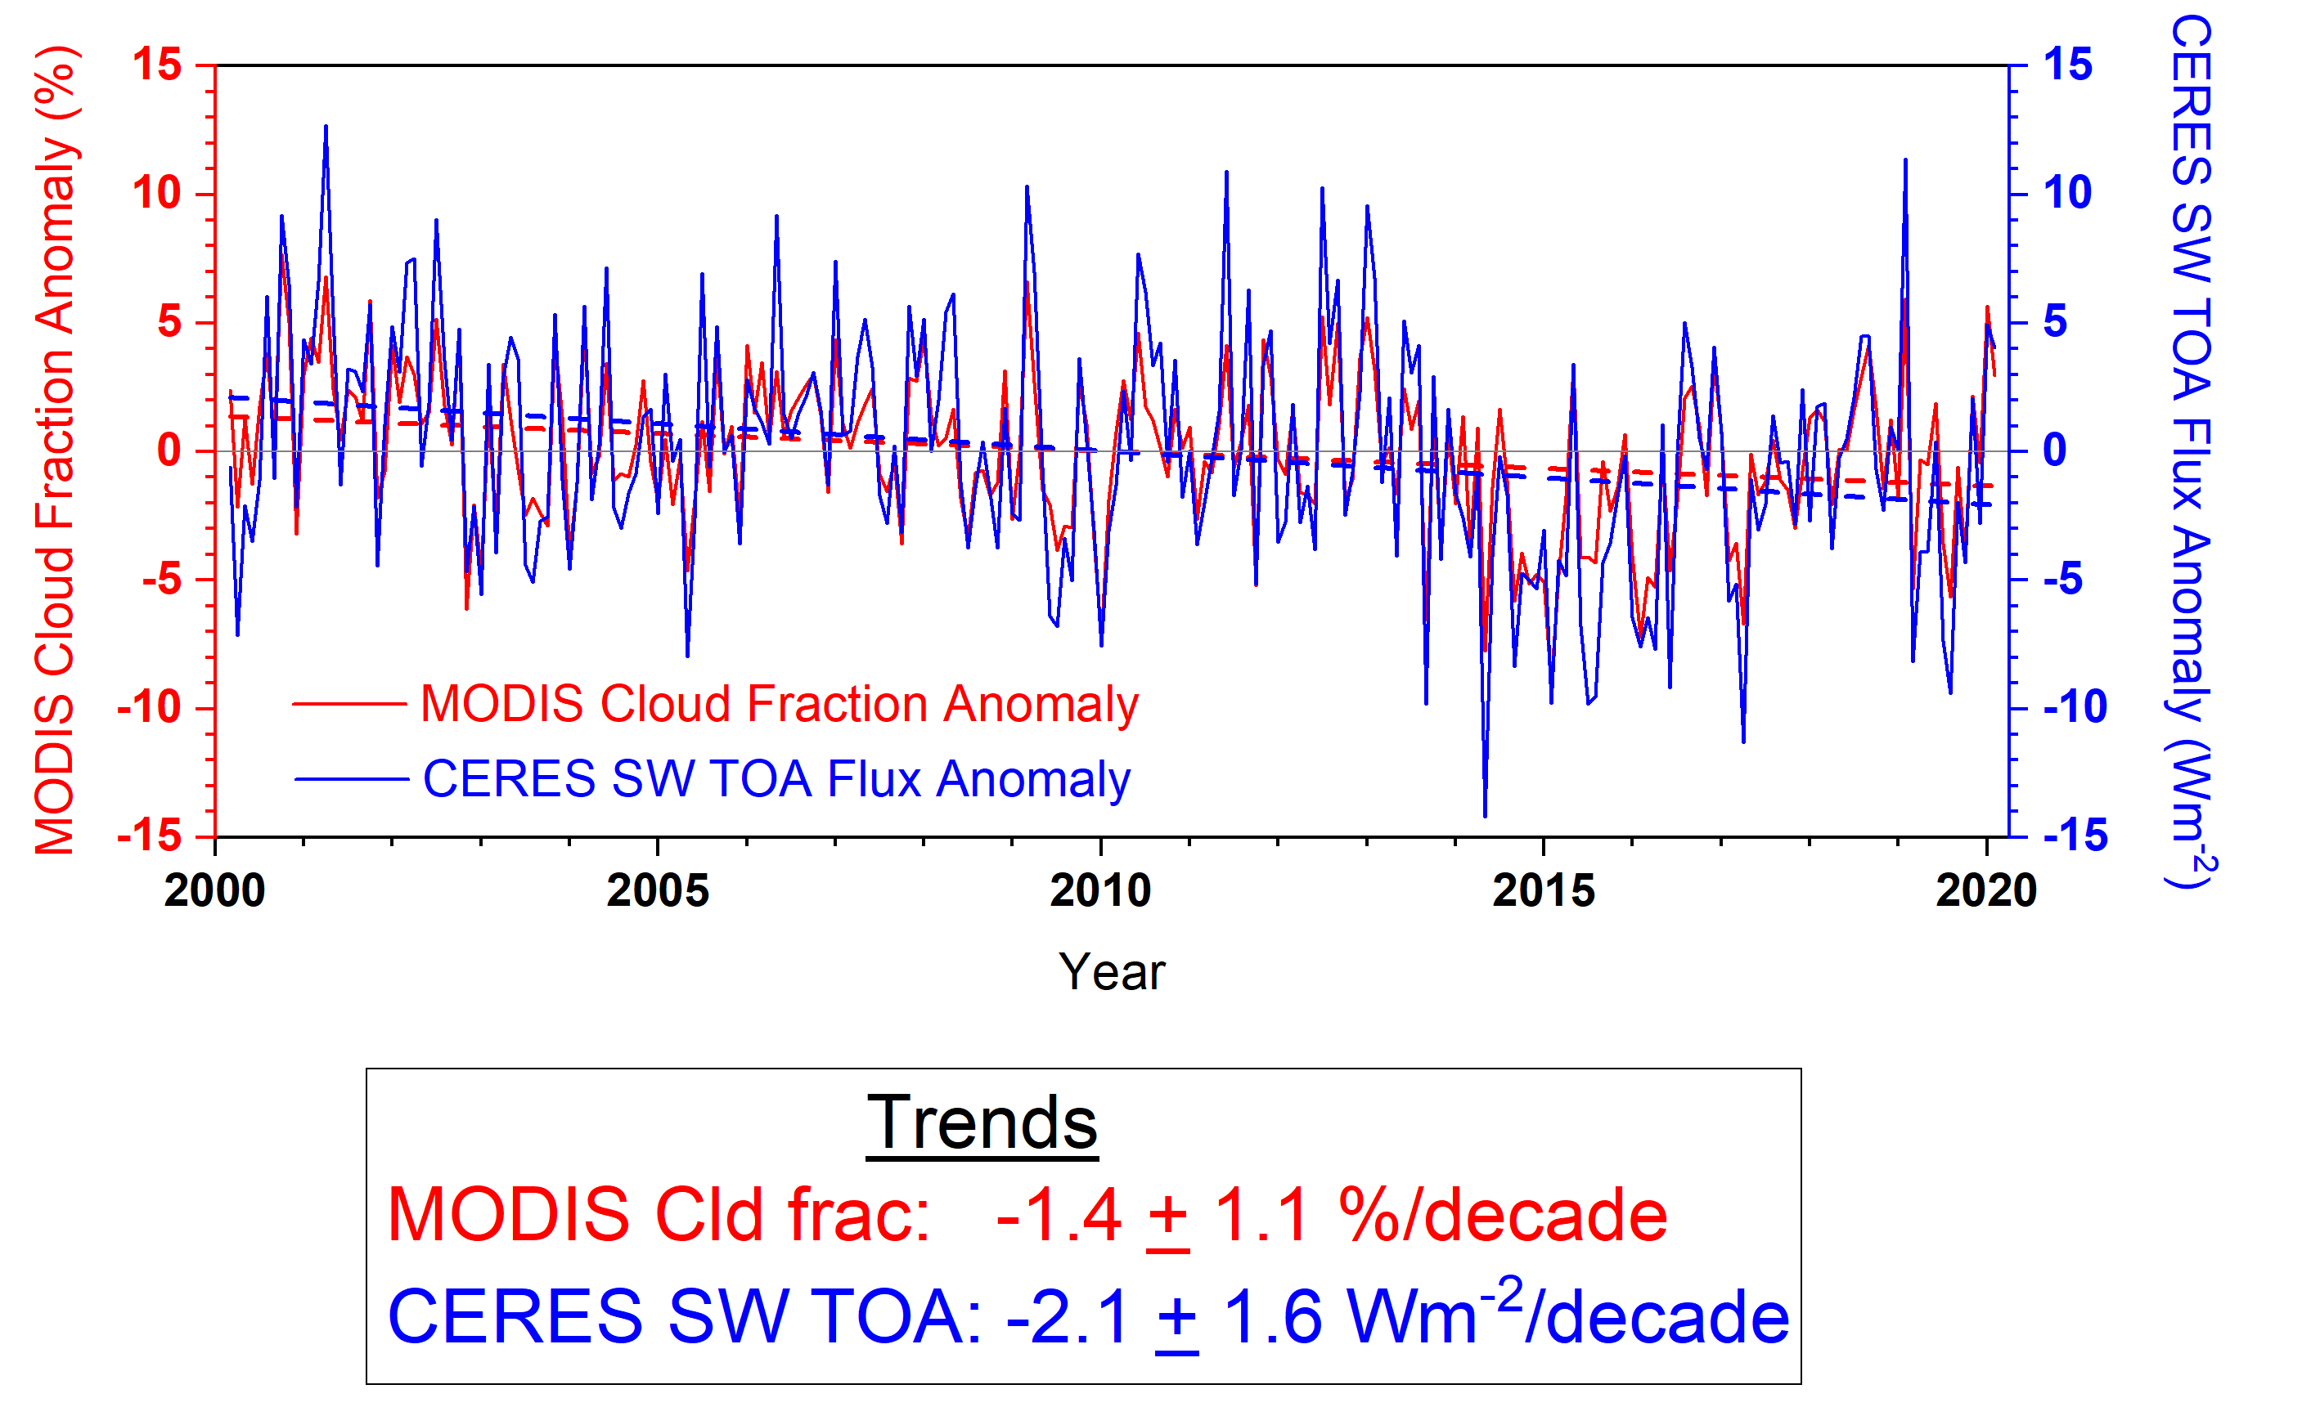
MODIS Cloud Fraction and CERES SW TOA Flux Monthly Anomalies Over Eastern Pacific (10º-40ºN, 150º-110ºW)
Figure S1 Anomalies in MODIS cloud fraction and CERES SW TOA flux for a region over the Eastern Pacific (10º-40ºN, 150º-110ºW) for 03/2000-02/2020.
Loeb et al. JGR, 2022 (in press)

Slide 8
Motivation for Study
Use the FluxbyCldType product to determine what cloud types contributed most to the cloud trends in each hemisphere

Slide 9
Methodology
Determine meteorology by cloud type:
  Read in meteorological variables (EIS, T_{skin}) in SSF1deg-daily for one month.
  Sort and average meteorology by cloud type categories in FluxbyCldTyp-daily files to produce monthly meteorology by cloud type (6 cloud optical depth, 7 cloud-top pressure).
Determine flux by cloud class:
  Read in monthly meteorology by cloud type from step 1.
  For each gridbox, determine overall cloud fraction and mean SW TOA flux contribution for the following cloud classes:
  Determine anomalies and trends for each cloud class (07/2002-12/2021)
Cloud Class | Cloud Top Press (hPa) | EIS (K) | Latitude Range
Stratocumulus (Sc) | > 680 | > 5 | ∣λ∣ < 60∘
Stratocumulus-to-Cumulus Transition (SCT) | > 680 | 0 – 5 | ∣λ∣ < 60∘
Shallow Cumulus (Cu) | > 680 | < 5 | ∣λ∣ < 60∘
Middle | 440 – 680 | – | ∣λ∣ < 60∘
High | < 440 | – | ∣λ∣ < 60∘
Polar | – | – | ∣λ∣ > 60∘

Slide 10
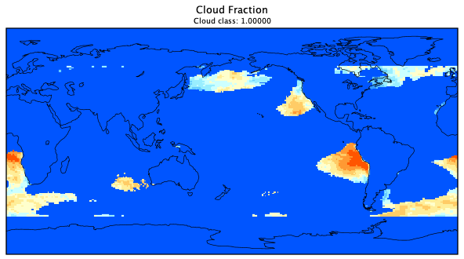
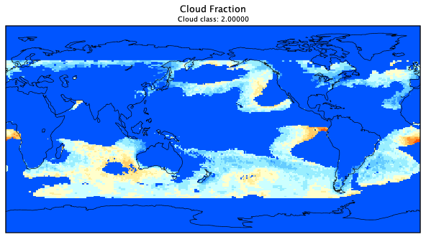
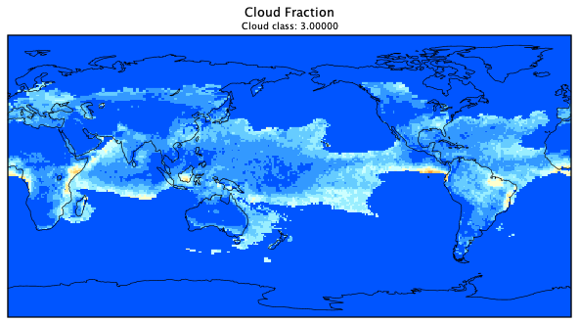
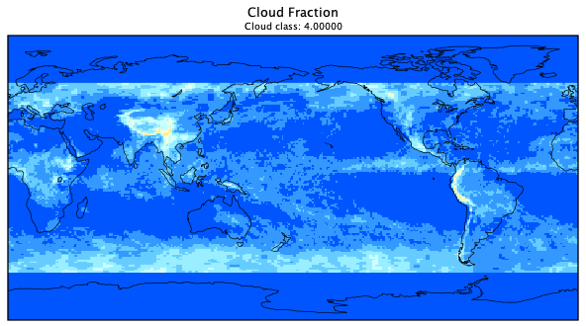
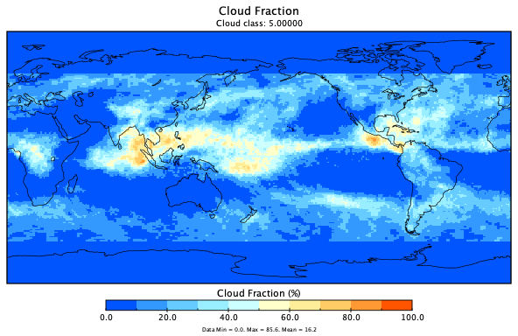
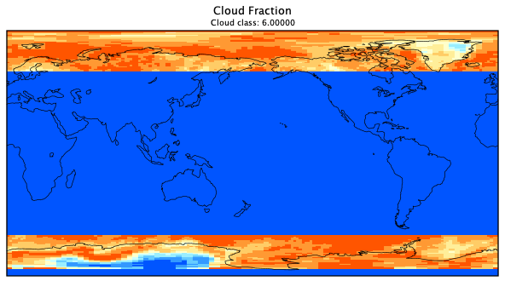
Cloud Fraction by Cloud Class (September 2002)
Stratocumulus (Sc)
Sc-to-Cu Transition (SCT)
Shallow Cumulus (Cu)
Global: 6%
Global: 13%
Global: 9%
Middle
High
Polar
Global: 11%
Global: 11%
Global: 16%

Slide 11
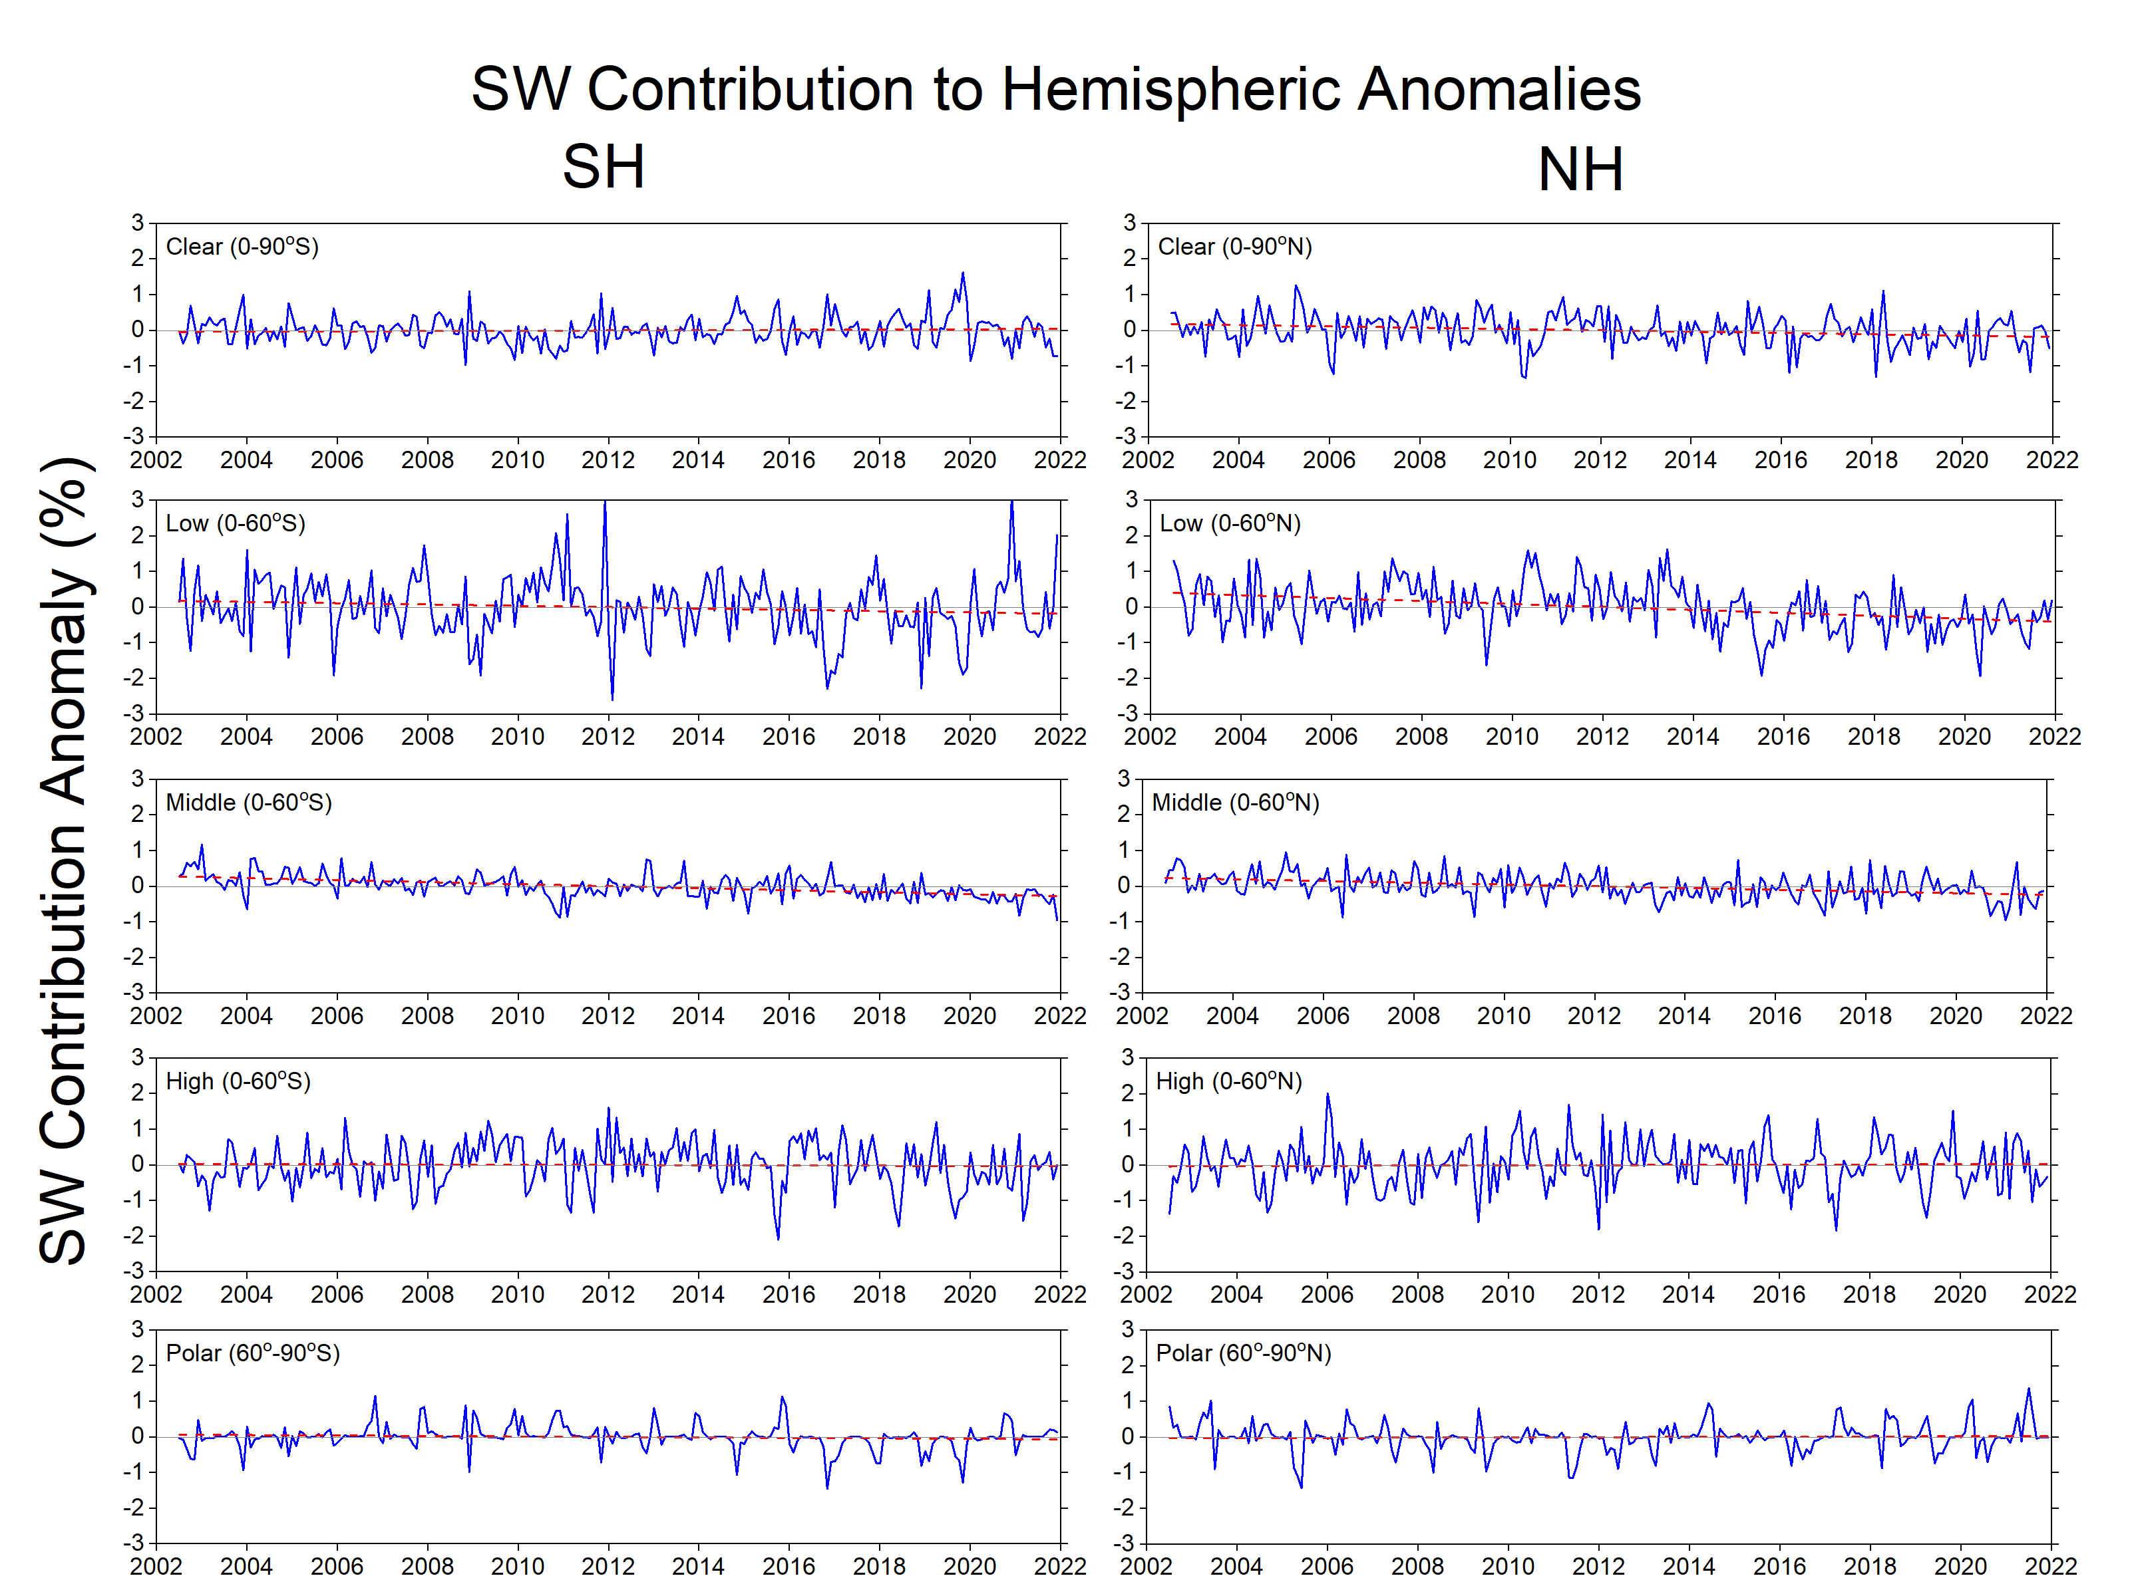
Std: 0.41 Wm⁻²
Std: 0.47 Wm⁻²
Std: 0.87 Wm⁻²
Std: 0.67 Wm⁻²
Std: 0.33 Wm⁻²
Std: 0.37 Wm⁻²
Std: 0.64Wm⁻²
Std: 0.66 Wm⁻²
Std: 0.35 Wm⁻²
Std: 0.40 Wm⁻²

Slide 12
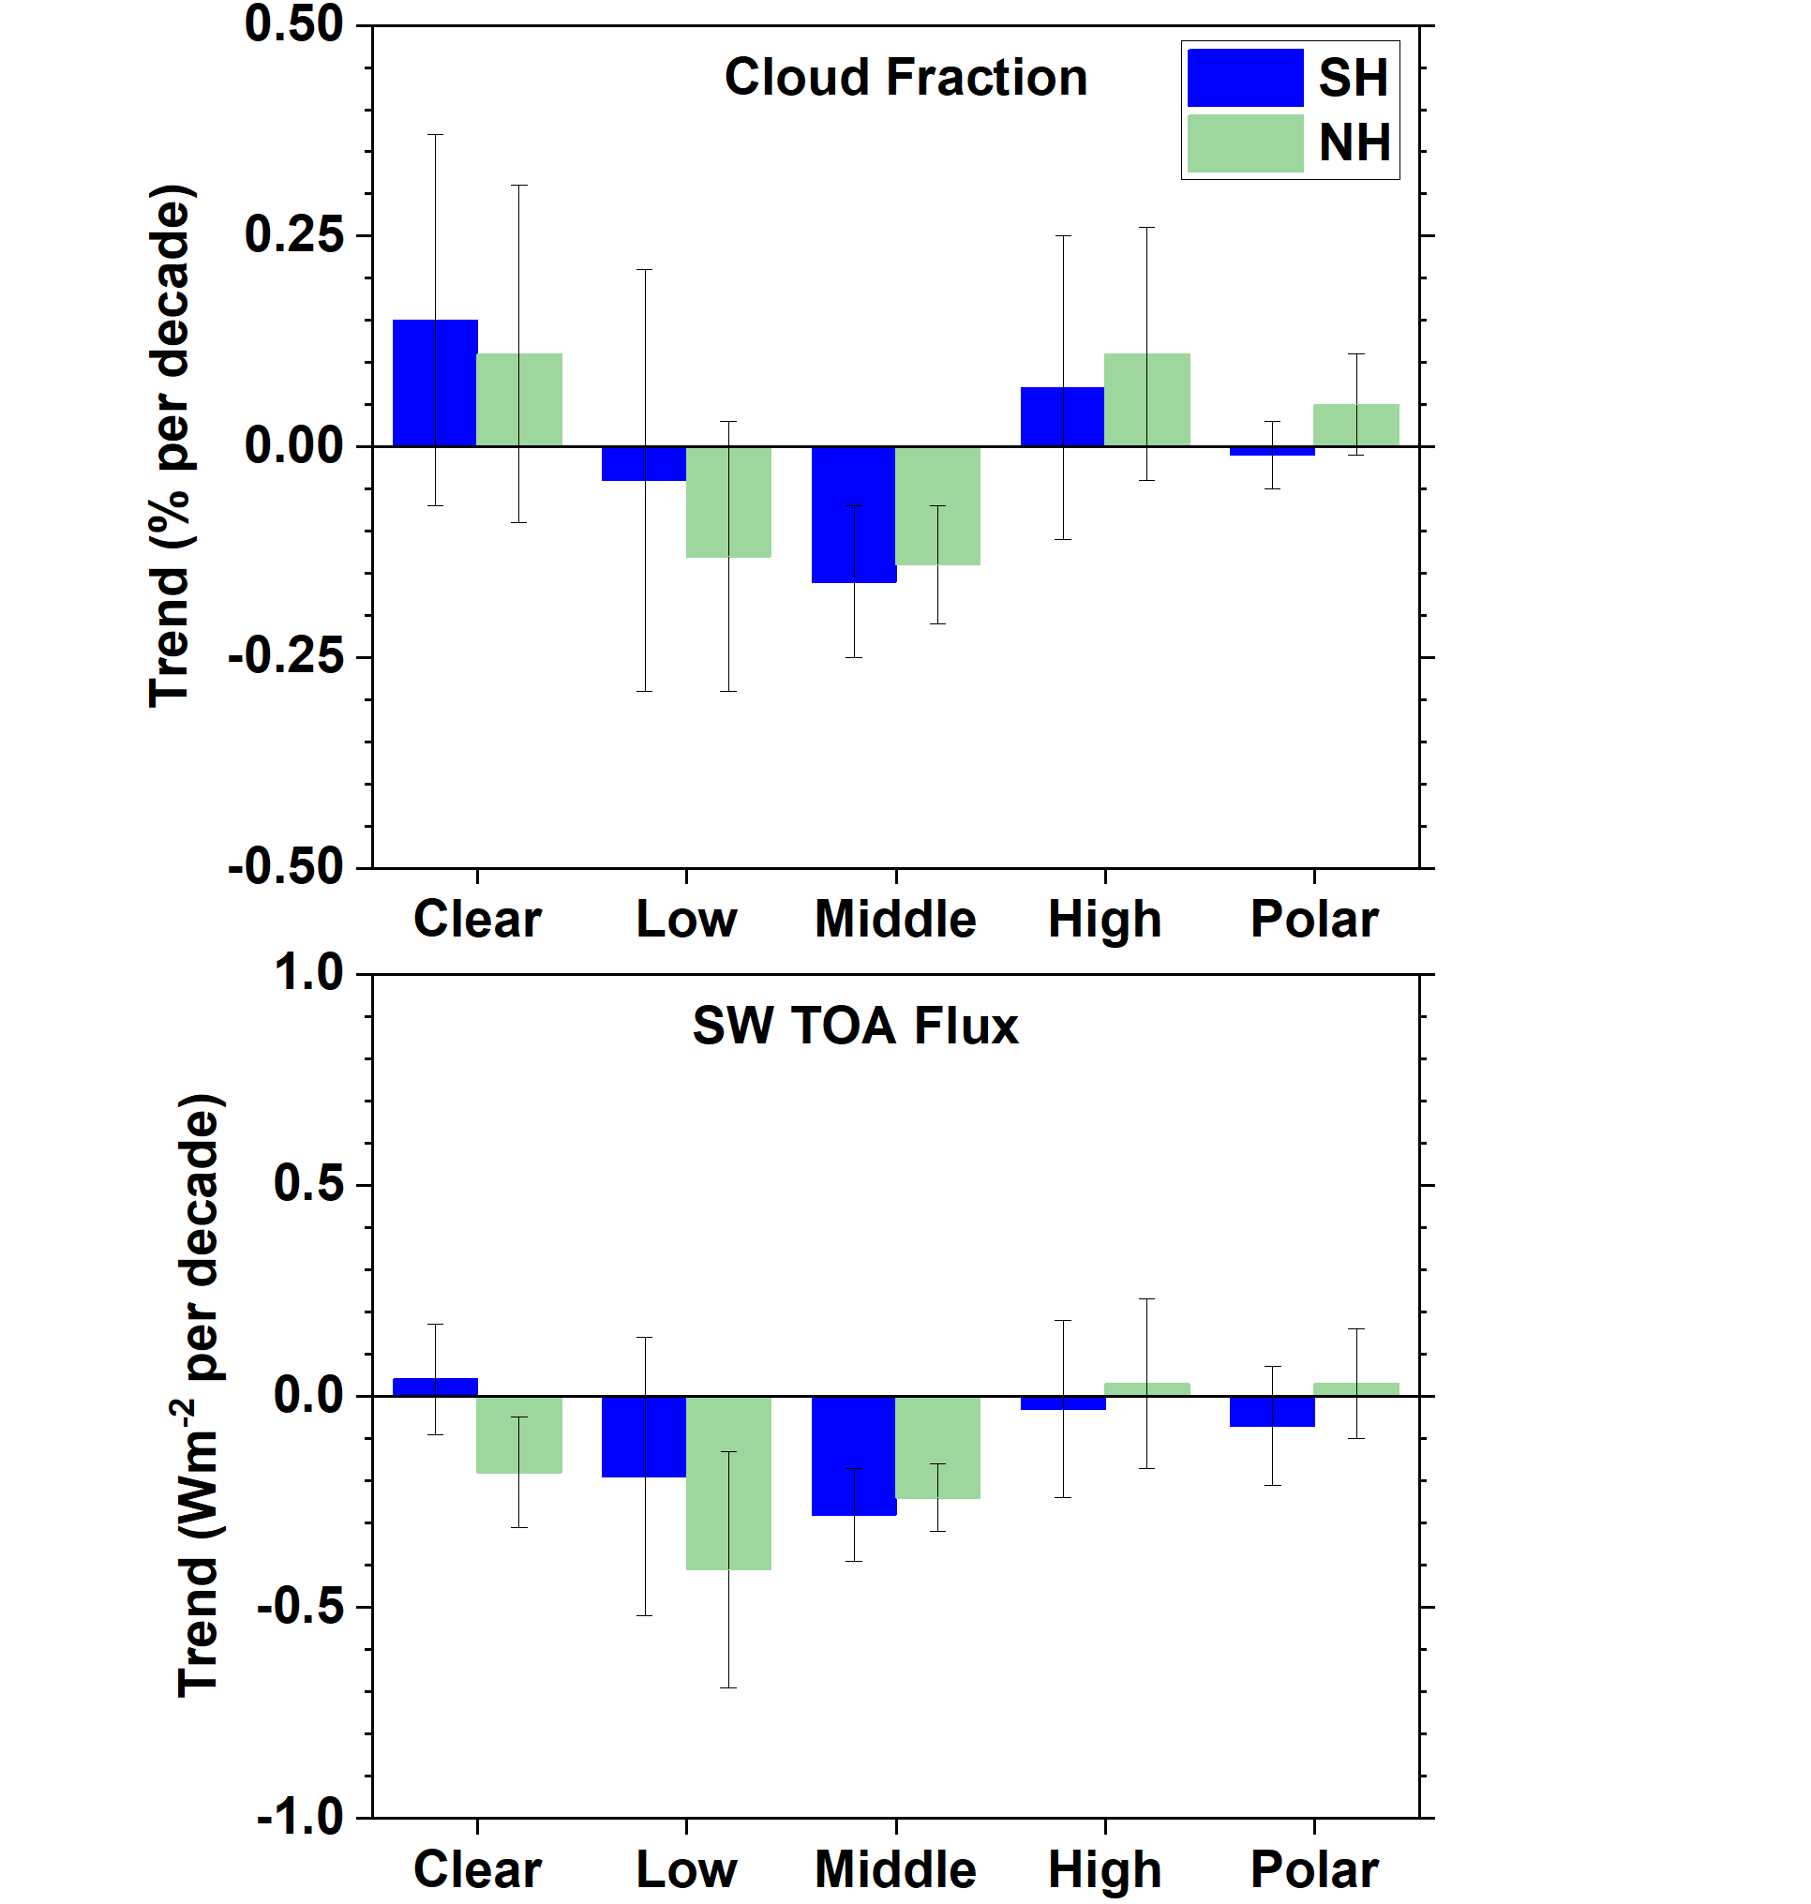
Trends in Cloud Fraction & SW TOA Flux (07/2002– 12/2021)
Increase in CLR fraction (SH & NH)
Decreases in low and middle clouds (SH & NH)
NH CLR SW flux decrease due to decreases in sea-ice fraction and aerosols
Middle cloud decreases are main reason for SW TOA flux changes in SH.
Low cloud decreases are main reason for SW TOA flux changes in NH

Slide 13
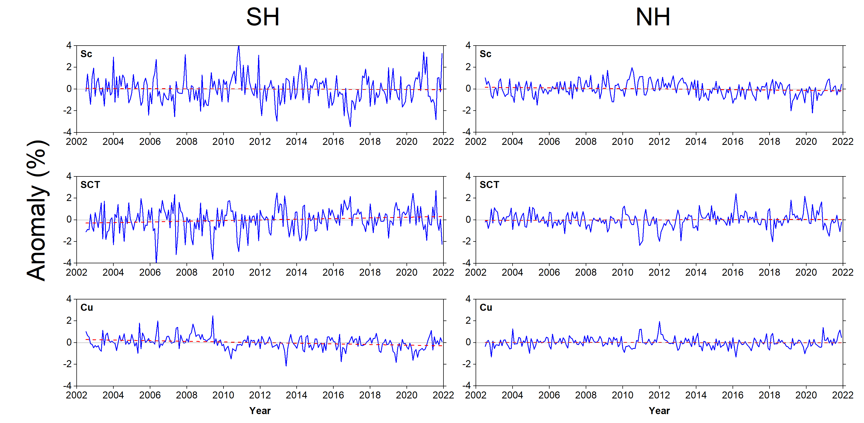
Low Cloud Fraction Anomalies
Std: 1.3%
Std: 0.67%
Std: 1.2%
Std: 0.71%
Std: 0.62%
Std: 0.45%

Slide 14
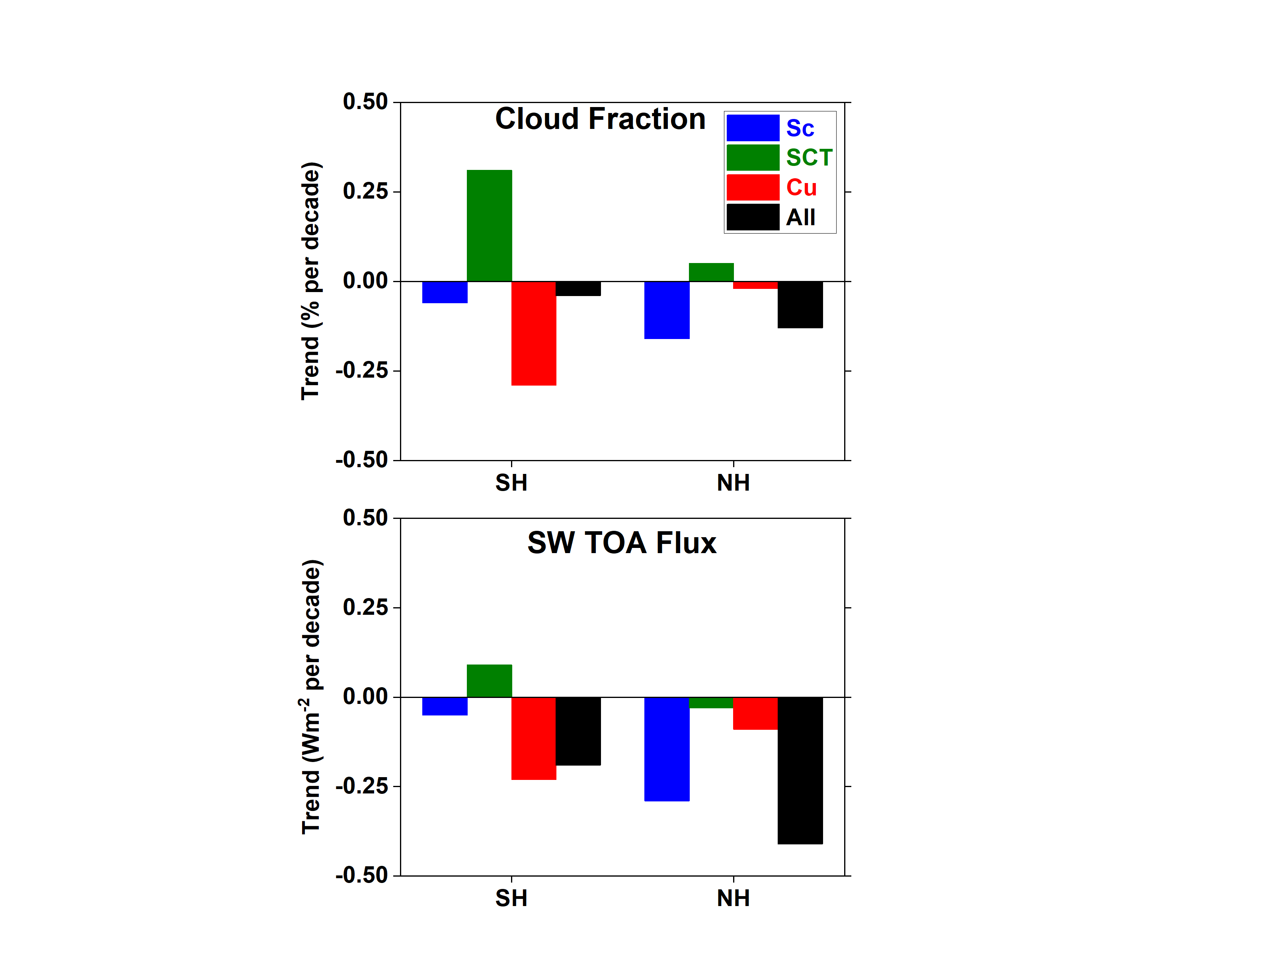
Low Cloud Trends by Type
SH: Weak overall low cloud change due to compensation between SCT and Cu
NH: Sc dominate the low cloud changes

Slide 15
Summary
Increase in clear area fraction in both hemispheres
NH CLR SW flux decreases due to decreases in sea-ice fraction and aerosols
Middle cloud decreases are main reason for SW TOA flux changes in SH.
Low cloud decreases (mainly Sc) are main reason for SW TOA flux changes in NH
Next Steps
Use the C3M data product to compare trends in cloud fraction from MODIS with those from active sensors (CALIPSO & CloudSat) for 2007-2017.
Analyze active sensor data in a manner analogous to MODIS: examine cloud fraction for the clouds exposed to space (sort clouds according to top layer visible from space).

