Slide 1
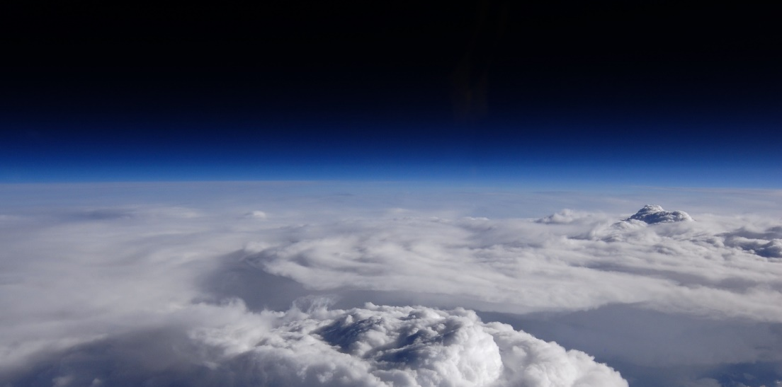
Daniel Watters¹, Patrick Gatlin², Pierre Kirstetter^{3,4,5,6}, George Huffman⁷, Jackson Tan^{7,8}, Dave Bolvin^{7,9},
Eric Nelkin^{7,9}, Dave Wolff¹⁰, Jianxin Wang^{7,9}, Bob Joyce^{7,9}, Sarah Ringerud^{7,11}
1 - NASA Postdoctoral Program, NASA Marshall Space Flight Center, Huntsville, Alabama
2 – NASA Marshall Space Flight Center, Huntsville, Alabama
3 – Advanced Radar Research Center, University of Oklahoma, Norman, Oklahoma
4 – School of Civil Engineering and Environmental Sciences, University of Oklahoma, Norman, Oklahoma
5 – School of Meteorology, University of Oklahoma, Norman, Oklahoma
6 – NOAA/National Severe Storms Laboratory, Norman, Oklahoma
7 – NASA Goddard Space Flight Center, Greenbelt, Maryland
8 – University of Maryland, Baltimore County, Baltimore, Maryland
9 – Science Systems and Applications, Inc., Lanham, Maryland
10 – NASA Wallops Flight Facility, Wallops Island, Virginia
11 – Earth Systems Science Interdisciplinary Center, University of Maryland, College Park, Maryland
IMERG and GPROF Validation with the GPM Validation Network

Slide 2
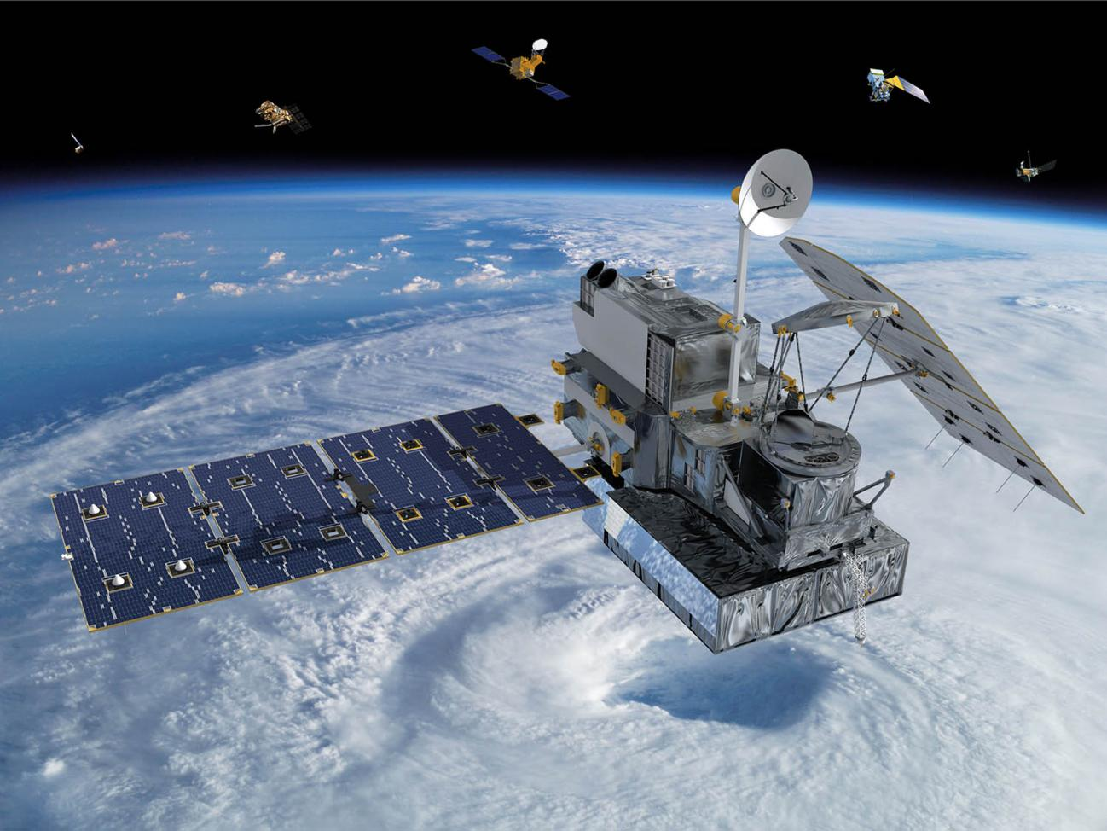
Overview
Aims:
To conduct oceanic validation of the IMERG and GPROF products for GMI measurements;
To trace errors from the L2 GPROF product through to the L3 IMERG product.
The GPM Validation Network
Oceanic Validation with the Validation Network
  Results from:
    Hawaii [PHKI, PHMO]
    Alaska’s Middleton Island [PAIH]
    Kwajalein [KWAJ]
Conclusions and Future Studies

Slide 3
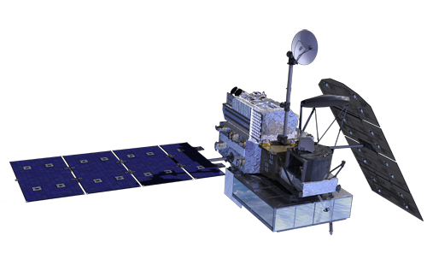
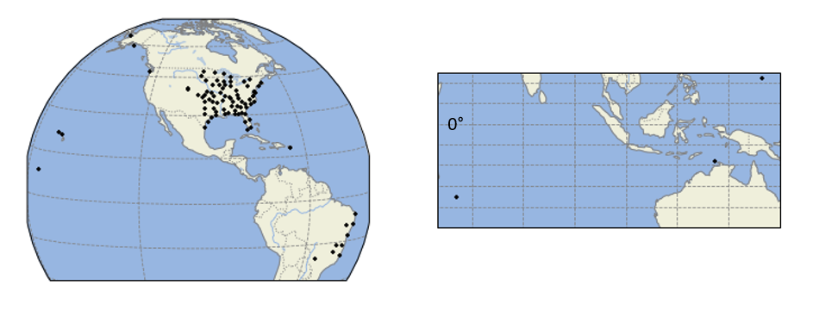
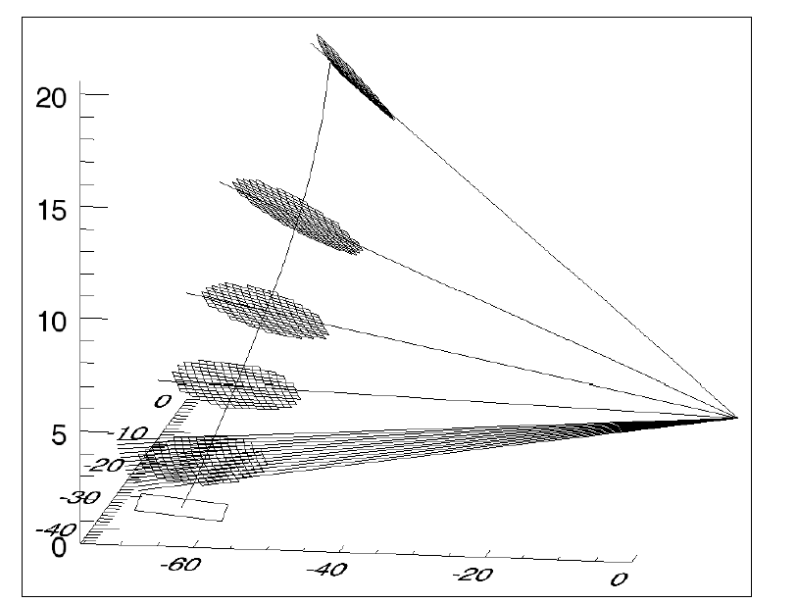
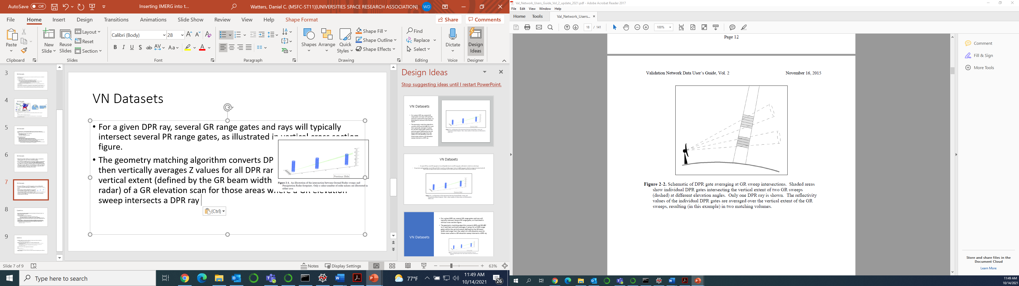
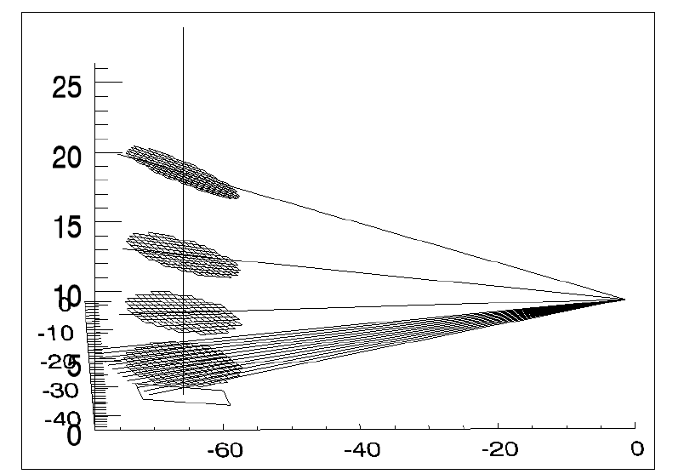
The GPM Validation Network
Validation Network Ground Radar (GR) Sites
GR to GPROF-GMI Matchup
Line of Sight
GPM Core
Alaska
Washington
Eastern CONUS
Guam
GR
Hawaii
Puerto Rico
Kwajalein
Darwin
Vertical Profile
Island-based radars with GPROF-GMI 3D matchups
Eastern Brazil
La Reunion
GPM Core
Adapted from Gatlin et al. (2020)
GR
A NASA software system run at Marshall Space Flight Center that geometrically matches 3D precipitation retrievals from GPM Core sensors to ground-based radars.
Adapted from NASA’s GPM Validation Network Guide (2021)

Slide 4
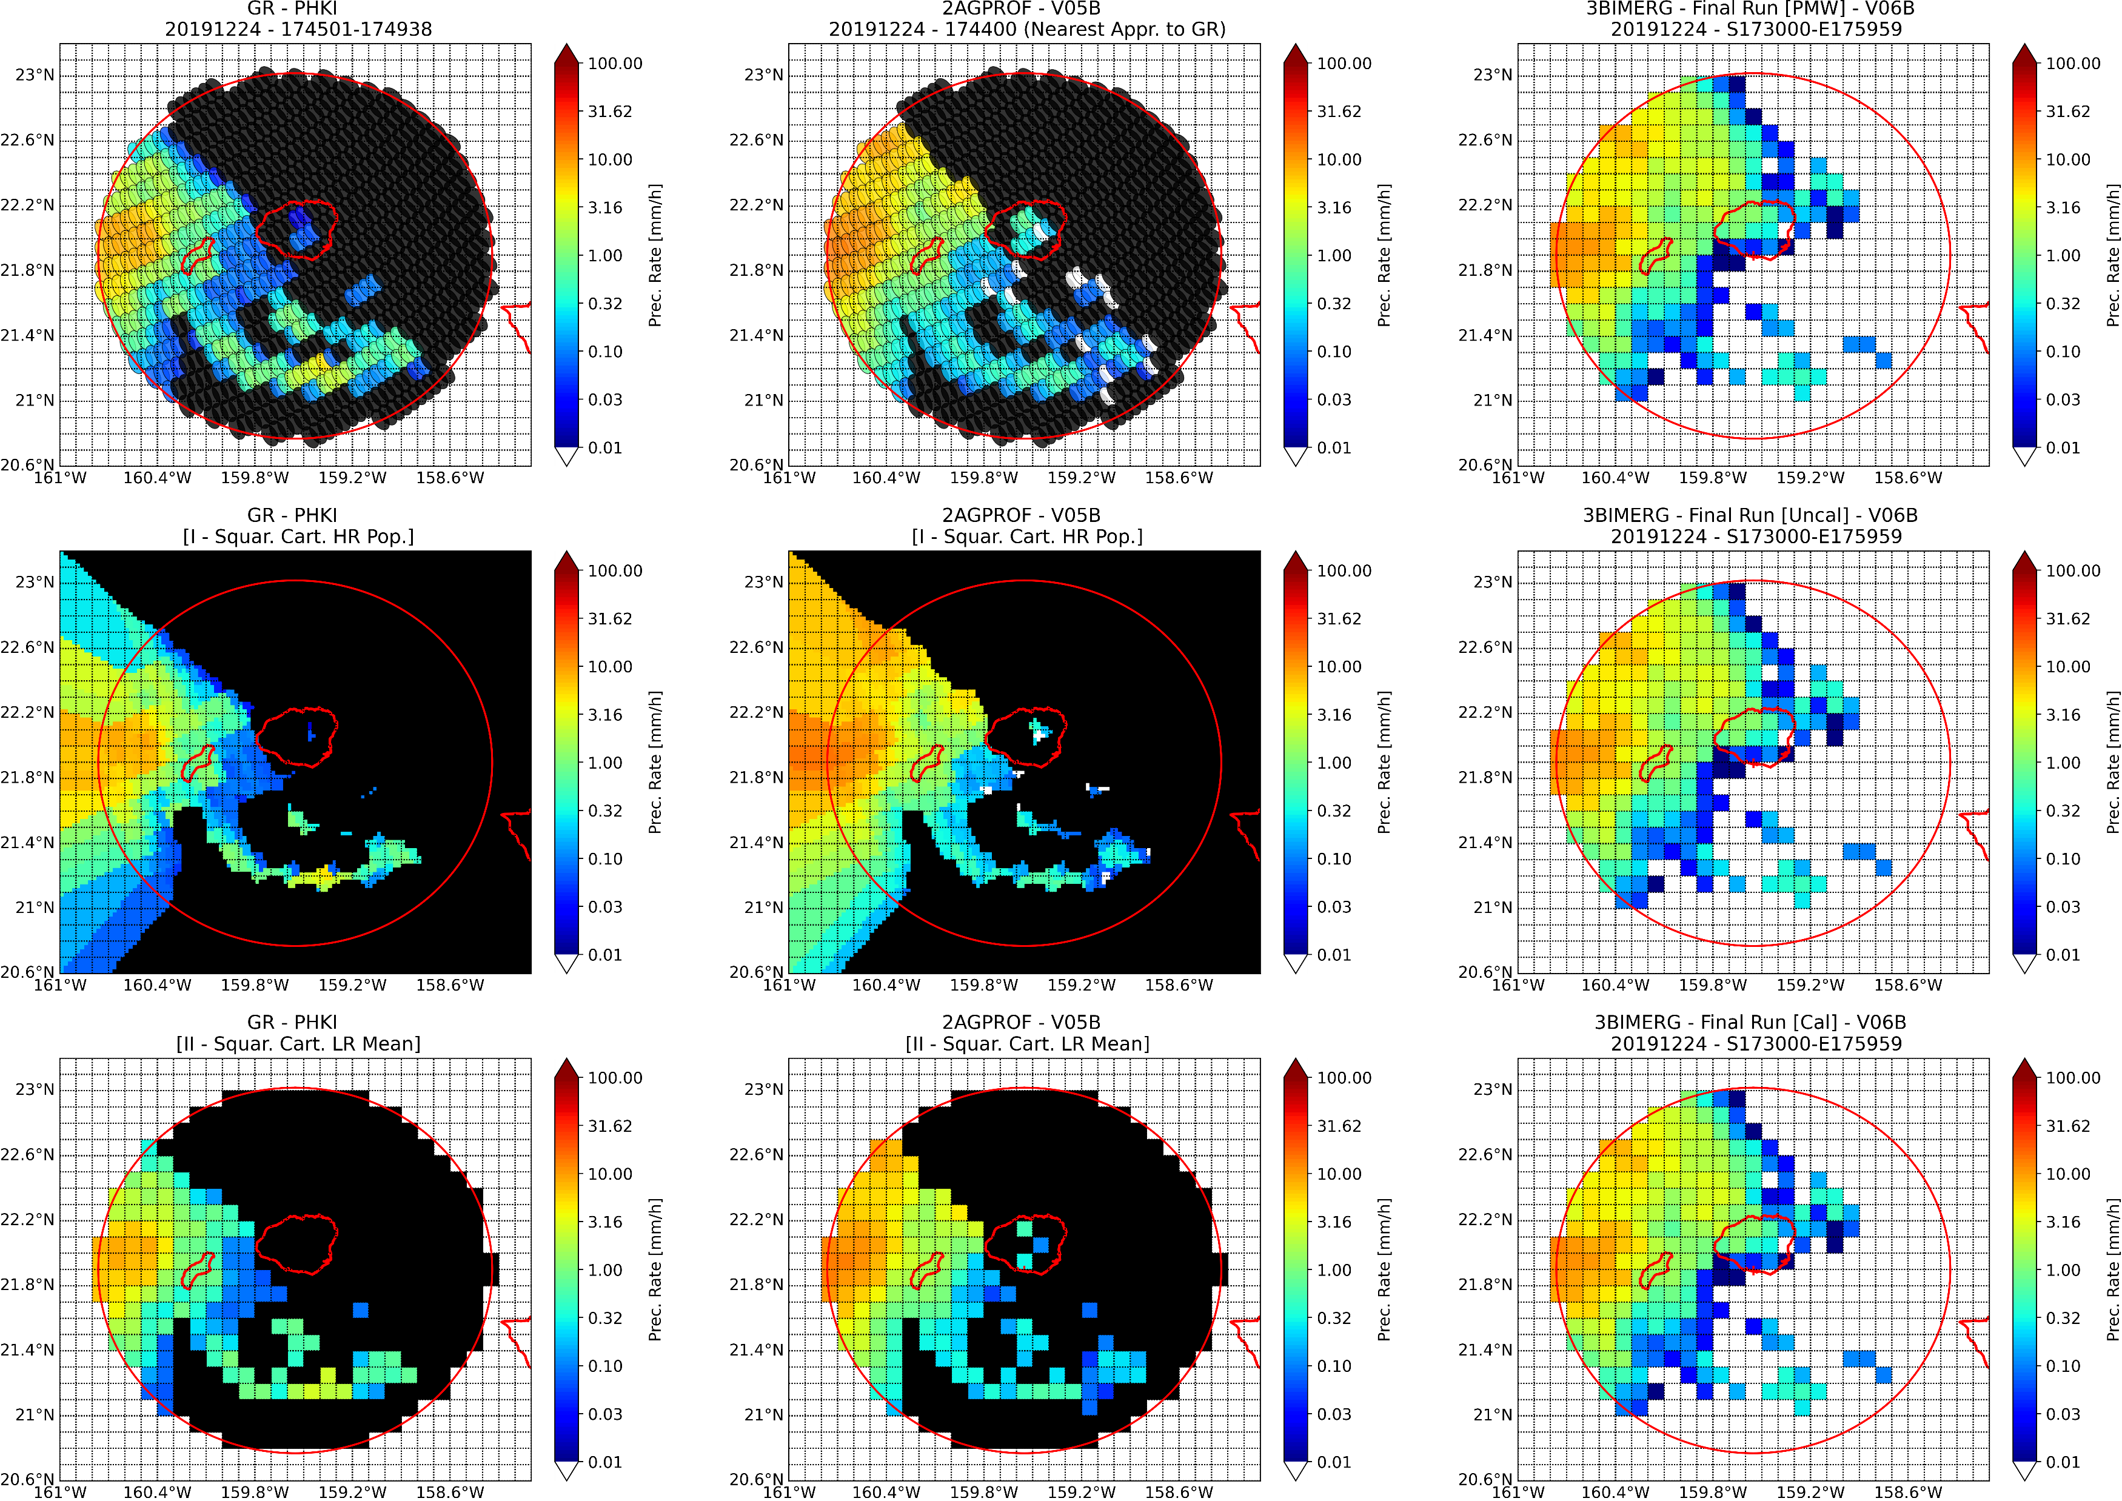
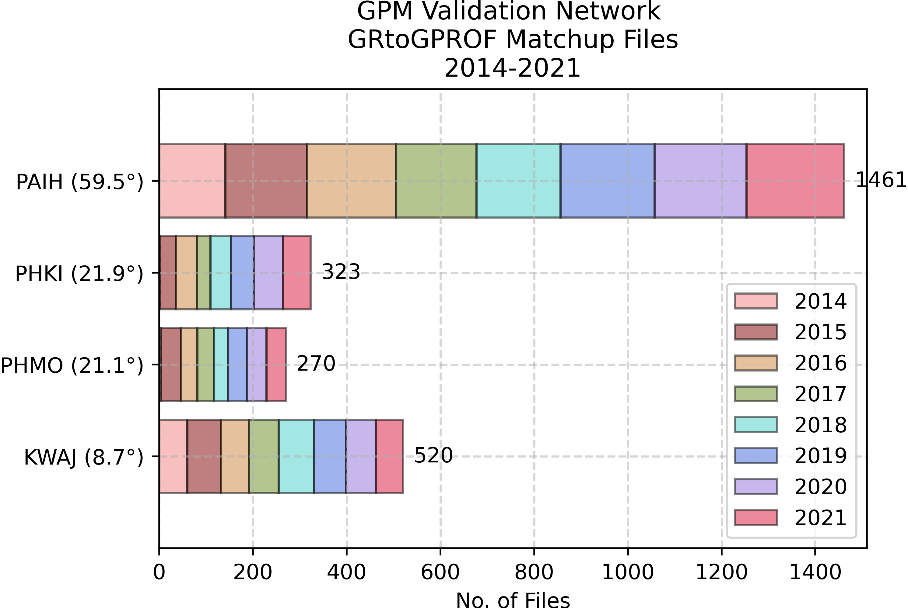
The GPM Validation Network
GR to GPROF-GMI to IMERG Matchup
Oceanic Validation using Island Sites
Approximation of the IMERG backward gridding technique for gridding precipitation at the GPROF-footprint scale.
Validate IMERG V06B and GPROF V05A/B over :
  Alaska’s Middleton Island [PAIH]
  Hawaii [PHKI; PHMO]
  Kwajalein Atoll [KWAJ]
GR [GPROF Footprints]
GR [0.1-Deg. Grid]
Public matchup files (GRtoGPROFtoIMERG) to be added to the Validation Network later in 2022.

Slide 5
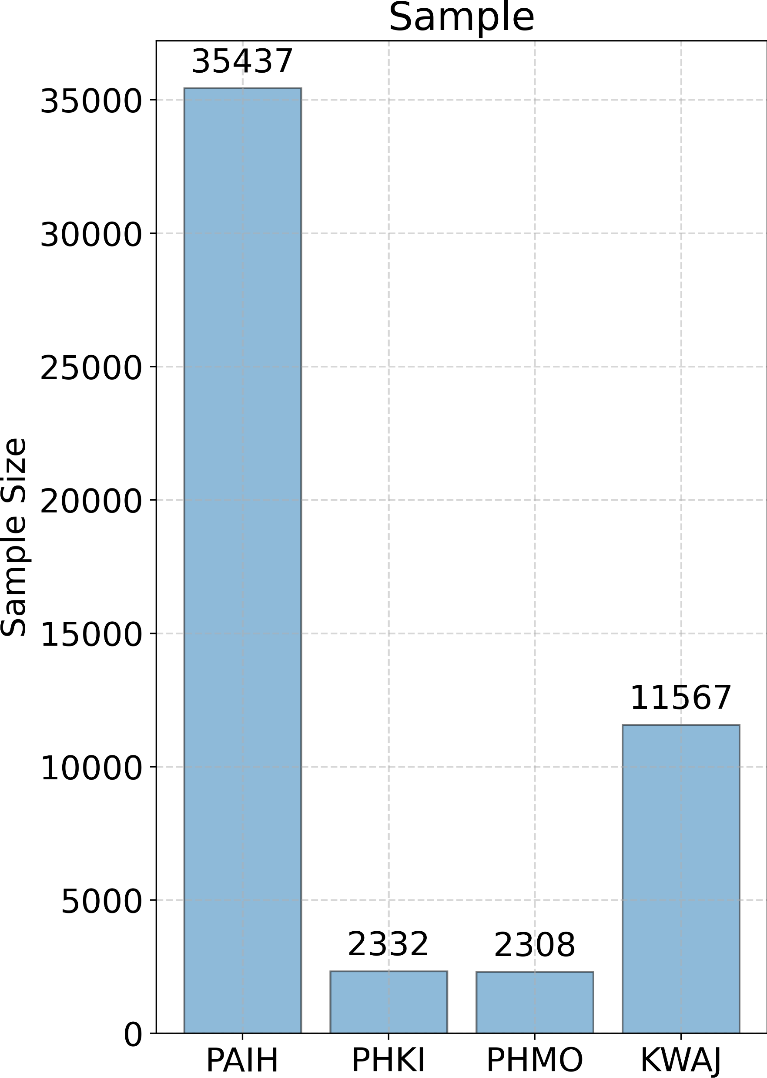
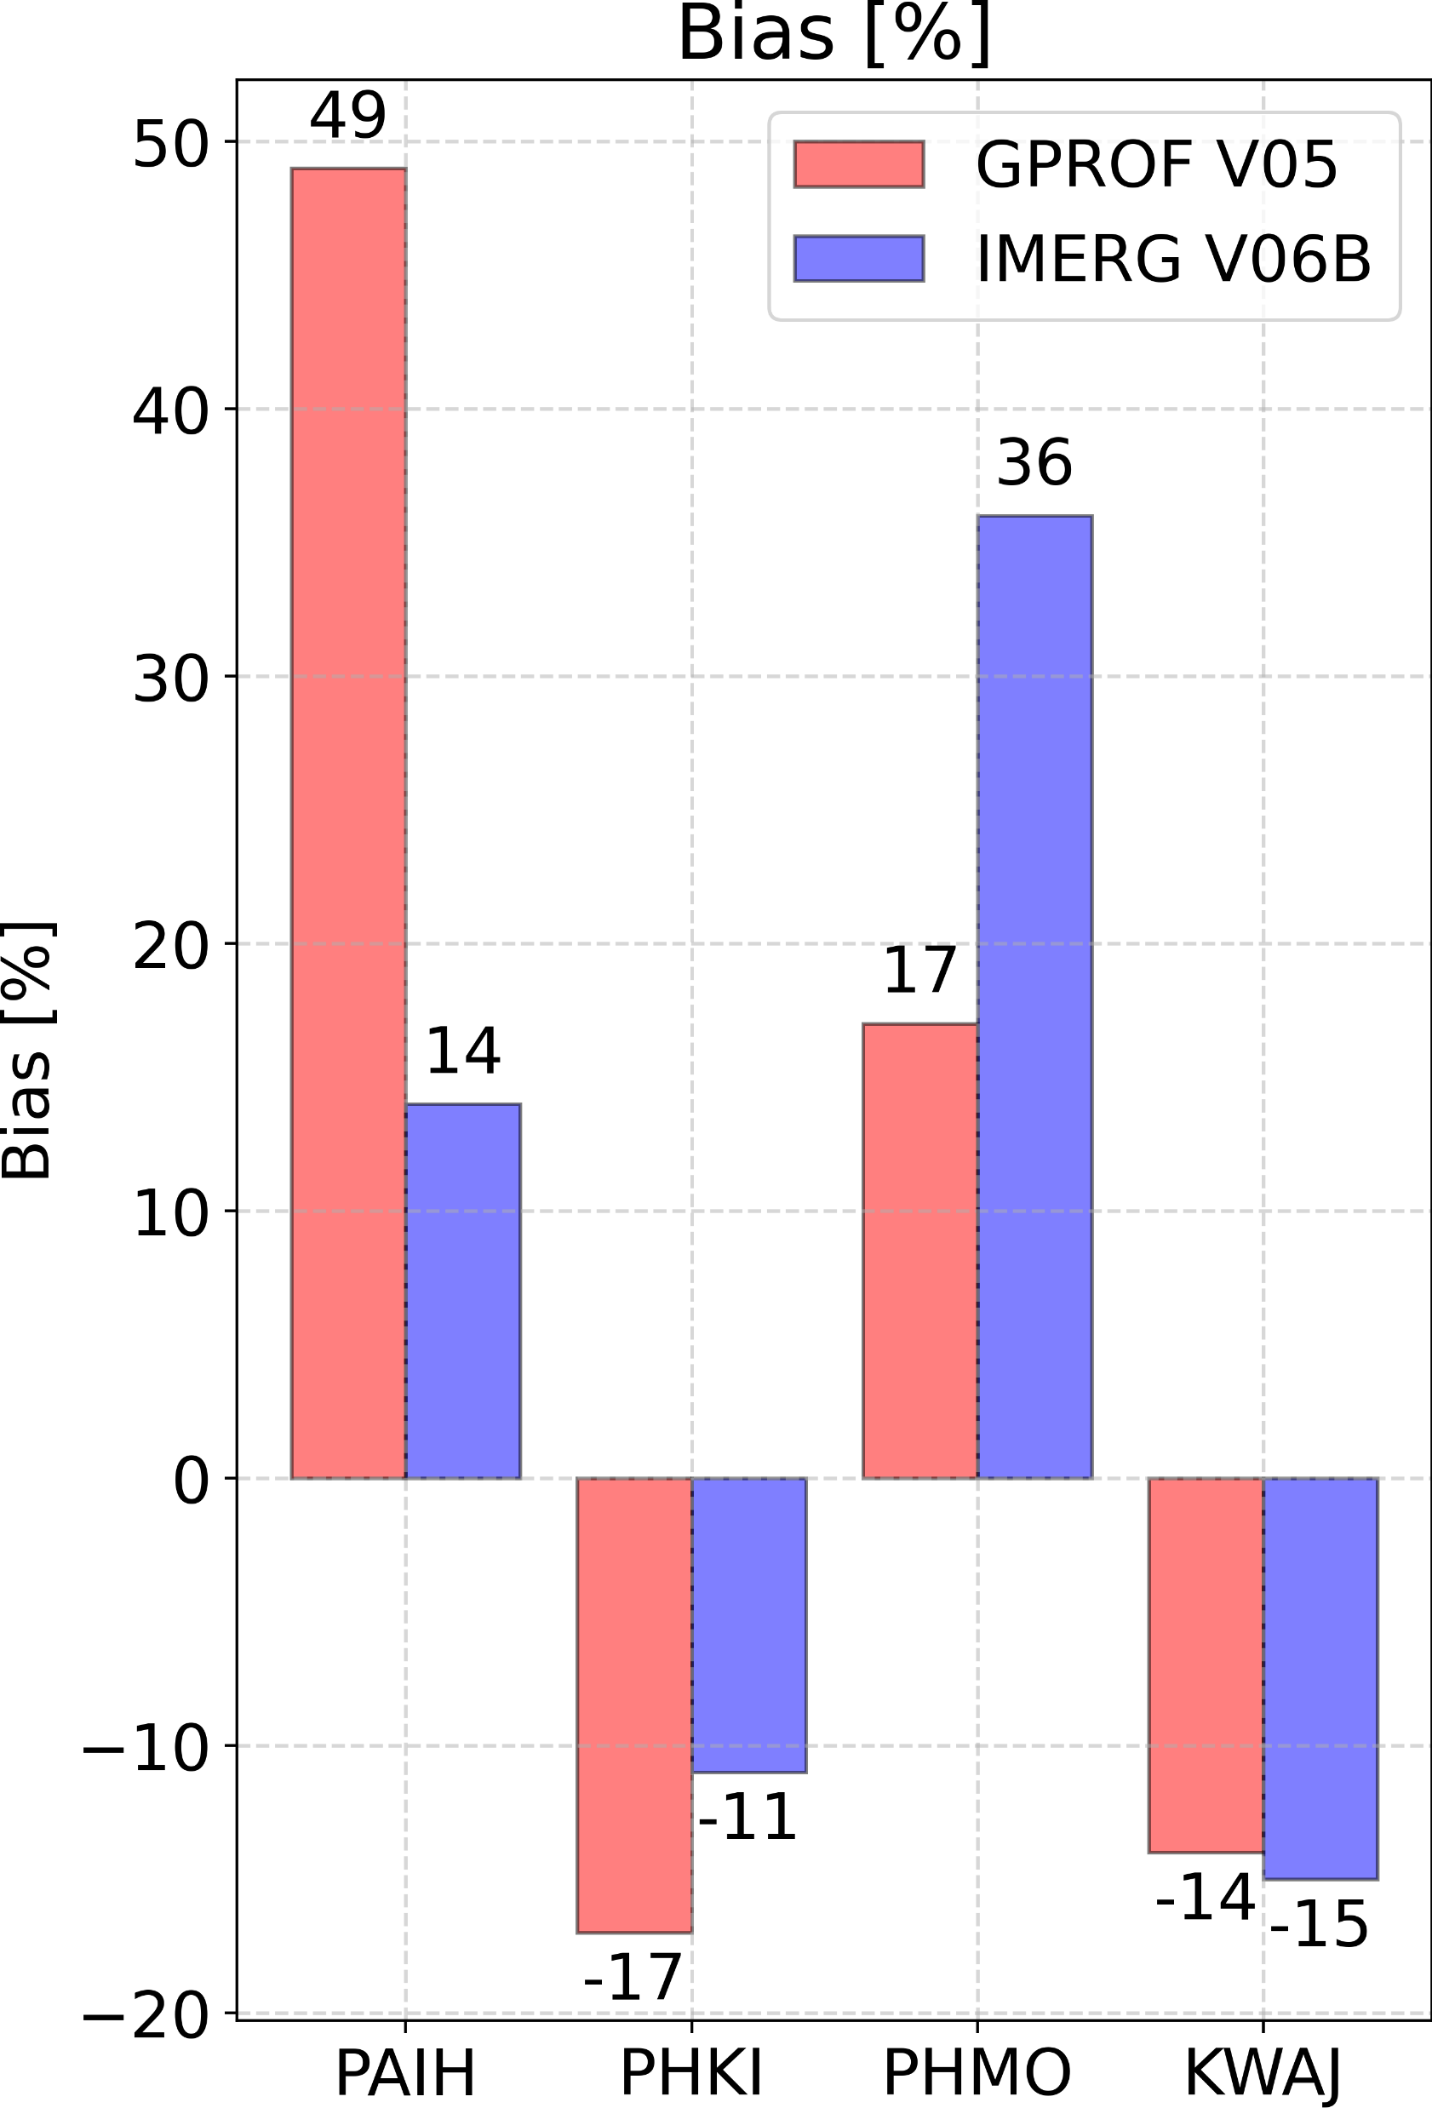
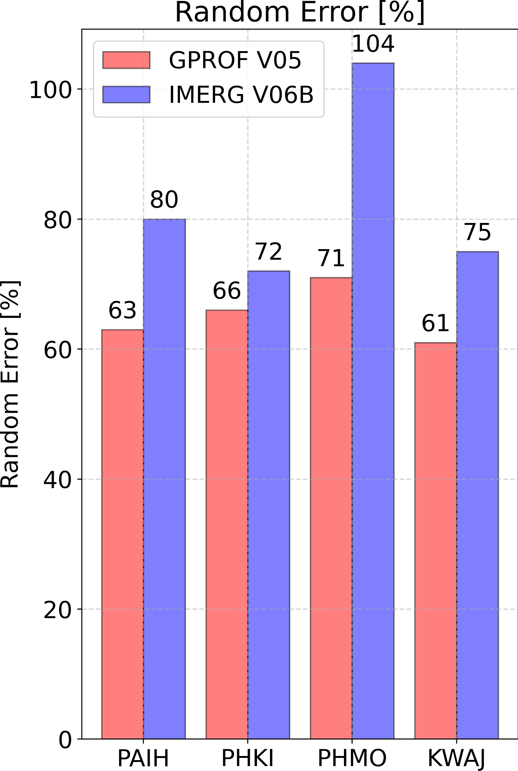
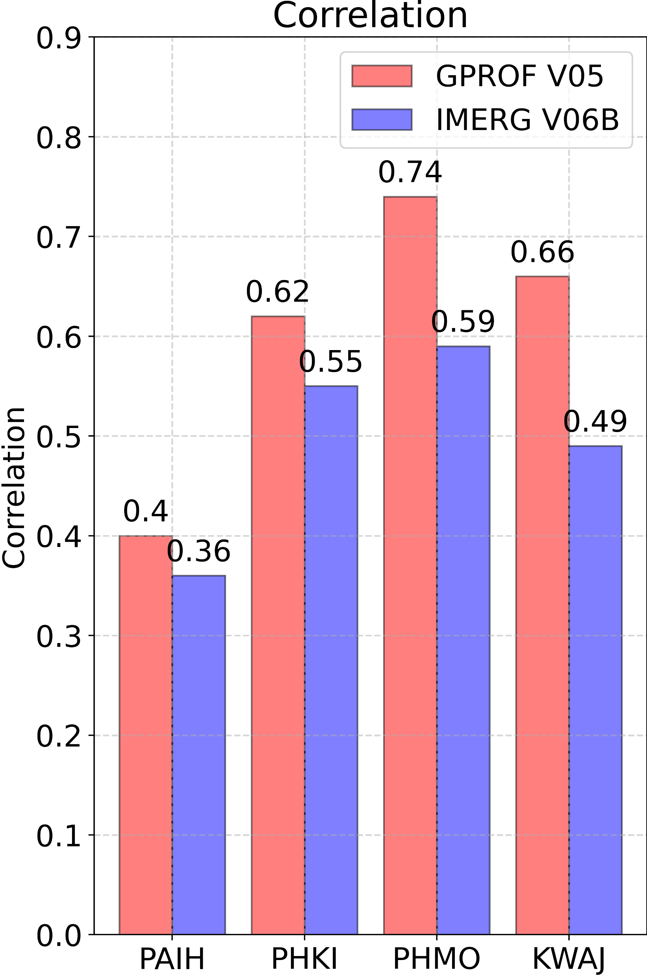
Oceanic Validation with the Validation Network
IMERG decreases GPROF oceanic mean biases for PAIH and PHKI, whilst increasing them for PHMO and KWAJ.
IMERG has more variable oceanic biases and weaker correlation with GRs than GPROF.
Rain-No Rain Threshold: 0.2 mm/h
PAIH: <75-km range only to prevent inclusion of frozen precipitation. KWAJ: 2018 & 2019 data removed due to GR calibration offset.

Slide 6
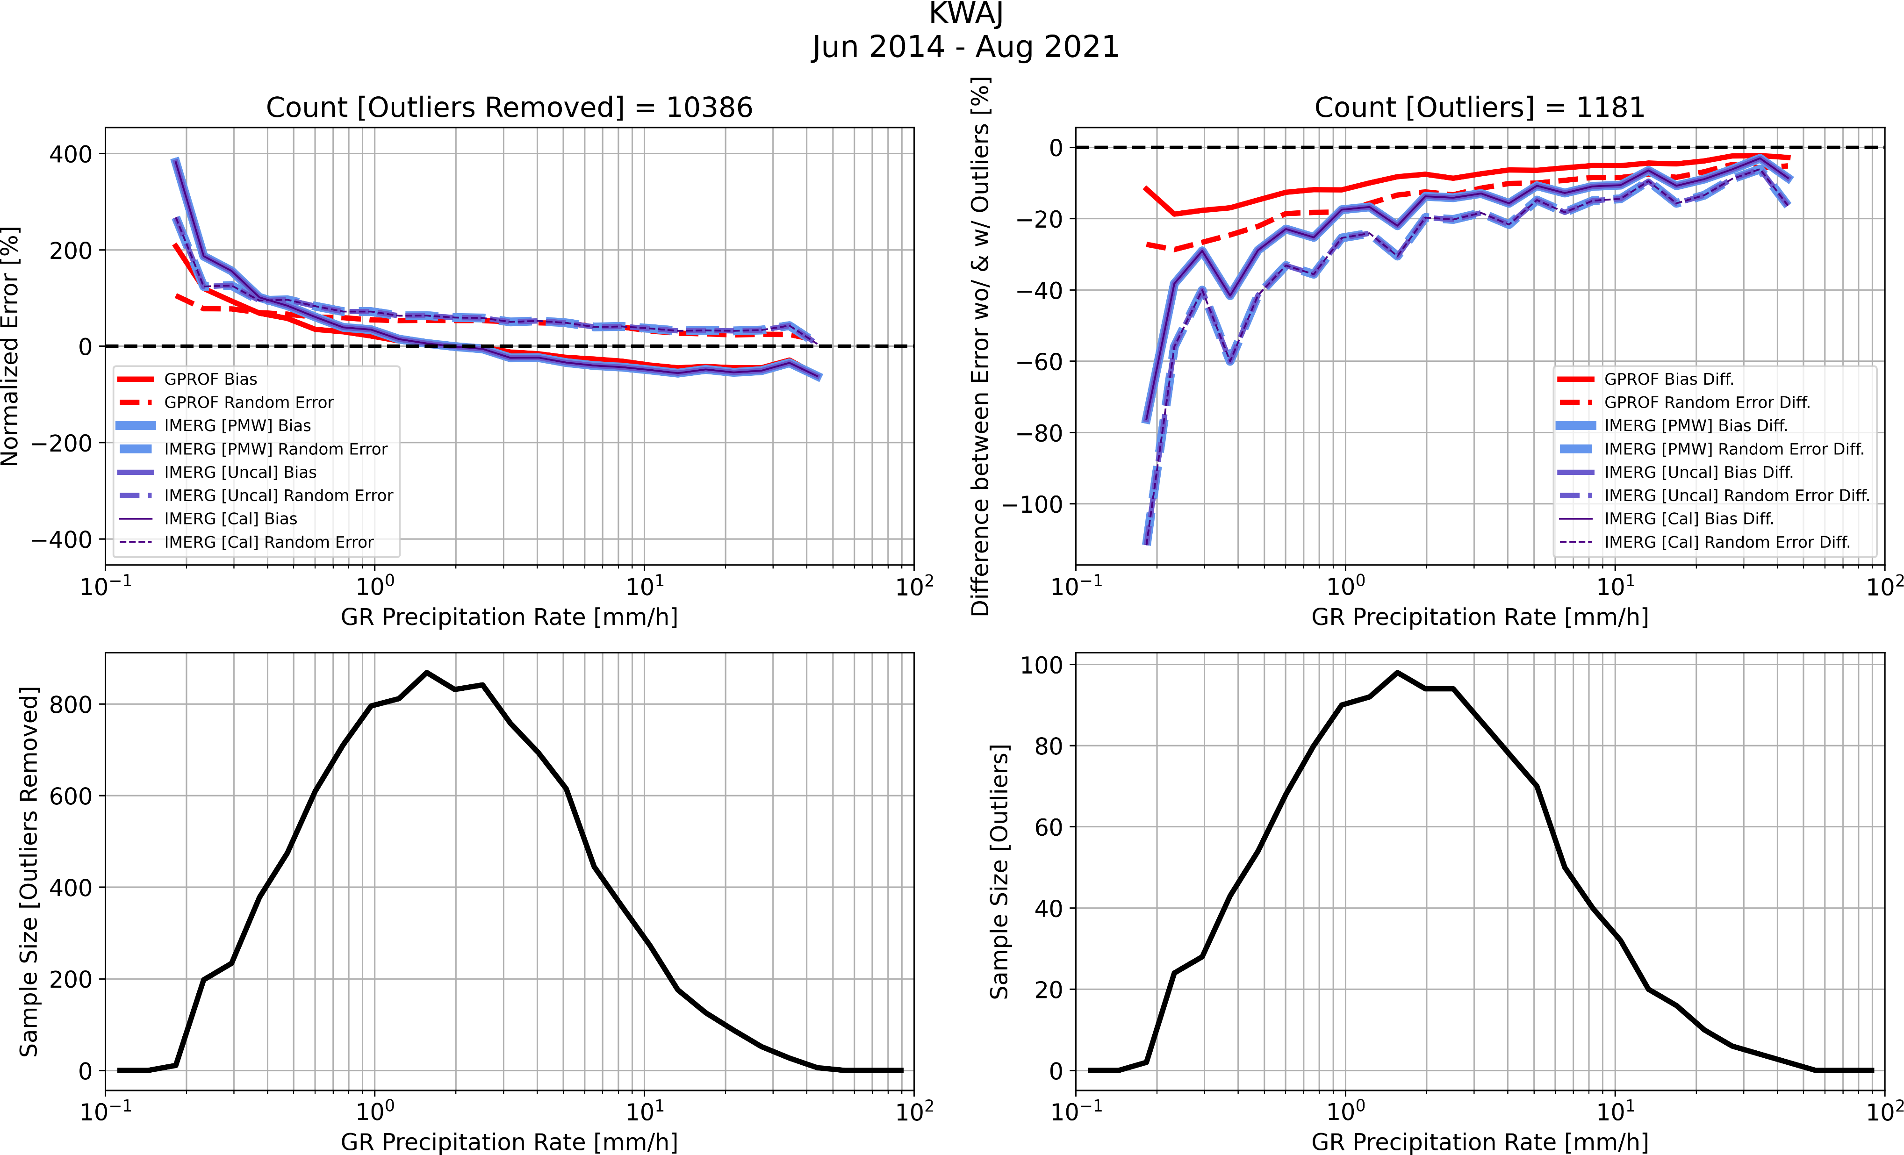

Oceanic Validation with the Validation Network
IMERG appears to increase overestimating bias from GPROF for light precipitation rates across all sites.
IMERG V06B and GPROF V05 showcase overestimation of light rain and underestimation of heavy rain across all sites (except PHMO where heavy rain estimates are in close agreement with GR). V07 should address these biases across the rainfall spectrum.
The IMERG GMI tropical biases may vary from those for IMERG estimates without passive microwave observations, for which the frequency of light precipitation rates is higher and heavy precipitation rates is lower (Rajogopal et al., 2021).

Slide 7
Conclusions and Future Work
IMERG and GPROF exhibit varying performance for GMI measurements over different oceanic regions – highlights requirement for more oceanic evaluation of spaceborne precipitation products.
IMERG decreases GPROF oceanic mean biases for PAIH and PHKI, whilst increasing them for PHMO and KWAJ. IMERG has more variable oceanic biases and weaker correlation with GRs than GPROF.
GRtoGPROFtoIMERG matchup files to be produced and available publicly later in 2022.
Next steps - Include Validation Network’s 3D reflectivity, water content and hydrometeor identification profiles in analysis.

Slide 8
References
Gatlin, P.N., Petersen, W.A., Pippitt, J.L., Berendes, T.A., Wolff, D.B. and Tokay, A. (2020). The GPM Validation Network and Evaluation of Satellite-Based Retrievals of the Rain Drop Size Distribution. Atmosphere, 11(9), p.1010. https://doi.org/10.3390/atmos11091010
NASA (2021). Global Precipitation Measurement (GPM) Mission Ground Validation System – Validation Network Data Product User’s Guide – Volume 2 – GPM Data Products. Accessed May 5, 2022, https://gpm.nasa.gov/sites/default/files/document_files/Val_Network_Users_Guide_Vol_2_Nov2015.pdf.
Rajagopal, M., Zipser, E., Huffman, G., Russell, J. and Tan, J., 2021. Comparisons of IMERG version 06 precipitation at and between passive microwave overpasses in the tropics. Journal of Hydrometeorology, 22(8), pp.2117-2130. https://doi.org/10.1175/JHM-D-20-0226.1

Slide 9
Supplementary Material

Slide 10
The GPM Validation Network
Line of Sight
GPM Core
Ground Radar (GR) to GPROF-GMI Matchup
Matchup event criterion: GPM Core 2AKu product identifies certain rain for >100 grid pixels (4 km x 4 km) within 100 km of GR
3D spatial matchups: GPROF near-surface precipitation field is matched to GR reflectivity and dual-polarization fields along:
  Line of sight
  Vertical profile
Temporal matchups: GR scan set with first sweep closest in time to GPM Core overpass time is selected.
GR
Vertical Profile
GPM Core
GR

Slide 11
The GPM Validation Network
GR to GPROF-GMI to IMERG Matchup
Uses an approximation of the IMERG backward gridding technique for gridding precipitation at the GPROF-footprint scale.
Assign footprint precipitation rates to a 0.025-degree grid using a nearest neighbor population technique;
Coarsen the 0.025-degree precipitation grid to the IMERG 0.1-degree resolution.
GR [GPROF Footprints]
GR [0.025-Deg. Grid]
GR [0.1-Deg. Grid]
Directly comparable to IMERG
Public matchup files (GRtoGPROFtoIMERG) to be added to the Validation Network later in 2022.

