Slide 1
Qualification of Domestic Lyocell-Based Phenolic Impregnated Carbon Ablator (PICA-D) for NASA Missions
Matt Gasch¹, Mairead Stackpoole¹, Ethiraj Venkatapathy¹, Don Ellerby¹, Frank Milos¹, Keith Peterson¹, Kristina Skokova², Jonathan Morgan¹, Dinesh Prabhu², Jeremie Meurisse², Greg Gonzales², Steven Violette³, Patrick Sullivan³ and Michael Johnson³
¹NASA Ames Research Center, Moffett Field, CA 94035
²AMA, NASA Ames Research Center, Moffett Field, CA 94035
³Fiber Materials Inc./SPIRIT AeroSystems, Biddeford, ME, 04005
2nd International Conference on Flight Vehicles, Aerothermodynamics and Re-entry Missions & Engineering (FAR)
19 - 23 June 2022. Heilbronn, Germany

Slide 2
Outline
Background
  Heritage PICA
  PICA Sustainability Challenge
Sustainability
  Lyocell: An alternative precursor to rayon
  PICA Manufacturing
Development of PICA-D
  Establish PICA-D as a drop-in replacement for Heritage PICA
  PICA-D Arc Jet Campaign
  Lyocell Fiberform/PICA-D Billet and Near-Net-Shape Single-Piece Aeroshell Processing
PICA-D and Three Exciting NASA missions
Summary
Acknowledgements

Slide 3
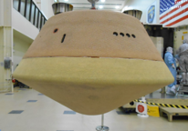
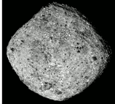
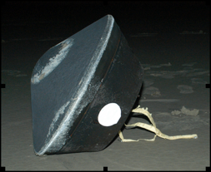
Background – PICA
State of the Art Low Density Carbon Phenolic Ablators
Phenolic Impregnated Carbon Ablator (PICA)
  First used as forebody single piece heatshield for Stardust
Low density coupled with efficient ablative capability at medium-high heat fluxes
Since Stardust-
  Under the Orion program PICA was shown to be capable for both ISS and lunar return missions but was not selected as the baseline TPS
  PICA was transitioned to Mars Science Lab (MSL) post CDR in a tiled configuration when the mission environments went beyond the capabilities of SLA561V; re-flown on Mars 2020
  OSIRIS-REx sample return capsule as a single piece
    On Dec. 3, 2018, the OSIRIS-REx spacecraft arrived at its target, near-Earth asteroid Bennu
Stardust forebody TPS. (~0.8m diameter)
MSL Heat Shield (4.5m diameter)
OSIRIS-REx forebody TPS. (~0.8m diameter)
Bennu taken by the OSIRIS-REx spacecraft from a distance of ~ 50 miles
https://www.nasa.gov/osiris-rex

Slide 4
Challenges with PICA Sustainability over the Years
In 2016 NASA learned that the “heritage” rayon used in PICA was ceasing production, leading to a flight-qualified PICA sustainability concern
  The carbon fiber precursor for PICA has become obsolete 2x since the material was developed and used on Stardust, so a secure source is essential to maintain PICA capabilities for future missions
In FY16/17, NASA ARC was funded by the Planetary Science Division of the Science Mission Directorate to address PICA rayon sustainability
Lyocell Based PICA (PICA-D) was manufactured, and limited testing performed – initial results indicated Lyocell is a good candidate as a replacement for heritage rayon
Time Line | Mission/ Project | Precursor Type | Rayon Sustainability | Changes /Updates to PICA
Early 2000’s | Stardust Near Net Shape 0.8m | Liberty rayon | US source – production ceased in the 90s | Developing process to fabricate NNS within the project density specification required – no regrind
2010 | Orion CEV ADP Billets | Multiple sources – settled on SNIACE | Multiple international sources evaluated | Optimized densification process for billets, tested the bounds of the density specification and the influence on performance / properties
2012 | MSL Billets | SNIACE rayon | International source – production ceased in ~ 2017 | Leveraged ADP data to allow use on MSL
2016 | OSIRIS Rex Near Net Shape 0.8m | SNIACE rayon | International source – production ceased in ~ 2017 | Spec tightened over Stardust for NNS casting range . Phenolic adjustments based on lessons learned from ADP/MSL. No RG
2018-2019 | M2020 Billets | SNIACE rayon – source depleted | International source – production ceased in ~ 2017 | Leveraged MSL
2016 | PICA-D Development Billets | Lyocell w/ Ti - USA Dulling Agent | Domestic/international sister plants. Greener processing | MSL specification range – Eliminated use of “re-grind” Domestic supply - Alabama
2017 | PICA-D Development Near Net Shape 0.8m | Lyocell w/ Ti - USA Dulling Agent | Domestic/international sister plants. Greener processing | Leveraged OSIRIS REx/MSL – No re-grind Domestic supply - Alabama
2018 | PICA-D Development Billets | Lyocell - Austria | Domestic/international sister plants. Greener processing | MSL/M2020 specification range – No re-grind Foreign Supply - Austria
2018 | PICA-D Development Near Net Shape 1.5m | Lyocell - Austria | Domestic/international sister plants. Greener processing | Leveraged OSIRIS REx/MSL – No re-grind Foreign Supply - Austria
4

Slide 5
Lyocell – A Sustainable Precursor
Traditional rayon manufactured from wood pulp involves many steps and the conversion of wood pulp into rayon or regenerated cellulose results in toxic byproducts
  rayon manufacturing was discontinued and is no longer a viable process in the US and Europe
Lyocell - solvent spinning technique is simpler and more environmentally sound
  uses a non-toxic solvent chemical that is 99% recycled in the manufacturing process
Lenzing – sister factories in US, Austria and UK able to provide the same Lyocell precursor – multiple supply routes alleviate future sustainability concern
  There are some small processing differences between factories
Refer to below links if interested in information on how fibers are made from wood pulp:
https://www.youtube.com/watch?v=tHdJGFv99fE
https://www.youtube.com/watch?v=14PZNgRoEUM

Slide 6
PICA Manufacturing Overview
6

Slide 7
PICA Capability Sustainment (PCS) 2019-2021
In 2019 NASA learned that FMI was planning to stop commercial production of FiberForm
  Existing FiberForm facilities were in dis-repair and floor space was being repurposed for other product lines at FMI
  Equipment moves were required, necessitating remaining equipment be brought up to current OSHA/safety codes
  Also presented an opportunity to modernize and digitize the PICA product line for material repeatability and knowledge retention
Timeline | Mission/ Project | Precursor Type | Rayon Sustainability | Changes /Updates to PICA
Early 2000’s | Stardust Near Net Shape 0.8m | Liberty rayon | US source – production ceased in the 90s | Developing process to fabricate NNS within the project density specification required – no regrind
2010 | Orion CEV ADP Billets | Multiple sources – settled on SNIACE | Multiple international sources evaluated | Optimized densification process for billets, tested the bounds of the density specification and the influence on performance / properties
2012 | MSL Billets | SNIACE rayon | International source – production ceased in ~ 2017 | Leveraged ADP data to allow use on MSL
2016 | OSIRIS Rex Near Net Shape 0.8m | SNIACE rayon | International source – production ceased in ~ 2017 | Spec tightened over Stardust for NNS casting range . Phenolic adjustments based on lessons learned from ADP/MSL. No RG
2018-2019 | M2020 Billets | SNIACE rayon – source depleted | International source – production ceased in ~ 2017 | Leveraged MSL
2016 | PICA-D Development Billets | Lyocell w/ Ti - USA Dulling Agent | Domestic/international sister plants. Greener processing | MSL specification range – Eliminated use of “re-grind” Domestic supply - Alabama
2017 | PICA-D Development Near Net Shape 0.8m | Lyocell w/ Ti - USA Dulling Agent | Domestic/international sister plants. Greener processing | Leveraged OSIRIS REx/MSL – No re-grind Domestic supply - Alabama
2018 | PICA-D Development Billets | Lyocell - Austria | Domestic/international sister plants. Greener processing | MSL/M2020 specification range – No re-grind Foreign Supply - Austria
2018 | PICA-D Development Near Net Shape 1.5m | Lyocell - Austria | Domestic/international sister plants. Greener processing | Leveraged OSIRIS REx/MSL – No re-grind Foreign Supply - Austria
2019-2021 | PICA Capability Sustainment | Lyocell - Austria | Facility Upgrades | Commercial FiberForm Line Ended. NASA only product now. Upgrades to electrical, FiberForm and PICA Infusion equipment for future missions.
2021 → | Dragonfly / MSR SRL | Lyocell - USA | -- | No changes

Slide 8
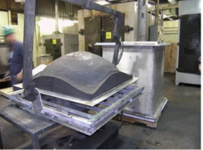

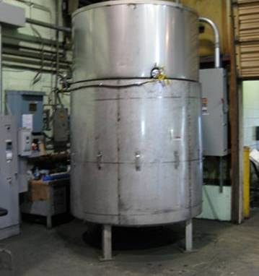
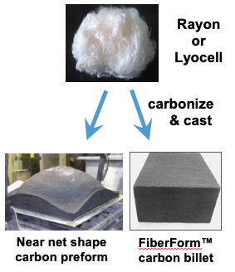
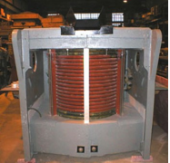
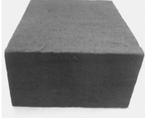
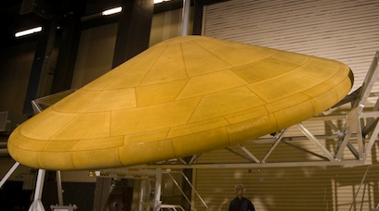
PICA Manufacturing Process Updates
FMI
Near Net Shape Forming
TPS Assembly & Integration
Rayon / Lyocell Procurement
Staple Fiber Carbonization and Graphitization
Fiber Chopping
Billet Carbonization and Graphitization
PICA Infusion
Lot Acceptance
Tile Machining
Rigid Billet Fabrication
PICA Infusion
Near-Net-Shape Casting
Single Piece PICA (Stardust)
Lyocell
White-Goods
Conversion
to Carbon & Graphitization
Tiled PICA
(MSL, M2020)
Previously Rayon
Rigid FiberForm® Billet Casting
Fiber Change
Minor Process Modification
Control System Upgrade

Slide 9
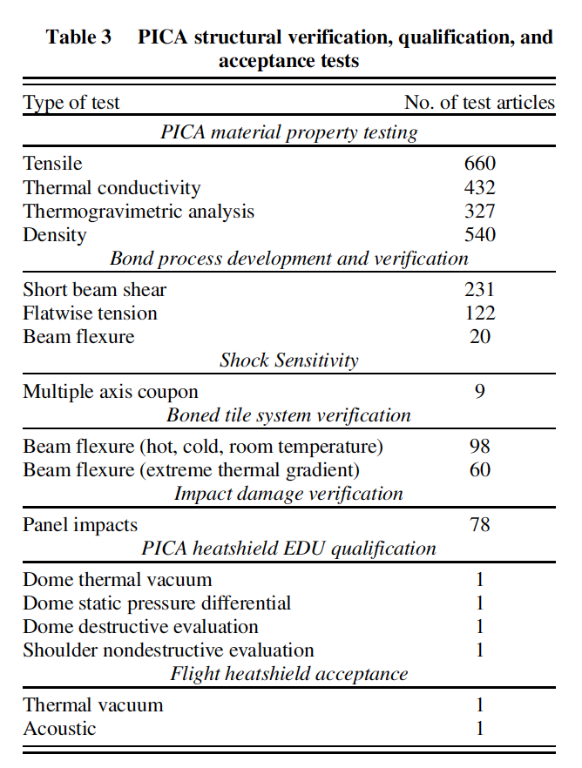
PICA/PICA-D Testing
Property testing was all per the Lot Acceptance Test (LAT) described in the PICA/PICA-D process specification
  Bulk and Sample Density
  TGA/Char Yield (Resin uniformity)
  In-plane (IP) Tensile Strength
  Through-thickness (TT) Tensile Strength
  TTT Thermal Conductivity at two temperatures
All other testing was considered “Mission Specific” and therefore out of scope of PICA-D project test plan
Christine Szalai, et. al, “Mars Science Laboratory Heatshield Development, Implementation, and Lessons Learned” JOURNAL OF SPACECRAFT AND ROCKETS Vol. 51, No. 4, July–August 2014
Notes:
Carl ?
Additional Tests – Structural?
Review structural property testing
Lien for additional testing

Slide 10
PICA-D Qualification Testing - Complete ✅
2 infusion runs in each PICA Vessel – Combo of 6-inch and 8-inch thick billets
Total 22 PICA-D billets to be fabricated (essentially 4 different lots of material)
Std LAT - every billet
  FMI to complete LAT material testing
  Additional testing of FF strength and density distribution and char (resin uniformity)
PICA Spec LAT Matrix (per billet)
Test Type
 | Tests per billet
Density @ RT, TTT | 5
TGA – RT to 900C in N2 | 3
Total Tests
110
66
Run 1
General
Test Type
 | Tests per billet
IP tension | 3
TTT Tension | 3
Total Tests
66
66
Structural
Test Type | Virgin Property Testing @ 0.2atm Ar
 | Temp 1 | Temp 2
TTT Conductivity | 2 | 2
IP Conductivity | 2 | 2
Run 2
Total Tests
88 (44@each Temp)
88 (44@each Temp)
Thermal
PICA-D qualification testing is based on standard PICA (MSL/M2020) Lot Acceptance Test
Notes:
Carl ?
Additional Tests – Structural?
Review structural property testing
Lien for additional testing

Slide 11
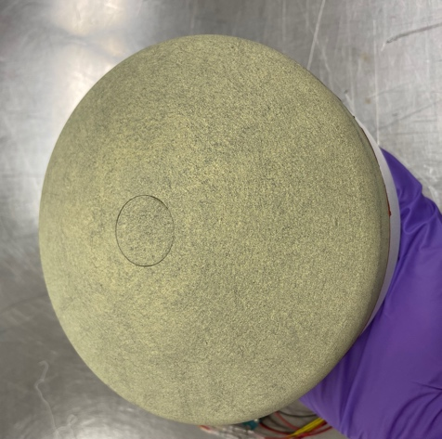
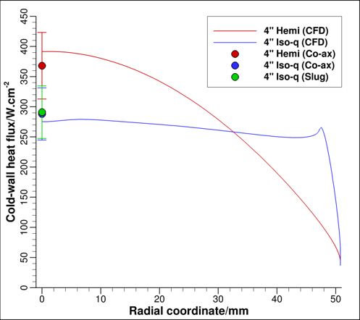
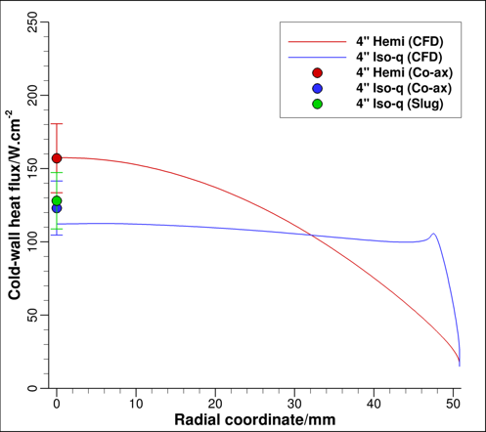
PCS PICA-D Qualification Arc Jet Testing (Oct 2021)
6-in dia.
Thermal Response Model
Thermal Response Model testing was planned to span range of past conditions to show equivalence to heritage PICA while also encompassing proposed DF and SRL entry conditions
  All runs included M2020 PICA models for direct
  comparison to PICA-D performance
Testing performed in IHF 13-inch nozzle using 6-inch
diameter, IsoQ models
Condition 1 – Expt. & CFD
Arc Jet Test Matrix was informed by
environments of SRL and Dragonfly
Condition 2 – Expt. & CFD
Notes:
Do we know AEDC availability for our testing?

Slide 12
Thermal Response Arcjet Results- Recession
Low Model Density | High Model Density
0.277 g/cm³ | 0.287 g/cm³
Ave Model Density
0.291 g/cm³

Slide 13
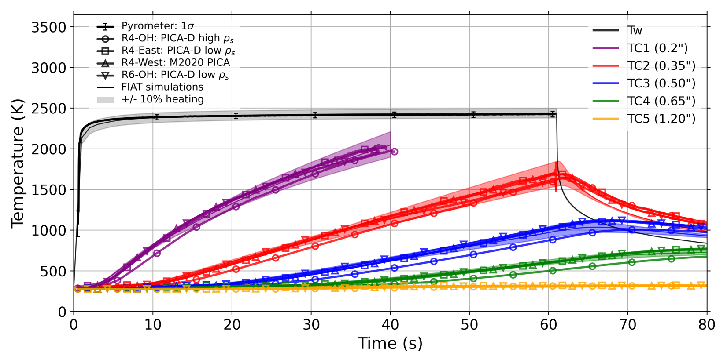
Results- FIAT In Depth Temperature Response
Condition 1 (High)
FIAT
version 4.c

Slide 14
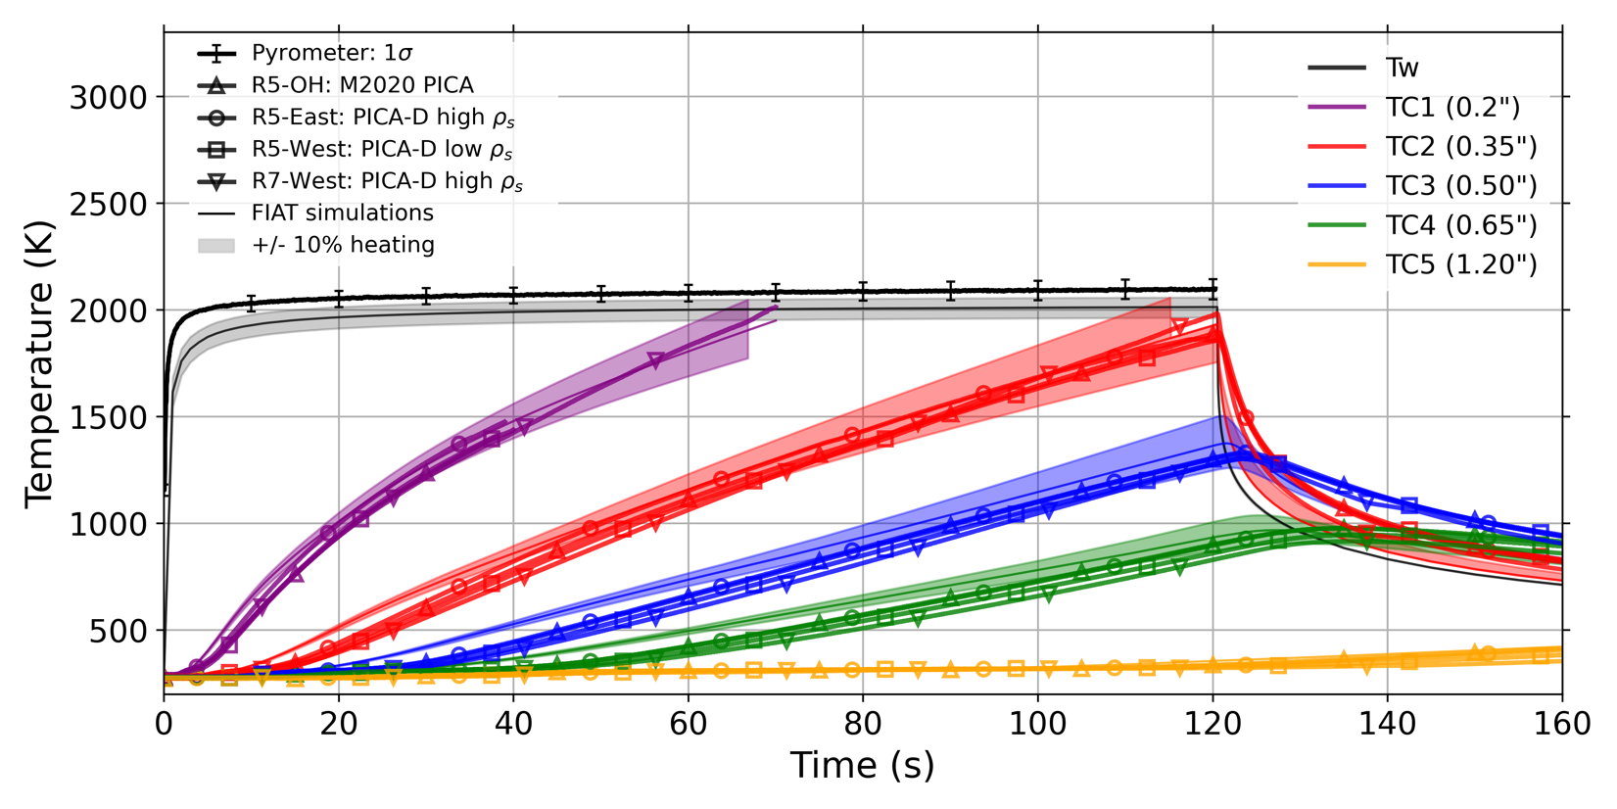
Results- FIAT In Depth Temperature Response
Condition 2 (Low)
FIAT
version 4.c

Slide 15
Summary and Conclusions
All PICA-D/PCS materials have met the PICA-D spec per Lot Acceptance Requirements that were unchanged from M2020 requirements
Apart from Char Retention and IP Tension Strength, all PICA-D/PCS average values are also within +/- 1 sigma variation of M2020 averages
Thermal Response of PICA-D compared very well with M2020 PICA
Current version of FIAT predicts in-depth response of PICA-D well and also conservatively predicts PICA-D recession
  NO changes to PICA thermal model are required for Flight Projects

