Slide 1
Presentation to UMBC Physics department
Dr. Harry Shaw
Staff Engineer, Telecommunication and Network Technologies Branch, NASA/GSFC
Advanced Communications Capabilities for Exploration and Science Systems (ACCESS) Project office
May 11, 2022

Slide 2
Introduction
I lead the technical work in quantum research in the Exploration and Space Communications division, Advanced Communications Capabilities for Exploration and Science Systems (ACCESS) Project office at NASA/GSFC along with Dr. Haleh Safavi (UMBC alum)
We have developed an excellent relationship with the UMBC Physics department
Our primary focus areas are:
  Basic and applied research with our partners to support the development of doctorates in quantum-related fields.
    Some of them will end up within NASA
  Planning for eventual operations of quantum enabled satellites
  Improving “quantum literacy” within the American student population with an emphasis on bringing women and underrepresented minorities into the quantum world
    We have a very robust intern program.
  We are not full-time researchers. We have “day jobs” operating communications satellites and ground stations

Slide 3




A little bit about how GSFC is organized
Engineering Directorate
Signs timecards, does performance evaluations.
Serves as our “straight line” boss that we directly report to
Flight Project Directorate
A set of specific engineering
disciplines called Branches.
My team is in the Telecommunications and Technologies Branch
Instead of Branches there is a set of Projects that executes
missions and generally gets the
funding from HQ for the matrixed Engineering Branch employees. We are
matrixed to the ACCESS Project which
operates the Tracking and Data Relay satellites and ground stations around the world. Our HQ boss is the Space Communications and Navigation Directorate (SCaN)
Science Directorate
Our main customers
Provides funding and work assignments
Provides inputs to our Performance Evaluations
Serves as our “dotted line boss”
A set of Branches that usually
define what science is to be accomplished via spaceflight missions which are proposed and run by GSFC If awarded by HQ. We talk to them to understand what services they require.

Slide 4
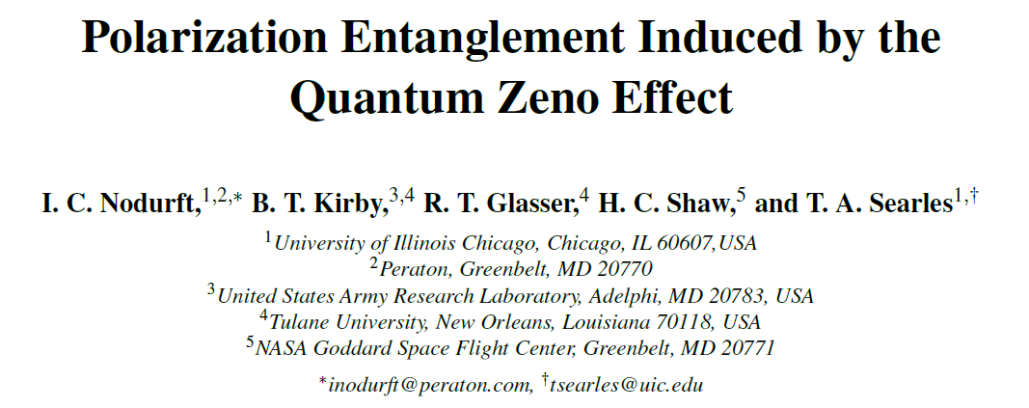
Highlights from our current collaboration
We reach UMBC through a subcontract from the NASA/GSFC (ACCESS) Project office.
Our first collaboration was with Ian Nodurft from the Franson’s group. He is currently a post-doctorate fellow at University of Illinois-Chicago.
  One of his projects is exploration of the quantum zeno effect.
NASA is interested in this technology
We plan to build a working device based upon Ian’s theoretical concepts

Slide 5
Motivation
Photon-based quantum information is often performed with single-photons and vacuum states
  Mode-entanglement is robust against certain forms of decoherence.
Certain practical requirements and drawbacks:
  High-efficiency detectors
  Photon loss keeps the system in basis, alters qubit states
Polarization entanglement has several advantages:
  Loss brings the system out of the logical basis
  Polarization can be readily altered with waveplates.
Entanglement has been generated via the quantum Zeno effect:
  Atomic qubits
  Energy-time entanglement for photons
(March 2022 APS meeting)

Slide 6
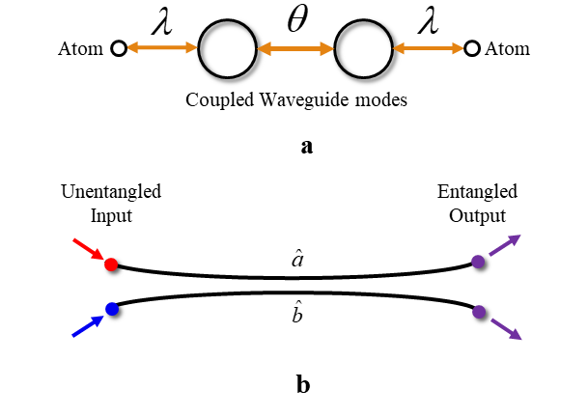
Entangling Photons with the Zeno Effect
The basic design of the system is shown at the right:
  Two coupled waveguides (optical fibers)
  Each waveguide is (separately) coupled to a series of absorbers (atoms)
These atoms are specially chosen such that:
  Unentangled photons enter the waveguide
  Entangled photons leave the wavegudie
(March 2022 APS meeting)

Slide 7
Current collaborations
We are working with Sebastian Deffner’s Quantum Thermodynamics group
  Nathan Myers recently conducted a successful defense of his dissertation titled Quantum Engines at the Frontiers of Physics
  Max Aifer has recently joined our group and will be working with NASA on a variety of problems, including investigations into polarization dispersion from a quantum context (Classical and Quantum Evolution of Polarization)
  This work is directly tied to investigations we will be undertaking to characterize the quantum behavior of the Laser Communications Relay Demonstration (LCRD) 1550nm downlink

Slide 8
Some of the things we are doing
We have a new quantum communications lab facility under development.
In November 2021, we moved into a temporary lab to host some of our equipment and experiments
We have a combination of Commercial-off-the-shelf systems and discrete hardware for a variety of quantum investigations.
  There is an emphasis on having facilities for our graduate students (including our university partners) to conduct their research
  Optical Angular Momentum (OAM) for quantum communications
  QKD using Chaotic Communications
  Polarization dispersion experiments

Slide 9
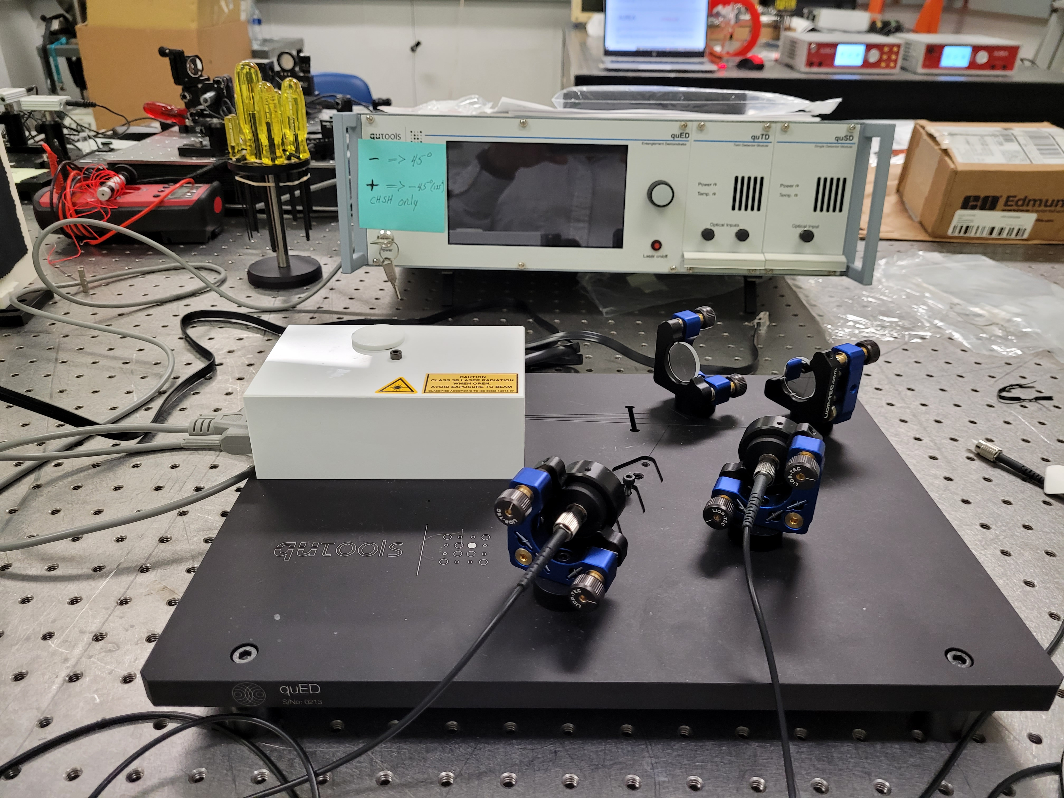
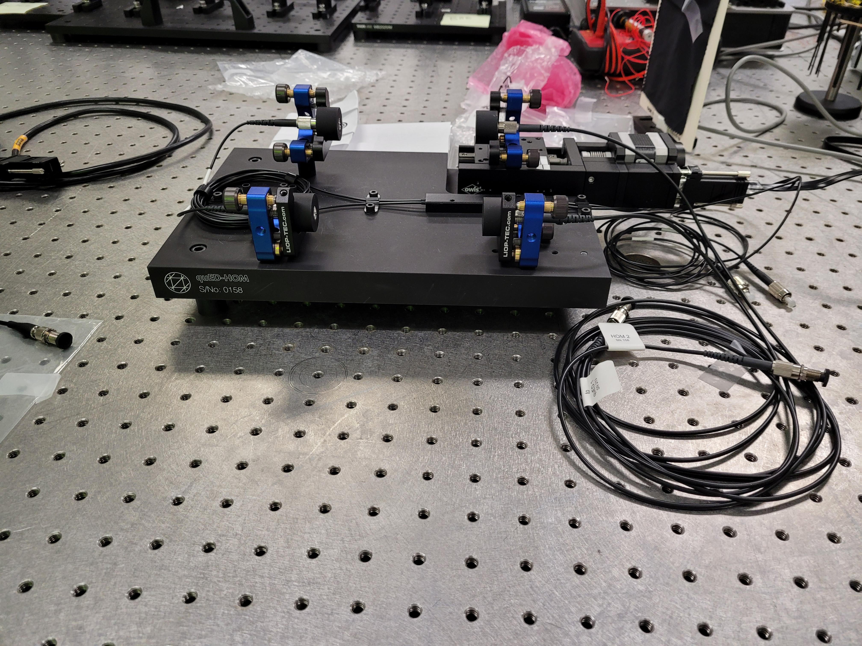
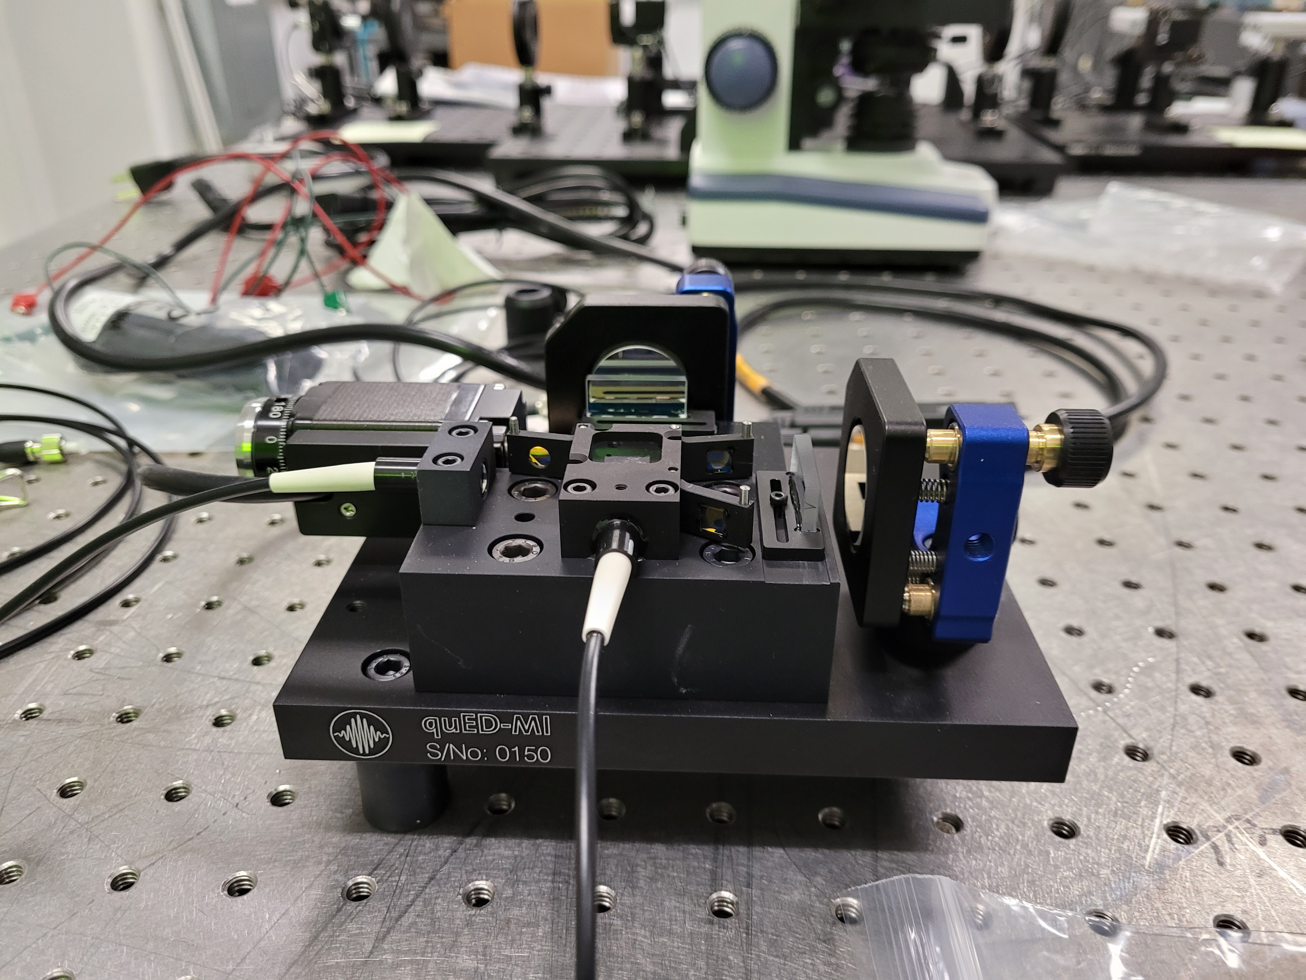
Qutools: This equipment will be used together to perform a variety of experiments
810nm Polarization
Entanglement System
Hong-Au-Mandel fixture
Michelson Interferometer
Photon Pair Experiments with Polarisation Entanglement
Violation of Bell’s Inequality (CHSH)
“Non-Classical” Polarisation Correlations
Tomographic State Reconstruction of an Entangled Photon State
Quantum Cryptography/QKD: BBM Protocol
Quantum Cryptography: Ekert Protocol
Photon Pair Experiments without Polarisation Entanglement
Hong-Ou-Mandel 2-Photon Interference
Hong-Ou-Mandel Interference + Hanbury Brown & Twiss
Franson Interference
Single Photon Experiments without Interference
Particle Nature of Photons
Quantum Cryptography/QKD: BB84 Protocol
Tomographic Single Photon State Reconstruction
Quantum Random Number Generation
Single Photon Experiments with Interference
Wave Nature of Photons: Single Photon Michelson Interferometer
Quantum Eraser
Wave-Particle Dualism: Michelson + HBT

Slide 10
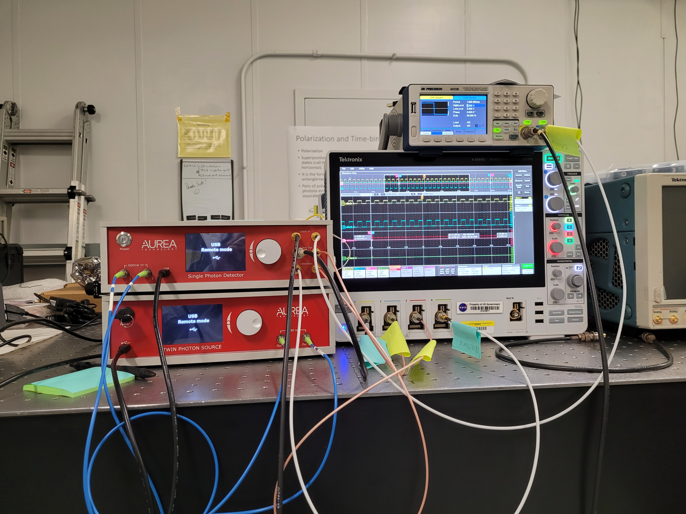
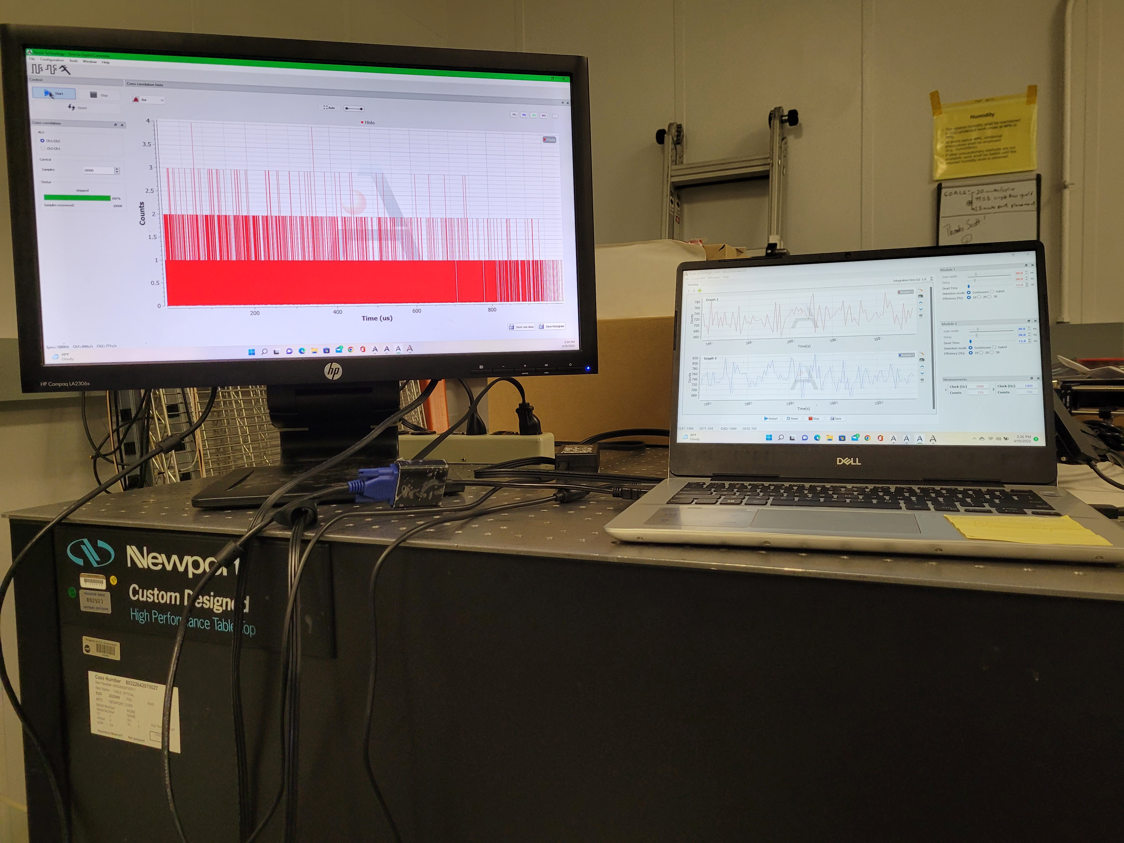
Aurea: This equipment will be used as building blocks for experiments with other equipment
1550 nm dual channel time resolving receiver with single photon detectors
Time correlation software and coincidence detection software
1550 nm dual channel entanglement source

Slide 11
Unpublished Work in Progress

Slide 12
Low cost, above LN₂ temperature quantum circuits
We have a research project to develop quantum circuits relying on stable tautomeric isomers
Harry Shaw (NASA/GSFC), Kyle Sherbert(NASA/GSFC intern), Virginia Ayres (Michigan State), Deborah Preston (retired)
Tautomers are conformational isomers that can take two states
General questions we are looking at include:
  Does the transition in states involve a superposition of states?
  Does it involve quantum entanglement?
  What is uniquely “quantum” about the circuit implementation?
  How do we implement these materials in real-world quantum circuits?
We have two tautomers we are looking at in great detail in simulation
  Croconic acid
  Azobenzene

Slide 13
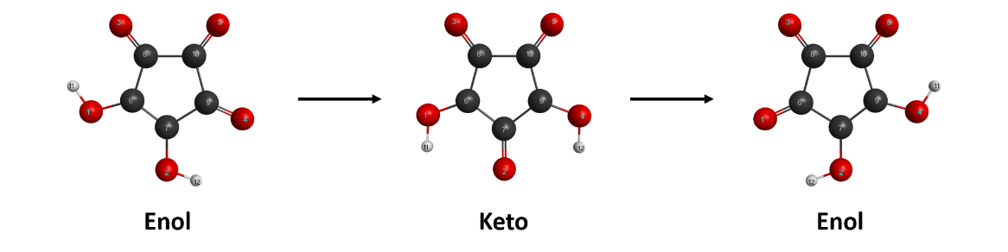
Proton tautomerism in croconic acid
Croconic acid is an important ferroelectric organic with favorable properties for classical circuits.
The proton shift certainly provides for a possibility of a quantum oscillator
There are a number of interesting thermodynamic issues to be explored
Kyle Sherbert’s GAMESS simulation

Slide 14
Transition path and the potential energy surface
We are performing simulations of the transition involving the proton transfer in croconic acid.
We are using the Amsterdam Modeling Suite (AMS) from SCM and GAMESS
AMS has a Potential Energy Surface explorer tool
You define Expeditions and Explorers. They seek out potential energy scans with minimum energy.
Required multiple iterations
  1st iteration: Use many expeditions and a few explorers
  2nd iteration. Narrow down candidates from the 1st iteration
  Speed is tied to the number of cores in the machine. I have 4 cores, so I used only 12 explorers and 50 expeditions the first run and 12 explorers and 8 expeditions for second run

Slide 15
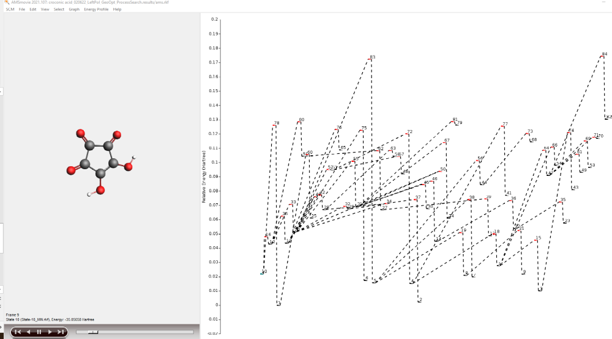
PES explorer 1st run
Many states, most of which do not correspond to any physical reality
Relative Energy (Hartree)
State 10
State number (each state is an updated search conformation)

Slide 16
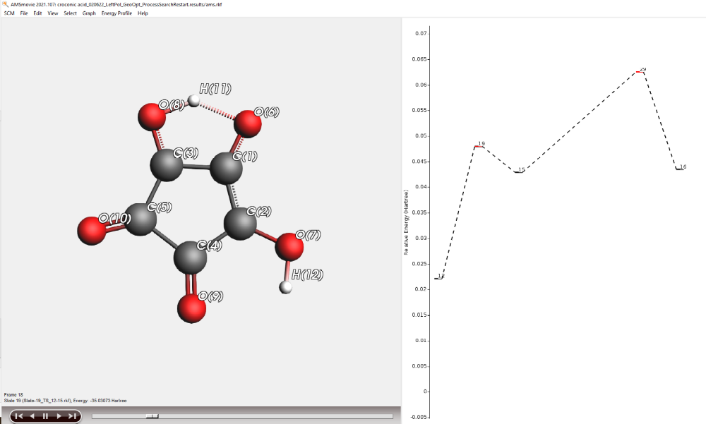
Transition State
State 19
State number

Slide 17
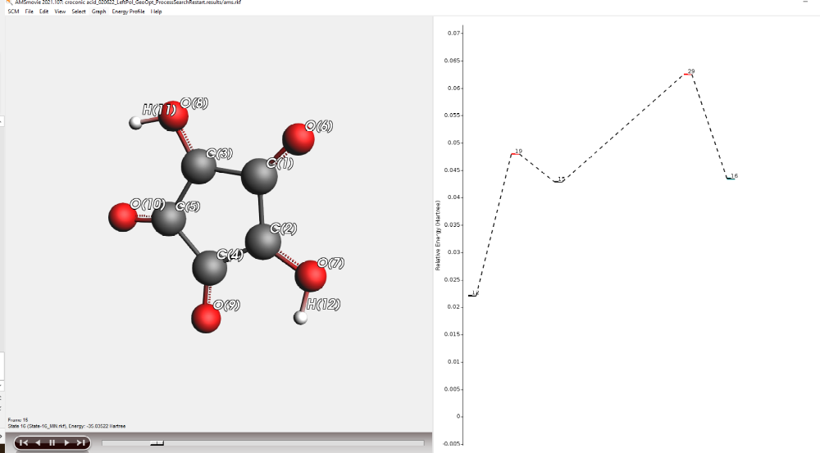
PES final run
It has been narrowed down to five states for which GAMESS and AMS seem to be in agreement (mostly)
State 16
State number

Slide 18
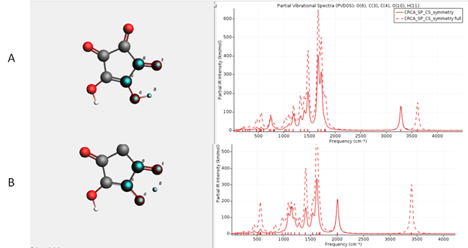
Vibrational spectra and density of states
Both are important in understanding the mechanisms at work and how we might implement a functioning circuit
Vibrational spectra of the ground state (A) vs the transition state (B). The stretching mode of H11-O6 (circled) is the single imaginary vibrational mode at -886 cm⁻¹ in the tautomeric transition state Note the appearance of the peak at 2005 cm⁻¹ in the transition state and the split carbonyl peaks at 3282 cm⁻¹ and 3607 cm⁻¹ in the ground state appear as a single peak at 3395 cm⁻¹ in the transition state.

Slide 19
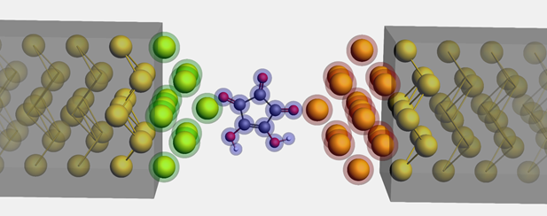
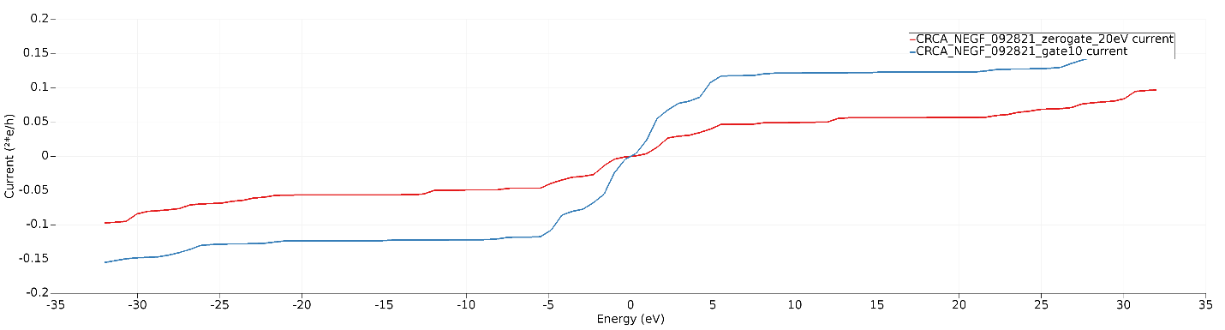
Electronic transport through croconic acid. Single molecule circuit simulation
AMS uses a non-equilibrium Green’s function approach to simulate electron transport
There is much refinement to be done on these models. We need to include the polarization reversal that occurs under tautomerization. And deep dives into the practical interpretation of the simulation results are to be conducted.
Additional work is planned to investigate electron and hole mobilities
Single molecule circuit of croconic acid between gold electrodes
I-V response at zero bias and 10V bias for single molecule croconic acid circuit

Slide 20
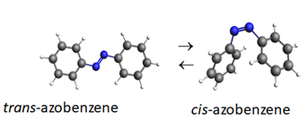
cis- & trans- tautomerism in azobenzene
Azobenzene can be optically stimulated at UV between the ground state (trans-) and an excited state (cis-) with reasonable thermal stability and reverse switched with visible light
Azobenzene, and a number of derivatives are also important candidates for classical organic circuit elements such as photoswitches. In our case, we are interested in quantum memories
We are using AMS modeling suite, GAMESS and ChemOffice which has a good MM2 and MM94 modeling interface

Slide 21
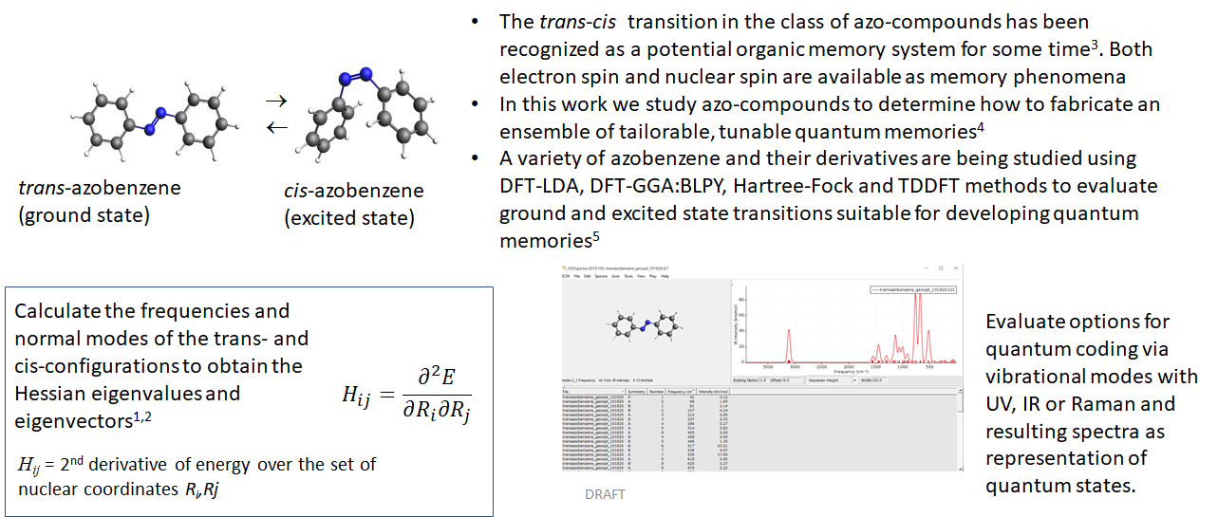
Azophenol-based Quantum Memories using excitable tautomeric state transitions
https://www.scm.com/doc/AMS/Vibrational_Spectroscopy.html#irfrequencies
Petrone, Alessio, et al. "Ab Initio Excited-State Transient Raman Analysis." The Journal of Physical Chemistry A 121.20 (2017): 3958-3965.
Reimer, Jeffrey A. "Nuclear hyperpolarization in solids and the prospects for nuclear spintronics." Solid state nuclear magnetic resonance 37.1-2 (2010): 3-12
Goswami, Sreetosh, et al. "Robust resistive memory devices using solution-processable metal-coordinated azo aromatics." Nature materials 16.12 (2017): 1216-1224.
Jacquemin, Denis, et al. "Extensive TD-DFT benchmark: singlet-excited states of organic molecules." Journal of Chemical Theory and Computation 5.9 (2009): 2420-2435.

Slide 22
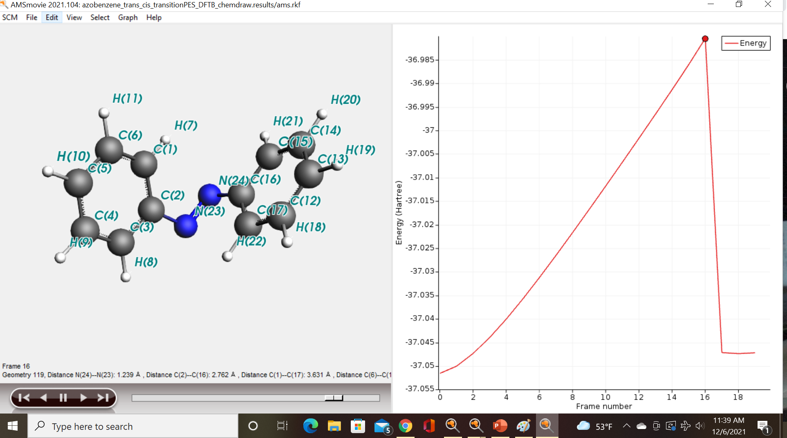
Used the Potential Energy Scan procedures to find the transition point

Slide 23
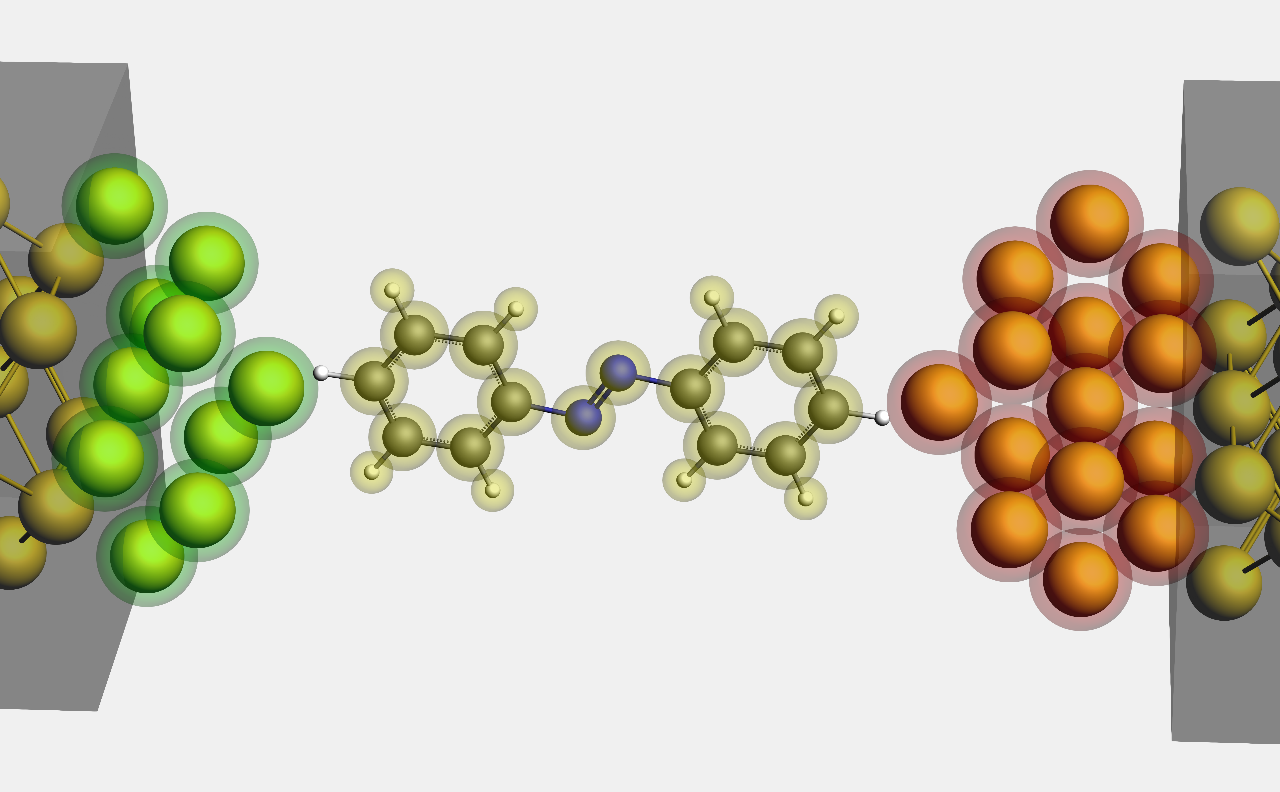
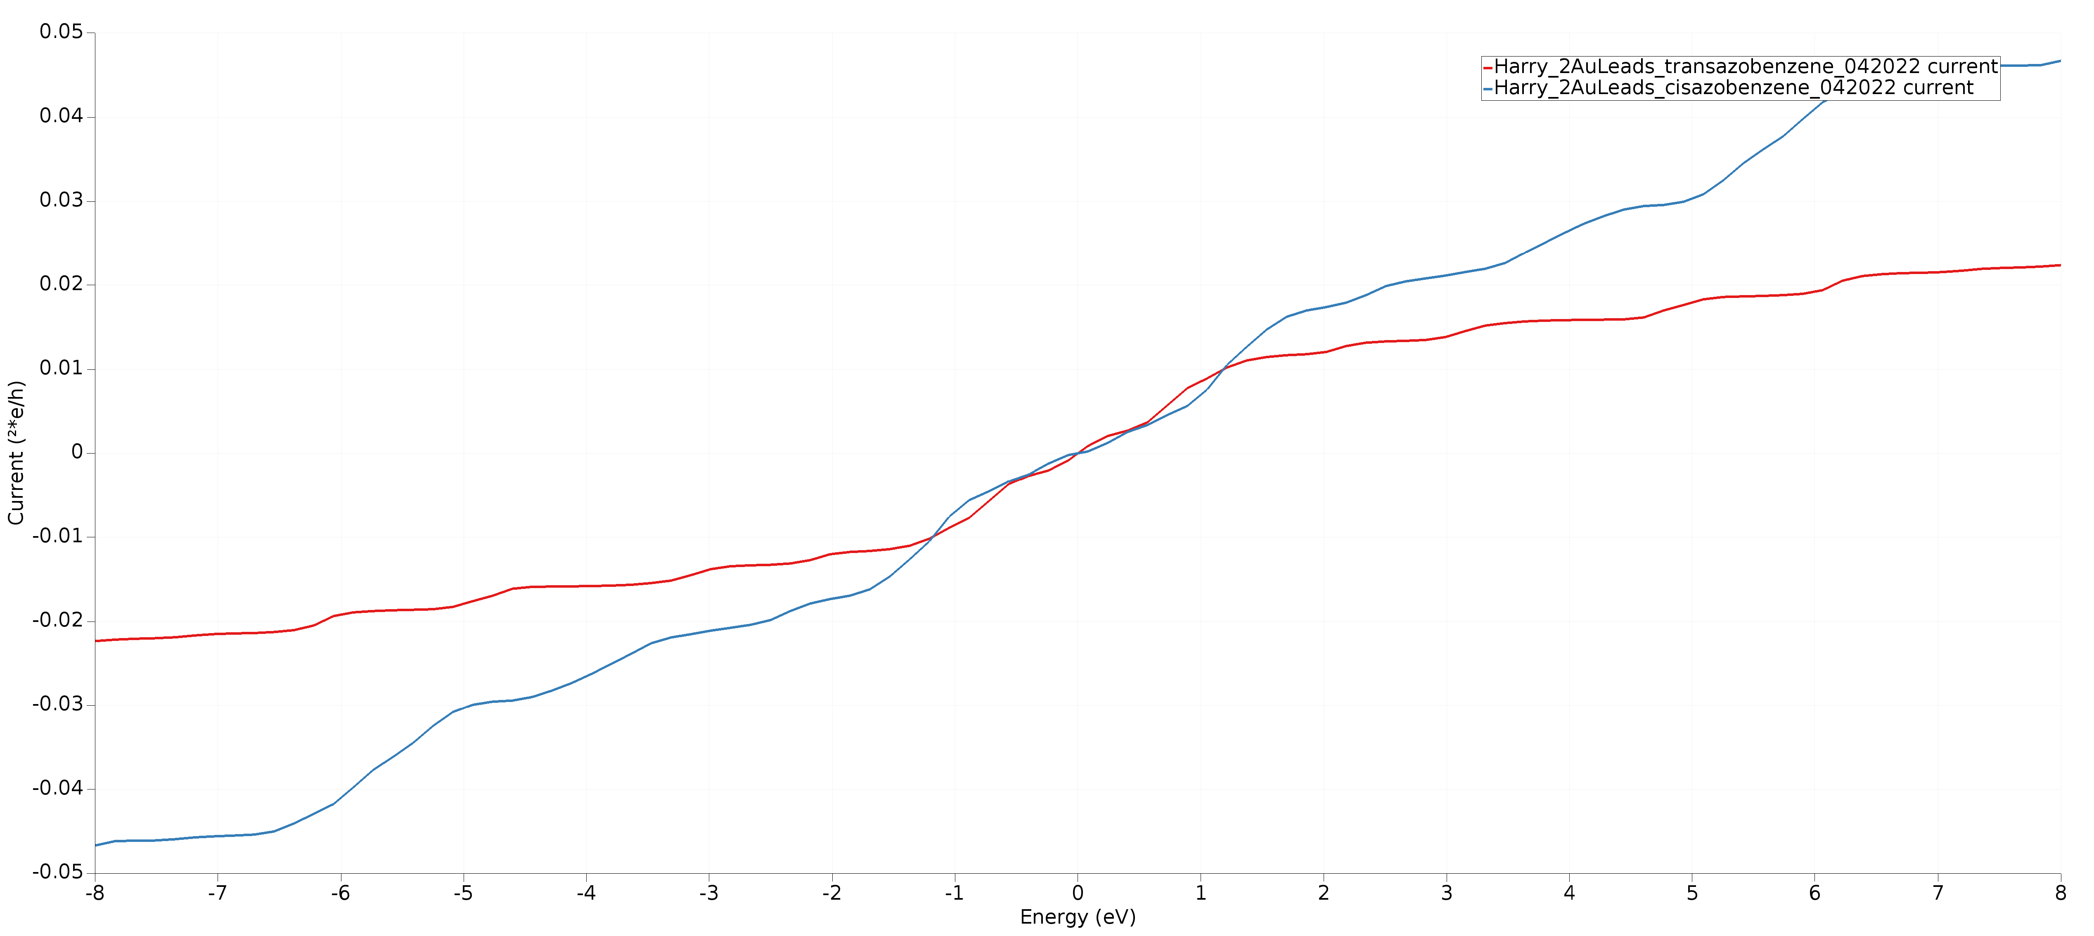
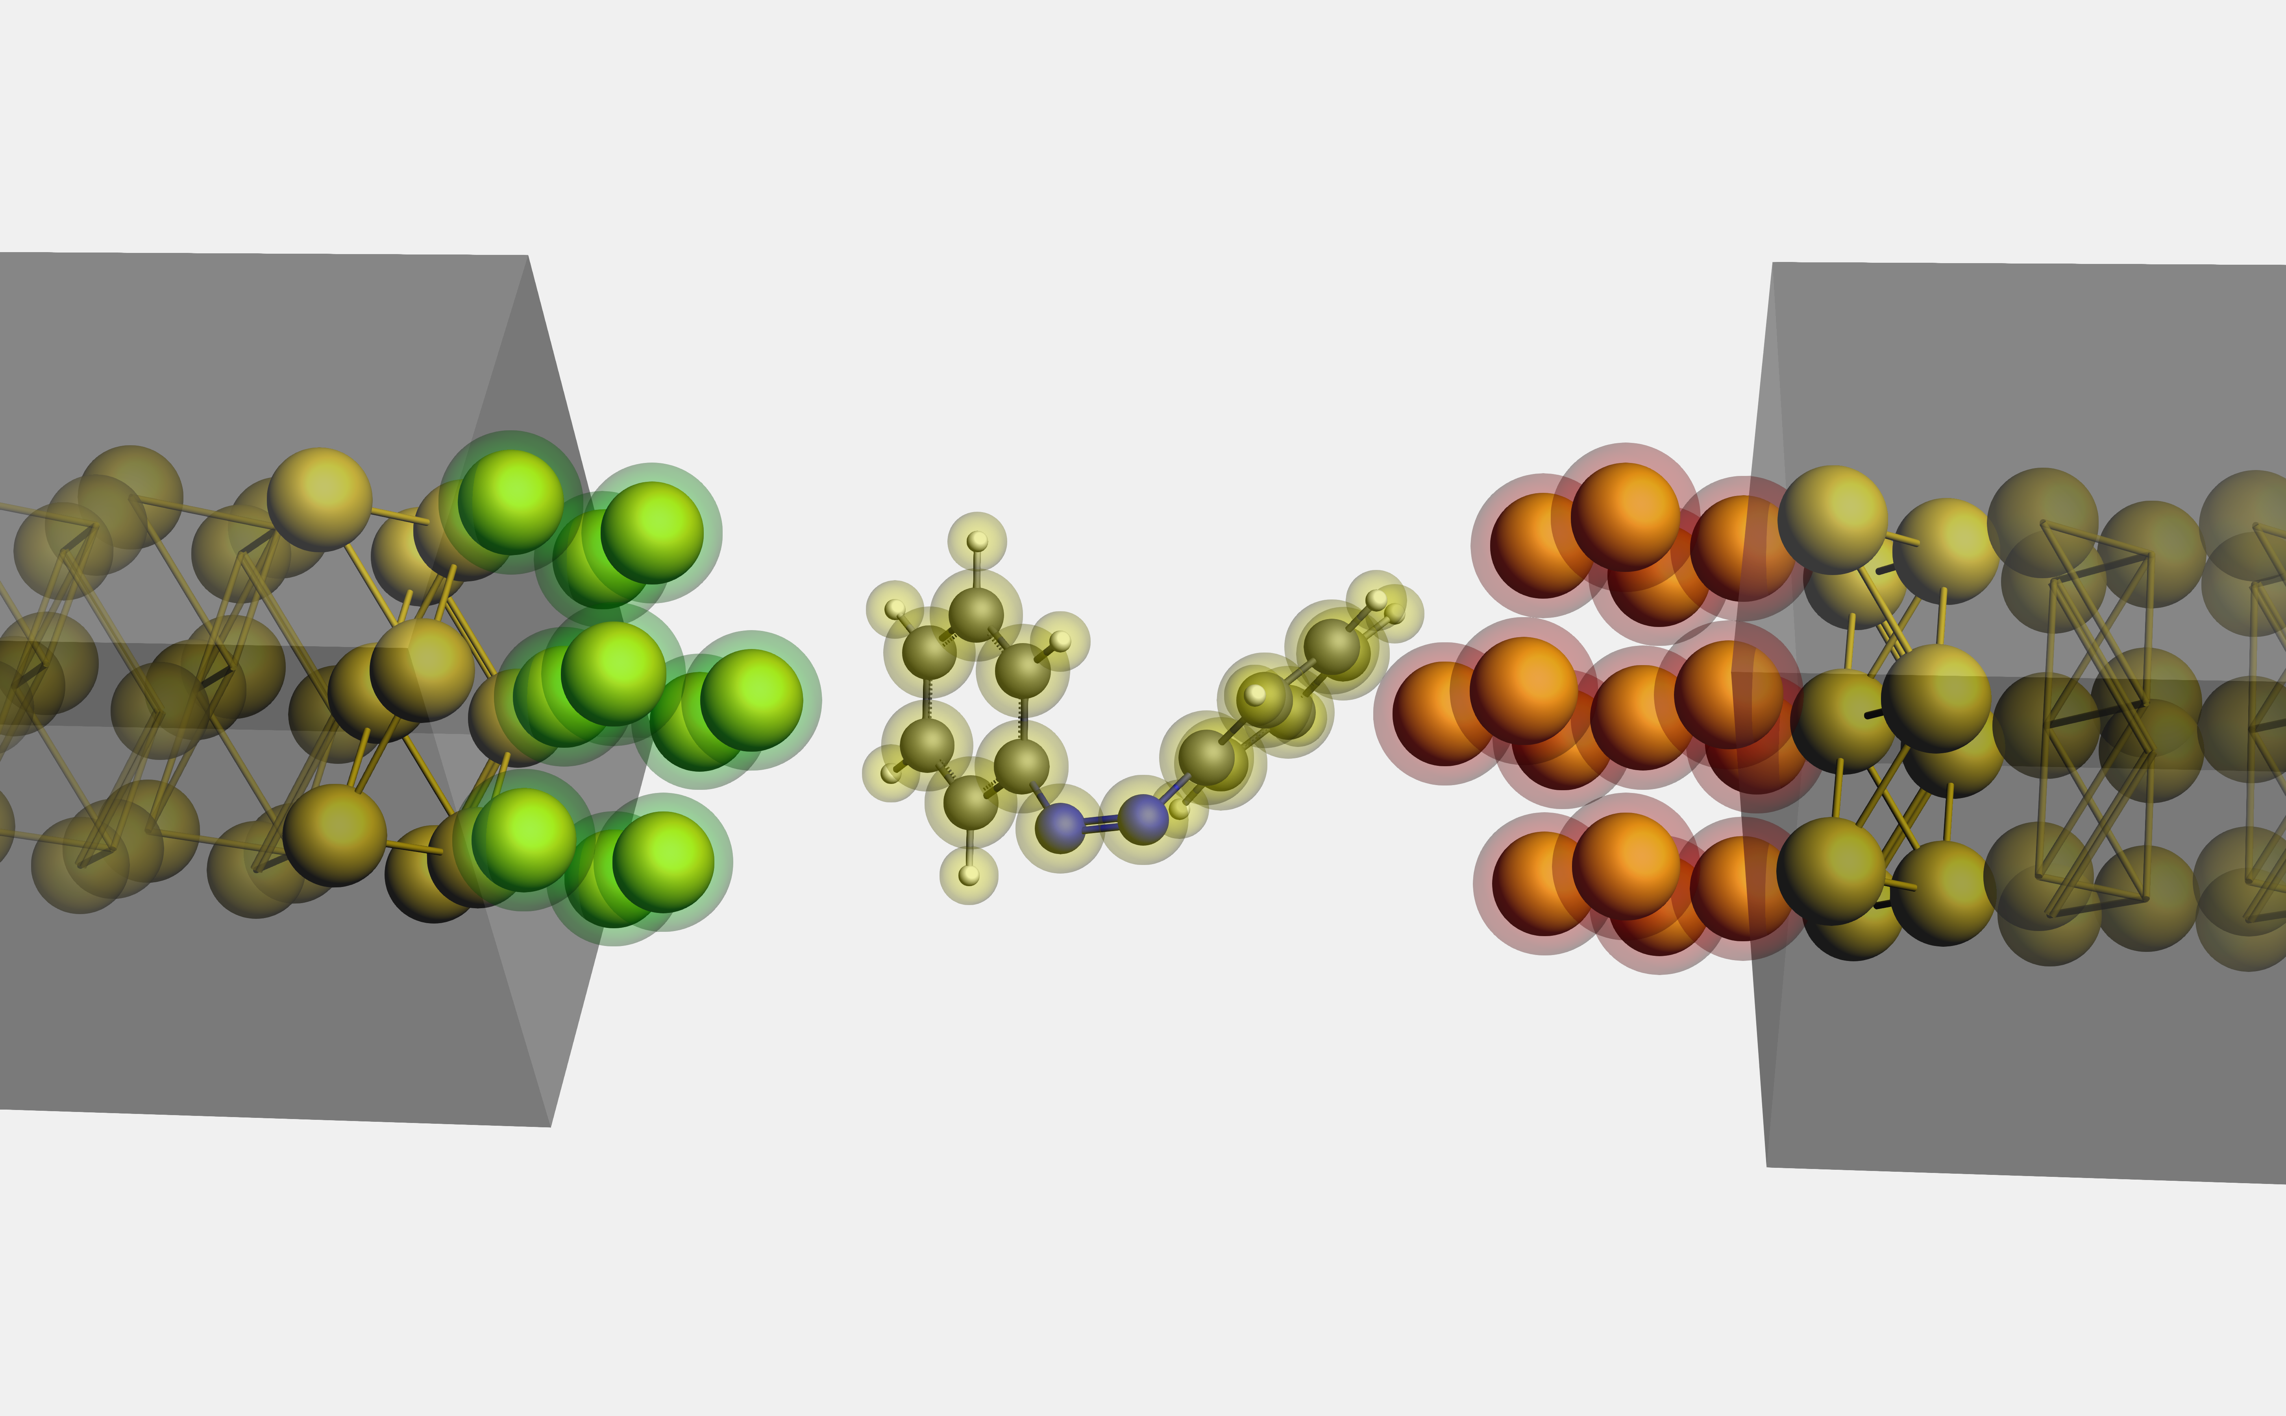
Electronic transport through azobenzene. Single molecule circuit simulation
We are looking at transport properties through, trans-, cis-, and transition state
There is much refinement to be done on these models. And deep dives into the practical interpretation of the simulation results are to be conducted
Additional work is planned to investigate electron and hole mobilities
We’re investigating read out options of either an electronic or spectroscopic nature, probably Raman
trans-
cis-

Slide 24
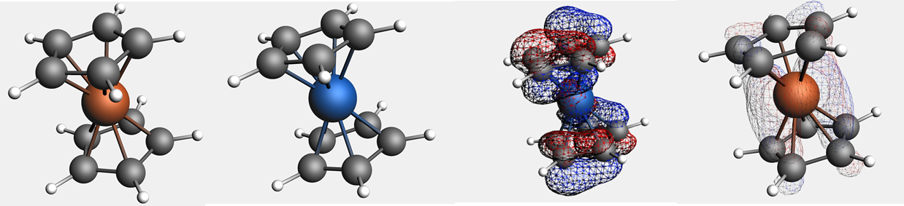
Spin transport through metal cyclopentadienyls
We are investigating the use metal cyclopentadienyls such as ferrocene and cobaltocene for quantum spin transport
These molecules are exceeding difficult to model correctly. The highly delocalized nature of the central transitional metal atom to the cyclopentadienyl rings must be accounted for in evaluating the simulation options and results.
Ferrocene, Cobaltocene and their derivatives are under evaluation with considerations for Aufbau and non-Aufbau⁶ solutions, staggered, eclipsed and skewed configurations, with each constituting a separate symmetry basis
Ground state, Ferrocene and Cobaltocene eclipsed configuration
Cobaltocene and Ferrocene HOMO occupations
6. Ghosh, Sayantani, et al. "Entangled quantum state of magnetic dipoles." Nature 425.6953 (2003): 48-51

Slide 25
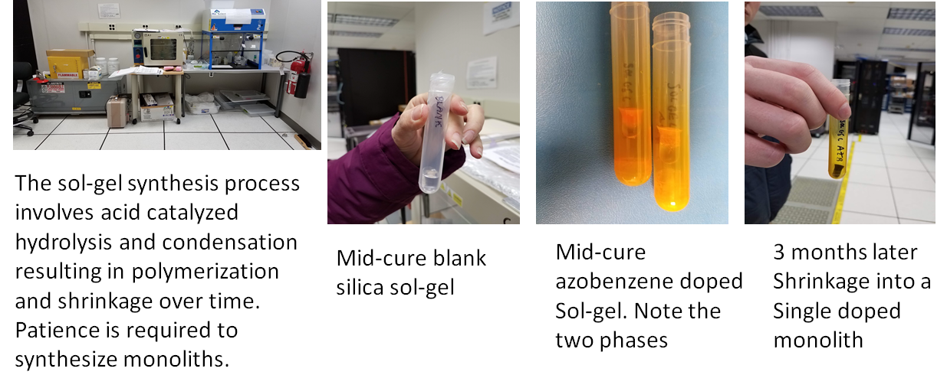
Sol-gels
We have our quantum materials, how are we going to implement them in a practical application?
Dr. Preston and I are investigating doping silica sol-gel as a substrate.
We specialize in low temperature synthesis of silica sol-gel and doping them for novel applications ^{8,9}
Next applications are quantum dots
8. US 6,445,861 B1, 9/3/2002, Sol-Gel Processing To Form Doped, Sol-Gel Monoliths Inside Hollow Core Optical Fiber And Sol-Gel Core Fiber Devices Made Thereby. Harry Shaw, Melanie Ott, Michele Manuel (U of Florida)
9. Preston, Deborah, Jean Claude Pouxviel, Thomas Novinson, William C. Kaska, Bruce Dunn, and Jeffrey I. Zink. "Photochromism of spiropyrans in aluminosilicate gels." Journal of Physical Chemistry 94, no. 10 (1990): 4167-4172.

Slide 26
Off the beaten track
Some other interesting things I’ve been working on (Ultimately, it’s all about communications)

Slide 27
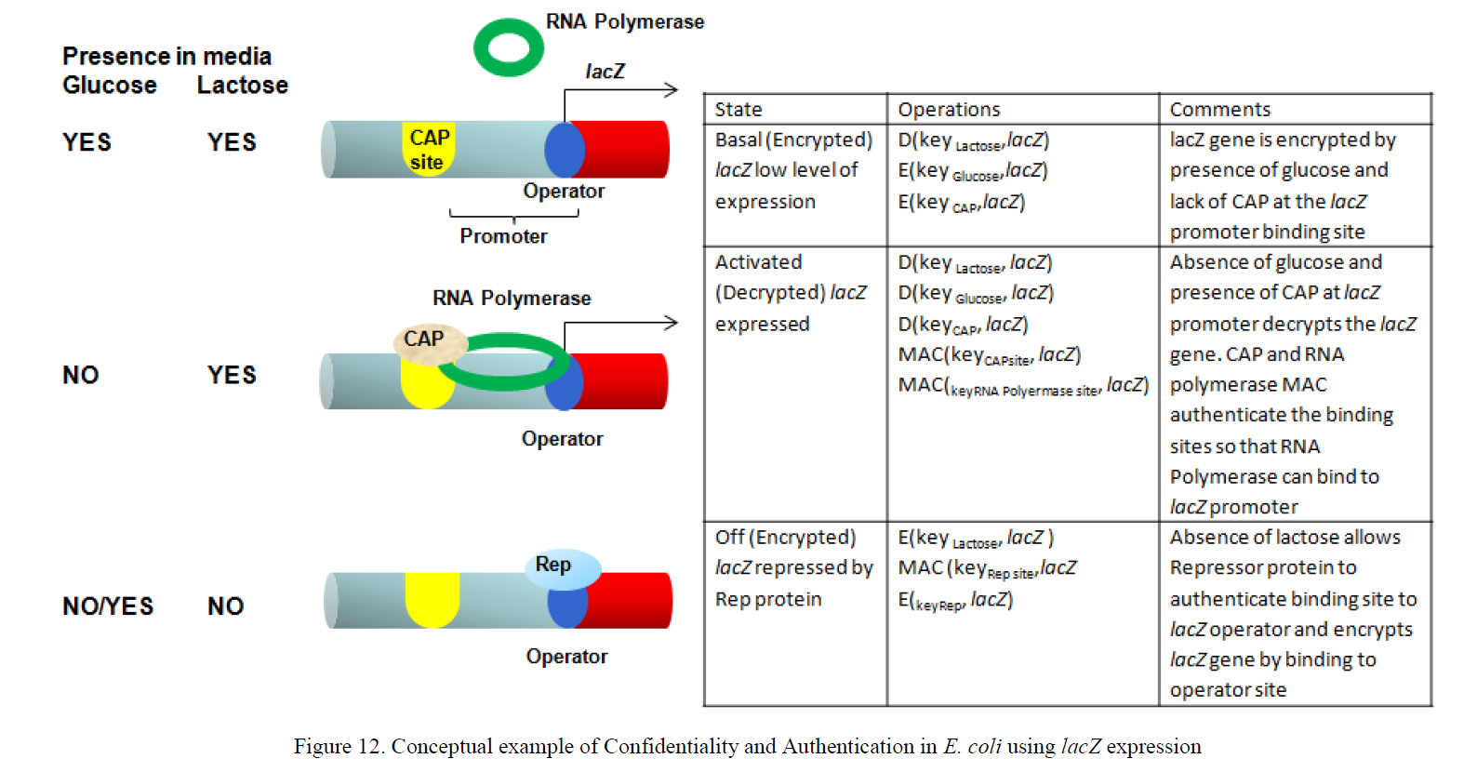
Genomics and Proteomics Based Security Protocols for Secure Network Architectures. U.S. Patent 8,898,479, 2014
I have a series of papers using genomics and proteomics for information security which culminated in a patent
I explore the synergy between molecular biology and information security¹⁰
10. Shaw, Harry, Sayed Hussein, and Hermann Helgert. "Genomics-based Security Protocols: From Plaintext to Cipherprotein." International Journal on Advances in Security 4, no. LEGNEW-OLDGSFC-GSFC-LN-1046 (2011).

Slide 28
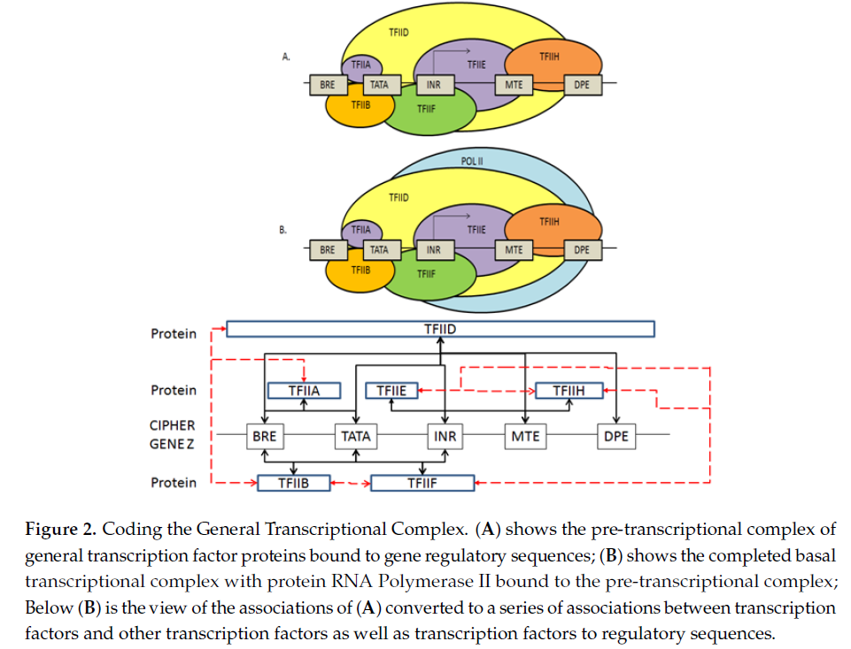
A Cryptographic System Based upon the Principles of
Gene Expression
The patented system goes far beyond a simple substitution code of bases or codons to and from plain text. It mimics a network of gene expression for a variety of applications ¹¹
11. Harry Shaw, A Cryptographic System Based upon the Principles of Gene Expression, Cryptography 2017, 1, 21; doi:10.3390/cryptography1030021

Slide 29
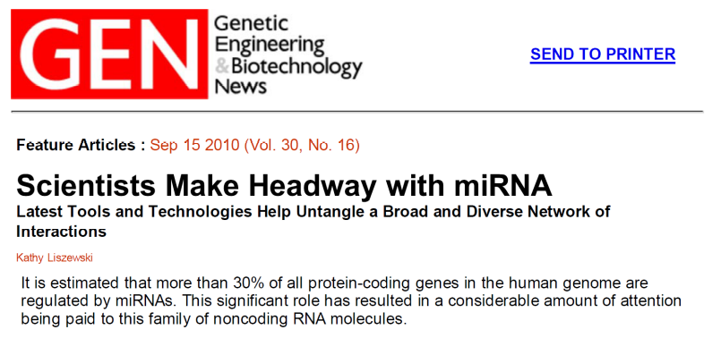
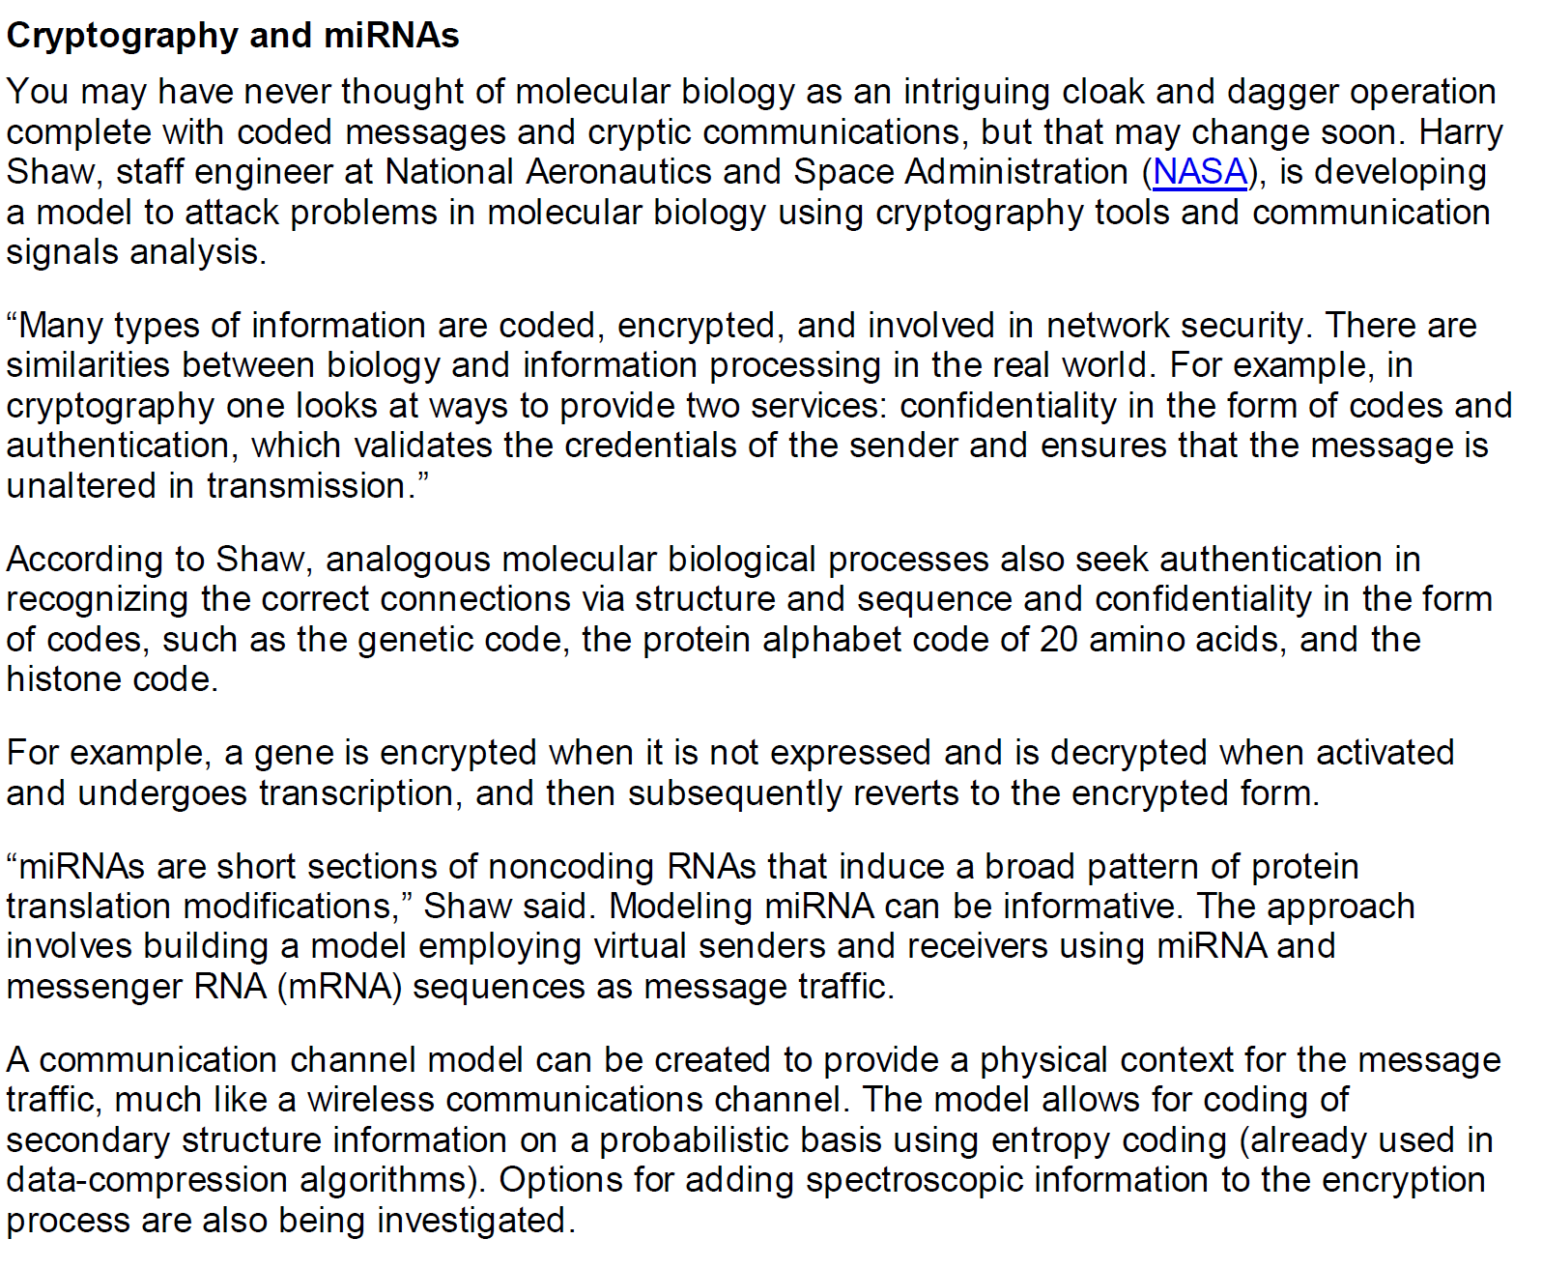
Early progress in the area
I have a few publications in this area over the last 12 years or so.

Slide 30
2019 53rd Annual Conference on Information Sciences and Systems (CISS)
Johns Hopkins University
Information theory and signal processing methodology to identify nucleic acid-protein binding sequences in RNA-protein interactions
Harry Shaw*, Nagarajan Pattabiraman**, Deborah Preston†, Tatiana Ammosova ††, Yuri Obukhov††, Sergei Nekhai†† and Ajit Kumar**
*Telecommunication Networks and Technologies Branch, Staff Engineer, NASA/Goddard Space Flight Center, Greenbelt, MD
**Department of Biochemistry and Molecular Medicine, The George Washington University, Washington, DC
†University of Maryland, College Park, MD
††Department of Medicine, Howard University School of Medicine, Washington DC

Slide 31
Introduction and Approach
RNA-protein binding is central to cellular processes
  Knowledge of the structure of the RNA-protein complex and its formation are key to understanding these processes.
  In only a fraction of known RNA-protein complexes, structures of bound complexes have been produced using X-ray crystallography or solution NMR.
The initial goal of this research: predict the binding sites of the microRNA to the each protein using MS/MS assay data.
  Stretch goal: distinguish the strongly bound microRNA-proteins from the weakly bound microRNA-proteins in the same assay.
Develop a model that predicts ΔG for RNA-protein binding sites
Test the model against published RNA-protein binding data. Testing over 200,000 nucleotide:peptide fragments
The result is an information entropy derived model calibrated against published RNA-protein ΔG for an entire set of assay data.
Apply to mass spec data from RNA-protein co-immunoprecipitation assays

Slide 32
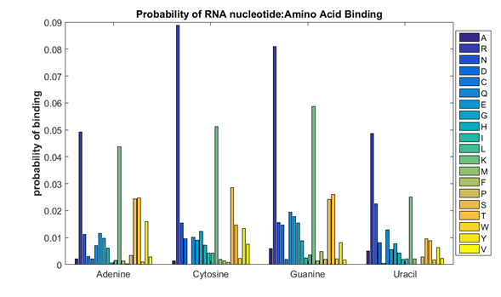
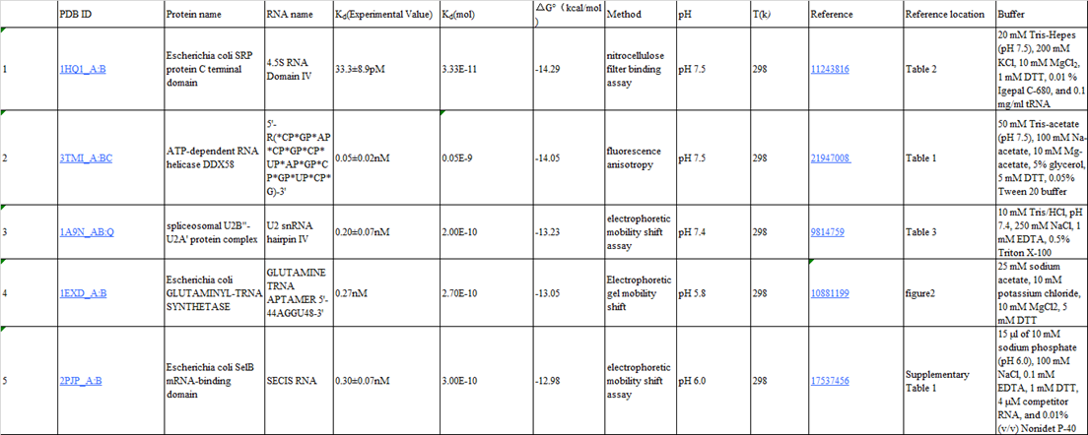
Inputs to the model
The statistics of RNA nucleotide-amino acid binding data from the Amino Acid-Nucleotide Interaction data-base (AANT)¹².
The Dataset for Protein-RNA Binding Affinity ¹³, which lists 73 protein-RNA complexes with measured equilibrium constants (K_{d}) to generate a calculated delta Gibbs free energy via the standard relationships;
Protein Data Bank (PDB) data and structures ¹⁴.
A test dataset of MS/MS co-immunoprecipitation assay data results from the co-authors at Howard University.
12 Hoffman MM, Khrapov MA, Cox JC, Yao J, Tong L, Ellington AD. AANT: the Amino Acid-Nucleotide Interaction Database. Nucleic Acids Res. 2004 Jan 1;32(Database issue):D174-81. doi: 10.1093/nar/gkh128. PMID: 14681388; PMCID: PMC308862.
13 Yang X, Li H, Huang Y, Liu S. The dataset for protein-RNA binding affinity. Protein Sci. 2013 Dec;22(12):1808-11. doi: 10.1002/pro.2383. PMID: 24127340; PMCID: PMC3843634.
14 Berman, Westbrook, Feng, Gilliland, Bhat, Weissig, Shindyalov, Bourne, Nucleic Acids Research (2000)

Slide 33
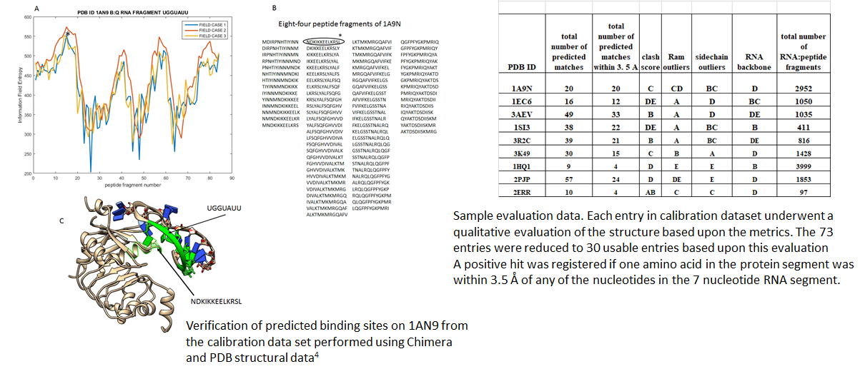
Produce information field entropy spectra and apply digital signal processing techniques to tease out peaks of interest
¹⁵Pettersen, Goddard, Huang, Couch, Greenblatt, Meng, Ferrin. J Comput Chem. (2004)
Molecular graphics and analyses performed with the UCSF Chimera package, Resource for Biocomputing, Visualization, and Informatics UCSF

Slide 34
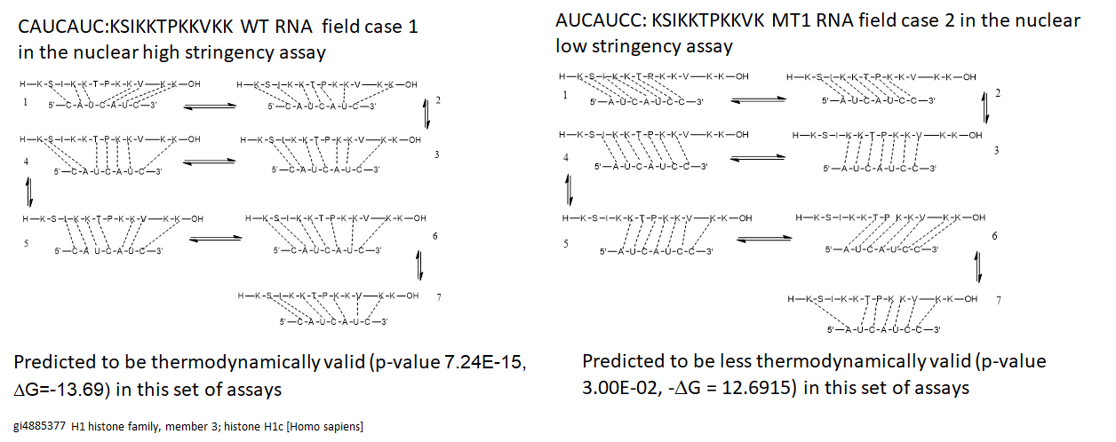
Proposed interpretation of the results is that stronger linear correlation between information field entropy and SEQUEST score equates with more favorable thermodynamics for binding

Slide 35
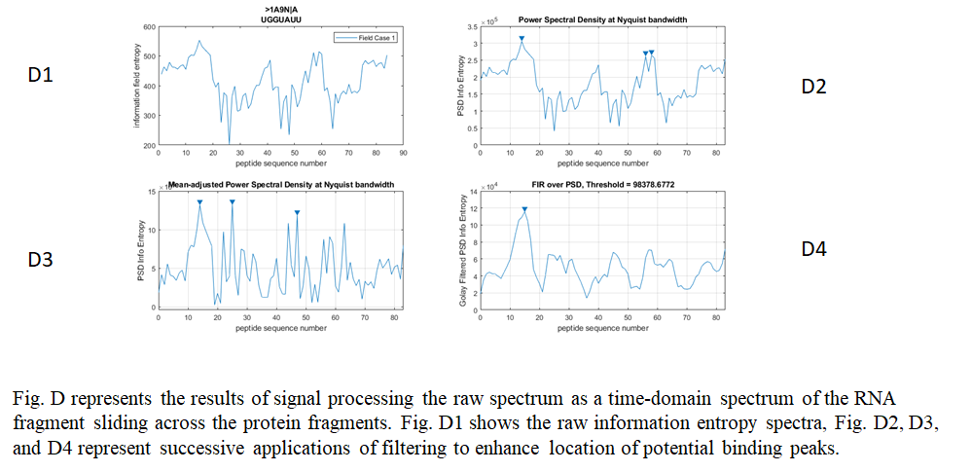
Apply digital signal processing to enhance analysis of peaks

Slide 36
Conclusion
Thanks very much for the opportunity to speak to the UMBC Physics department
Looking forward to continuing our successful relationship and investigating new problems.
I would like to acknowledge the support of the NASA/GSFC ACCESS Project, Exploration and Space Communications Division and the NASA HQ Space Communications and Navigation (SCaN) Program Office.

