Slide 1

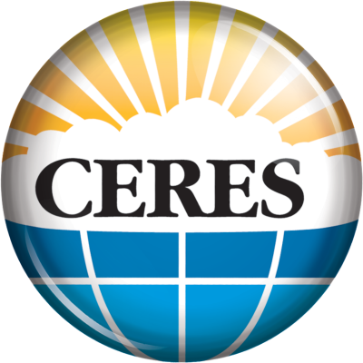
Cloud Radiative Swath Update: Enhancing Level 2 Surface Fluxes w/ the Fu-Liou RTM & Machine Learning
Ryan Scott¹, Paul Stackhouse Jr.¹, Fred Rose²,
Norman Loeb¹, David Rutan², Seiji Kato¹,
David Doelling¹, Patrick Taylor¹, Bill Smith Jr.¹
¹ NASA Langley Research Center
² Science Systems & Applications, Inc.
Spring 2022 CERES Science Team Meeting
ryan.c.scott@nasa.gov

Slide 2
CERES L2 Surface Fluxes
Climate studies require info on energy flows internal to the climate system, esp. @ surface, on various scales
Current L2 Single Scanner Footprint (SSF) products estimate broadband surface fluxes with simple parameterizations:
Surface-Only Flux Algorithms (SOFA) Models A, B, C – all are limited in scope & accuracy, were meant as a temporary solution
Spring 2022 CERES Science Team Meeting
ryan.c.scott@nasa.gov

Slide 3
CERES L2 Surface Fluxes
Climate studies require info on energy flows internal to the climate system, esp. @ surface, on various scales
Current L2 Single Scanner Footprint (SSF) products estimate broadband surface fluxes with simple parameterizations:
Surface-Only Flux Algorithms (SOFA) Models A, B, C – all are limited in scope & accuracy, were meant as a temporary solution
The Cloud Radiative Swath (CRS) data product builds upon the standard L2 SSF by calculating a suite of instantaneous irradiances at the footprint scale using the NASA LaRC Fu-Liou radiative transfer model (RTM)
Developed in 2000s & last released w/ Ed 2. SARB has resurrected CRS to provide more sophisticated L2 flux products
SW↓↑ & LW↓↑ broadband flux profiles; spectral surface (↓) & TOA (↑) fluxes; surface direct + diffuse SW↓, PAR, UV
Spring 2022 CERES Science Team Meeting
ryan.c.scott@nasa.gov

Slide 4
CERES L2 Surface Fluxes
Climate studies require info on energy flows internal to the climate system, esp. @ surface, on various scales
Current L2 Single Scanner Footprint (SSF) products estimate broadband surface fluxes with simple parameterizations:
Surface-Only Flux Algorithms (SOFA) Models A, B, C – all are limited in scope & accuracy, were meant as a temporary solution
The Cloud Radiative Swath (CRS) data product builds upon the standard L2 SSF by calculating a suite of instantaneous irradiances at the footprint scale using the NASA LaRC Fu-Liou radiative transfer model (RTM)
Developed in 2000s & last released w/ Ed 2. SARB has resurrected CRS to provide more sophisticated L2 flux products
SW↓↑ & LW↓↑ broadband flux profiles; spectral surface (↓) & TOA (↑) fluxes; surface direct + diffuse SW↓, PAR, UV
Here we report our latest progress toward enhancing the CERES & FLASHFlux Level 2 surface flux products
How accurate are CRS Ed4 surface fluxes? How does CRS perform compared to current-generation SOFA models?
Validation of surface ↓ fluxes stratified by cloud conditions & surface type against a global network of observations
CRS vs the SOFA (Models A, B, C) fluxes available in current CERES & FLASHFlux SSF products
Plus: unique validation opportunities in remote polar environments - MOSAiC, Arctic Ocean & Siple Dome, Antarctica
Spring 2022 CERES Science Team Meeting
ryan.c.scott@nasa.gov

Slide 5
CERES L2 Surface Fluxes
Climate studies require info on energy flows internal to the climate system, esp. @ surface, on various scales
Current L2 Single Scanner Footprint (SSF) products estimate broadband surface fluxes with simple parameterizations:
Surface-Only Flux Algorithms (SOFA) Models A, B, C – all are limited in scope & accuracy, were meant as a temporary solution
The Cloud Radiative Swath (CRS) data product builds upon the standard L2 SSF by calculating a suite of instantaneous irradiances at the footprint scale using the NASA LaRC Fu-Liou radiative transfer model (RTM)
Developed in 2000s & last released w/ Ed 2. SARB has resurrected CRS to provide more sophisticated L2 flux products
SW↓↑ & LW↓↑ broadband flux profiles; spectral surface (↓) & TOA (↑) fluxes; surface direct + diffuse SW↓, PAR, UV
Here we report our latest progress toward enhancing the CERES & FLASHFlux Level 2 surface flux products
How accurate are CRS Ed4 surface fluxes? How does CRS perform compared to current-generation SOFA models?
Validation of surface ↓ fluxes stratified by cloud conditions & surface type against a global network of observations
CRS vs the SOFA (Models A, B, C) fluxes available in current CERES & FLASHFlux SSF products
Plus: unique validation opportunities in remote polar environments - MOSAiC, Arctic Ocean & Siple Dome, Antarctica
Using Machine Learning to provide CRS-quality surface ↓ fluxes in near real-time on the FLASHFlux SSF
iii. Tuning hyperparameters of XGBoost regressor trained on CRS simulations for enhanced generalization performance
iv. How the models will be applied to FLASHFlux SSF near real-time data production
Spring 2022 CERES Science Team Meeting
ryan.c.scott@nasa.gov

Slide 6
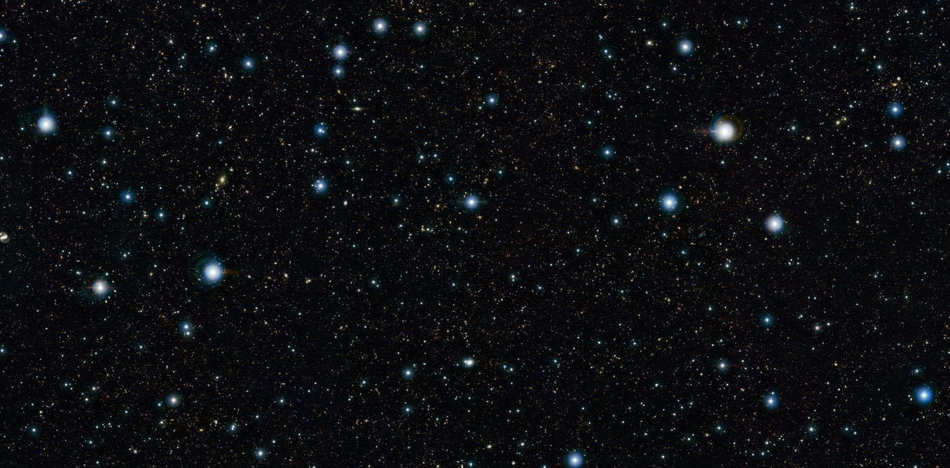
CERES SSF
TOA
Surface-Only Flux Algorithms (SOFA)
Model B (All-Sky)
Langley Parameterized LW Algorithm
Langley Parameterized SW Algorithm
Model A (Clear-Sky Only)
Model C (All-Sky, LW Only)
Surface
SW↓↑
LW↓↑
~20-50 km
CERES Footprint / FOV
Terra, Aqua, NPP, NOAA-20

Slide 7
CERES CRS
Inputs
CERES SSF Ed4A
geolocated FOVs, etc.
GEOS 5.4.1
T(z), p(z), q(z), O₃(z)
surface wind speed
MODIS
cloud properties (Ed4)
AOD (sometimes)
spectral albedo
land temp (clear)
MATCH hourly
aerosol profiles & AOD
IGBP surface type
Surface albedo history
map (cloudy)
Outputs
instantaneous vertical profiles (6 levels) of broadband & spectrally-resolved fluxes @ the surface (↓) and TOA (↑)
2-stream LW
4-stream SW
LW : 12 bands
SW : 14 bands
SW↓ direct + diffuse
PAR, UV fluxes
All-sky
Clear-sky
Pristine-sky
All-sky no aerosol
NASA Langley Fu-Liou
Radiative Transfer Model
TOA
70 mb
SW↓↑
200 mb
LW↓↑
500 mb
850 mb
Surface
~20-50 km
CERES Footprint / FOV
Terra FM1, Aqua FM3

Slide 8
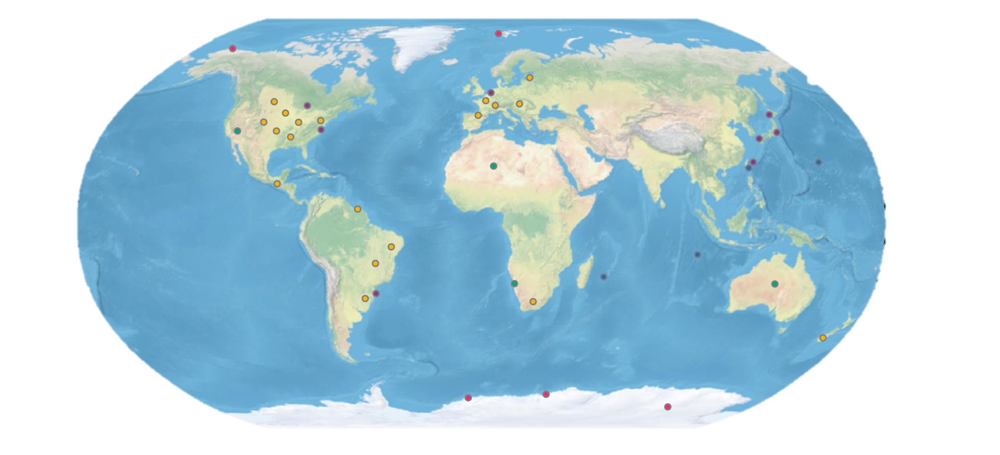
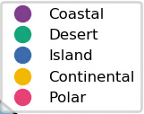
CERES L2 Surface Validation Sites
Spring 2022 CERES Science Team Meeting
ryan.c.scott@nasa.gov
i. CRS vs SOFA Surface Flux Validation

Slide 9
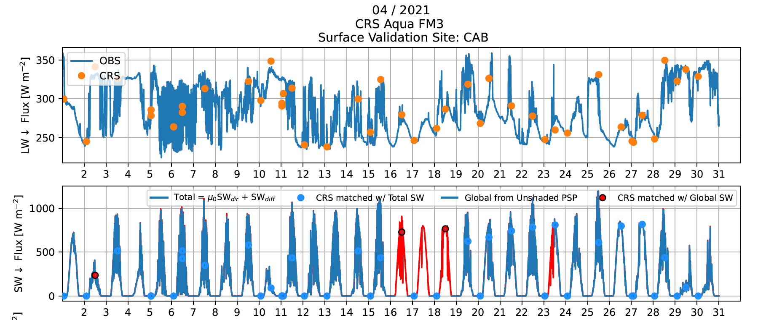
Surface Flux Validation Methodology
Using 1-min resolution surface data
Extracting footprints within 10 km
LW↓ : instantaneous match to pyrgeometer obs. at footprint time
SW↓ : averaging surface obs. for 30 mins centered at footprint time
Total = Direct + Diffuse, resort to Global from unshaded PSP if total is unavailable
SW↓_{CRS} scaled by avg(μ_{OBS}) / μ_{CRS} to account for changing μ = cos(SZA)
Sort by surface type & cloud conditions
Cabauw, Netherlands
Spring 2022 CERES Science Team Meeting
ryan.c.scott@nasa.gov
i. CRS vs SOFA Surface Flux Validation

Slide 10
SW↓
Comparable bias
34, 39%
RMS reduction
relative to Model B
10% higher correlation
Notes:
Reduction in RMSE by 34-39% (50-60 Wm2) relative to Model B (CERES SSF and FLASHFlux SSF)
Increase in correlation by 8-12%

Slide 11
SW↓
Cloud fraction > 95%
41, 47%
RMS reduction
relative to Model B
30% higher
correlation
Notes:
Reduction in RMSE by 34-39% (50-60 Wm2) relative to Model B (CERES SSF and FLASHFlux SSF)
Increase in correlation by 8-12%

Slide 12
SW↓
Cloud fraction < 5%
Lowest bias
Dist. center near 0
73, 76%
RMS reduction
relative to Model B
Notes:
Reduction in RMSE by 34-39% (50-60 Wm2) relative to Model B (CERES SSF and FLASHFlux SSF)
Increase in correlation by 8-12%

Slide 13
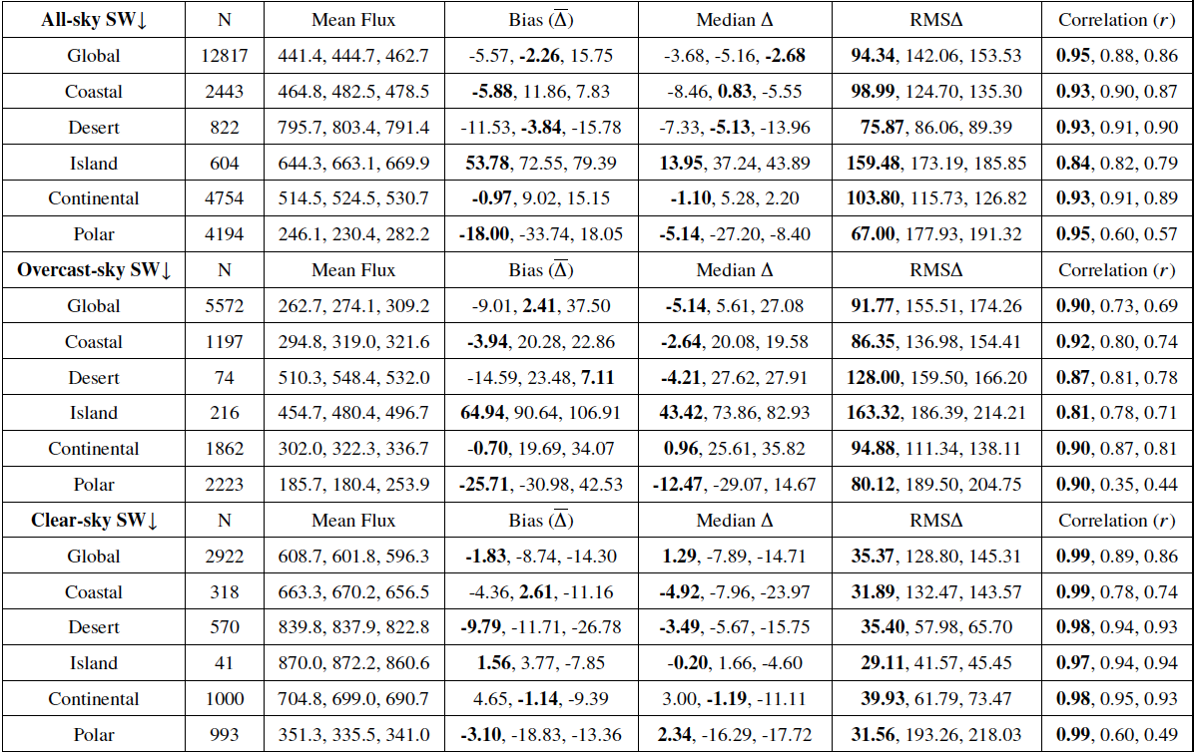
CERES Aqua FM3 Surface SW↓ [W m⁻²]
CRS vs SOFA Model B (Daytime)
Cells with multiple entries correspond to
CRS (Fu-Liou), SSF Ed4A (Model B), SSF V4A (Model B)
i. CRS vs SOFA Surface Flux Validation

Slide 14
LW↓
Smallest
mean/med. bias
18, 19%
RMS reduction
relative to Model B
Slight corr. increase
Notes:
Reduction in RMSE by 34-39% (50-60 Wm2) relative to Model B (CERES SSF and FLASHFlux SSF)
Increase in correlation by 8-12%

Slide 15
LW↓
Cloud fraction > 95%
Smallest mean/median bias
25% overcast
RMS reduction
relative to Model B
Notes:
Reduction in RMSE by 34-39% (50-60 Wm2) relative to Model B (CERES SSF and FLASHFlux SSF)
Increase in correlation by 8-12%

Slide 16
LW↓
Cloud fraction < 5%
Smallest mean/median bias
26% clear
RMS reduction
relative to Model B
Notes:
Reduction in RMSE by 34-39% (50-60 Wm2) relative to Model B (CERES SSF and FLASHFlux SSF)
Increase in correlation by 8-12%

Slide 17
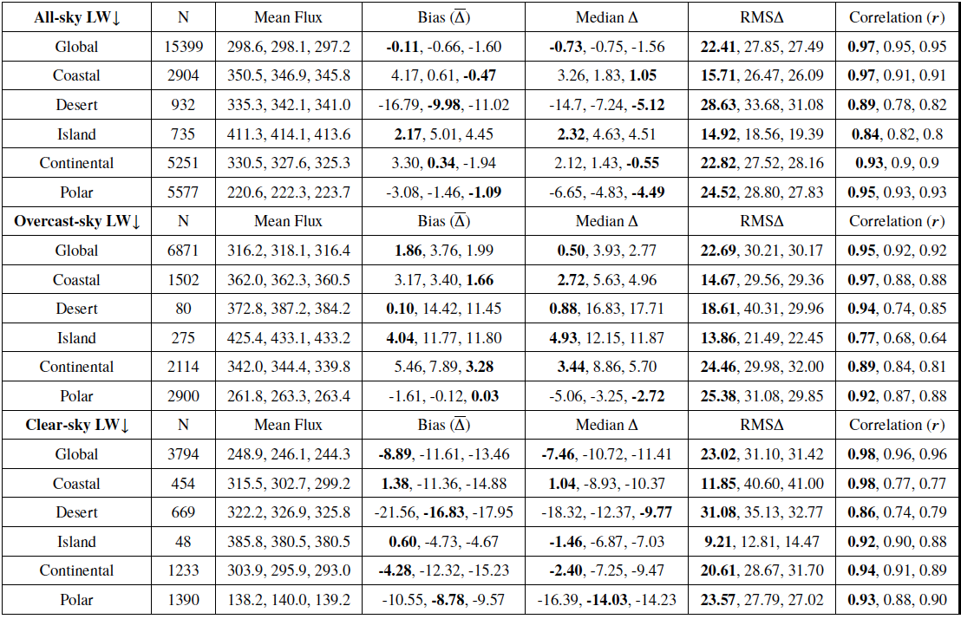
CERES Aqua FM3 Surface LW↓ [W m⁻²]
CRS vs SOFA Model B (Daytime)
Cells with multiple entries correspond to
CRS (Fu-Liou), SSF Ed4A (Model B), SSF V4A (Model B)
i. CRS vs SOFA Surface Flux Validation

Slide 18
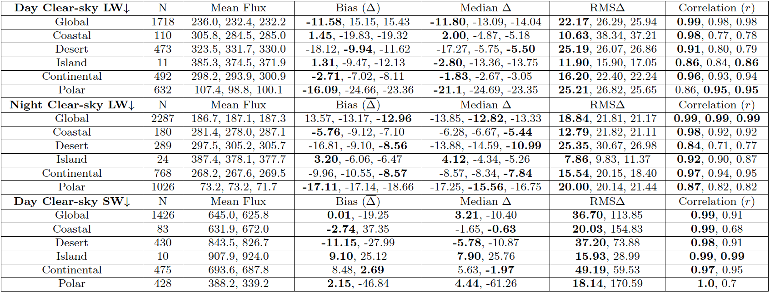
CERES Aqua FM3 Surface LW↓ & SW↓ [W m⁻²]
CRS vs SOFA Clear-Sky Model A
Cells with multiple entries correspond to
CRS (Fu-Liou), SSF Ed4A (Model A), SSF V4A (Model A)
i. CRS vs SOFA Surface Flux Validation

Slide 19
SW↓
Cloud fraction = 0%
SW Model A is only for clear footprints
FLASHFlux does not run SW Model A
CRS eliminates a large systematic bias present in SW Model A
Model A flux Δ histogram is bimodal while CRS’s is approx. normal
CRS exhibits a 67% drop in RMSΔ
from ~114 to 37 W m⁻²
8% higher correlation
Notes:
Reduction in RMSE by 34-39% (50-60 Wm2) relative to Model B (CERES SSF and FLASHFlux SSF)
Increase in correlation by 8-12%

Slide 20
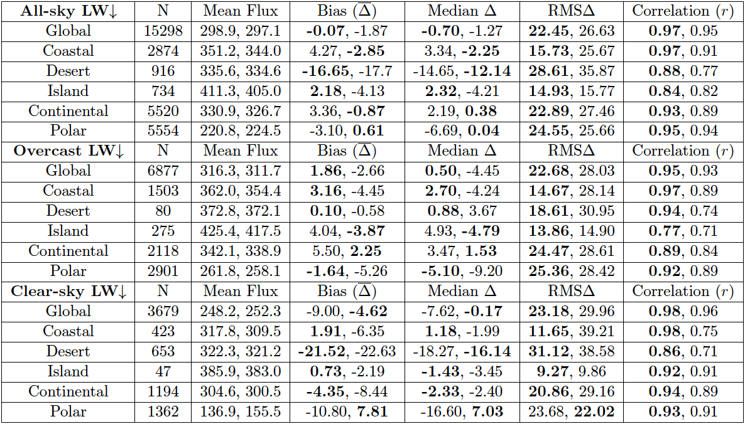
CERES Aqua FM3 Surface LW↓ [W m⁻²]
CRS vs SOFA All-Sky LW Model C
Cells with multiple entries correspond to
CRS (Fu-Liou), SSF Ed4A (Model C)
i. CRS vs SOFA Surface Flux Validation

Slide 21
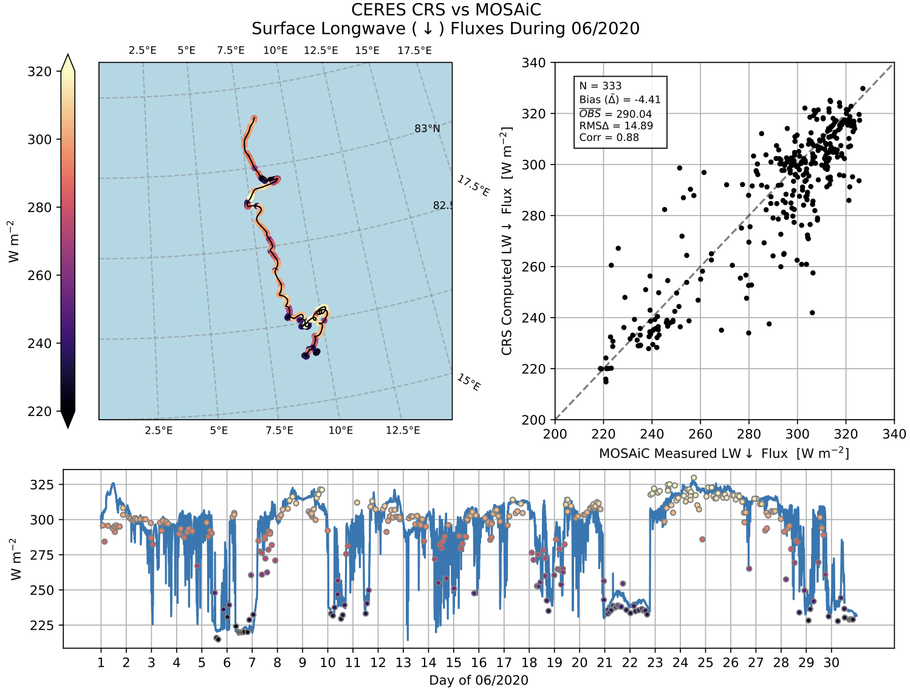
Arctic Summer CRS Surface
LW↓ Flux Validation @ MOSAiC
Polarstern
Ship Track
06/2020
MOSAiC measured surface fluxes in the high Arctic from the Polarstern icebreaker from 09/2019-10/2020 (Shupe et al. 2022)
Spring 2022 CERES Science Team Meeting
ryan.c.scott@nasa.gov
ii. CRS vs MOSAiC in the Arctic

Slide 22
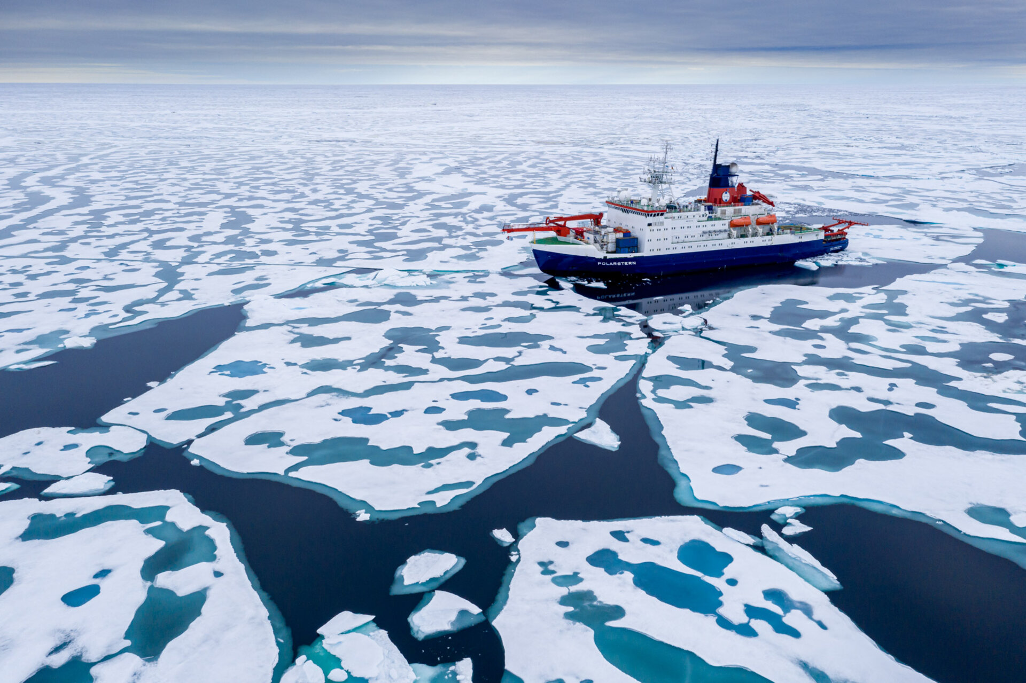
Arctic Summer CRS Surface
LW↓ Flux Validation @ MOSAiC
Polarstern
Ship Track
06/2020
@ESA
CRS surface LW↓ from Terra FM1 & Aqua FM3 vs pyrgeometer measurements
CRS captures the variations in LW↓
Small mean LW↓ bias of -4.4 W m⁻²
Lower RMS𝚫 (14 W m⁻²!) than typically seen at routine surface measurement sites
Spring 2022 CERES Science Team Meeting
ryan.c.scott@nasa.gov
ii. CRS vs MOSAiC in the Arctic

Slide 23
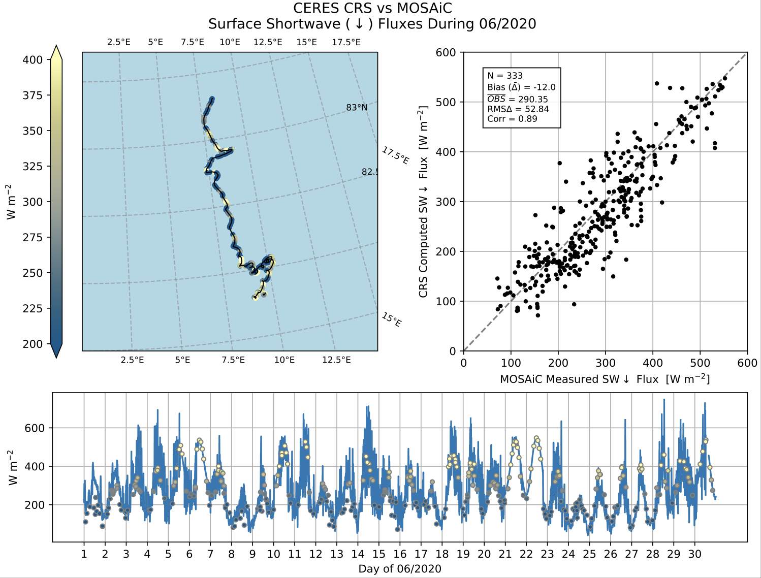
Arctic Summer CRS Surface
SW↓ Flux Validation @ MOSAiC
Polarstern
Ship Track
06/2020
@ESA
CRS surface SW↓ from Terra FM1 & Aqua FM3 vs unshaded PSP measurements (Shupe et al. 2022)
Small mean bias of -12 W m⁻² consistent w/ well documented Ed4A polar cloud optical depth bias
Lower RMS𝚫 than typical at routine surface measurement sites
Spring 2022 CERES Science Team Meeting
ryan.c.scott@nasa.gov
ii. CRS vs MOSAiC in the Arctic

Slide 24
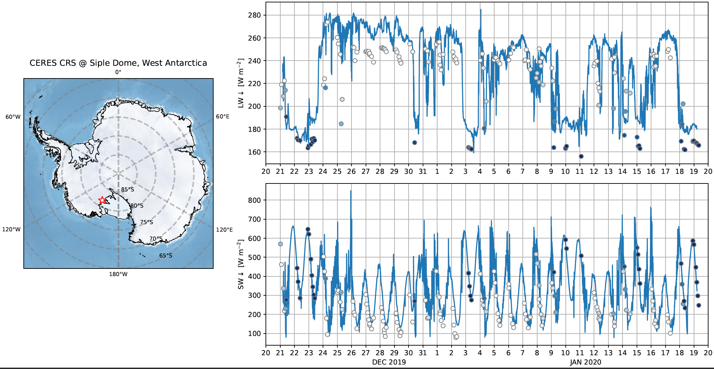
Antarctic Summer CRS Surface
Flux Validation @ Siple Dome
LW↓
SW↓
0 CERES MODIS Ed4 Cloud Fraction 1
Lubin et al. measurements (Scripps/UCSD)
Good clear-sky SW↓, cloudy LW↓, but…
Occasional cloud base height errors?
Clear-sky LW↓ : unresolved surface dT/dz > 0
Excessive cloud optical depth (expect to be resolved in Ed5)

Slide 25
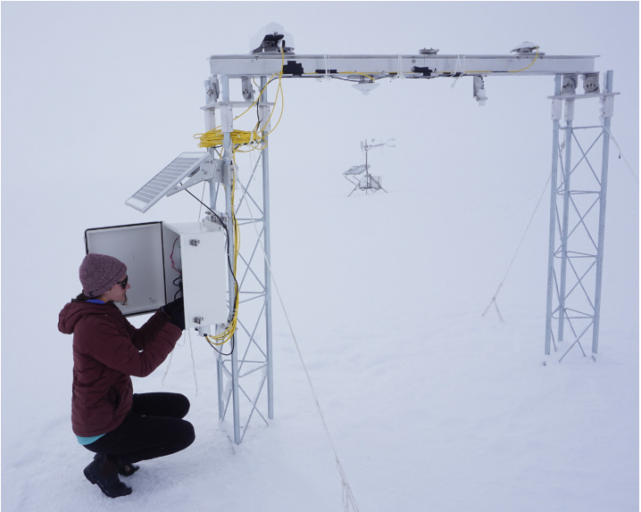
Antarctic Summer CRS Surface
Flux Validation @ Siple Dome
LW↓
Kipp & Zonen
SW & LW radiometers
SW↓
0 CERES MODIS Ed4 Cloud Fraction 1
Lubin et al. measurements (Scripps/UCSD)
Good clear-sky SW↓, cloudy LW↓, but…
Occasional cloud base height errors?
Clear-sky LW↓ : unresolved surface dT/dz > 0
Excessive cloud optical depth (expect to be resolved in Ed5)

Slide 26
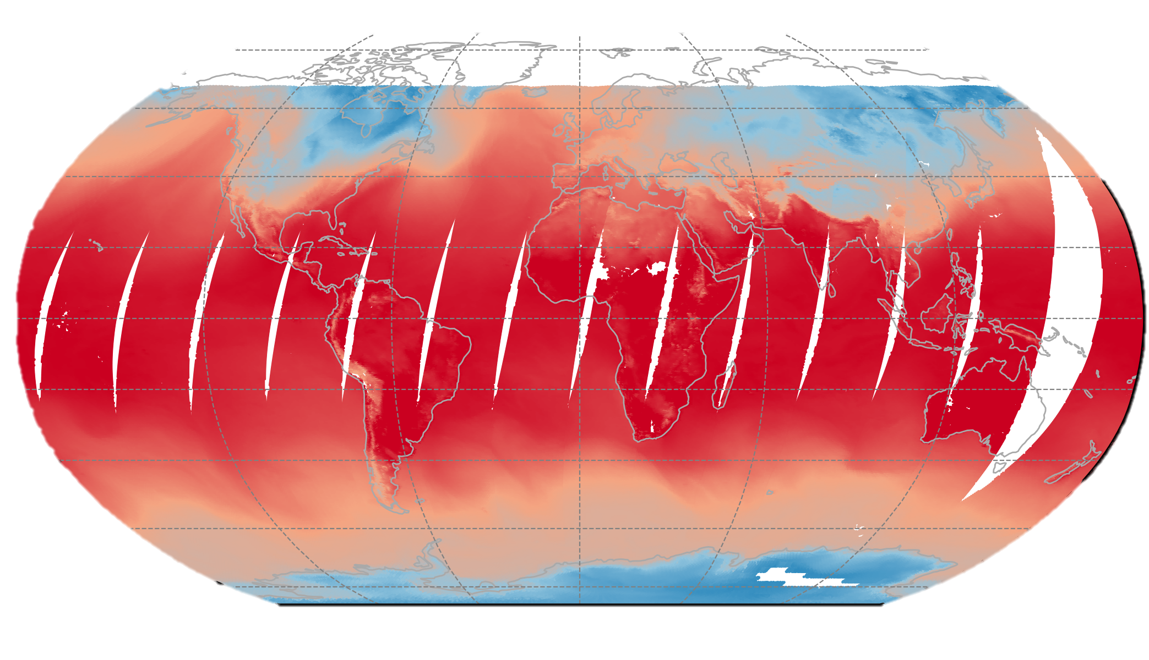
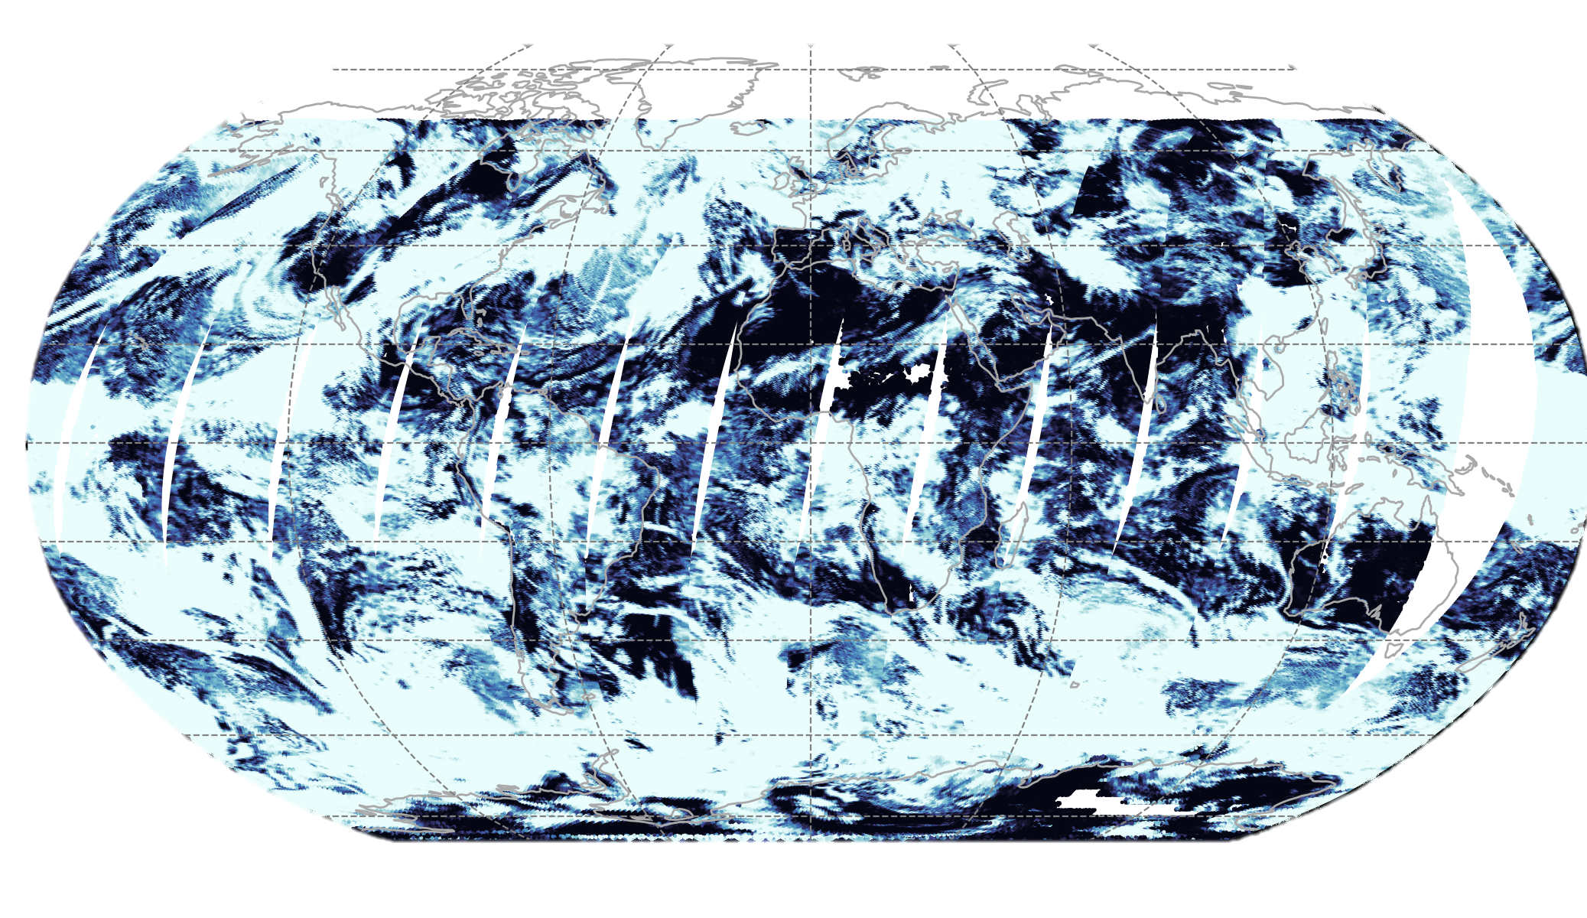
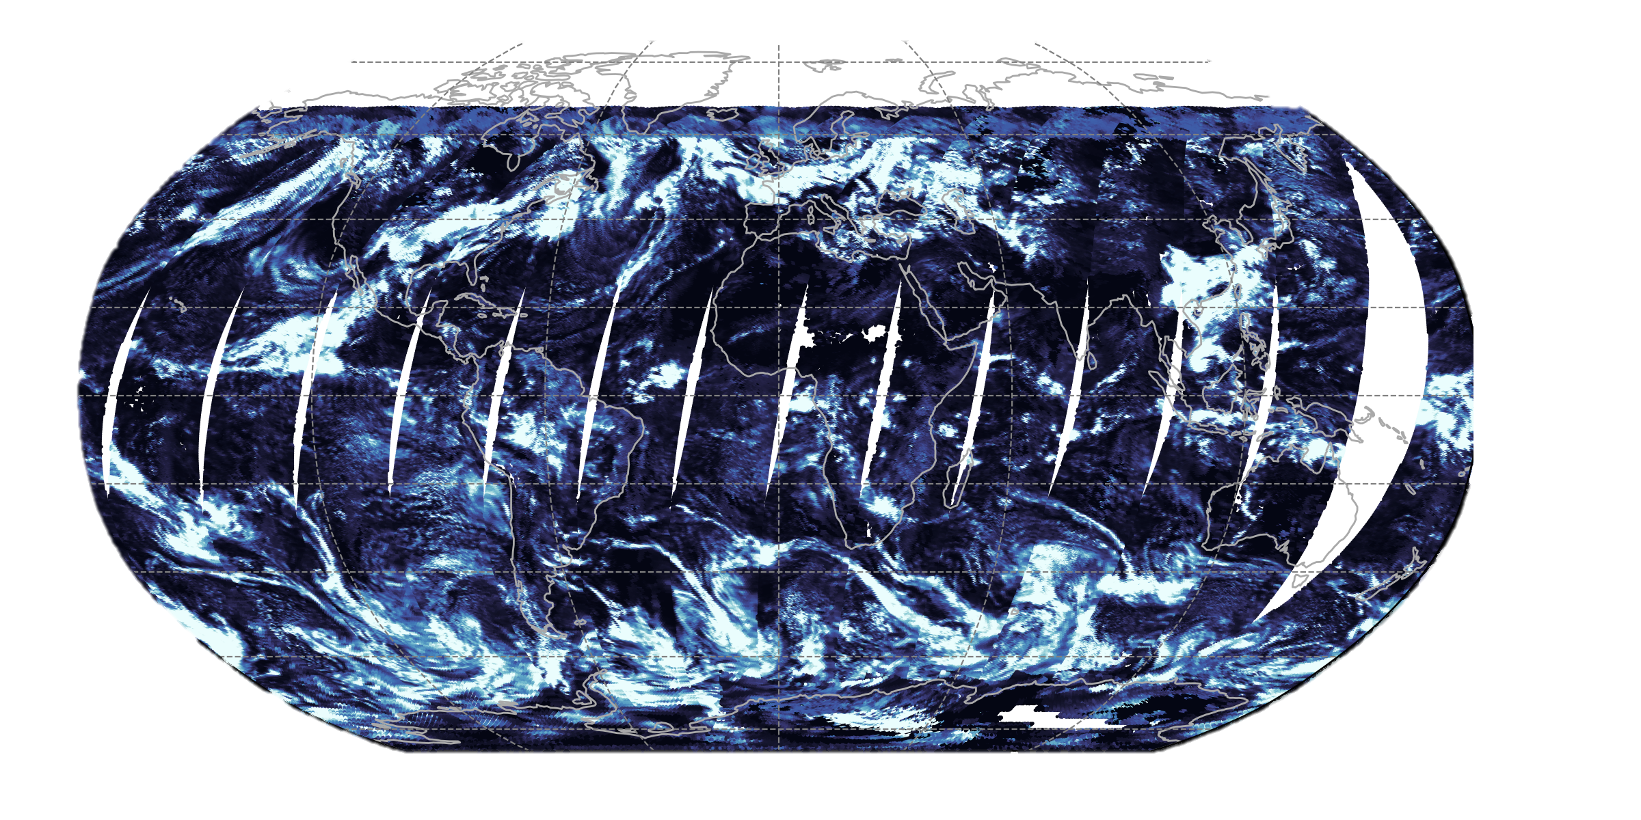
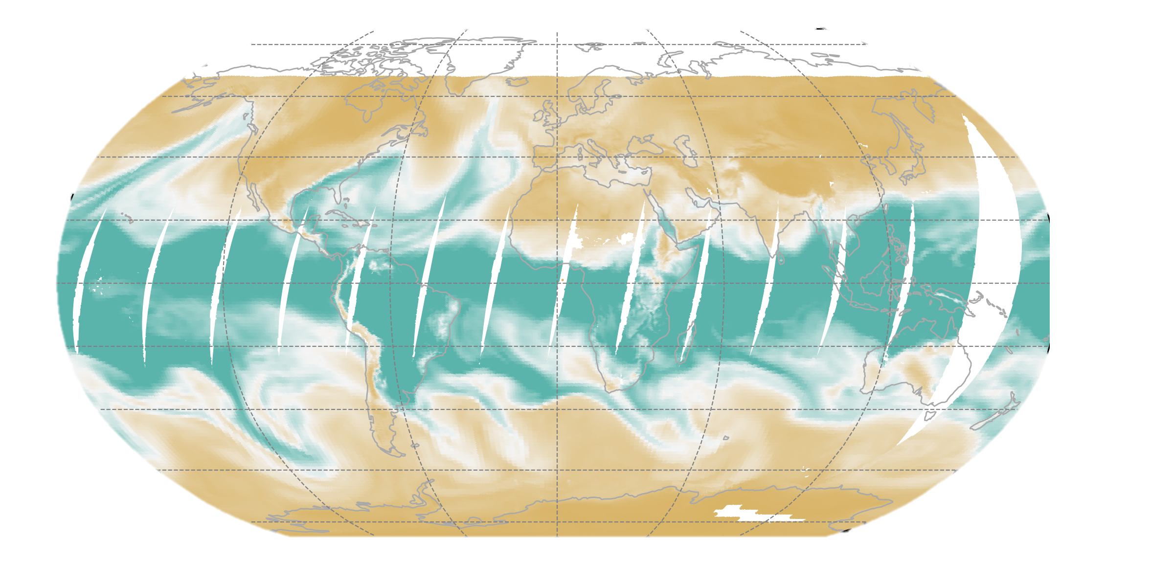
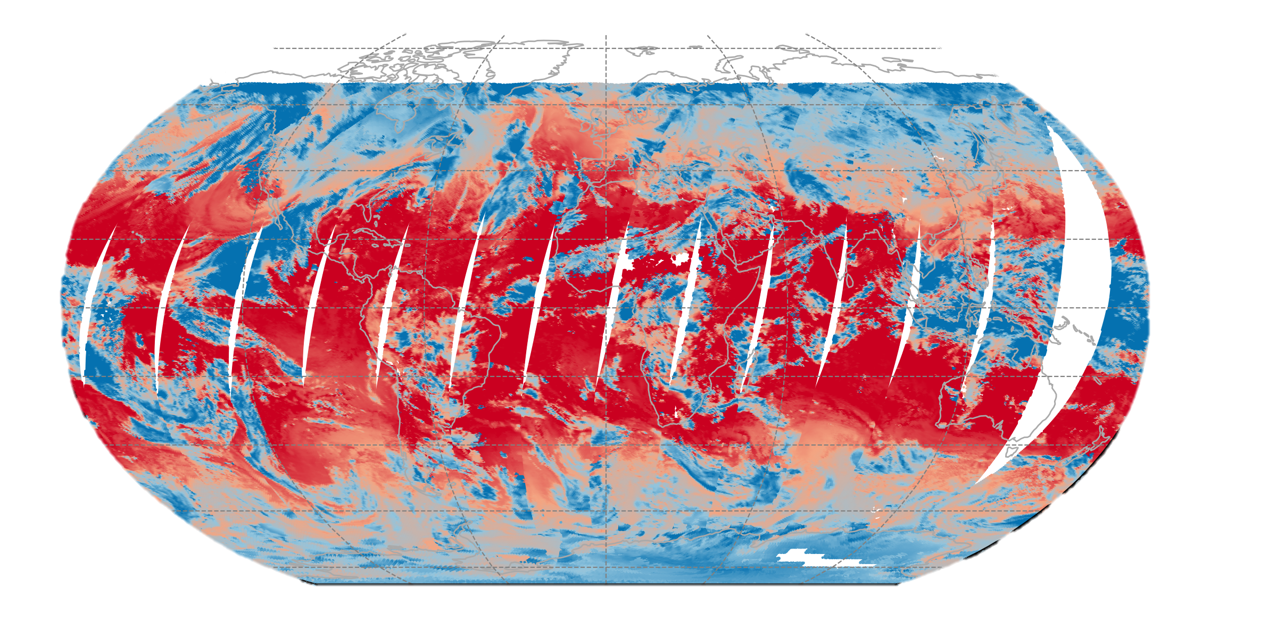
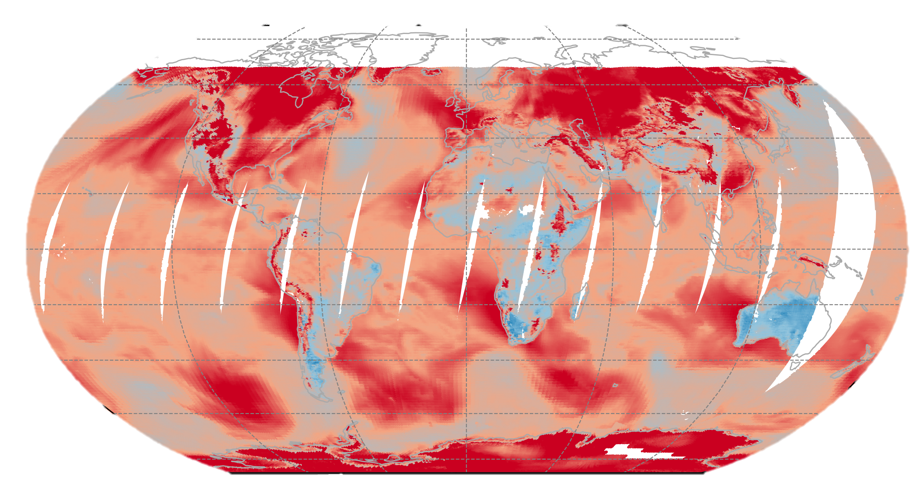
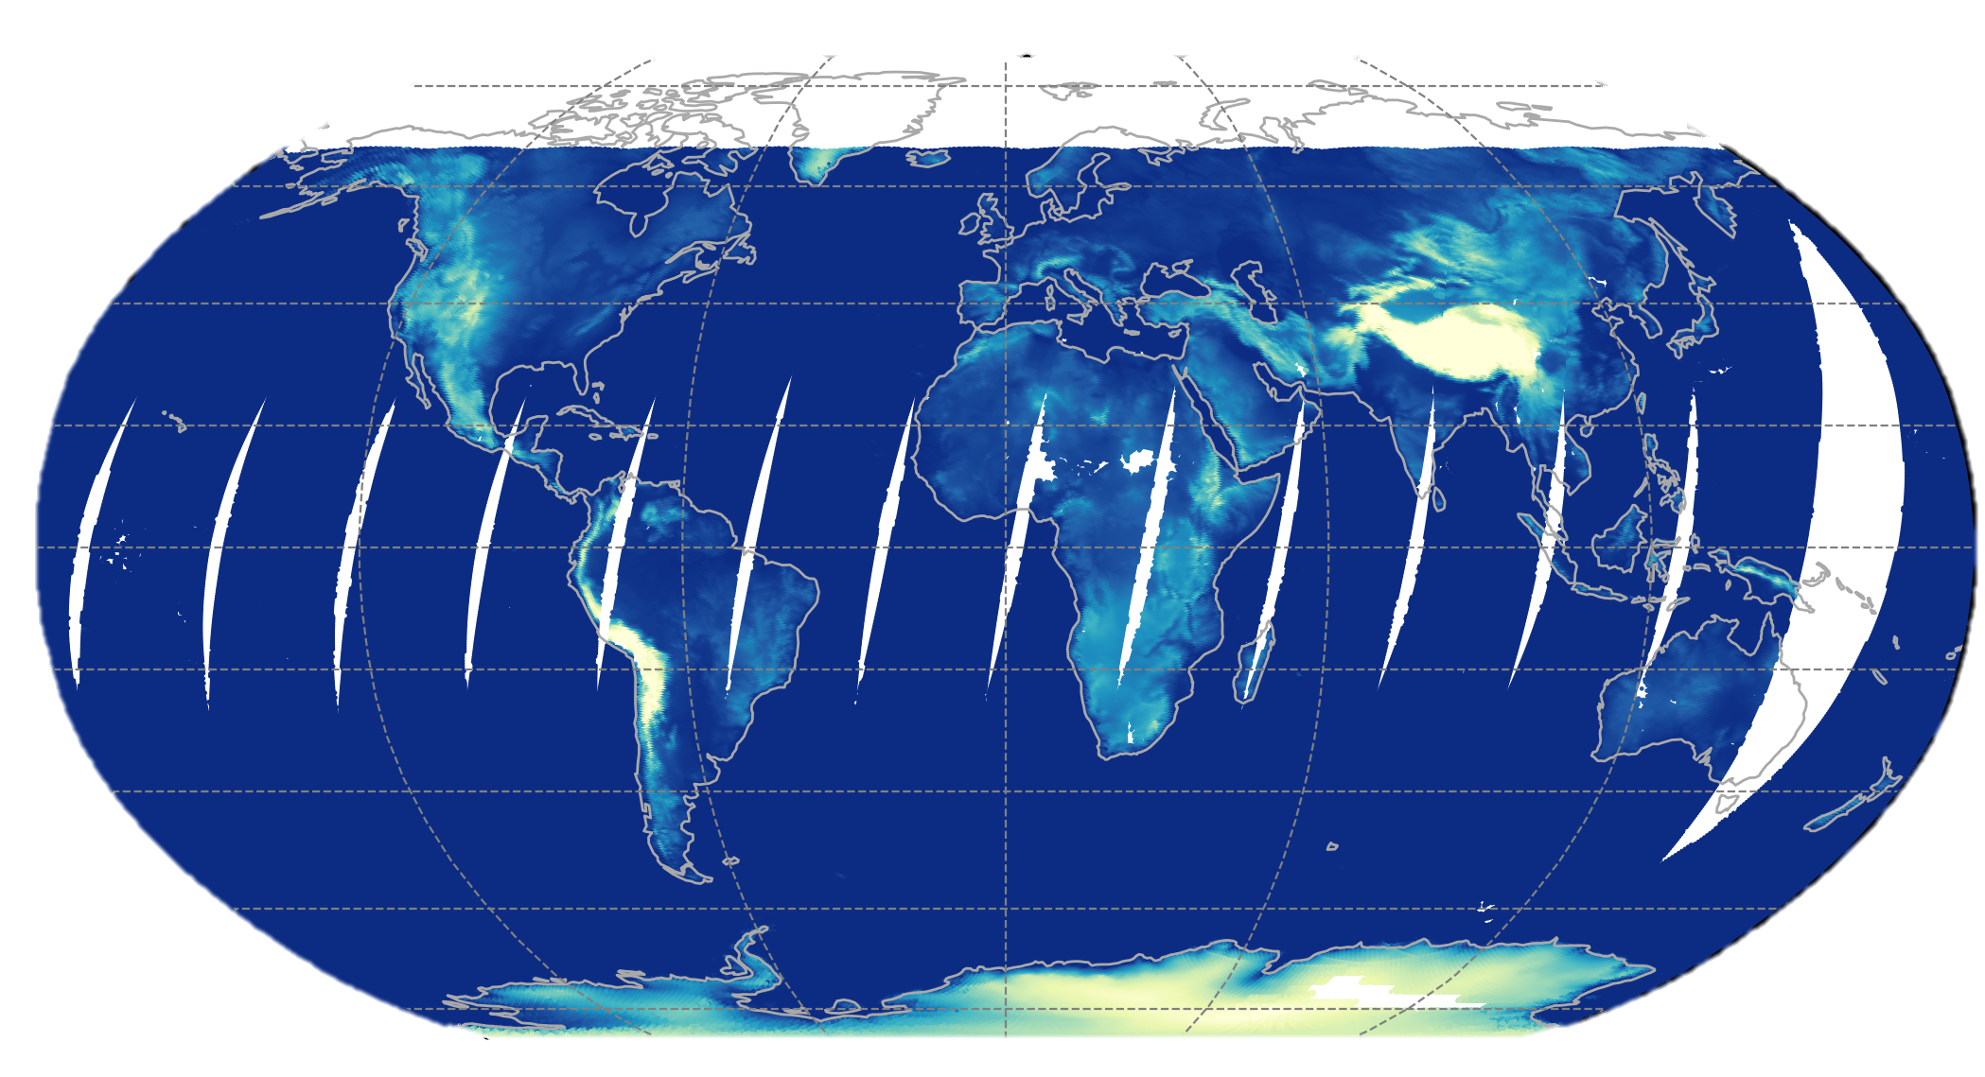
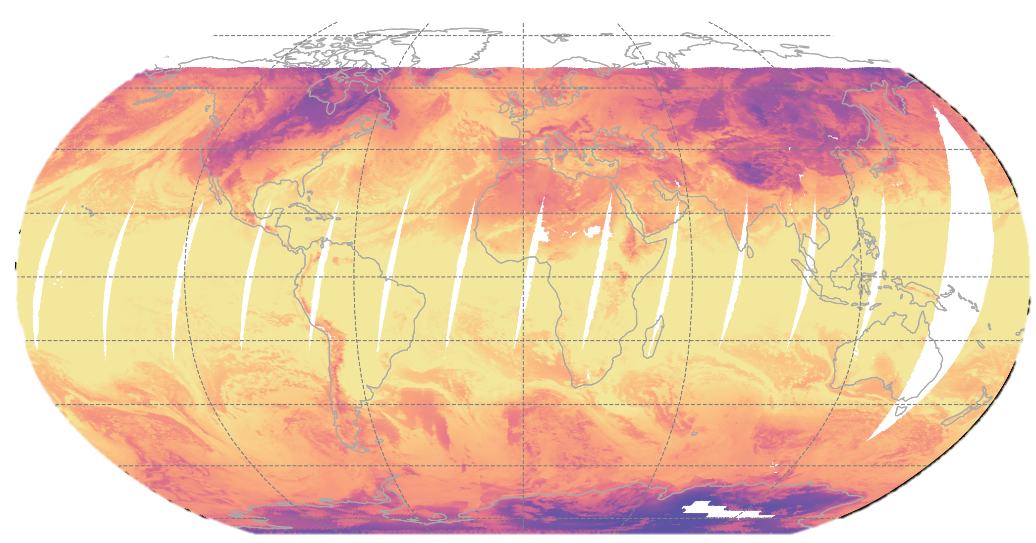
Eff. Emission Temperature (T)
Cloud Fraction (CF)
Cloud Optical Depth (COD)
Precipitable Water Vapor (PWV)
Eff. Cloud Temperature (CT)
Lower Tropospheric Stability (LTS)
Surface Altitude (ALT)
Provides functional mappings between meteorological parameters
that are physically relevant and readily available in the FLASHFlux data processing stream & the CRS flux
Supervised ML Algorithms:
Random Forest
Deep Neural Network
XGBoost
Standardize X prior to training
Train on day & night footprints for multiple days from same month of the previous year
Evaluate generalization performance & tune hyperparameters using:
K-Fold Cross Validation (CV)
Randomized Grid Search CV
X =
T, CF, COD, CT, PWV, LTS, ALT
Surface Longwave Flux (LW↓)
LW↓ = f_{i} (X)
iii. CRS / FLASHFlux Machine Learning

Slide 27
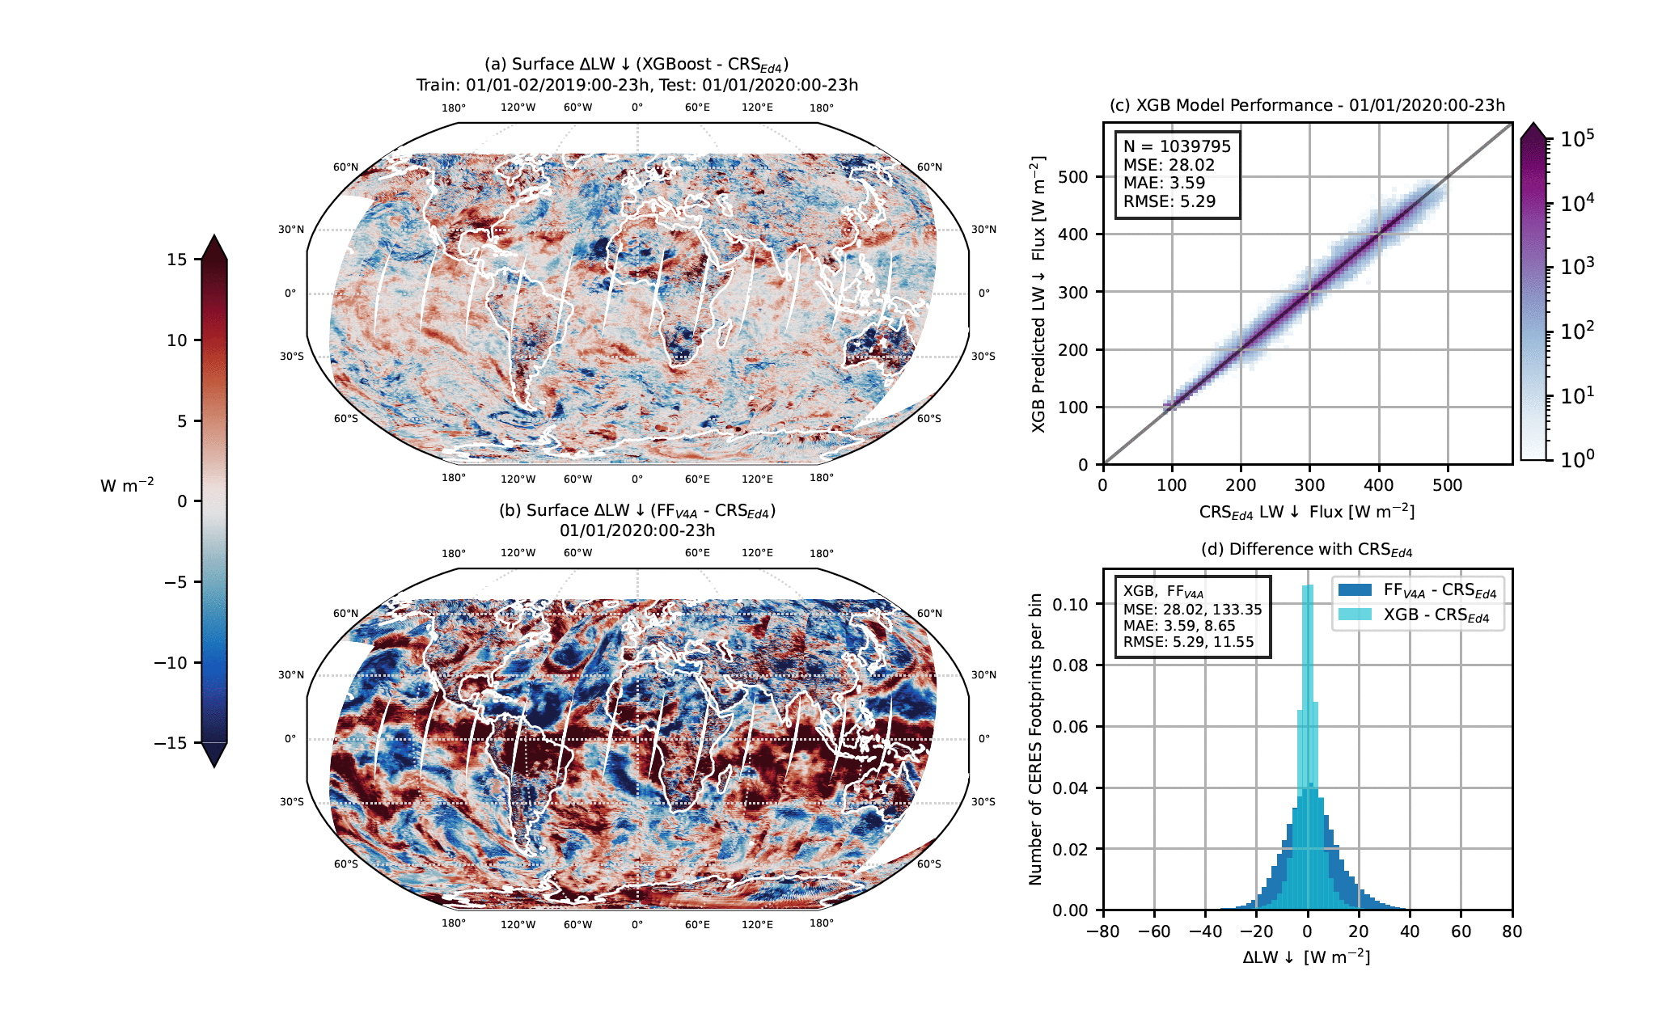
LW↓

Slide 28
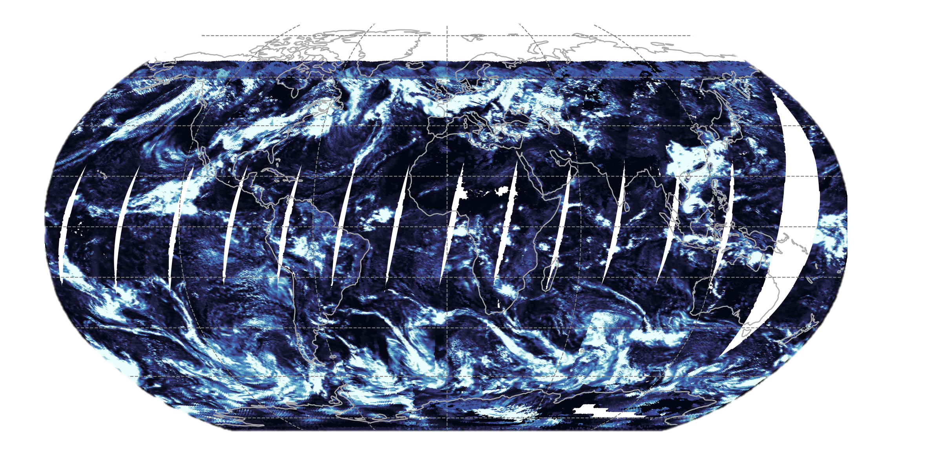
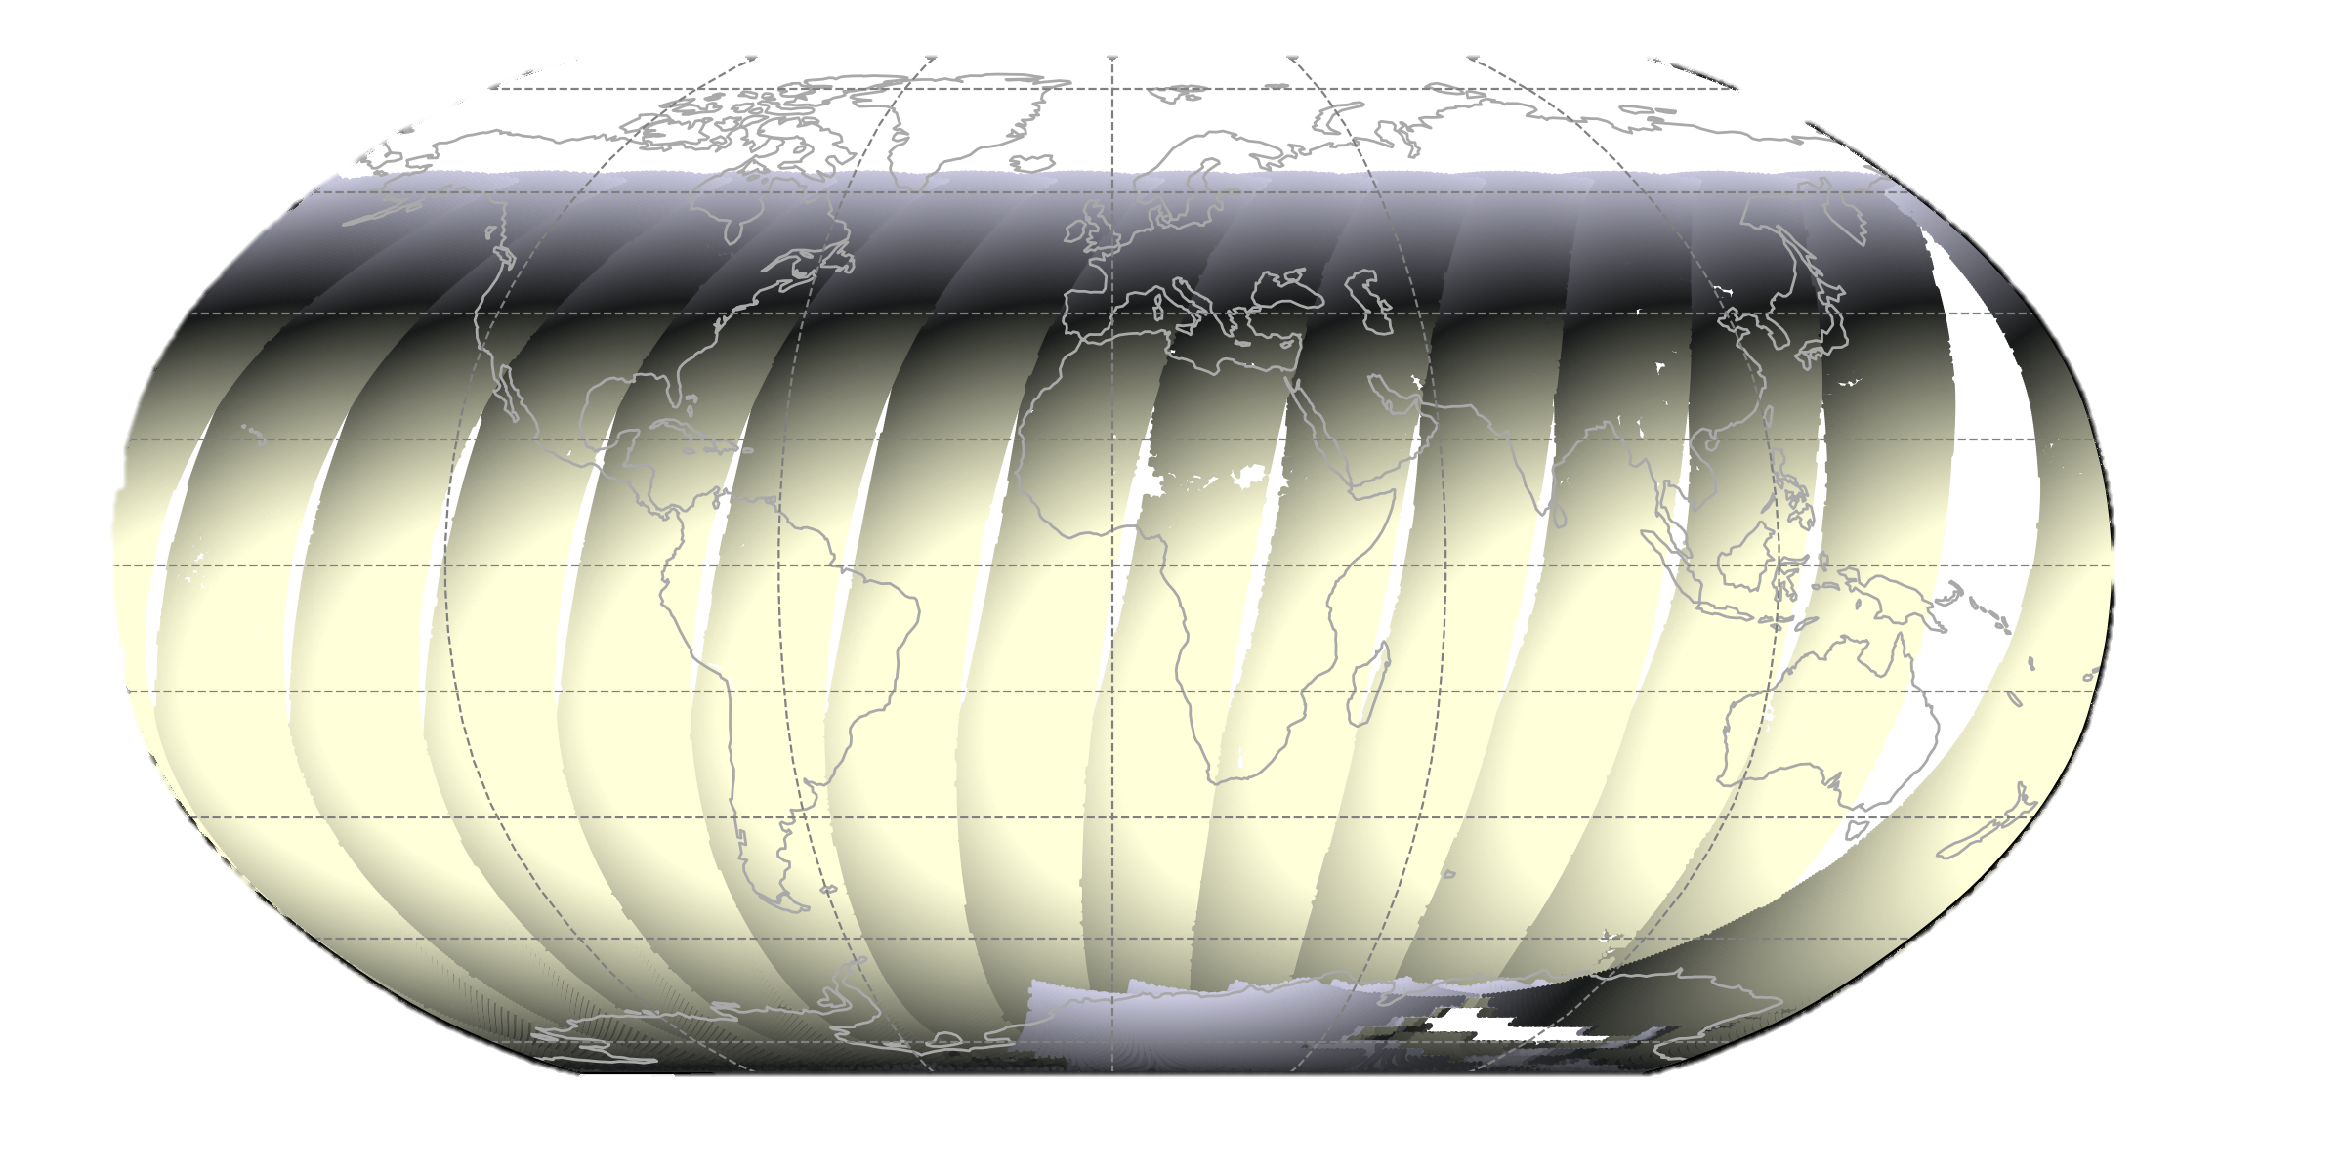
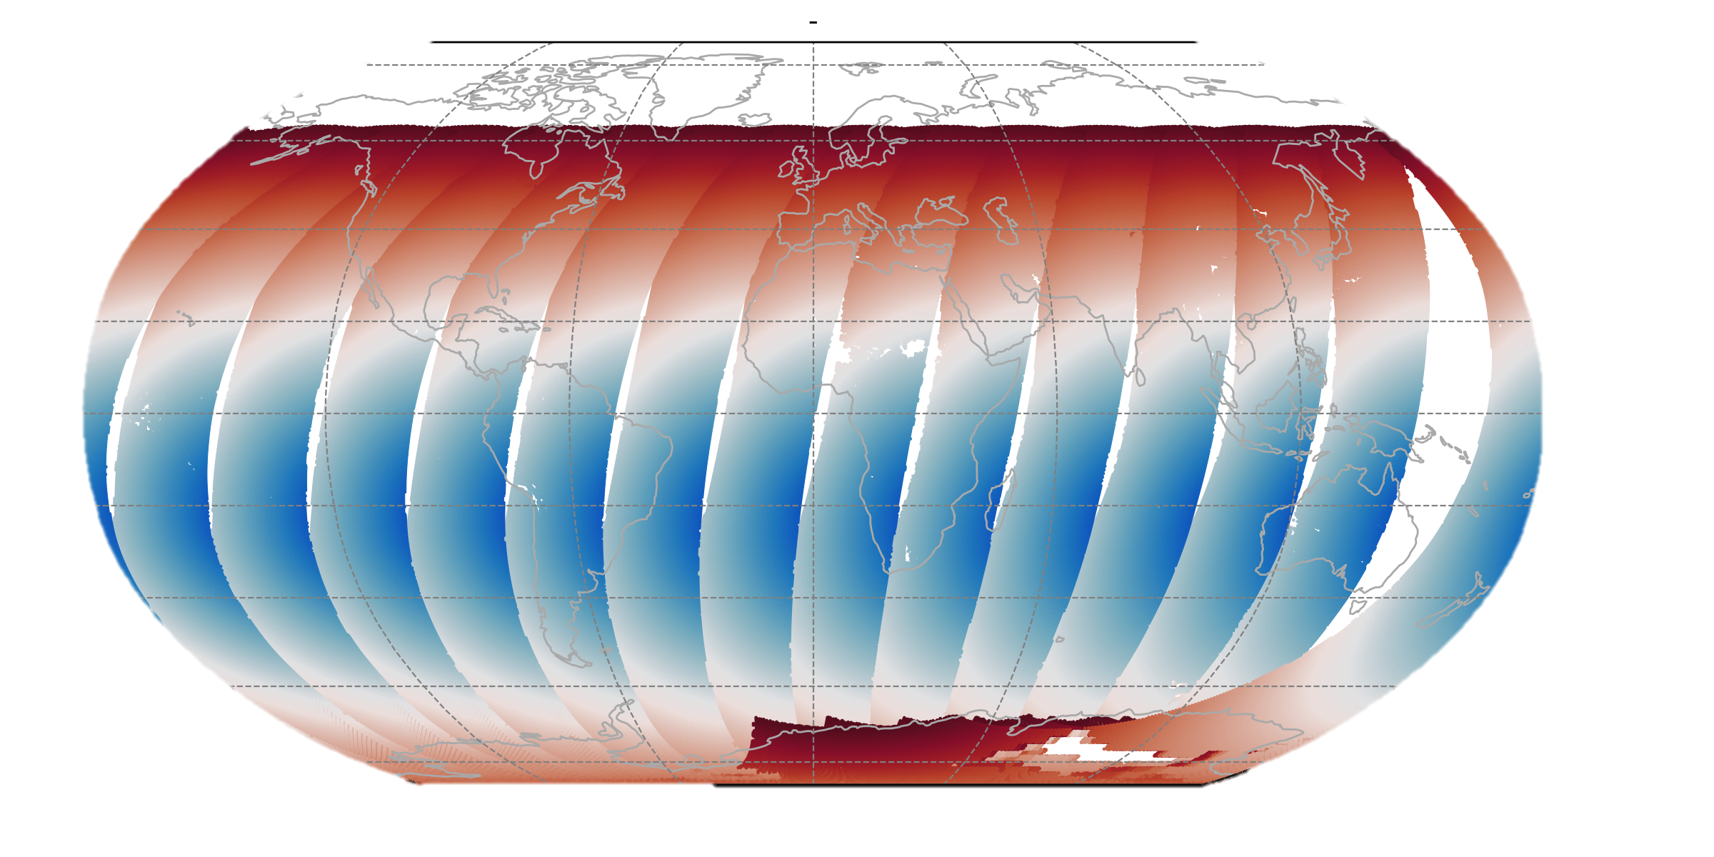
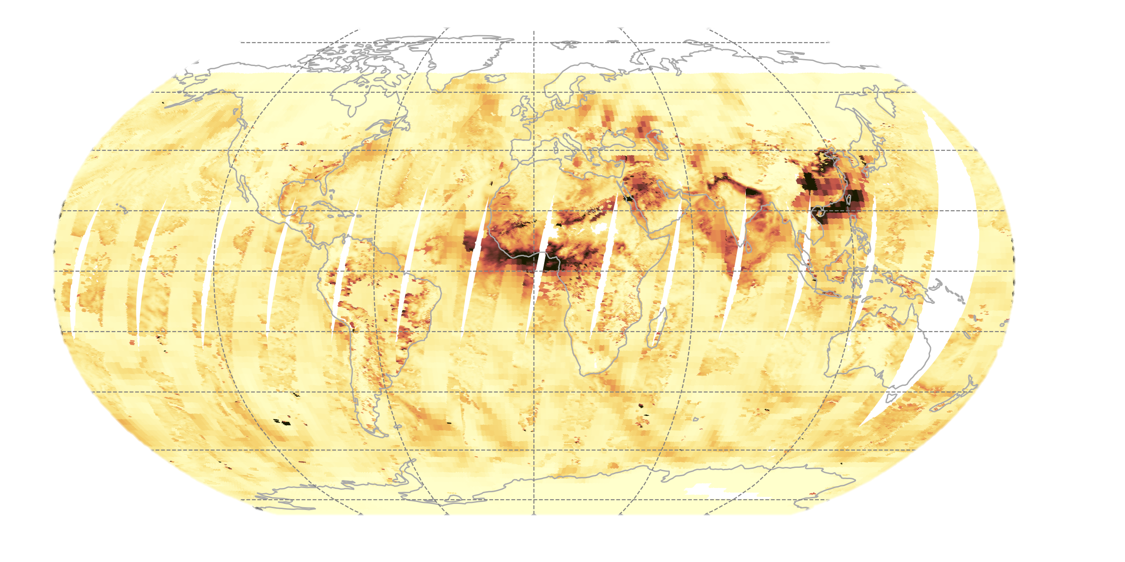
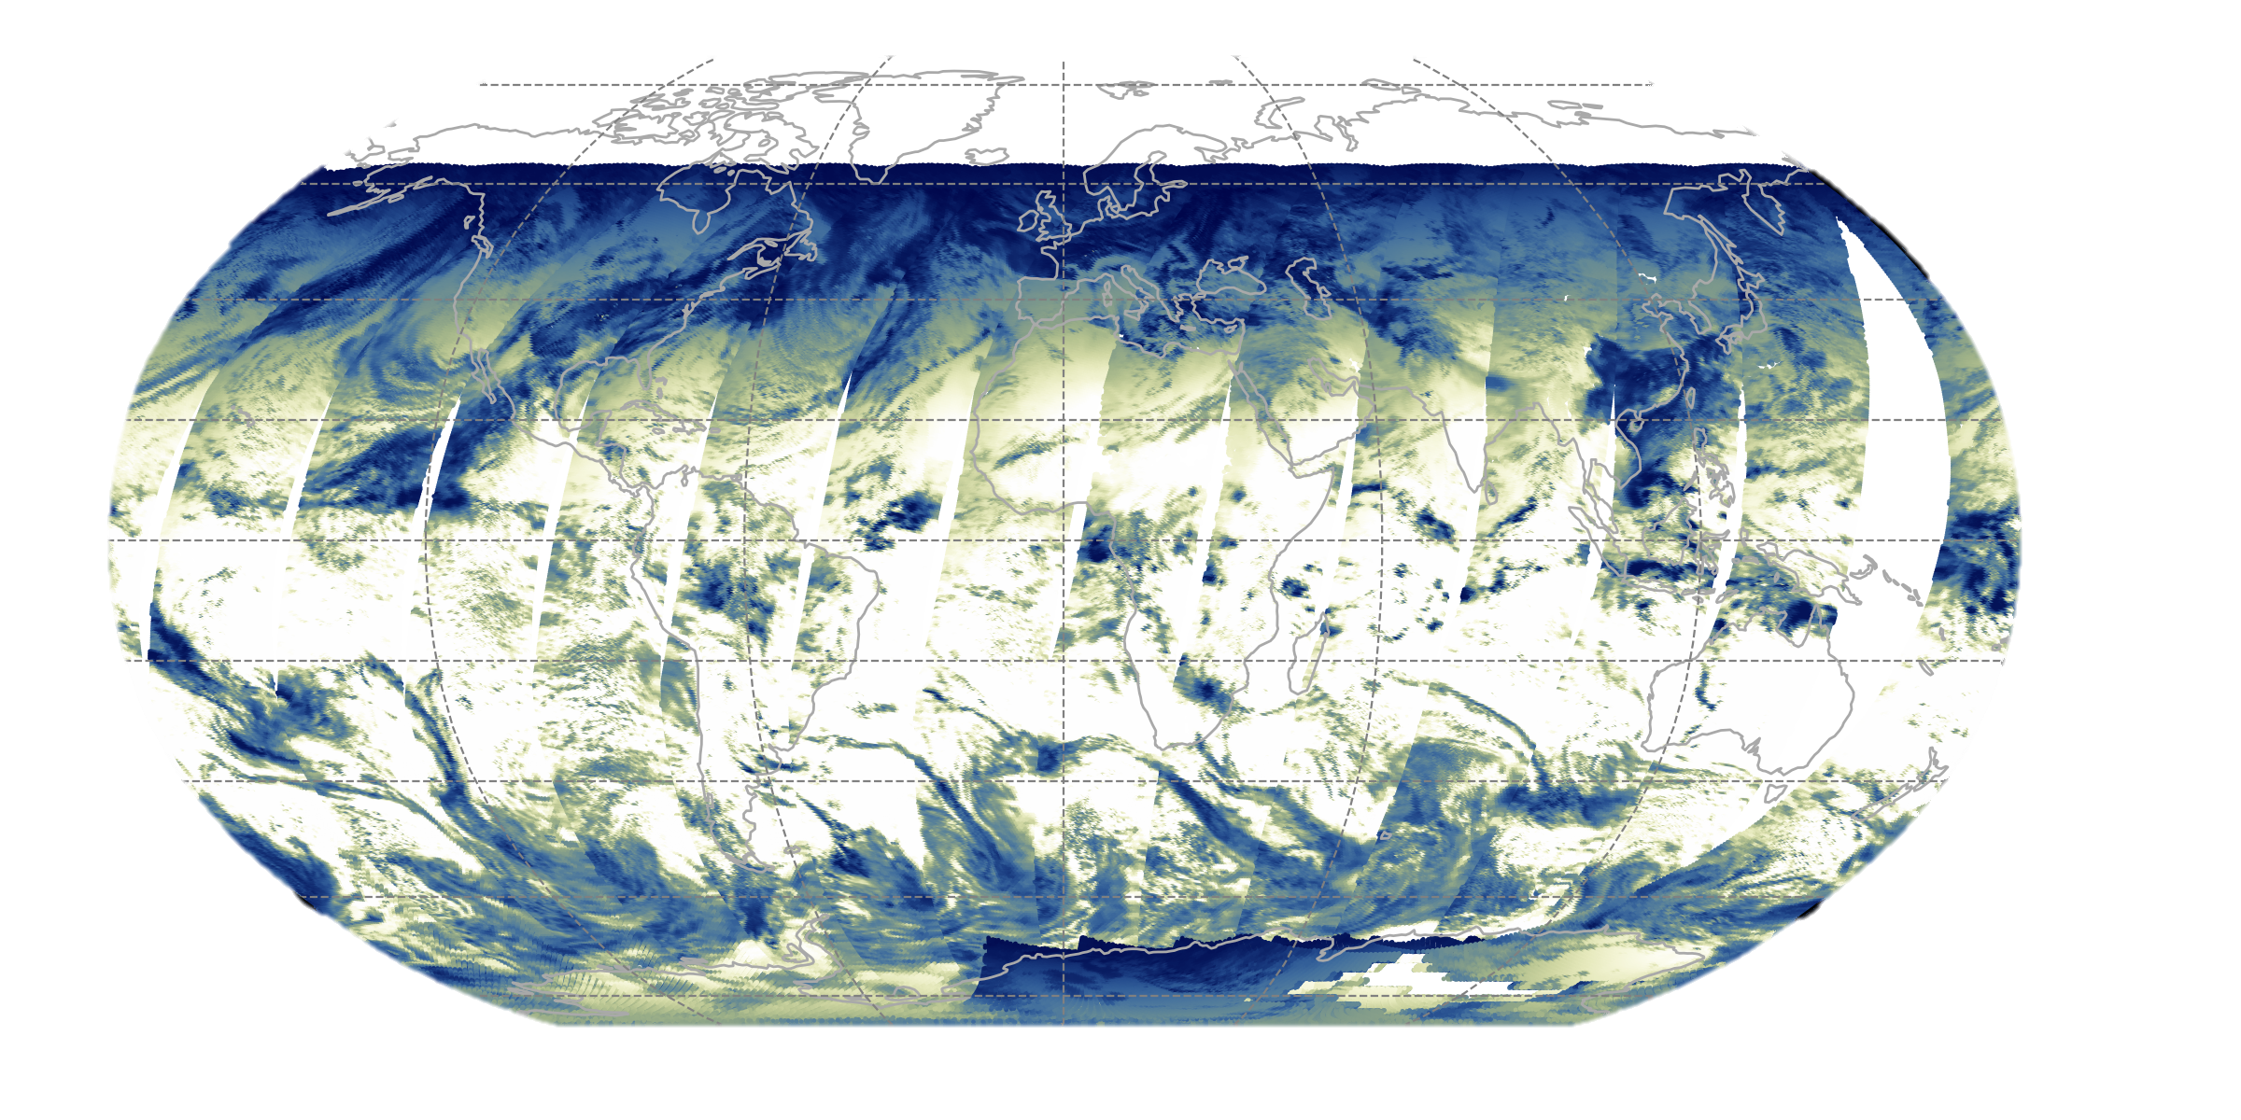
Cloud Fraction (CF)
Cloud Optical Depth (COD)
TOA Insolation (INS)
Solar Zenith Angle (SZA)
Precipitable Water Vapor (PWV)
Aerosol Optical Depth (AOD)
Surface Altitude (ALT)
Provides functional mappings between meteorological parameters
that are physically relevant and readily available in the FLASHFlux data processing stream & the CRS flux
Supervised ML Algorithms:
Random Forest
Deep Neural Network
XGBoost
Standardize X prior to training
Train using multiple days of daytime footprints only from same month of the previous year
Evaluate generalization performance & tune hyperparameters using:
K-Fold Cross Validation (CV)
Randomized Grid Search CV
X =
INS, SZA, CF, COD, AOD, PWV, ALT
Surface Shortwave Flux (SW↓)
SW↓ = g_{i} (X)
iii. CRS / FLASHFlux Machine Learning

Slide 29
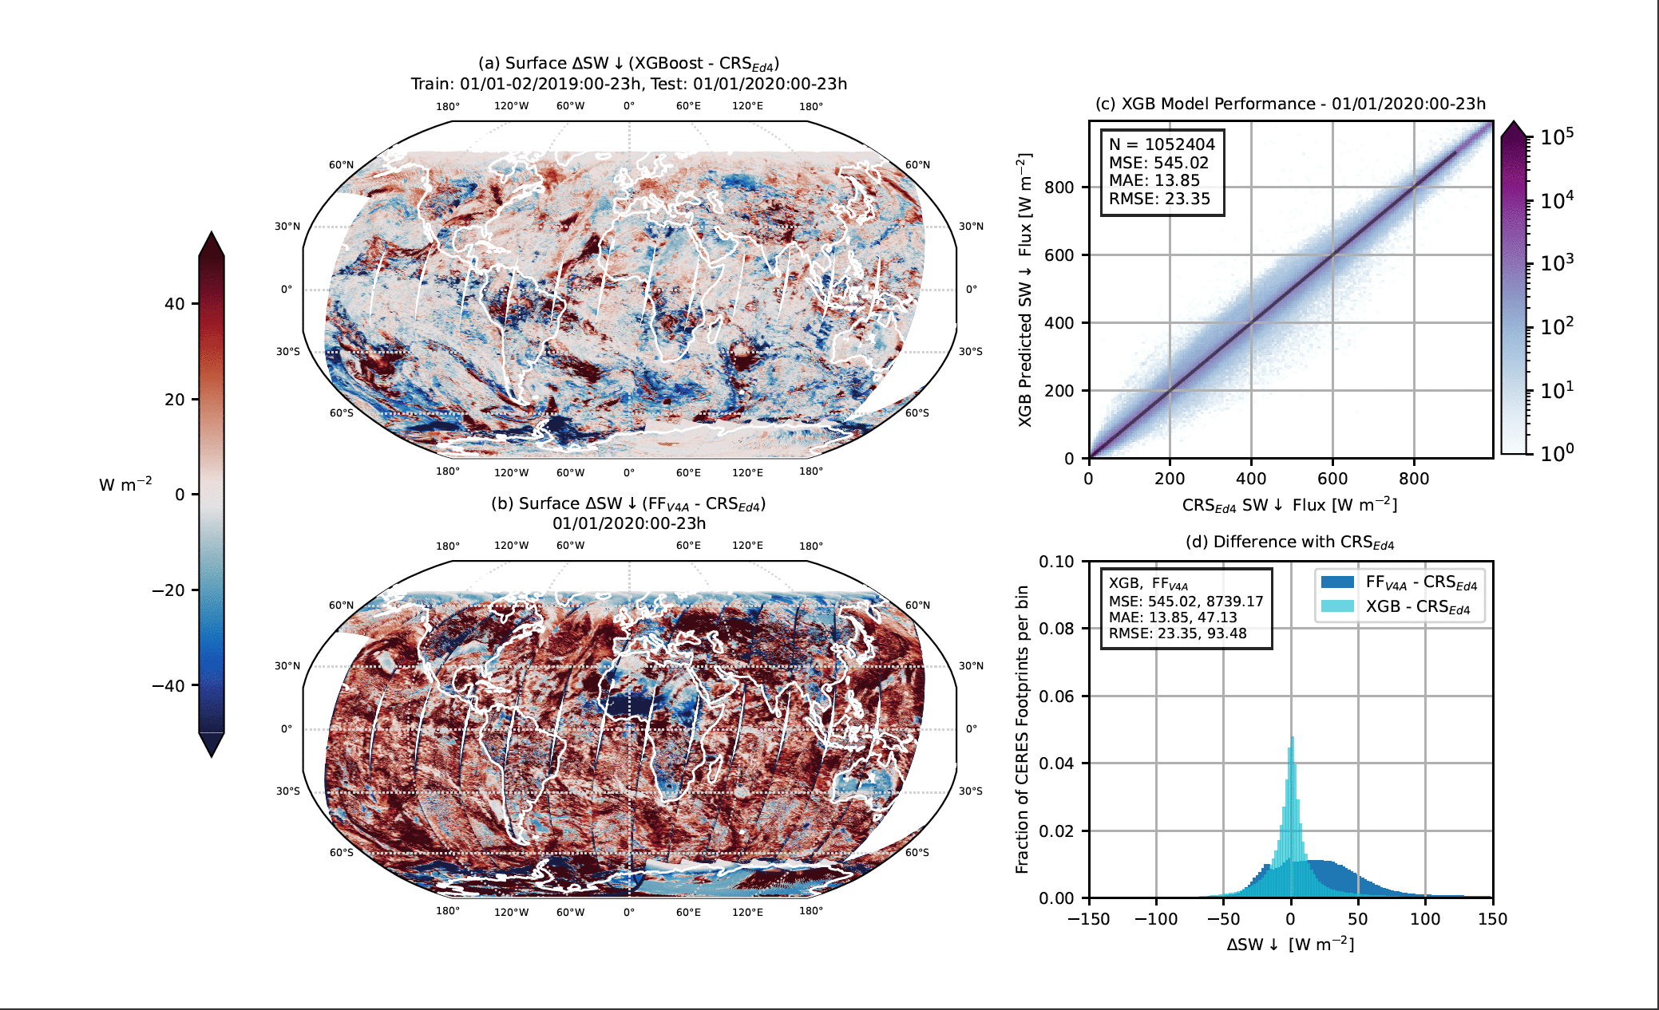
SW↓

Slide 30
Summary & Outlook
CRS generally outperforms SOFA parameterizations available on the CERES/FLASH SSF products (Ed4A, v4A)
Based upon comprehensive validation & comparisons to SOFA Models A, B, & C at a network of 40 surface sites
CRS SW↓ & LW↓ fluxes show lower RMS𝚫 & higher corr. w/ measurements – independent of sky conditions & surface type
In some places/conditions, CRS is often but not always less biased, highlighting a need to refine the CRS flux algorithm
Comparisons with remote polar field measurements in the Arctic & Antarctica show impressive performance
Scott, R. C., F. G. Rose, P. W. Stackhouse, Jr., N. G. Loeb, S. Kato, D. R. Doelling, D. A. Rutan, P. C. Taylor, W. L. Smith, Jr. (2022), Clouds & the Earth’s Radiant Energy System (CERES) Cloud Radiative Swath (CRS) Edition 4 Data Product,
Journal of Atmospheric & Oceanic Technology, in review
We’ve successfully tuned machine learning model hyperparameters & developed a scalable method to provide CRS-quality surface ↓ radiative fluxes in near real-time on the FLASHFlux SSF
Need near real-time fluxes during May 2022? Use models trained on CRS computations for May 2021
Tuned XGBoost SW↓ & LW ↓ fluxes are > 50% closer (global MAE, RMSE) to CRS than FF SSF Model B fluxes are
Beginning to work w/ FLASHFlux team to integrate models into production
Next steps: (1) predict fluxes in near real-time using FLASHFlux-derived meteorological predictors X_{FLASH}
(2) validate the fluxes to confirm performance enhancements & refine algorithms as necessary
CRS data will be released (ahead of schedule) as part of Ed4 for a 5-year period (2017-2021)
Terra FM1 & Aqua FM3 data will be accompanied by the above publication & Data Quality Summary (in progress)
Thank You!
Spring 2022 CERES Science Team Meeting
ryan.c.scott@nasa.gov

Slide 31
Extra Slides
Spring 2022 CERES Science Team Meeting
ryan.c.scott@nasa.gov

Slide 32
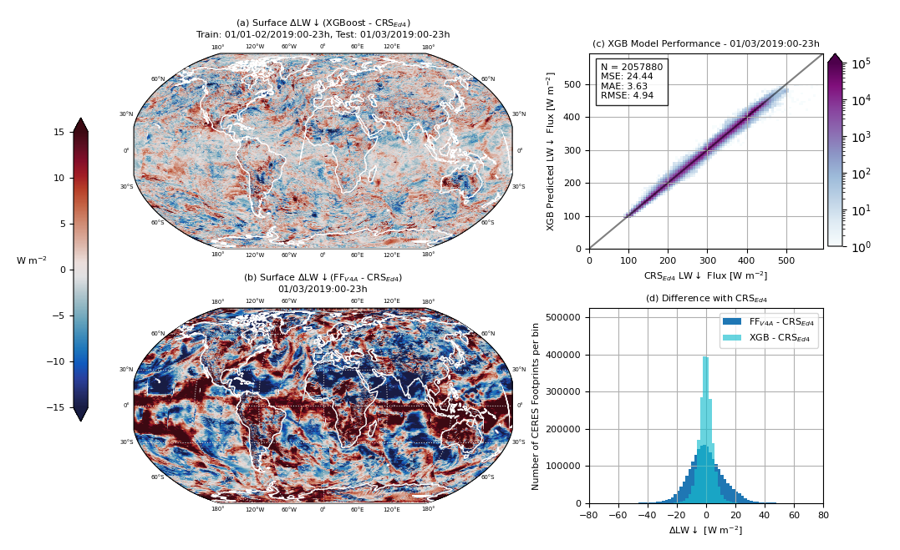
Hyperparameter Tuning Improves Generalization Performance
LW↓
XGBoost untuned

Slide 33
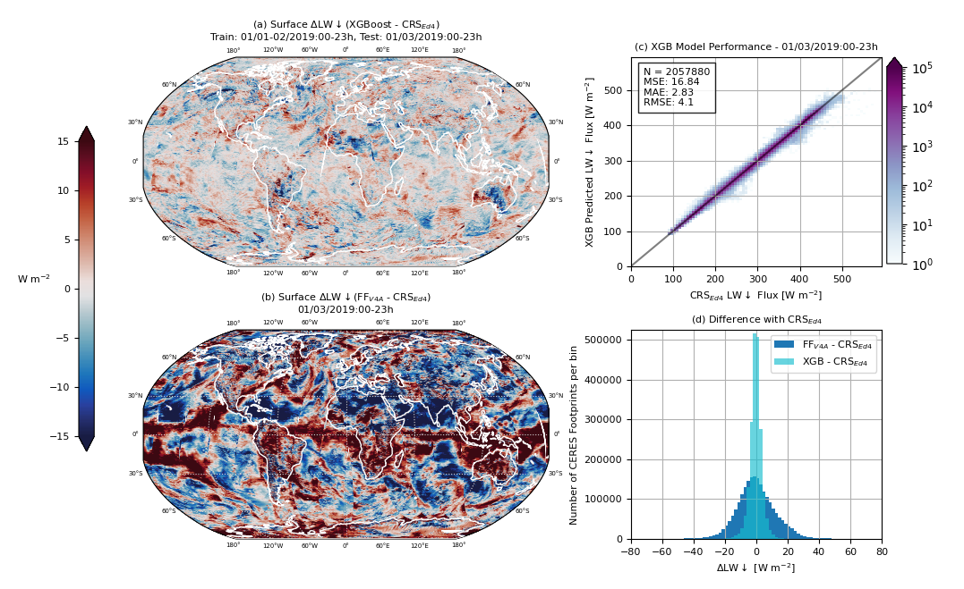
LW↓
XGBoost tuned

