Slide 1


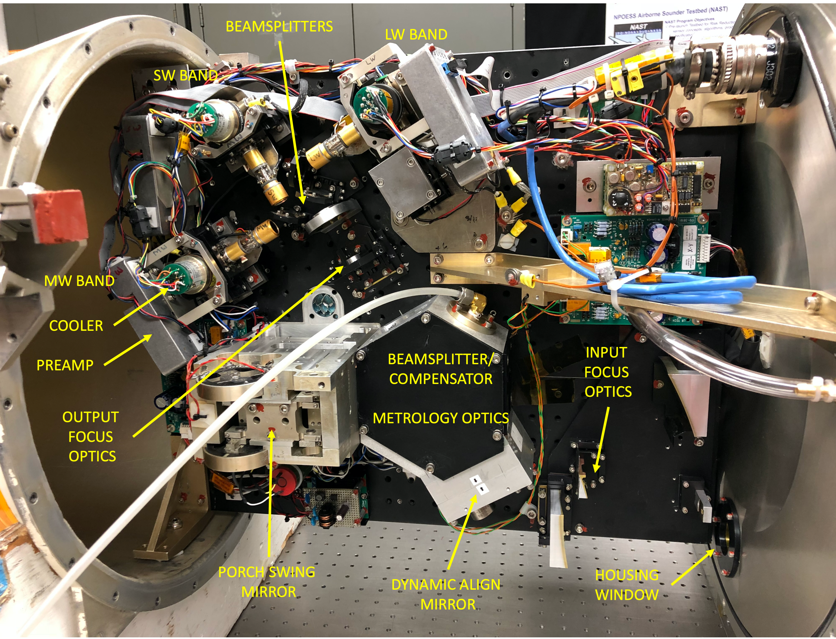
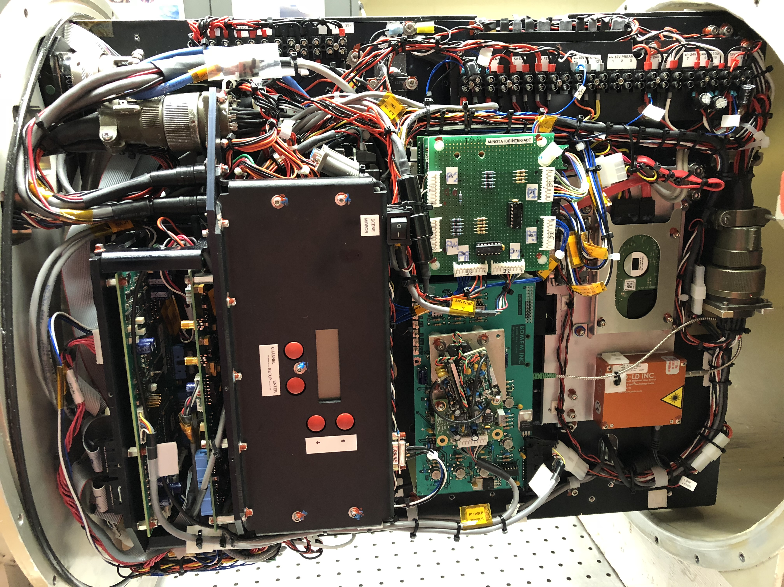
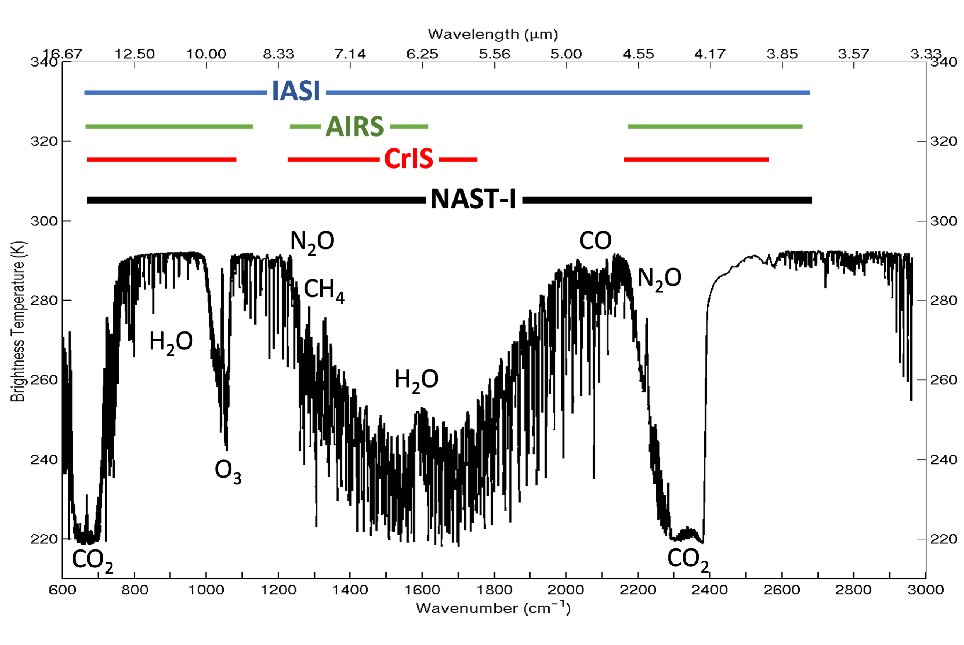
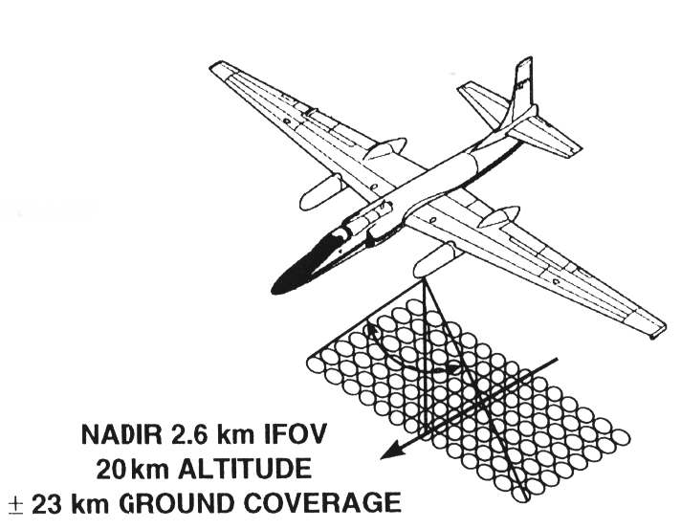
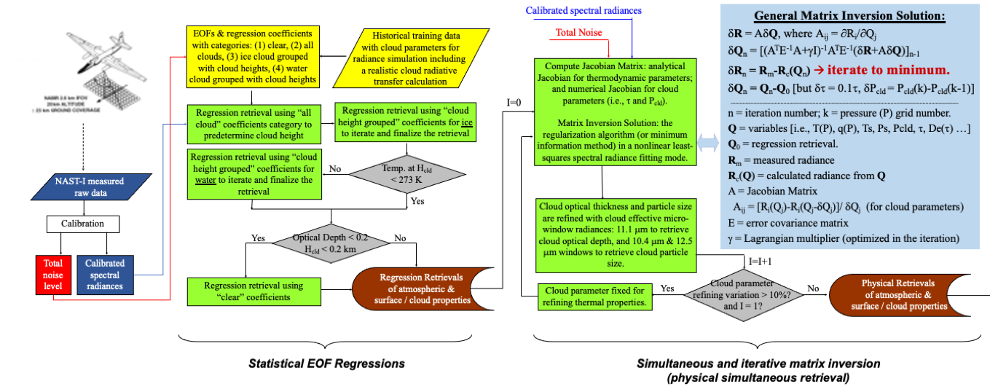
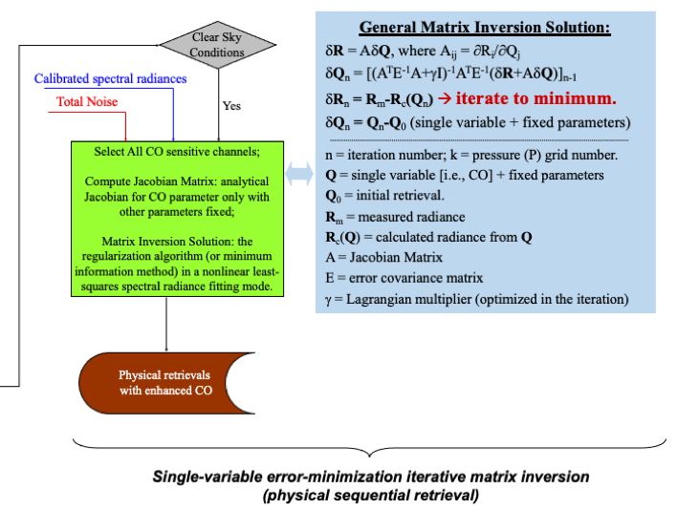
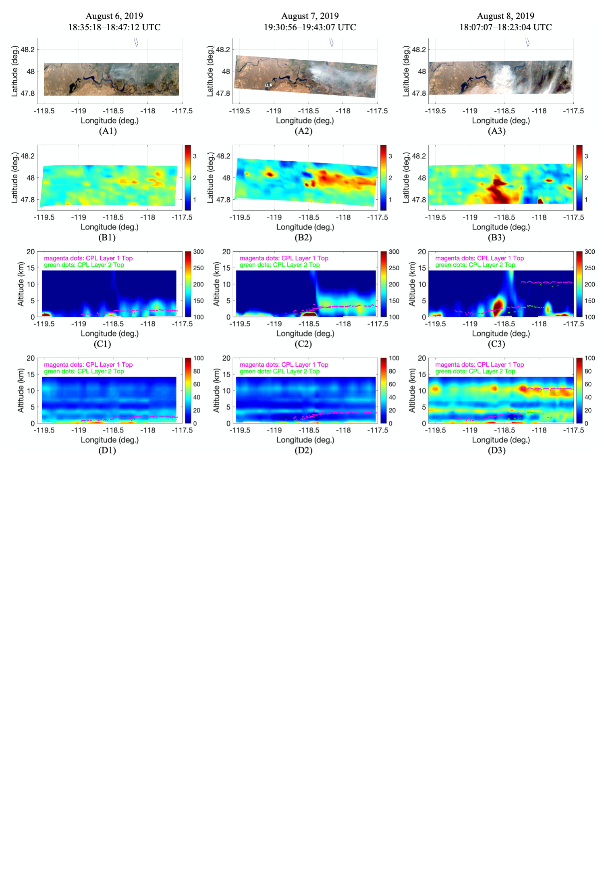
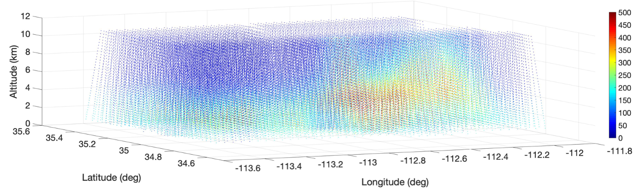
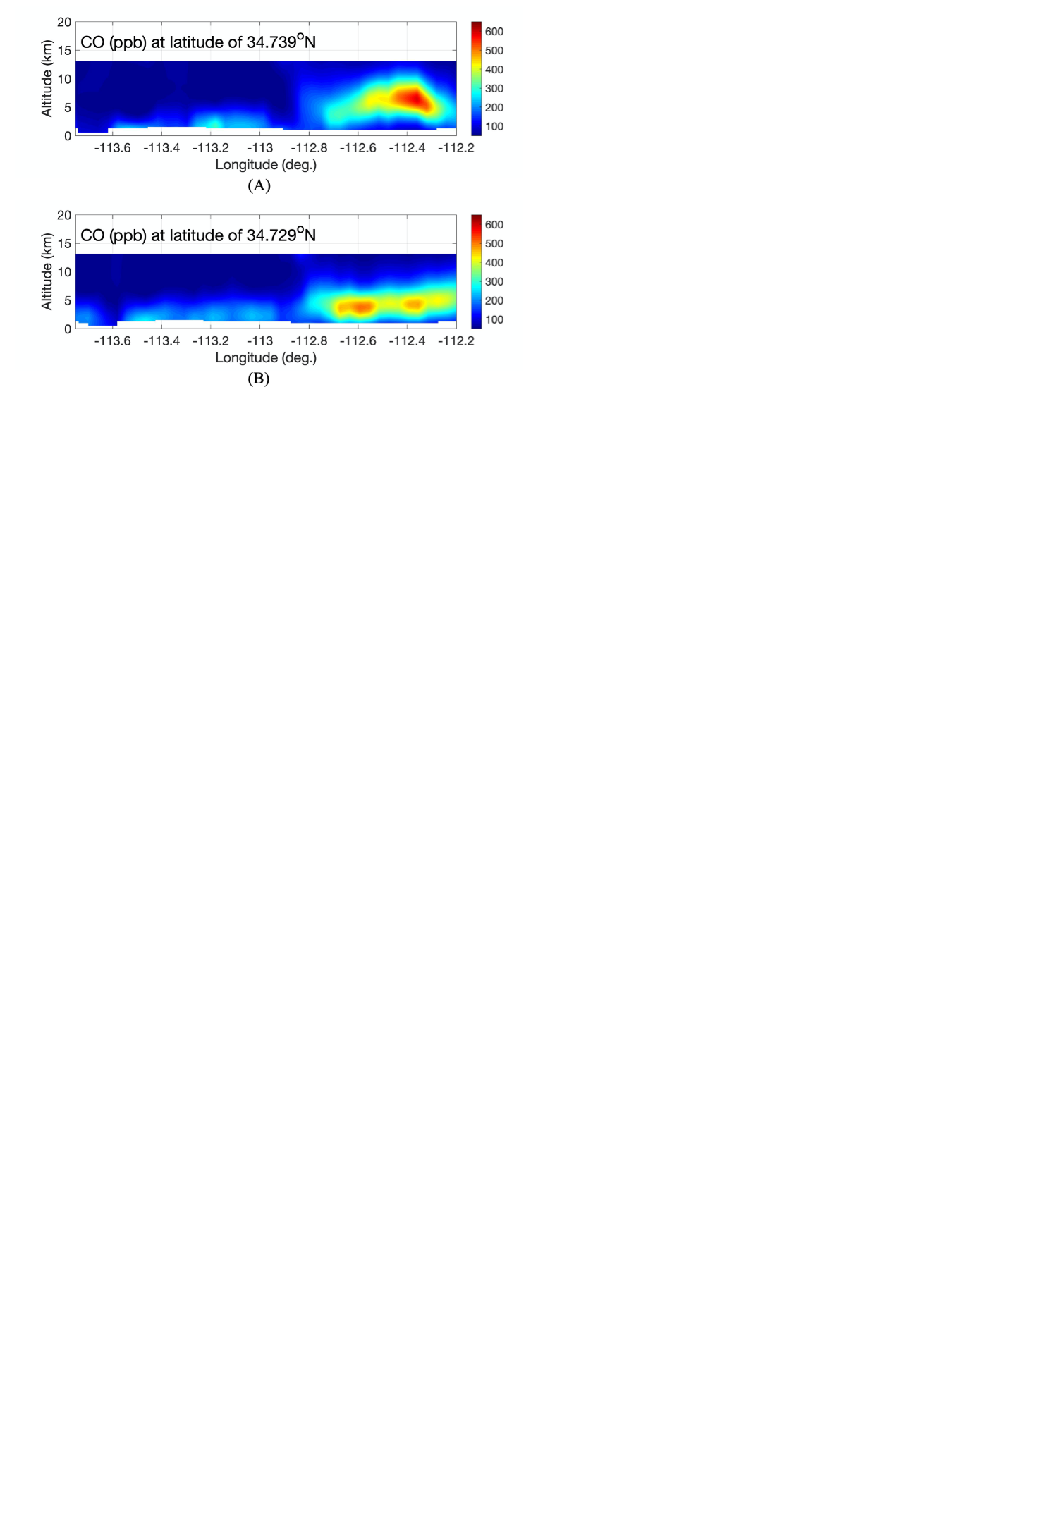
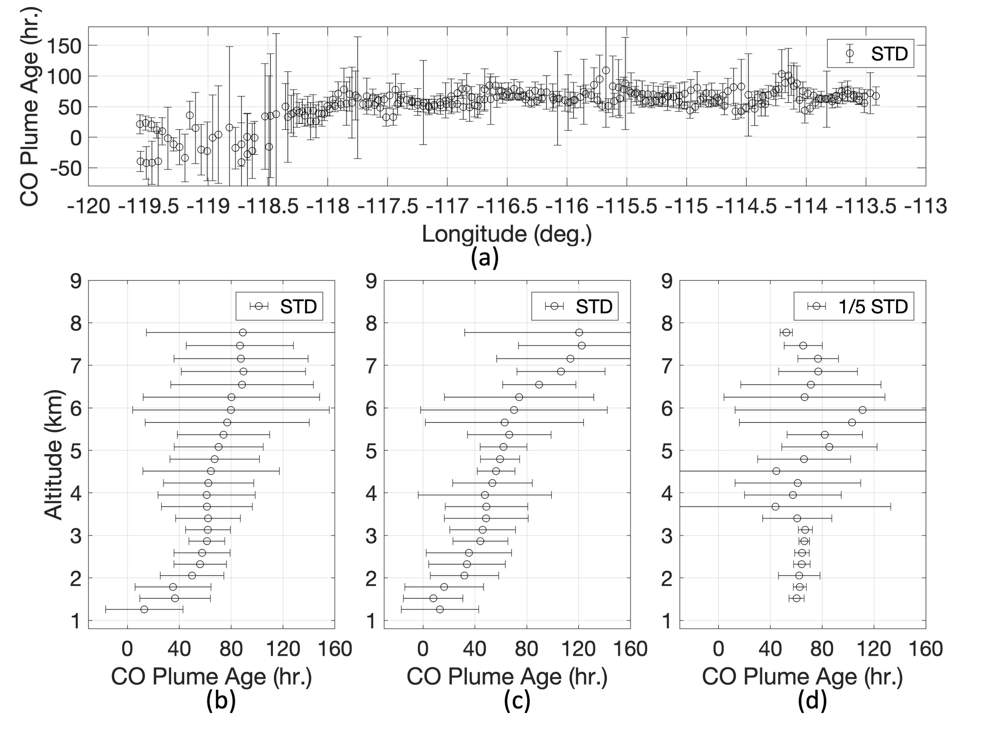
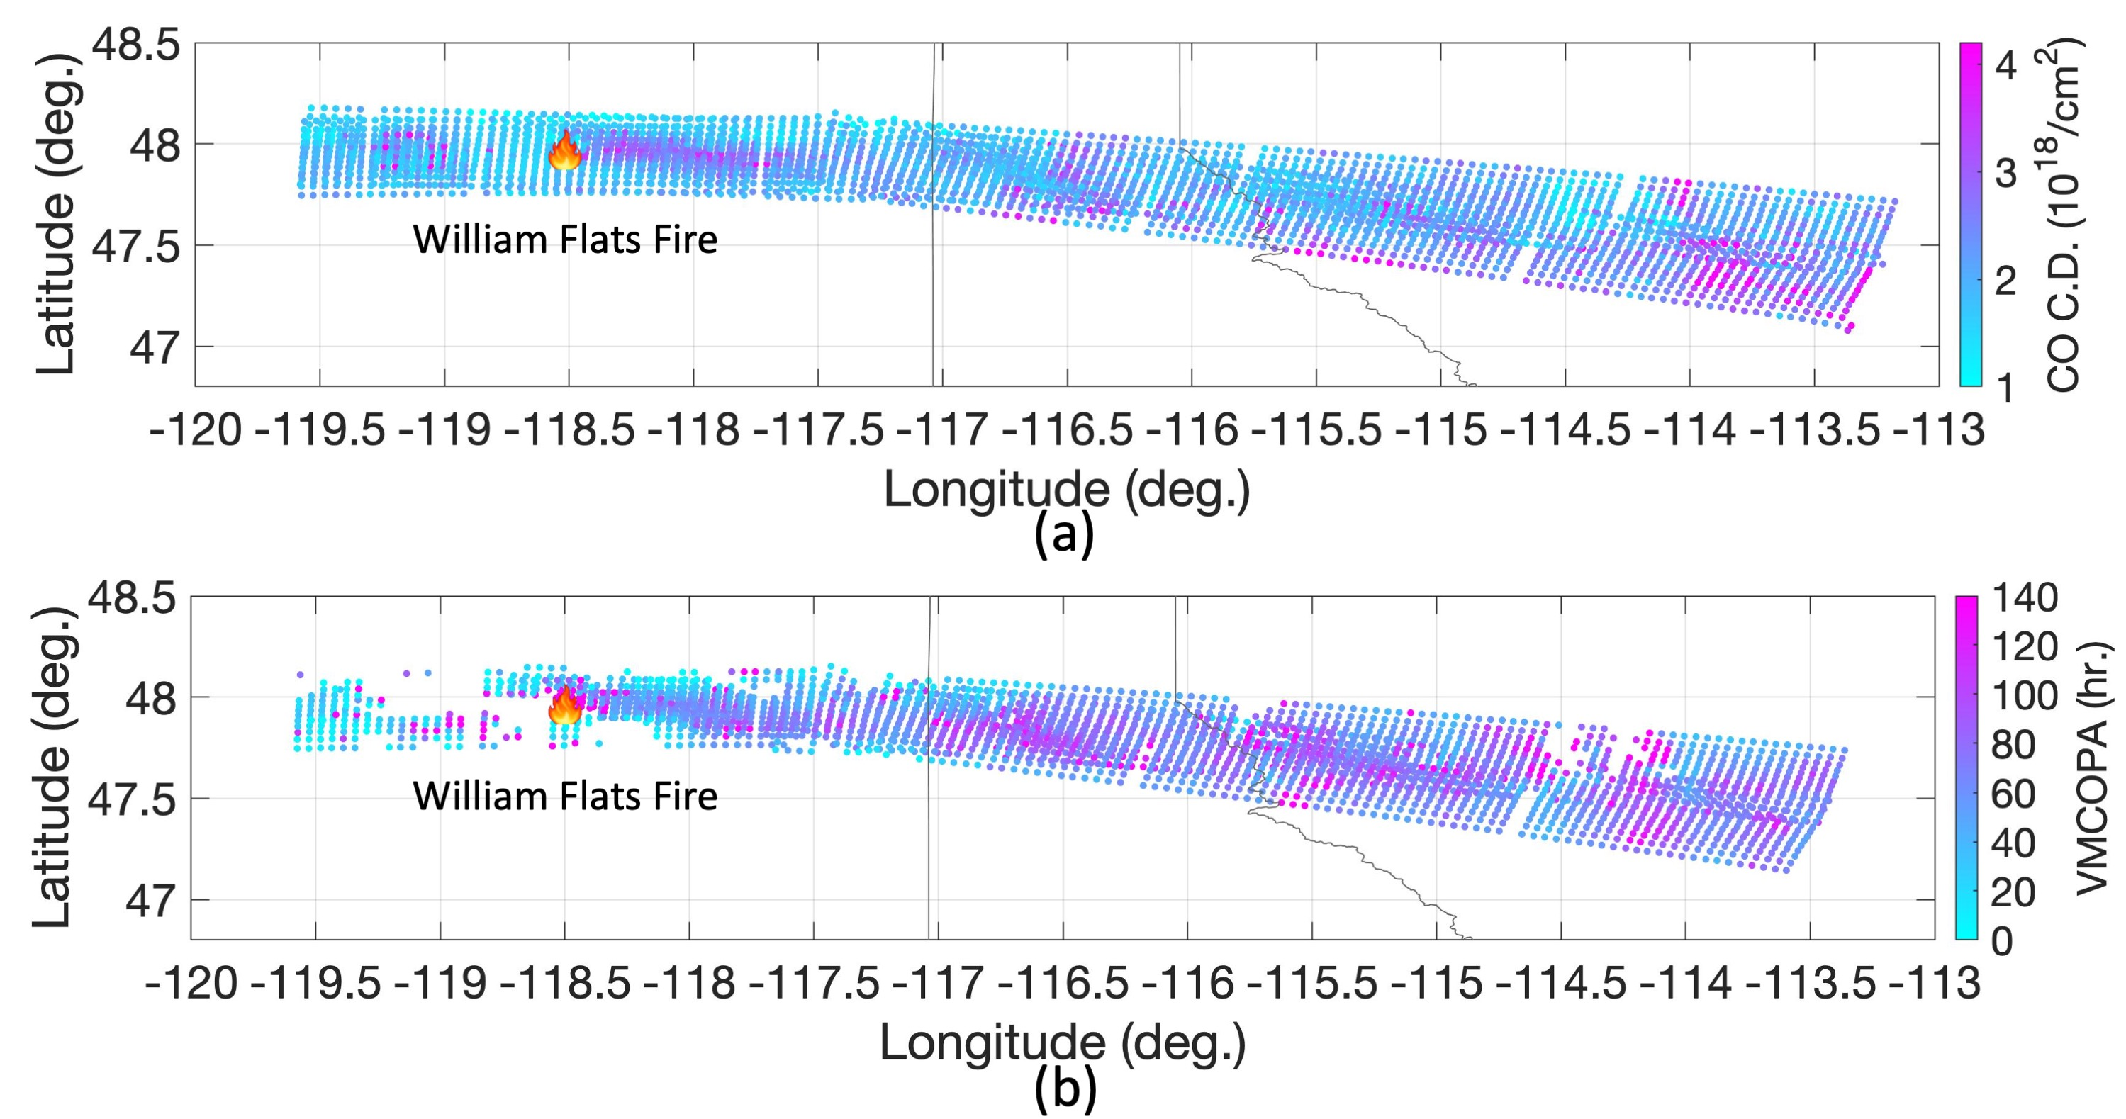
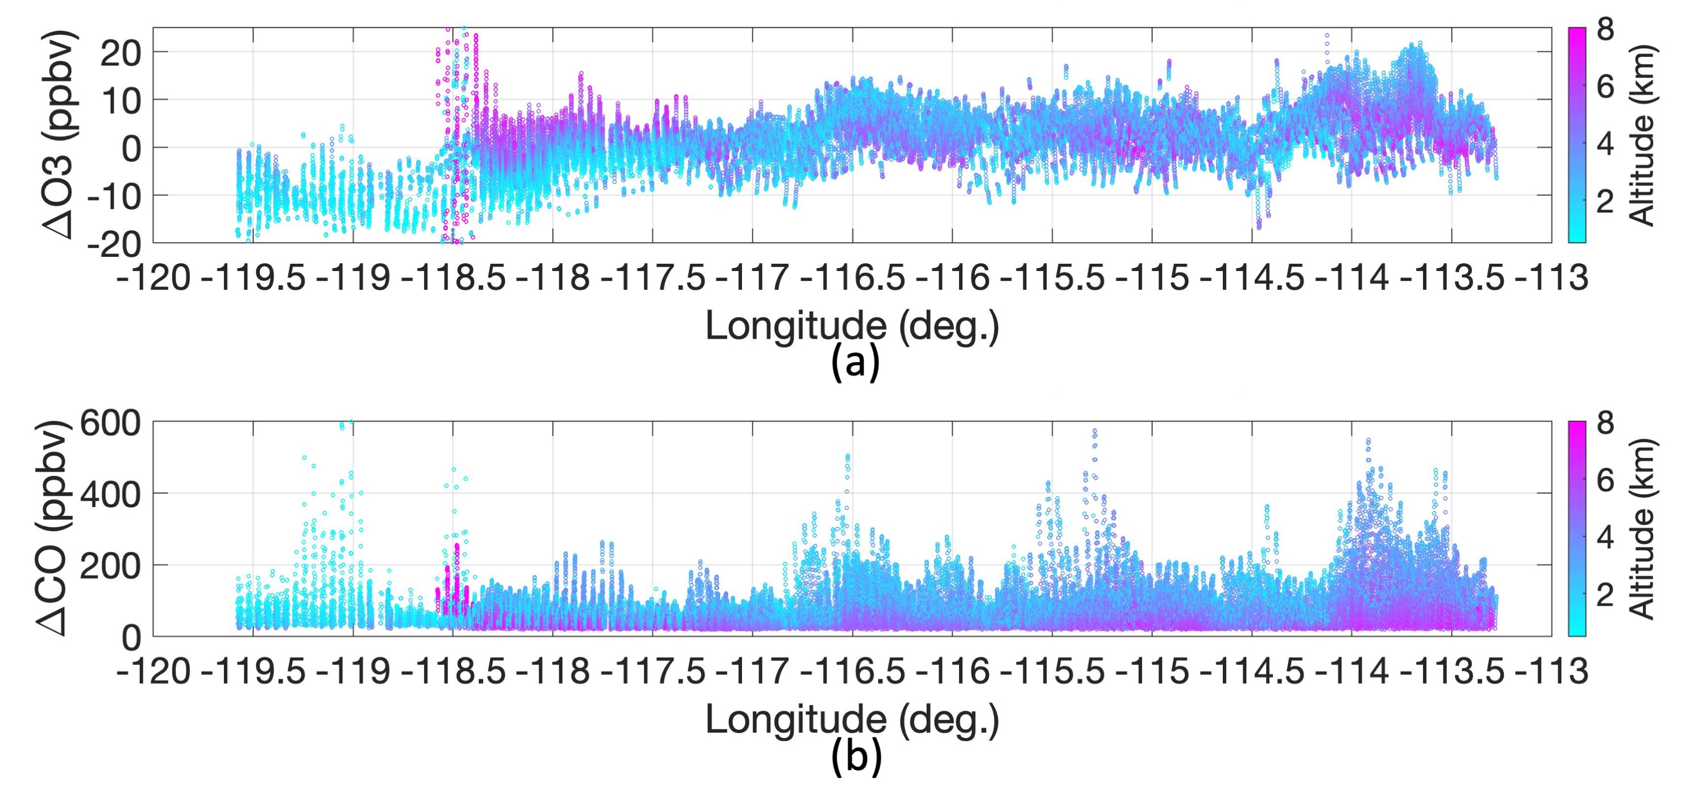
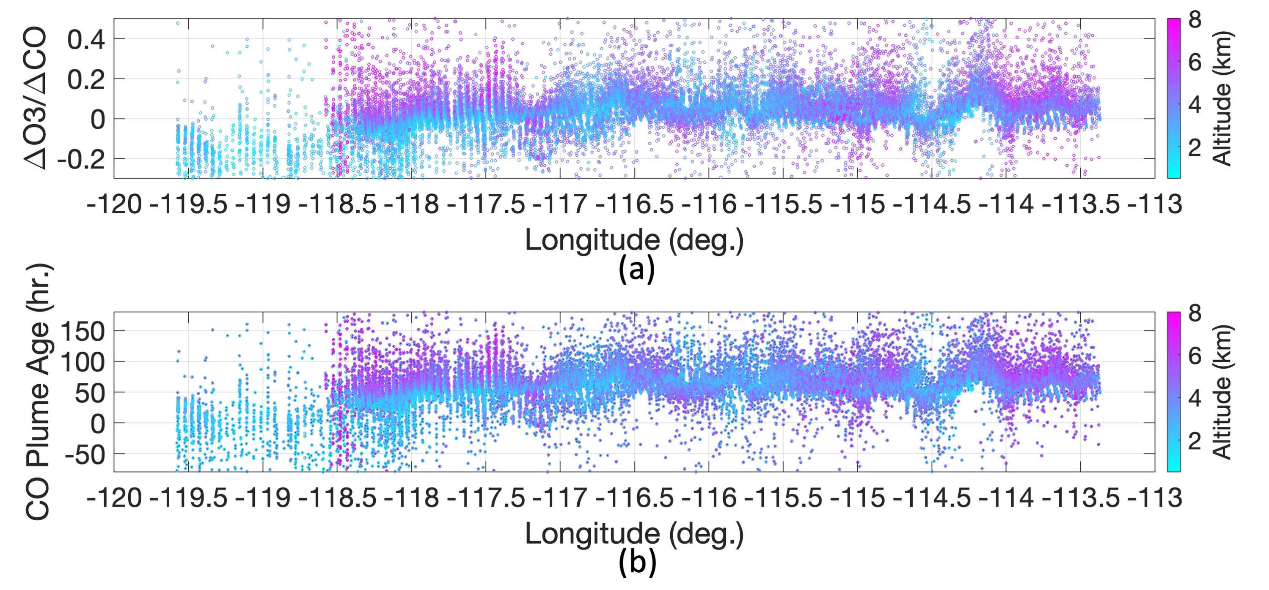
Wildfire-Induced CO Plume Observation from NAST-I
Daniel K. Zhou, Allen M. Larar, Xu Liu, and Anna M. Noe
NASA Langley Research Center, Hampton, VA 23681
IRS 2022; Thessaloniki, Greece; July 4-8, 2022
Introduction
NAST-I: Brief Description and Objectives
Ultra-spectral resolved infrared measurements from aircraft and space-based observations contain information about tropospheric carbon monoxide (CO) and ozone (O₃), as well as other trace species. A methodology of retrieving these tropospheric trace species from such remotely sensed spectral data has been developed and validated for the National Airborne Sounder Testbed-Interferometer (NAST‑I). The Fire Influence on Regional to Global Environments and Air Quality (FIREX‑AQ) field campaign was conducted during August 2019 to investigate the impact of wildfire and biomass smoke on air quality and weather in the continental United States. NAST‑I CO and O₃ measurements from the recent FIREX‑AQ field campaign are presented herein and used to estimate wildfire plume age. Results show enhanced CO plume evolution and transport away from fire ground site, and its plume age associated with the plume distance in both vertical and horizontal directions from the wildfire location, as enabled by the moderate-vertical and high-horizontal resolution obtained from the NAST‑I remotely sensed IR spectrometer onboard NASA ER‑2 aircraft. This study advances our knowledge of fire-induced plume with its evolution and age in 3-dimensional space.
NAST-I was developed in 1997-1998; refurbished in 2009 & 2016.
NAST-I Sensor Characteristics:
Michelson interferometer (FTE).
~8500 spectral channels, ~650-2800 cm⁻¹ at 0.25 cm⁻¹ spectral resolution.
Spatial resolution ~130 m/km flight altitude.
Radiances ~0.5 K absolute accuracy with 0.1 K precision.
Aircraft Accommodation:
ER-2 wing super pod
PROTEUS underbelly pod
WB-57 underbelly pallet.
NAST-I Field Campaigns:
Before AIRS launch (<2002): 9 missions collecting geophysical field state characterization for satellite remote sensing system risk mitigation (sensors and algorithms).
After AIRS launch (>2002): 13 missions for advanced satellite remote sensor Cal/Val (e.g., Aqua AIRS, MetOp IASI, & SNPP/JPSS CrIS), and airborne science.
The most recent field campaign: FIREX-AQ (August 2019).
NAST-I spectral coverage encompasses all satellite IR sounders with a higher (or equivalent) spectral resolution and higher spatial resolution.
NAST-I Level 2 Data Processing
Williams Flats Fire Induced CO Plume Progression
Sheridan Fire Induced CO Distribution and Evolution
NAST‑I three-dimensional CO (ppb) distribution shows the plume evolution and transport near the Sheridan fire ground location (34.80º latitude, ‑112.85º longitude) from August 21, 2019.
Williams Flats fire progression from August 6 (left column), to August 7 (middle column), then to August 8 (right column). (A) eMAS true-color imageries, (B) CO column density (10¹⁸/cm²), (C) CO vertical profile (ppb) cross section with CPL layer top, and (D) the relative humidity vertical profile (%) cross section with CPL layer top.
CO time-evolution shown in its vertical profile cross sections up- and down-wind of the Sheridan fire location (about 140 km) from (A) 23:28:13–23:39:37 UTC of August 21, 2019, to (B) 00:38:35–00:49:24 UTC of August 22, 2019. (A) and (B) are about 70 minutes apart.
Wildfire CO Plume Age Estimation
Wildfire plume age is estimated using O₃ and CO data based on an empirical relationship derived from in-situ measurements*. A positive relationship is found between the △O₃/△CO ratio and plume age.
For this case study of wildfire plume age, we have chosen the ER‑2 sorties over the William Flats fire and the extended downwind area from August 7, 2019, as the ER-2 sorties have ~450 km downwind flight leg segments
Distribution of (a) CO column density and (b) vertical mean CO plume age (VMCOPA).
(a) △O₃ and (b) △CO distribution within the fire-induced plumes
△O₃/△CO distribution along the longitude within the fire-induced plumes, and (b) estimated plume age distribution
(a) Plume age distribution along the longitude. Plume age distribution along the altitude: (b) all data shown from (a), (c) data from longitude less than ‑117.0º (near fire location), and (d) data from longitude greater than ‑117.0º (further away from fire location.
*D. A. Jaffe and N. L. Wigder, “Ozone production from wildfires: A critical review,” Atmospheric Environment, 51, 1-10 (2012).
Conclusion
Wildfire induced CO plumes in the troposphere, in conjunction with their evolution and transport, are readily identified with NAST‑I measurements.
NAST‑I retrieval ability is demonstrated showing the contrast between nominal atmospheric background levels and fire-induced elevated CO profiles.
NAST‑I remotely-sensed CO is evaluated by favorable inter-comparisons with the DACOM in-situ CO measurements which show a positive agreement (not shown here).
Plume characterization correlation between CO and smoke-dust detected by the CPL and eMAS is assessed and presented a good correspondence.
Plume characterization correlation between CO and smoke-dust detected by the CPL and eMAS is assessed and presented a good correspondence.
Elevated tropospheric CO induced by the wildfire is associated and correlated with the total carbon emission from biomass burning (not shown here).
Plume age estimation in a 3-d high-spatial-resolution adds critical temporal information of the fire-induced plume, demonstrating the capability of an ultraspectral remote sensor with a higher spectral and spatial resolution to monitor CO and O₃ and its advantage of giving broader spatial and temporal assessment by rapidly covering a large field of observation.
This work also demonstrates 3-d plume age estimation and advances our measurement ability to observe fire-induced plumes and characterize their evolution and age .

