Slide 1
Aqua vs. GCOM-W1
Orbit Passing Event
Executive Summary
May 18, 2022
Aqua
Bill Guit
Aqua Mission Director - Code 584/428
Mission Validation and Operations Branch
Earth Science Mission Operations Project
NASA/Goddard Space Flight Center
William.J.Guit@nasa.gov

Slide 2
Aqua/GCOM-W1
Passing/Crossing Summary
Aqua team working closely with GCOM-W1 team. (See slides 4&5)
Aqua predicted to pass GCOM-W1 on April 3, 2022.
Northern Hemisphere close approaches generally have a smaller overall miss distance and smaller radial miss distances.
  Actively monitored multiple consecutive close approach (CA) events
  09:08:46 UTC CA minimum miss distance
  See Pc Time History (slide 13) and RIC Miss Distances (slides 15-17)
Timing and miss distances of the minimum miss distance close approach complicated by changes in atmospheric drag.
  3/30: X-Class Solar Flare (X1.38) with peak at 17:37 GMT
  Atmospheric Drag prediction on 3/30 shown on slide 3
  Closely monitored all screening reports, Daily status updates provided
Aqua entered Safe Mode on 3/31 at 17:59:08 UTC.
  Maneuver capability recovery not expected before the 4/3 passing event
  3/31: ESMO recommended GCOM-W1 begin RMM planning
  4/1: By late in the GMT day, it appeared risk level was dropping (slide 13)
  4/2: GCOM-W1 Telecon cancelled, Aqua recovered maneuver capability

Slide 3
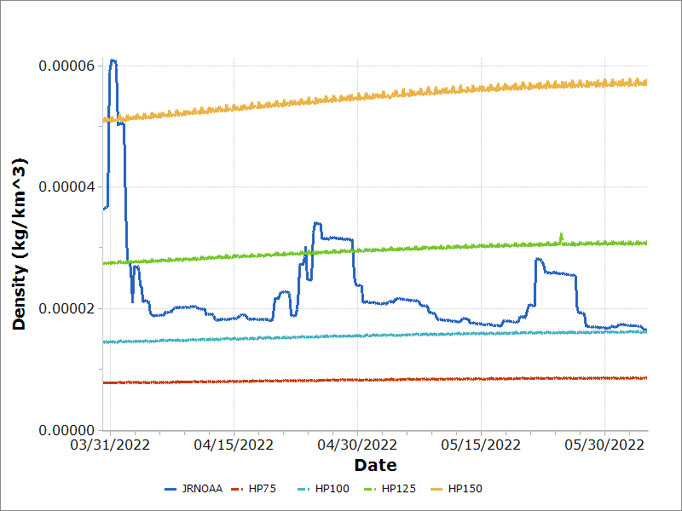
Atmospheric Density Predictions (3/30/2022)

Slide 4
Aqua/GCOM-W1
Passing/Crossing Activities
  01/21/2022: Aqua Passing Plan, Initial DRAFT, V3 DRAFT on 1/31
  02/07/2022: GCOM-W1 Kick-off Telecon #1
    Passing/Crossing predicted for 3/21 (had be 3/28)
  02/11/2022: Aqua Passing Plan V5.1 distributed by Mike Machado
  02/28/2022: GCOM-W1 Telecon #2 – Passing/Crossing predicted for 3/31
  03/14/2022: GCOM-W1 Telecon #3 – Passing/Crossing predicted for 4/3
  03/22/2022: Distributed FINAL Aqua/GCOM-W1 Passing Plan
  03/28/2022: Passing events in Conjunction Assessment (CA) Reports
  03/29/2022: GCOM-W1 Telecon #4
  03/31/2022: Aqua Sate Mode
  03/31/2022: GCOM-W1 Telecon #5 (Emergency/Aqua Anomaly Telecon)
    Briefed Aqua situation to JAXA/GCOM-W1 team
  04/01/2022: CARA HIE Briefing for Aqua/GCOM-W1 Passing Event
  04/01/2022: GCOM-W1 Telecon #6 –
    Suggested GCOM-W1 should begin RMM planning (if needed)
  04/02/2022: GCOM-W1 Telecon #7 – Cancelled after risk dropped off
  04/03/2022: Aqua safely flew under GCOM-W1
    Total Miss Distance = 1028 m, Radial Miss Distance = 73.3 m, Pc = 0.0
  04/18/2022: Post Event Briefing

Slide 5
Aqua/GCOM-W1
Passing/Crossing Calendar
 | Sun | Mon | Tue | Wed | Thu | Fri | Sat
January 2022 | January 16 | 17 | 18 | 19 ► GCOM-W1 IAM #21 | 20 ► OCO-2 IAM #33 | 21 | 22
 | 23 | 24 | 25 | 26 | 27 ► OCO-2 IAM #34 | 28 | 29
 | 30 | 31 | 01 | 02 | 03 ► OCO-2 IAM #35 | 04 Distribute Baseline Aqua/GCOM-W1 Passing Plan | 05
February 2022 | 06 | 07 Aqua/GCOM-W1 Kick-Off Telecon #1 | 08 | 09 ▲ GCOM-W1 Retro-grade Maneuver | 10 ► OCO-2 IAM #36 | 11 National Foundation Day (Japan) | 12
 | 13 | 14 | 15 | 16 | 17 | 18 Aqua/GCOM-W1 Passing Plan Feedback due | 19
 | 20 | 21 President’s Day (US) | 22 | 23 Emperor's Birthday (Japan) ► GCOM-W1 IAM #22 | 24 | 25 | 26
 | 27 | Aqua/GCOM-W1 Telecon #2 | 01 | 02 ► Aura IAM #77 | 03 GCOM-W1/81668 HIE – Potential RMM | 04 GCOM-W1 Tentative DMUM Plan Update Passing Plan | 05Aqua 39874 HIE
March 2022 | 06 1-Month to Passing GCOM-W1 | 07 Aqua/GCOM-W1 Telecon 8pm ***IF NEEDED*** | 08 GCOM-W1 Fixed DMUM Plan | 09 ► Aura IAM #78 ▲ GCOM-W1 Drag Make Up Maneuver | 10 | 11 GCOM-W1 Post DMUM Ephemeris delivery | 12
 | 13 Daylight saving time starts (U.S.) | 14 Aqua/GCOM-W1 Telecon #3 | 15 GCOM-W1 Ephemeris delivery | 16 ► Aura IAM #79 | 17 | 18 Distribute updated Aqua/GCOM-W1 Passing Plan | 19 GCOM 38132 HIE
 | 20 | 21 Vernal Equinox Day (Japan) | 22 GCOM-W1 Ephemeris Delivery | 23 | 24 | 25 | 26
 | 27 | 28 Aqua/GCOM-W1 Conjunction Assessment (CA) Data In Daily CA Screening Reports | 29 Aqua/GCOM-W1 Telecon #4 Aqua/42251 HIE “Not Actionable” | 30 GCOM-W1/82932 TCA on 3/31 HIE – Potential RMM | 31 Aqua Safe Mode Aqua/GCOM-W1 Telecon 8pm | 1 Aqua/GCOM-W1 Telecon 8pm | 2
April 2022 | 3 Aqua Passing GCOM-W1 | 4 Aqua/GCOM-W1 Telecon (Post-Passing) *** Postponed *** | 5 Aqua/36012 Low Miss Distance HIE Self-mitigated | 6 Aqua/35227 HIE Self-mitigated | 7 | 8 Old Aqua / GCOM-W1 Passing Date (one of many) | 9

Slide 6
Aqua Pre-Passing Analysis
The Aqua team performed weekly passing analysis using the latest GCOM-W1 ephem delivered to CCS and current Aqua ephemeris. Analysis was performed with Aqua being the primary object.
GCOM-W1: SOEMP-MAN-LONG.GCOMW1.F20220322.000000.T20220501.000000 Aqua: PM_EOSEPHM7_082_2022_01.e (Predicted STK3 format product rule)
GCOM-W1 vs. Aqua: Passing Analysis (SpaceNav)
TCA (UTC) | Total Miss (m) | Radial (m) | In-Track (m) | Cross-Track (m) | Crossing
2022-04-03 at 13:15:58 | 932.396 | 321.862 | 875.006 | 11.478 | south
2022-04-03 at 14:05:25 | 102.133 | 102.106 | 2.345 | -0.007 | north
GCOM-W1 vs. Aqua: Passing Analysis (FDS)
TCA (UTC) | Total Miss (m) | Radial (m) | Along-Arc (m) | Cross Track (m) | Crossing
Apr 03 13:15:58.1 | 932.41 | 321.92 | 875.02 | 7.27 | Southern
Apr 03 14:05:24.7 | 102.20 | 102.11 | 2.37 | 3.59 | Northern

Slide 7
Minimum Miss Distance
Close Approach (ASW vs. ASW)
6-Days and 5-Days from the predicted passing/crossing time (4/3 at 09:08:45 UTC) data in the CRMS Screening Reports was as expected. This far from Time of Closest Approach (TCA) data is for situational awareness.
Report Gen Time to TCA [Days] | Screening Epoch | TCA [UTC] | Collision Probability | Total Miss [m] | Radial Miss (Uncertainty) [m] | In-Track Miss (Uncertainty) [m] | Cross-Track Miss (Uncertainty) [m]
6.7 | 2022-03-27 14:09:49 | 2022-04-03 09:08:45 | 1.72e-04 1:5814 | 825 | 68 (27.3) | 823 (3219.0) | -7 (33.9)
6.4 | 2022-03-27 22:14:43 | 2022-04-03 09:08:45 | 4.92e-07 1:2M | 767 | 114 (26.4) | 759 (3132.2) | -7 (33.7)
6.1 | 2022-03-28 06:10:33 | 2022-04-03 09:08:45 | 1.29e-07 1:8M | 194 | 131 (27.9) | 143 (2952.7) | -1 (31.8)
5.7 | 2022-03-28 14:27:47 | 2022-04-03 09:08:45 | 8.07e-08 1:12M | 382 | 127 (25.6) | 360 (2244.8) | -3 (24.9)
5.4 | 2022-03-28 22:05:29 | 2022-04-03 09:08:45 | 6.02e-09 1:166M | 260 | 145 (26.4) | 216 (2273.3) | -2 (25.3)
5.0 | 2022-03-29 07:08:22 | 2022-04-03 09:08:45 | 7.43e-09 1:135M | 435 | 152 (27.7) | -407 (2286.0) | 4 (25.6)

Slide 8
Minimum Miss Distance
Close Approach (ASW vs. ASW)
4-Days and 3-Days from the predicted passing/crossing event time the conjunction transitioned from “planning” potential RMMs to “execute” RMM if risk remains high.
Report Gen Time to TCA [Days] | Screening Epoch | TCA [UTC] | Collision Probability | Total Miss [m] | Radial Miss (Uncertainty) [m] | In-Track Miss (Uncertainty) [m] | Cross-Track Miss (Uncertainty) [m]
4.7 | 2022-03-29 14:04:43 | 2022-04-03 09:08:45 | 2.47e-05 1:40K | 100 | 100 (28.6) | -10 (1920.6) | 0 (22.4)
4.4 | 2022-03-29 22:12:36 | 2022-04-03 09:08:45 | 1.57e-06 1:636K | 374 | 106 (24.1) | -358 (1883.6) | 3 (22.3)
4.0 | 2022-03-30 07:09:14 | 2022-04-03 09:08:44 | 3.71e-06 1:269K | 990 | 96 (24.7) | -986 (2961.1) | 9 (31.8)
3.7 | 2022-03-30 14:04:07 | 2022-04-03 09:08:44 | 1.77e-05 1:56K | 899 | 81 (22.6) | -896 (2667.2) | 8 (29.0)
3/30: X-Class Solar Flare (X1.38) with peak at 17:37 GMT
3.4 | 2022-03-30 22:13:05 | 2022-04-03 09:08:44 | 1.31e-04 1:7634 | 1004 | 64 (21.2) | -1002 (2524.5) | 8 (27.3)
3.1 | 2022-03-31 05:57:37 | 2022-04-03 09:08:44 | 8.41e-04 1:1189 | 1040 | 45 (19.7) | -1039 (2322.3) | 8 (25.2)

Slide 9
Minimum Miss Distance
Close Approach (ASW vs. ASW)
Less than 3-days to the the predicted TCA the SpaceNav Collision Risk Management System (CRMS) begins generating RMM options to be screened.
Report Gen Time to TCA [Days] | Screening Epoch | TCA [UTC] | Collision Probability | Total Miss [m] | Radial Miss (Uncertainty) [m] | In-Track Miss (Uncertainty) [m] | Cross-Track Miss (Uncertainty) [m]
2.9 | 2022-03-31 08:15:02 | 2022-04-03 09:08:44 | 2.23e-03 1:448 | 938 | 34 (18.6) | -938 (2056.1) | 7 (22.8)
2.7 | 2022-03-31 14:26:14 | 2022-04-03 09:08:44 | 2.67e-03 1:375 | 1087 | 33 (17.6) | -1087 (1764.0) | 8 (20.1)
2.7 | 2022-03-31 14:41 | 2022-04-03 09:08:44 | 2.67e-03 1:375 | 1087 | 33.5 | -1087.4 | 8.9
2.4 | 2022-03-31 22:03:35 | 2022-04-03 09:08:44 | 3.23e-03 1:310 | 1023 | 33 (17.5) | -1022 (1431.9) | 8 (17.2)
2.1 | 2022-04-01 02:23:43 | 2022-04-03 09:08:44 | 2.05e-03 1:488 | 871 | 39 (17.1) | -870 (1367.9) | 7 (17.4)
2.1 | 2022-04-01 03:11:12 | 2022-04-03 09:08:44 | 1.44e-03 1:694 | 849 | 43 (16.7) | -848 (1216.6) | 7 (15.4)
2.1 | 2022-04-01 03:43:36 | 2022-04-03 09:08:44 | 1.53e-03 1:654 | 834 | 43 (16.6) | -833 (1212.9) | 6 (15.3)

Slide 10
Minimum Miss Distance
Close Approach (ASW vs. ASW)
About 35-hours from the predicted TCA the Pc dropped below the RMM planning threshold of 1.0e-05.
Report Gen Time to TCA [Days] | Screening Epoch | TCA [UTC] | Collision Probability | Total Miss [m] | Radial Miss (Uncertainty) [m] | In-Track Miss (Uncertainty) [m] | Cross-Track Miss (Uncertainty) [m]
1.9 | 2022-04-01 06:07:48 | 2022-04-03 09:08:45 | 2.36e-03 1:424 | 608 | 42 (15.7) | -606 (734.0) | 5 (11.7)
1.9 | 2022-04-01 07:40:53 | 2022-04-03 09:08:45 | 2.36e-03 1:424 | 608 | 42 (15.7) | -606 (734.0) | 5 (11.7)
1.7 | 2022-04-01 14:25:20 | 2022-04-03 09:08:44 | 2.42e-03 1:413 | 842 | 37 (14.8) | -841 (579.9) | 6 (10.8)
1.4 | 2022-04-01 22:09:09 | 2022-04-03 09:08:44 | 4.08e-07 1:2M | 1071 | 76 (13.7) | -1068 (433.9) | 9 (10.4)
1.3 | 2022-04-02 00:13:15 | 2022-04-03 09:08:44 | 6.31e-08 1:16M | 1051 | 80 (13.1) | -1048 (376.5) | 9 (10.4)
1.2 | 2022-04-02 02:36:31 | 2022-04-03 09:08:44 | 6.32e-08 1:16M | 1078 | 79 (12.9) | -1075 (364.1) | 9 (10.3)
1.2 | 2022-04-02 04:11:41 | 2022-04-03 09:08:44 | 2.12e-08 1:47M | 1048 | 78 (12.9) | -1045 (273.2) | 9 (10.1)
1.1 | 2022-04-02 06:04:44 | 2022-04-03 09:08:45 | 5.91e-09 1:169M | 1011 | 78 (12.8) | -1008 (236.2) | 8 (10.0)

Slide 11
Minimum Miss Distance CA
ASW vs. ASW Screening Epoch: 4/3 at 6:34:51Z
(Last Screening prior to TCA)
The day of the predicted passing event the Pc continued to drop and Aqua uneventfully passed GCOM-W1 with nether mission required to take evasive action.
Report Gen Time to TCA [Days] | Screening Epoch | TCA [UTC] | Collision Probability | Total Miss [m] | Radial Miss (Uncertainty) [m] | In-Track Miss (Uncertainty) [m] | Cross-Track Miss (Uncertainty) [m]
0.7 | 2022-04-02 14:26:30 | 2022-04-03 09:08:44 | 6.60e-14 1:15T | 997 | 50 (11.5) | -996 (141.0) | 8 (9.5)
0.5 | 2022-04-02 20:52:14 | 2022-04-03 09:08:44 | 4.70e-33 | 968 | 54 (10.5) | -966 (82.4) | 8 (9.2)
0.4 | 2022-04-02 21:58:56 | 2022-04-03 09:08:44 | 6.13e-42 | 954 | 53 (10.5) | -953 (71.7) | 8 (9.1)
0.1 | 2022-04-03 06:34:51 | 2022-04-03 09:08:45 | 0.00e+00 | 997 | 49 (10.3) | -996 (54.8) | 8 (9.2)
Post-Event Analyses
Post-Event CDM | 2022-04-04 12:02:29 | 2022-04-03 09:08:44.933 | 0.00e+00 | 1028 | 73.2 | -1025.9 | 9.0
Definitive | 2022-04-08 | 2022-04-03 09:08:44.8 | 0.00e+00 | 974.18 | 104.22 | -968.55 | 8.0

Slide 12
Post-Event FDS Definitive
(4/8/2022)
The EOS Aqua Flight Dynamics Support (FDS) team performed a post-event analysis using the latest GCOM-W1 definitive ephemeris delivered to CCS, and an Aqua definitive ephemeris. The analysis was performed with Aqua as the primary object and the following passing information was found:
GCOM-W1 vs. Aqua: Passing GCOM: SOEMP-DEF_GCOMW1_F20220327_000000_T20220404_000000 Aqua: PM_EOSEPHM7_097_2022_01.e (Predicted STK3 format product rule
Crossing | TCA (UTC) | Total Miss (m) | Radial (m) | Along-Arc (m) | Cross Track (m)
Southern | Apr 03 08:19:18.0 | 347.59 | 333.27 | -98.61 | -5.17
Northern | Apr 03 09:08:44.8 | 974.18 | 104.22 | -968.55 | 8.00

Slide 13
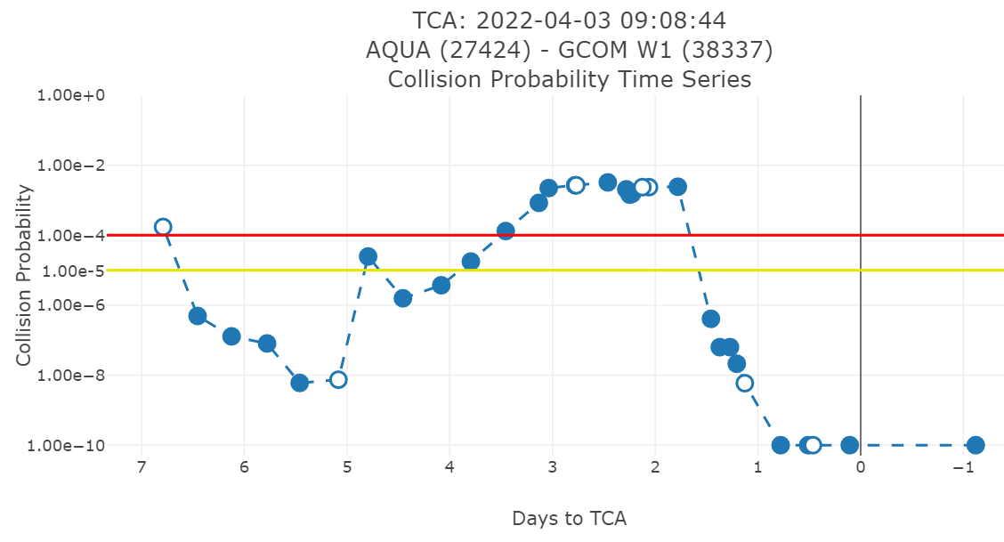
Aqua passing GCOM-W1 Event
(4/4/2022 Post-Event Collision Probability)

Slide 14
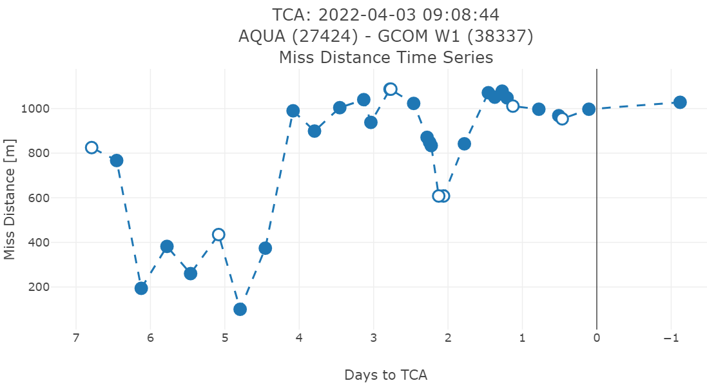
Aqua passing GCOM-W1 Event
(4/4/2022 Post-Event Miss Distance)

Slide 15
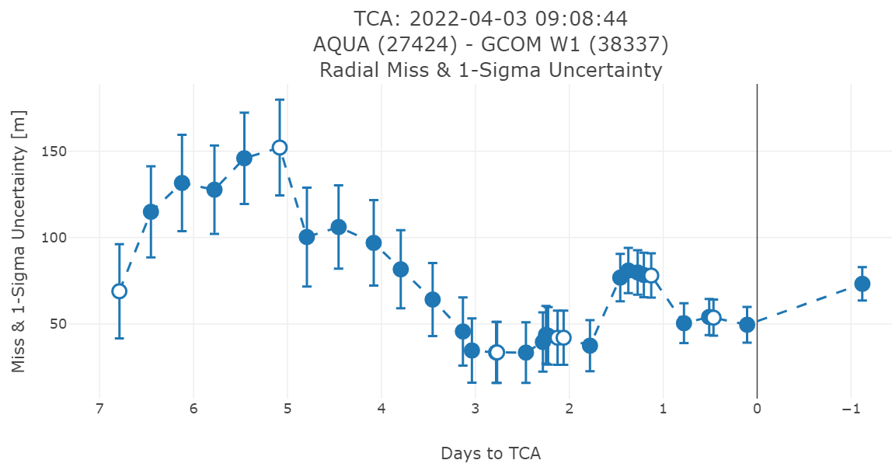
Aqua passing GCOM-W1 Event
(4/4/2022 Post-Event Radial Miss)

Slide 16
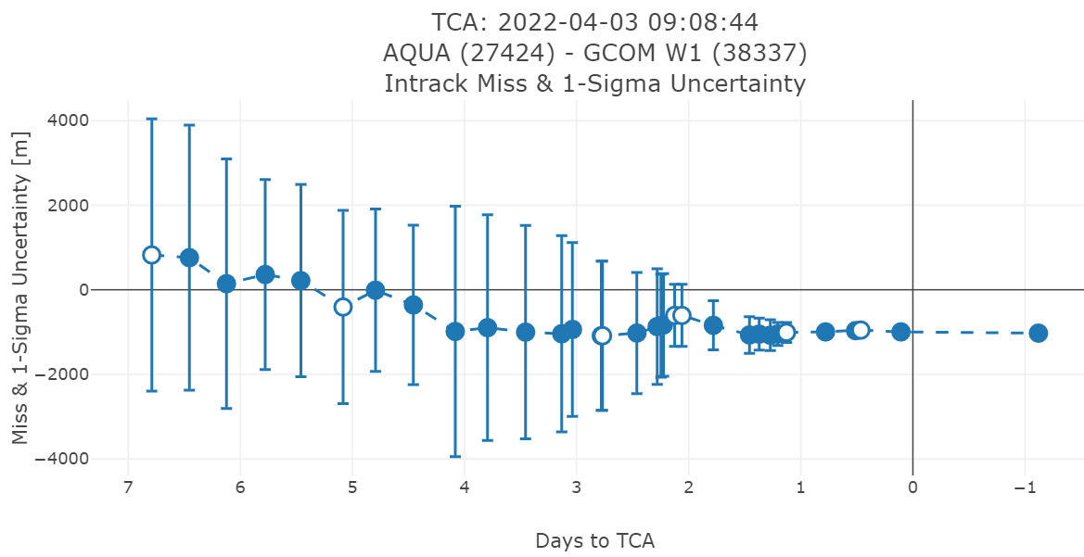
Aqua passing GCOM-W1 Event
(4/4/2022 Post-Event In-track Miss)

Slide 17
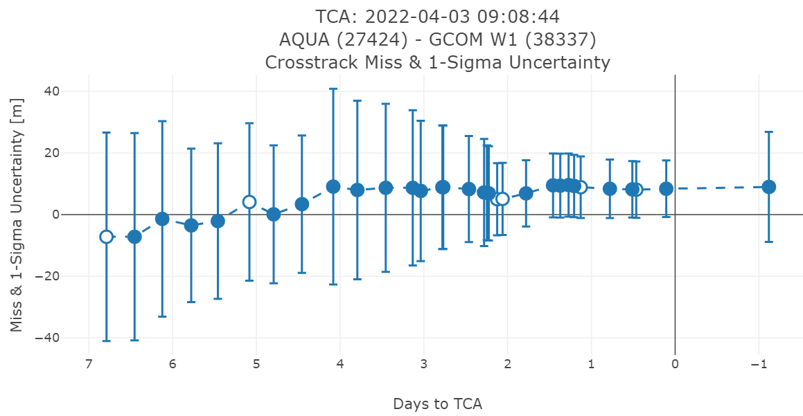
Aqua passing GCOM-W1 Event
(4/4/2022 Post-Event Cross-track Miss)

Slide 18
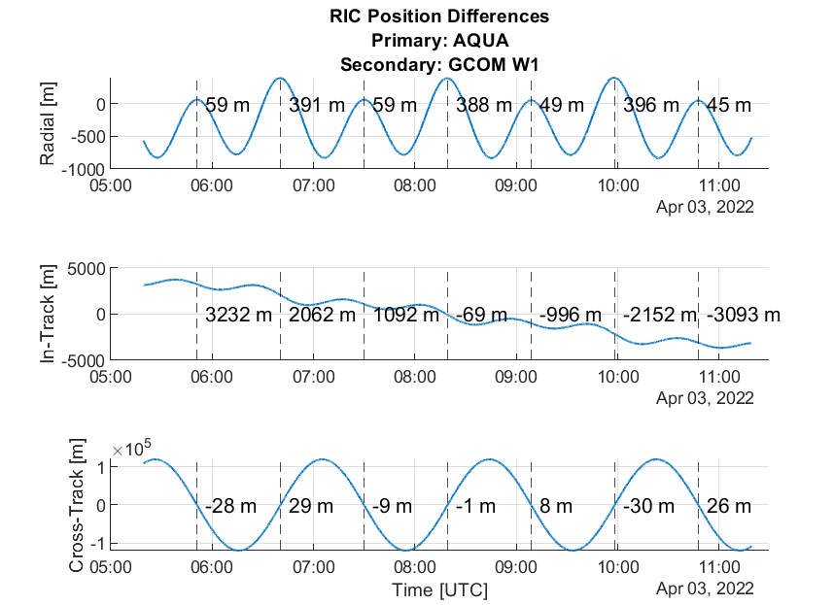
Aqua passing GCOM-W1
SpaceNav Orbit Phasing Analysis
4/6/2022

Slide 19
Observations
(Lessons Learned)
Every passing/crossing event is unique.
Despite multiple passing/crossing events experienced by the International ESC Morning Constellation (MC) & A-Train missions.
  2011: Landsat-5 and SAC-C crossings with the A-Train
  2021: Landsat-7 crossings with the MC and the A-Train
Aqua passing GCOM-W1 event experienced significant complicating factors.
  General nature of the passing event – Surely a 1st for Aqua
    Near co-planar, low relative velocity
    Multiple monitor volume violations
  Significant X-Class Solar Flare (X1.38) at 17:37 GMT on 3/30
  Aqua Safe Mode at 17:59:08 GMT on 3/31
Despite the multiple challenges it was successfully managed by the multiple teams involved – Thank You.

Slide 20
Questions/Comments

Slide 21
Abbreviations / Acronyms List
  CA – Conjunction Assessment
  CA – Close Approach
  CAM – Command Authorization Meeting
  CARA – Conjunction Assessment Risk Analysis
  CCS – Constellation Coordination System
  CRMS – Collision Risk Management System
  DAM – Debris Avoidance Maneuver
  EOS – Earth Observing System
  ESC – Earth Science Constellation
  ESMO – Earth Science Mission Operations
  FDS – Flight Dynamics System
  FDSS-III – Flight Dynamics Support Services III contract
  FOT – Flight Operations Team
  GCOM-W1 – Global Change Observation Mission for Water (1)
  GMT – Greenwich Mean Time
  HIE – High Interest Event
  JAXA – Japan Aerospace Exploration Agency
  km – kilometer
  m – meter
  NASA – National Aeronautics & Space Administration
  NID – NASA Interim Directive
  OCO-2 – Orbiting Carbon Observatory-2
  PMCOC – Post Maneuver Conjunction of Concern
  RIC – Radial, In-track and Cross-track
  RMM – Risk Mitigation Maneuver
  s or sec – second
  TCA – Time of Closest Approach
  UTC – Coordinated Universal Time

