Slide 1
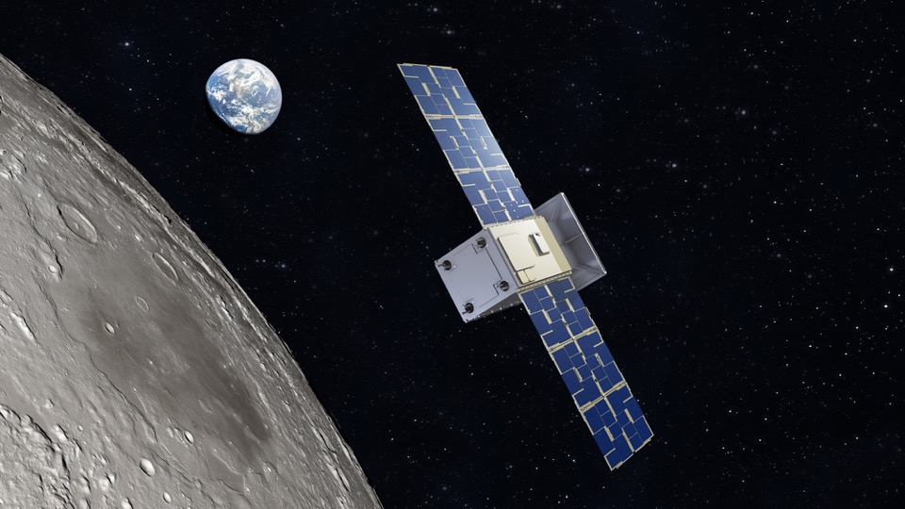


Space Technology Mission Directorate
Small Spacecraft Technology
National Aeronautics and
Space Administration
Roger Hunter
Program Manager,
Small Spacecraft Technology
NASA Ames Research Center
4S Symposium
Vilamoura, Portugal
16-20 May 2022
www.nasa.gov

Slide 2
NASA Organizational Chart

Slide 3
NASA Small Spacecraft Technology Objectives
The Small Spacecraft Technology program expands U.S. capability to execute unique missions through rapid development and demonstration of capabilities for small spacecraft applicable to exploration, science and the commercial space sector.
Enable execution of missions at much lower cost than previously possible.
Substantially reduce time required for development of spacecraft.
Enable and demonstrate new mission architectures.
Expand the capability of small spacecraft to execute missions at new destinations and in challenging new environments.
Enable the augmentation of existing assets and future missions with supporting small spacecraft.

Slide 4
2022-2023 Launch Schedule
Technology Demonstrations | Launch Timeframe
Pathfinder Technology Demonstrator-3: Payload: TBIRD 200GB Laser Communications | May 25, 2022
CPOD: CubeSat Proximity Operations Demonstration | May 25, 2022
CAPSTONE: Cislunar Autonomous Positioning System Tech Ops and Navigation Experiment | May 27, 2022 (NET)
CLICK-A: CubeSat Laser Infrared CrossLinK | Jun. 2022 (NET)
Starling: Demonstration of Autonomous Swarm Technologies | Aug. 2022 (NET)
PACE-2: Payload Accelerator for CubeSat Endeavors | Oct. 2022
ACS3: Advanced Composite Solar Sail System | Nov. 2022
Lunar Flashlight: Mapping of Water and Volatiles at the Lunar Surface | First Half of 2023
Pathfinder Technology Demonstrator-4: Payload: LISA-T High-Power Deployable Solar Array Antenna | Jan. 2023 (NET)
CLICK B/C: CubeSat Laser Infrared CrossLinK | Jun. 2023 (NET)
Tipping Points
DUPLEX: Dual Propulsion Experiment | Sep. 2022
SEP: Solar Electric Propulsion | Dec. 2022

Slide 5
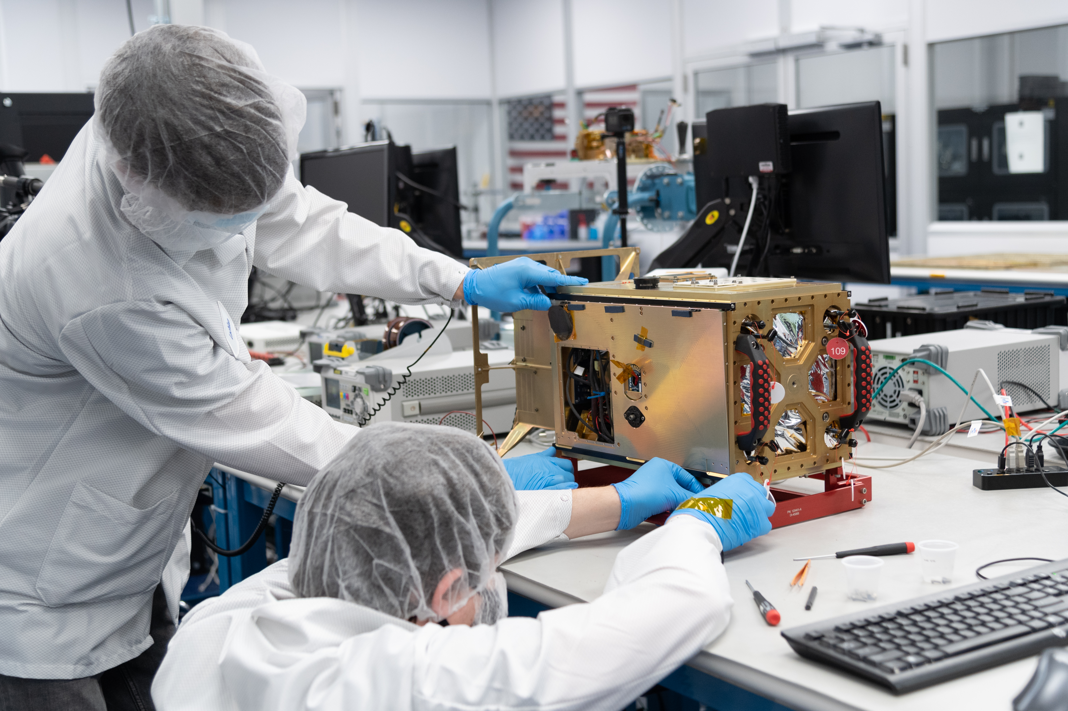
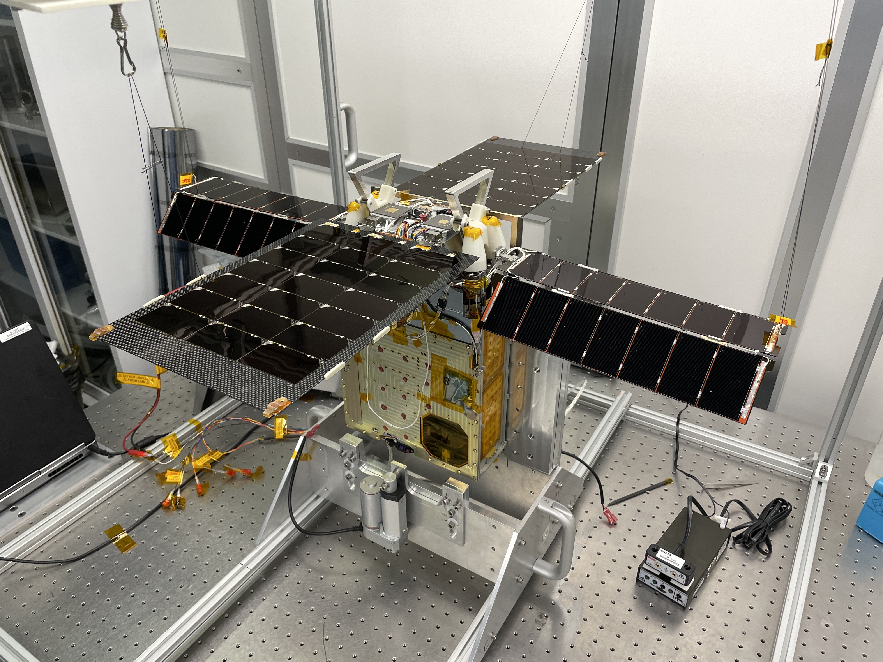
Upcoming U-Class Exploration Missions
CAPSTONE
Launch Timeframe: NET May 27, 2022
Demonstrate how to enter and function in a near rectilinear halo orbit around the Moon and demonstrate spacecraft-to-spacecraft navigation
Lunar Flashlight
Launch Timeframe: First Half of 2023
Characterize lunar in-situ resource utilization potential. Measure quantity and distribution of surface ice deposits in lunar South Pole cold traps with a compact laser spectrometer
Image Credits: NASA
Image Credits: NASA/JPL-Caltech
5

Slide 6
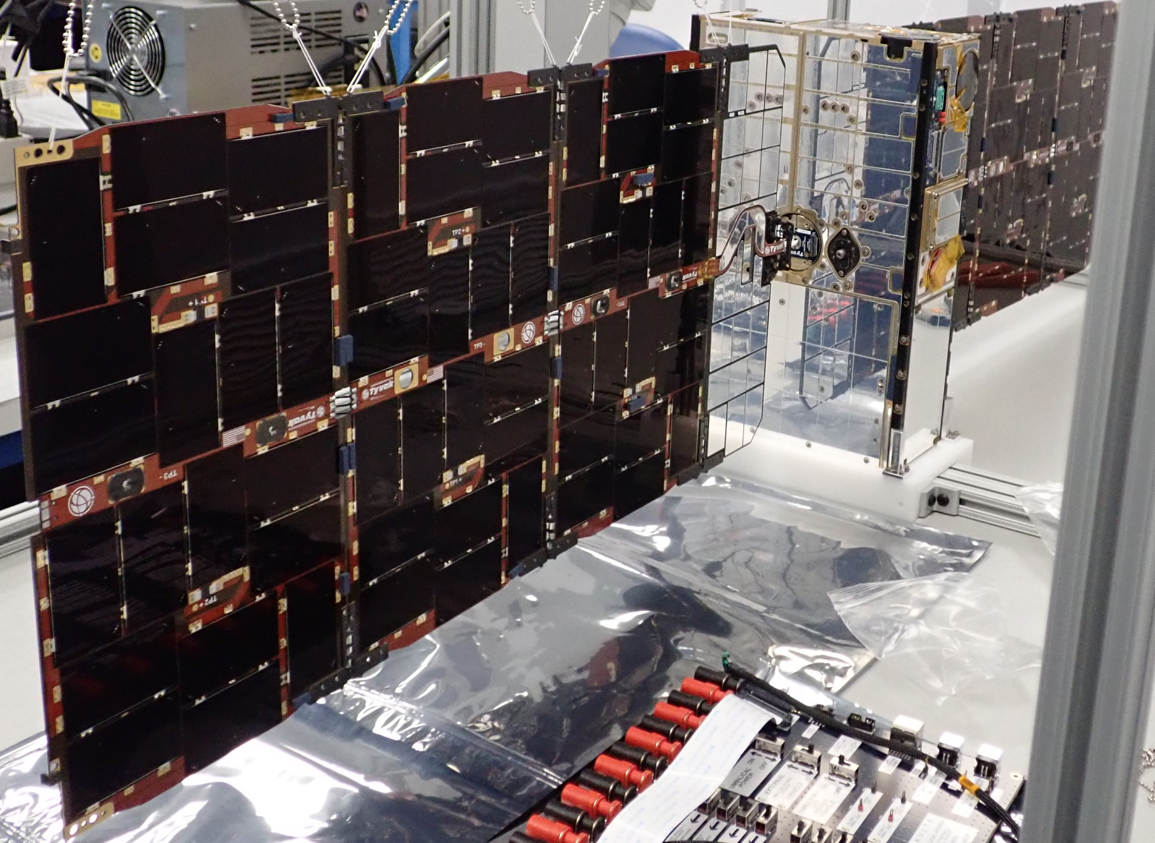
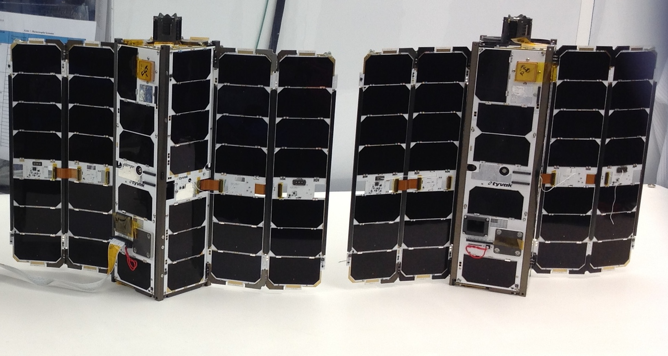
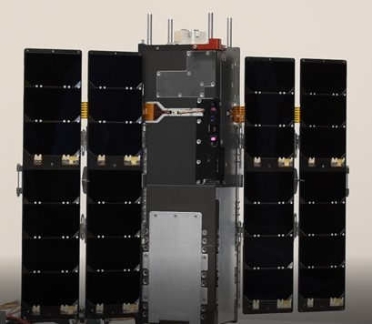
Upcoming U-Class Technology Demonstration Missions – 2022
Pathfinder Technology Demonstrator (PTD-3)
Launch: May 25, 2022
Demonstrate TeraByte InfraRed Delivery (TBIRD) technology for high-bandwidth laser communications - 200 gigabit per second data downlink rate
CubeSat Proximity Operations Demonstration (CPOD)
Launch: May 25, 2022
Demonstrate rendezvous, proximity operations and docking using two 3U CubeSats
CubeSat Laser Infrared CrossLinK (CLICK-A)
Launch: NET June 2022
Risk reduction mission to test elements of an optical communications system via a single 3U spacecraft and a ground station telescope
Image Credits: Terran Orbital Corporation
Image Credits: Terran Orbital Corporation
Image Credits: Blue Canyon Technologies
6

Slide 7
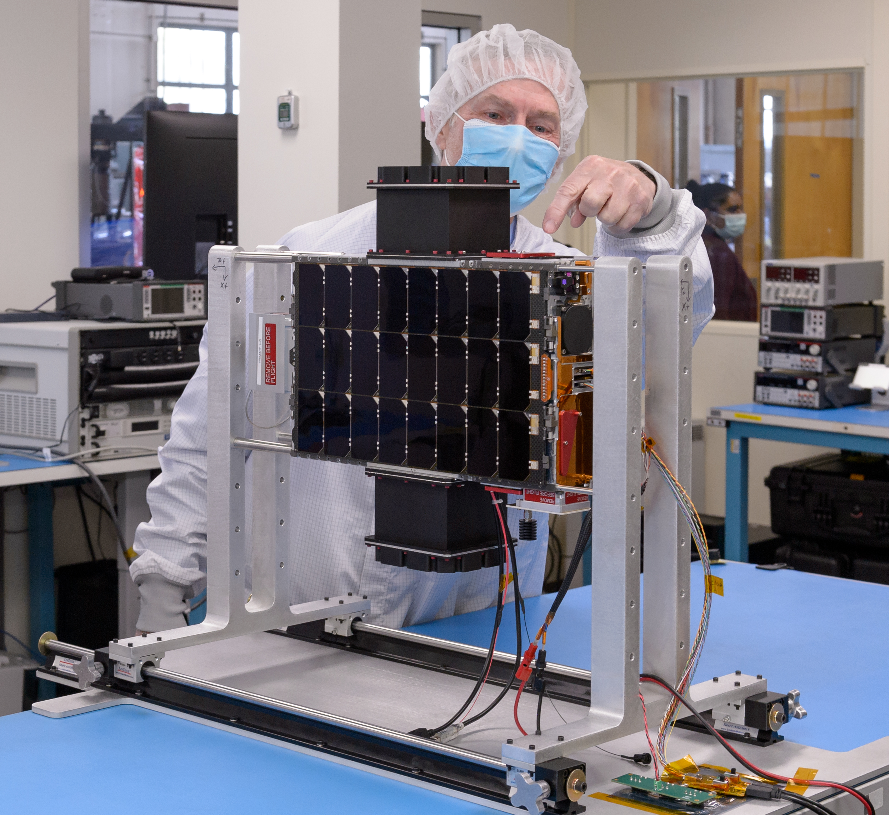
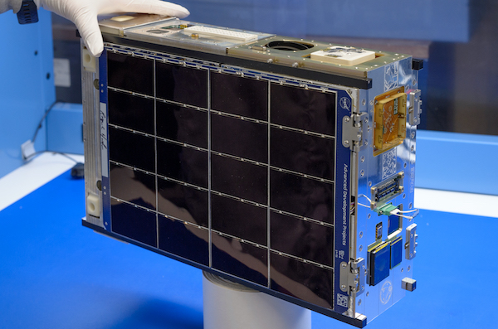
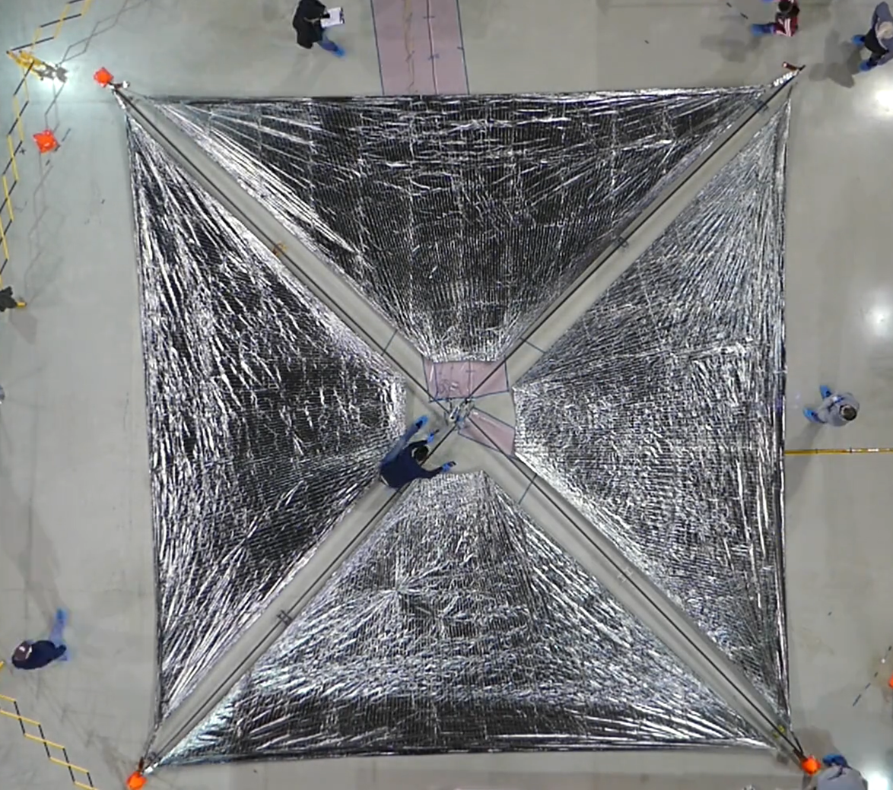
Upcoming U-Class Technology Demonstration Missions – 2022
Starling
Autonomous Swarm Tech.
Launch: NET Aug. 2022
Demonstrate swarm maneuver planning and execution, communications networking, relative navigation, and autonomous coordination between four 6U CubeSats
PACE-2
Launch: Oct. 2022
Demonstrate upgrades to the PACE avionics system as well as a camera and image processing payload
Advanced Composite Solar Sail System (ACS3)
Launch: Nov. 2022
Demonstrate deployment
of the composite boom
solar sail in low-Earth orbit. The unfurled solar sail will measure approximately 84 m²
Image Credits: NASA
Image Credits: NASA
Image Credits: NASA
7

Slide 8
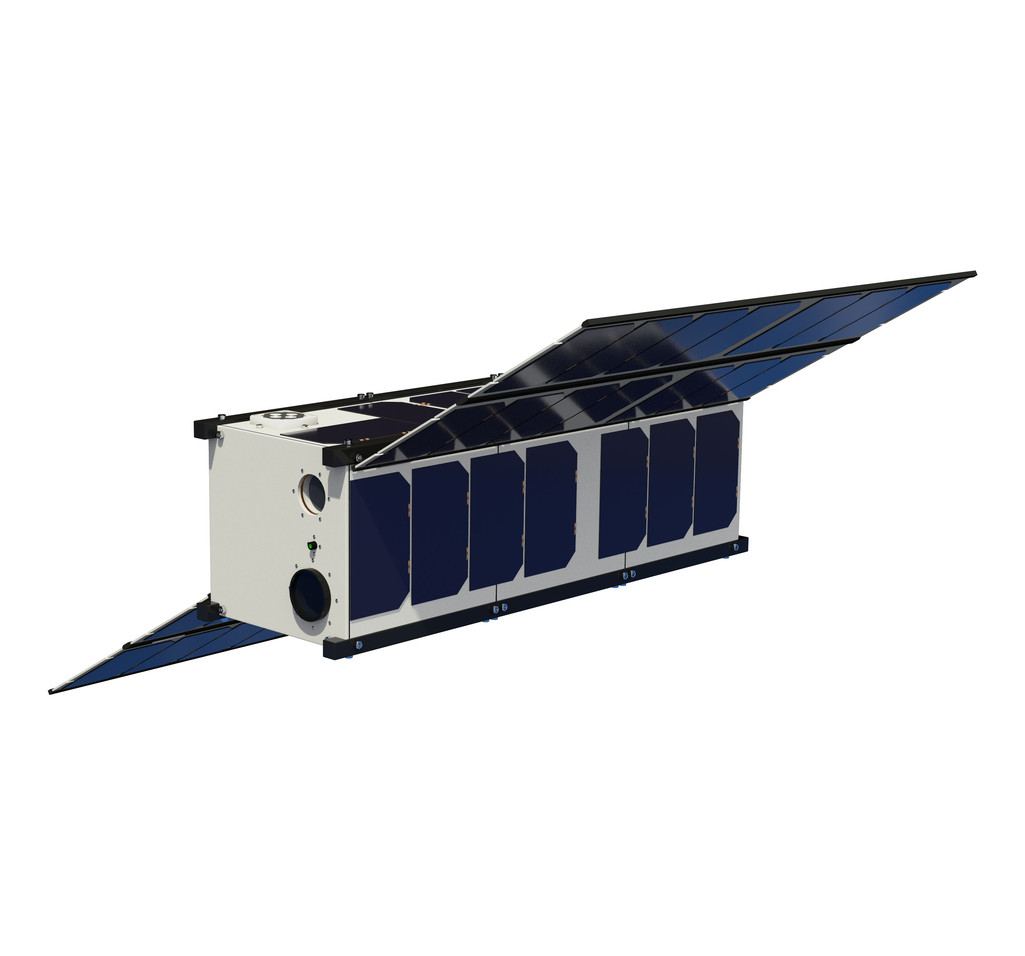
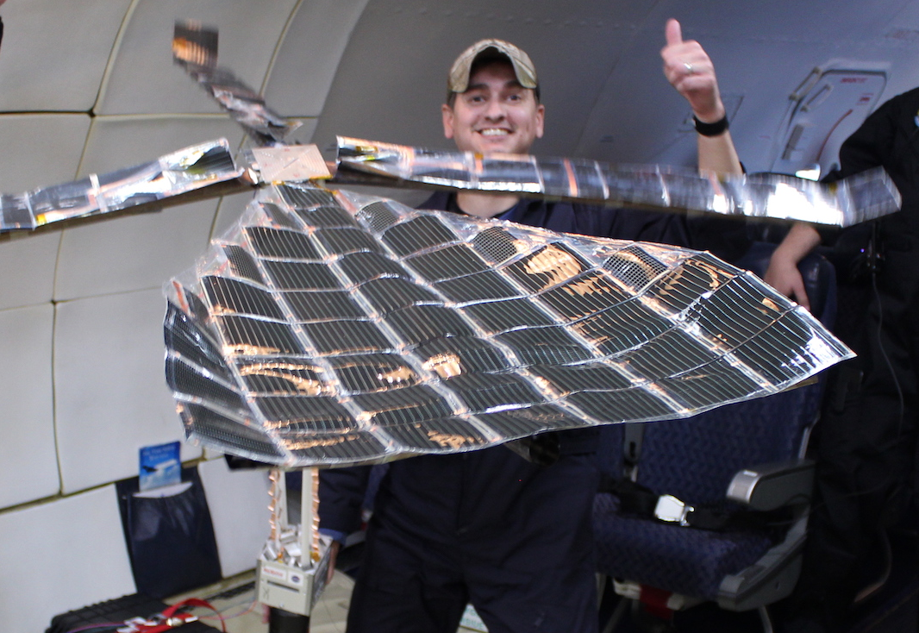
Upcoming U-Class Technology Demonstration Missions - 2023
Pathfinder Technology Demonstrator
(PTD-4)
Launch: Jan. 2023
Demonstrate Lightweight Integrated Solar Array and anTenna (LISA-T), a high-power, low-volume deployable solar array with an integrated antenna
CubeSat Laser Infrared CrosslinK
(CLICK B/C)
Launch: Jun. 2023
Demonstrate optical crosslink and precision ranging between two 3U CubeSats at a data rate of 20 Mbps and range up to 580 km
Image Credits: NASA
Image Credits: NASA (illustration) and
Blue Canyon Technologies (photograph)

Slide 9

SmallSat Technology Partnerships Overview
Overview:
U.S.-based university and NASA center, PI-lead cooperative agreements
Competitive solicitations
Specific technology topics vary
Grants for max duration of two years
Year-2 option after first annual review
5 “classes” to-date: 2013, 2015, 2016, 2018, 2020
Investments:
  Over $26,468,000 awarded
  8 of 10 NASA Centers partnered
  30 Universities in 18 states
  46 partnerships in 5 class years
Results:
  1 Intersatellite Network Planning/ Routing tool software open-sourced
  4 New Technology Reports / Patents
  13 flight demonstrations planned
  27+ Conference presentations
  46+ Papers published
  100+ Students involved + Many TRLs raised
30 Universities in 18 States
8 NASA Centers (including JPL FFRDC)
2013 $6,500,000 17 awards; 13 Y2 option
2015 $3,590,150 8 awards; 8 Y2 option
2016 $4,676,693 8 awards; 8 Y2 option
$5,802,500 8 awards; 8 Y2 option
2020 $5,900,000 9 awards: (assumes 2 yrs)
Notes:
Lessons Learned: (see 2013, 2015 reports)

Slide 10
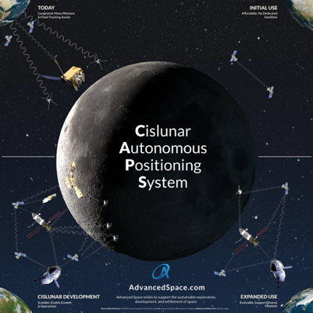
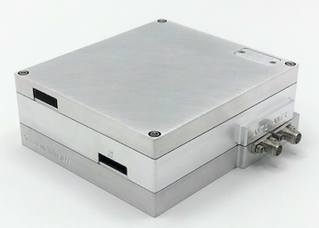
Announcement of Collaboration Opportunity Projects – 2018
Diagram of the concept of operations for the Cislunar Autonomous Position System (CAPS). CAPS is an innovative spacecraft-to-spacecraft navigation solution to be demonstrated on the CAPSTONE mission launching no earlier than May 2022. CAPS is anticipated to allow future spacecraft the ability to determine their location relative to the Moon without relying exclusively on tracking from Earth.
Image Credits: Advanced Space, LLC
A public-private partnership with NASA’s Goddard Space Flight Center
The Vulcan Wireless CubeSat radio, NSR-SDR-S/S. This CubeSat radio is a fully integrated, full-duplex, software-defined radio transponder. The radio transponder is being tested for compatibility with NASA’s Space Network.
Image Credits: Vulcan Wireless, Inc.
A public-private partnership with NASA’s Goddard Space Flight Center

Slide 11
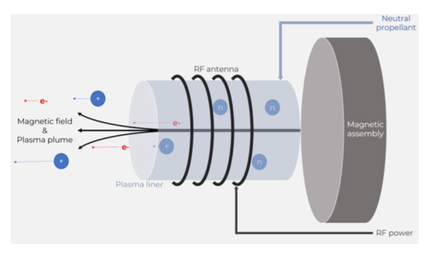
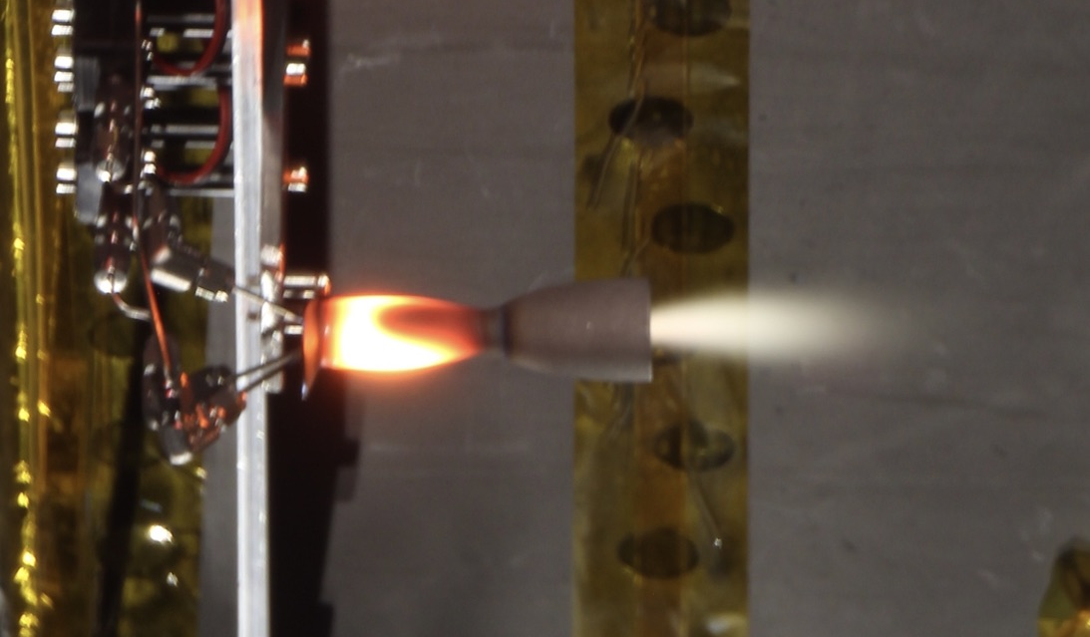
Announcement of Collaboration Opportunity Projects - 2020
The Phase Four RF plasma thruster operates by using RF to heat propellant into ionized plasma that is then ejected away from a spacecraft by a permanent magnet, creating thrust.
Image Credits: Phase Four
A public-private partnership with NASA’s Glenn Research Center
A prototype bipropellant thruster is shown in ambient pressure testing. The key technology being tested is the propellant pump - an enabling technology for launch safety approval (no stored gas) and system performance (lightweight tanks). Testing includes a propulsion system composed of monopropellant and bipropellant systems.
Image Credits: Stellar Exploration, Inc.
A public-private partnership with NASA’s Ames Research Center

Slide 12
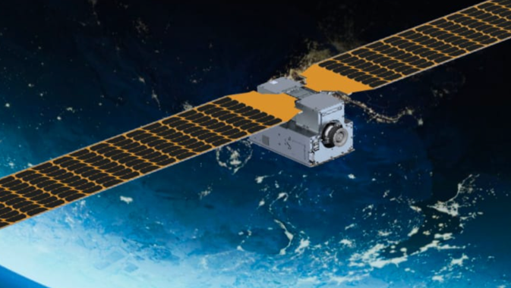
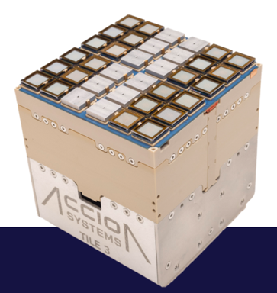
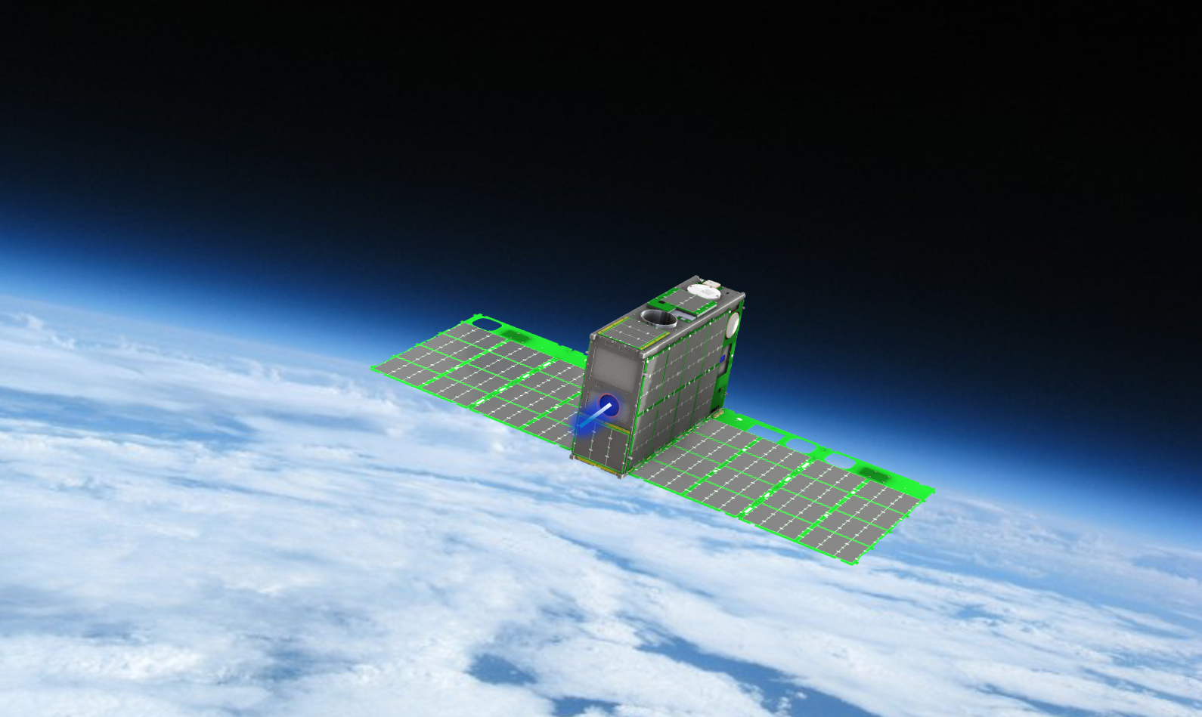
Tipping Point Projects – 2019
The 12U Courier CubeSat contains a compact, high impulse solar electric propulsion module. The mission will demonstrate a Halo Hall Effect Thruster which operates between 85-175 watts.
Image Credits: ExoTerra Resource, LLC.
Accion’s Tiled Ionic Liquid Electrospray 3. The
compact, modular electric system uses a non-volatile ionic salt propellant.
Image Credits: Accion Systems, Inc.
A 6U Dual Propulsion Experiment CubeSat. Both propulsion systems, the Fiber-fed Pulsed Plasma Thruster and Monofilament Vaporization Propulsion, were developed with NASA SBIR funding.
Image Credits: CU Aerospace, LLC.

